Slide 1
North Area Commissioning
168th EATM
L. Nevay on behalf of BE-EA-LE
9th April 2024

Slide 2
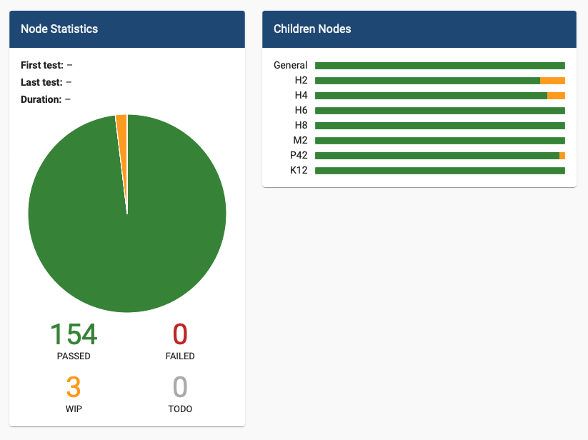
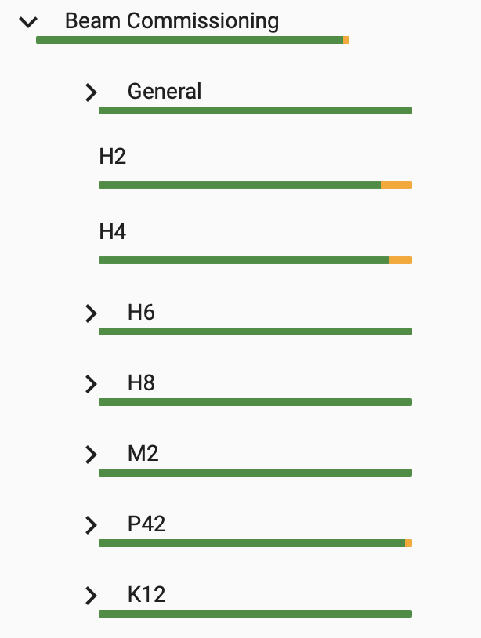
Introduction
North Area beam commissioning was from Tuesday 26th March → Wednesday 10th April
  in fact, the SPS was ready a little early and we started on Saturday 23rd March
The period for beam commissioning was slightly longer than 2023
Beam commissioning finished yesterday and offered one day as MD time as no user was interested to take the beam earlier
Majority of commissioning was done on weekends and holidays
^{Monday} | ^{Tuesday} | ^{Wednesday} | ^{Thursday} | ^{Friday} | ^{Saturday} | ^{Sunday}
¹⁸ | ¹⁹ | ²⁰ | ²¹ | ²² | ²³ | ²⁴
²⁵ | ²⁶ | ²⁷ | ²⁸ | ²⁹ | ³⁰ | ³¹
¹ | ² | ³ | ⁴ | ⁵ | ⁶ | ⁷
⁸ | ⁹ | ¹⁰ | ¹¹ | ¹² | ¹³ | ¹⁴
beam downtime
Easter - reduced expert availability
EHN1 moving-beam test

Slide 3
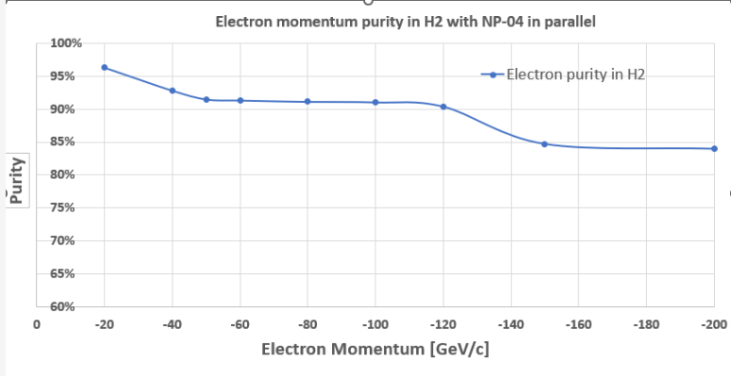
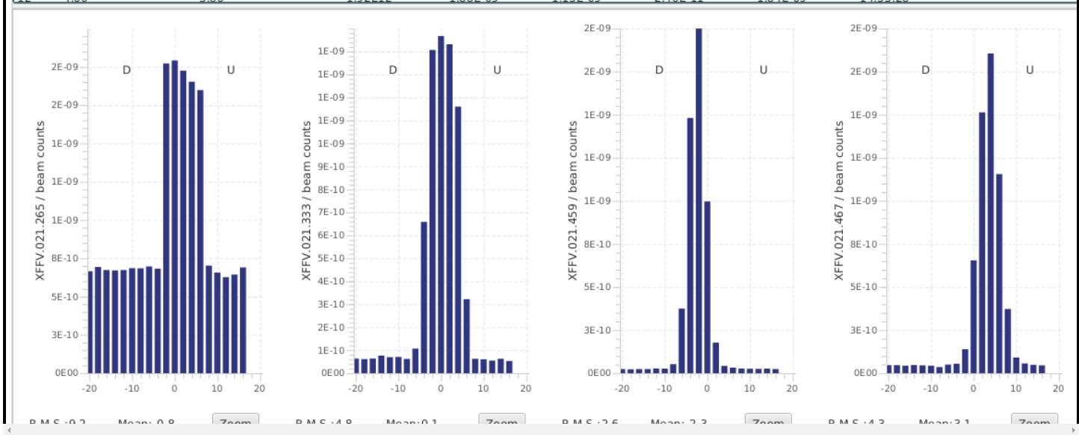
H2
Commissioning smoothly completed.
H2-VLE not commissioned – tentative slot for commissioning beam instrumentation on week 16 or 17, if no users are allocated).
All wobbling configurations of the year tested, electron purities in the various cases measured and communicated to the users.
NA61 beam
Electron users parallel to NP-04

Slide 4
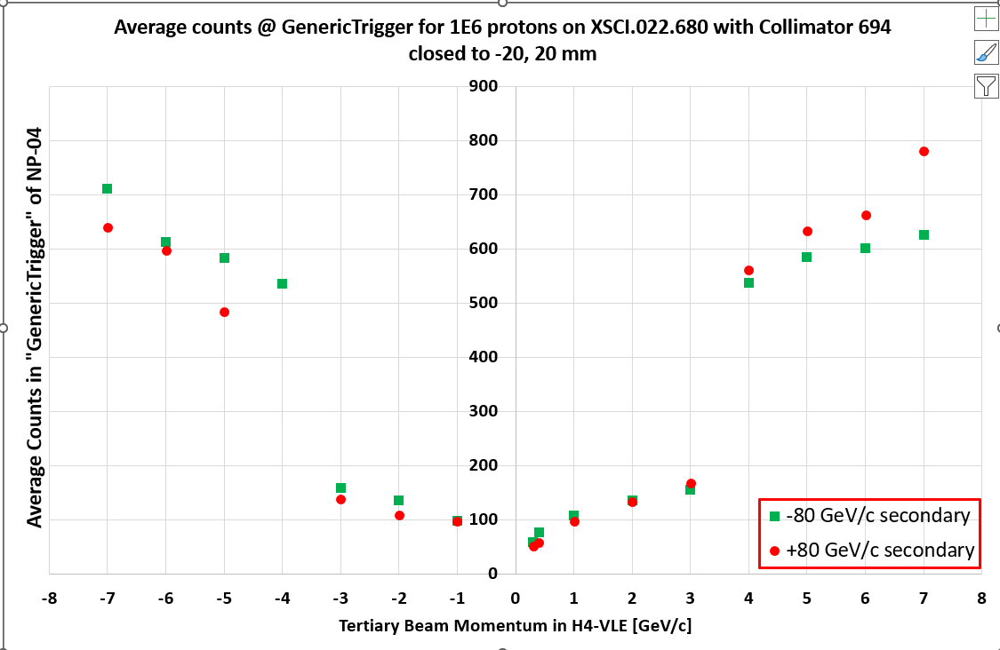
H4
Commissioning smoothly completed.
Replaced magnet MSNH.022.031 works as expected – thank you very much for the challenging exchange!
H4-VLE: Beam on after 5.5 years, performance as expected. Still a few small issues with the XCETs, followed up with SY/BI.
  Many thanks to the BE-GM alignment team – great job!
Configurations of the year tested, purities and possibilities have been communicated to the experiments and the SPS coordinator – no showstoppers identified.
H4-VLE measurements transmitted to NP-04 for their planning for both polarities

Slide 5
H6
120 GeV mixed hadron beam commissioned with good transmission, beam rates and expected beam sizes as in previous years
Characterisation of e± tertiary and secondary beams for a range of momenta
Up to +170 GeV (-160 GeV) mixed hadron beam made
  even with standard ‘wobbling’ setup of 120 GeV nominal in H6
  low e± content above 100 GeV as expected
For tertiary beams |p| < 60 GeV, high purity was found (>98 %)
Real rates will be up to 10x higher with longer target and greater intensity on the target
Many thanks to the BE-GM team for the realignment of H6
Momentum GeV | e⁻ Purity | e⁻ / Spill
100 | 68.1 % | 2570
80 | 89.9 % | 2190
70 | 91.3 % | 1810
60 | 98.8 % | 1430
40 | 99.6 % | 1010
20 | 99.8 % | 663
10 | >99.9 % | 343

Slide 6
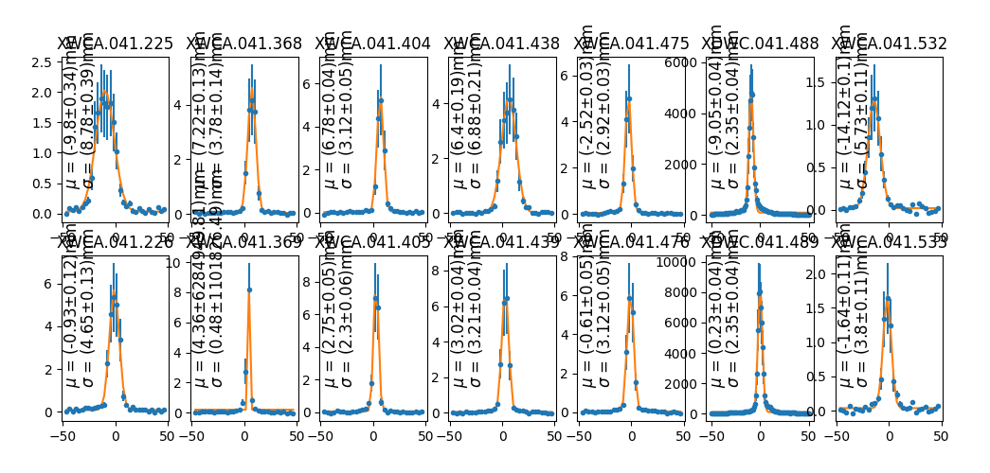
H6 Optics Studies
New final focus optics implemented for smaller focus in PPE156
  should reduce horizontal size mostly
  reduces the x-p correlation (‘dispersion’) at the focus
Some development of scripted scanning for optics measurements
Initial kick-response study by new HI-ECN3 fellow F. Metzger
varied focus distances through PPE146 - 156

Slide 7
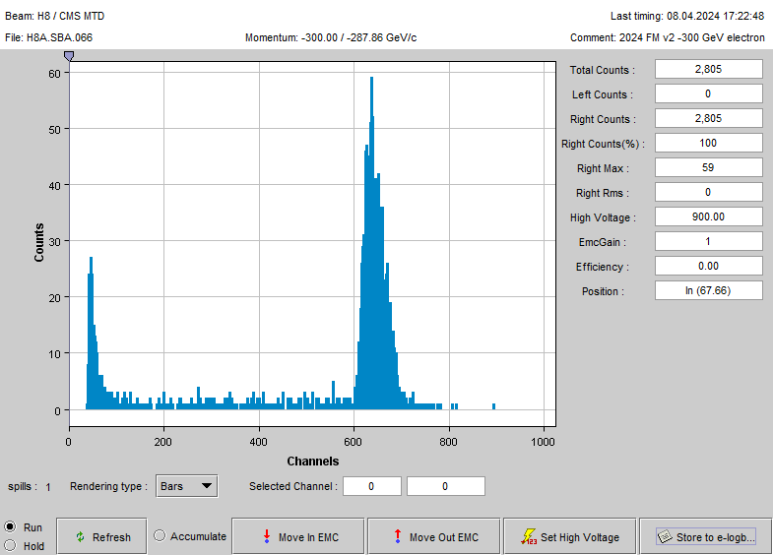
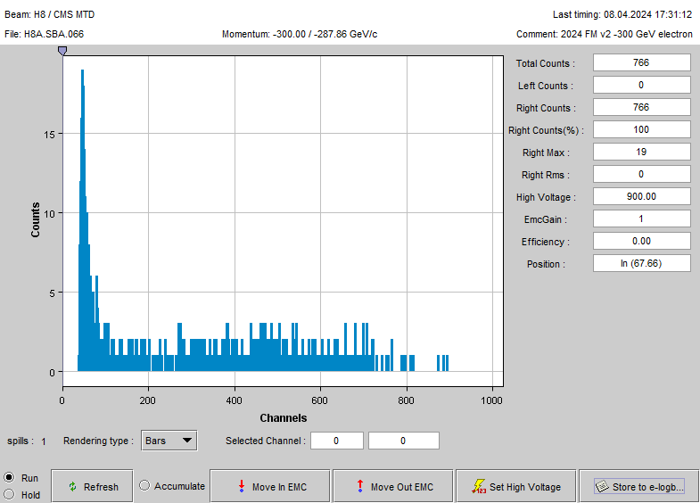
H8
-287 GeV/c
electrons
Commissioning completed for main beams
  Main beam at +180 GeV/c fully tuned
  New optics for parallel and tertiary beams
Electron purity tested for some settings
  Tertiary from +180 GeV/c to +50 GeV/c ~60% (absorber)
    Was expected to be ~60-70% seen last year (XEMC)
    Will be checked further
  Tertiary from -80 GeV/c to -40 GeV/c ~95% (absorber)
  Secondary electron beam at -300 GeV/c looks very nice
    Hadrons separate by synchrotron radiation and collimated away
    Showcase: complete removal by inserting 6mm Pb XCON (130m)
Many thanks to the BE-GM team for the realignment of H8
Removal by 6mm Pb
absorber (130m)

Slide 8
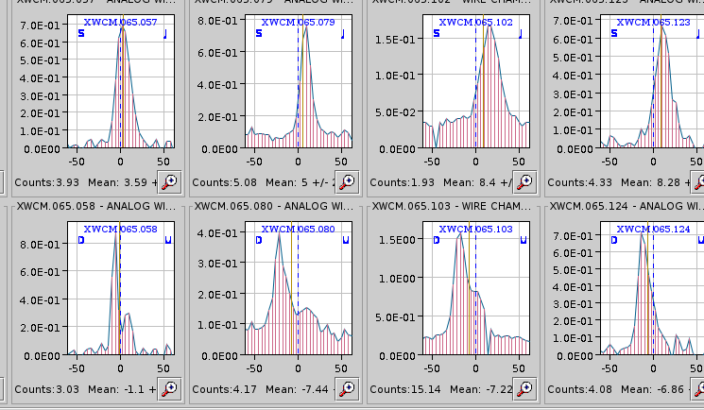
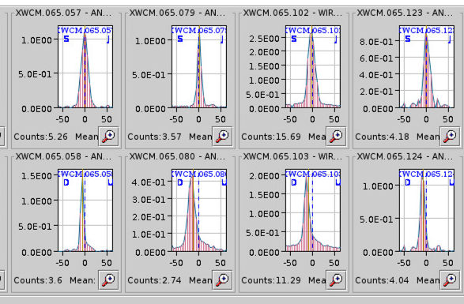
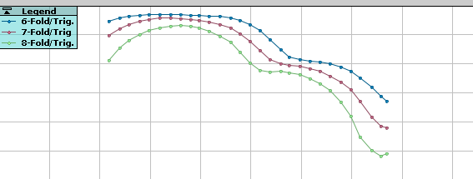
M2
80 – 250 GeV/c hadron beams and 160 GeV/c muon beams commissioned.
-190 GeV/c hadron beam has also been checked with lower number of units but same collimator settings for high intensity that showed the double peak feature at the CEDARs.
  Realignment done around Bend6 during the YETS 2023/24 by BE-GM.
  Beam steered with Trim5/6. The best combination keeps the beam slightly mislaigned at the XWCM.065102 and downstream but the alignment can be corrected at AMBER with Bend7/9 later.
Divergence for the hadron beams at the CEDARs also checked.
The CEDARs were refurbished including improvements in precision and stability of the diaphragm and motor controls.
Double peak last year
This year after correction
The refurbished CEDARs have been commissioned with huge improvement in the diaphragm and motor controls (awaiting user feedback). They can reach 5 µm precision now.
  The improvement requires that mutliple motors cannot be moved at the same time i.e., if the diaphragm is moving the XY table cannot be moved at the same time. Users are requested to note this until a functionality is added in CESAR to monitor the status of the motors (ongoing). In the meantime this dashboard is available https://wrap.cern.ch/dashboard/99357 showing the motor status (1 -> Available to Move; 0 -> Moving)
-190 GeV/c

Slide 9
M2 Main Issues
The profile monitors had the wrong gas mixtures which was fixed on 26th March.
On 26th March a fault was observed in SM2 coming from a cooling interlock. On 27th March, C. Cot confirmed that the issue has been solved. The water-cooled cables were replaced for the power converter after LS2 but the eletta still remained. When CV switched off their valves for a leak in a gallery it triggered the eletta. This has been disconnected now and the cables are marked.
CEDAR 065.083 was again found reaching a limit for alignment in the vertical with the XY table. On 4th April morning the downstream end of the CEDAR was lifted by 2-3 mm. This fixed the issue, and the CEDAR can be aligned well.
  During de-installation it has been agreed with BE-GM that the alignment will be re-measured, and the alignment system checked as the issue occurred twice in a row.
The FISCs were not working at the beginning and the PMTs have been replaced on 4th April. On 5th April the delays have also been set and they are now operational.

Slide 10
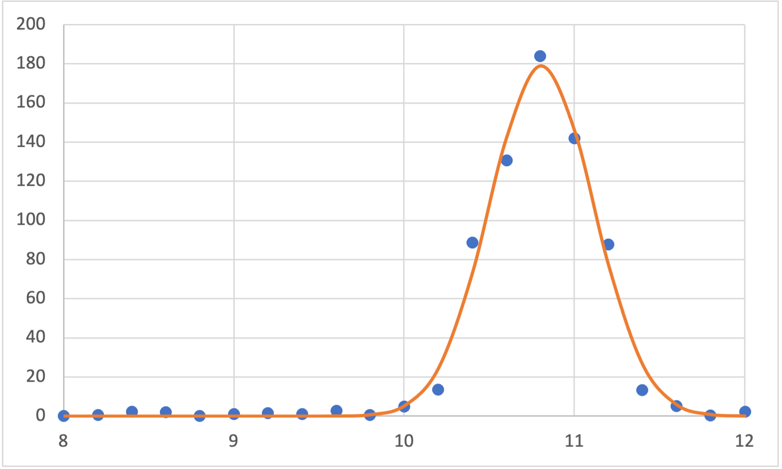
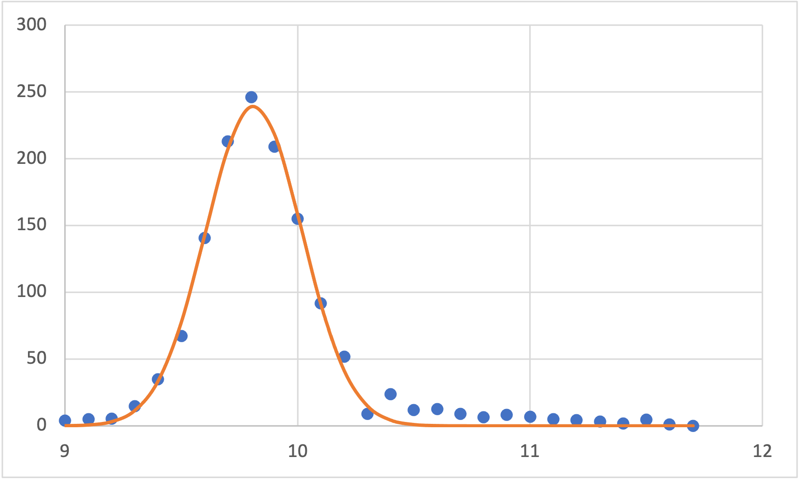
P42 Beam Commissioning
σ_{H} = 303 µm
Very smooth commissioning period that has been well prepared by the equipment groups, no real issues besides minor ones with the BSIs in the beginning that were quickly fixed.
Found quite different values for Q2 (Δ18 A) and Q3 during focusing exercise. These are the quadrupoles to match P42 to TT20. With Q2 acting mostly on the horizontal plane, this is something to understand better in the upcoming MDs.
Several possible wobbling settings for this year have been checked and tested, always with a good transmission for P42.
The overall rate of losses in the lines looks comparable to last year.
σ_{V} = 207 µm
Beam spot on T10 TBIU BBS

Slide 11
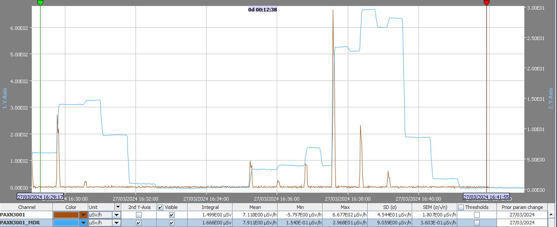
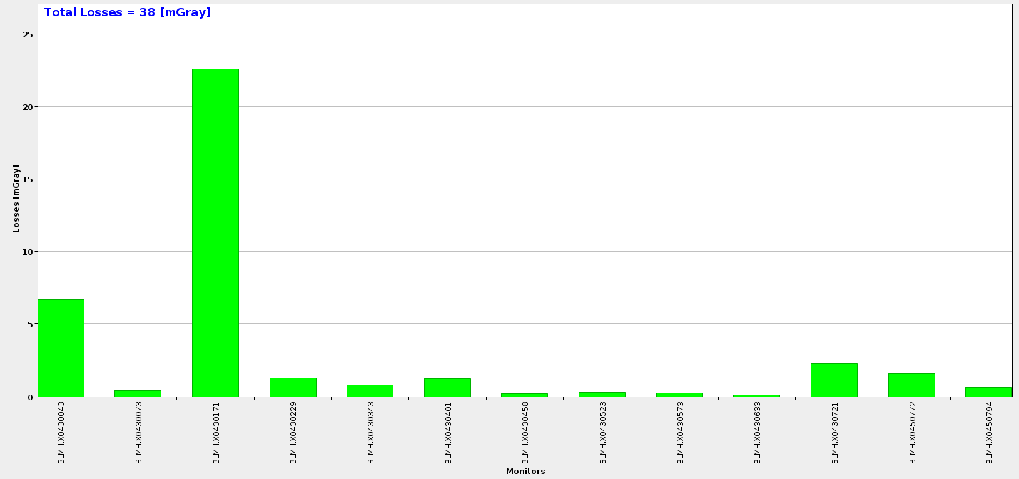
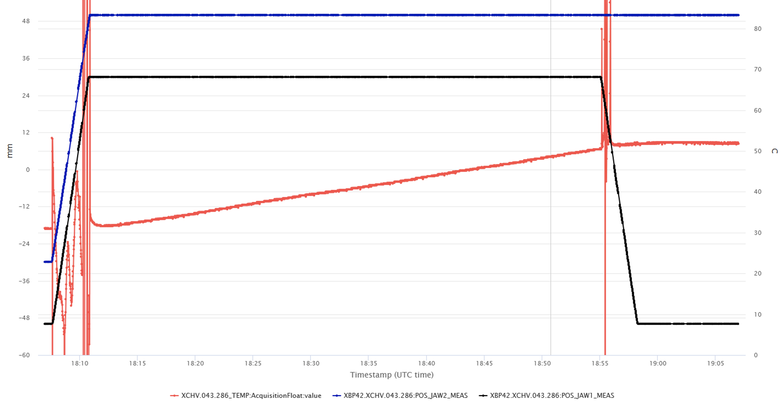
P42 Beam Commissioning
C. Ahdida / RP
Radiation at bridge monitor
Several other tests have been performed during the commissioning period that are relevant to operation for NA62 and the upcoming HIECN3 project
Radiation at the TCC8/ECN3 bridge (collaboration HSE-RP): The full beam was steered at low intensity at the Q20 quadrupole, which is supposed to be the most harmful loss for radiation at the bridge. While the monitor typically does not count anything beyond background, we found 670 µSv/h within the spill when we fully hit the magnet. That means losses at this location are most probably in the order of 10⁻⁴ or lower.
Several quadrupole scans have been done for validation of the P42 optics. Some kick response measurements are still to be performed.
One of the collimators has been hit and heated up by the beam to benchmark the EA FLUKA and ANSYS equipment models (framework of NA-CONS).
P42 BLMs
Temperature Collimator 286 in P42

Slide 12
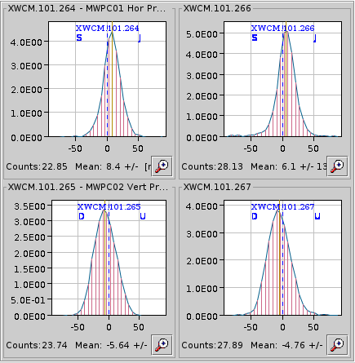
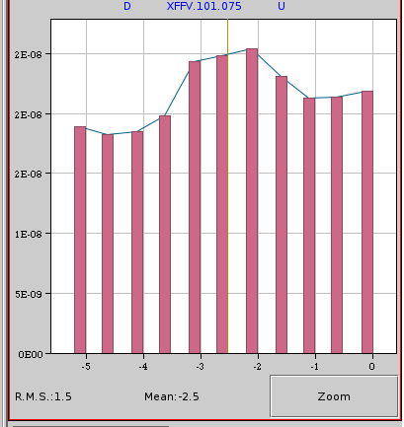
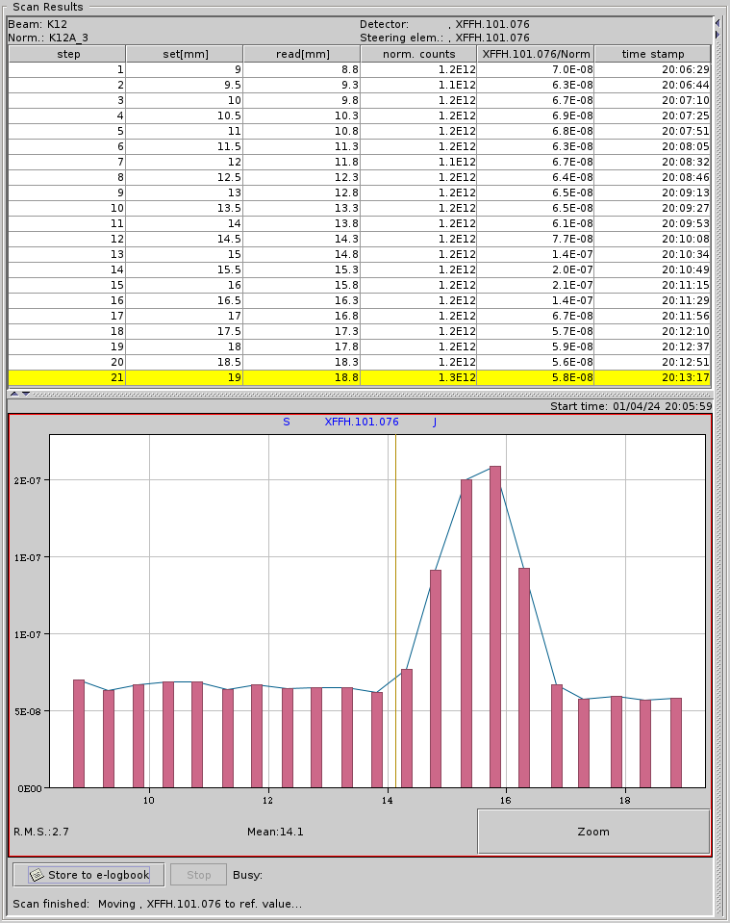
K12 Beam Commissioning
Beam commissioning for K12 also went rather smooth.
One issue was the coincidence/threshold settings of the FISC scanners, which has been solved before Easter.
The beam is ready for NA62 and has been already given to the users, waiting for further feedback (mostly position in GTKs, CEDAR alignment).
FISC coincidence before and after tuning
K12 beam spot end of ECN3

Slide 13
Summary
North Area lines fully commissioned and ready for physics
Systematic studies of beam parameters to validate and improve
Tuning procedures for each line revised and updated
A huge thanks to all the teams involved in getting the North Area ready for physics and for supporting the beam commissioning
Thank you to the SPS and OP teams for flexibility helping us make the most of the beam time even when there were unexpected downtimes
Let’s do some physics!

