Slide 1

ECR/Documents for Information and Approval
Giulia Romagnoli and Natalya Kahn for BE-EA, 2024-04-09
EA Documents - Agile Board - CERN Central Jira

Slide 2
LIST OF DOCUMENTS for Info
FOR INFORMATION EATM
Summary | Reporter | EA Projects | EDMS number | EDMS Status
Risk Assessment for the Individual System Tests of AD Kickers | Christophe Lolliot | AD | 3006593 – AD-MK-SR-0002 | Released
Risk Assessment for the Individual System Tests of ELENA Ring Fast Deflectors (ZDFA) | Nicolas Voumard | AD, ELENA | 3006586 – LNA-ZDFA-SR-0002 | Released
Risk Assessment for the Individual System Tests of the Elena Kicker | Christophe Lolliot | AD, ELENA | 3006567 – LNA-MKKFH-SR-0001 | Under Approval
Risk Assessment for the Individual System Tests of ELENA Transfer Lines' Fast Deflectors (ZDFA) | Nicolas Voumard | AD, ELENA | 3006581 – LNA-ZDFA-SR-0001 | Under Approval
Asset Replacement Request - FTA.TAR9065 | Edouard Grenier-Boley | AD | 3000228 – AD-TARAD-ARR-0001 | Released
Consolidation Program for the XCED Detectors | Miguel Lino | North Area – NACONS | 2742855 – SPSX-B-WD-0002 | Released
Functional Specification for the AD E-Cooler HV Powering | Christophe Machado | AD | 2938278 – AD-LNT-ES-0004 | Engineering check
NACONS WP 3.4 - Supports Structures | Miguel Lino | North Area – NACONS | 2798515 – SPSX-H-WD-0002 | Released
North Area Secondary Beam Areas (SBAs) Vacuum System Consolidation | Miguel Lino | North Area – NACONS | 2488128 – SPSX-V-WD-0001 | Released
NA Vacuum System Consolidation NA-CONS & TT20 | Anthony Harrison | North Area – NACONS | 2175400 – SPSX-V-WD-0003 | Released

Slide 3
LIST OF DOCUMENTS for Info
FOR INFORMATION EATM
Summary | Reporter | EA Projects | EDMS number | EDMS Status
Fire Detection, Protection, and Voice Alarm Systems for SPS North Area Underground Facilities | Rachid Haddad | North Area, NACONS | 2476161 – SPSX-SF-WD-0001 | Engineering check
Geodetic network installation, Alignment and Smoothing | Camille Vendeuvre | North Area, NACONS | 2712293 – SPSX-G-WD-0001 | Under Approval
Feasibility study - BA80 (899) | David Rodriguez Gomez | North Area, NACONS | 3024192 – SPSX-J-RPT-0008 | Engineering check
Feasibility study - BA81 (890) | David Rodriguez Gomez | North Area, NACONS | 3024194 – SPSX-J-RPT-0009 | Engineering check
Feasibility study - BA82 (891) | David Rodriguez Gomez | North Area, NACONS | 3024196 – SPSX-J-RPT-0010 | Engineering check
Mandate of the Planning Officer of the NA-CONS Project | Yacine Kadi | North Area, NACONS | 2458833 – SPSX-PM-MG-0003 | Engineering check
Functional Specification of Polaris Converter Family for TT20 and North Area Consolidation | Ivan Josifovic | North Area, NACONS | 2801702 – SPSX-R-ES-0001 | Engineering check
TDC2-TCC2 Cable Exposure Analysis | Fernando Pedrosa | North Area | 3071544 – SPSX-E-ES-0001 | Engineering check
NEPTUNE Converter Family for North Area and SPS Consolidation | Jerome Savary | North Area, NACONS | 3018519 – SPSX-R-ES-0004 | Under Approval
Installation d'un Contrôle d'Accès Provisoire à la Porte YDPZ01.853=BX83 | Fabrice Gautheron | North Area, NACONS | 2967321 – SPSX-S-PRD-0001 | Engineering check

Slide 4
LIST OF DOCUMENTS for Info
FOR INFORMATION EATM
Summary | Reporter | EA Projects | EDMS number | EDMS Status
XCED Thermal Housing Functional Specification | Miguel Lino | North Area – NACONS | 2957089 – SPSX-X-ES-0005 | Released
New XCIO for Muon Production in PPE124 on H4 Beamline | Nikolaos Charitonidis | North Area – NACONS | 2801784 – SPSX-LHN1-EC-0001 | Released
Mandate of the NA-CONS Project Safety Officer | Filipa Duque Carvalho | North Area – NACONS | 2458825 – SPSX-PM-MG-0002 | Released

Slide 5
LIST OF DOC for FUTURE APPROVAL
ECR INFO/FUTURE APPROVAL EATM
Summary | Reporter | EA Projects | EDMS number | EDMS Status
NA-CONS Fire Safety and Access WP 5.1.3 Fire-Resistant Partition | Adem Kaymak | North Area – NACONS | 3010259 - SPSX-SF-EC-0006 | Engineering check
Space Reservation Request Fire-resistant Partitions | Adem Kaymak | North Area – NACONS | 2907780 – SPSX-SF-EC-0003 | Under Approval
Smoke Detector in EHN1 Galleries | Michael Jeckel | North Area – NACONS | 3072500 – SPSX-SF-EC-0008 | Engineering check
BA80 Fire Detection Equipment | Florian Andre Deperraz | North Area – NACONS | 2997829 - SPSX-SF-EC-0005 | Under Approval
Shielding Improvement for the High Intensity Hadron Operation of M2 | Dipanwita Banerjee | North Area | 2868386 - SPSX-J-EC-0002 | Engineering check
User Requirement for the XABS Absorbers in M2 Line in North Area | Dipanwita Banerjee | North Area – NACONS | 3012379 – SPSX-T-ES-0007 | In Work
User Requirements for XTAX Absorbers in North Area Beamlines | Miguel Lino Diogo Dos Santos | NACONS, Equipment | 2747997 - SPSX-T-ES-0003 | Under Approval
User Requirements for the XCSH/V, XCHV and XCBV Collimators | Nikolaos Charitonidis | North Area – NACONS | 2742301 – SPSX-TC-ES-0004 | Under Approval
Replacement of Big Vertical Collimator XCBV on M2 Beamline in TT84 | Giulia Romagnoli | North Area - NACONS | 2976670 - SPSX-TC-EC-0002 | Under Approval
Installation of XCET Detectors in Neutrino Platform NP02 and NP04 | Giulia Romagnoli | North Area | 2811758 - SPSX-X-EC-0001 | Under Approval
Installation Water Cherenkov Test Experiment in T09 beamline During YETS 23-24 | Dipanwita Banerjee | EA | 2960989 – PSZ-J-EC-0003 | Engineering check

Slide 6
LIST OF MISSING ECRS for YETS 23/24
MISSING ECRS
Summary | Reporter | EA Projects | EDMS number
NP Platform Installation on H4 | Filippo Resnati | North Area | Coming soon…
Installation Tuyauterie BA81-TT81/Installation Baie SDI - Detection Incendie | Rachid Haddad | North Area – NACONS | Coming soon…

Slide 7
LIST OF DOCs for APPROVAL
ECR APPROVAL EATM
Summary | Reporter | EA Projects | EDMS number | EDMS Status
Renovation of Gas Distribution Infrastructure for Building 887 Jura Side | David Jaillet | North Area | 2973540 - SPSX-F-EC-0005 | Under Approval
BA80 Carottage | Michael Jeckel | North Area | 3016495 - SPSX-J-EC-0004 | Under Approval
Space Reservation Request - North Area Surface Fire Detection Racks | Michael Jeckel | North Area | 3018433 – SPSX-SF-EC-0007 | Under Approval
User Requirements for XCM Magnetic Collimators and XCMIB Magnetized Iron Blocks in North Area Beamlines | Dipanwita Banerjee | North Area | 2798464 – SPSX-TC-ES-0006 | Under Approval
User Requirements for XTCX Fixed Collimators in North Area Beamlines | Dipanwita Banerjee | North Area – NACONS | 2802303 – SPSX-TC-ES-0008 | Under Approval
High-Intensity Beam to IRRAD/CHARM | Federico Ravotti | EA | 3024761 – PSZ-L-EC-0002 | Under Approval

Slide 8
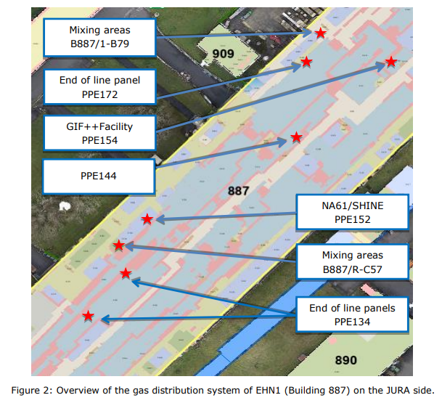
ECR for Approval
SPSX-F-EC-0005
Version 0.2
Renovation of Gas Distribution Infrastructure for Building 887 Jura Side
By David Jaillet
This document covers the renovation of the gas distribution infrastructure in EHN1 (Building 887), Jura side.
The renovations will involve:
Updating the piping network from the gas buildings to the mixing areas;
Updating the piping network from the mixing areas to the PPEs;
Updating the ATEX-area safety criteria of the mixing areas and reducing these areas to a limited space, adding ATEX air extraction;
Adding closed end-of-line panels in PPE134 and PPE172;
Removing accessible flammable gas panels from the Jura wall.
The infrastructure changes include:
Dismantling existing gas installations;
Supply and installation of two gas mixing cabinets;
Supply and installation of three gas end-of-line panels;
Supply and installation of all interconnection piping between Buildings 909 and 887.

Slide 9
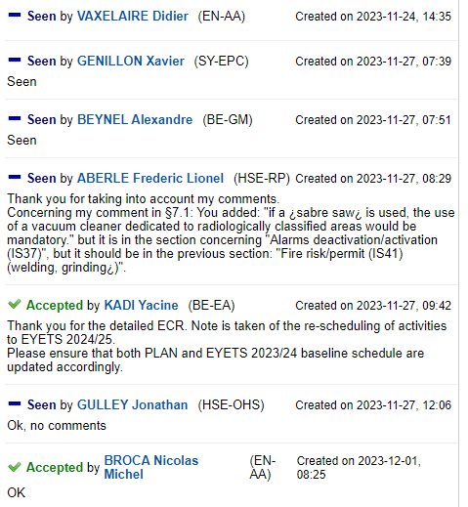
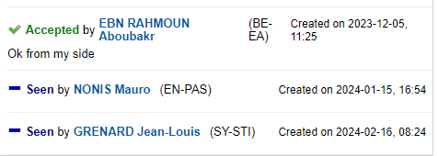

ECR for Approval
SPSX-F-EC-0005
Version 0.2
Renovation of Gas Distribution Infrastructure for Building 887 Jura Side
By David Jaillet
Seeking approval from EATM

Slide 10
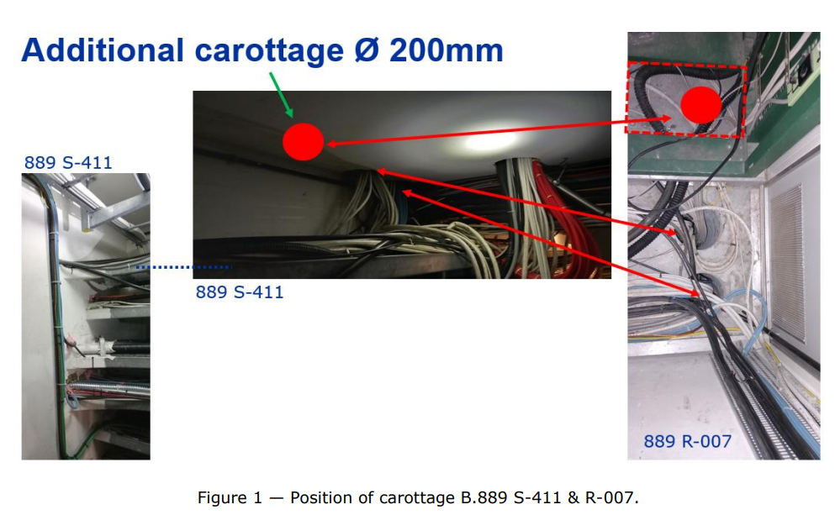
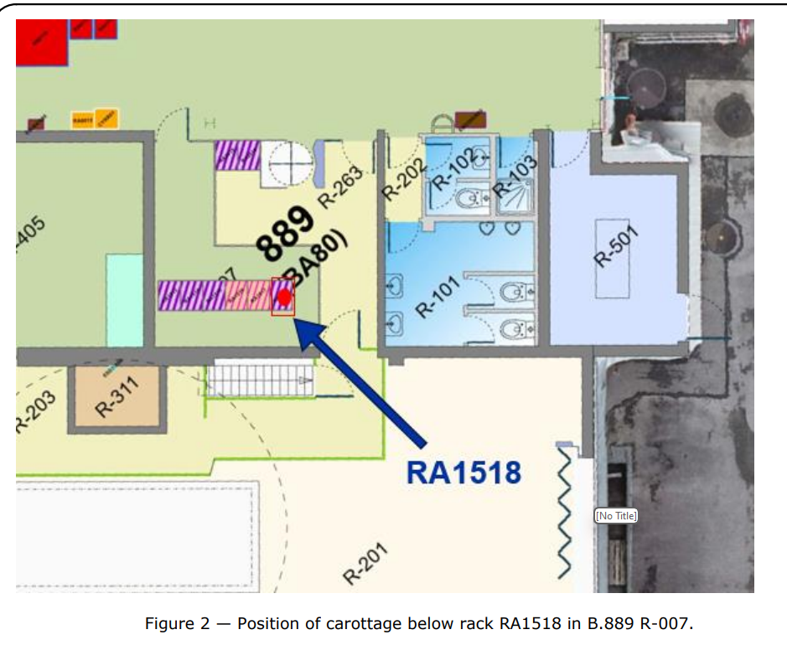
ECR for Approval
SPSX-J-EC-0004
Version 0.2
BA80 Carottage
By Michael Jeckel
A Ø 200mm carottage below the fire detection rack RA1518 in BA80 – 889 R-007 is required to pass the dedicated cables from the rack to the cable tray below 889 S-411 towards the north part of the building
A cable passage is needed to connect fire detection devices and power supply cables to the fire detection rack.
An additional Ø 200mm carottage dedicated to the fire detection system is needed to ensure its future evolution within NA-CONS. This will be added directly below the rack RA1518.

Slide 11
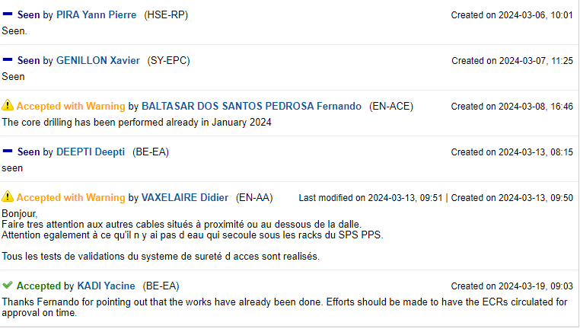
ECR for Approval
SPSX-J-EC-0004
Version 0.2
BA80 Carottage
By Michael Jeckel
Seeking approval from EATM

Slide 12
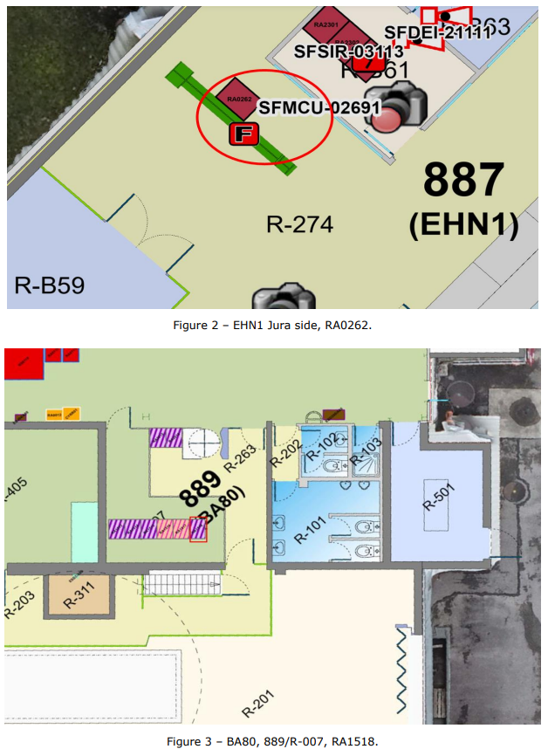
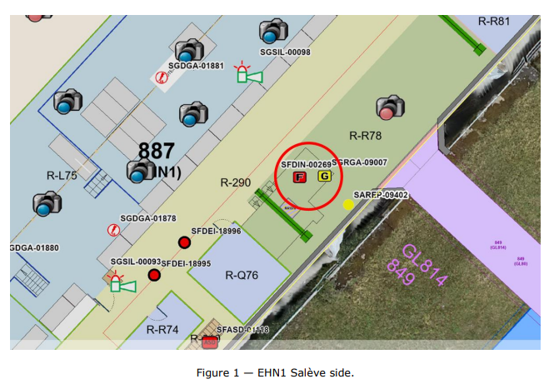
ECR for Approval
SPSX-SF-EC-0007
Version 0.2
Space Reservation Request - North Area Surface Fire Detection Racks
By Michael Jeckel
This SRR is a request for racks of the surface fire detection in EHN1, BA80 & BA81.
Existing racks are already in use by the fire detection system. The existing Fire Detection Central in EHN1 & BA81 will be refurbished and an additional Fire Detection Central rack will be installed in BA80.
Summary of the changes:
Keep two existing racks in EHN1 Salève for SFDIN-00269
Keep two existing racks in EHN1 Jura for SFMCU-02691
Recuperate rack RA1518 in 889/R-007 (BA80) for SFMCU-02692
Keep the existing rack RA9922 in 890/R-001 (BA81) for SFMCU-02693

Slide 13
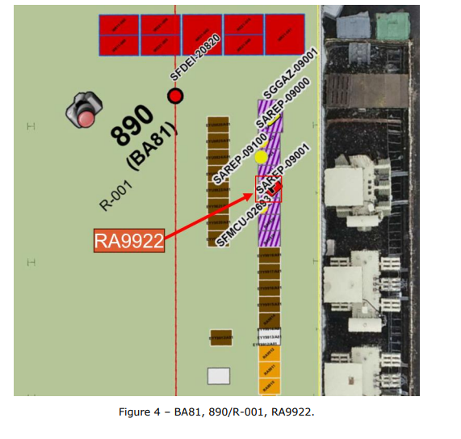
ECR for Approval
SPSX-SF-EC-0007
Version 0.2
Space Reservation Request - North Area Surface Fire Detection Racks
By Michael Jeckel

Slide 14
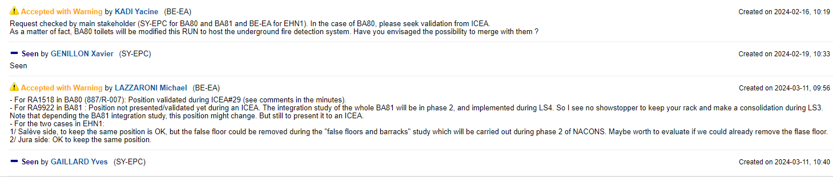
ECR for Approval
SPSX-SF-EC-0007
Version 0.2
Space Reservation Request - North Area Surface Fire Detection Racks
By Michael Jeckel
Seeking approval from EATM

Slide 15
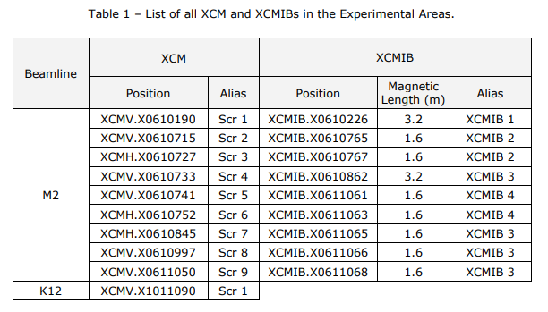
ECR for Approval
SPSX-TC-ES-0006
Version 0.2
User Requirements for XCM Magnetic Collimators and XCMIB Magnetized Iron Blocks in North Area Beamlines
By Dipanwita Banerjee
This document summarizes the needs of the users and the physics requirements for the magnetic collimators in the North Area.
Magnetic collimators are used for collimation of muon beams, both in the M2 and K12 beamlines. There are two types of toroidal magnets currently in use in the North Area:
Magnetic Collimator (XCMH/V) also known as ‘scraper’ – a design with variable aperture.
Magnetized Iron Block (XCMIB) – a design with larger, fixed aperture and overall larger dimensions.
Both systems are normally used together.
The magnetic collimators and magnetized iron blocks have been operating since 1978, and have started to show signs of degradation.
Additionally, there are future requests for a high-intensity hadron beam for a kaon program in M2, as part of the AMBER experiment, which will require the entire beamline to be put under vacuum (including the scrapers).

Slide 16
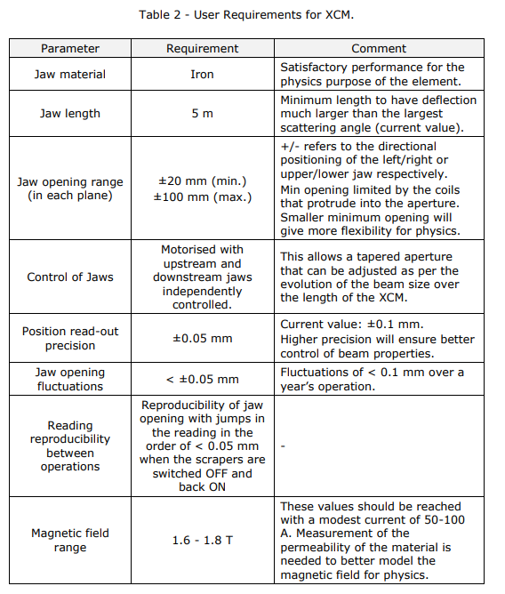
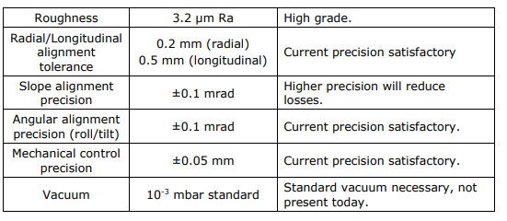
ECR for Approval
SPSX-TC-ES-0006
Version 0.2
User Requirements for XCM Magnetic Collimators and XCMIB Magnetized Iron Blocks in North Area Beamlines
By Dipanwita Banerjee

Slide 17
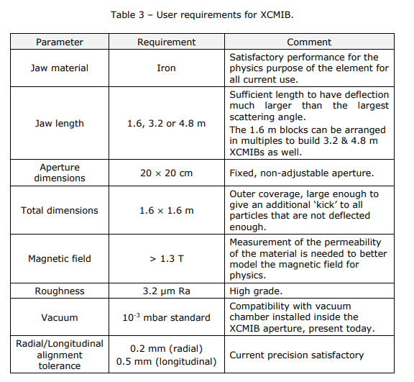
ECR for Approval
SPSX-TC-ES-0006
Version 0.2
User Requirements for XCM Magnetic Collimators and XCMIB Magnetized Iron Blocks in North Area Beamlines
By Dipanwita Banerjee
If the scraper jaws cannot be tuned under vacuum, the needed apertures where the vacuum pipes need to be inserted, during LS3 for 2 operation years, following the shape of the apertures (rectangular/tapered) are:
Scraper 1 → upstream ± 30 mm, downstream ± 30 mm
Scraper 2 → upstream ± 30 mm, downstream ± 30 mm
Scraper 3 → upstream ± 28 mm, downstream ± 28 mm
Scraper 4 → upstream -41 mm +45 mm, downstream -63 mm +67 mm
Scraper 5 → upstream ± 61 mm, downstream ± 75.4 mm
Scraper 6 → upstream ± 28 mm, downstream ± 28 mm
Scraper 7 → upstream ± 52 mm, downstream ± 52 mm
Scraper 8 → upstream ± 75 mm, downstream ± 75 mm
Scraper 9 → upstream ± 30 mm, downstream ± 30 mm

Slide 18
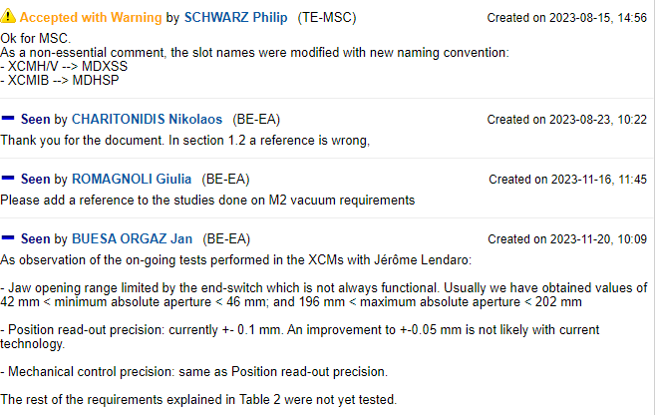
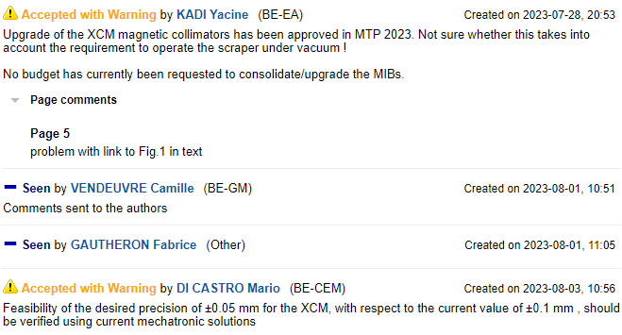
ECR for Approval
SPSX-TC-ES-0006
Version 0.2
User Requirements for XCM Magnetic Collimators and XCMIB Magnetized Iron Blocks in North Area Beamlines
By Dipanwita Banerjee
Seeking approval from EATM

Slide 19
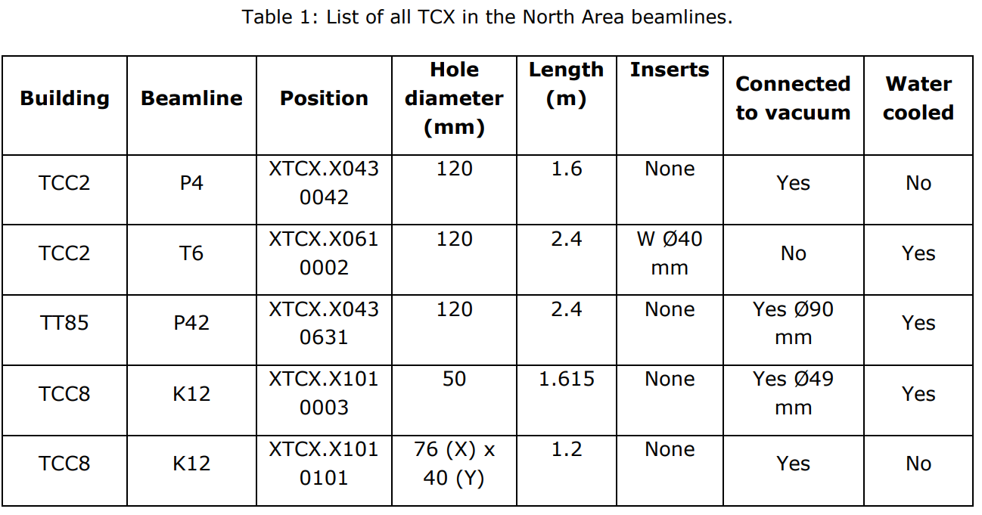
ECR for Approval
SPSX-TC-ES-0008
Version 0.2
User Requirements for XTCX Fixed Collimators in North Area Beamlines
By Dipanwita Banerjee
The TCX Fixed Collimators are collimating devices able to withstand primary beam intensities and are used to precisely control the intensities and stop the secondaries. This document summarises the user requirements for all the TCX used in the North Area beamlines.
The TCX are modular collimators, made from cast-iron blocks. The blocks bear fixed aperture holes and can take stainless-steel inserts, allowing for different collimating apertures in both size and shape, depending on the needs of the beamline.

Slide 20
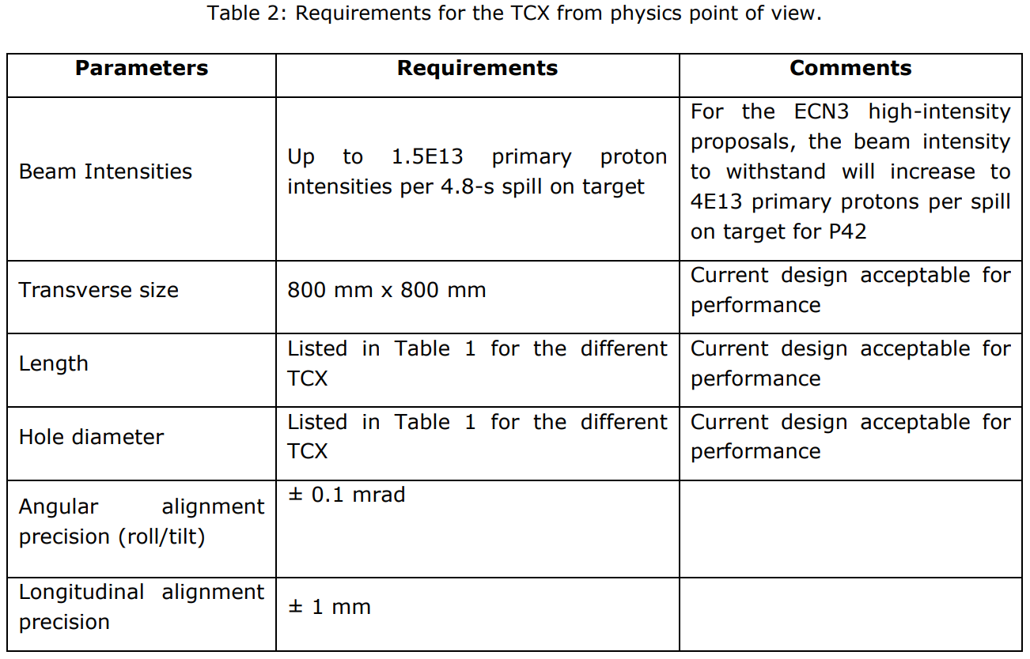
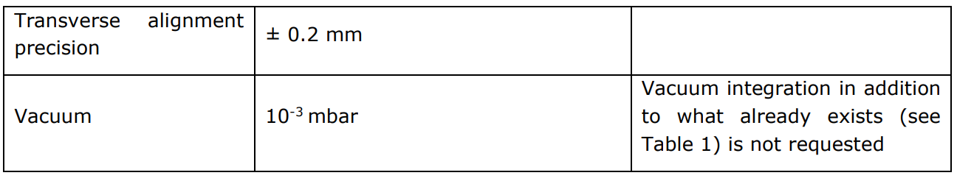
ECR for Approval
SPSX-TC-ES-0008
Version 0.2
User Requirements for XTCX Fixed Collimators in North Area Beamlines
By Dipanwita Banerjee

Slide 21
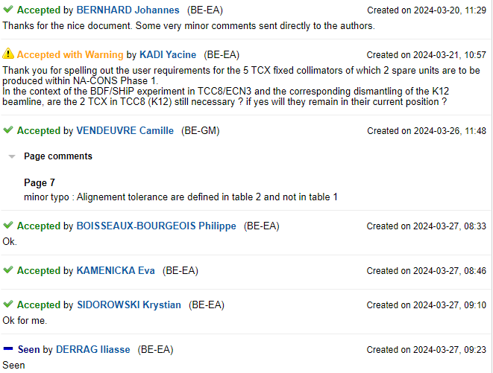
ECR for Approval
SPSX-TC-ES-0008
Version 0.2
User Requirements for XTCX Fixed Collimators in North Area Beamlines
By Dipanwita Banerjee
Seeking approval from EATM

Slide 22
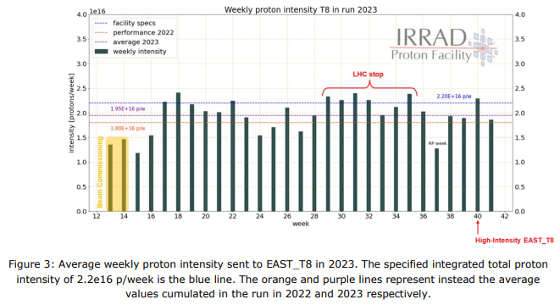
ECR for Approval
PSZ-L-EC-0002
Version 0.2
High-Intensity Beam to IRRAD/CHARM
By Federico Ravotti
To meet the target cumulative intensity during proton operation and increase the operation flexibility, this document describes a proposal to increase the maximum beam intensity per cycle up to 80e10 protons to the EAST_T8 destination.
Since LS2, more and more user experiments in IRRAD and CHARM need these target values to be met, while the requested integrated total intensity per week was only reached during 40–50% of the operation time during 2022 and 2023. Adding cycles with IRRAD destination becomes difficult because of the already well-packed super-cycle composition.
The possibility of accelerating and extracting an EAST_T8 cycle with an increased intensity from the PS was proposed in 2022 and was tested during 2023, taking into account beam stoppers, the dump, thermo-mechanical simulations, radiation protection and operational considerations.

Slide 23
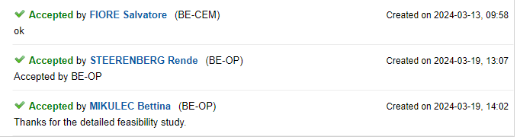
ECR for Approval
PSZ-L-EC-0002
Version 0.2
High-Intensity Beam to IRRAD/CHARM
By Federico Ravotti
Seeking approval from EATM

Slide 24
Thank you!

