Slide 1
3 MeV test stand:
RFQ2 commissioning and beyond

Slide 2
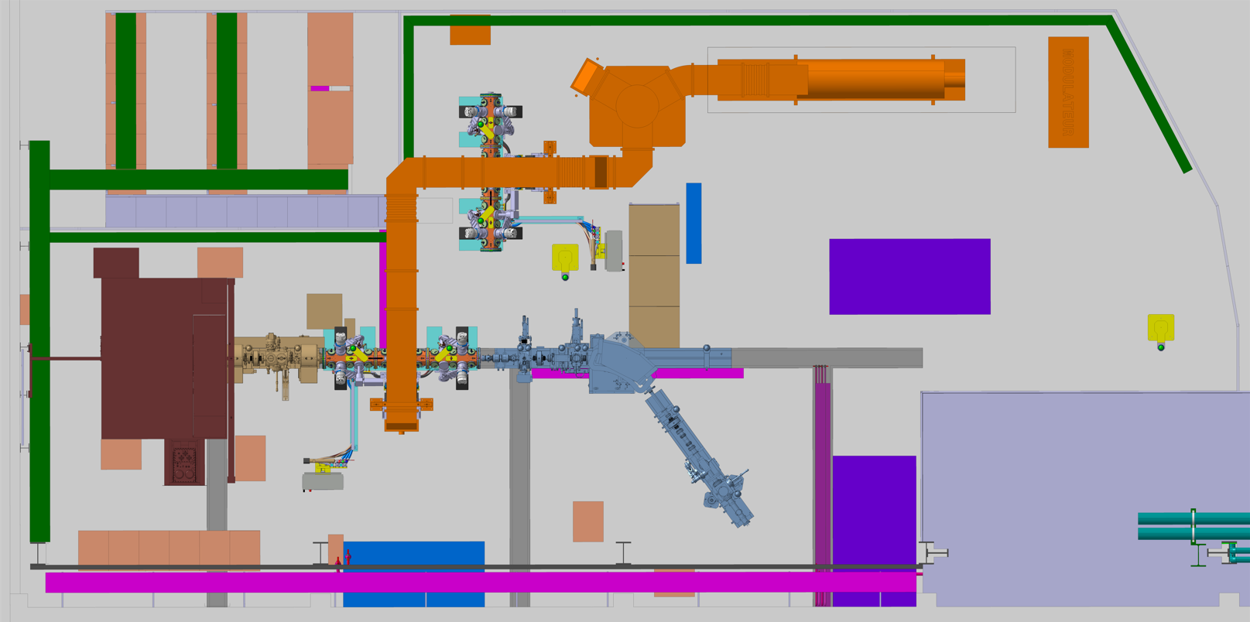
Integration in the Zone 152-R-012
RFQ
Conditioning
+Parking
Klystron
Circulator
Klystron
Modulator
WG
Reserve 202MHz test
Source
RFQ
Beamline
Bending
Oven test
Dump
RFQ water cooling skid

Slide 3
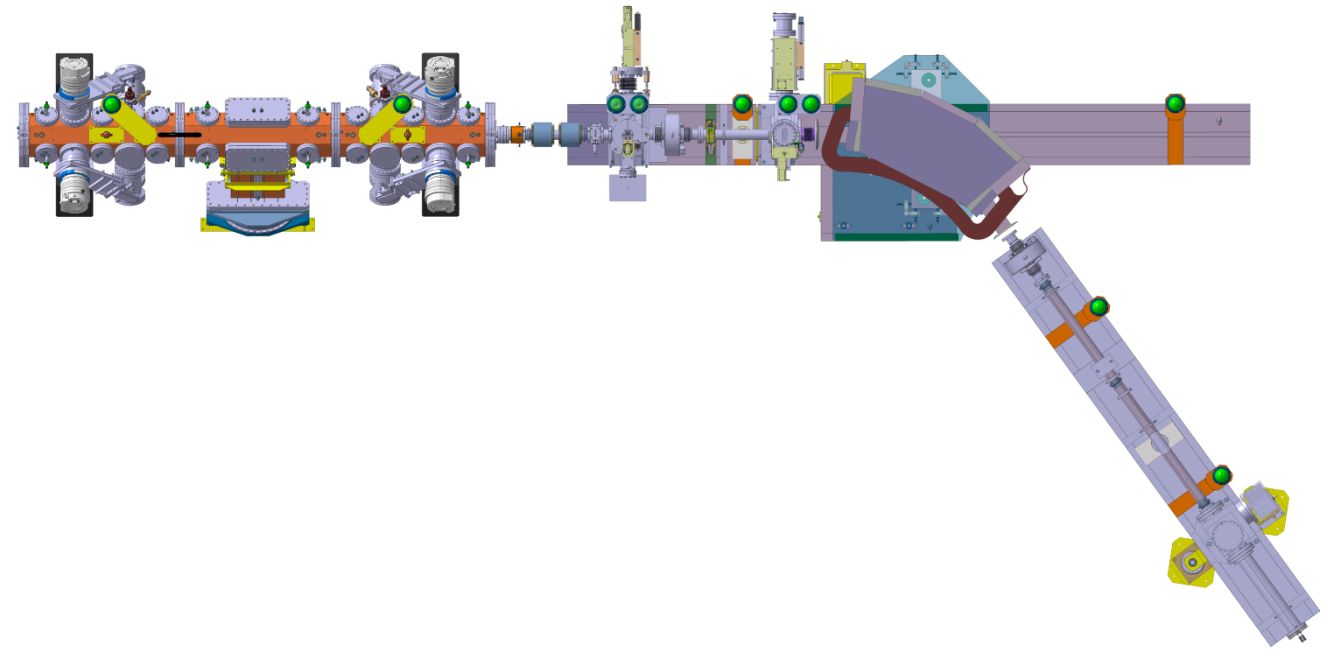
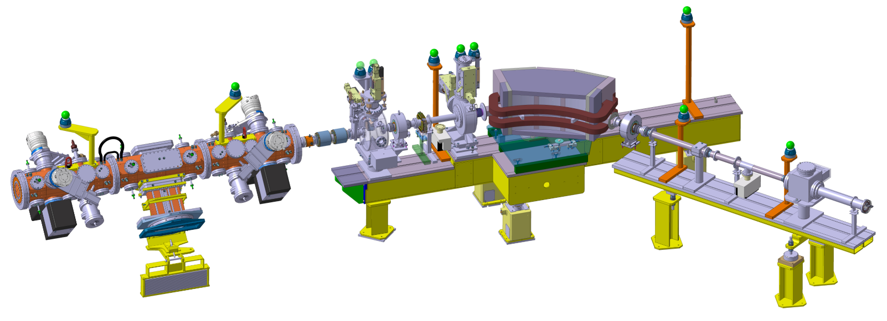
Integration views

Slide 4
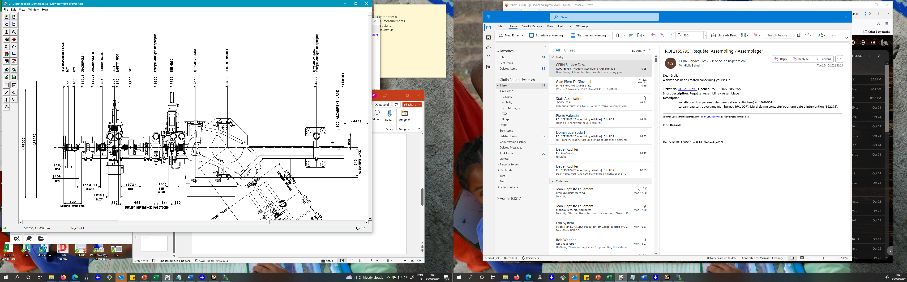
















steerer
RFQ

Slide 5
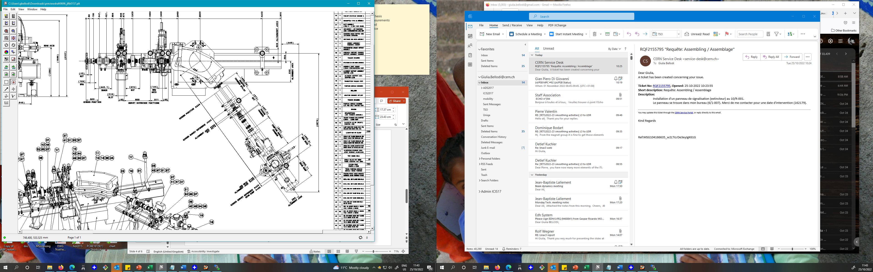
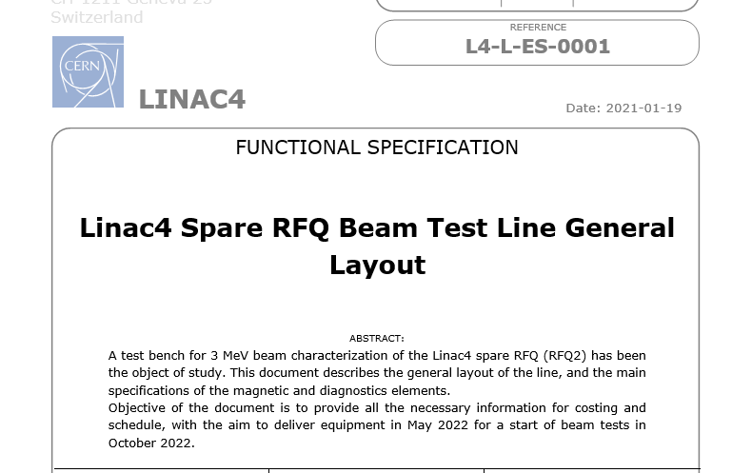




54 deg
Baseline: 300 us pulse length and a max current of 25-30mA.
+
dedicated periods of testing at higher than baseline beam current, up to a maximum of 50mA

Slide 6
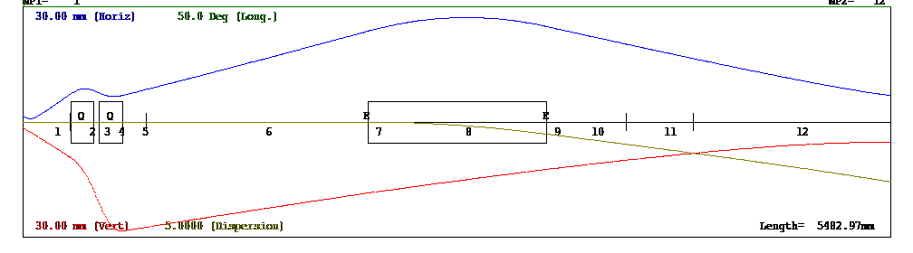
2020 design under tight budget (Re-use various and sundry items from 2013 test benches where still available (instrumentation, supports, chambers etc)
EM SEM
Spectro SEM
slit
have ~zero beam losses before the slit for representative transverse measurements
allow sufficient distance between EM slit and SEM
transport the beam at the end of the spectrometer line with good resolution for longitudinal measurements

Slide 7
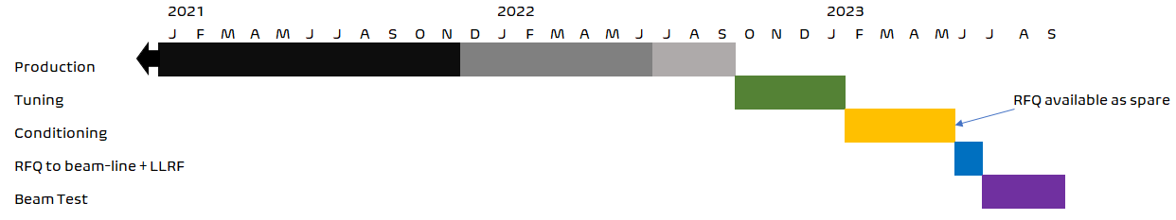
General Schedule to end 2023
The test stand is in the installation phase. No powering of equipment yet
Electrical inspections for equipment before switching on
RFQ assembly to start mid-November (~2 weeks delay)
Beam commissioning to start in July 2023 for 3 months

Slide 8
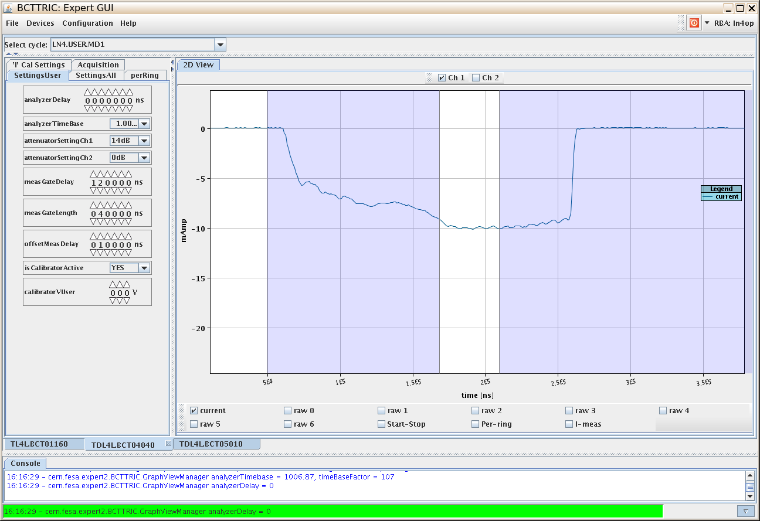
Back in 2013: RFQ1 commissioning
~ 3 weeks of measurement in parallel to RF conditioning, commissioning/debugging of diagnostics, interlocks, powering
First 3MeV beam
[Wednesday 13-Mar-2013 DAY]
19/02/2013 RF conditioning start,
07/03 RFQ connection,
13/03 first beam through RFQ with 75% transmission,
3 weeks RFQ commissioning (stage1) to first week of April
  RFQ+MEBT commissioning to end June
Tuesday 02-Apr-2013 DAY “Today the RFQ operation is stopped.
The Diagnostic line is being prepared to be moved to its new location after the MEBT line”
Final report:
CERN-ACC-2013-0259

Slide 9
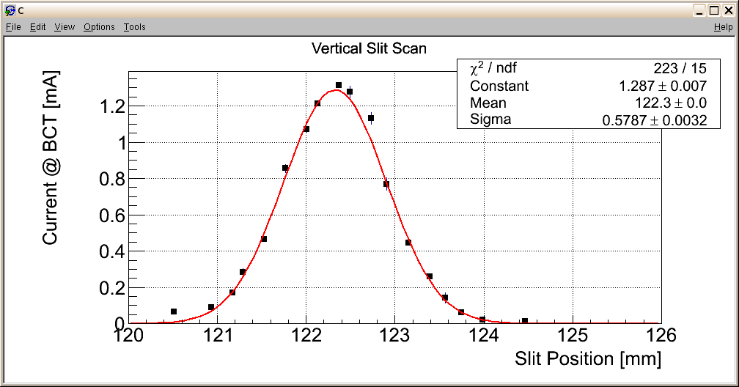
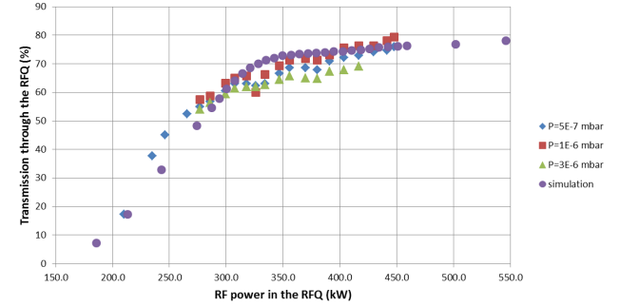
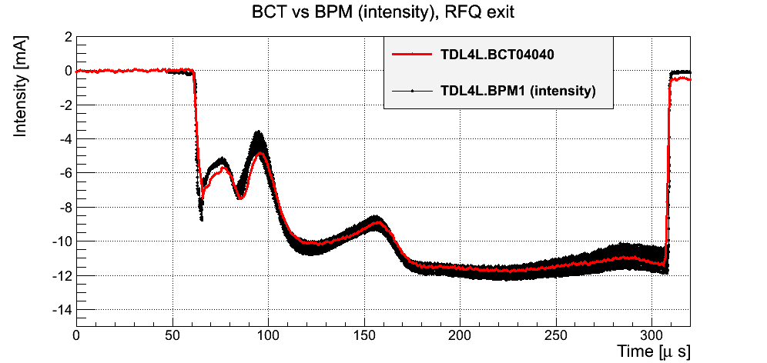
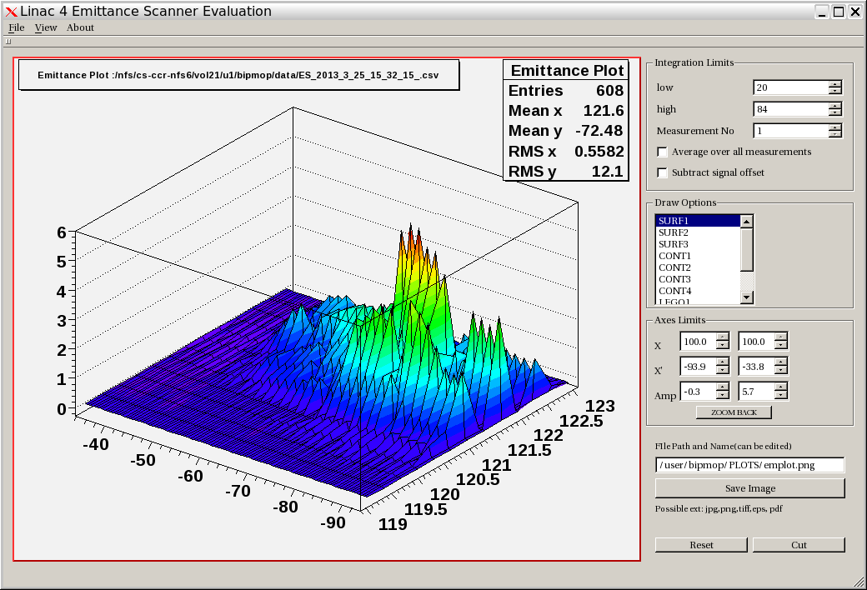
RFQ transmission scans as a function of amplitude at different LEBT pressures
Guillotine profile measurements with quad scans
BPM measurements

Slide 10
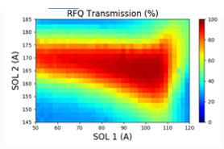
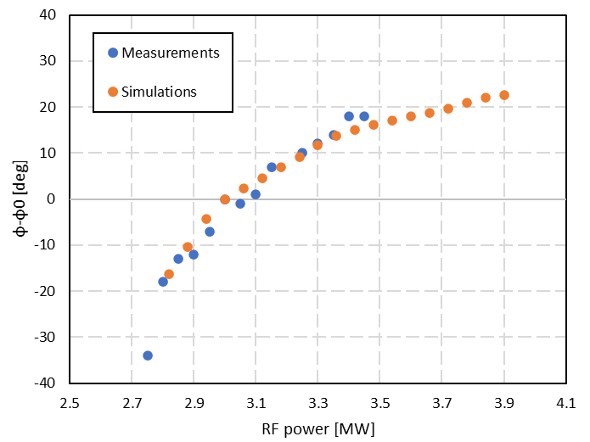
RFQ2 commissioning :
Performance validation key measurements:
RFQ Transmission vs voltage/amplitude scan
Energy/energy spread in spectrometer line
Transverse emittance
Source /LEBT matching: map of RFQ transmission vs LEBT solenoid tuning
RFQ calibration via beam loading/phase measurements
https://indico.cern.ch/event/888416/contributions/3832645/attachments/2022712/3382810/bdm_20200420.pdf
The time of flight between the RFQ and the first buncher depends on the voltage applied to the RFQ due to the variation of the longitudinal phase advance in the RFQ.
Repeat above measurements for different input beam currents from source/LEBT and RFQ amplitudes
V Bencini

Slide 11
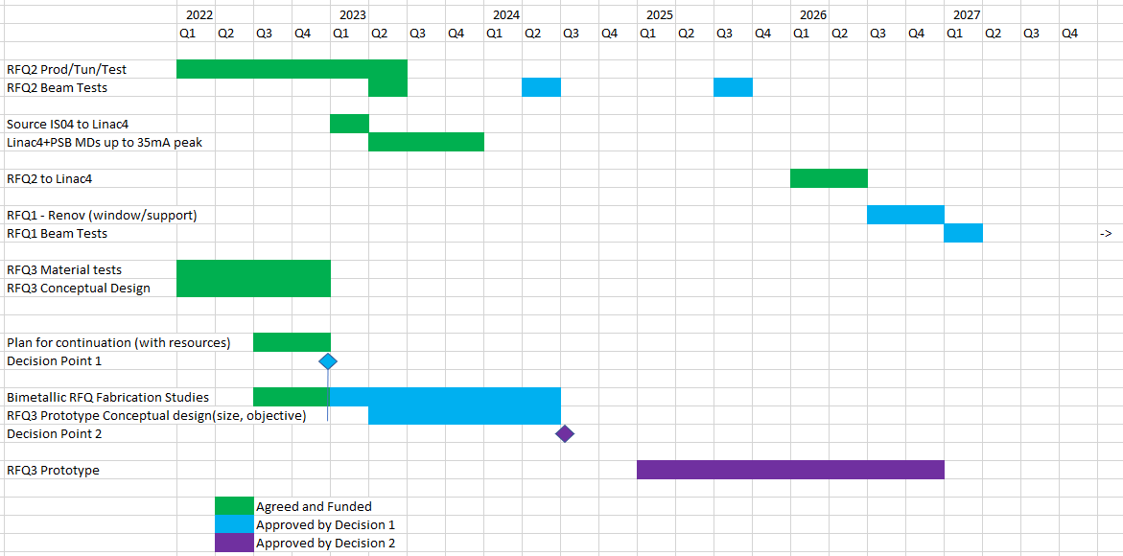
Longer term future proposals

Slide 12
3 MeV Test stand: RFQ2 commissioning and vision beyond 2023
By 12/2023: Defined mandate for RFQ2 commissioning with performance validation measurements.
After 2023:
Unique opportunity provided by a dedicated test stand facility, key for keeping ABP excellence in beam dynamics and build-up of human potential as training/educational ground
Source development (IS04 optimization)
LEBT redesign for more compact solution / multi-electrode extraction
Matching studies to RFQ – rethink RMS section/LEBT-to-RFQ smoother transition
Next generation RFQs studies
Beam dynamics: halo growth, inter-planes correlations effects , space charge
Test and development of instrumentation
Key points for this:
Keep modularity for variable test stand layouts
Investigate using a “cheap” RFQ from industry for more extended beam testing (~150k)
Re-organization/ clean-up of test stand area infrastructure for more permanent use (→ further budget details to be provided)

Slide 13
BI/STI tests
Beyond 2023:
Consider installing additional pick-ups for beam position/TOF measurements at 3 MeV
Possible new SY/BI R&D items :
  Fast FC development (still to be started..)
  Use of 3 MeV beam for R&D to test new materials for existing diagnostics devices (wires, screens etc)
  Beam gas fluorescence studies
-

Slide 14
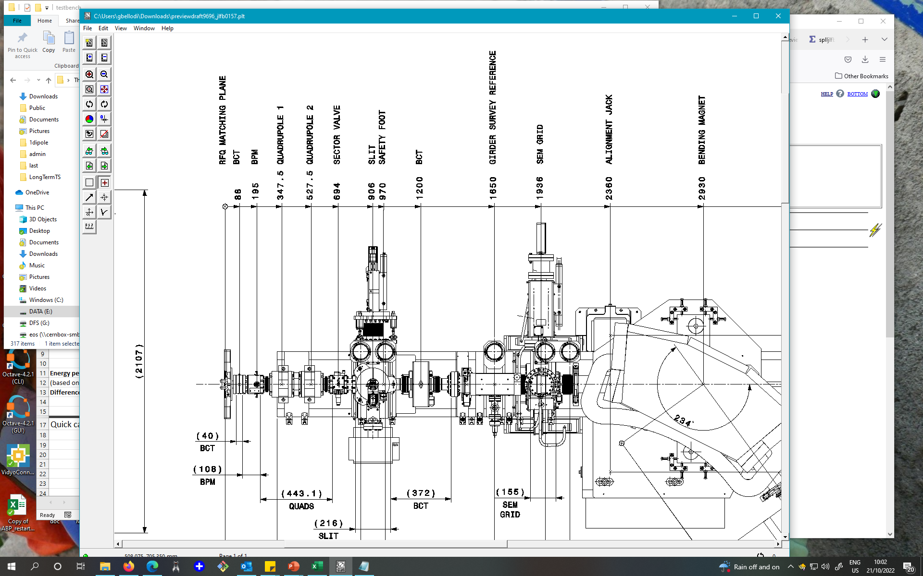
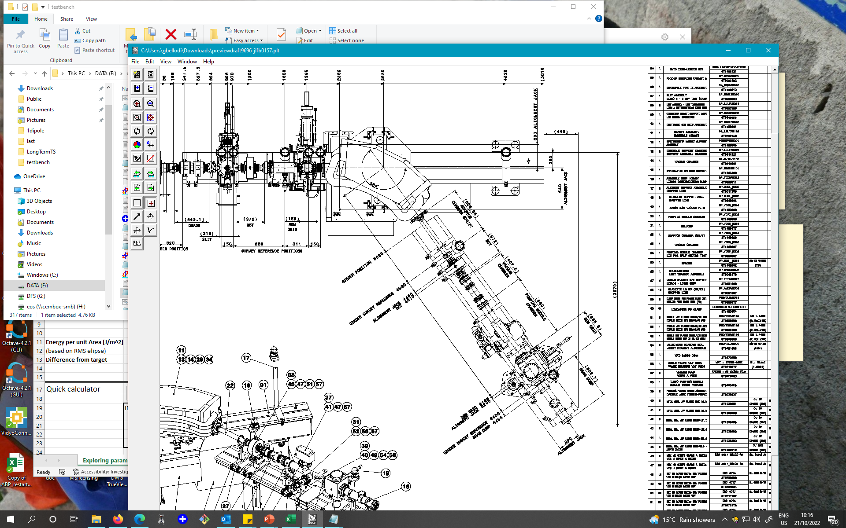
SY/STI irradiation facility
Location #1
Location #2
744mm
3m

Slide 15
2023 measurement plan
RFQ transmission curve vs amplitude
RFQ transmission vs LEBT solenoids settings : map
Beam phase measurements vs RF amplitude
Transverse emittance measurements
Energy/ energy spread in spectro line
Repeat for different input currents

