Slide 1
Visit of Dr. Geert Noels
Welcome and introduction
March 19st, 2024

Slide 2

CERN
Founded in 1954
23 Member States
Austria, Belgium, Bulgaria,
Czech Republic, Denmark, Finland,
France, Germany, Greece,
Hungary, Israel, Italy,
Netherlands, Norway, Poland,
Portugal, Romania, Serbia,
Slovak Republic, Spain, Sweden,
Switzerland and United Kingdom.
3 Associate Member States in the pre-stage to Membership
Cyprus, Estonia and Slovenia
7 Associate Member States
Croatia, India, Latvia, Lithuania, Pakistan, Türkiye and Ukraine
Observer Status
Japan (LHC) and the United States of America (LHC and HL-LHC)
European Union (CERN) and UNESCO (CERN)

Slide 3
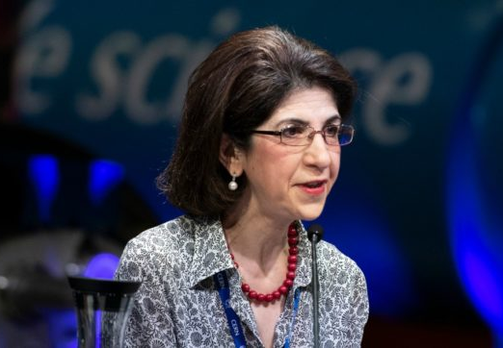
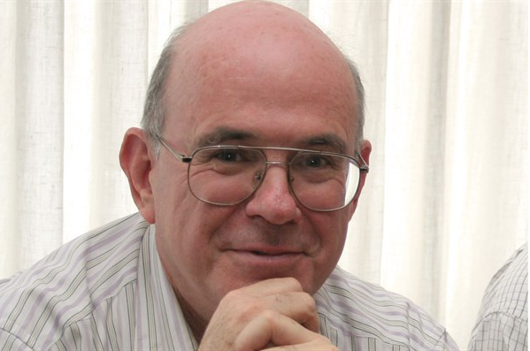
CERN Governance
The CERN Council is the highest authority of the Organization and has responsibility for all-important decisions. It controls CERN’s activities in scientific, technical and administrative matters.
The Council is assisted by the Scientific Policy Committee and the Finance Committee.
The Director-General, appointed by the Council, manages the CERN Laboratory.
The Director-General is assisted by a directorate and runs the Laboratory through a structure of departments.
Director-General of CERN, Fabiola Gianotti
President of the CERN Council, Eliezer Rabinovici

Slide 4

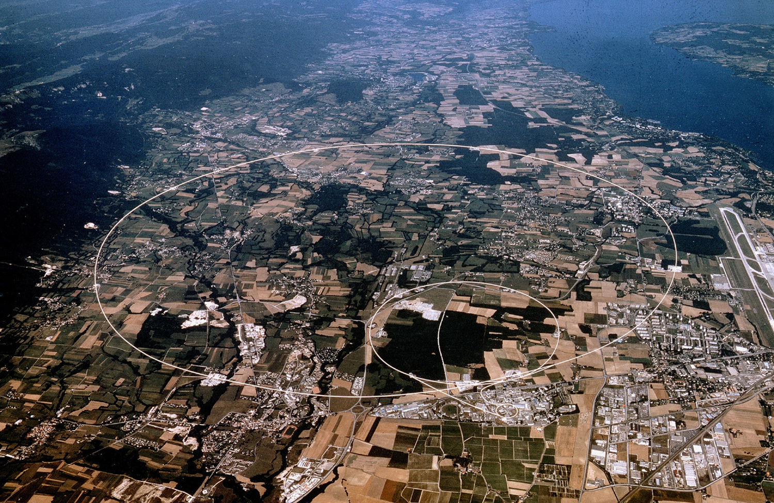
The CERN’s accelerator complex

Slide 5
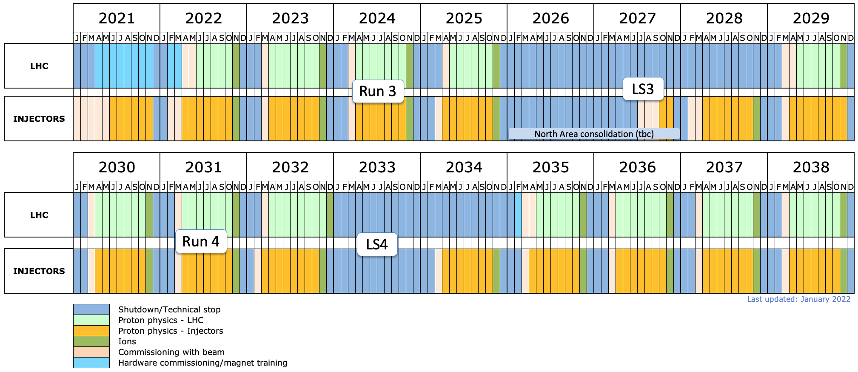
LHC Roadmap
LHC Run-3
LS3: final implementation of HL-LHC’s modifications
HL-LHC era
At present, HL-LHC is the most important CERN’s project. Its objective is to accumulate about 10 times more integrated luminosity compared to what was achieved so far (from 2009) in LHC in ATLAS and CMS for 12 years of operation (3000 fb⁻¹). The beam optics close to the two main experimental areas must be upgraded (and therefore the vacuum system as well).

Slide 6
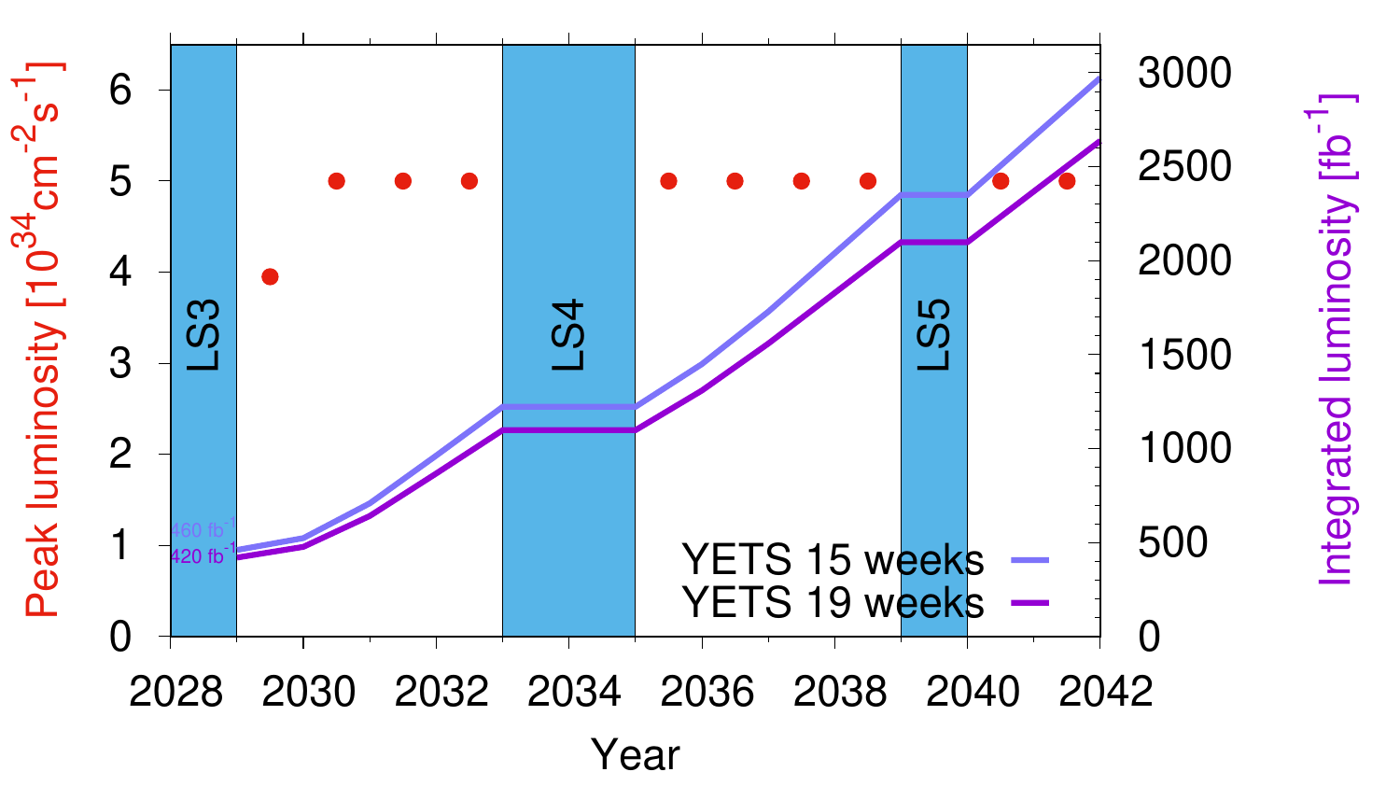

Slide 7

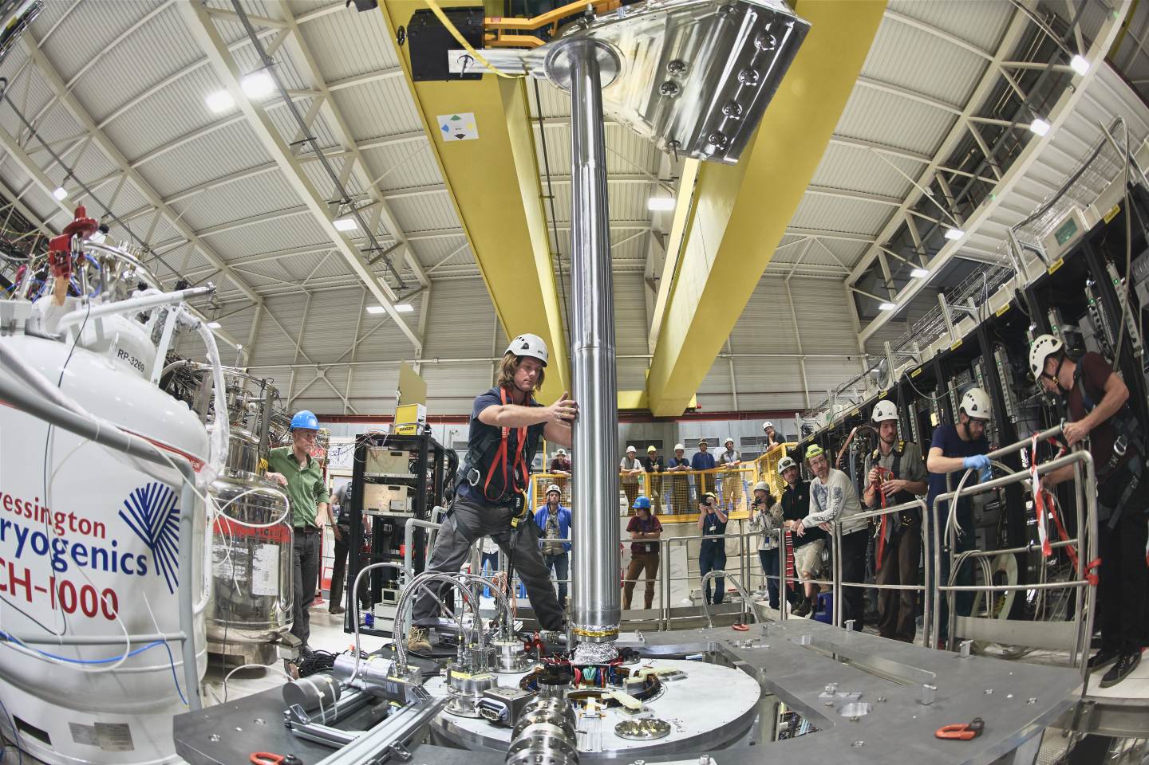
Other physics frontiers: antimatter
In a paper published last week in Nature, the ALPHA collaboration at CERN’s Antimatter Factory shows that, within the precision of their experiment, atoms of antihydrogen – a positron orbiting an antiproton – fall to Earth in the same way as their matter equivalents.

Slide 8
CERN’s Vacuum, Surfaces and Coatings
(VSC) group

Slide 9
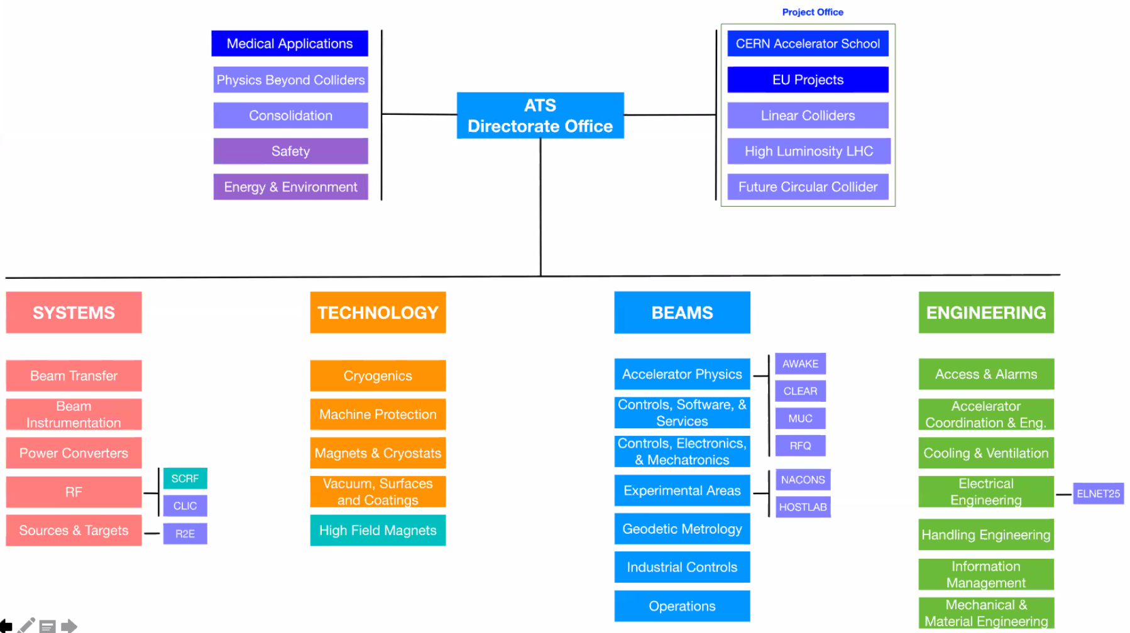
CERN: 5 sectors
(DG, ATS, FHR, IR, RCS)
Courtesy of Mike Lamont

Slide 10
TE-VSC
Paolo Chiggiato GL
Mauro Taborelli DGL
TE-VSC-BVO
Beam Vacuum Operation
G.Bregliozzi
TE-VSC-DLM
Design Logistics & Methods
C.Garion
TE-VSC-ICM
Interlock, Control & Monitoring
G.Pigny
TE-VSC-IVO
Injector Vacuum Operation
J.Ferreira
TE-VSC-SCC
Surface, Coatings & Chemistry
M.Taborelli
TE-VSC-VSM
Vacuum Studies & Measurements
V.Baglin
Personnel in 2023:
Most important lines of expenditure in operation:
Blanket contracts
Industrial support
CERN internal services
CERN store
Associate member of the personnel.
72 staff members
around 50 students, trainees, early career graduates
Payment budget in 2023:
Operational budget: ≈ 5 MCHF
Project budget: ≈ 13 MCHF (mainly HL-LHC)

Slide 11
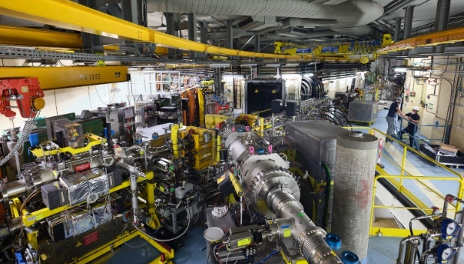
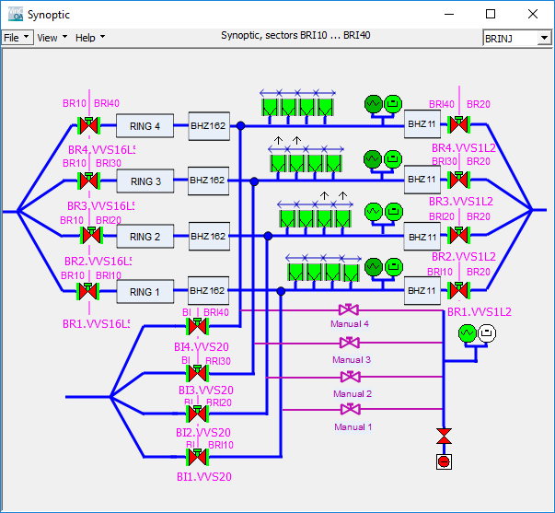
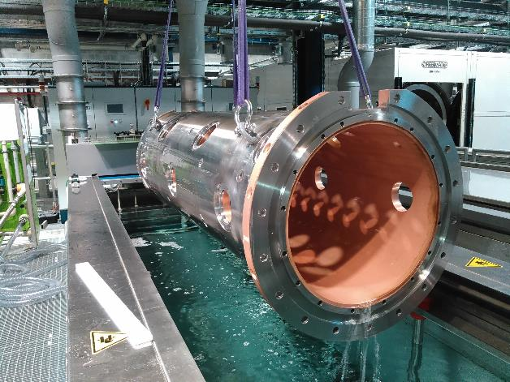
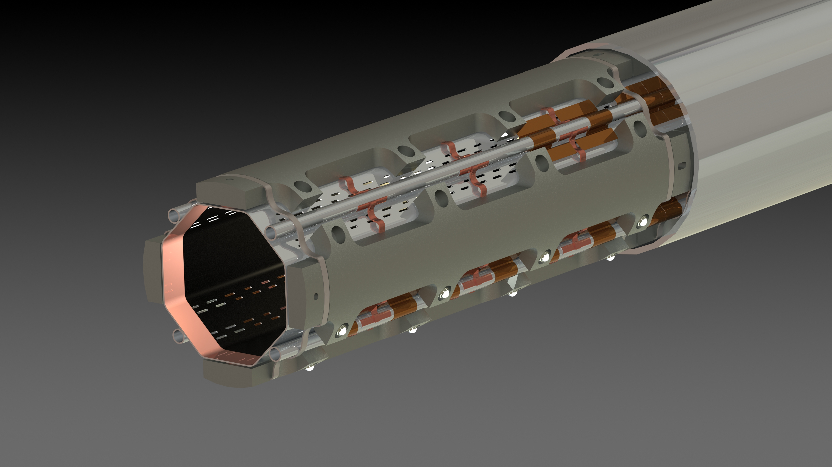
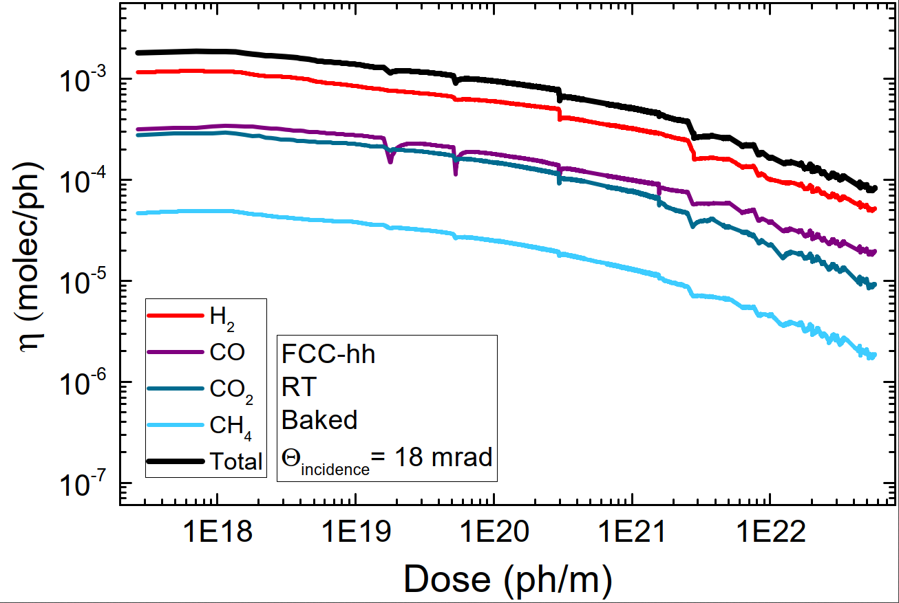
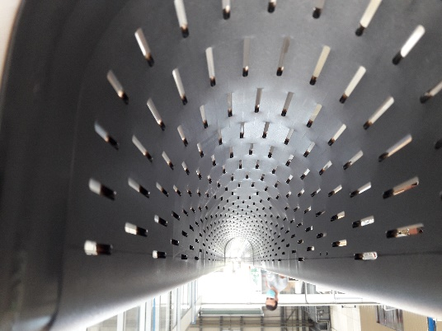
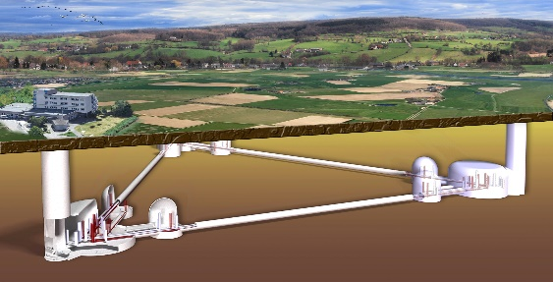
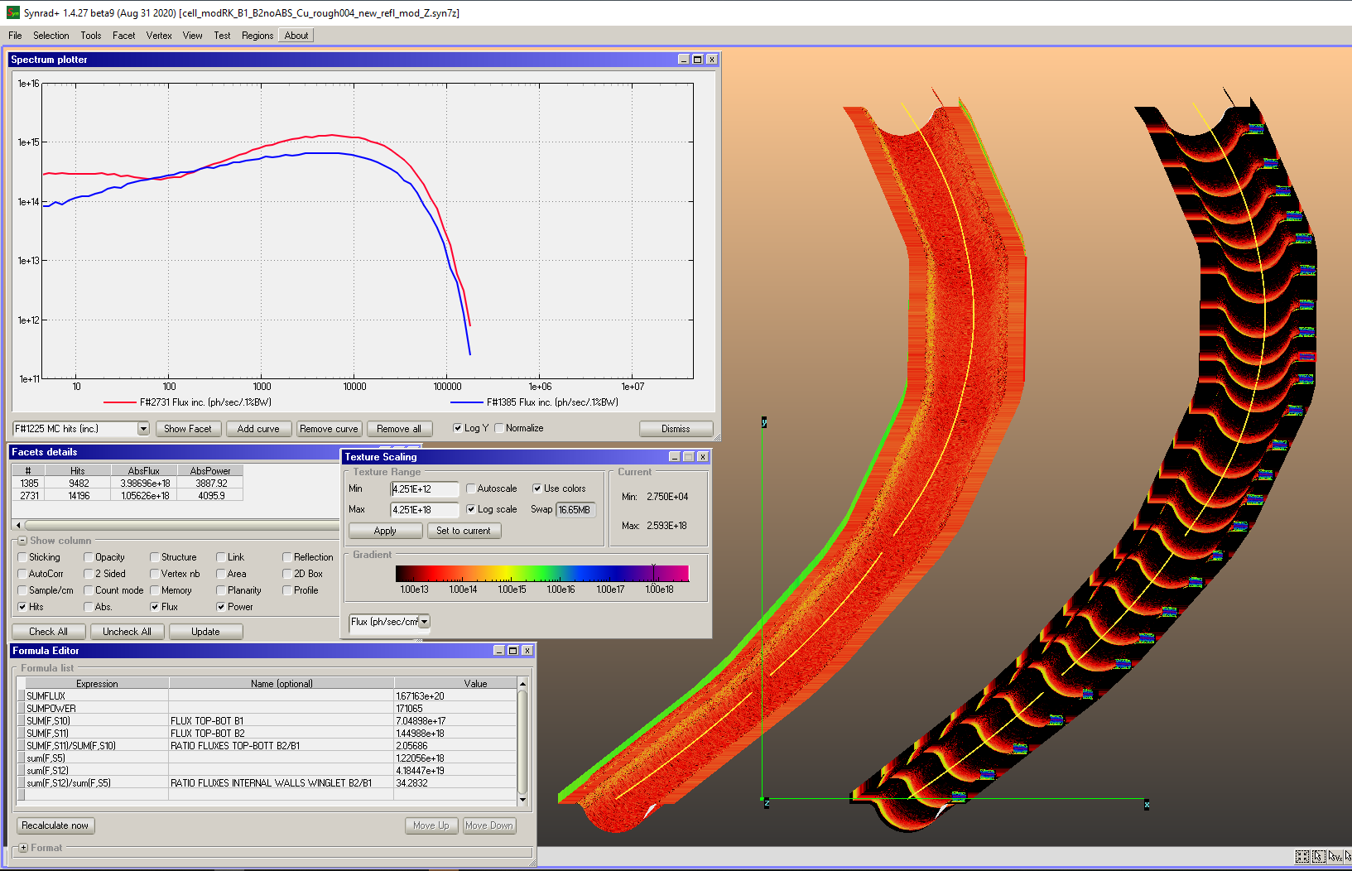
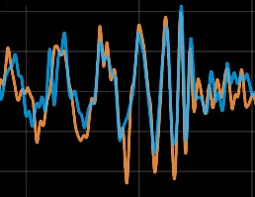
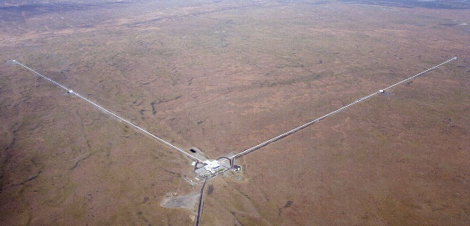
DTL tanks for ESS
Operation
Maintenance
Consolidation
HL-LHC triplet BS
FCC-hh meas. at KARA
Ecloud E spectra
Services for HEP community
TE-VSC
HL-LHC Project
EI
Studies
Collaborations
a-C coated RF shield of TDI
CE
FCC-ee photoadsorbers positioning

Slide 12
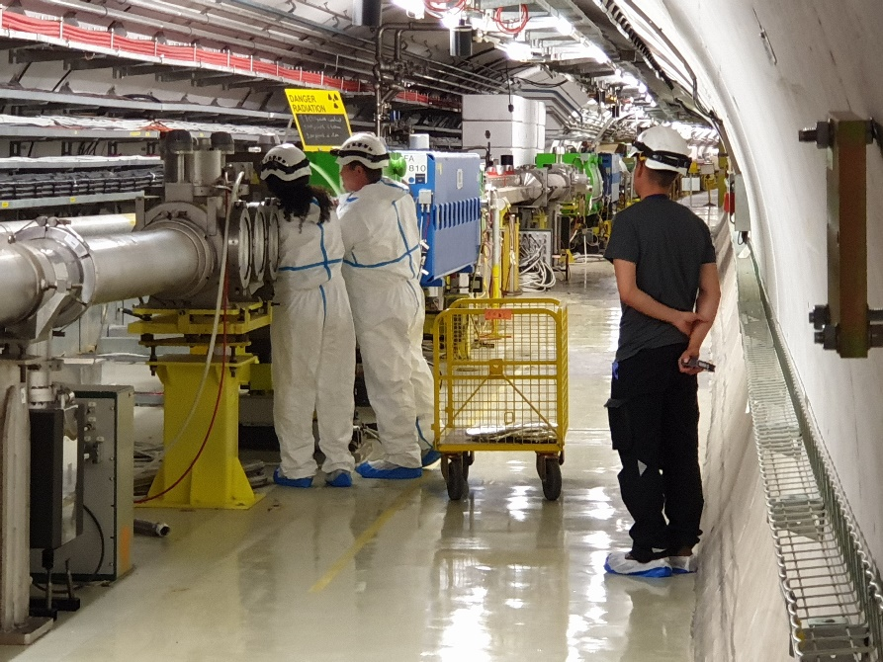
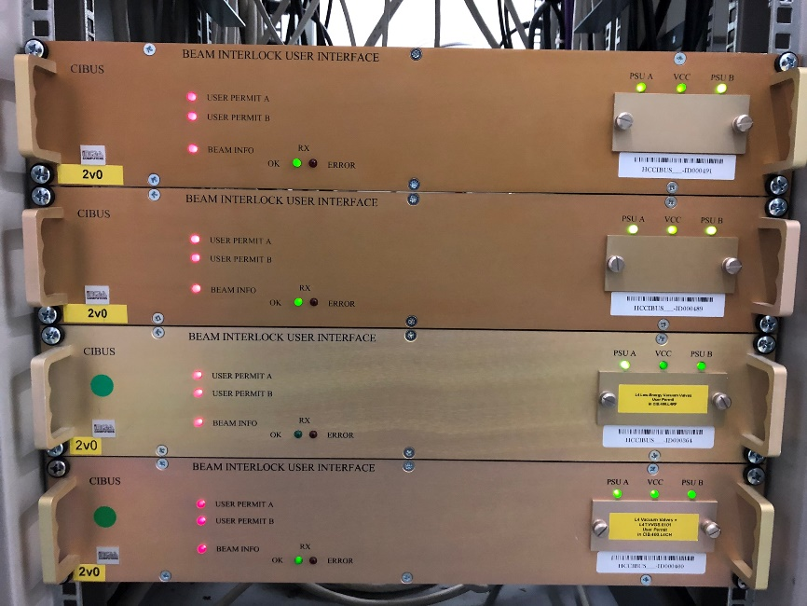
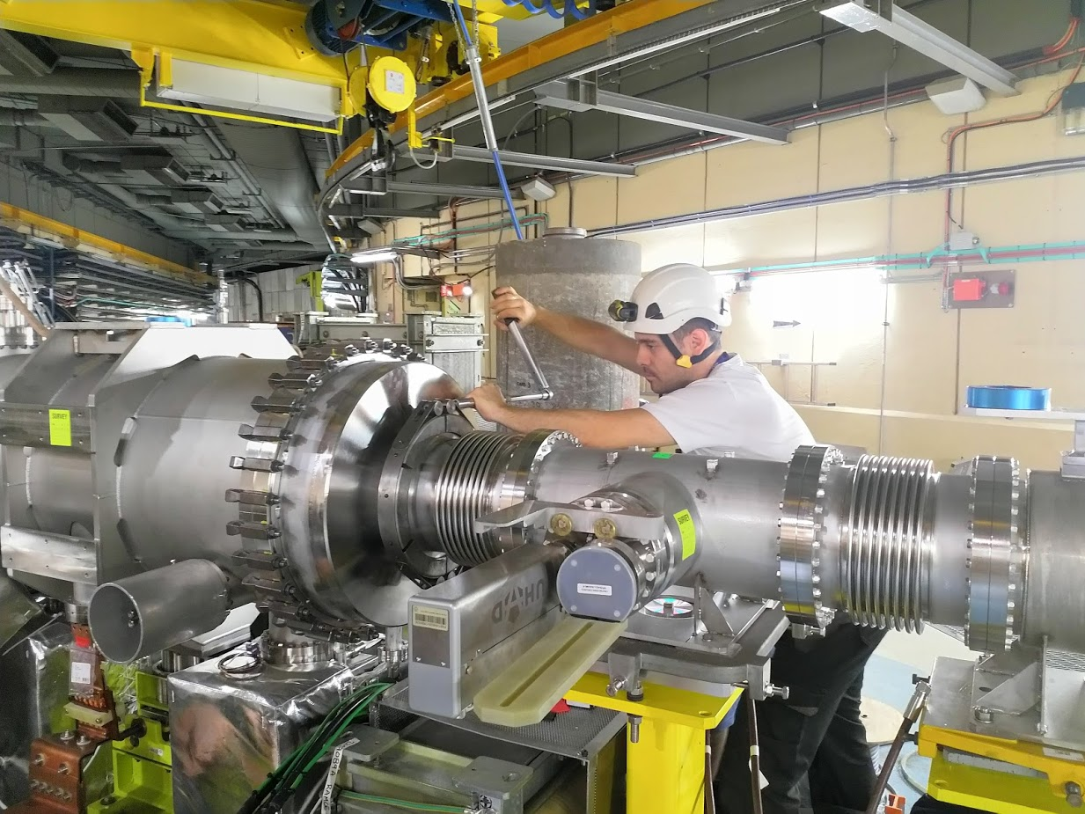
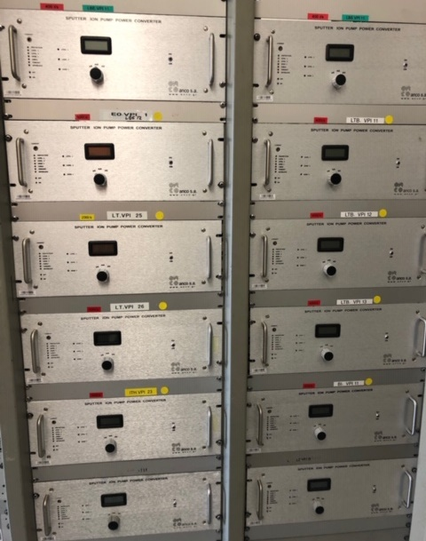
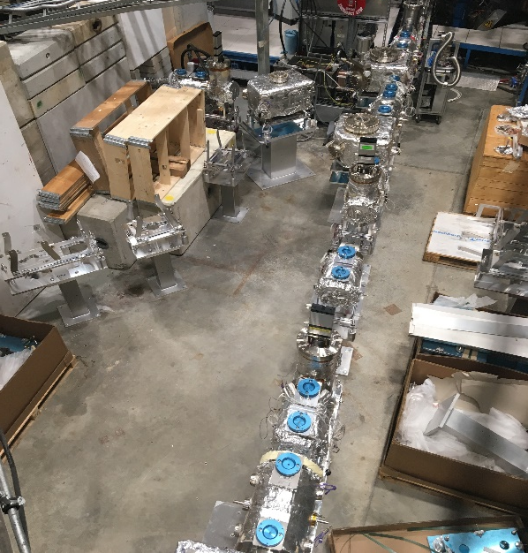
Vacuum systems of CERN’s accelerators

Slide 13
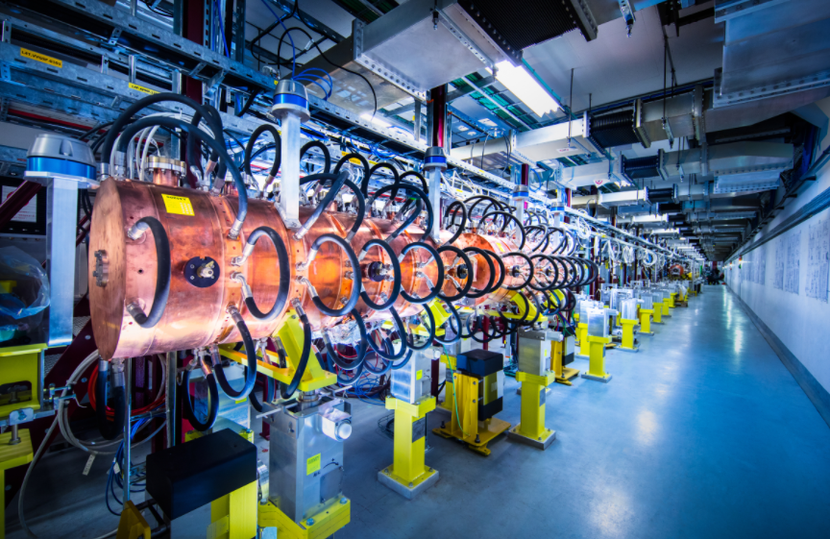
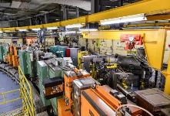
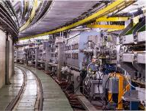
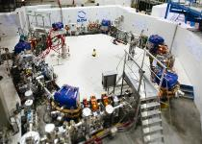
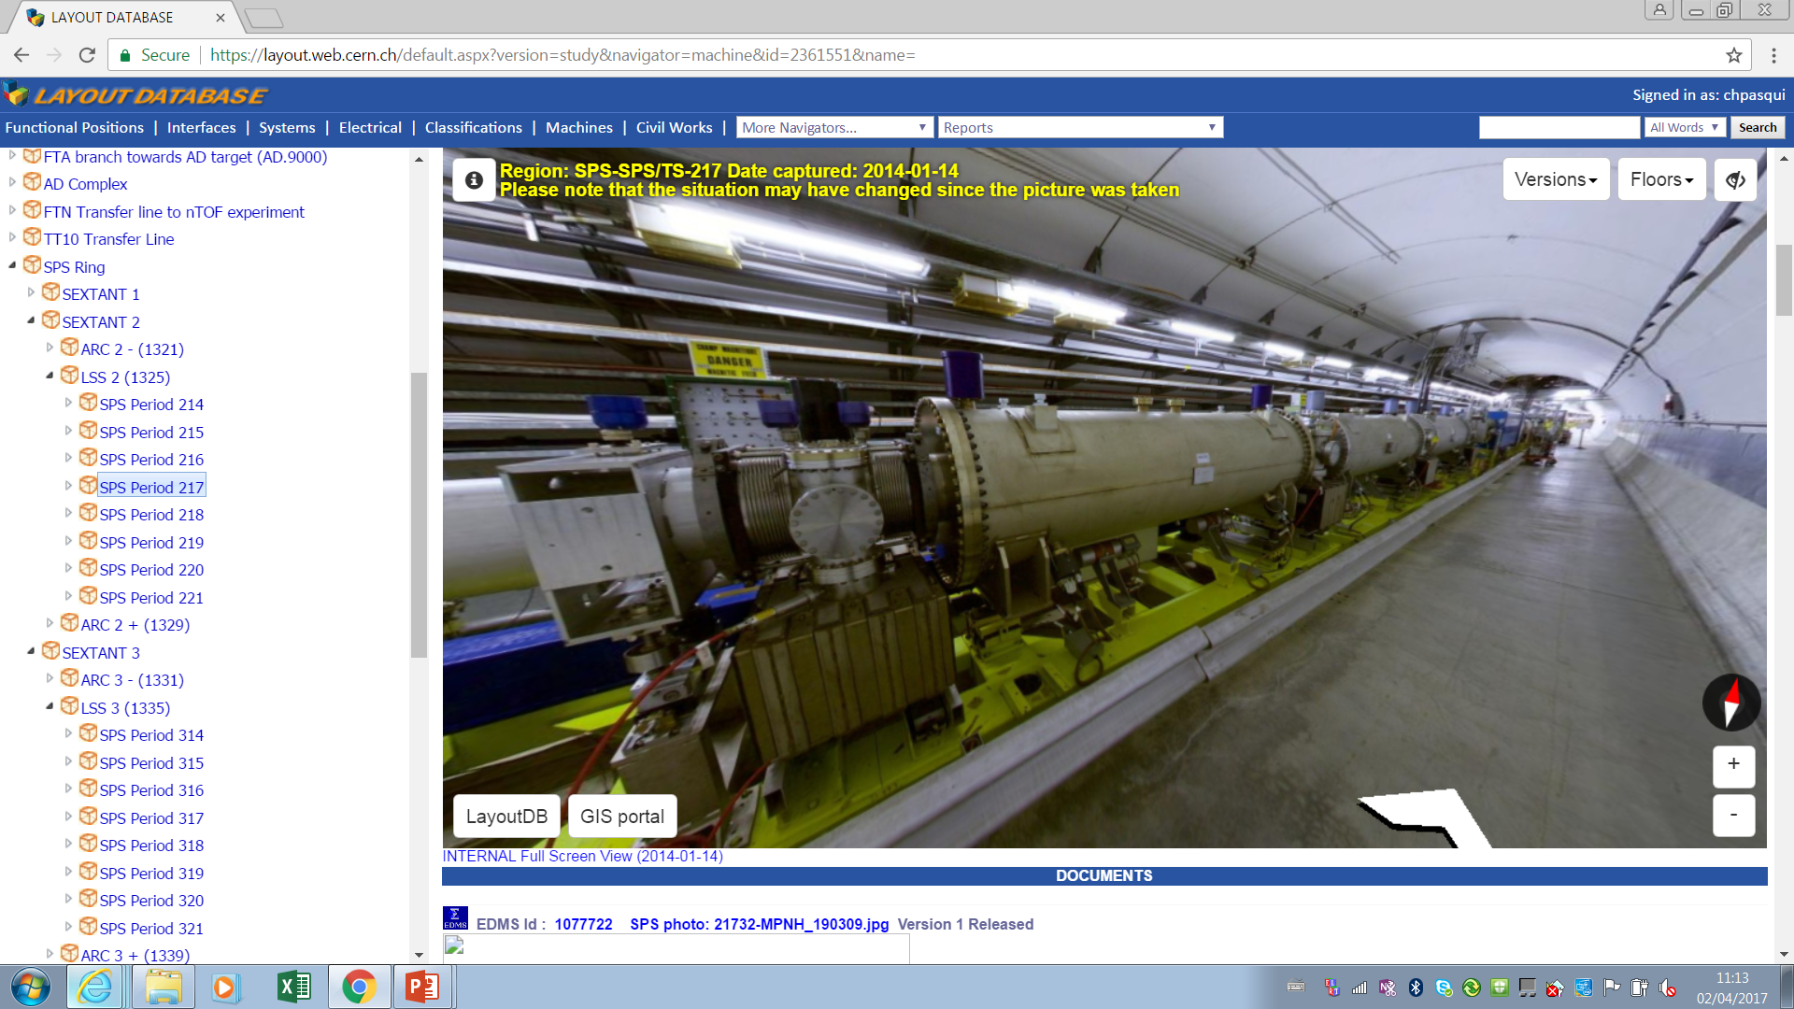
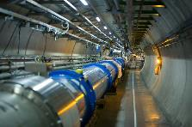
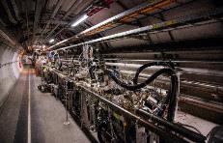
Wide range and many kilometers of accelerator vacuum
Linac4 <2*10⁻⁷ mbar*
PSB <5*10⁻⁸ mbar*
PS <2*10⁻⁸ mbar*
ELENA <4*10⁻¹² mbar
* After 24 h pumpdown
SPS LSS <10⁻⁷ mbar*
LHC arcs <10⁻⁸ mbar
LHC LSS <10⁻¹⁰ mbar
Unbaked systems
TMP, ion pumps, Ti sublimators
Cryogenic systems
Cryopumping
Baked systems
Ion pumps, NEG coating
127 km long vacuum system

Slide 14
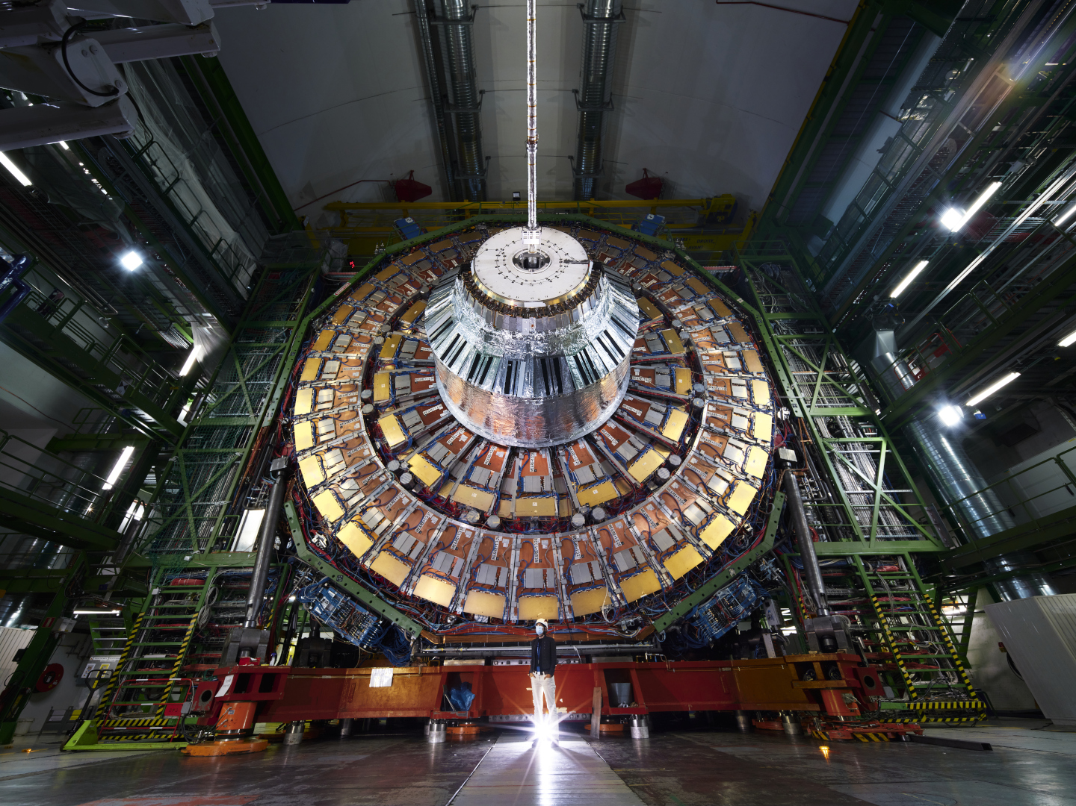
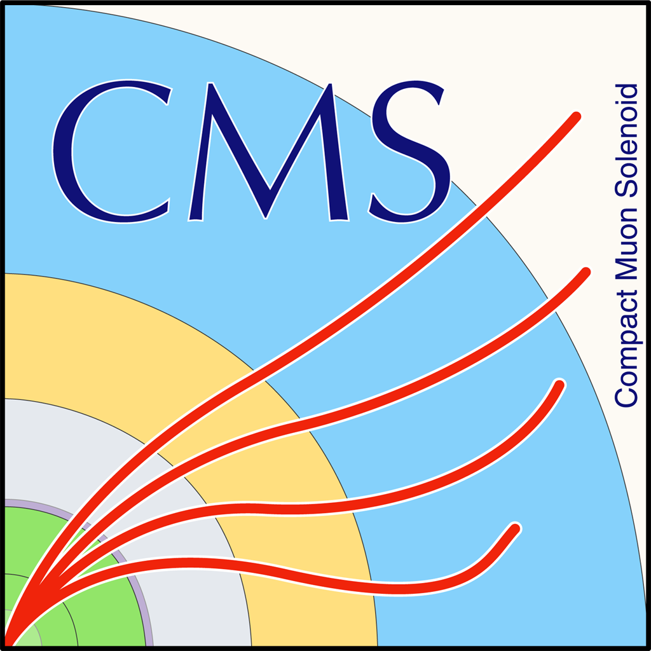
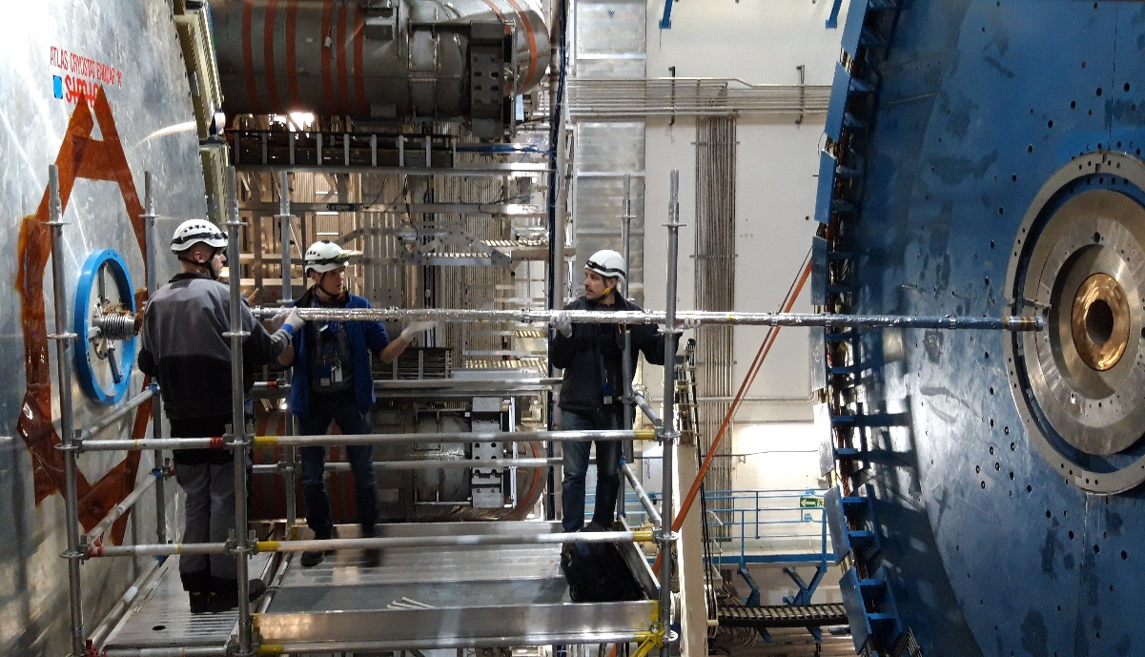
…and experimental areas
Operation, maintenance, consolidation and upgrade of LHC experimental vacuum system

Slide 15
A selected number of facilities
and competences

Slide 16
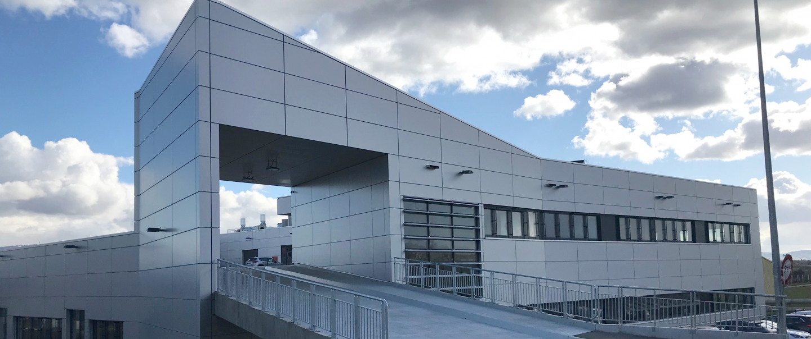
The main CERN’s workshop for chemical surface treatments

Slide 17
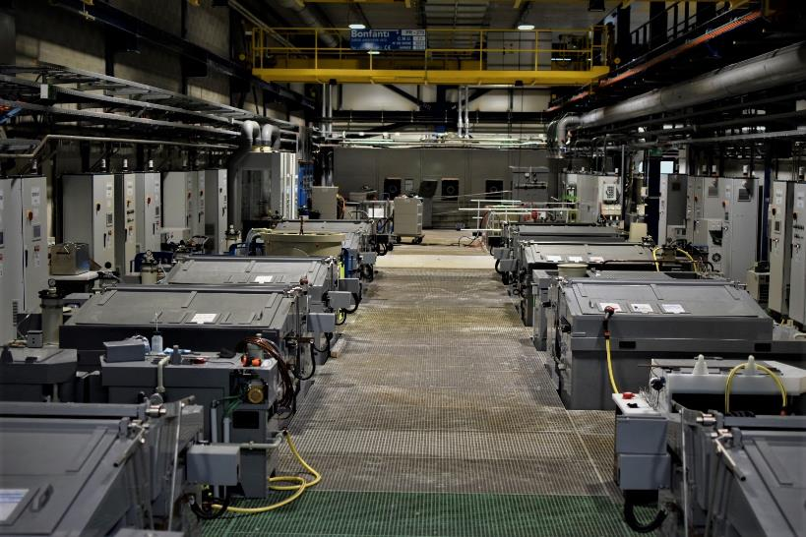
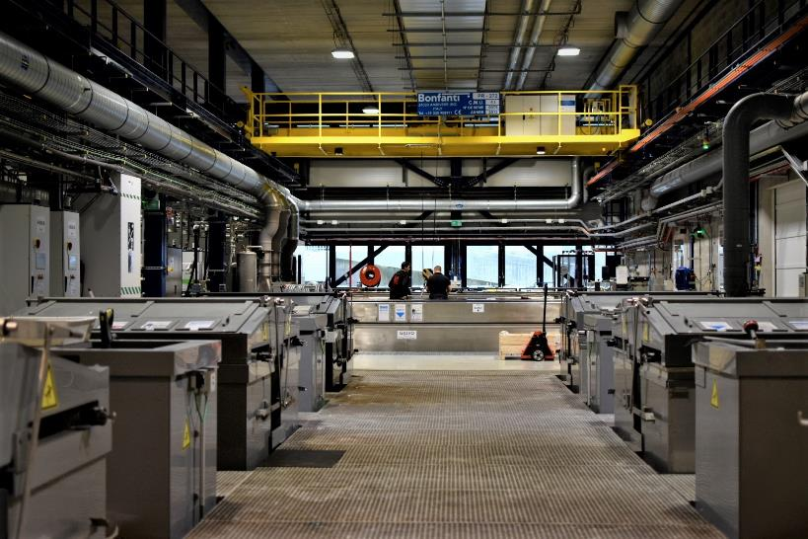
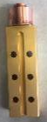
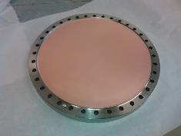
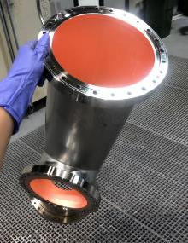
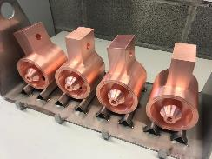
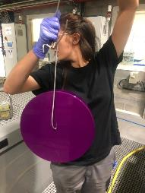
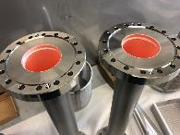
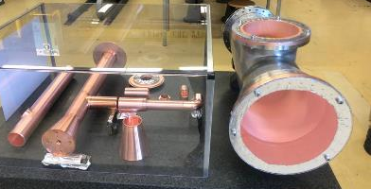
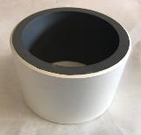
Chemical surface finishing

Slide 18
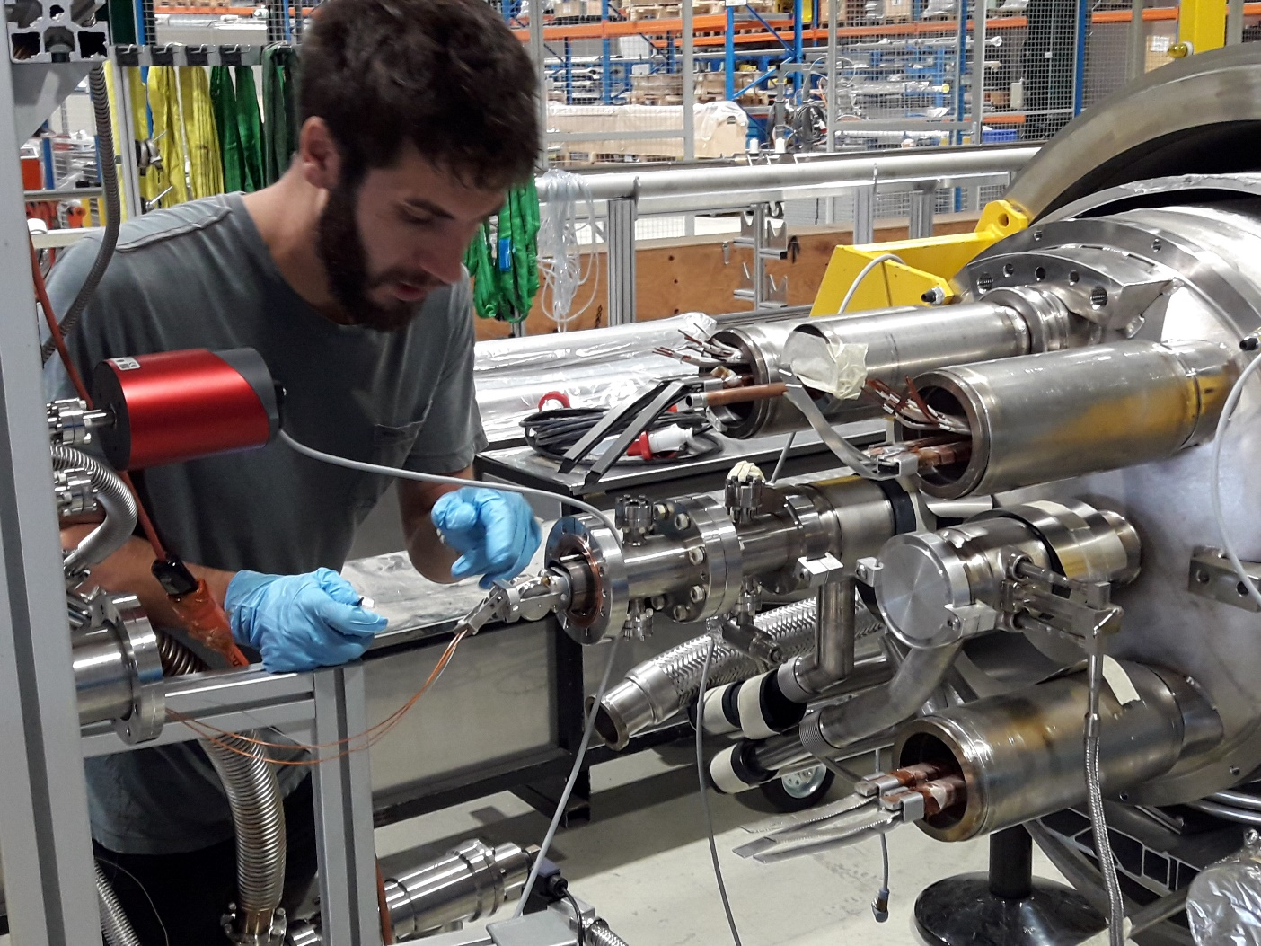
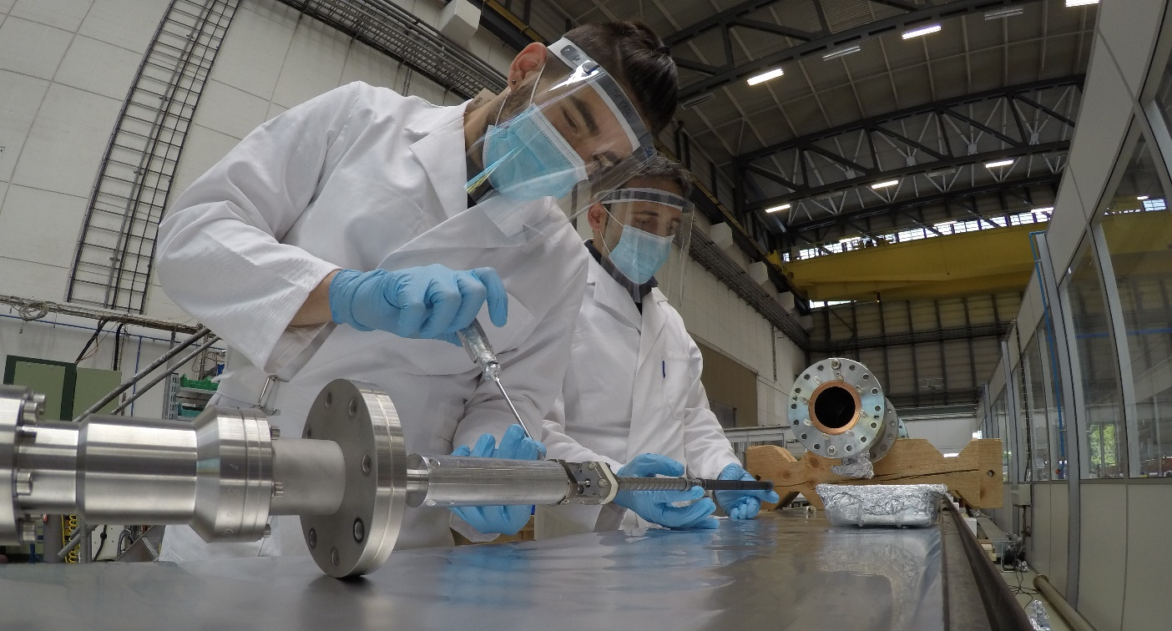
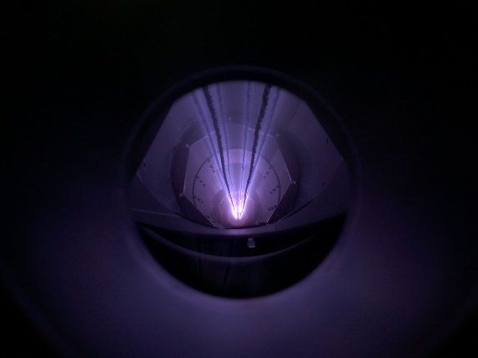
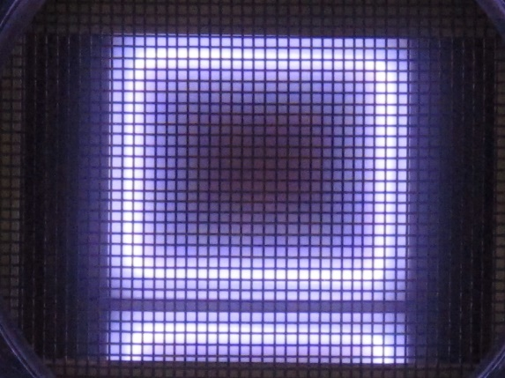
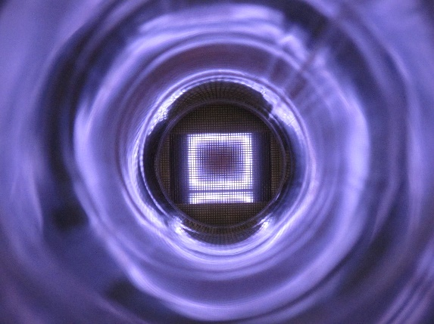
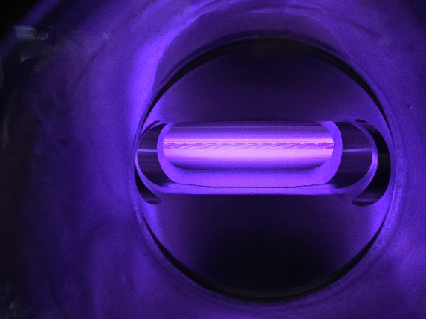
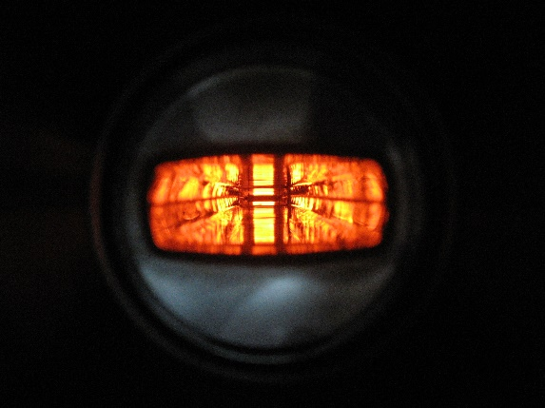
Coatings
Thin film coatings for CERN’s accelerators

Slide 19

In-situ laser treatment.
Roughening of surfaces by laser to reduce secondary electron emission

Slide 20

Mechanical design, prototyping and manufacturing: HL-LHC shielded beam-screens
Thermal links:
Cold bore (CB) at 1.9 K:
Tungsten alloy blocks:
Pumping slot shields:
Beam screen at 60-75 K:
High Mn High N stainless steel
Internal copper layer (75 μm) for impedance
a-C coating for e- cloud mitigation
cooling tubes: Laser welded on the beam screen
elastic supporting system: Ceramic ball and titanium spring

Slide 21


Vacuum measurement: Acceptance tests

Slide 22

Acceptance tests

Slide 23


Sub-assembly validations for prototype double beam collimator for HL-LHC
Vacuum acceptance tests
TCLPX jaws

Slide 24
Vacuum related instrumentation and control
Pressure range from 10⁻⁴ to 10⁻¹² mbar (10⁻¹⁴ mbar in labs)
9000 vacuum instruments to be controlled and monitored along the accelerator lines:
  3900 gauges
  520 Fixed Pumping Groups
  3100 Ion Pumps; 280 NEG Pumps; 270 Sublimation Pumps
  720 Sector Valves
  Mobile equipment (only during technical stops): 176 Mobile Pumping Groups, 100 Bake-out racks
400 PLCs; 3000 Industrial or Custom Controllers
15 SCADA applications

Slide 25

Vacuum Control System | Architecture

Slide 26
The future after the HL-LHC project
FCC-ee
Muon collider
Physics beyond colliders
Participation in other European projects

Slide 27





FCC-ee
FCC-ee (Z, W, H, $\text{t}\overline{\text{t}}$) as Higgs factory, electroweak & top factory at highest luminosities
90 km length, 45-182 GeV beams
Fully NEG coated
Intense synchrotron radiation (MW) to the walls (absorbers)
2020 - 2040
2045 - 2063
2070 - 2095

Slide 28


Support to other scientific equipment
Example: future GW telescopes
Einstein Telescope: 120 km of ≈1.0-m diameter vacuum pipes.
Two possible sites: Sardinia (Italy) and Lindborg, across the Dutch-German-Belgium border.
Cosmic Explorer: two installations 80x2=160 km of 1.2-m diameter vacuum pipes.

Slide 30
VSC Mandate 2021-2025
Design, construction, operation, maintenance and upgrade of high and ultra high vacuum systems for accelerators and detectors;
  Expertise and support on thin-walled vacuum chambers, windows and bellows compensation systems.
  Expertise in vacuum sealing and leak-tightness technology.
  Expertise in dynamic vacuum phenomena.
  Management of the industrial support contract for vacuum work in accelerators.
  Expertise in vacuum control systems, vacuum interlocks and monitoring tools.
  Simulation of pressure profiles and synchrotron radiation distribution in accelerators.
Coatings, surfaces treatments, surface and chemical analysis for accelerators and detectors. Expertise and support in the fields of:
  Coatings, electroplating and surface cleaning techniques.
  Plasma characterisation and simulation.
  UHV characterization of material and surfaces.
  Degassing analysis and treatments.

