Slide 2
HFM Forum
First Thoughts about a
4-layer Cos-theta Design
Author: R.U. Valente and M. Sorbi on behalf of INFN Milano and Genova
Date: 30 May 2024

Slide 3
Table of contents
INFN-CERN agreement proposal
Technical requirements for high-field dipoles
HFM Nb₃Sn conductor specs
Past examples of 4-layers magnet
First studies on 4-layers magnet configurations

Slide 4
INFN-CERN agreement proposal
The INFN-CERN agreement proposal has been launched in the Nov. 2023 HFM general meeting
Discussion for details is currently underway
It will include, among other activities, the study and construction of a demonstrator cos-theta dipole for FCC-hh, to 14 T field level
The INFN activities are carried out in collaboration between Milano and Genova
The construction will be realized in the new infrastructure at LASA of IRIS program (Supercond. Magnet Lab. - SML)

Slide 5
INFN-CERN agreement proposal
The proposal is a 6 years program with the following milestones:
Milestones | Months after agreement start
Electromagnetic design and conductor choice | M6
Technical design report | M12
Coil engineering design report | M18
Winding test completion and tooling assessment | M24
Coil construction readiness review | M30
Manufacture of 1 dummy (copper) coil | M36
Magnet engineering design report | M42
Manufacture of 1 Nb₃Sn practice coil | M48
Manufacture of 2 Nb₃Sn coils | M54
Magnet assembly | M60
Manufacture of additional 2 Nb₃Sn coils | M66
Cold test at LASA at 4.5 K | M66
Cold tests at CERN with test report in collaboration with CERN | M72

Slide 6
INFN-CERN agreement proposal
The e.m. preliminary design study has already started at LASA
Master’s thesis – G. Attanasio
The mechanical design is not considered in this study
but reasonable assumptions are taken
The target and criteria are coherent with HFM program
see next slides

Slide 7
Technical requirements for dipoles
The HFM target is to fabricate dipoles of 14 T
J
1.9 K
Max stress on coils ≈ 120 Mpa
Aperture Ø 50 mm
Margin ≈ 5 K
80% of loadline
B

Slide 8
Technical requirements for dipoles
Extra feature: explore the performance towards 16 T
J
1.9 K
Max stress on coils < 150 Mpa
Aperture Ø 50 mm
Margin ≈ 2.5 K
90% of loadline
B

Slide 9
Technical requirements for dipoles
From analytic analysis with 60° sector coil
if we use Nb₃Sn (J_{overall} ≈ 400 A/mm²)
We need an equivalent coil width ≈ 50 mm
(see E. Todesco, https://indico.cern.ch/event/915752/ )
Possible Solution: 4-layer cos-theta (most efficient)

Slide 10
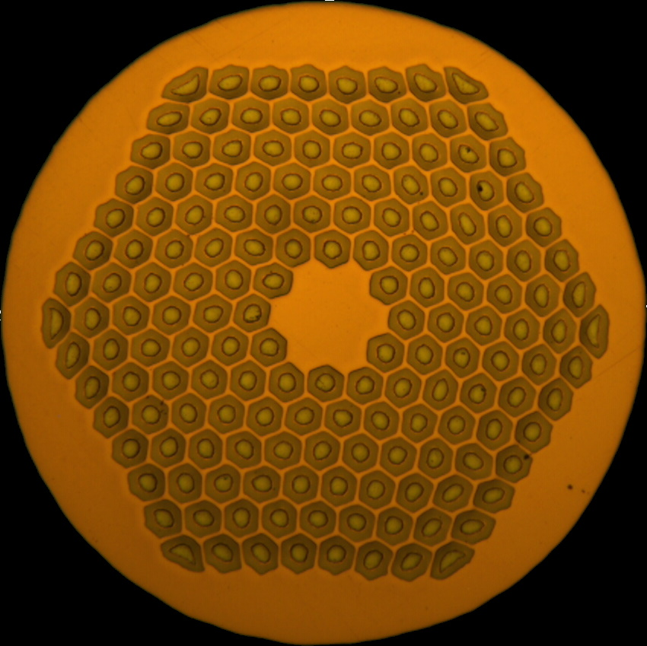
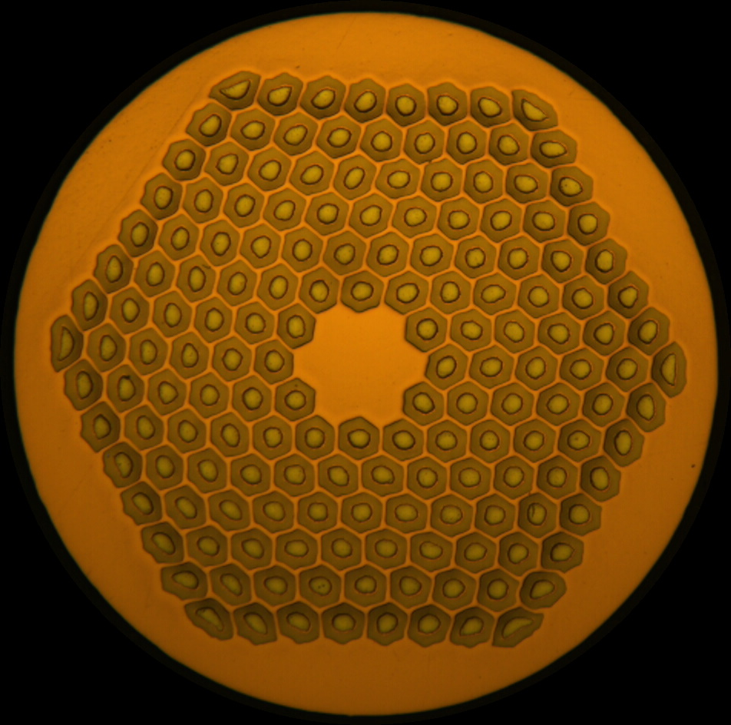
HFM Nb₃Sn conductor specs
RRP® Wire available for HFM programme
 | HL-LHC |  | HFM
 | 11 T dipole | MQXF | ERMC-1 | DEM-1.1
Diameter (mm) | 0.7 | 0.85 | 1.0 | 1.1
Layout | 108/127 |  | 162/169
d_{s} (µm) | 45 | 54 | 58 | 64
Cu/non-Cu | 1.15 ± 0.1 | 1.2 ± 0.1 | 0.9 ± 0.2
Nb:Sn | 3.6 (reduced Sn) |  | 3.4 (standard Sn)
Heat treatment | 650 °C 50 h | 665 °C 50 h | 650 °C 50 h | 665 °C 50 h
S. C. Hopkins et al.
doi: 10.1109/TASC.2023.3254497

Slide 11
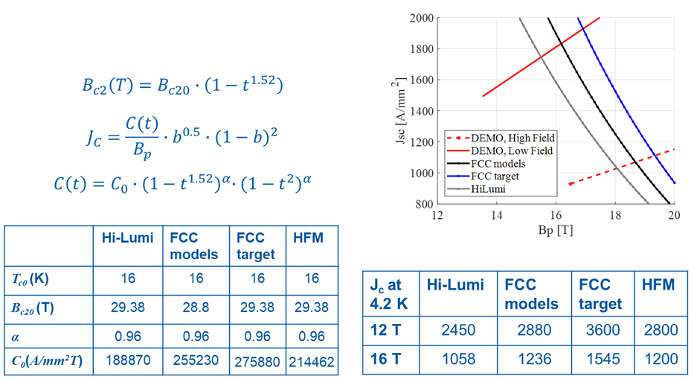








HFM Nb₃Sn conductor specs
Info received from A. Haziot

Slide 12
Past examples of 4-layers magnet
Parameter | HF | LF
Strand diameter (mm) | 0.750 | 0.480
N strands | 37 | 47
Cu/No_Cu | 0.43 | 1.00
Critical current density (A/mm²) | 515 (13.5 T, 4.22 K) | 1519 (10.5 T, 4.22 K)
Overall current density (A/mm²) | 250 | 450
Cable width (mm) | 14.45 | 11.63
Eq. coil width (mm) | 44.8
Cable mid thickness (mm) | 1.369 | 0.873
Keystone angle (°) | 0.000 | 0.000
N. turns | 42 | 96
N. blocks | 7 | 6
LBNL – D20 (1997)
Max Bore field
13.5 T @ 1.8 K
A. D. McInturff et al.
doi: 10.1109/PAC.1997.753158
E. Todesco
https://indico.cern.ch/event/926968/

Slide 13
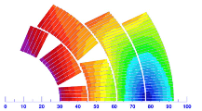
Past examples of 4-layers magnet
Parameter | LF | HF
Strand diameter (mm) | 1.0 | 0.7
N strands | 28 | 40
Cu/No_cu | 1.13 | 1.13
Critical current density (A/mm²) | 1500 (15 T, 4.22 K) | 1500 (15 T, 4.22 K)
Overall current density (A/mm²) | 330 | 440
Cable width (mm) | 15.10 | 15.10
Eq. coil width (mm) | 52.3
Cable mid thickness (mm) | 1.870 | 1.319
Keystone angle (°) | 0.805 | 0.805
N. turns | 44 | 65
N. blocks | 5 | 2
FNAL – MDPTC1 (2021)
Max Bore field
14.5 T @ 1.9 K
V. Zlobin et al.,
doi: 10.1109/TASC.2021.3057571
E. Todesco
https://indico.cern.ch/event/926968/

Slide 14
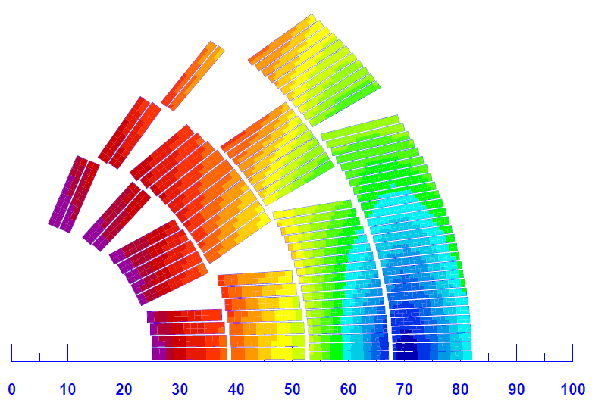
Past examples of 4-layers magnet
Parameter | LF | HF
Strand diameter (mm) | 1.1 | 0.7
N strands | 22 | 38
Cu/No_cu | 0.8 | 2.1
Critical current density (A/mm²) | 1500 (16 T, 4.22 K)
Overall current density (A/mm²) | 378 | 513
Cable width (mm) | 13.2 | 14
Eq. coil width (mm) | 48.3
Cable mid thickness (mm) | 1.870 | 1.319
Keystone angle (°) | 0.5 | 0.5
N. turns | 32 | 68
N. blocks | 7 | 5
High
Performance
16 T EuroCircol study – INFN option (2019)
Bore field
16 T @ 1.9 K
FCC-hh Conceptual Design Report,
https://doi.org/10.1140/epjst/e2019-900087-0

Slide 15
First studies on 4-layers magnet configurations – strand size
The best choice for grading is Ø 1.1 mm (HF) and Ø 0.7 mm (LF)
(from EuroCircol experience)
→ Already available in HFM
 | High Field | Low Field
Diameter (mm) | 1.1 | 0.7
Layout | 162/169 | 108/127
d_{s} (µm) | 64 | 45
Cu/non-Cu | 0.9 ± 0.2 | 1.15 ± 0.1
Nb:Sn | 3.4 (standard Sn) | 3.6 (reduced Sn)
Heat treatment | 665 °C 50 h | 650 °C 50 h
J_{c} @16 T, 4.2 K (A/mm²) | 1200 | 1058

Slide 16
First studies on 4-layers magnet configurations – HT cable expansion
We design the cross-section considering the cable size increasing after heat treatment
N. Andreev et al, https://doi.org/10.1063/1.1472635
We set guess values based on Hi-Lumi experience
D. Schoerling and A. V. Zlobin. Nb3Sn Accelerator Magnets: Designs, Technologies and Performance. Springer Nature, 2019.
+1% Width
+3% thickness

Slide 17
First studies on 4-layers magnet configurations – Cable design
 | HF (layers 1-2) | LF (layers 3-4)
N° of strands | 26 | 40
Strands diameter [mm] | 1.1 | 0.7
Cu/Sc | 0.9 | 1.15
Width [mm] | 15.862 | 15.141
Inner thickness [mm] | 1.911 | 1.216
Outer thickness [mm] | 2.047 | 1.346
Keystone angle [°] | 0.5 | 0.5
Insulation thick radial [mm] | 0.150 | 0.150
Insulation thick azimuthal [mm] | 0.150 | 0.150
Insulated cable filling factor [%] | 35.40 | 29.44
Cables have to be considered bare and already reacted.

Slide 18
First studies on 4-layers magnet configurations – Optimization strategy
The 1st and 2nd layers define the field quality
Promising configurations are with 3 or 4 blocks in the 1° layer
(as in the past magnets)

Slide 19
First studies on 4-layers magnet configurations – Optimization strategy
The 3rd and 4th layers increase the bore field
→ few big blocks

Slide 20
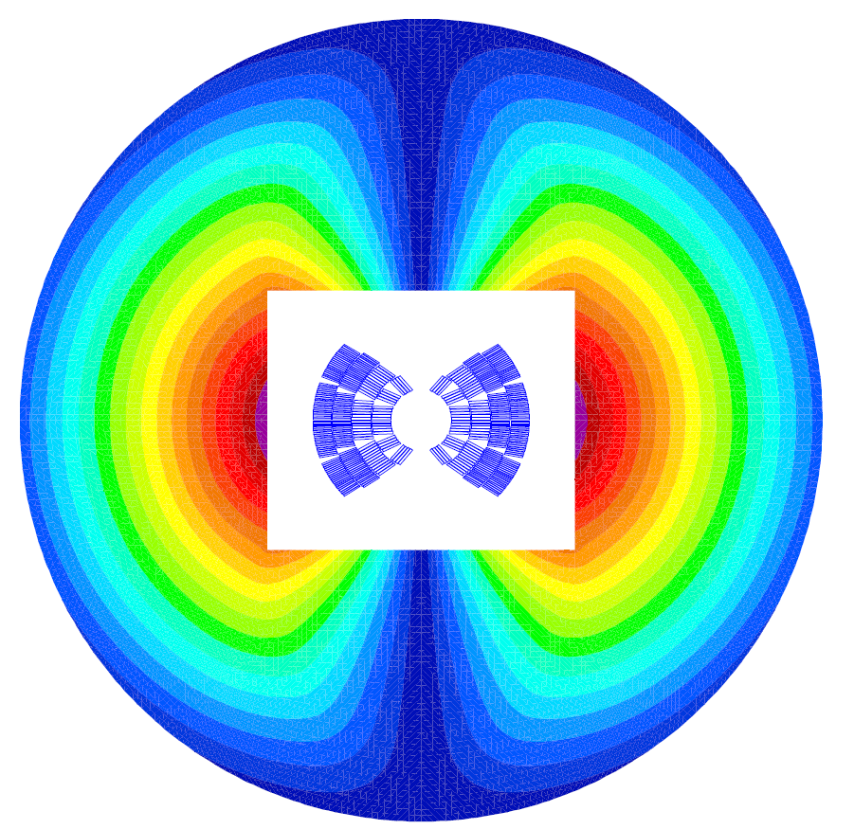
First studies on 4-layers magnet configurations – Iron yoke
The yoke is designed to set up the bladder and key system
Flat interfaces between iron and pads

Slide 21
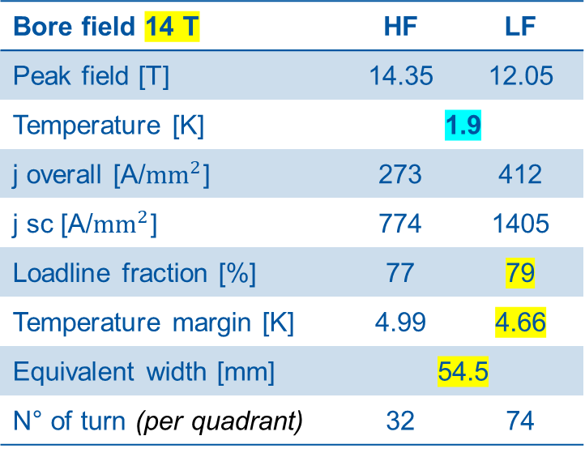
First studies on 4-layers magnet configurations – Case A (3 blocks IL)
Bore field 14 T | HF | LF
Peak field [T] | 14.35 | 12.05
Temperature [K] | 1.9
j overall [A/${mm}^{2}$] | 273 | 412
j sc [A/${mm}^{2}$] | 774 | 1405
Loadline fraction [%] | 77 | 79
Temperature margin [K] | 4.99 | 4.66
Equivalent width [mm] | 54.5
N° of turn (per quadrant) | 32 | 74
The lower margin is on LF cable → fully exploited (J_{overall} 412 A/mm²)
The HF cable is not fully exploited → strand number could be reduced from 26 to 24 (discarded to keep margins)

Slide 22
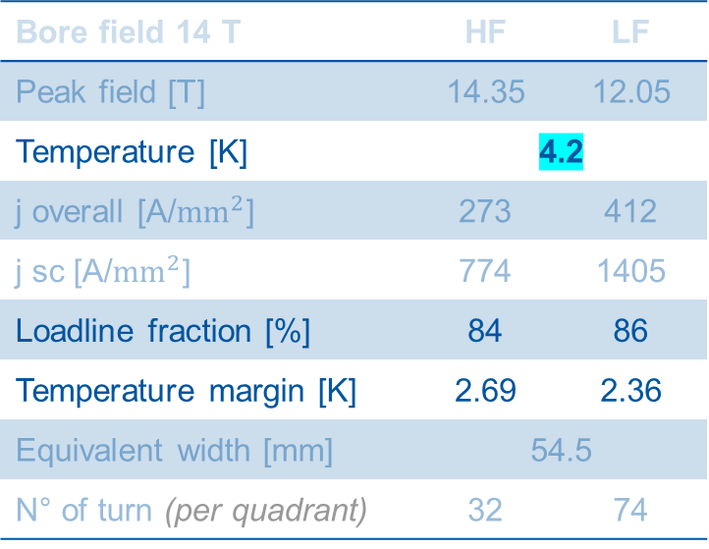
First studies on 4-layers magnet configurations – Case A (3 blocks IL)
Bore field 14 T | HF | LF
Peak field [T] | 14.35 | 12.05
Temperature [K] | 4.2
j overall [A/${mm}^{2}$] | 273 | 412
j sc [A/${mm}^{2}$] | 774 | 1405
Loadline fraction [%] | 84 | 86
Temperature margin [K] | 2.69 | 2.36
Equivalent width [mm] | 54.5
N° of turn (per quadrant) | 32 | 74
The margins are still safe at 4.2 K

Slide 23
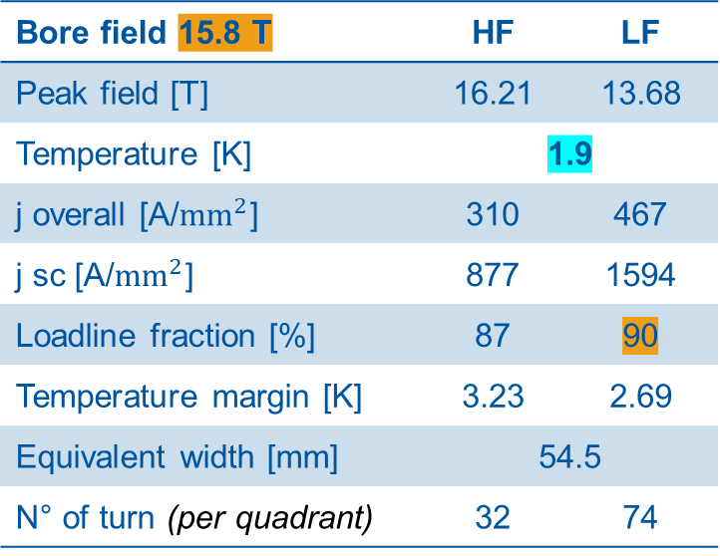
First studies on 4-layers magnet configurations – Case A (3 blocks IL)
Bore field 15.8 T | HF | LF
Peak field [T] | 16.21 | 13.68
Temperature [K] | 1.9
j overall [A/${mm}^{2}$] | 310 | 467
j sc [A/${mm}^{2}$] | 877 | 1594
Loadline fraction [%] | 87 | 90
Temperature margin [K] | 3.23 | 2.69
Equivalent width [mm] | 54.5
N° of turn (per quadrant) | 32 | 74
Max. loadline working point at 90% (LF) → Bore field 15.8 T

Slide 24
First studies on 4-layers magnet configurations – Case A (3 blocks IL)
b₅ = 5.41
b₇ = 5.01
b₃ = -0.14
Inner layer with 3 blocks → more challenging to improve field quality

Slide 25
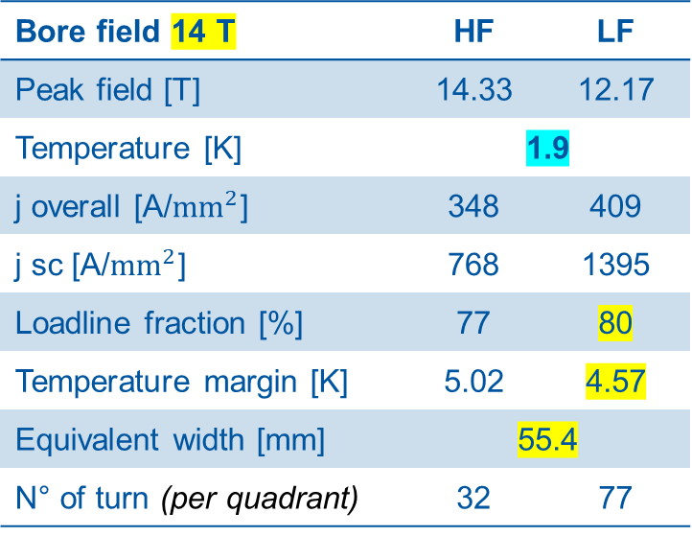
First studies on 4-layers magnet configurations – Case B (4 blocks IL)
Bore field 14 T | HF | LF
Peak field [T] | 14.33 | 12.17
Temperature [K] | 1.9
j overall [A/${mm}^{2}$] | 348 | 409
j sc [A/${mm}^{2}$] | 768 | 1395
Loadline fraction [%] | 77 | 80
Temperature margin [K] | 5.02 | 4.57
Equivalent width [mm] | 55.4
N° of turn (per quadrant) | 32 | 77
The lower margin is on LF cable → fully exploited (J_{overall} 409 A/mm²)
The HF cable is not fully exploited → strand number could be reduced from 26 to 24 (discarded to keep margins)

Slide 26

First studies on 4-layers magnet configurations – Case B (4 blocks IL)
Bore field 14 T | HF | LF
Peak field [T] | 14.35 | 12.05
Temperature [K] | 4.2
j overall [A/${mm}^{2}$] | 273 | 412
j sc [A/${mm}^{2}$] | 774 | 1405
Loadline fraction [%] | 84 | 87
Temperature margin [K] | 2.72 | 2.27
Equivalent width [mm] | 54.5
N° of turn (per quadrant) | 32 | 74
The margins are still safe at 4.2 K

Slide 27
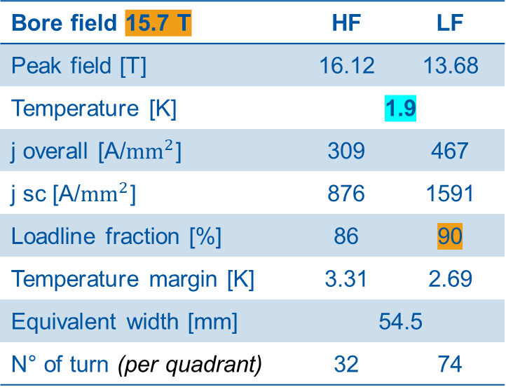
First studies on 4-layers magnet configurations – Case B (4 blocks IL)
Bore field 15.7 T | HF | LF
Peak field [T] | 16.12 | 13.68
Temperature [K] | 1.9
j overall [A/${mm}^{2}$] | 309 | 467
j sc [A/${mm}^{2}$] | 876 | 1591
Loadline fraction [%] | 86 | 90
Temperature margin [K] | 3.31 | 2.69
Equivalent width [mm] | 54.5
N° of turn (per quadrant) | 32 | 74
Max. loadline working point at 90% (LF) → Bore field 15.7 T

Slide 28
First studies on 4-layers magnet configurations – Case A (3 blocks IL)
b₃ = -0.02
b₅ = -0.80
b₇ = -1.11
Inner layer with 4 blocks → easy to improve field quality

Slide 29
First studies on 4-layers magnet configurations – recap
The equivalent coil width is larger to have more margin

Slide 30
First studies on 4-layers magnet configurations – recap
 | case A |  | case B |  | D20 |  | MDPCT1
 | HF | LF | HF | LF | HF | LF | HF | LF
Bore field [T] | 14 |  | 14 |  | 13 |  | 15
Peak field [T] | 14.35 | 12.05 | 14.33 | 12.17
Temperature [K] | 1.9 | 1.9 | 1.9 | 1.9 | 1.9 | 1.9 | 1.9 | 1.9
operating current [A] | 10060 | 10060 | 9990 | 9990 | 5800 | 5800 | 10900 | 10900
j overall [A/mm^2] | 273 | 412 | 348 | 409 | 250 | 450 | 330 | 440
j sc [A/mm^2] | 774 | 1405 | 768 | 1395 | 507 | 1364 | 1056 | 1508
Loadline fraction [%] | 77 | 79 | 77 | 80 | 90 |  | 87
Temperature margin [K] | 4.99 | 4.66 | 5.02 | 4.57
Equivalent width [mm] | 54.5 |  | 55.4 |  | 44.8 |  | 52.3
N° of turn (per quadrant) | 32 | 74 | 32 | 77 | 42 | 96 | 44 | 65
N. blocks | 5 | 4 | 6 | 4 | 7 | 6 | 5 | 2
aperture [mm] | 50 | 50 | 50 | 50 | 50 | 50 | 60 | 60
N° of strands | 26 | 40 | 26 | 40 | 37 | 47 | 28 | 40
Strands diameter [mm] | 1.1 | 0.7 | 1.1 | 0.7 | 0.75 | 0.48 | 1 | 0.7
Cu/Sc | 0.9 | 1.15 | 0.9 | 1.15 | 0.43 | 1 | 1.13 | 1.13
Bare cable Width [mm] | 15.862 | 15.141 | 15.862 | 15.141 | 14.45 | 11.63 | 15.1 | 15.1
Bare cable Inner thickness [mm] | 1.911 | 1.216 | 1.911 | 1.216 | 1.369 | 0.873
Bare cable Outer thickness [mm] | 2.047 | 1.346 | 2.047 | 1.346 | 1.369 | 0.873
Keystone angle [°] | 0.5 | 0.5 | 0.5 | 0.5 | 0 | 0 | 0.805 | 0.805
Insulation thick radial [mm] | 0.15 | 0.15 | 0.15 | 0.15
Insulation thick azimuthal [mm] | 0.15 | 0.15 | 0.15 | 0.15
Insulated cable filling factor [%] | 35.4 | 29.44 | 35.4 | 29.44

Slide 31
Conclusion
INFN-CERN agreement proposal is under discussion; meanwhile:
  We already started preliminary studies
  We are in the process of building a Superconducting Magnet Lab (SML) for fabricating short models
We believe the state-of-art conductor allows us to build a 14 T dipole operating at 80% on LL @1.9 K
First configurations have been found, considering also the past experiences in the community

Slide 33
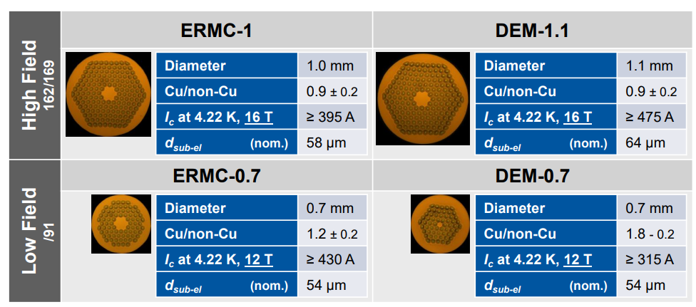


04/06/2024 – Review after the meeting
The strand RRP Ø 0.7 mm used for Hi-Lumi is not available for the HFM programme, use the HFM one
The stress limits reported in slides 7 and 8 must not be intended as targets
The table in slide 30 must be completed with the following data (see next slide):
  Case A HFM and Case B HFM with the HFM RRP Ø 0.7 mm strand for the Low Field cable
  Eurocircol design with HFM strands

Slide 34
04/06/2024 – Review after the meeting
 | case A HFM |  | case B HFM |  | case A (11T LF) |  | case B (11T LF) |  | D20 |  | MDPCT1 |  | EuroCircol
 | HF | LF | HF | LF | HF | LF | HF | LF | HF | LF | HF | LF | HF | LF
Bore field [T] | 14 |  | 14 |  | 14 |  | 14 |  | 13 |  | 15 |  | 14
Peak field [T] | 14.35 | 12.05 | 14.33 | 12.17 | 14.35 | 12.05 | 14.33 | 12.17 |  |  |  |  | 14.41 | 11.09
Temperature [K] | 1.9 | 1.9 | 1.9 | 1.9 | 1.9 | 1.9 | 1.9 | 1.9 | 1.9 | 1.9 | 1.9 | 1.9 | 1.9 | 1.9
operating current [A] | 10060 | 10060 | 9990 | 9990 | 10060 | 10060 | 9990 | 9990 | 5800 | 5800 | 10900 | 10900 | 9840 | 9840
j overall [A/mm^2] | 273 | 412 | 348 | 409 | 273 | 412 | 348 | 409 | 250 | 450 | 330 | 440 | 313 | 425
j sc [A/mm^2] | 774 | 1438 | 768 | 1428 | 774 | 1405 | 768 | 1395 | 507 | 1364 | 1056 | 1508 | 894 | 1480
Loadline fraction [%] | 77 | 76 | 77 | 77 | 77 | 79 | 77 | 80 | 90 |  | 87 |  | 79 | 72
Temperature margin [K] | 4.99 | 5.13 | 5.017 | 5.049 | 4.99 | 4.66 | 5.02 | 4.57 |  |  |  |  | 4.61 | 5.78
Equivalent width [mm] | 54.5 |  | 55.4 |  | 54.5 |  | 55.4 |  | 44.8 |  | 52.3 |  | 49.5
N° of turn (per quadrant) | 32 | 74 | 32 | 77 | 32 | 74 | 32 | 77 | 42 | 96 | 44 | 65 | 32 | 68
N. blocks | 5 | 4 | 6 | 4 | 5 | 4 | 6 | 4 | 7 | 6 | 5 | 2 | 7 | 5
aperture [mm] | 50 | 50 | 50 | 50 | 50 | 50 | 50 | 50 | 50 | 50 | 60 | 60 | 50 | 50
N° of strands | 26 | 40 | 26 | 40 | 26 | 40 | 26 | 40 | 37 | 47 | 28 | 40 | 22 | 38
Strands diameter [mm] | 1.1 | 0.7 | 1.1 | 0.7 | 1.1 | 0.7 | 1.1 | 0.7 | 0.75 | 0.48 | 1 | 0.7 | 1.1 | 0.7
Cu/Sc | 0.9 | 1.15 | 0.9 | 1.15 | 0.9 | 1.15 | 0.9 | 1.15 | 0.43 | 1 | 1.13 | 1.13 | 0.9 | 1.8
Width [mm] | 15.862 | 15.141 | 15.862 | 15.141 | 15.862 | 15.141 | 15.862 | 15.141 | 14.450 | 11.630 | 15.100 | 15.100 | 13.596 | 14.420
Inner thickness [mm] | 1.911 | 1.216 | 1.911 | 1.216 | 1.911 | 1.216 | 1.911 | 1.216 | 1.369 | 0.873
Outer thickness [mm] | 2.047 | 1.346 | 2.047 | 1.346 | 2.047 | 1.346 | 2.047 | 1.346 | 1.369 | 0.873
Keystone angle [°] | 0.5 | 0.5 | 0.5 | 0.5 | 0.5 | 0.5 | 0.5 | 0.5 | 0 | 0 | 0.805 | 0.805 | 0.5 | 0.5
Insulation thick radial [mm] | 0.15 | 0.15 | 0.15 | 0.15 | 0.15 | 0.15 | 0.15 | 0.15
Insulation thick azimuthal [mm] | 0.15 | 0.15 | 0.15 | 0.15 | 0.15 | 0.15 | 0.15 | 0.15
Insulated cable filling factor [%] | 35.4 | 29.44 | 35.4 | 29.44 | 35.4 | 29.44 | 35.4 | 29.44

Slide 35
04/06/2024 – Review after the meeting
Case A and Case B:
High Field strand unchanged (HFM Ø 1.1 mm)
HiLumi

