Slide 1
FalconD 12T: mechanical design
Authors: N. Sala on behalf of FalconD collaboration
Date: March 18th, 2024

Slide 2
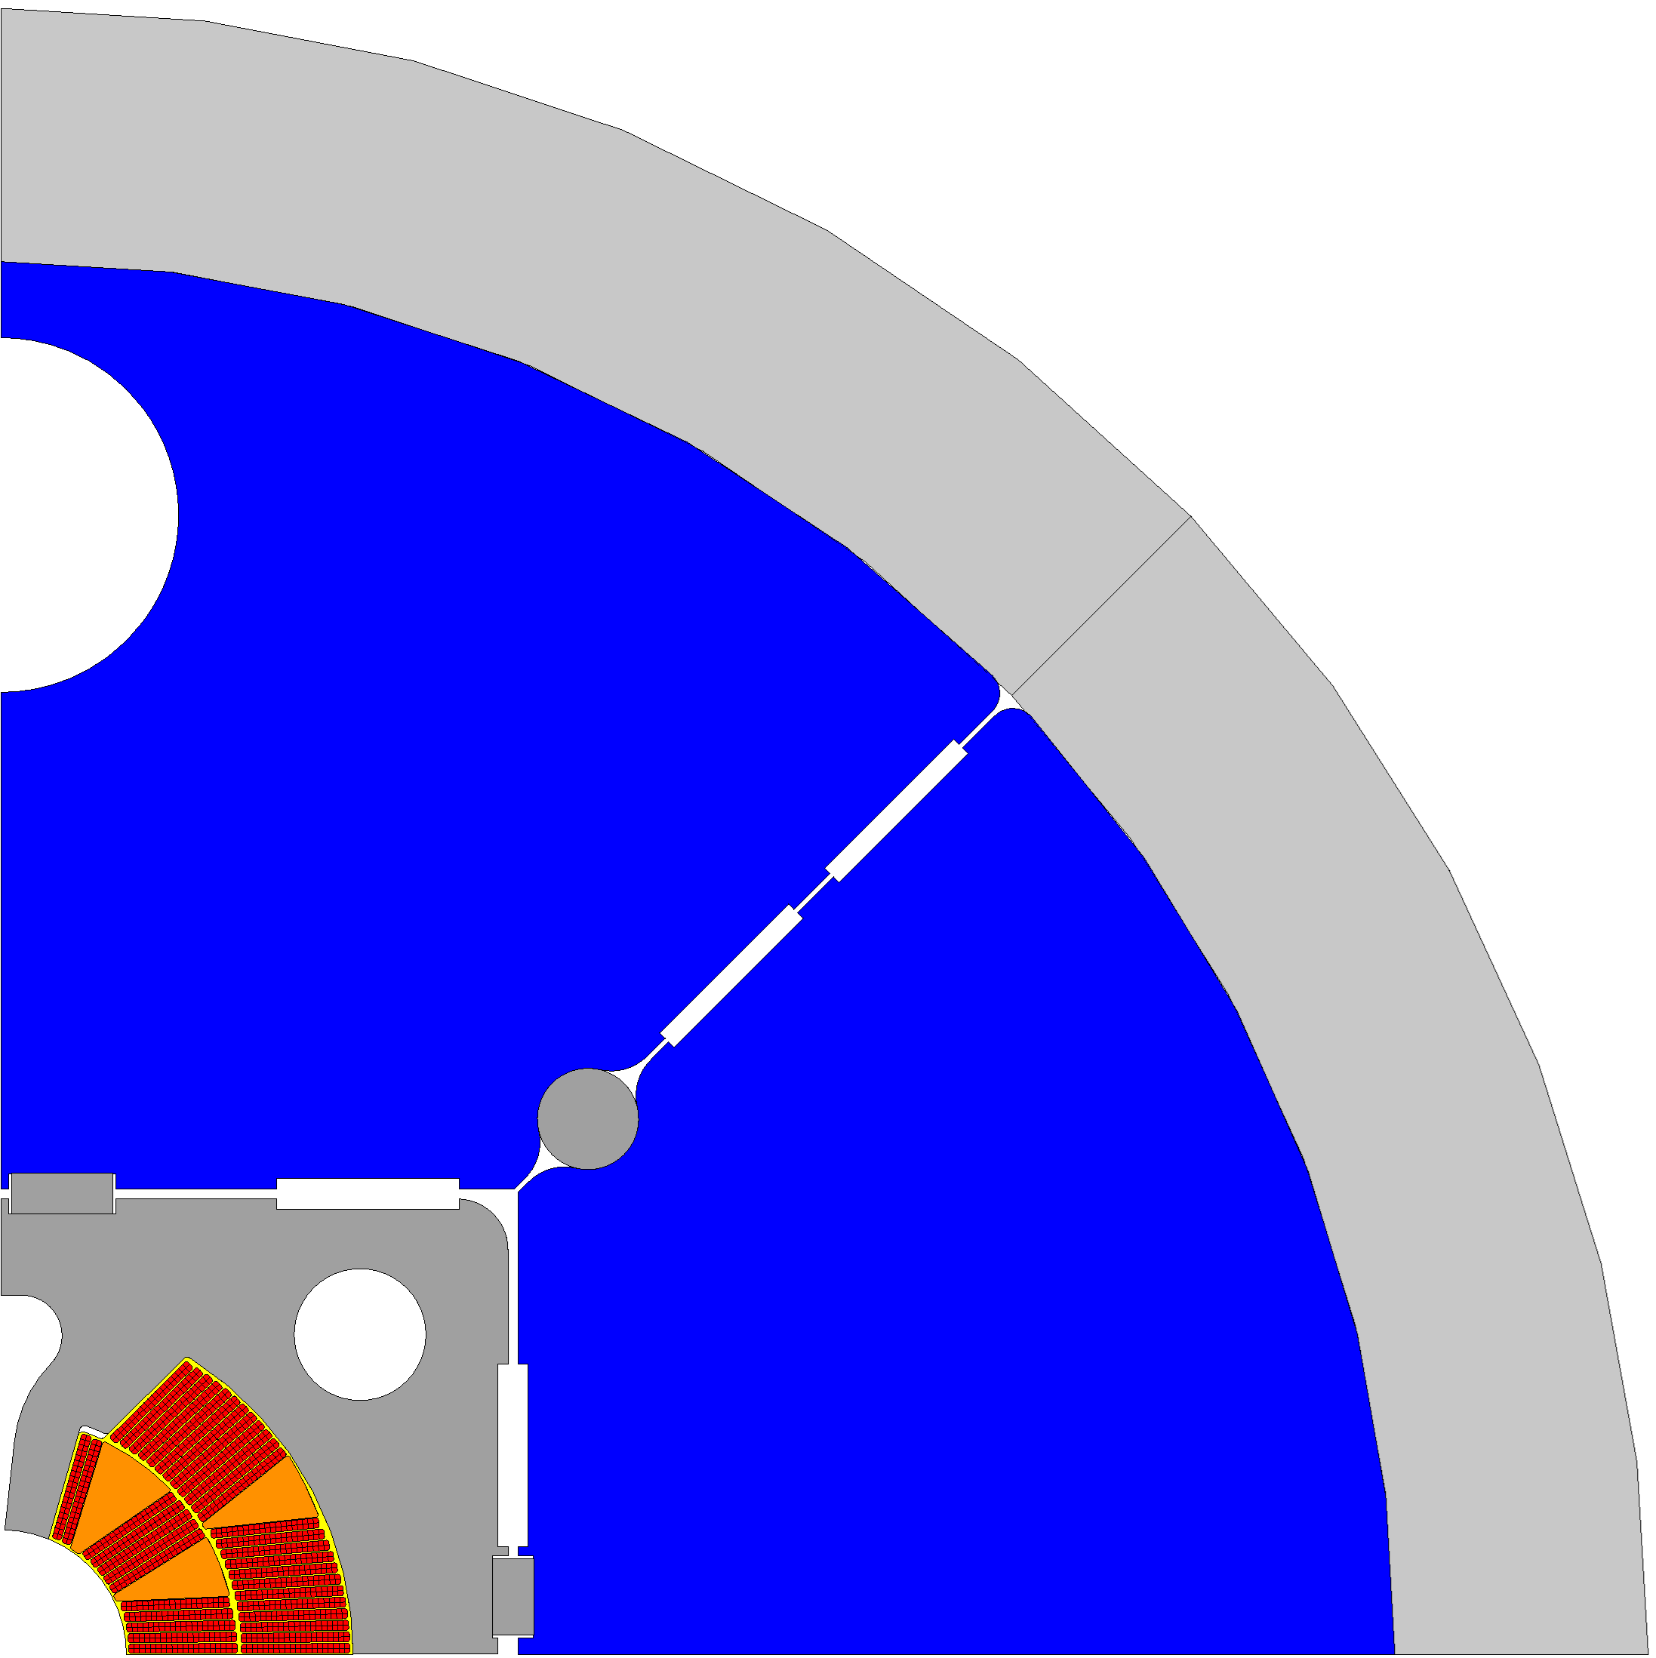
Mechanical structure: parameters
45º split iron yoke (r_{yoke} = 275 mm)
SS stiffener (r_{stiff} = 12 mm)
SS pad (x_{pad}= 100 mm, y_{pad}= 90 mm)
Aluminum shell (th = 50 mm)
SS or KAWA keys

Slide 3
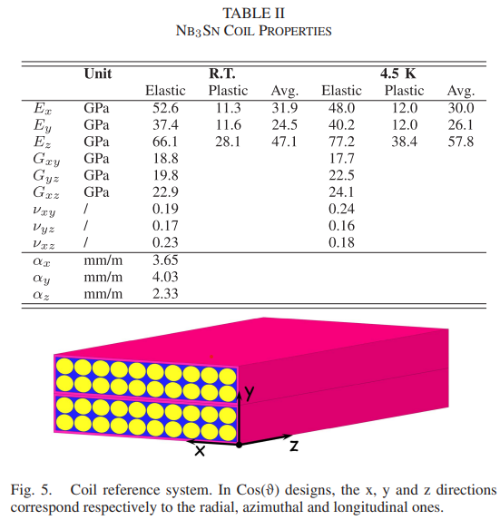

mechanical properties: MQXF*
*
* «A Review of the Mechanical Properties of Materials Used in Nb3Sn Magnets for Particle Accelerators» by G. Vallone (2023)
DOI: 10.1109/TASC.2023.3248544
Nicola Sala
3

Slide 4
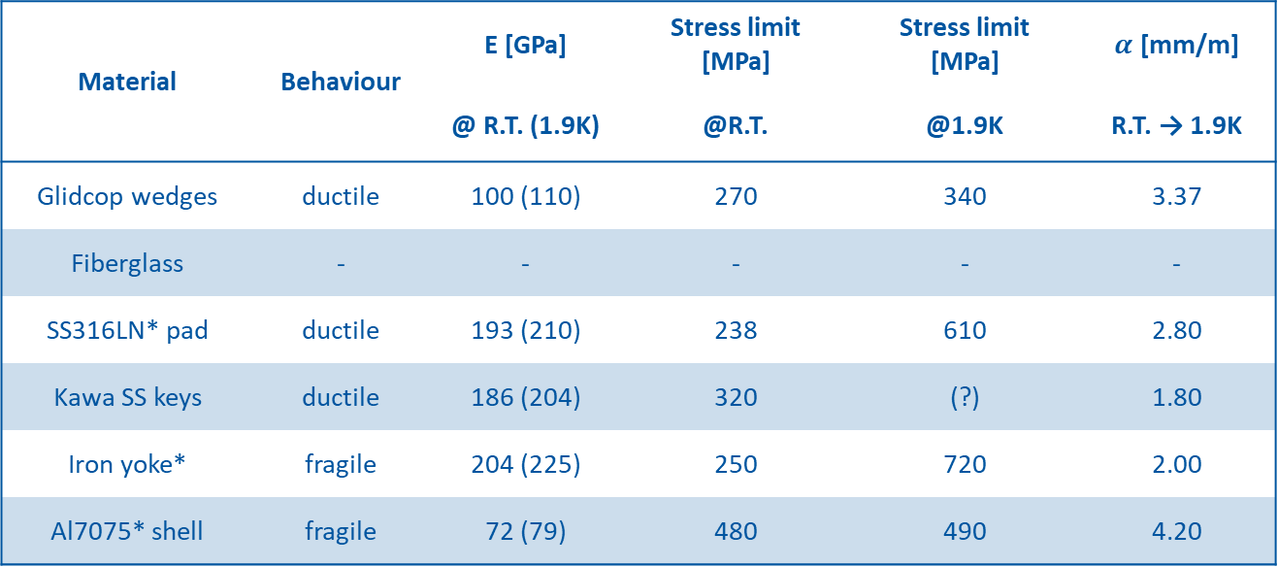
ANSYS Mechanical model: properties*
Material | Behaviour | E [GPa] | Stress limit [MPa] | Stress limit [MPa] | $α$ [mm/m]
 |  | @ R.T. (1.9K) | @R.T. | @1.9K | R.T. → 1.9K
Glidcop wedges | ductile | 100 (110) | 270 | 340 | 3.37
Fiberglass | - | - | - | - | -
SS316LN* pad | ductile | 193 (210) | 238 | 610 | 2.80
Kawa SS keys | ductile | 186 (204) | 320 | (?) | 1.80
Iron yoke* | fragile | 204 (225) | 250 | 720 | 2.00
Al7075* shell | fragile | 72 (79) | 480 | 490 | 4.20
*A Review of the Mechanical Properties of Materials Used in Nb3Sn Magnets for Particle Accelerators by G. Vallone

Slide 5

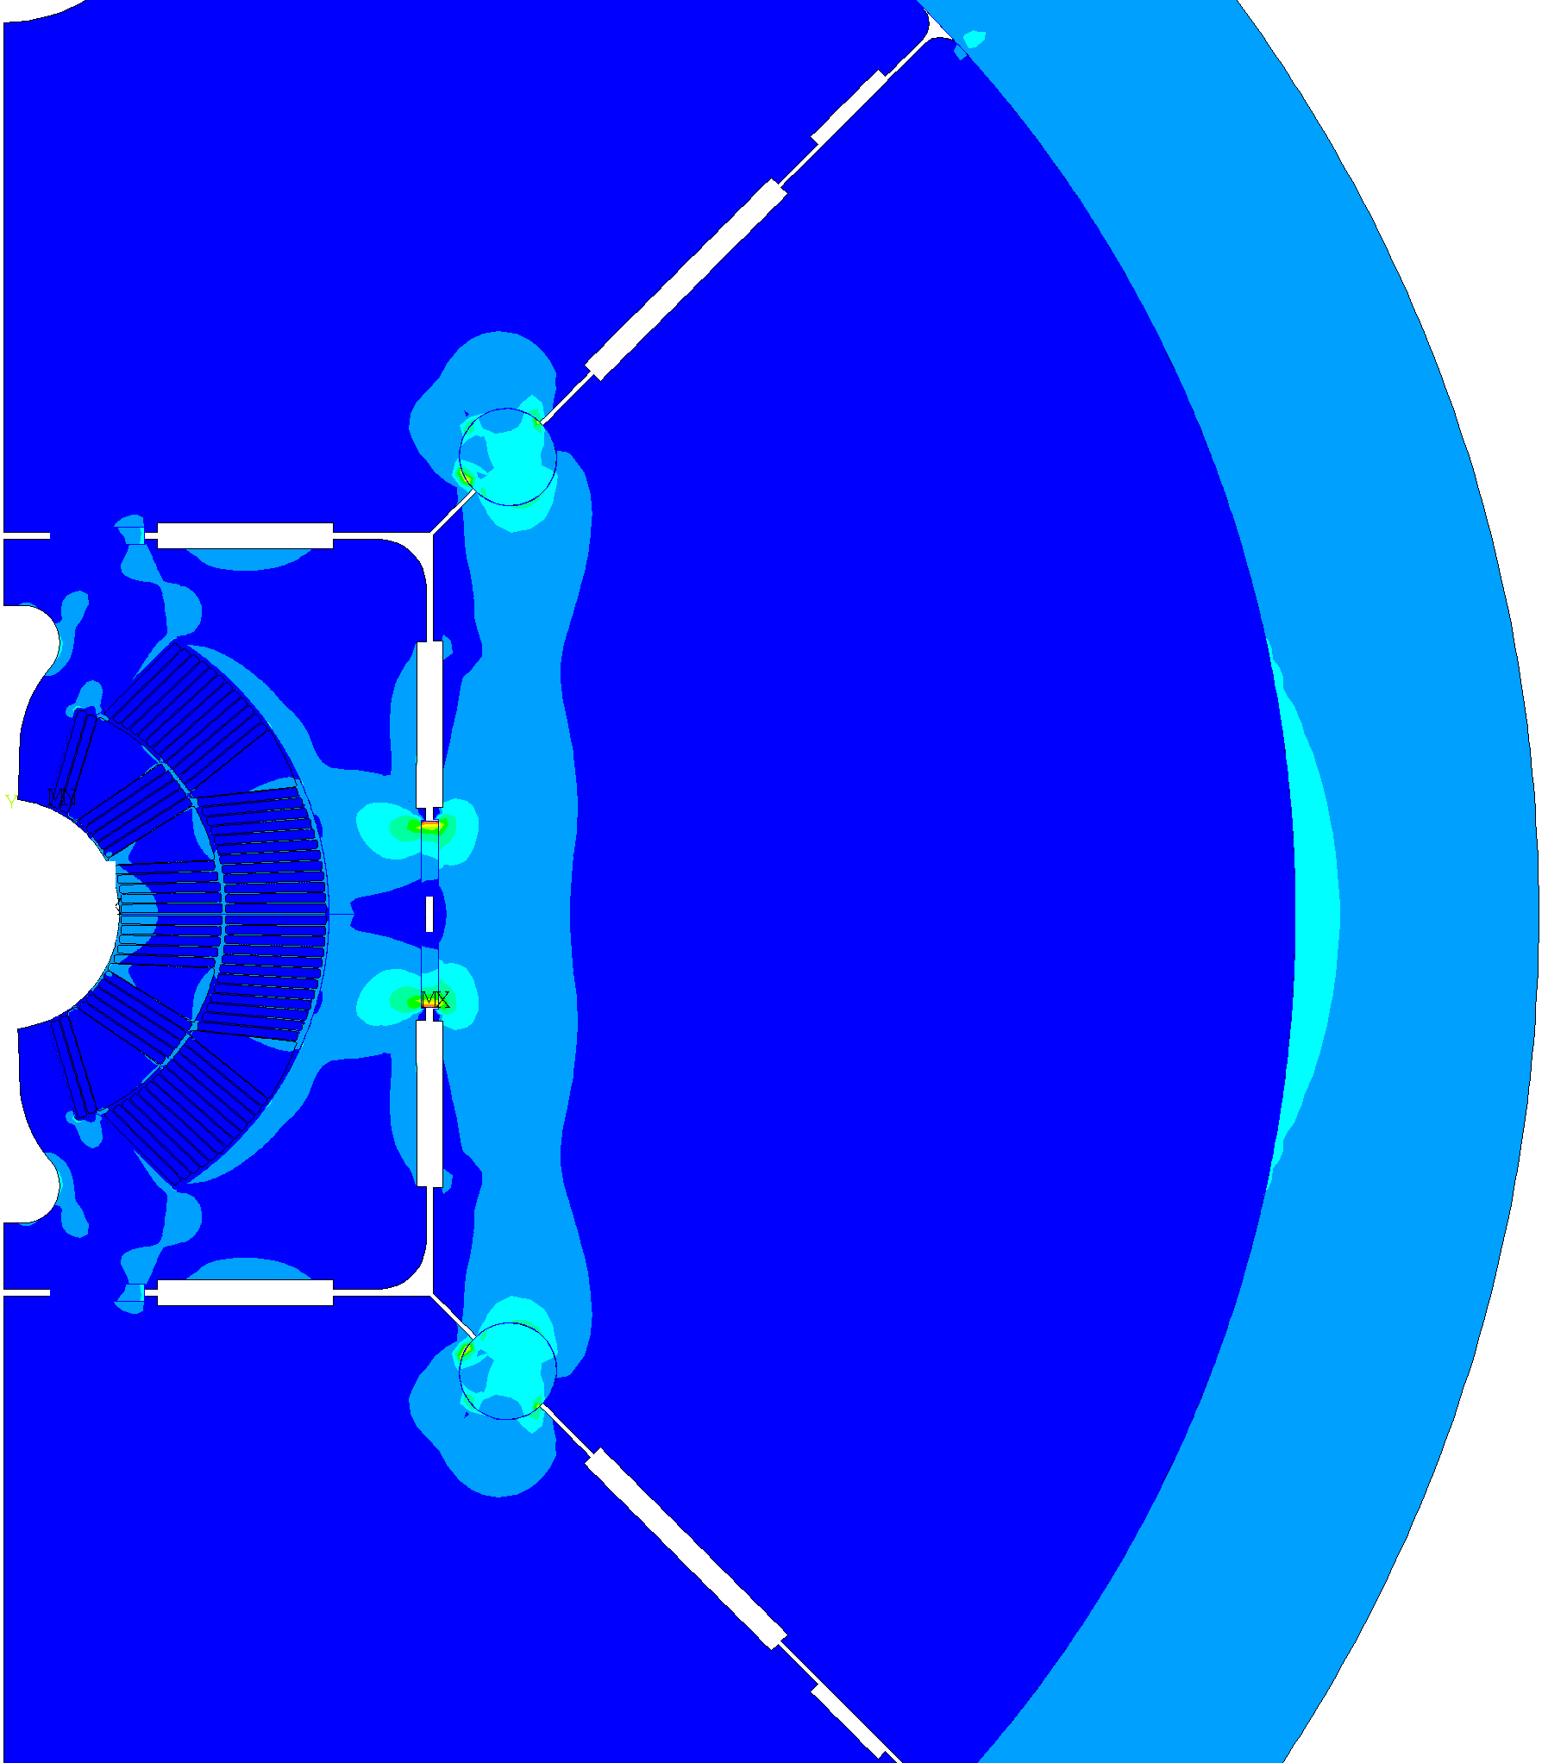
Mechanical structure: protect coils
soft to assemble @ RT
(absorb overstress @ RT)
hard to deform @ 1.9 K
(“low” stress coils @ 1.9 K)

Slide 6
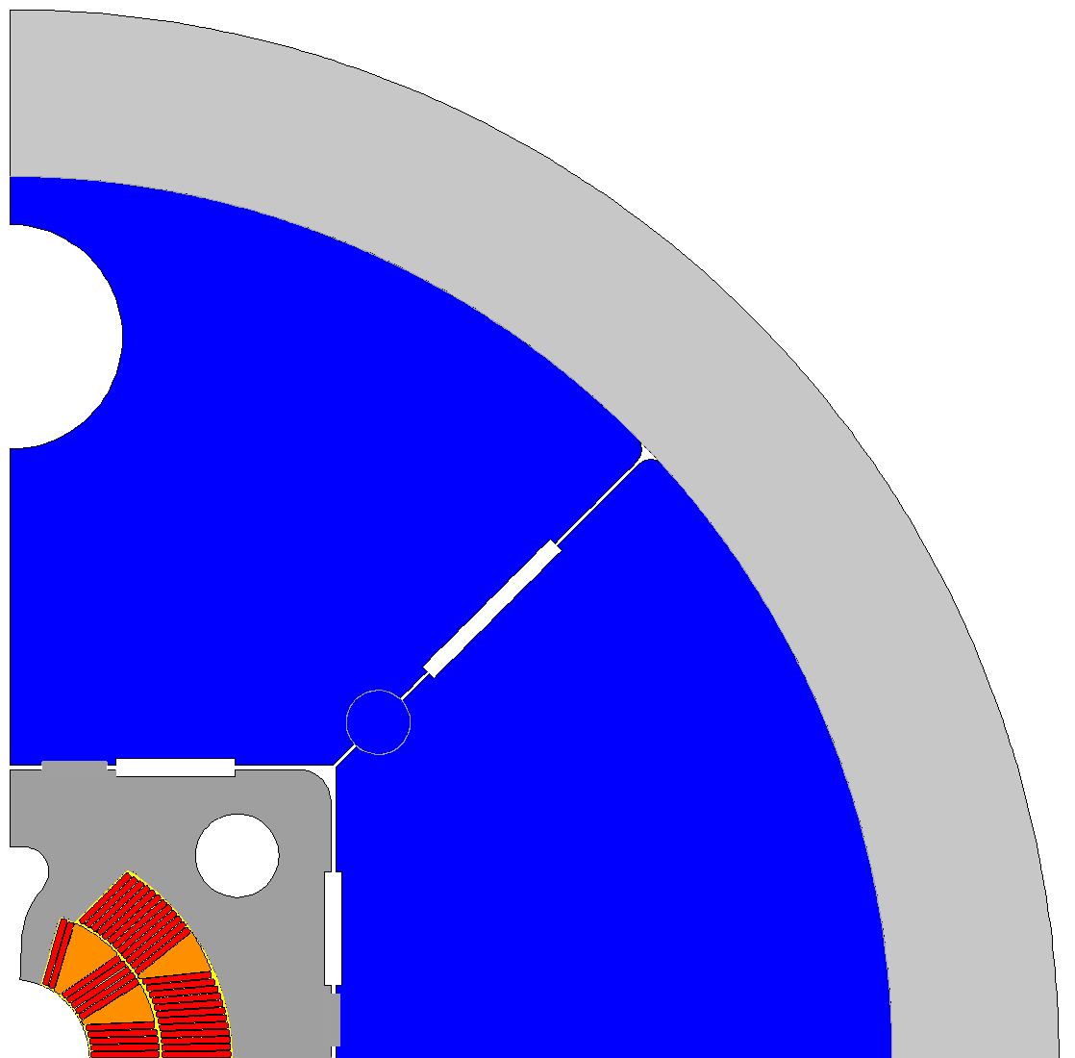
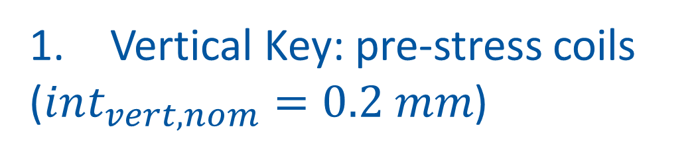
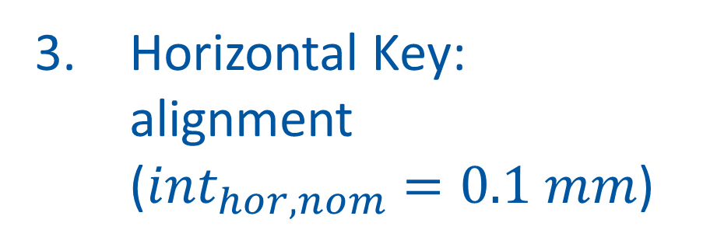
Assembly: priorities
Vertical Key: pre-stress coils
($int_{vert, nom}=0.2 mm$)
45° Degree Stiffener:
hard to deform @1.9K
3.
2.
Horizontal Key:
alignment
($int_{hor, nom}=0.1 mm$)
1.

Slide 7

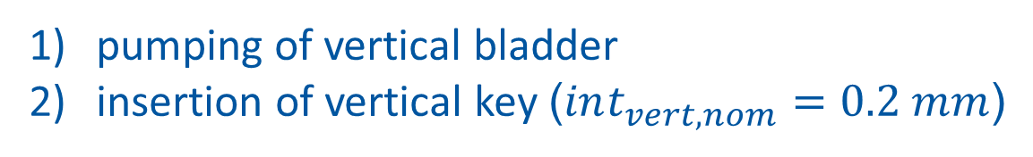
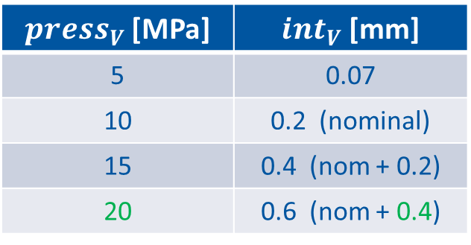

vertical key @ R.T.
pumping of vertical bladder
insertion of vertical key ($int_{vert, nom}=0.2 mm$)
$$press_{vert} up to 20 MPa$$
$press_{V}$[MPa] | ${int}_{V}$[mm]
5 | 0.07
10 | 0.2 (nominal)
15 | 0.4 (nom + 0.2)
20 | 0.6 (nom + 0.4)

Slide 8
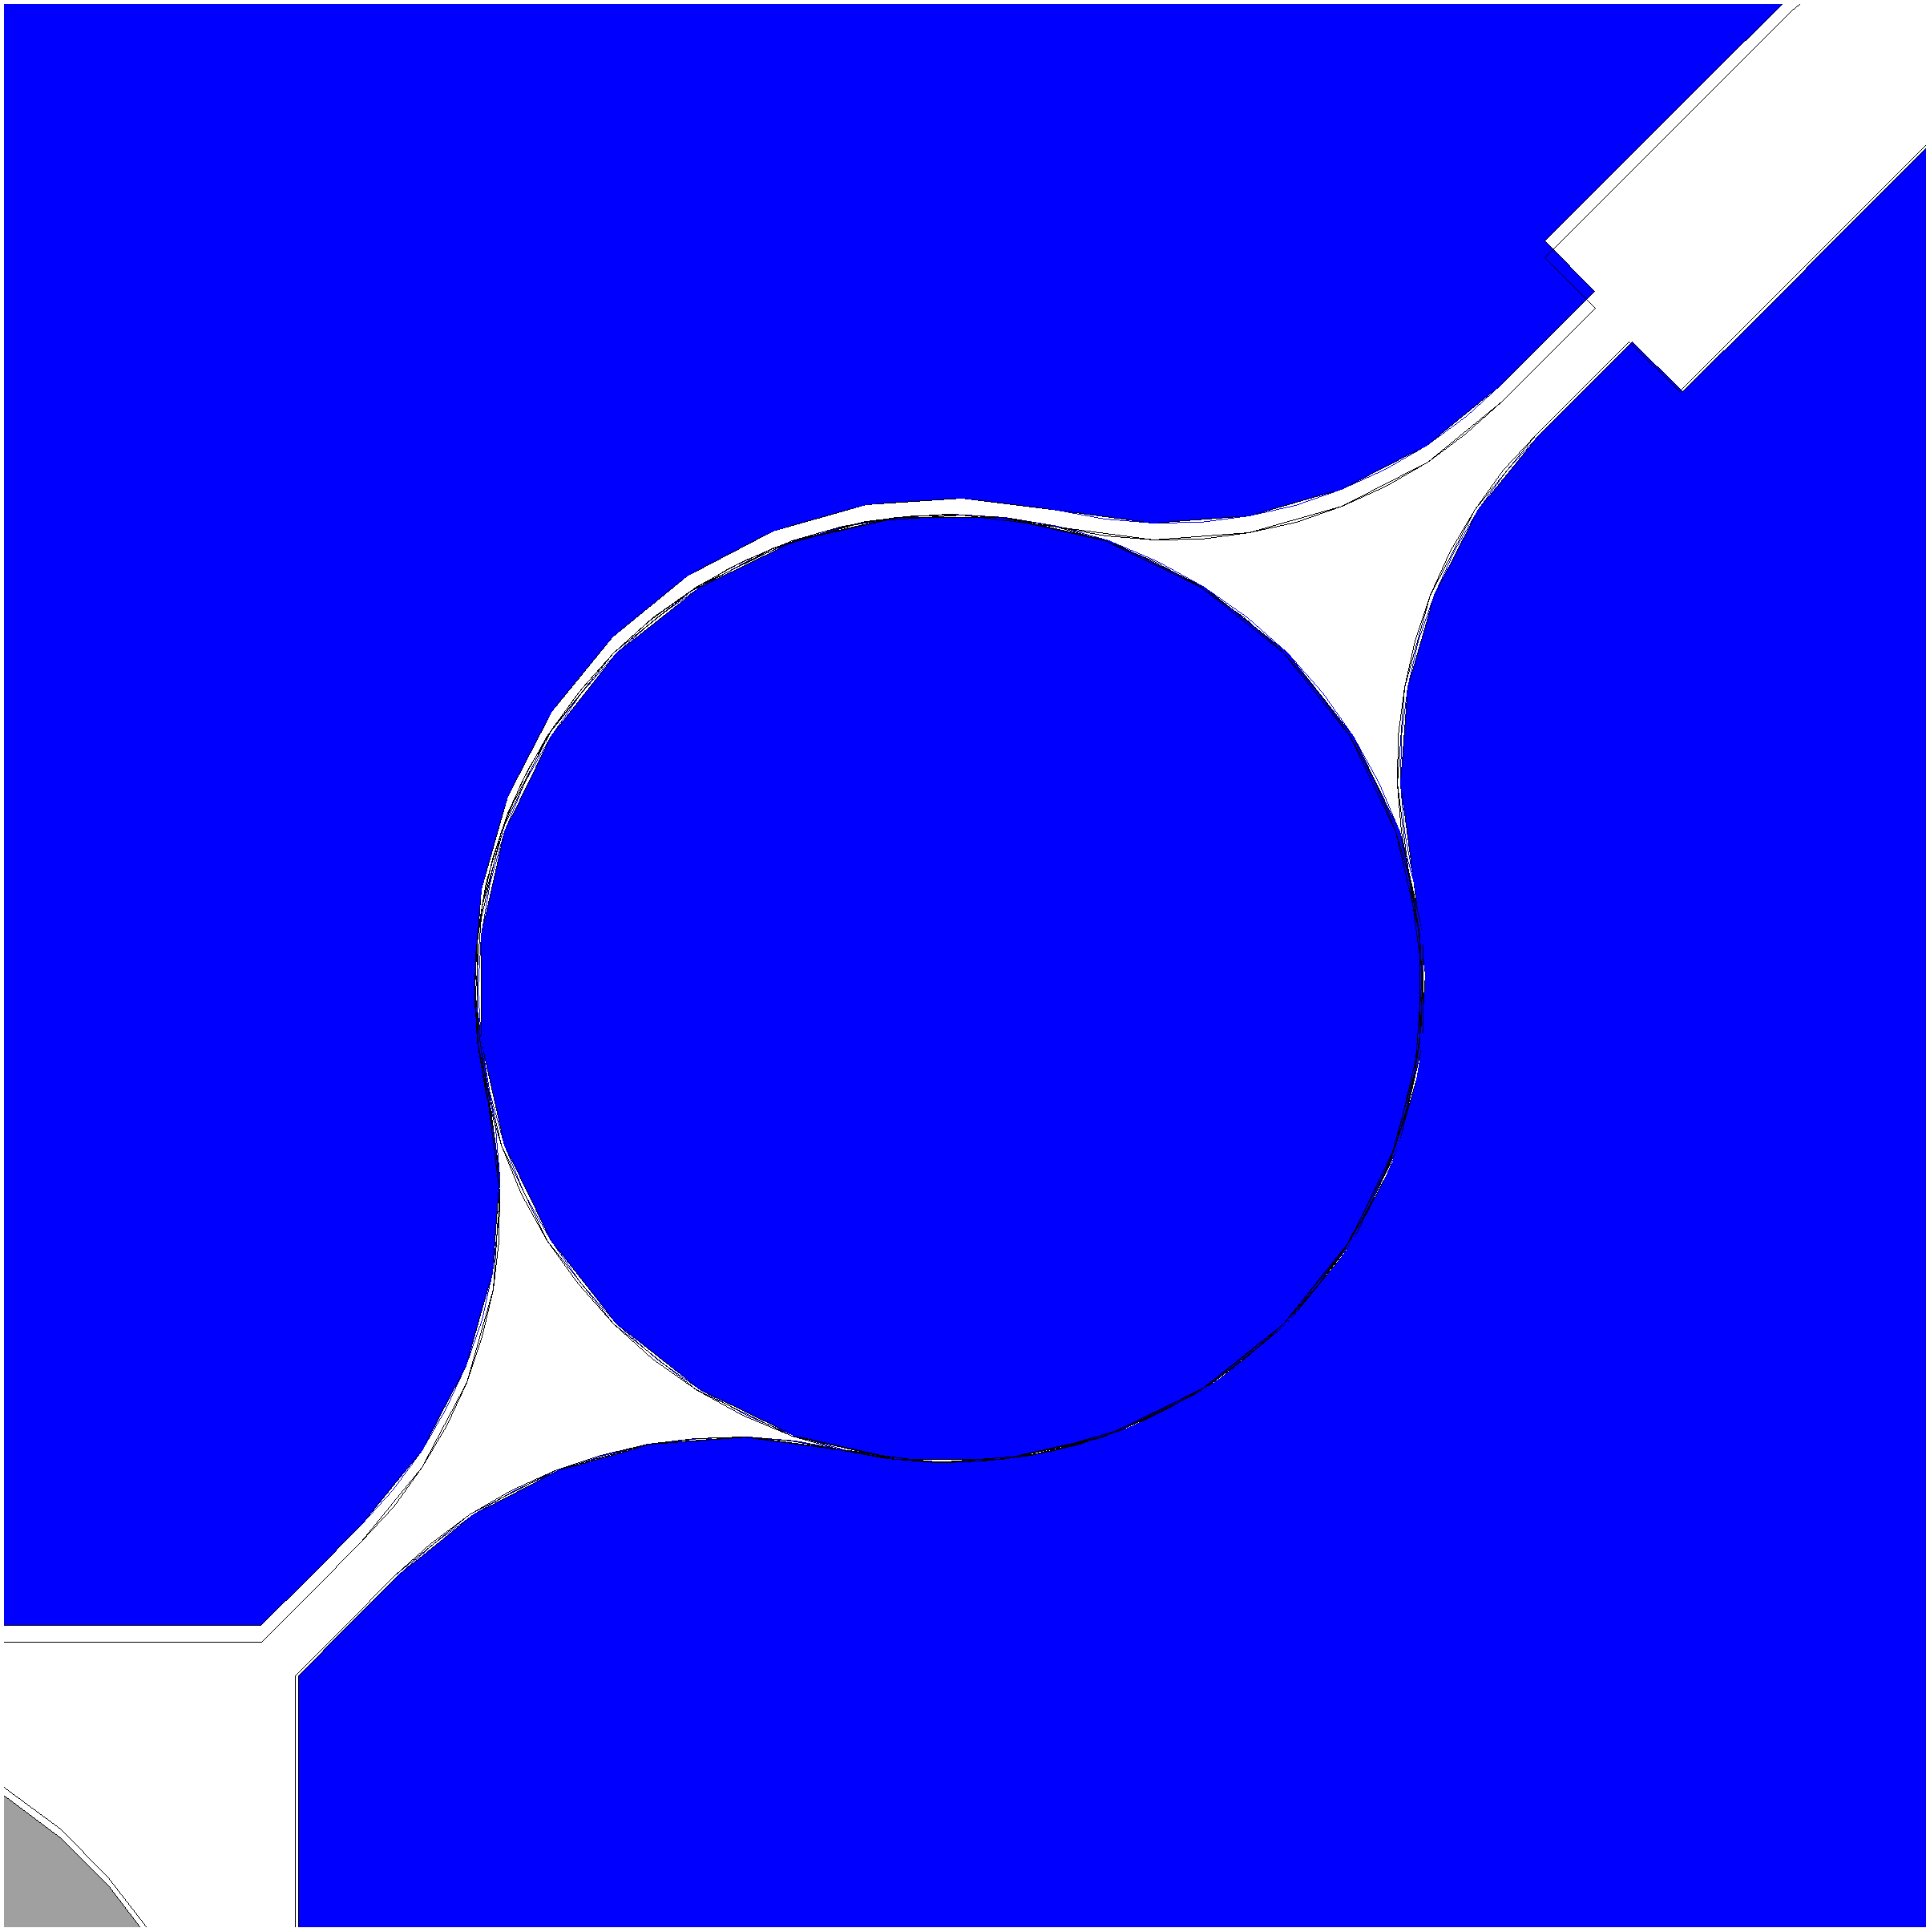
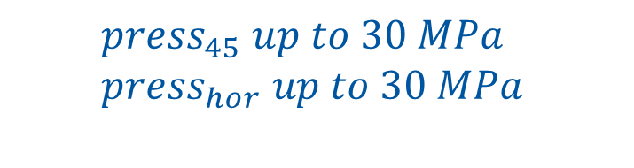
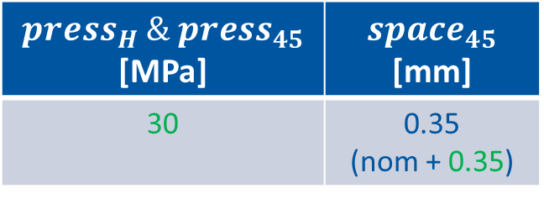
stiffening @ R.T.
pumping both horizontal & 45 degrees bladders
insertion of «stiffener» (no interference)
$$press_{45} up to 30 MPa \\ press_{hor} up to 30 MPa$$
$press_{H} \& {press}_{45}$ [MPa] | ${space}_{45}$ [mm]
30 | 0.35 (nom + 0.35)

Slide 9

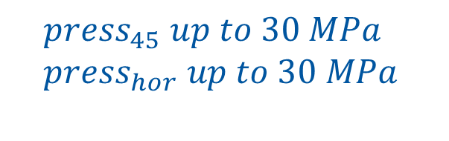
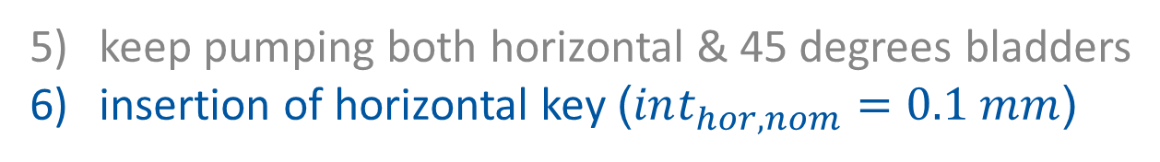
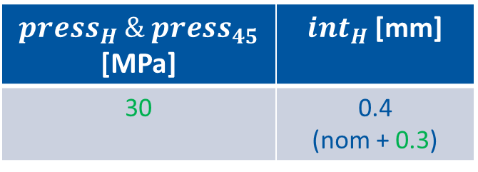
horizontal key @ R.T.
keep pumping both horizontal & 45 degrees bladders
insertion of horizontal key ($int_{hor, nom}=0.1 mm$)
$$press_{45} up to 30 MPa \\ press_{hor} up to 30 MPa$$
$press_{H} \& {press}_{45}$ [MPa] | $int_{H}$ [mm]
30 | 0.4 (nom + 0.3)

Slide 10
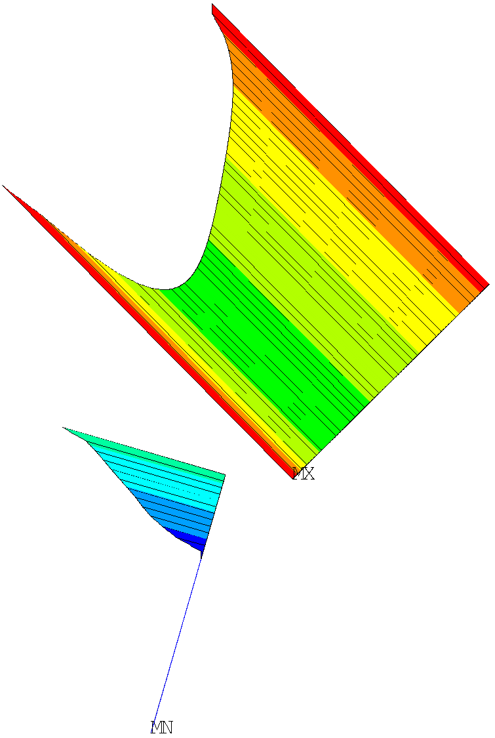
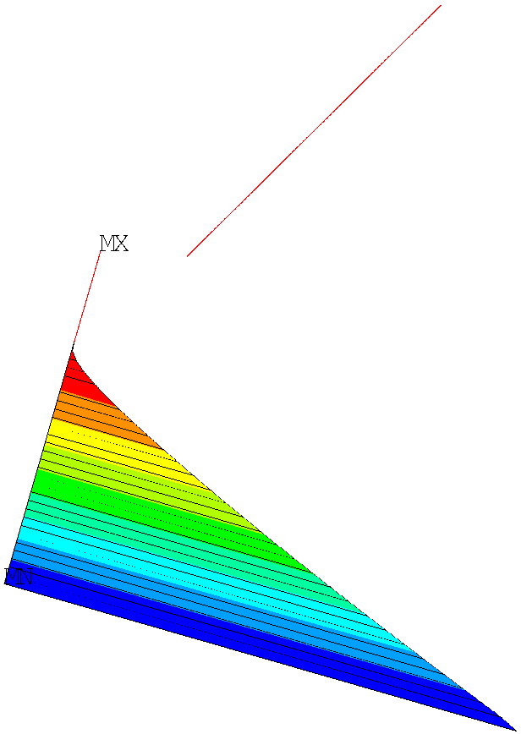
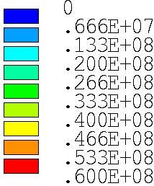
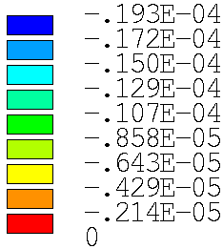


end of assembly @ R.T.
$$press_{max}=60 MPa$$
$$gap_{max}=20 μm$$

Slide 11
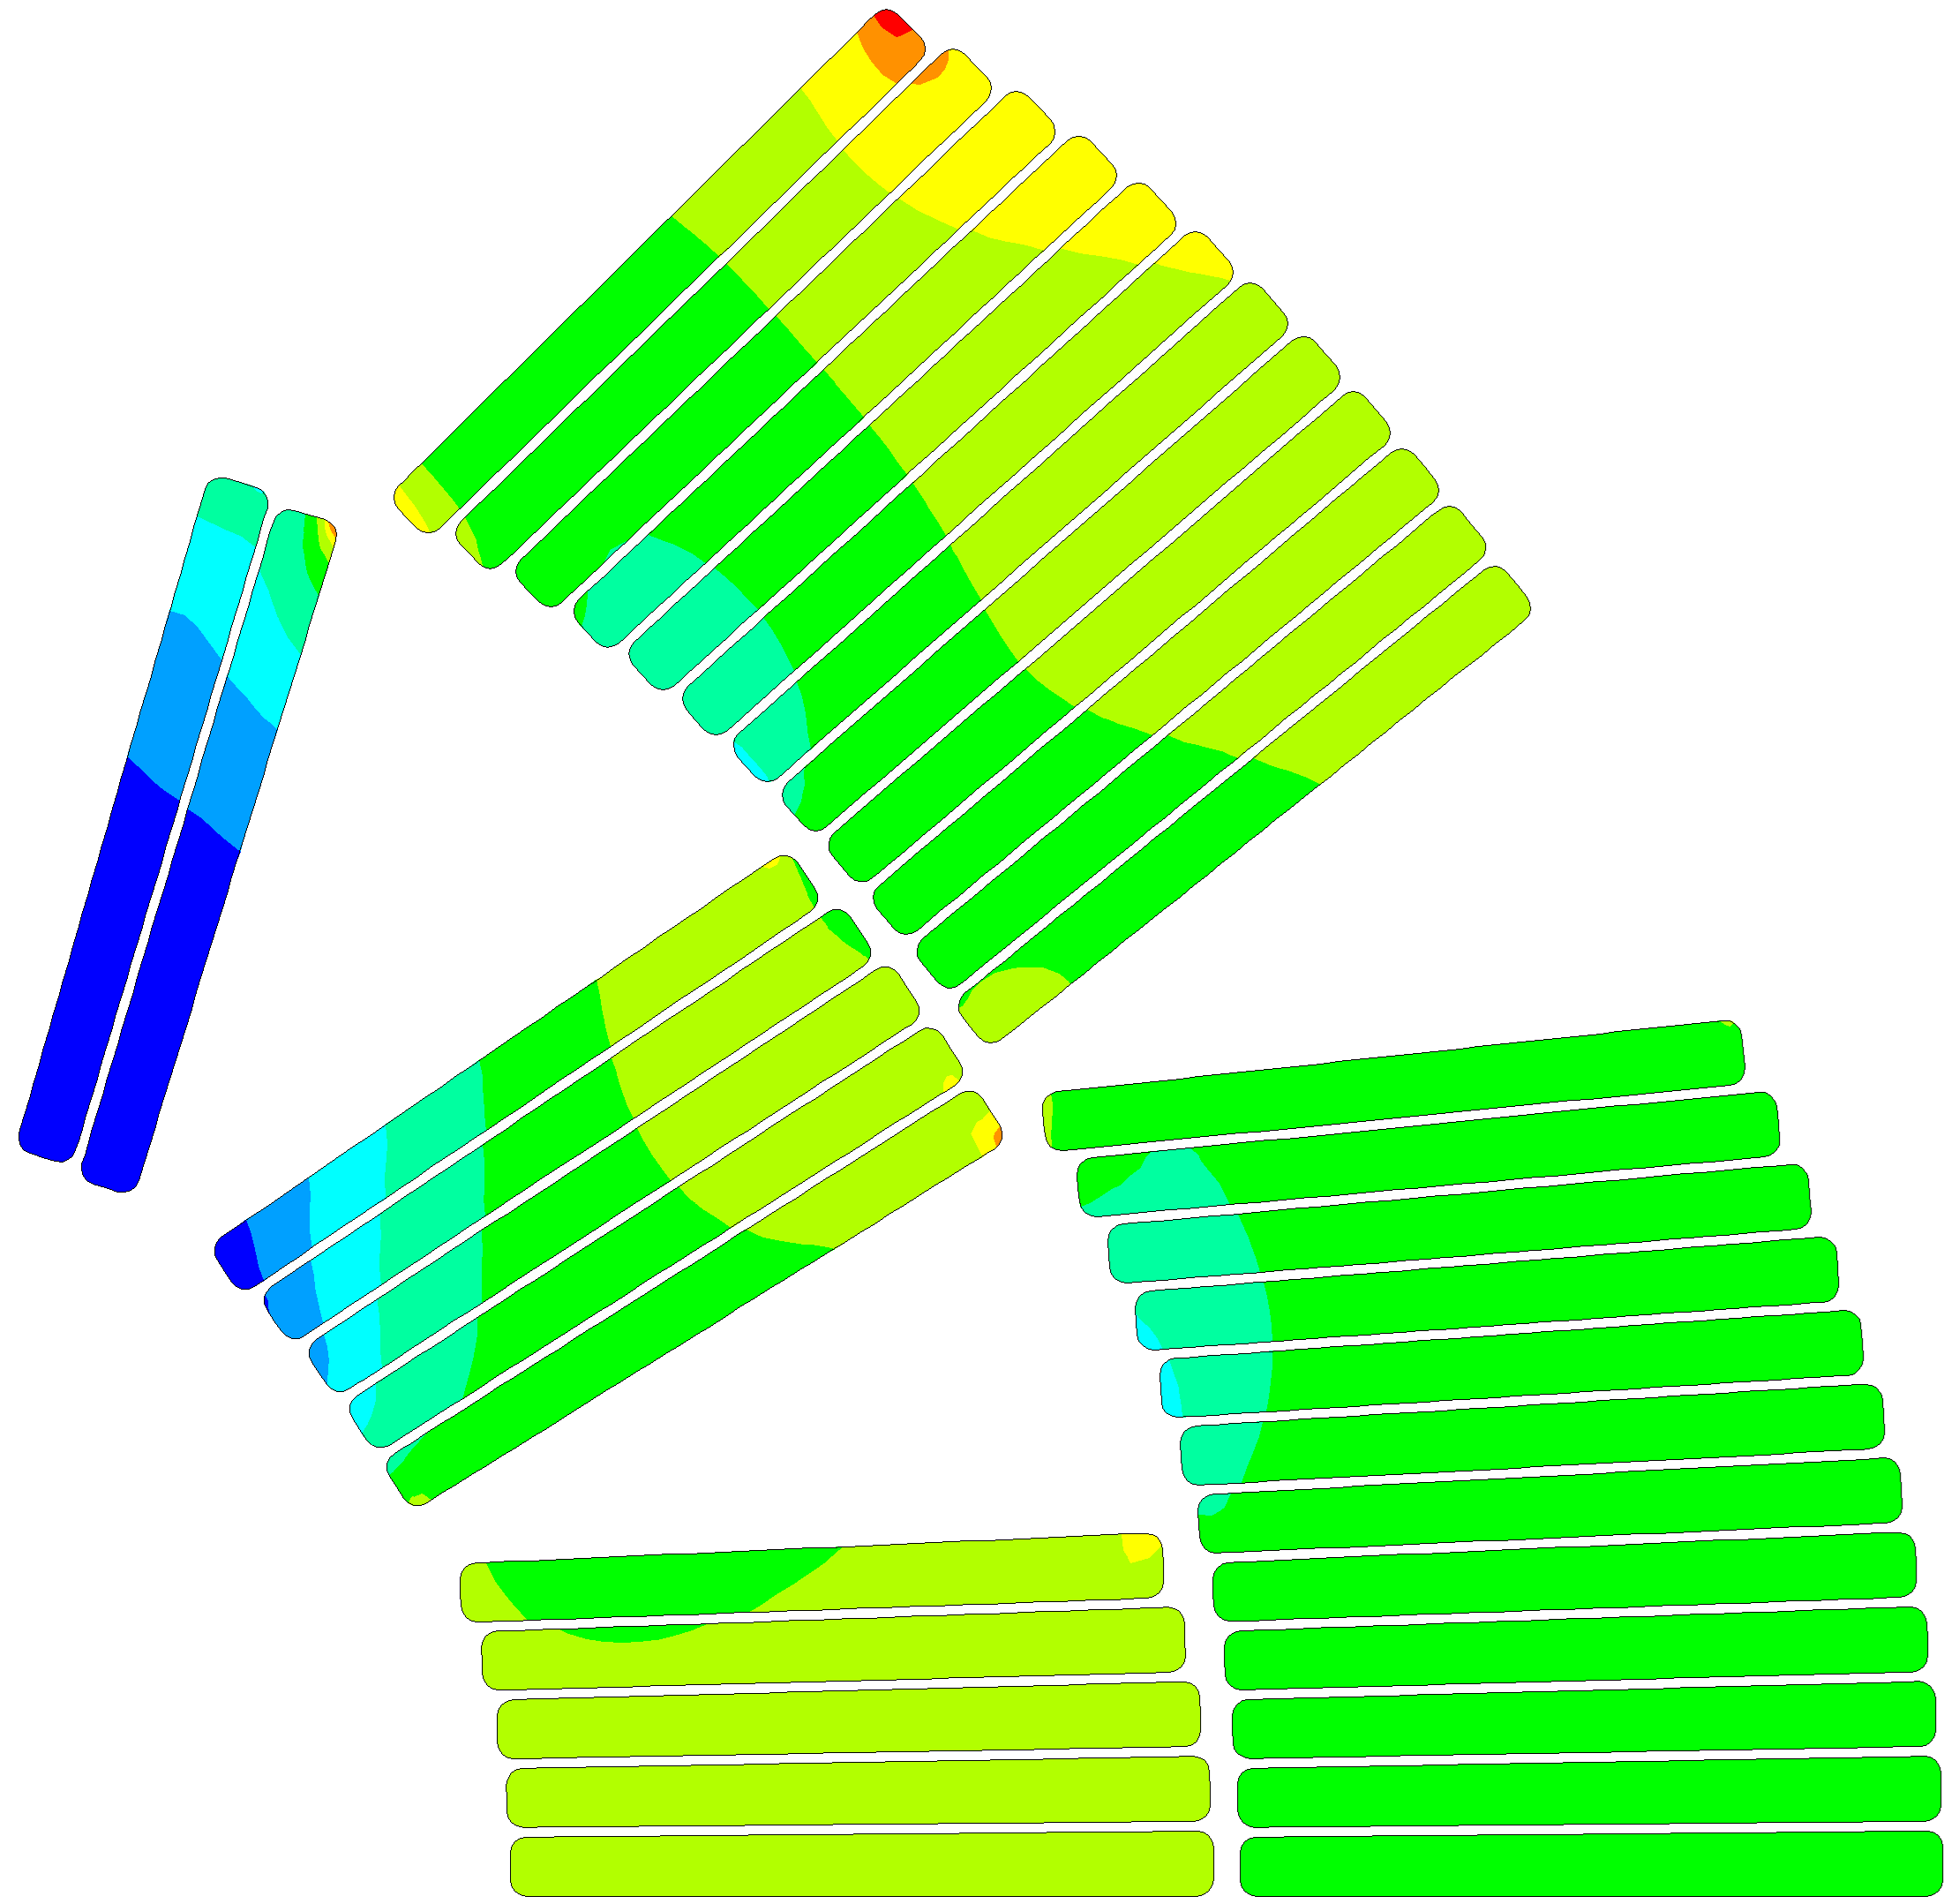
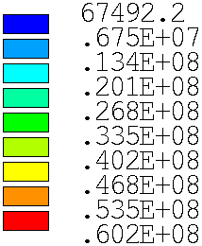
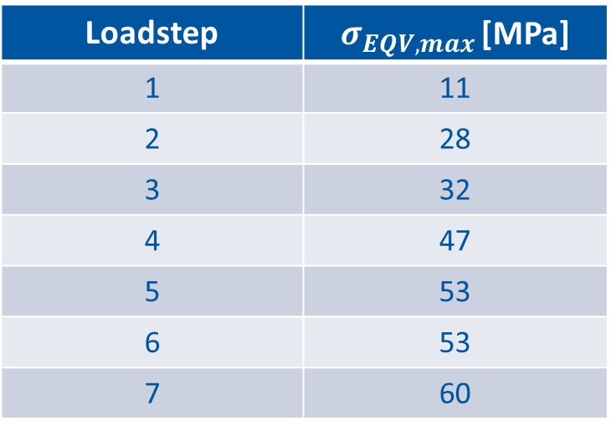


end of assembly @ R.T.
$$σ_{safe, R.T.}=100 MPa$$
Loadstep | $σ_{EQV,max }$[MPa]
1 | 11
2 | 28
3 | 32
4 | 47
5 | 53
6 | 53
7 | 60
$$σ_{eqv,max}=60 MPa$$

Slide 12
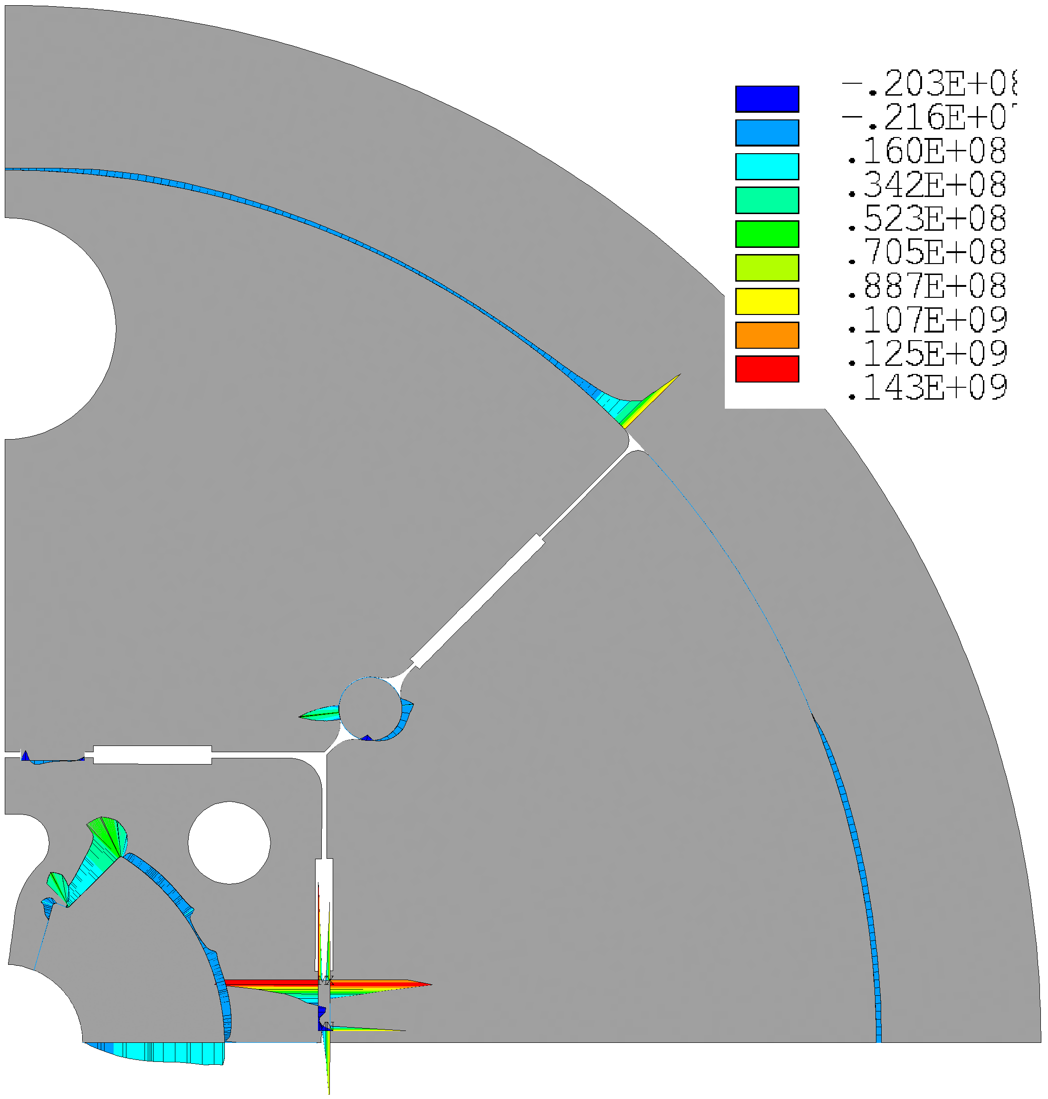
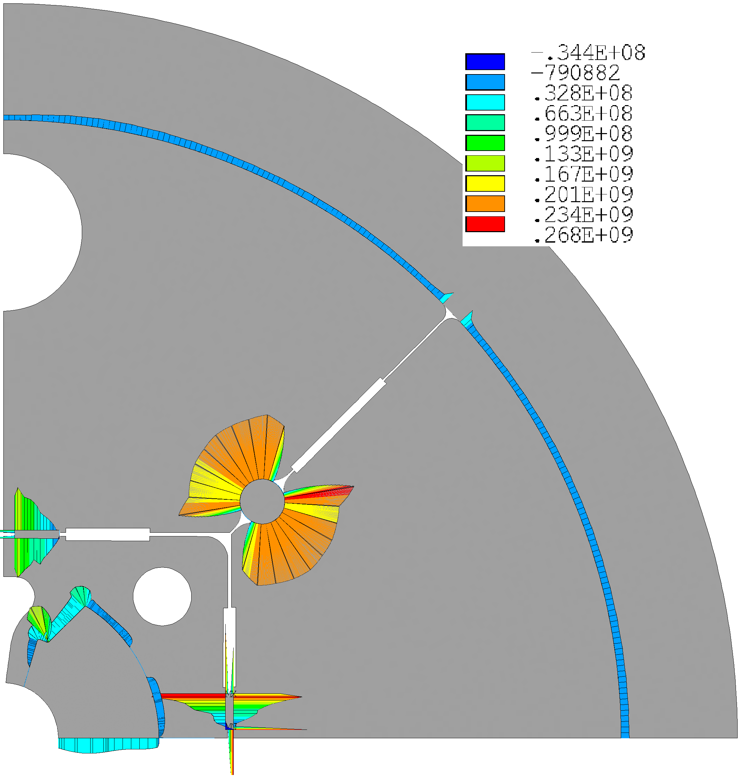

cooling down (R.T. 1.9 K)
End of assembly
End of cool down
Stiffening !

Slide 13
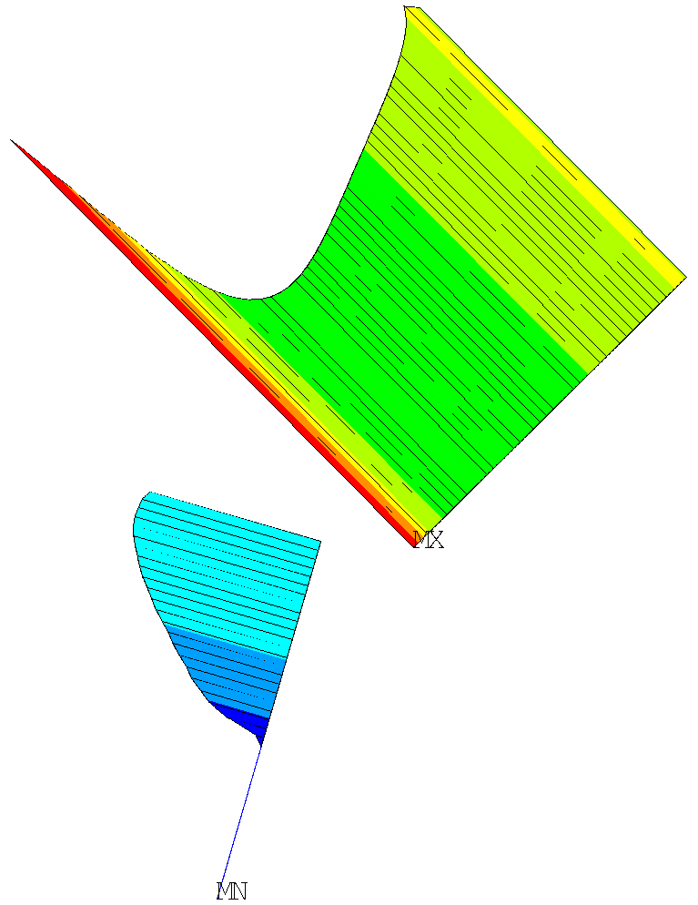
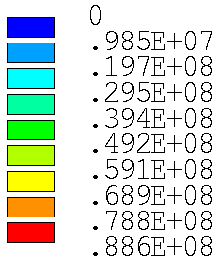




cooling down (R.T. 1.9 K)
End of assembly
End of cool down
$${pres}_{avg, layer1}\sim 3 MPa$$
$${pres}_{avg, layer1}\sim 10 MPa$$
$$pres_{avg,layer2}\text{\sim } 35 MPa$$
$$pres_{avg,layer2}\text{\sim } 50 MPa$$

Slide 14
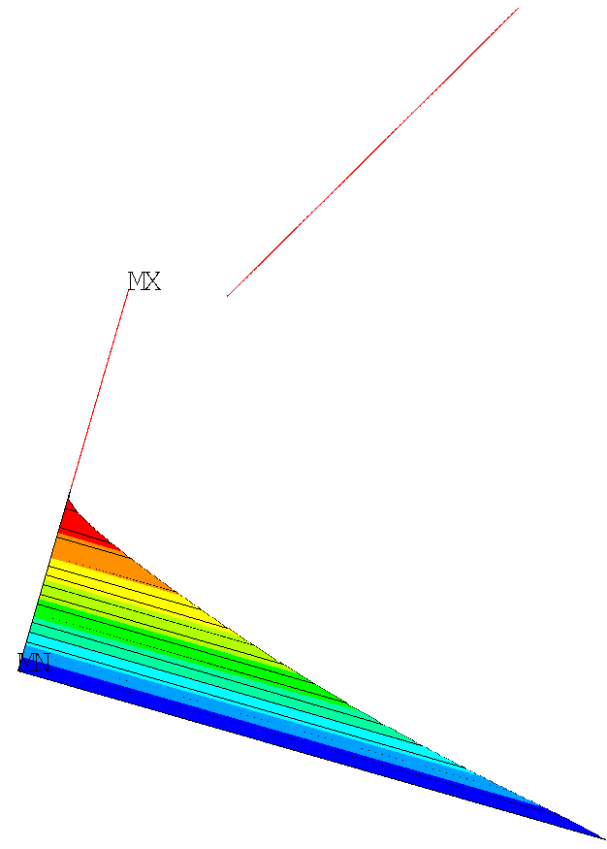
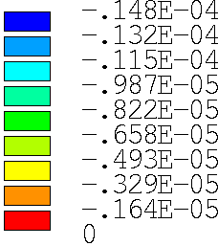




cooling down (R.T. 1.9 K)
End of assembly
End of cool down
$${gap}_{max, layer1}\sim 0 μm$$
$${gap}_{max, layer1}\sim 0 μm$$
$${gap}_{max,layer2}\text{\sim } 19 μm$$
$${gap}_{max,layer2}\text{\sim } 15 μm$$

Slide 15
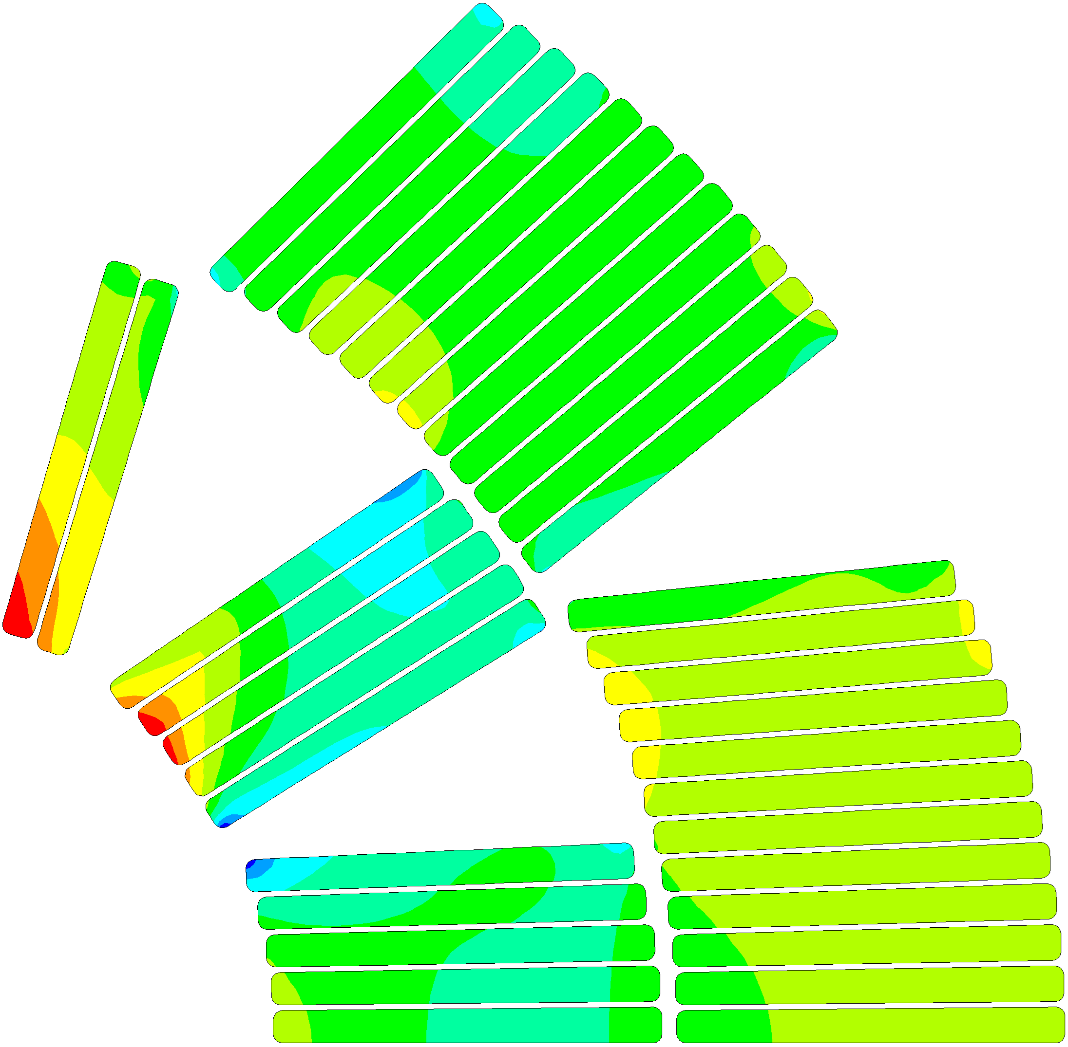
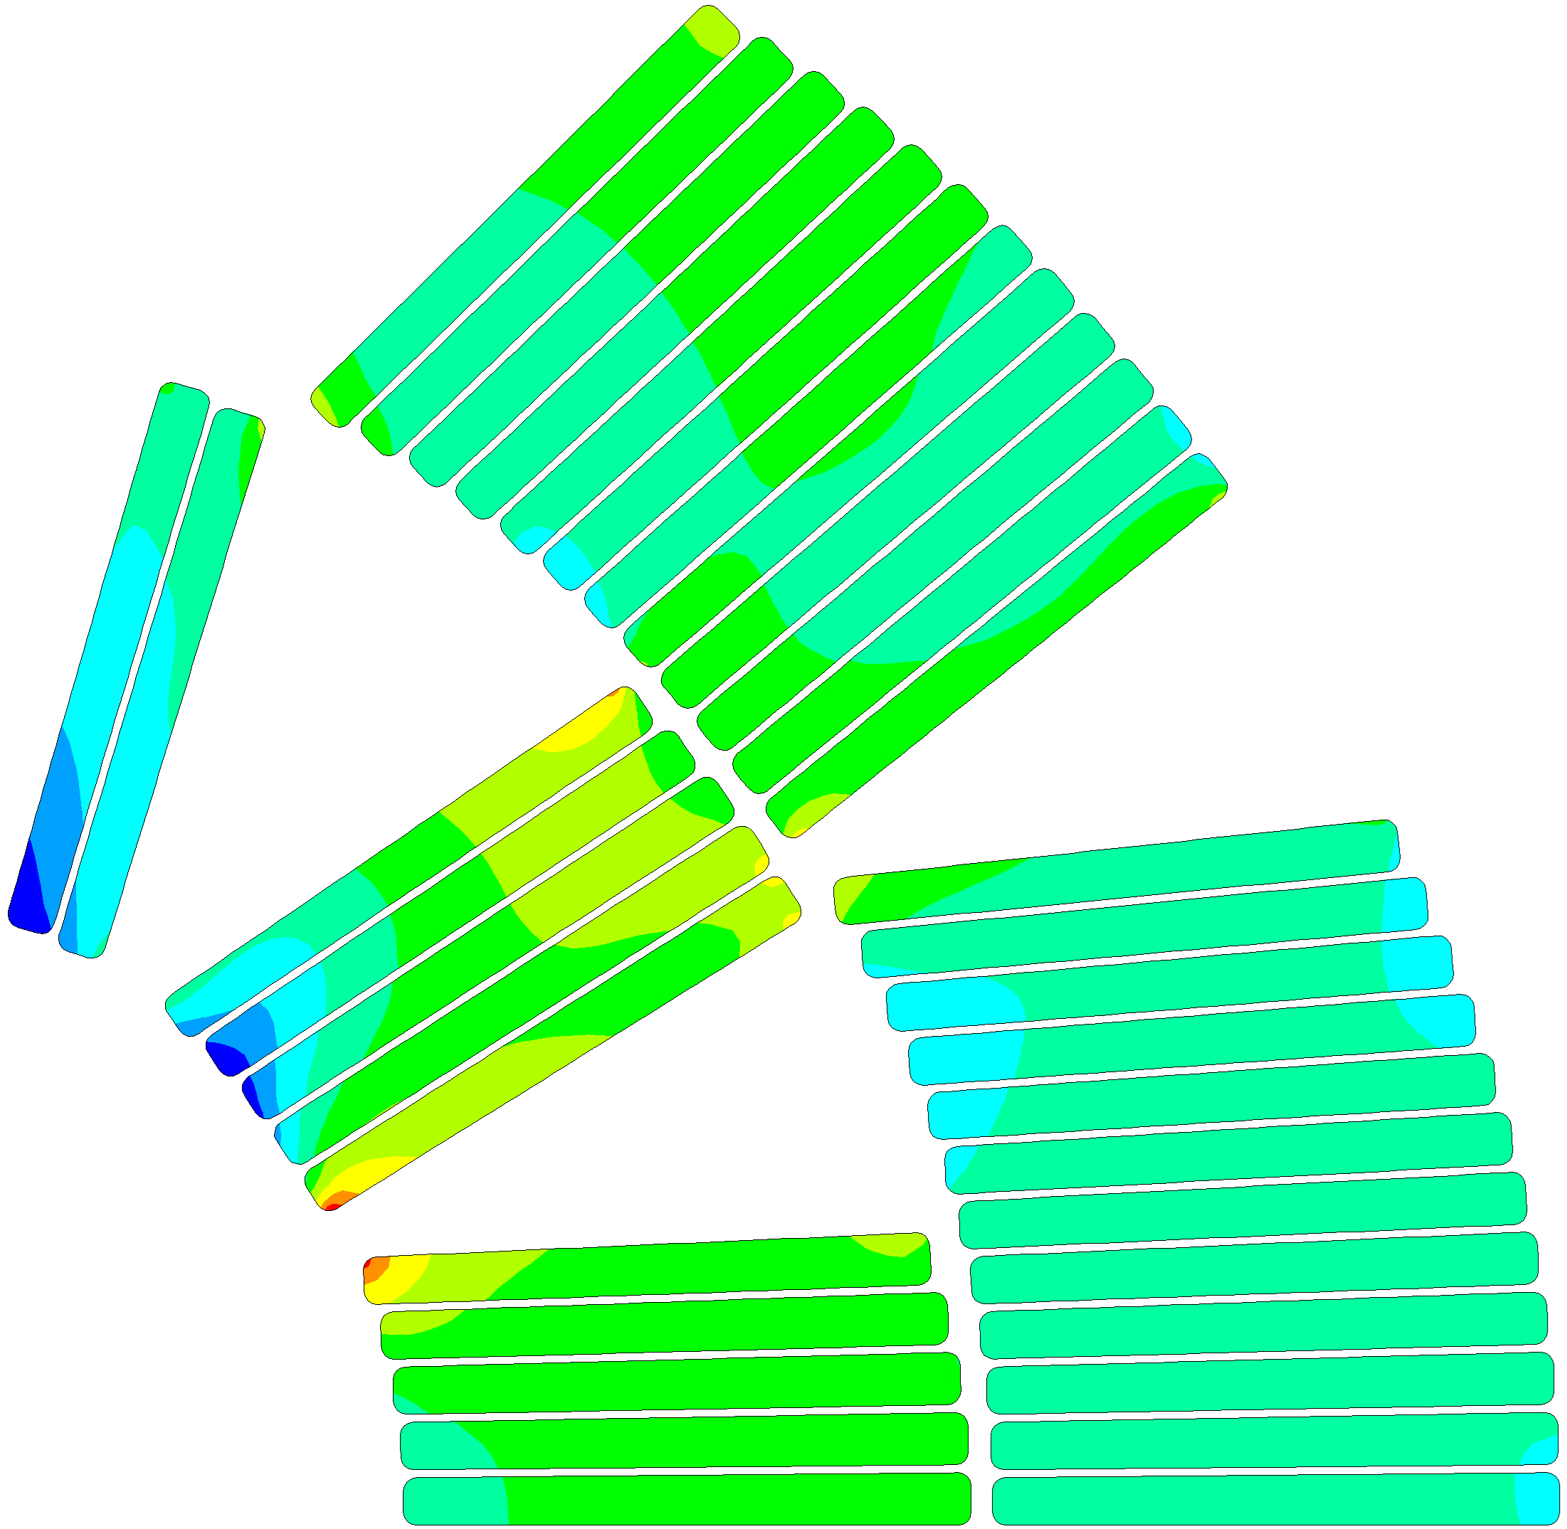
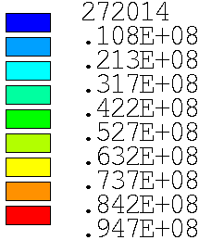
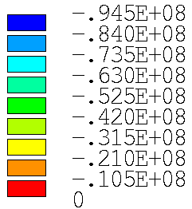



cooling down (R.T. 1.9 K)
$$σ_{safe, 1.9 K}=120 MPa$$
$$σ_{III, max}=−94.5 MPa$$
$$σ_{eqv,max}=94.7 MPa$$

Slide 16
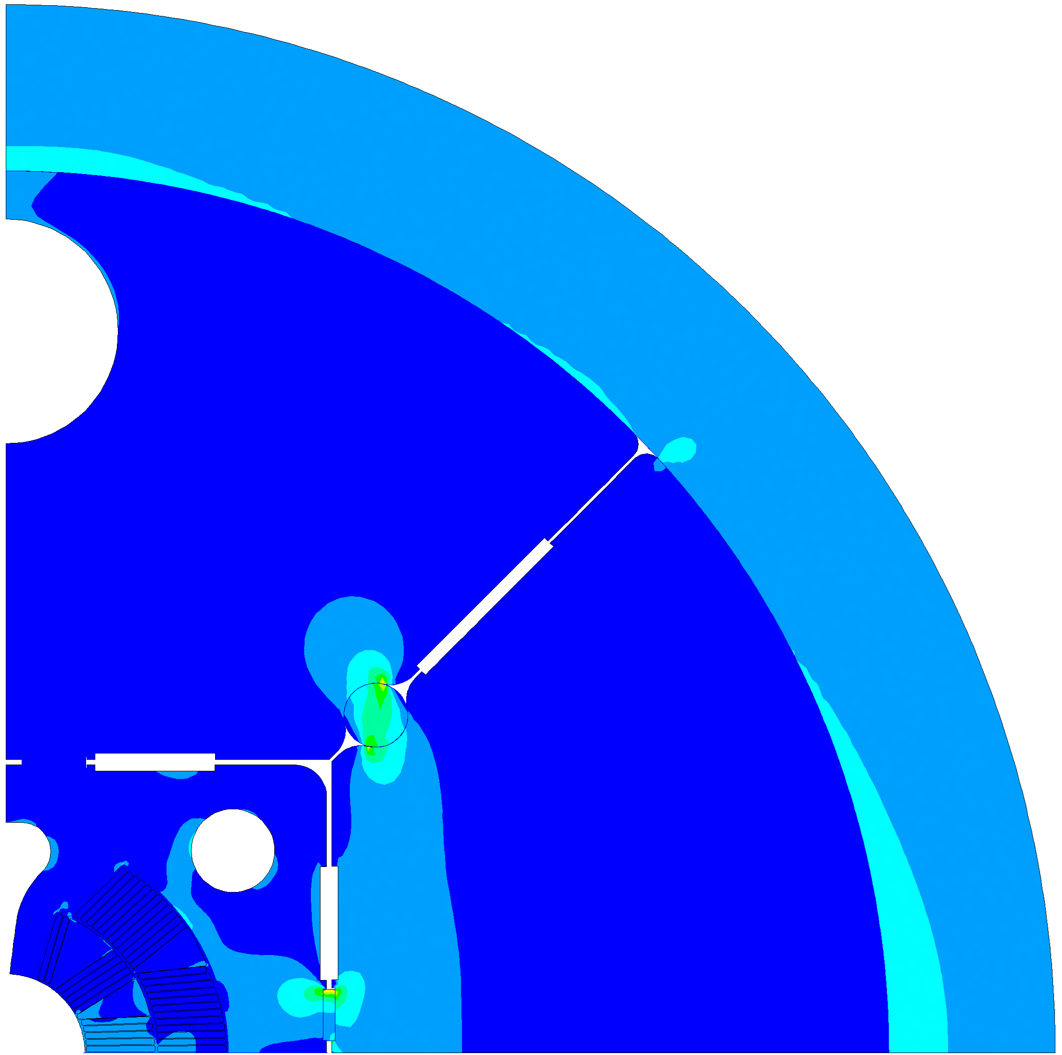
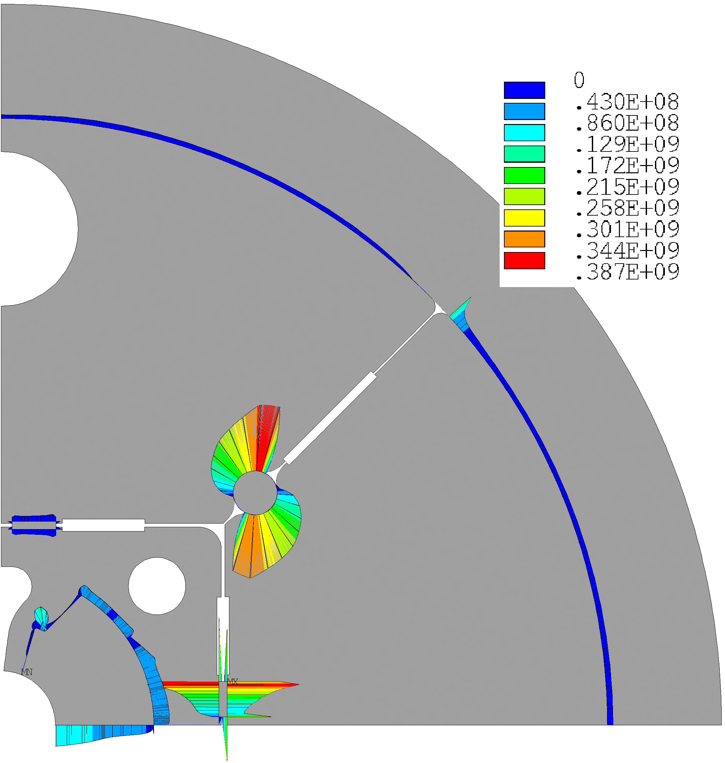
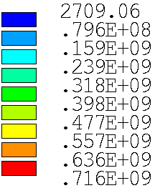
hard to deform @ 1.9 K

Slide 17

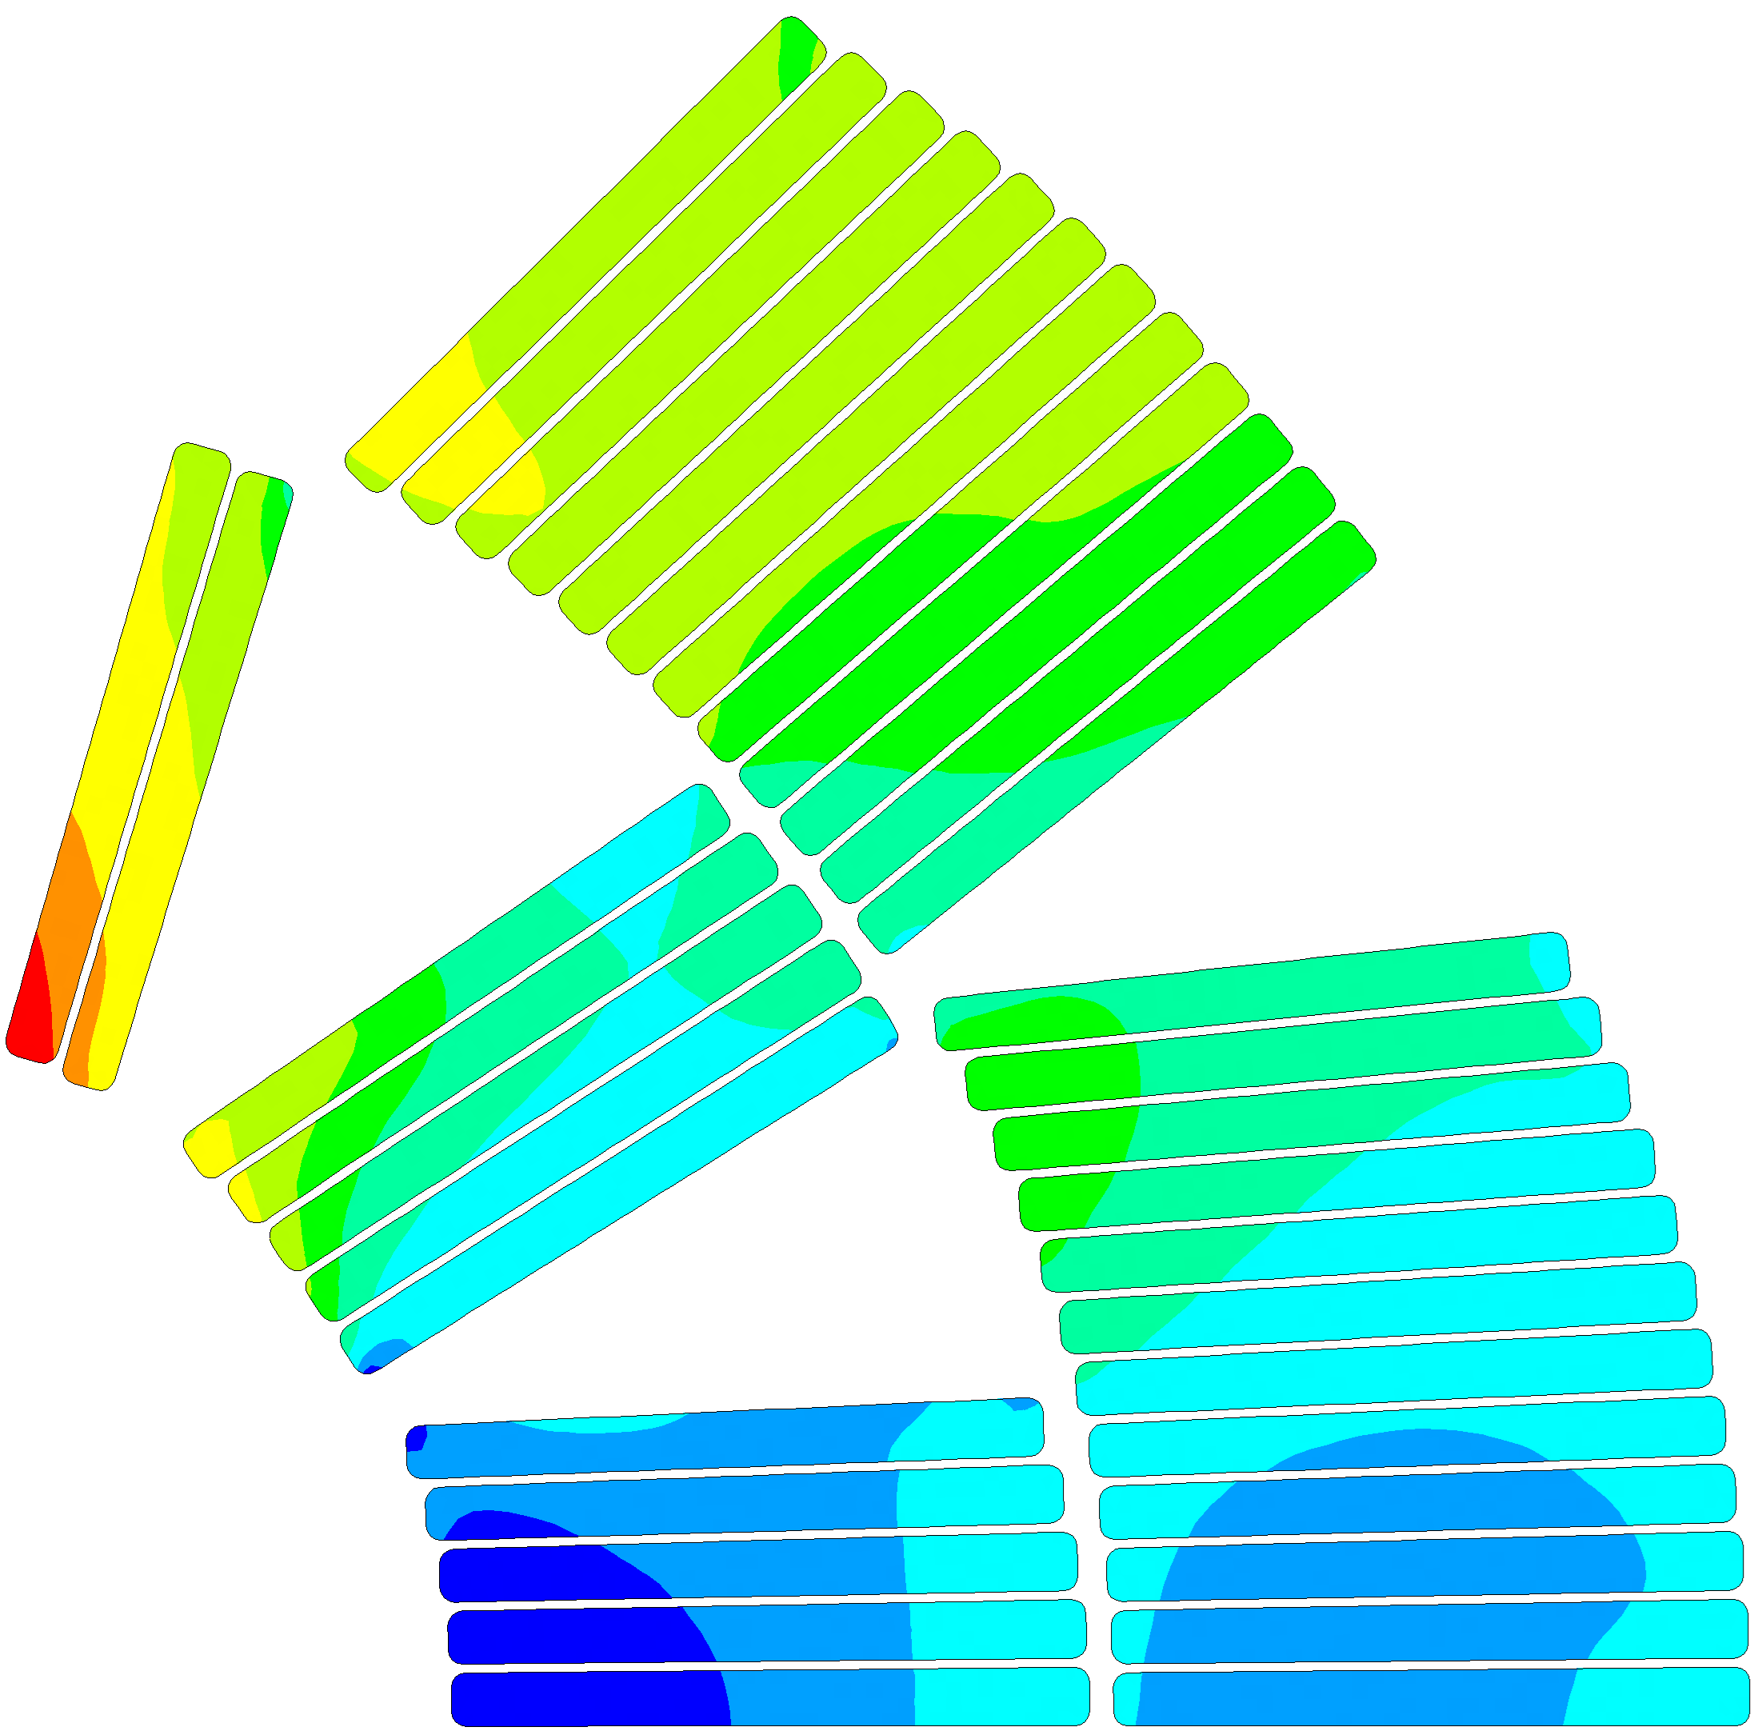
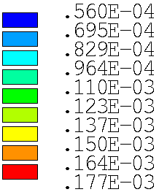
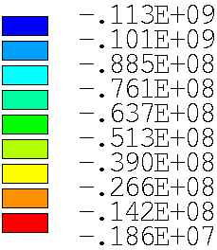



hard to deform @ 1.9 K
$$σ_{safe, 1.9 K}=120 MPa$$
$$δ_{A}<100 μm$$
$$δ_{A}$$
$$σ_{III}=−113 MPa$$

Slide 18
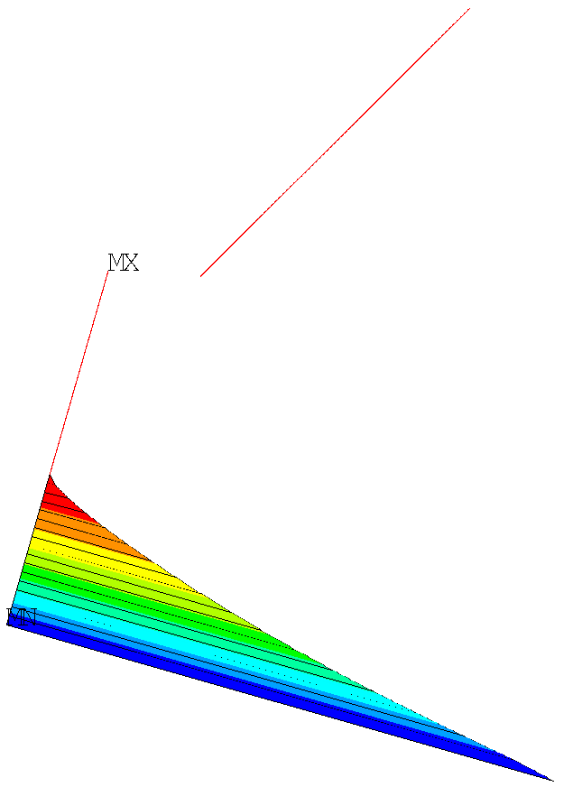
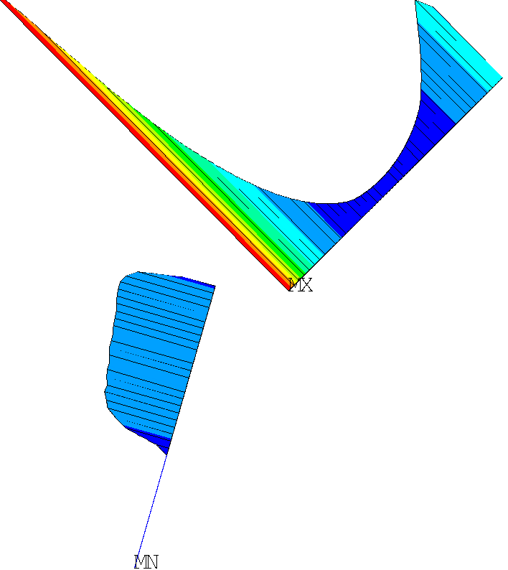
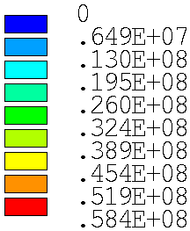
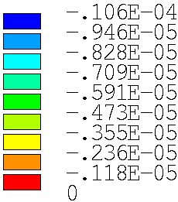


Energization 12T @ 1.9K
$$press_{max}=59 MPa$$
$$gap_{max}=10 μm$$

Slide 19
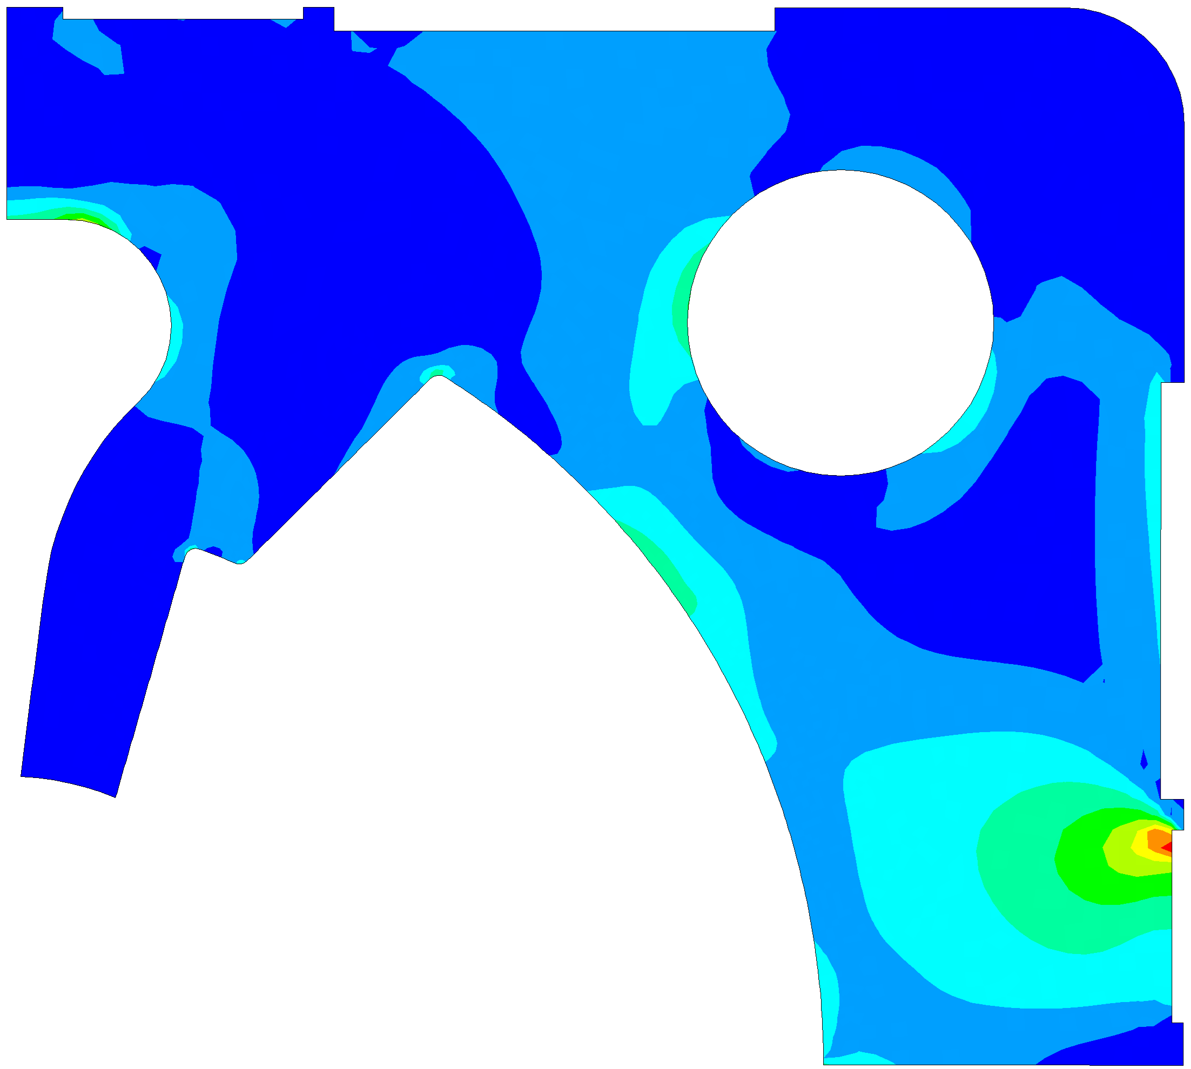
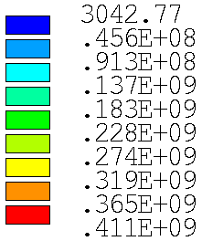
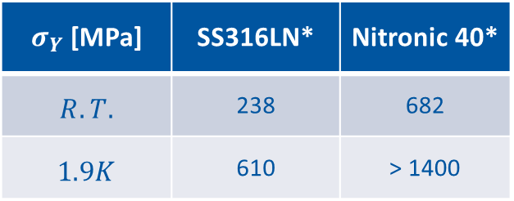
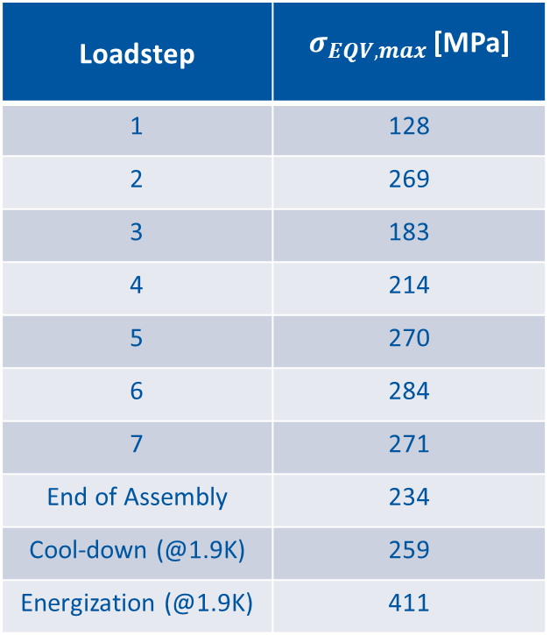

SS Pad (ductile): static analysis
Loadstep | $σ_{EQV,max }$[MPa]
1 | 128
2 | 269
3 | 183
4 | 214
5 | 270
6 | 284
7 | 271
End of Assembly | 234
Cool-down (@1.9K) | 259
Energization (@1.9K) | 411
$σ_{Y}$ [MPa] | SS316LN* | Nitronic 40*
$$R.T.$$ | 238 | 682
$$1.9K$$ | 610 | > 1400
$$σ_{eqv, max, EN}=411 MPa$$
*A Review of the Mechanical Properties of Materials Used in Nb3Sn Magnets for Particle Accelerators by G. Vallone

Slide 20

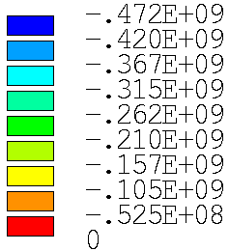


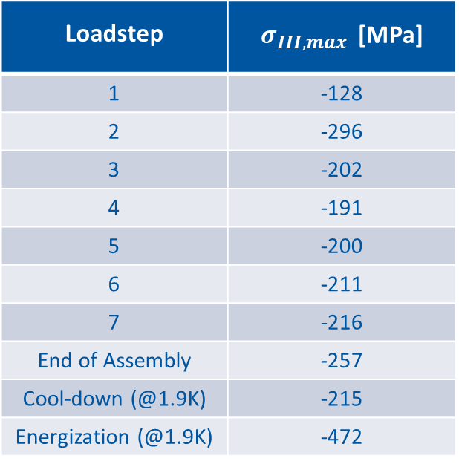

SS Pad: fatigue analysis (compressive)
$$σ_{y, R.T.}=… MPa$$
$$σ_{III, max,EN}=−472 MPa$$
$$σ_{y, 1.9K}=… MPa$$
Loadstep | $σ_{III,max }$[MPa]
1 | -128
2 | -296
3 | -202
4 | -191
5 | -200
6 | -211
7 | -216
End of Assembly | -257
Cool-down (@1.9K) | -215
Energization (@1.9K) | -472

Slide 21
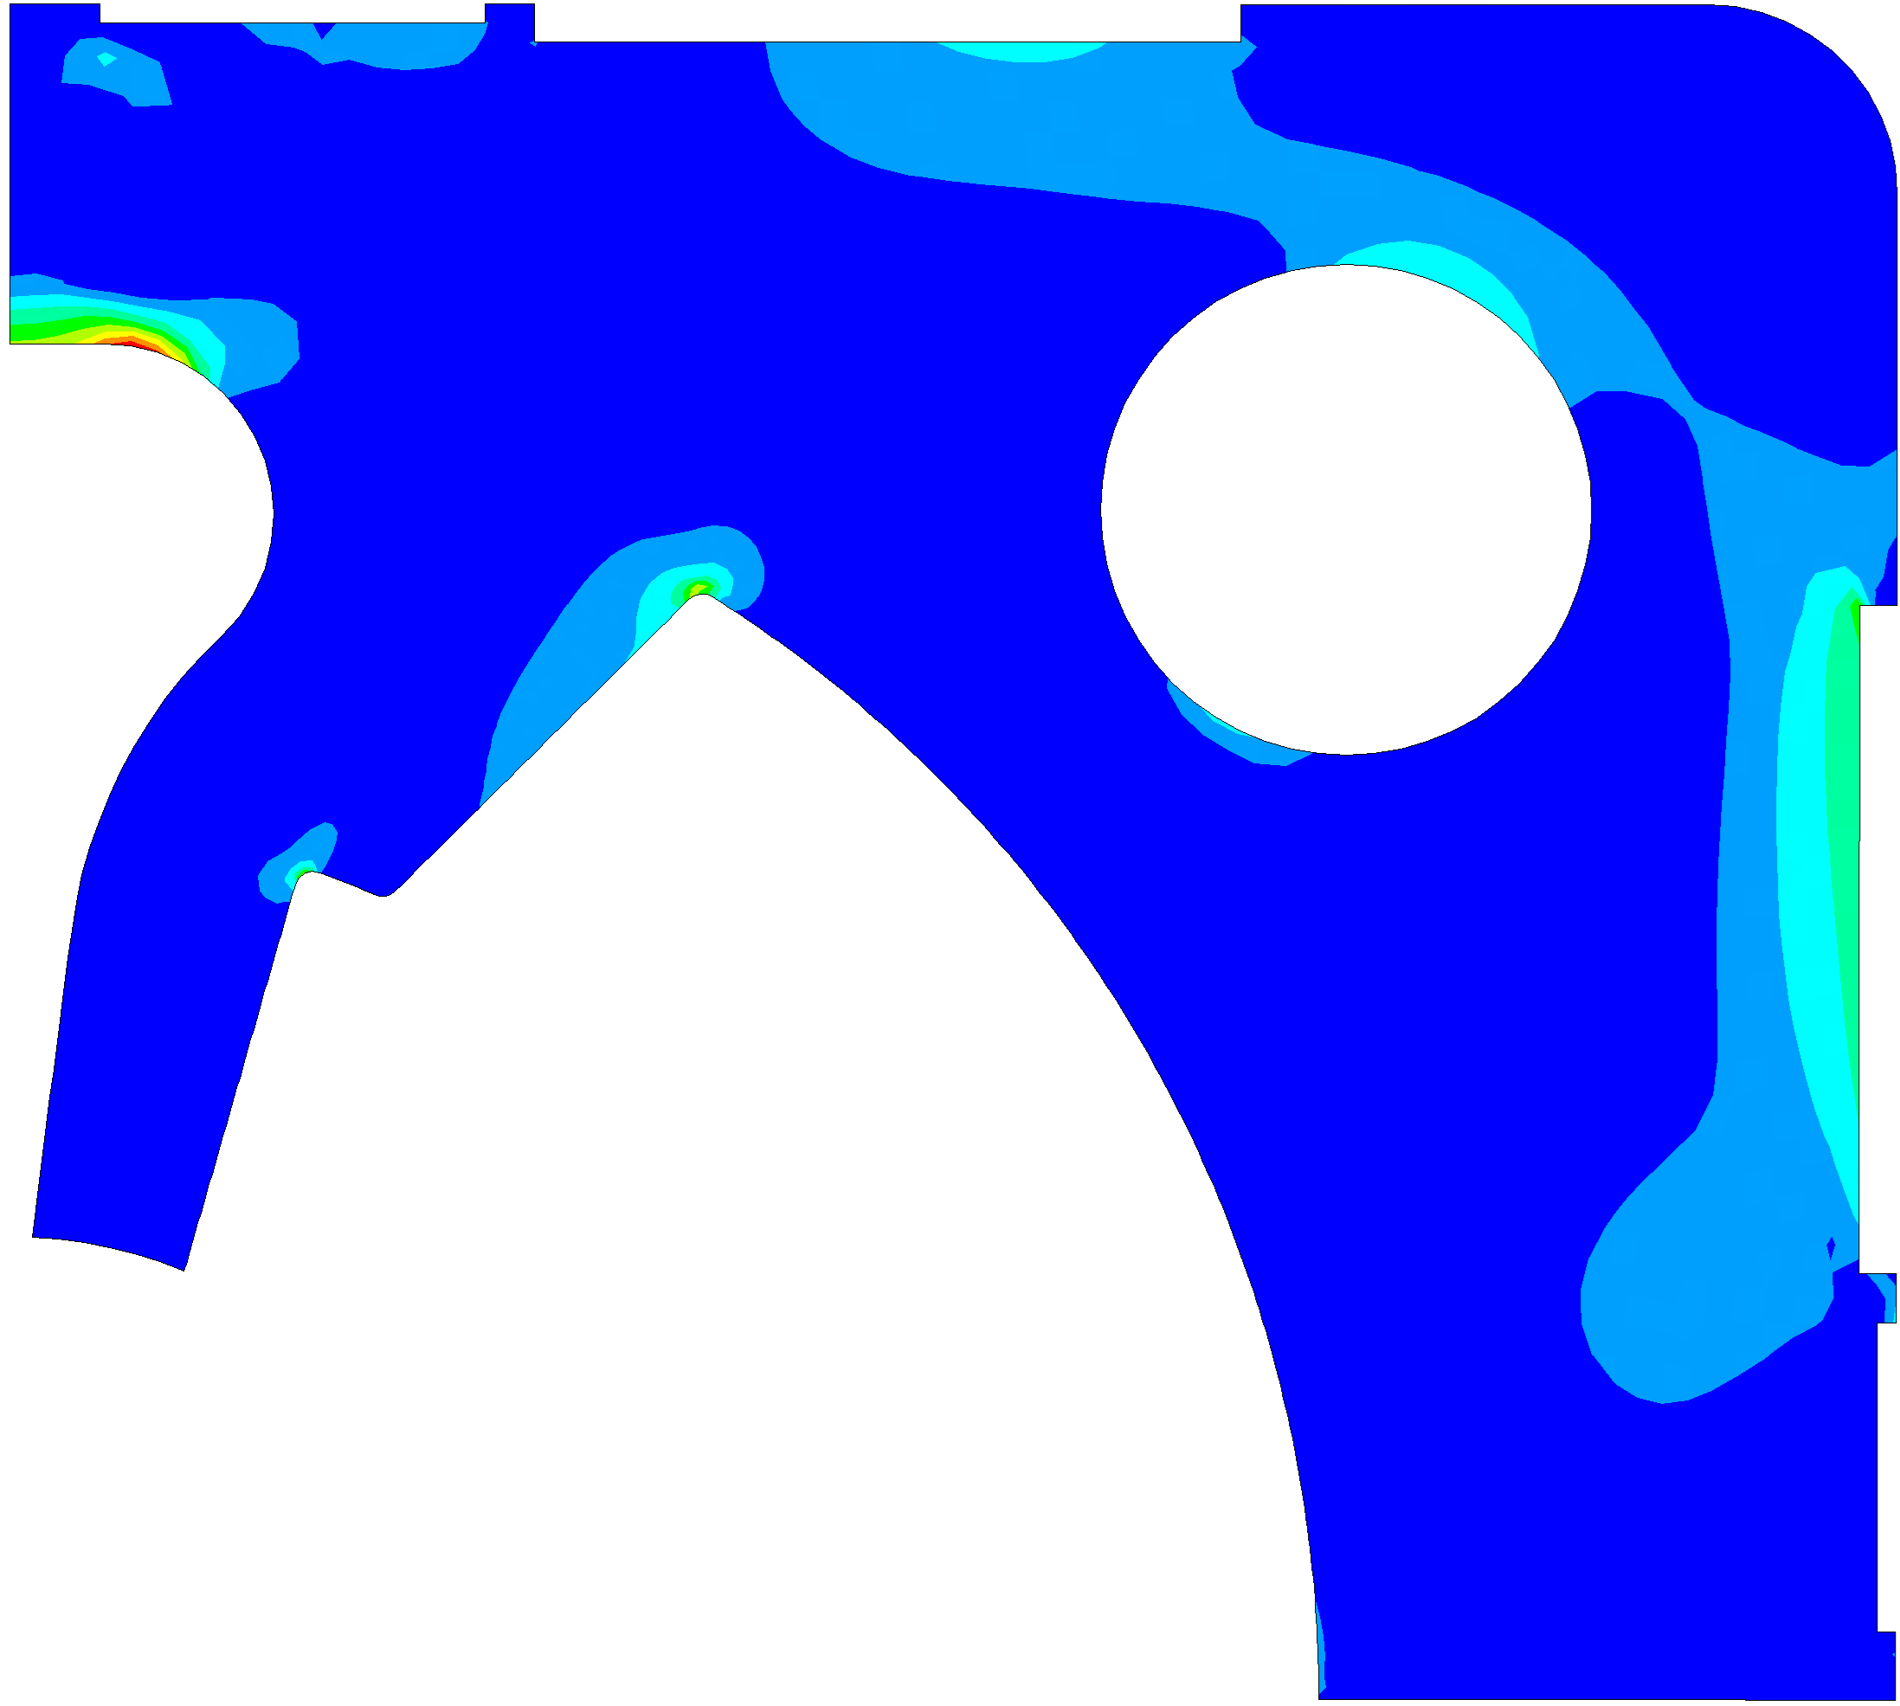
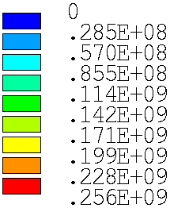


SS Pad: fatigue analysis: (tensile)
$$σ_{y, R.T.}=… MPa$$
$$σ_{I, max,EN}=256 MPa$$
$$σ_{y, 1.9K}=… MPa$$
Loadstep | $σ_{I,max }$ [MPa]
1 | 92
2 | 267
3 | 192
4 | 197
5 | 250
6 | 271
7 | 251
End of Assembly | 214
Cool-down (@1.9K) | 245
Energization (@1.9K) | 256

Slide 22





Copper wedges (ductile): static analysis
Loadstep | $σ_{EQV,max }$[MPa]
1 | 13
2 | 23
3 | 21
4 | 46
5 | 54
6 | 64
7 | 73
End of Assembly | 65
Cool-down (@1.9K) | 100
Energization (@1.9K) | 207
$σ_{Y}$ [MPa] | Copper
$$R.T.$$ | 270
$$1.9K$$ | 340
$$σ_{eqv, max, EN}=207 MPa$$
*A Review of the Mechanical Properties of Materials Used in Nb3Sn Magnets for Particle Accelerators by G. Vallone

Slide 23




SS keys (ductile): static analysis
Loadstep | $σ_{EQV,max }$[MPa]
1 | -
2 | -
3 | 204
4 | 162
5 | 178
6 | 184
7 | 184
End of Assembly | 334
Cool-down (@1.9K) | 237
Energization (@1.9K) | 677
$σ_{Y}$ [MPa] | SS316LN* | Nitronic 40*
$$R.T.$$ | 238 | 682
$$1.9K$$ | 610 | > 1400
$$σ_{eqv, max, EN}=677 MPa$$
*A Review of the Mechanical Properties of Materials Used in Nb3Sn Magnets for Particle Accelerators by G. Vallone

Slide 24





45° SS key static analysis
Loadstep | $σ_{EQV,max }$[MPa]
1 | -
2 | -
3 | -
4 | -
5 | -
6 | 8
7 | 9
End of Assembly | 7
Cool-down (@1.9K) | 10
Energization (@1.9K) | 574
$σ_{Y}$ [MPa] | SS316LN* | Nitronic 40*
$$R.T.$$ | 238 | 682
$$1.9K$$ | 610 | > 1400
$$σ_{eqv, max, EN}=574 MPa$$
*A Review of the Mechanical Properties of Materials Used in Nb3Sn Magnets for Particle Accelerators by G. Vallone

Slide 25





Al7075 Shell (*brittle): static analysis
Loadstep | $σ_{EQV,max }$[MPa]
1 | 8
2 | 63
3 | 83
4 | 81
5 | 110
6 | 141
7 | 169
End of Assembly | 84
Cool-down (@1.9K) | 19
Energization (@1.9K) | 195
$σ_{Y}$ [MPa] | Al7075
$$R.T.$$ | 480
$$1.9K$$ | 490
$$σ_{eqv, max, EN}=195 MPa$$
*A Review of the Mechanical Properties of Materials Used in Nb3Sn Magnets for Particle Accelerators by G. Vallone

Slide 26





Iron yokes (*brittle): static analysis
Loadstep | $σ_{EQV,max }$[MPa]
1 | 65
2 | 44
3 | 120
4 | 110
5 | 120
6 | 124
7 | 148
End of Assembly | 204
Cool-down (@1.9K) | 158
Energization (@1.9K) | 655
$R_{m}$ [MPa] | Magnetil | ARMCO
$$R.T.$$ | 250 | 286
$$1.9K$$ | 720 | 975
$$σ_{eqv, max, EN}=655 MPa$$
*A Review of the Mechanical Properties of Materials Used in Nb3Sn Magnets for Particle Accelerators by G. Vallone

Slide 27





Irons: fatigue analysis (compressive)
Loadstep | $σ_{III,max }$[MPa]
1 | -7
2 | -44
3 | -138
4 | -127
5 | -139
6 | -143
7 | -170
End of Assembly | -215
Cool-down (@1.9K) | -182
Energization (@1.9K) | -756
$R_{m}$ [MPa] | Magnetil | ARMCO
$$R.T.$$ | 250 | 286
$$1.9K$$ | 720 | 975
$$σ_{III, max, EN}=−756 MPa$$
*A Review of the Mechanical Properties of Materials Used in Nb3Sn Magnets for Particle Accelerators by G. Vallone

Slide 28





Irons: fatigue analysis (tensile)
Loadstep | $σ_{I,max }$[MPa]
1 | 7
2 | 13
3 | 15
4 | 15
5 | 22
6 | 28
7 | 34
End of Assembly | 54
Cool-down (@1.9K) | 25
Energization (@1.9K) | 225
$R_{m}$ [MPa] | Magnetil | ARMCO
$$R.T.$$ | 250 | 286
$$1.9K$$ | 720 | 975
$$σ_{I, max, EN}=225 MPa$$
*A Review of the Mechanical Properties of Materials Used in Nb3Sn Magnets for Particle Accelerators by G. Vallone

Slide 29



during assembly @ R.T.
$$h_{gap}=0.2±tolerances →pads does not close$$
$$h_{gap}≪0.2 mm→pads close early \\ (coils unloaded)$$
$$h_{gap}=0.2 mm$$

Slide 30

Increasing field @ 1.9 K
F(t) = force linearly scaled from 12T

Slide 31
FalconD: Closed Cavity model
cons: Irons intercept part of the shell contraction, what fraction on the coils?
How do I control?
We can «increase» the load (es. thk of Al shell but not the % of load on coils).

Slide 32
FalconD: Closed Cavity model
Irons intercept part of the shell contraction, what fraction on the coils?
How do I control?
Instrumented yoke lamination ?

Slide 33


FalconD: Open Cavity model
+
Horizontal splitted Yoke
Assembly features

Slide 34

FalconD: Open Cavity model
pros: Cool Down easier to control
(100% shriks on coils)

Slide 35



FalconD: Open Cavity model
cons: softer system means higher stresses
$$δ_{{\left(CD−EN\right)}_{A}}=173 μm$$
$$A$$

Slide 36




FalconD: Open Cavity model
$${↑K}_{system}→ ↑h_{yoke}…but rails?$$
$K_{system }\text{∝} h_{yoke}^{3}$
$$h_{yoke}$$
$${↑↑K}_{system }→ ↓Int_{vert }$$

Slide 37
Thank you For your attention!

