Slide 1
Pb ion Collimation Performance with and without IR3 upgrade
G Bellodi
With contributions from R. Bruce, F. Burkart,
J.M. Jowett, G. Valentino, D. Wollmann

Slide 2
Heavy Ion collimation is very different from proton collimation
Ions undergo nuclear interactions in primary collimators (TCPs) before acquiring necessary kick to reach secondary collimators
→ One stage cleaning only!
Hadronic fragmentation → Large variety of daughter nuclei, Monte Carlo calculated specific cross-sections
Electro-magnetic dissociation→ Mainly loss of 1 neutron (59%) or 2 (11%) → ²⁰⁷Pb, ²⁰⁶Pb
Typical transverse momentum transferred in nuclear/dissociation events < 1MeV/c/n (compared to ~10 MeV/c/n due to beam emittance).

Slide 3
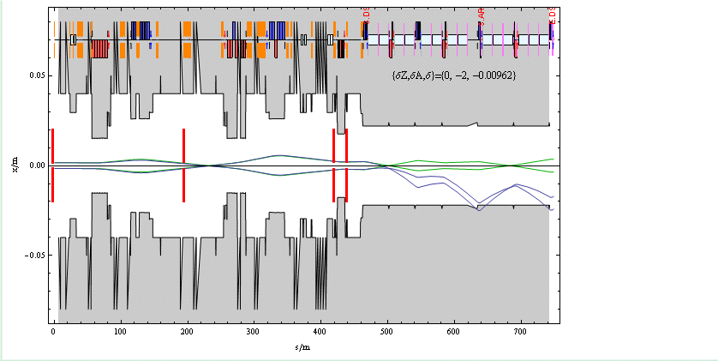
One stage cleaning
After first impact/grazing with TCPs:
  high probability of nuclear interactions with TCP material
  production of isotopes with different Z/A ratio and momentum and direction almost unchanged
  fragments follow locally generated dispersion and are lost downstream in SC magnets because of different Bρ
²⁰⁴Pb -1.92% | ²⁰⁵Pb -1.44% | ²⁰⁶Pb -0.96% | ²⁰⁷Pb -0.48% | ²⁰⁸Pb 0.0%
²⁰³Tl -1.2% | ²⁰⁴Tl -0.71% | ²⁰⁵Tl -0.23% | ²⁰⁶Tl 0.26% | ²⁰⁷Tl 0.75%
²⁰²Hg -0.46% | ²⁰³Hg 0.04% | ²⁰⁴Hg 0.53% | ²⁰⁵Hg 1.02% | ²⁰⁶Hg 1.51%
Change in rigidity:
LHC energy acceptance:
- arcs: ~ ±1%
- IR3: ~ ±0.2%
Example:
²⁰⁶ Pb
J.M. Jowett, Collimation Review 2009

Slide 4
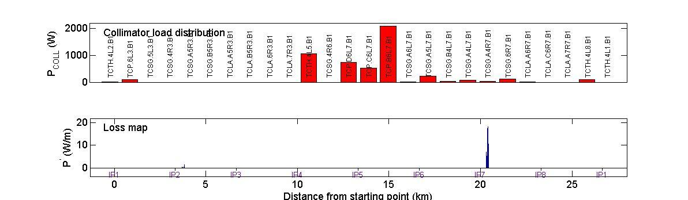
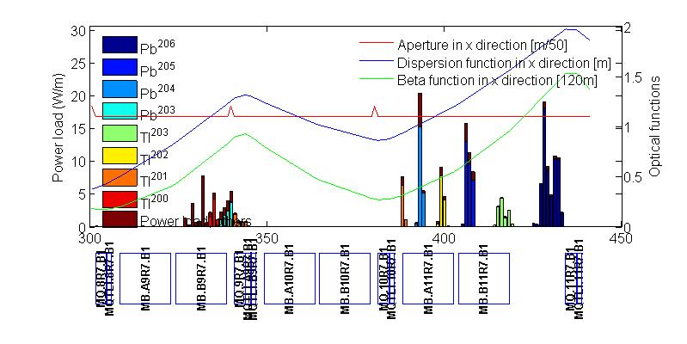
IR7 β-tron cleaning at 7 Z TeV
Simulations
(ICOSIM program by H. Braun):
τ=12 min lifetime
50,000 ions statistics
E= 7 Z TeV = 2.76 A Tev
Nominal beam parameters:
7e7 x 592= 4.14×10¹⁰ ions intensity (3.8MJ)
Collision optics (ideal)
Standard collimator settings (as per LHC p setup)
IR7 DS
Quench limit (theory) ~ 8.5W/m
Max TCP load ~ 2700W
Peak loss in DS3 ~ 18W/m
η (local) = 0.007
Betatron collimation:

Slide 5
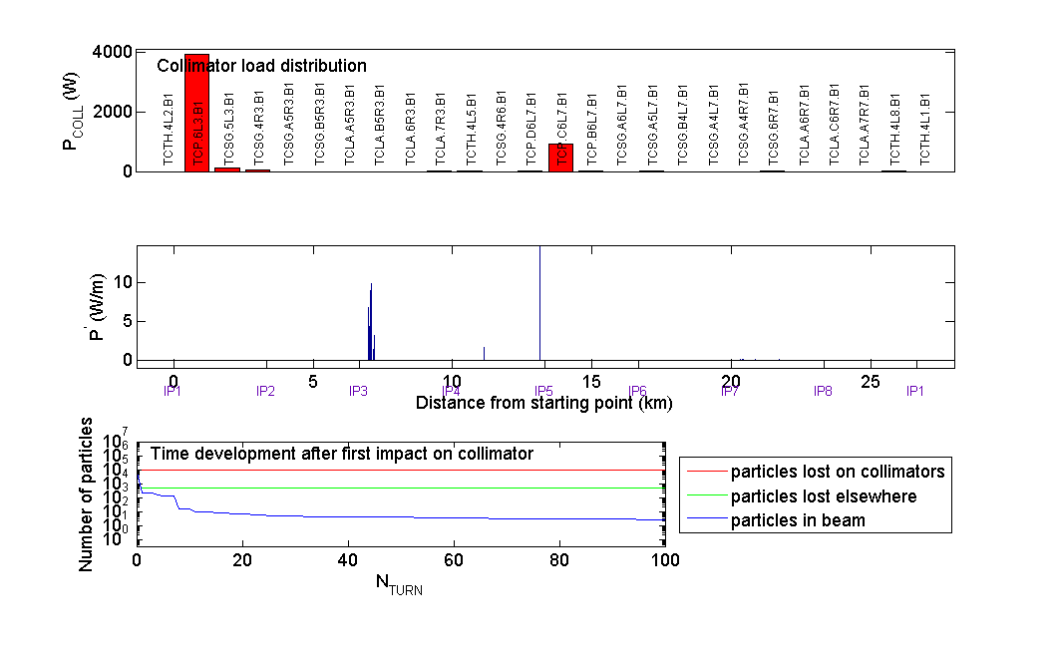
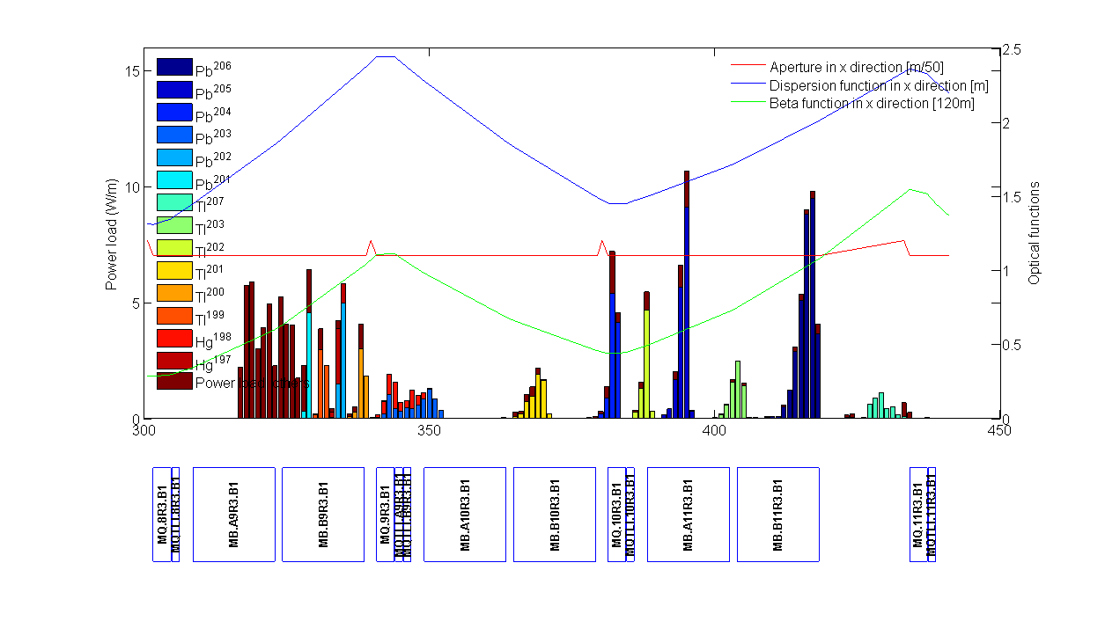
IR3 momentum cleaning at 7 Z TeV
Simulations:
100k particles, 100 machine turns
τ=12 min lifetime
7e7 x 592= 4.14×10¹⁰ ions intensity (3.8MJ)
Max TCP load ~ 3900W
Peak loss in DS3 ~ 12W/m
η (local) = 0.003
IR3 DS
Standard momentum collimation

Slide 6
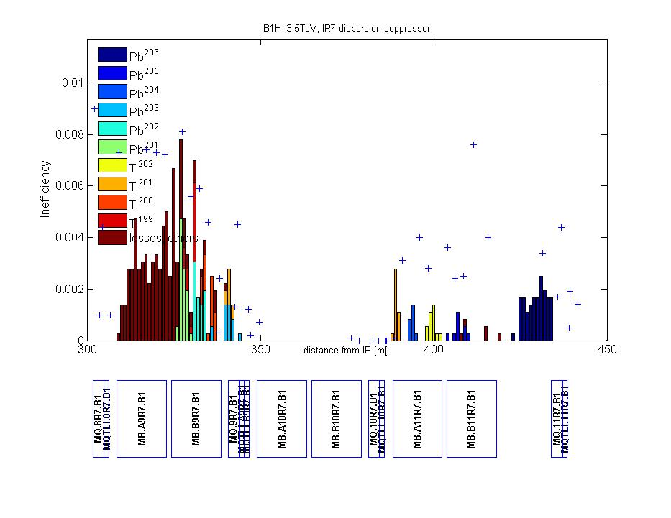
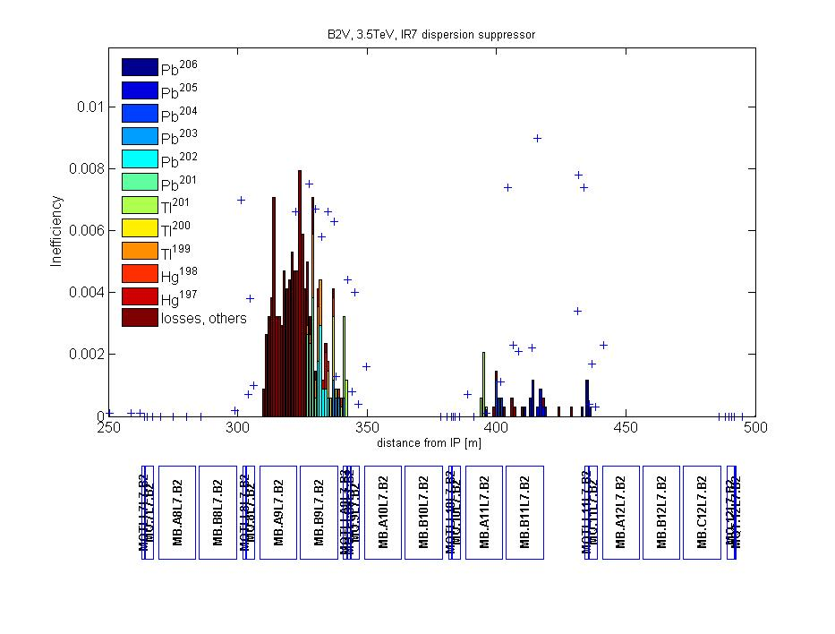
Ion commissioning loss maps vs simulation – Nov 2010
B1H
B2V
 | DS | COLD | TCT
B1h | 0.02 | 0.006 | 1.0 ×10⁻⁴
B1v | 0.027 | 0.005 | 0.001
B2h | 0.03 | 0.011 | 8×10⁻⁵
B2v | 0.025 | 0.006 | 1.4×10⁻⁴
B1+B2 pos. off momentum | 0.045 | 8e-4 | 0.06
B1+B2 neg. off momentum | 0.007 | 2e-4 | 0.005
3.5TeV eq.
Physics conditions
D Wollmann, Evian Dec 2010

Slide 7
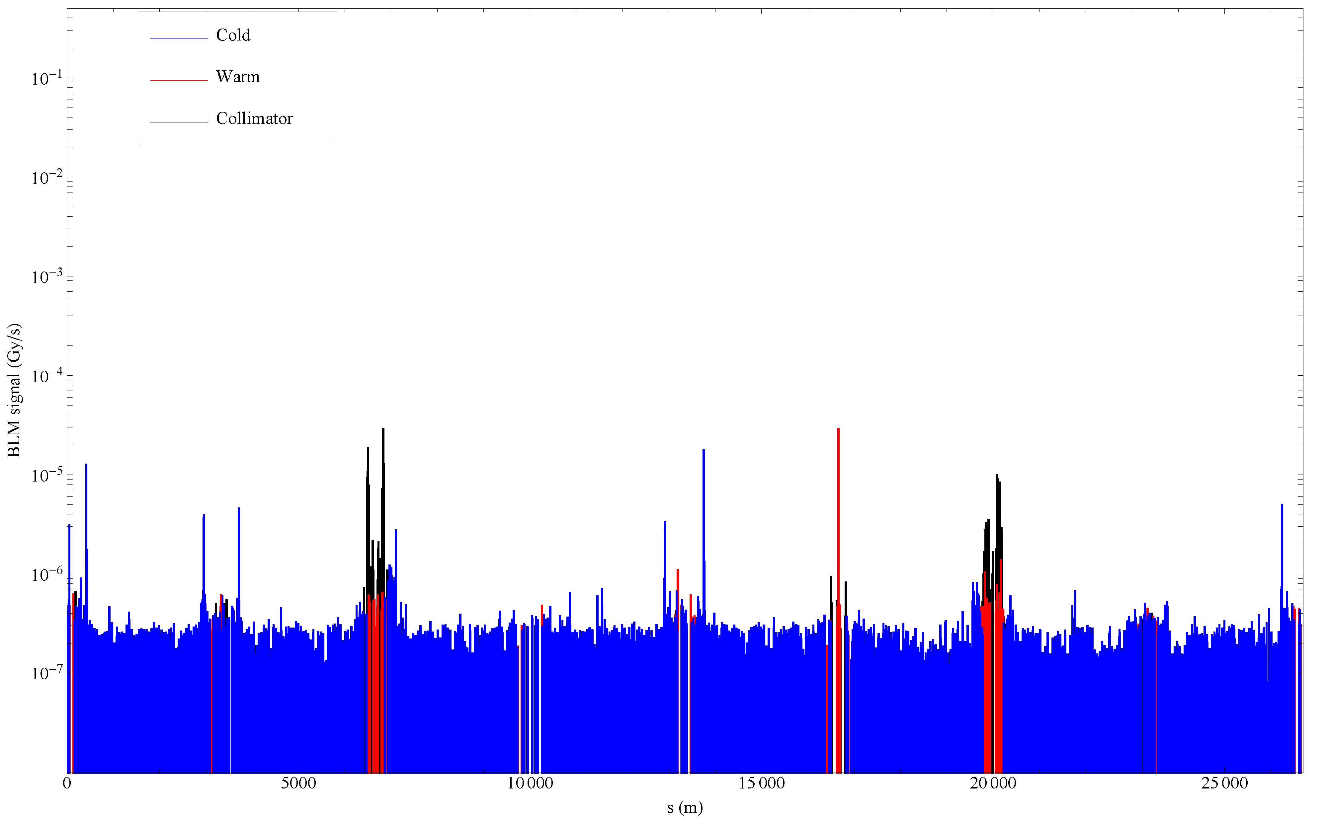
Global view of losses, Pb-Pb stable beams
Record luminosity, the last fill of 2010
Momentum collimation: ²⁰⁸Pb⁸²⁺ (IBS)
²⁰⁷Pb⁸²⁺ (EMD1)
Betatron collimation: ²⁰⁶Pb⁸²⁺ (EMD2 in TCP)
+ many other nuclides from hadronic fragmentation and EMD in TCPs
²⁰⁸Pb⁸¹⁺(BFPP at ATLAS)
²⁰⁸Pb⁸¹⁺ BFPP at CMS
²⁰⁸Pb⁸¹⁺(BFPP at ALICE)
Possibly: ²⁰⁶Pb⁸²⁺ (EMD2 at IPs), other nuclides from collimation ??
J.M. Jowett, Chamonix 2011

Slide 8
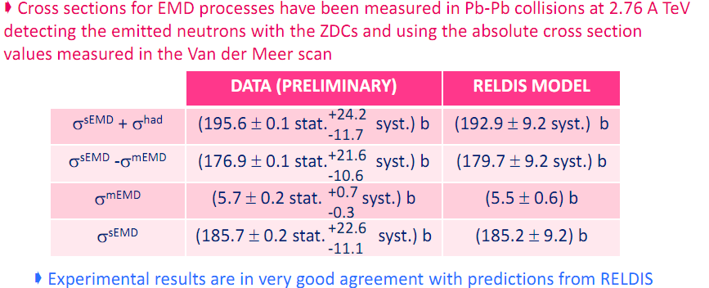
Commissioning lessons
Positions of loss peaks in the dispersion suppressor are well reproduced in simulations.
Leakage is higher in measurements than in simulations.
Higher losses in IR3 than expected (combination of BFPP-luminosity effects and off-momentum feed-down from IR7?)
Simulations performed with perfect machine conditions
Cross sections uncertainties: good news from 2011 Quark-Matter conference (talk by C. Oppedisano)
ALICE results

Slide 9
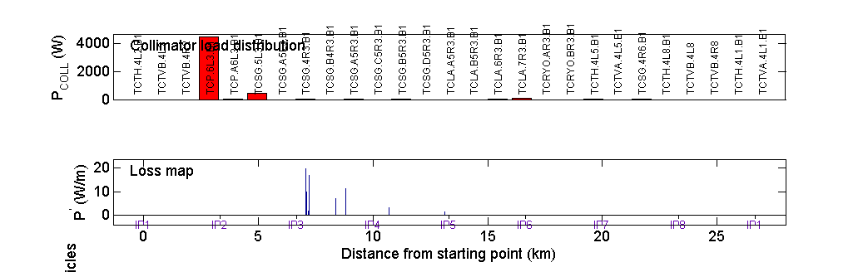
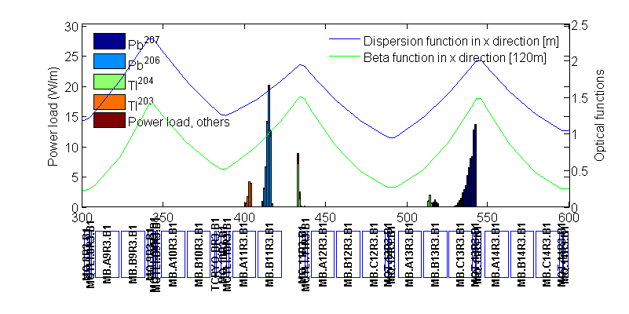
IR3 combined cleaning without TCRYOs
Sector | Family | Half gap
LSS7 | TCP IR7 | Open
 | TCSG IR7 | Open
 | TCLA IR7 | open
LSS3 | TCP IR3 | 6
 | TCSG IR3 | 7
 | TCLA IR3 | 10
LSS1/2/5/8 | TCTH | 8.3
 | TCTV | 8.3
τ=12 min lifetime
7×10⁷ ×592= 4.14×10¹⁰ ions
E=7 Z TeV eq.
Max TCP load ~ 4500W
Peak loss in DS3 ~ 20W/m
η (local) = 0.0044

Slide 10
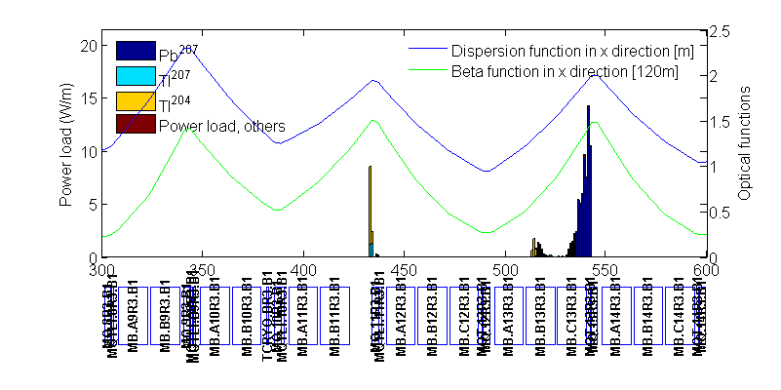
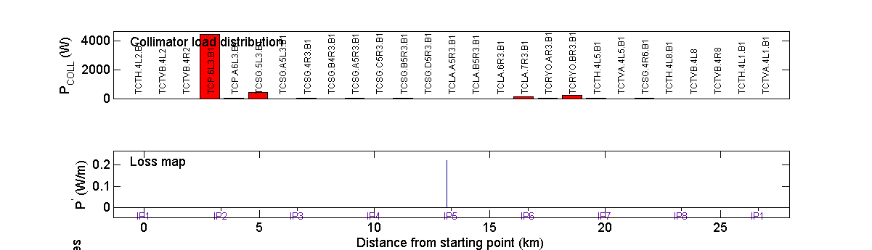
and with TCRYOs in
50 sigma half gap –
DS already significantly cleaner
20 sigma half gap,
No losses visible!

Slide 11
Performance reach without TCRYOs: extrapolation from proton MD
DATA
1) Minimum lifetime for steady-state losses derived from data (end Nov ion runs)
τ= ~1-1.5 hrs (vs 12 min used in simulations) at 3.5 TeV eq. (DW, FB)
2) Protons quench test (16 bunches at 3.5 TeV in 1s):
336W deposited on DS Q8 w/o quench – lower limit
3) Same BLM response as for protons (factor of 2 between primary and DS)
?
Correction factors
Highest measured local cleaning inefficiency
Minimum lifetime (measured)
Quench limit x dilution length

Slide 12
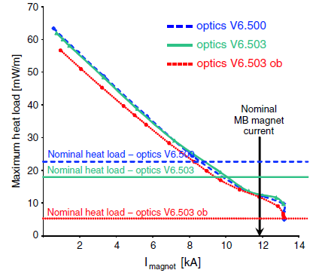
At 3.5 Z TeV:
336 W on Q8 → ~60W on MB or 2.6E6 ions/s (with BLM factor 2)
Assume η=0.045, τ=3600s and x2 dilution length safety factor
N_max (ions) = 1×10¹¹ Pb = 2.4 × Pb nominal intensity
R. Bruce et al. Phys. Rev. ST AB, 12, 071002 (2009)
At 7 Z TeV:
60 W → ~24W
(Heat flow simulations for BFPP
give quench limit scaling
with magnet current )
= 0.52E6 ions/s
Assume η=0.045, τ=3600s and x2 dilution length (for Pb) safety factor
N_max (ions) ~ 2×10¹⁰ Pb = 0.5 × nominal Pb intensity

Slide 13
Assumptions/caveats/disclaimers
Same minimum beam lifetime at 3.5 TeV and 7 TeV.
Minimum beam lifetime independent from intensity.
Safety factor x2 in dilution lengths to account for different ion loss patterns (more concentrated and localised, less diffractive scattering effects.. )
R. Bruce et al, Phys. Rev. ST Accel. Beams 12, 071002 (2009)
Same spatial distribution of losses in SC magnets at 3.5 TeV and 7 TeV
No change in cleaning inefficiency between 3.5 TeV and 7 TeV
BLM response as for protons
Losses are mainly collimation/intensity driven ... possible luminosity effects are not considered
.....

Slide 14
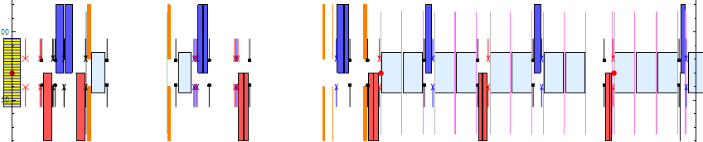
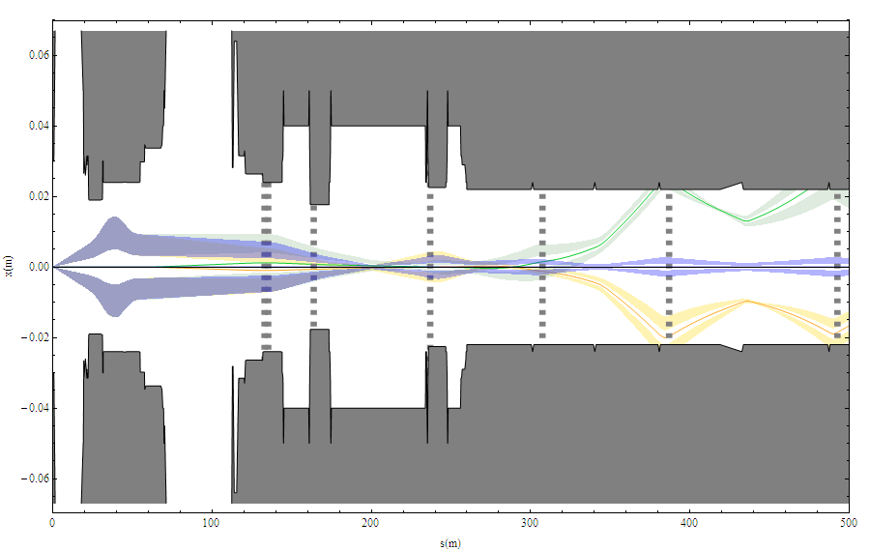
Main and secondary Pb beams from ALICE IP
Collimators in dispersion suppressors around experiment(s) will be needed to overcome luminosity (not intensity) limit for Pb-Pb collisions.
Optimal position for one “cryo”-collimator/beam.

Slide 15
IR2 DS collimators
BFPP is direct limit on Pb-Pb luminosity in each IP
  Continuous, localised loss during luminosity
  Expect very effective mitigation from DS collimators around IPs
  Installation is different from IR3/IR7
  No resources for detailed layout study so far
ALICE has requested IR2 be equipped
  Next step after IR3, 2017 shutdown
  If IR3 installation is delayed, can both IR3 & IR2 be done in 2018? Otherwise risk that IR2 installation will be so late as to compromise integrated Pb-Pb luminosity up to ~2020 (see next slide …)
Similar installations for IR1, IR5
  May be needed for p-p luminosity debris in future
  HL-LHC beyond 2021 ??
  Would also help their Pb-Pb luminosity

Slide 16
LHC medium-term heavy-ion programme
Year | HI beams | TCRYO in 2013-14 | Delayed TCRYO
2011 | Pb-Pb, 3.5 Z TeV | I_{tot} limited | I_{tot} limited
2012 | p-Pb/Pb-Pb | I_{tot} limited | I_{tot} limited
2013-14 | LS1 | TCRYOs in IR3 | No TCRYOs
2015-16 | Pb-Pb, 7 Z TeV | L limited | I_{tot} limited
2017 | p-Pb/Pb-Pb | L not limited/limited | I_{tot} limited
2018 | LS2 | TCRYOs in IR2 | TCRYOs in IR3
2019 | Pb-Pb, 7 Z TeV | L not limited | L limited
2020 | p-Pb (D-Pb??) | L not limited | ??
2021 | Ar-Ar | ?? | ??
2022 | LS3 | TCRYOs in IR1, IR5 ? | TCRYOs in IR2 ?
Highly simplified scheme:
“I_{tot} limited” means close to limit, as determined in previous slides
“L limited” means probably factor ~2-4 below design of 10²⁷cm⁻²s⁻¹
see R. Bruce et al. Phys. Rev. ST AB, 12, 071002 (2009)

Slide 17
Conclusions
2010 measurements successfully validated predictions on DS loss locations and patterns and EMD/had Pb ion cross sections
Observed leakage to IR7 (IR3) DS is more important than predicted: especially high losses seen with stable beams in IR3 (combined effect?)
Solution for combined betatron and momentum cleaning in IR3 (one extra vertical TCP) is expected to have similar collimation efficiency to IR3 momentum only/IR7 betatron only schemes.
  Hardly sufficient to meet the needs for Pb ion operation performance at 7 Z TeV and nominal intensity.

Slide 18
Without
IR3 upgrade
With
IR3 upgrade
Performance reach estimate on the basis of recent MD results:
At 3.5 Z TeV:
N_{max} ~ 1×10¹¹ Pb
=(2.4×nominal Pb intensity)
At 7 Z TeV:
N_{max} ~ 2×10¹⁰ Pb
=(0.5×nominal Pb intensity)
Important assumptions (are they all justified??) → large error bars / far reaching extrapolation....
No margin for higher beam intensities / operation with different ion species (Ar40 more demanding!)
IR2 probably delayed
IR3 DS upgrade with cryogenic collimators is an effective solution to the ion collimation problem.
all leakage in the DS is absorbed even at > 20 σ jaw opening.
Scheme has been shown (in simulations) to work for:
higher beam intensities
light ions operation
(⁴⁰Ar study in 04/2009 review)
Single bunch intensity 70% > nominal already demonstrated (Early scheme only, so far)
Opens the way for timely IR2 upgrade to remove BFPP limit on luminosity for main part of Pb-Pb programme.

