Slide 1
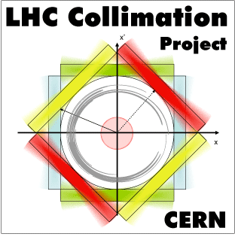

Energy deposition with and without IR3 upgrade
Predicted energy deposition with and without IR3 (IR7)dispersion suppressor collimators. Gain from collimators. Performance reach from comparing peak heat deposition with quench limit. Comparison with MD results.
Outline:
Benefit of the DS collimator for the (peak) power deposition on the super conductive coils and cables of the magnets in the DS;
Short discussion of the May 8th/9th MD (quenching test);
Vittorio Boccone for the FLUKA Team (EN/STI)

Slide 2
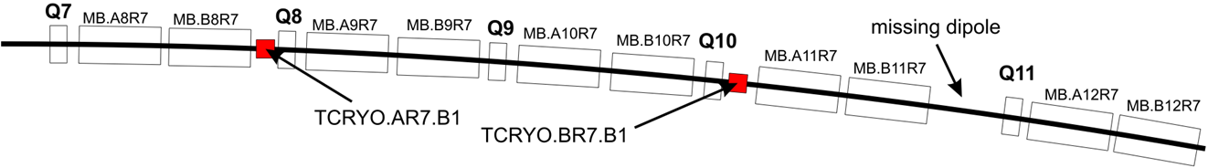
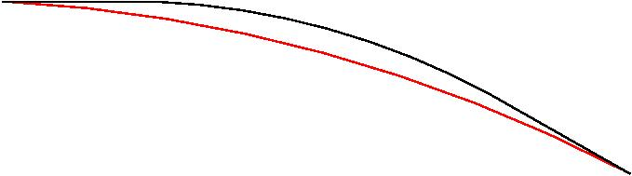
Impact of the DS-collimator
-3m shifted in s
MQ.7R7.B1
MQTLI.7R7.B1
MCBCH.7R7.B1
MCDO.8R7.B1
MB.A8R7.B1
MCS.A8R7.B1
MB.B8R7.B1
MCS.B8R7.B1
+3m shifted in s
3m
transversely shifted by 3 cm
MCDO.11R7.B1
MB.A11R7.B1
MCS.A11R7.B1
MB.B11R7.B1
MCS.B11R7.B1
old DS-collimator configuration R. Assmann ‘09
3m
The impact of the DS collimator (alias TCLD and formerly know as TCryo) as studied in the case of IR7 (2009 and 2010) at 7 TeV, nominal LHC (0.2h lifetime);
The scenario in IR3 is slightly different as the TCLD and Q10 are now swapped;
The differences do not change the overall effects of protection of the DS elements. For this reason the results for IR7 can still be considered “valid” from a point of view DS-power load and peak power on the coils of the downstream magnets.
14/06/11
V.Boccone - Collimator Review 2011
2

Slide 3
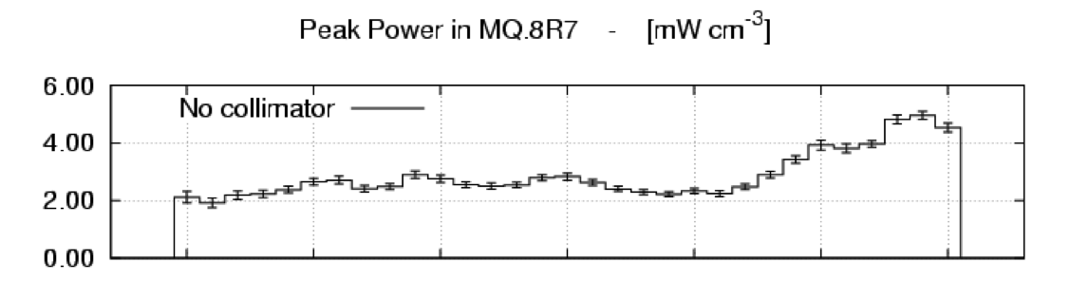
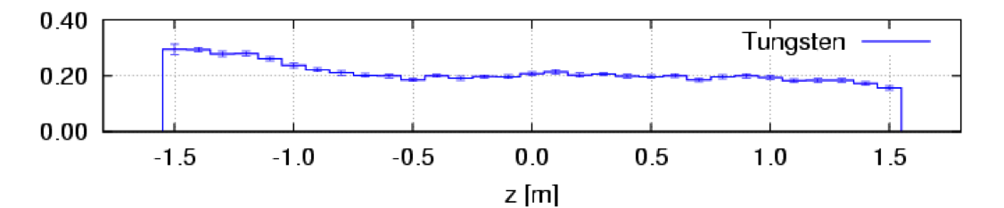
Impact of the DS-collimator
Peak Power on superconductive coils in IR7 (2009)
The benefits of the DS collimator from the point of view of the reduction of the peak power in the superconductive coils of the magnets were shown by F.Cerutti at the CDR LHC Phase II Collimation, April 2nd 2009 (DS in IR7, only horizontal losses);
The beneficial effect of the DS collimator were quantified. Peak power is below (but not far from) the quench limit. The 1.5 factor for the ultimate intensity does not change the picture.
Peak Power along the MQ.8R7 (7 TeV, 0.2h beam lifetime, LHC nominal)
[mW/cm³]
14/06/11
V.Boccone - Collimator Review 2011
3

Slide 4
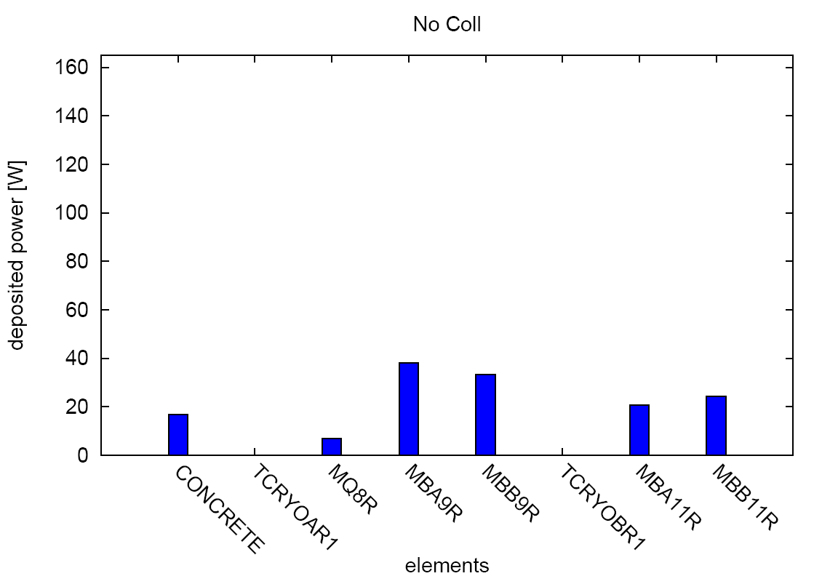
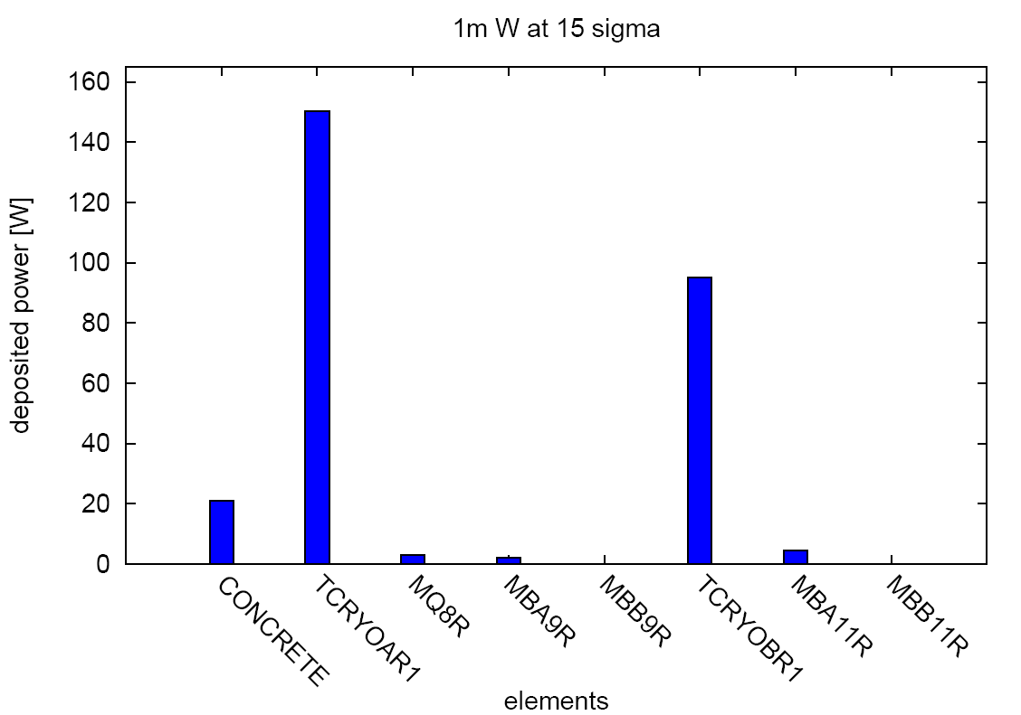
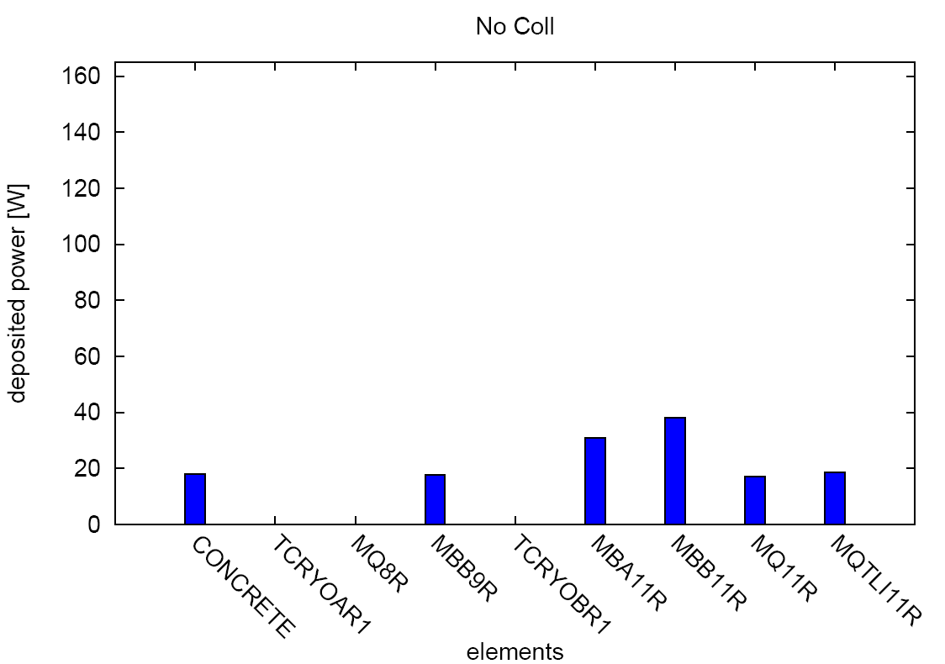
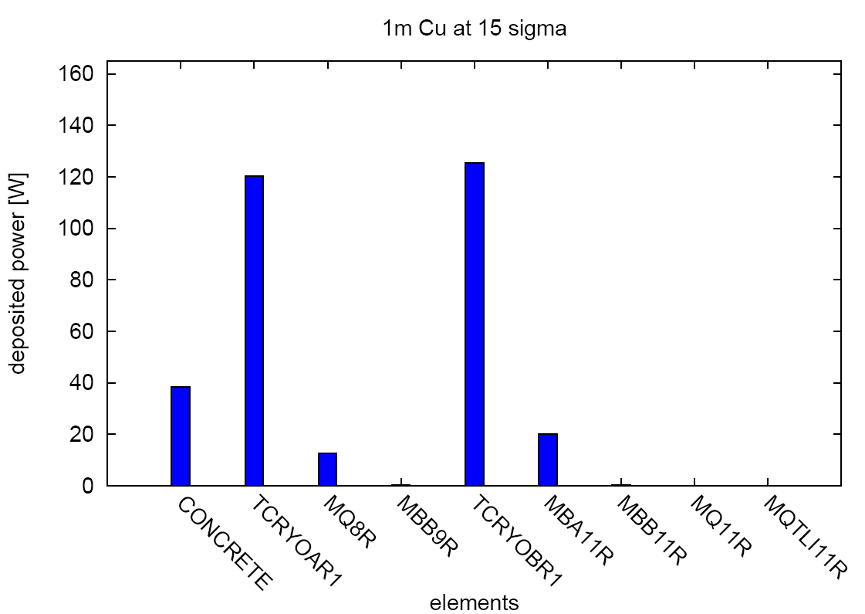
Impact of the DS-collimator
Power Impacting on the DS (IR7)
protons, no DS coll.
protons, DS coll. in tungsten @15σ
from F. Cerutti (CDR LHC Phase II Collimation, April 2nd 2009)
Total power for 7 TeV, nominal LHC 0.2h beam lifetime scenario
171 W
277 W
Pb-ions, no DS coll.
Pb-ions, DS coll. in copper @15σ
161 W
327 W
14/06/11
V.Boccone - Collimator Review 2011
4

Slide 5
Impact of the DS-collimator
A recall to the conclusions of 2009
For the LHC proton beam, the addition of the TCLDs is expected to decrease the predicted peak power in the superconducting coils of the DS magnets by a factor from 5 (1m copper jaws) to 15 (1m tungsten jaws), which is critical for quench occurrence;
The total load on the cold magnets is decreased as well;
The benefits are not strongly dependent on the TCLD aperture (provided that it is not too large);
The reduction is even more significant for the lead beam (a factor of 10 with 1m Cu jaws);
Possible issues:
The 2009 loss maps (IR7) was only including protons SD from the horizontal TCP;
The 2011 loss maps (IR3) show a non negligible contribution of vertical component.
14/06/11
V.Boccone - Collimator Review 2011
5

Slide 6
Few consideration about the May 8th/9th MD
For a detailed analysis, description and discussion of the May 8th/9th MD
D.Wollman “Collimation setup and performance” (morning session);
A.Rossi “Proton beam performance with and without IR3 upgrade” (about an hour ago).
MD was on beam2 and (DS.left) but we have only the loss maps for beam1 (DS.right).
Question we try to answer only using FLUKA and the collimator loss map from SixTrack:
Where do we lose the protons?
Which was the power deposited on the magnets?
Are we compatible with the non quench scenario?
Quenching limits assumptions (MB/MQ)?
3.5 TeV (I=6 kA) P_{peak}≈ 41 mW/cm³;
7 TeV (I=12 kA) P_{peak}≈ 15 mW/cm³;
Estimated through the results of heat transfer measurements, in case of localized and distributed loss (courtesy of P.P. Granieri and E. Todesco).
from P.P. Granieri
14/06/11
V.Boccone - Collimator Review 2011
6

Slide 7
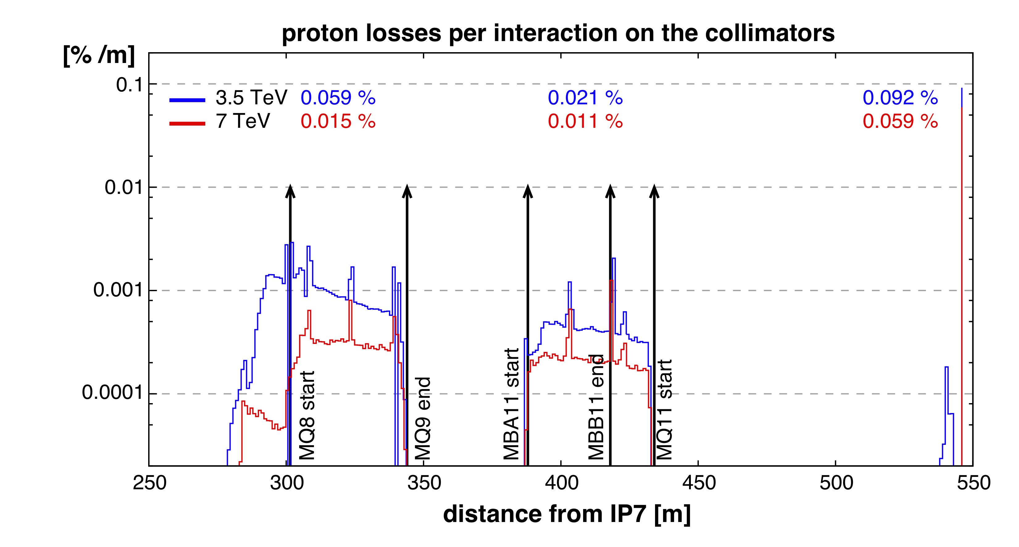
Proton loss pattern in IR7 DS.R
Few consideration about the May 8th/9th MD (2/5)
FLUKA tracking from the impact maps on the primary collimators (provided by SixTrack only horizontal halo):
E=3.5 TeV intermediate collimator settings (R. Bruce, Nov. 2010), 10 μm mean impact parameter in the TCP.C6L7.B1
E=7 TeV nominal (tight) collimator settings (Jul. 2009), 20 μm mean impact parameter in the TCP.C6L7.B1
protons lost in cell 8-9
protons lost in cell 11
protons exaping the DS
Very sensitive on
machine aperture
14/06/11
V.Boccone - Collimator Review 2011
7

Slide 8
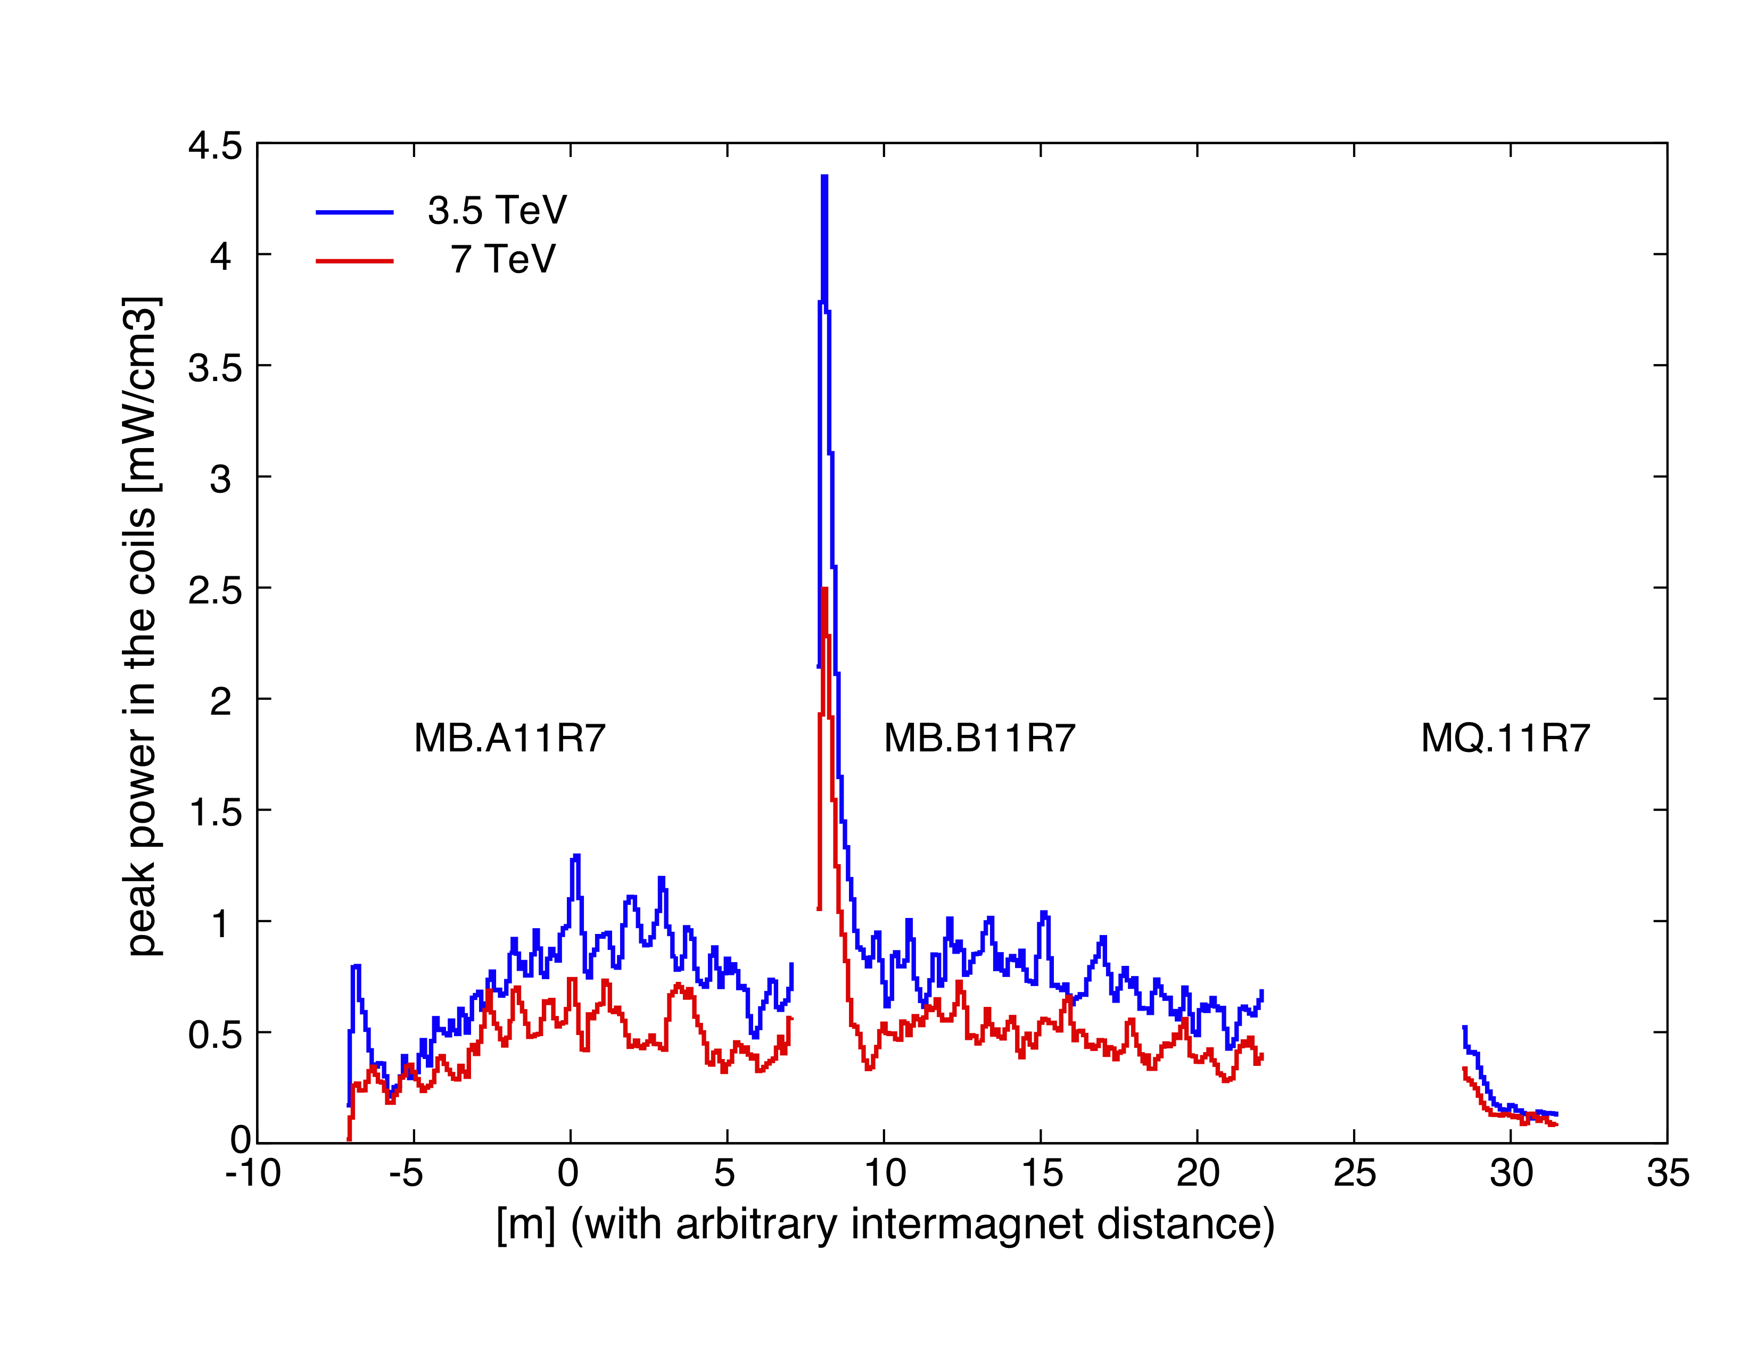
Peak Power profile in sector 11
Few consideration about the May 8th/9th MD (3/5)
Loss rate assumptions:
3.5 TeV: 9 10¹¹ p/s
7 TeV: 4.3 10¹¹ p/s (0.2h beam lifetime, nominal intensity)
averaged over the cable radial thickness (15mm)
Below quenching limits
14/06/11
V.Boccone - Collimator Review 2011
8

Slide 9
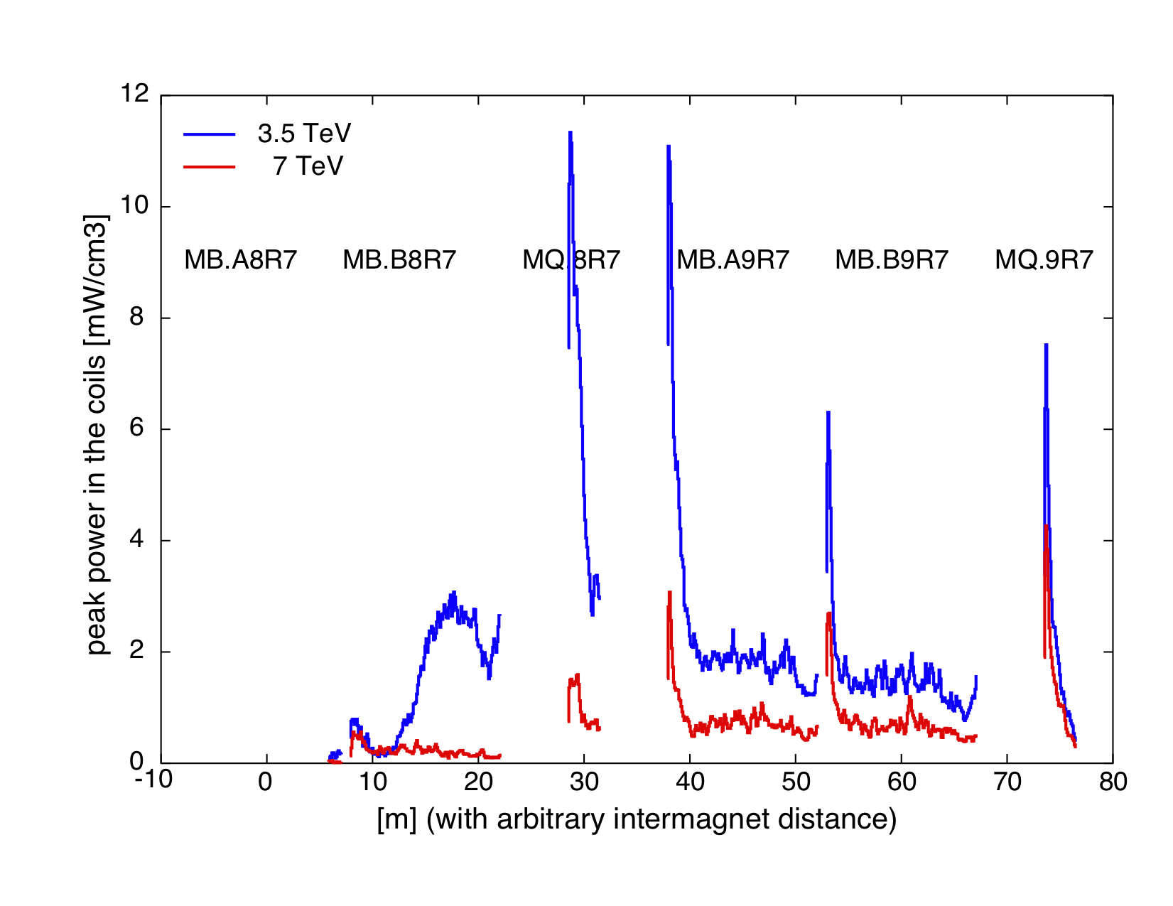
Peak Power profile in sector 8-9
Few consideration about the May 8th/9th MD (4/5)
Results are self consistent with previous simulation for IR7
Loss rate assumptions:
3.5 TeV: 9 10¹¹ p/s
7 TeV: 4.3 10¹¹ p/s (0.2h beam lifetime, nominal intensity)
averaged over the cable radial thickness (15mm)
Below quenching limits
14/06/11
V.Boccone - Collimator Review 2011
9

Slide 10
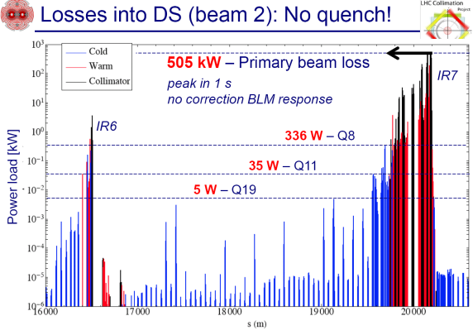
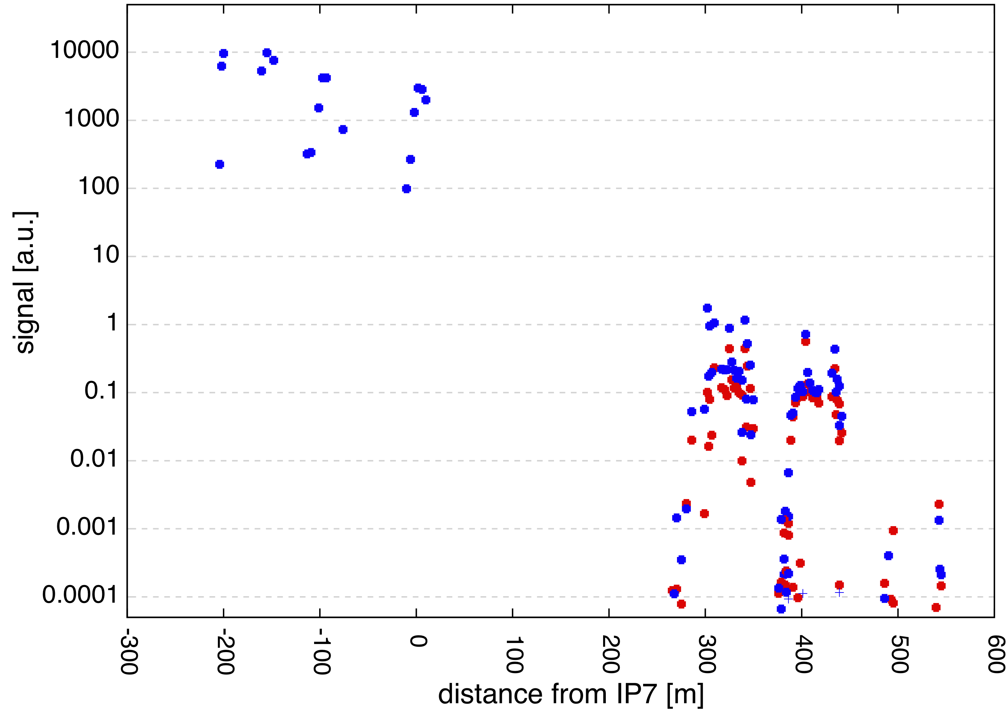
Losses in the DS and BLM pattern
Few consideration about the May 8th/9th MD (5/5)
Preliminary comparison (only local proton power deposition) between BLM pattern and Fluka calculation.
MD was on B2 (IR7 left) while we had loss maps only for B1 (IR7 right) => Possible issues with asymmetry in BLM positions.
Ratio (MD) LSS/Q8 ≈ 1.5 10³
Ratio (MD) LSS/Q11 ≈ 1.44 10⁴
BLM signal Ratio | MD 8th/9th May '11 | Fluka Calculations
LSS/Q11 | 1.44 10⁴ | 1.5 10⁴
LSS/Q8 | 1.5 10³ | 6.0 10³
Ratio (Fluka) LSS/Q8 ≈ 0.6 10⁴
Ratio (Fluka) LSS/Q11 ≈ 1.5 10⁴
Loss rate assumptions:
3.5 TeV: 9 10¹¹ p/s
7 TeV: 4.3 10¹¹ p/s (0.2h beam lifetime, nominal intensity)
The difference for Q8 is explained by the asymmetry of the BLM position and by the secondary particles leaking from the LSS (not considered in this preliminary results because of the short timescale of the simulation)
cell
8 - 9
cell
11
14/06/11
V.Boccone - Collimator Review 2011
10

Slide 11
Conclusion
We recall the results of the DS-collimator simulation for the IR7 case. The addition of the TCLDs is expected to decrease the predicted peak power in the superconducting coils of the DS magnets up to a factor of 15 (1m tungsten jaws).
Peak power is below (but not far from) the quench limit. The 1.5 factor for the ultimate intensity does not change the picture.
Few consideration about the May 8th/9th MD:
  Simulated peak power in the elements of cell 8-9 and cell 11 were below the quenching limits for the MD at 3.5 TeV and for the 0.2h scenario at 7 TeV;
  Preliminary comparison of the BLM loss pattern with the one measured in the MD.
14/06/11
V.Boccone - Collimator Review 2011
11

Slide 12
BACKUP
SLIDES
14/06/11
V.Boccone - Collimator Review 2011
12

Slide 13
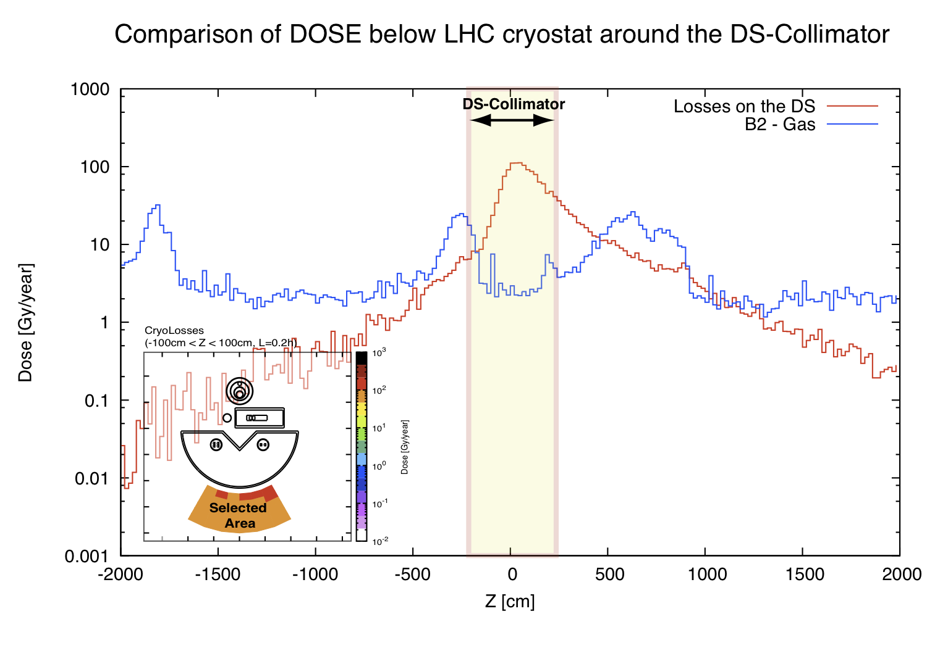
Dose on the tunnel floor
Peak power deposition on the superconductive BB links
QPS possible
locations
Information needed for the relocation of the QPS
14/06/11
V.Boccone - Collimator Review 2011
13

Slide 14
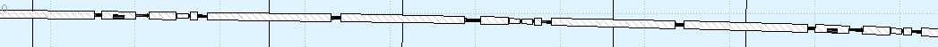
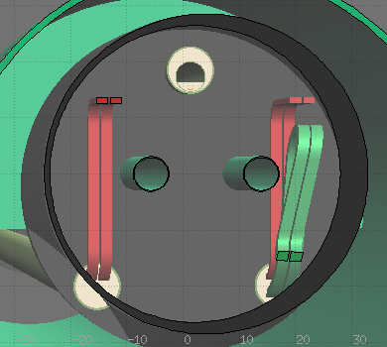
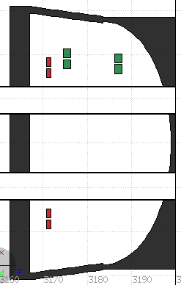
TCLD model in the IR3 layout
Peak power deposition on the superconductive BB links
Portion of the DS.R3
MB.B8
MQ.8
MB.A9
MB.9
MQ.9
MB.A10
MB.B10
MQ.10
TCLD.8
TCLD.10
Loading protons at the entrance of the collimator (proton map from SixTrack simulation by A.Rossi D.Wollmann)
The new DS-collimator optics (IR3) layout for the was implemented
The TLCD FLUKA model includes the BB rerouting in the cryogenic bypass (very close to Beam Pipe);
Implement a virtual BB rerouting in front of the MQ downstream the TCLD collimator;
TLCD Collimators opened at 15 sigma;
Two loss maps corresponding to the interaction of the horizontal and vertical primary collimators;
M1
M3
M2
M1
section at
beam height
M3
Beam 1
≈ 4 cm
M2
Calculation are ongoing.
14/06/11
V.Boccone - Collimator Review 2011
14

Slide 15
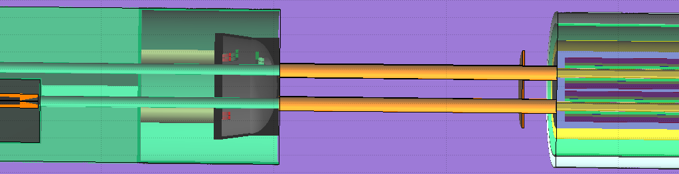
Details of the geometry
Peak power deposition on the superconductive BB links
BB Rerouting
Virtual BB
Impacted Jaws
Coils of the MQ
14/06/11
V.Boccone - Collimator Review 2011
15

Slide 16
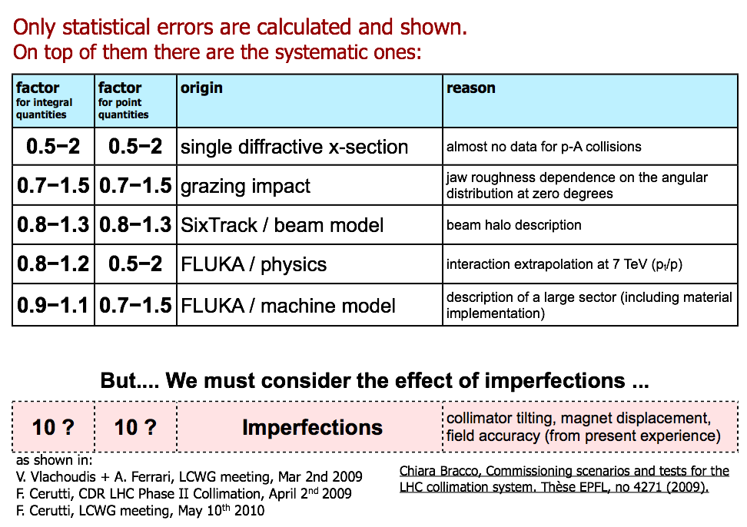
Uncertainties
V.Boccone, Review of Proposed LHC Collimation Work in DS for 2012
14/06/11
V.Boccone - Collimator Review 2011
16

Slide 17
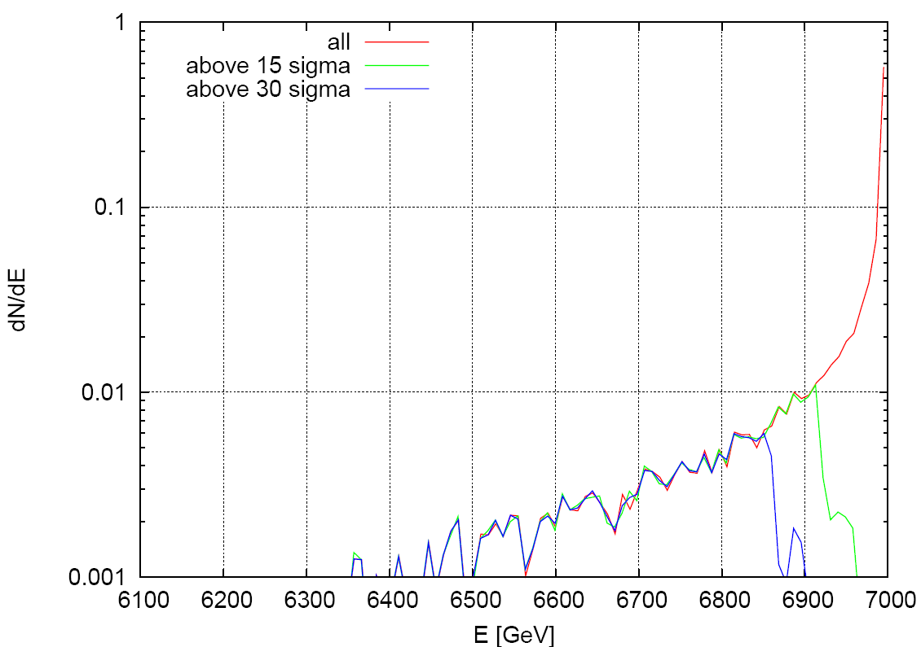
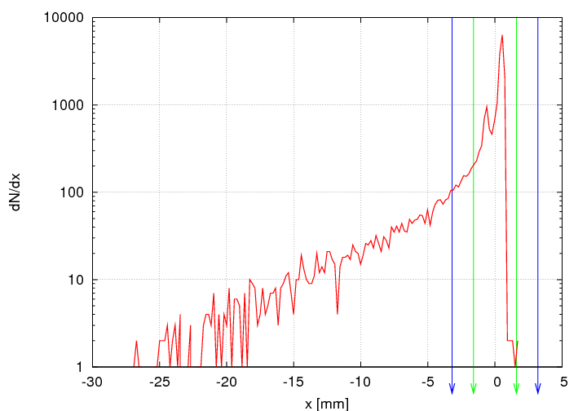
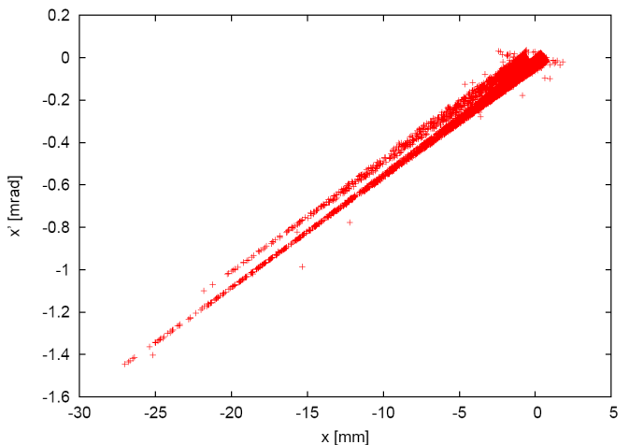
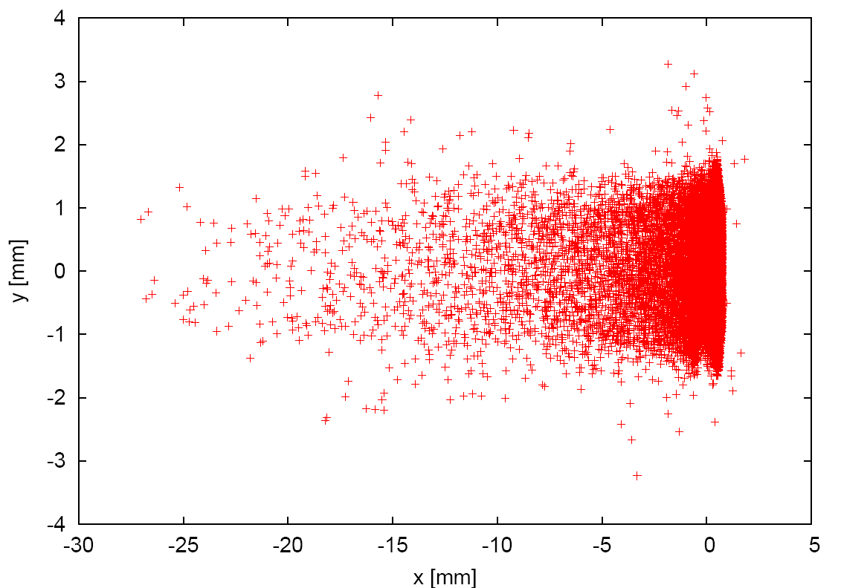
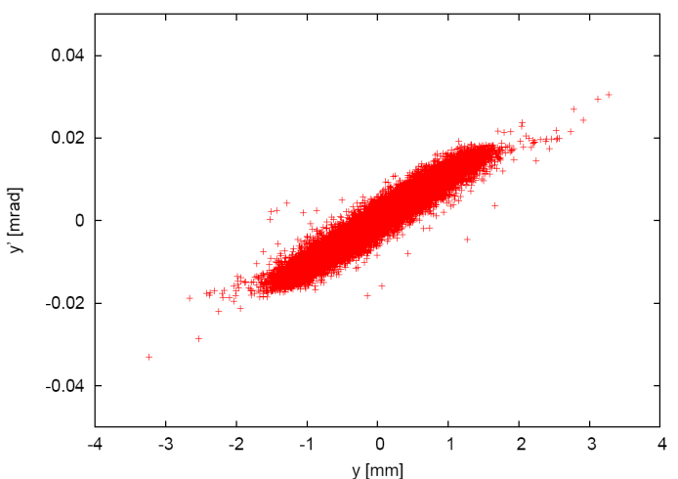
Beam Halo (protons)
Slide from: F. Cerutti, LCWG meeting, May 10th 2010
at the entrance of TCRYO.AR7.B1
132 (→179) W
[→ correction by FLUKA]
91 (→128) W
16% (→ 23%) above 15 sigma
11% (→ 16%) above 30 sigma
CDR LHC Phase II Collimation,
April 2nd 2009
[T. Weiler]
14/06/11
V.Boccone - Collimator Review 2011
17

Slide 18
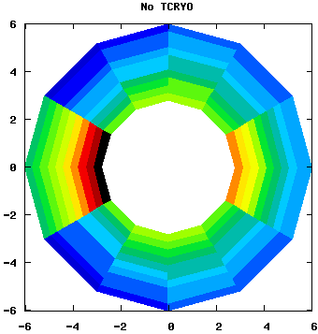
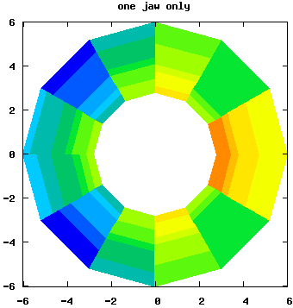
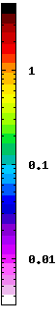
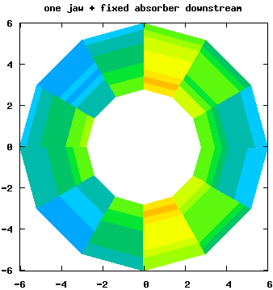
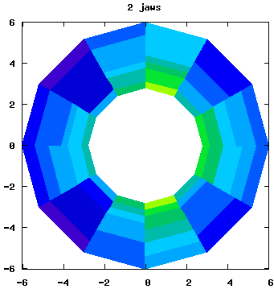
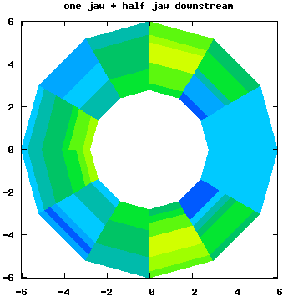
Power deposition in the MQ.8R7.B1 coils
Slide from: F. Cerutti, LCWG meeting, May 10th 2010
z = 290-300cm
z = 10-20cm
[being z
the distance from
the magnet front face]
for 0.2h beam lifetime
[mW/cm³]
5.0
1.1
y [cm]
x [cm]
z = 0-10cm
z = 0-10cm
0.76
z = 0-10cm
0.30
0.39
TCRYO jaw:
1m tungsten @ 15 sigma
10cm x 20cm transverse section
2cm x 3cm transverse section
14/06/11
V.Boccone - Collimator Review 2011
18

Slide 19
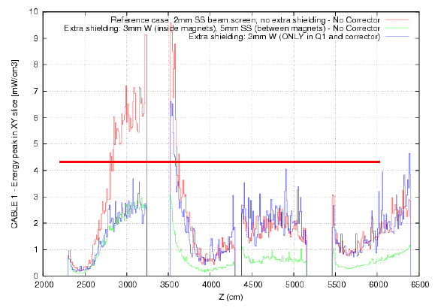
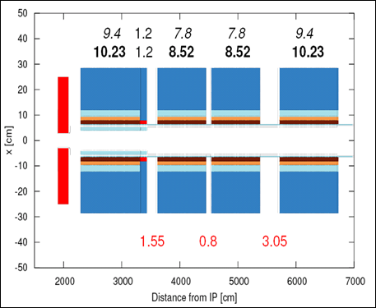
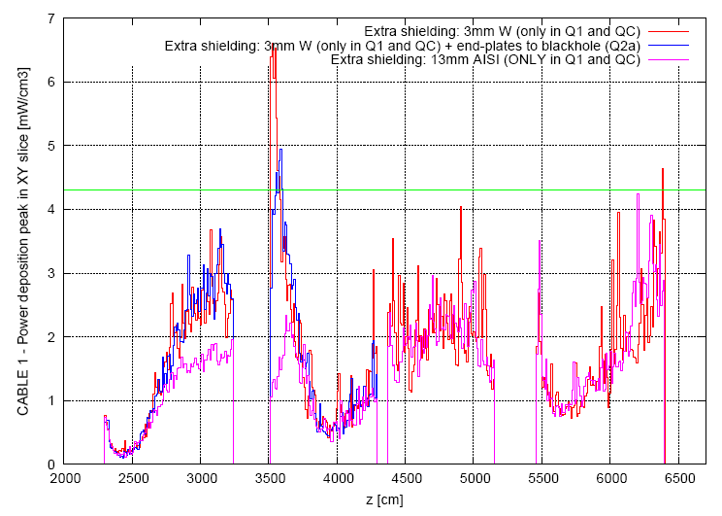
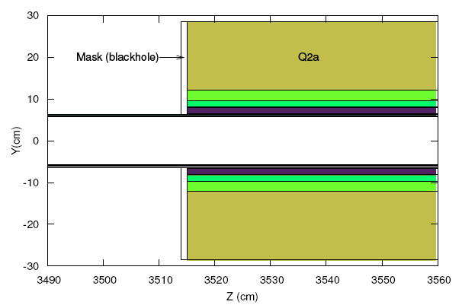
Shielding options
Slide from: F. Cerutti HL-LHC Kick of internal meeting, April 11th 2011
ideally a continuous liner (here 3mm tungsten, green curve) is quite effective
L=2.5L₀
130mm coil aperture
the role of the interconnections! jump at the Q2a front face with liner limited to the first element, blue curve
Q1
Q2a
Q2b
Q3
as an alternative, a thick liner in Q1 (here 13mm stainless steel, purple curve) casting a shadow over Q2a
assumed as totally absorbing! blue curve
Q2a
Q2b
Q3
Q1
end plates of limited help
14/06/11
V.Boccone - Collimator Review 2011
19

Slide 20
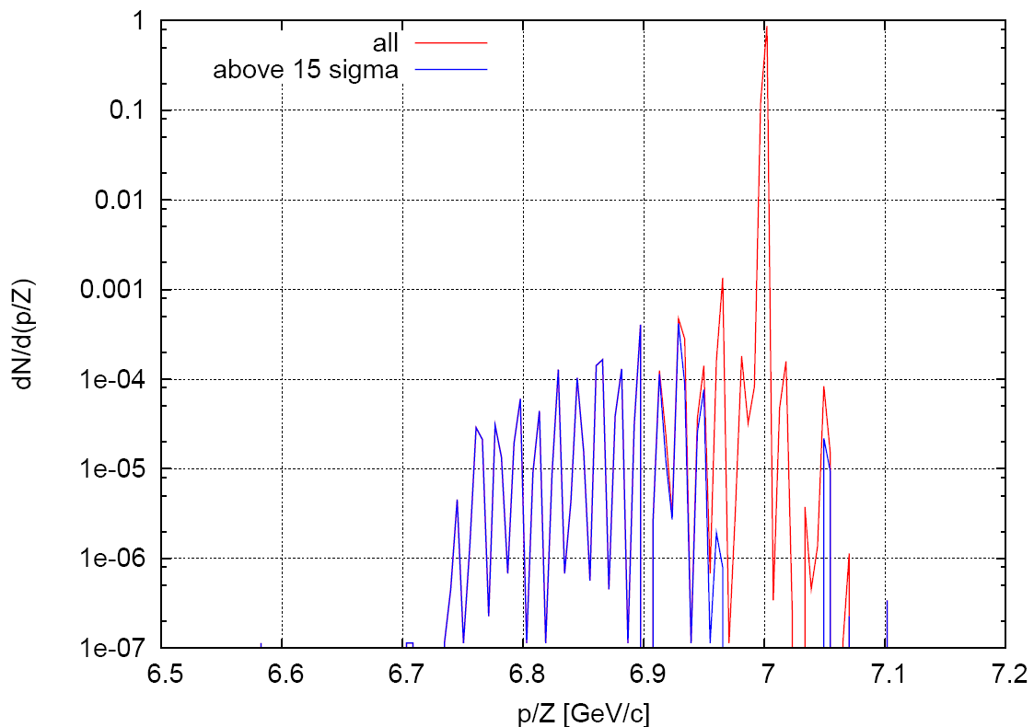
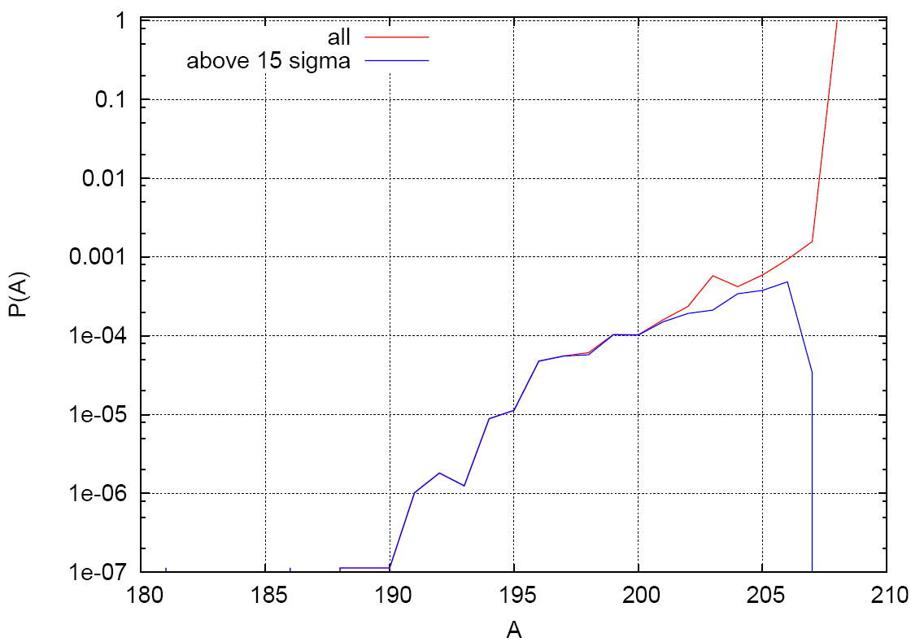
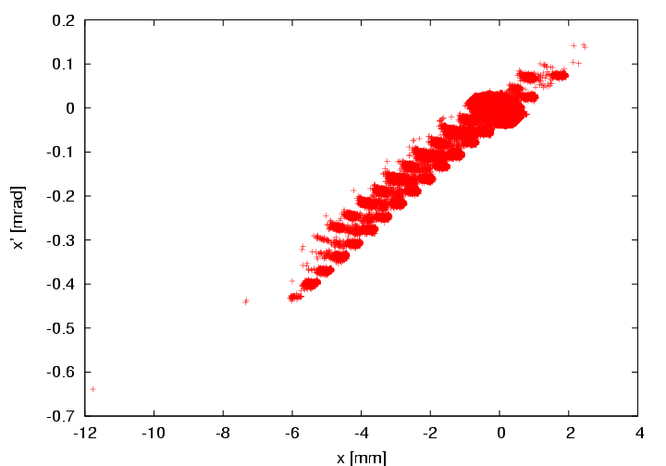
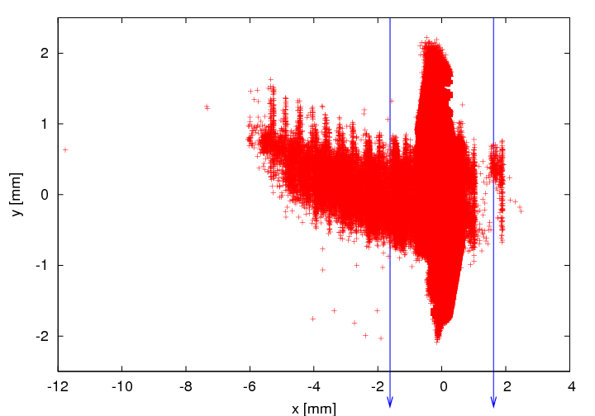
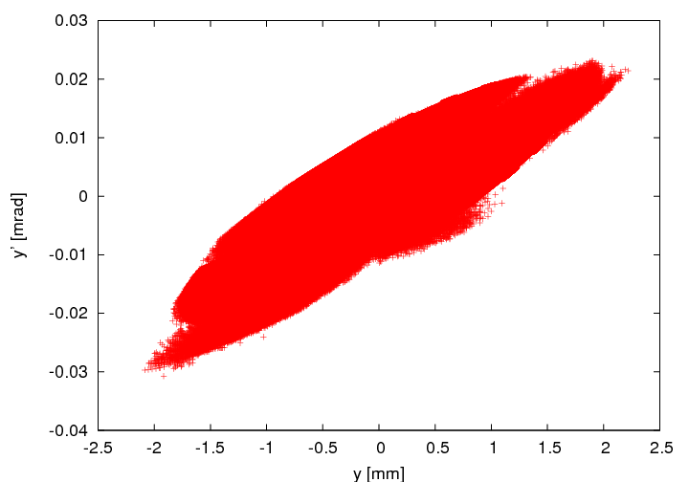
The Pb beam Halo
Slide from: F. Cerutti, LCWG meeting, May 10th 2010
at the entrance of TCRYO.AR7.B1
0.22%
above 15 sigma
175 W
CDR LHC Phase II Collimation,
April 2nd 2009
2.6 W
[ at the entrance
of TCRYOB
161 W ± 2%
22.5 W ± 6% ]
[G. Bellodi]

Slide 21
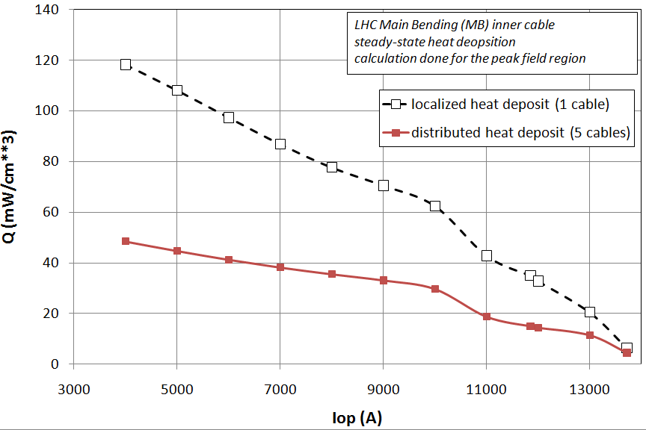
MB Quench Limit
Slide from P.P. Granieri - MB quench limit and stability
The steady-state heat deposit the MB cables can withstand is estimated through the results of heat transfer measurements, in case of localized and distributed loss
The driving mechanism is indeed the heat transport through the cable electrical insulation. (Slightly) conservative assumptions are considered to account for the differences between the experimental setup and the real magnet
The considered heat deposit is
uniform in the cable cross-section, as
well as in the longitudinal direction
Further analyses are ongoing to
model the heat flux distribution in
the coil, thus allowing to improve
the quench limit estimation
14/06/11
V.Boccone - Collimator Review 2011
21

Slide 22
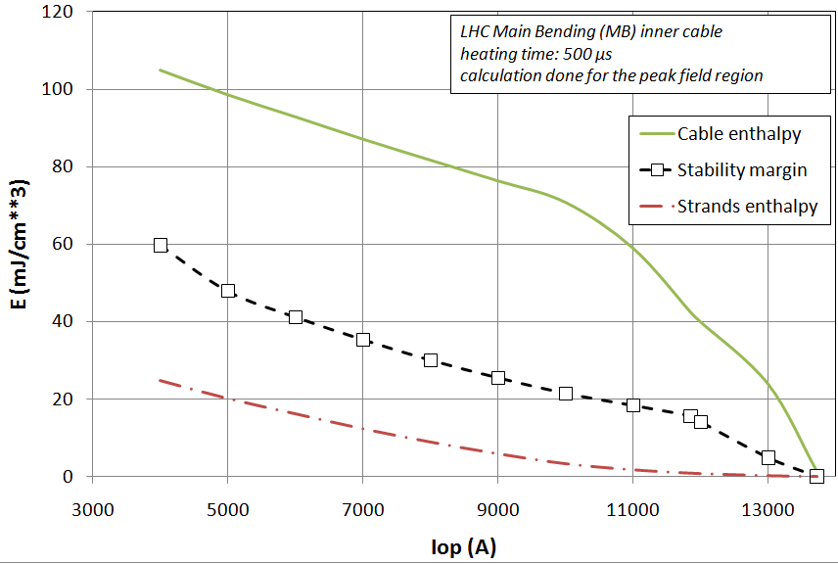
MB Stability
Slide from P.P. Granieri - MB quench limit and stability
The stability of the MB cables with respect to transient heat deposit is estimated through numerical calculation
The mechanism that confers stability is the transient heat transfer between strands and helium in the cable. Hence the model pays particular care to its definition, considering the different helium phases
Strands and cable enthalpy represent
lower and upper limit for stability
The considered heat deposit is uniform
in the cable cross-section, as well as in
the longitudinal direction
Experimental tests would be needed to
obtain a deeper insight of the stability
underlying mechanisms
14/06/11
V.Boccone - Collimator Review 2011
22

