Slide 1


Application of TRACCC seeding to the CEPC vertex detector
YiZhou Zhang¹, WeiDong Li¹, Xiaocong Ai², Tao Lin¹
zhangyz@ihep.ac.cn
1. The Institute of High Energy Physics, IHEP, China
2. Zhengzhou University, ZZU, China
ACTS Developers Workshop 2024
Vaud, Switzerland
18th Nov 2024

Slide 2
2
1
Introduction
2
Integration of TRACCC with CEPCSW
3
Geometry & EDM
Outline
4
Extension of seeding algorithm
5
Performance
6
Summary & Plan

Slide 3
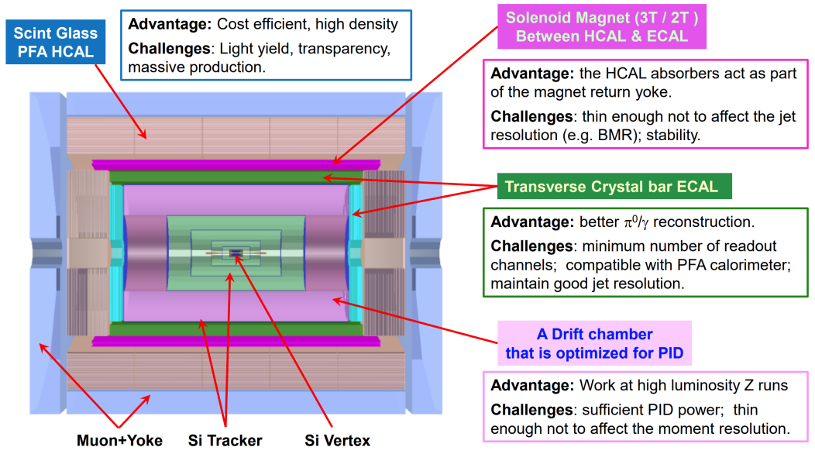
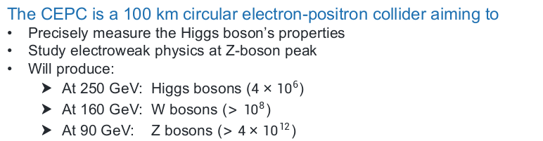
1
3
Introduction
Circular Electron Positron Collider (CEPC)
The CEPC is a 100 km circular electron-positron collider aiming to
Precisely measure the Higgs boson’s properties
Study electroweak physics at Z-boson peak
Will produce:
  At 250 GeV: Higgs bosons ($4×{10}^{6}$)
  At 160 GeV: W bosons ($>{10}^{8}$)
  At 90 GeV: Z bosons ($>4×{10}^{12}$)
The conceptual design report (CDR) has been completed in Oct. 2018.
High track efficiency (~100%)
High momentum resolution (~0.1%)
The 4th conceptual detector was proposed on the basis of the CEPC CDR
is characterized by a combination of silicon detectors and drift chamber designed to provide both tracking and PID for charged particles
Schematic view of CEPC‘s 4th Concept Detector
Notes:
Pile-up of multiple events: High-energy collisions generate numerous events, increasing the complexity of data processing.
High beam background (Z energy region): The background noise from high-energy collisions, especially in the Z energy region, affects data accuracy.
High data acquisition rate: The system needs to handle a massive amount of data per second, demanding exceptional data acquisition and processing capabilities.
Large number of hits per event: Each event produces a significant number of hits, posing a high demand on track recognition and resulting in substantial computational load.
Multi-environment algorithm operation: The same reconstruction algorithm must operate both offline and in the online Event Filter environment, adding to its complexity.
Heterogeneous computing/parallelization: To meet CEPC’s computational demands, heterogeneous computing and parallelization techniques are required.

Slide 4
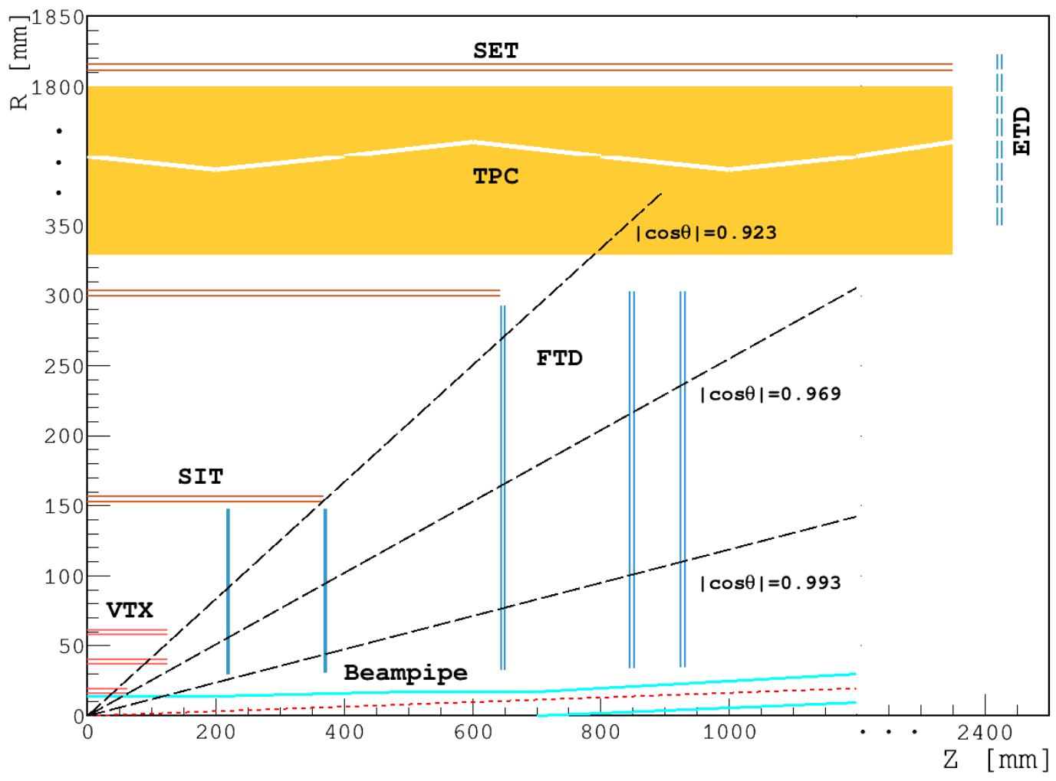
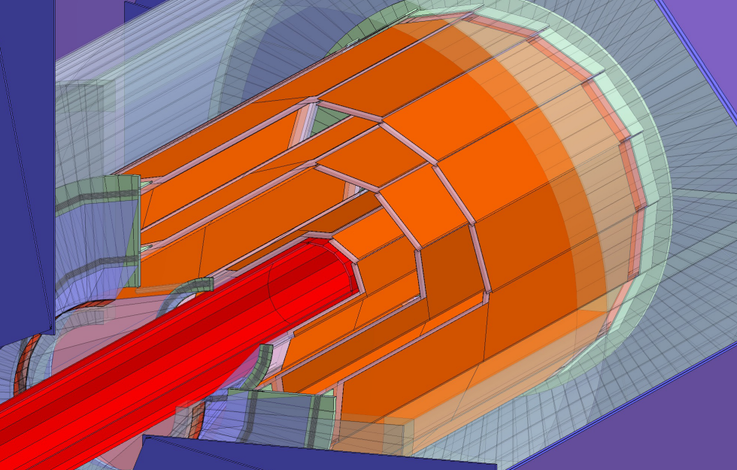
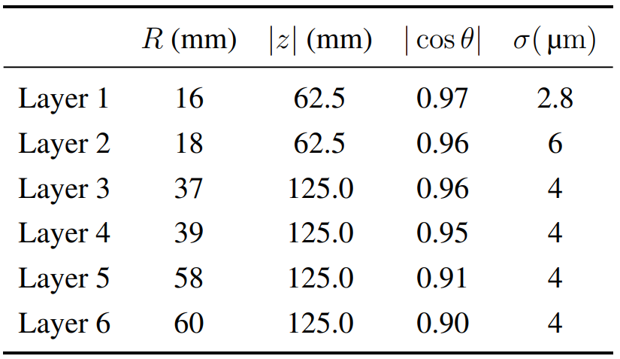
1
4
Introduction
Vertex Detector of CEPC
CEPC Vertex Detector
is the innermost tracker playing a dominant role in determining the vertices of a collision event.
Covers:
  radial range from 16 mm to 60 mm
  Z range from -125mm to 125mm
The baseline layout of the Vertex Detector consists of
6 concentric cylindrical layers of high spatial resolution silicon pixel sensors.
Two layers of silicon pixel sensors are mounted on both sides of each of three ladders to provide 6 space points.
Schematic view of CEPC Vertex Detector
Only the silicon sensor sensitive region (in orange) is depicted.
The vertex detector surrounds the beam pipe (in red).
Layers of CEPC Vertex Detector
Layout of the CEPC baseline tracker
The VTX is located closest to the interaction point.
Notes:
Pile-up of multiple events: High-energy collisions generate numerous events, increasing the complexity of data processing.
High beam background (Z energy region): The background noise from high-energy collisions, especially in the Z energy region, affects data accuracy.
High data acquisition rate: The system needs to handle a massive amount of data per second, demanding exceptional data acquisition and processing capabilities.
Large number of hits per event: Each event produces a significant number of hits, posing a high demand on track recognition and resulting in substantial computational load.
Multi-environment algorithm operation: The same reconstruction algorithm must operate both offline and in the online Event Filter environment, adding to its complexity.
Heterogeneous computing/parallelization: To meet CEPC’s computational demands, heterogeneous computing and parallelization techniques are required.

Slide 5
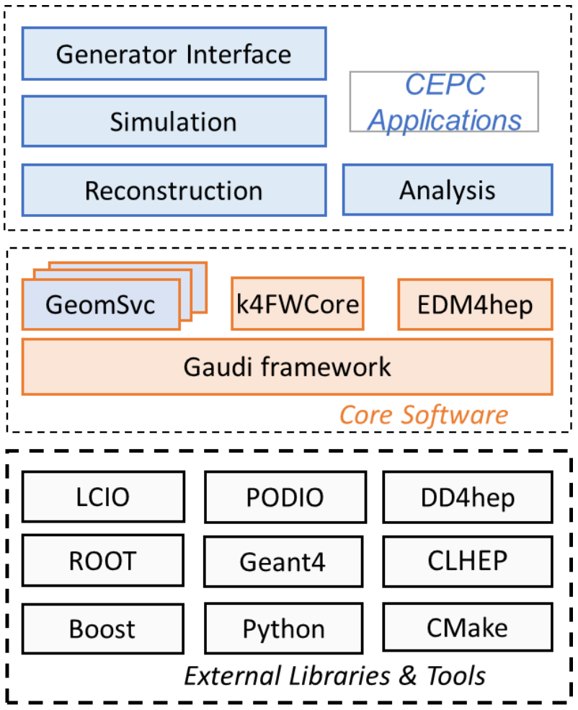
1
5
Introduction
CEPC software (CEPCSW) environment
CEPCSW is organized as a multi-layer structure
Applications: simulation, reconstruction and analysis
Core software
External libraries
The key components of core software include:
Gaudi/Gaudi Hive: defines interfaces to all software components and controls their execution
EDM4hep: generic event data model
k4FWCore: manages the event data
DD4hep: geometry description
CEPC-specific components: GeomSvc, detector simulation, beam background mixing, fast simulation, machine learning interface, etc.
https://code.ihep.ac.cn/cepc/CEPCSW

Slide 6
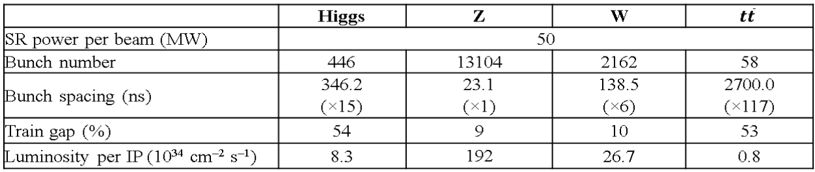
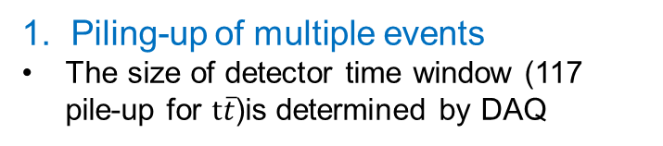
1
6
Introduction
Challenges for tracking in the CEPC Vertex Detector
1. Piling-up of multiple events
The size of detector time window (117 pile-up for $t\overline{t}$)is determined by DAQ
2. High beam-related background
particularly in Z energy region
Requirements: Physical Event Rate
Reuse of offline tracking algorithm for the purpose of online high level trigger
Same rec algorithm: offline environment & online Event Filter
Conclusion:
huge # of hits & background / event:
  high demand on track recognition
  substantial computational load
→ heterogeneous computing (e.x. TRACCC) and parallelization techniques are required.
* This contribution mainly focuses on:
  the implementation of seeding algorithm for the vertex detector (VTX), based on TRACCC, in the CEPCSW environment.
Notes:
* Each event has a significant number of hits, posing a high demand on track recognition and resulting in substantial computational load.
* The same reconstruction algorithm needs to be executed in both offline environment and in the online Event Filter which bringsmore complexity.
* To meet CEPC’s computational demands, heterogeneous computing and parallelization techniques (e.x. TRACCC) are required.
This contribution mainly focuses on the implementation of seeding algorithm for the VTX detector, based on TRACCC, in the CEPCSW environment.

Slide 7
7
1
Introduction
2
Integration of TRACCC with CEPCSW
3
Geometry & EDM
Outline
4
Extension of seeding algorithm
5
Performance
6
Summary & Plan

Slide 8
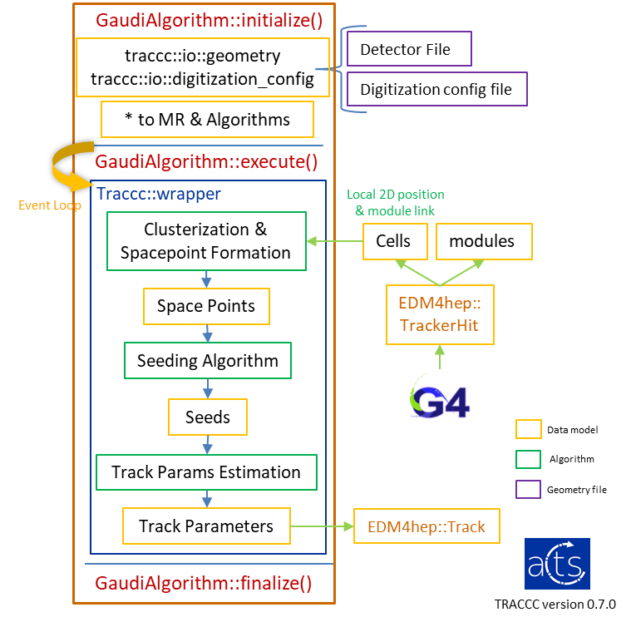
2
8
Integration of TRACCC with CEPCSW
Implement a Gaudi algorithm for seeding
Initialize():
  Read the detector file and digitization config file
  Initialize the memory resource and the algorithms
Execute():
  For each event, read hits and run the algorithms
    EDM4hep::TrackerHit is converted to Cells & modules
    👆 will only converted to Cells in TRACCC v0.16.0
  Since CEPCSW and TRACCC are using different compilers (Clang, GCC), respectively
    Develop a wrapper for TRACCC SYCL algorithms
  Algorithms includes:
    Clusterization & Spacepoint Formation (only CPU)
    Seeding Algorithm
    Track Params Estimation
Gaudi Algorithm using TRACCC reconstruction

Slide 9
9
1
Introduction
2
Integration of TRACCC with CEPCSW
3
Geometry & EDM
Outline
4
Extension of seeding algorithm
5
Performance
6
Summary & Plan

Slide 10
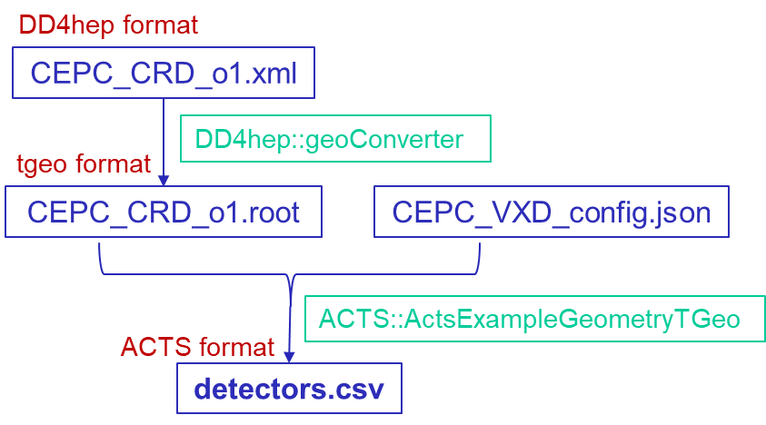
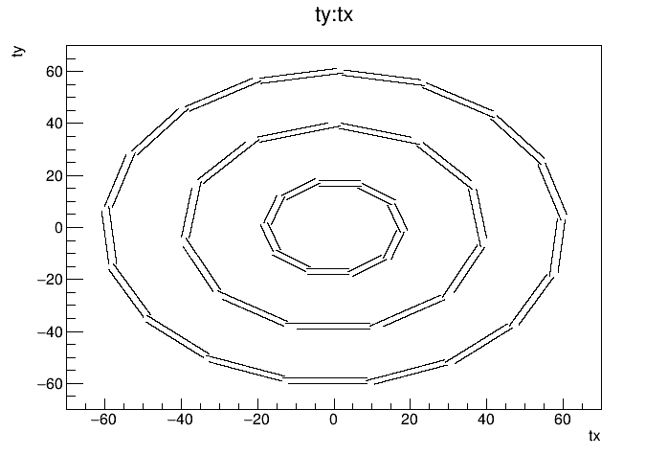
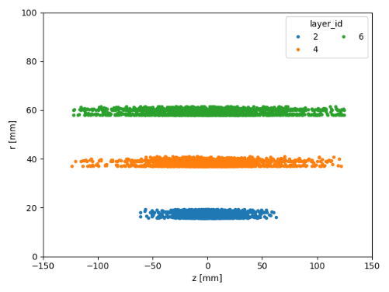
3
Geometry conversion
10
Geometry & EDM
Geometry are prepared using various ACTS tools
Convert the CEPC VTX geometry file (in DD4hep format) to TGeo format
The geometry file is translated into Acts::Surface objects using Acts::TGeoLayerBuilder, and is exported to a detector file by Acts::CsvTrackingGeometryWriter.
A digitization config file is written to provide the segmentation information of each surface.
Verification:
Use Fast ATLAS Track Simulation (FATRAS) & ACTS’ digitization tool to produce full simulation information and generate cells.
Gid of fatras of ACTS
X-Y projection of VTX

Slide 11
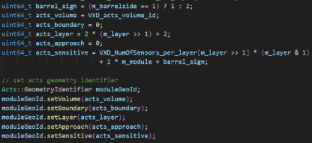
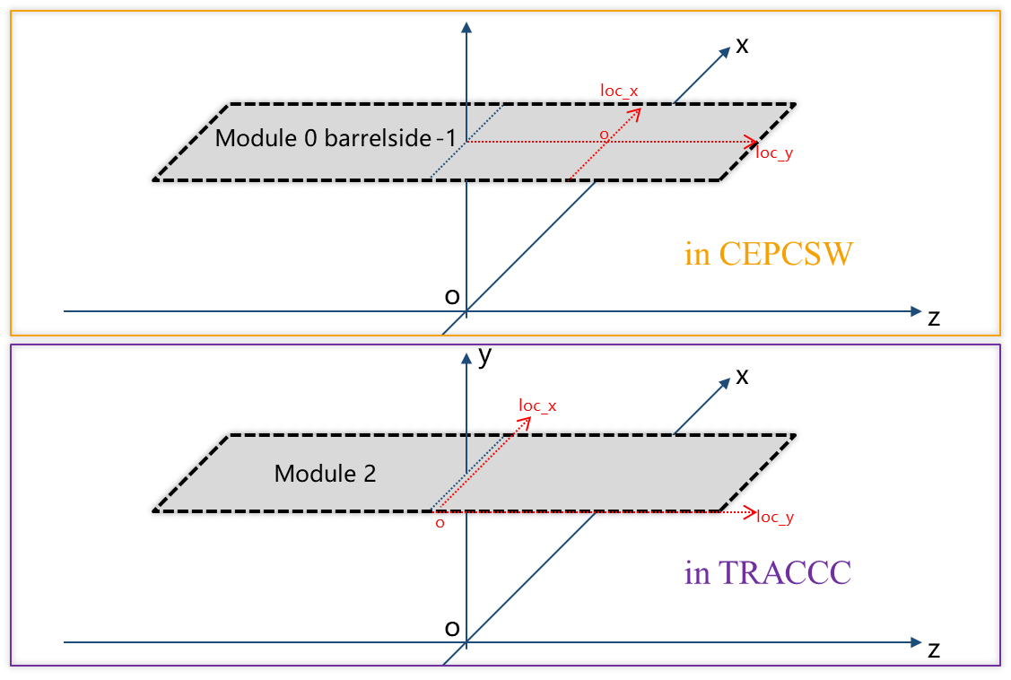
3
Data model conversion
11
Geometry & EDM
Cell ID conversion between EDM4hep & TRACCC
CEPCSW cell id needs to be converted into the TRACCC gid to retrieve correct geometry
Cells local position:
CEPCSW:
take center point as the origin
TRACCC
use the lower left corner as the origin.
So the cells’ local coordinates need to be modified.
CEPCSW cell id:
Layer: {0,1,2,3,4,5} # Indicate 6 layers from inside to outside
Module: { L0: 0-9, L1: 0-9, L2: 0-10, L3: 0-10, L4: 0-16, L5: 0-16}
# Indicate ladders in the φ direction
Sensor: 0
Barrelside: 1 for z > 0 else -1
# one ladders has 2 sensors separated by z
TRACCC gid:
Volume: {3}
Boundary: 0
Layer: {2, 4, 6} # adjacent layers are treated as the same layers
Approach: 0
Sensitive: {L2: 1-40, L4: 1-44, L6:1-68}
The sensitive counts from z>0 to z<0, then counts in φ direction (the order is same to CEPC), and then counts from inner to outer layers.
Converter for VXD gid
Adjust the local coordinates
for the difference between CEPCSW & TRACCC

Slide 12
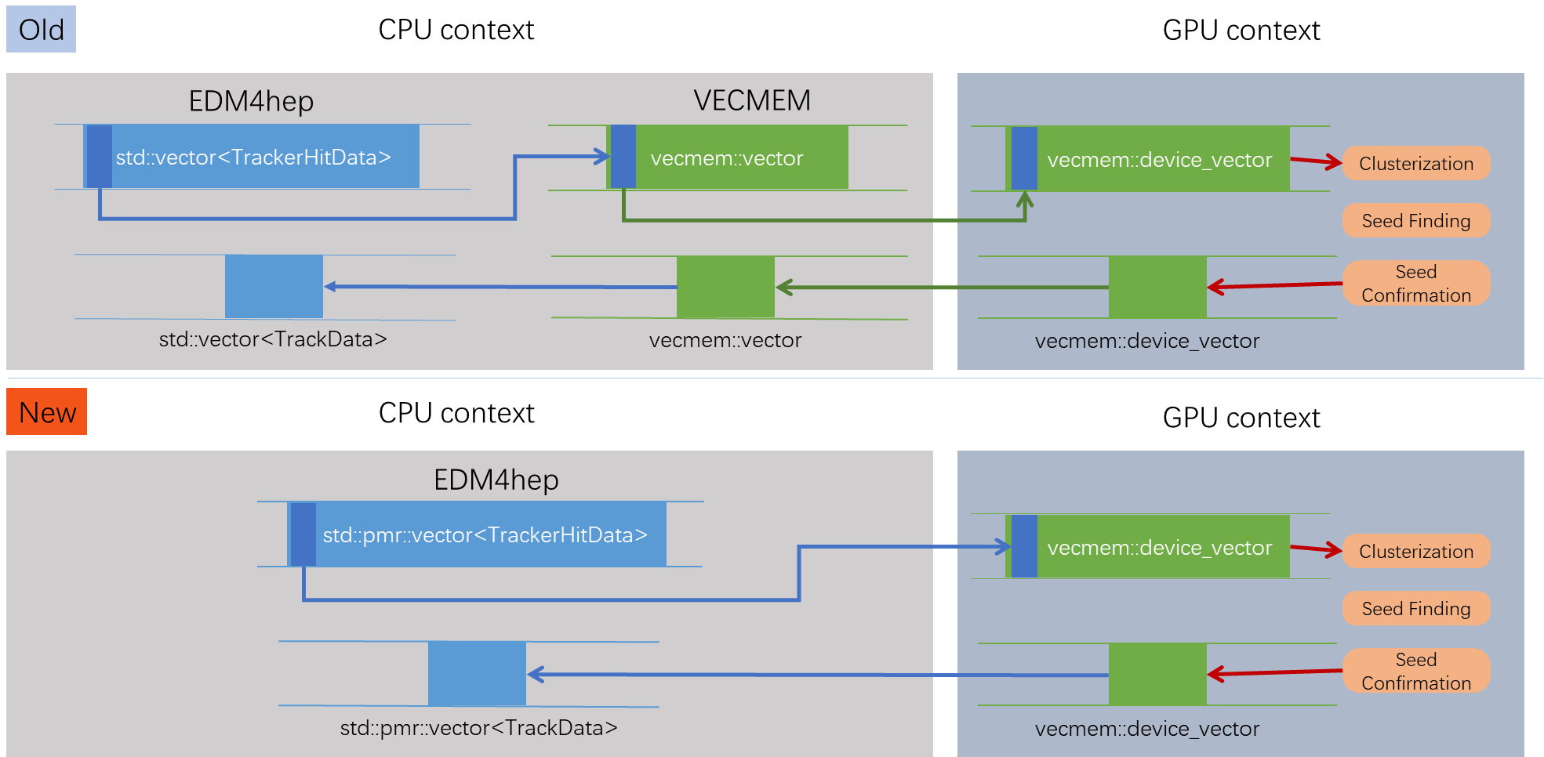
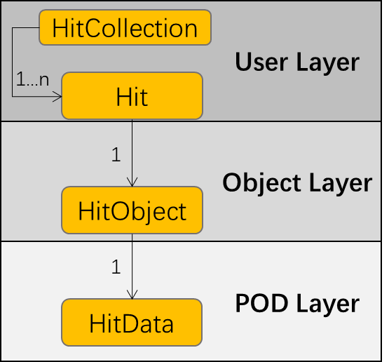
3
12
Geometry & EDM
Common memory for EDM4hep & VecMem
We want TRACCC to use hits data from EDM4hep directly !!
TRACCC uses VecMem as the vectorised data model across multiple device types.
EDM4hep and VecMem may use the same storage format (std::pmr::vector), so TRACCC can directly use the hit data with no data-copy.
Modified data transfer process
Modify the data storage format of PODIO
EDM4hep is generated by PODIO,
so we modify the DataContainer of PODIO.
Add Collection layer interfaces:
Add CollectionData layer interfaces:
Modify the DataContainer storage format (vector → pmr::vector)
Layout of the PODIO storage format
We add interfaces to get pmr::vector directly.

Slide 13
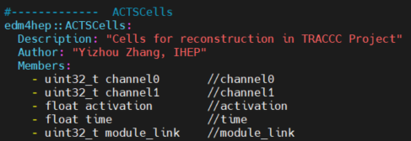
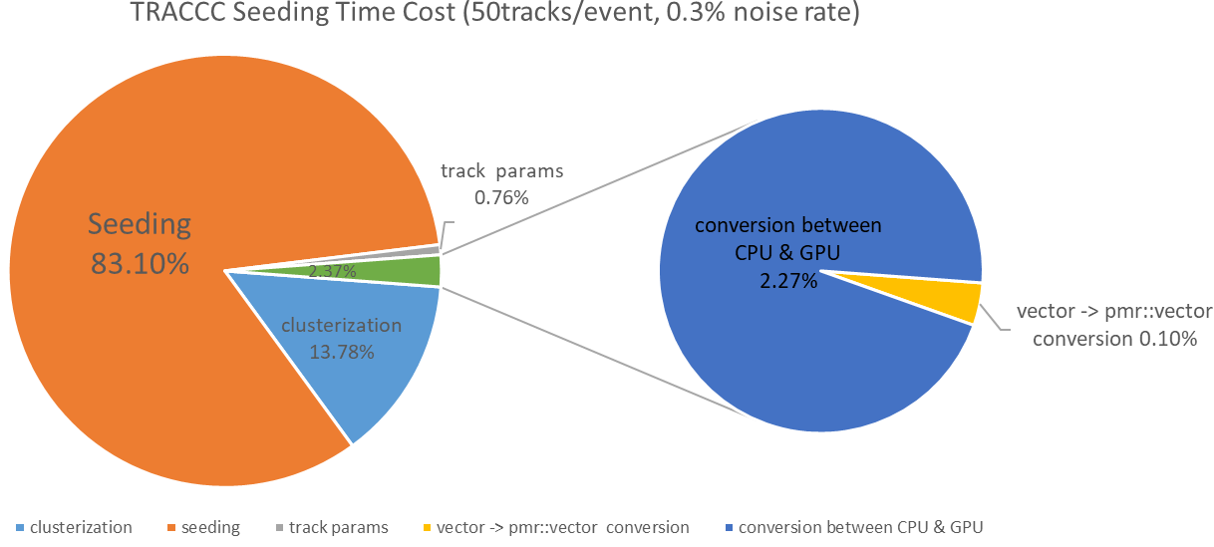
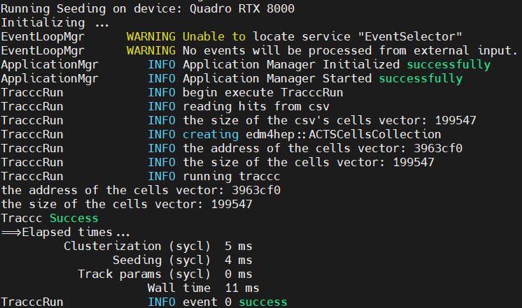
3
13
Geometry & EDM
Customized EDM4hep data collection
Define a data collection whose member is completely the same as the EDM of TRACCC
So we can directly use edm4hep::ACTSCells as the input of TRACCC.
Verification
Now TRACCC can directly read the simulated hits from Geant4 which is stored in EDM4hep format
No non-essential data-copy is needed
Modified edm4hep.yaml
In CEPCSW alg
×
In TRACCC alg
The address of pmr::vector does not changed.
Reduce time overhead of vector → pmr::vector conversion

Slide 14
14
1
Introduction
2
Integration of TRACCC with CEPCSW
3
Geometry & EDM
Outline
4
Extension of seeding algorithm
5
Performance
6
Summary & Plan

Slide 15
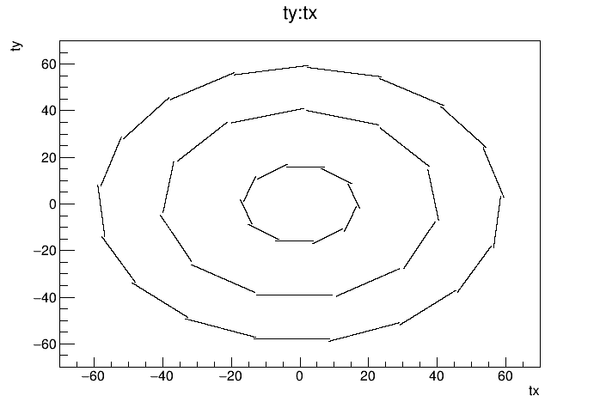
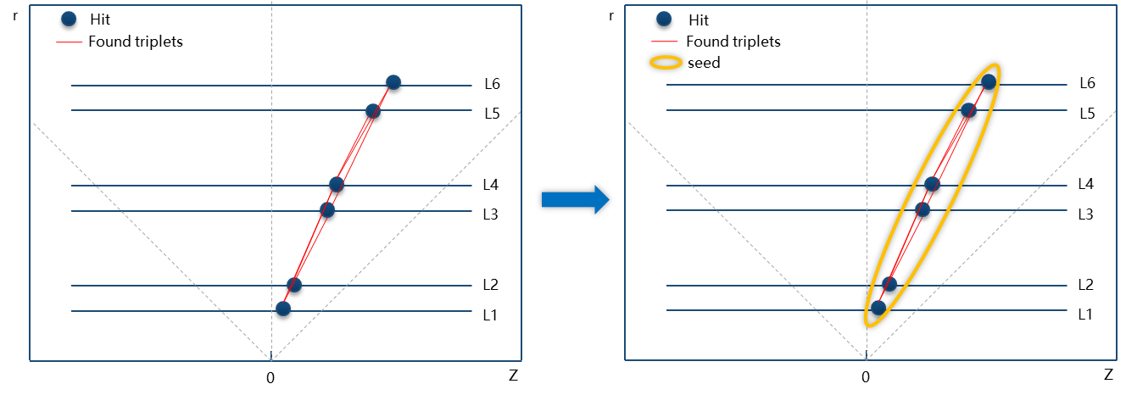
4
6-layers seeds finding
15
Extension of seeding algorithm
CEPC VTX detector:
Two sides of each layer have sensors
A single seed contains 6 space points
Default TRACCC seeding alg:
creates 3-space-point seeds
→ The seeding alg needs to be extended for 6-space-points case.
Seed Formation
Seed Formation Alg:
After seeding, combine the found triplets that sharing the same space-points into a “bigger” seed.
We have implemented Seed Formation algorithm in TRACCC
Notes:
The CEPC VTX detector has three layers and both sides of each layer are mounted with silicon pixel sensors.
To accommodate this specific detector structure, the default seeding algorithm in TRACCC, which creates three-space-points seeds, has been extended for six space points case

Slide 16
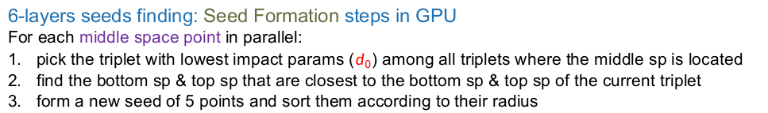
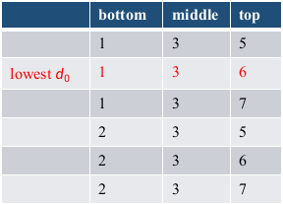
4
 | bottom | middle | top
 | 1 | 3 | 5
lowest $d_{0}$ | 1 | 3 | 6
 | 1 | 3 | 7
 | 2 | 3 | 5
 | 2 | 3 | 6
 | 2 | 3 | 7
16
Extension of seeding algorithm
r
In GPU
Example:
Paralleling for hit 3 👉
Hit
Found triplets
Paralleling middle sp
7
6
L6
5
L5
4
L4
3
L3
Bot_inner | Bot_outer | Mid_inner | Mid_outer | Top_inner | Top_outer
1 | 2 | 3 | 3 | 5 | 6
2
L2
1
L1
{1，2}
1.radius() < 2.radius()
{5，6} | {7, 6}
5.radius() < 6.radius()
0
Z
6-layers seeds finding: Seed Formation steps in GPU
For each middle space point in parallel:
pick the triplet with lowest impact params ($d_{0}$) among all triplets where the middle sp is located
find the bottom sp & top sp that are closest to the bottom sp & top sp of the current triplet
form a new seed of 5 points and sort them according to their radius
Notes:
(distance to the origin of coordinates)

Slide 17
4
17
Extension of seeding algorithm
In CPU
r
For hit 3 👇
Hit
Found triplets
Bot_inner | Bot_outer | Mid_inner | Mid_outer | Top_inner | Top_outer
1 | 2 | 3 | 3 | 5 | 6
middle sp
7
6
L6
5
L5
For hit 4 👇
＋
4
L4
Bot_inner | Bot_outer | Mid_inner | Mid_outer | Top_inner | Top_outer
1 | 2 | 4 | 4 | 5 | 6
3
L3
2
L2
1
L1
Bot_inner | Bot_outer | Mid_inner | Mid_outer | Top_inner | Top_outer
1 | 2 | 3 | 4 | 5 | 6
0
Z
{3，4}
3.radius() < 4.radius()
6-layers seeds finding: Seed Formation step in CPU
Iterate through all new 5-point seeds:
if two seeds have the same bottom sp & top sp, merge both into hexaplets (6-layer seeds)

Slide 18
18
1
Introduction
2
Integration of TRACCC with CEPCSW
3
Geometry & EDM
Outline
4
Extension of seeding algorithm
5
Performance
6
Summary & Plan

Slide 19
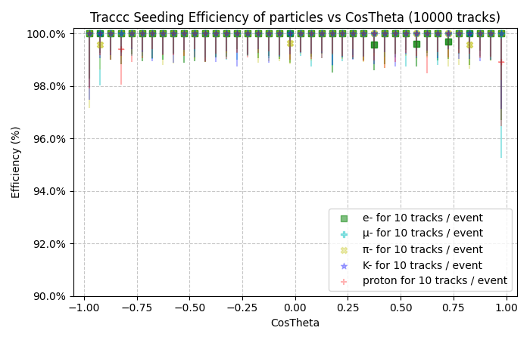
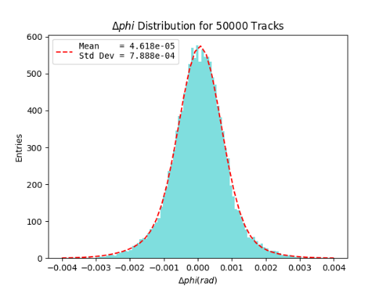
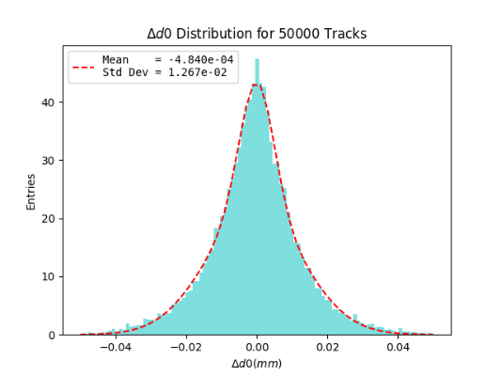
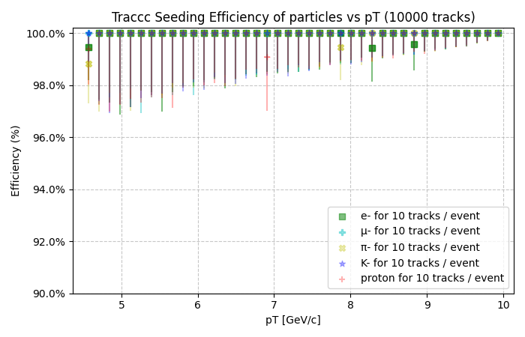
5
Seeding efficiency with different particles
19
Performance
Particle: mu-/pi-/e-/K-/proton Energy: 10 GeV
Number of events: 1000 Number of tracks per event: 10
Good seed: half space-points of the seed are from the same particle.
Pick tracks with polar angle |cosθ| < 0.921 to avoid boundary effects.
The seeding efficiency is above 99.5% without background for all types of particles
Resolution of d0/phi is as expected
Difference between rec and sim track param
Track parameters include d0, phi (particle: mu-)
Notes:
, especially for single µ-particles where the trajectory efficiency is close to 100%

Slide 20
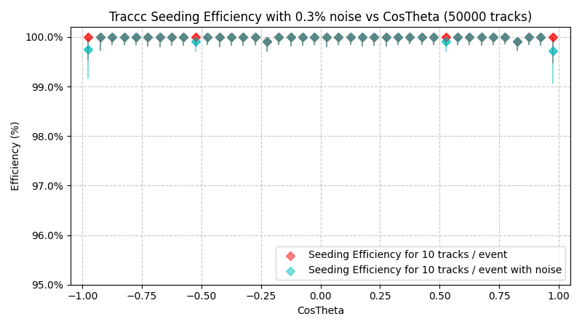
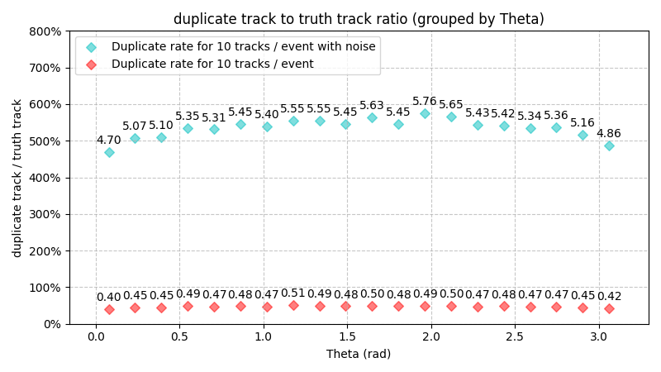
5
Performance
Seeding efficiency with background
20
Particle: mu- Energy: 10 GeV
Number of events: 5000
Number of tracks per event: 10
After adding 0.3% noise, reconstruction efficiency drops slightly.
  Reason for the decrease in efficiency: If the noise and hit are too close, they may be grouped in the same space-point during clustering, which may result in *wrong position* or *wrong particle id*.
Higher repetition rate after adding noise.
  Why no-noise case has ≈30% repetition rate: When processing the Seed Formation algorithm, if there are two triplets from the same track that do not share points at all, a duplicate seed is generated.
Notes:
Noise in the VTX comes from a variety of factors such as the detector itself and the beam background. Increasing noise will increase the difficulty of tracing, affect the hit efficiency and hit purity, and thus reduce the momentum resolution and spatial resolution. Therefore, it is very important to check the performance of trail reconstruction after mixing the background.

Slide 21
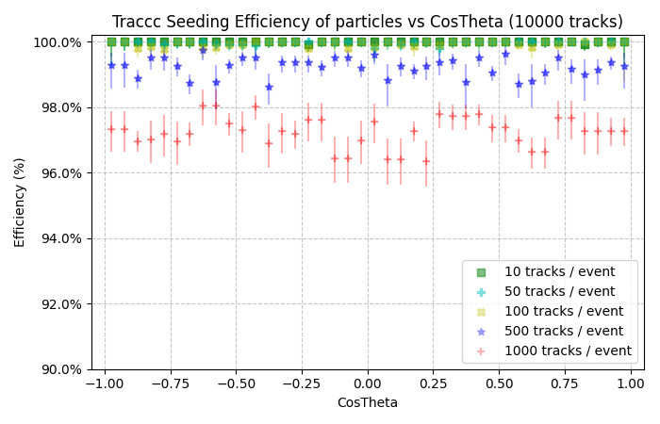
5
21
Performance
Seeding efficiency versus # of track / event
Particle: mu- Energy: 10 GeV
Total track num: 50000
Number of tracks per event: 10/50/100/500/1000
Conclusion:
The Seed Formation algorithm may combine two triplets with different particle id into a Seed. And the marked particle id of that is defined as the mode of the particle id of all space-points, which causes the absence of the proper particle id.
Notes:
A single event containing multiple tracks increases the complexity and difficulty of the reconstruction algorithm and reduces the efficiency of the reconstruction.

Slide 22
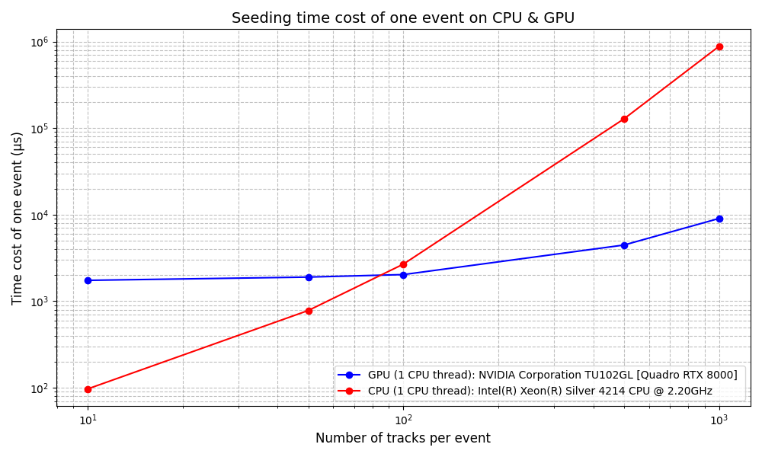
5
22
Performance
Computing evaluation of TRACCC seeding
Particle: mu- Energy: 10 GeV
Run TRACCC in heterogeneous device:
CPU: Intel(R) Xeon(R) Silver 4214 CPU @ 2.20GHz
GPU: NVIDIA Corporation TU102GL [Quadro RTX 8000]
We tested the computing efficiency on CPU&GPU with only single CPU thread
Even in this circumstances, we can beat a single CPU with a single “workstation” GPU at 100 tracks’ event.
With multiple CPU cores in use, GPU can only “win” at large pipe-up case.

Slide 23
23
1
Introduction
2
Integration of TRACCC with CEPCSW
3
Geometry & EDM
Outline
4
Extension of seeding algorithm
5
Performance
6
Summary & Plan

Slide 24
6
24
Summary & Plan
Summary
TRACCC has been applied to the CEPCSW for the first time.
  The geometry conversion can be easily done by ACTS Tools.
  The EDM conversion needs careful manually search for one-to-one correspondence
  The TRACCC’s algorithm can be extended for the special detector
For the performance of TRACCC
  The physical performance of the seeding algorithm is promising
  GPU shows better computing performance than the CPU for large pile-up events
Ongoing work:
Apply ACTS seeding + ACTS CKF at silicon track (VTX+SIT+FTD) of CEPC.
Previous Report: https://indico.cern.ch/event/1406633/

Slide 25
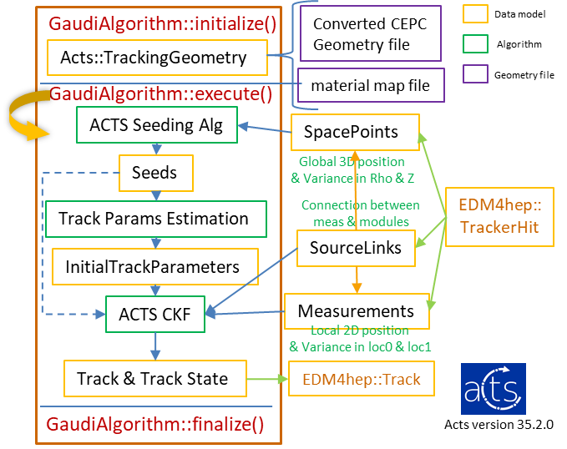
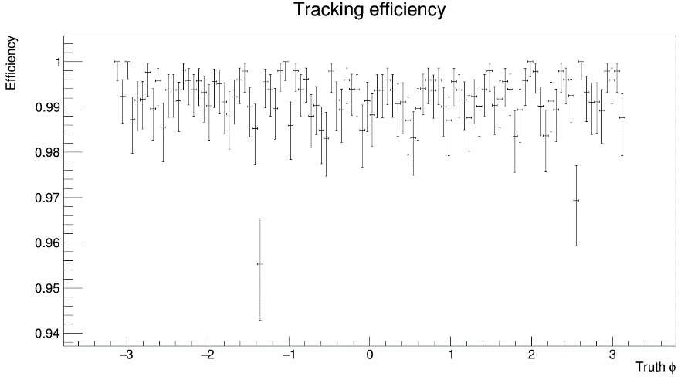
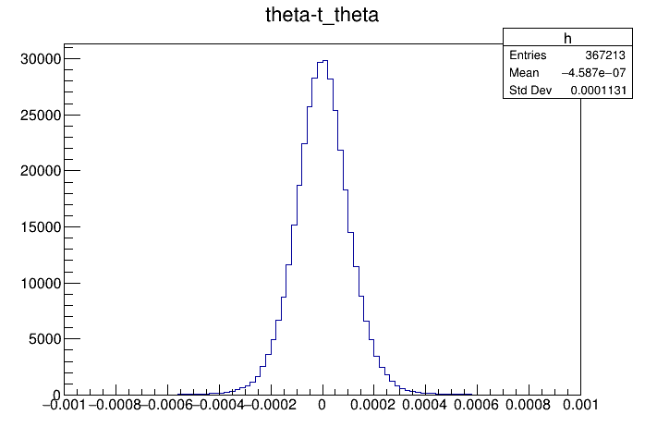
6
25
Summary & Plan
Ongoing work
ACTS has been used as one of the tracking methods at CEPC
  Geometry & EDM conversion is broadly consistent with TRACCC
Preliminary performance tests
  Satisfying tracking performance
  Faster computing eff (≈ 0.2 ms/event) comparing to CEPC’s origin tracking algorithm (≈ 10 ms/event) with single thread
Geometry is about to be upgraded to TDR（ongoing）
Gaudi Algorithm using ACTS reconstruction
ACTS Tracking efficiency with cosθ
Distribution of Δθ

Slide 26
Thank You
YiZhou Zhang¹, WeiDong Li¹, Xiaocong Ai², Tao Lin¹
zhangyz@ihep.ac.cn
1. The Institute of High Energy Physics, IHEP, China
2. Zhengzhou University, ZZU, China
ACTS Developers Workshop 2024
Vaud, Switzerland
18th Nov 2024

Slide 27
Backup

Slide 28

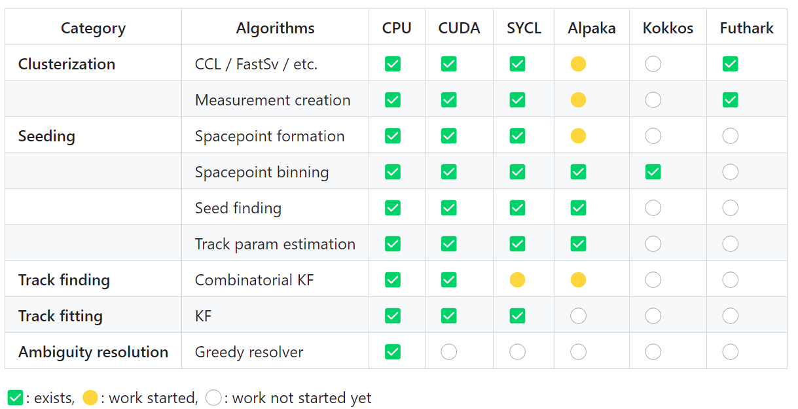
1
28
Introduction
TRACCC: track reconstruction on accelerators
TRACCC
* TRACCC is one of the ACTS R&D projects, which is developing full track reconstruction algorithms that can run on accelerators.
Discussions on 20 November:
  https://indico.cern.ch/event/1397634/sessions/547939/#20241120
Is standalone and features a modular architecture
Has excellent physics and computing performance
SYCL
SYCL is a high-level C++ programming model. An uniformed written code can run on a variety of platforms.
* High Portability and Programming Efficiency 👆
Status of TRACCC
Notes:
Developing track reconstruction algorithms using SYCL is one of the main development directions of TRACCC.
SYCL is a high-level C++ programming model. An uniformed written code can run on a variety of platforms.
* High Portability and Programming Efficiency

