Slide 1
Beam halo monitoring with the HL-LHC BGI (?)
James Storey (SY-BI-XEI)
3rd Beam Halo Monitoring Working Group Meeting, 26th April 2024

Slide 2
Beam halo monitoring with the HL-LHC BGI (?)
Beam Gas Ionisation (BGI) profile monitor
BGI is a new non-destructive transverse beam profile monitor under development for HL-LHC.
Based on the direct detection of individual ionisation electrons with Timepix4 Hybrid Pixel Detectors (HPD) inside the beam pipe.
Each ionisation electron detected with a single Timepix4 HPD with a spatial position σ_{spatial}=16μm & time resolution σ_{time}=200ps.
Transverse beam profile is determined by counting the number of ionisation electrons as a function of transverse position.

Slide 3
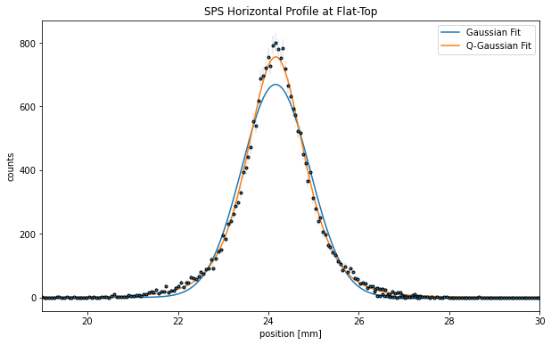
Example measurement with SPS BGI of LHC beam
SPS BGI-Horizontal:
LHC single bunch at Flat-Top on 7th March 2024
Ionisation electron signal proportional to:
Residual (or injected) gas pressure;
Integration time;
Beam intensity.
How much signal do we have?
Example: SPS BGI measurment of LHC single bunch
Residual gas pressure = 5x10⁻⁸ mbar
Integration time = 2 ms
Beam intensity = 9.8x10¹⁰ charges
Signal = 24,000 ionisation electrons

Slide 4
Expected ionisation signal for LHC beam
Expected LHC ionisation electron signal with residual gas ionisation only
Assumptions:
Residual gas pressure = 1x10⁻¹⁰ mbar
Integration time = 1s
HL-LHC beam = 2.2x10¹¹ ppb x 2760 bunches
→ 15x10^6 electrons / second (*)
What would be the beam halo “signal”? Assume beam profile is Gaussian and define the beam halo as the region > +-5σ
Beam halo signal = 4 electrons / s
Conclusion: Insufficient beam halo signal with residual gas ionisation.
(*) Need 1000 electrons for reasonable measurment.

Slide 5
What about with gas injection?
Expected ionisation electron signal with Neon gas injection system (*)
Assumptions:
Residual gas pressure = 1x10⁻¹⁰ mbar Neon gas pressure = 1x10⁻⁸ mbar
Integration time = 1s
HL-LHC beam = 2.2x10¹¹ ppb x 2760 bunches
→ 15x10^6 electrons / second 8x10^9 electrons / second
What would be the beam halo “signal”? Assume beam profile is Gaussian and define the beam halo as the region > +-5σ.
Beam halo signal = 4 electrons / s 2200 electrons / second
Conclusion: “Useful” beam halo signal with neon gas injection.
(*) Old LHC BGI’s used Neon gas injection systems.

Slide 6
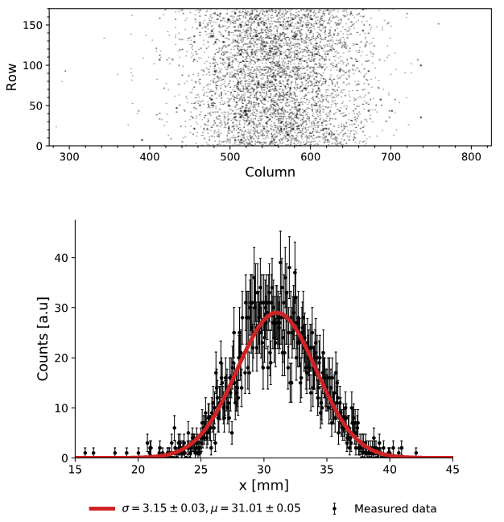
Timepix4 bandwidth limitations
Timepix4 limited to maximum readout of 1x10⁹ electrons / s.
With gas injection full signal is 8x10⁹ electrons / s → readout saturation.
However, Timepix4 allows to mask individual pixels, whereby allowing to mask the “core” ( i.e. sort of “digital-coronagraph” )
Example: Masking all pixels within a 3*sigma beam core window reduces the data rate from 8e9 to 1e7 electrons / beam / s.
Could still leave unmasked some pixels under the “core” distribution to allow for a complete profile measurement.
Readout saturation avoided by digitally masking pixels beneath the beam “core”

Slide 7
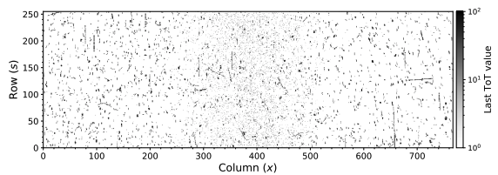
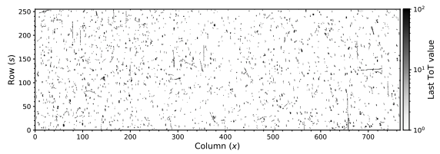
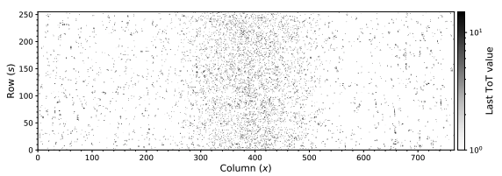
What about backgrounds?
Raw data = Signal + Background
Background(s)
Timepix4 Hybrid Pixel Detector is sensitive to any charged particle crossing the sensor.
Possible sources of charged particle backgrounds include:
  Secondary particles from inelastic beam gas interactions;
  Particles from the decay of surrounding activated material;
Other possible backgrounds = synchrotron light, florescence of injected gases, etc.
Mitigation
Use cluster finding methods (e.g. DBSCAN) to transform Timepix4 events into particle events and then apply selection criteria (e.g. cluster size, cluster energy) to select only ionisation electrons.
Method already demonstrated at the PS to remove beam loss “background” from the ionisation electron “signal” at injection.
Clusters passing Background selection
Clusters passing Signal selection

Slide 8
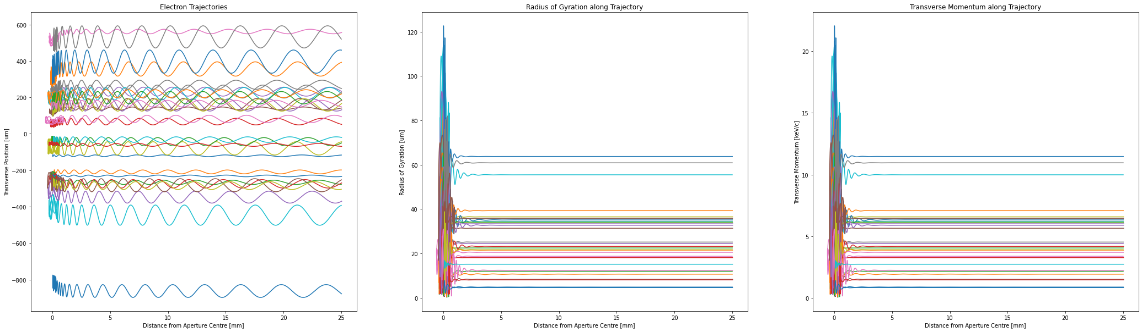
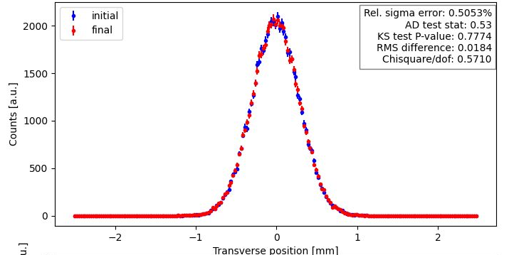
Systematic effects to be investigated
Simulation of Fleisig BI-XEI) LHC BGI (Clara
Preservation of the ionisation electron transverse position
Transport of ionisation electron from formation to the electron detector studied with CSTStudio (Static EM-fields) & IPMSim (Tracking of ionisation electron in dynamic and static EM-fields.)
Simulation used to specify B-field requirements (strength & field uniformity) to measure LHC beam at flat top energy.
However, projection of the ionisation electrons created by protons in the halo has not been specifically studied ( & by definition is a minor contribution to the overall beam size measurement error.)
Would need to be studied…

Slide 9
Summary
With Neon gas injection sufficient signal for continuous HL-LHC beam halo measurement at ~2Hz with 1000 samples per beam halo measurement.
To avoid Timepix4 readout saturation it is necessary to mask pixels under the beam core (aka. “digital-coronagraph.”)
Charged particle backgrounds can be suppressed by cluster finding & selection methods.
Need to study (with simulations) the preservation of the ionisation electron transverse position in the tails of the beam profile distribution.
Neon gas injection system not currently included in the HL-LHC BGI budget.

