Slide 1
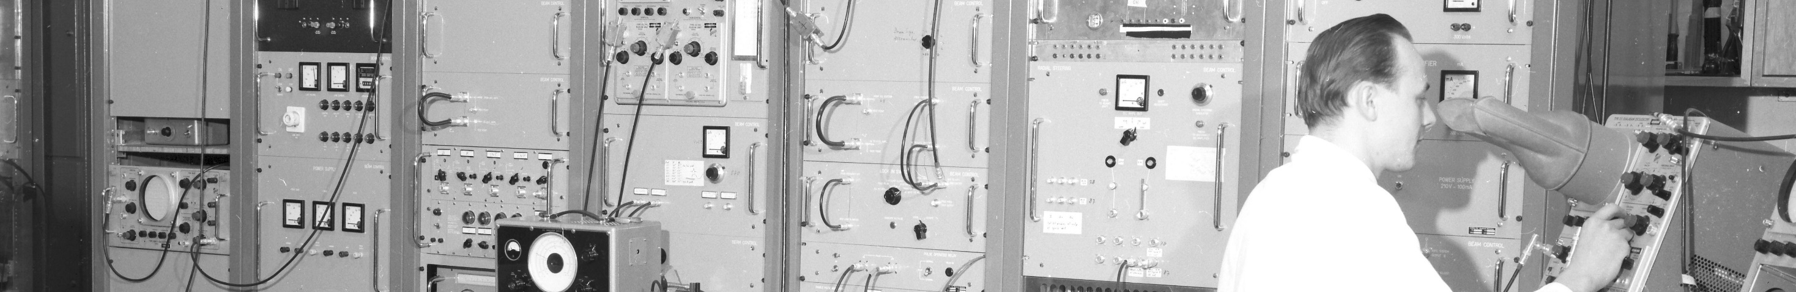
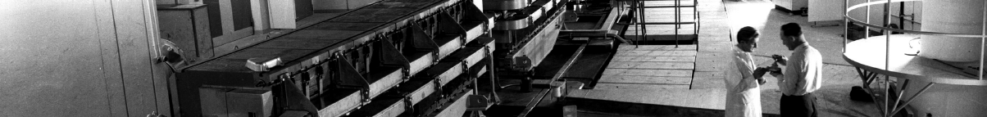
PS Report week 13
Many thanks
to the PS OP and coordination teams as well as all equipment experts and support teams!

Slide 2
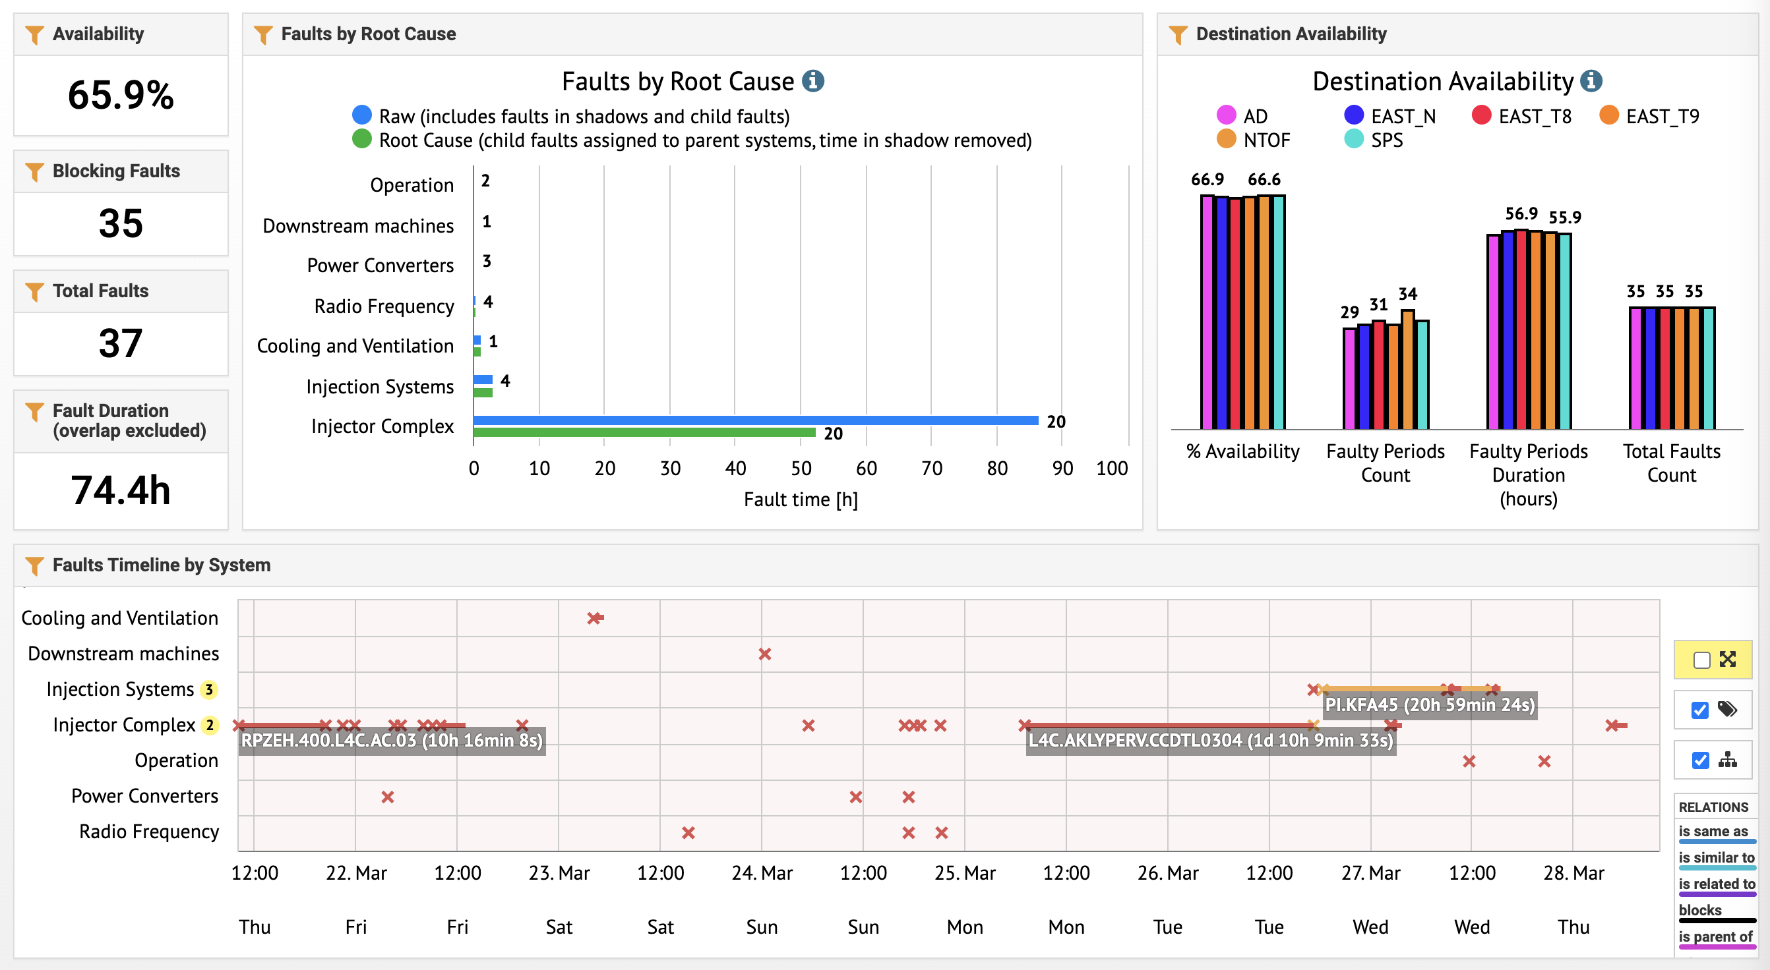
Beam availability

Slide 3
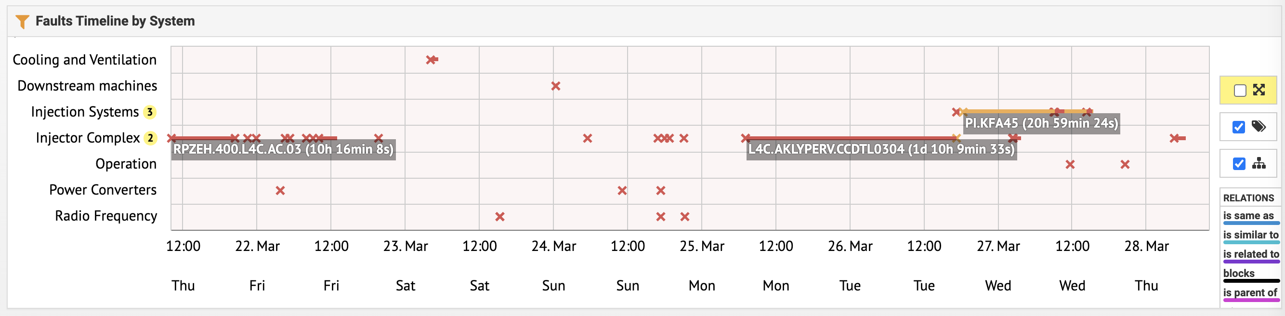
Main issue
2 long stops this week due to L4 interventions.
      CCDTL3/4 : Klystron exchange on Monday / Tuesday.
1 period of degraded beam in PS on Tuesday / Wednesday because of issues on PS injection kicker KFA45
Stable operation since yesterday 15h30

Slide 4
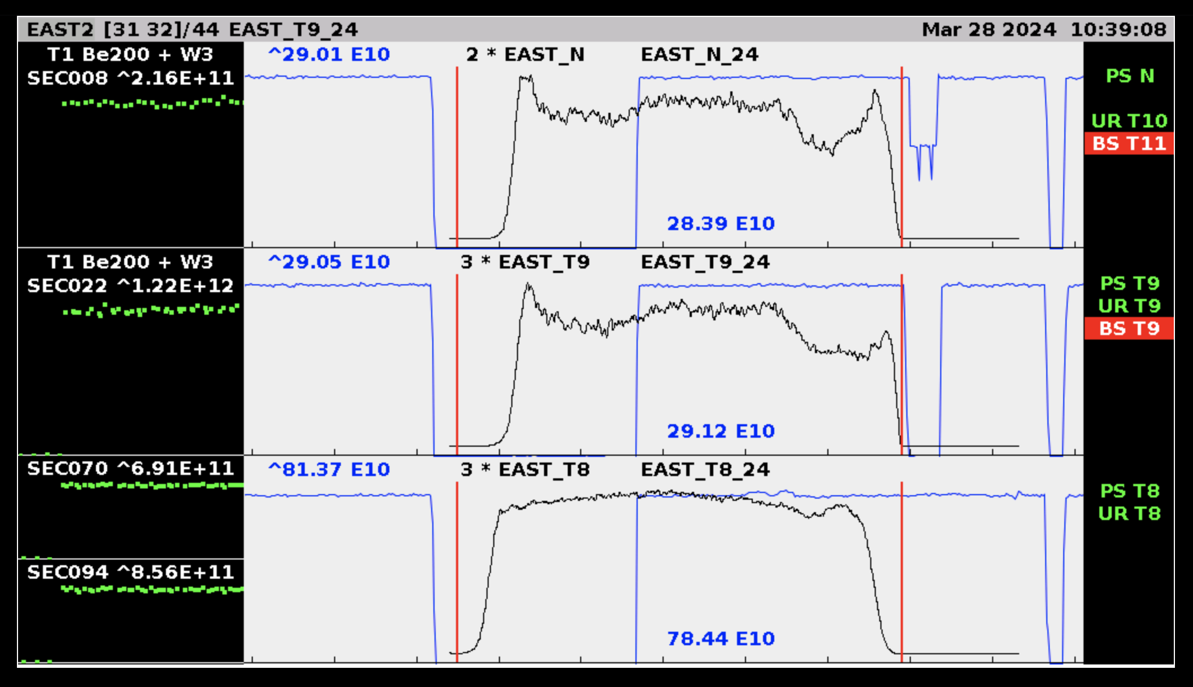
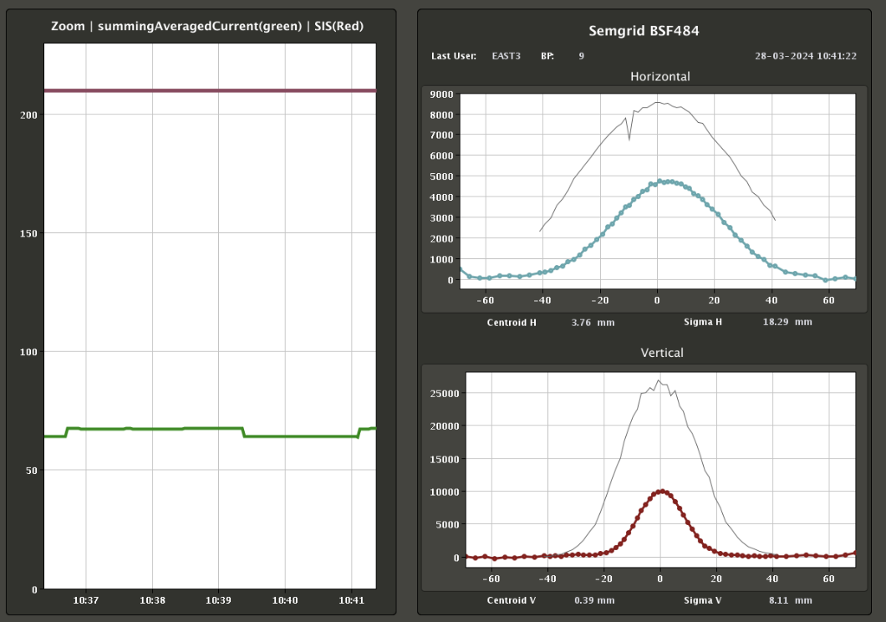
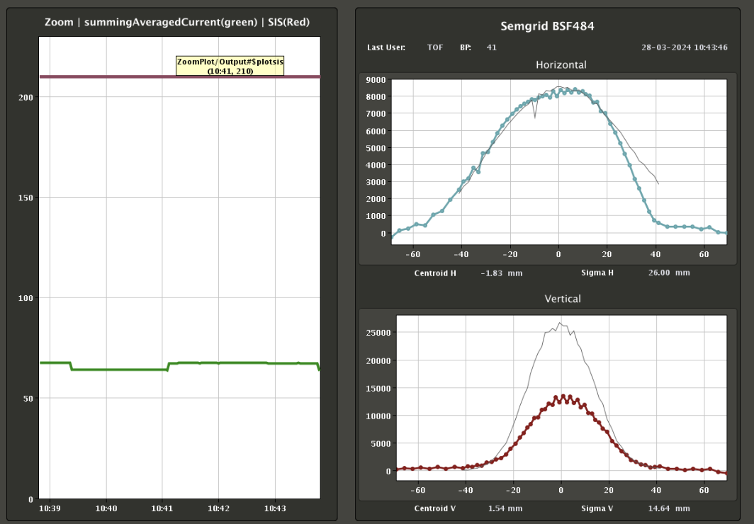
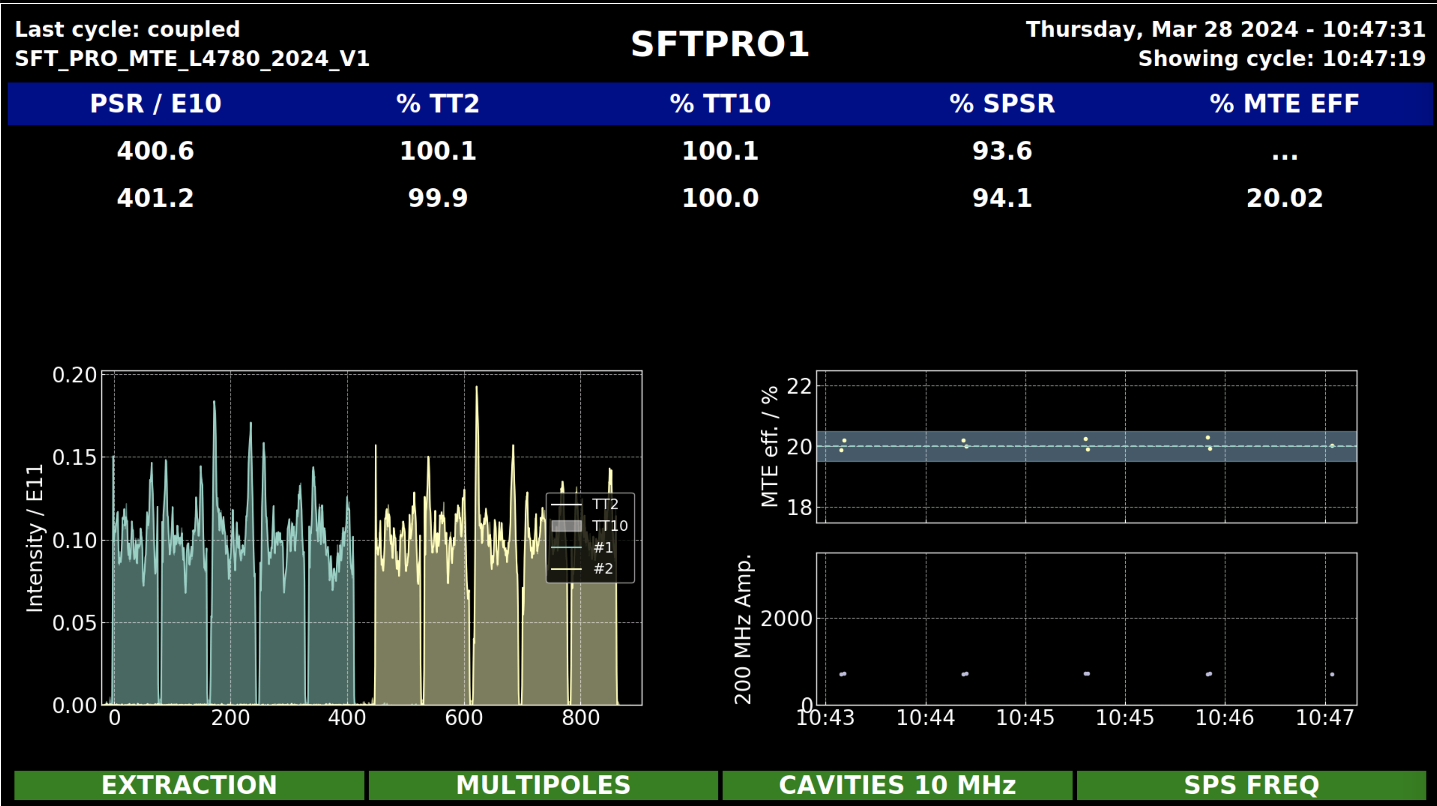
nTOF parasitic beam on target IP=350e10
8 EAST beams sent to EAST AREA
nTOF dedicated beam on target IP=840e10
MTE beam sent to SPS Ip = 400e10

Slide 5
Status of operational beams
Fixed target beams | Status | Comment
SFTPRO (core only) | Operational
SFTPRO (5 turn extraction) | Operational up to 1700e10
AD | Operational at 1700e10 | intensity up to 2000e10 ppp
TOF | Operational | Intensity up to 840e10 ppp, auto steering in TL is running
EAST | Operational
IEAST | On hold
LHC-type beams | Status | Comment
LHCPILOT, LHCINDIV | Operational
LHC25 (3bp, 72b) | Operational | Running up to 3.0e11 ppb with 72b
LHC25 (2bp, 12b to 48b) | Operational | Tested up to 2.4e11 ppb with 48b
LHC25 BCMS (48b) | Operational
LHC25 8b4e (56b) | Operational
AWAKE | Copied from LHCINDIV
HiRadMat | To be copied from LHC2
ILHC (1b), ILHC (4b) | On hold

Slide 6

Questions and Comments ?
09:30 ON MONDAY: PS-MPC
Zoom link to follow the meeting on remote: https://cern.zoom.us/j/62700463149?pwd=VWdOd1U1UGgrQVlCc2xNRkMwcFFoQT09
09:00 WED and FRI: BC meetings
Zoom link to follow the meeting on remote: https://cern.zoom.us/j/9372114100?pwd=L29BcmlHUENCdFBRSytXYVcrM1B4Zz09
Meeting ID : 937 211 4100
Passcode: 525463

