Slide 1
Diving:Data&AI
A personal walk through amazing profession

Slide 2

A short BIO
Antonio Torrado González
Data Enthusiast
Born in Porto do Son, too many years ago, moved early to San Sebastian here I did my High School.
From the whys and the back-shop in those days, there was no option but embarking in the Marvel of Physics forever
Loved my Physics studies in Santiago & Complutense ‘87-’92
And then, concessions had to be made… to embark in the engineering world of electronics in the UK
Until, very casually bumped into the rare world of Business Intelligence & Data, where I lived passionately for the later 24 yr. in UK, USA, Spain and back home again
Hand in hand with amazing companies like Microstrategy | HP | SDG.
“Physics is home”, as it remains to be one of my favorite joys.

Slide 3
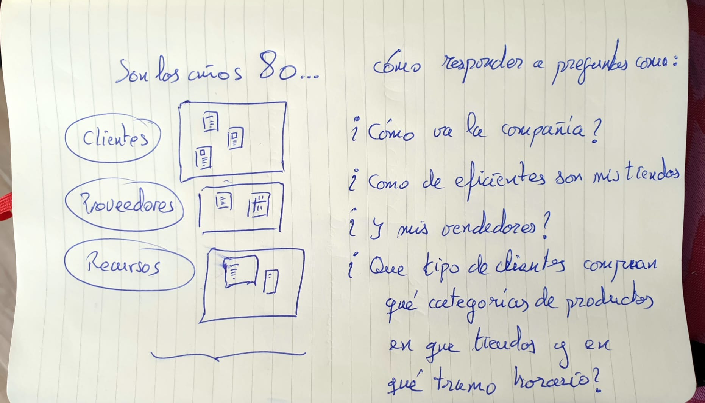
The origins of Data
In a nutshell?
CRM
SC
ERP
Operational Systems

Slide 4
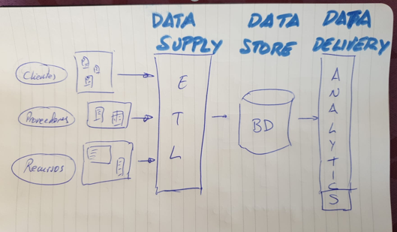
The origins of Data
In a nutshell?
CRM
SC
ERP
Operational Systems
Informational Systems

Slide 5
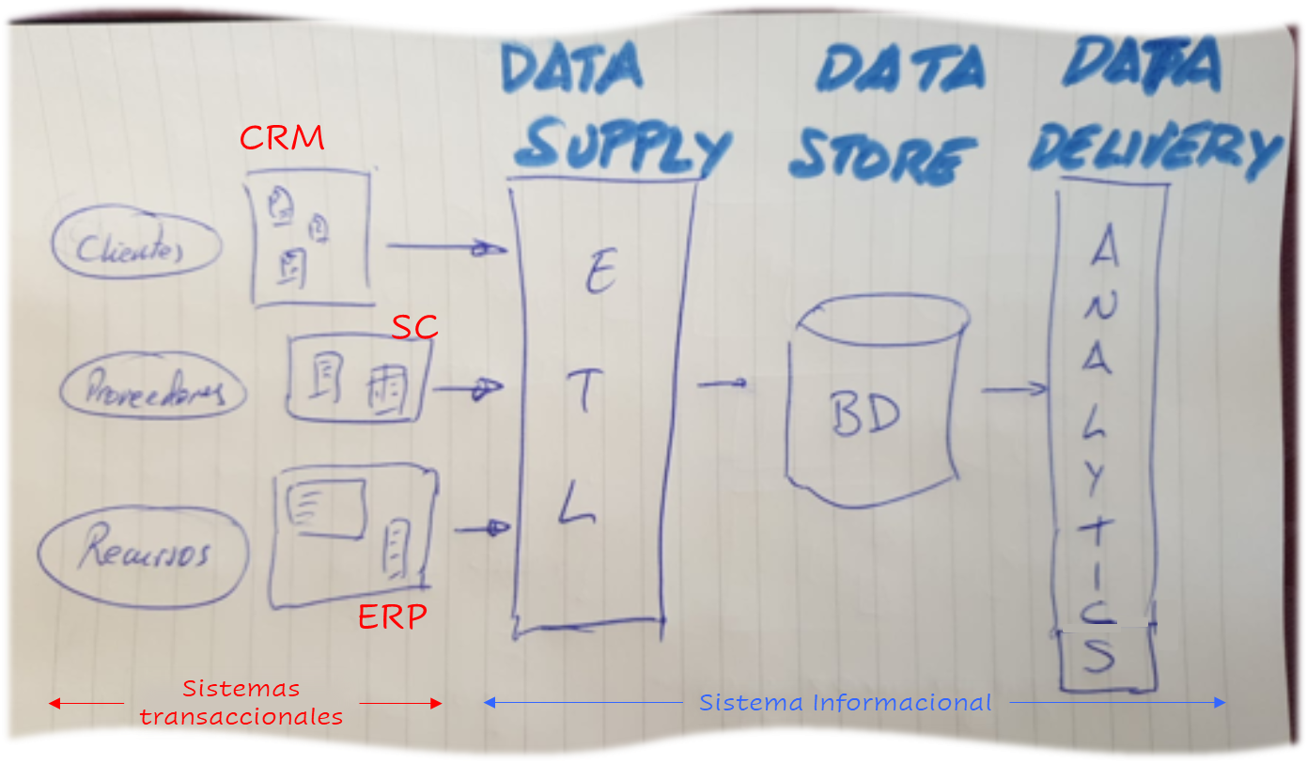
The origins of Data
In a nutshell?
Non intrusive decoupling from critical systems
Integrated Data. Single source of information
Data in Business Terms
Historic Data, Maximum Granularity.
Massive Data, All In !
Performance for complex Queries
Single Version of the Truth
Enables Data Driven Decision Making:
  Semantic Layer to Access Data
  Dashboarding
  Reporting
  Self Service BI
  Data Discovery
  Embedded Analytics, etc.
The Enterprise Data Warehouse was born, and this profession with it

Slide 6
The origins of Data
In a nutshell?
Enterprise Data Warehouse
Cloud and Modern BI
1990-2002
2002-2012
2014-2020
Dawn
2022…
Early Days
Big Data Revolution
[Massive Data + ML]
The Gen.AI Era

Slide 7












What is the actual
Data & AI Space?
Business Functions
Industries
Sales
AI & Generative AI
Data & AI Strategy
Finance
Forecasting
Prediction
Classification
Recommending Engines
Optimizations
Personalization
Prescriptive Analytics
Model Servicing
AI & GenAI
Computer vision
NLU & NLP
AI Agents
D&AI Vision
Advisory
Data Assessment
AI Assessment
Data Maturity Model
AI Maturity Model
Road-Mapping
Benchmarks
Data Strategy
Data Governance
Data Compliance
AI Governance
AI Compliance
AI TRiSM
Data & AI Adoption
Data & AI Discovery
Innovation
Tech Radar
Education & ReSkilling
PoC & MVPs
Data & AI Community
ESG Services
Competitive Intelligence
Procurement
Supply Chain
BI, Reporting, Analytics
HR
Data Viz
Executive Analytics
Data Storytelling
Self-service BI
Real-time Data Viz
Business Alerts
Data Activation
Embedded BI
Composable Analytics
Business Insights
Headless BI
Graph Analytics
Customer
Operations
Data & AI Foundation
Logistics
Data Warehouse
Data Lake & Lakehouses
Data Modernization
Data Virtualization
ML Systems
Master Data Management
Data Security & Privacy
Data Fabric & Data Mesh
Data Platform
Data Engineering
Data Observability
Data Quality
Data Sharing
Synthetic Data
Real-time Data analytics
Streaming Data Activation
IoT data Ingest
Cloud Engineering
Data & AI FinOps
Data Continuity Services
Metadata Management
Corporate
IT&Media

Slide 8
Why Data & AI
The why´s of a career in Data & AI

Slide 9

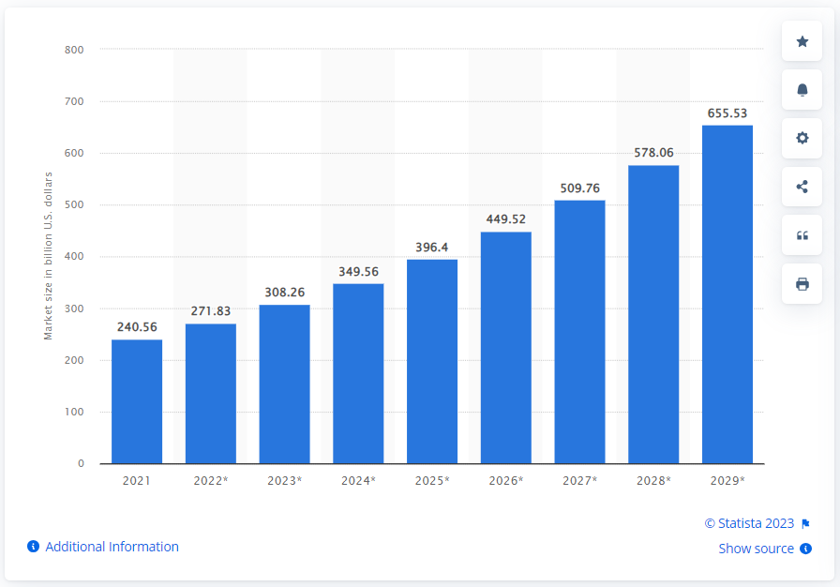
Why a career in Data & AI
A massive healthy market
EUROPE
The Europe big data analytics market is expected to grow from US$ 63.89 million in 2022 to US$ 153.92 million by 2028 (Business Market Insights); it is estimated to grow at a CAGR of 15.8% from 2022 to 2028.
According to Statista, driven by the boost in AI, the Europe big data analytics market is expected to grow from US$ 63.89 million in 2022 to US$ 153.92 million by 2028 (Business Market Insights); it is estimated to grow at a CAGR of 15.8% from 2022 to 2028.
Big Data & Analytics
WORLDWIDE MARKET FORECAST 2021-2029 (USD BN)
SPAIN
Data Bridge Market Research analyses that the Spain big data and data engineering Services market value, which was USD 55.14 billion in 2021, is expected to reach the value of USD 192.95 billion by 2029, at a CAGR of 16.95 % during the forecast period 2022 - 2029.
CAGR >15% (depending on the source) for the next 5 to 8 years
Statista
Precedence Research. The global data analytics market size was exhibited at USD 30 billion in 2022 and is projected to surpass around USD 393.35 billion by 2032, poised to grow at a projected CAGR of 29.4% during the forecast period 2023 to 2032.

Slide 10

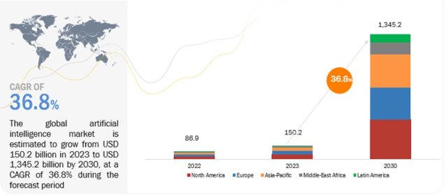
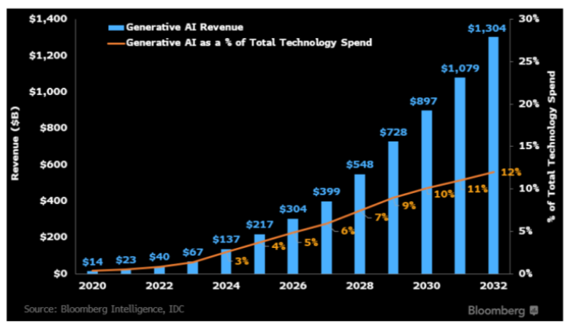
Why a career in Data & AI
A massive healthy market
Statista projects the Artificial Intelligence size market to reach US$305.90bn in 2024 with an annual growth rate (CAGR 2024-2030) of 15.83%, resulting in a market volume of US$738.80bn by 2030.
Bloomberg & IDC project similar size and CAGR, with Gen.AI increasing % of Total Technology Spend, from 3% in 2024 to 10% in 2030.
AI WORLDWIDE MARKET FORECAST 2022-2030 (USD BN)
GEN AI WORLDWIDE MARKET FORECAST 2020-2032 (USD BN)
Bloomberg
Markets and Markets
CAGR >15% (depending on the source) for the next 5 to 8 years

Slide 11
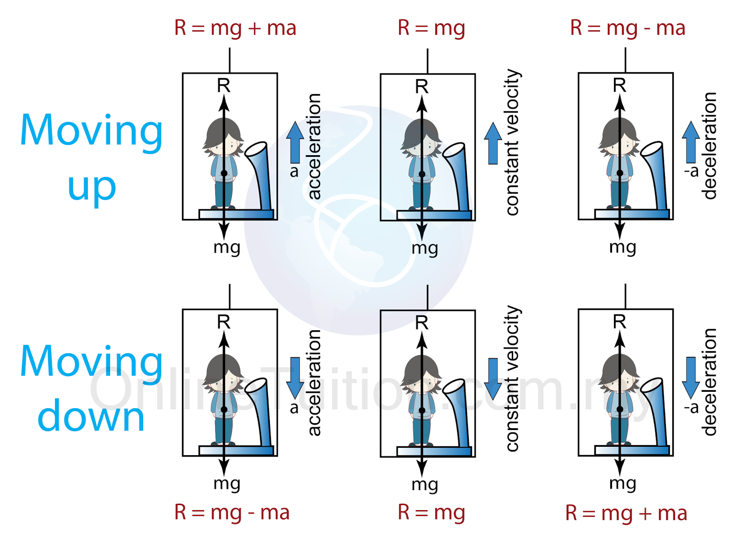
Why a career in Data & AI
The lift metaphor
Source: onlinetuition.com.my
Notes:
Pls, do not jump on elevators
An elevator going up, it is not going to make the job for you… but it certainly helps !

Slide 12

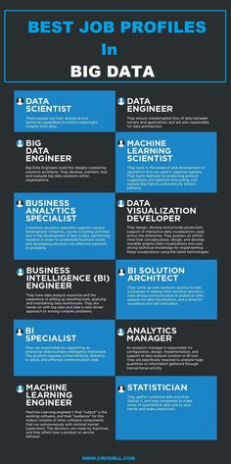
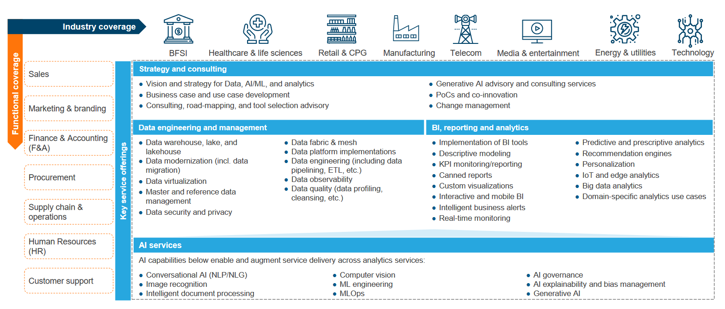
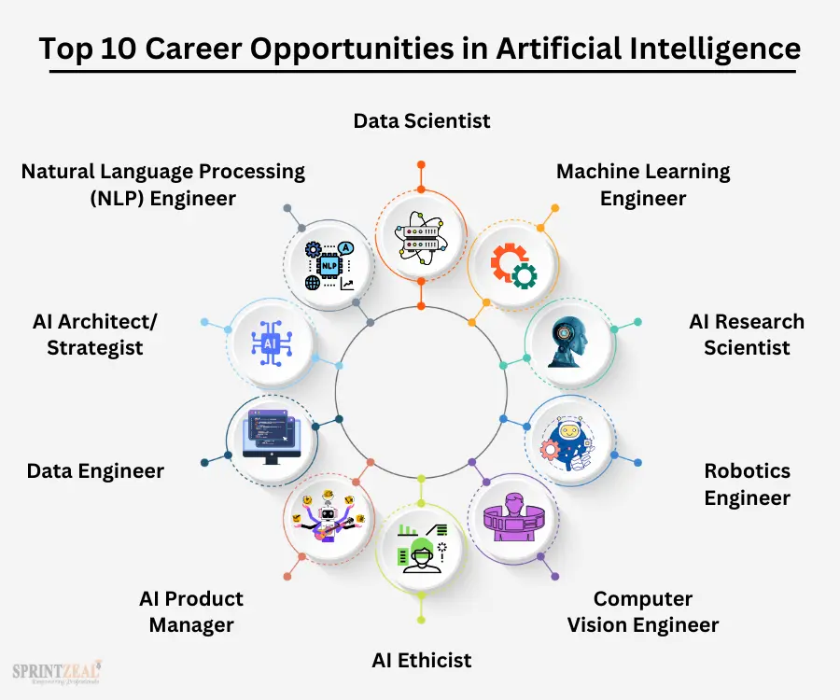
Why a career in Data & AI
Variety of professional lives… with a tip
https://www.credibll.com/
Notes:
Most of people I know in this profession… is in love with it !
No one that I know, leaves it

Slide 13

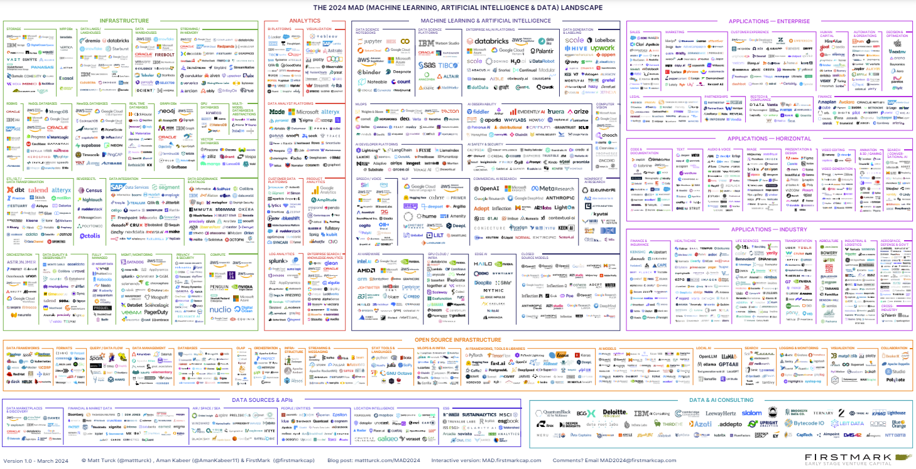
Why a career in Data & AI
Thriving Innovation & Technology… your will need more lives
https://mattturck.com/data2020/

Slide 14









































Why a career in Data & AI
A window to many worlds
2000
2001
2002
2003
2004
2005
2006
2007
2008
2009
2010
2011
2012
2013
2014
2015
2016
2017
2018
2019
2020
2021
2022
2023
2024

Slide 15
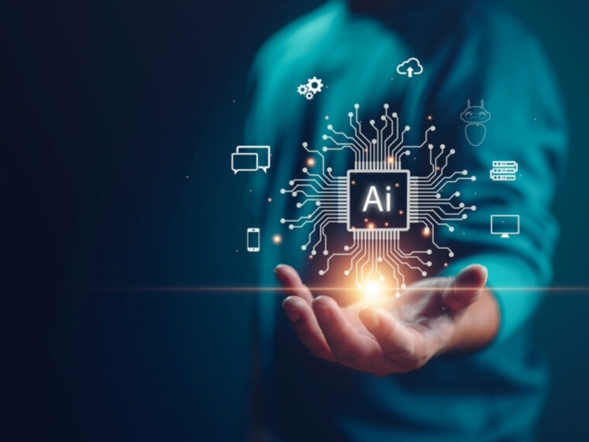

Why a career in Data & AI
and live inside the Gen.AI Revolution
Gen.AI to boost
Annual GDP
$2.6 trillion to $4.4 trillion
based on mere implementation of 63 use cases in all industries
Source: The economic potential of generative AI. McKinsey & Co. June 2023.
Earth´s GDP in 2023 was $104,5 Trillion

Slide 16

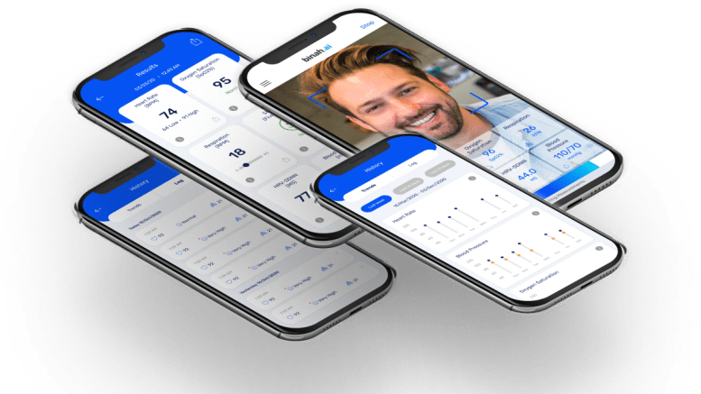
Why a career in Data & AI
Make it matter !
DocDot
DocDot is named by the World Health Organization as one of the most innovative Digital Health solutions on a global scale
Global Pharma
Covid Times, all help was needed
https://youtu.be/Dcp08FRULqY
Multimodal AI for Clinical Trials competitive intelligence to early detection of trends key to drive investments & Societal Impact
Spanish Utility
Safety Analytics, an AI predicting probability of Accident and its causes, in Electrical Network Operations.
Local NGO
Food Bank Zero to Digital & Data
Global Hospitality
Data was key to survival

Slide 17




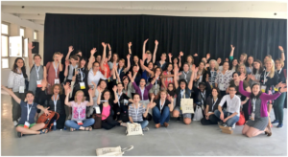
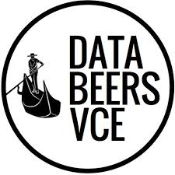

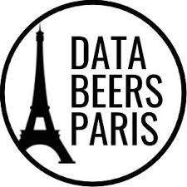


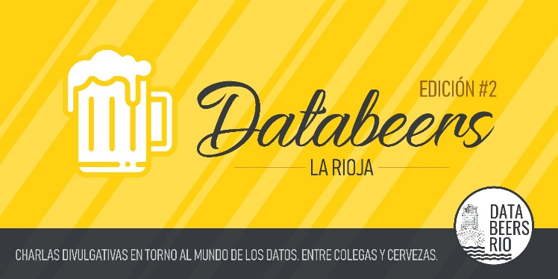
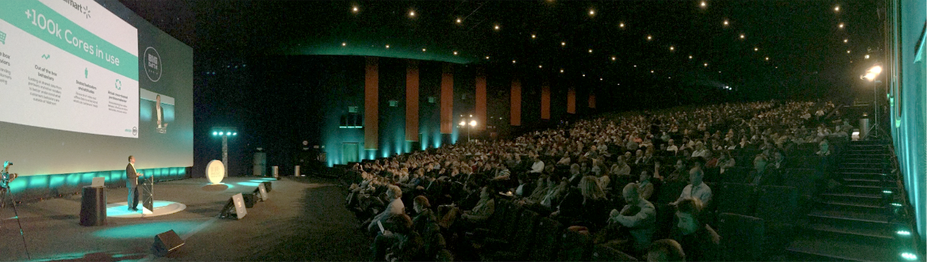
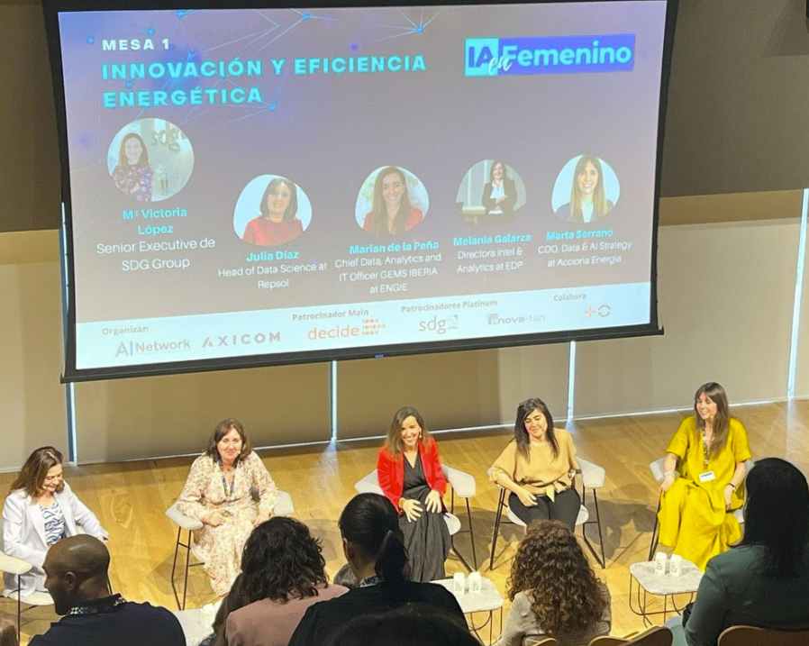

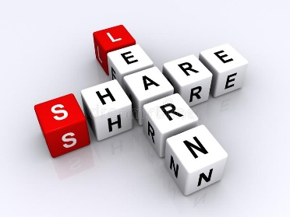
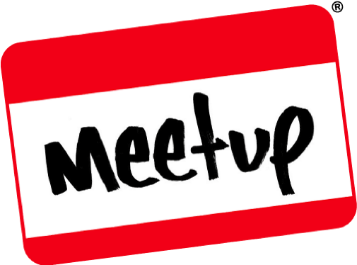

Why Physicists in Data & AI
Time for fun

Slide 18
Are you talking to me?
Physicists Wanted !

Slide 19

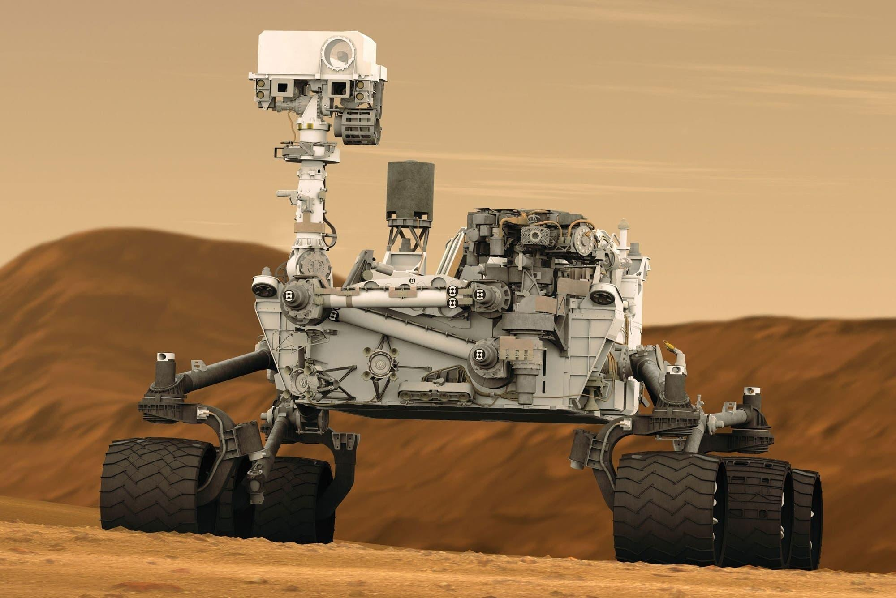

Why Physicists in Data & AI
Are you talking to me?
Notes:
You have injected with the fuel of curiosity and causality (going to the root of things, the whys, where the truth lies (business insights in corporate terms)

Slide 20
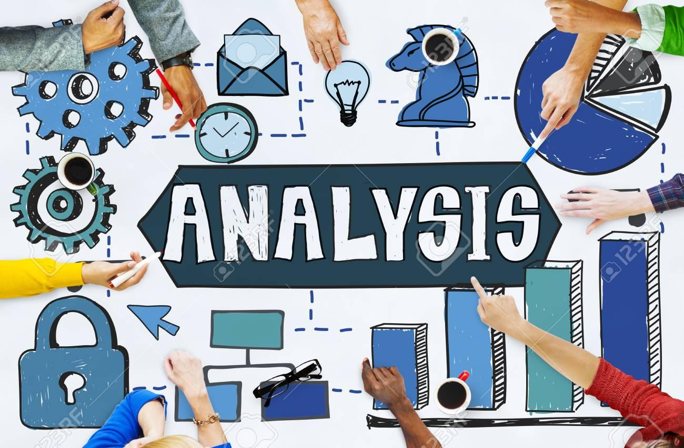

Why Physicists in Data & AI
Are you talking to me?
CONCEPTUALIZACIÓN, ABSTRACCIÓN, GENERALIZATION

Slide 21


Why Physicists in Data & AI
Are you talking to me?
PROBLEM SOLVING
LATERAL THINKING

Slide 22

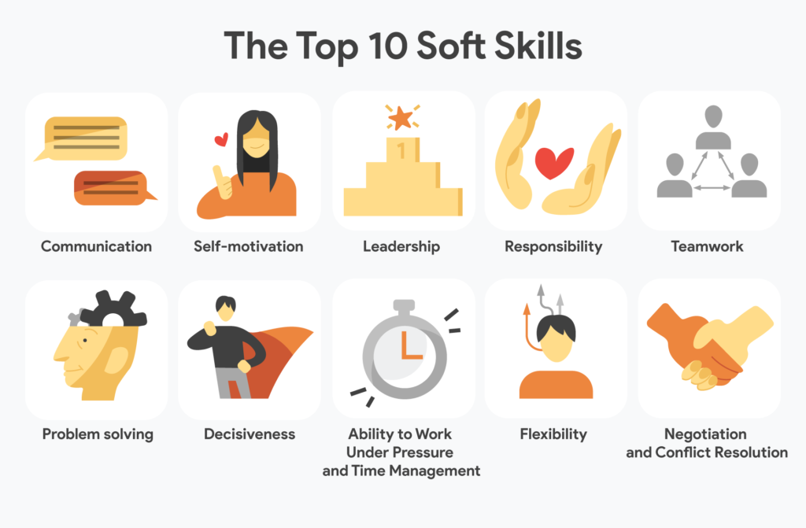
Why Physicists in Data & AI
Are you talking to me?
RESILIENCE & SURVIVING FAILURE
YES, DATA & AI PROFESSION, STILL PART OF THE REAL WORLD

Slide 23
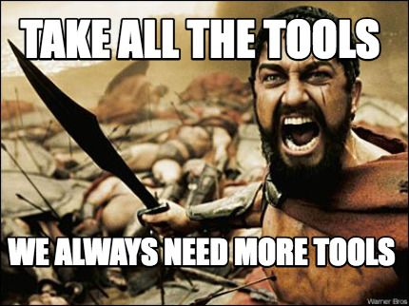








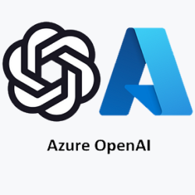




Why Physicists in Data & AI
Are you talking to me?
MATHS, STATISTICS… CODING & SOFTWARE ENGINEERING

Slide 24
What we do
Data & AI Stories

Slide 25



Slide 26

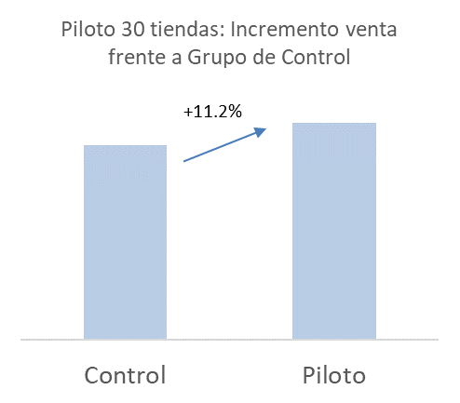
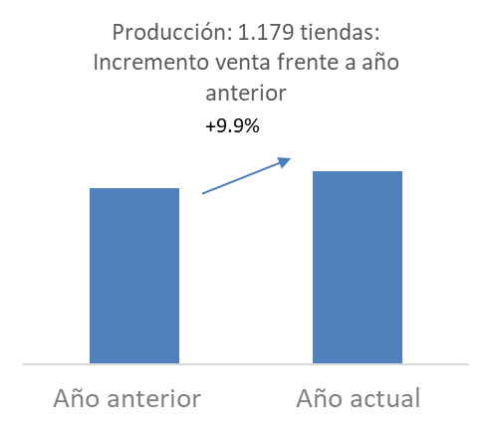
Data & AI stories
The Bread & Butter of Data & AI?
THE BREAD
  Increase in net profit of +9.9%
  Margin obtained of 460,000 Euro/month for the group, approximately 5.5M Euro / year
THE FLOUR
Sale by product, store and batch
Characteristics of the stores and bakeries (hours, size, influx, location, franchisee...).
Surplus stock of products at the end of the batch
Product sales cash receipts
Calendar information and promotions

Slide 27


Slide 28


Data & AI stories
Water Matters… Loss Prediction & Prevention
Improvements in hydraulic performance of around 5% - 8% in the municipalities where it has been deployed.
Significant economic savings due to the possibility of being able to anticipate possible leaks or breakdowns.
Improvement of the operational chain. The fact of being able to detect leaks early and notify technicians preventively has meant a great improvement in the entire operational or value chain. This has also contributed to the company's entire digitalization and improvement plan.
The regularization of the leak detection methodology, together with the use of Machine Learning, has allowed us to abandon a practically heuristic model based on the intuition of some more experienced operators and rely on objective models, with data as the only Source of Truth.

Slide 29


Slide 30
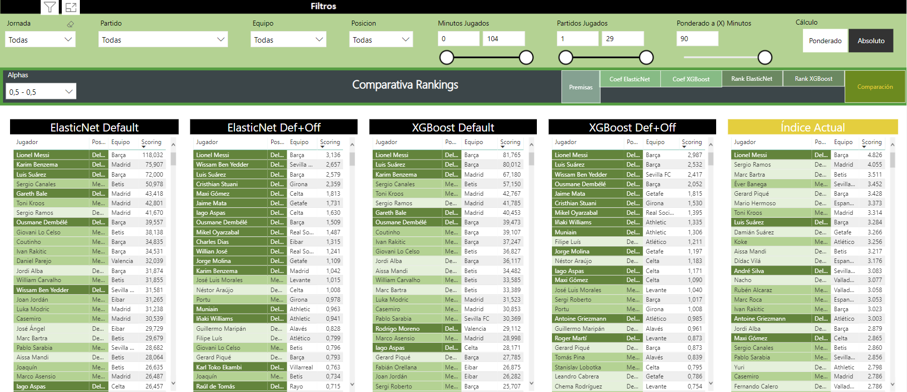
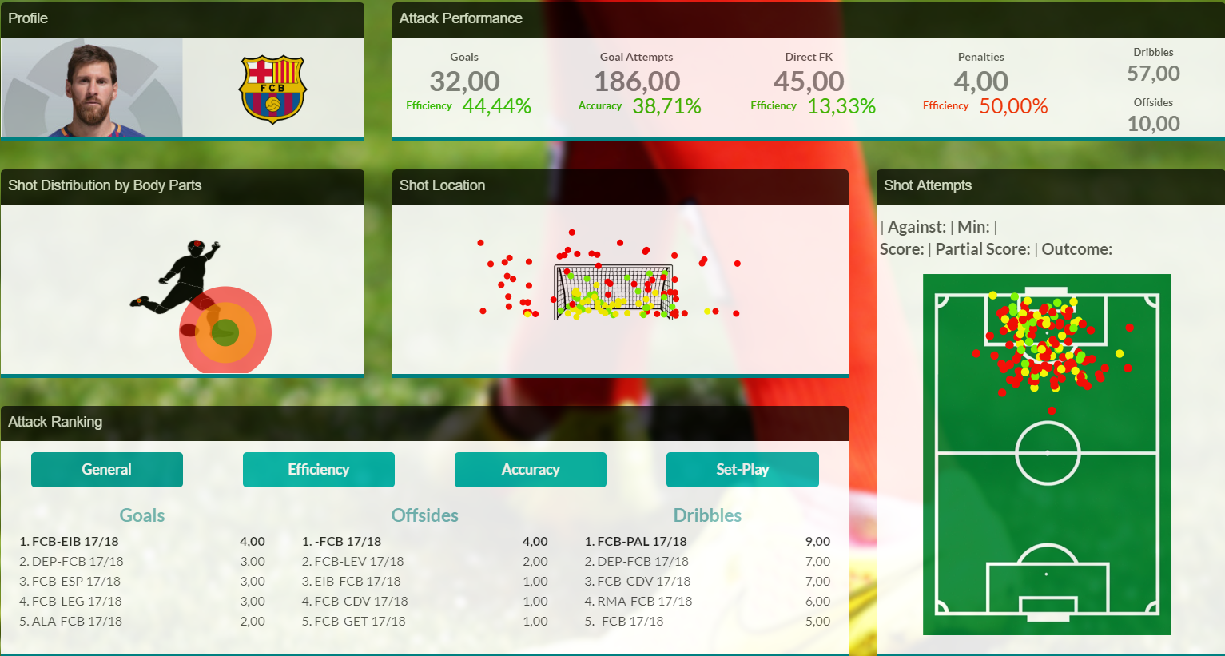
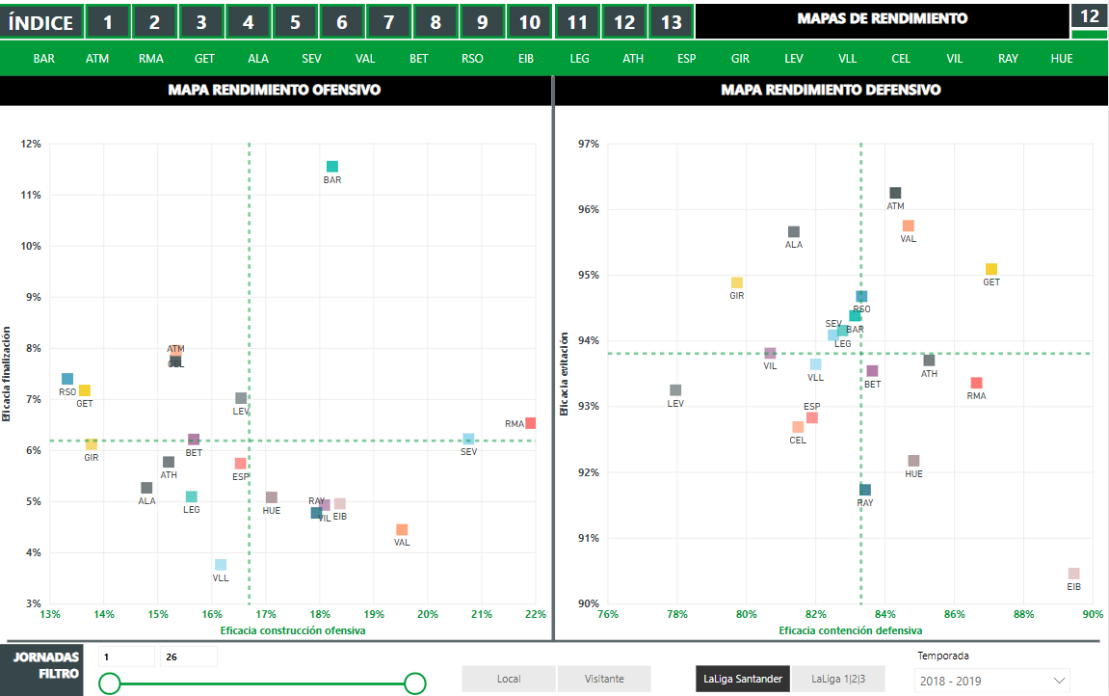
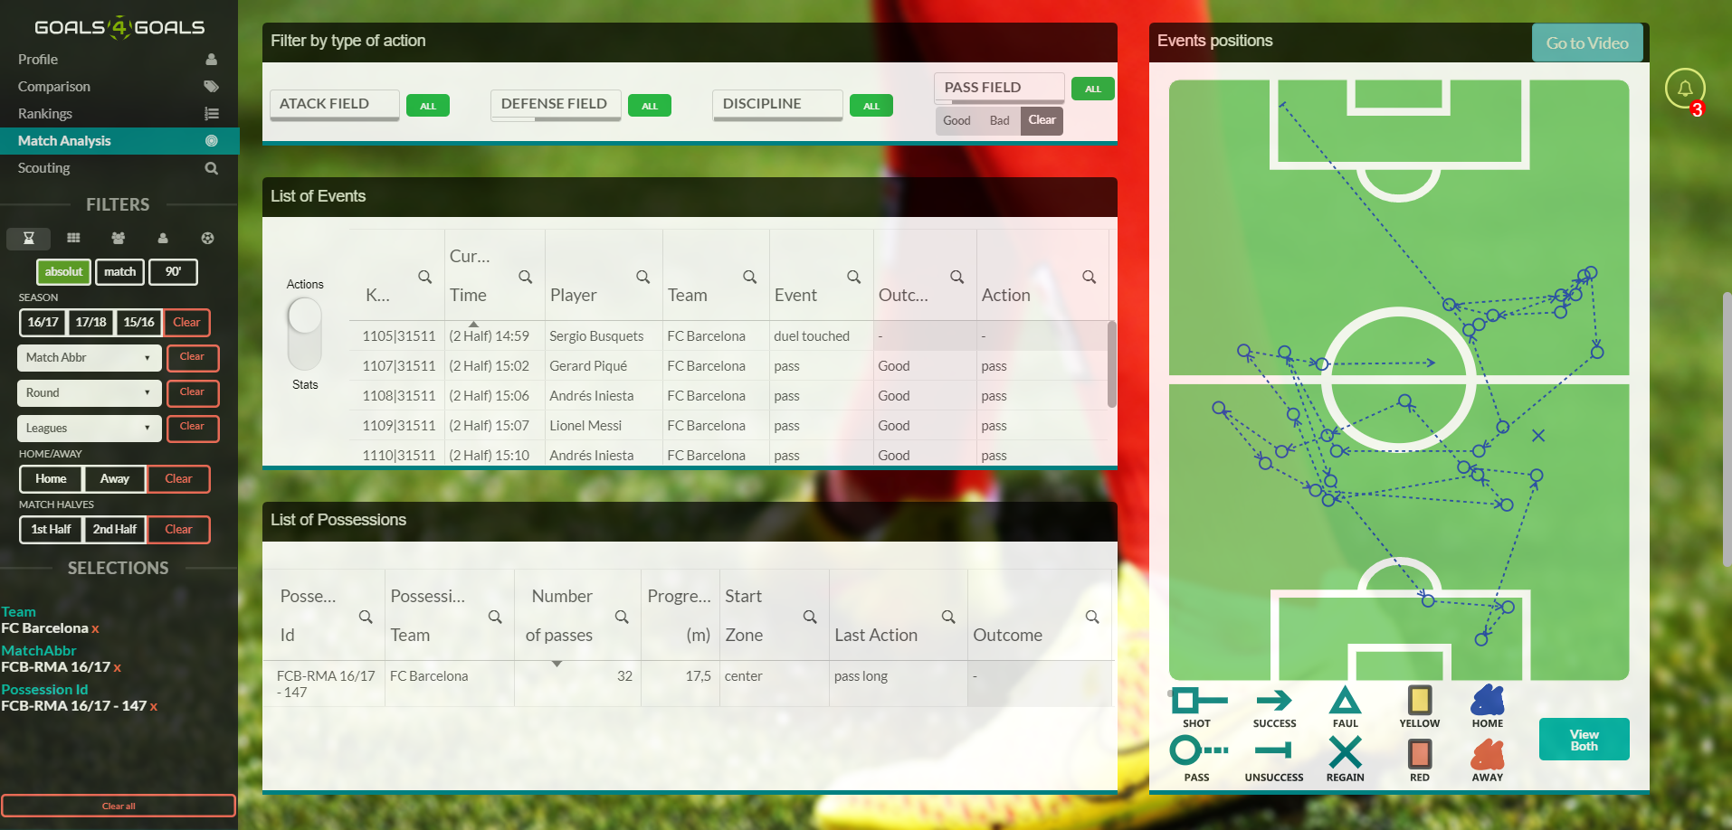
Data & AI stories
Moneyball… not just about wining

Slide 31

Data & AI stories
Fly safe… surprise findings !

Slide 32
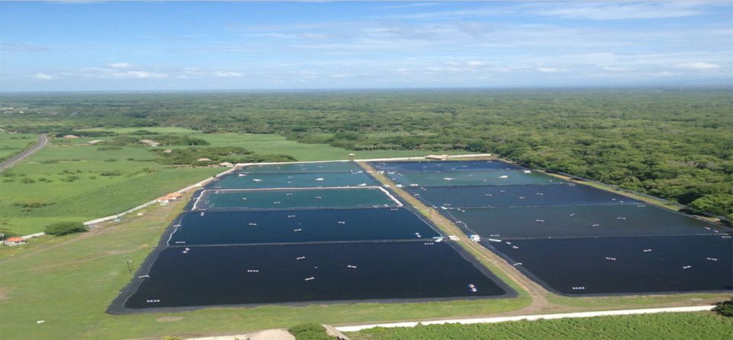
Data & AI stories
Smart Farming

Slide 33



Data & AI stories
AI augmented Wine Making

Slide 34

Notes:
https://www.livrarialello.pt/

Slide 35
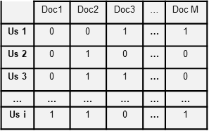


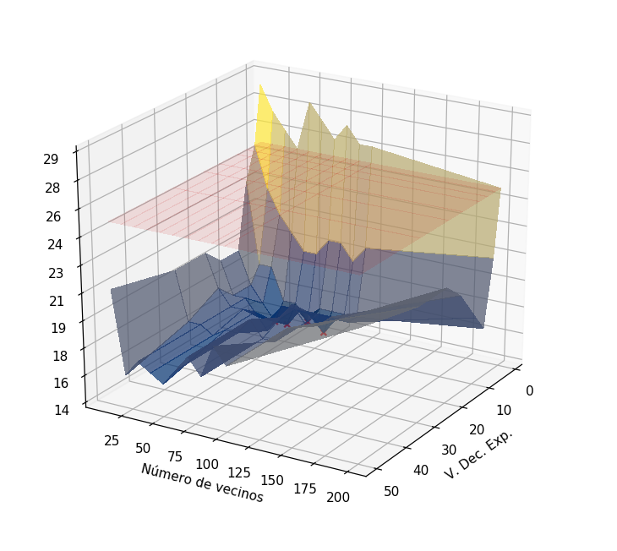
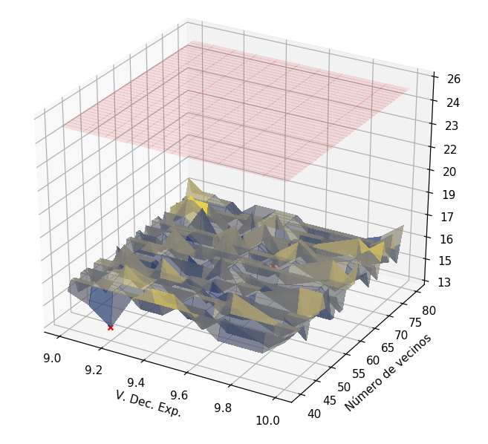

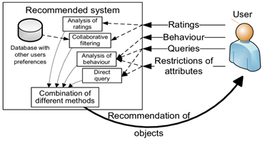

Data & AI stories
Book Recommender
Historical book request data from the last 7 years is used to construct the recommendations.
Firstly, it is necessary to carry out in-depth data cleaning to avoid duplication and consolidate the cases of the same books in different languages. There are also cases that need to be refined (e.g. parents who reserve books for their children).
Datos
Argus
Book consumption by library users
Bibliogràfics
Reducció de duplicats
Characteristics of the book: author, language, theme…
Stock of books available in each library
A common problem in recommendation systems is dealing with the enormous volume of data and possible combinations. The solution was to use the collaborative filter algorithm with Euclidean distances applied in distributed calculation in Databricks.
Validity with real data from H2.2019.
Increase in book reserves of 2.3%, discounting trends and seasonality.
Increase in user satisfaction and great reception according to a survey carried out by the Department of Culture

Slide 36


Notes:
AI Systems for (1) Optimizing Supply chain with demand by predicting delays or rupture of custom car components; and (2) Smart Assortment of Complementary Ferrari products: Predicting future sales to improve profitability at Point of Sale.

Slide 37
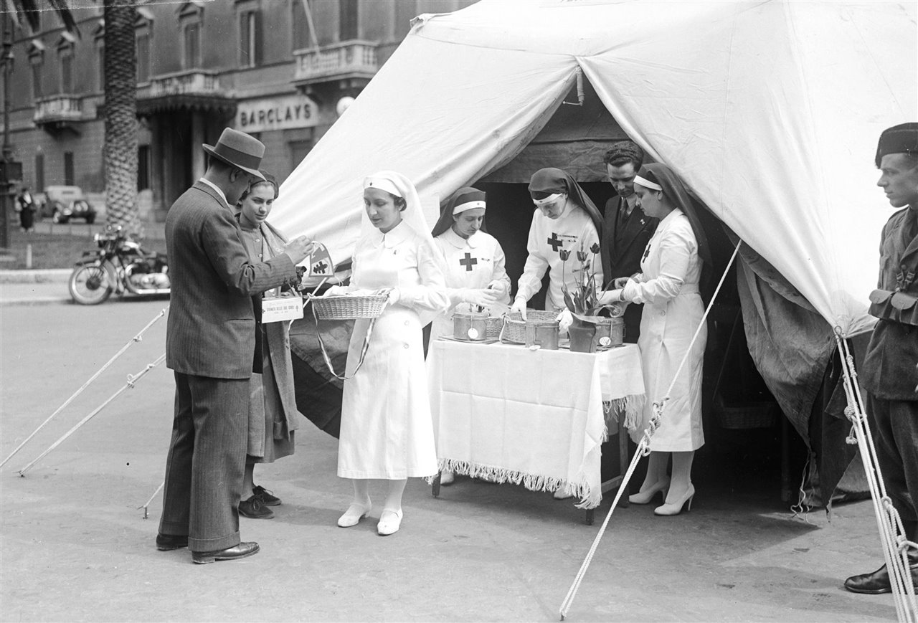
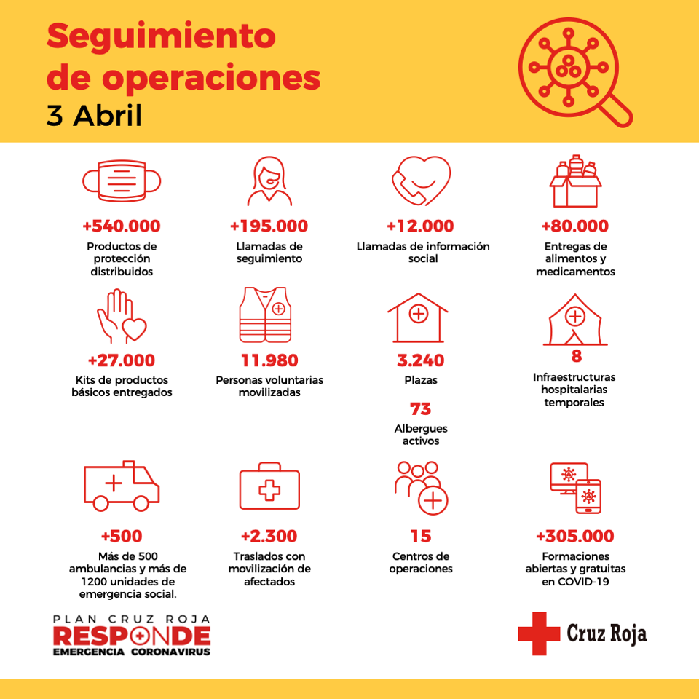
Data & AI stories during COVID times
Red Cross Critical KPIs for Resource Allocation

Slide 38
A wealth of Data & AI stories
Over 3000 Big Data & AI Projects
Pharma. Patient Adherence
Pharma. Clinical Trial Optimization
Pharma. Prediction of Melanoma from Skin Images
Pharma. Toxicity Prediction
Banking. Detection of Fraud and Money Laundering
Banking. Claims Segmentation
Insurance. Early Customer Service Prediction
Insurance. Fraud Detection using NLP
Utilities. Counter Tampering Detection.
Utilities. Water Network Leak Prediction
Airlines. Predictive Maintenance of Aircraft Wheels
Airlines. Optimization of Operations in the face of events.
Airlines. Luggage on board prediction
Utilities. Prediction of accidents in Red Eléctrica Ops
Finance. Cash Flow Prediction.
Gaming. Gambling Behavior Prediction
Insurance. Risk Modeling
Retail. Price Optimization
Industrial. Quality Prediction
Industrial. Demand Prediction
Retail. Hot Spot Prediction
Transportation Fuel consumption prediction
Airlines. Reduce InFlight F&B waste & optimize lounges.
Energy. Plant Location Optimization
Retail. Assortment Mix Optimization
FMCG. Next Best Action
Customer. Channel Optimization
Customer. Complaint Mngment Acceleration
Telco. Anomaly Detection in the Network
HR. Diversity & Salary Chasm.
Telco. Roaming Intelligence
Telco. Workforce Prediction
Telco. AI-Driven Process Mining for Logistics
Telco. Foundation of AI Ops Systems
All. Customer Churn Prediction
All. Customer Lifetime Value Prediction
All. Supply Chain & Ops Optimization
All. Campaign Efficiency
Primary. Crop Optimization
Primary. Smart Fish Farming
Sports. Smart Scouting & Player/Team Performance
Telco. Energy Optimization in 4G/5G Network
Mining. Resource Demand Planning
…
All. Tech Foundation for Data & AI Systems
Willem Einthoven invented the electrocardiogram in 1903.

Slide 39
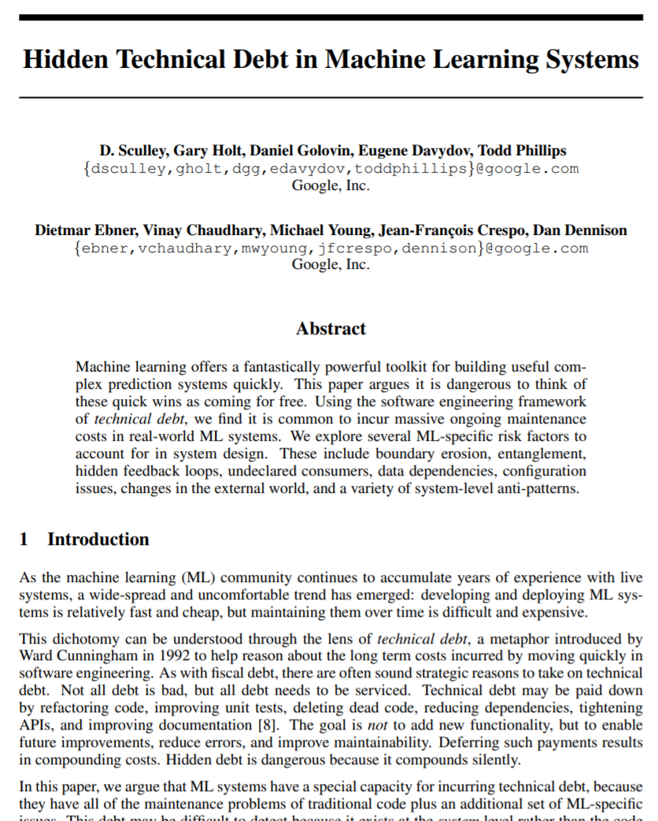
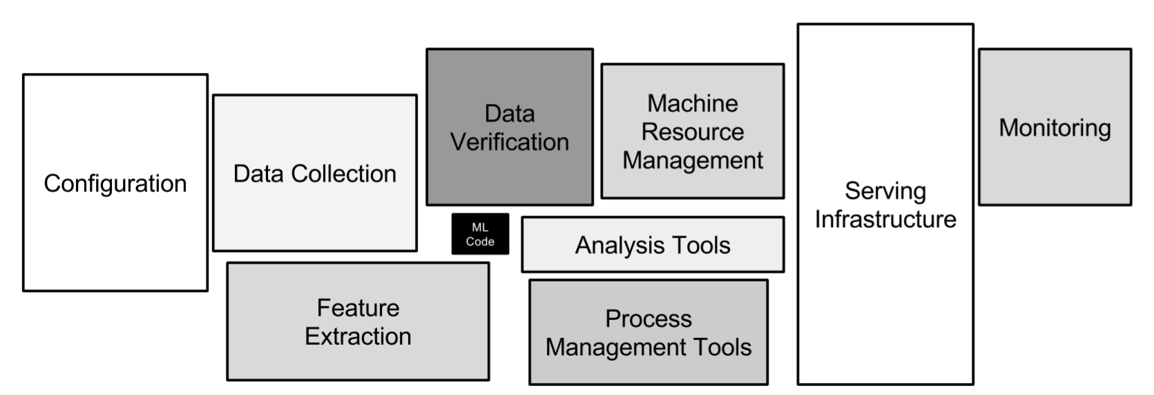
Why a career in Data & AI
Disambiguating the AI & Data Markets
https://papers.nips.cc/paper/2015/file/86df7dcfd896fcaf2674f757a2463eba-Paper.pdf

Slide 40
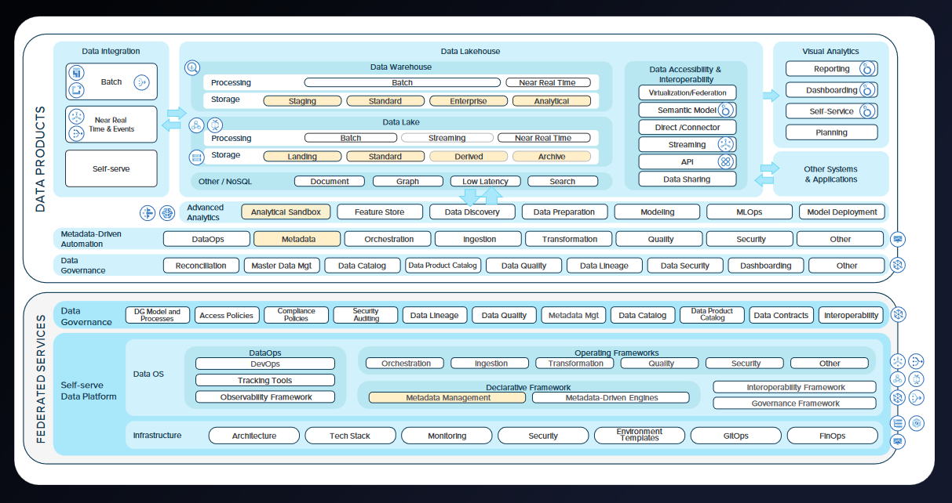
Why a career in Data & AI
Well Architected Data Platforms

Slide 41
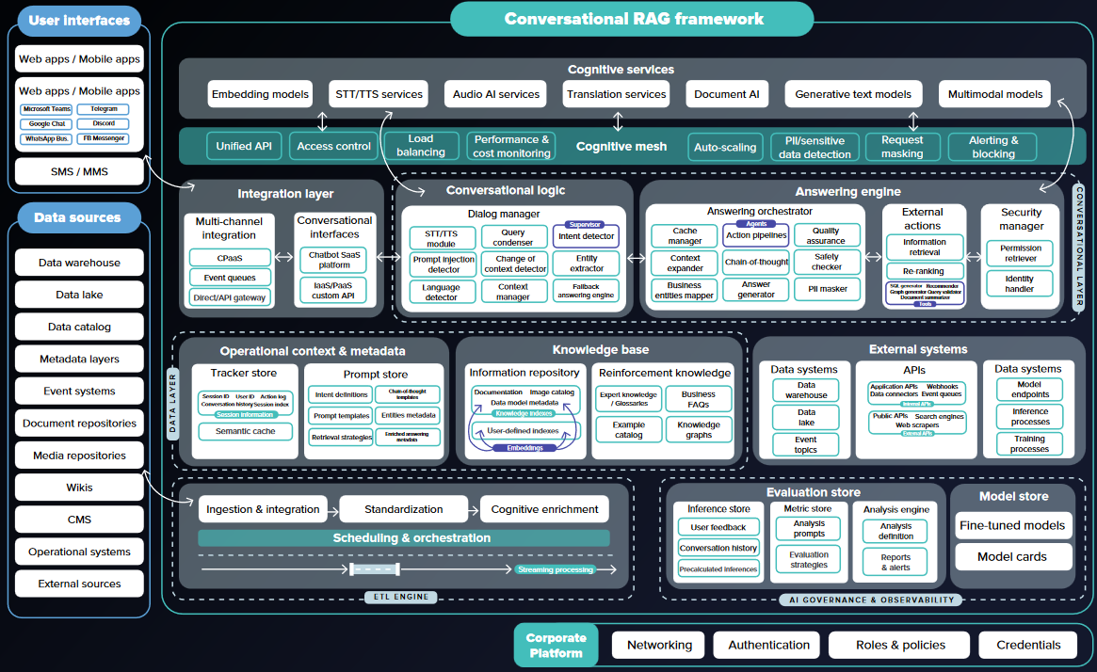
Why a career in Data & AI
Next-Gen AI & Gen.AI Systems

Slide 42
Take Home Message
If you were to ask me, yes, I´d do it again!

