Slide 1






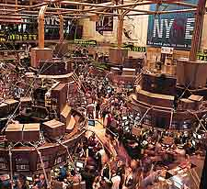
ECONOPHYSICS
Data Science in Fundamental Physics
and the bridge to industry & society
SANTIAGO DE COMPOSTELA, GALICIA, SPAIN 3 – 7 JUNE 2024
Luis Miguel Varela
Grupo de Nanomateriales y Materia Blanda
Dpto. Física de Partículas
Universidad de Santiago de Compostela
luismiguel.varela@usc.es

Slide 2
Econophysics
TOC
Econophysics
- Physics and Economics: the story of a “love affair”
- Standard financial model.
- Complex systems
- Critical phenomena
- Turbulent flows in fluids
- Economic complexity: the economy as a complex evolutionary system
- Complex networks

Slide 3

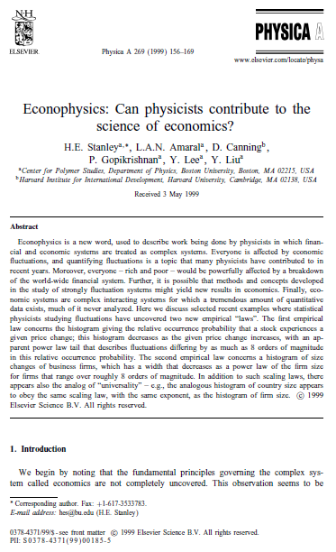
ECONOPHYSICS
• ECONOMICS + PHYSICS (H. E. Stanley, Calcutta, 1995) and appears for the first time in the proceedings published in Physica A 1996.
• Organization and complex dynamics of financial markets (scale invariance, systems with self-organized criticality)
PHYSICS OF COMPLEX SYSTEMS

Slide 4
FÍSICA Y ECONOMÍA
LA HISTORIA DE UN “ROMANCE”
Síntesis neoclásica (Hicks: marginalismo y+ keynesianismo)
Principios
1) los individuos tienen preferencias racionales
2) los individuos maximizan utilidad y las empresas ganancia.
3) los individuos actúan independientemente sobre las bases de información completa y relevante.
Equilibrio general
Monetarismo

Slide 5
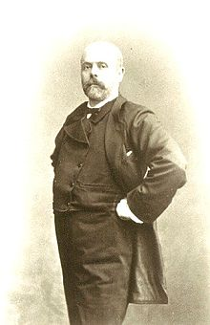
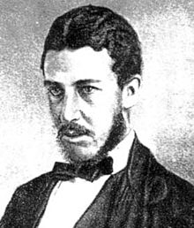
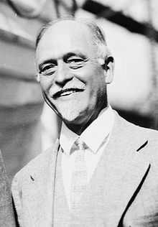
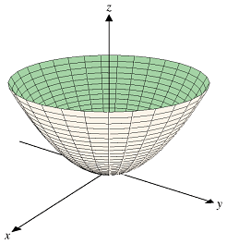
PHYSICS AND ECONOMY
History of a “love affair”
S. XIX Economy becomes a quantitative science (marginalism)
Economic dynamics in an irrotationl Price field
Slutsky
Leon Walras
W. S. Jevons
I. Fisher
Utility –quant.
General Equilibrium
W. Jevons
Irving Fisher
Budget restriction

Slide 6

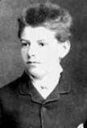
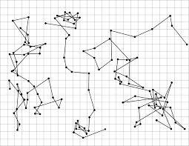
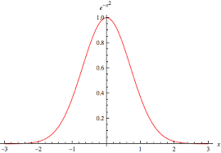
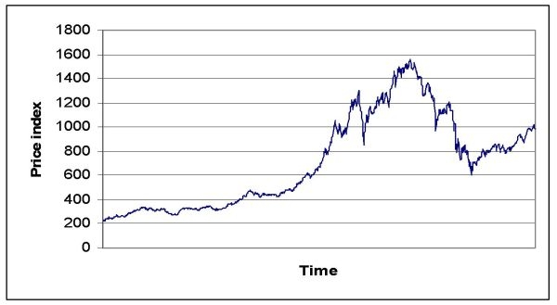
STANDARD MODEL OF FINANCE
(L. Bachelier, 1900)
THEORIE DE LA SPÉCULATION

Slide 7
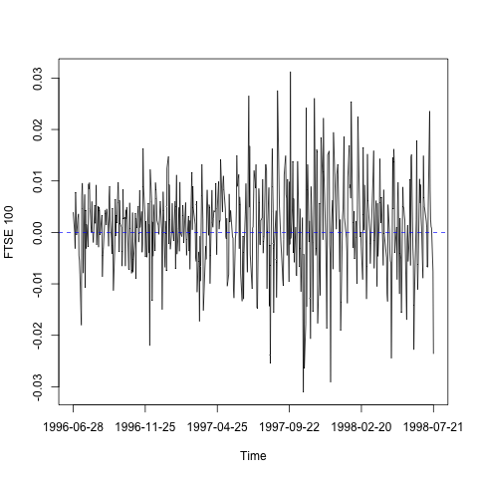
STANDARD FINANCIAL MODEL
(Black-Merton-Scholes)
Black-Merton-Scholes model for valuing derivatives
- Efficient and complete market (Fama hypothesis: all information in the price; informationally efficient markets)
- Formulation of the efficient market hypothesis in terms
of martingales.
- Risk-free (hedging strategy).
- There are no transaction costs.
- All market participants use all options
arbitration (arbitrage-free).
- The stochastic process followed by the underlying assets (stocks)
It is geometric Brownian motion (price dynamics).
FTSE 100

Slide 8
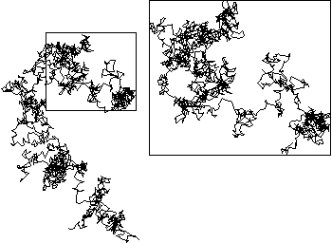
STANDARD FINANCIAL MODEL
(Black-Merton-Scholes)
Black-Merton-Scholes model for valuing derivatives
- Efficient and complete market (Fama hypothesis: all information in the price; informationally efficient markets)
- Formulation of the efficient market hypothesis in terms
of martingales.
- Risk-free (hedging strategy).
- There are no transaction costs.
- All market participants use all options
arbitration (arbitrage-free).
- The stochastic process followed by the underlying assets (stocks)
It is geometric Brownian motion (price dynamics).

Slide 9
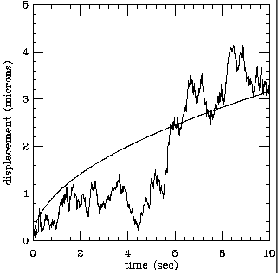
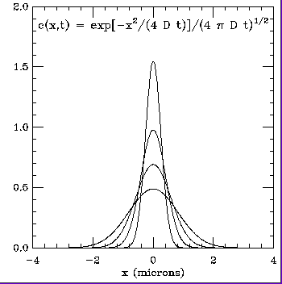
STANDARD FINANCIAL MODEL
(Black-Merton-Scholes)

Slide 10



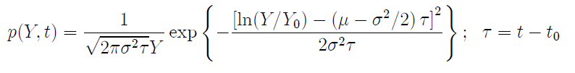
STANDARD FINANCIAL MODEL
(Black-Merton-Scholes)
UNDERLYING STOCK DYNAMICS
Brownian motion
Itô process (v.a. iid)

Slide 11



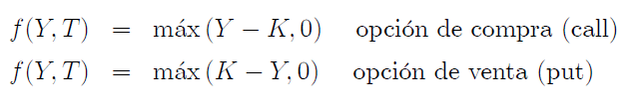
STANDARD FINANCIAL MODEL
(Black-Merton-Scholes)
OPTIONS
• Parabolic differential equation in linear partial derivatives of 2nd order
• Operator structure similar to the Fokker-Planck equation (Physics)
or Kolmogorov (Mathematics).
• Equation similar to that of diffusion with negative diffusion constant.
Nobel Prize (Bank of Sweden), 1997
-Merton/Scholes

Slide 12
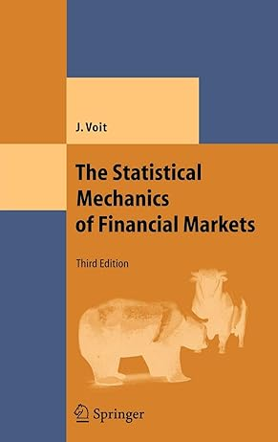
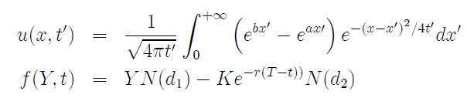
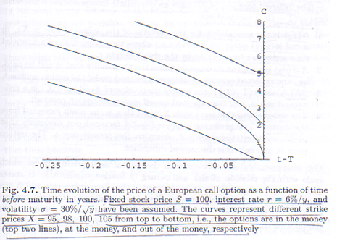
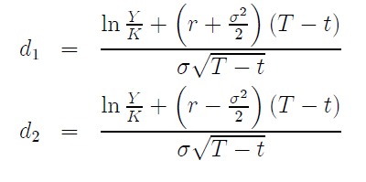
STANDARD FINANCIAL MODEL
(Black-Merton-Scholes)
J. Voit, The Statistical Mechanics of Financial Markets.

Slide 13
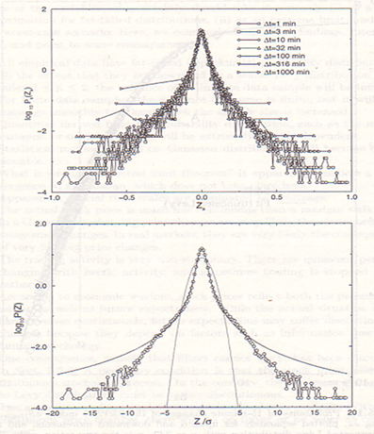
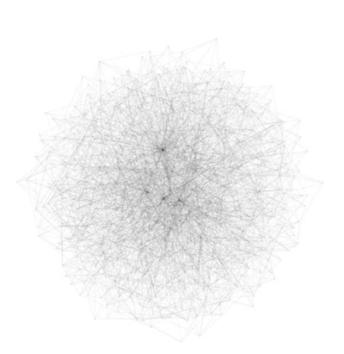
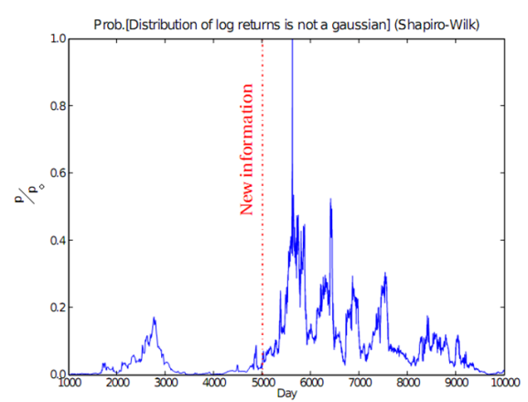

STANDARD FINANCIAL MODEL
(Black-Merton-Scholes)
Deficiencies of the Black_Merton-Scholes model
• Non-Gaussian stock price returns
• Existence of long-range memory in time series of prices
- Information asymmetries during information inputs to the market.
-Investor networks.
-Commissions.
Carrete-Varela, 2008, unpublished

Slide 14
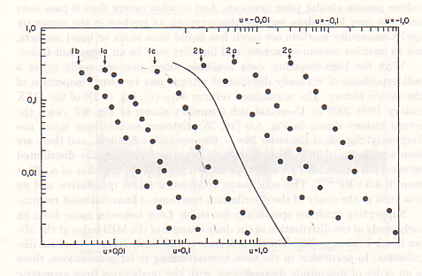
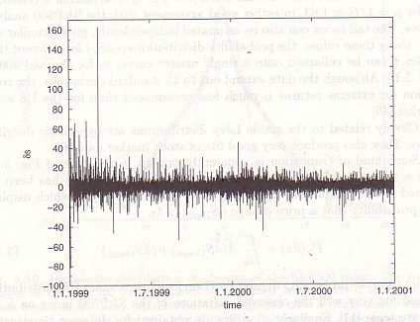
STANDARD FINANCIAL MODEL
(Black-Merton-Scholes)
Deficiencies of the Black_Merton-Scholes model
History of returns normalized with the standard deviation of the German DAX index during 1999 and 2000, with data taken with a time scale of 15 s. Note the occurrence of one event at 160s and several at (30s, 60s) (J. Voit, The Statistical Mechanics of Financial Markets. Springer, Berlin, 2003).
Frequencies of positive (1) and negative (2) changes in logarithms of cotton prices in various US markets. The solid line represents a cumulative Lévy distribution of indica 1.7. (B. Mandelbrot, J. Business 40, 394 (1963)).

Slide 15
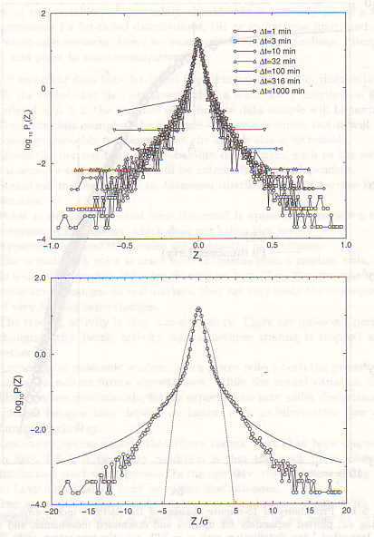
STANDARD FINANCIAL MODEL
(Black-Merton-Scholes)
Deficiencies of the Black_Merton-Scholes model
Probability distribution of changes in the S&P500 index. Comparison with Gaussian and stable Lévy distributions.

Slide 16
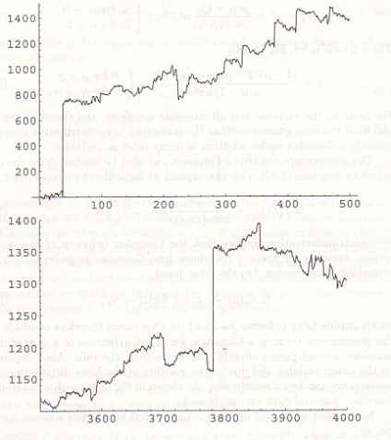
MODELO FINANCIERO STANDARD
(Black-Merton-Scholes)
Deficiencies of the Black_Merton-Scholes model
LÉVY FLIGHT
NEW INFORMATION
ENTERS THE MARKET

Slide 18
COMPLEX SYSTEMS
Systems with a very high number of constituent parts that interact with each other in a non-linear manner, which causes the existence of complex organization and dynamics.
• Existence of correlations: importance of fluctuations (Statistical Mech.)
• Non-linearity: there are no simple cause-effect relationships between elements.
A small stimulus can cause a big effect or none at all. Extreme events. Non-Gaussian
Lévy distributions.
• Scale invariant phenomena: lack of a characteristic scale (criticality, self-organization, fractality)
• Feedback mechanisms in both amplification and attenuation of effects.
• Open systems.
Critical phenomena
Applications
Fluid turbulence
Economy (Econophysics)

Slide 19
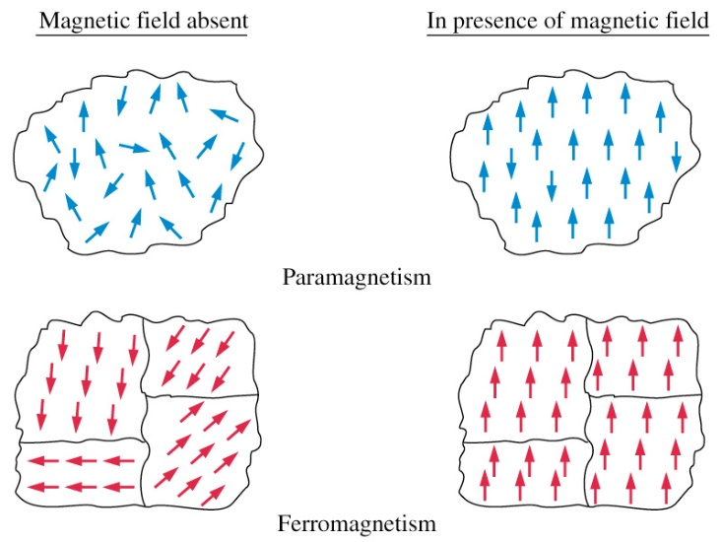
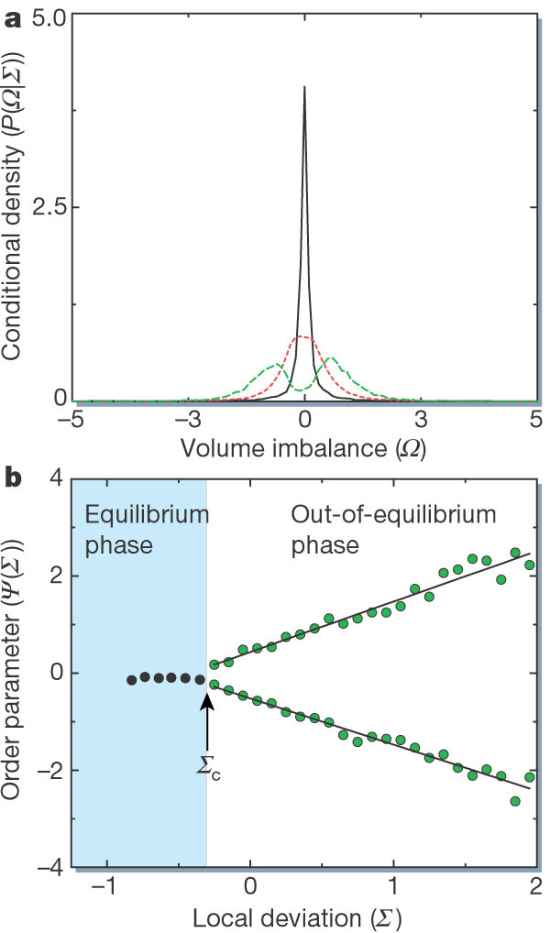
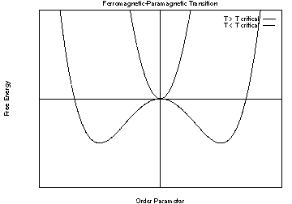
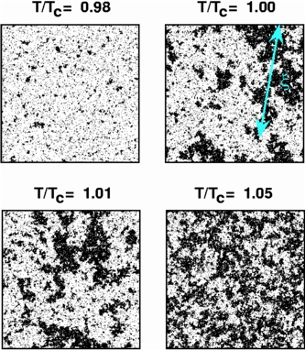
CRITICAL PHENOMENA
Ferromagnetic pase transition.

Slide 20
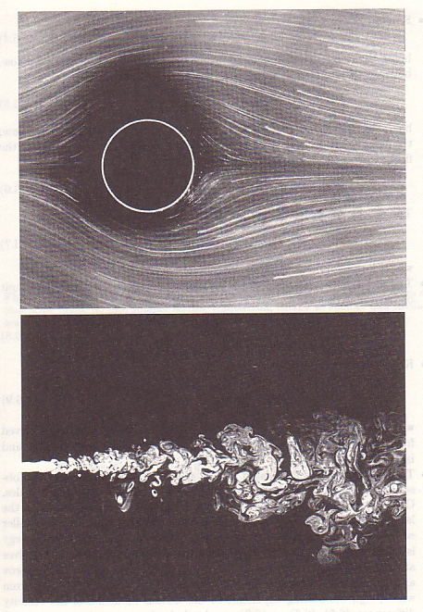
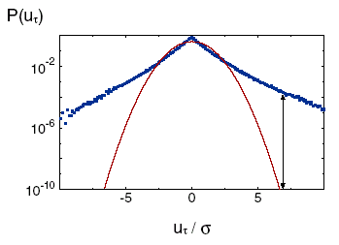
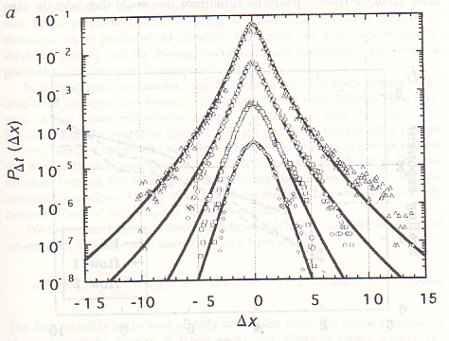
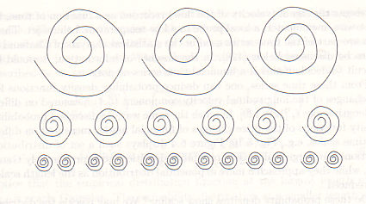
TURBULENT FLUXES IN FLUIDS
Distribution of changes in wind speed during 4 s intervals obtained on the German North Sea coast. The curve represents the Gaussian distribution with the sample standard deviation.
R=1.>54
R=2300
Reynolds number
R=lv/h
Probability density for variations in the US$/DEM exchange rate in intervals of 640, 5120, 40960 and 163840 s (from top to bottom). Nature 381, 767 (1996).
Cascade model: Transfer of energy between
scales of the system.
J. Voit, The Statistical Mechanics of Financial Markets. (Springer-Verlag, Berlín, 2003)

Slide 21
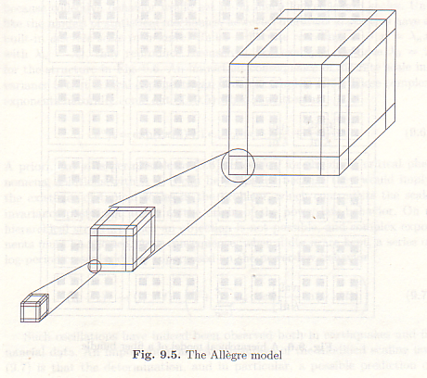
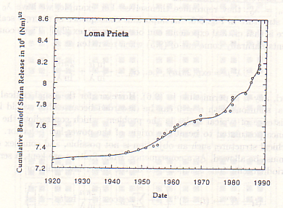
CRISIS CRÍTICAS DEL MERCADO: SISTEMAS JERÁRQUICOS
Allègre model of earthqueakes
•Multiscale systems
• Interconnenction between objects in diferent scales.
Benioff stress prior to the Loma Prieta earthquake fitted to a power law with log-periodic corrections. D. Sornette, C. G. Sammis, J. Phys. I (France), 5, 607 (1995).
J. Voit, The Statistical Mechanics of Financial Markets. (Springer-Verlag, Berlín, 2003)

Slide 22
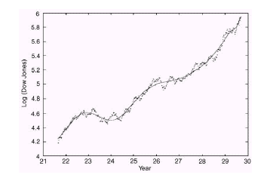
CRISIS CRÍTICAS DEL MERCADO: SISTEMAS JERÁRQUICOS
Allègre model of earthqueakes
•Multiscale systems
• Interconnenction between objects in diferent scales.
Time dependence of the Dow Jones index from June 1921 to September 1929 and fit with a modified log-periodic equation. Sornette, D., Johansen, A., Large financial crashes. Physica A 245, 411 (1997).
J. Voit, The Statistical Mechanics of Financial Markets. (Springer-Verlag, Berlín, 2003)

Slide 23
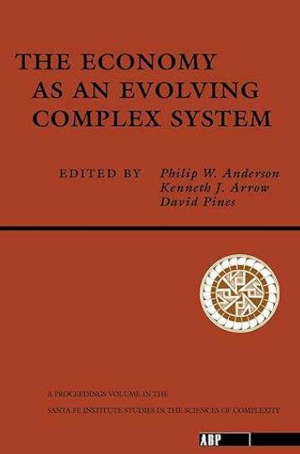
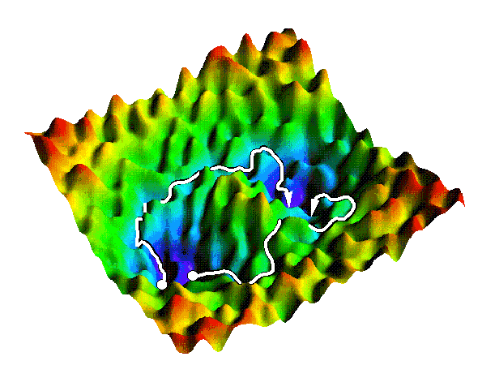
ECONOMIC COMPLEXITY: THE ECONOMY AS AN EVOLVING COMPLEX SYSTEM
Is the economy a complex system?
http://gold.cchem.berkeley.edu/Pictures_and_Images/rugged.gif

Slide 24

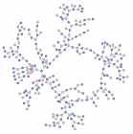
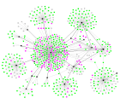
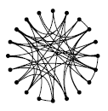
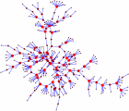

ECONOMIC COMPLEXITY: THE ECONOMY AS AN EVOLVING COMPLEX SYSTEM
Formal description of the structure and dynamics of a complex system
Structure: network formed by agents (vertices) and interactions between them (connectors).
www-personal.umich.edu/~mejn/networks/

Slide 25

ECONOMIC COMPLEXITY: THE ECONOMY AS AN EVOLVING COMPLEX SYSTEM
Formal description of the structure and dynamics of a complex system
Mathematical description
Theory of complex networks.
Statistical mechanics of stable processes. Fractals.
Nonlinear dynamic systems. Chaos theory.
Statistical Mechanics (phase transitions, self-organized criticality...).
Thermodynamics of irreversible processes (nonlinear regime).
Computer simulation.
BSC supercomputer

Slide 26

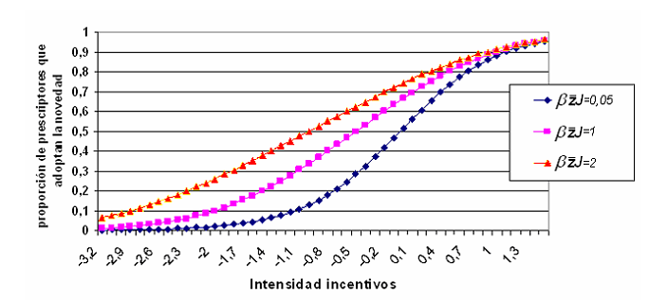
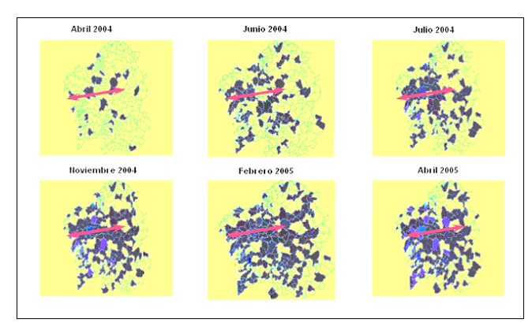
COMPLEX NETWORKS
Dynamic processes in complex systems
DYNAMICS: Complex network as a substrate for nonlinear dynamic processes. Relationship between structure and dynamics of complex networks.
Propagation processes: market penetration

Slide 27
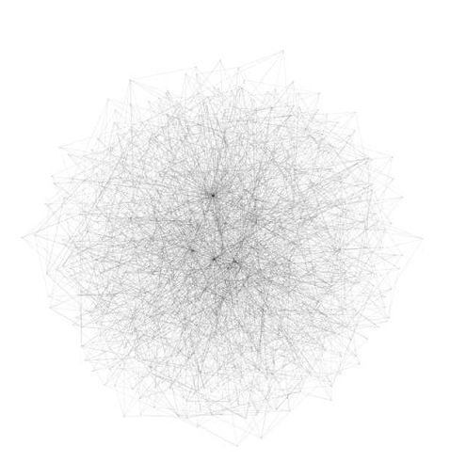
COMPLEX NETWORKS
Dynamic processes in complex systems
Diffusion processes in financial markets.
AB scale-free network (N=500) employed in the simulations of financial markets.

Slide 28

SIMULATIONS OF FINANCIAL MARKETS

Slide 29
POTENTIAL JOBS
QUANTITATIVE ANALYST (STOCK EXCHANGE)
INSURANCE ACTUARY
DATA ANALYST
RISK AND CRISIS MANAGEMENT
QUALITY AND CONTROL
FINANCES IN GENERAL
UNIV. FRIBURGO
UNIV. SILESIA
CNR
https://wwwold.iac.cnr.it/~filippo/projects/econophysics.html

Slide 30
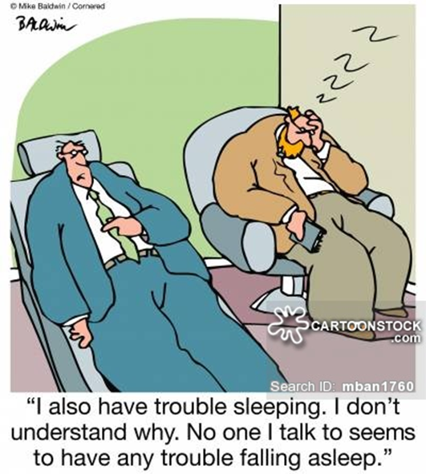
THANKS A LOT
FOR YOUR
ATTENTION

Slide 31
REFERENCES
1. P. Samuelson, P., W. D. Nordhaus, Economía, 16ª edición (McGraw-Hill, Madrid, 1999).
2. http://es.wikipedia.org
3. W. Brian Arthur, Science, 284, 107 (1999).
4. H. Takayasu, Fractals in the Physical Science, (Manchester University Press, Manchester, 1990).
5. R. N. Mantegna, H. E. Stanley, An Introduction to Econophysics (Cambridge University Press, Cambridge, 2000).
6. The Complex Networks of Economic Interactions: Essays in Agent-Based Economics and Econophysics. Akira Namatame, Taisei Kaizouji, Yuuji Aruka (Eds) (Springer, 2006).
7. Statistical Mechanics of Complex Networks. Romualdo Pastor-Satorras, Miguel Rubi, Albert Diaz-Guilera (Eds.) (Springer, 2003).
8. The Economy As An Evolving Complex System (Santa Fe Institute Studies in the Sciences of Complexity Proceedings) Philip W. Anderson, Kenneth Arrow, David Pines et al. (Westview, 1988)
9. J. Voit, The Statistical Mechanics of Financial Markets. (Springer-Verlag, Berlín, 2003).
10. Per Bak, C. Tang, K.Wiesenfeld, Phys. Rev. Lett. 59, 381 (1987 ).
11. Duncan J. Watts, Steven H. Strogatz, Nature 393, 440 (1998)
12. Alun L. Lloyd, Robert M. May, Science 292, 1316 (2001).
13. R. Albert, A.-L. Barabási, Rev. Mod. Phys. 74, 47 (2002)
14. S. Boccaletti et al. Physics Reports 424 (2006) 175 –308.
15. Y. Moreno, R. Pastor-Satorras, A. Vespignani Eur. Phys. J. B 26, 521 (2002).
16. R. Pastor-Satorras, A. Vespignani, Phys. Rev. E, 65, 036104 (2002)
17. T. Saramäki, K. Kaski, J. Theor. Biol. 234, 413 (2005).
18 J.C. Sprott, Chaos 18, 023135 (2008)
19. A. Consiglio, V. Lacagnina, A. Russino, Quantitative Finance 5, 71 (2005)

Slide 32
ECONOPHYSICS
Data Science in Fundamental Physics
and the bridge to industry & society
SANTIAGO DE COMPOSTELA, GALICIA, SPAIN 3 – 7 JUNE 2024
Luis Miguel Varela
Condensed Matter Physics
Dpto. Física de Partículas
Universidad de Santiago de Compostela
luismiguel.varela@usc.es

