Slide 1
S302 Job and Task management
S302 Contract activity is defined by Job creation in JMT.
Job Title has to be relevant enough, mentioning Experiment/Project and activity brief description.
Ideally, in order to keep a good granularity and by consequent an appropriate activity control, job duration should not exceed 160h.
In some specific cases, especially when one person only is dedicated for an experiment/Project, create a Job each month is not very easy and efficient (budget request, signature…).
One solution is to provide a tool to divide a main job in sub-tasks.

Slide 2
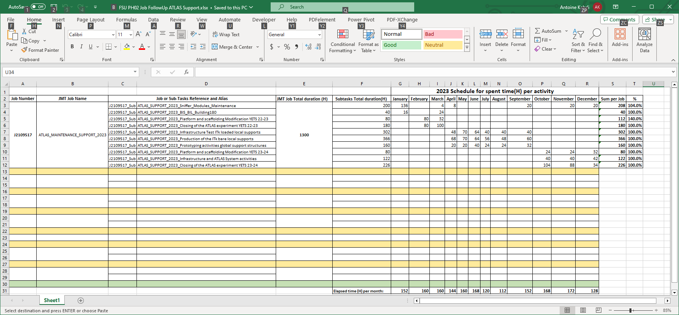
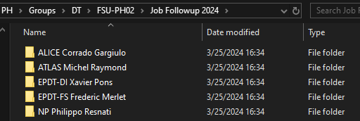
S302 Job and Task management
Already introduced for test in 2023.
Based on Excel file.
Each Supervisor has a dedicated file.

Slide 3
S302 Job and Task management

Slide 4
S302 Job and Task management
All data can be modified online in case of activity change.
Possibility to schedule tasks over the year (recurrent tasks).
No limitation on the amount of tasks.
Several JMT Job can be divided in sub-tasks in the same file (separated by yellow line).

Slide 5
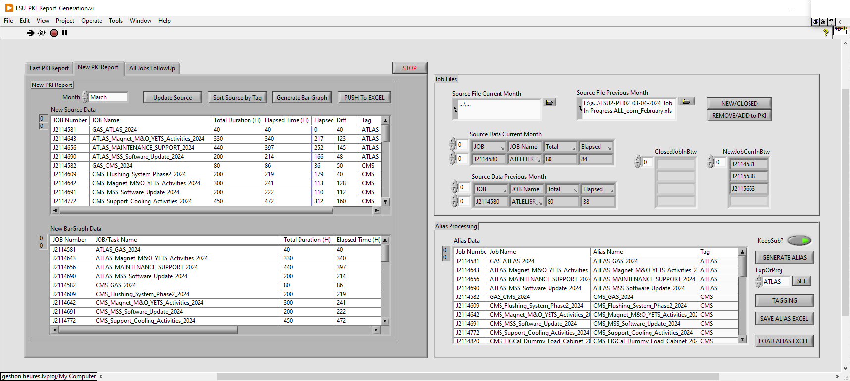
S302 Job and Task management
Data Processed by a dedicated application to generate a monthly Follow-Up Activity Report :

Slide 6
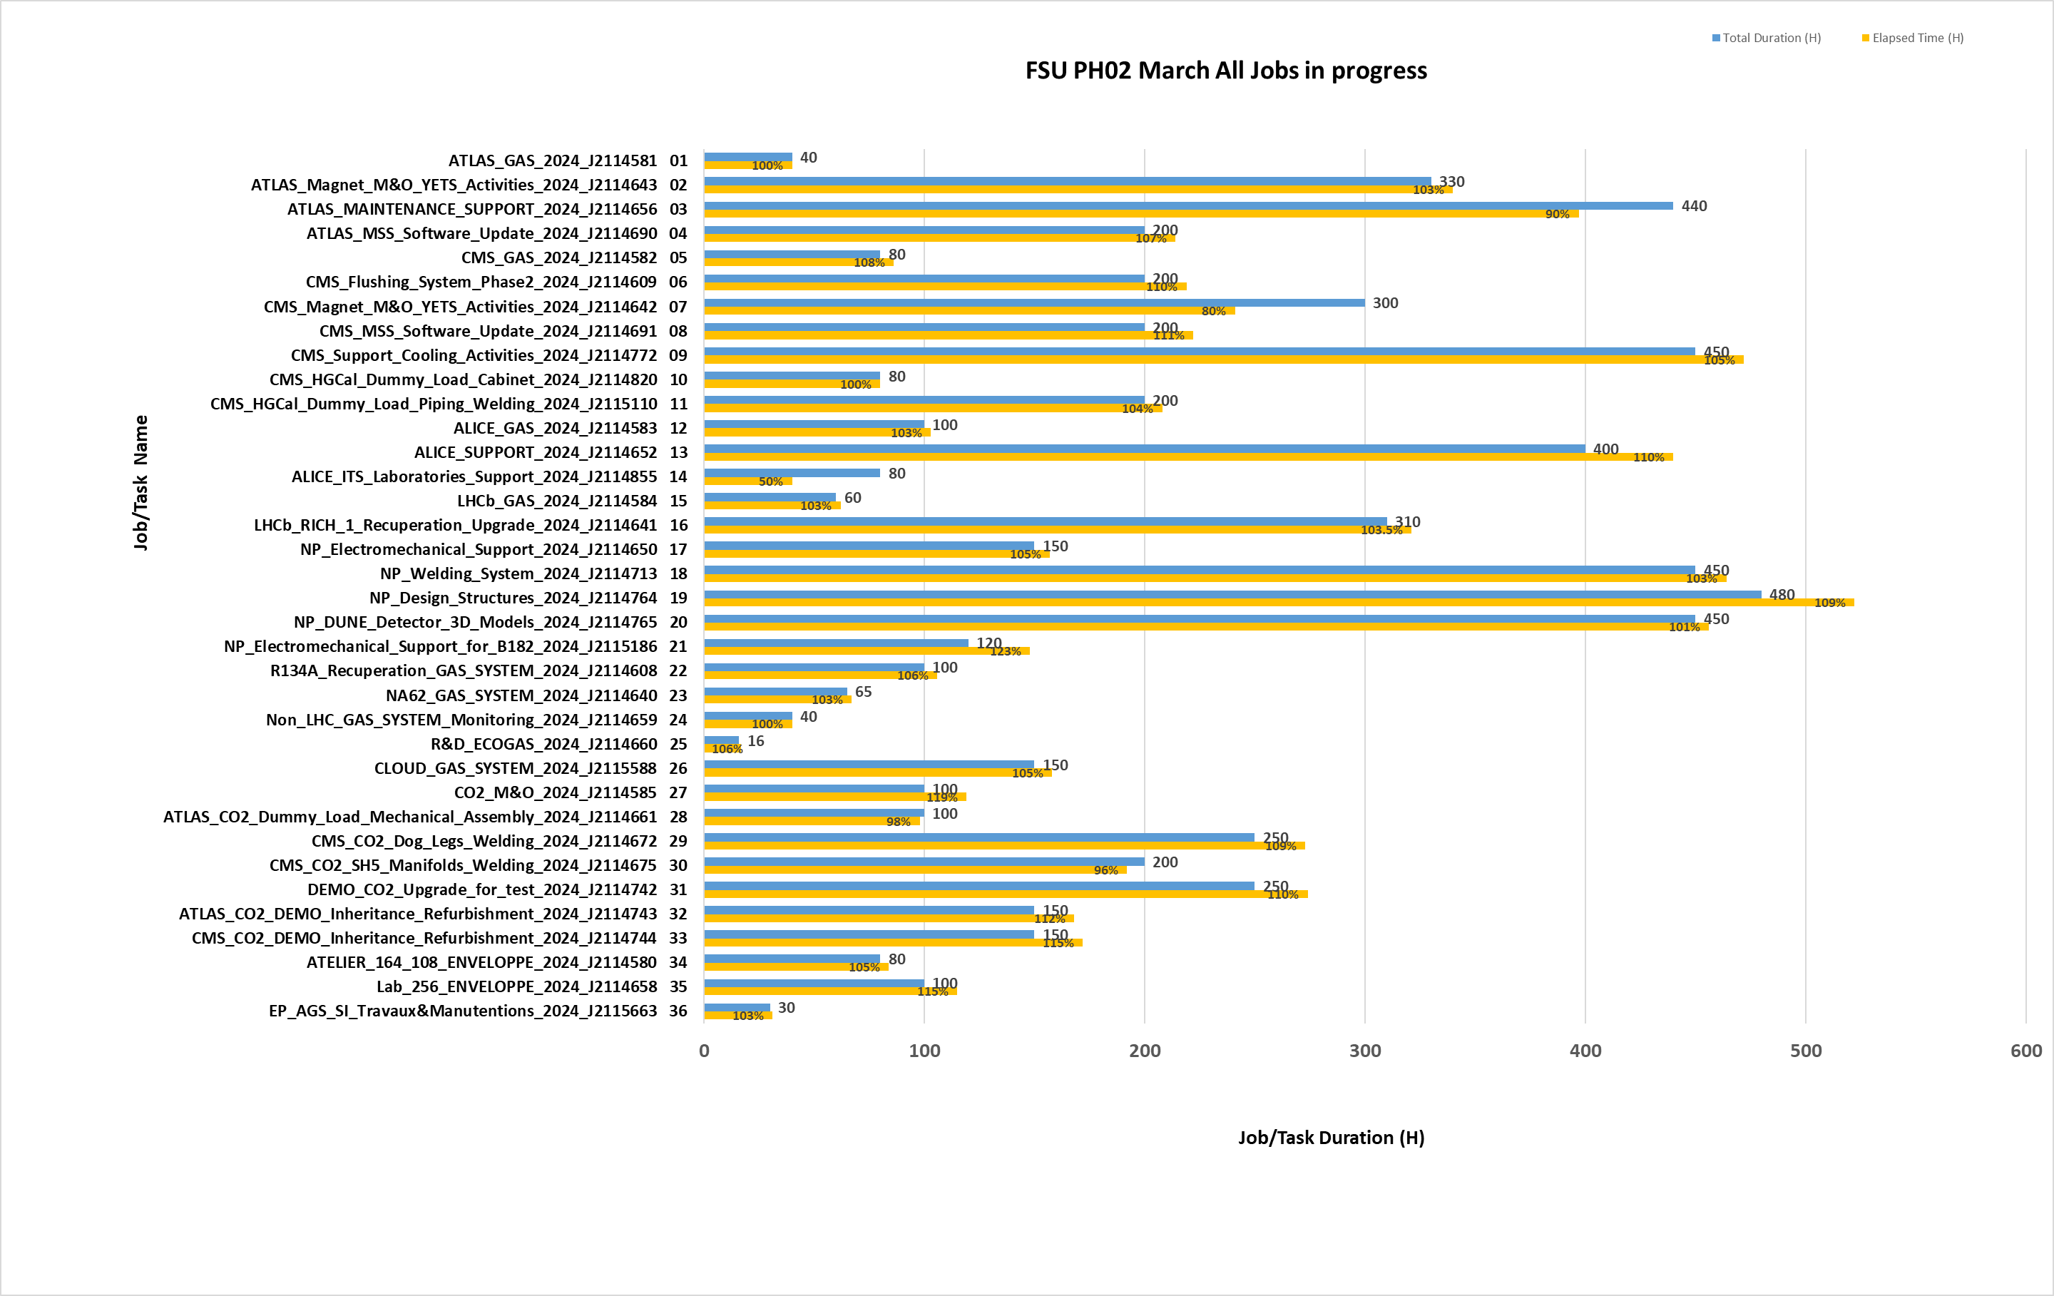
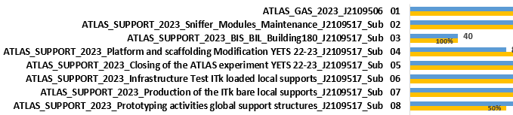
S302 Job and Task management
Bar Graph based on current Jobs/Tasks
for Month activity.

Slide 7
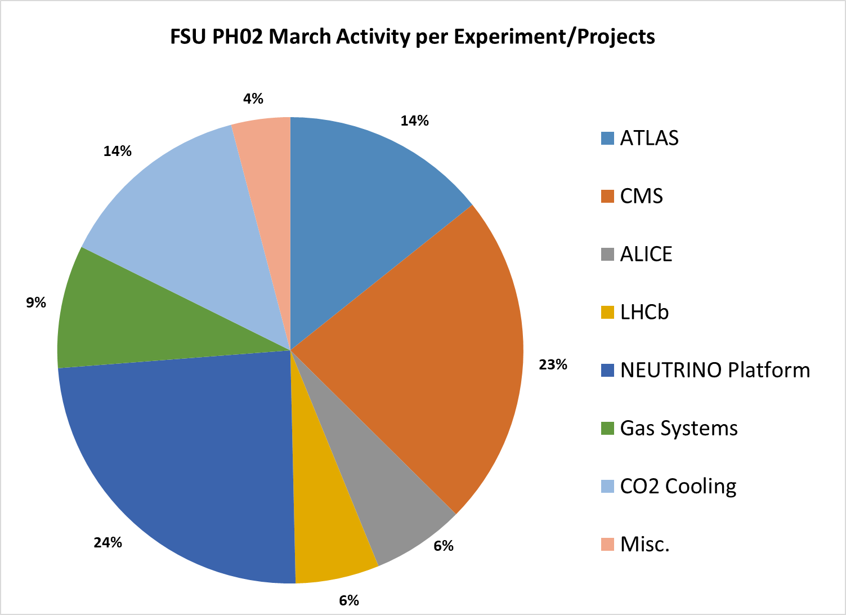
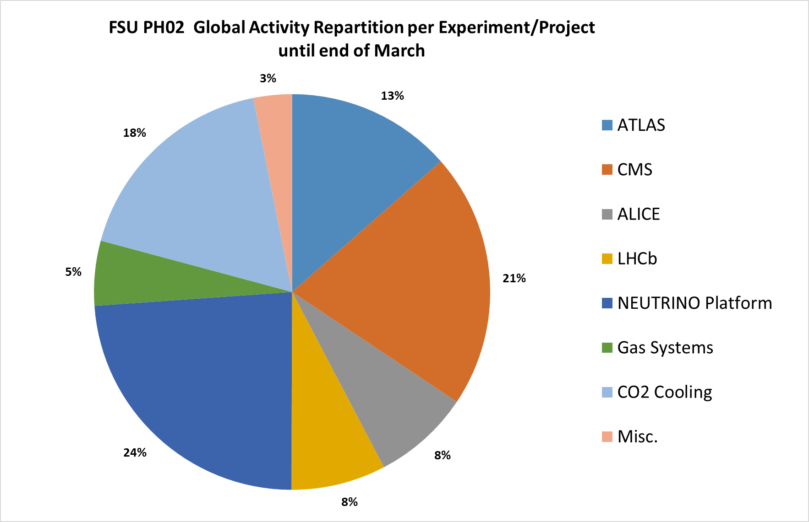
S302 Job and Task management
Pie Chart for monthly activity repartition per Exp/Project
Pie Chart for activity repartition from beginning of year per Exp/Project

