Slide 1


Protection of beam vacuum with fast shutters or existing gate valves
Friday, 27th May 2011
Jérôme Chauré

Slide 2
Introduction
Following the sector 3-4 incident in September 2008 it has been decided by the CERN management to consolidate the LHC beam vacuum system in order to minimise the possibility of collateral damage to LHC systems should a similar incident take place in the future.
Part of this consolidation will include the addition of fast shutters and / or an improvements to the current gate valves, which will allow a faster sectorisation of the beam vacuum and so prevent the propagation of contamination to sensitive in-vacuum equipment near to the site of the incident.

Slide 3
Dynamic pressure wave
A dynamic pressure wave in the vacuum system can reach a velocity of 1000 ms⁻¹ at room temperature and 35 ms⁻¹ at cryogenic temperature.
Case 1: Incident in cold section (arc)
valve
Debris at 35 ms⁻¹
Zone to protect
0.7 m
20ms closure
OK
NOK
35 m
1s closure
OK
NOK

Slide 4
Dynamic pressure wave
A dynamic pressure wave in the vacuum system can reach a velocity of 1000 ms⁻¹ at room temperature and 35 ms⁻¹ at cryogenic temperature.
Case 2: Incident in LSS
valve
Debris at 1000 ms⁻¹
Zone to protect
20 m
20ms closure
OK
NOK
1000 m
1s closure
OK
NOK

Slide 5
Dynamic pressure wave
Following Cedric Garion’s studies, the cold stand alone magnets in the Long Straight Section aren’t long enough to significantly decrease the velocity of the dust and particles.
It is clear that it will not be possible to protect all equipment under all circumstances.

Slide 6
Equipment to be protected
The purpose of these valves is to protect some LHC components with sensitive elements inside the beam vacuum that would either require replacement or extensive re-conditioning if contaminated.
injection kickers
Injection kicker magnets (MKI) are installed in groups of 4 in IR2L and IR8R. They are sensitive to contamination by dust or larger particles. They may also be sensitive to rapid changes in pressure.
RF cavities
The main RF accelerating cavities (ACS) are installed in one group of 4 modules symmetrically centred on IR4. They are sensitive to contamination by dust or larger particles. Contamination should be less than experienced by the cavities during assembly in a clean room.

Slide 7
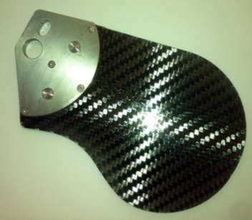
Addition of Fast Shutter
LEP Fast shutter.
Patrick Coly’s work:

Slide 8
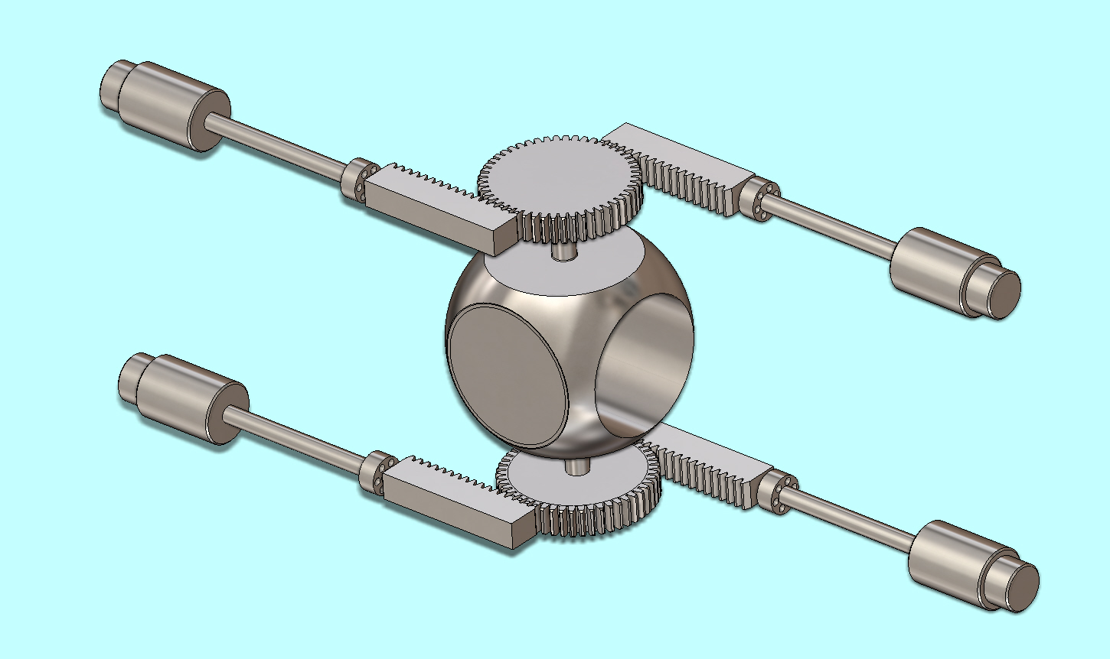
Addition of Fast Shutter
Studies from students at Oxford University Engineering Department:
Beam path
Open Position

Slide 9
Improvement on existing Gate Valve
Position indicator
Solenoid
Gate
Pneumatic actuator

Slide 10
Gate Valve
Source: VAT catalog

Slide 11
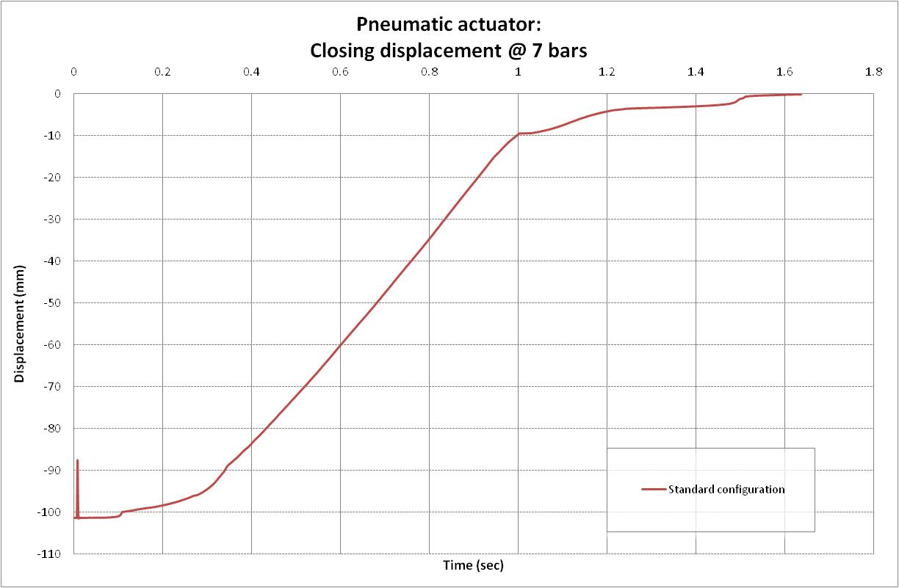
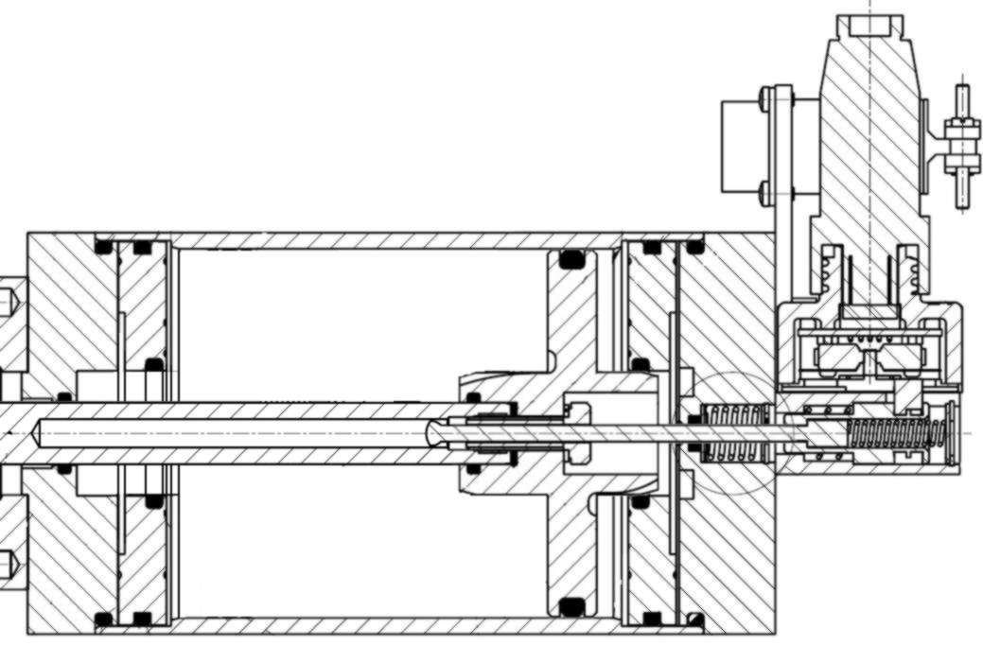
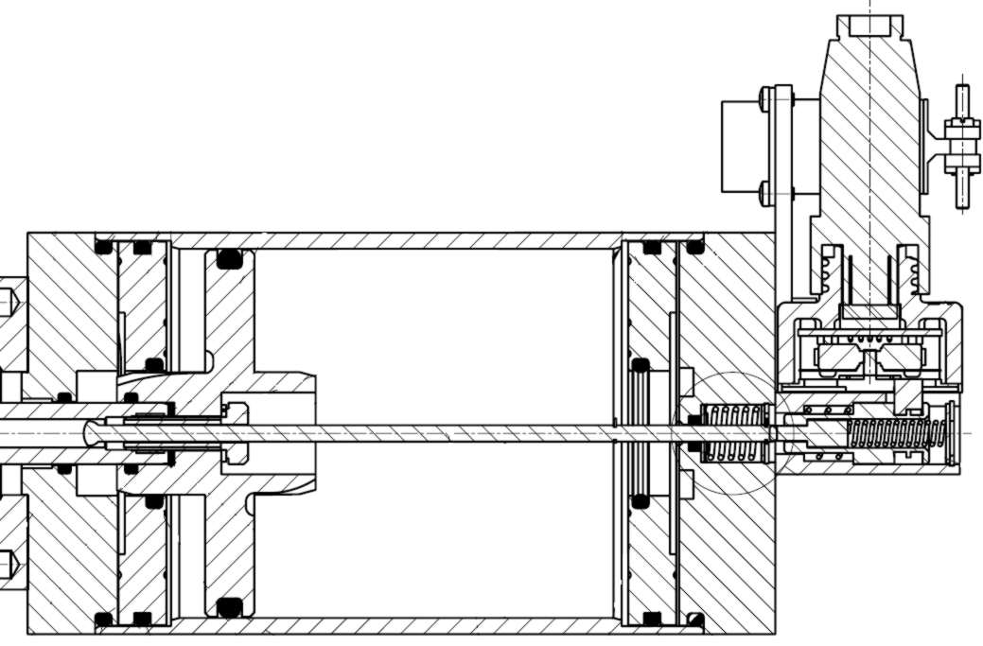
Gate Valve
Damping to be kept

Slide 12
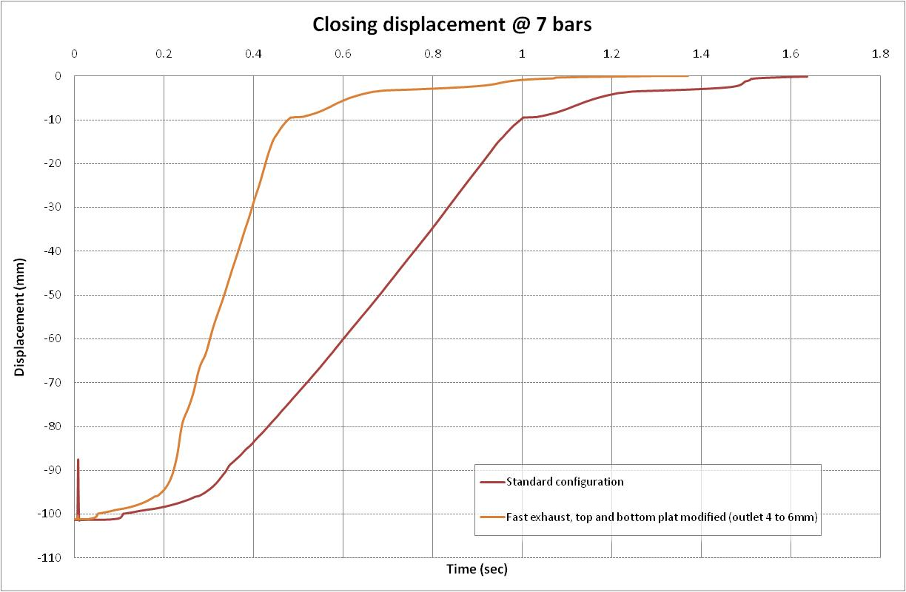
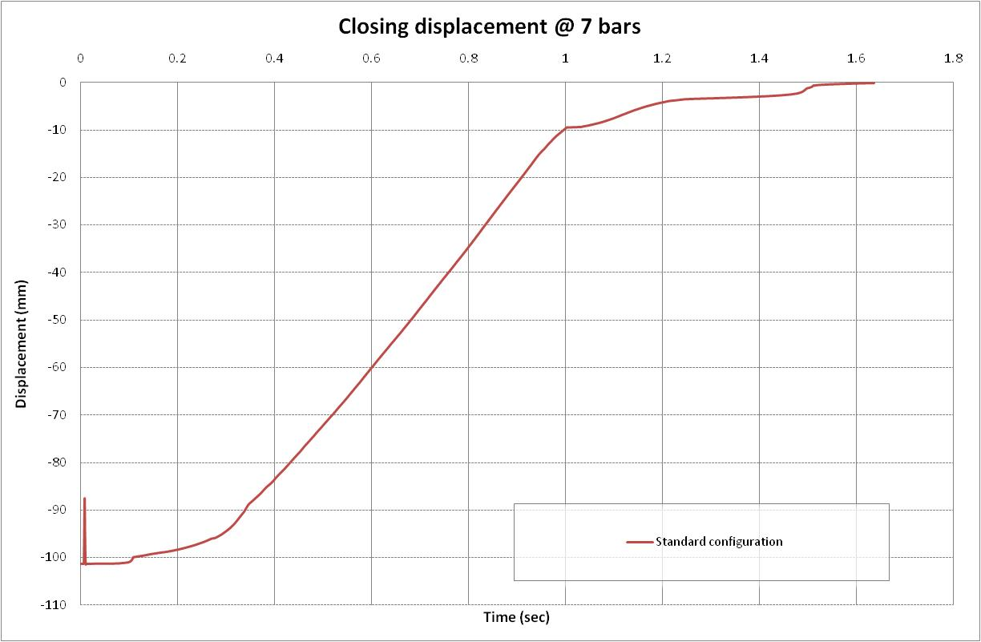
Improvement on
Gate Valve DN63 Type A

Slide 13
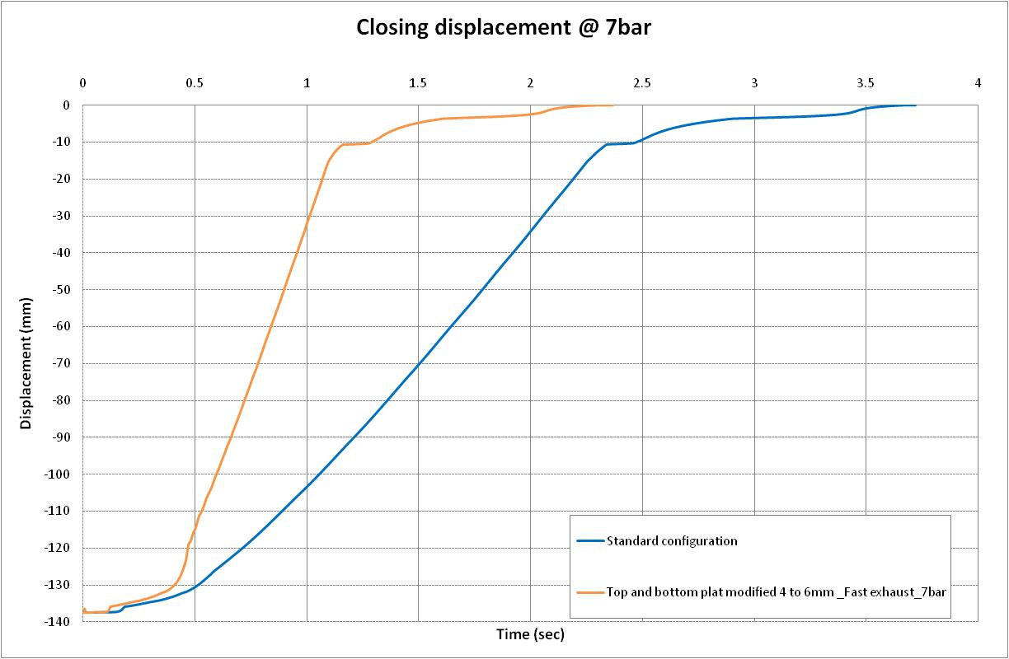
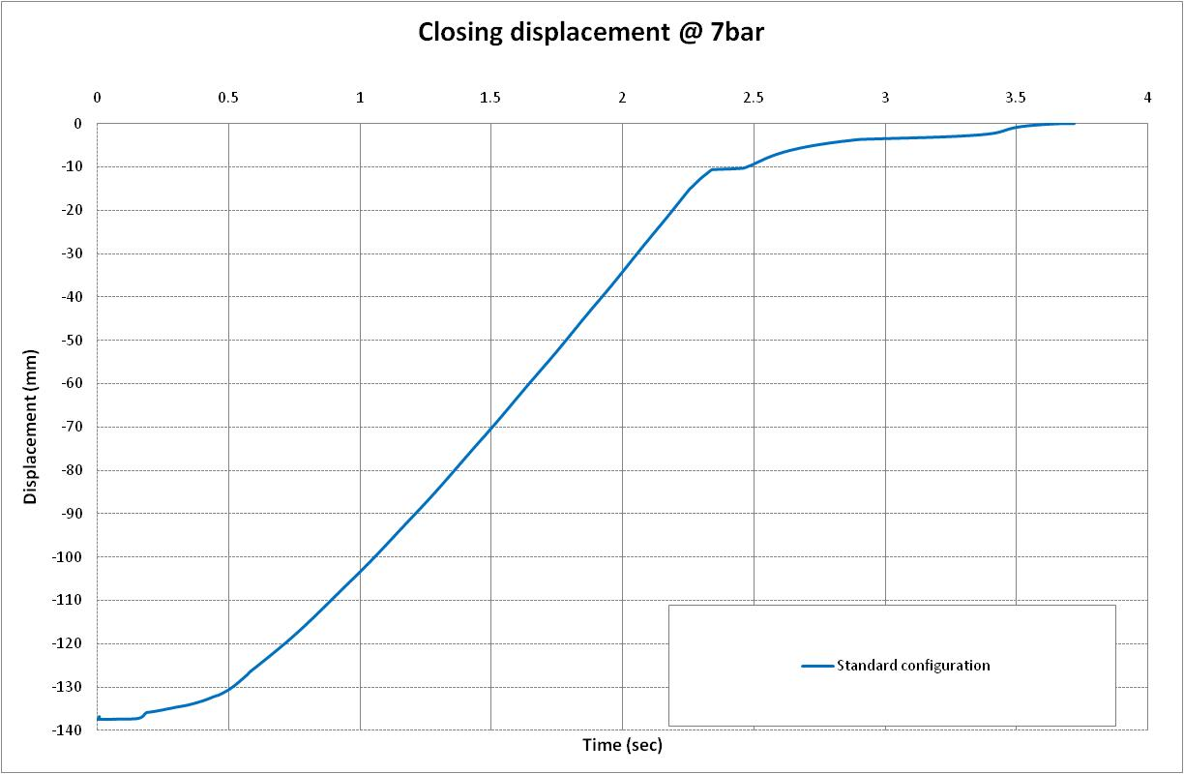
Improvement on
Gate Valve DN100 Type D

Slide 14
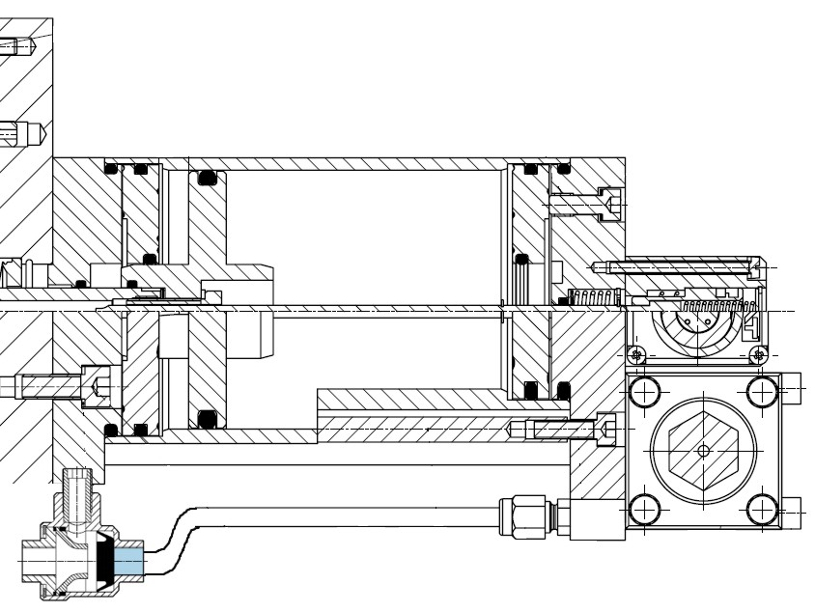
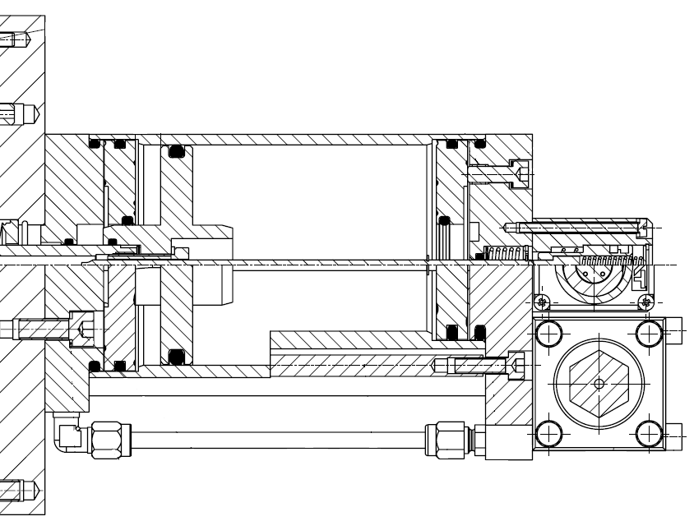
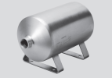
Closing time improvement for a gate valve
These improvements are due to:
An implementation of a fast exhaust:
An improvement from the air pressure pipe:
  Addition of air reservoir near the valve.
  Increase in pipe diameter from 6*1 to 8*1 mm.
An improvement from the inlet and outlet diameters from the closed plates.
Source: Festo & VAT

Slide 15
Conclusions

Slide 16
Acknowledgements
Patrick Coly, Paul Cruikshank, Eugénie Gallay, Cedric Garion, Michael Guinchard, Hendrik Kos,
Willemjan Maan, Benoit Rio, Raymond Veness.

