Slide 1
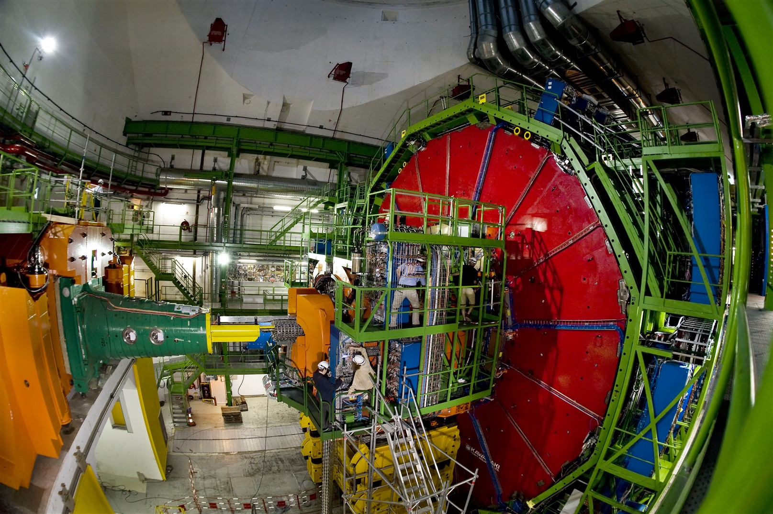
Stress and Buckling Analysis of CMS Experimental Beam Pipes for Intervention Loading Conditions
Study interventions to CMS with the beampipe under vacuum
  [ VSC - CMS Work Package 2.1.3 ]
  Vacuum systems currently vented to atmosphere to avoid any risk to components and personnel.
  Time/Resource saving

Slide 2
Stress and Buckling Analysis of CMS Experimental Beam Pipes for Intervention Loading Conditions
Problems
  Different support configurations during stages of the opening procedure
  Added stress to beam pipe from vacuum
  Buckling failure possible under vacuum

Slide 3
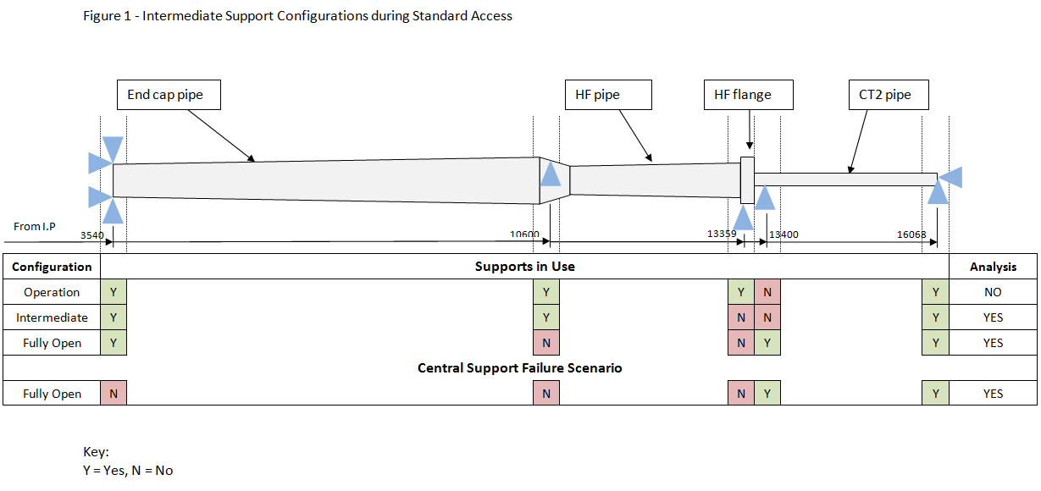
Stress and Buckling Analysis of CMS Experimental Beam Pipes for Intervention Loading Conditions
Support Configurations of Forward Region
CMS Opening procedure – EDMS 1075283

Slide 4
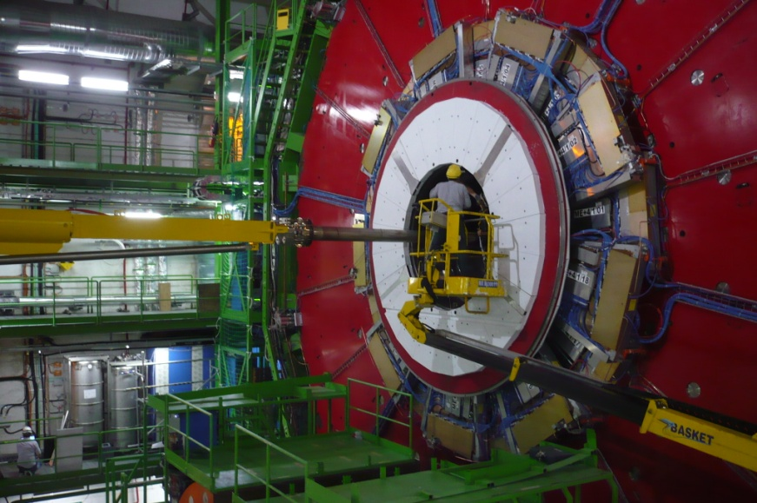
Stress and Buckling Analysis of CMS Experimental Beam Pipes for Intervention Loading Conditions
Methodology
  Compare loading cases with and without vacuum
    Fully open
    Intermediate
  Stress, Sag, Buckling Analyses
  Compare calculations with metrology for verification

Slide 5
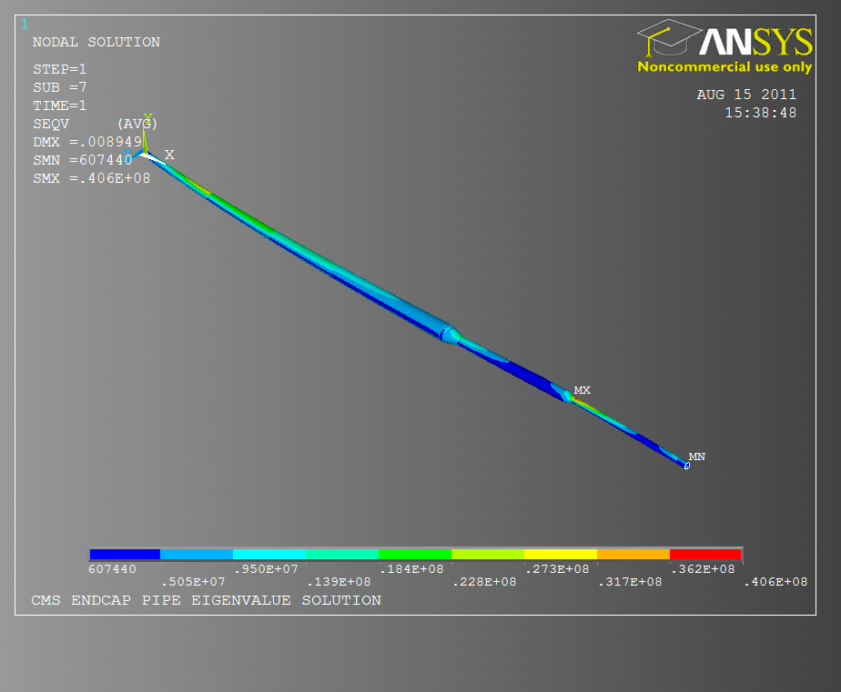
Stress and Buckling Analysis of CMS Experimental Beam Pipes for Intervention Loading Conditions
Fully Open Conditions
  Boundary Conditions:
  Comparison Vacuum vs. No Vacuum
    2% increase in max.
    stress under vacuum
    [40.6 > 39.8 MPa]
    No detectable change
    in sag

Slide 6
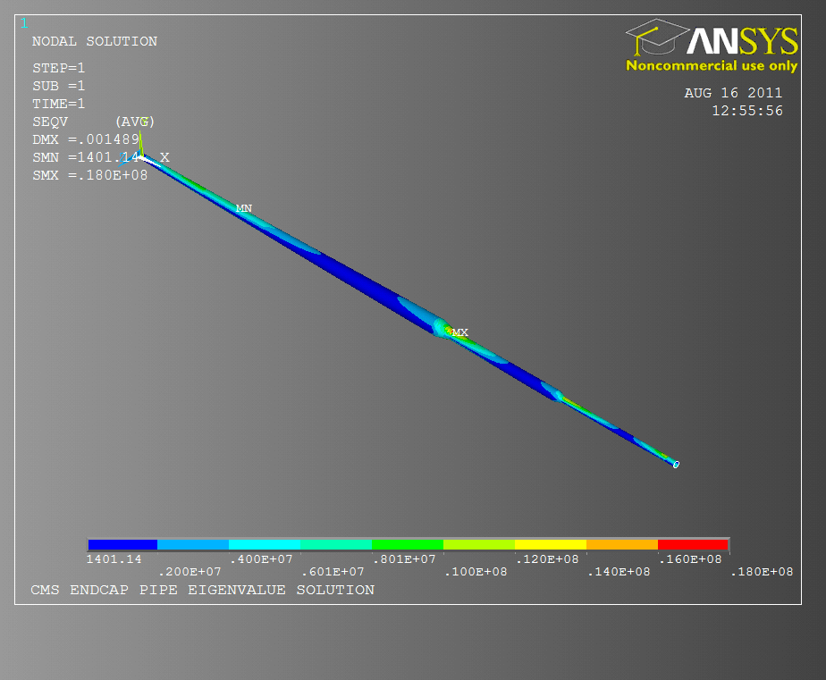
Stress and Buckling Analysis of CMS Experimental Beam Pipes for Intervention Loading Conditions
Intermediate Conditions
  Boundary Conditions:
  Comparison Vacuum vs. No Vacuum
    6% increase in max.
    stress under vacuum
    [19.1 > 18.0 MPa]
    No detectable change
    in sag

Slide 7
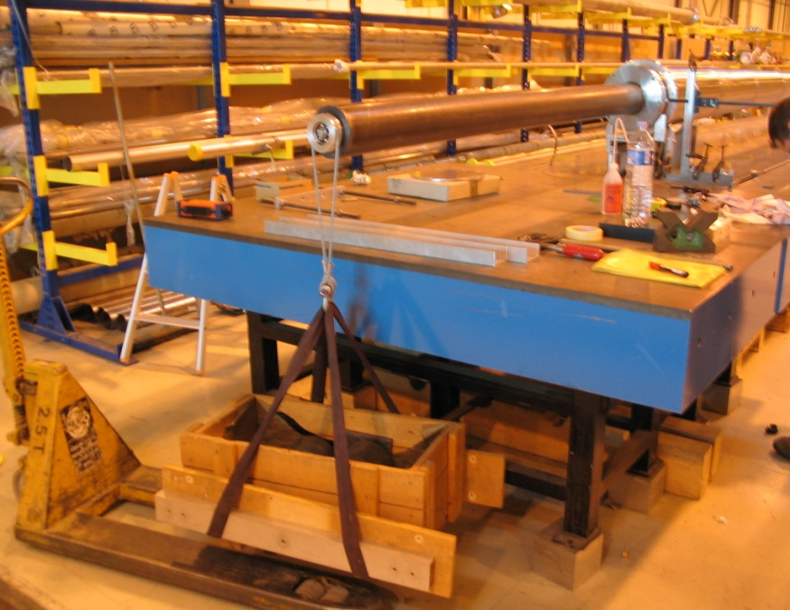
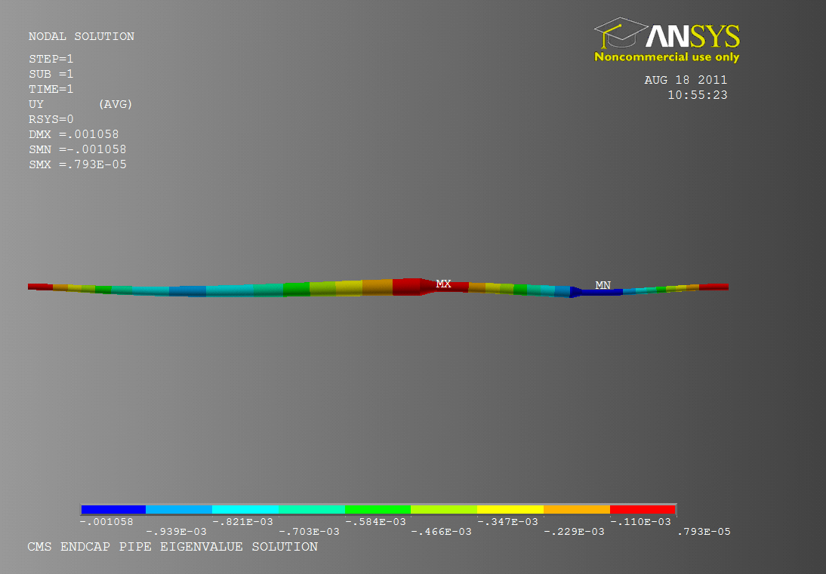
Stress and Buckling Analysis of CMS Experimental Beam Pipes for Intervention Loading Conditions
Comparison with Metrology
  Previous metrology takes
  into account Intermediate
  conditions
    Sag
    Metrology – 0.97 mm
    FE Analysis – 0.94 mm
    3% difference

Slide 8
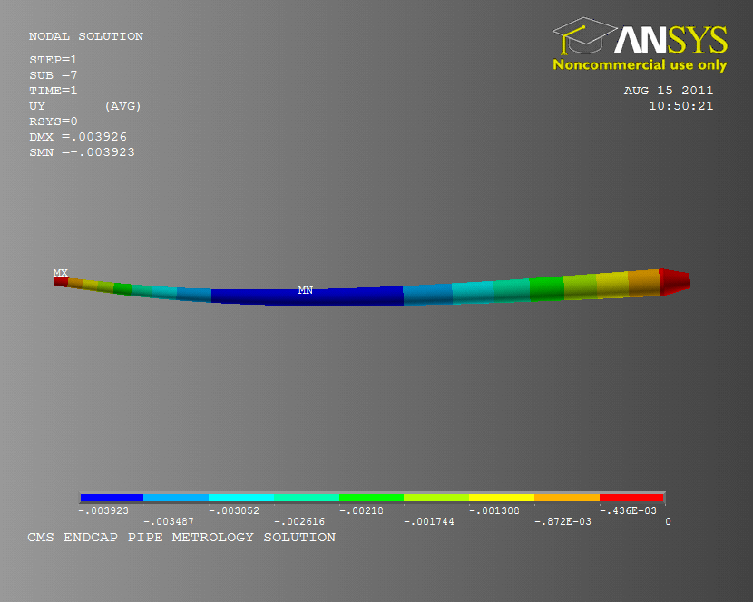
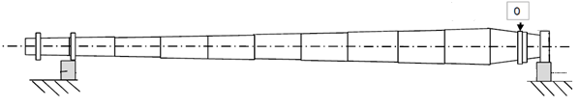
Stress and Buckling Analysis of CMS Experimental Beam Pipes for Intervention Loading Conditions
  Recent Metrology of End Cap pipe

Slide 9
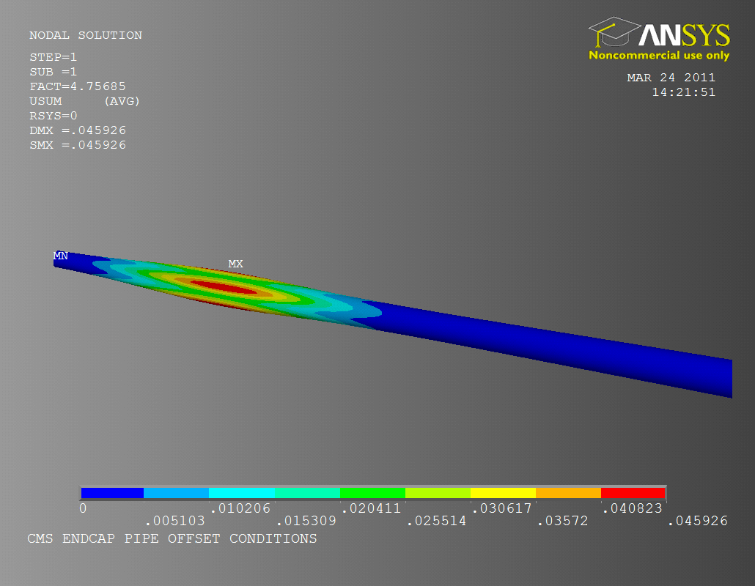
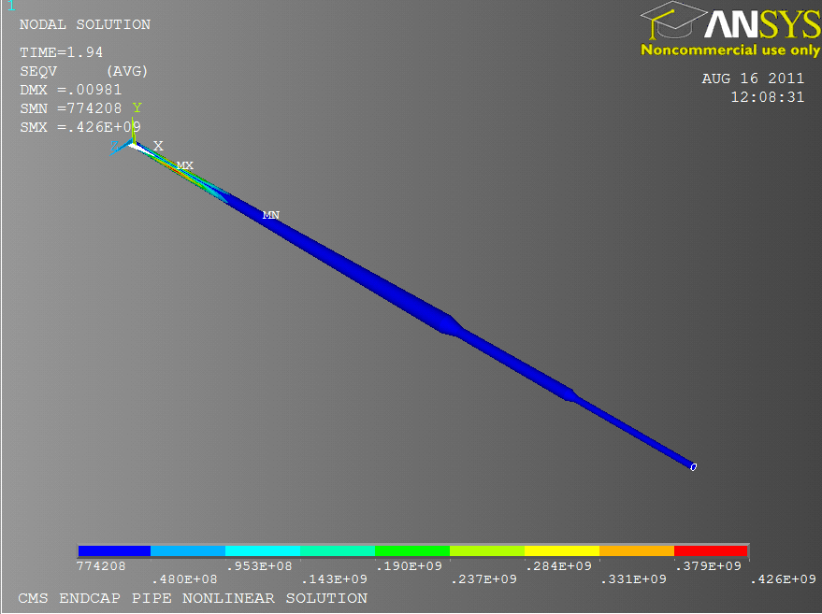
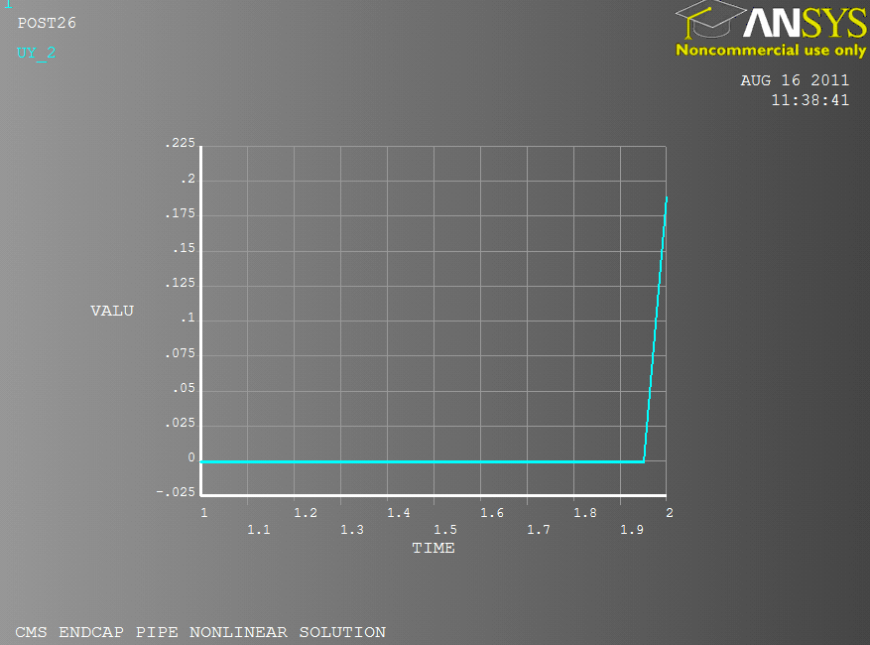
Stress and Buckling Analysis of CMS Experimental Beam Pipes for Intervention Loading Conditions
Buckling Analysis
  Fully Open support configuration
  External uniform pressure (Vacuum inside)
    Eigenvalue analysis;
      4.39 Safety Factor (SF)
    Deformed geometry;
    Scaled to tolerance;
      0.1 mm Circularity
    Non-linear analysis;
    Buckling safety factor
      4.36 SF

Slide 10
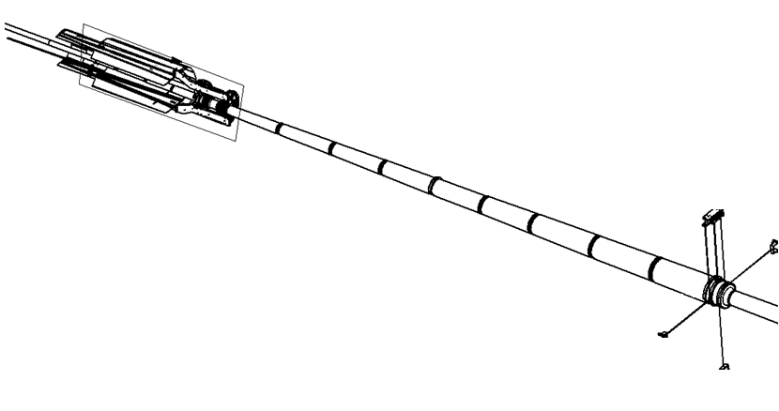
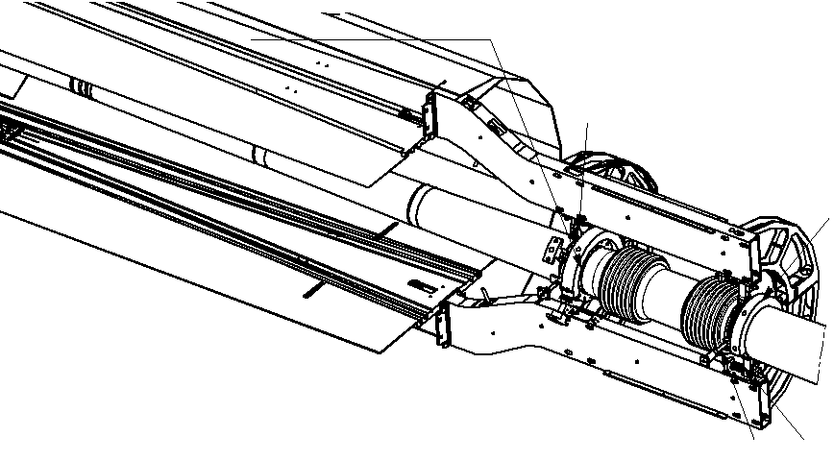
Stress and Buckling Analysis of CMS Experimental Beam Pipes for Intervention Loading Conditions
Catastrophic Failure
      Central Support System
End Cap Pipe
Central Support System
Central Pipe
U-Bellows

Slide 11
Stress and Buckling Analysis of CMS Experimental Beam Pipes for Intervention Loading Conditions
Modes of Failure
  Column Buckle due to conical pipe + vacuum
  Yield from bending stress
Axial and/or Unbalanced Force Due To Vacuum Ruled Out

Slide 12
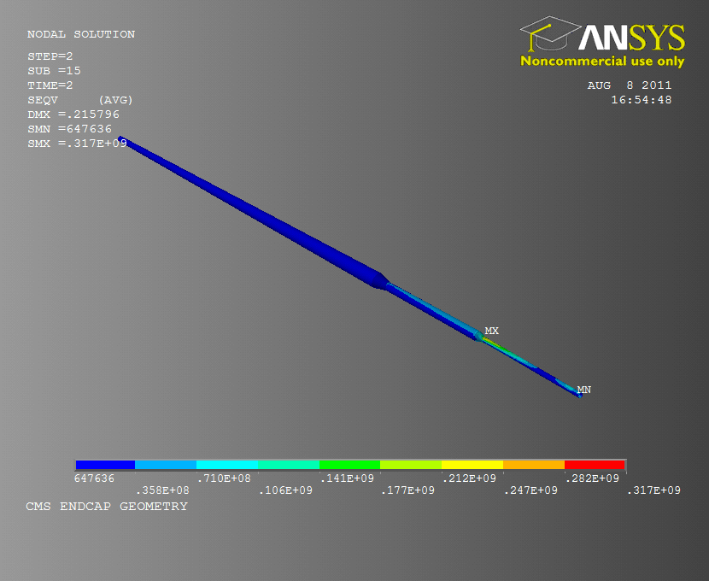
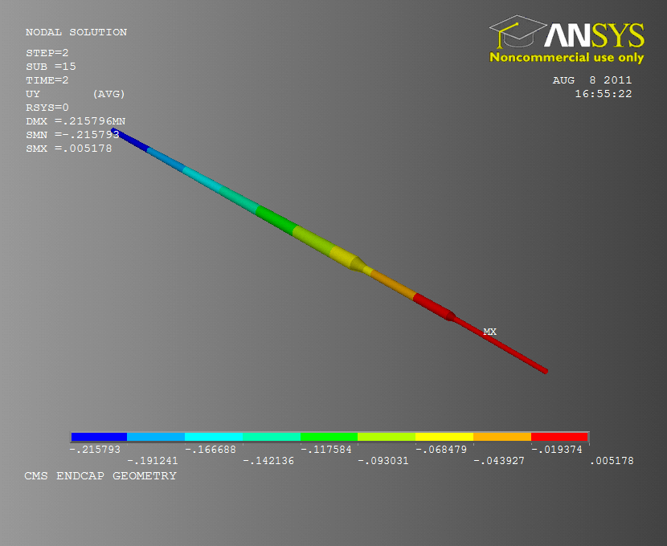
Stress and Buckling Analysis of CMS Experimental Beam Pipes for Intervention Loading Conditions
Central Support Failure
Central Support no longer connected to End Cap
Non-Linear Analysis of Forward region
Max. Stress:
  317 MPa
Max. Vertical displacement: 21.5 cm
Failure of U-bellows section;
Risk to central beam pipe.

Slide 13
Stress and Buckling Analysis of CMS Experimental Beam Pipes for Intervention Loading Conditions
Summary of Analysis
Configuration of Supports | Loading Conditions | Maximum Stress(MPa) | Stress Safety Factor | Maximum Vertical Displacement (mm) | Failure Pressure (MPa) | Buckling Safety Factor
Intermediate | Vacuum in pipe | 19.1 | 15.1 | 1.49 | - | -
 | No pressure diff. | 18 | 16.1 | 1.49 | - | -
Fully Open | Vacuum in pipe | 40.6 | 7.14 | 8.9 | 4.3 | 4.3
 | No pressure diff. | 39.8 | 7.29 | 8.9 | - | -
 | Central support failure | 317 | 0.91 | 21.6 | - | -

Slide 14
Stress and Buckling Analysis of CMS Experimental Beam Pipes for Intervention Loading Conditions
With thanks to
Ray Veness
Expert Guidance
Mark Gallilee
Expert Guidance
Paul Cruikshank
Brainstorming, meeting contributions
Patrick Lepeule
Guidance, technical support and data contributions
Cedric Garion
Technical guidance, meeting contributions
Jean Rigaud
Metrology support
Giuseppe Bregliozzi
LBV advice, meeting contributions
Giulia Lanza
LBV advice, meeting contributions

