Slide 1
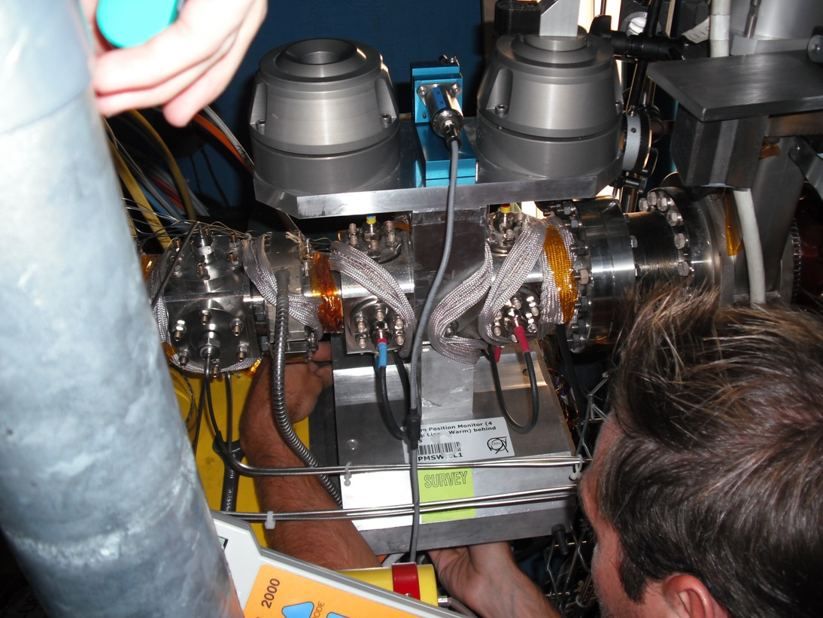
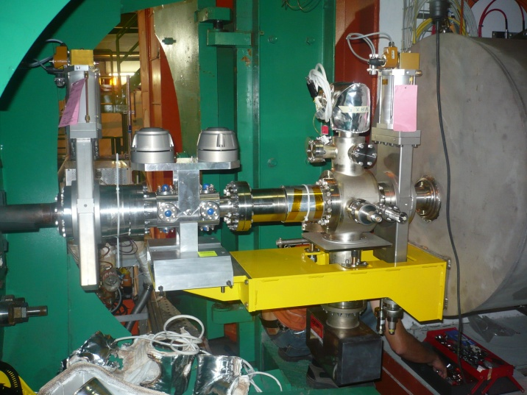
CMS + ATLAS TAS Design Study
Introduction
Bellows between TAS and Q1 in CMS and ATLAS only allowed 2mm lateral offset
Vacuum personnel must enter TAS/Q1 area during TAS re-alignment
High radiation background + cryogens cause safety risks
Investigate the situation, aim to reduce risk to personnel

Slide 2
CMS + ATLAS TAS Design Study
What Causes Offset?
Movements occur from following situations:
  Installation Offset
  TAS Stability
  Survey Accuracy
  Human Error
  TAS Shielding Load (ATLAS only)

Slide 3
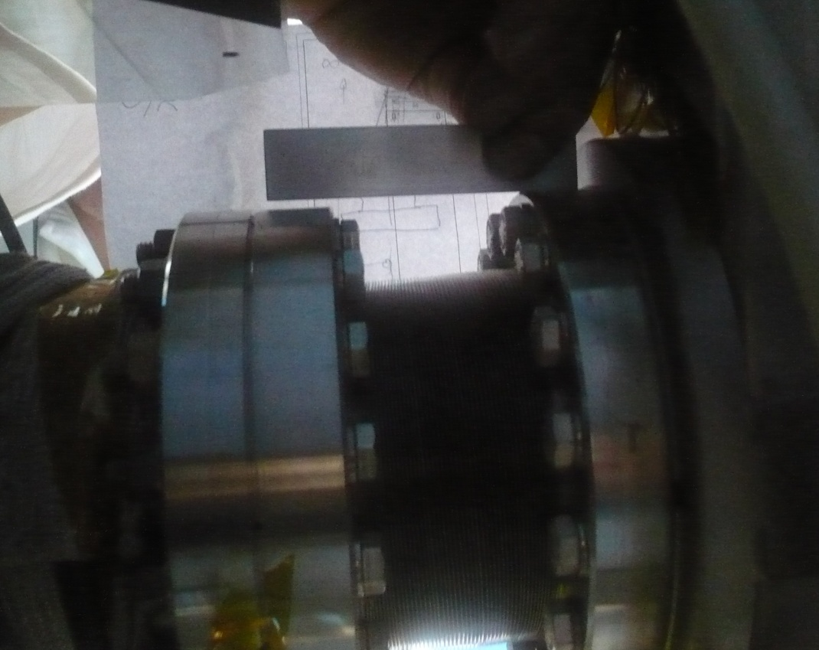
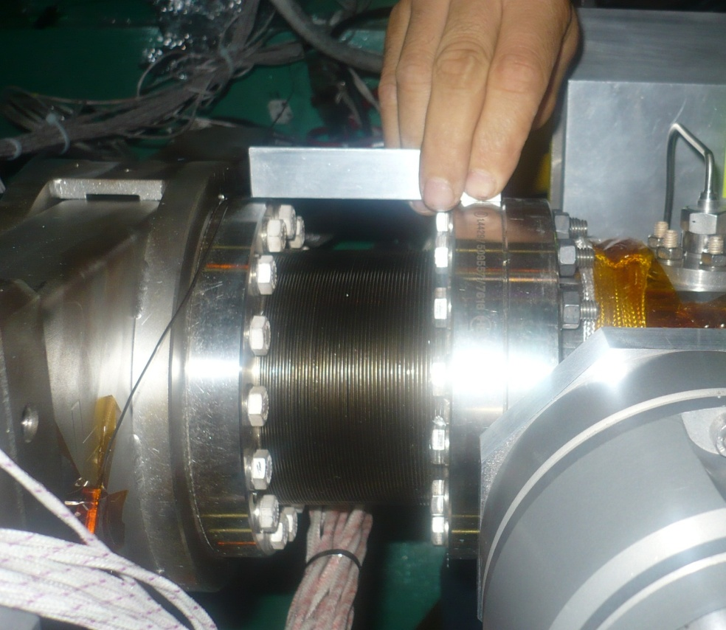
CMS + ATLAS TAS Design Study
Installation
Can have installation offsets of up to 2mm
Source: Patrick Lepeule

Slide 4
CMS + ATLAS TAS Design Study
What Causes Offset?
Movements occur from following situations:
  Installation Offset
  TAS Stability
  Survey Accuracy
  Human Error
  TAS Shielding Load (ATLAS only)
2mm

Slide 5
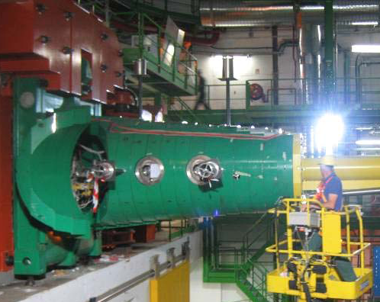
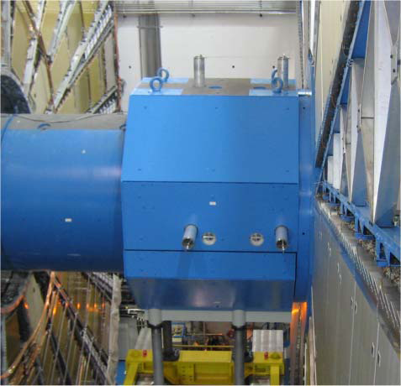
CMS + ATLAS TAS Design Study
2. TAS Stability
Survey measurements every 6 months
Normally less than 0.5mm
Worst case 1mm
EDMS: 1020699
EDMS: 1056593
Tige 8
Tige 7
Tige 8
Tige 7
Tige 6
Tige 5
Tige 6
Tige 5
Tige 6
Tige 5
CMS
ATLAS

Slide 6
CMS + ATLAS TAS Design Study
What Causes Offset?
Movements occur from following situations:
  Installation Offset
  TAS Stability
  Survey Accuracy
  Human Error
  TAS Shielding Load (ATLAS only)
2mm
1mm

Slide 7
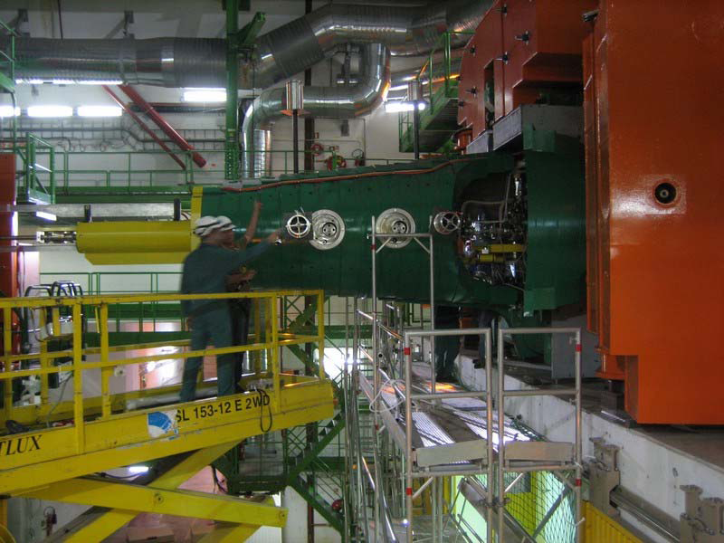
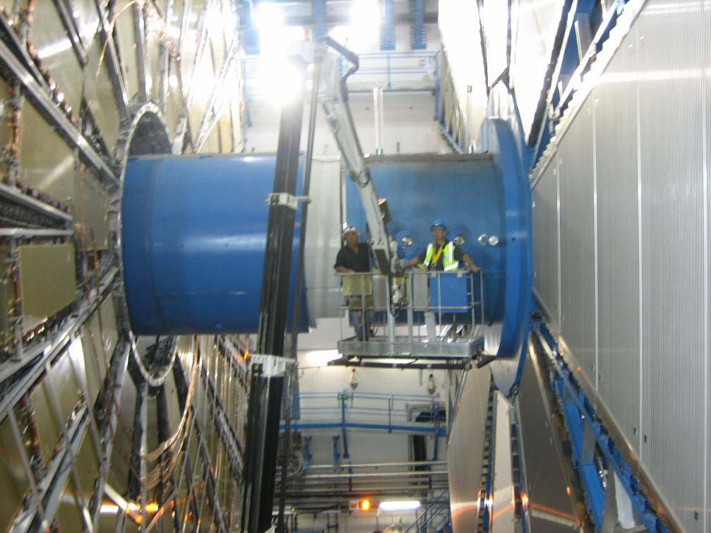
CMS + ATLAS TAS Design Study
3. Survey Accuracy
At 2 Sigma, best accuracy:
CMS – 1.2mm
ATLAS – 1mm
EDMS: 1058386
EDMS: 1020699

Slide 8
CMS + ATLAS TAS Design Study
What Causes Offset?
Movements occur from following situations:
  Installation Offset
  TAS Stability
  Survey Accuracy
  Human Error
  TAS Shielding Load (ATLAS only)
2mm
1mm
1.0/1.2mm

Slide 9
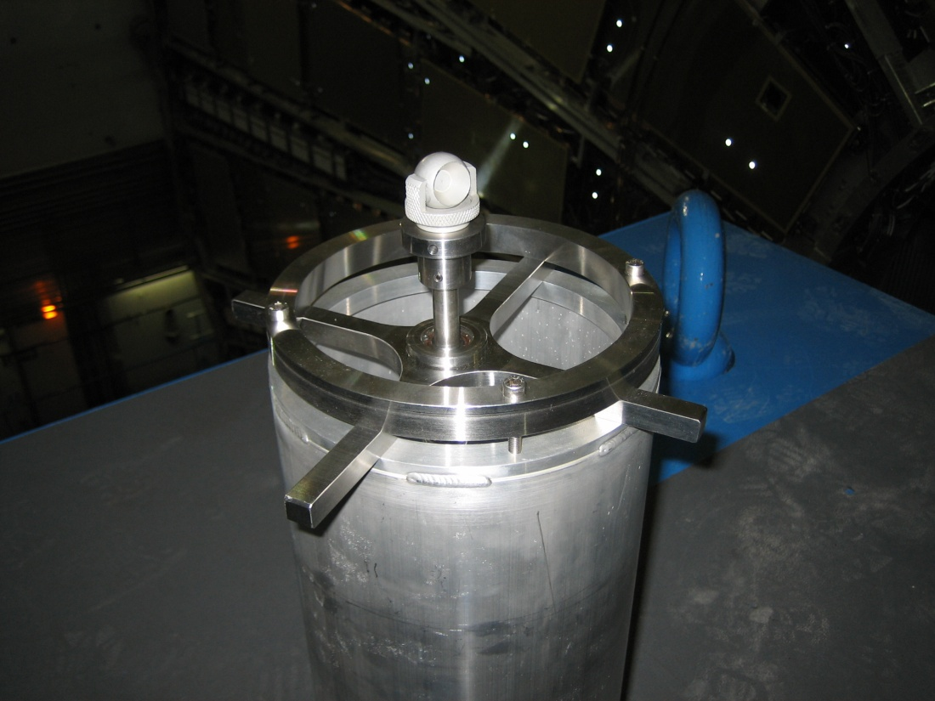
CMS + ATLAS TAS Design Study
4. Human Error
Turns in stages, each stage = 0.2mm TAS movement
3 wrong turns + lever effect = worst case of 0.78mm offset on bellows

Slide 10
CMS + ATLAS TAS Design Study
What Causes Offset?
Movements occur from following situations:
  Installation Offset
  TAS Stability
  Survey Accuracy
  Human Error
  TAS Shielding Load (ATLAS only)
2mm
1mm
1.0/1.2mm
0.78mm

Slide 11
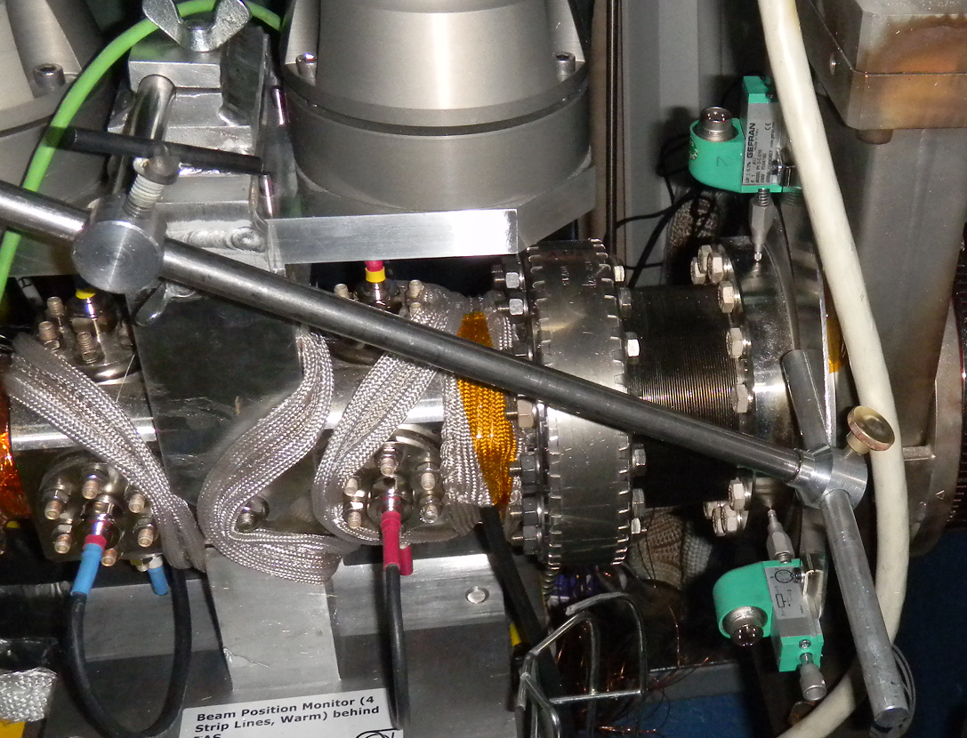
CMS + ATLAS TAS Design Study
5. TAS Shielding Load (ATLAS only)
From experiment, max vertical displacement 0.05mm
Take conservative value of 0.2mm
Source: Sebastien Evrard

Slide 12
CMS + ATLAS TAS Design Study
What Causes Offset?
Movements occur from following situations:
  Installation Offset
  TAS Stability
  Survey Accuracy
  Human Error
  TAS Shielding Load (ATLAS only)
Movements impose shear on bellows and RF Finger
RF Finger should remain in contact during operation
2mm
1mm
1.0/1.2mm
0.78mm
0.2mm

Slide 13
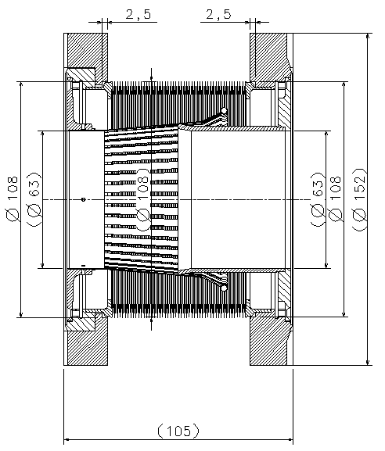
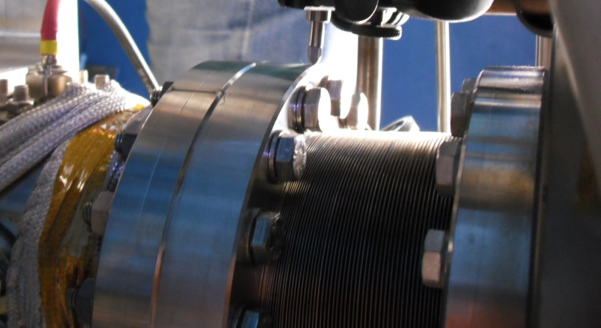
CMS + ATLAS TAS Design Study
Worst Case Movements
Addition of movements gives the following worst case offset:
ATLAS – Operational – 5.52mm
Adjustment – 6.27mm
CMS – Operational – 5.80mm
Adjustment – 6.39mm
Edge-Welded Bellows

Slide 14
CMS + ATLAS TAS Design Study
Current Bellows Axial Length
Affects lateral offset
Current installed lengths of bellows with new BPM layout are (105mm nominal):
ATLAS: Left – 94mm
Right – 115mm
CMS: Left – 106mm
Right – 102mm
Bake-out will impose an additional compression of 9mm

Slide 15
CMS + ATLAS TAS Design Study
Bellows Performance
Following data from bellows supplier

Slide 16

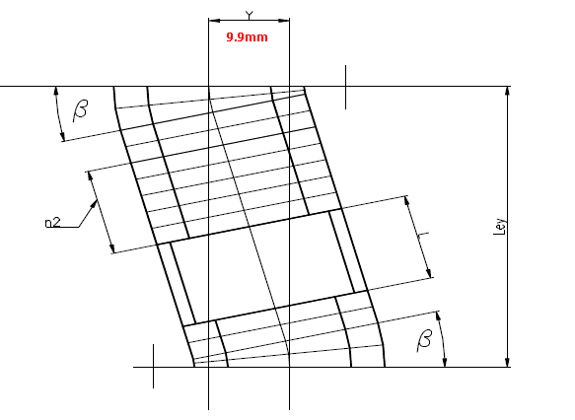
CMS + ATLAS TAS Design Study

Slide 17
CMS + ATLAS TAS Design Study
Bellows Performance
Following data from bellows supplier
Maximum Lateral Offset:
ATLAS: Left – 7.6mm (94mm)
Right – 9.9mm (115mm)
CMS: Left – 9.9mm (106mm)
Right – 9.6mm (102mm)
So each bellows is sufficient in normal conditions
…However, RF Finger inside bellows is more critical.
Bellows (mm) | Nominal Length (mm) | Installed Length (mm) | Bake-out Minimum Length (mm) | Worst Case Adjustment (mm) | Max Lat. Offset (mm) | Max Lat. Offset at Bake-out Length (mm)
ATLAS A | 105 | 94 | 85 | 6.27 | 7.6 | 5.0
ATLAS C | 105 | 115 | 106 | 6.27 | 9.9 | 9.9
CMS 54 | 105 | 106 | 97 | 6.39 | 9.9 | 7.6
CMS 56 | 105 | 102 | 93 | 6.39 | 9.6 | 7.6

Slide 18
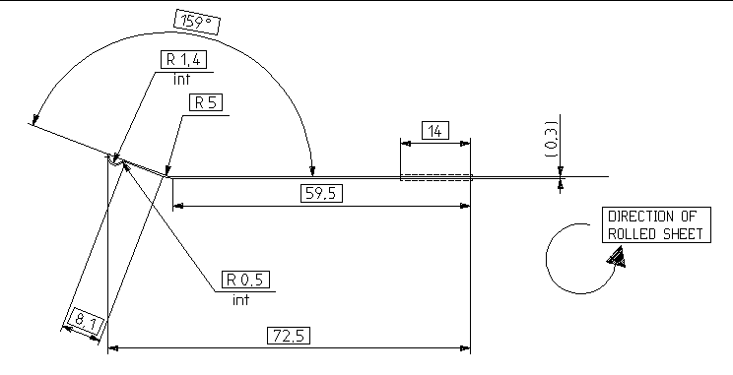
CMS + ATLAS TAS Design Study
RF Finger
Installed with 3mm of initial offset
Allows 3mm offset before some contact is lost
Tension spring will improve this figure but hard to quantify
Behaviour strongly affected by Bellows’ axial length
One RF Finger

Slide 19
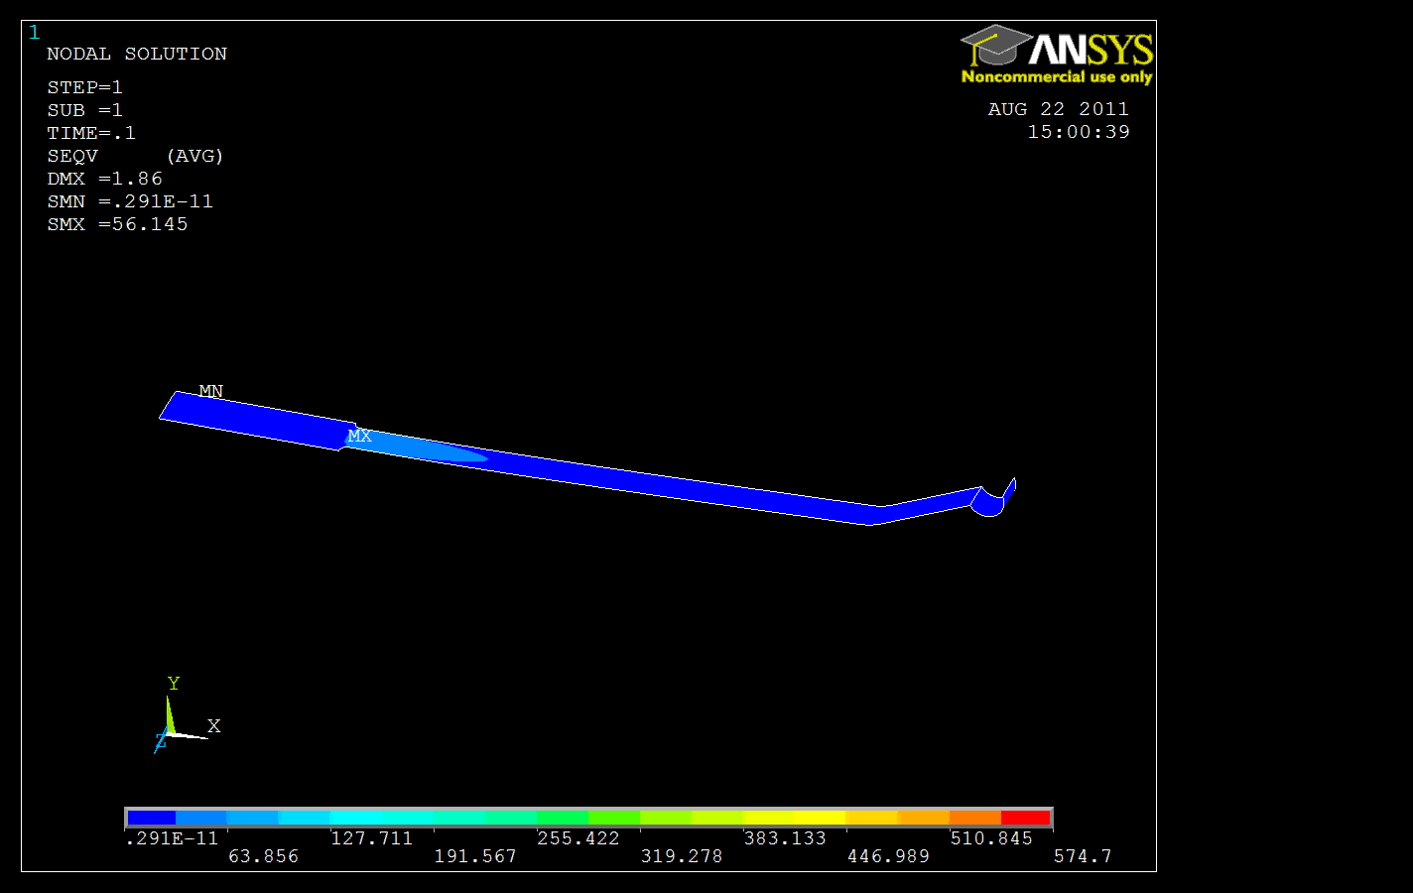
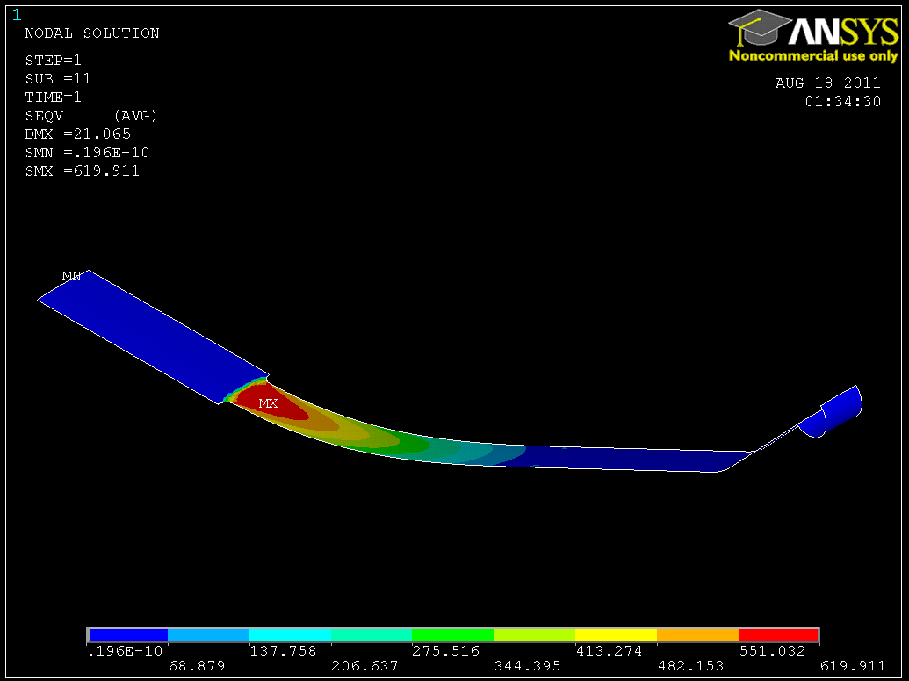
CMS + ATLAS TAS Design Study
RF Finger During Re-alignment
At nominal length, RF Finger can sustain 10mm offset with no plastic deformation
In most compressed bellows, RF Finger can sustain 7.9mm movement before plastic deformation occurs
Source: Alexandre Lacroix

Slide 20
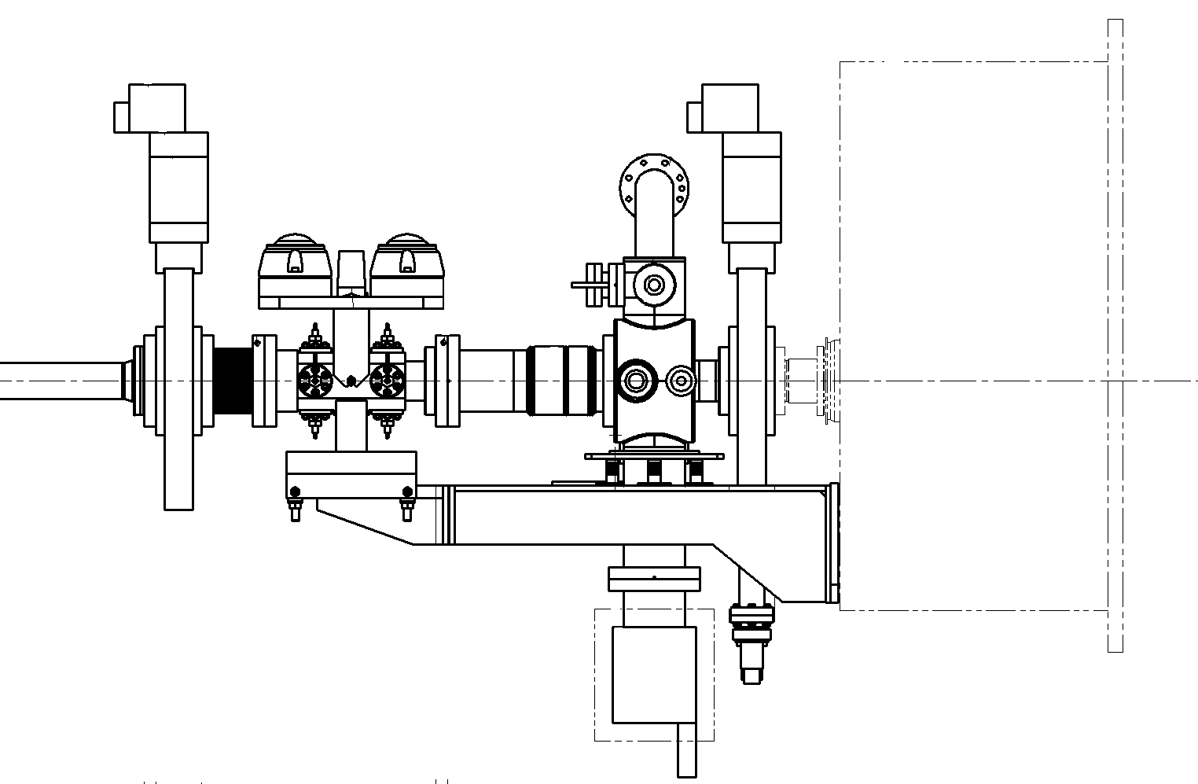
CMS + ATLAS TAS Design Study
Other Considerations
Tension spring susceptible to falling out
Re-alignment should ideally be done before bake-out occurs
VAX length unlikely to change with new design (according to Giuseppe Bregliozzi)
BPM only component that can affect bellows’ length

Slide 21
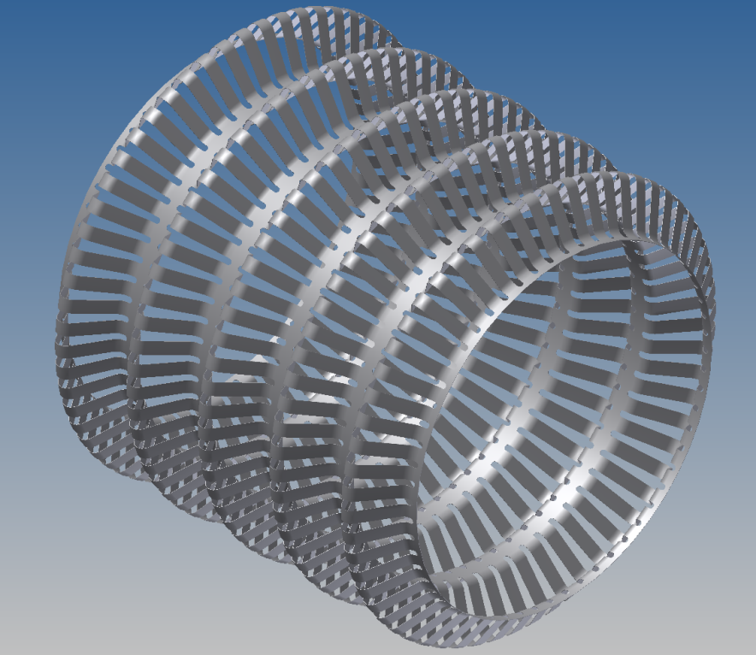
CMS + ATLAS TAS Design Study
Future
What angle of deflection does spring escape?
Larger bellows length would decrease RF Finger angle
New RF Finger design?
Source: Alexandre Lacroix & Cedric Garion
With thanks to: Mark Gallilee, Dirk Mergelkuhl, Antje Behrens, Ray Veness, Alexandre Lacroix, Sebastien Evrard, Erik Kos, Eric Page, Cedric Garion, Francois Butin, Patrick Lepeule, Martin Gastal
*Photography from Survey Department, CDD Drawings and Vacuum Group

