Slide 1
WP3: Tools and services for software quality and FAIRness
Thomas Vuillaume Kirsty Pringle & Neil Chue Hong
LAPP, CNRS, ESCAPE University of Edinburgh
Kick-off Meeting
11-13 March 2024,Thessaloniki, Greece
This project has received funding from the European Union’s Horizon Europe Programme under GA 101129744 — EVERSE — HORIZON-INFRA-2023-EOSC-01-02

Slide 2
WP3: Overview and scope
Objectives
O3.1: To establish a technology watch identifying and gathering tools and services targeting scientific software, code, and workflows quality and FAIRness
O3.2: To assist the Science Clusters in measuring and improving software, code, and workflows quality and FAIRness globally by combining existing tools and services into common frameworks
This WP connects existing individual tools and services with developers and Science Clusters in three steps:
collecting existing tools and services for software (including all forms of executable code) quality
linking them in common pipelines or frameworks
integrating them with platforms used in the Science Clusters
This WP collaborates with the Science Clusters identified in WP4 that helps to shape the developed tools to their needs.

Slide 3
WP3: Tasks
Task 3.1 (M01-M36): Technology watch for tools and services to assess, curate and improve scientific software, code, and workflows quality in the Science Clusters.
Lead: SKAO, co-Lead: UEDIN
Task 3.2 (M07-M36): Consolidation of tools and services to ease their implementation and use in research communities.
Lead: BSC, co-Lead: FAU
Task 3.3 (M07-M36): To provide the means to measure globally the software quality in the Science Clusters.
Lead: NLeSC, co-Lead: UPM

Slide 4
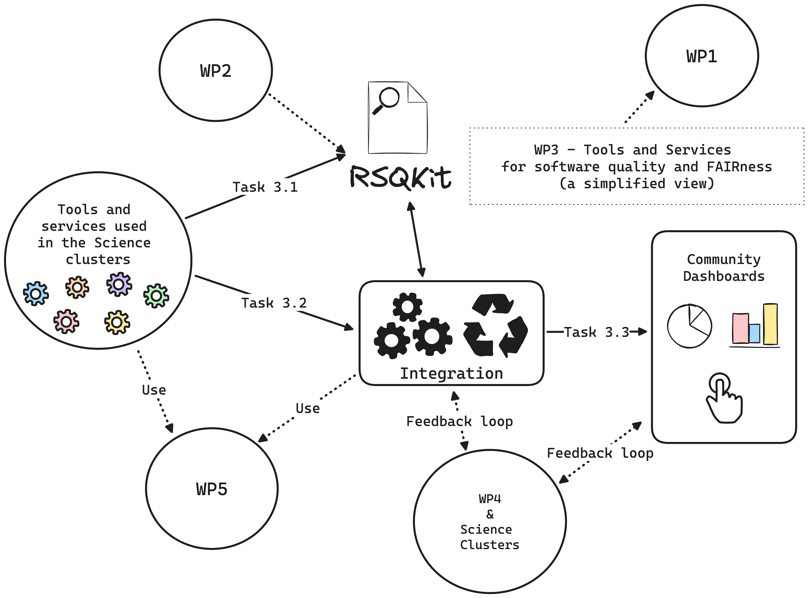

Slide 5
WP3: Expected (but not exhaustive) interactions with other WPs
WP1 | WP2 | WP4 | WP5
Engage with the communities Provide resources on the tools and services (website, seminars...) | align tools with the good practices fill the RSQKit align tools with the software quality indicators and metrics | gather existing tools and services used in the Science clusters provide tools and support to adopt them to the Science clusters adapt the tools to the clusters specific needs get feedback on the tools (developers' experience) | tools to assess training materials quality and FAIRness RSEs recognition by providing the means to assess their contributions to (good quality) research software include tools in the training material

Slide 6
Deliverables and Milestones
Deliverables/Milestones | Name | Due Month | Lead
D3.1 | First collection of existing tools and services usable in the Science clusters to assess, curate and improve software quality and FAIRness. | M09 | HZDR
D3.2 | Catalogue of RSQkit Tools for Assessing and Improving Software Quality and FAIRness | M18 | NLESC
D3.3 | Impact of Pipelines and Dashboards on Software Quality: Final Adoption Report | M36 | CNRS
MS3.1 | First evaluation of the tools and services in the form of a workshop against WP2 initial best practices (MS2.1) and recommendations to adapt these tools if necessary | M14 | UEDIN
MS3.2 | First version of a metadata framework for software quality indicators and of actionable pipelines based on community selected use- cases to assist software developers and maintainers assessing and improving software quality, metadata and FAIRness | M18 | FAU
MS3.3 | Dashboard prototypes demonstrating capabilities to track software quality and tested in the Science Clusters | M24 | NLESC
MS3.4 | Demonstration of the outcome of the common framework to the research community, by showing software quality indicators in existing services (such as OpenEBench, WorkflowHub, Research Software Directory, ENVRIHUB, etc) based on the dashboard prototype | M30 | UPM
Month | M03 | M06 | M09 | M12 | M14 | M18 | M21 | M24 | M27 | M30 | M33 | M36
M/D |  |  | D3.1 |  | MS3.1 | D3.2 MS3.2 |  | MS3.3 |  | MS3.4 |  | D3.3
T3.1
T3.2
T3.3

Slide 7
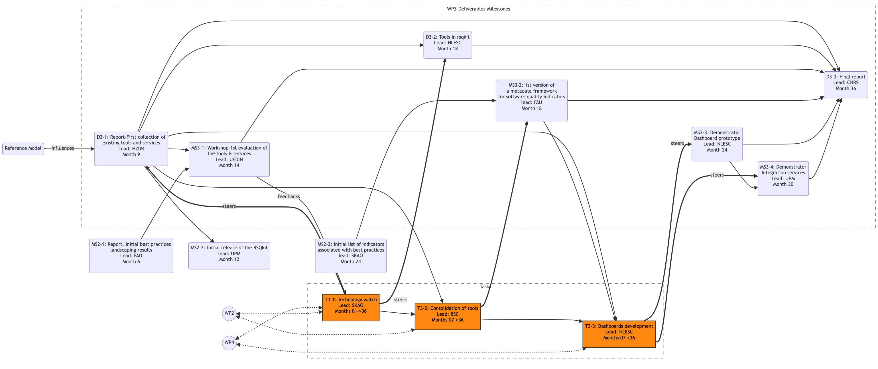
WP3 map of tasks & deliverables
*refer to the grant agreement for a more exhaustive description

Slide 8
WP3 map of tasks & deliverables
Potential source of misalignement
*refer to the grant agreement for a more exhaustive description

Slide 9
Tasks & partners involvement
From the proposal document, but everyone can contribute to all tasks
 | T3.1 | T3.2 | T3.3
SKAO | lead
UEDIN | co-lead |  | x
CNRS-LAPP | x | x | x
NLESC | x | x | lead
UPM | x | x | co-lead
FAU | x | co-lead
HZDR | x
BSC | x | lead
UNIMAN |  | x | x
CU |  | x | x
CERN |  | x | x
HZDR |  | x
CERTH |  |  | x
UvA |  |  | x

Slide 10
WP3 meetings & organisation
Regular meeting: 4th Monday of the month (see dates https://indico.cern.ch/category/18101/)
Subscribe to the indico calendar:
  EVERSE: https://indico.cern.ch/category/18089/events.ics
  WP3: https://indico.cern.ch/category/18101/events.ics
Rolling collaborative minutes
  Document appended every meeting
  A snapshot of the actual meeting minutes will be copied to the corresponding indico page
Each task will organize their own independent meetings with the required partners
  WP3 meetings to coordinate and share information

Slide 11
Rolling minutes: https://warehouse.inab.certh.gr/index.php/f/3591471
Indico: https://indico.cern.ch/category/18101/
Mattermost channel #WP3-tools
list: everse-wp3@lists.certh.gr
Thomas: thomas.vuillaume@lapp.in2p3.fr
Neil: n.chuehong@epcc.ed.ac.uk
Kirsty: k.pringle@epcc.ed.ac.uk
Thank you!
This project has received funding from the European Union’s Horizon Europe Programme under GA 101129744 — EVERSE — HORIZON-INFRA-2023-EOSC-01-02

