Slide 1
Civil engineering for the
Future Circular collider
Michael BENEDIKT – FCC Study Leader
Timothy WATSON – Coordinator for FCC Civil Engineering

Slide 2
Contents
Brief Introduction to the FCC Study
Background of civil engineering at CERN
Civil Engineering Aspects of the FCC Study
Topics for Discussion with Porr

Slide 3
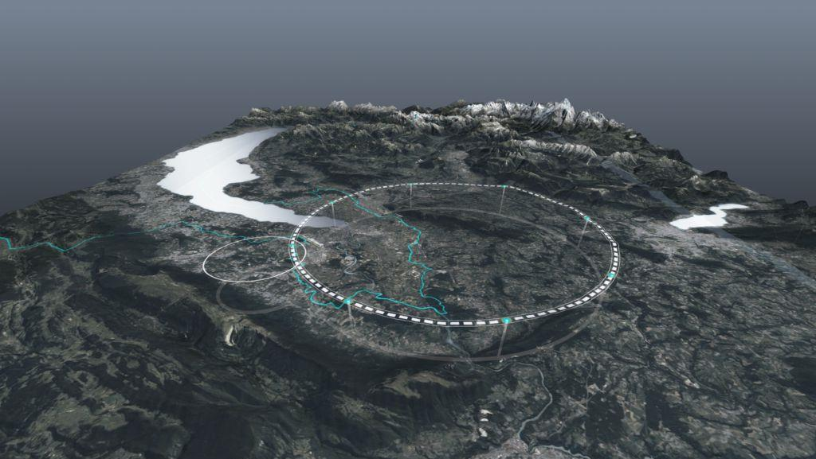










FCC Overview and Status
CERN
15 January 2024
Michael Benedikt, CERN
on behalf of FCC collaboration & FCCIS DS team
http://cern.ch/fcc
Work supported by the European Commission under the HORIZON 2020 projects EuroCirCol, grant agreement 654305; EASITrain, grant agreement no. 764879; iFAST, grant agreement 101004730, FCCIS, grant agreement 951754; E-JADE, contract no. 645479; EAJADE, contract number 101086276; and by the Swiss CHART program
photo: J. Wenninger

Slide 4

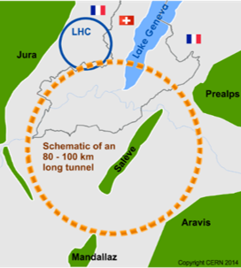
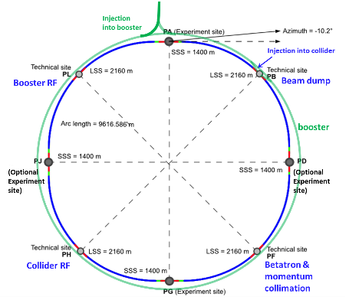
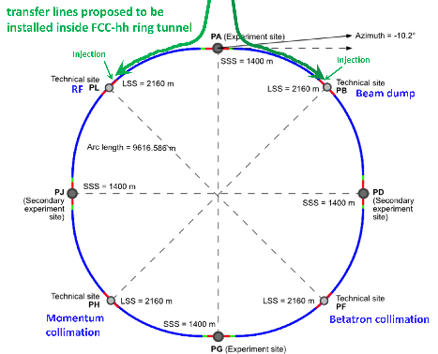
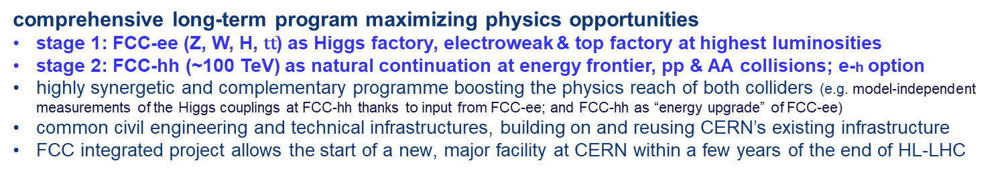
FCC integrated program
comprehensive long-term program maximizing physics opportunities
stage 1: FCC-ee (Z, W, H, $\text{t}\overline{\text{t}}$) as Higgs factory, electroweak & top factory at highest luminosities
stage 2: FCC-hh (~100 TeV) as natural continuation at energy frontier, pp & AA collisions; e-h option
highly synergetic and complementary programme boosting the physics reach of both colliders (e.g. model-independent measurements of the Higgs couplings at FCC-hh thanks to input from FCC-ee; and FCC-hh as “energy upgrade” of FCC-ee)
common civil engineering and technical infrastructures, building on and reusing CERN’s existing infrastructure
FCC integrated project allows the start of a new, major facility at CERN within a few years of the end of HL-LHC
FCC-ee
FCC-hh
2020 - 2046
2048 - 2063
2073 -

Slide 5
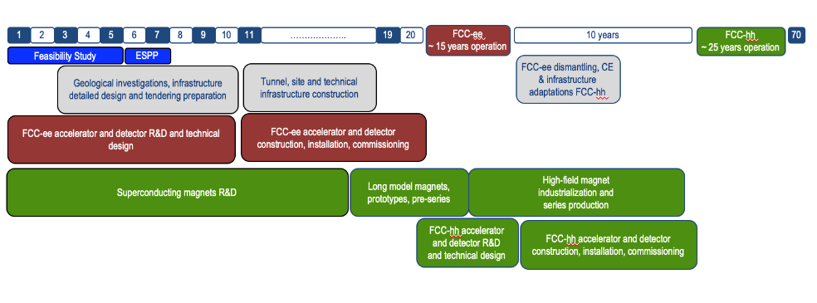
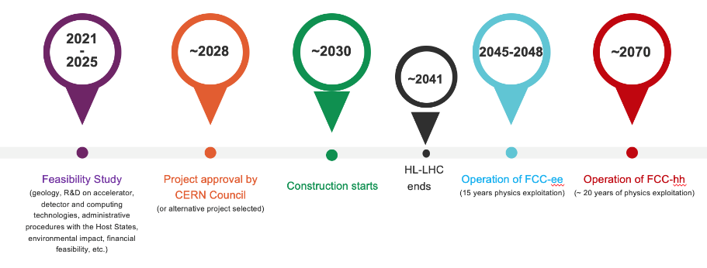
FCC integrated program - timeline
Note: FCC Conceptual Design Study
started in 2014 leading to CDR
in 2018
Realistic schedule takes into account:
CERN Council approval timeline
past experience in building colliders at CERN
that HL-LHC will run until ~ 2041
ANY future collider at CERN cannot
start physics operation before 2045-2048
(but construction will proceed in parallel to
HL-LHC operation)
2033
2048
2073

Slide 6
FCC Feasibility Study 2021-2025: main objectives
Demonstration of the geological, technical, environmental and administrative feasibility of the tunnel and surface areas
and optimisation of the placement and layout of the ring and related infrastructure.
Pursuit, together with the Host States, of the preparatory administrative processes required for a potential project approval.
Optimisation of the design of FCC-ee and FCC-hh colliders and their injector chains, supported by R&D to develop the
needed key technologies.
Elaboration of a sustainable operational model for the colliders and experiments in terms of human and financial resource needs,
as well as environmental aspects and energy efficiency.
Development of a consolidated cost estimate, as well as the funding and organisational models needed to enable the project’s technical design completion, implementation and operation.
Identification of substantial resources from outside CERN’s Budget for the implementation of the first stage of a possible future project (tunnel and FCC-ee).
Consolidation of the physics case and detector concepts and technologies for both colliders.
Objectives and deliverables presented to SPC and Council in June 2021:
https://indico.cern.ch/event/1038466/contributions/4386283/attachments/2259574/3834905/spc-e-1161-c-e-3588_FCC_MainDeliverables.pdf
Feasibility Study funded from CERN budget: 100 MCHF total over 5 years; in addition: ~ 20 MCHF/year for high-field magnet R&D
Additional funding from the European Commission and collaborating institutes (e.g., CHART collaboration with Switzerland)

Slide 7
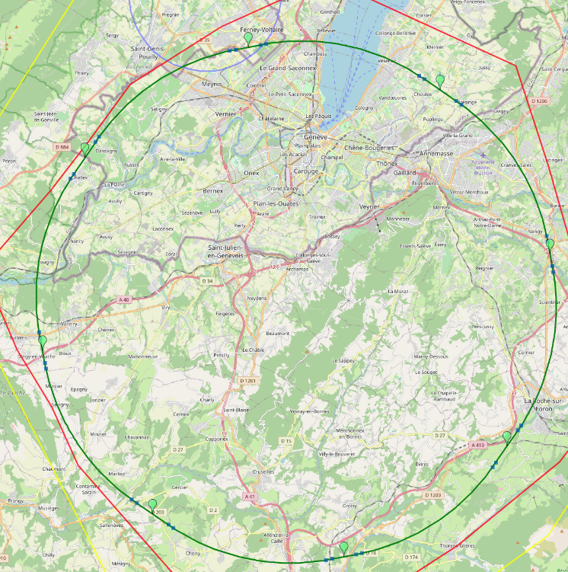
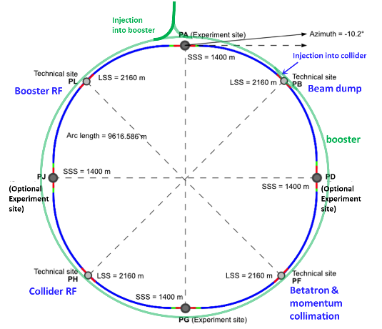
Optimized placement and layout for feasibility study
V. Mertens,
J. Gutleber
Layout chosen out of ~ 100 initial variants, based on geology and
surface constraints (land availability, access to roads, etc.), environment, (protected zones), infrastructure (water, electricity, transport), machine performance etc.
“Avoid-reduce -compensate” principle of EU and French regulations
PA: Experiment
PB: technical
PL: technical
Overall lowest-risk baseline: 90.7 km ring, 8 surface points,
Whole project now adapted to this placement
Number of surface sites | 8
Surface requirements | ~40 ha
LSS@IP (PA, PD, PG, PJ) | 1400 m
LSS@TECH (PB, PF, PH, PL) | 2032 m
Arc length | 9.6 km
Sum of arc lengths | 76.9 m
Total length | 90.7 km
PD: experiment
PJ: experiment
PF: technical
PH: technical
7
PG: experiment

Slide 8
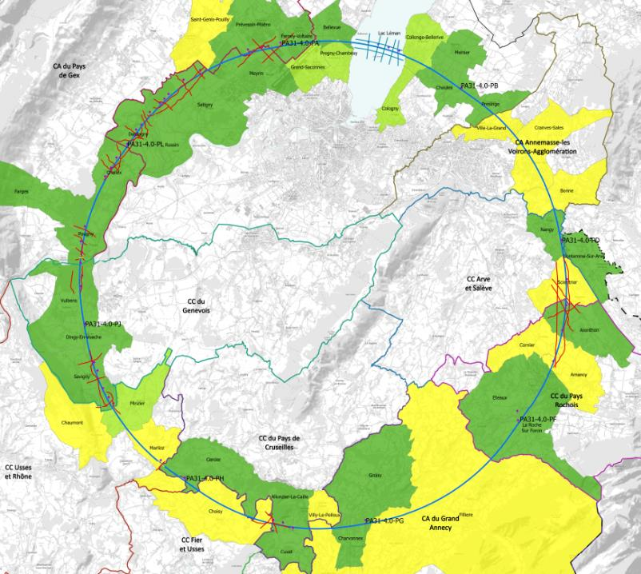
progress with implementation baseline PA31 90.7 km
Meetings with municipalities concerned
in France (31) and Switzerland (10)
PA – Ferney Voltaire (FR) – site experimental
PB – Présinge/Choulex (CH) – site technique
PD – Nangy (FR) – site experimental
PF – Roche sur Foron/Etaux (FR) – site technique
PG – Charvonnex/Groisy (FR) – site experimental
PH – Cercier (FR) – site technique
PJ – Vulbens/Dingy en Vuache (FR) site experimental
PL – Challex (FR) – site technique
status as of 10 November 2023
Individual meeting
Individual meeting planned
Collective meeting
The support of the host states is greatly appreciated and essential for the study progress!

Slide 9
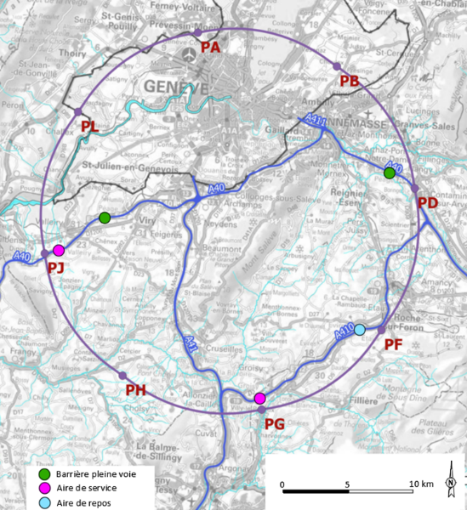
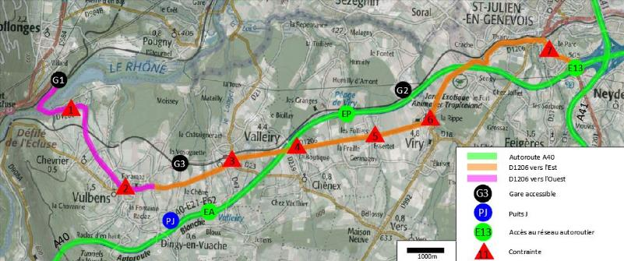
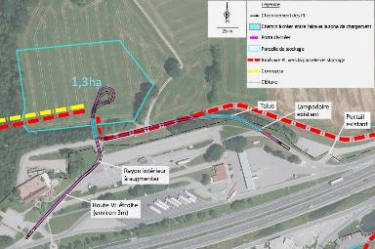
Connections to transport infrastructure
Road accesses identified and documented for all 8 surface sites
Four possible highway connections defined (materials transport)
Total amount of new roads required < 4 km (at departmental road level)
Detailed road access scenarios & highway access creation study carried out by Cerema, including regulatory requirements in France
E.g. Valleiry Nord

Slide 10
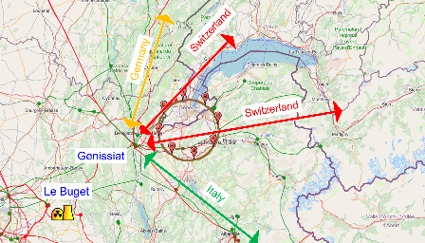
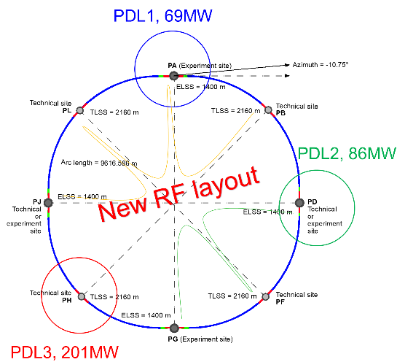

Connections to electrical grid infrastructure
Updated FCC-ee energy consumtion | Z | W | H | TT
Beam energy (GeV) | 45.6 | 80 | 120 | 182.5
Max. Power during beam operation (MW) | 222 | 247 | 273 | 357
Average power / year (MW) | 122 | 138 | 152 | 202
Total FCC-ee yearly consumption (TWh) | 1.07 | 1.2 | 1.33 | 1.77
Yearly consumption CERN & SPS (TWh) | 0.70 | 0.70 | 0.70 | 0.70
Total yearly consumpt. CERN & SPS & FCC-ee (TWh) | 1.77 | 1.90 | 2.03 | 2.47
The loads could be distributed on three main sub-stations (optimally connected to existing regional HV grid):
Point D with a new sub-station covering PB – PD – PF – PG
Point H with a new dedicated sub-station for collider RF
Point A with existing CERN station covering PB – PL – PJ
Connection concept was studied and confirmed by RTE (French electrical grid operator) ➔ requested loads have no significant impact on grid
Powering concept and power rating of the three sub-stations compatible with FCC-hh
R&D efforts aiming at further reduction of the energy consumption of FCC-ee and FCC-hh

Slide 11
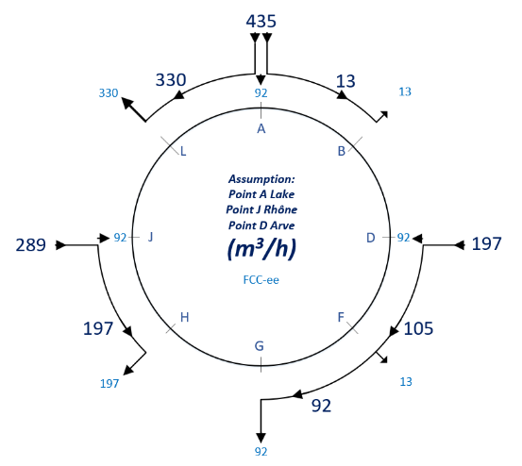
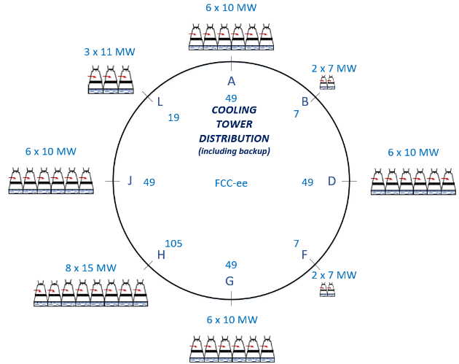
Cooling water supply concept
Potential sources of cooling water Geneva lake (PA), Rhone (PJ) and Arve (PD).
Existing line with lake water provided by SIG to CERN LHC P8 (LHCb) sufficient for FCC-ee.
Pipework in the tunnel will connect the remaining points to points PA, PD and PJ.
Main cooling towers placed at experiment points (PA, PD, PG, PJ), and RF sites (PL, PH).

Slide 12
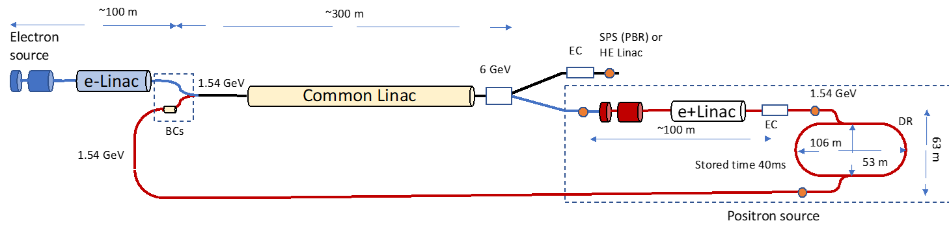
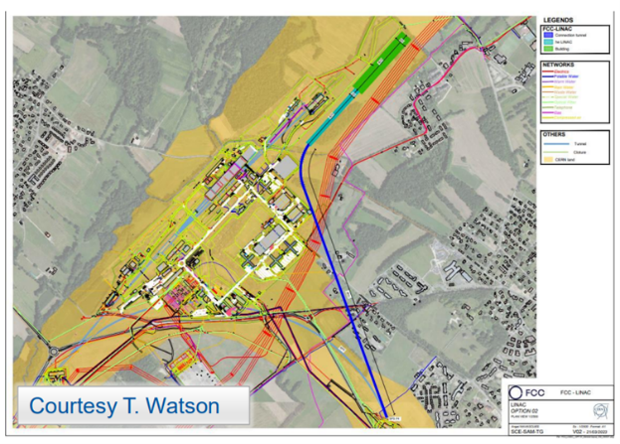
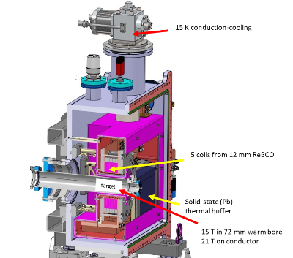
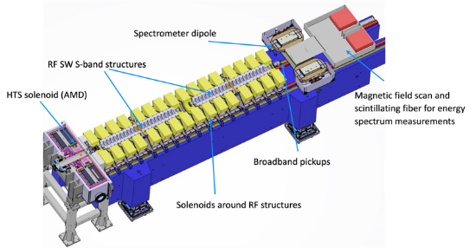
FCC-ee injector layout & implementation
P. Craievich, I. Chaikovska, A. Grudiev, C. Milardi, et al
implementation study on Prevessin site
“Positron production experiment” at PSI’s SwissFEL,
beam tests from 2025/26
6 GeV linac
20 GeV linac
W. Bartmann
HTS NI target solenoid
J. Kosse, T. Michlmayr, H. Rodrigues

Slide 13
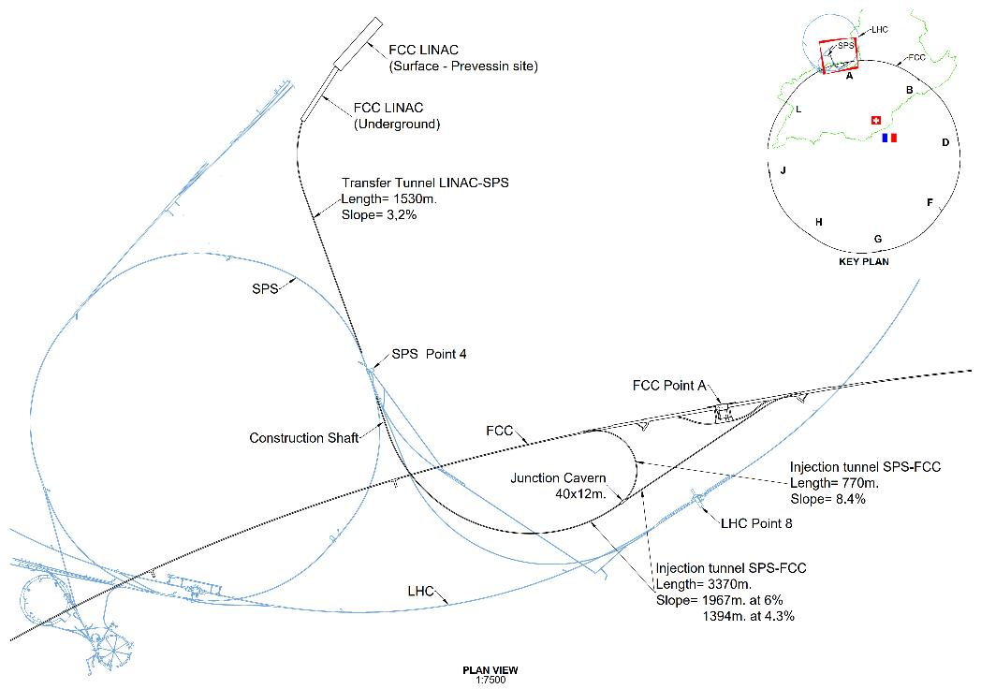
Transfer lines and overall integration
LINAC and Injection Tunnels
Designed to enable injection either from SPS as pre-booster or from a new HE Linac sited at Prevessin
Single tunnel with spur to enable anti-clockwise injection
Design allows re-use for FCC-hh if injector in the SPS tunnel (SC-SPS option)
  SPS Point 4 to FCC (clockwise)
  SPS Point 6 to FCC (counter-c.w.)

Slide 14

Status of FCC global collaboration
increasing international collaboration as a prerequisite for success
150
Institutes
32
Companies
34
Countries
EC
H2020
FCC Feasibility Study: Aim is to increase further the collaboration, on all aspects,
in particular, on Accelerator and Particle/Experiments/Detectors (PED).

Slide 15
FCC Feasibility Study –status summary
Focus 2021 - 2023:
identifying best placement & layout and adapting entire project to new placement
this provided the input for the mid-term review documentation and cost estimate update
Fruitful collaboration between scientific & technical actors, in close cooperation with the host state services concerned, at departmental/cantonal and local level. Direct exchange in place with communes concerned by surface sites. Environmental studies ongoing.
Focus 2024 - 2025:
Subsurface investigations, further optimization of implementation, surface sites, synergies, etc.
Full design iteration in view of technical and cost optimisation of entire project.
Development of project implementation plan, possibly aiming at start of CE construction early 2030ies.

Slide 16
Civil Engineering

Slide 17
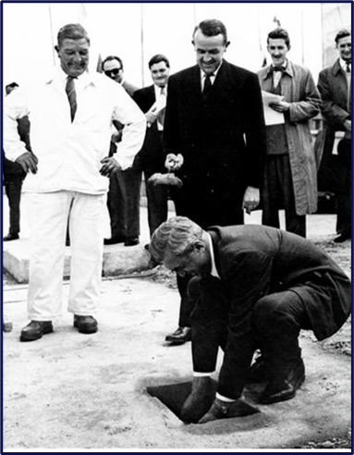
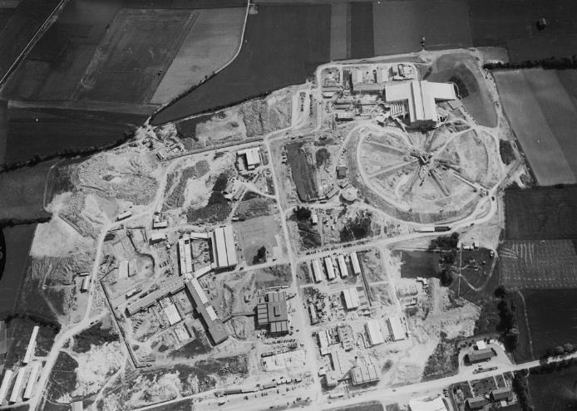

CERN has been undertaking civil engineering project since the “first stone” was laid in 1953.
The early civil engineering consisted of surface buildings and cut and cover structures for the accelerators (for radiation protection).
1957

Slide 18
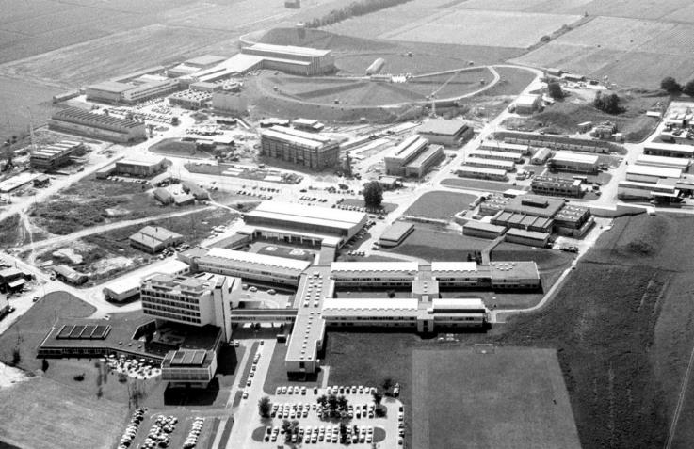
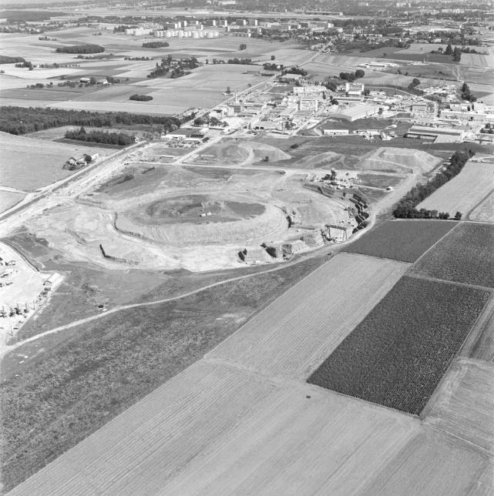
1961
1968

Slide 19
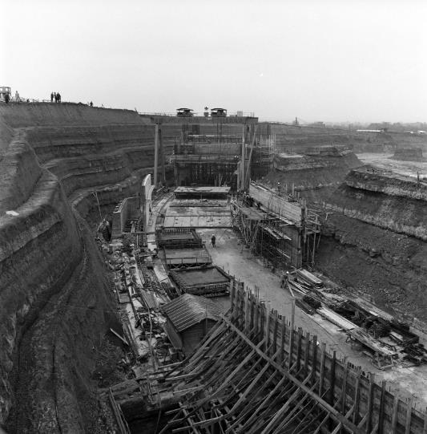
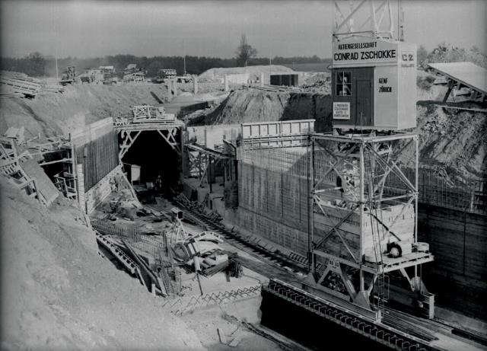
Up to 1976 the cut and cover method was used for housing the accelerators (radiation protection)
Complexe ISR en construction – 1967 (Dumez et Hochtief)
Proton Synchrotron en construction - 1956

Slide 20
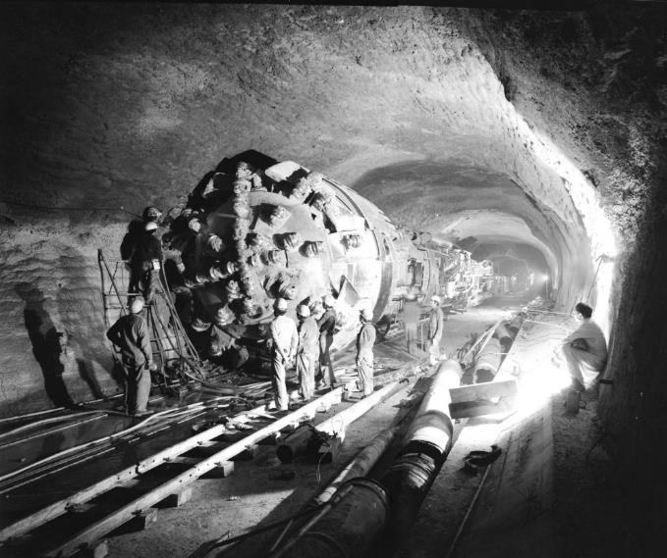
Histoire de la construction souterraine
In 1974, CERN completed the construction of its first underground accelerator , the Super Proton Synchrotron (SPS).
This accelerator is still in operation today and serves as an injector for the Large Hadron Collider (LHC).
The tunnel was 7 km long and had an average depth of about 40 m.
The tunnel crosses the French-Swiss border six times.
24 months with a single Robbins TBM
Hochtief, GTM and Eiffel.

Slide 21
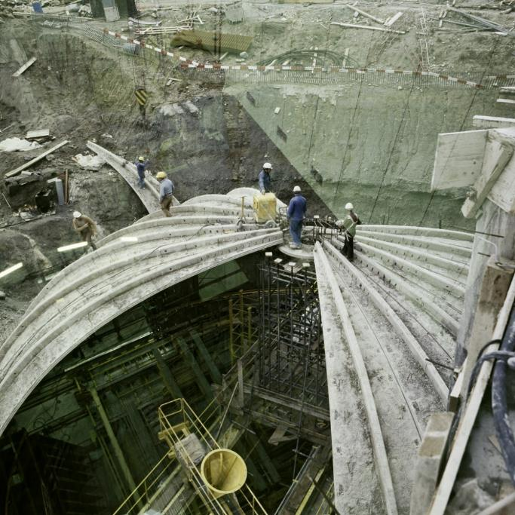
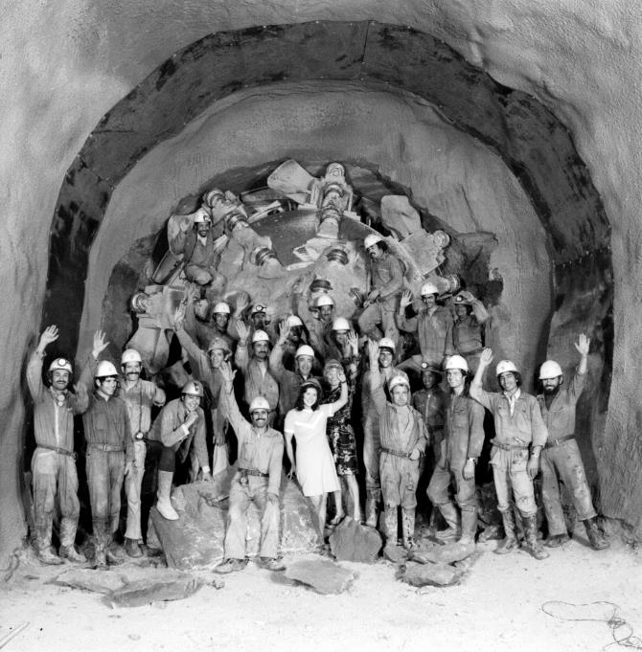
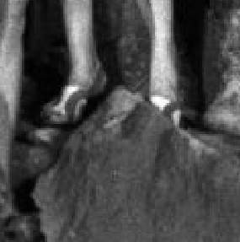

Slide 22
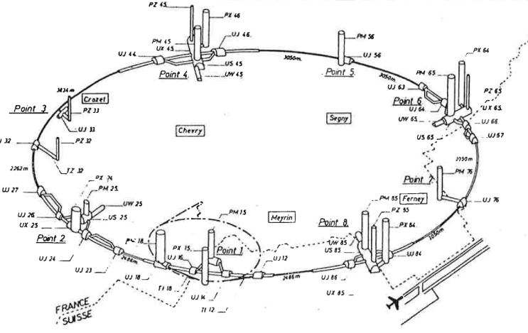
LEP
In the 1980s, CERN built the 27 km LEP machine.
The tunnel of this machine was located at depths of between 60m and 140m and was located mainly in molasse rock but also partly in the Jura limestone.
The tunnel was dug using three Wirth TBMs (1 open front and 2 double shield).
18 access shafts were built as well as numerous caverns up to 20m in diameter and 80m deep.
The tunnel was subsequently used for the LHC, the current flagship accelerator

Slide 23
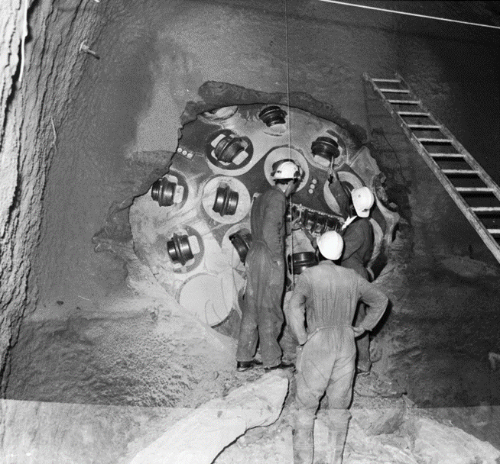
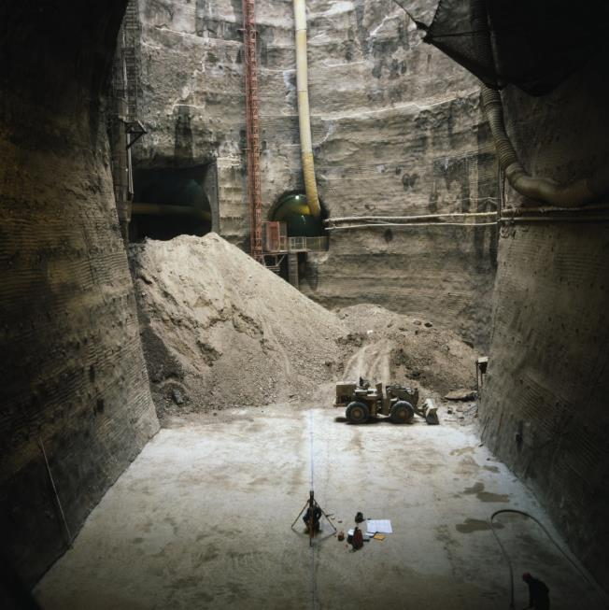
LEP

Slide 24
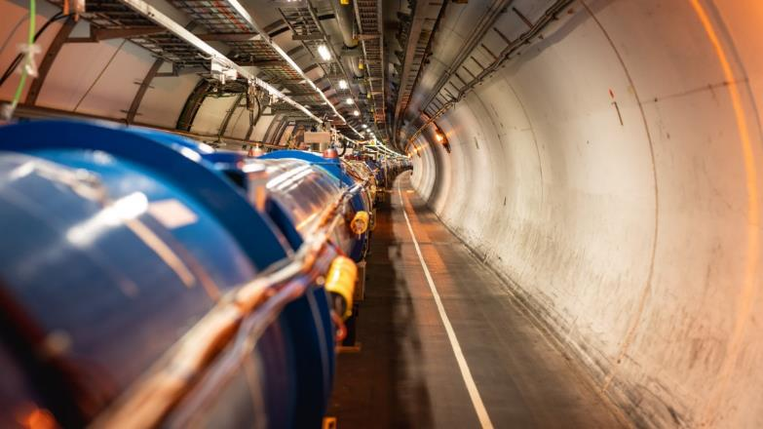
LHC
In 1998, CERN began civil engineering work on the new accelerator, the Large Hadron Collider (LHC).
This machine required the construction of two new injection line tunnels, as well as new tunnels and caverns for the beam absorbers.
Two new experimental areas have also been built for the CMS and ATLAS detectors

Slide 25
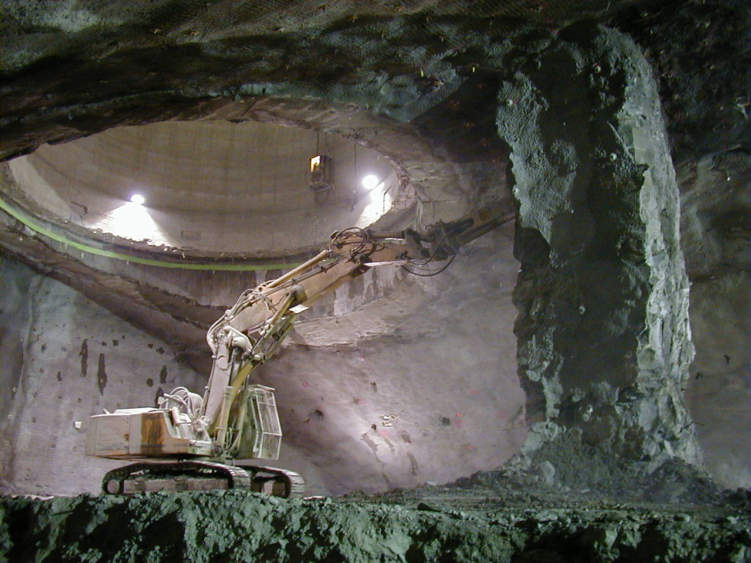
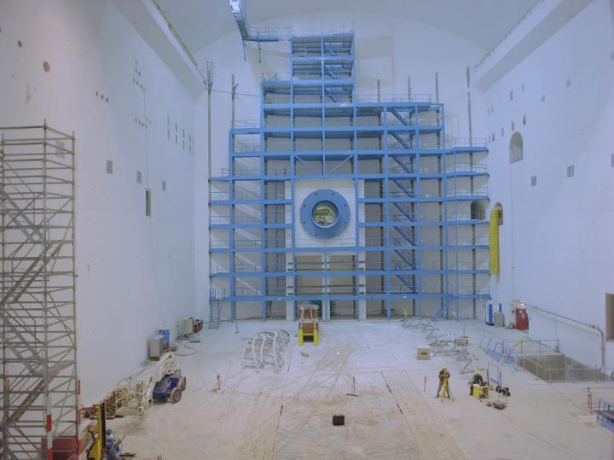
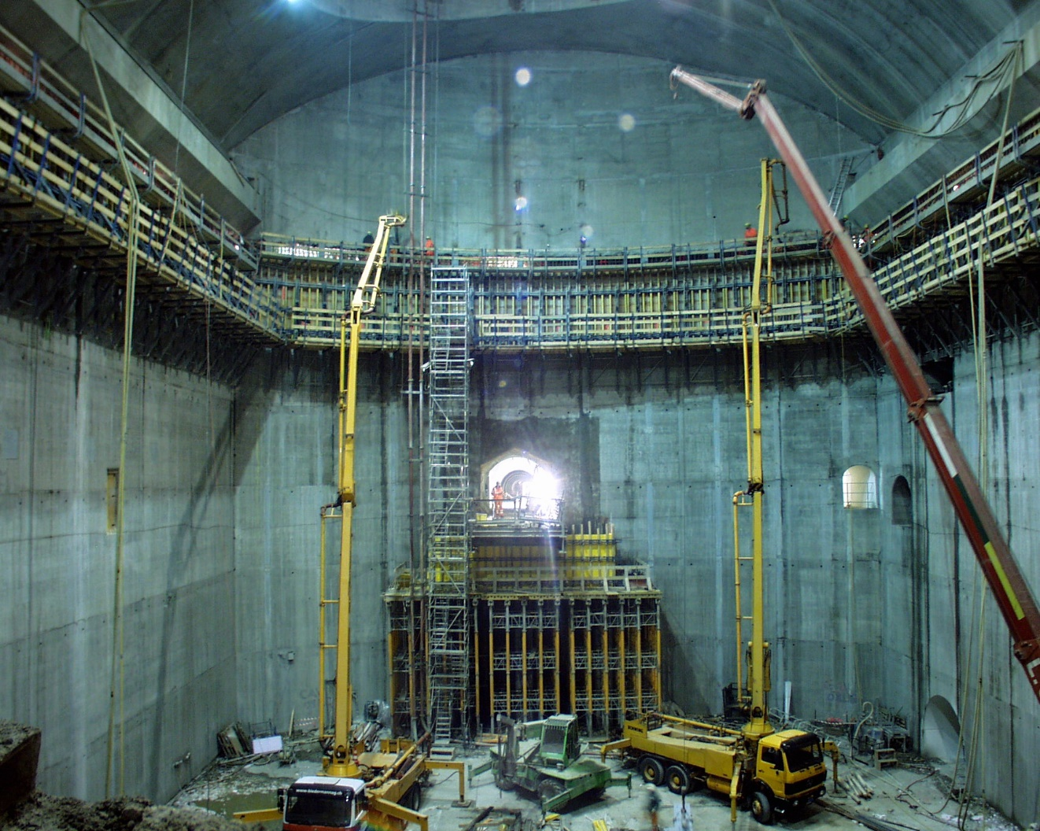
Cavern for the ATLAS Detector

Slide 26
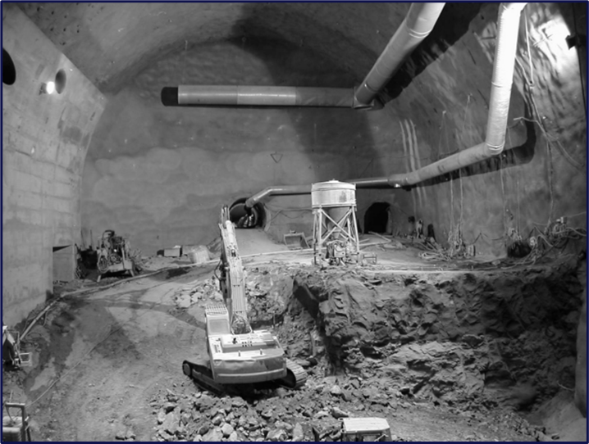
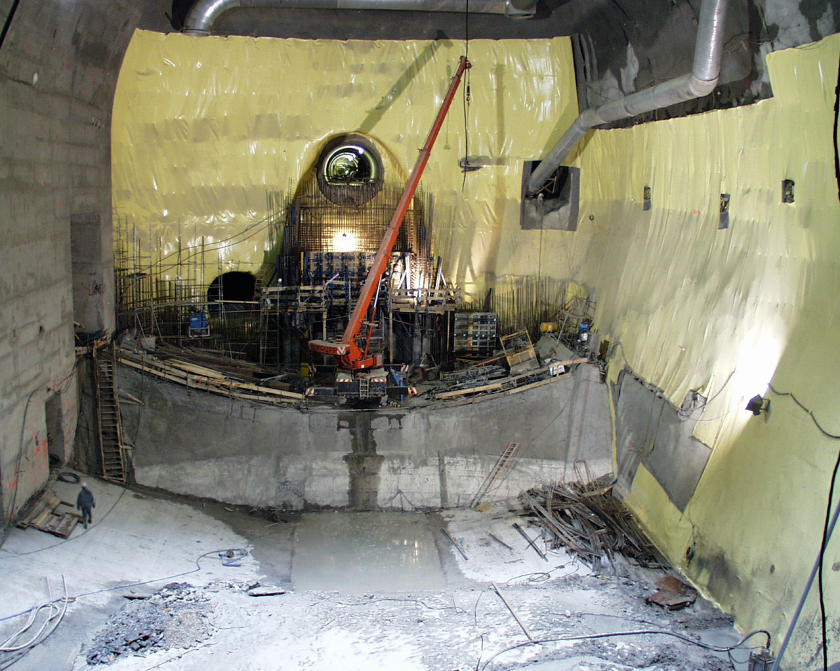
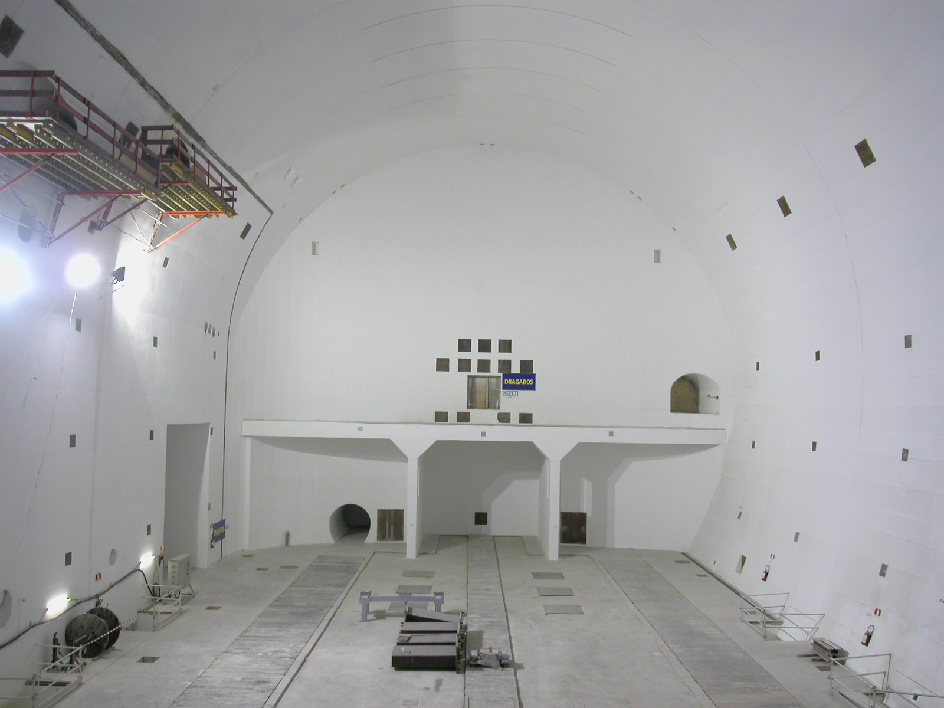
Cavern for the CMS Detector

Slide 27
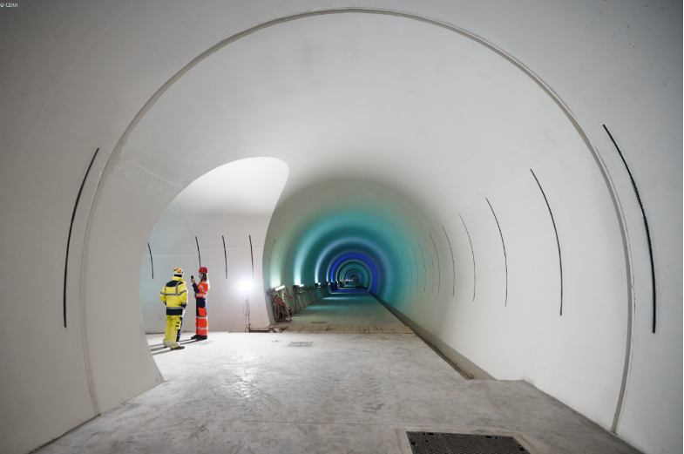
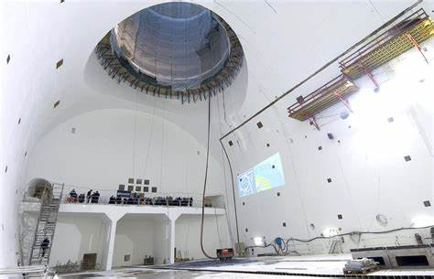

Slide 28
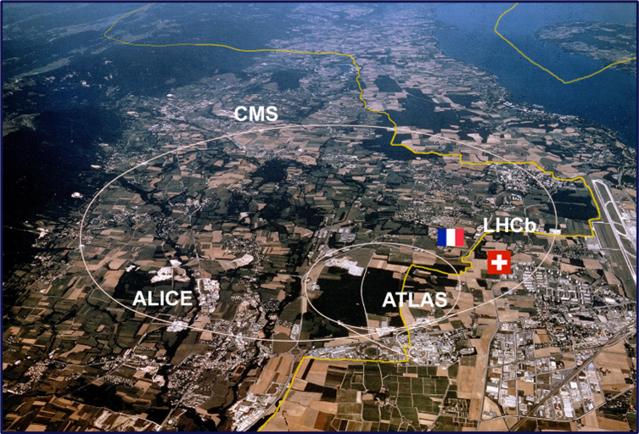

Slide 29
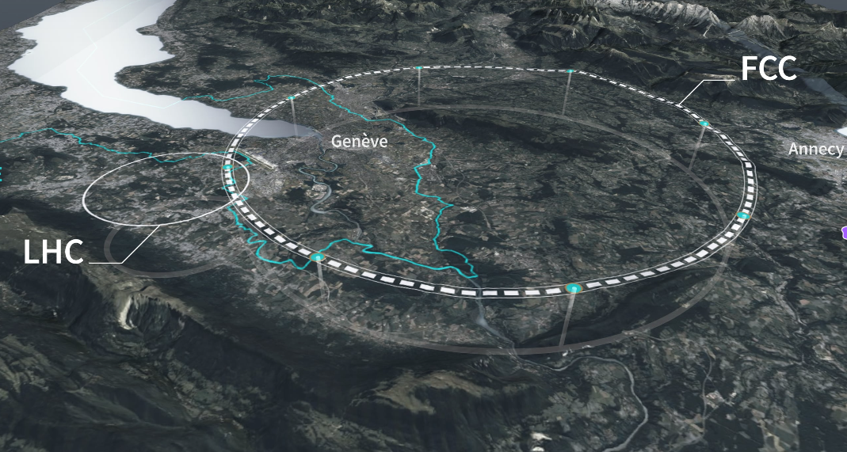

Slide 30
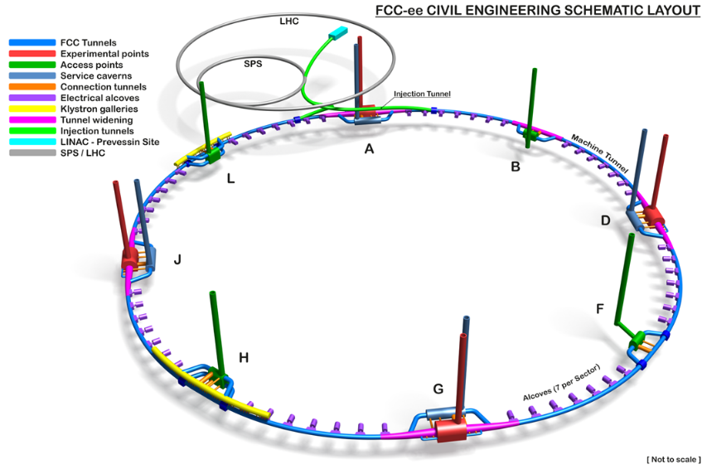
92 km main tunnel with a internal diameter of 5.5 m.
Depth varies between 50m and 600m.
12 shafts up to 400 m deep and 18 m in diameter.
2 very large caverns (35m span).
2 large caverns (span 25m).
>70 small caverns.
4 km transfer tunnel from the surface.
3.2 km of Klystron Gallery tunnels.
8 surface sites up to 7 ha each
Schematic Layout of the FCC ee Underground Works as Baselined for the Mid-term Review

Slide 31
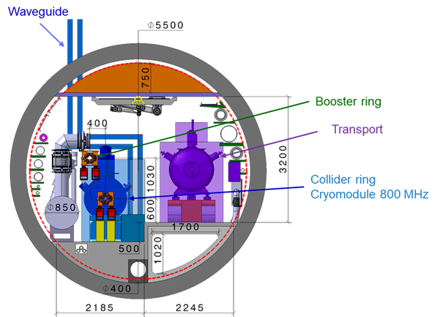
FCC – Civil Engineering
The main tunnel will house the accelerator, booster and all the necessary technical infrastructure.
A corridor for an automated vehicle to circulate is required.
Ventilation ducts on the floor and ceiling will allow compartmentalized ventilation.

Slide 32
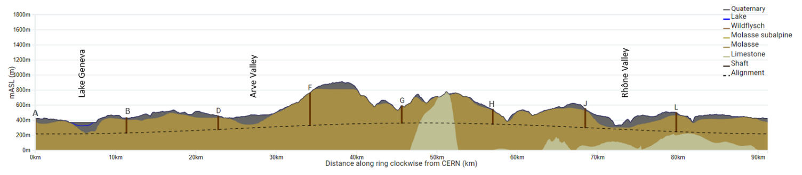
Simplified Long Profile
Shaft Depths:
A: 201 m
B: 201 m
D: 181 m
F: 400 m
G: 226 m
H: 235 m
J: 253 m
L: 250 m

Slide 33
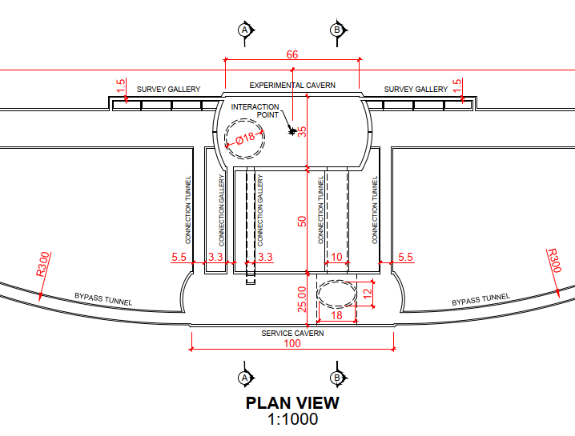

Large Cavern Complex

Slide 34


Designs from Concept Design Phase

Slide 35



FCC Proposed Large Caverns and ATLAS / CMS Caverns
FCC
ATLAS
CMS

Slide 36


Klystron Gallery - Point H
Klystron gallery
9.8 x 5.4 m
Service staircase
1990 m length Klystron gallery
Service tunnels to both Klystron gallery and machine tunnel
Waveguide duct
Klystron gallery
1990 m
Service cavern in centre of straight section
Machine tunnel, 5.5 m dia
Credit: Fani Valchkova-Georgieva
Machine tunnel

Slide 37
FCC – Initial Site Investigations
Ideally, CERN would like the tunnel to remain in molasse rock as far as possible.
A subsurface investigation campaign is underway with approximately 48 deep drill holes and 80 km of geophysical lines planned.
These will target areas where information is currently limited, for example under Lake Geneva, under the Rhone and near the Jura Mountains.
The results will be used to update our 3D geological model which will then be used to optimize the depth and inclination of the tunnel to minimize the total depth of the shaft while remaining in the molasse.
Further site surveys will be carried out after 2025 to obtain more detailed information on the specific characteristics of the rocks.

Slide 38



Campagne d’investigation du sous-sol
Site investigation campaign in areas where geological conditions are uncertain:
The optimization of the location of drilling sites continues with site visits since the end of 2022.
Alignment with host countries (FR and CH) on the process of obtaining authorization procedures. Underway for the start of drilling in Q2/2024.
Contract Status:
Engineering Services Contract and Engineer Role During Construction, Active Since July 2022
Tender underway for contract award in December 2023 and mobilization from January 2024.
Drilling works on the lake

Slide 39

Planning
The schedule takes into account the following parameters:
Availability of 1 or 2 shafts at each access point.
Surface constraints in the vicinity of shafts.
Potential opportunities for spoil removal at each point.
Each TBM will be driven from one access shaft to the other.
The removal of the TBM may have to be done through a construction site under the responsibility of another contractor.
Each 11 km section with it associated shafts, cavern, etc is expected to take between 6 and 8 years

Slide 40



Schedule (examples)
T. Watson
CE linear construction schedule
Point D – Example of linear schedule

Slide 41

Current Planning for Critical Path activities to Start Construction

Slide 42


Contracts
CERN will need to develop a strategy for the delivery of the civil engineering during 2024.
The simplest strategy will be to follow previous CERN projects and divide the works up into geographical areas and assign an Engineering/Oversight contract and a Construction contract for each site.
This would lead to 9 Engineering/oversight and 9 Construction contracts.
Variations on this would include grouping the Engineering Contracts and possibly some of the construction contracts. There are numerous possible combinations for this.
It seems difficult to avoid interfaces between contracts for the extraction of the TBMs.

Slide 43
Main Risks
Obtaining permission for surface sites (host states to decide).
Finalize an alignment that will allow the tunnel to be constructed as far as possible into the molasse rock.
Disposal of 8 million m3 of excavated rock.
Purchase of 8 TBMs at about the same time.
Contracts with up to 9 engineering companies and 9 contractors.
Workforce availability.
Tunnelling through the limestone outcrop of Mandallaz.
Setting up a CERN team to manage a project of this magnitude.

Slide 44

Experiment Site

Slide 45
Next Steps to Finalize the Feasibility Study
Complete the on-site investigation campaign.
Verify the safety, logistics and ventilation of a single 11 km long tunnel.
Finalize plans and dimensions for all underground structures.
Continue to find solutions for the disposal of 8 million m3 of excavated rock.
Verify the tunnel design and the performance of the TBM in the molasse with water inflow.
Develop contracting strategies.
Consolidate the schedule.
Consolidate the cost estimate.
Review of technical challenges by professional entities from industry (consultants, contractors)

Slide 46

16 Novembre 2023
If I wanted to come here today, it's to show my confidence in the teams and our will, our ambition, to keep the first place in this field [particle physics]

Slide 47
END

Slide 48
Reasons for this early discussion with Porr
CERN rarely undertakes large scale civil engineering projects.
We are aware that the way infrastructure projects are delivered changes with time.
We are aware that practices differ between countries and between continents.
CERN is somewhat unique in terms of its status as an international organization which on one hand allows us to do things with some freedom from national rules or customs, but at the same time we are bound by the rules and regulations governing the organization.
CERN is seeking early engagement with industry to obtain a wide view on the options open to us for delivering the project and which options may be most appropriate for the FCC.

Slide 49
Purpose of this early discussion with Porr
Since the LEP, CERN has followed the traditional Engineer/Contractor route for delivering civil engineering under one of the FIDIC standard forms.
Larger projects are sub-divided to allow spread of contracts and financial return to member states.
Civil engineering has always been done in advance of and dis-associated from the HV/MV/LV electrical systems, Water networks, lifts, cranes and other mechanical systems.
The FCC is an order of magnitude larger than LHC.
For civil engineering (at least) CERN will need to ramp up a client team from the current handful of staff working on the FCC FS.
CERN wishes to consider alternative options for delivery of the civil engineering and perhaps some of the other infrastructure to improve schedule and perhaps cost.

Slide 50
Purpose of this early discussion with Porr
CERN business as usual approach:
Each discipline (civil, mechanical, electrical, HVAC, cooling) manages their own design, procurement, installation, commissioning without a strong centralized strategy.
The civil engineering would be near-complete before handover to CERN and the commencement of the installation of the other infrastructure which would normally be coordinated by a central CERN team.
The civil engineering would be divided into appropriate work packages, probably based on geographical location and CERN would have small teams of 2 or 3 people for each set of geographically based packages (a package being one contract for the design, one for the construction and possibly some common contracts for safety, architecture, legal support etc.)

Slide 51
Purpose of this early discussion with Porr
For FCC a first consideration has been 9 sets of contracts for the 9 geographical areas concerned (8 surface sites each with a set of shafts, caverns and one 11km sector of the tunnel) and one contract for the injector/transfer lines. This would give an approximate value of the order of CHF 500MCHF for each of the 9 sites.
There may be some logic to group some of the design and/or construction contracts thereby reducing to 3 or 4.
This would require CERN to recruit, build and empower a client team of about 25 to 30 people just to set up and oversee the contracts (exclude resources for procurement, legal, administration, liaison with Host States).
The same or similar process would be needed for each of the other infrastructure disciplines.
A possible alternative would be to contract the overall responsibility (management) to a single industrial consortium who would undertake directly or through sub-contracting the works scope to deliver the final product.

Slide 52
Technical Questions
What are your immediate thoughts on the technical challenges for this project?
Do you consider that the CERN approach to use the sites with two shafts to drive two TBMs (in opposite directions) to be optimal?
What risks do you see associated with the depth of tunnelling (up to about 500m and with an average of about 200m)
What technologies are available for evacuation the excavated material through the deep shafts (up to 400m).
What technologies are available for excavating the shafts (moraine and molasse)?
Do you see an issue with using a single shaft for all access to the underground?
CERN is assuming an average advance rate of 18m/day in the molasse. Do you consider this achievable?
Do you have experience of leaving a TBM “buried” underground so that it does not have to be removed?
In case of removal what are the issues when removal needs to be carried out through another contractor’s worksite?
Are there alternative TBM suppliers in Europe other than Herrenknecht?
Do you see any advantage to include the installation of the classical technical infrastructure (pipes, cable trays, cable pulling) into the same contract as the civil engineering.
Carbon footprint of civil works (especially concrete) is an important topic. How do you see the industry evolving to meet this challenge? How do you foresee the situation in 10 years time?

Slide 53
Selection of non-technical Questions for Porr
Are there any specific strategies that would improve schedule? Or reduce cost? Lower risk?
To maximize the number of interested qualified bidders, would you propose several "smaller" contracts (e.g. 9 sets) or fewer "bigger contracts (e.g. 4-5 sets, or even less)?
What type of contracts would you recommend for this type of work? E.g. FIDIC Red book/Emerald, or other standard or bespoke?
We understand that NEC has been used as models for collaborative contracts. Are you familiar with these? What is your feedback? Do you have any thoughts on the SIA 2065 proposed model?
What kind of time would be required to prepare a bid for one construction contract assuming FIDIC remeasurement contract.
What companies would you ideally partner with for this type of work taking into account the location and the fact it is CERN contract?
What was your honest feedback from previous CERN contracts you have completed in the past?
What would you recommend CERN to do in order to ensure an equal opportunity to all member states for the contracts?

Slide 54
Selection of non-technical Questions for Porr
How would a project of this magnitude and technical complexity be constructed? Examples of previous large-scale projects would be useful to understand along with the successes and failures.
Are there benefits to early contractor involvement for underground civil works and how can this be managed within a competitive environment and where CERN is expected to aim for a so called “fair return” to its member states?
Does Porr have experience of projects where clients brought in contractor’s expertise early on to help develop appropriate technical solutions?
What is the position within CERN member states with regard to Project Management companies able to undertake the civil engineering as a turn-key venture?
Do you see a resourcing issue for such a large project with significant underground works?
CERN is currently looking into disposal options for the excavated material. What is Porr experience in this sensitive subject?

