Slide 2
HL-LHC WP3
Status of activities on resistive magnets
P.A. Thonet

Slide 3
Points 1 and 5

Slide 4
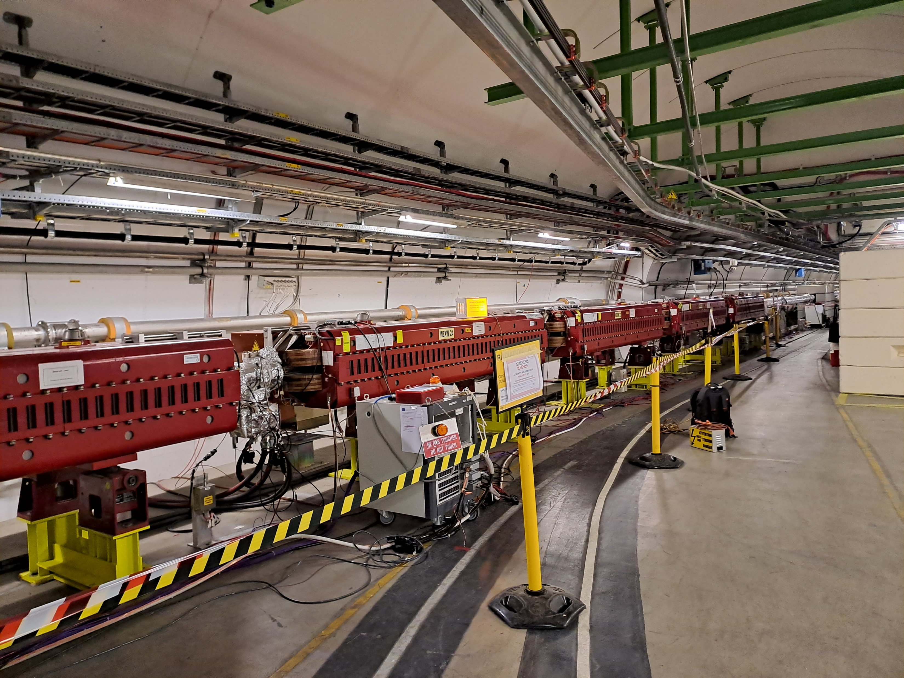
Points 1 and 5: Removal of 24 MBXW magnets
Activity being organized with colleagues from other groups (EN-HE, EN-CV, TE-VSC, TE-MPE, BE-SU, EN-EL,…)
Request for a storage space in view to keep these magnets in stock for potential use in other machines/projects (~50 m² as these magnets can be stacked by 3 or 4 units).

Slide 5
Points 3 and 7

Slide 6
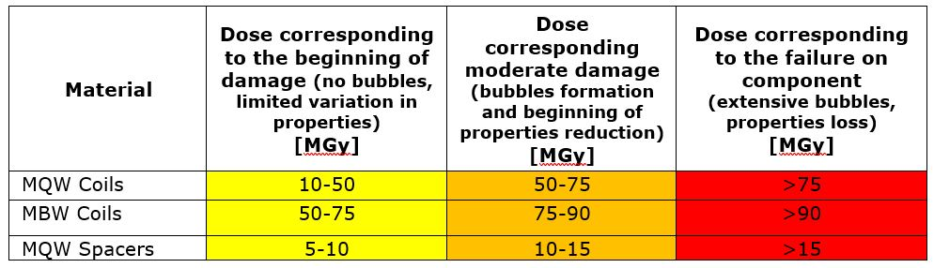
Points 3 and 7
Given high integrated dose expected on MQW and MBW magnets in points 3 and 7 a study and test campaign was performed to:
  Evaluate and keep (in collaboration with SY-STI) the expected integrated dose until the end of HL-LHC up-to-date.
  Evaluate the resistance to radiation of critical magnet components:
  Find some ways to mitigate the dose and implement the solution.
  Evaluate and implement possible corrective actions in case of failure.

Slide 7
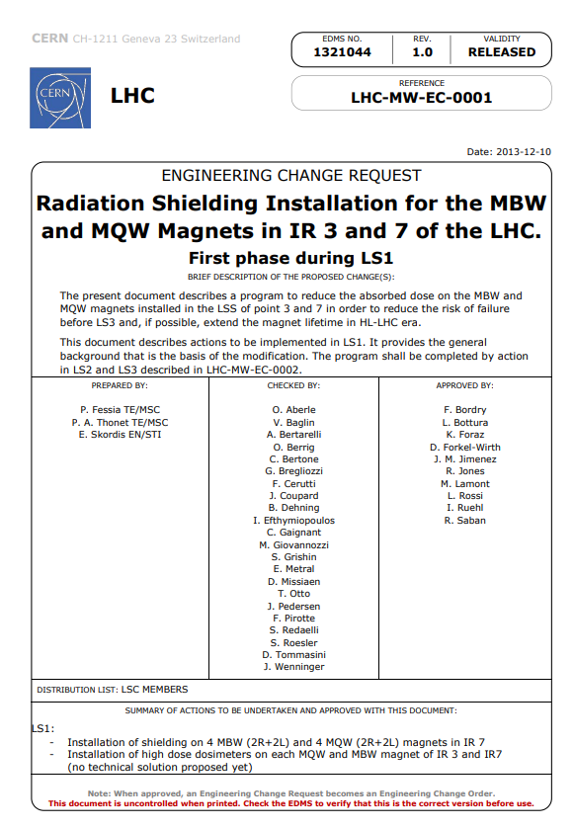
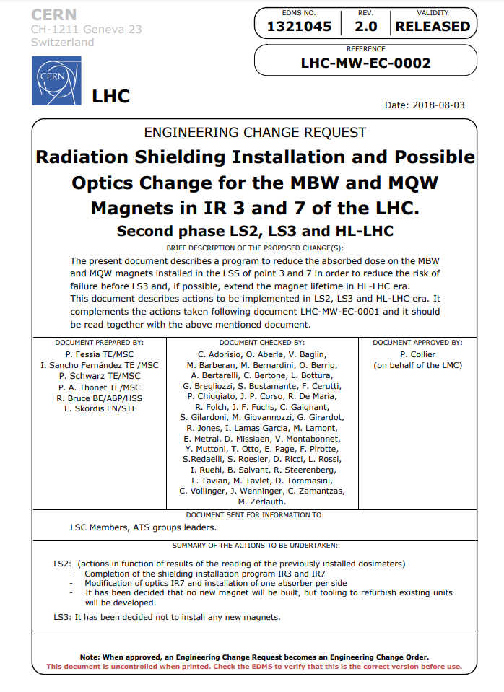
Installation of radiation shielding completed
Courtesy P. FESSIA

Slide 8
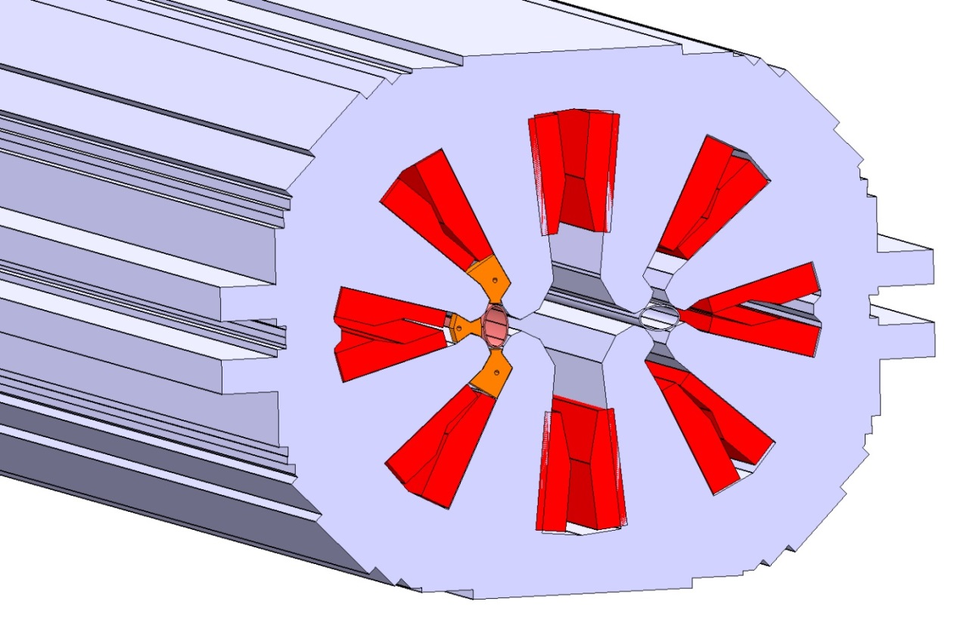
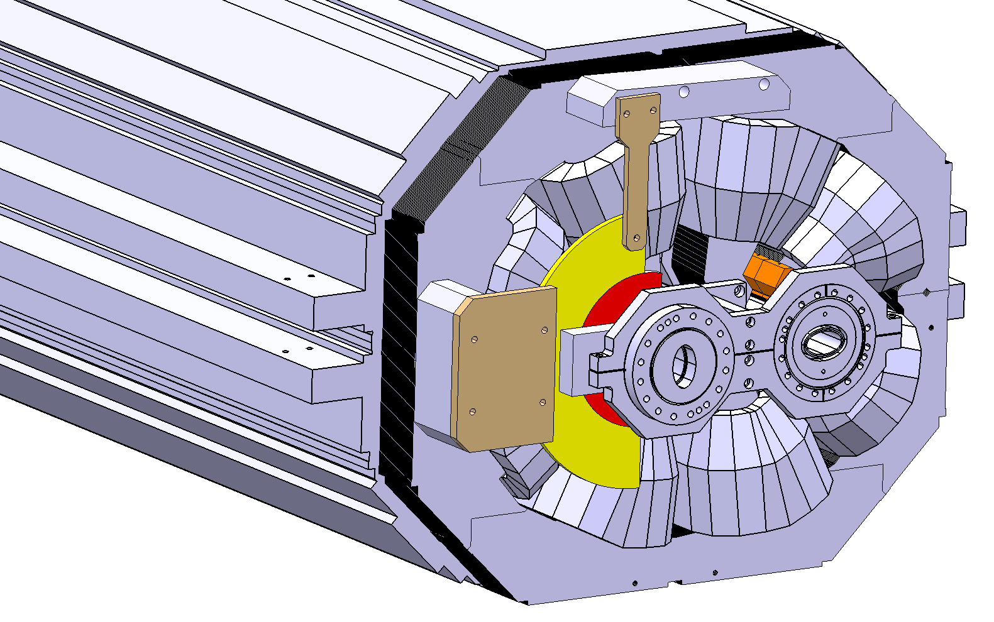
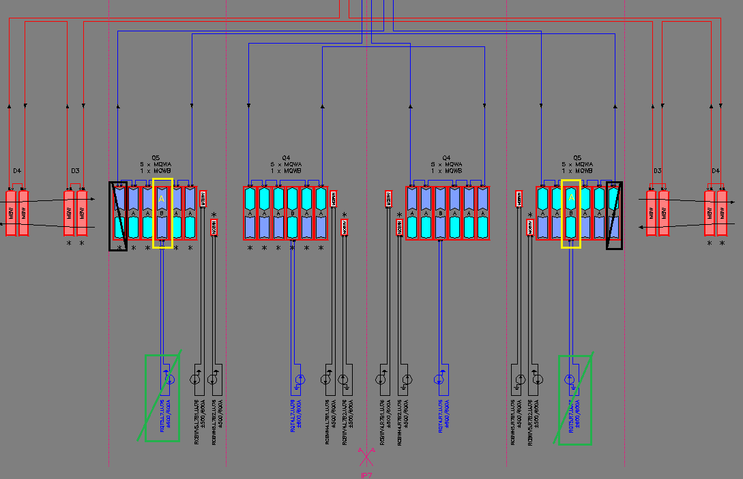
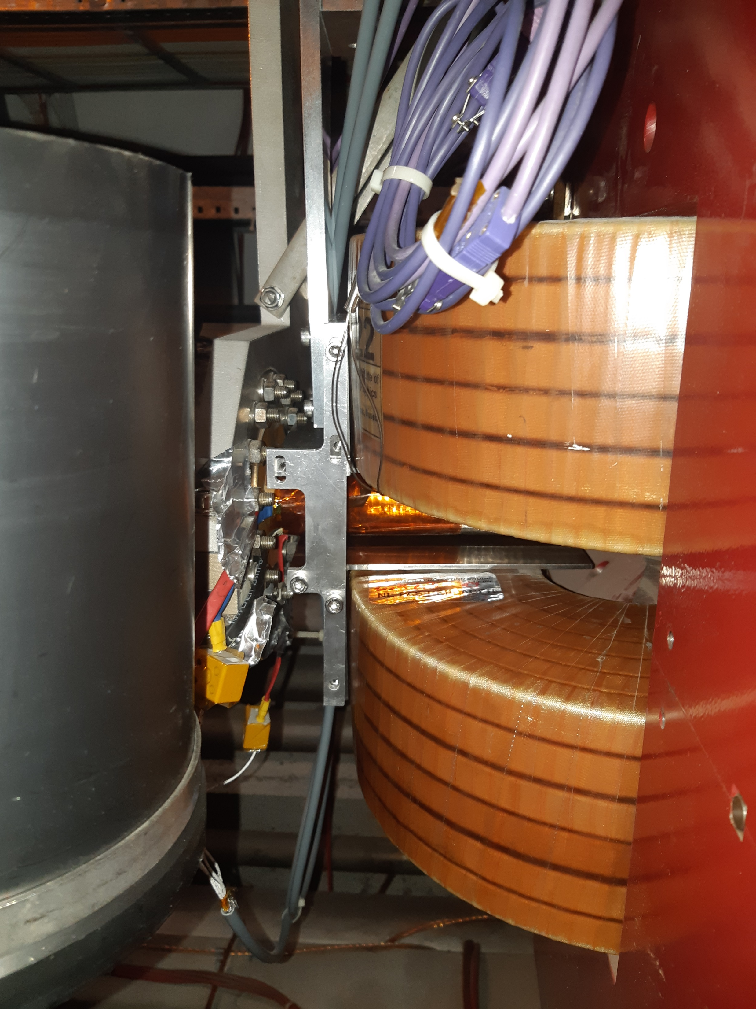
Installation of radiation shielding completed
Pictured: Shielding on MQW quadrupoles
Pictured: MQW optic change in point 7
and installation of an absorber
Pictured: Shielding on MBW dipoles

Slide 9
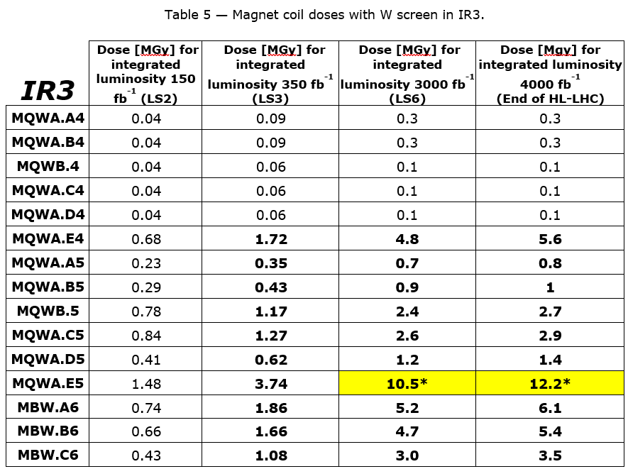
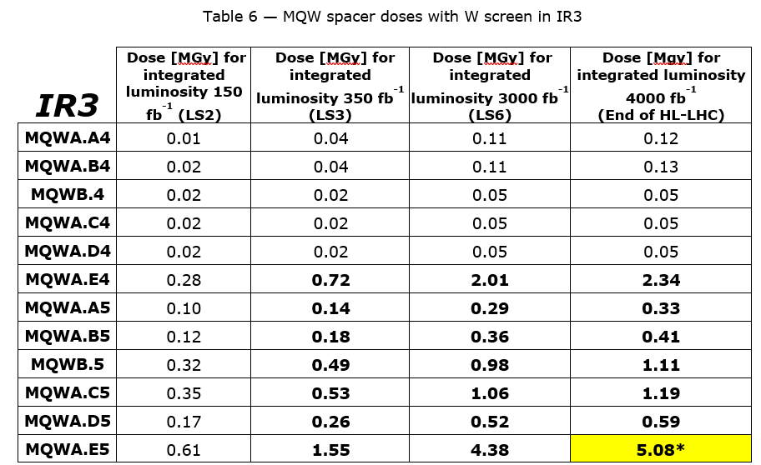
Expected dose in point 3 (from 2018 study)
All work listed in ECR 1321044 and 1321045 was completed during LS2 (few minor exceptions for front-face shields on MQW due to space constraints)
It includes the installation of shielding on MQW and MBW
Expected integrated doses on magnet components mostly below limits which start to degrade insulation and shimming materials
Study on going to update the integrated dose with latest RPLs measurements, taking into account the magnets where front-face shields were not installed

Slide 10
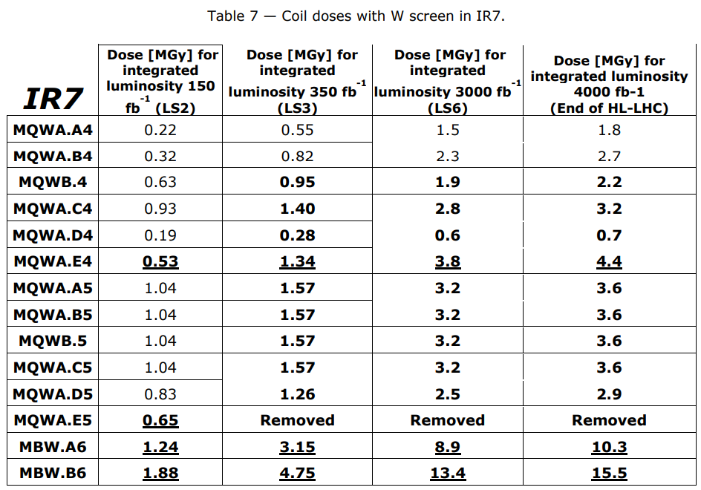
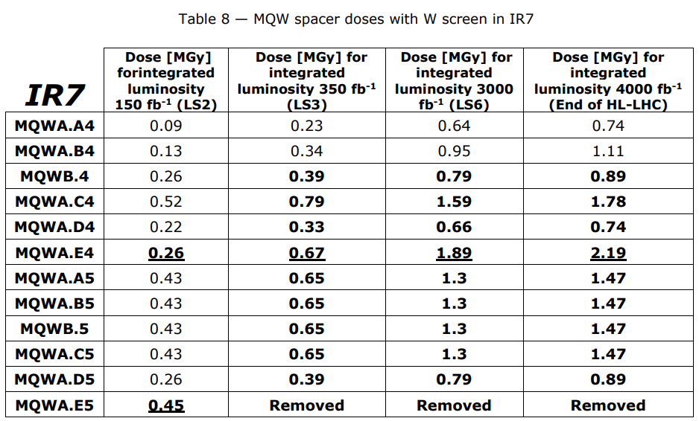
Expected dose in point 7 (from 2018 study)
All work listed in ECR 1321044 and 1321045 was completed during LS2
It includes the installation of shielding on MQW and MBW and removal of the 2 MQWA.E5 (reconfiguration of MQWB.5 in MQWA) and installation of an absorber
No further work to be done
Expected integrated doses on magnet components below limits which start to degrade insulation and shimming materials

Slide 11
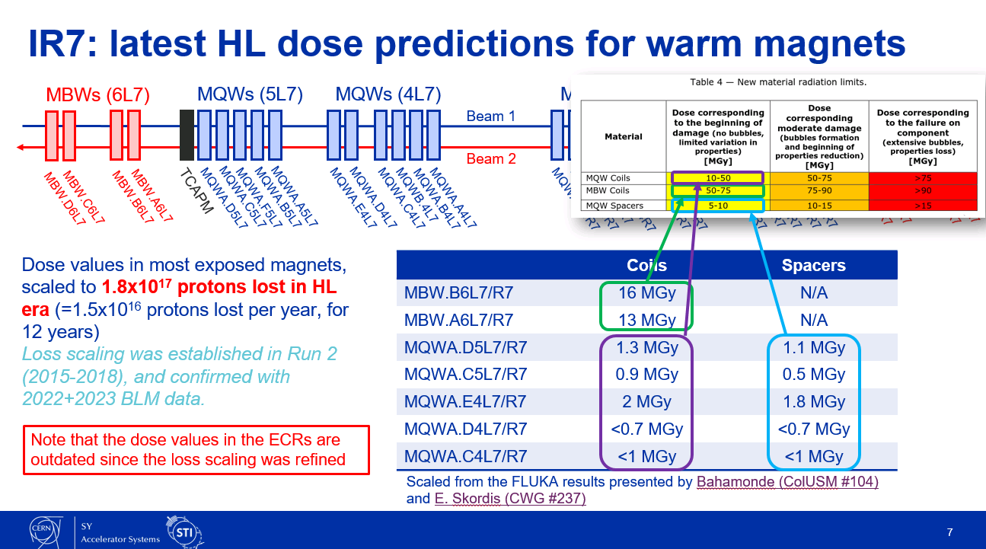
Expected dose in point 7 (updated 2024)
Courtesy A. Lechner

Slide 12
LHC resistive magnets spare status
All spare magnets were certified, and vacuum chambers installed in 2023-2024. For each type, some spares are available and ready to be installed (excepting MSI due to different vacuum chamber configurations in points 2 and 8).
Depending on magnet type and location a magnet exchange would take 1 to 2 weeks. Original installation documentation exists, and handling equipment is still available.
LHC RESISTIVE MAGNETS
Name | Magnet type | Number of installed magnets | Magnet location | Number of spare magnets | Number of spare magnets ready to be installed (with vacuum chamber) | Remarks
MQW | QUADRUPOLE | 46 | Points 3 and 7 | 6 | 5 | 5 magnets out of 6 equipped with vacuum chamber
MBXWS | HORIZONTAL DIPOLE | 2 | Point 8 | 1 | 1
MBXWT | VERTICAL DIPOLE | 2 | Point 2 | 1 | 1
MBW | HORIZONTAL DIPOLE | 20 | Points 3 and 7 | 4 | 2 | 2 magnets equipped with vacuum chambers supports of each type
MBXW | HORIZONTAL DIPOLE | 24 | Points 1 and 5 | 4 | 3
MBXWH | HORIZONTAL DIPOLE | 1 | Point 8
MCBWV | VERTICAL DIPOLE | 8 | Points 3 and 7 | 2 | 1
MCBWH | HORIZONTAL DIPOLE | 8 | Points 3 and 7 | 2 | 1
MBWMD | VERTICAL DIPOLE | 1 | Point 2 | 1 | 1
MSIA | SEPTA MAGNET | 4 | TI2 and TI8 | 2 | 0 | Vacuum chambers available but different configuration for points 2 and 8
MSIB | SEPTA MAGNET | 6 | TI2 and TI8 | 3 | 0 | Vacuum chambers available but different configuration for points 2 and 8
MSDA | SEPTA MAGNET | 10 | Point 6 | 5 | 5
MSDB | SEPTA MAGNET | 10 | Point 6 | 5 | 5
MSDC | SEPTA MAGNET | 10 | Point 6 | 5 | 5

Slide 13
Regular inspections and tests
All Magnets are inspected every year. No noticeable color change of the coil resin observed so far.
Dosimeters are exchanged and measured every year (EDMS 2881444 for 2022, EDMS 3027410 for 2023).
Heat run at nominal current is done every year. No problem detected so far.
High voltage test and heat run with thermal inspection is done during long stops. No problem detected so far.

Slide 14
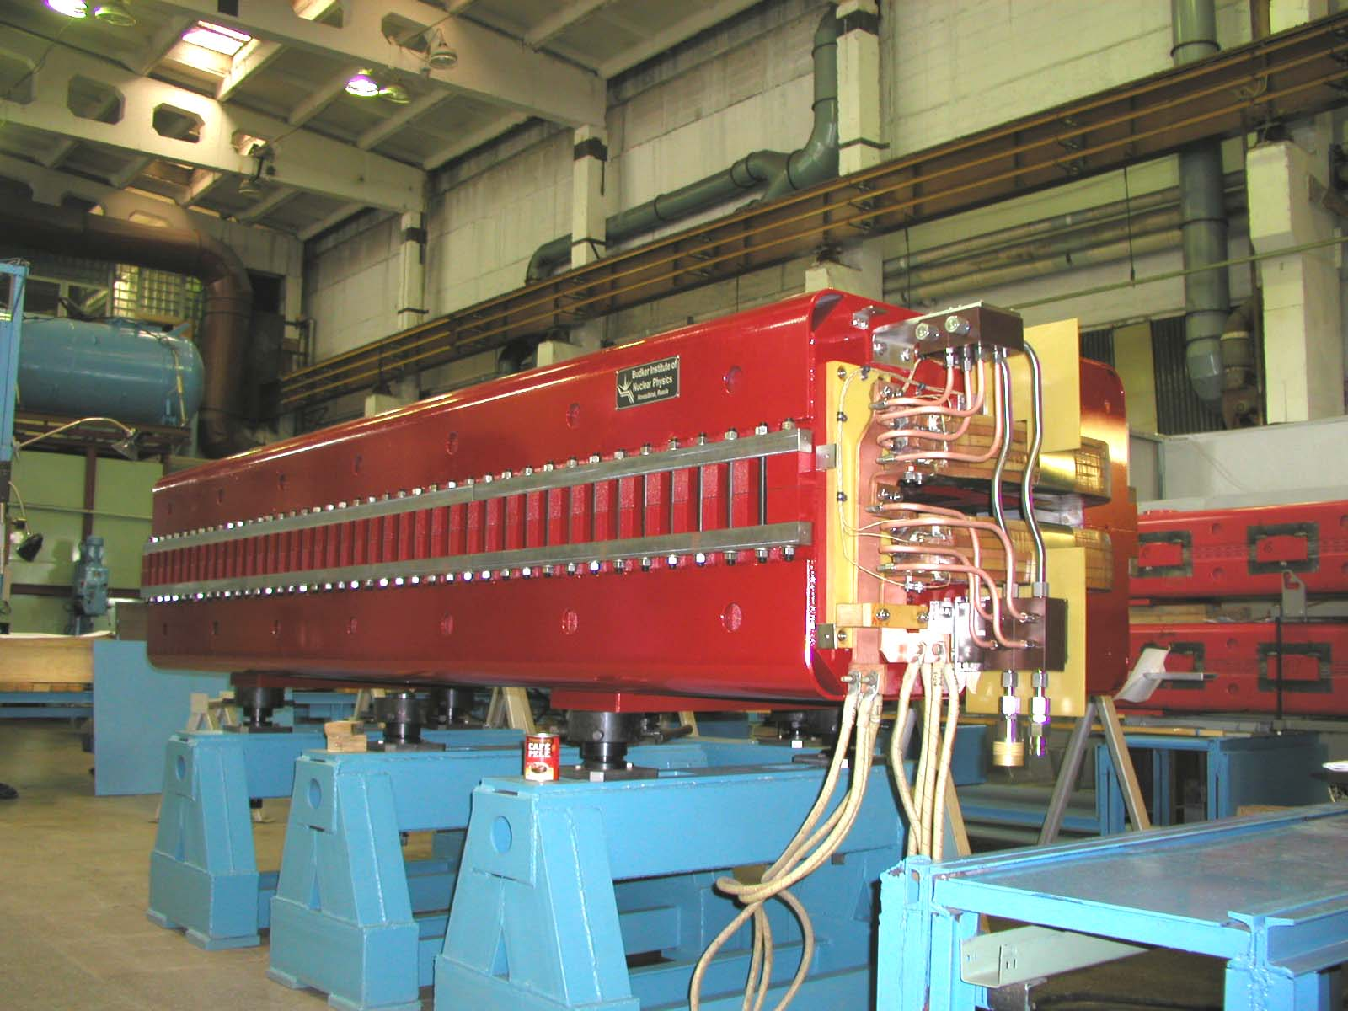
In case of MBW failure and replacement
Bolted yoke construction
Coil replacement would fall in standard procedure for coil replacement and shimming, using existing equipment.
=> No further work to be done

Slide 15
In case of MQW failure and replacement
Non-standard procedure and equipment to refurbish these magnets
A procedure explaining manufacturing and assembly, taken from Alstom exists and is relatively well detailed, including pictures.
A tooling inventory was done and there are not many equipment that were found and can be re-used (or it is in bad condition).
Most of the assembly tooling will have to be re-designed (based on existing drawings).
In case of failure of an MQWA, it was proposed some years ago to convert a MQWB into an MQWA to continue the run (eventually in slightly degraded mode), as it was done for circuit RQ5.LR7 in point 7.

Slide 16
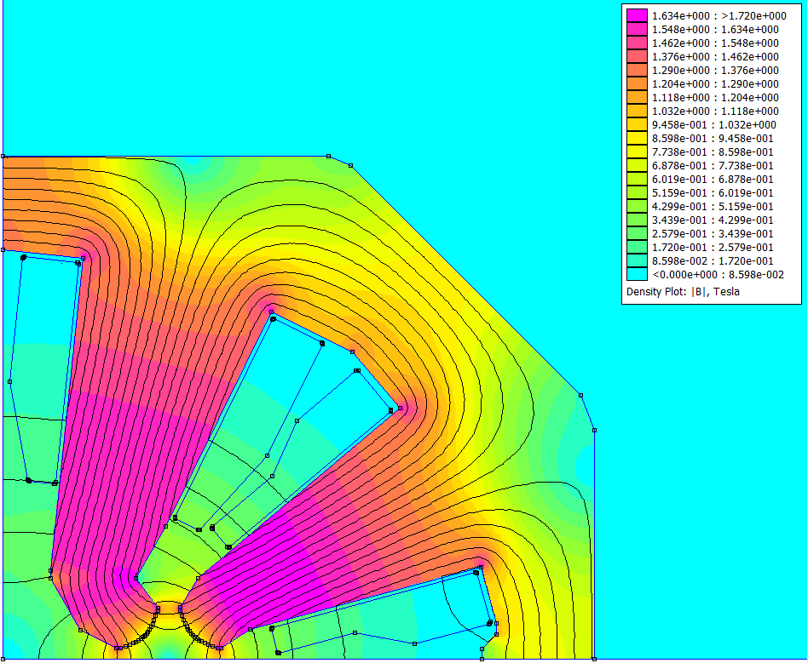
How MQW coils are stressed
Maximum of 450 Volts for ground insulation
Maximum of few Volts between turns
Maximum forces on coil of 6 kN over the 3.1 m length
Relatively low water velocity and pressure
Operation in DC (with slow ramp)
6 kN
=> Not heavily stressed
6 kN

Slide 17
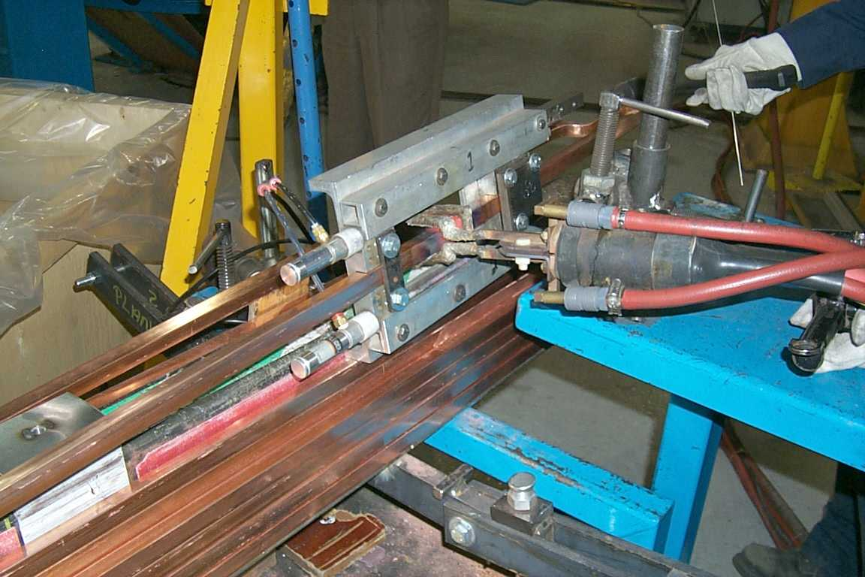
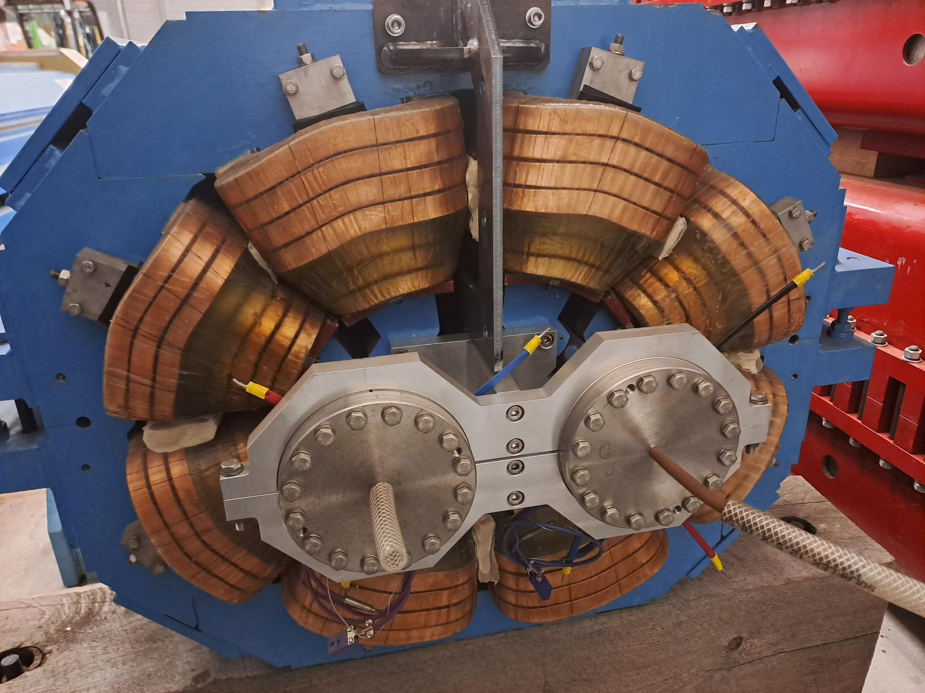
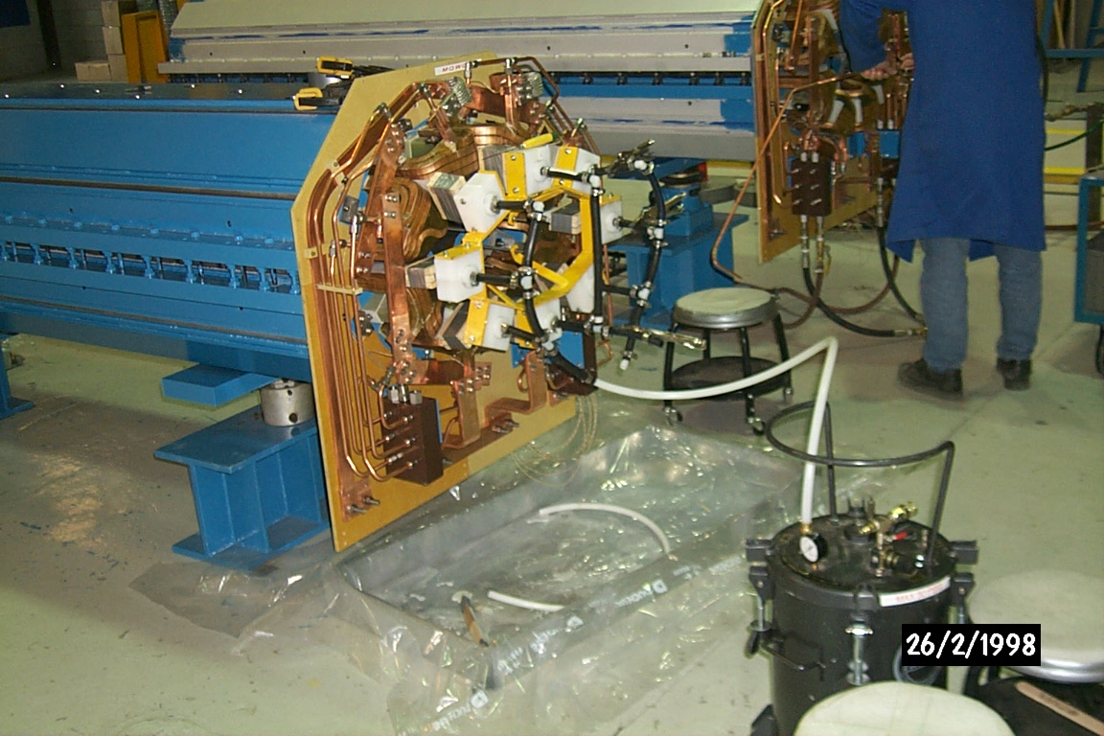
MQW potential weaknesses
Internal brazing are present (as in many over LHC or CERN complex resistive magnets). Risk on internal short circuit in case of leak.
Potential degradation of resin performance due to integrated radiation doses.
Shimming between coil made of charged epoxy resin injected in pockets. It is more subject to radiation damage than coils. Mainly coils on upper half yoke are concerned.

Slide 18
A possibility to repair coil shimming
In case of shimming degradation, It may be possible to inject new pockets on the outside and inside of the coils.
For the inside ones, the installed shielding would help to constraint the pockets in any directions.

Slide 19
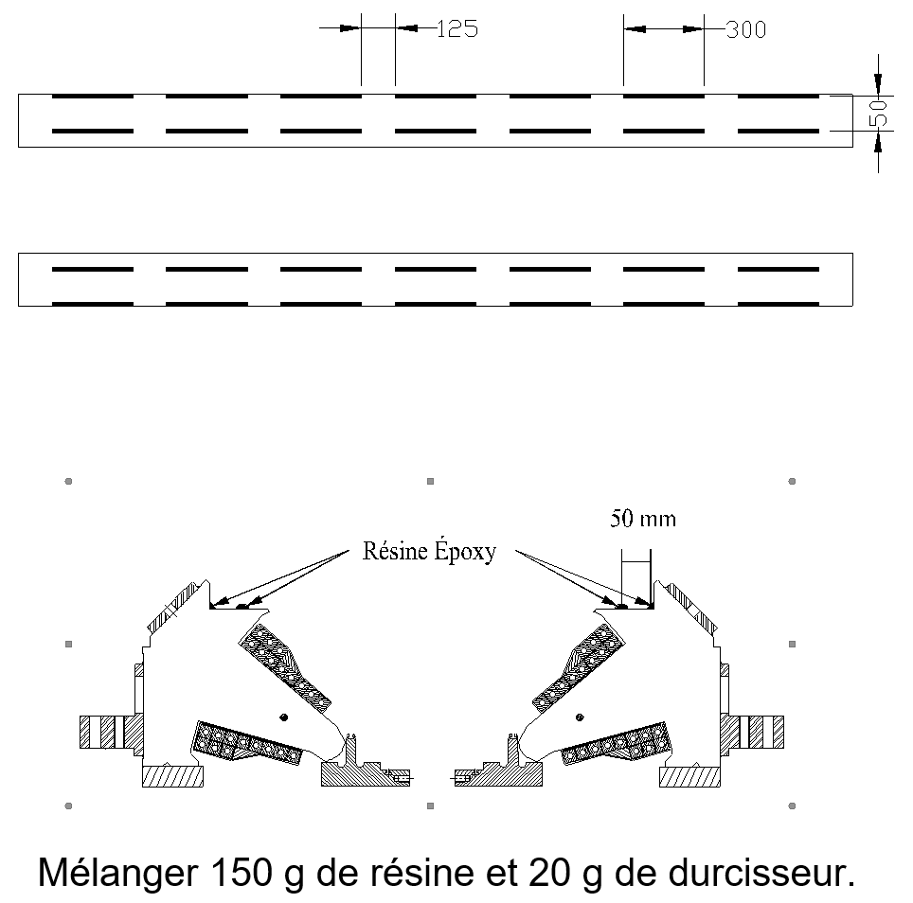
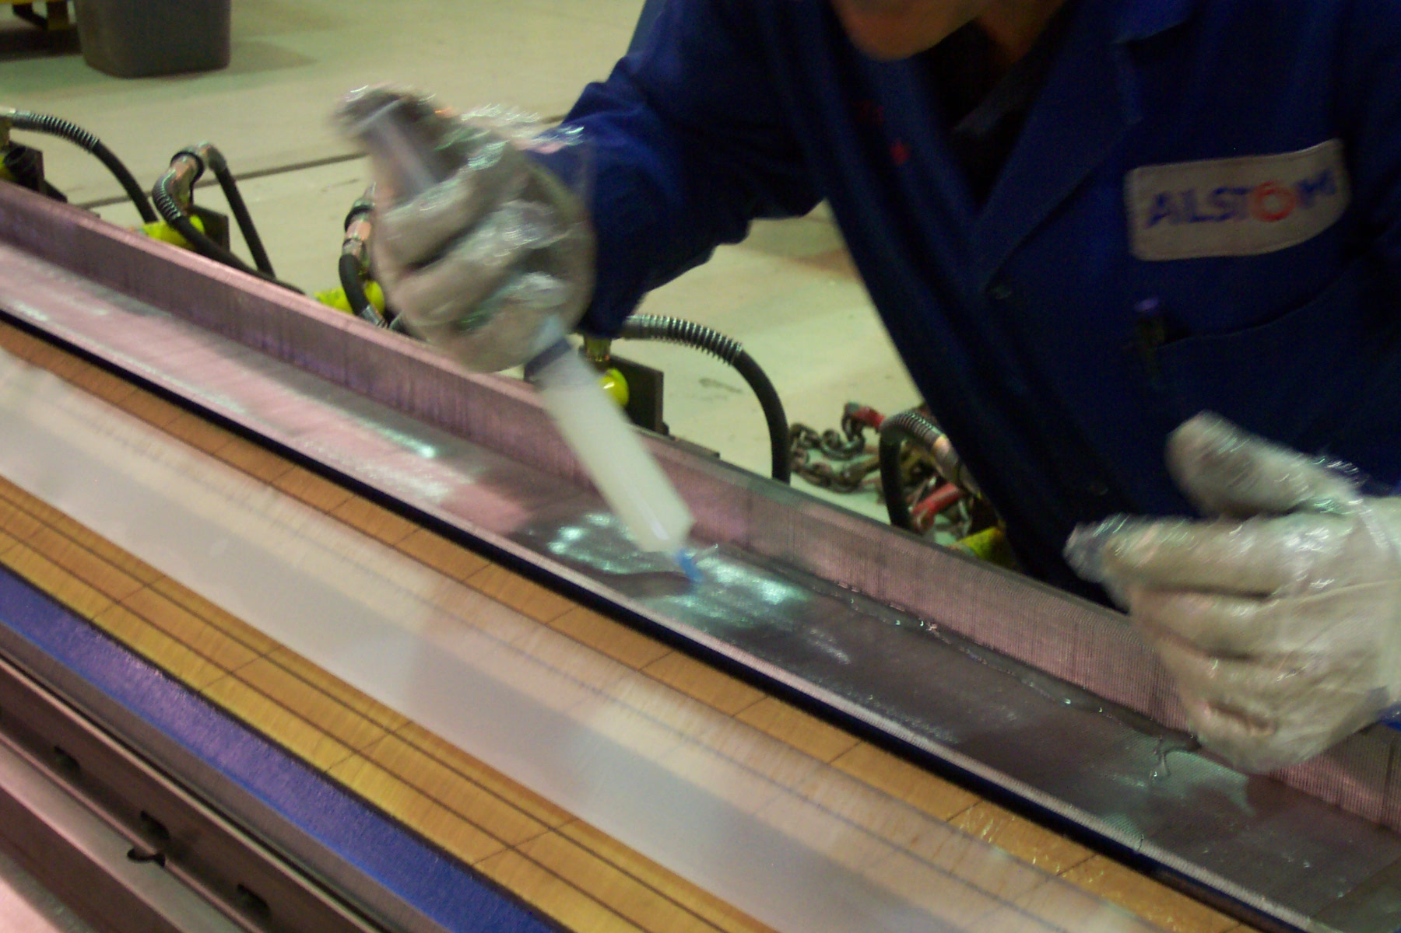
Potential difficulty to open an MQW
It was recently found that the quadrants were glued together with epoxy before being welded.
The glue is used to fill the space and has no structural purpose but if it performs well, it may be tricky to separate the quadrants.
Source Alstom

Slide 20
MQW future actions
Development of a solution and process to re-shim coils with injected pockets in case of coil shimming repair and in case of opening and closing operation.
Monitoring of coils potential movements when cycling (YETS 24-25).
Endoscopy of cooling channels to identify potential brazing problems or degradation of brazed joints (connexions pieces and internal brazing if possible). Test to be done in 2024 on 2 magnets taken out from point 7.
Request for demineralized water analysis (network and MQW outlet) and comparison with SPS and PSB (YETS 24-25).
Design of opening/closing tool was started with EN-MME but put on hold since LS2. It is at early stage and would still require a lot of work (opening of the magnet, machining, handling of the quadrants, alignment and closing). It is proposed to document what is already done and restart this design only if one of the MQW fails in the machine.

Slide 21
CONCLUSION
For any of the LHC resistive magnet types (excepting MSI septa), spare magnets are ready to be installed.
Regular inspection and tests are done to identify any condition changes or damages. No visible damage identified so far.
All work planned (minor few exceptions due to space constraints) in ECR 1321044 and 1321045 was completed during LS2.
Continue dose monitoring and update the integrated dose previsions to keep up-to- date the risk of degradation of coils insulation and shimming material due to radiation (to be decided until when we do this and if it will be acceptable for people to take such radiation dose for RPLs exchange during HL-LHC).
For MQW magnets:
  Given current situation (expected radiation dose minored, no degradation), it appears safe to rely on available spare magnets until the end of HL-LHC.
  Measurement campaign to be done (2024 and YETS 24/25) to detect any coil movement or brazed joints degradation.
  Tooling and process to re-shim coils to be set in 2024-2025.
  Opening and closing tooling design would restart only if a MQW magnet fails.

