Slide 1
Status and plan for magnetic measurement devices
Lucio Fiscarelli
Ricardo Beltron Mercadillo
Guy Deferne
Olaf Dunkel
David Giloteaux
Piotr Rogacki
WP3 meeting, 17/04/2024

Slide 2
Outline
Rotating coils for tests on horizontal benches
    Introduction
    Status
    Plan
    Quench antennas
    Introduction
    Status
    Plan
Other instruments such as rotating-coil scanners and stretched-wire systems are not discussed in this presentation.
WP3 meeting 13 September 2023
https://indico.cern.ch/event/1323751/
2

Slide 3
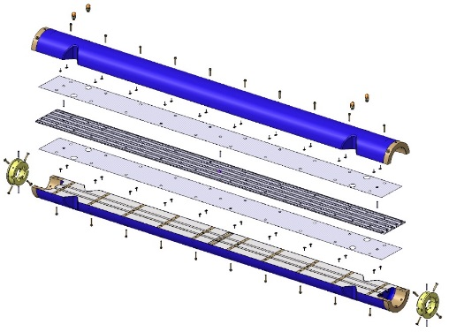
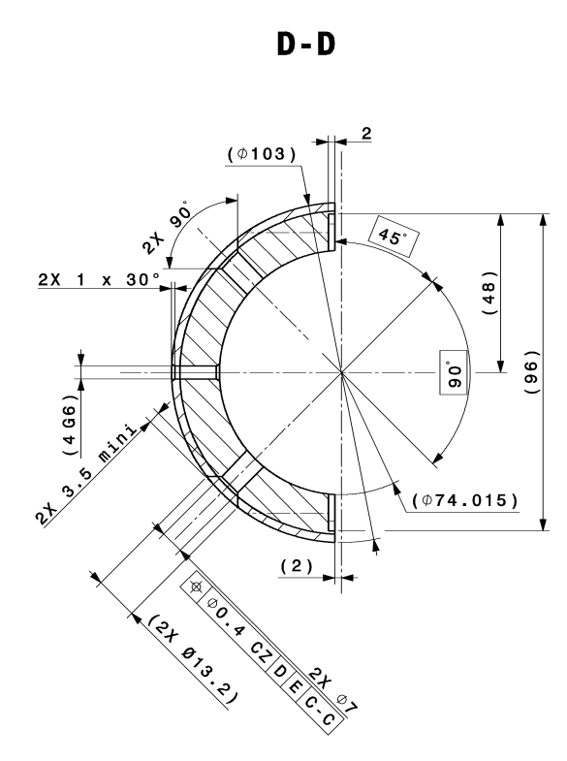
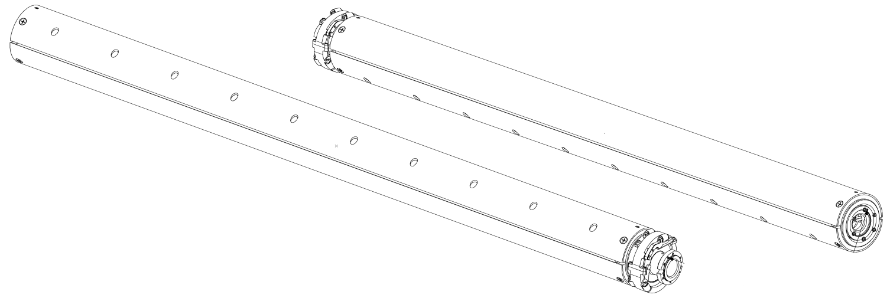
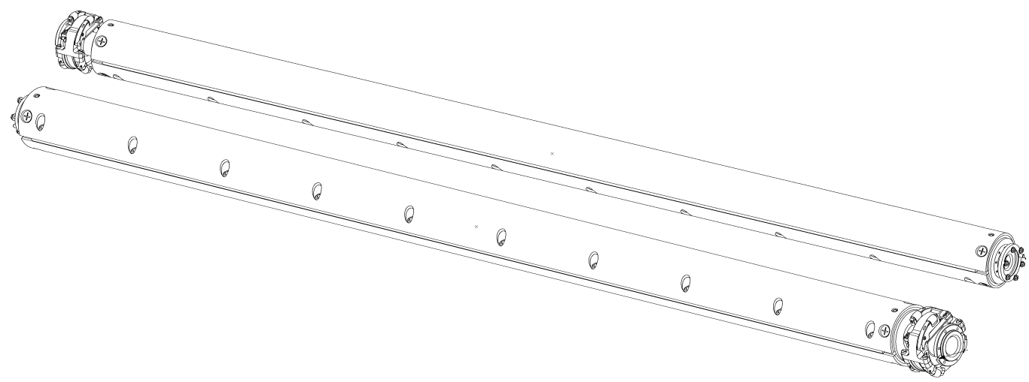
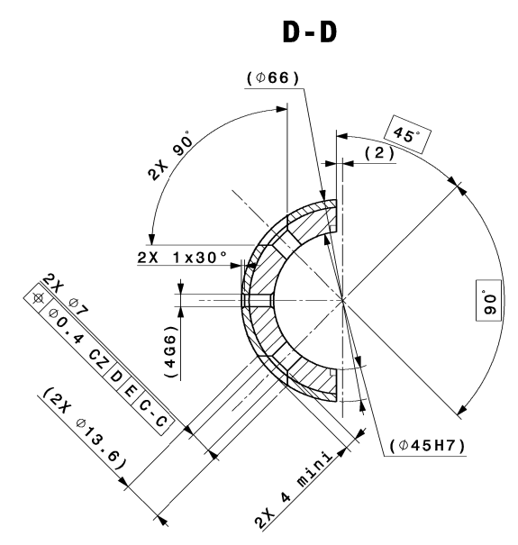
Rotating coils: segments
  The basic element is the segment:
  A PCB supported by two half shells with end caps providing the mechanical interface with a ball-bearing and a roller
  For HL-LHC magnets: 2 types of segment
  Type 1: diameter 103 mm and length 1.3 m
  Type 2: diameter 66 mm and length 1.2 m
3

Slide 4
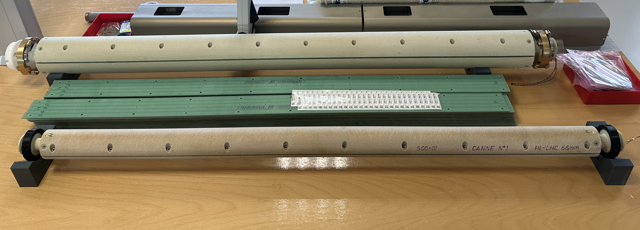
Rotating coils: segments in reality
  Roller PCB Half shells End cap
4

Slide 5
Rotating coils: shaft configurations
  4 configurations (see Appendix)
    Q2 (used as well for Q1/Q3)
      2 shafts, 6 segments, 4 coils per segment connected
    1 shaft is a spare.
    D1
      1 shaft, 5 segments, 5 coils per segment connected
      No spare unit but the CP shaft can be used
    CP
      1 shaft, 5 segments, 5 coils per segment connected
      No spare unit but the D1 shaft can be used
    D2
      2 shafts, 10 segments, 2 coils per segment connected
      No spare but the other shaft can be used
    Spare segments of all types
5

Slide 6
Rotating coils: number of required segments
 |  | N. shafts | N. segments
Type 1 ø 103 | Q2 | 1 + 1 spare | 14
 | D1 | 1 | 6
 | CP | 1 | 5
 | SPARES |  | 4
 | TOTAL |  | 29
Type 2 ø 66 | D2 | 2 | 20
 | SPARES |  | 4
 | TOTAL |  | 24
  The Q1/Q3 tested at CERN will be measured by using the Q2 shaft
6

Slide 7
Rotating coils: performed tests
  The MQXFB magnets tested in the temporary cold-mass were measured by using the prototype shaft made of carbon fiber
  The D2 (with MBRDP1) prototype was tested by reusing the LHC MB anti-cryostats. The LHC MB shafts (R = 17 mm) were the only ones fitting these anti-cryostats. The measurement precision is affected for multipoles n>6 .
  The D1 prototype (MBXFP1) was measured by using the prototype shaft (carbon fibre) as well as the new shaft made of glass fibre of 103-mm (first validation test)
  The first Q2b (with MQXFBP2) was not measured
  The first Q2a (with MQXFBP3) was measured by using the new shaft made of glass fibre of 103-mm (second validation test)
  The Q2b (with MQXFB04) is going to be measured by using the new 103-mm shaft made of glass fibre
  The first Q1/Q3, at CERN, will be measured by using the same shaft as Q2 with a change of configuration (additional extension)
7

Slide 8
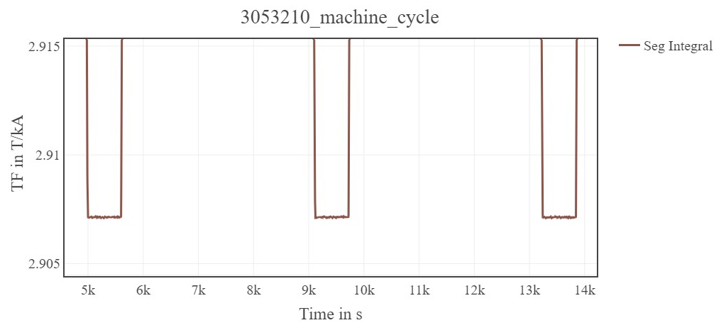
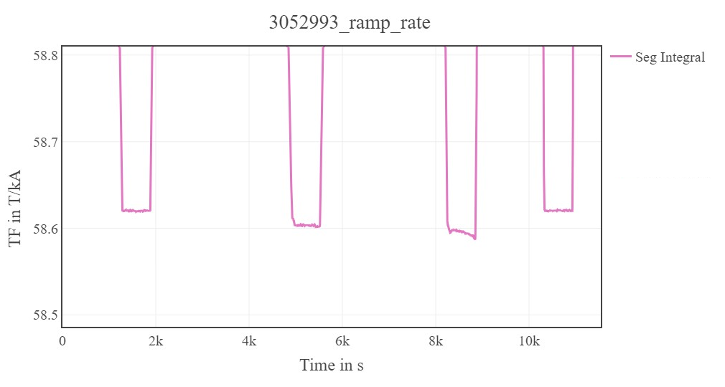
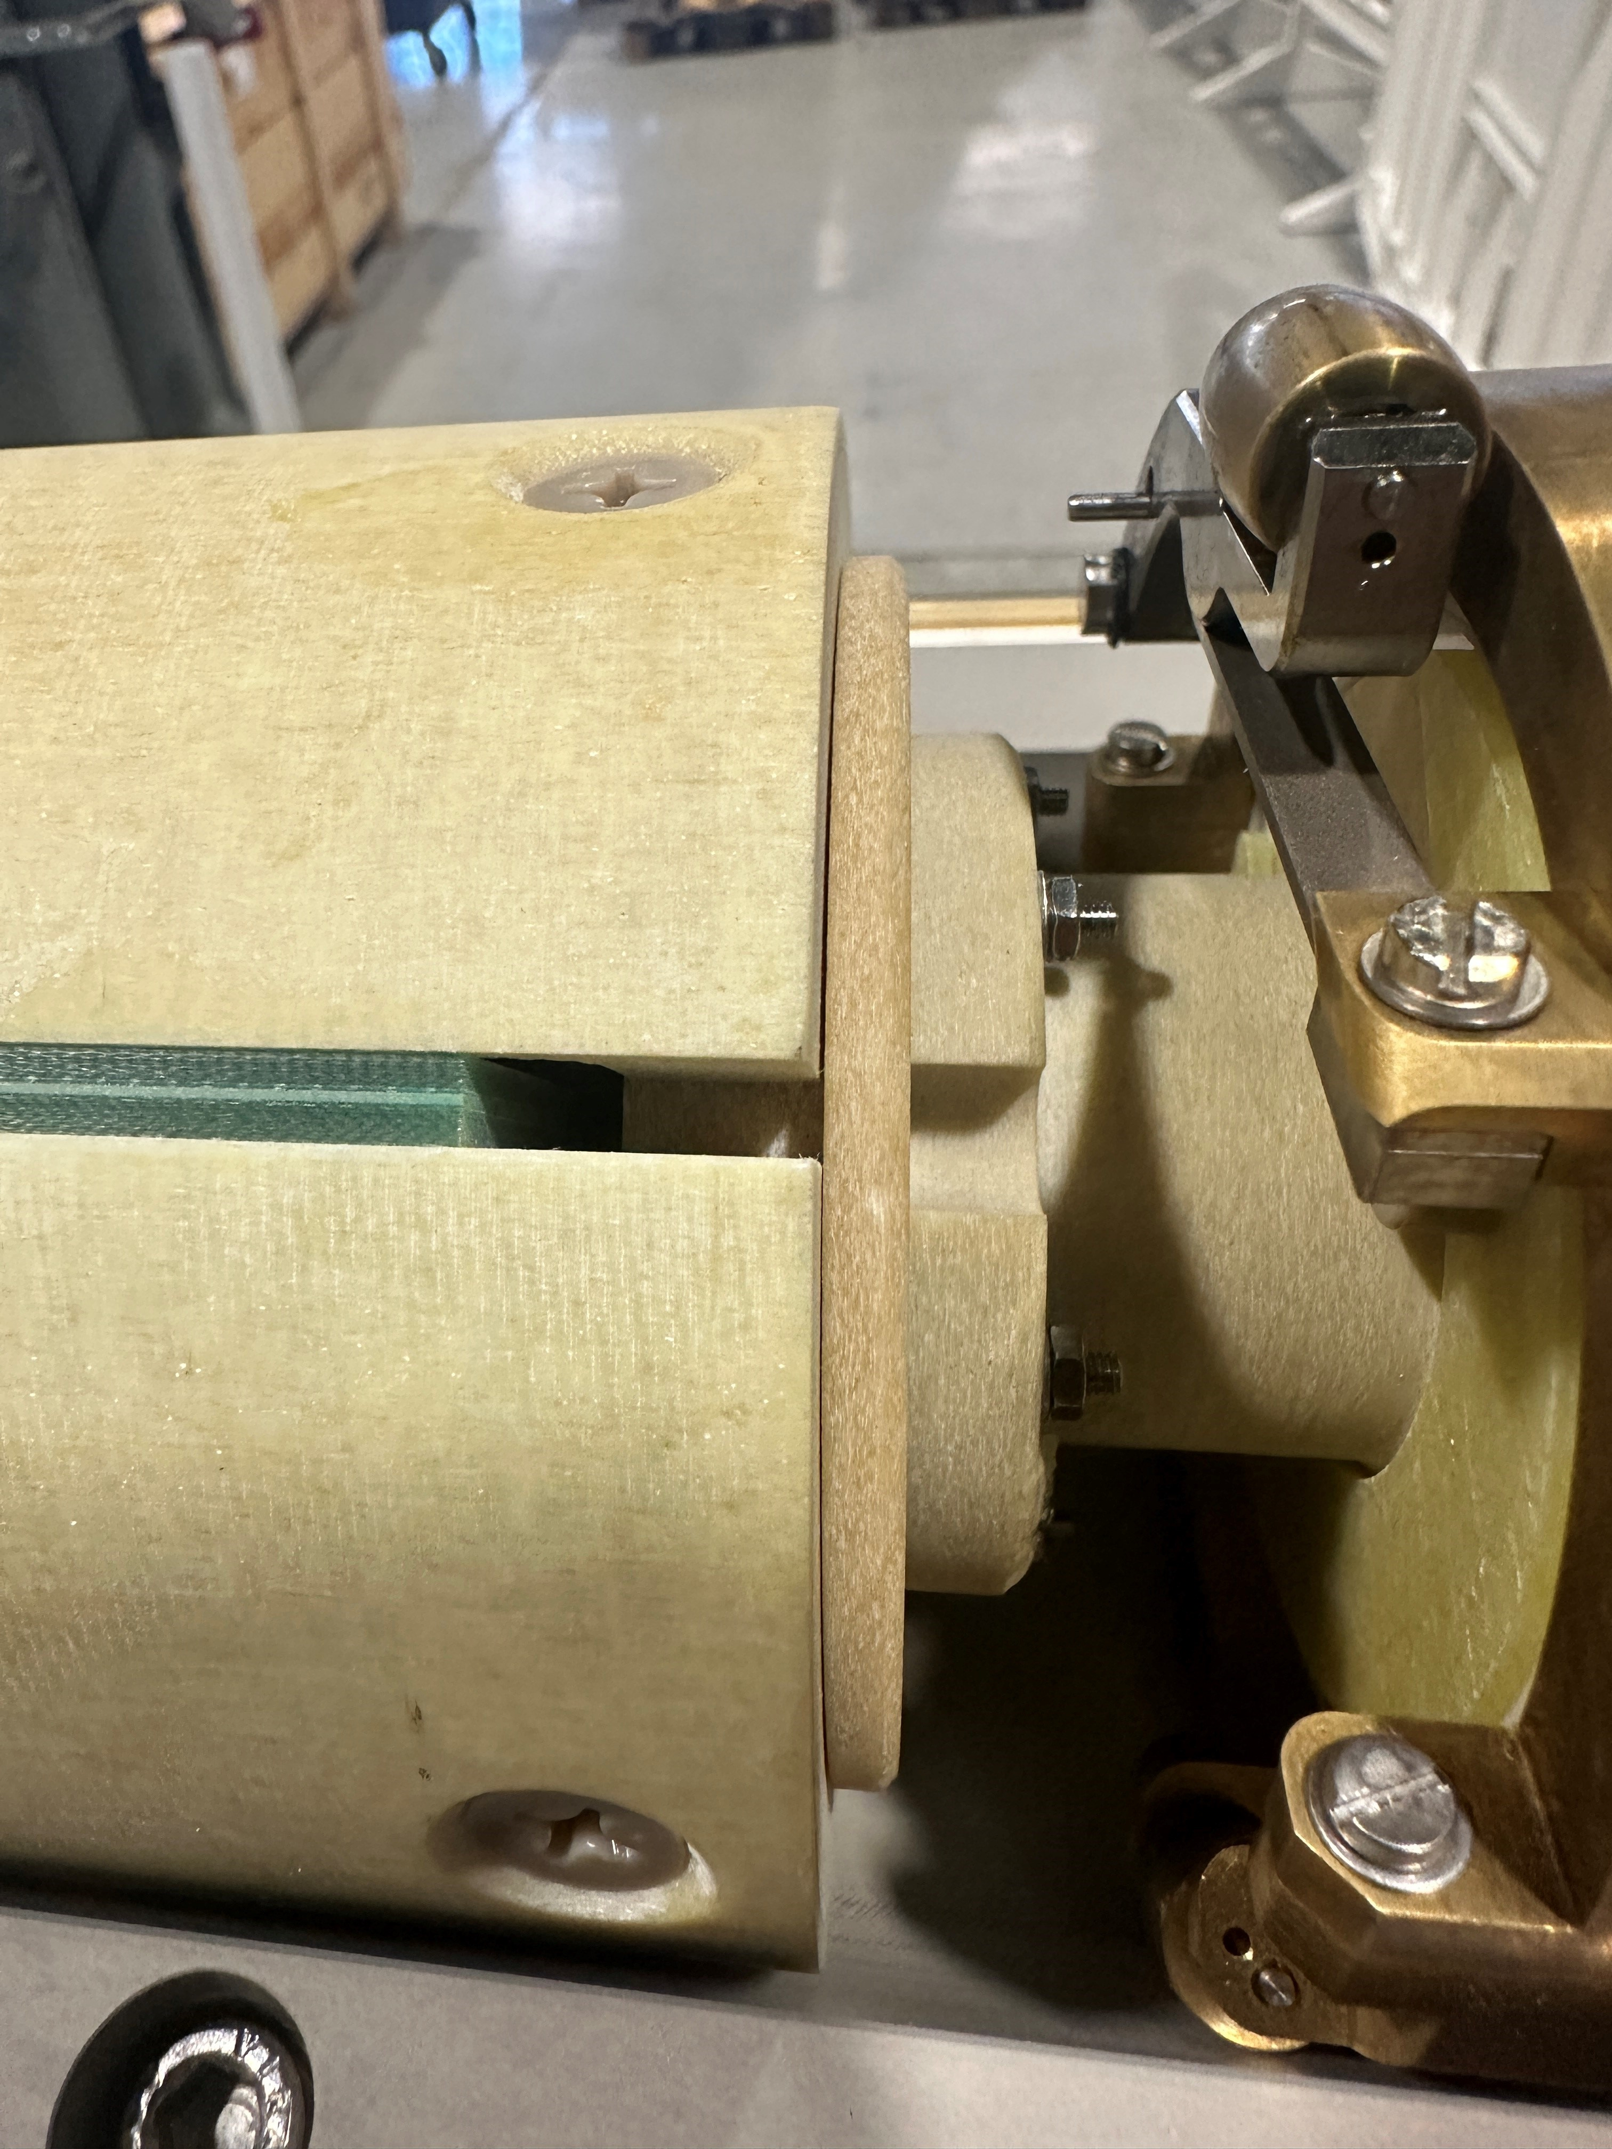
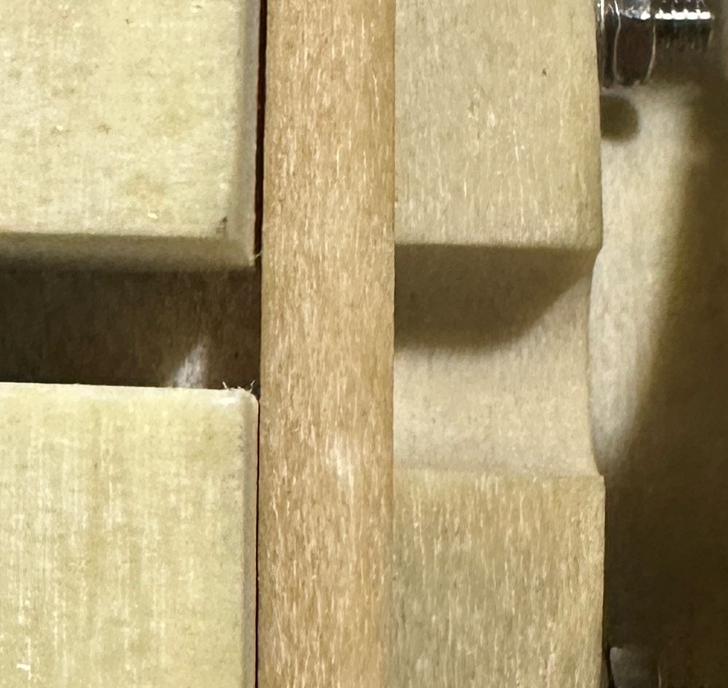
Feedback from tests: precision and mechanical stability
D1 prototype (MBXFP1)
  The results of tests performed so far show:
  Excellent precision in the dipole (<1 unit)
  Deviations up to ~3 units in the quadrupole
  A mechanical instability is affecting one of the segments. It seems to be caused by the tolerances of the half-shell length.
  To improve :
  Sorting of the half shells to match the length
  Addition of a 0.4-mm washer to be sure that the “end caps” are in compression
5 units
Q2a (MQXFBP3)
5 units
8

Slide 9
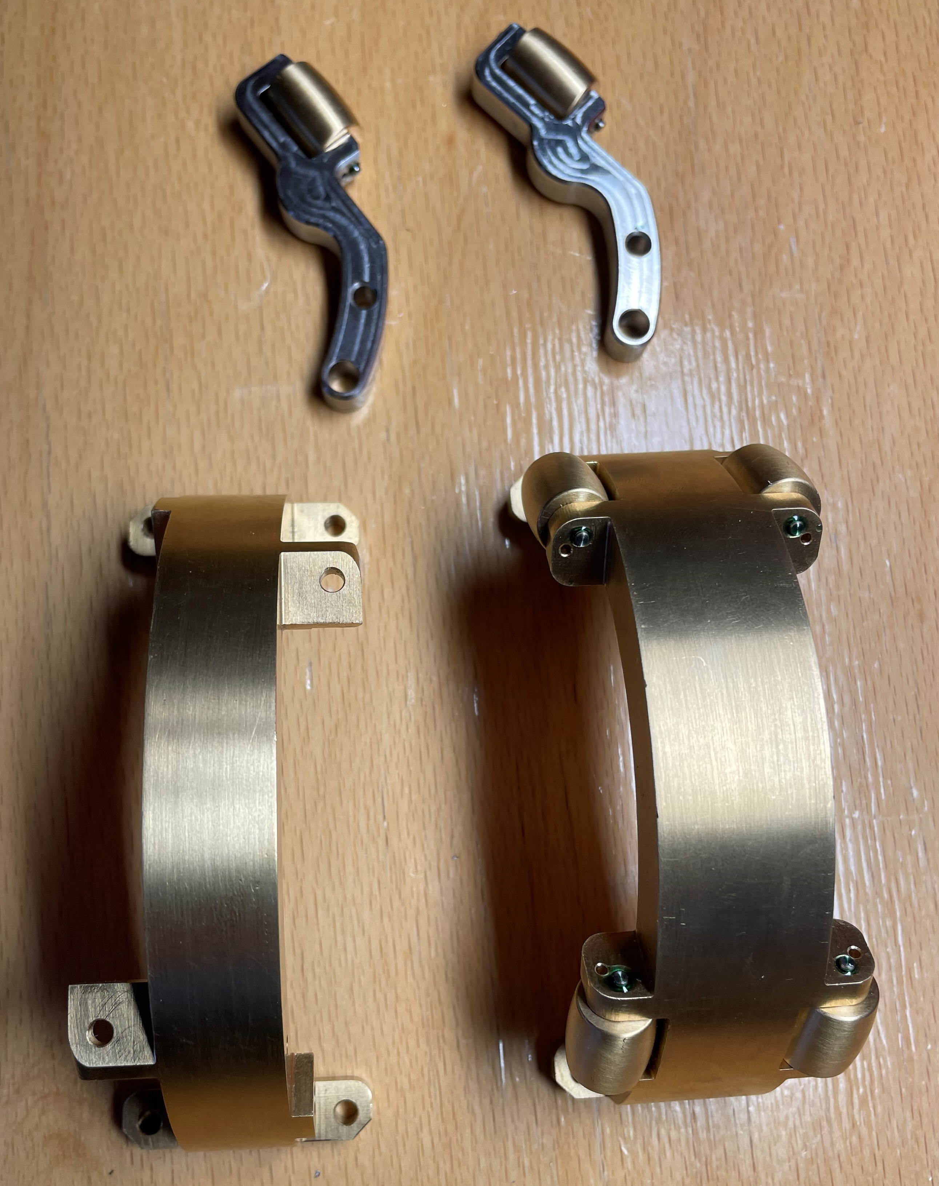
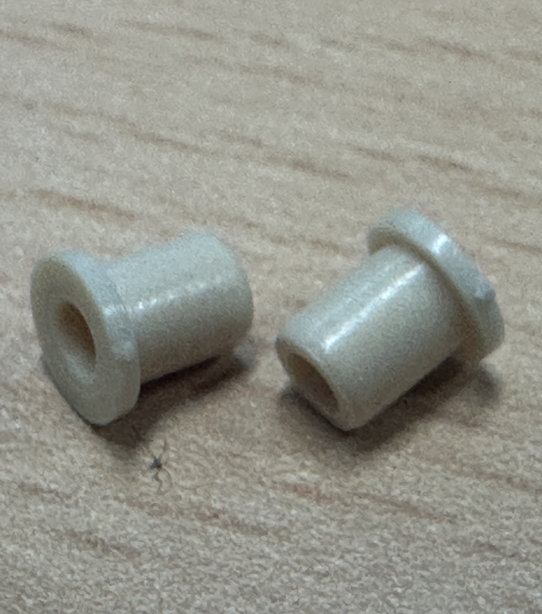
Feedback from tests: friction of rollers
  The sliding of the new shafts, made of fiberglass therefore heavier than carbon fiber, is difficult due to the friction of the roller wheels.
  Some metallic dust is produced by the friction of the wheel against its axel
  The dust accumulates on the sides of the wheel and fills the small gap in between the wheel and the support arm
  Improvements are under test:
  Modification of the wheel (narrower and with a larger hole)
  Addition of bushing elements between wheel and axle
9

Slide 10
Rotating coils: plan
  For the D2 series - 66 mm (higher priority)
    Main components are available (half shells and PCB’s)
    Rollers (old design) should arrive in 1 week
    Extensions should arrive in 2 weeks
    Cables are in stock
    Assembly and calibration process already started (2 weeks/shaft)
  The two shafts will be normally available for the test of the next D2
  For the D1 series and CP series - 103 mm
    Half shells are available for all required segments
    PCB’s production about to be started (~3 months)
    Rollers: order after modification of wheel design (~2 months)
    Cables: stock not enough, a new order is required (~4 months)
    Assembly and calibration (2 weeks/shaft)
  The additional 103-mm shafts available in ~October 2024
10

Slide 11
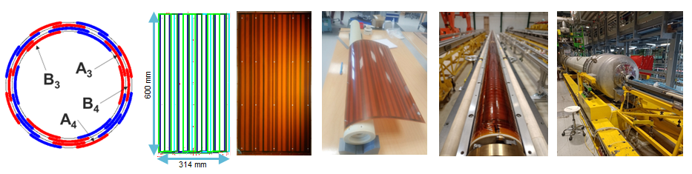
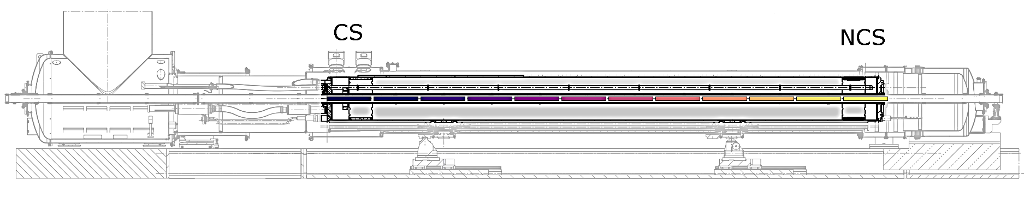
Quench antenna
  For the precise (few millimeters) quench localization, a different device is used:
  the “quench antenna”
  Similarly to the rotating coils, it is a segmented shaft equipped with pickup coils
  It is not rotating (but can be oriented at different angles)
  The sensitivity of the pickup coils is different (sensitive to specific single multipoles)
  The rotating coils can be used for quench localization but with much less resolution (!)
  12 segments to cover the length of a MQXFB
11

Slide 12
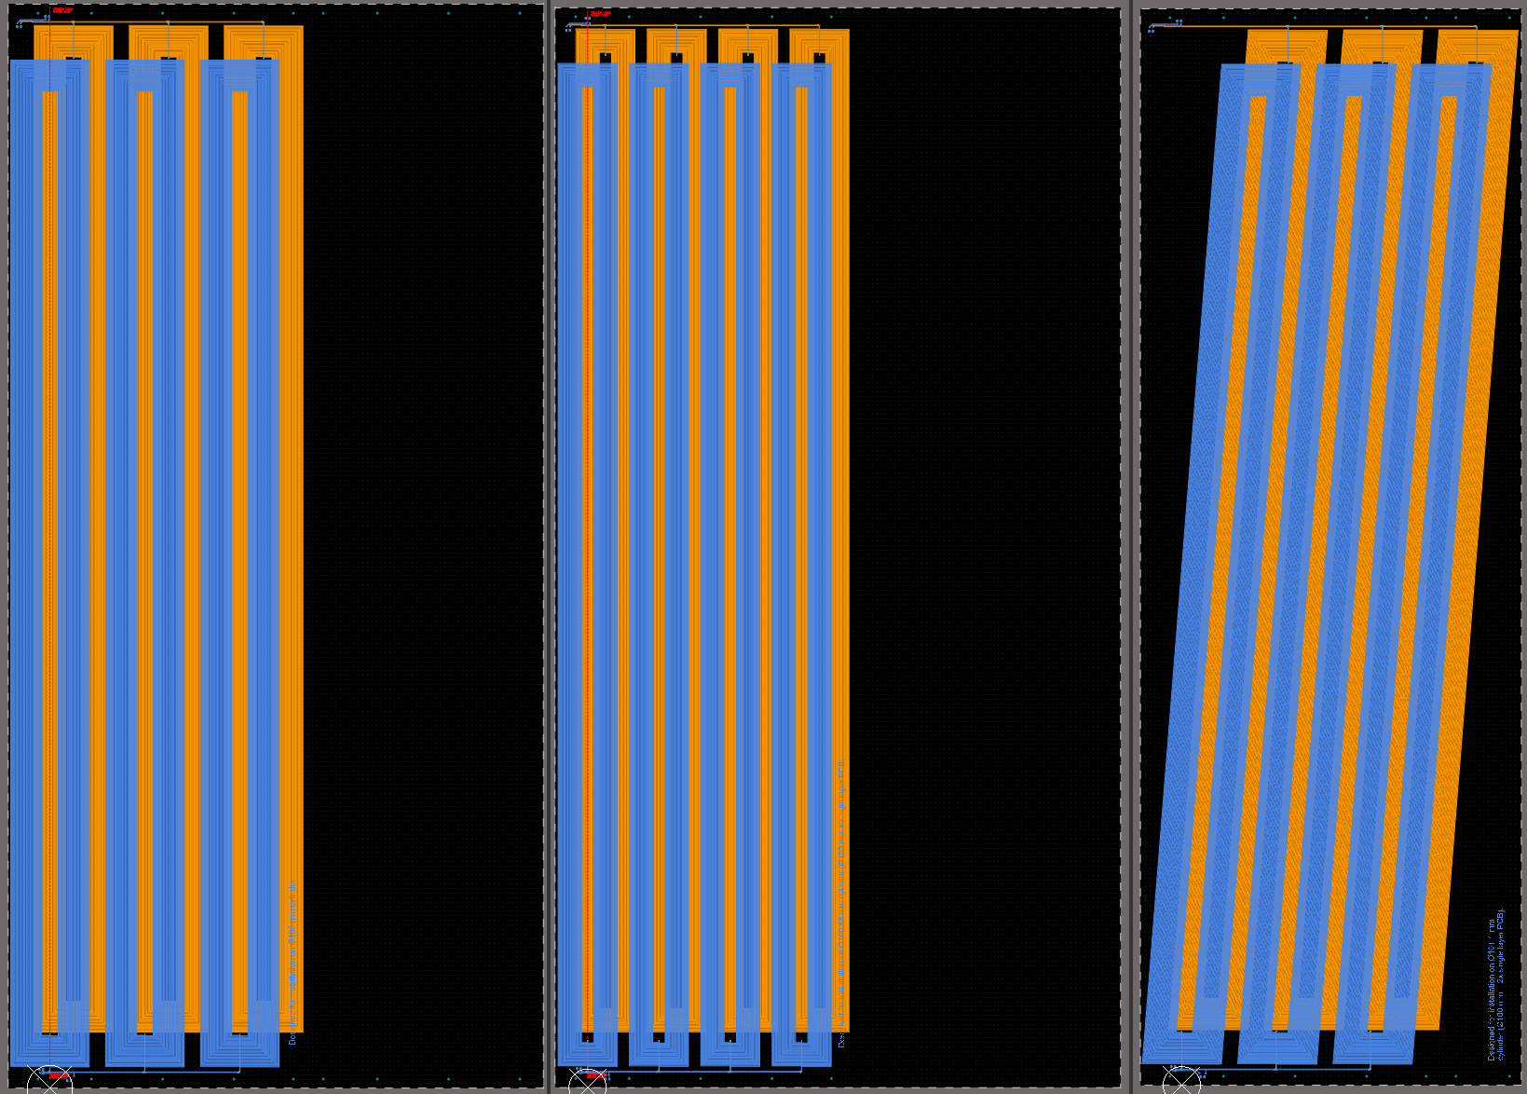
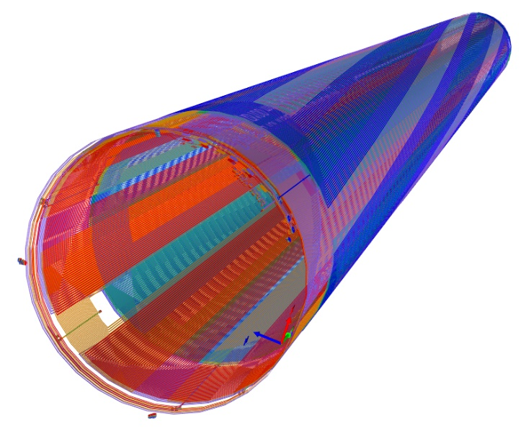
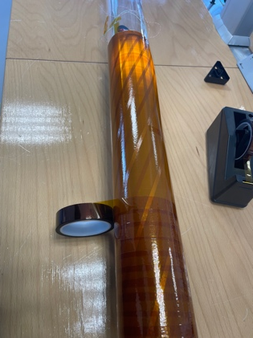
Recent development for precise localization
On one segment there are 3 sets of coils:
Straight coils sensitive to B3/A3 and B4/A4
Additional tilted coils sensitive to B3/A3
The transversal position is obtained from B3/A3 and B4/A4 measured with straight coils.
The longitudinal position is proportional to the phase shift of the signals from tilted coils respect to the signals from the straight coils.
B₃, A₃ B₄, A₄ B₃, A₃
tilted
12

Slide 13
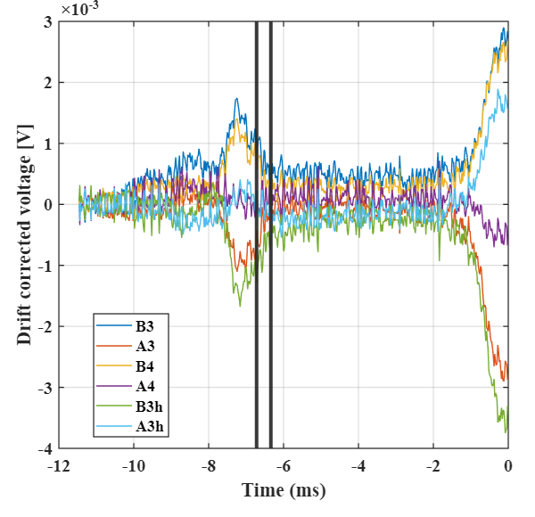
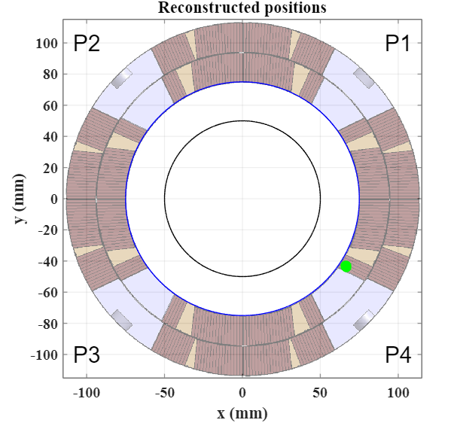
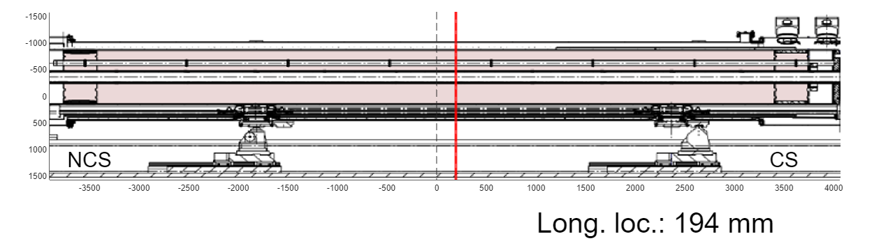
Example of quench localization
Test of the first Q2a with MQXFBP3
Transverse plane
Longitudinal direction
13

Slide 14
Quench antennas: status and plan for Q2
  For the Q2 (compatible for the D1)
    A full-length quench antenna (12 segments of 600 mm) is in operation since August 2022
    One additional segment, implementing the new design for precise longitudinal localization, was added in December 2023 and later validated
    Given the intense use of the device, a spare unit would be beneficial
  Plan to build a new full-length quench antenna with all segments based on the new design with longitudinal localization
    Design of coils finished and production about to start (~3 months for production)
    Reuse of the design for all mechanical component (~3 months for production in parallel with the coils)
    Cables must be procured (~4 months pending agreement with procurement office)
    Assembly more complex than a rotating coil (~1 month/shaft)
  The new quench antenna for Q2 will be ready in ~November 2024
14

Slide 15
Quench antennas: status and plan for D2
  For the D2 (not compatible with the Q2!)
    Baseline was to use the rotating coil as quench antenna
    The localization would be much less precise
      Coil sensitivity is not optimized for quench measurement (difficult detection)
      The length of segments is 1.2 m (poor longitudinal resolution)
  Plan to change the baseline (if agreed)
    Improve the sensitivity by connecting 3 coils per segment
    Reduce the total number of segments from 10 to 7 (MCBRD’s will not be covered!) to cope with the limited number of available sliding contacts (~50)
    Equip the 2 extreme segments with flex PCB’s that allows a precise transversal and longitudinal localization
      Design of coils (~1 month)
      Production of PCB coils (~3 months)
      All other components are already available (same as rotating coils)
  The new segments with precise quench localization would be ready in ~October 2024
15

Slide 16
In summary
  Rotating coils
    For the 150-mm magnets (Q2, D1, CP)
      One shaft is in operation
      The additional units, required to optimize operations and to have spares in case of major issues, will be ready in ~4/5 months
      Based on the feedback from tests, some improvements will be implemented
    For the 105-mm magnets (D2)
      Assembly of the 2 required shafts is already ongoing
      They will be normally ready for the test of the first D2 series
  Quench antennas
    For the 150-mm magnets (Q2, D1, CP)
      One quench antenna is in operation
      One additional unit, to optimize operations and to have a spare in case of major issues, will be ready in ~5 months
      The new unit will be based on the new design with high longitudinal resolution
    For the 105-mm magnets (D2)
      If agreed, change of baseline to improve quench localization
      Shorter rotating-coil shafts (correctors will not be covered!)
      Integration of quench localization coils on the rotating-coil shafts
16

Slide 17
Appendix
17

Slide 18
Configuration for Q2
Segments of type 1 (103 mm)
  2 shafts (1 spare)
  6 segments each
  Extension of 2 m
  Cabling: 4 coils connected (4*2*6=48 contacts)
18

Slide 19
Configuration for D1
Segments of type 1 (103 mm)
  1 shaft (the shaft for CP can be as well used)
  5 segments
  Extension of 2 m
  Cabling: 5 coils connected (5*2*5=50 contacts)
19

Slide 20
Configuration for CP
Segments of type 1 (103 mm)
  1 shaft (the shaft for D1 can be as well used)
  5 segments
  Extension of 2 m
  Cabling: 5 coils connected (5*2*5=50 contacts)
  A displacent is required to cover all magnets
20

Slide 21
Configuration for D2
Segments of type 2 (66 mm)
  2 shafts (no spare)
    option 1: 10 segments to cover MBRD and MCBRD’s
    option 2: 7 segments to cover the MBRD only
  Cabling:
    option 1: 2 coils connected (2*2*10=40 contacts)
    option 2: 3 coils connected (3*2*7=42 contacts)
  Extension of 2 m
21

Slide 22
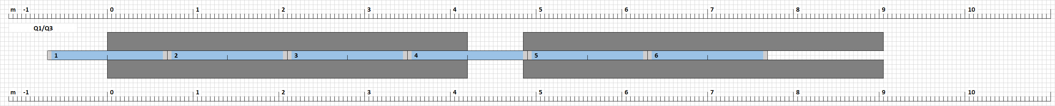
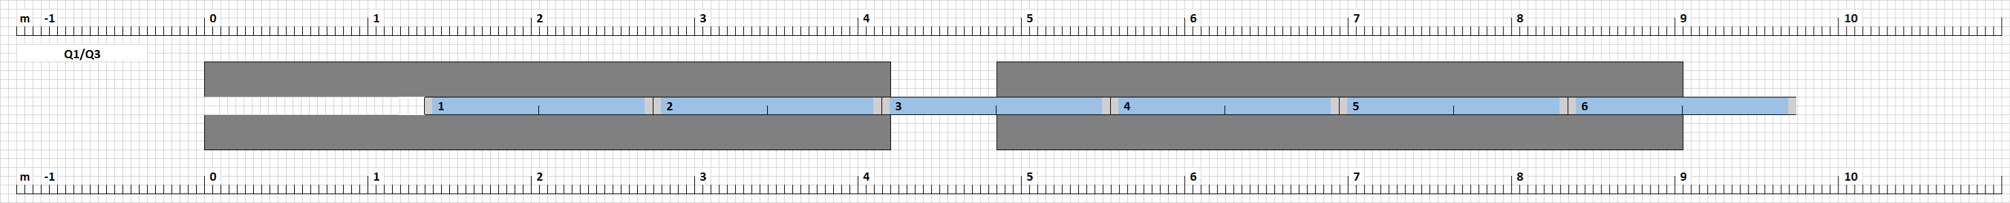
Configuration for Q1/Q3
Segments of type 1 (103 mm)
  No specific shaft – the one for Q2 can be used
  Extra extension required
  Measurement in two steps
22

