Slide 1
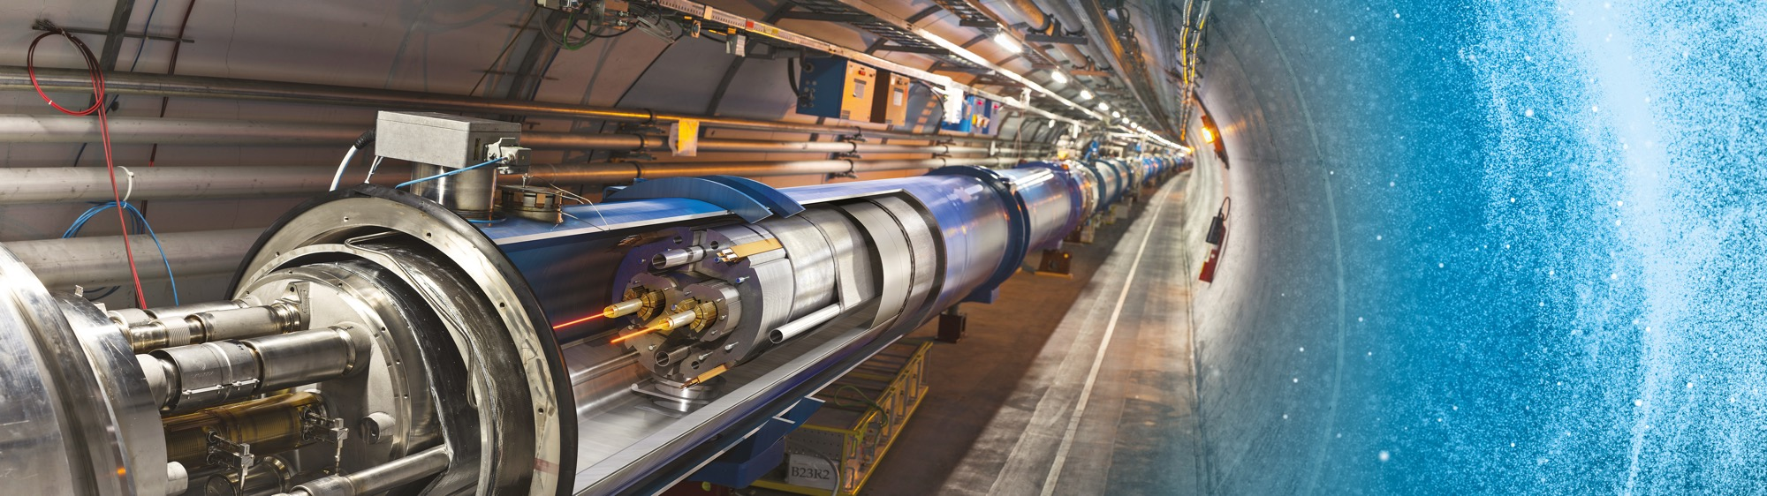
Upcoming Tenders at CERN
Visit of the Polish Electric Power Industry Association
Floris Bonthond
IPT-PI 07-06-2024

Slide 2
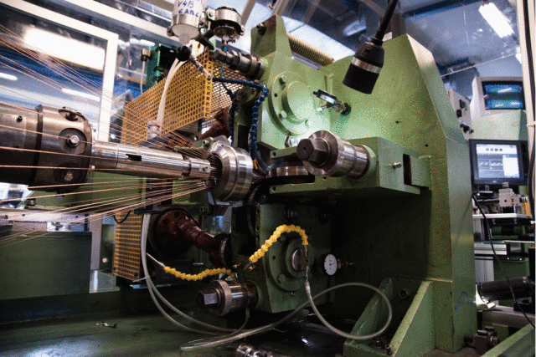
60-wire planetary cabling machine
Procurement Code: 02 25 05 03
Cost Range: ≤ 750 k CHF
Planning: MS: published (MS-4905)
IT: Q3 2024
Description & Specific Conditions:
Supply of a cabling machine for the manufacturing of Rutherford and round cables with up to 60 superconducting or copper wires.
Interested firms shall have a proven experience and competence in designing and manufacturing planetary cabling machines for metal wires.
Contact: Thierry.Boutboul@cern.ch
Notes:
Used by CERN magnet group to fabricate accelerator Rutherford cables. New machine needed to increase the number of copper wires that can be assembled into a cable to support the HFM program.
Firms must have produced at least one planetary cabling machine for cables based on 30+ wires in the last 5 years.

Slide 3
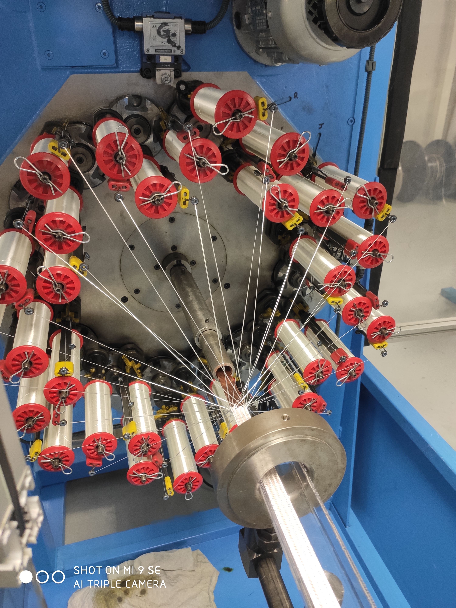
Fibre-glass braiding machine for HFM Programme
Procurement Code: 02 25 04 03
Cost Range: 200 kCHF ⬄ 750 kCHF
Planning: Tender: Q3 2024 - MS-4971/TE
Delivery: Q4 2024
Description & Specific Conditions:
Supply of a fibre glass braiding machine for the insulation of superconducting cables:
compatible with glass fiber;
be equipped with a horizontal line with a horizontal pulling system;
32 carriers;
a wind-off system for the cable drum;
cable tension control;
accurate braiding pitch regulation.
Contact: Francois-Olivier.pincot@cern.ch
Notes:
Supply of a fibre glass braiding machine for the insulation of superconducting cables:
compatible with glass fiber;
be equipped with a horizontal line with horizontal pulling system;
32 carriers;
a wind off system for the cable drum;
cable tension control;
accurate braiding pitch regulation.

Slide 4
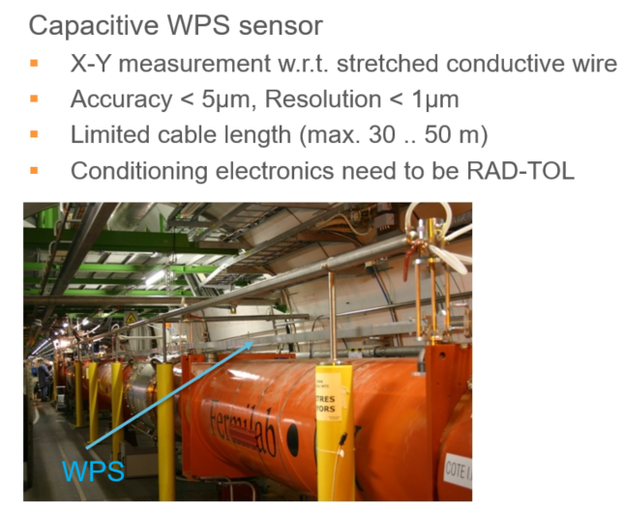
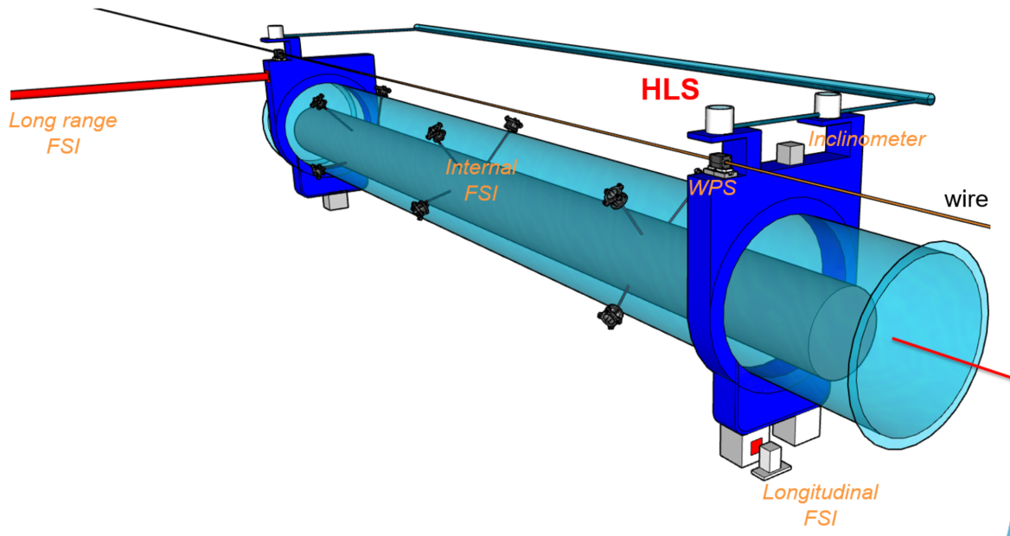
Sensors for alignment
Cost Range : ≤ 750 k CHF
Planning: Q4 2024
Contact: Helene.Mainaud.Durand@cern.ch
Description & Specific Conditions:
Alignment system including:
  Wire Positioning Sensors (WPS);
  Hydrostatic Levelling Sensors (HLS).
Notes:
For the FRAS for HL-LHC, well known sensor manufacturers seem to be able to do this (DO-33883 done for IT string of the WPS only), check this to get a better idea for what it’s about). Off-the-shelf sensors should work, radiation tolerance up to 2 MGy.

Slide 5
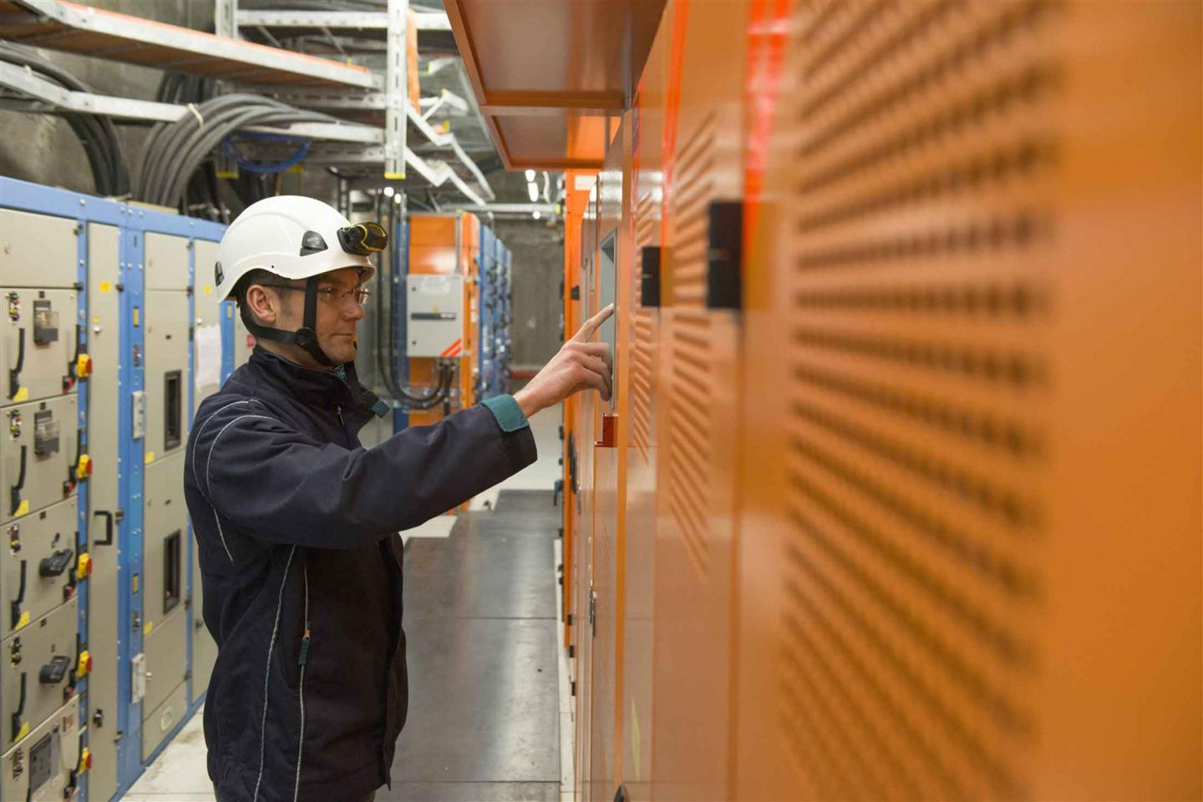
UPS 20-200 kVA
Description & Specific Conditions:
Design, manufacture and supply of modular UPS.
CERN intends to place two contracts for the supply of:
About 40 full modular UPS;
High-Power UPS up to 3 MVA.
Procurement Code: 02 30 40 00
Cost Range: < 750 k CHF
Planning: MS-4959: Q2 2024, IT: Q4 2024
Contact: Joel.Lahaye@cern.ch
Notes:
UPS that kick-in in case of black outs (batteries mainly). kVA = kilo volt amps (apparent power, in a 100% efficient system 1 kW = 1 kVA)

Slide 6
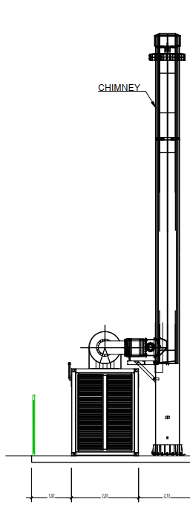
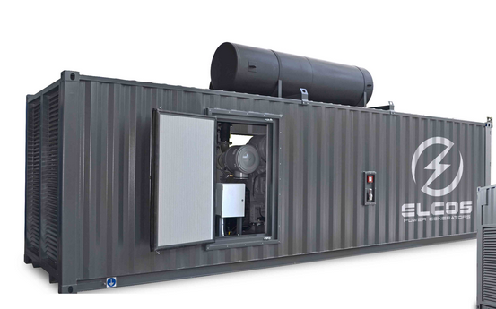
Three Diesel Generators
Description & Specific Conditions:
Supply, installation and maintenance of three diesel generators power stations (including the containers, the chimneys, the diesel tanks, the control systems, the testing and all the civil engineering works):
One unit of 400 V 800 kVA ESP (replacement of an existing generator);
Two units of 400 V 2MVA ESP (including chimney and diesel buried tank).
Procurement Code: 02 70 01 00
Cost Range: 750 kCHF ⬄ 5 MCHF
Planning: MS: published (MS-4974) / IT: Q3 2024
Pre-engineering (done by CERN) during 2024
Design + engineering during Q1 and Q2 2025
Start of commissioning Q4 2025
Working on the CERN site: France
Interested firms shall have a proven experience and competence in:
Design, supply, installation and commissioning of diesel generators power stations of an ESP (Emergency Standby Power system) of at least 2 MVA;
Project management of a turnkey projects covering engineering, procurement, civil engineering works, installation, and commissioning of diesel generators;
Civil engineering works following French regulations or an ability to evaluate, analyse and comply with them.
Contact: Pablo.Valdes@cern.ch

Slide 7
DCCTs 600 A – Standard and Radiation resistant
Description & Specific Conditions:
Supply of current output DCCTs with 1000:1 ratio and 600A maximum current:
900 standard units;
636 radiation resistant DCCT’s.
Five year blanket purchase contract.
Procurement Code: 02 10 09 00
Cost Range: 200 kCHF ⬄ 750 kCHF
Planning: MS: published (MS-4996)
IT: Q3 2024
Contact: greg.hudson@cern.ch
Interested firms shall have a proven experience and competence in DCCT production during the last five years and shall propose off the shelf units.
Notes:
DCCTs for power converters.
Radiation tolerance up to 400 Gy needed. Samples ordered during the MS and tested at CHARM.
Large batch (600 standard, 630 radtol) delivered in 2025.
MS is published
There will be two ITs

Slide 8
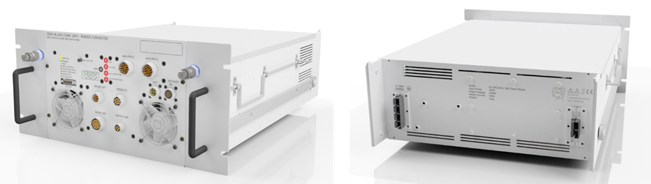
Power Modules 14 kA
Description & Specific Conditions:
Design, manufacture and testing of power modules:
90 18kA, 10V;
168 3kA, 25V;
216 14kA, 8V.
Build-to-print.
Interested firms shall have a proven experience and competence in production and testing of power modules.
Procurement Code: 02 10 05 00
Cost Range: 750 kCHF ⬄ 5 MCHF
Planning: MS: published (MS-4854)
IT: Q3 2024
Contact: Yves.Thurel@cern.ch

Slide 9
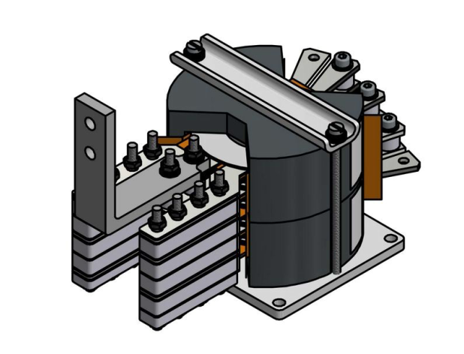
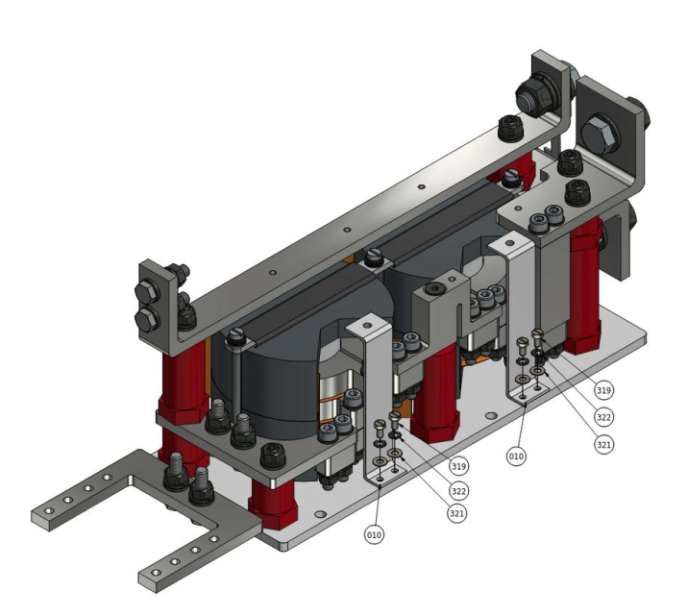
Power Magnetics for 14 kA Power Modules
Description & Specific Conditions:
Supply (production and test) of 580 Power Transformers and 580 Power Inductors that will be used for the series units of HL-LHC (14 kA;08 V) power converters.
Firms must have in-house facilities for the assembly and testing of the specified power magnetics and hold ISO9001-2000 quality certification or equivalent.
Procurement Code: 02 10 10 00
Cost Range: 200 kCHF ⬄ 750 kCHF
Planning: MS: published (MS-4982)
IT: Q3 2024
Contact: Yves.Thurel@cern.ch
Notes:
MS is published

Slide 10
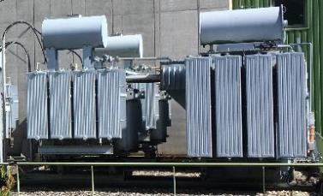
Step-up transformers for RF LHC
Description & Specific Conditions:
Supply of five oil tanks containing two identical transformers rated at 2MVA, 28kV/1kV each, insulated to ground at 60kV.
Each unit of this supply consists of two immersed oil transformers in one tank for outdoor use.
Interested firms must have in-house facilities for the production, assembly, and testing of Oil-immersed High Voltage Power transformers.
Procurement Code: 02 01 05 00
Cost Range: 200 kCHF ⬄ 750 kCHF
Planning: MS: published (MS-4979)
IT: Q3 2024
Contact: davide.aguglia@cern.ch

Slide 11
Diode Bridge for RF LHC
Description & Specific Conditions:
Supply of 5 air insulated and high-voltage diode bridge rectifier assemblies.
Each assembly shall be composed of sub-modules to compose a full diode bridge rectifier rated at 60kV- 40Adc.
Interested firms shall have in-house facilities for the production, assembly, and testing of the specified air insulated diode bridge rectifiers and shall have proven experience in the integration of High-voltage (up to 60kV 2.4MW) power electronics and in the use of standards for testing power electronic equipment.
Procurement Code: 03 01 02 09
Cost Range: 200 kCHF ⬄ 750 kCHF
Planning: MS: published (MS-4976)
IT: Q3 2024
Contact: davide.aguglia@cern.ch

Slide 12
Filter Choke for RF LHC
Description & Specific Condition :
Supply of 5 units of oil-immersed High-Voltage filter chokes for twelve-pulse rectifiers.
The supply includes the production and testing of five oil tanks containing one filter choke (composed of at least 2 coils), rated at 2.4MW, 60kV each.
Interested firms must have in-house facilities for the production, assembly, and testing of Oil-immersed High Voltage Power inductors.
Procurement Code: 03 02 03 03
Cost Range: 200 kCHF ⬄ 750 kCHF
Planning: MS: published (MS-4975)
IT: Q3 2024
Contact: davide.aguglia@cern.ch

Slide 13
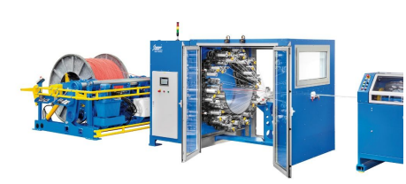
Fibre glass cable insulation
Description & Specific Conditions:
3-year blanket purchase contract for the supply of an estimated length of 57 km of cables to be insulated.
Tailor-made insulation in fibre glass for magnet cables.
Production line shall be in a separate, dedicated space to avoid contamination.
The firm shall have a horizontal braiding machine which shall be dedicated for CERN products.
Key conditions:
• Clean room (grey, ISO8);
• Proven experience with fibre (glass) braiding;
• Proven experience with braiding around large rectangular cables;
• Proven experience with horizontal braiding systems.
Procurement code: 02 25 04 03
Cost Range: 750 k CHF ⬄ 5 M CHF
Planning: MS: published (MS-4968)
IT: Q3-2024
Contact: Francois-Olivier.Pincot@cern.ch
Notes:
MS is published

Slide 14
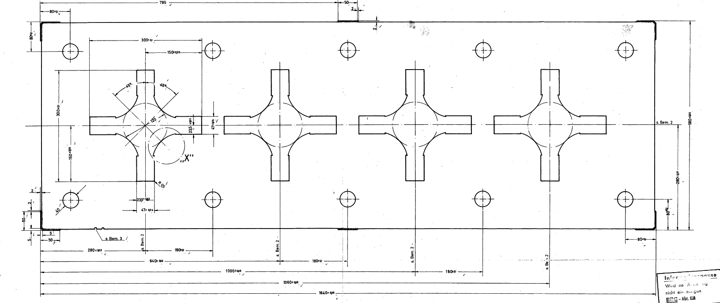
Quadrupole Magnet Lamination (including electrical steel)
Description & Specific Conditions:
Supply of 134 t of electrical steel with 10k laminations including the assembly of the punching tool and its storage, the lamination stamping and the complete metrology. The Supply shall be delivered within 36 weeks after entry into force of the Contract.
Key conditions:
• Production capacity;
• In-house tool production;
• Proven experience in production of large accelerator magnet/motor laminations;
• In-house metrology.
Start of the Contract: Q3 2024.
Procurement Code: 02 25 02 00
Cost Range: 200 kCHF ⬄ 750 kCHF
Planning: MS: published (MS-4993)
IT: Q3 2024
Contact: antony.newborough@cern.ch
Notes:
MS is published

Slide 15
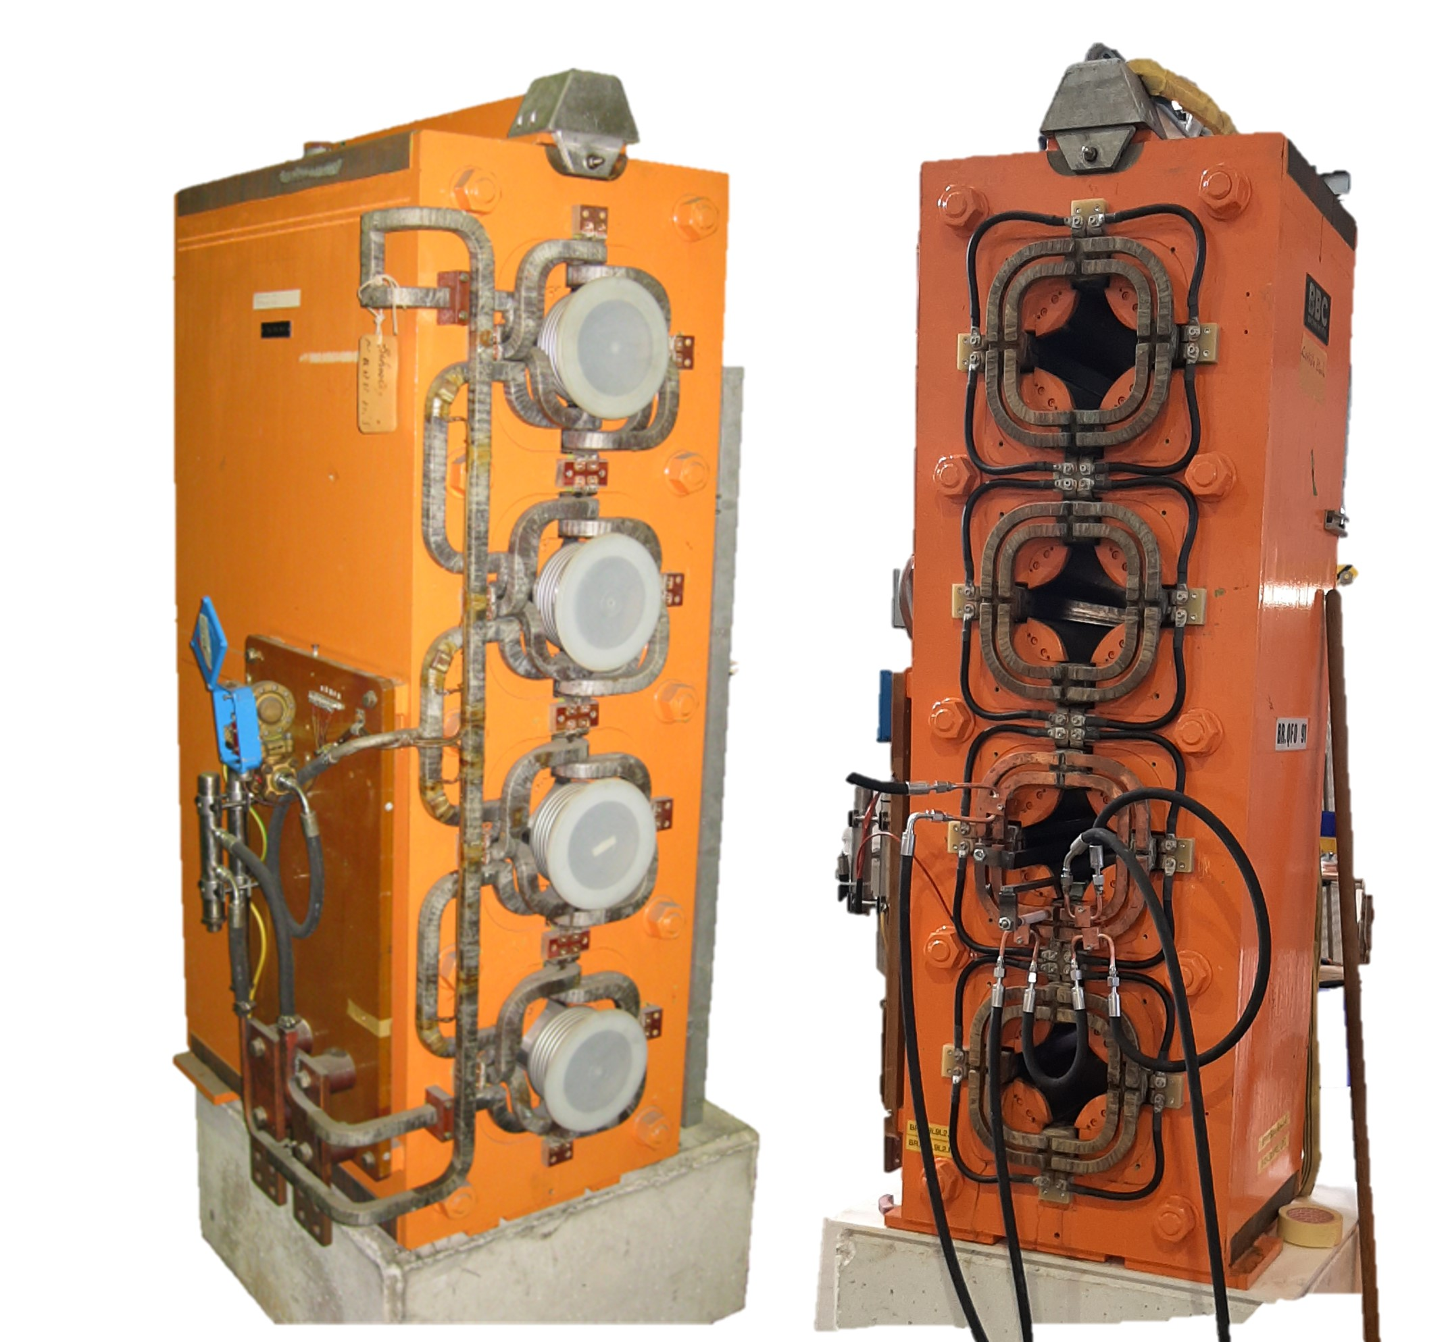
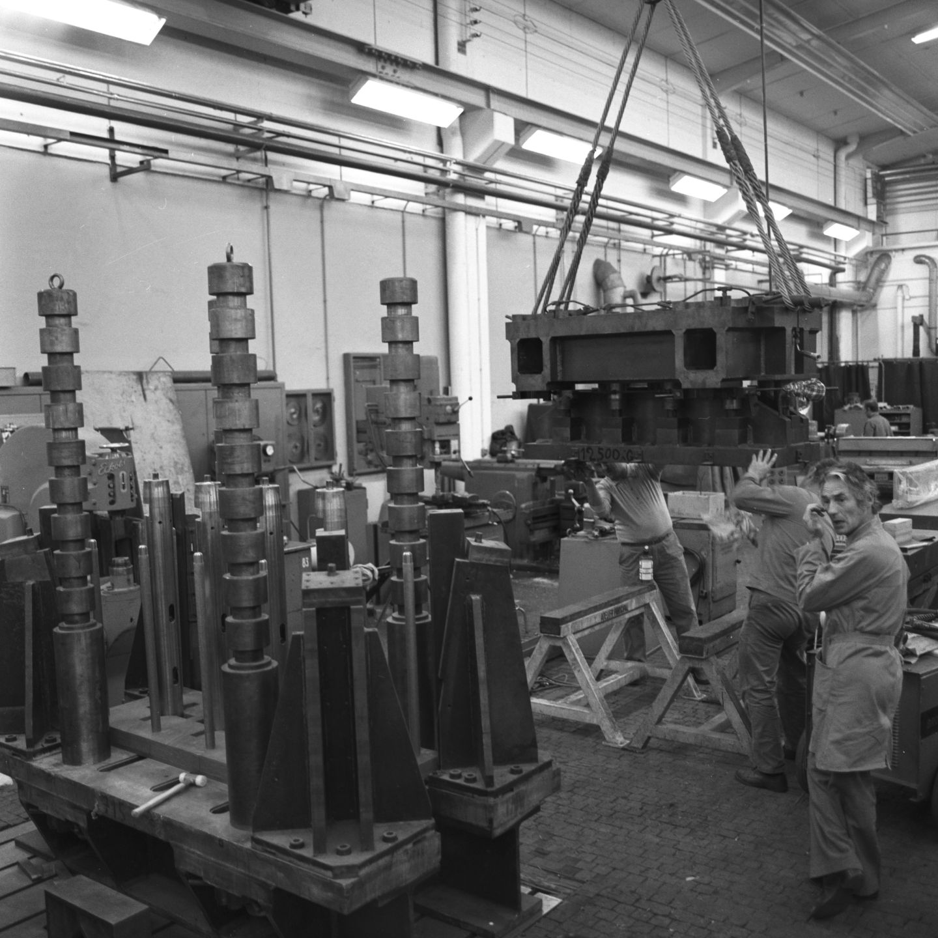
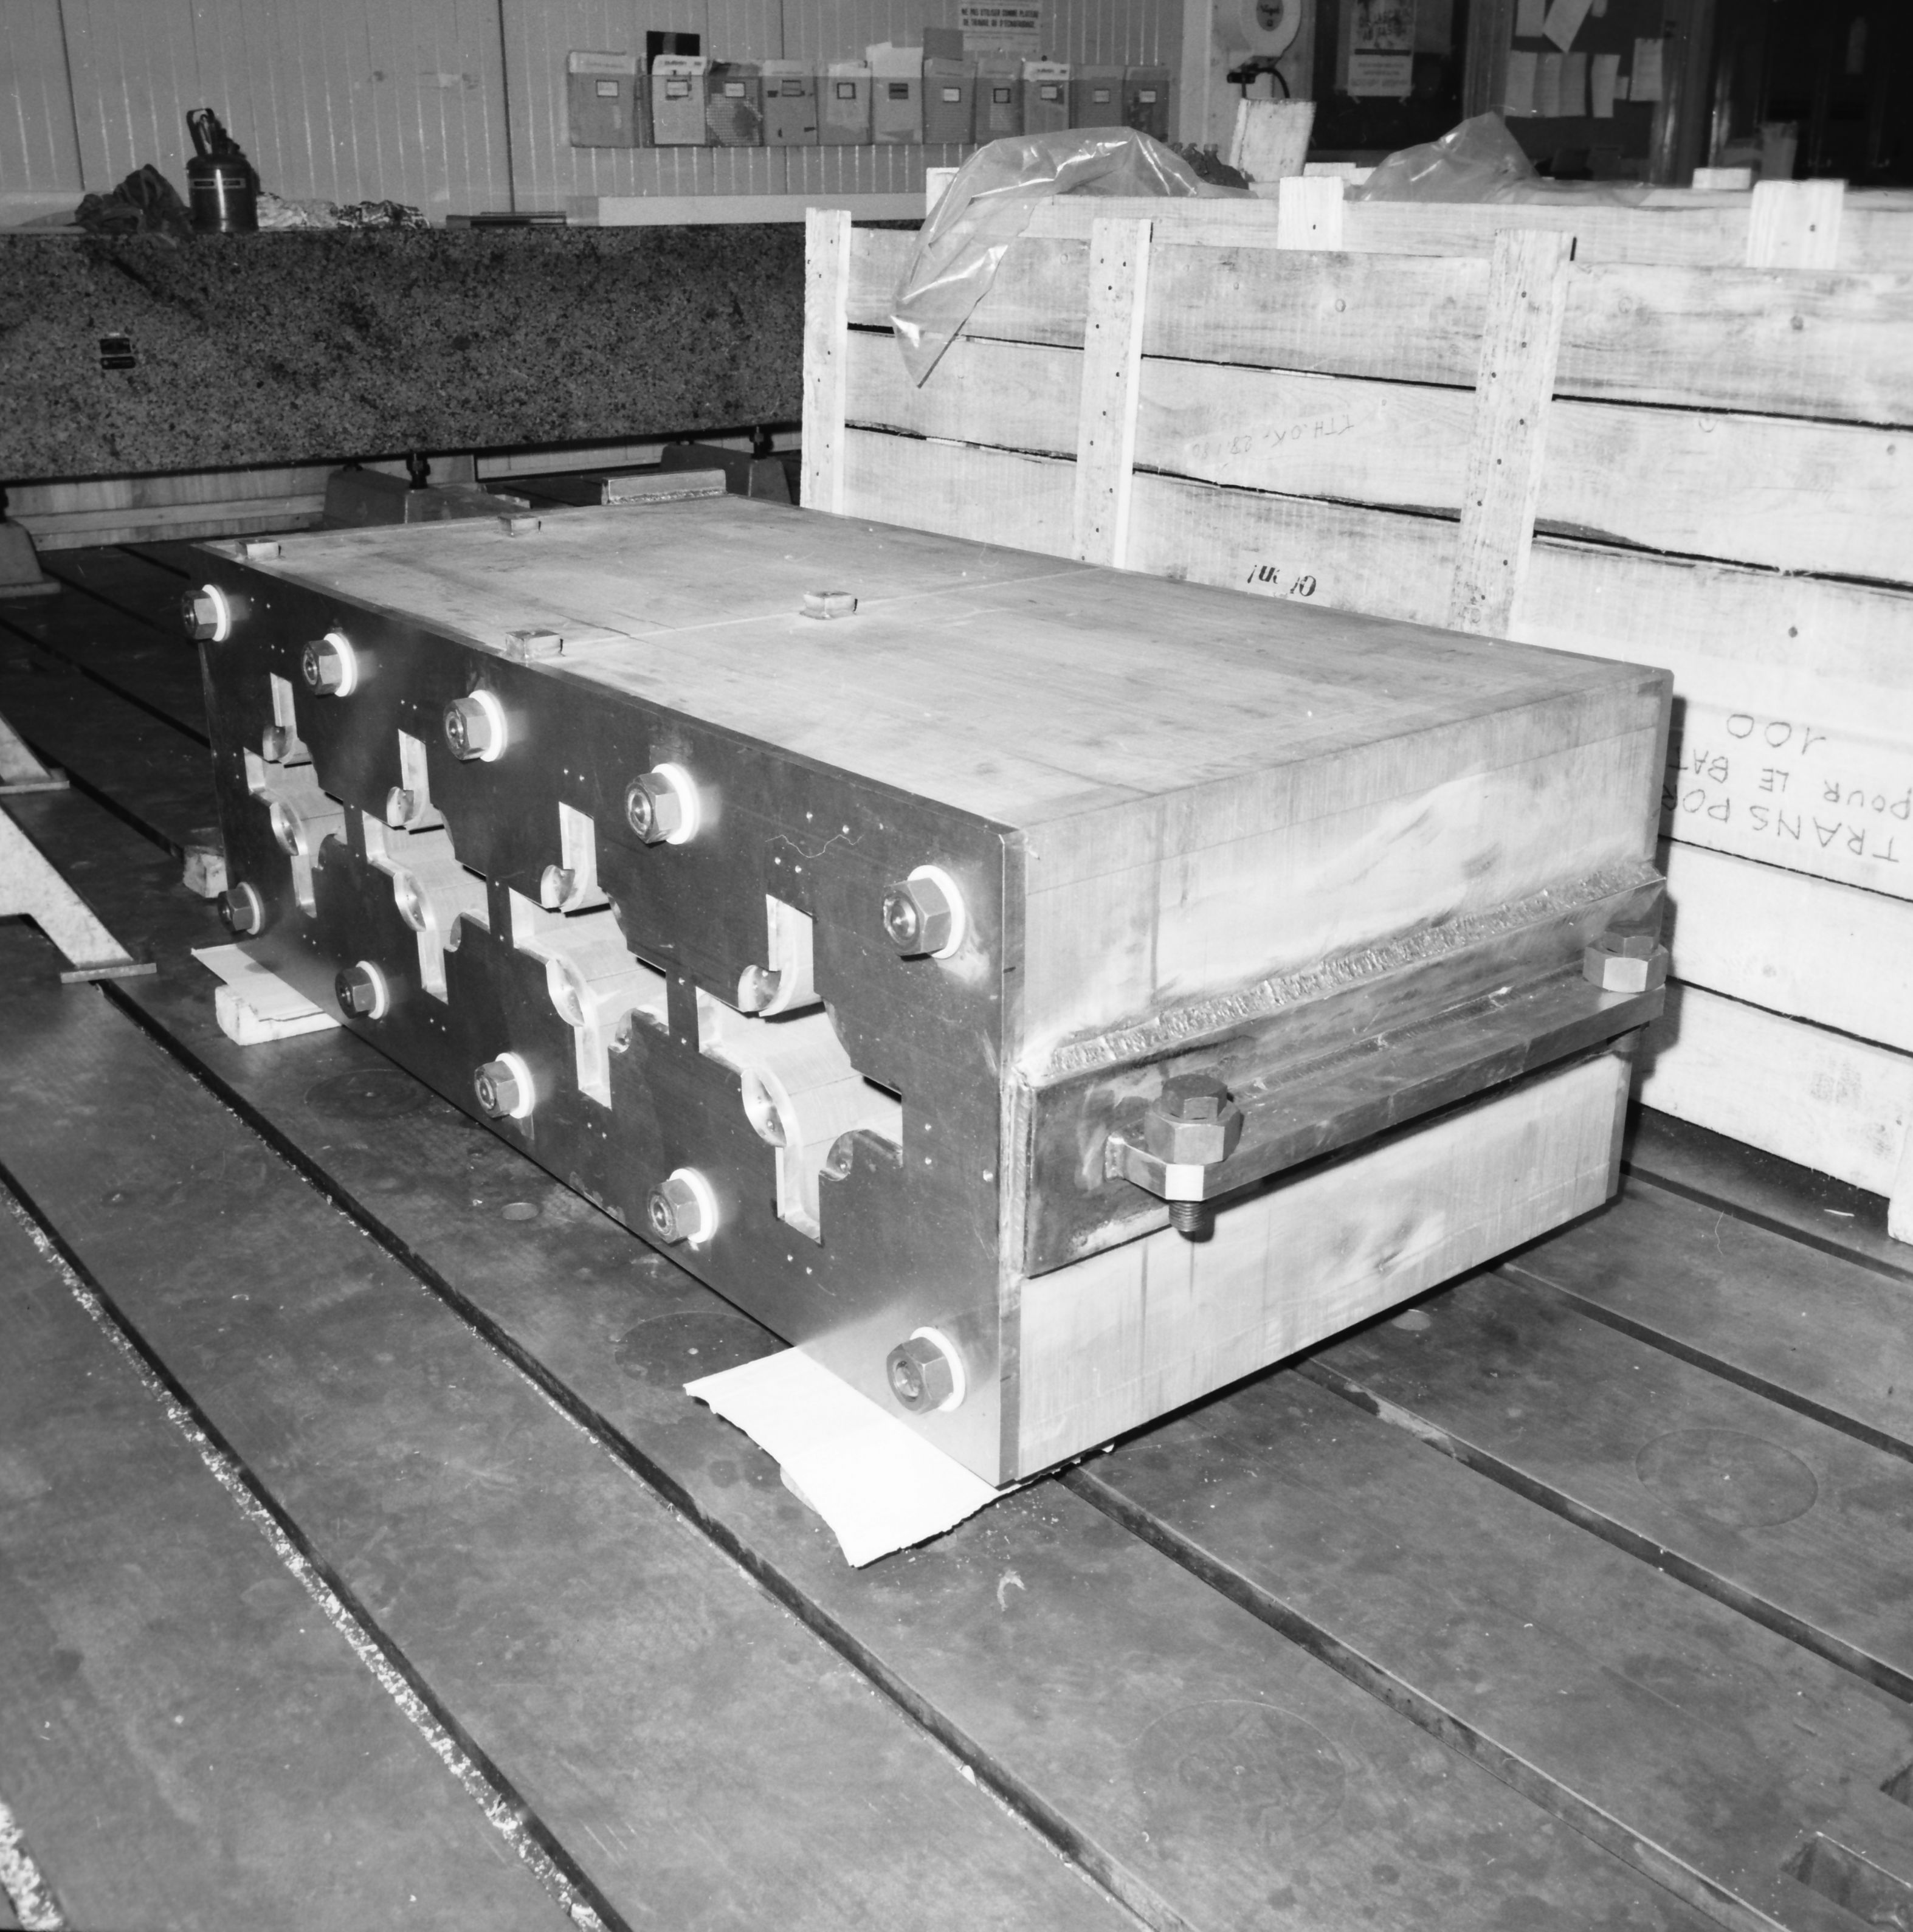
Normal-conducting Electromagnets, Yokes, and Coils
Description & Specific Conditions:
Assembly of eight focusing quadrupoles and four defocusing quadrupoles including the supply of normal-conducting electromagnets, yokes and coils, the design, the manufacturing of the tools and the tests. Pre-series shall be delivered within one year after the notification of the award of the Contract. The Series shall be delivered within one year after the acceptance of the Pre-series.
• Magnets:
Laminated (Air/Water Cooled) from 1 to 20 tons;
Solid (Air/Water Cooled) from 1 to 20 tons.
• Yokes:
Laminated (Air/Water Cooled) from 1 to 20 tons;
Solid (Air/Water Cooled) from 1 to 20 tons.
• Coils:
Length: Up to 1000 mm;
Length: From 1000 to 5000 mm;
Length: Above 5000 mm.
Procurement Code: 02 25 02 00
Cost Range: 750 kCHF ⬄ 5 MCHF
Planning: MS: published (MS-4994)
IT: Q3 2024
Contact: antony.newborough@cern.ch
Notes:
MS is published

Slide 16
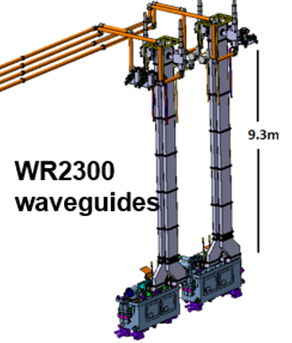
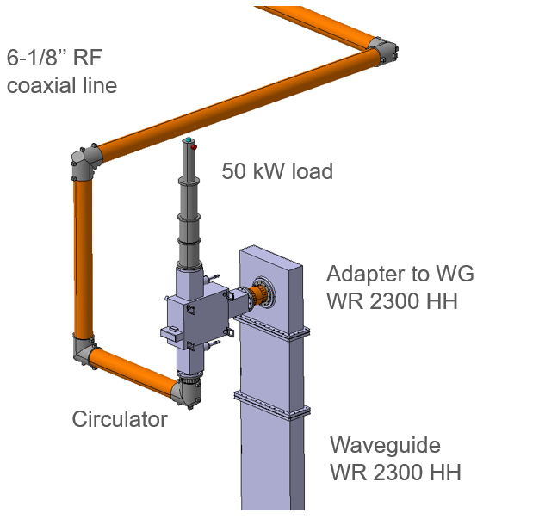
HL-LHC Crab cavities RF Circulators & Loads
Description & Specific Conditions:
Supply of 18 circulators for the HL-LHC Crab cavities.
Key conditions:
Design & manufacturing expertise: CERN will provide a functional specification and the Contractor shall design and manufacture accordingly (Detailed Design File to be approved by CERN);
Capacity to manufacture 18 units in less than 3 years;
Proven experience with circulators and loads for High Power RF Systems.
Start of the Contract: Q1 2025.
Procurement Code: 03 06 01 00
Cost Range: 750 kCHF ⬄ 5 MCHF
Planning: MS: Q3 2024
IT: Q4 2024
Contact: eric.montesinos@cern.ch

Slide 17
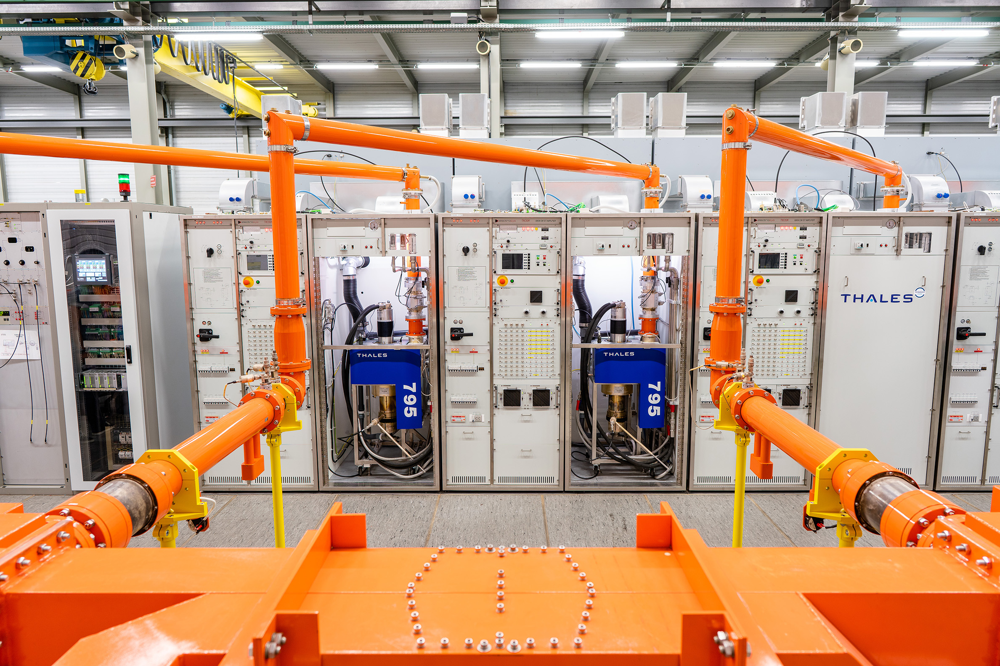
HL-LHC Crab cavities HPRF stations
Description & Specific Conditions:
Supply of 18 High Power Radio Frequency stations powering IOTs for the HL-LHC Crab cavities.
Key conditions:
• Design and manufacturing expertise in HPRF equipment;
• Capacity to produce the systems in the required timeframe.
Start of the Contract: Q1 2025.
Procurement Code: 03 06 01 00
Cost Range: 5 MCHF ⬄ 10 MCHF
Planning: MS: Q3 2024
IT: Q4 2024
Contact: eric.montesinos@cern.ch

Slide 18
Thank you

