Slide 1
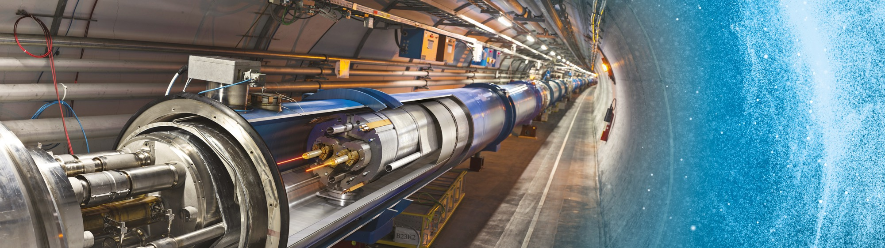
Visit of the Polish Electric Power Industry Association
Floris Bonthond
7 June 2024

Slide 2
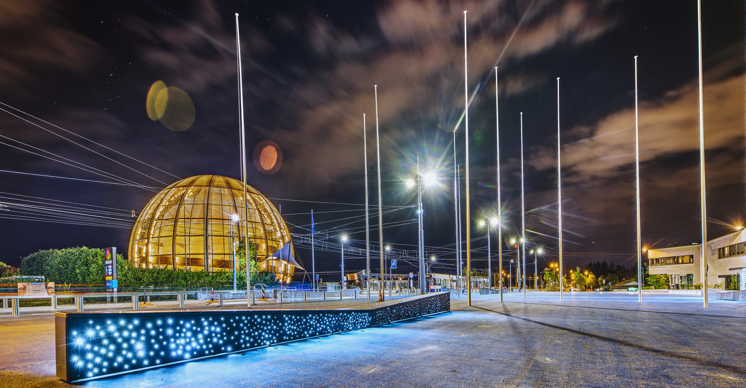
AGENDA
Introduction
Statistics
Procurement @ CERN - the rules
Impact of Doing business with CERN
Procurement website

Slide 3

INTRODUCTION

Slide 4

CERN - the world’s biggest laboratory for particle physics
International Organization
established on 1 July 1953 -
“Science for Peace”
Immunity of jurisdiction
and execution
Notes:
This slide addresses two questions:
“Where are we?”
Use the map to indicate the location of CERN, headquartered in Geneva, straddling the Franco-Swiss border
“What is CERN?”
CERN is one of the world’s leading laboratories for particle physics
CERN’s vision (long-term goal) is to understand the fundamental particles and laws of the Universe (This is the Vision statement that features in CERN’s communication strategy)
Thus, CERN is first and foremost a research laboratory

Slide 5

CERN is entitled to establish its own internal rules necessary for its proper functioning, including:
Procurement Rules
Safety Rules
Staff Regulation of its own personnel

Slide 6

In 1954 CERN had 12 Member States
The first contacts between Poland and CERN were established in 1959 when several scholarships were awarded to young Polish physicists from Krakow and Warsaw. This soon developed into a wider collaboration between CERN and Polish institutes. In 1963 Poland became an Observer state at CERN, the only country from Eastern Europe to accede to this status. In 1991, Poland became the 16th member of CERN, and thus the first Member State from the former Eastern block.
Today, CERN has:
23 Member States
3 Associate Member States in the pre-stage to membership
8 Associate Member States
6 Observers
Geographical & cultural diversity
110 nationalities,
from 77 countries
~ 2676 Staff members
~ 2000 contractors’ employees
~ 13000 physicists /users
Yearly budget ~ 1255 MCHF
Notes:
The speaker can highlight CERN’s second mission as stated when it was established: to foster peaceful collaborations between nations that had recently been at war.
This slide will have information on the country of the visiting delegation:
Location on the world map
Date of accession (if Member State or Associate Member State)
For information:
Member States – Austria, Belgium, Bulgaria, Czech Republic, Denmark, Finland, France, Germany, Greece, Hungary, Israel, Italy, Netherlands, Norway, Poland, Portugal, Romania, Serbia, Slovak Republic, Spain, Sweden, Switzerland, United Kingdom
Associate Member States in the pre-stage to membership – Cyprus, Estonia, Slovenia
Associate Member States – Croatia, India, Latvia, Lithuania, Pakistan, Turkey, Ukraine
Observers – USA, Russia, Japan, (EU, JINR, UNESCO)

Slide 7

Four pillars underpin CERN’s mission
RESEARCH
EDUCATION
& TRAINING
COLLABORATION
INNOVATION

Slide 8
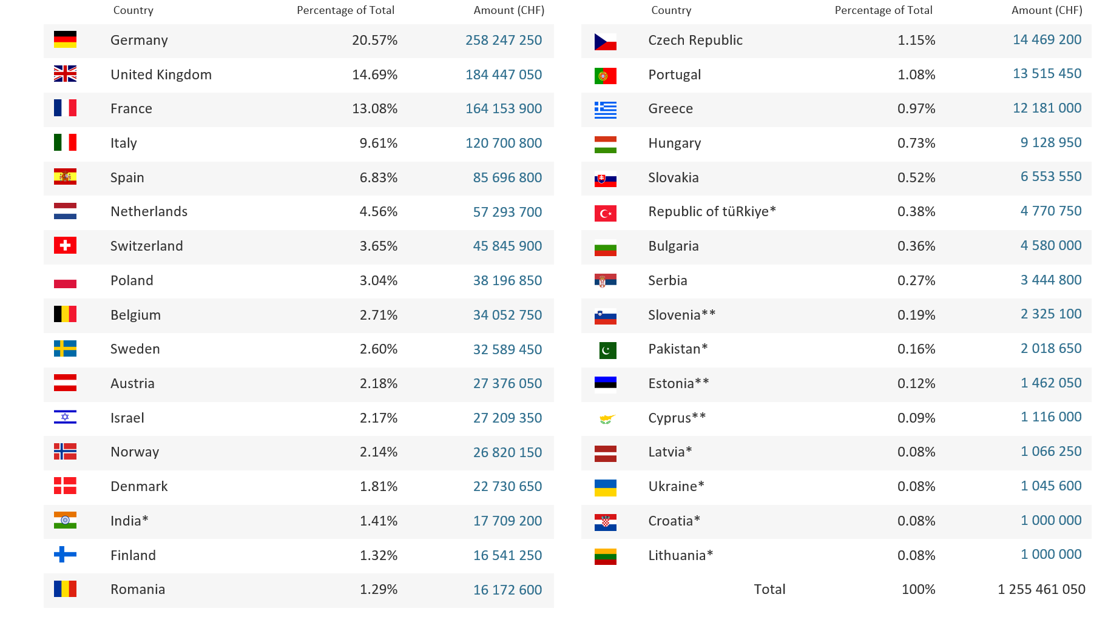
Yearly Budget (contributions 2024)*
*Brazil joined as an Associate Member State on 13 March 2024

Slide 9

STATISTICS

Slide 10
Procurement Expenditure

Slide 11
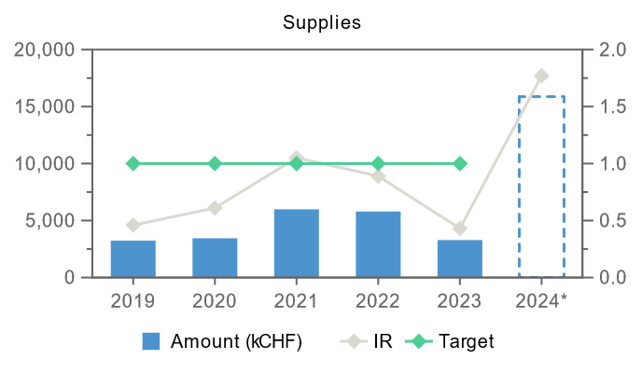
Industrial Return for Poland (supplies)
* provisoire

Slide 12
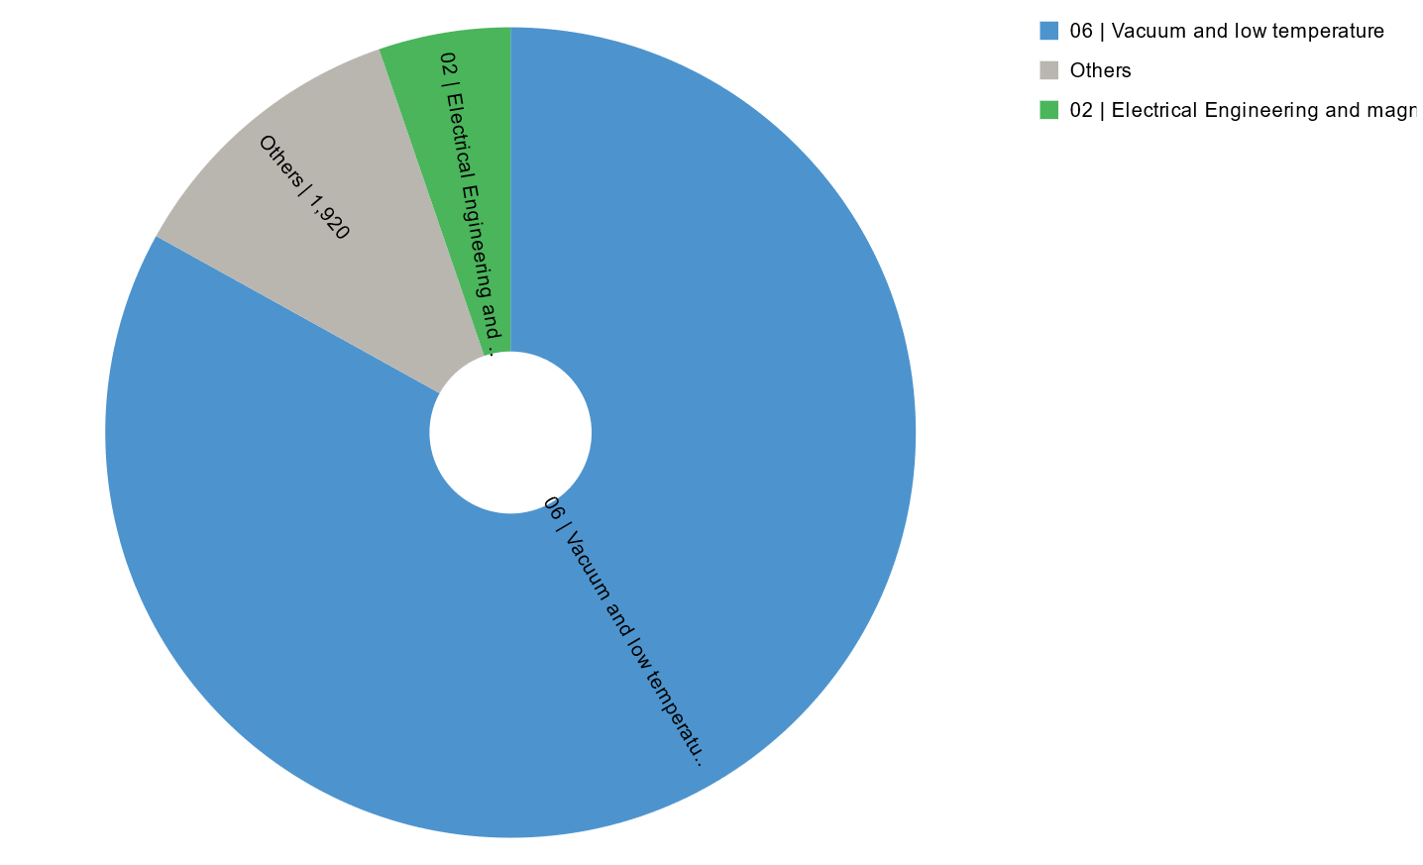
Industrial Return for Poland (supplies)
* provisoire

Slide 13
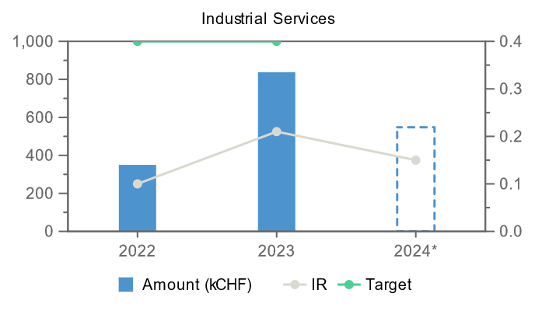
Industrial Return for Poland (services)
* provisoire

Slide 14
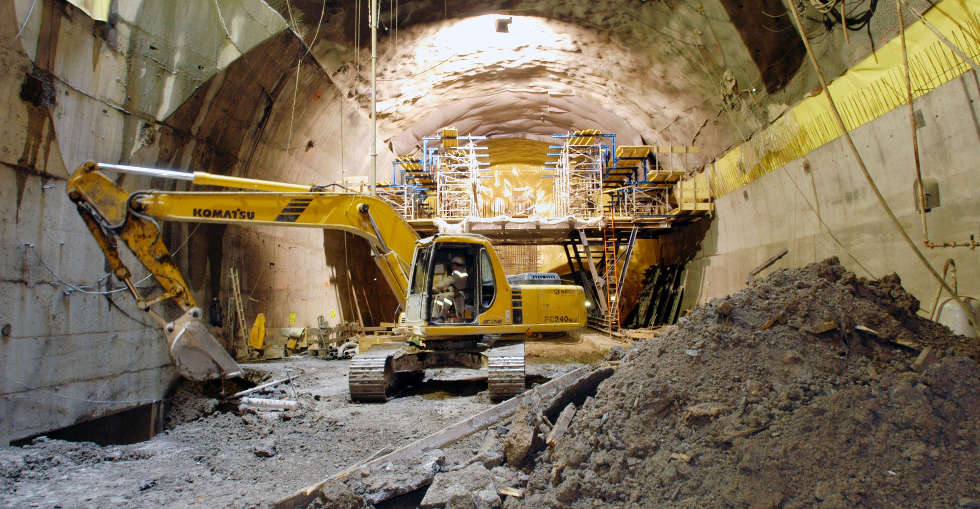
What does CERN buy?
Civil engineering:
  Construction
  Renovation of buildings
  Metallic structures
  Earthworks
  Roads
Cooling and ventilation
equipment

Slide 15
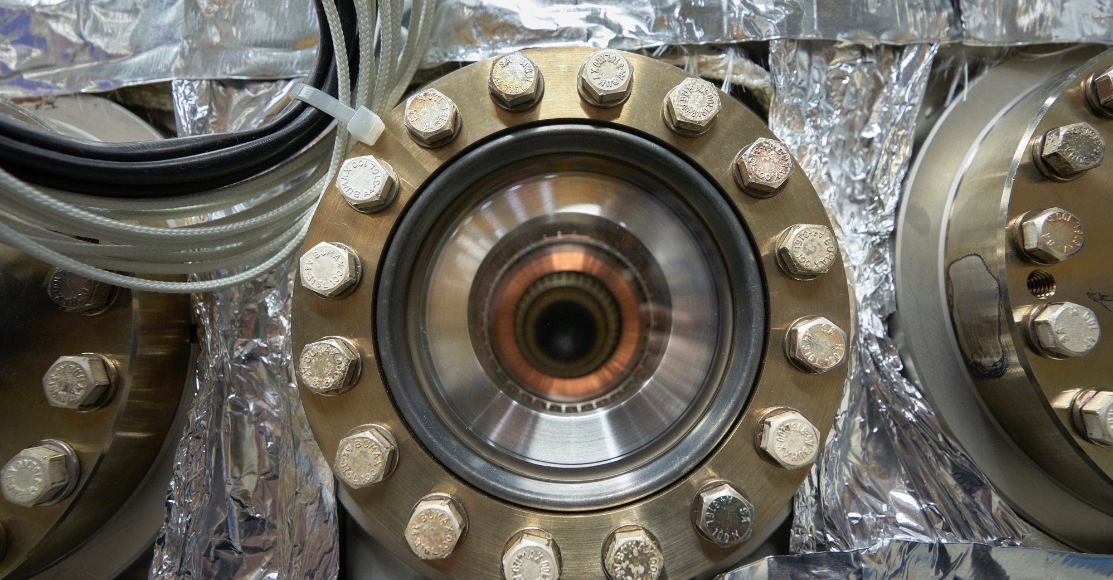
What does CERN buy?
Electrical engineering and magnets
  Transformers
  Switchboards and switchgears
  Cables
  Automation
  Power supplies
  Magnets

Slide 16
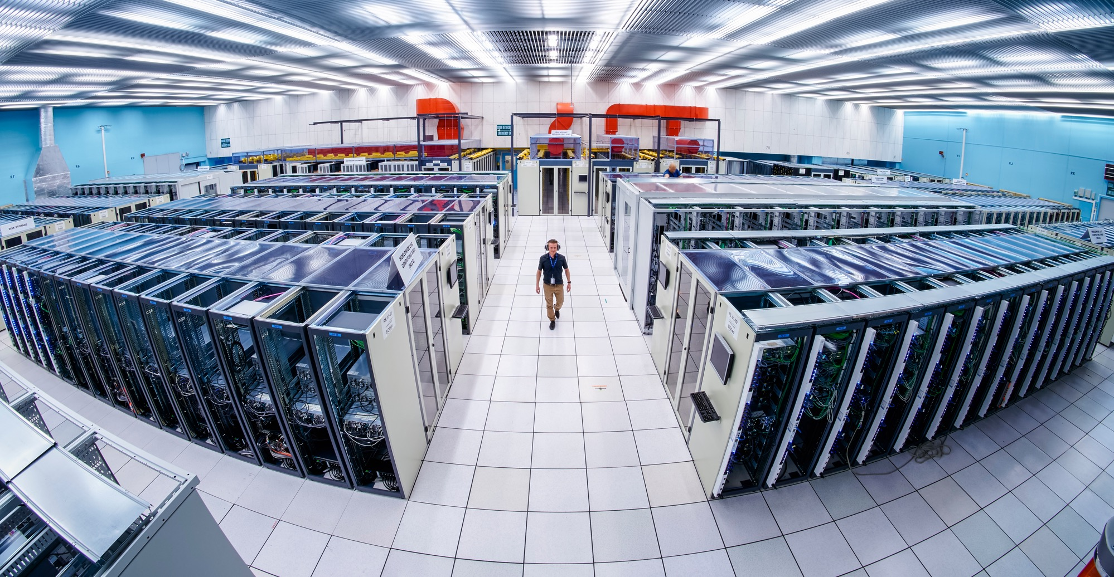
What does CERN buy:
Information Technology
  Computing systems
  Servers
  Software
  Network equipment
  Personal computer equipment

Slide 17
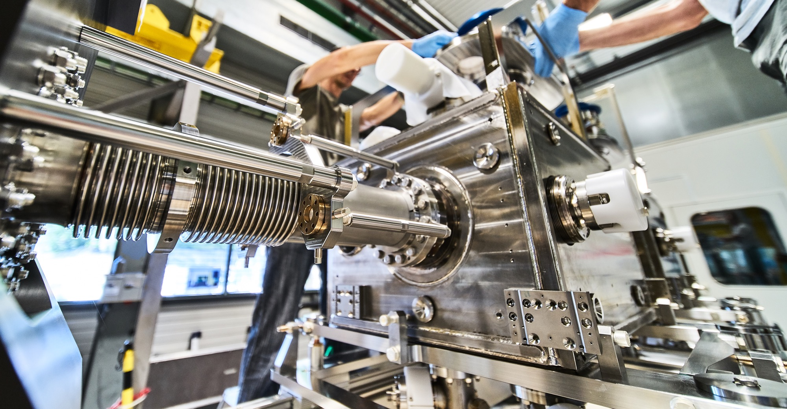
What does CERN buy?
Mechanical engineering and raw materials:
  Machining
  Sheet metal work
  Welding (arc, MIG, TIG, EBW)
  Special fabrication techniques
  Raw materials, finished and semi-finished products (plates, pipes, etc.)
  Offsite engineering and testing

Slide 18
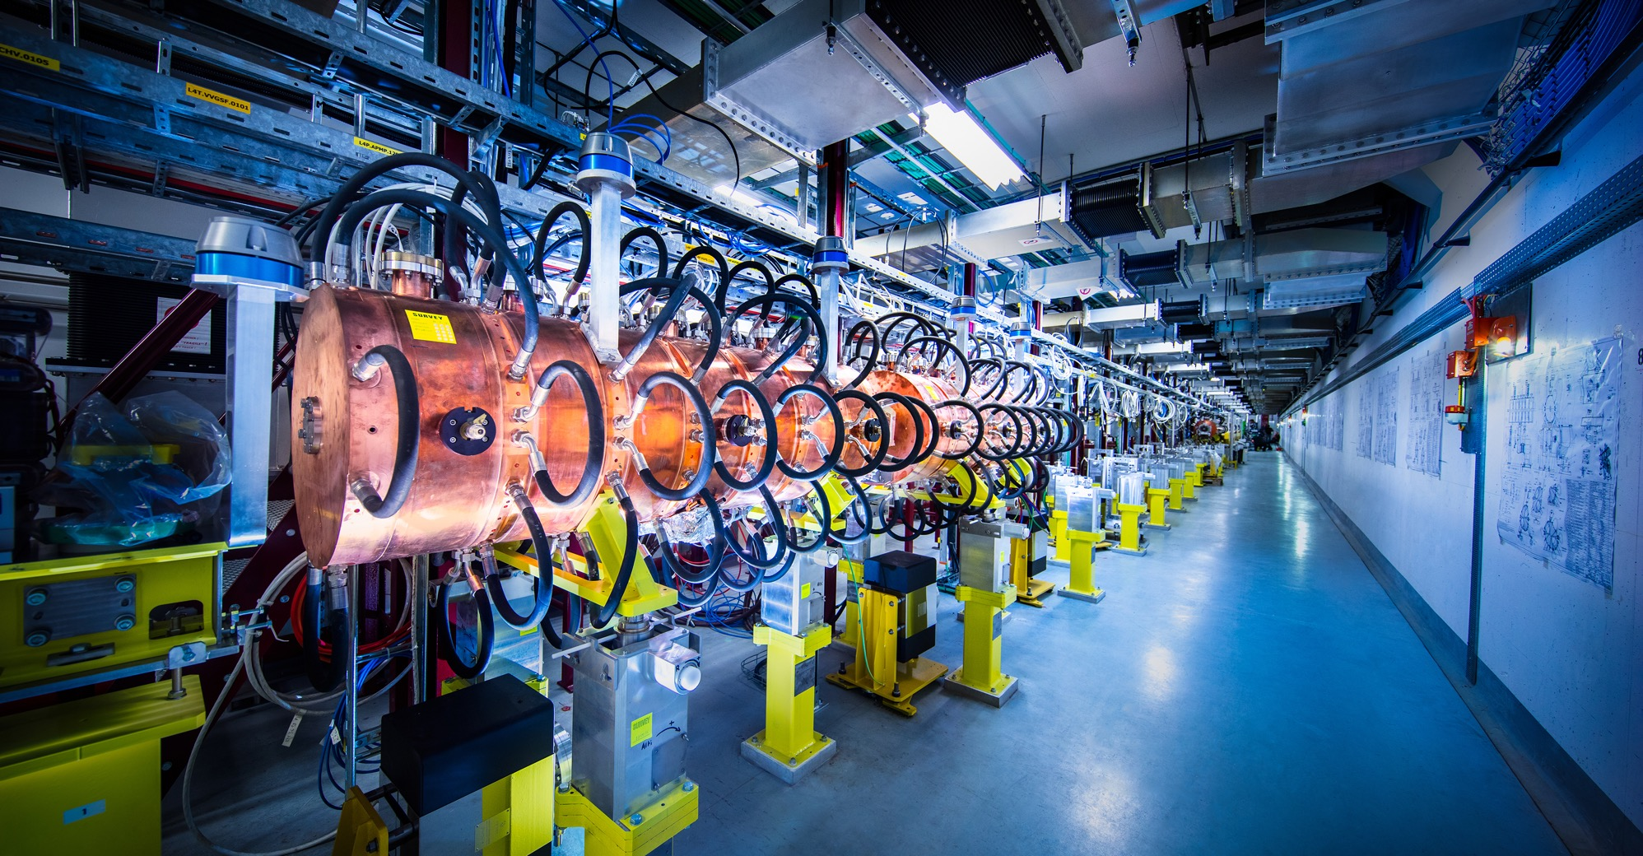
What does CERN buy?
Electronics and radio frequency:
  Electronic components (active, passive)
  PCBs and assembled boards
  LV and HV power supplies
  Radio frequency plants
  Amplifiers

Slide 19
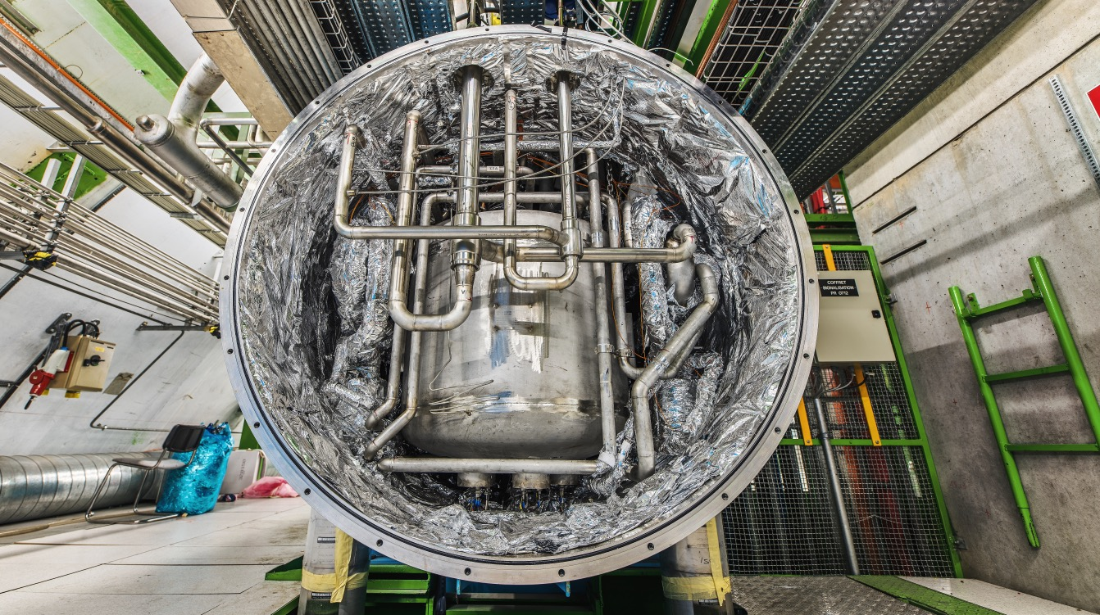
What does CERN buy?
As well as:
  Cryogenic and vacuum equipment
  Optics and photonics
  Particle and photon detectors
  Health and safety equipment
  Transport and handling equipment
  Office supply, furniture
  Industrial services on the CERN site

Slide 20
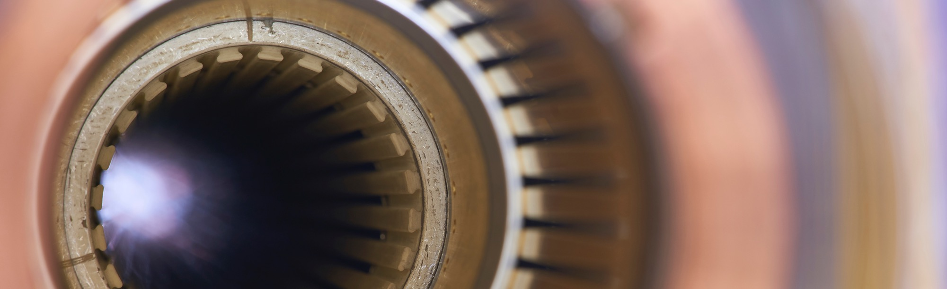
Current project - upgrade of the LHC to
High Luminosity LHC
Hi-Lumi will provide greater precision and discovery potential
Hi-Lumi will start operating in 2026, and run until 2035
CERN is already looking beyond 2035, with several projects in R&D or study stages

Slide 21
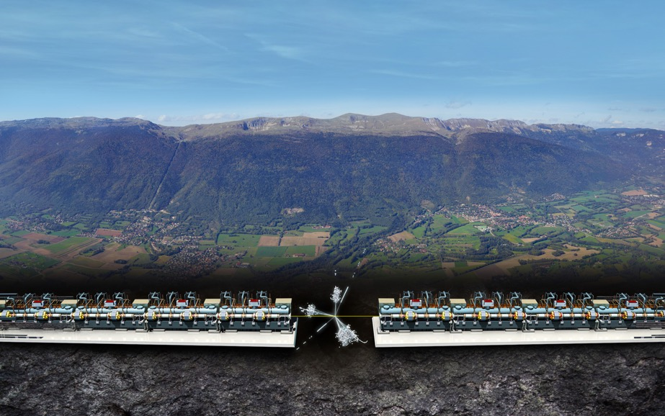


Two biggest projects for future of particle physics at CERN
Future Circular Collider (FCC)
New technology magnets 100 TeV pp collisions in 100km ring
e⁺e⁻ collider (FCC-ee) as 1st step
FCC
Compact Linear Collider (CLIC)
Linear e⁺e⁻ collider √s up to 3 TeV
LHC

Slide 22
Supplies (254 M CHF spent in 2022 – CERN budget only)

Slide 23
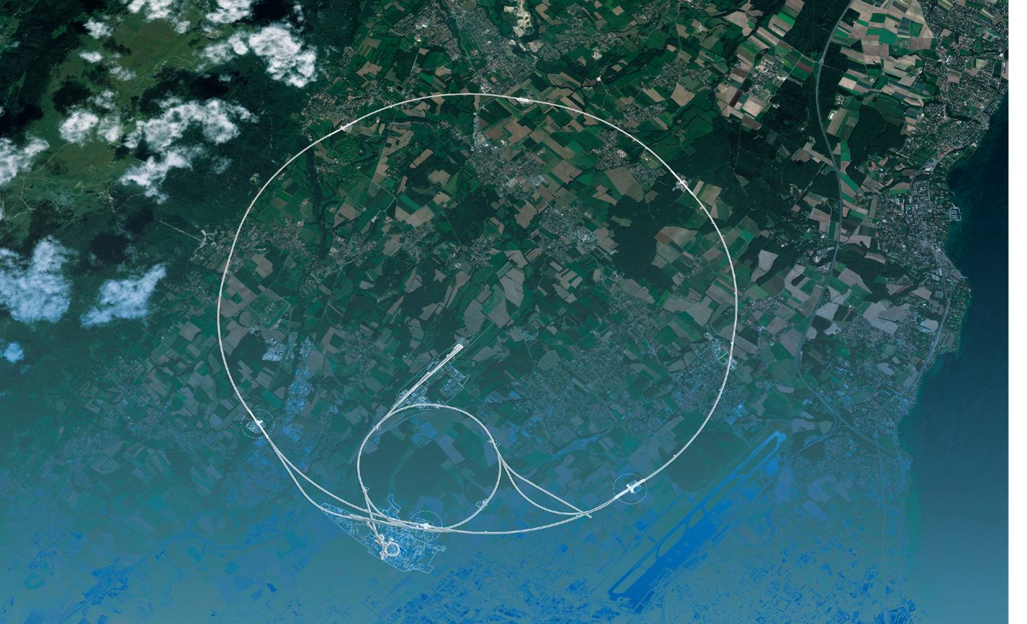
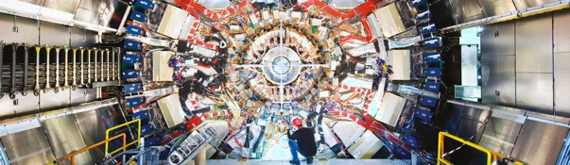
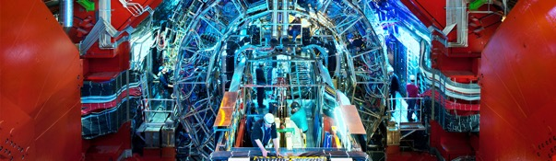
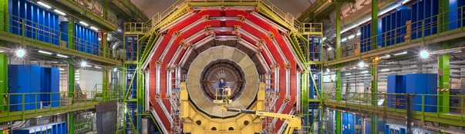
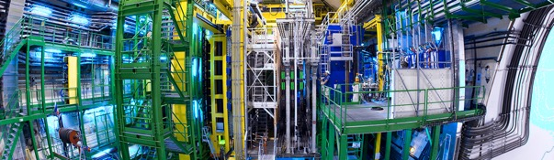
CERN also buys for the LHC experiments
The Compact Muon Solenoid (CMS) is a general-purpose detector.
It has a broad physics programme ranging from studying the Standard Model
(including the Higgs boson) to searching for extra dimensions and particles
that could make up dark matter.
CMS
ALICE (A Large Ion Collider Experiment) is a detector dedicated
to heavy-ion physics. It is designed to study the physics of strongly
interacting matter at extreme energy densities, where a phase of
matter called quark-gluon plasma forms..
ALICE
ATLAS
LHCb
The ATLAS experiment (short for "A Toroidal LHC Apparatus") detects
the tiny subatomic particles created after beams of particles smash into
each other at near light speed.
The Large Hadron Collider beauty (LHCb) experiment
specialises in investigating the slight differences between
matter and antimatter by studying a type of particle called
the "beauty quark", or "b quark".

Slide 24

How does CERN buy?
  Off-the shelf or non-standard products which can be produced with existing manufacturing techniques or technologies:
  Functional specification
  Non-standard products where industry has neither the required know-how nor the interest to develop and design the products:
  Build-to-Print specification
Prototypes and or pre-series might be required

Slide 25


PROCUREMENT @CERN
The rules

Slide 26
The Procurement Service
Mission
The Procurement Service (PS) procures all supplies and services for CERN
Meeting the specified and contractual technical, delivery
and performance requirements
At the lowest possible overall cost
While achieving balanced industrial return for CERN Member States
Respecting CERN
Procurement Rules

Slide 27
Principles of the Procurement Rules (1/4)
1
Transparency and Impartiality
2
Tenders open to Member States only
3
Objectivity and equal treatment: tendering packages are objective and impartial

Slide 28
Principles of the Procurement Rules (2/4)
Selective tendering procedures: CERN’s tendering procedures are not open to any interested firm
Confidentiality: Opening and evaluation of bids as well as negotiations are not public

Slide 29
Principles of the Procurement Rules (3/4)
Awards for supplies (and exceptionally for services,) based on:
Lowest compliant bid
Technical
Financial
2
Delivery
Alignment rule

Slide 30
Principles of the Procurement Rules (4/4)
Award for industrial services based on:
Best Value For Money
2
No alignment rule

Slide 31

Enquiries between 10’000 and 200’000 CHF
“Price enquiry” (Demande d’Offre - DO)
Submission deadline: 4 weeks from date of dispatch
All price enquiries above 50’000 CHF are also sent to the
Industrial Liaison Officers (ILOs) for information
Price enquiries consist of:
  Technical specification and annexes
  Tender form
  Technical questionnaire (optional)
  CERN’s General Conditions (contracts, invitations to tender, safety, etc.)

Slide 32

Enquiries exceeding 200’000 CHF (1/2)
“Market Survey” (MS)
Prior announcement on CERN’s procurement website, see
“Business Opportunities”
  At this stage, interested firms are encouraged to contact CERN in
  order to have a clear understanding of the requirement, allowing
  them to begin their organisation ahead of the tendering process
Market surveys consist of:
  Technical Description
  Qualification Questionnaire (financial and technical)
Submission deadline: 4 weeks, or more if the MS is still online

Slide 33

Enquiries exceeding 200’000 CHF (2/2)
“Invitation to tender” (IT)
Sent to selected firms only
Submission deadline: 4 weeks from date of dispatch (with a longer period for more complex requirements)
Firms are strongly encouraged to ask all questions in writing to understand all requirements and prepare a bid that best matches CERN’s needs
All invitations to tender are sent to the Industrial Liaison Officers (ILOs) for information
Bids (tender form) shall exclusively be submitted via CERN’s e-tendering interface
Notes:
Invitations to tender consist of:
Technical specification and annexes;
Tender form (and a technical annex - optional);
General Conditions of CERN (contracts, invitations to tender, Safety, etc.)

Slide 34
Country of origin
SUPPLIES
“Country(ies) where the supplies (including their components and sub-assemblies) are manufactured or undergo the last major transformation by the contractor or its sub-contractor”.
If at least 60% of the total amount of the bid comes from (a) poorly balanced MS, then the whole bid will be treated as that from a bidder in a poorly balanced MS.
SERVICES
“Country(ies) in which the bidder is established.”
If at least 40% of the total amount of the bid comes from a poorly balanced MS, then the whole bid will be treated as that from a bidder in a poorly balanced MS.

Slide 35
Alignment rule
Applicable for:
1
Contracts awarded on the lowest
compliant basis (mainly supply contracts)
2
With a total amount exceeding
100’000 CHF
Under certain conditions, as defined in CERN Procurement Rules, a bidder offering goods originating* in poorly balanced Member States is allowed to align his price to that of the
lowest bidder and thereby be awarded the contract
RULE
* At least 60% for supply contracts or; at least 40% for service contracts awarded on the lowest compliant basis

Slide 36
Alignment rule (Scenario 1)
Lowest compliant bid from a Poorly-Balanced Member State
Bid (CHF)
Contract
Well balanced MS
Poorly balanced MS

Slide 37
Alignment rule (Scenario 2)
Lowest compliant bid from a Well-Balanced Member State
  (a) 1st bidder from PB MS (+ max 20%) accepts to align its price
Bid (CHF)
<20%
Contract
Well balanced MS
Poorly balanced MS

Slide 38
Alignment rule (Scenario 2)
Lowest bid from a Well-Balanced Member State
  (b) if not, 2nd lowest bidder from PB MS (+ max 20%) accepts to align its price
Bid (CHF)
<20%
Contract
Well balanced MS
Poorly balanced MS

Slide 39
Alignment rule (Scenario 2)
Lowest bid from a WB MS
  (c) if no alignment of next two PB MS bidders, contract placed with lowest bidder from WB MS
Bid (CHF)
<20%
Contract
Well balanced MS
Poorly balanced MS

Slide 40
Alignment rule with splitting (Scenario 3)
  Lowest bid from a PB MS, another bid from a PB MS falls within 20% of the lowest
  Bidder from PB MS aligns contracts placed with the 2 lowest bidders from PB MS
Bid (CHF)
<20%
Contract
Well balanced MS
Poorly balanced MS

Slide 41
Alignment rule with splitting (Scenario 4)
  Lowest bid from a WB MS and two bids from PB MS fall within 20% of the lowest
  Both bidders from PB MS align contracts placed with bidders from PB MS
Bid (CHF)
<20%
Contract
Well balanced MS
Poorly balanced MS

Slide 42
Alignment rule with splitting (Scenario 5)
  Lowest bid from a WB MS and a bid from PB MS falls within 20% of the lowest
  Lowest bidder from PB MS align contracts placed with the lowest bidder (from WB MS) and the bidder from PB MS
Bid (CHF)
<20%
Contract
Well balanced MS
Poorly balanced MS

Slide 43

Industrial return coefficient
Industrial return
coefficient
Over a 4-year period:
Very poorly balanced : < 0.40
Poorly balanced (PB) : 0.40 ≥ x < 1
Well balanced (WB): ≥ 1
For Supply contracts and for a
12-month period starting on
1st March, defined as:
“The ratio between a Member State's percentage share of the value of all Supply contracts and that Member State's percentage contribution to the CERN Budget over the same period”.
Status definition
% expenditure in the MS
Return Coef.=
% contribution to CERN budget for this MS

Slide 44
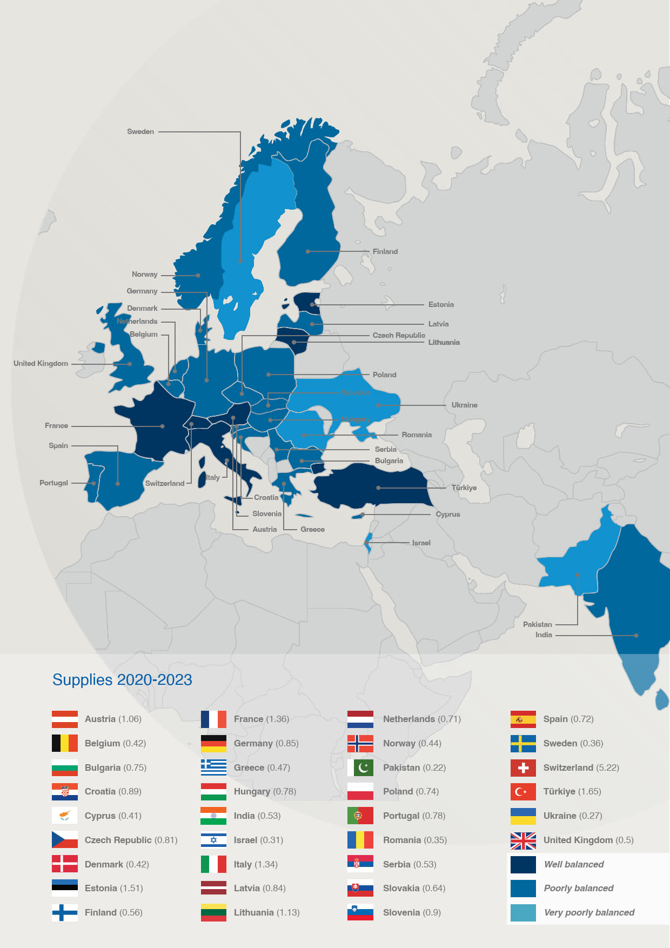

Poorly balanced Member States* (Supplies)
(1st March 2024 – 28 February 2025, based on the previous 4 calendar years):
Well Balanced (≥1) | Poorly Balanced (0.40 ≥ x < 1) | Very Poorly Balanced (< 0.40)
Austria Estonia* France Italy Lithuania* Switzerland Türkiye* | Belgium Bulgaria Croatia* Cyprus* Czech Republic Denmark Finland Germany Greece Hungary India* Latvia* Netherlands Norway Poland Portugal Serbia* Slovak Republic Slovenia* Spain United Kingdom | Brazil* Israel Pakistan* Romania Sweden Ukraine*
*Associate Member States
** Brazil joined as an Associate Member State on 13 March 2024

Slide 45
Limited tendering
« Limited tendering is foreseen by the CERN Procurement Rules to improve the industrial return of very poorly balanced Member States. »
Conditions
Firms established in very poorly balanced Member States only (industrial return <0.4)
ILO can ask to add firms, provided they are established in very poorly Member States
Used in case where there is sufficient competition

Slide 46

Impact of
Doing business with CERN

Slide 47
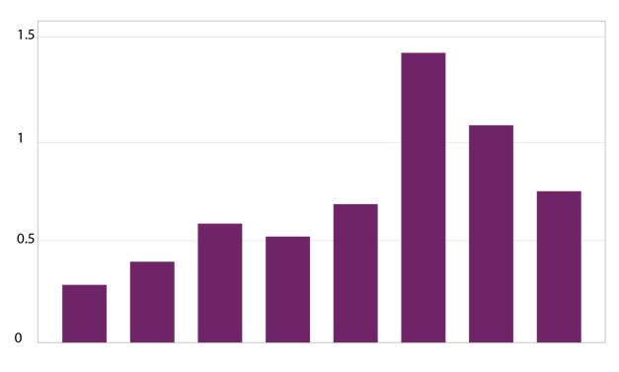
The economical impact of CERN Procurement on supplier’s performance (Castelnovo et al, 2018)
Empirical studies (by the analysis of financial data from 1995 to 2008 from 365 CERN suppliers for the LHC) show that after working with CERN on high-tech contracts, CERN suppliers
out-perform their peers by:
Investing more in R&D and filing more patents
Higher productivity, revenue and profitability
Order/contract received from CERN
Increase in R&D
Innovation
Productivity growth
increase revenues & profitability
Patents per firm
More than
2 years before
2-1 years before
Date of order
1,2 years later
3,4 years later
5,6 years later
7,8 years later
More than
8 years later
Notes:
Average number of patents filed before and after the beginning of the procurement relationship with CERN
The X-axis shows the «relative years», that are the difference between a given year and the year the first order is received. Therefore, CERN(0) is, for each company, the year of beginning of the procurement relationship.

Slide 48
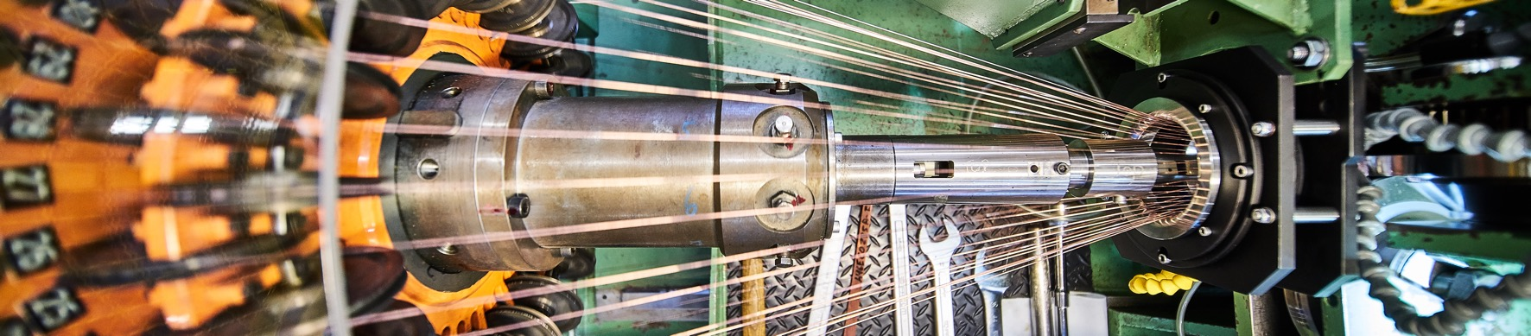
Doing business with CERN: the facts
Supplier survey (669 suppliers in 33 countries, 2017):
48%
improved products and services
42%
developed new products
55%
improved technical knowledge
in their field
18%
found or opened a new market to address
62%
used CERN as a marketing reference
Most firms experienced
no financial loss
Notes:
The key message here is that CERN is an open institution: open to its neighbours, and open to citizens from across the globe. We welcome them to CERN and go out to meet them
This slides summarises the outreach activities carried out by CERN.
It also includes a mention of CERN’s fundraising activities, for projects that are not part of CERN’s core activity. These fall into three categories: education & outreach, culture and creativity, innovation and knowledge exchange

Slide 49
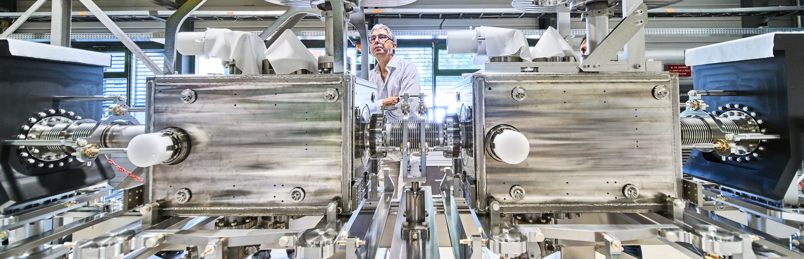
Doing business with CERN: the facts
Using CERN as a marketing reference improves Suppliers’ reputation

Slide 50
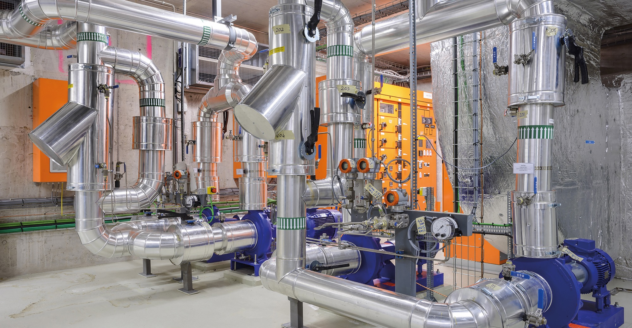
Social
Cost-Benefit Analysis (CBA) calculated by the University of Milan
“Each CHF invested in
HL-LHC project pays back approximately 1.8 CHF on societal benefits, including scientific, economic and cultural value (development of innovative technologies, industrial spillovers, skills acquired by students, etc.).”

Slide 51

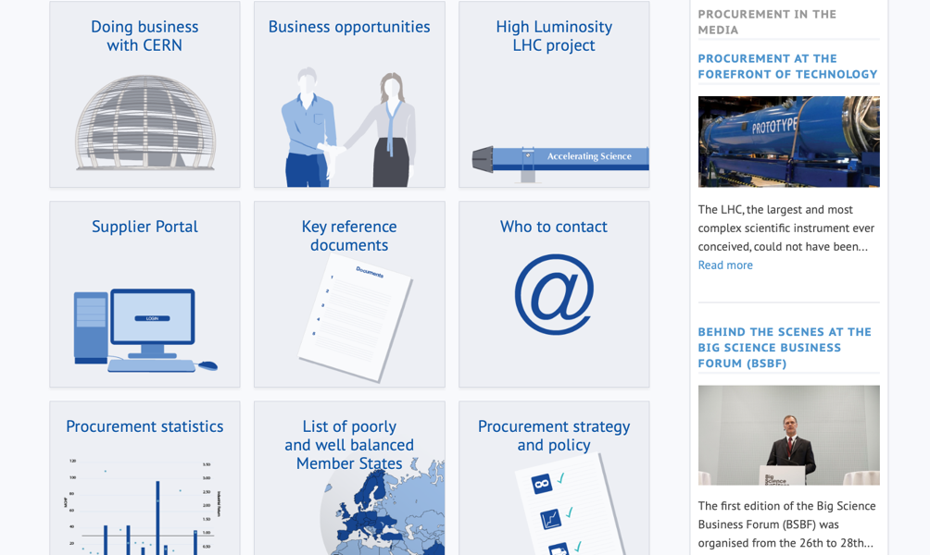
Procurement
website

Slide 52
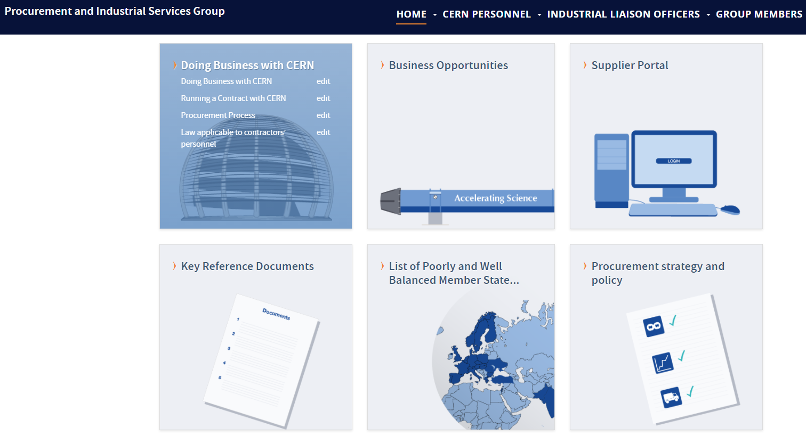
Website of the Procurement Service
http://procurement.web.cern.ch

Slide 53
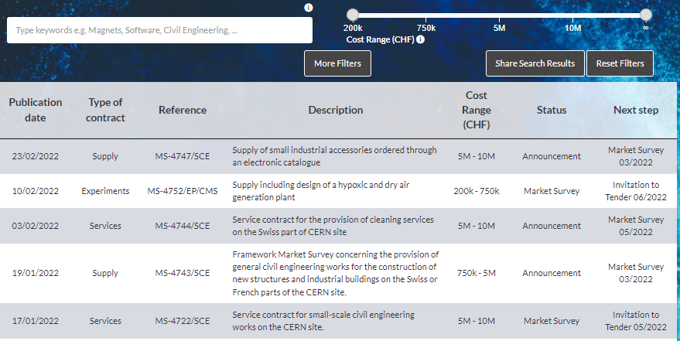
CERN Shopping List
https://forthcoming-ms.app.cern.ch/#!/

Slide 54
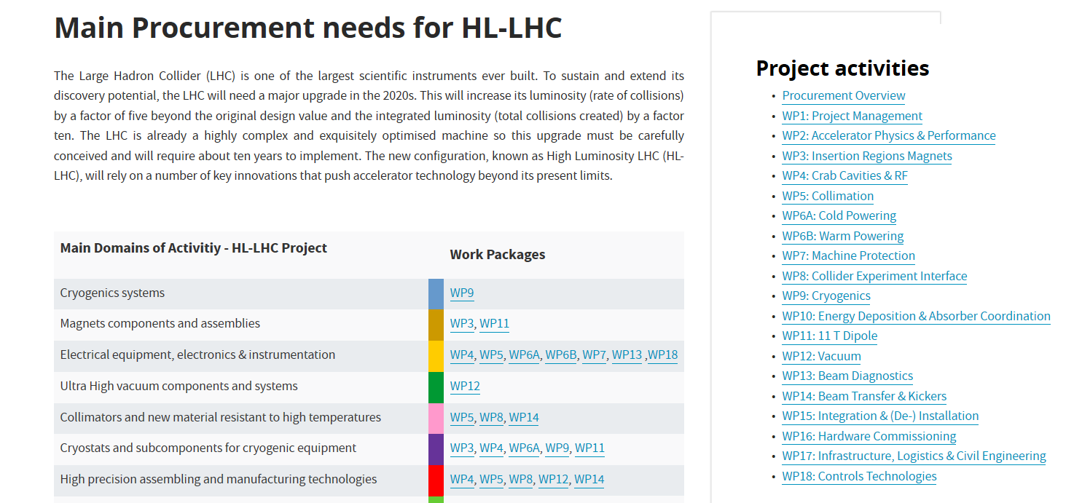
HL-LHC Shopping list
https://project-hl-lhc-industry.web.cern.ch/wp/main-procurement-needs-hl-lhc

Slide 55
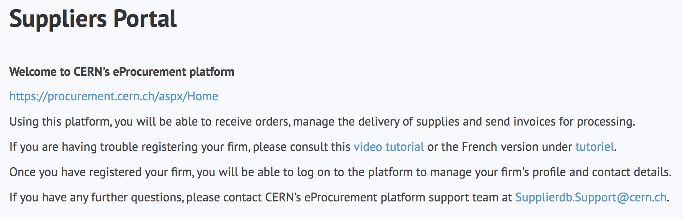
Register in the Suppliers’ Portal
For all exchanges with CERN, in particular to:
Be visible for future opportunities
(with the procurement codes you have indicated)
Receive and follow-up orders
Send invoices
MANDATORY

Slide 56
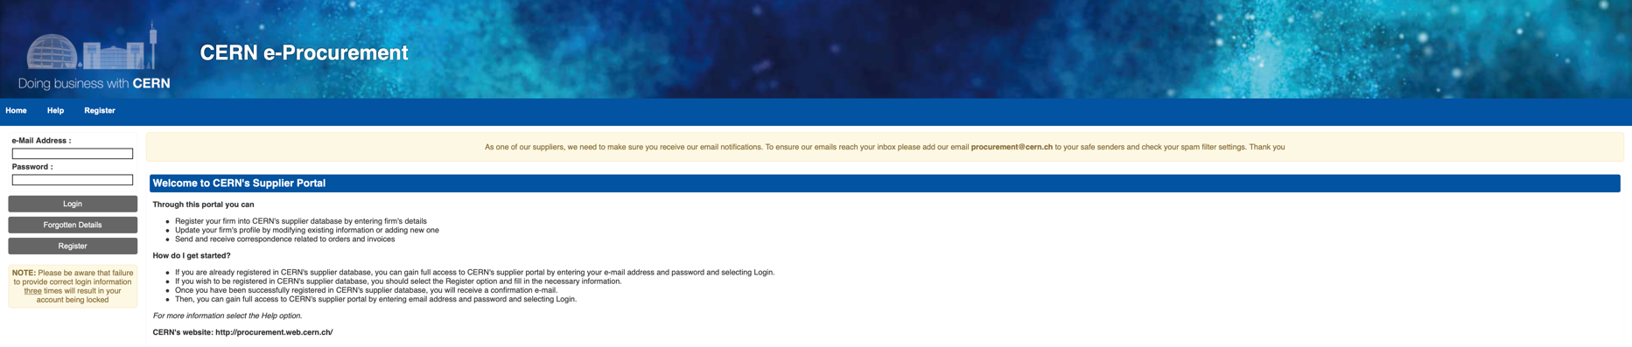
CERN e-Procurement
To ensure our emails reach your inbox, please add our email procurement@cern.ch to your safe senders and check your spam filter settings.

Slide 57

Contacts at CERN (Procurement and Technical)

Slide 58
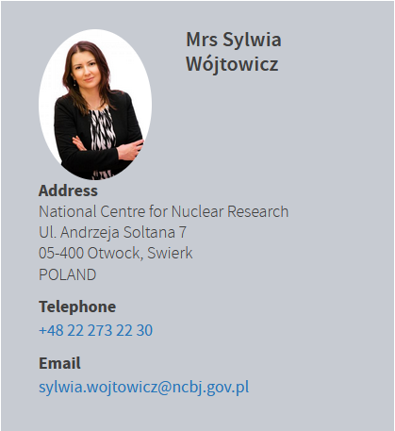
Contact in your country
ILO: Industrial Liaison Officer
Who to contact in your Country
    Industrial Liaison Officers (ILO's) are appointed by CERN's Member States to facilitate the flow of communication between CERN and its suppliers. ILO's can provide advice on the opportunities available for doing business with CERN and the support available to firms in their local regions.

Slide 59
Thank you

