Slide 1
Thoughts on superconducting cable stability
E.Felcini
27/03/2024

Slide 2
Introduction
These few slides are a very rough introduction to the wide topic of stability in superconducting magnets.
For a serious and complete discussion, please have a look at: L. Bottura, “Superconductivity for accelerators”, CAS Superconductivity for Accelerators, Erice, Italy, 2014
The majority of the material of this presentation is a mere copy-paste from Bottura’s lecture
These slides are intended just to facilitate the discussion and brainstorming on risk management

Slide 3
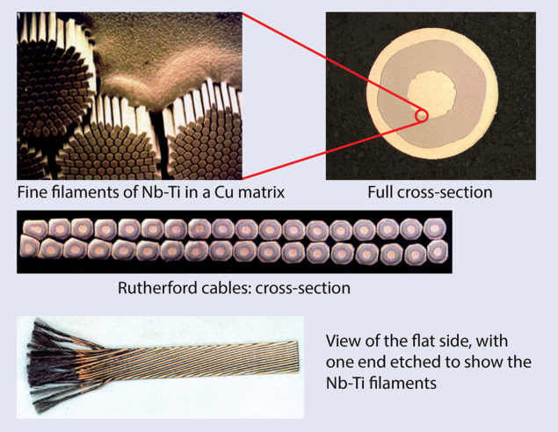
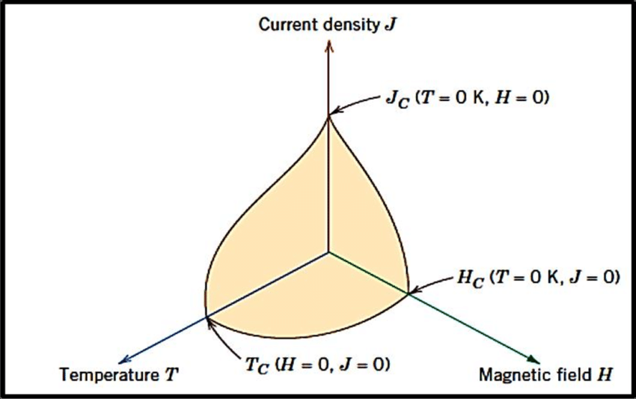
Superconductivity
https://cerncourier.com/a/superconductivity-and-the-lhc-the-early-days-2/
Below the critical temperature, the SC has zero resistance
Above the critical temperature, the SC has a very high resistance
→ the current prefer to flow in the copper

Slide 4
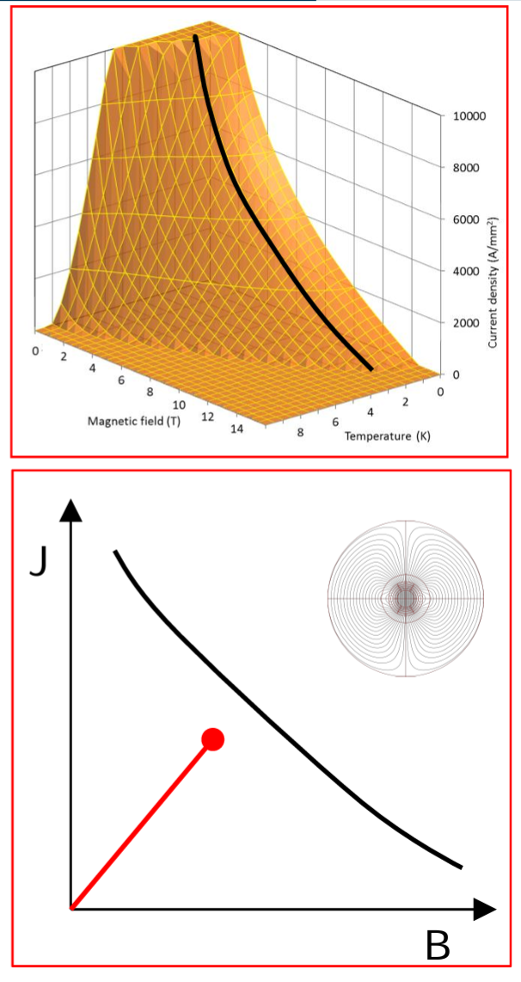
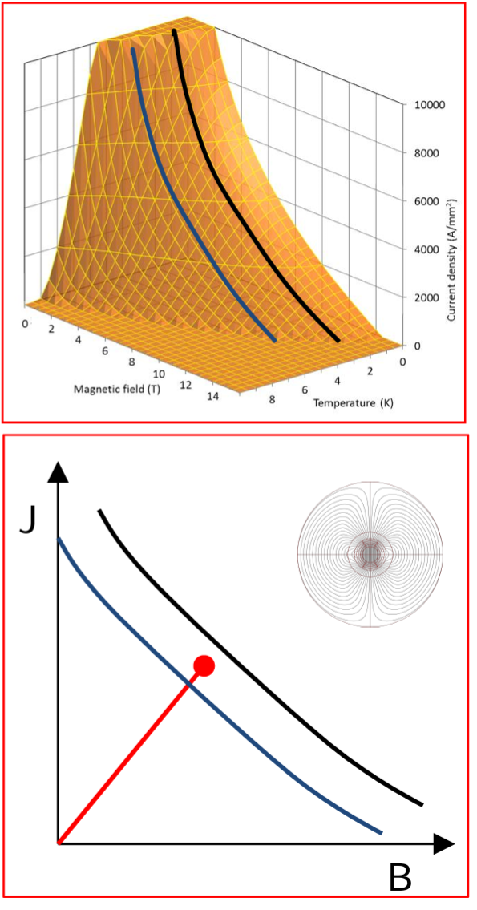
Superconductivity
P. Ferracin, Superconducting Magnets Section IV,
Joint Universities Accelerator School, 2024
In the design phase, we fix the temperature and select an operating point with a given margin (~20%)
If the temperature of the SC increases, we may eat up all the margin and loose superconductivity properties
→ quench
Margin
2 K
2 K
5 K

Slide 5
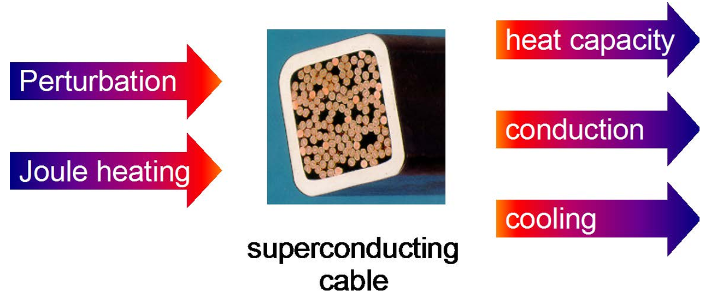
Superconductivity

Slide 6
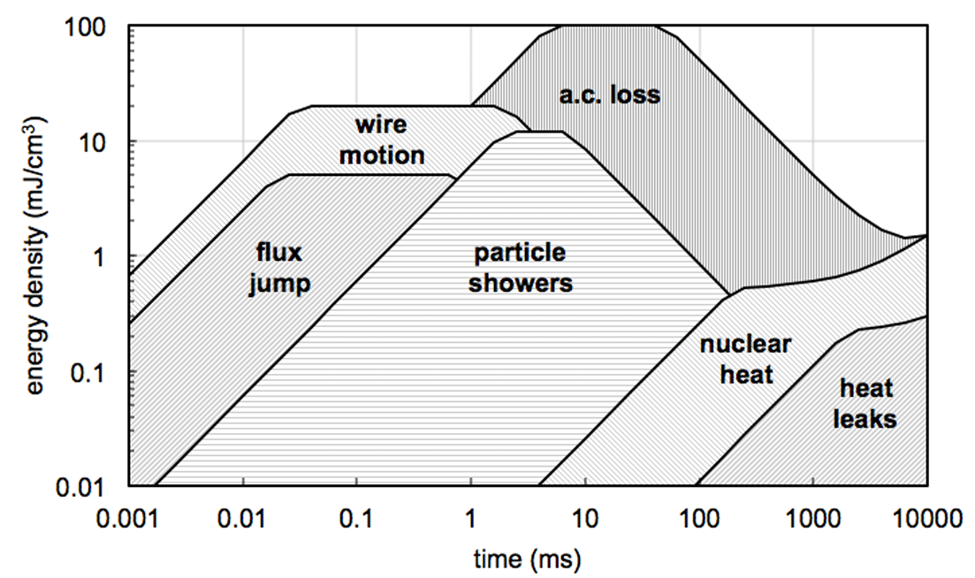
Superconductivity

Slide 7
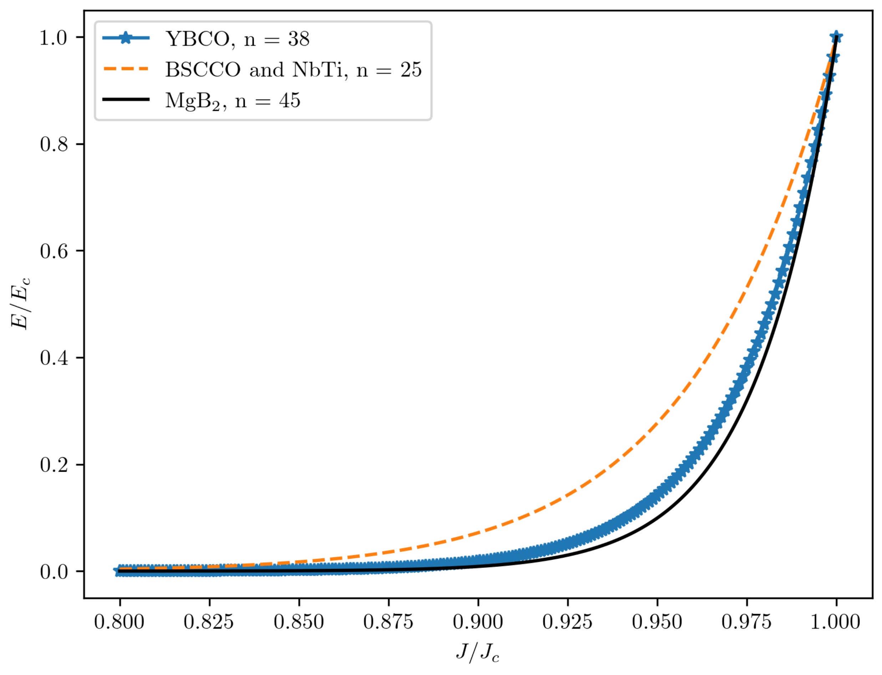
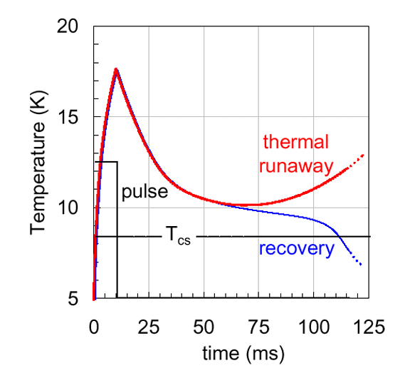
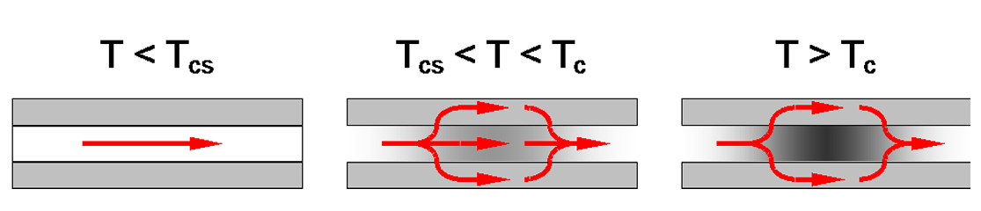
Superconductivity
Treshold to activate
the protection system
Santos BMO, Dias FJM, Trillaud F, Sotelo GG, de Andrade Junior R. A Review of Technology Readiness Levels for Superconducting Electric Machinery. Energies. 2023; 16(16):5955.
Tc → critical temperature
Tcs → temperature of current sharing
Above Tcs the current start following in the copper → Joule heating → Voltage increase

Slide 8
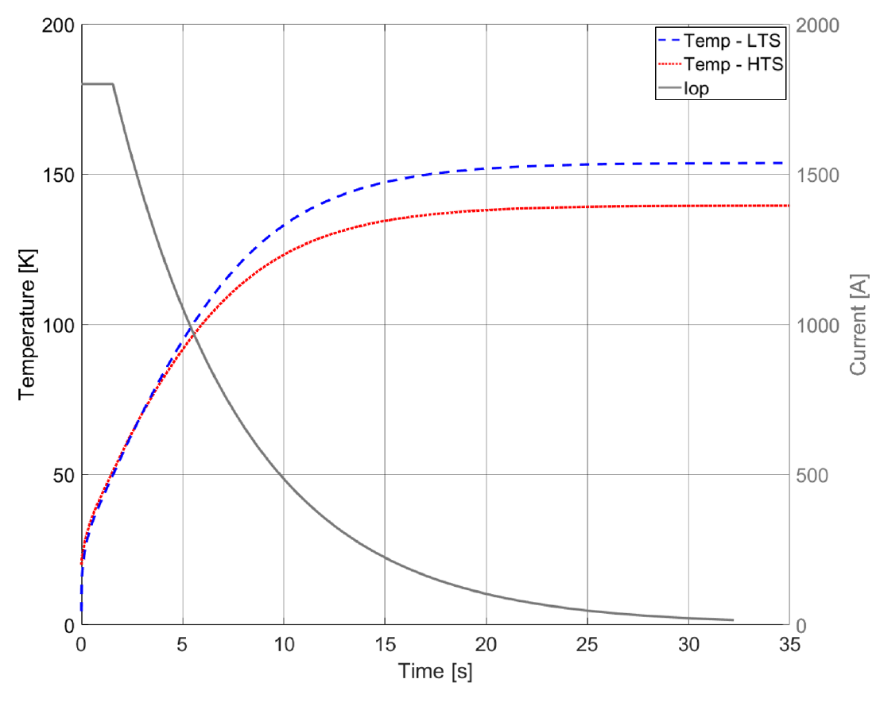
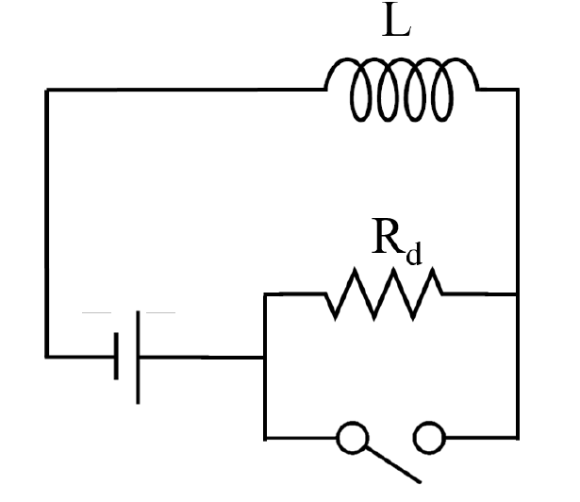


Superconductivity
$$I_{0}e^{−\frac{t}{τ}}$$
$$τ=\frac{L}{R_{d}}$$
A possible protection system is based on an external dump resistor.
When the voltage threshold value is reached, the current is discharged from the
SC magnet to an external resistor with a time constant.
It is crucial to verify the maximum temperature con the conductor to avoid irreversible damage.
E. Felcini, Analysis of a Novel Toroidal Configuration for Hadron Therapy Gantries, PhD thesis, EPFL, Lausanne, 2021

Slide 9
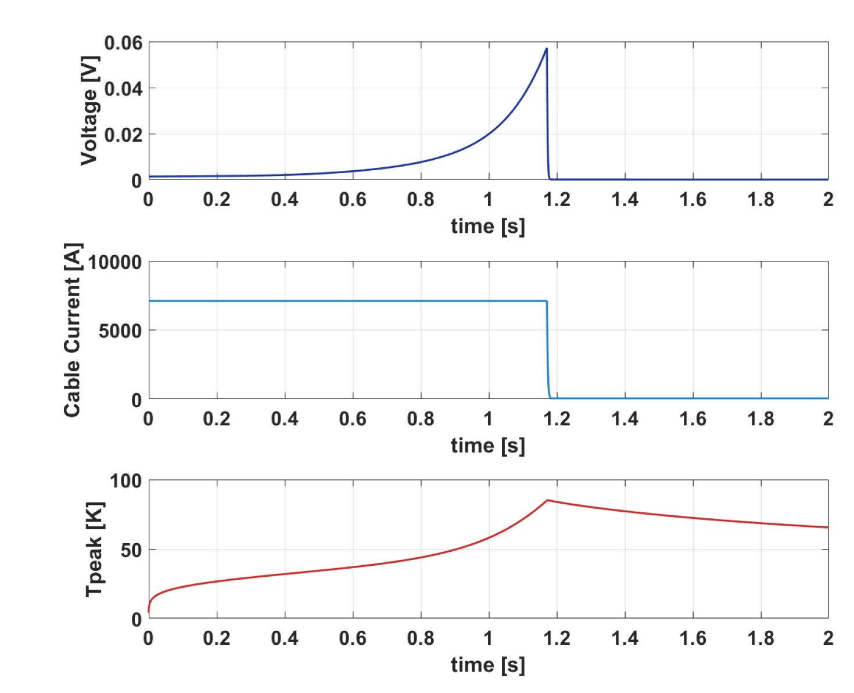
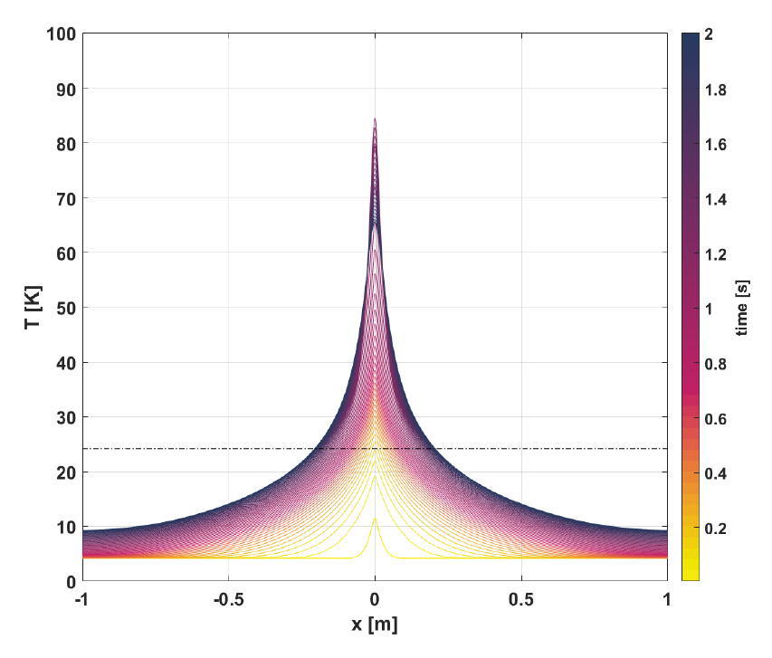
HTS conductor (“special case”)
• introduction of 1 cm defect in the centre of the cable
• adiabatic conditions
• one dimensional quench propagation (along the cable length)
• quench detection threshold set at 50 mV
• validation and reaction time of 20 ms
Superconductivity
E. Felcini, Analysis of a Novel Toroidal Configuration for Hadron Therapy Gantries, PhD thesis, EPFL, Lausanne, 2021

Slide 10
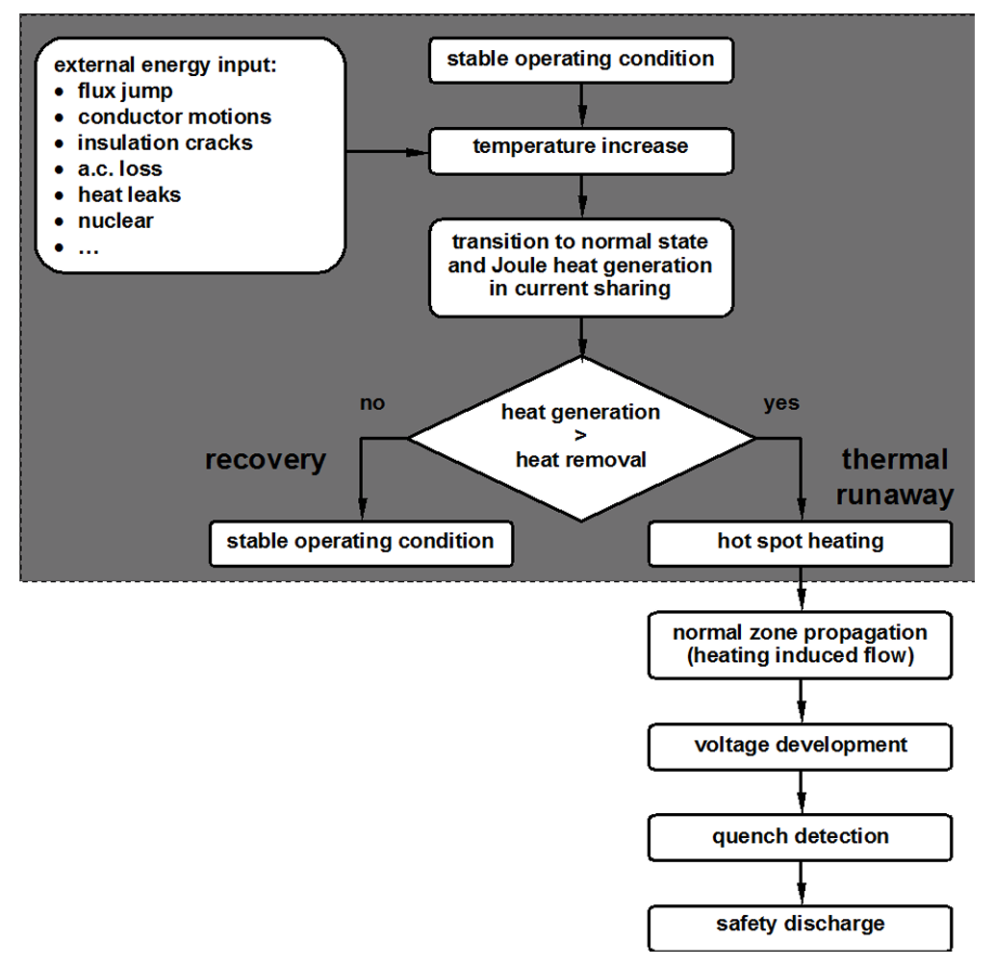
Superconductivity

