Slide 1
MC2NC
Report from Uta Bilow (IMC)

Slide 2
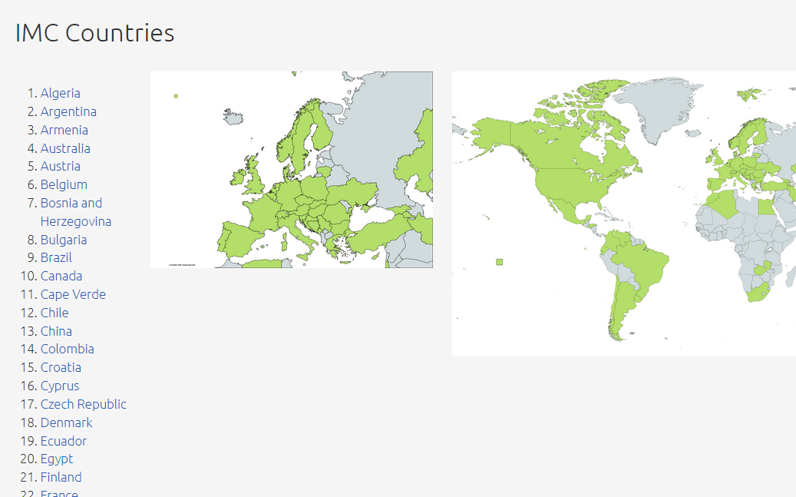
Overview of countries
New IMC presence on IPPOG website: https://ippog.org/imc-international-masterclasses
Overview of countries and institutes https://ippog.org/international-masterclasses/countries-and-institutes
List with 64 countries, from Algeria to Zambia
2 maps: world and Europe

Slide 3
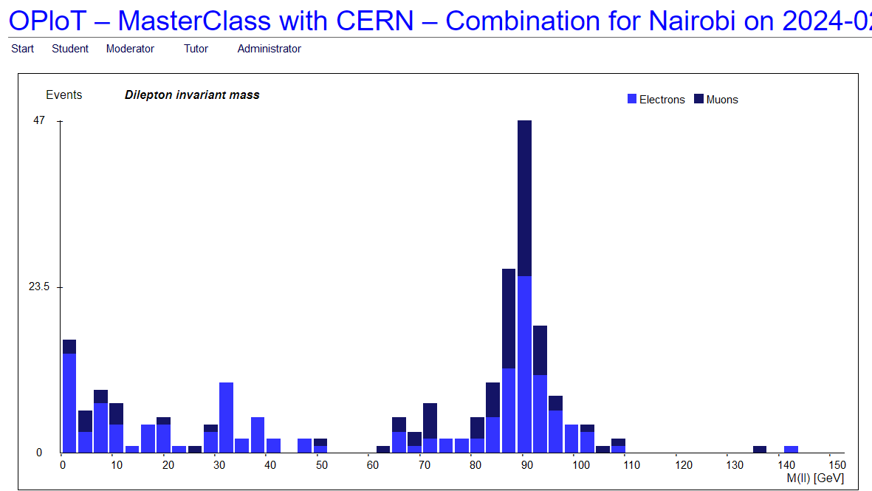
New countries in IMC24: Kenya
Kenyatta University of Nairobi
14 students on Feb 26, ATLAS Z Masterclass
Facilitated by Lydia Roos, ATLAS physicist, currently working with a few colleagues in Kenya
Need for earlier VC time (2 hours behind CET, transportation of pupils forbidden after 18:00)
The school we have invited is in a poor area of Nairobi. For most of the students, if not all of them, it was their first time using a computer. I think they did very well. They were extremely attentive and serious. CERN must look so strange to them, such a different world from their usual environment!
During the videoconference, it was quite striking how different was the behaviour of the students in Jerusalem, relaxed, at ease, and the behaviour of the students in Nairobi, very formal, very polite! Finally, we were quite lucky not to have any powercut yesterday nor serious internet issue.
I am willing to repeat this next year. We could even have two or more sessions if we can find more partners who can accomodate with our time constraints.

Slide 4
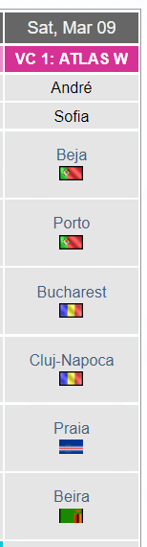
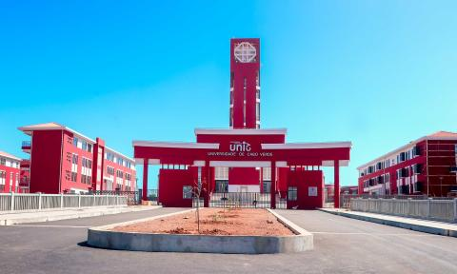
New countries in IMC24: Cape Verde
University of Cape Verde, Praia
90 students on March 9, ATLAS W Masterclass
Contact facilitated by Pedro
Pedro: „They had a problem with their data analysis. They did however participated in the videoconference.“

