Slide 1


Site and Civil Engineering Department
Technical Seminar
Automate for an excellent service
…delivered by your contractors!
CERN, 1st July 2024
Notes:
SCE Tech Seminars are a forum to exchange knowledge and to promote our work, internally and externally. That discussion is what we are looking for, so please prepare many questions, and save them for the end of the presentation!

Slide 2

Agenda
Introduction
Gyorgy BALAZS (SCE-SMS)
Managing network field support using only ServiceNow
Daniele POMPONI (IT-CS)
Integrated process across systems for Electrical&HVAC interventions Andrea FERRUS PICO, Guillaume ROUGE (SCE-SAM-IN)
Building components of accelerators using a well orchestrated workflow Wim WETERINGS (SY-AR)
(New!) ServiceNow + InforLN to manage external jobs and billing efficiently David MOLINER REYERO (SCE-SMS)
Q & A

Slide 3
Managing network field support using only ServiceNow
Daniele POMPONI (IT-CS)
01-07-2024
Notes:
Daniele Pomponi - Responsible for Network Operations and Datacenter Network Deployment in IT/CS.
Daniele oversees contract performance exclusively using powerful dashboards in ServiceNow, where data also provides the base for a simplified billing mechanism;

Slide 4


ServiceNow Work-Tasks
Reports and Dashboard
More granularity on the tasks carried out by the contractor.
Easy and transparent billing life-cycle for both parties.
Firstline contract background:
Reports and Dashboard
Based on standard tasks
A team of 12 technicians
Installation and maintenance of network and telephony equipment at CERN
24/7 support for critical IP and telephony networks
Work-Tasks
Templates
Record producers
Testing and automation
And so on …

Slide 5

How the Firstline interacts with ServiceNow
USERS
MONITORING
2ND LINE SUPPORT
IT-CS
SNOW TICKET
SNOW TICKET
TI OPERATORS
FIRSTLINE

Slide 6
How the Firstline interacts with ServiceNow
USERS
MONITORING
2ND LINE SUPPORT
IT-CS
SNOW TICKET
SNOW TICKET
TI OPERATORS
FIRSTLINE

Slide 7
How the Firstline interacts with ServiceNow
USERS
MONITORING
2ND LINE SUPPORT
IT-CS
SNOW TICKET
SNOW TICKET
SNOW TICKET
TI OPERATORS
FIRSTLINE

Slide 8
Why Service-Now Work-Tasks?
Granularity: we have a record of each standard task applied by the contractor to fulfil the SNOW ticket.
SNOW TICKET
Consistency with time: the status (open/closed) of each work-task it is independent from the other work-tasks and from the SNOW ticket itself.
WORK TASK ID 1
Amount of task ID 1
Total time task ID 1
+
+
WORK TASK ID 2
Amount of task ID 2
Total time task ID 2
+
+
WORK TASK ID 3
Amount of task ID 3
Total time task ID 3
=
=
Transparency: total task / time claimed by the contractor to fulfil the SNOW Ticket

Slide 9
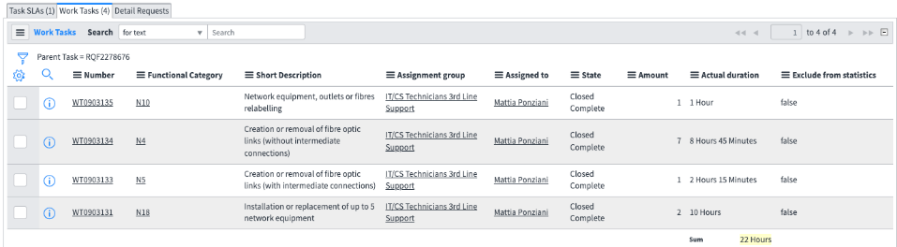
Real example: SNOW request to install, cable, configure and label 7 network switches in the computer centre.
1
2
3
4
5
6
7
1
Amount of time that a given standard task has been applied
RQF2278676: main SNOW
Work-task for each different standard task applied to fulfil SNOW request
5
2
Time of the corresponding standard-task defined in the contract S268, multiplied by the amount of time that the given task has been applied to fulfil the request
Standard-task defined in the contract S268
6
3
Excluded from statistics flag used in case of human mistake during the creation of WT: allowed only to FE functional managers
Standalone state (open/closed) for each work-task linked to the parent ticket
4
7

Slide 10
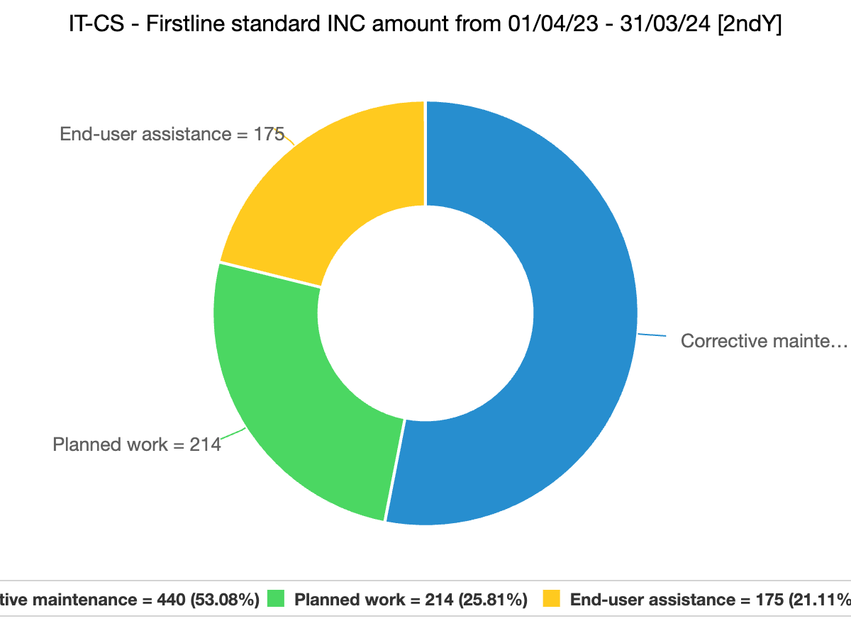
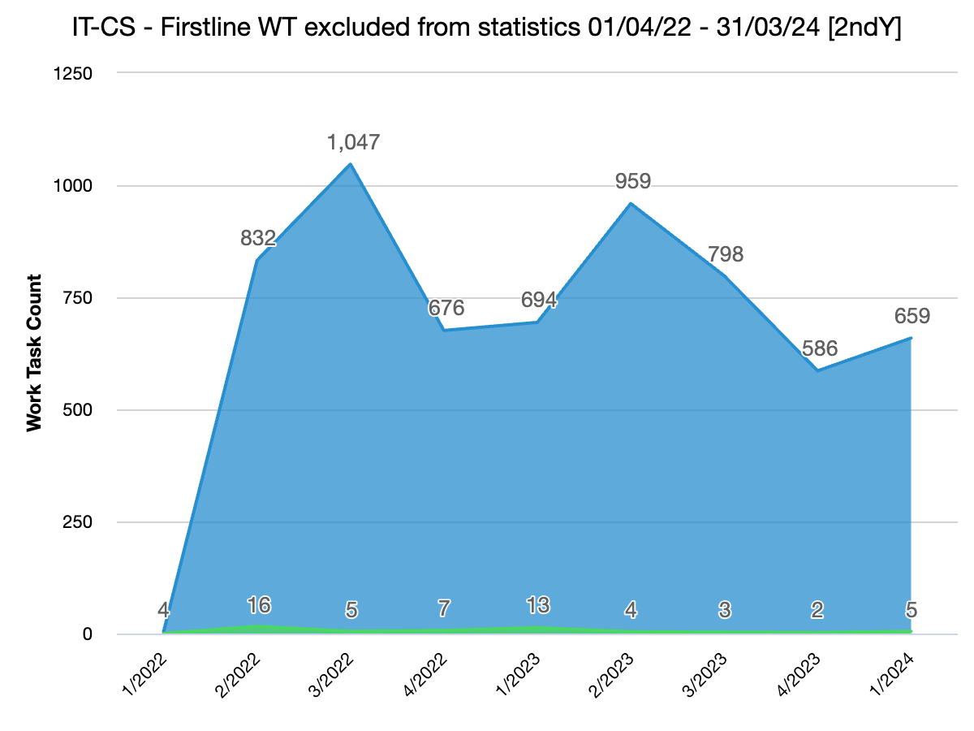
Work-task automation and data validation
The creation of work-tasks can be automated for tickets generated through a record producer.
Work-tasks can be easily inspected with reports acting as sanity checks.
During the second year of contract S268, thanks to this automation 830 WORK-TASKS have been generated automatically without additional administrative clicks on the contractor side.
During the first year of contract S268, only 41 WTs out of 3293 have been flagged as “exclude from statistics” (1.25%) – last year only 14 WTs out of 3017 (0.46%)

Slide 11
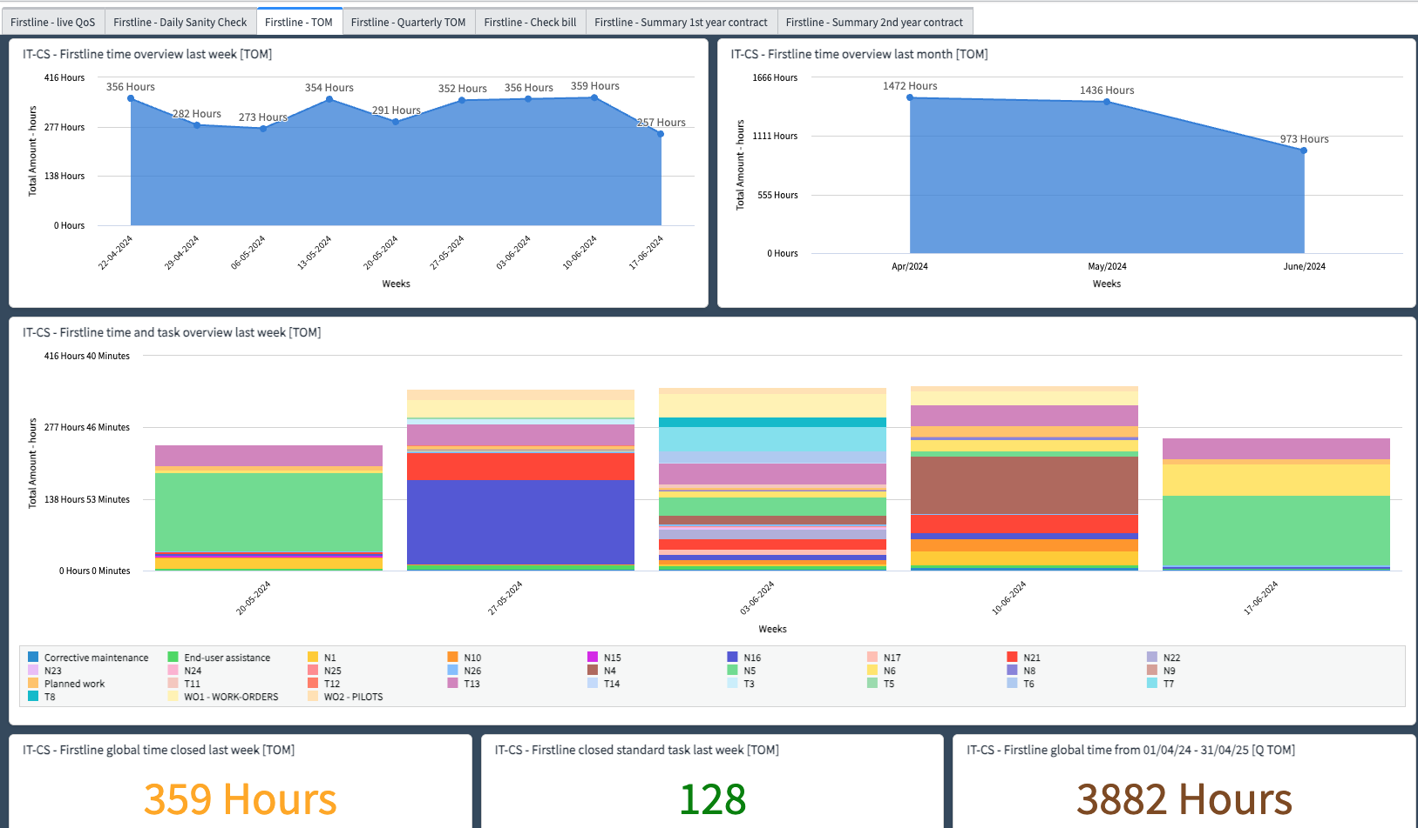
Overall view thanks to ServiceNow Dashboards

Slide 12
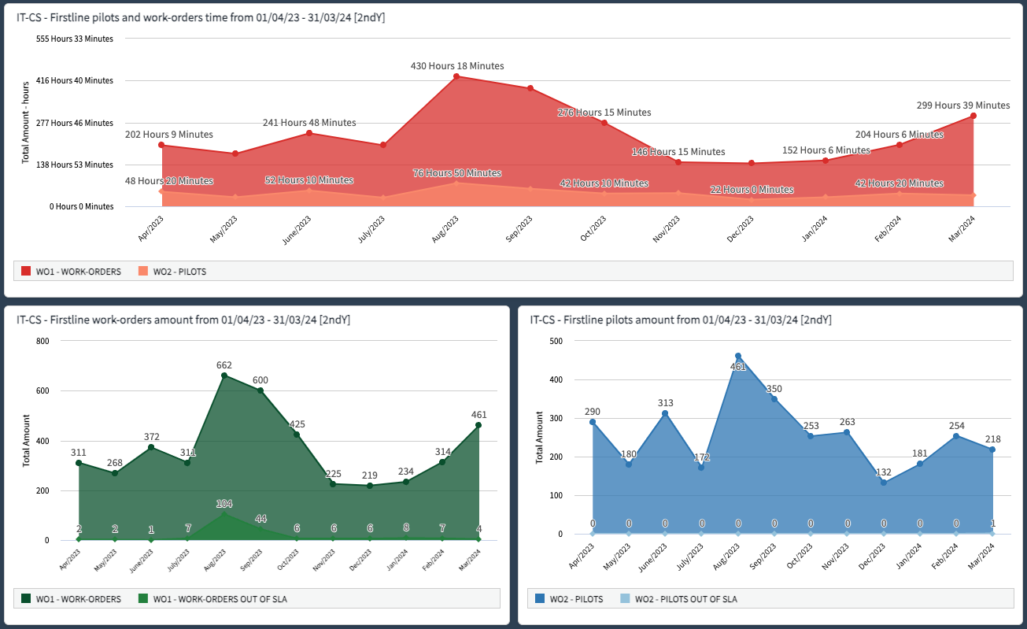
Statistics about connection requests:

Slide 13
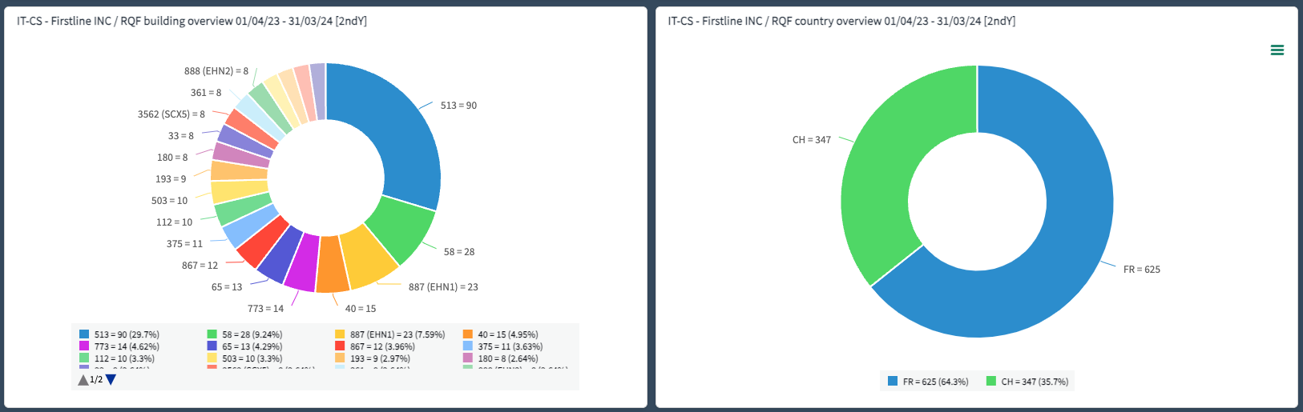
Statistics about locations:

Slide 14

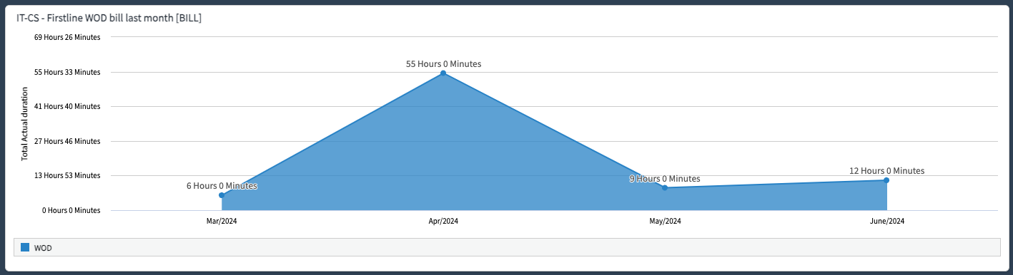
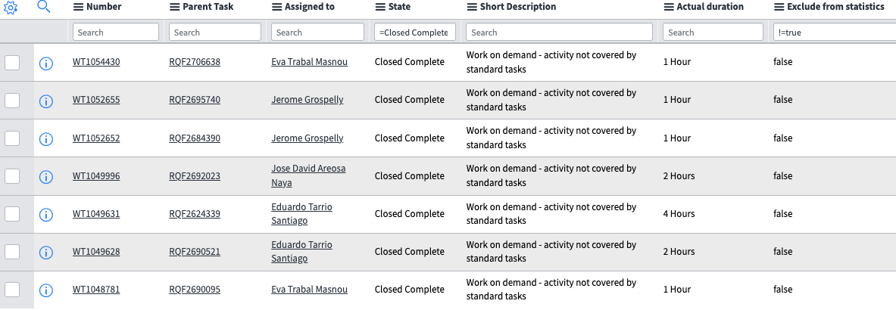
Easy and transparent billing life-cycle for both parties
START
Monthly bill sent by the contractor claiming for a
certain amount of money justified by 12 hours.
Delivery Acceptance (RECEP)
Does it match with SNOW?
NO
YES
Analyse the data and solve the inconsistency
Sign EDH (OSVC)
END
= 12

Slide 15
Our opinion after two years
Work-tasks have proven to be a perfect solution to have the right granularity where a ticket requires multiple tasks to be fulfilled, and the administrative part remains easily manageable.
Dashboards are user-friendly: easy to build and maintain. With a solid base of data present in SNOW we can keep everything under control efficiently.
Dashboards have proven to be an added value for both parties: our group and the contractor.
This tool is used daily as a single source of truth to constantly monitor activities and performance from both users (QoS) and contractual point of view (SLAs and Billing life-cycle).
We strongly believe that this type of contract management approach will also have a positive impact when defining the requirements for future contractor tenders. We will be able to make predictions on the type of tasks more precisely and consequently optimize costs and management.

Slide 16
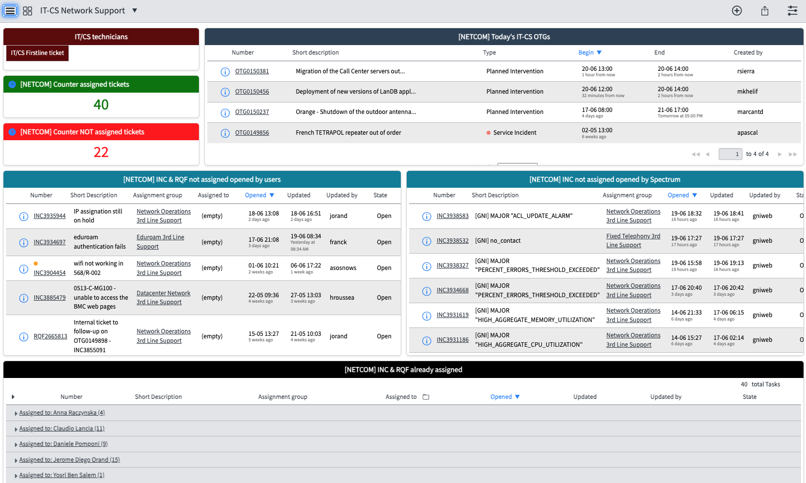
Dashboards: not only to monitor contractors!

Slide 17
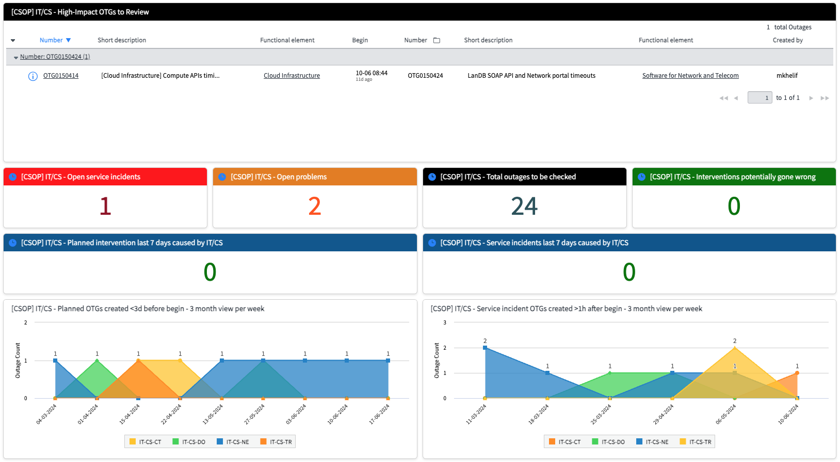
Dashboards: not only to monitor contractors!

Slide 18

Thanks for your attention!
Thanks to:
G. Blazas (SCE-SMS)
N. Kane (IT-TD-SM)
F. Trevisani (IT-TD-SM)

Slide 19
Integrated process across systems for Electrical & HVAC interventions
Guillaume Fernand Rouge (SCE-SAM-IN), Andrea Ferrus Pico (SCE-SAM-IN)
01/07/2024
Notes:
Guillaume Rouge - Manager of the Cooling and Ventilation contract in SCE-SAM
Andrea Ferrus Pico - Mechanical Engineer in the Cooling and Ventilation team of SCE-SAM
Our colleagues in SAM/IN rely on high level of automation across ServiceNow, EAM and billing to keep their clients up to date, manage contract performance and related finances;

Slide 20
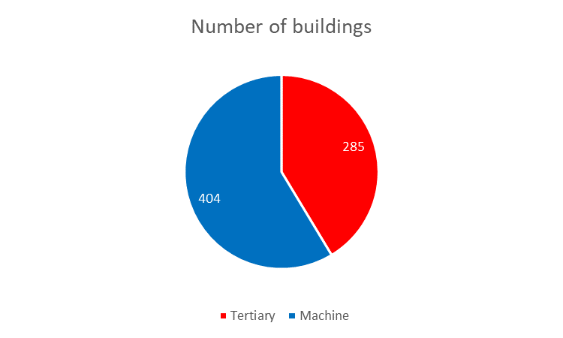
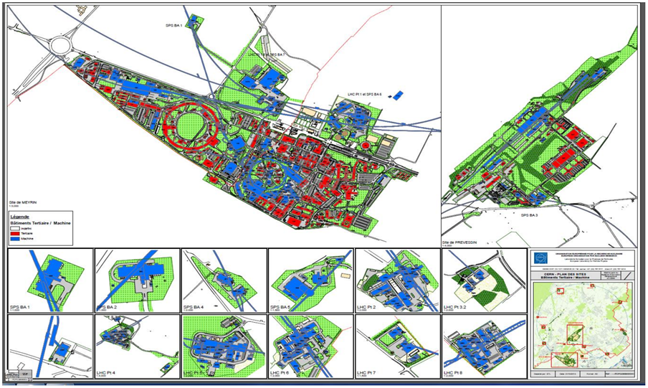
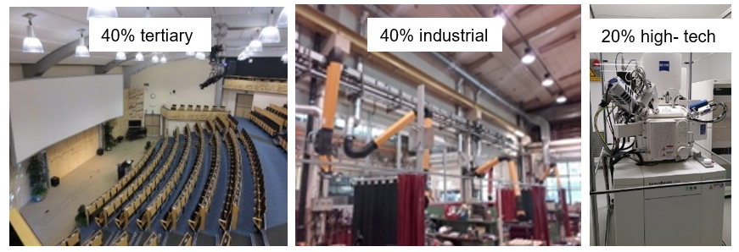
Mandate
  SCE-SAM-IN section is in charge of the design, specification,
  tendering, works follow up, tests, acceptance, operation,
  and maintenance, in the following fields:
    HVAC (Heating, Ventilation, Cooling, air conditioning, specific extraction)
    Fluids (water cooling, compressed air, gas, fire fighting, filling)
    Electricity (power distribution, lighting, machine powering)
    Sanitary (drinking water, domestic water, solar panels, water fountains, safety)
For CERN «tertiary» buildings

Slide 21
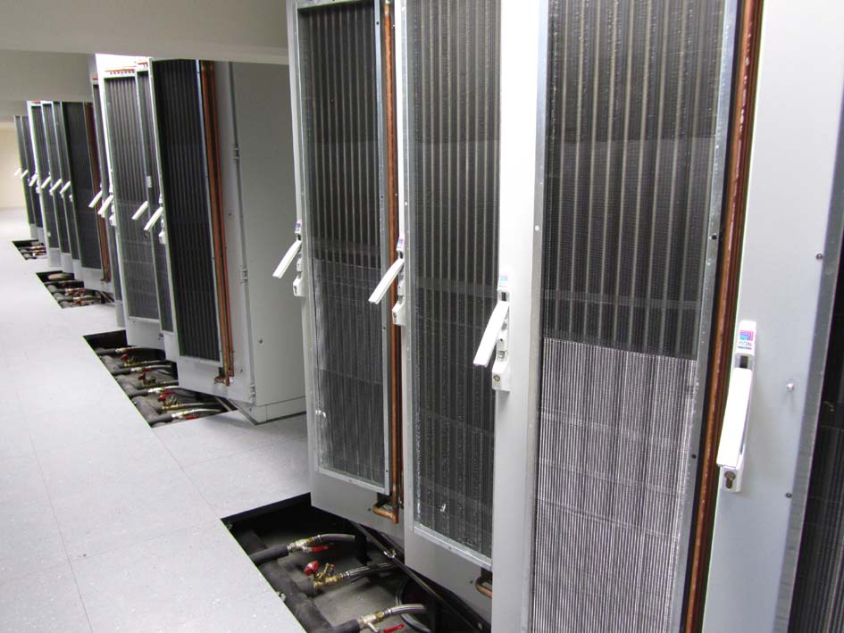
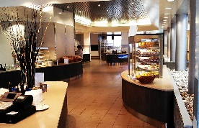
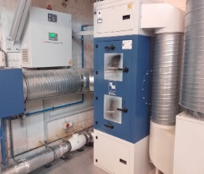
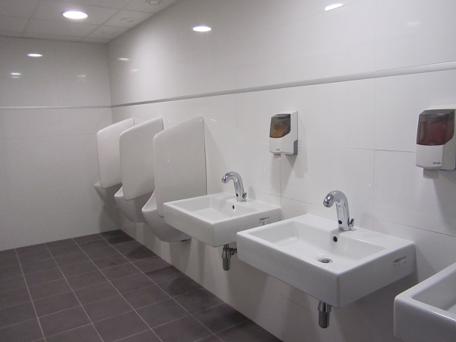
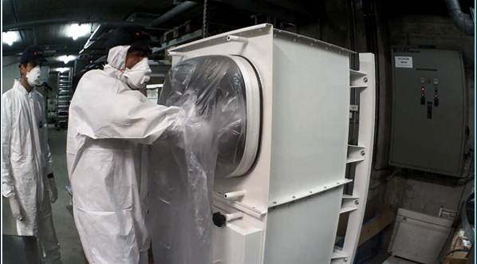
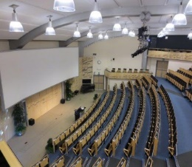
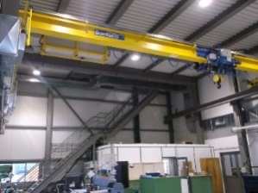
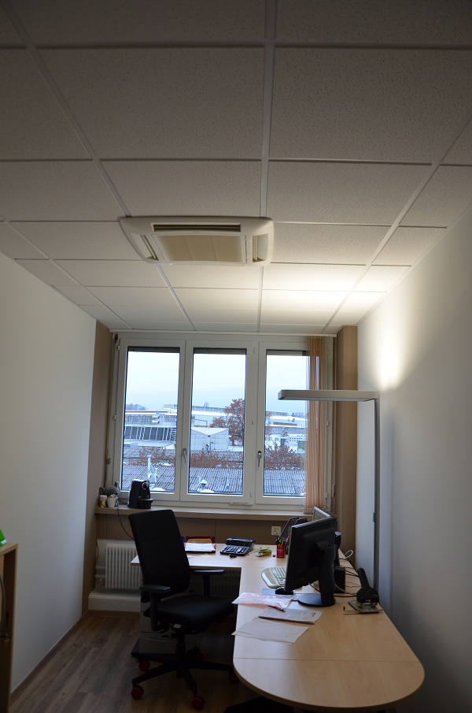
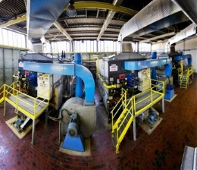
HVAC, SANITARY & ELECTRICAL Domains
Heating plants, district heating and heating circuits,
Chilled water productions and a/c units,
Ventilation systems,
Compressed air distribution,
Hot domestic water production,
Water distribution, sanitary devices, solar panels,
Electrical power and control boards and plcs,
Indoor lighting and public lighting,
Electrical power systems and sockets.
350 structures and baraques,
1 children school, 3 restaurants, 3 hotels (495 rooms) 150 meeting & conference rooms
100 workshops, 400 labs
30 clean rooms, 20 RP areas and source labs.
2 heating plants, 6 boilers.
27 km district heating.
100 heating sub-stations
200 domestic hot water productions
100 000 lighting points
500 AHUs, 350 extraction fans
70 chillers, 500 split systems
1000 electric boards.

Slide 22
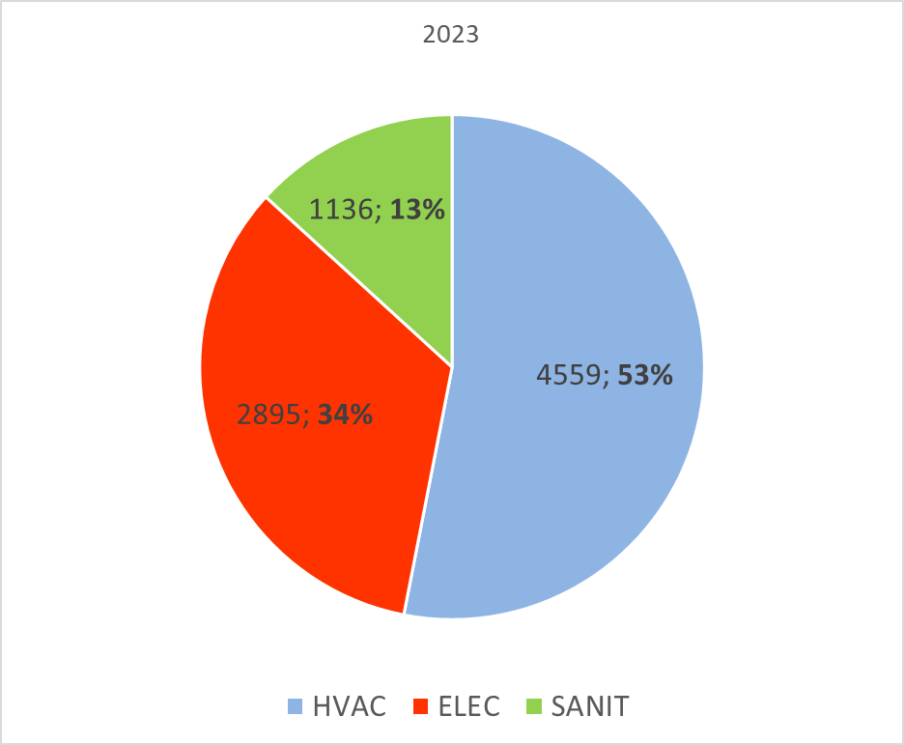
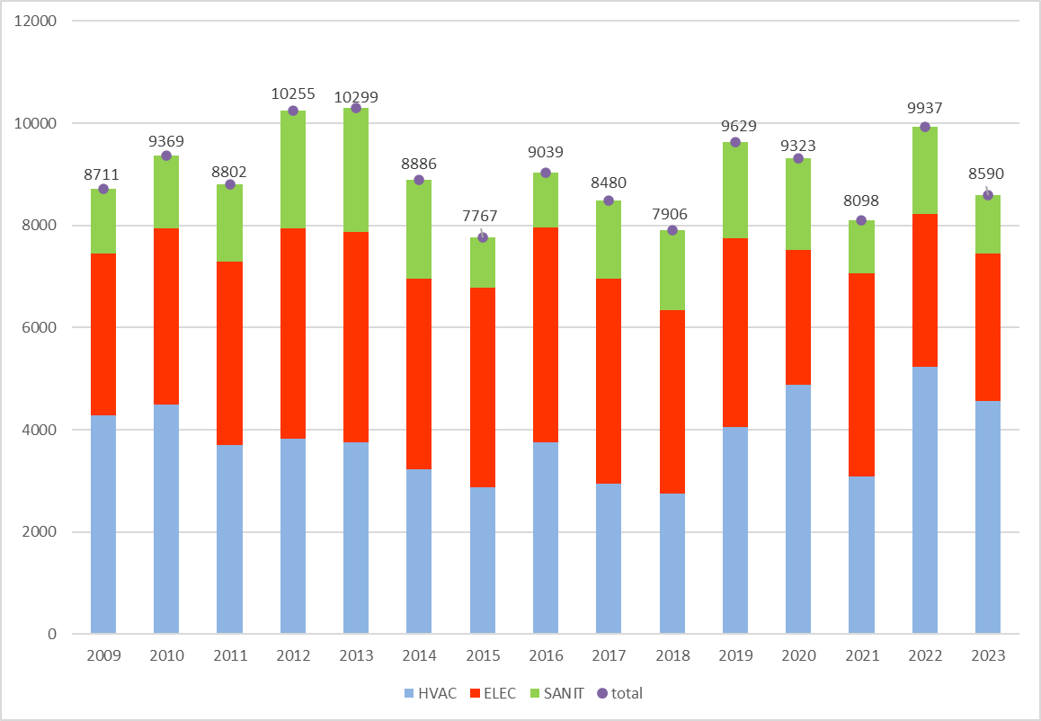
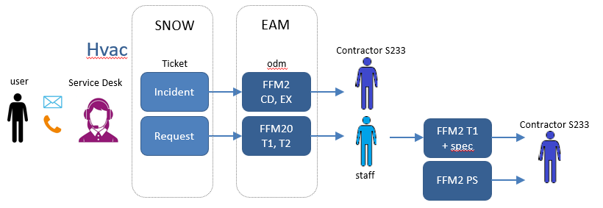
Service: number of ODMs (<> tickets)
TOTAL NUMBER OF WOs in 2023: 8583 WOs
TOTAL NUMBER OF WOs/year
Incidents
Request
Preventive maintenance
Works and modifications
Consolidation
Projects, new buildings

Slide 23










Workflow tickets and WOs with automated messages
Service Desk
SCE-SAM-IN & Contractor(s)
TICKET
WO
TICKET lifecycle
Service Desk
Service Now
Incident INC
Request RQF
WO lifecycle
SCE/SAM-IN & Contractor
Your request has been registered.
A technician should start intervening on site within 8 working hours (INC)/5 working days (RQF).
REGISTRATION
USER
R
A user has a problem (incident) or request related to Electrical, HVAC or Sanitary Systems for tertiary buildings.
The service provider has informed us that spare parts are needed to resolve your request.
The parts will be ordered and will be installed as soon as possible once they are delivered on site.
If PROBLEMS
RADP
RAD
RADC
The intervention has been postponed due to a technical problem. The intervention shall be rescheduled as soon as possible.
2nd line
START
The technician has just started intervening on site.
RADT
RC
RADV
END
RTE
The contractor has informed us that your request has been resolved.
If you consider the solution provided does not meet your expectations, please re-open the ticket.
RT
RTI
RMAJ

Slide 24







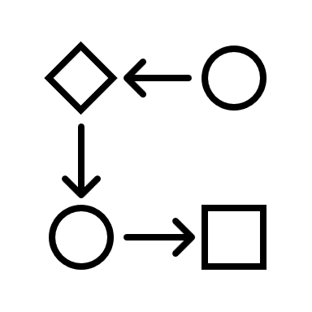
Pros, Cons and their future actions
Improved responsiveness and keep fluent communication with the requester.
Complex process.
ACTION
Documentation, revision and process maintenance.
Reduction in communication errors.
Loss of visibility in the second line.
Traceability.
To improve the 2nd line management process.
ACTION

Slide 25
SY Departmental Service Support
Wim WETERINGS (SY-AR)
01-07-2024
Notes:
Wim Weterings - DGL of Administration and Resources group in SY dep, SY Industrial Service Contract Coordinator
The SY Departmental Service Support (DSS) contract managed by Wim requires efficient routing of requests for estimates and approvals across various stakeholders before executing works, relying on smart workflows in an integrated tool set; Building components of accelerators using a well orchestrated workflow

Slide 26
SY Departmental Service Support (DSS)
The DSS S264/SY contract started in July 2022
With Services divided into 2 distinct Competencies:
Mechanical Departmental Services M-DSS
Electrical/Electronic Departmental Services M-DSS
Manufacturing | Construction | Logistics Inventory, etc. | Electrical assembly | Controls & Electronics | Stand-by Interventions
DSS workforce grouped by Competency and execute the requested Services within the whole SY department.
Each DSS Service has a specific hourly rate and DSS personnel is invoiced on performed Services and not qualification (as was for FSU).

Slide 27
Mechanical Departmental Service Support (M-DSS)
Activities | Services | Description
Manufacturing machining, turning and milling with traditional and CNC machines, sheet metal work, welding and fitting of (stainless) steel, copper, brass and non-metallic materials | MM1 | Conventional Machining
 | MM2 | Non-Conventional Machining
 | MM3 | Sheet Metal Work
 | MM4 | Joining Techniques
 | MM5 | Work-shop supervision
Construction assembly, maintenance, and installation of a large variation of accelerator technical systems | MC1 | General Assembly
 | MC2 | Cleanroom Assembly
 | MC3 | Electro-Mechanical Assembly
Other Activities logistics, inventory, test bench preparation and Ultra High Vacuum (UHV) related activities | MO1 | Logistics, Inventory & Storage
 | MO2 | Test Benches & Instrumentation
 | MO3 | Vacuum Activities
Supervision | DSS-TEM | Technical management of the DSS

Slide 28
Electrical/Electronic Departmental Service Support (E-DSS)
Activities | Services | Description
Controls & Electrical Assembly assembly, electrical cabling, maintenance and installation of control chassis, racks and electrical installations | EC1 | Controls Systems Assembly
 | EC2 | Controls Systems Wiring
 | EC3 | Testing and debugging
 | EC4 | Electrical Assembly
Electronics assembly, maintenance, installation, measurements and testing of electronics components and printed circuit boards | EE1 | Acquisition Systems
 | EE2 | PCB & SMD work
 | EE3 | Testing and debugging
Interventions lock-in and lock-out procedures and first line intervention of electrical installations | EI0 | 24/7 Stand-by Servicey of 2 workers
 | EI1 | Intervention electrical installations
 | EI2 | Lock-in/out electrical installations
 | EI3 | Preventive & Corrective Maintenance
 | EI4 | Reporting
Other Activities logistics, inventory, spare parts management, documentation and test bench preparation | EO1 | Logistics, Inventory & Storage
 | EO2 | Test Benches & Instrumentation
 | EO3 | Documentation
Supervision | DSS-TEM | Technical management of the DSS

Slide 29
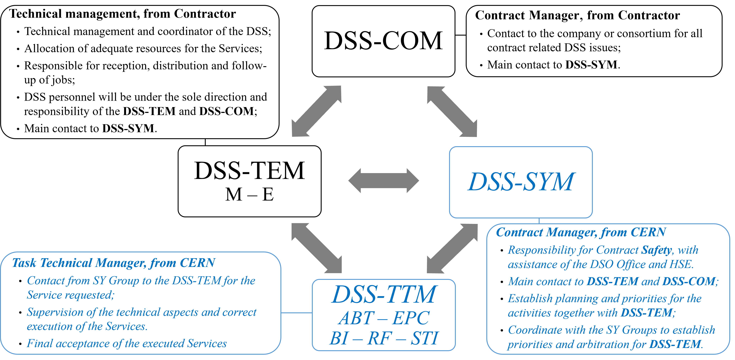
Management and Supervision

Slide 30
Contractor’s organisation & roles
DSS-COM
Deputy DSS-COM
M-DSS-TEM 2
E-DSS-TEM 1
E-DSS-TEM 2
Manufacturing
Construction
Controls & Electronics
Electrical Systems
Finance Administration
Safety
M-DSS-TEM 1
Human Resources
30

Slide 31
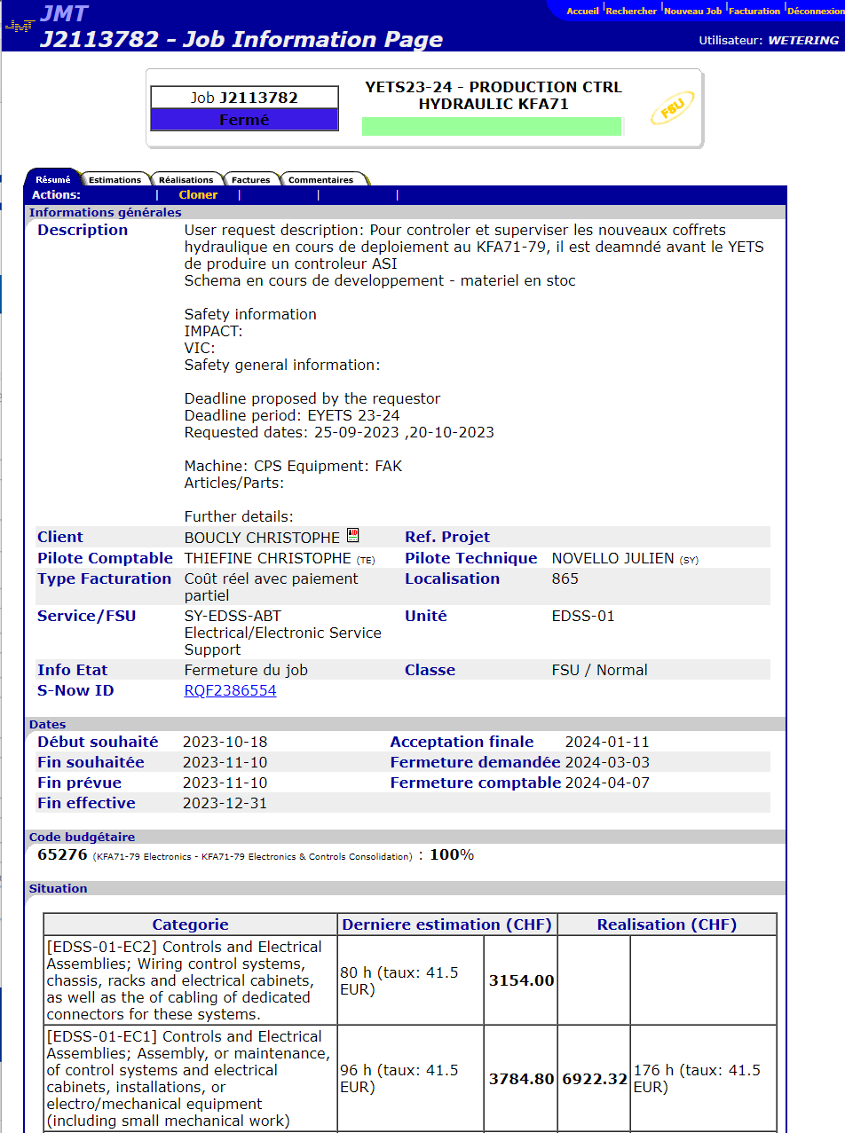
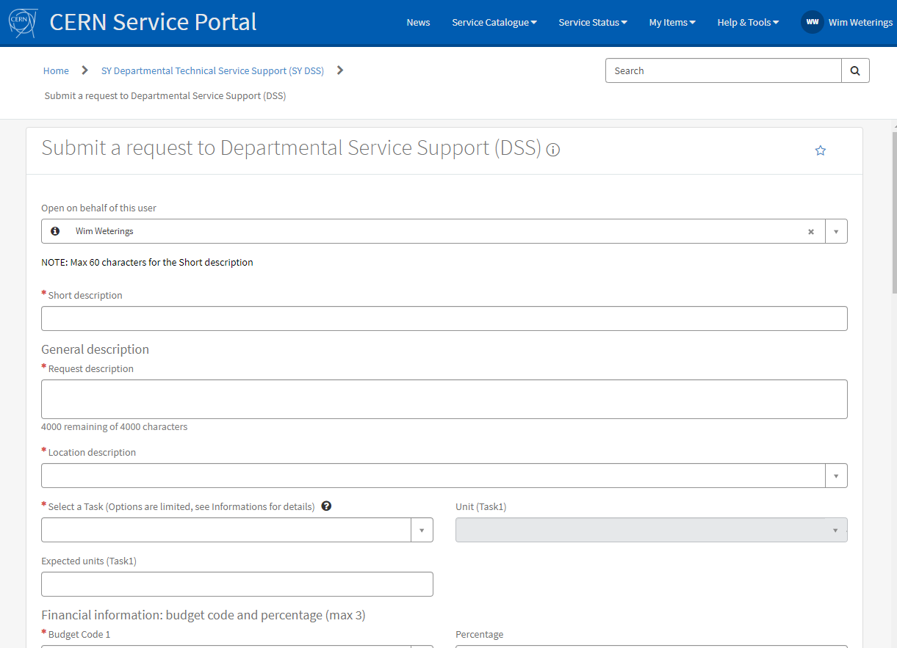
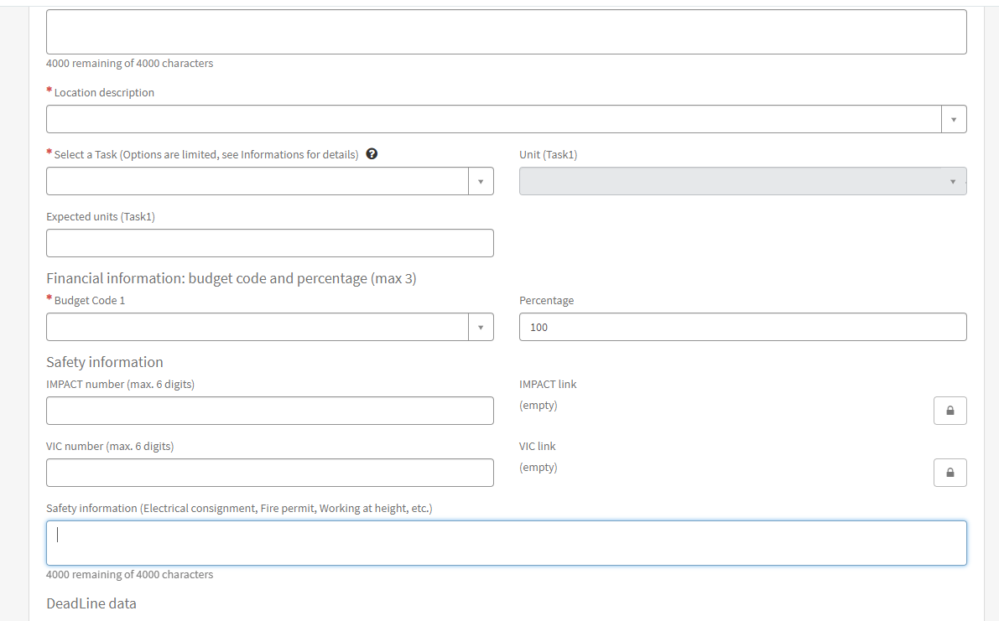
Jobs via SNow to JMT

Slide 32
Job request Workflow
SY Client
DSS-COM
B&S Administration
M-DSS-TEM 1 (Manufacturing)
M-DSS-TEM 2 (Construction)
E-DSS-TEM 1 (Controls & Electronics)
E-DSS-TEM 2 (Electrical Systems)
M-DSS-TTM
(SY Group Technical Task Manager)
M-DSS-TTM
(SY Group Technical Task Manager)
Creation of JMT Job
Request for Services is made by SY client by filling in the dedicated SNow form, stipulating:
DSS-TEM estimates:
JMT job is created:
Job description
Budget code(s)
IMPACT / VIC / Safety
Start / End date
INFOR (SY-ABT only)
Requested Services:
MM1, MM2, etc
or
EC1, EC2, etc.
Required number of hours per activity
and
Start / End date
The SNow ticket routing automatically set for:
Functional Element
Assignment Group
Depending the request:
M-DSS
or
E-DSS
and
SY Group structure
But DSS-COM can change routing (absence of TEM, etc.)
Manual routing to EDH (done by B&S)
Communication during Job execution via SNow ticket
Partial monthly invoicing on progress
Acceptance will close JMT Job and SNow ticket
DSS-TTM can:
Refuse the estimate;
→ ticket will go back to M-DSS-TEM for re-evaluation
Accept the estimate:
→ ticket is pushed to JMT to create Job
SY Client
DSS-COM
B&S Administration
M-DSS-TEM 1 (Manufacturing)
M-DSS-TEM 2 (Construction)
E-DSS-TEM 1 (Controls & Electronics)
E-DSS-TEM 2 (Electrical Systems)
M-DSS-TTM
(SY Group Technical Task Manager)
M-DSS-TTM
(SY Group Technical Task Manager)
Creation of JMT Job
Request for Services is made by SY client by filling in the dedicated Snow form, stipulating:
DSS-TEM estimates:
JMT job is created:
Job description
Budget code(s)
IMPACT / VIC / Safety
Start / End date
INFOR (SY-ABT only)
Requested Services:
MM1, MM2, etc
or
EC1, EC2, etc.
Required number of hours per activity
and
Start / End date
The Snow ticket routing automatically set for:
Functional Element
Assignment Group
Depending the request:
M-DSS
or
E-DSS
and
SY Group structure
But DSS-COM can change routing (absence of TEM, etc.)
Manual routing to EDH (done by B&S)
Communication during Job execution via Snow ticket
Partial monthly invoicing on progress
Acceptance will close JMT Job and Snow ticket
DSS-TTM can:
Refuse the estimate;
→ ticket will go back to M-DSS-TEM for re-evaluation
Accept the estimate:
→ ticket is pushed to JMT to create Job
Refuse
Accept
Refuse
Accept
TEM - 3rd Line Support
TTM – 2nd Line Support
TEM - 2nd Line Support
TEM - 3rd Line Support
TTM – 2nd Line Support
TEM - 2nd Line Support

Slide 33
Conclusion
SY department started a new Departmental Service Support (DSS) contract 07/2022
Replacing the previous FSU contracts in SY
Services are divided in distinct competencies and linked activities
SY Clients request services via a SNow Ticket
  Routing of the ticket depends on requested services and client group
  Contractor makes the estimate of required hours and planned dates in SNow
  CERN accepts or declines the estimate in SNow
Upon acceptance in SNow, a JMT job is automatically created
  EDH approval, follow-up of executed hours, invoicing, etc. in JMT
  Client communication in SNow
  Acceptance of job in JMT closes SNow tickety

Slide 34
ServiceNow INFOR LN to manage external jobs and billing efficiently
David MOLINER REYERO (SCE-SMS)
01-07-2024
Notes:
David Moliner - Service-Now developer in SMS
David will present the upcoming integration of ServiceNow to InforLN to manage all aspects of jobs executed by contractors, providing upgraded replacement for the existing Job Management Tool (JMT).

Slide 35
INFOR LN
ERP (Enterprise Resource Planning) software developed by Infor
Used at CERN to manage the supply chain
Its use is being extended to work with external contractors
(replacing JMT)

Slide 36
Use cases
Creation of Service Orders directly in INFOR LN
Creation through ServiceNow
  User does not need to know how to use INFOR LN
  No need to know all the information required to create a Service Order
    Communication between the user and the support group
    Supporters can complete the missing data and automatically send it to INFOR LN

Slide 37
DEMO
Still under development

Slide 38
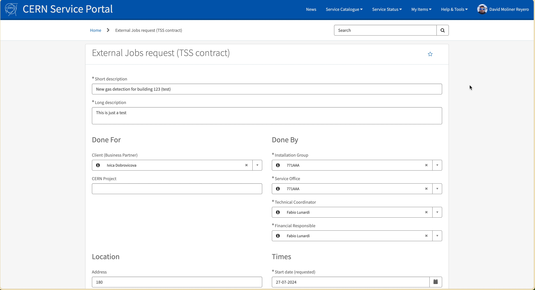

Slide 39
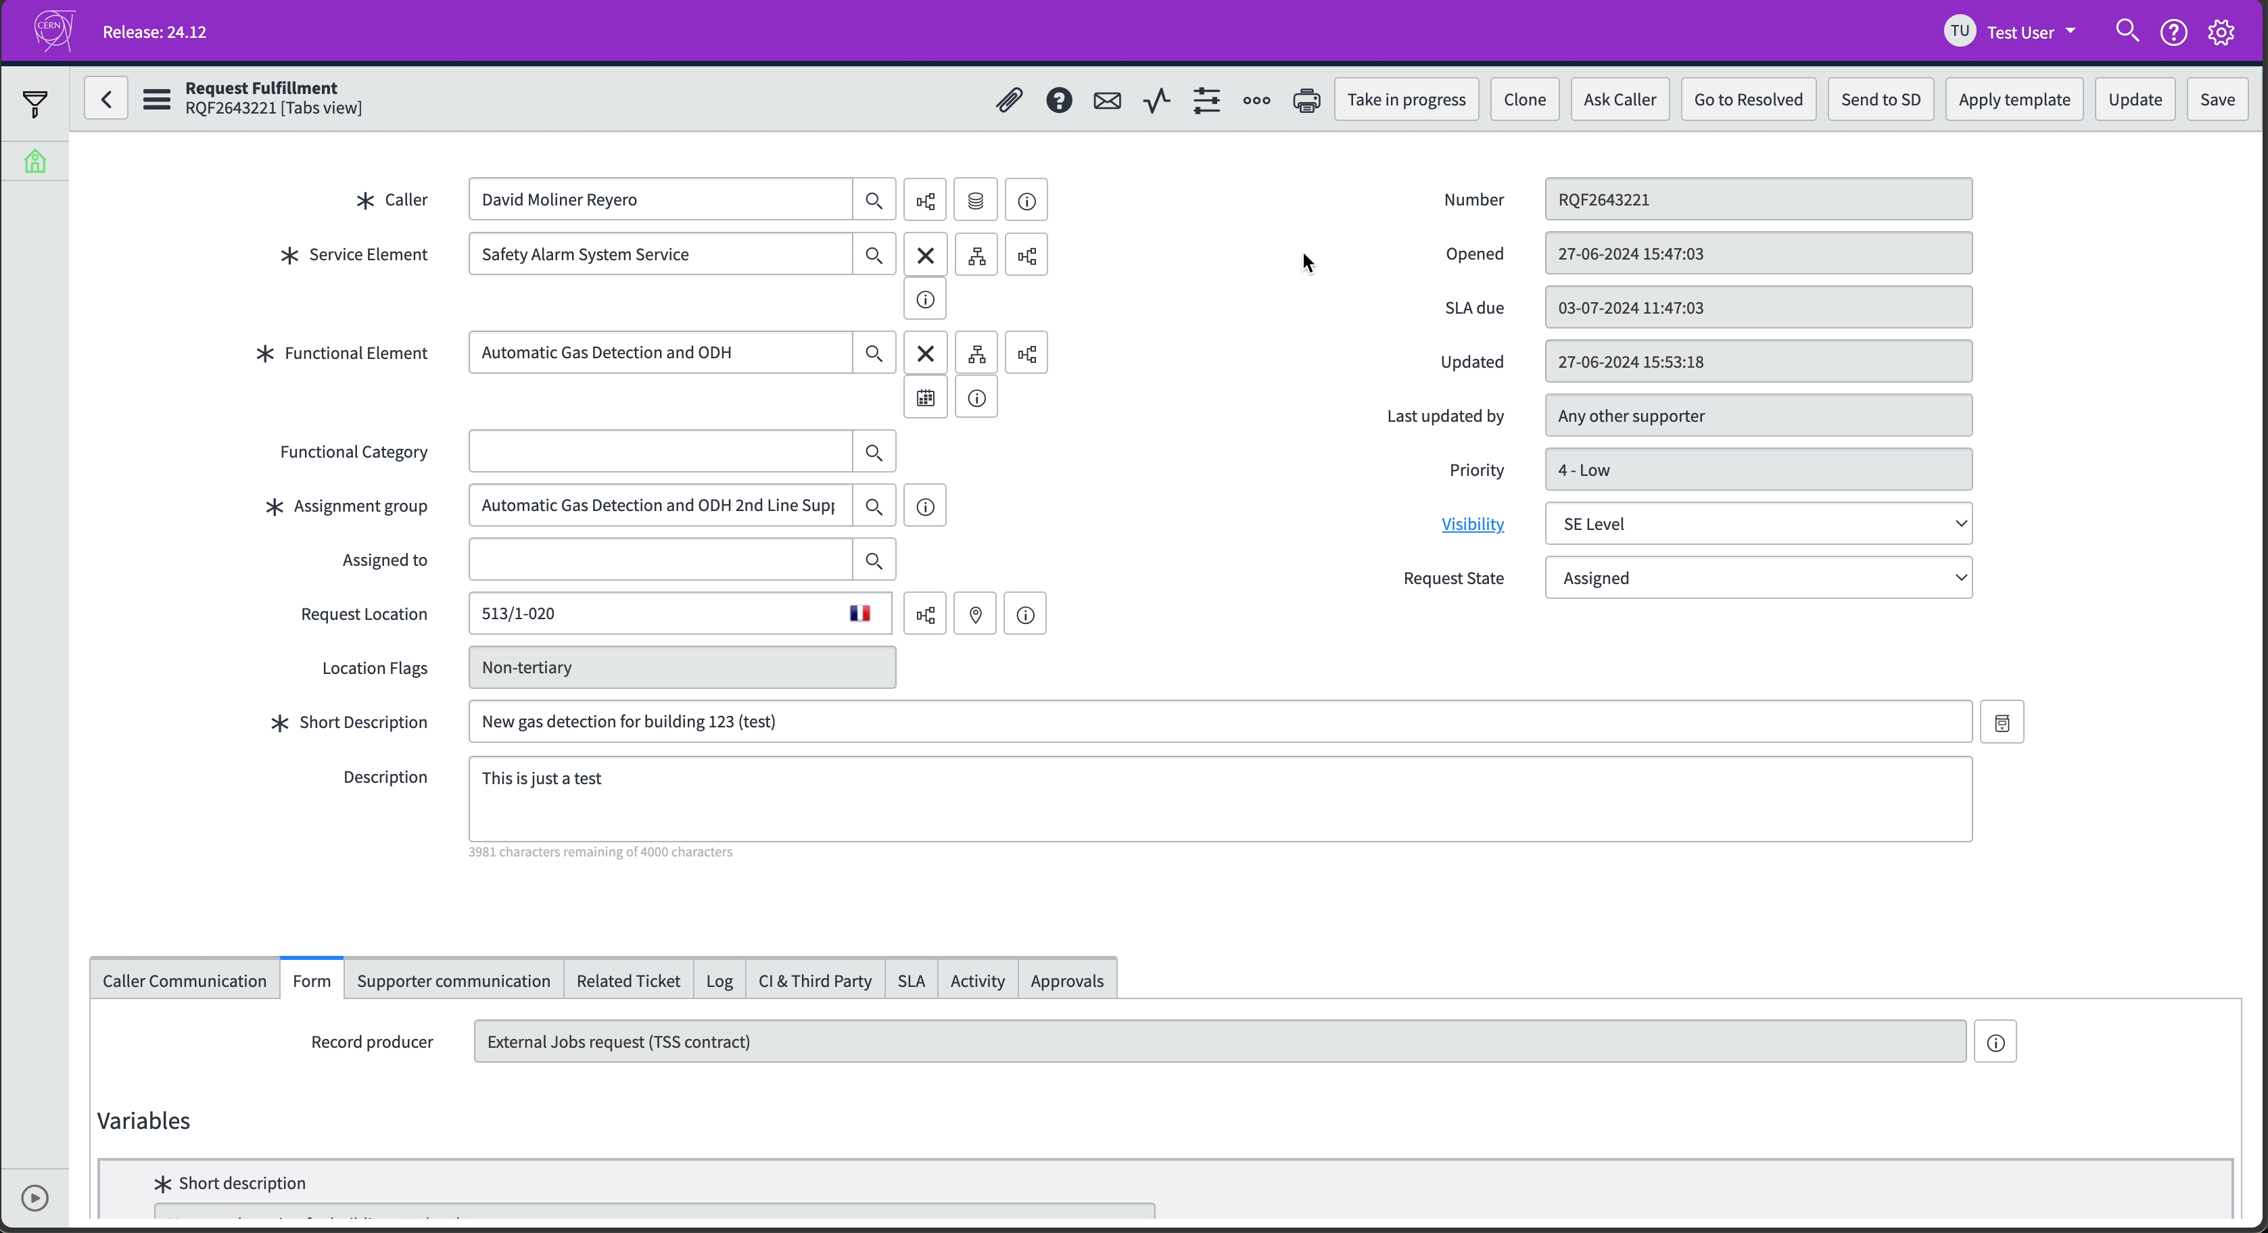

Slide 40
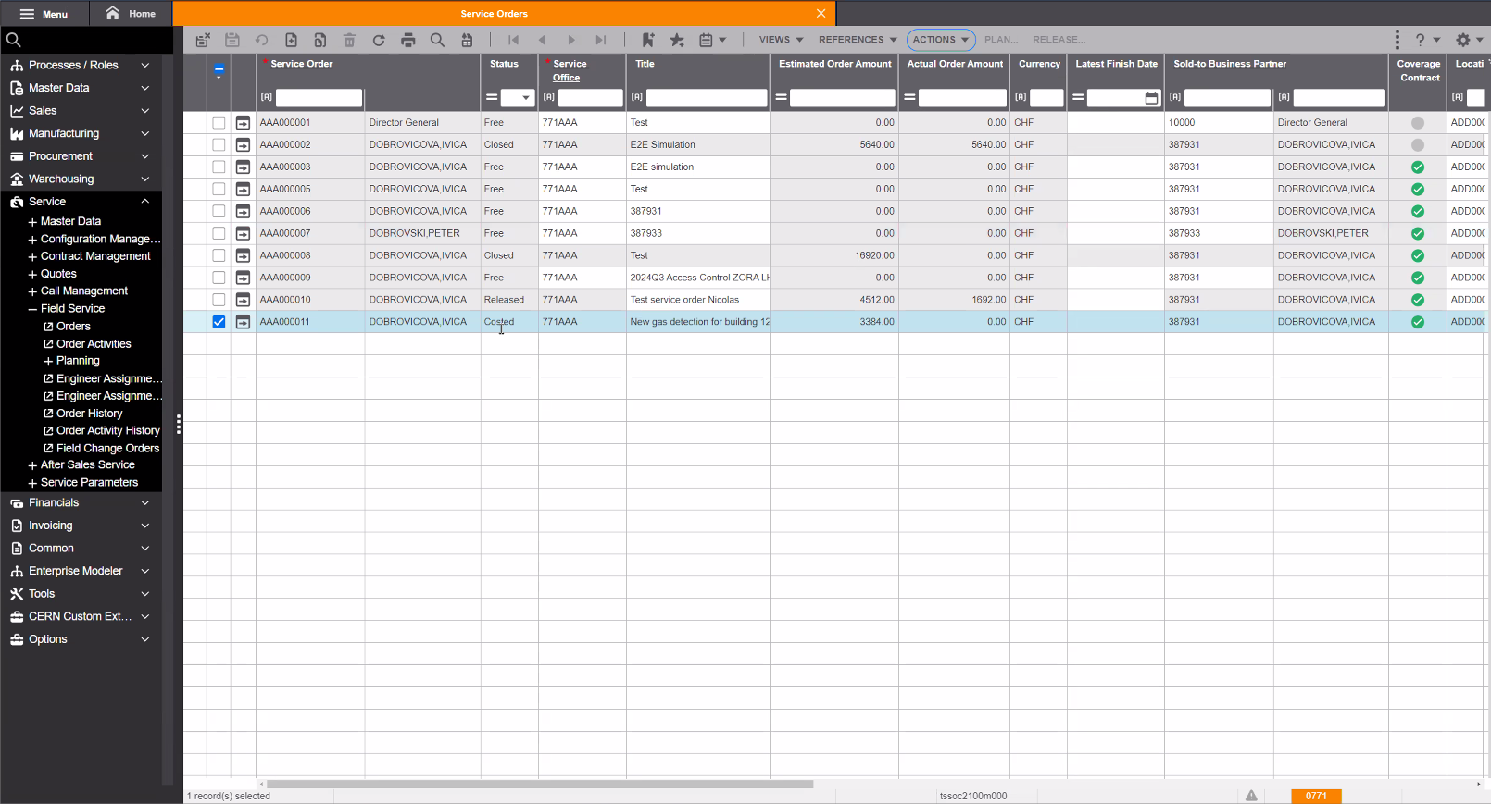

Slide 41
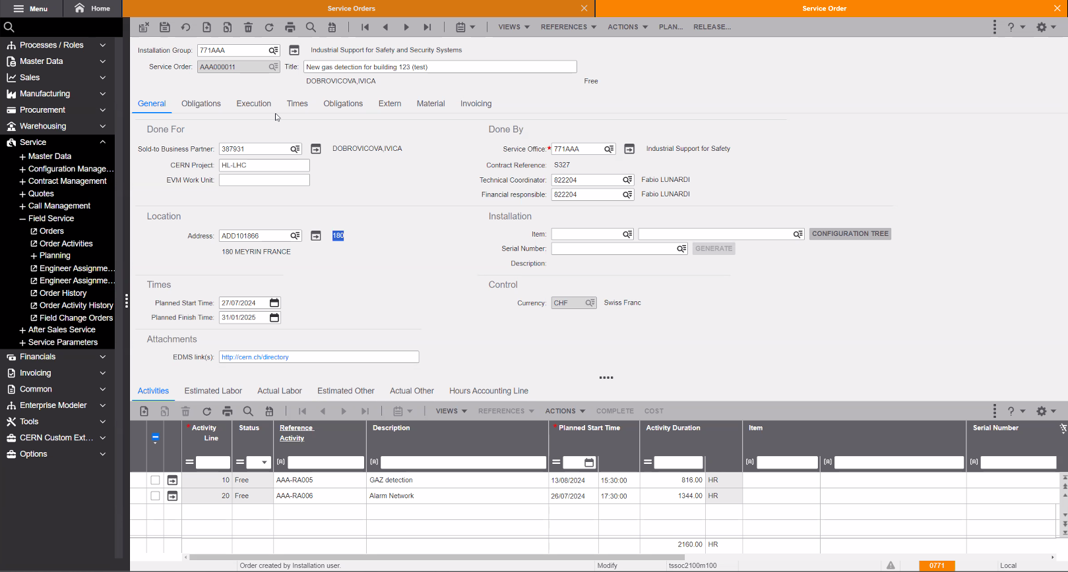

Slide 42

Q
A

