Slide 2
SIS status before first Stable Beams
J. Wenninger

Slide 3
SIS overall status
Operational, some tests to be completed (automatic (un)masking) require injections of >=12 b trains.
The new interlocks on TDIS and TCDIL gaps are tested and operational.
Some new things in the next two slides.

Slide 4
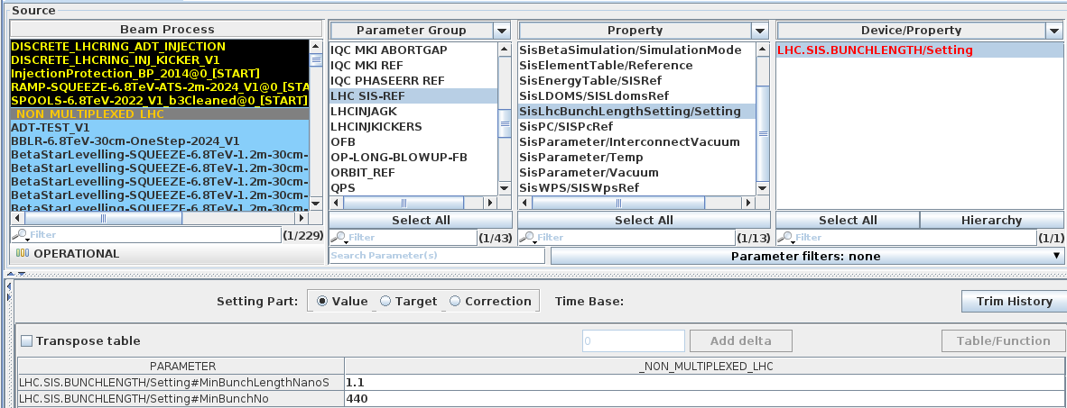
Bunch length interlock
The bunch length interlock for the ramp was revisited.
The logic (simple so far) was moved to UCAP node UCAP-NODE-LHC-SIS, one device per beam.
Introduced a new LSA critical setting with the min. bunch length and a bunch no. threshold below which the interlock does not act.
  Only applied by SIS if the mode is ramp.
The logic can of course be made more complex, scaling with no of bunches or with intensity…

Slide 5
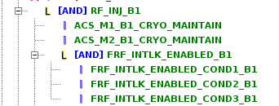
SIS interlock for … RF frequency interlock
During the MPS tests for LBDS, the RF frequency interlock (~ +- 100 Hz) did not work.
  The root cause was an incorrect configuration of a RF FESA class (A. Butterworth).
  Once correctly configured, the RF frequency interlock worked as expected.
A new SIS interlock was added to cover that issue for both beams, it includes the test of the 3 FESA fields that must be correctly set (3 conditions).
The interlock acts on INJECTION only, is that acceptable?
  Can therefore be broken once beam is in. This is unlikely, in addition there is no immediate danger.

