Slide 1
LHeC positron Challenge
Vitaly Yakimenko

Slide 2
Requirements
6mA average current or 4x10¹⁶ e⁺/sec
2x10⁷ bunches with 2x10⁹ e⁺/bunch
Normalized emittance 50 microns
Longitudinal emittance 5 MeV-mm or
10 mm normalized.

Slide 3
Pulsed Linac scheme
High efficiency pulsed linac to generate drive beam of many bunches
CO2 laser cavities to convert ~10% of the drive beam power into gamma beam by Compton back scattering
Gamma beam is converted into positrons on the Liquid Mercury jet target
Positrons are captured, accelerated to 5GeV
Longitudinal and transverse emittances exchanged/manipulation
Beam is stored in the 3km ring
Bunches extracted at CW rate to feed high energy ERL

Slide 4
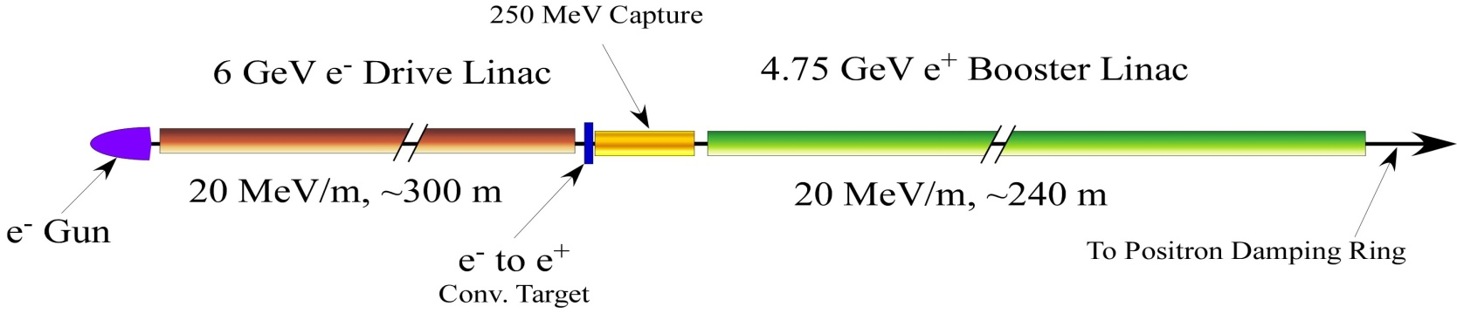
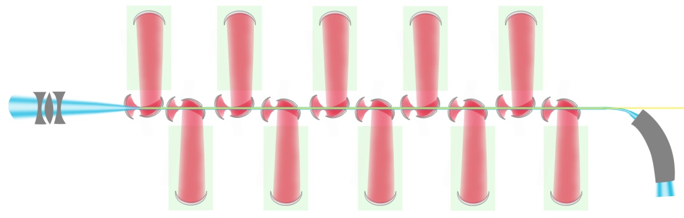
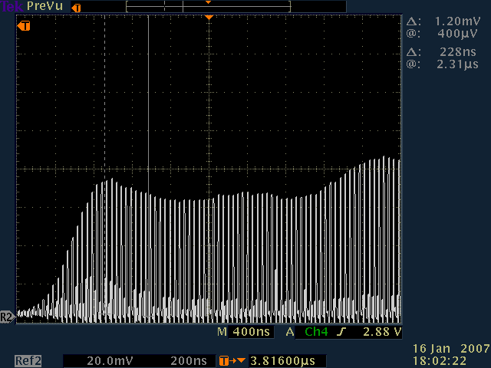
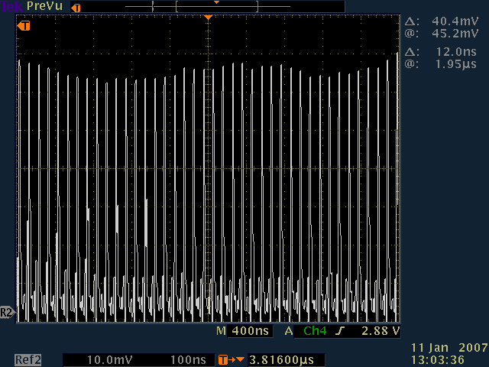
Positrons Source
Conventional Non-Polarized Positrons:
γ-ray beam is generated in the Compton back scattering inside optical cavity of CO2 laser beam and 6 GeV e-beam produced by linac.
Laser cavity needs R&D.
6GeV e⁻ beam
60MeV
γ beam
γ to e⁺ conv. target
30MeV
e⁺ beam
~2 m
First tests of the laser cavity:
3% over 1 μs

Slide 5
Reality check
(Power requirements)
  Output of conversion target:
  6 mA x 30MeV => 180kW e⁺ beam
Conversion efficiencies :
  γ -> e⁺ ~2% 9 MW γ beam
    (NLC, captured into 1mm x 1mm emittances)
  e⁻ -> γ ~10% 90 MW e⁻ beam
    Multi IP Compton converter with CO2 lasers
  Wall -> e⁻ ~50% 180 MW wall power
    CLIC type driver, 4GeV, 24mA => 96 MW,
    1 kHz; 20,000 bunches; 5ns spacing; 2x10¹⁰ e⁺/bunch
    1000 klystrons 15MW(peak) 10μs 1kHz => 150MW average

Slide 6
Reality check
(2x10⁷ bunches with 2x10⁹ e⁺/bunch)
1.6nC drive bunches is relatedly easy
2x10⁷ bunches, 5ns spacing => 3km long train with 300mA current (very expensive but likely doable)
No existing klystrons (Toshiba 7302E:325Hz, 50MW, 4μs)
Drive beam linac dominates the cost

Slide 7
Emittances E_{e}=4GeV
Positron beam emittance at the target exit
Acquired angular spread
Beam size
  Gamma beam divergence
  Scattering in the target
  e⁻ beam size on target
Longitudinal emittance

Slide 8
Alternatives:
2GeV Compton Ring with 2μm laser enhancement cavity:
  1 A current => 6 10¹³ e⁻ in the 3 km ring
  each 2 GeV electron needs to emit ~10⁵ 30 MeV gammas per sec. =>
  not realistic energy spread

Slide 9
Alternatives:
2 GeV ERL with 2μm laser enhancement cavity might offer a better power option
  Longitudinal phase rotation before and after IP is needed for energy recovery
  Very demanding laser system with 4-6
    enhancement cavities overlapped in a corks screw to make Compton interaction region compact
    1J / 50ns => 20 MW intra cavity power
    2kW “driver oscillator” / 10⁴ enhancement

Slide 10
Power requirements for ERL
  Output of conversion target:
  6 mA x 30MeV => 180kW e⁺ beam
Conversion efficiencies :
  γ -> e⁺ ~2% 9 MW γ beam
    (NLC, captured into 1mm x 1mm emittances)
  e⁻ -> γ ~0.5% 2 GW e⁻ beam (ERL !)
    Multi IP Compton converter with enhancement cavity
    2GeV, 1 A => 2 GW
  Wall -> e⁻ ~70% of 0.001*2GW
  Total ~30 MW wall power

Slide 11
Emittances E_{e}=2GeV
Beam size
  Gamma beam divergence
  Scattering in the target
  e⁻ beam size on target
Longitudinal emittance

Slide 12
Conclusions
Drive beam linac dominates the cost in the pulsed linac/CO2 laser scheme
  Higher charge per bunch/ fewer bunches would be beneficial for injector
Compton ring will not work
CW high current ERL / enhancement cavity could be a better option
  Laser cavity is the main R&D item
Tightly focused into conversion target 6MW gamma beam is needed
  (Liquid Mercury jet target ?)
Emittances are not satisfied in any scheme. Simple estimates overestimate emittance from the target in the strong magnetic field.

