Slide 1
Requirements
6mA, 4x10¹⁶ e⁺/s
Normalized emittance <50 μm
Longitudinal emittance <5 MeV-mm
Conversion target with optimized length
P_{primary} = P_{thermal} + P_{γ} + P_{e-} + P_{e+}
100% = 30% + 50% + 12% + 8%
<T_{e+} >≈ 5 MeV, ,
P_{Target} =5MV∙6mA / 0.08 = 375 kW
η_{acc}≈20%
P_{mains} = P_{Target} /0.2=1.9 MW
that’s not out of scale

Slide 2
Emittance of all positrons from target
ε_{N} ≈ 1-10 mm
required ε_{N} =0.05 mm
factor 100 emittance reduction required
Solution 1
cut phase space, needs unrealistic increase of primary beam power
Solution 2
collect all positrons, accelerate to 1 GeV and Log(100) ≈ 5 damping times
P_{RF}=1GeV ∙5mA∙5/0.2=150MW
Solution 3
produce positrons in smaller phase space volume
  Inherent transverse emittance from is pair production is small.
  The large phase space volume comes from multiple scattering
  in production target!
  Pair production from relativistic electrons in strong laser field
  no solid target, no multiple scattering !

Slide 3
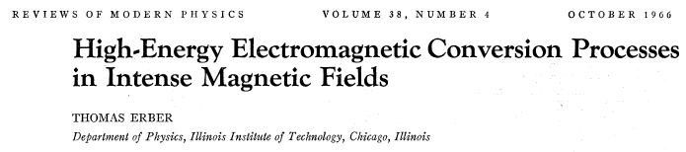
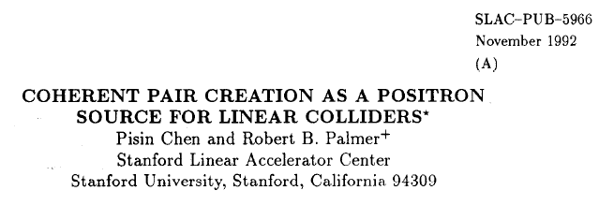
SLAC-Pub-8063, 1999 and Phys.Rev. D
Studies of Nonlinear QED in collisions of 46.6 GeV Electrons
with Intense Laser Pulses
many authors
To be reconsidered with 2011 state of the art TiSa lasers and X-ray FELs !

Slide 4
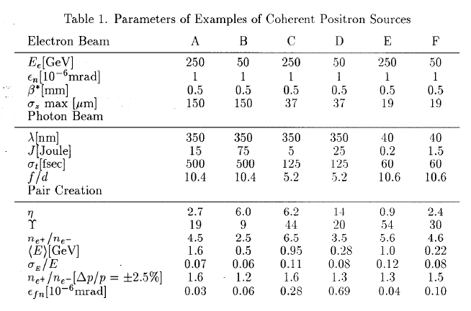
0.1
0.1 to be checked
5

