Slide 1




KM3NeT-INFRADEV2
WP5
Sustainability and socio-economic impact
Christos Markou
NCSR Demokritos
April 10th, 2024
Funded by the European Union. Views and opinions expressed are however those of the author(s) only and do not necessarily reflect those of the European Union or the European Research Executive Agency (REA). Neither the European Union nor the REA can be held responsible for them.

Slide 2


INTRODUCTION
Building on the results and the experience gained in the KM3NeT – INFRADEV project, the main objectives of WP5 include
      the investigation of possible solutions and identification of procedures for transforming the daily activities of the KM3NeT community to a sustainable configuration.
    the investigation of the potential impact of the KM3NeT decommissioning on the environment, and the definition of best-practice procedures, including recycling schemes of the KM3NeT infrastructure at the end of the project lifetime.
    the study the expected socio-economic impact of the KM3NeT infrastructure operation in the installation sites.
    the expansion of contacts with industry for the development of new technologies.
10/4/2024 WP5 – Sustainability and socio-economic impact, C. Markou 2

Slide 3
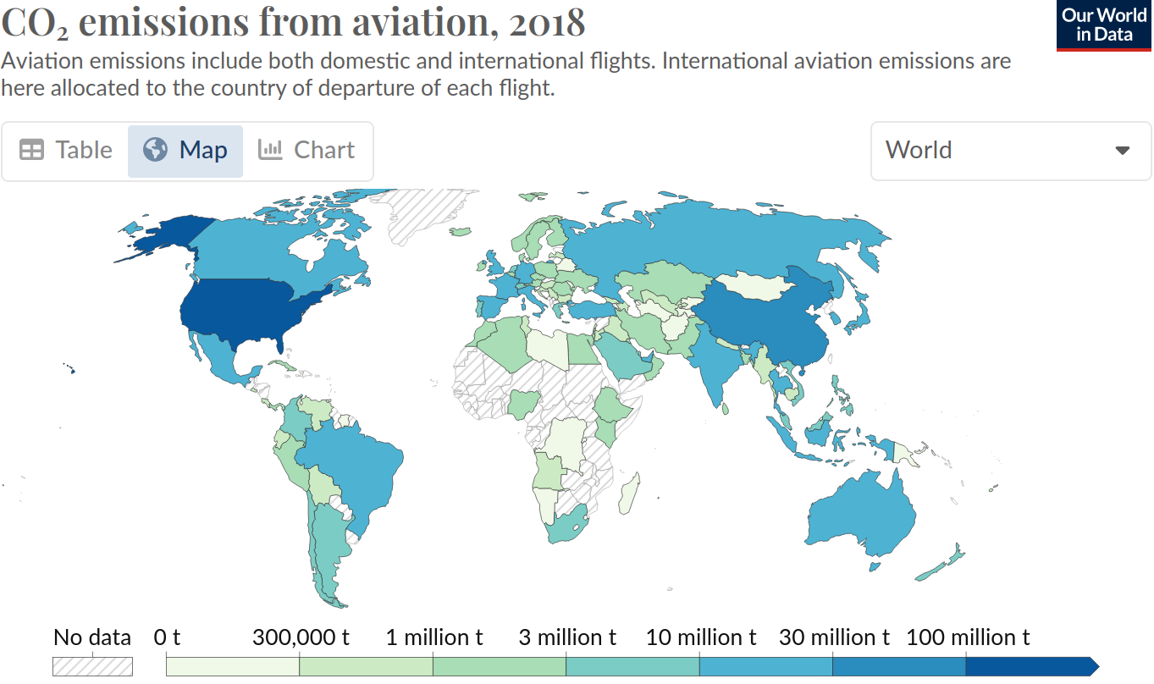
Task 5.1 – Sustainable travel & mobility
Aviation is responsible for 2.5 % of the global CO₂ emissions
Source
~19 % of the CO₂ aviation emissions come from EU
"…issues like travel for meetings, participation in construction and installation activities, participation to conferences and workshops can be adjusted so as to efficiently balance between physical and remote interaction as well as environmental impact. As there is no “one size fits all” solution, it is important to assess and measure the impact of all possible choices and then propose corrective measures and procedures."
10/4/2024 WP5 – Sustainability and socio-economic impact, C. Markou

Slide 4
Task 5.1 – Sustainable travel & mobility
Measuring our environmental impact – how?
A survey was sent to gather information on the travelling of the collaboration members that were considered as use-cases
The CO₂ equivalent emission for each person was calculated. Then added to extract the overall emission related to the CM
Departure & arrival locations as well as the modes of transportation were tabulated into .csv files
.csv files were inputs to a script with based on classes/functions from co2calculator, open software for work-related CO₂ emissions
10/4/2024 WP5 – Sustainability and socio-economic impact, C. Markou

Slide 5
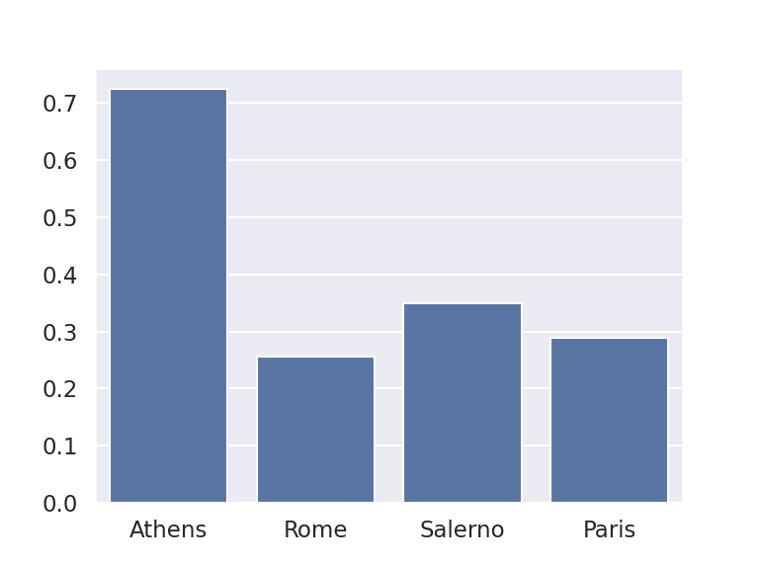
Task 5.1 – Sustainable travel & mobility
Measuring our environmental impact
Analysing the survey answers
Some qualitative remarks:
CO₂ eq. per person:
Using train significantly reduces the environmental impact
Some people from northern KM3NeT sites traveled to Rome by train with an intermediate station in Genova for the bootcamp. That seems to have an impact in the difference with Salerno CM emissions
Not a single person from France, Netherlands, Belgium and Germany traveled by plane to attend the CM in Paris
0.73 t
0.35 t
CO₂ eq. [t]
0.29 t
0.26 t
10/4/2024 WP5 – Sustainability and socio-economic impact, C. Markou

Slide 6
Task 5.1 – Sustainable travel & mobility
Outlook
A software has been developed to estimate the environmental impact of traveling within KM3NeT; used for the estimation of the impact of the past CMs.
Could be used to plan future meetings (decide number of remote/in-person meetings, location of a meeting)
To do
Plan future meetings with the aim to annually reduce the emissions according to the Nationally Determined Contributions (NDCs), set for the EU in the context of the Paris Agreement; Provide use cases.
Resources and deliverable
Person power from NCSR D and FAU, report on M18, expected to be in time, no issues identified.
10/4/2024 WP5 – Sustainability and socio-economic impact, C. Markou

Slide 7
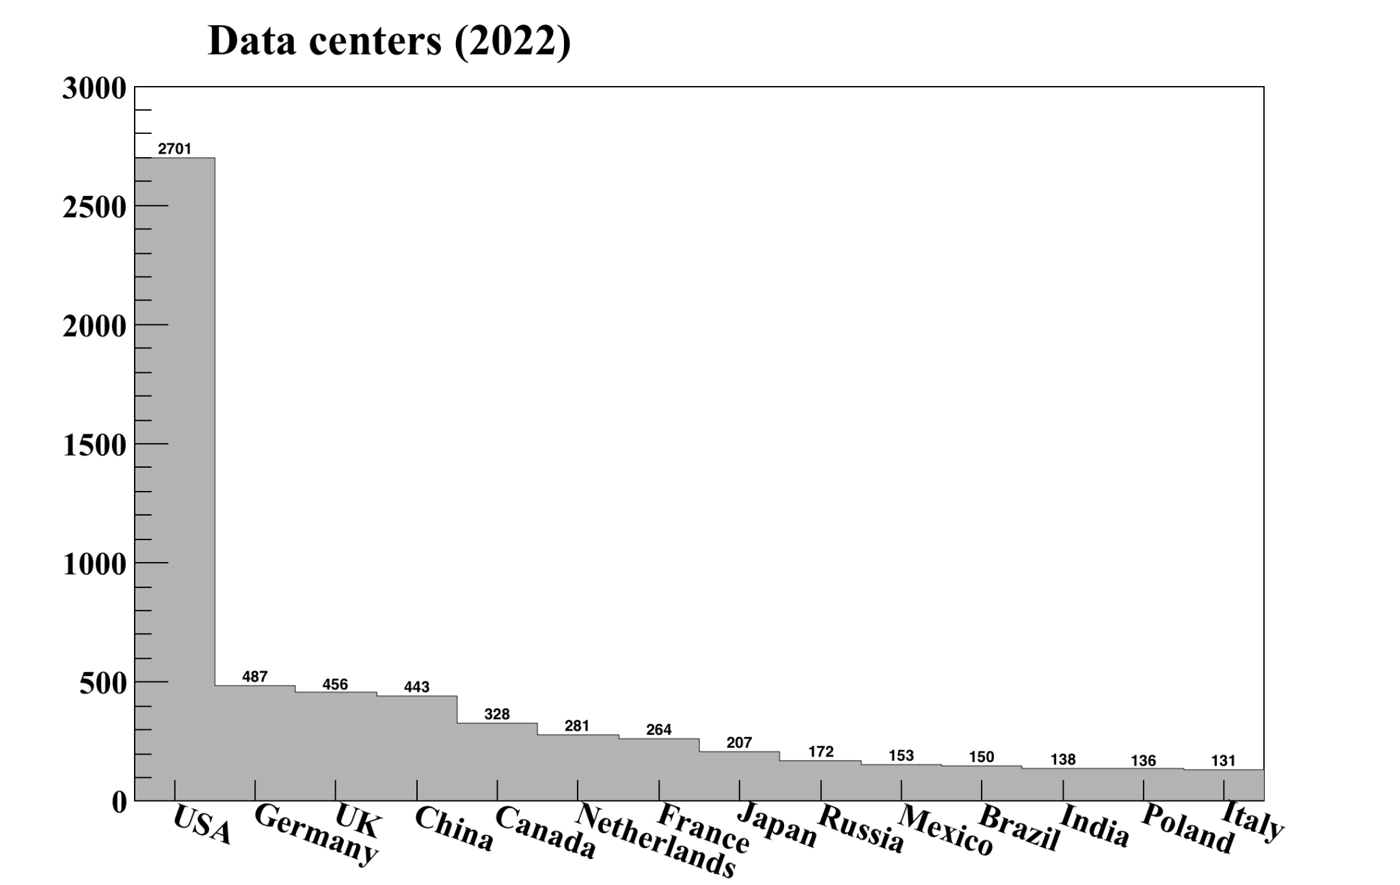
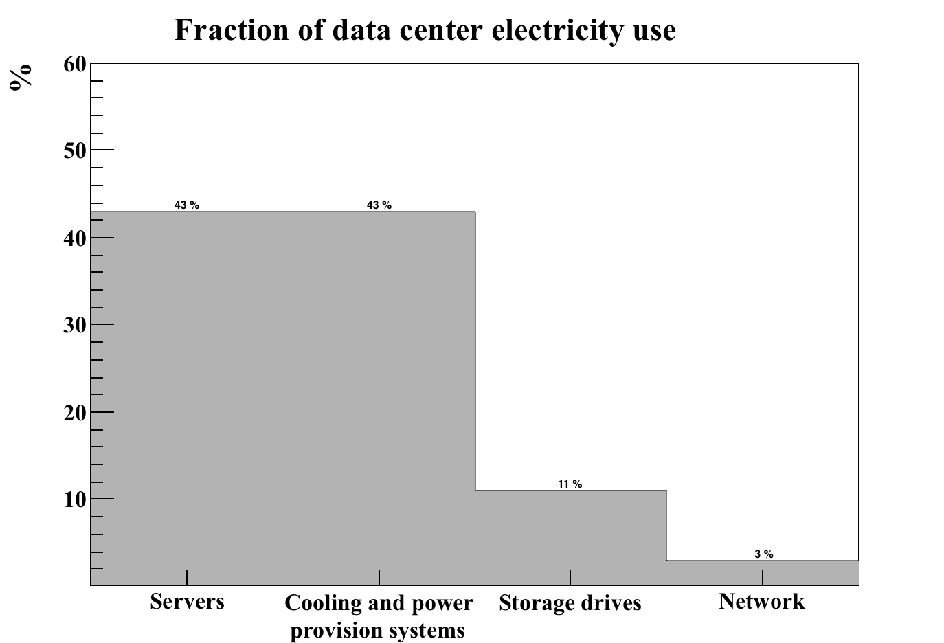
Task 5.2 – Green Computing
Computing needs are increasingly becoming an important contributor to the resources required for modern experiments, with corresponding impact on the running costs as well as their carbon footprint.
“Measure and assess the current situation regarding needed computing resources. Investigate possible solutions to reduce “carbon footprint” in both hardware and software and propose changes to the existing procedures.”
Recommendations :
Hardware
Software
KM3NeT-wide policies and procedures
User policies and procedures
Approximately 8000 data centers around the globe with energy consumption of 196-400 TWh annually
10/4/2024 WP5 – Sustainability and socio-economic impact, C. Markou

Slide 8
Task 5.2 – Green Computing
Hardware recommendations
  Measure energy consumption
    Smart power distributions units are more efficient
  Turn down idle equipment and consolidate lightly used servers
  Efficient use of resources
  Rise in ambient temperatures
    Modern equipment can do well in temperatures close to 25 ˚C
  Air conditioning
    Employ hot/cold aisle configuration
    Hot aisle containment helps you save a lot of energy
    Exploit climate whenever possible
Storage drives
  SSDs are more efficient than the common HDDs
  Enable the option for a drive to deactivate after a certain amount of time
10/4/2024 WP5 – Sustainability and socio-economic impact, C. Markou

Slide 9
Task 5.2 – Green Computing
Software recommendations
  Server virtualization
    Reduces energy consumption of idle servers
    Better use of hardware resources
  Programming language
    Interpreted languages consume ~ 50 time more than compiled ones
    This list includes script, perl, python, etc …
  Compiler flags
    Correct use of options result in better, more efficient code, avoiding unused variables
    and unnecessary waste of compute resources.
10/4/2024 WP5 – Sustainability and socio-economic impact, C. Markou

Slide 10
Task 5.2 – Green Computing
KM3NeT-wide policies and procedures
  Avoid data duplication in files
    Limit computational accuracy whenever possible
  Software for data production to be decided between the analysis and offline groups
    Input from analyzers
    Freeze a tagged version for each processing
  Analyze pilot samples before mass production
    Control variables to confirm that everything’s OK
    Green light to start processing
User oriented policies and procedures
Best practices – recommendations
Hardware and software management, use of resources,
‘common sense’ recommendations
10/4/2024 WP5 – Sustainability and socio-economic impact, C. Markou

Slide 11
Task 5.2 – Green Computing
Task 5.2 is quite advanced, with person power from NCSR D, NOW-I and CSIC,
and contributions from the Software and Computing Group of KM3NeT.
Deliverable to be submitted on month 24, expected to be in time.
10/4/2024 WP5 – Sustainability and socio-economic impact, C. Markou

Slide 12
Task 5.3 – Decommissioning and recycling procedures
“Define decommissioning processes for KM3NeT, including the recycling of recovered infrastructure at the end of the project lifetime. Propose possible uses of recovered equipment.”
Proactive planning for the environmentally friendly decommission phase of the infrastructure at the end of the data taking period.
Task force in place consisting of the 3 site managers of KM3NeT.
Study of existing (smaller scale) decommissioning plans of other infrastructures, in order to identify best-practices and relevant insights.
Expertise already in place through the decommissioning of ANTARES.
Deliverable due on month 36, expected to be delivered in time, no issues identified.
10/4/2024 WP5 – Sustainability and socio-economic impact, C. Markou

Slide 13
Task 5.4 – Socio-economic impact studies
“Establish the parameters of the indirect and direct socio-economic impact, especially for France and Greece. The integrated social-economic studies for Italy, France and Greece will become a major report to be used for the impact of KM3NeT to the community.”
The corresponding socio-economic impact study for Italy being completed already, the study for France and Greece will complete the set for dissemination to the communities and policy makers.
INFN is in the process of identifying a new hire at the post-doc level who will perform the studies under the supervision of Prof. Marco Romano
Deliverable due on month 36, expected to be delivered in time, no issues identified.
10/4/2024 WP5 – Sustainability and socio-economic impact, C. Markou

Slide 14
Task 5.5 – Promotion of technology developments
“Expand, promote and enhance technology developments in collaboration with specific industrial partners, in suitable technology fora and promotion sites.”
Following the work completed in the KM3NeT-INFRADEV project, work on the connection and links between KM3NeT and relevant industrial partners will be promoted and enhanced.
Work started in early 2024, with a senior researcher in NCSR D leading this effort.
Deliverable due on month 36, expected to be delivered in time, no issues identified.
10/4/2024 WP5 – Sustainability and socio-economic impact, C. Markou

Slide 15
Conclusions
Work-package 5 is well under way, with work on all tasks being satisfactorily progressing.
No special issues are identified.
All deliverables are expected to be completed in time.
10/4/2024 WP5 – Sustainability and socio-economic impact, C. Markou

