Slide 1
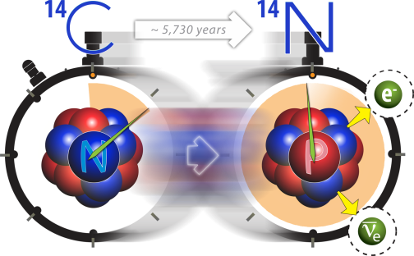
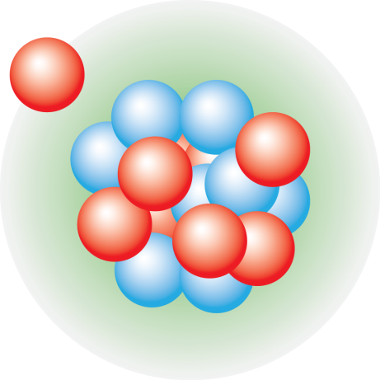



Nuclear theory for precision electroweak
Gaute Hagen
Oak Ridge National Laboratory
EPIC 2024: Electroweak Physics InterseCtions
Sardinia, September 23rd, 2024

Slide 2
Collaborators
@ ORNL / UTK: B. Acharya, Baishan Hu, G. R. Jansen, T. Papenbrock
@ LSU: Z. H. Sun
@ Chalmers: A. Ekström, C. Forssén
@ Mainz: F. Bonaiti, S. Bacca, J. E. Sobczyk
@ LANL/WUSTL: S. Novario
@ TRIUMF: P. Navratil

Slide 3

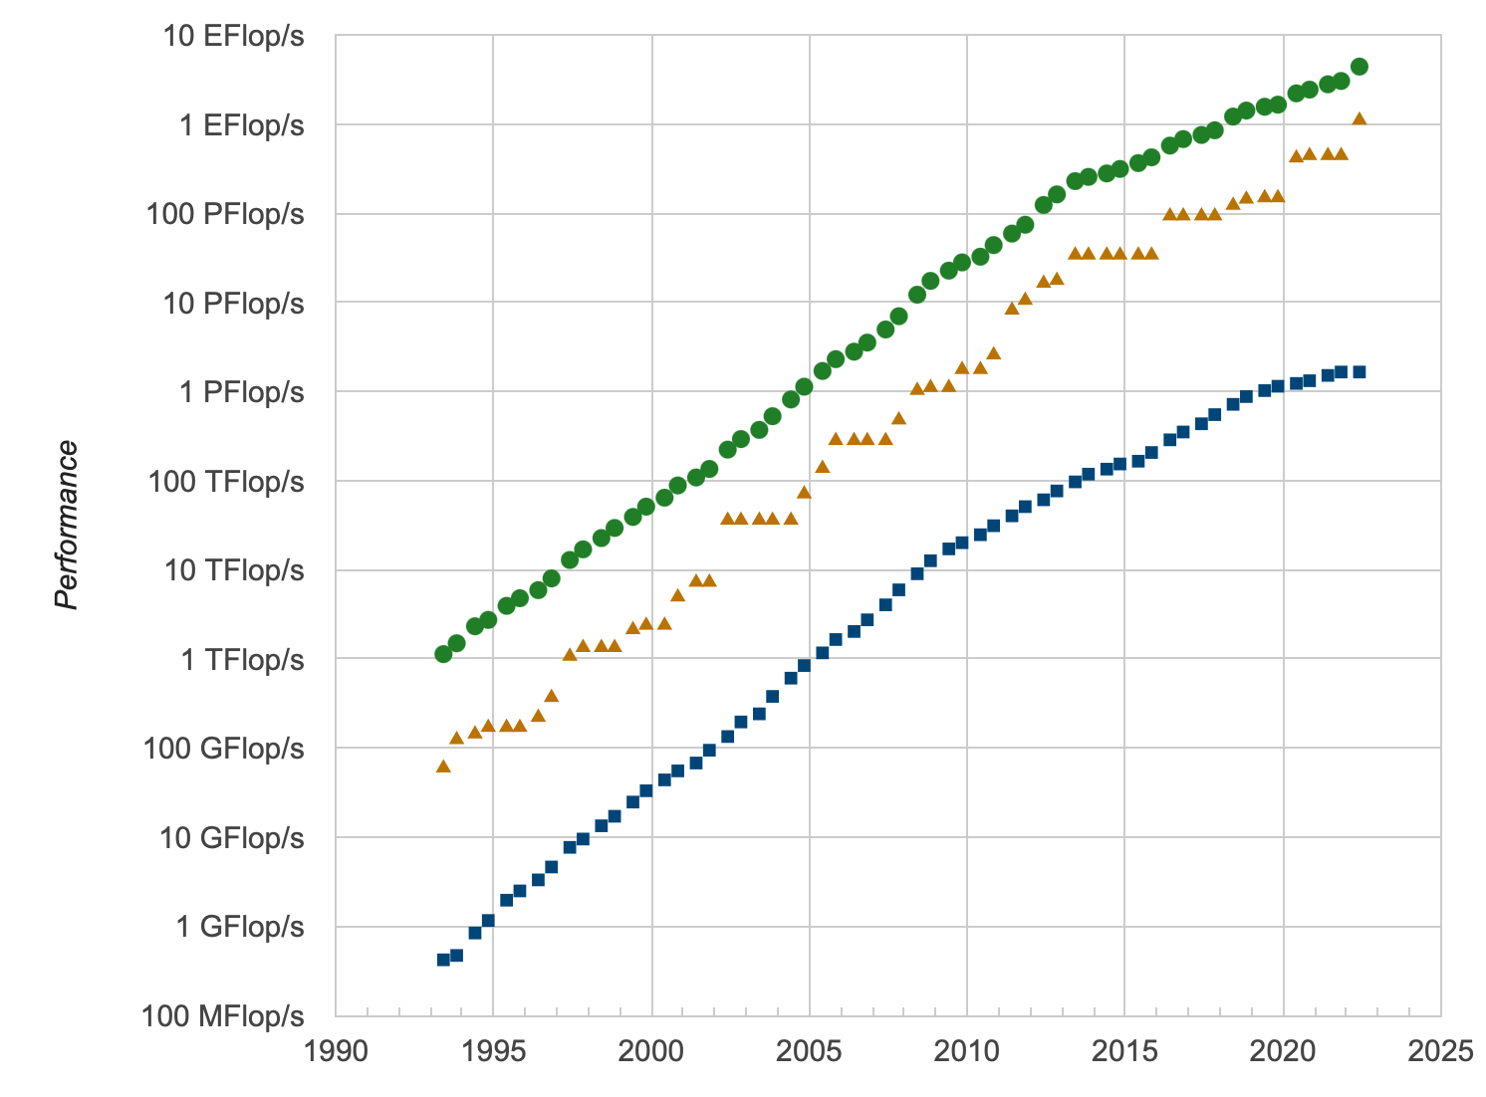
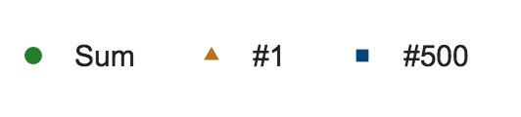
Trend in realistic ab-initio calculations
Tremendous progress in recent years because of ideas from EFT and the renormalization group
Computational methods with polynomial cost (coupled clusters 🙂quantum computing 🤔)
Ever-increasing computer power?
Development with time (top500.org)
No. 1 in 2024
Hu et al. Nat Phys (2022)
SUMMIT @OLCF
Notes:
he bars highlight the years of the first realistic computations of doubly magic nuclei. The height of each bar corresponds to the mass number A divided by the logarithm of the total compute power RTOP500 (in flops s−1) of the pertinent TOP500 list45. This ratio would be approximately constant if progress were solely due to exponentially increasing computing power. However, algorithms which instead scale polynomially in A have greatly increased the reach.

Slide 4
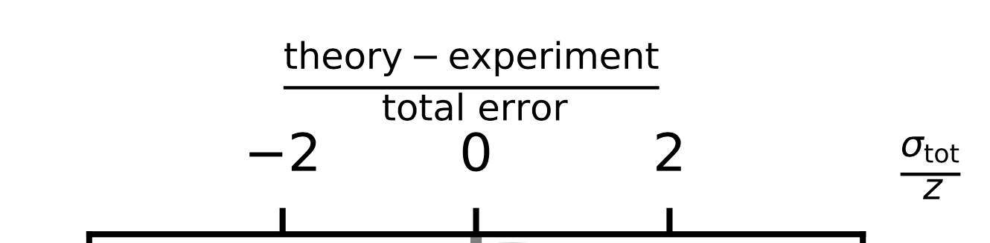
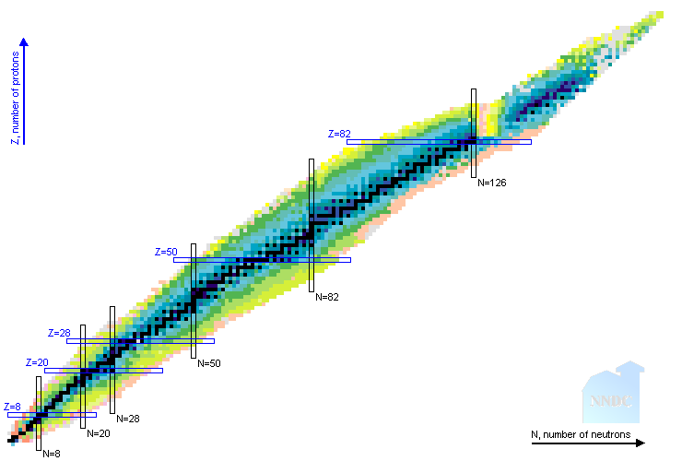
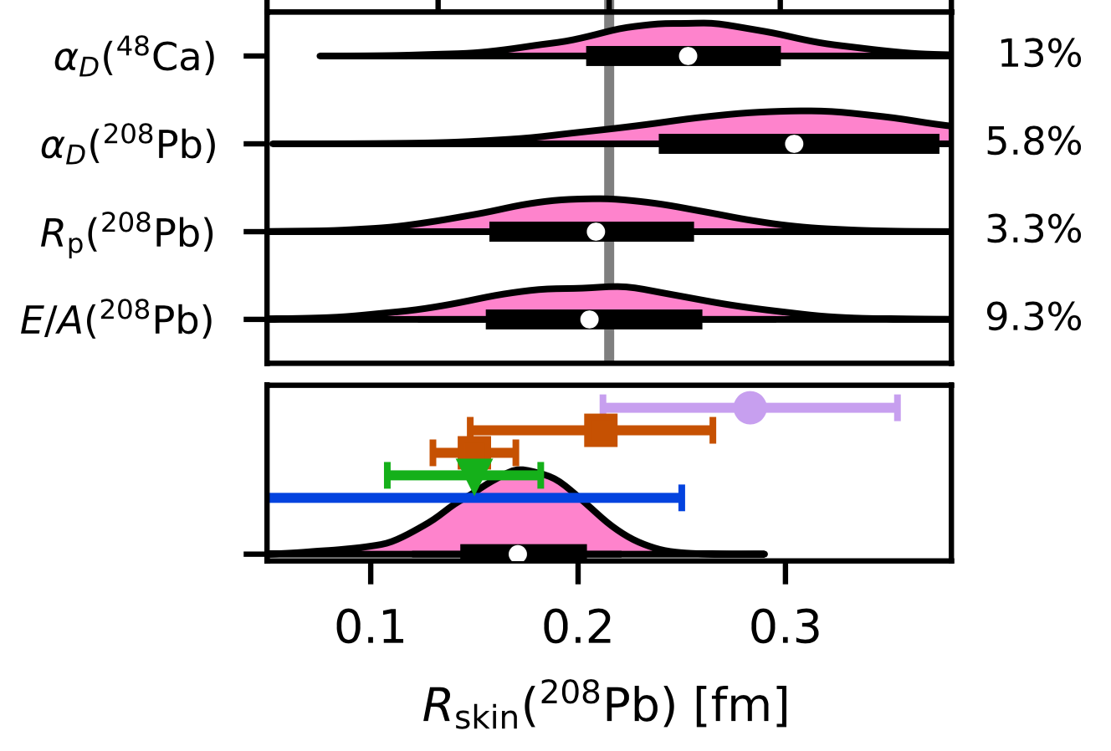
The Hamiltonian knows best
Gysbers et al, Nat Phys (2019)
Gysbers et al, Nat Phys (2019)
Ab-initio approaches are changing the way we compute nuclei
Hu et al. Nat Phys (2022)
Hagen, Jansen, Papenbrock,
Phys Rev Lett (2016)
Stroberg et al, Phys Rev Lett (2021)

Slide 5
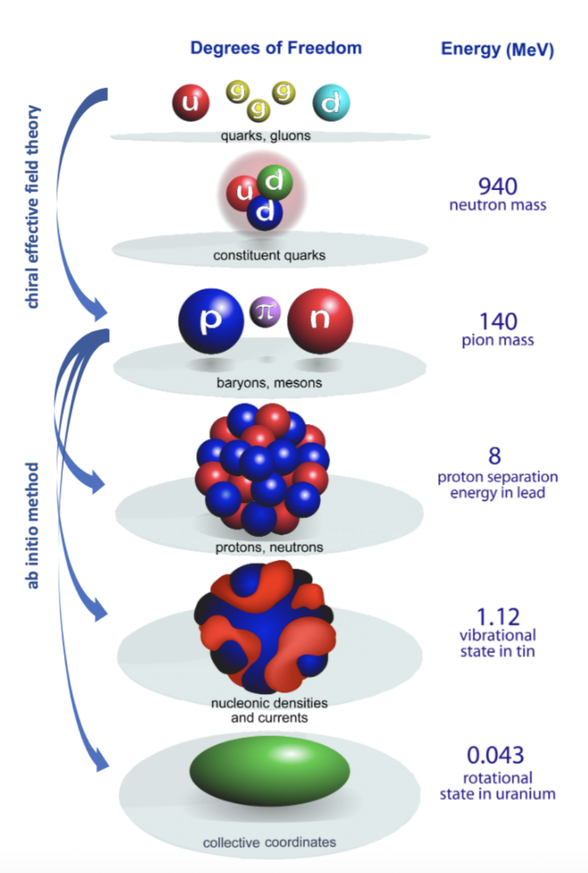
Multiscale physics of nuclei from ab-initio methods
What is ab initio in nuclear theory?
A. Ekström et al, Frontiers (2023)
“we interpret the ab initio method to be a systematically improvable approach for quantitatively describing nuclei using the finest resolution scale possible while maximizing its predictive capabilities”
Nuclei exhibit multiple energy scales ranging from hundreds of MeV in binding energies to fractions of an MeV for low-lying collective excitations.
Describing these different energy scales within a unified ab-initio framework from chiral interactions is a long-standing challenge
Figure adapted from Bertsch, Dean, Nazarewicz, SciDAC review (2007)
Notes:
Ab initio is interpreted differently to different people. Generic expression that benefits a vibrant competitive market place (reflect the creativity and innovation of scientist)
ab initio is unlike Tennessee Whiskey or French Champagne, which are internationally protected labels, but rather like Gruyère cheese, i.e., a generic expression that benefits a “vibrant, competitive marketplace”

Slide 6
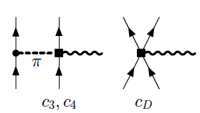
Interactions from chiral effective field theory
Parameters of the model
(16 at NNLO)
Constrained by data & carry uncertainties
Chiral EFT offers consistency between forces and currents
Figure adapted from Bertsch, Dean, Nazarewicz, SciDAC review (2007)

Slide 7
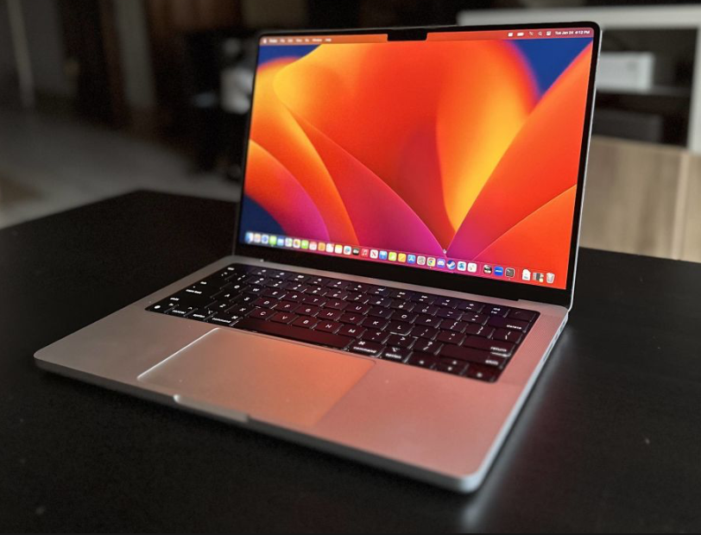
Solving the quantum many-nucleon problem
An exponentially hard problem to solve!
1.1 exaflops
IBM Q Experience
Polynomial scaling
Systematically improvable approaches with controlled approximations:
Coupled-cluster, IMSRG, Gorkov, SCGF,…
Emulators?
Fault tolerant quantum computing??

Slide 8
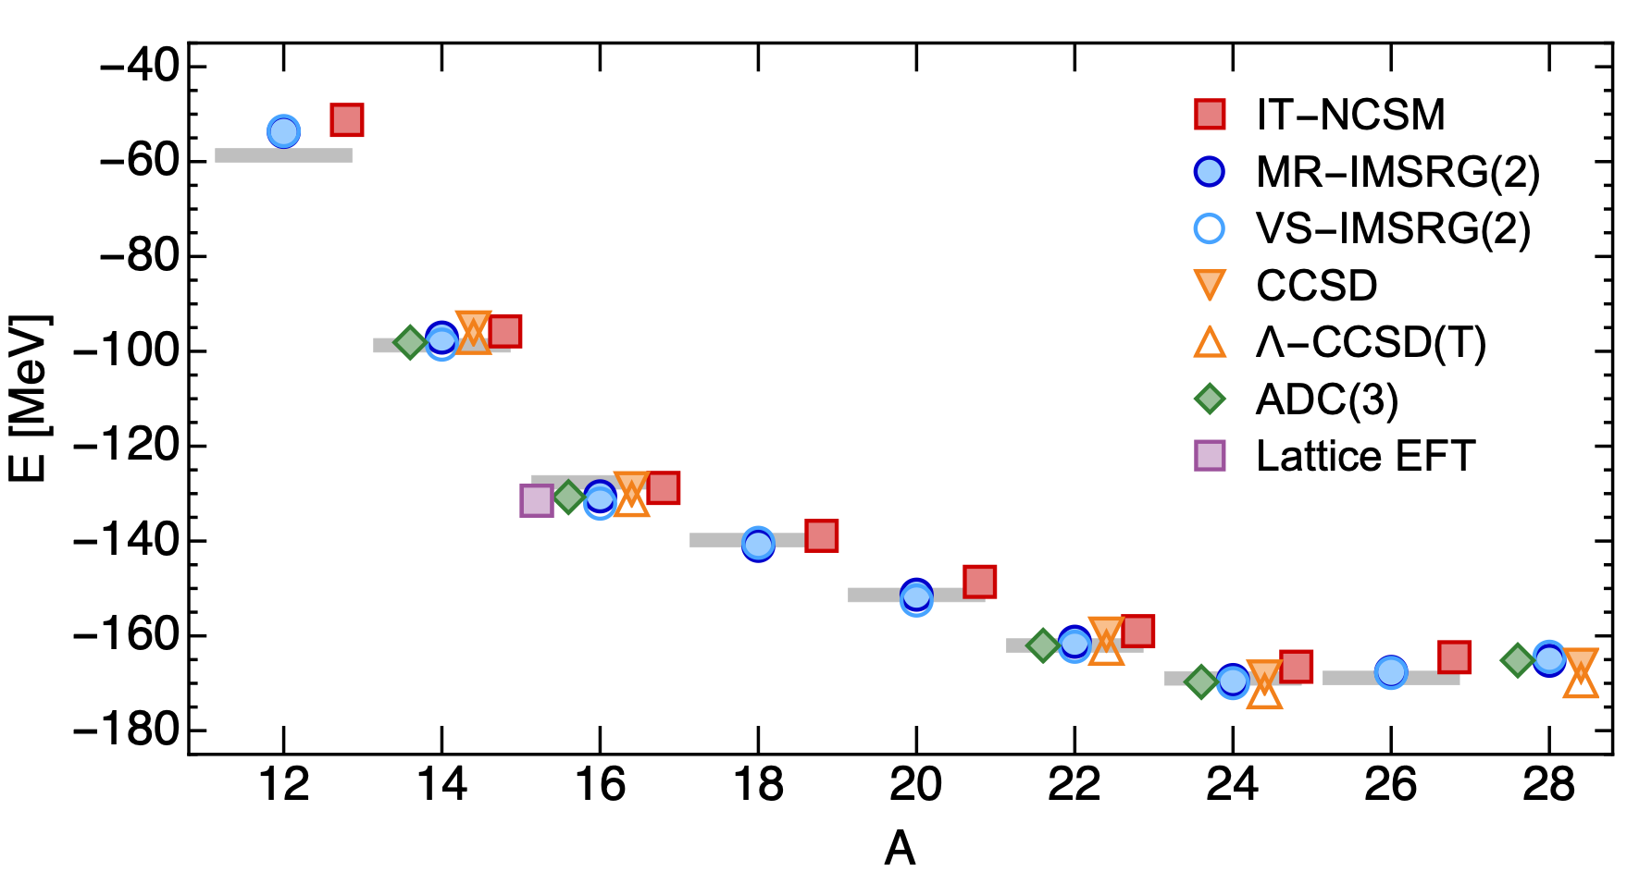
What precision/accuracy can we aim for in ab-initio modeling of nuclei?
Different many-body approaches (CC, IMSRG, SCGF,…) agree with each for binding energies and radii
(challenges exist for transitions, isotope shifts, and deformed shapes)
Some chiral potentials (models) work better than others
H. Hergert Front. Phys., (2020)
W. G. Jiang, et al., Phys. Rev. C 102, 054301 (2020)
Notes:
Motivation:
No data exists that can constrain the T=3/2 component of the 3NF in 3- and 4-body systems
Describe nuclear properties at low-energies, we don’t need phase shifts at several hundreds of MeVs
Many-body effects entering at higher orders might be reduced if heavier systems in which those effects are stronger are included in the optimization
Predictive power does not go together with large extrapolations

Slide 9
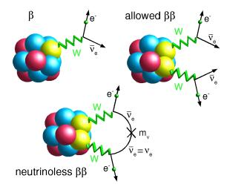
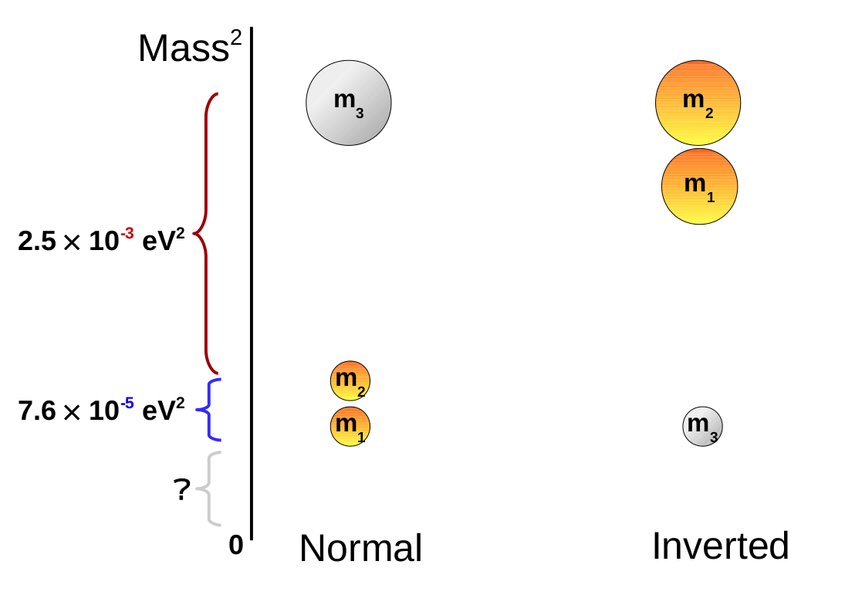
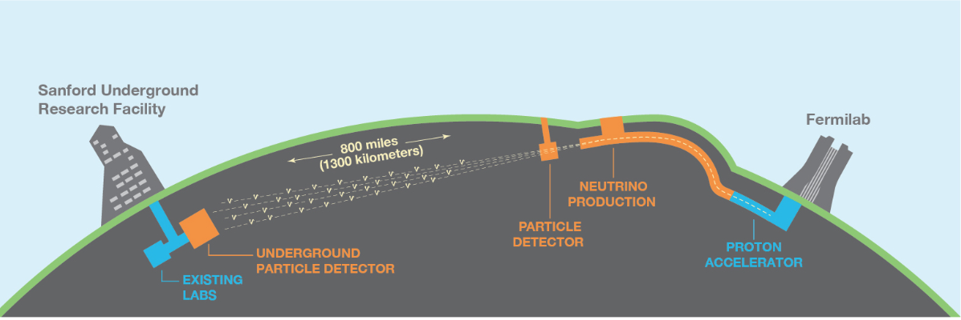
Addressing fundamental physics questions with ab-initio methods
  Are neutrinos their own antiparticles?
  Is the mass hierarchy inverted or normal?
  What is the neutrino mass scale?
Provide theory for upcoming ton-scale experiments on 0vbb
The Deep Underground Neutrino Experiment (DUNE)
?
?
Accelerator neutrino experiment is being designed to accurately measure neutrino oscillations and the neutrino mass hierarchy
Theory: neutrino-nucleus cross-sections
Notes:
Experimental 0νββ decay limits on the combination of neutrino masses with regions corresponding to the normal and inverted hierarchies, as a function of the mass of the lightest neutrino.

Slide 10
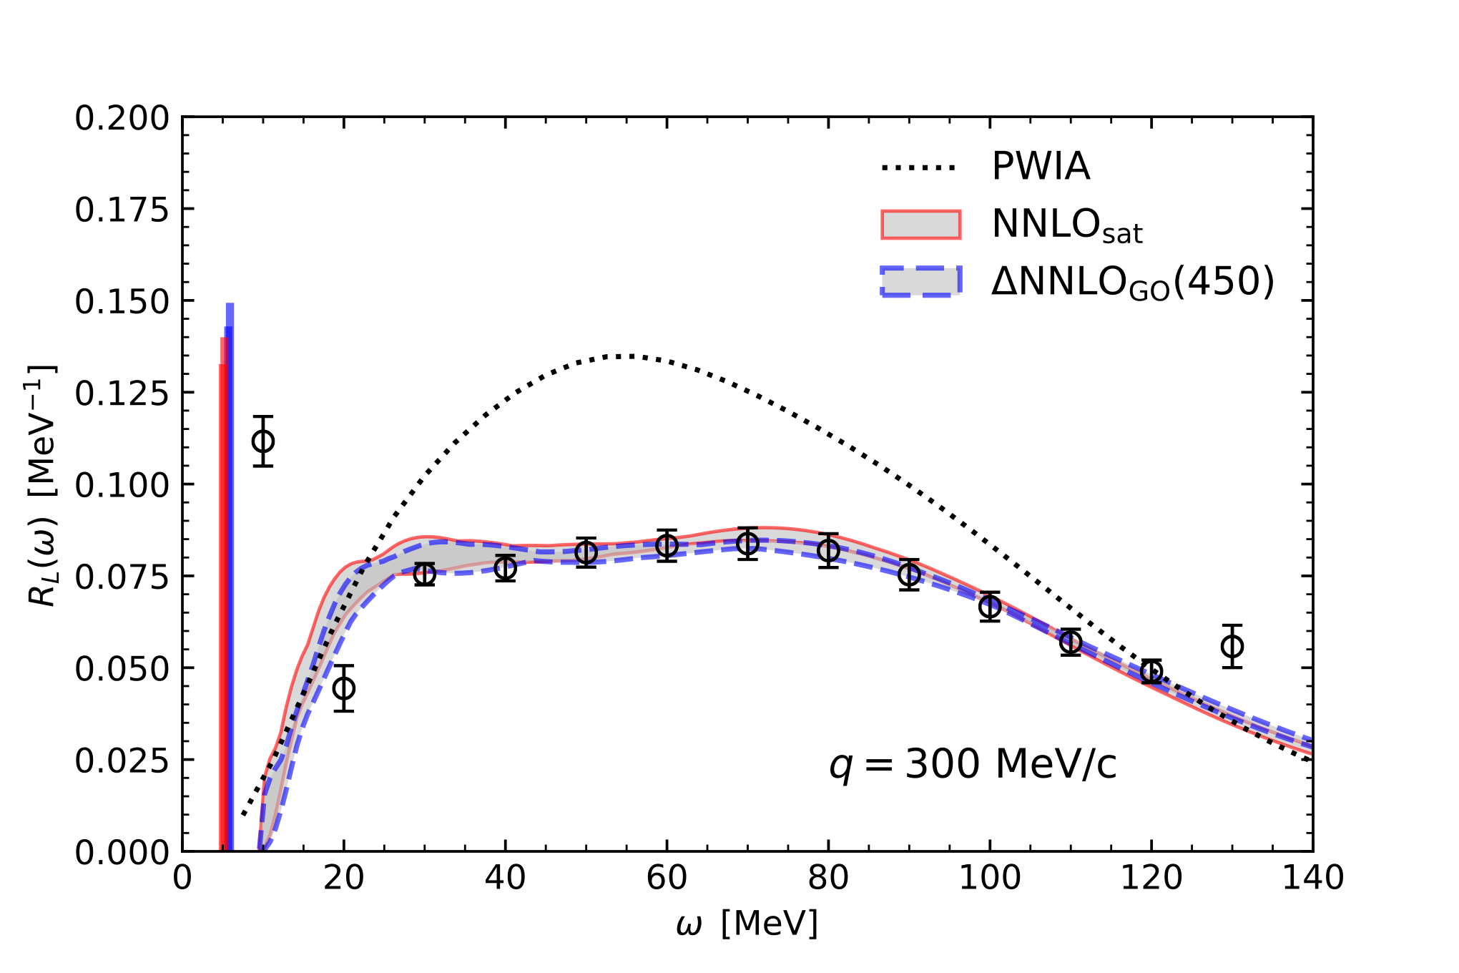
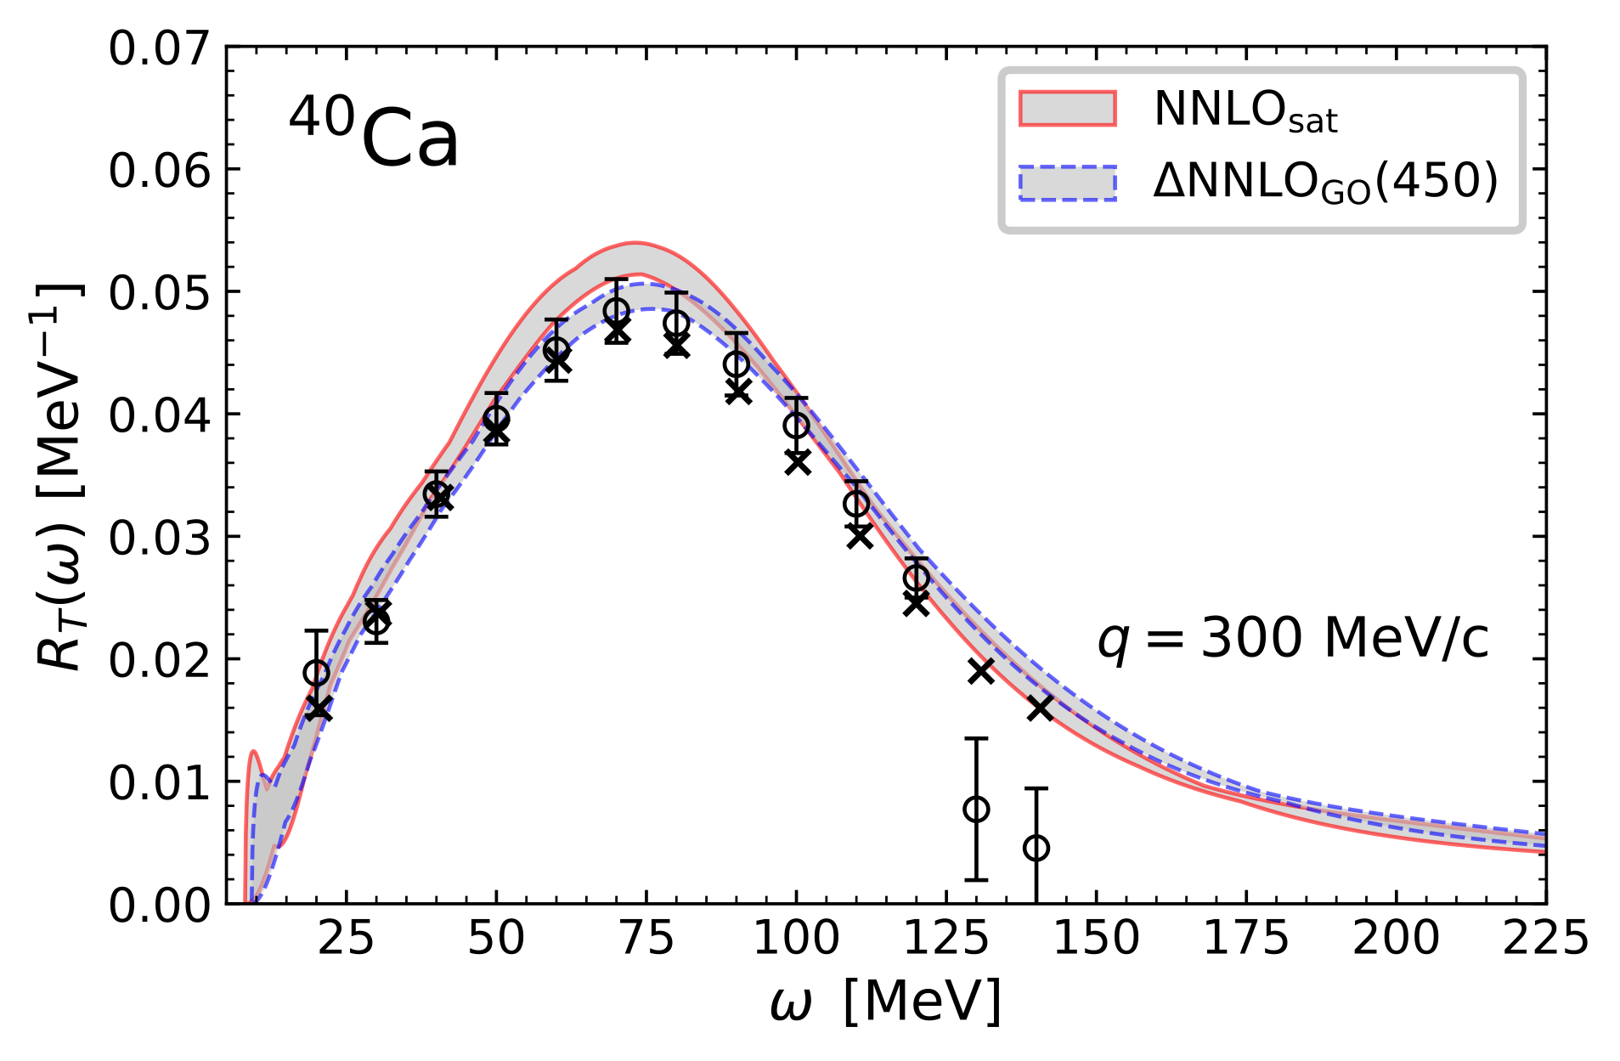
Quasi-elastic electron scattering off ⁴⁰Ca
Combined ab-initio coupled-cluster method with the Lorentz-Integral transform method to compute the response function for ⁴⁰Ca in the quasi-elastic energy regime
Good agreement with experimental data
This result is a stepping stone for computations of quasi-elastic neutrino scattering on ⁴⁰Ar
LIT-CC
⁴⁰Ca
LIT-CC
Sobczyk, Acharya, Bacca, Hagen, PRL 127 (2021) 7, 072501
Sobczyk, Acharya, Bacca, Hagen, PRC 109 (2024) 2, 025502

Slide 11
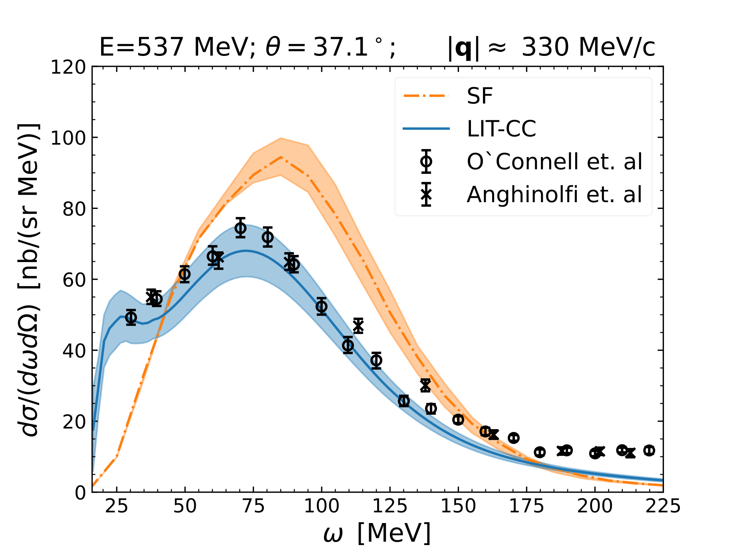
Quasi-elastic electron scattering off ¹⁶O
Acharya, Sobcyzk, Bacca, Hagen, Jiang in preparation (2024)
¹⁶O(e,e’)X
⁴⁰Ca
Notes:
16O(e, e′) differential cross section as a function of the energy transfer: the LIT-CC (solid line) and spectral function formalism (SF) (dashed- dotted line) calculations are compared to experimental data from Refs. [47, 48].

Slide 12
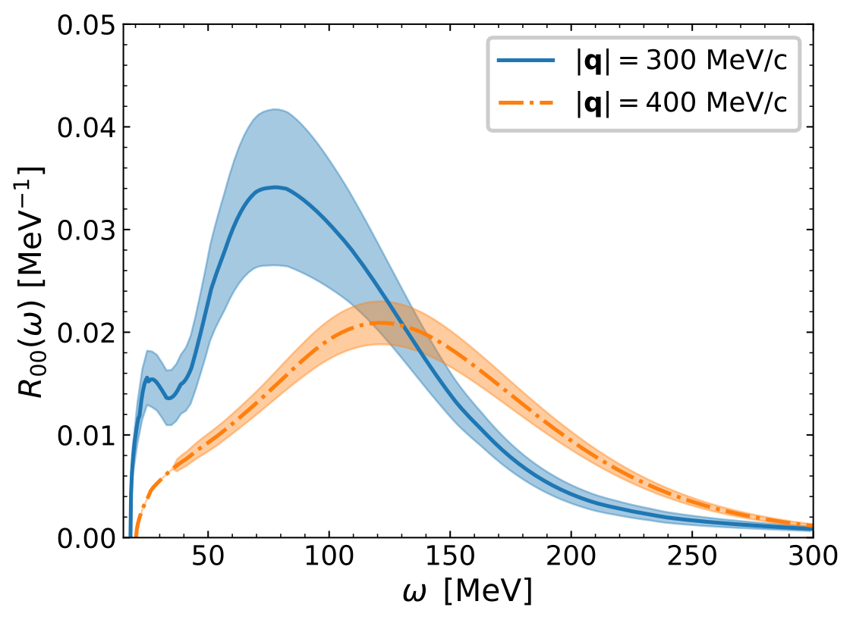
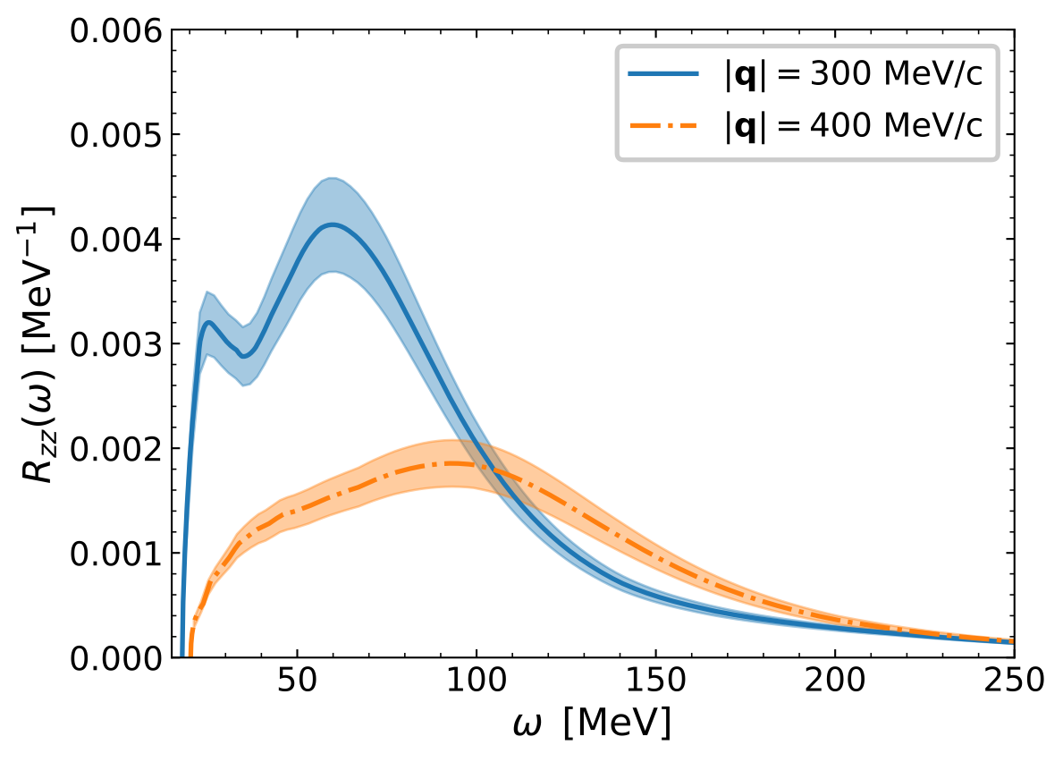
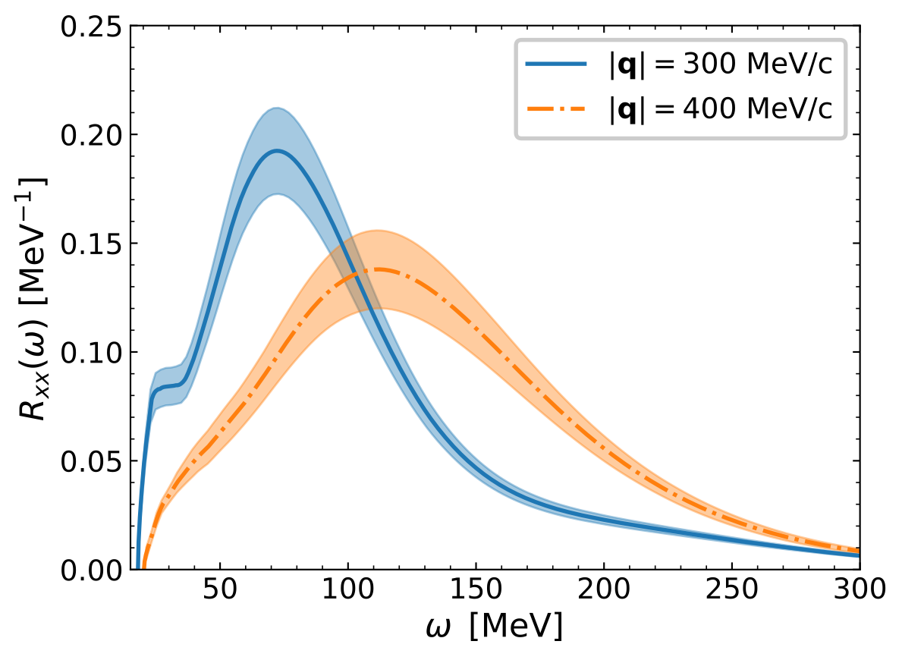
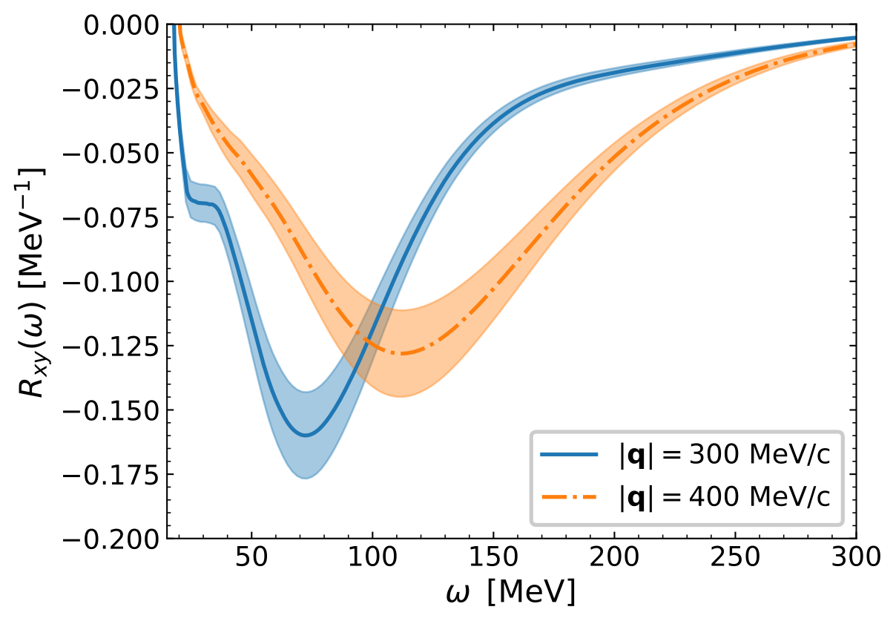
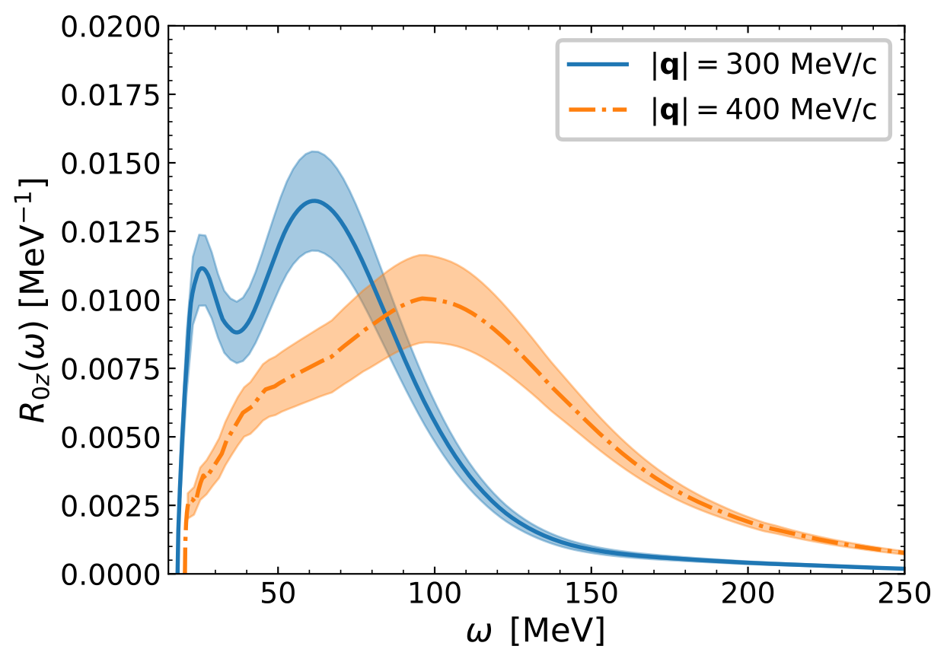
Neutrino scattering off ¹⁶O
Acharya, Sobcyzk, Bacca, Hagen, Jiang in preparation (2024)
See Weiguang Jiang’s talk on Friday
Notes:
The five different charge-current response functions related to 16O(νl, l−) reaction for q = 300, 400 MeV/c.

Slide 13
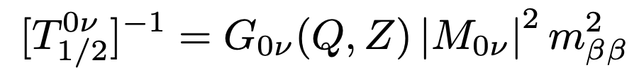
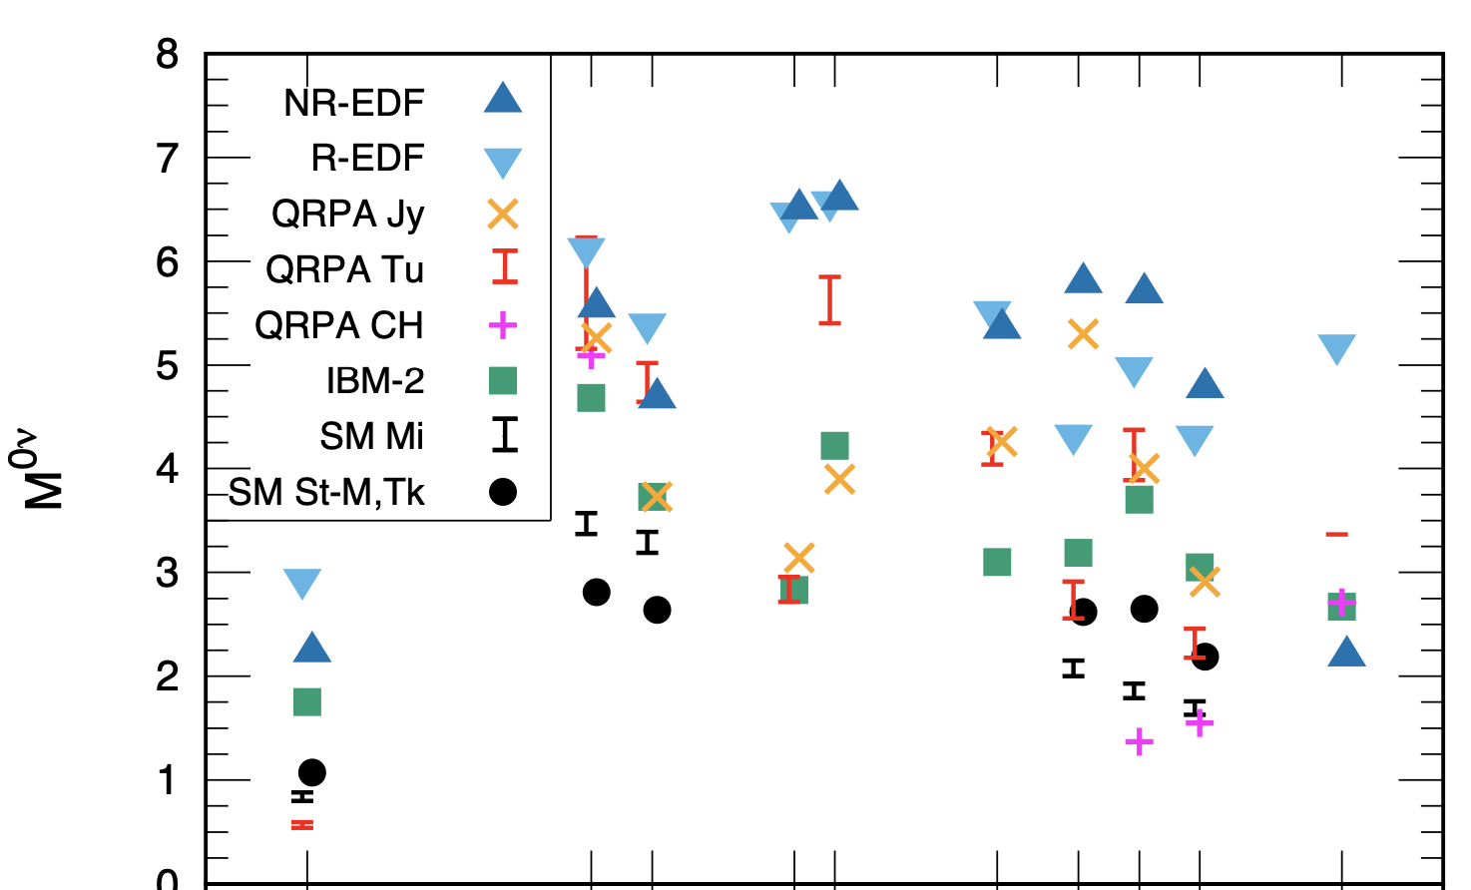
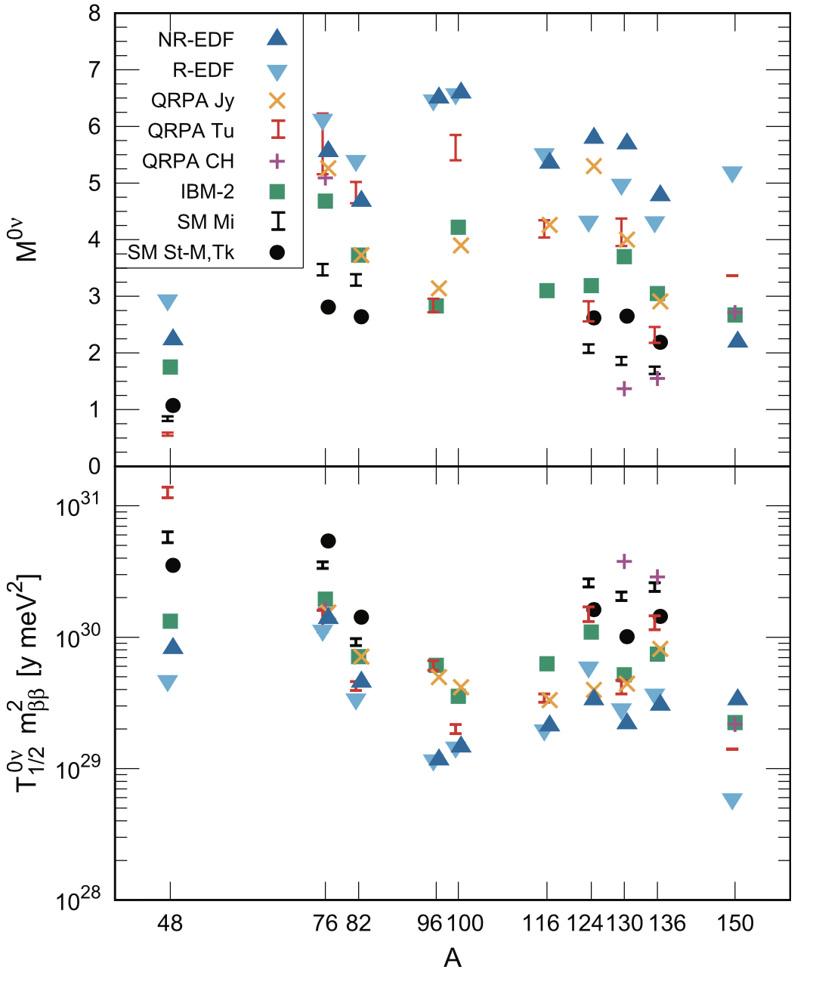
Neutrinoless ββ-decay of ⁴⁸Ca
The NME for 0νββ differ significantly depending on the method
Need to determine the NME more precisely with quantified uncertainties
What does ab-initio calculations add to this picture?
Nuclear matrix element for neutrinoless double beta decay for various candidates using different methods. J. Engel and Javier Menéndez, Rep. Prog. Phys. 80, 046301 (2017)

Slide 14
Neutrinoless ββ-decay of ⁴⁸Ca
0vbb benchmarks in light nuclei
S. J. Novario et al, Phys. Rev. Lett. 126, 182502 (2021)
First principles computations agree within uncertainties and predict a small value for the matrix element in ⁴⁸Ca
Next steps involve symmetry restoration, role of triaxial deformation, and heavier nuclei like ⁷⁶Ge used in upcoming ton-scale experimental programs

Slide 15
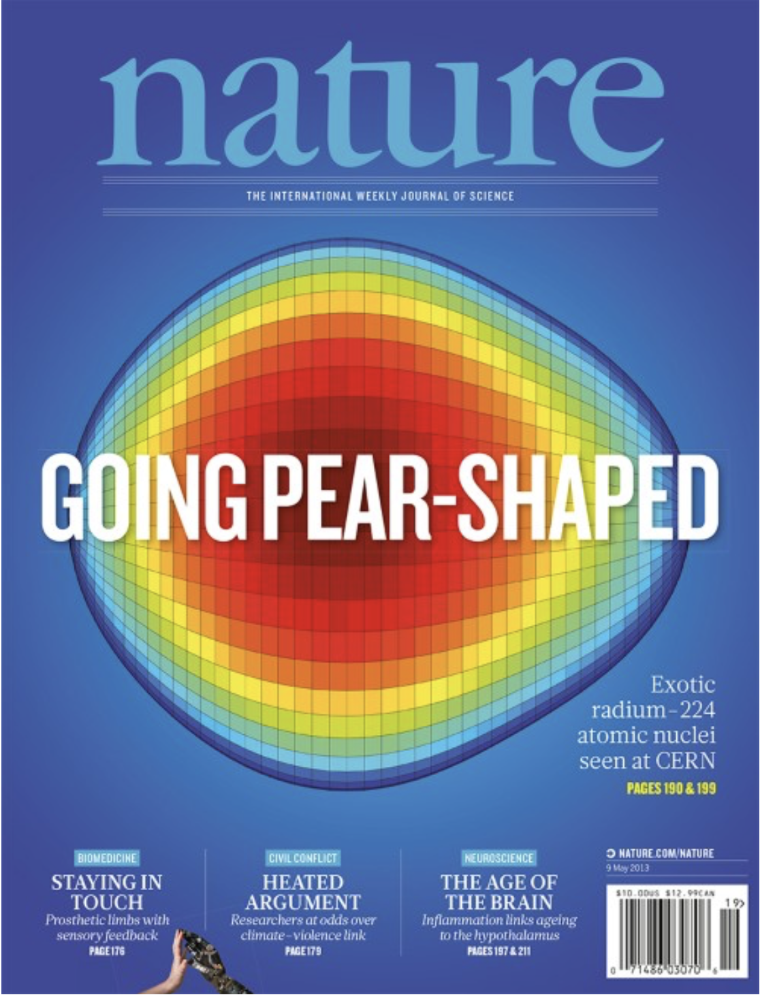
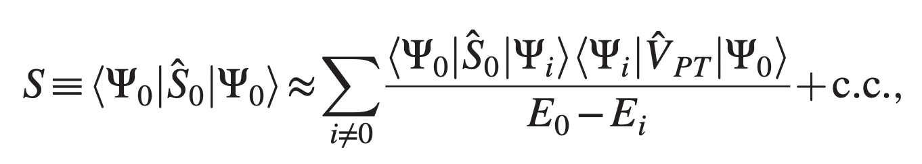
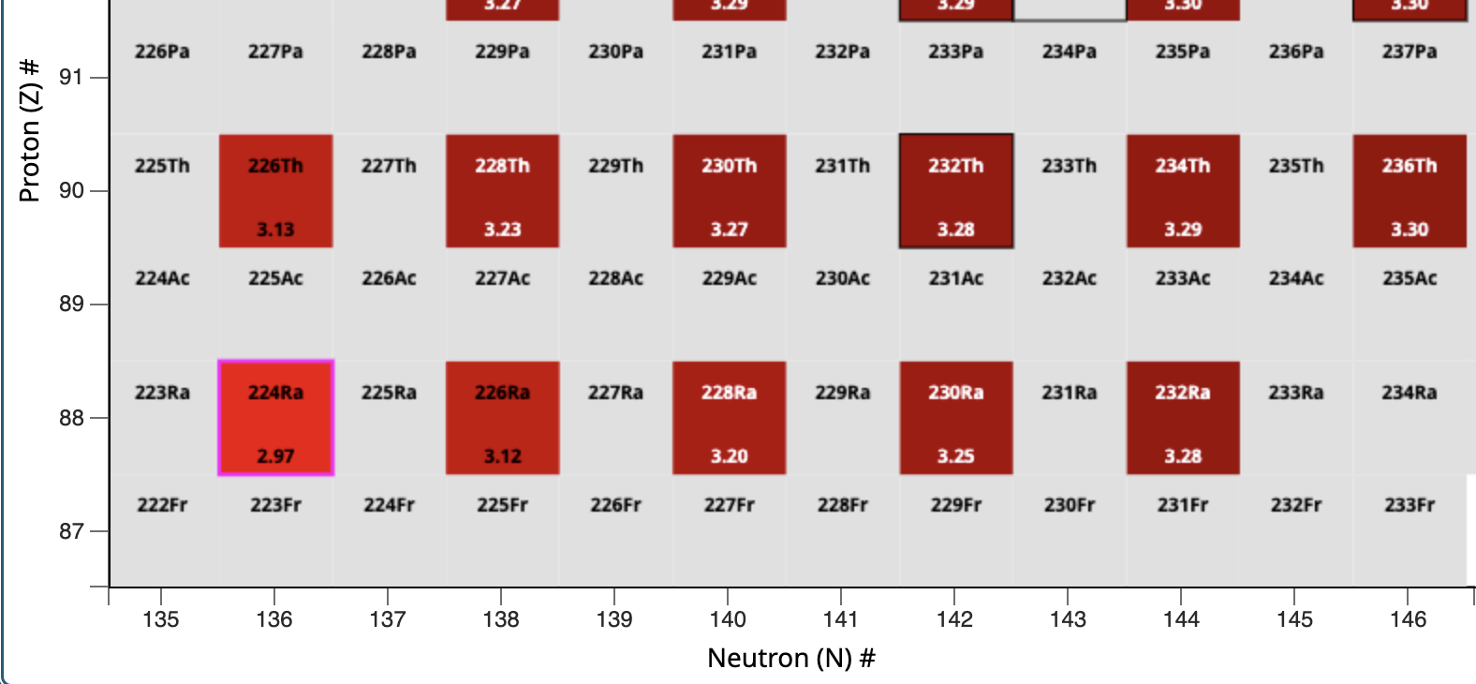
Towards ab-initio description of Schiff moments in ²²⁵Ra
Nature 2013,
octupole deformed ^{220,224}Ra
Computation of Schiff moment in ²²⁵Ra relevant for EDM searches in atoms and molecules. Schiff moment is particularly sensitive to octupole deformation
½+ and ½- parity doublet in ²²⁵Ra differ by only 50keV
Notes:
The scientific works were collaborations between theorists and hardware specialists (owners/operators of quantum chips).

Slide 16
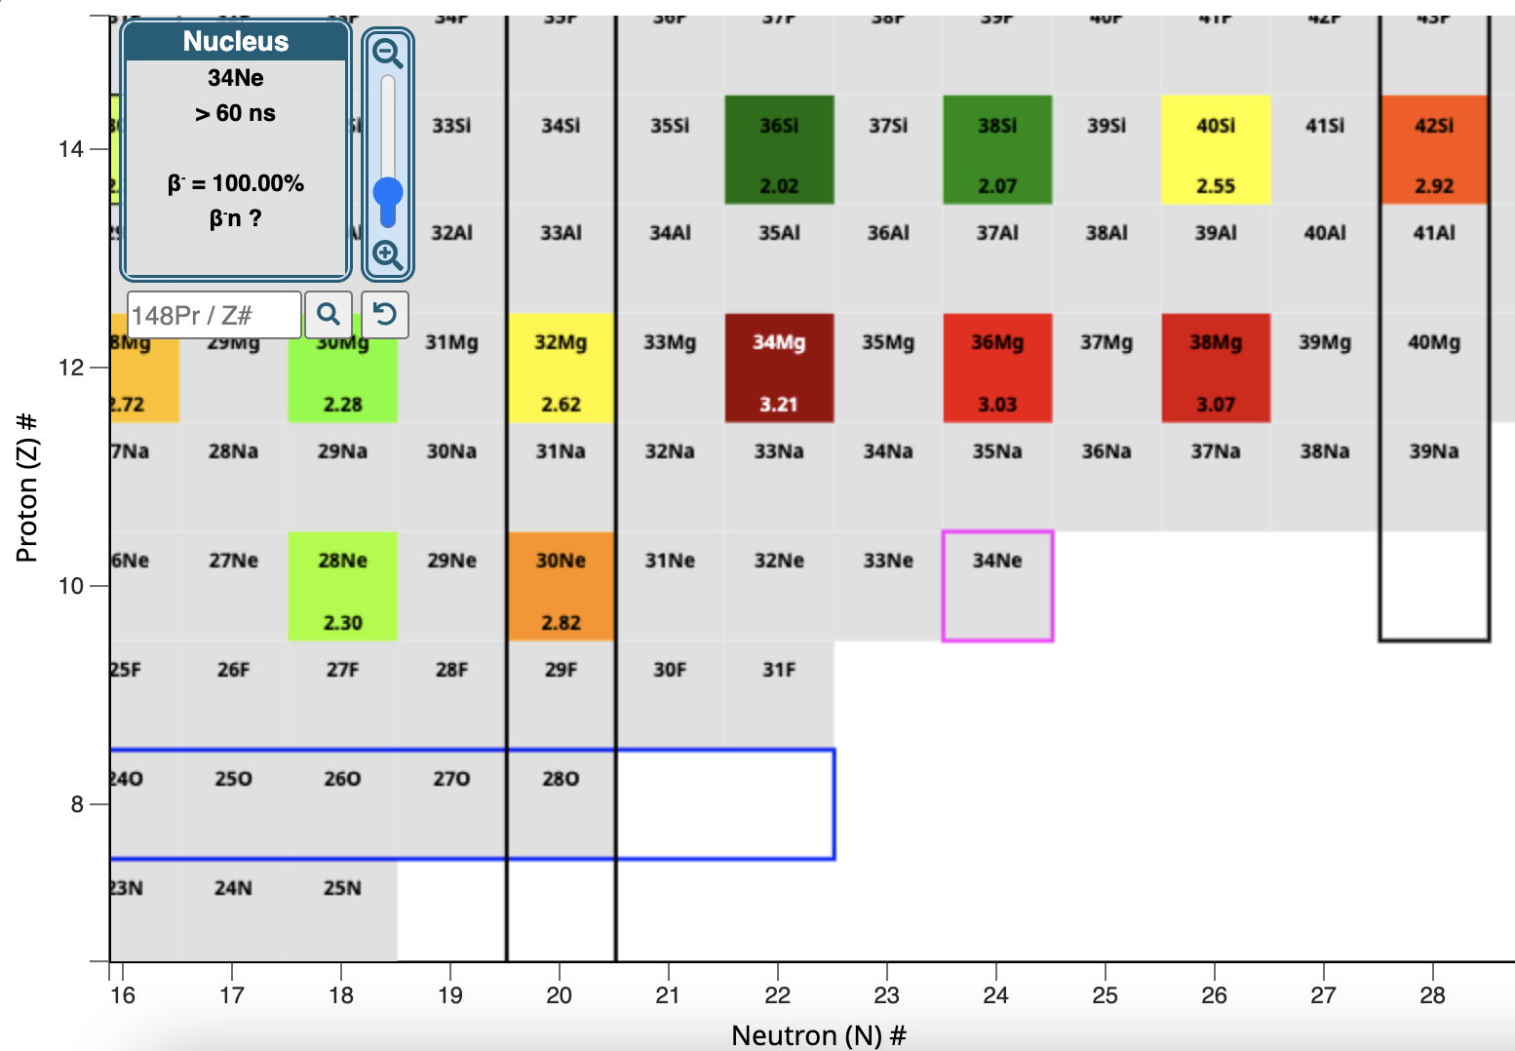
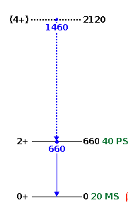
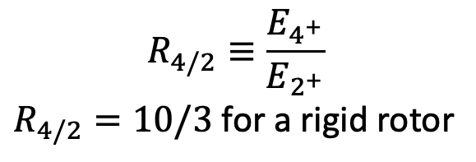
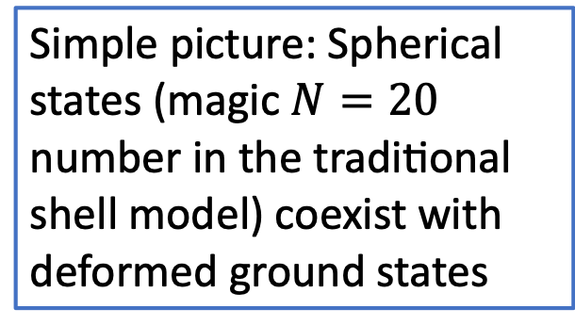
Neutron-rich nuclei beyond N = 20 are deformed
$$R_{4/2}≡\frac{E_{4^{+}}}{E_{2^{+}}}$$
$R_{4/2}=10/3$ for a rigid rotor
?
?
Simple picture: Spherical states (magic $N=20$ number in the traditional shell model) coexist with deformed ground states
³⁴Mg
(BE: 257MeV)
Poves & Retamosa (1987); Warburton, Becker, and Brown (1990); …

Slide 17
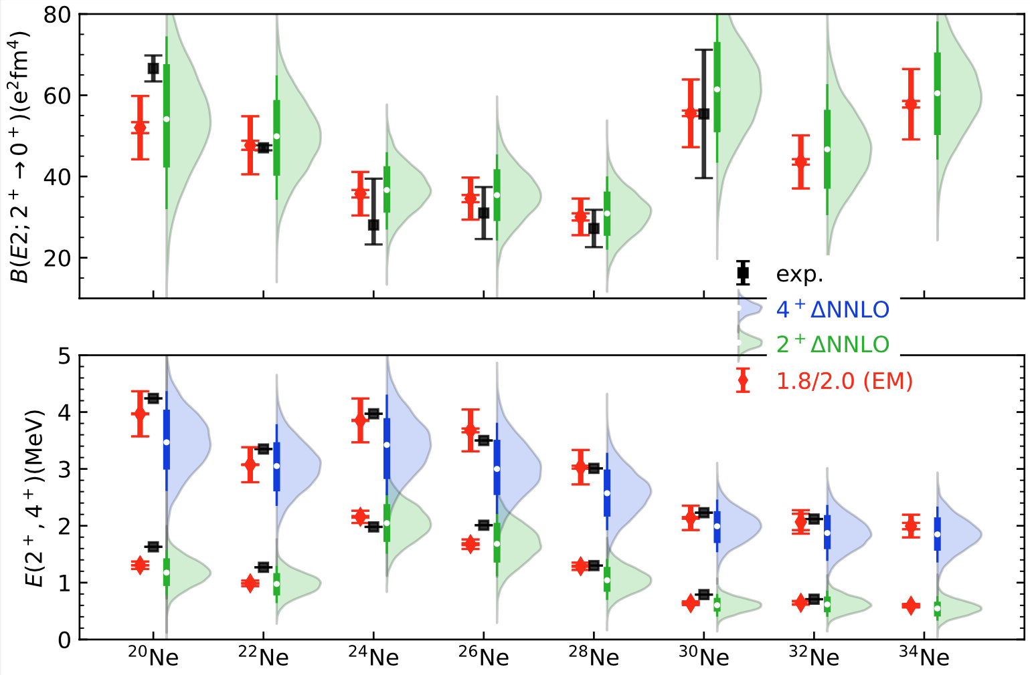
Collectivity in neon isotopes
Calculations follow data
No effective charges
Spectra of ³⁰⁻³⁴Ne follow that of a rigid rotor
Small energies reflect a large moment of inertia and a strong deformation
Ensemble of delta-full interactions from recent study of ²⁸O
Y. Kondo et al.,
Nature 620, 965–970 (2023)
Zhonghao Sun, A. Ekstrom, C. Forssen, G. Hagen. G. R. Jansen, T. Papenbrock arXiv:2404.00058 (2024)

Slide 18
Shape co-existence in ³⁰Ne
Zhonghao Sun, A. Ekstrom, C. Forssen, G. Hagen. G. R. Jansen, T. Papenbrock arXiv:2404.00058 (2024)
Notes:
signatures of the N = 20 magic number can be seen in our calculations and lead to shape coexistence

Slide 19
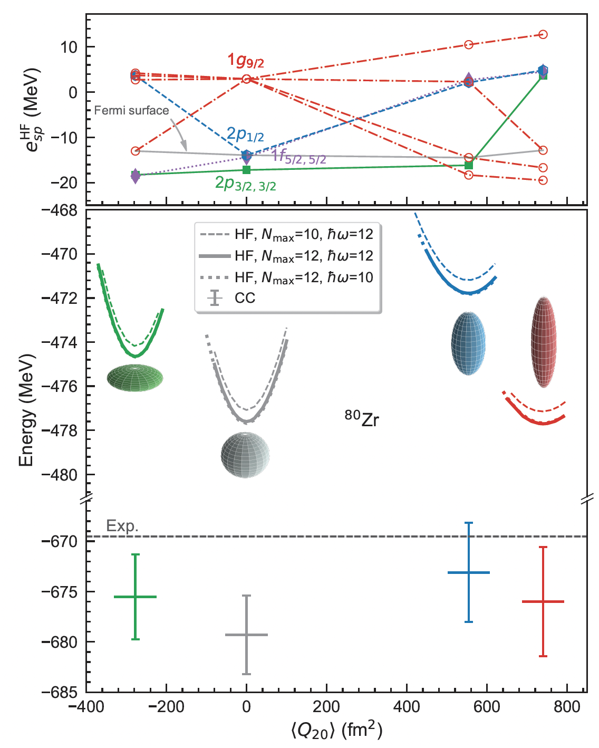
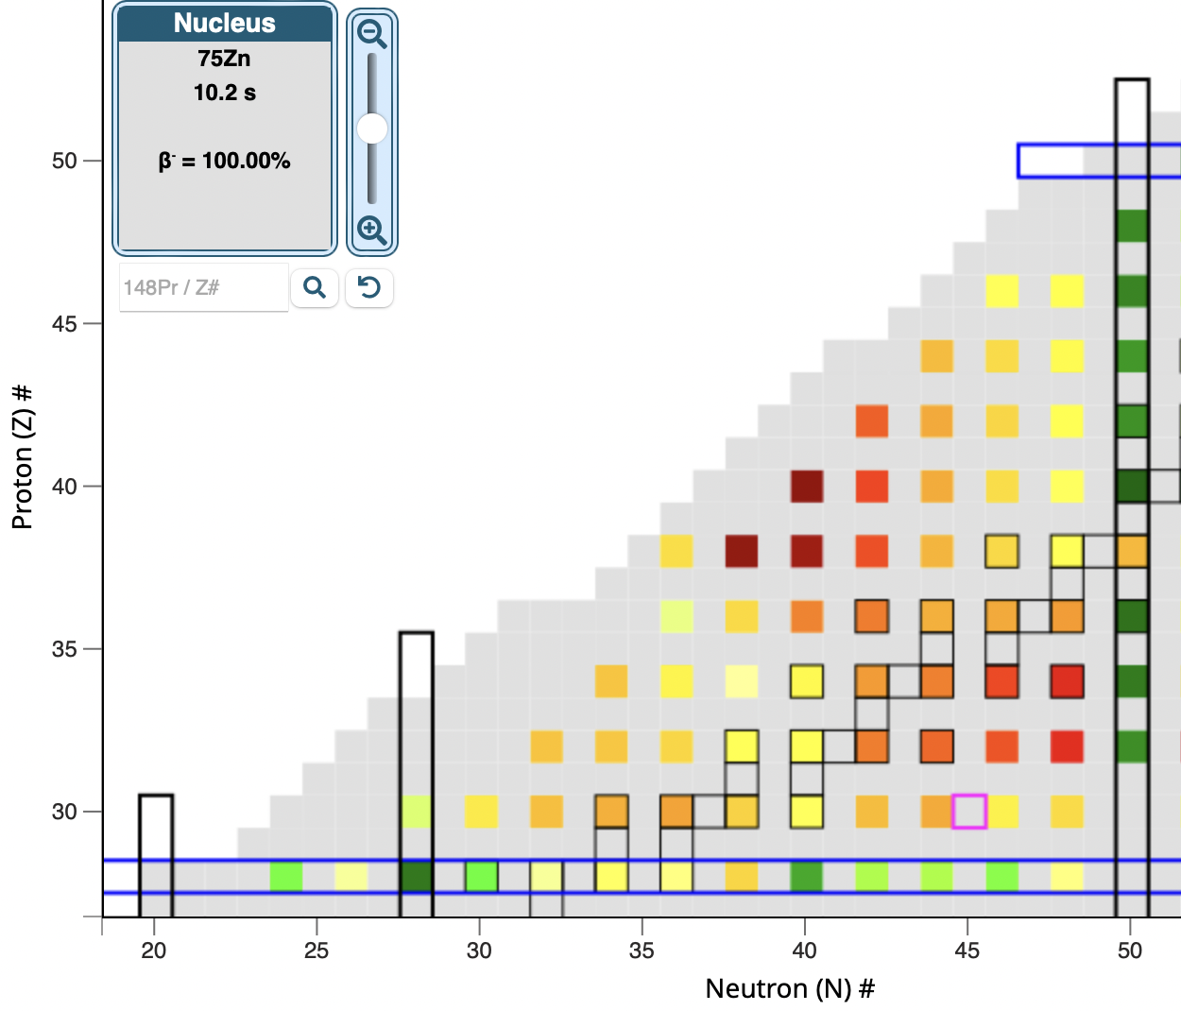
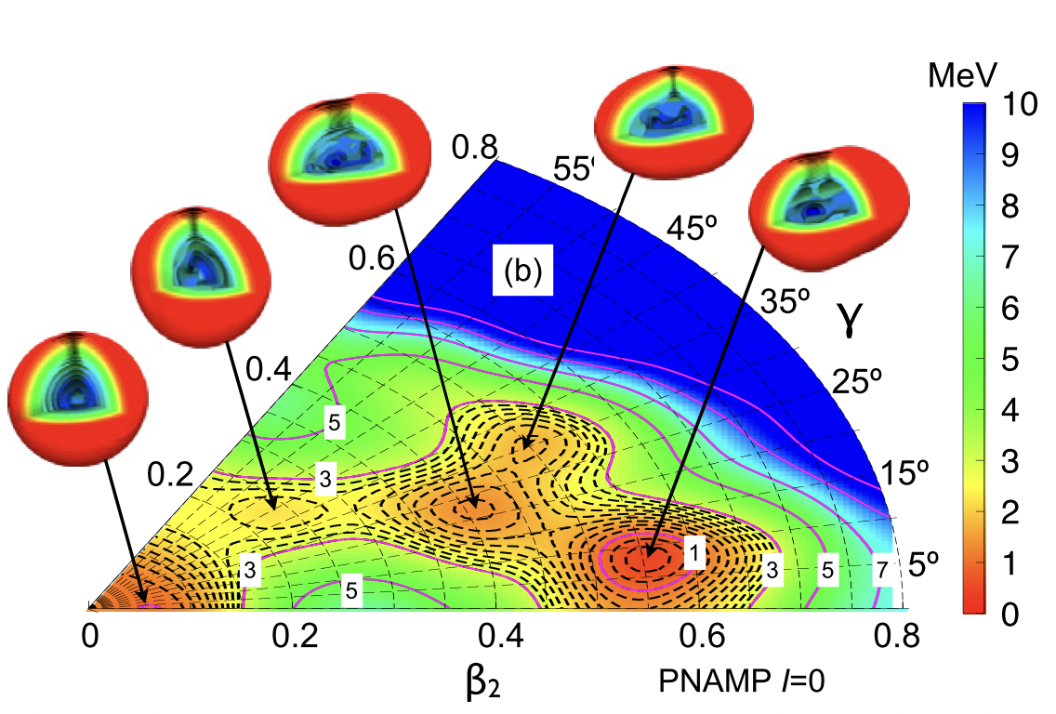
Strongly deformed nuclei around ⁸⁰Zr
Tomás R. Rodríguez, J. Luis Egido,
Phys. Lett. B 705 255 (2011)
N = Z
Baishan Hu, Zhonghao Sun, G. Hagen, T. Papenbrock. Phys. Rev. C 110, L011302 (2024)

Slide 20
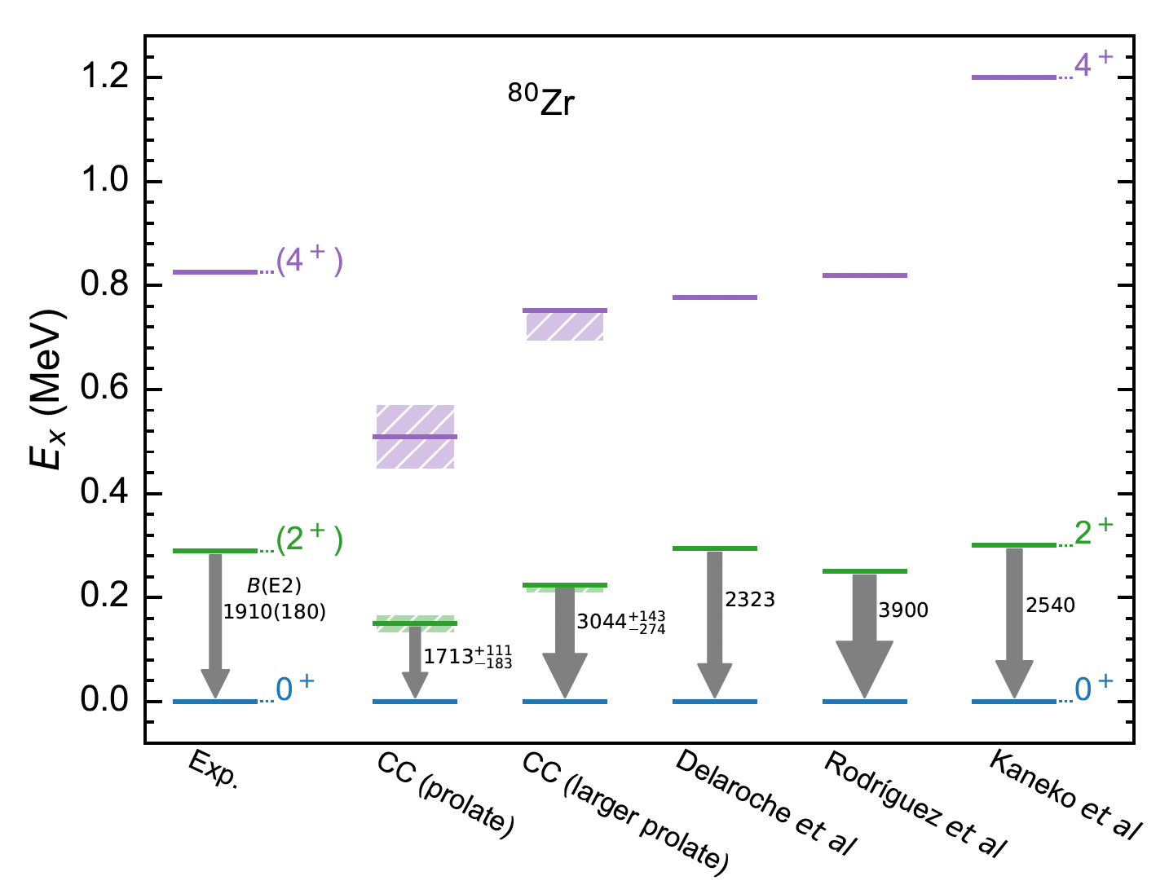
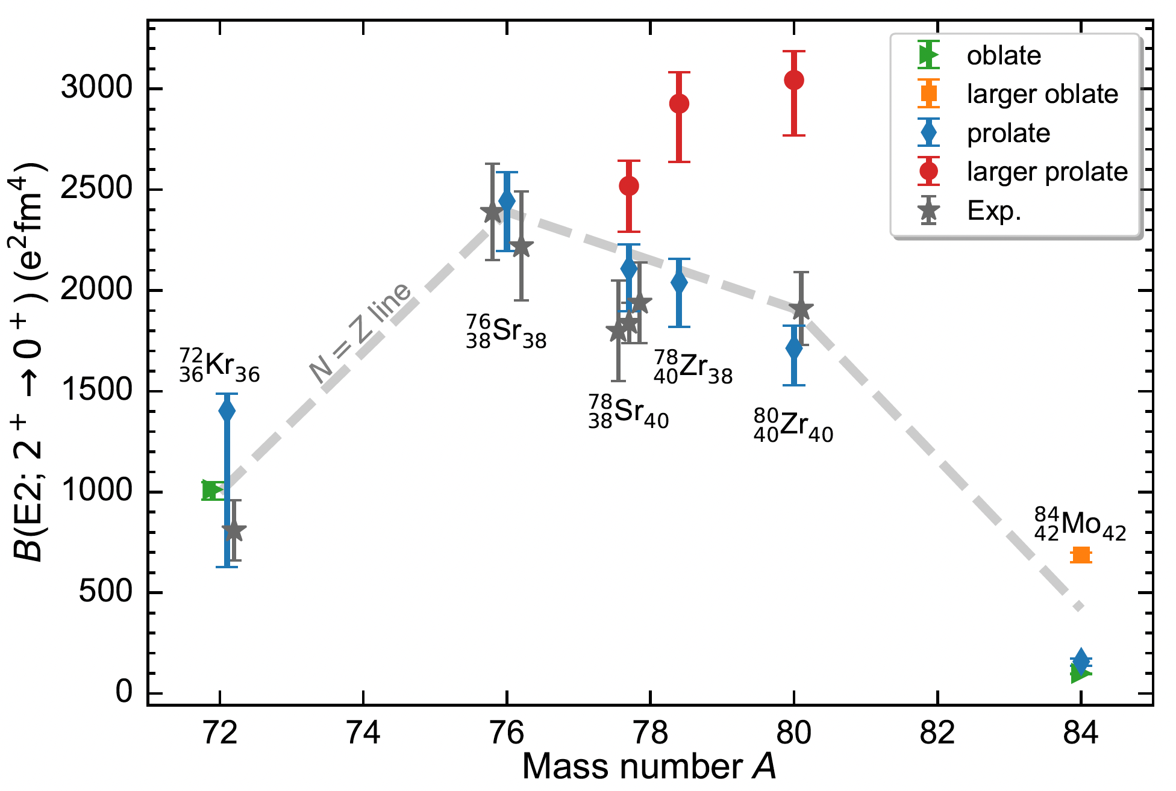

Coupled-cluster computations of strongly deformed nuclei around ⁸⁰Zr
Spectrum prefers larger prolate shape
$B(E2)$ prefers prolate band
1.8/2.0(EM)
Baishan Hu, Zhonghao Sun, G. Hagen, T. Papenbrock. Phys. Rev. C 110, L011302 (2024)

Slide 21
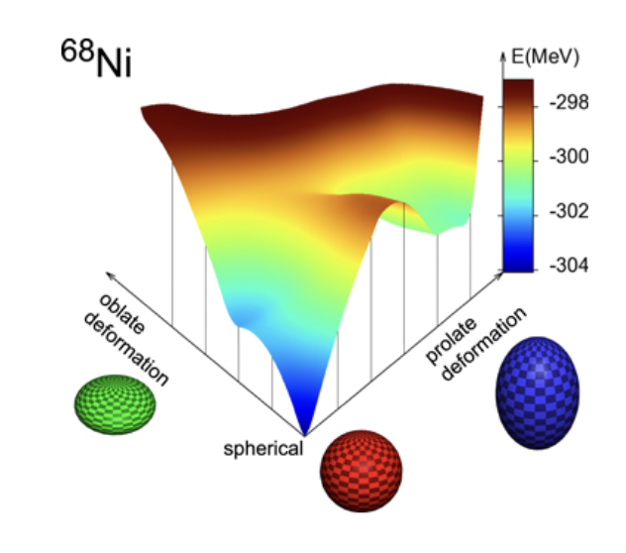
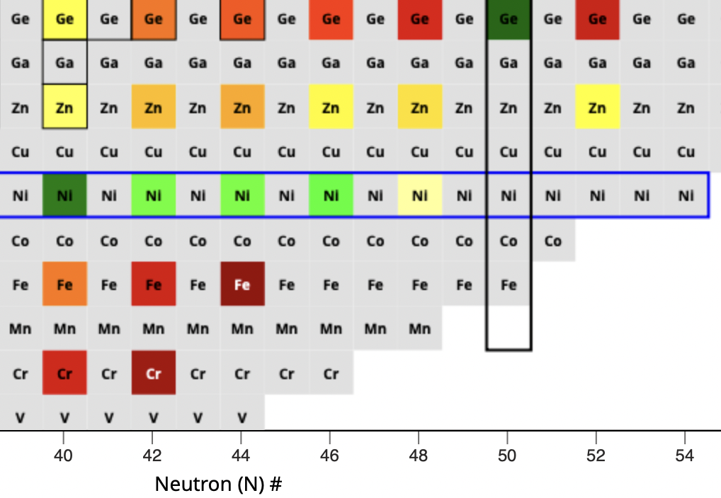
Deformation “south” of ⁷⁸Ni
R. Taniuchi, et al, Nature 569, 53 (2019)
T Otsuka and Y Tsunoda J. Phys. G 43 024009 (2016)
Deformed band?
Where is the band head?

Slide 22
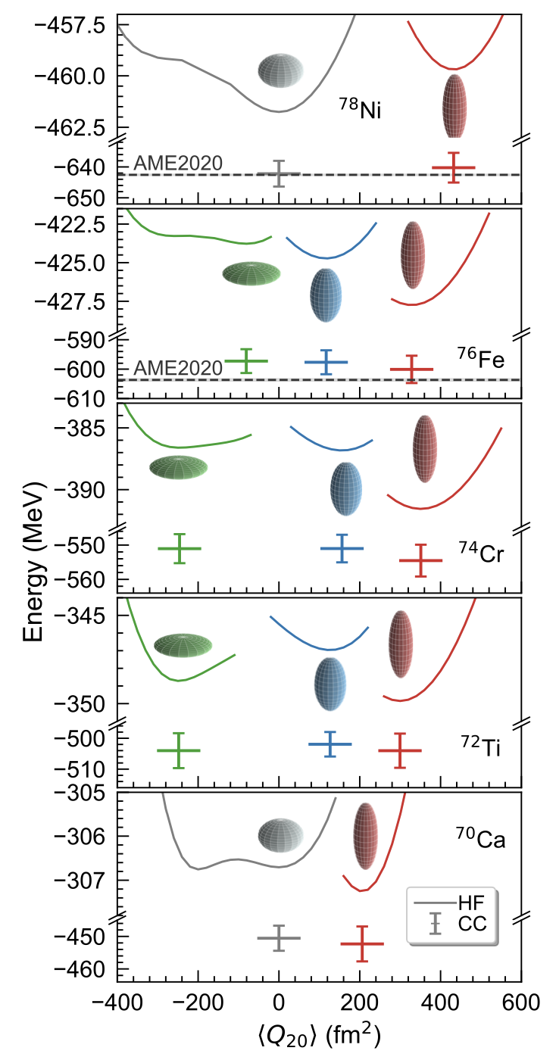
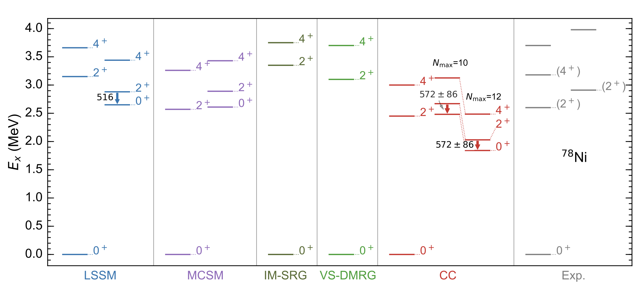
Deformation “south” of ⁷⁸Ni
Erosion of the magic number N = 50 toward ⁷⁰Ca manifested by onset of deformation in the ground-states
For ⁷⁸Ni we predict a low-lying rotational band consistent with recent data and other
B. Hu, Z. Sun, G. Hagen, G. R. Jansen, T. Papenbrock, Phys. Lett. B 858, 139010 (2024)

Slide 23
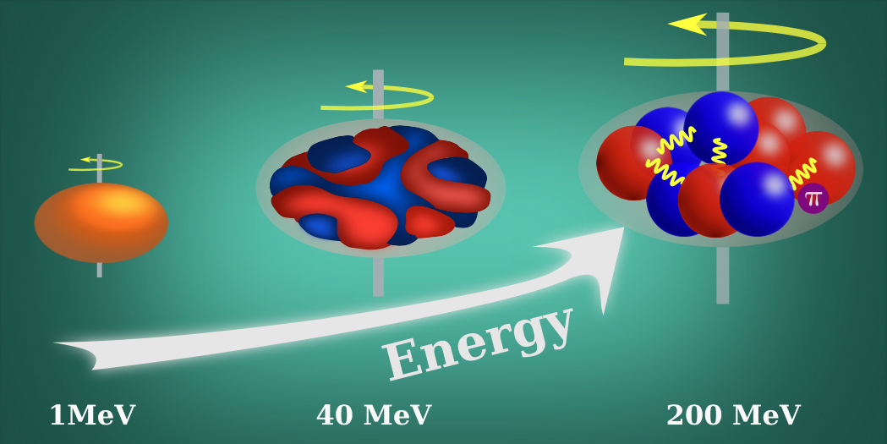
What drives deformation in nuclei?
50’s: surface vibrations of a liquid drop (Bohr/Mottelson)
60’s: competition between pairing and quadrupole interactions from HFB calculations in two shells (Baranger/Kumar)
70’s: isoscalar neutron-proton interactions dominate over isovector pairing from shell model (Federman/Pittel, Dufour/Zuker)
Parameters of the model
(17 at NNLO)
Constrained by data & carry uncertainties
Nuclear deformation viewed at different resolution scales

Slide 24
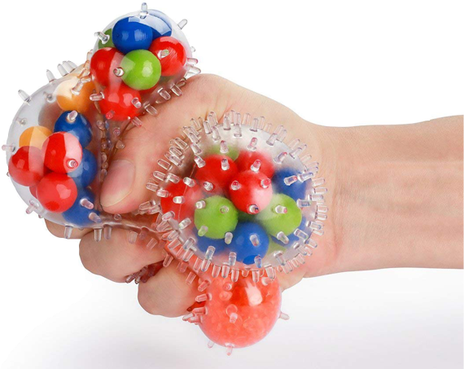
Global sensitivity analysis
Sensitivity analysis addresses the question ‘How much does each model parameter contribute to the uncertainty in the prediction?’
Global methods deal with the uncertainties of the outputs due to input variations over the whole domain.
Computational bottleneck
A global sensitivity analyses of properties of atomic nuclei typically would require more than one million model evaluations
Sensitivity analysis of the radius and binding energy of ¹⁶O
Andreas Ekström, Gaute Hagen PRL 123, 252501 (2019)

Slide 25
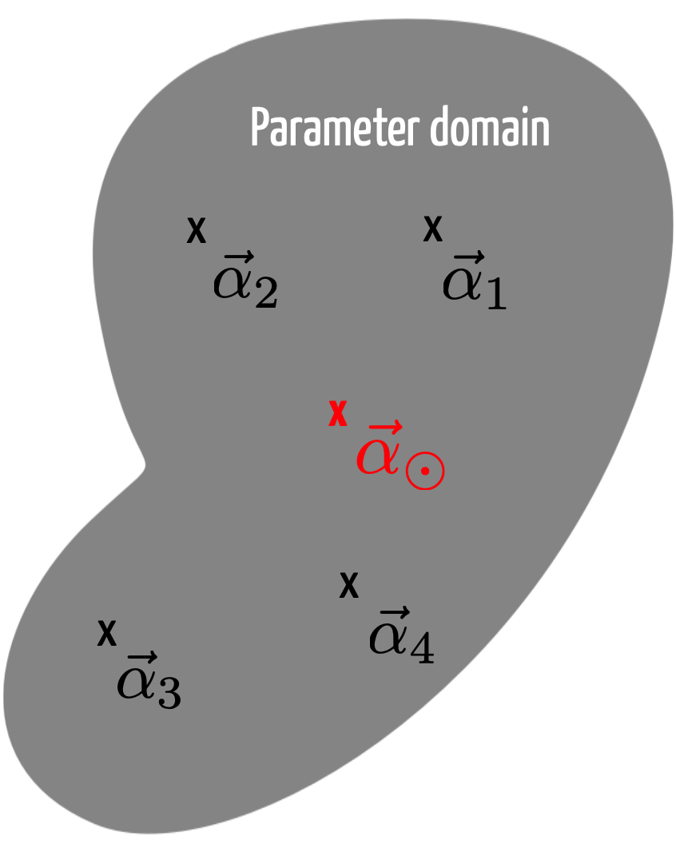
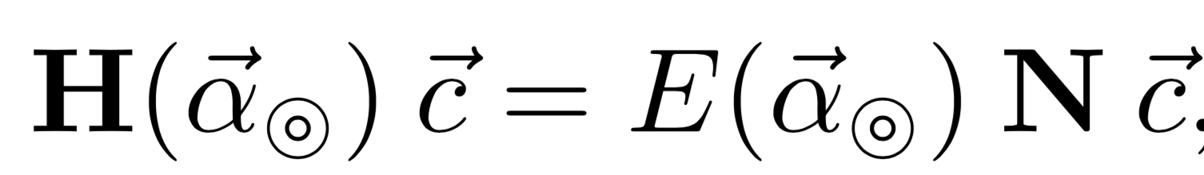
Reduced order model for deformed states
Zhonghao Sun, A. Ekstrom, C. Forssen, G. Hagen. G. R. Jansen, T. Papenbrock arXiv:2404.00058 (2024)
Eigenvector continuation method [Frame D. et al., Phys. Rev. Lett. 121, 032501 (2018), A. Ekström, G. Hagen PRL 123, 252501 (2019), S. König et al Phys. Lett. B 810 (2020) 135814]
Write the Hamiltonian in a linearized form
Select “training points” (snap-shots) where we solve the exact problem
Project a target Hamiltonian onto sub-space of training vectors and diagonalize the generalized eigenvalue problem
Latin Hypercube Sampling

Slide 26
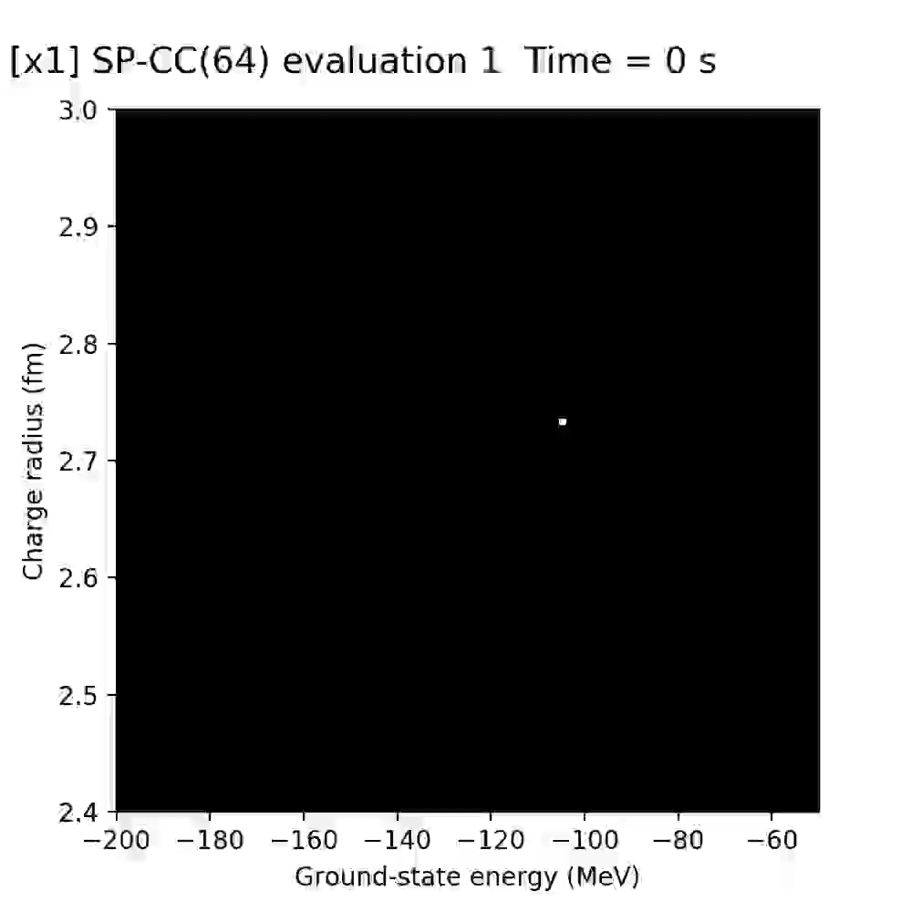
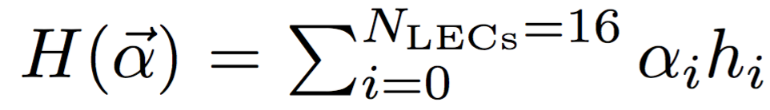
Computing nuclei at lightning speed
(~5 mins: ~10⁵ energy/radius calculations of ¹⁶O)
Realtime speed and accuracy of emulated ground-state energy and charge radius of ¹⁶O for different values of interaction parameters
Accuracy: roughly the pixel size
Speedup: 20 years of single node computations can be replaced by a 1 hour run on a laptop
Andreas Ekström, Gaute Hagen PRL 123, 252501 (2019)
Notes:
space-filling latin hypercube design
Select 64 and 128 sub-space vectors in the 16 dimensional space of LECs using a space-filling latin hypercube design

Slide 27
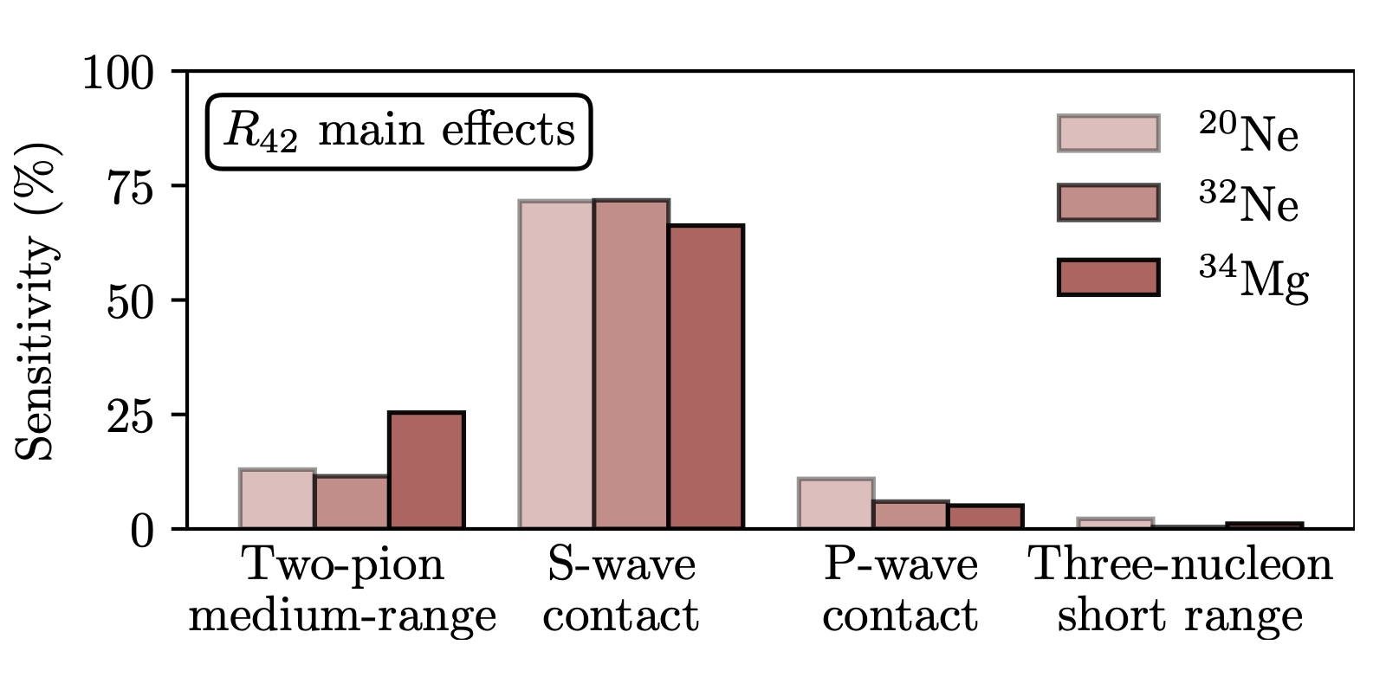
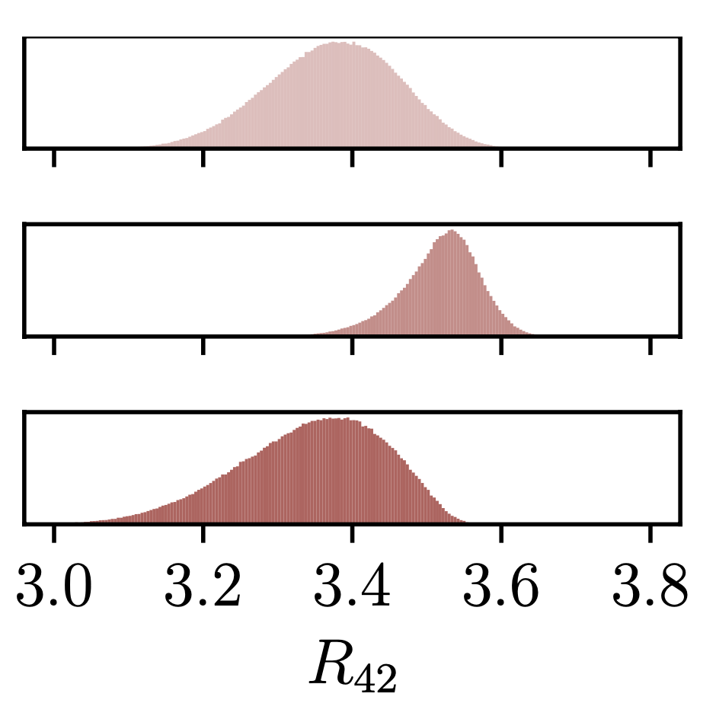
Linking deformation to nuclear forces
~10⁶ samples
More than 50% of the deformation is driven by the S-wave contact part of the interaction
Adding short-range repulsion increase deformation presumably by reducing pairing
Medium-range two-pion exchange is also important. Increasing its strength increases deformation, presumably by adding attraction in higher partial waves
Notes:
The first order sensitivity apportions the total variance in the model output to an individual model parameter αi. The higher-order indices, e.g. Sij, apportion the variance in the model output to the combination of parameters αi and αj

Slide 28

Ab-initio description of Schiff moments in heavy deformed nuclei?
Preliminary
N_{max} = 10, hw = 10MeV
E_{3max} = 28
1.8/2.0(EM)
Notes:
The scientific works were collaborations between theorists and hardware specialists (owners/operators of quantum chips).

Slide 29


Ab-initio description of Schiff moments in heavy deformed nuclei?
Preliminary
Notes:
The scientific works were collaborations between theorists and hardware specialists (owners/operators of quantum chips).

Slide 30
Summary
Breaking and restoring symmetries
  Exploits separation of scale between collective and specific UV physics
  Conceptually simple & computationally affordable
  Towards ab-initio modeling of neutrino-nucleus scattering
  Ab-initio theory predicts a smaller matrix element for 0vbb in 48Ca
  Shape coexistence in ³⁰Ne and ³²Mg
  Much improved B(E2) values with no effective charges in ^{3x}Ne, ^{3x}Mg, ⁸⁰Zr
  Connected deformation to microscopic forces
  Predict low-lying rotational band in ⁷⁸Ni consistent with data
  Towards ab-initio computations of Schiff moments in ²²⁵Ra

Slide 31
Questions:
What precision should we aim for with ab-initio methods?
Why do some interaction models work “better”?
How can we better assess the uncertainties?
Thank you for your attention!

Slide 32


Why do people care about M1 transitions?
Supernova 1987A
M1 spin excitations are dominated by isovector contributions.
The isovector-0 component of the Gamow-Teller operator translates to inelastic neutral-current neutrino-nucleus reactions at energies relevant for supernovae.
Our understanding of M1 impacts supernovae signals and dynamics.
Lüttge, von Neumann-Cosel, Neumeyer, Richter, Nucl Phys A (1996);
Langanke, Martinez-Pinedo, von Neumann-Cosel, Richter, Phys Rev Lett (2004);
Loens, Langanke, Martinez-Pinedo, Sieja, EPJA (2012);
Tornow et al, Phys Letts B (2022).
Review on $M1$:
K. Heyde, P. von Neumann-Cosel, A. Richter, Rev. Mod. Phys. 82, 2365 (2010).
February 24, 1987
Las Campanas Observatory

Slide 33




The status
$\left(e,e^{′}\right)$ scattering: $B\left(M1\right)=4{.0±0.3 μ}_{N}^{2}$ [Steffen et al 1980; 1983]
$\left(γ,n \right)$ scattering: $B\left(M1\right)=6{.8±0.5 μ}_{N}^{2}$ [Tompkin et al 2011]
$\left(p,p′\right)$ scattering: $B\left(M1\right)=3{.85\left(32\right)−4.63(38) μ}_{N}^{2}$ [Birkhan et al 2016]
Extreme s.p. model: $B\left(M1\right)=12 μ_{N}^{2}$
Theory has a hard time to reproduce a large amount of quenching
Meson-exchange currents claimed to explain small $B(M1)$
Harting, W. Weise, H. Toki, and A. Richter, Physics Letters B 104, 261 (1981).
J. B. McGrory and B. H. Wildenthal, Phys. Lett. B 103, 173 (1981).
Toru Suzuki, S. Krewald, and J. Speth, Phys. Lett. B 107, 9 (1981).
G. F. Bertsch, Nucl. Phys. A 354, 157 (1981).
M. Kohno and D. W. L. Sprung, Phys. Rev. C 26, 297 (1982).
K. Takayanagi, K. Shimizu, and A. Arima, Nucl. Phys. A 481, 313 (1988).
M. G. E. Brand, K. Allaart, and W. H. Dickhoff, Nucl. Phys. A 509, 1 (1990).
B. A. Brown and W. A. Richter, Phys. Rev. C 58, 2099 (1998).
J. D. Holt, J. Menendez, J. Simonis, and A. Schwenk, Phys. Rev. C 90, 024312 (2014).
J. Wilhelmy, et al., Phys. Rev. C 98, 034315 (2018).
All too high $B\left(M1\right);$
$B\left(M1\right)=7−8μ_{N}^{2}$; $B\left(M1\right)>5.1μ_{N}^{2};$
Reproduce $(e,e^{′})$ $B(M1)$ if quenched

Slide 34




The resonant 1⁺ state in ⁴⁸Ca at 10.224 MeV
Scattering / reactions that probe the $1^{+}$ state: $(e,e^{′})$, $(p,p′)$, $(p,n)$, or $(γ,n)$
Simple picture of the $1^{+}$ state: neutron 1p-1h excitation; extreme single-particle model: $B\left(M1\right)=12 μ_{N}^{2}$
Bijaya Acharya et al., Phys. Rev. Lett. 132, 232504 (2024)

Slide 35

Contributions to B(M1)
continuum
2p-2h correlations
2B currents
3p-3h correlations
Bijaya Acharya et al., Phys. Rev. Lett. 132, 232504 (2024)

Slide 36

Magnetic dipole transition in ⁴⁸Ca
Bijaya Acharya et al., Phys. Rev. Lett. 132, 232504 (2024)

Slide 37

Deformation “south” of ⁷⁸Ni
spectra largely agree with shell-model results within our uncertainty estimates
Baishan Hu, Zhonghao Sun, G. Hagen, G. R. Jansen, T. Papenbrock arXiv:2408.07856 (2024)

Slide 38

Summary
The discrepancy between $(e,e^{′})$ and $(γ,n)$ experiments regarding $B(M1)$ in ⁴⁸Ca is puzzling
Our ab initio computations based on chiral effective field theory, including treatment of the state as a resonance, yield $7μ_{N}^{2}<B\left(M1\right)<10 μ_{N}^{2}$
  Two-body currents do not yield a quenching
Resolution of this situation will impact ab initio computations and/or theory of neutrino-nucleus reactions relevant for supernova signals and dynamics
Thank you for your attention!

