Slide 1

Nuclear matter equation of state and electromagnetic observables in nuclei
Francesca Bonaiti, JGU mAinz
EPIC workshop, sardinia
September 26, 2024

Slide 2
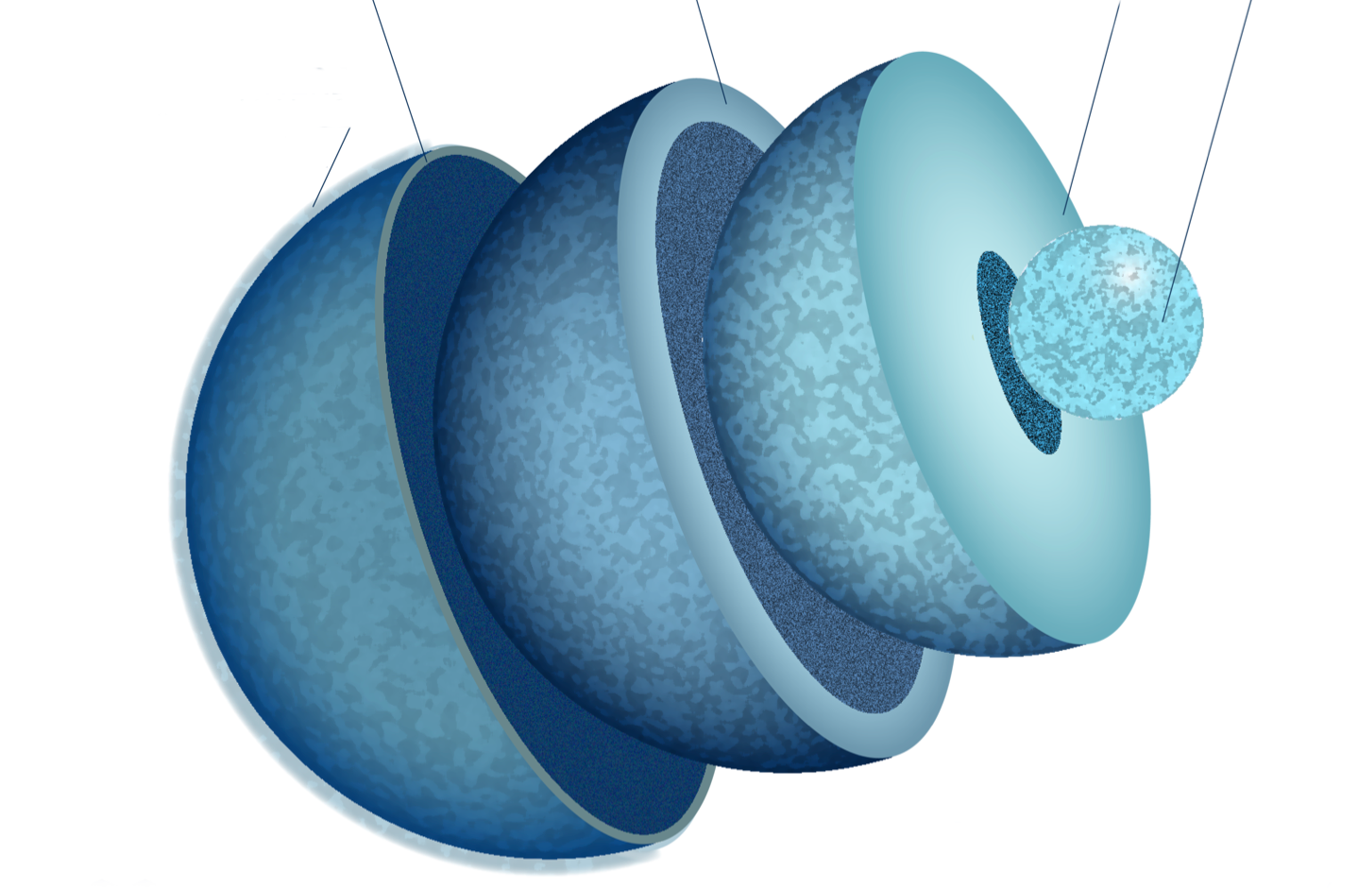
Extreme matter in neutron stars
Outer crust
Inner crust
Outer core
Atmosphere
Inner core
n = n₀ ∼ 0.16 fm⁻³
saturation density
Density
Image credits:
MUSES Collaboration

Slide 3
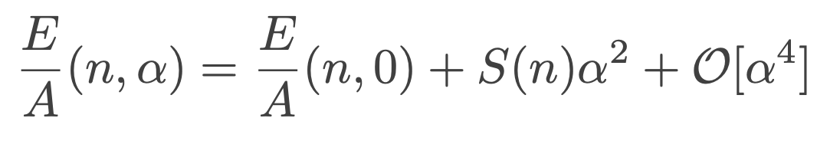

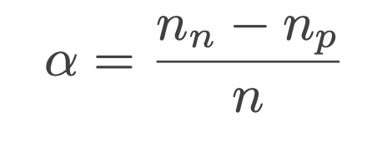
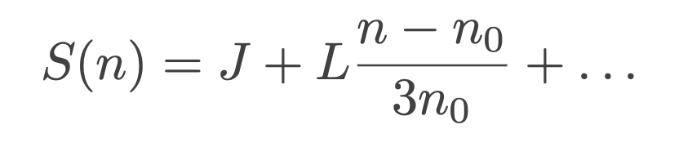
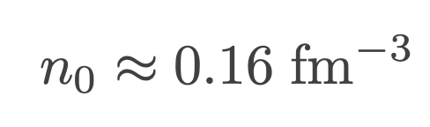
Neutron matter equation of state (EOS)
Infinite nuclear matter EOS:
where the symmetry energy is:
saturation density
symmetry energy
at saturation density
slope parameter, related to pressure of pure neutron matter
at saturation density

Slide 4
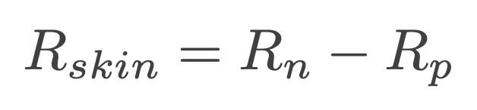
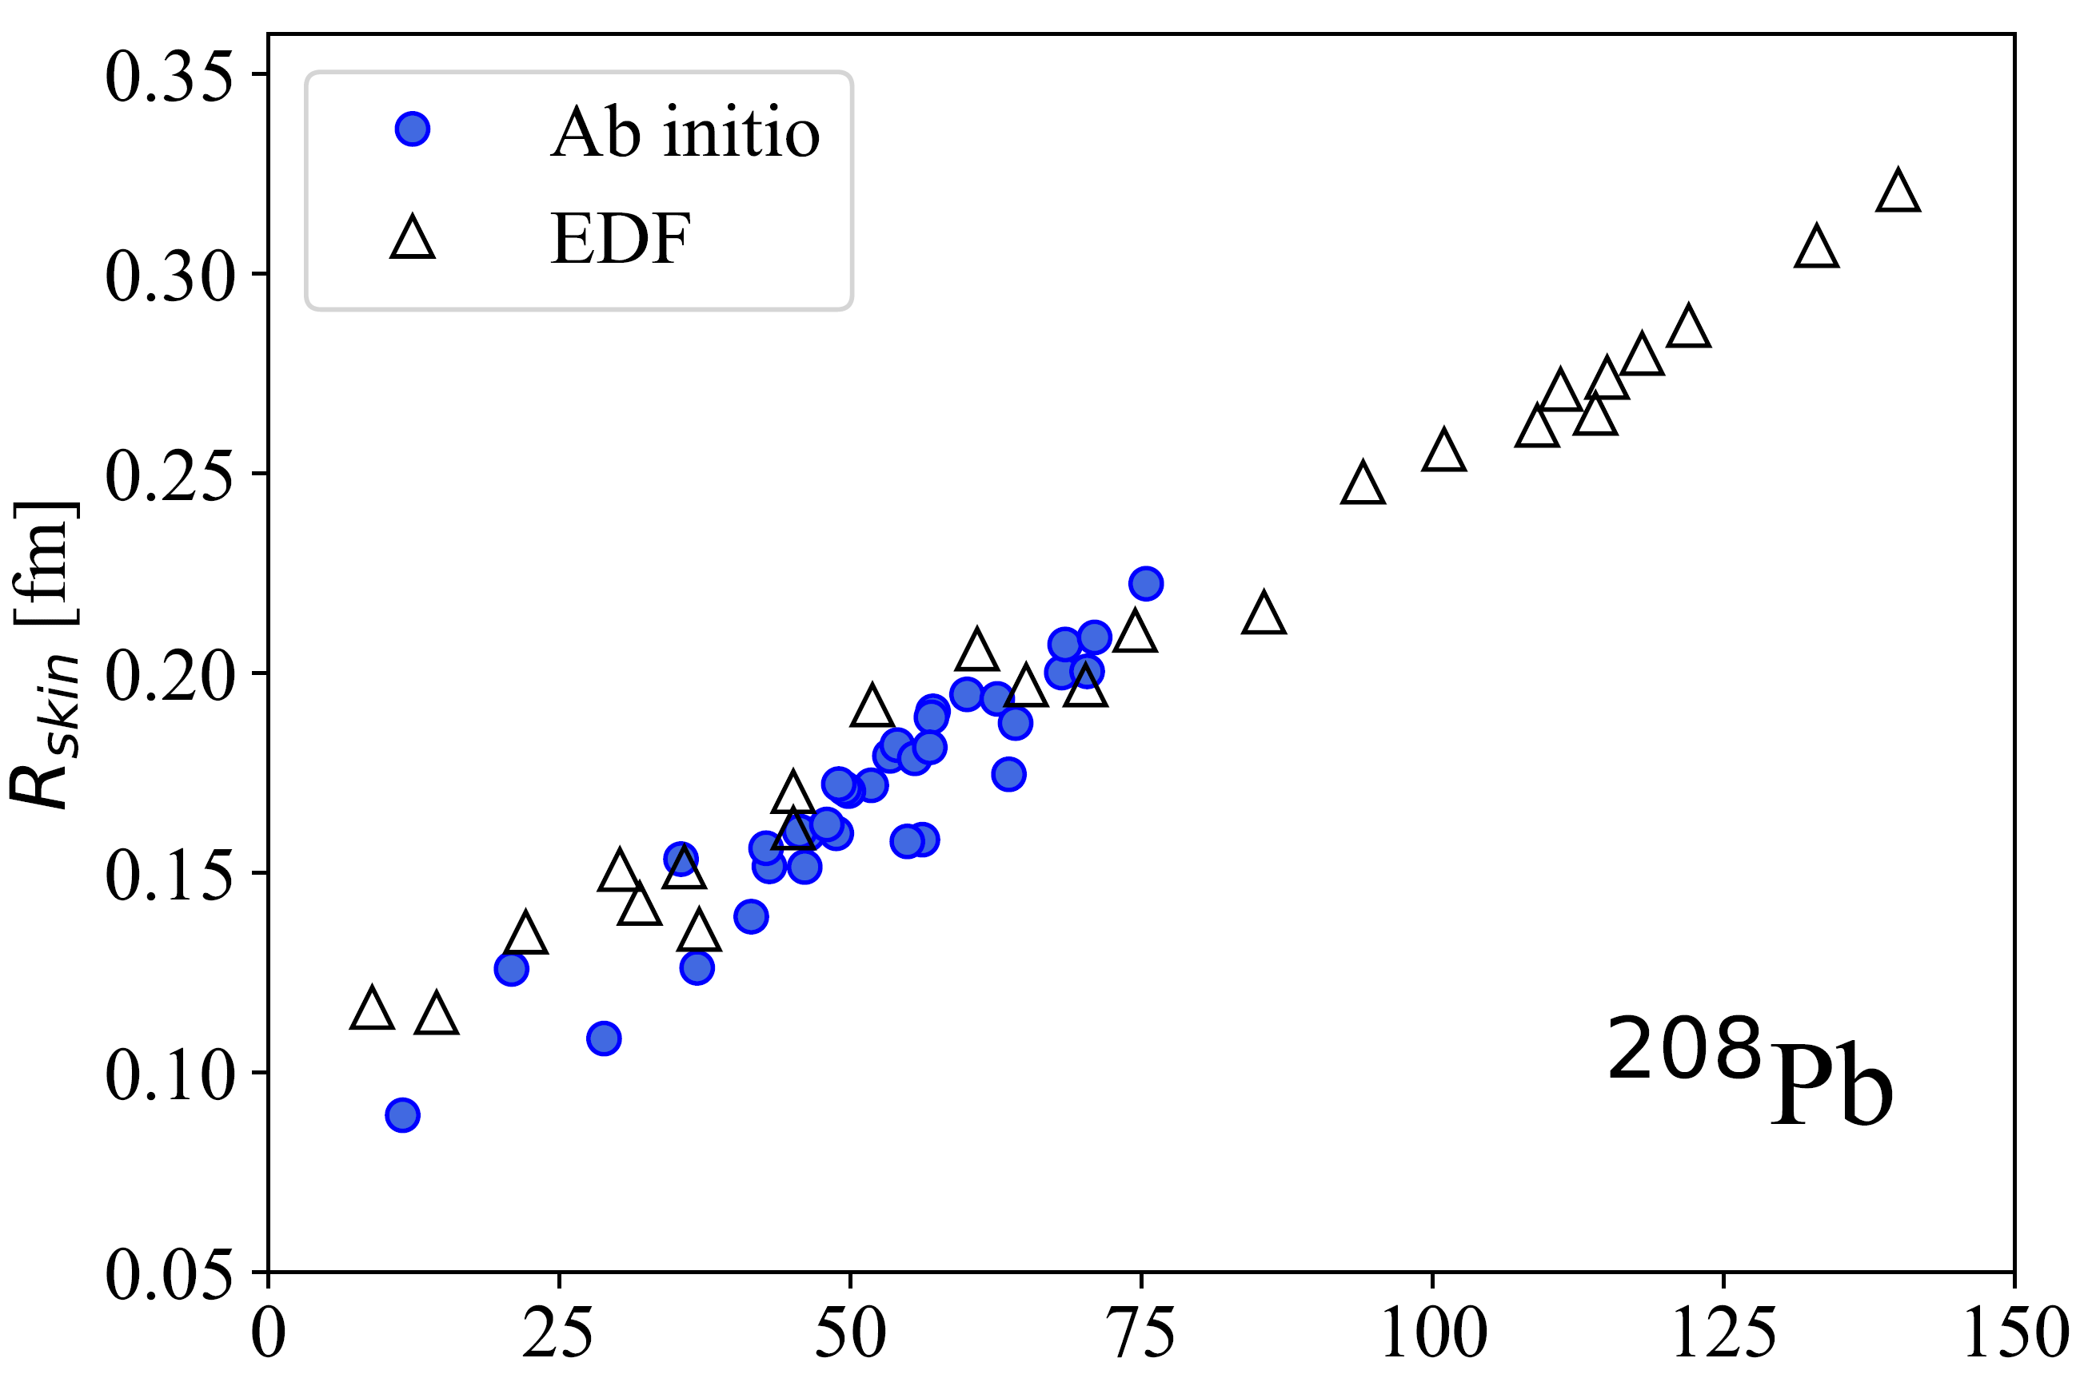
How to constrain L?
Neutron-skin
thickness
L [MeV]
Data from Centelles et al, PRC 82, 054314 (2010), Roca-Maza et al, PRC 88, 024316 (2013), Hu et al, Nat Phys. 18, 1196–1200 (2022).

Slide 5
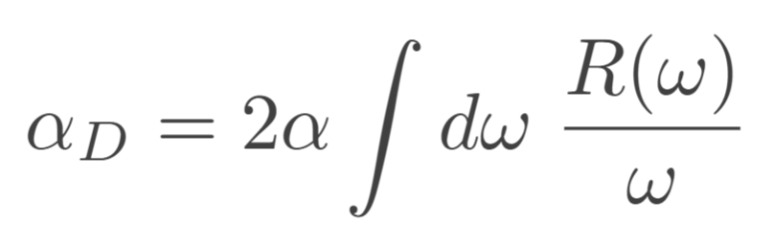
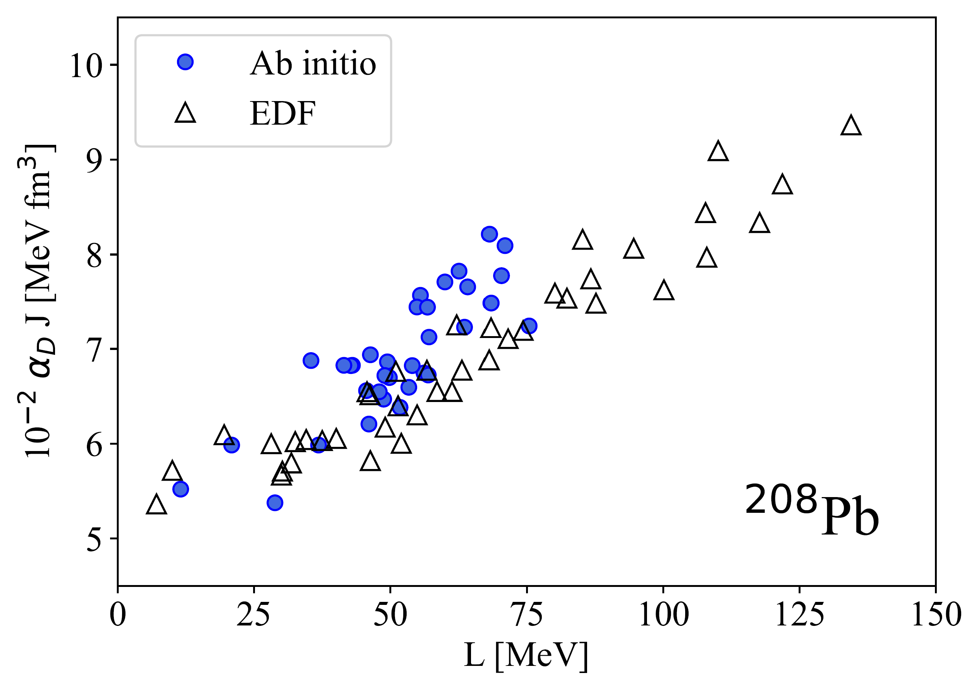
How to constrain L?
Neutron-skin
thickness
Electric dipole polarizability
L [MeV]
Data from Centelles et al, PRC 82, 054314 (2010), Roca-Maza et al, PRC 88, 024316 (2013), Hu et al, Nat Phys. 18, 1196–1200 (2022).

Slide 6
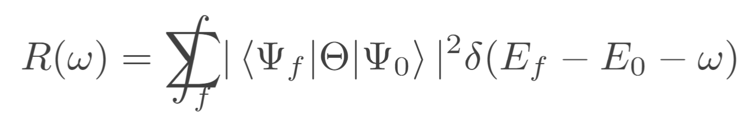
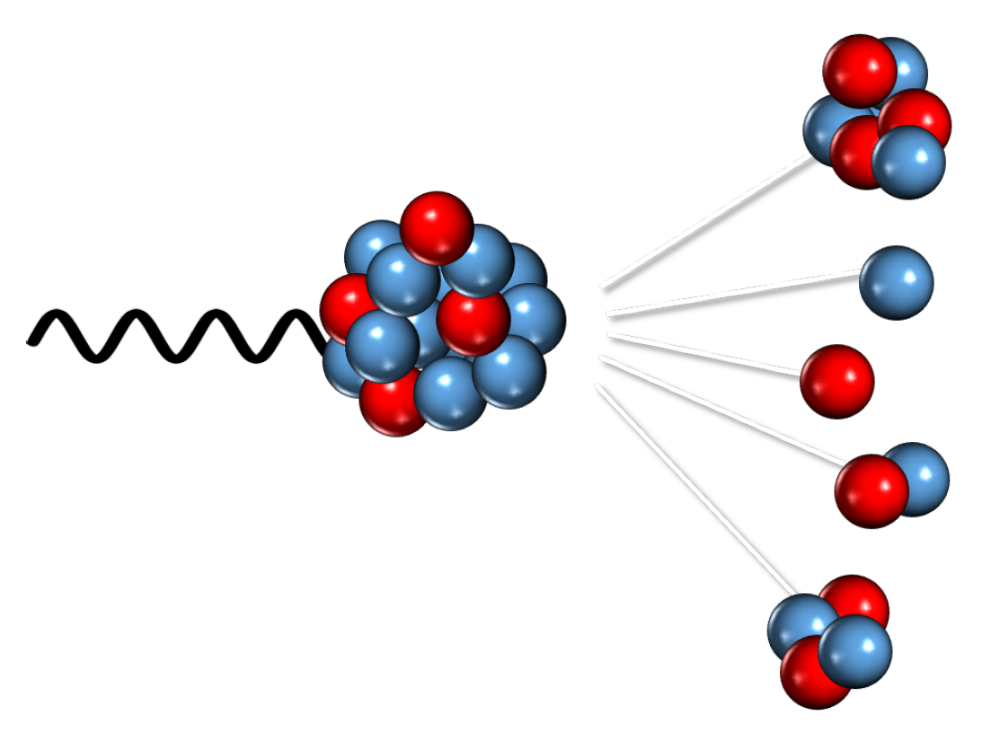
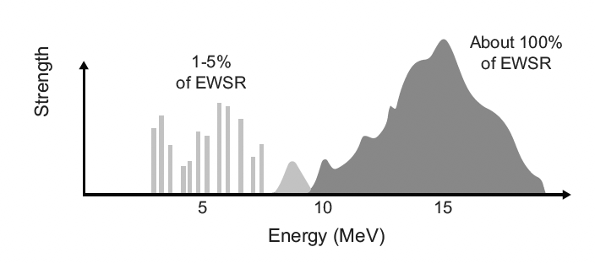
Nuclear response functions
Excited bound
states
Giant Dipole
Resonance
Pygmy Dipole
Resonance

Slide 7
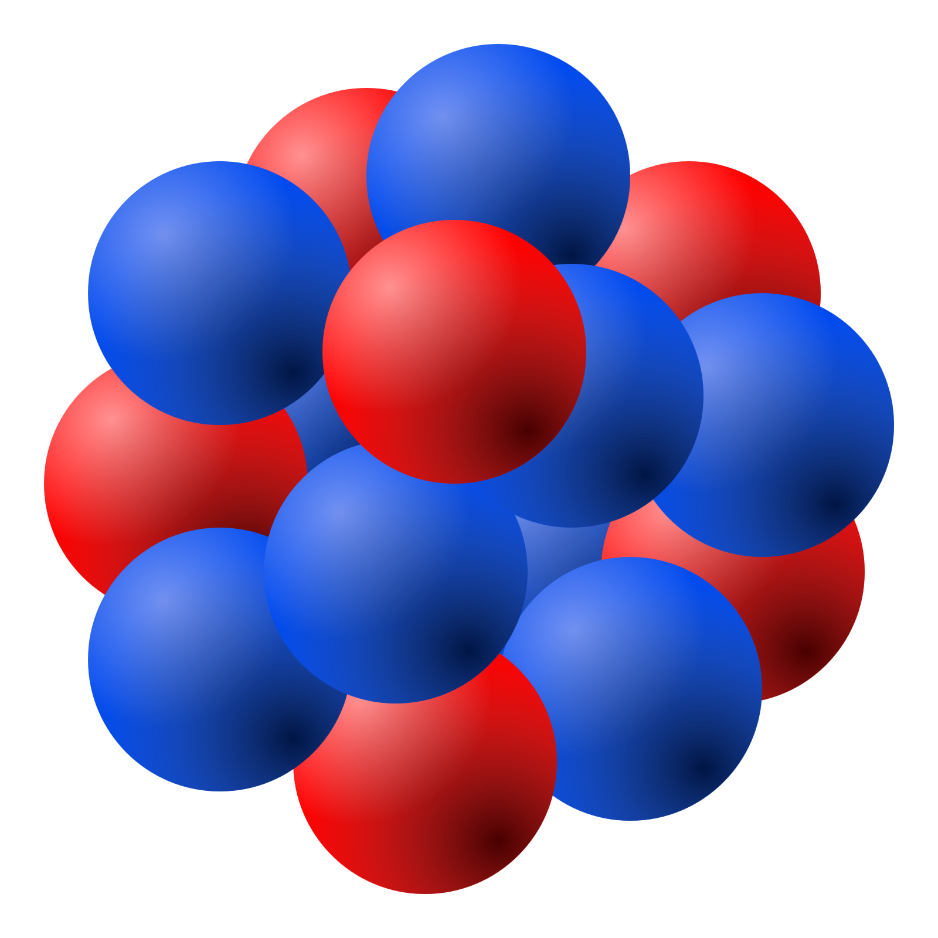
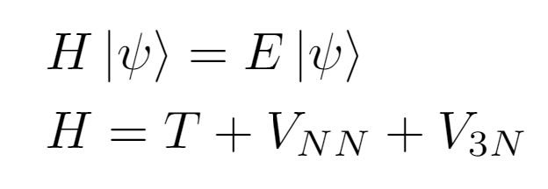
Ab initio nuclear theory
Building blocks: protons and neutrons.
Solve quantum many-body problem
with controlled approximations.
2 ingredients: nuclear interactions and many-body solver.
chiral EFT

Slide 8
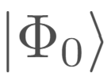
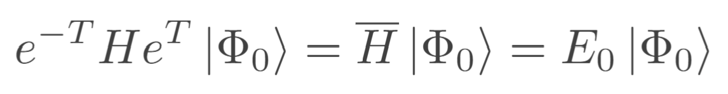
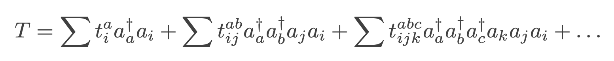
Coupled-cluster theory
Starting point: Hartree-Fock reference state
Add correlations via:
with
Similarity-transformed Hamiltonian
(non-Hermitian)
→ coefficients from
coupled-cluster equations
G. Hagen, T. Papenbrock, M. Hjorth-Jensen, D. J. Dean, RPP 77, 096302 (2014).

Slide 9
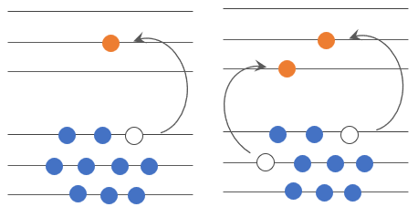
Coupled-cluster theory
Starting point: Hartree-Fock reference state
Add correlations via:
with
Similarity-transformed Hamiltonian
(non-Hermitian)
→ coefficients from
coupled-cluster equations
singles and doubles
(CCSD)
G. Hagen, T. Papenbrock, M. Hjorth-Jensen, D. J. Dean, RPP 77, 096302 (2014).

Slide 10
Coupled-cluster theory
Starting point: Hartree-Fock reference state
Add correlations via:
with
Similarity-transformed Hamiltonian
(non-Hermitian)
→ coefficients from
coupled-cluster equations
singles and doubles
(CCSD)
+ triples (CCSDT-1)
G. Hagen, T. Papenbrock, M. Hjorth-Jensen, D. J. Dean, RPP 77, 096302 (2014).

Slide 11

From bound to dipole-excited states
Continuum problem
S. Bacca, N. Barnea, G. Hagen, G. Orlandini, T. Papenbrock, PRL 111, 122502 (2013).

Slide 12
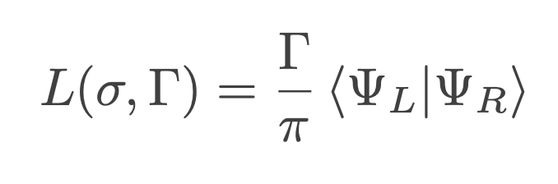


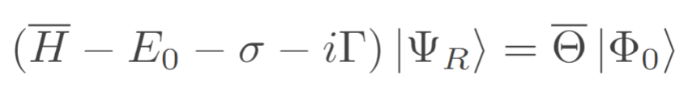
From bound to dipole-excited states
where
Lorentz Integral
Transform (LIT)
Continuum problem
Bound-state like problem
S. Bacca, N. Barnea, G. Hagen, G. Orlandini, T. Papenbrock, PRL 111, 122502 (2013).

Slide 13
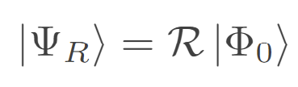
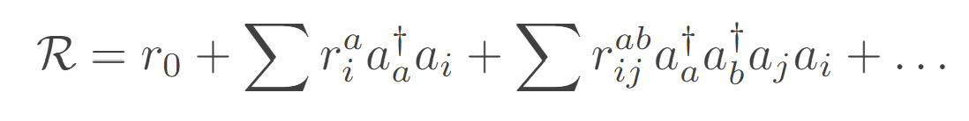
From bound to dipole-excited states
where
Lorentz Integral
Transform (LIT)
Continuum problem
Bound-state like problem
LIT-CC ansatz for closed-shell nuclei:
S. Bacca, N. Barnea, G. Hagen, G. Orlandini, T. Papenbrock, PRL 111, 122502 (2013).

Slide 14
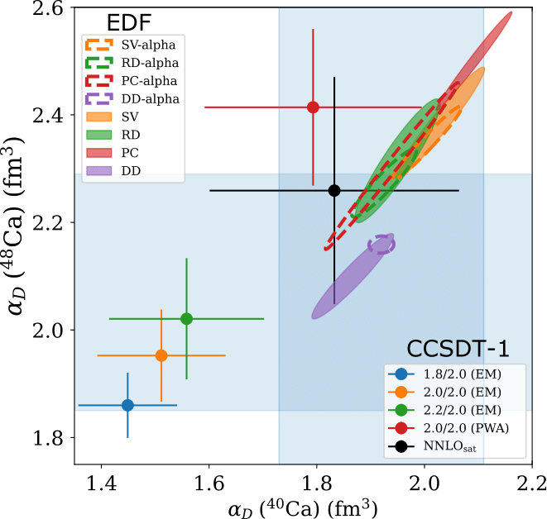
The case of ^{40,48}Ca
exp
R. Fearick, P. von Neumann-Cosel, S. Bacca, FB et al, PRR 5, L022044 (2023).

Slide 15
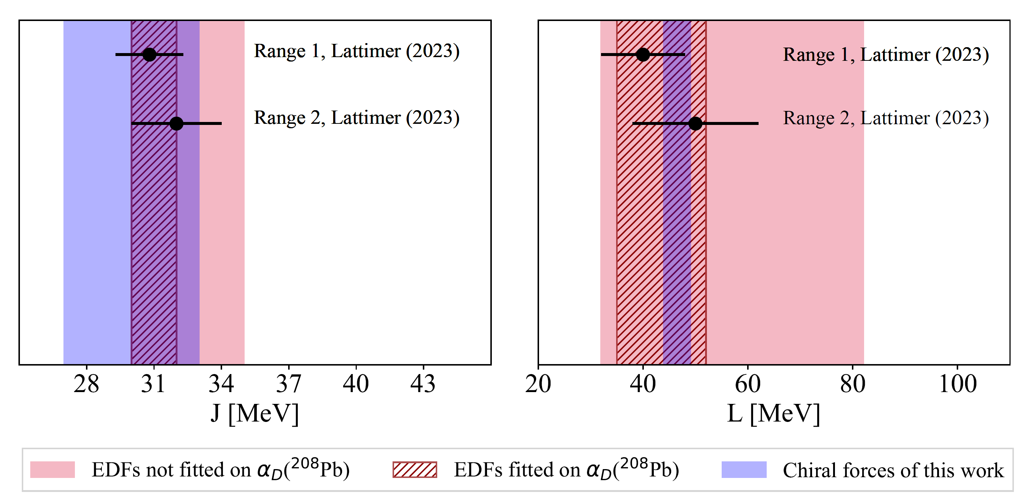
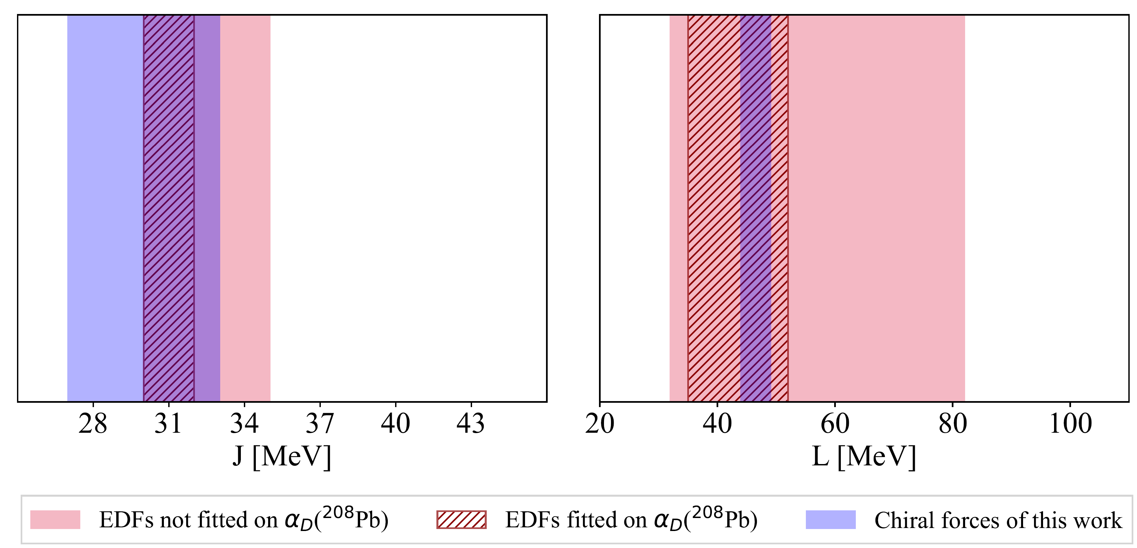
Constraints on symmetry energy
FB, PhD Thesis, JGU Mainz (2024).

Slide 16
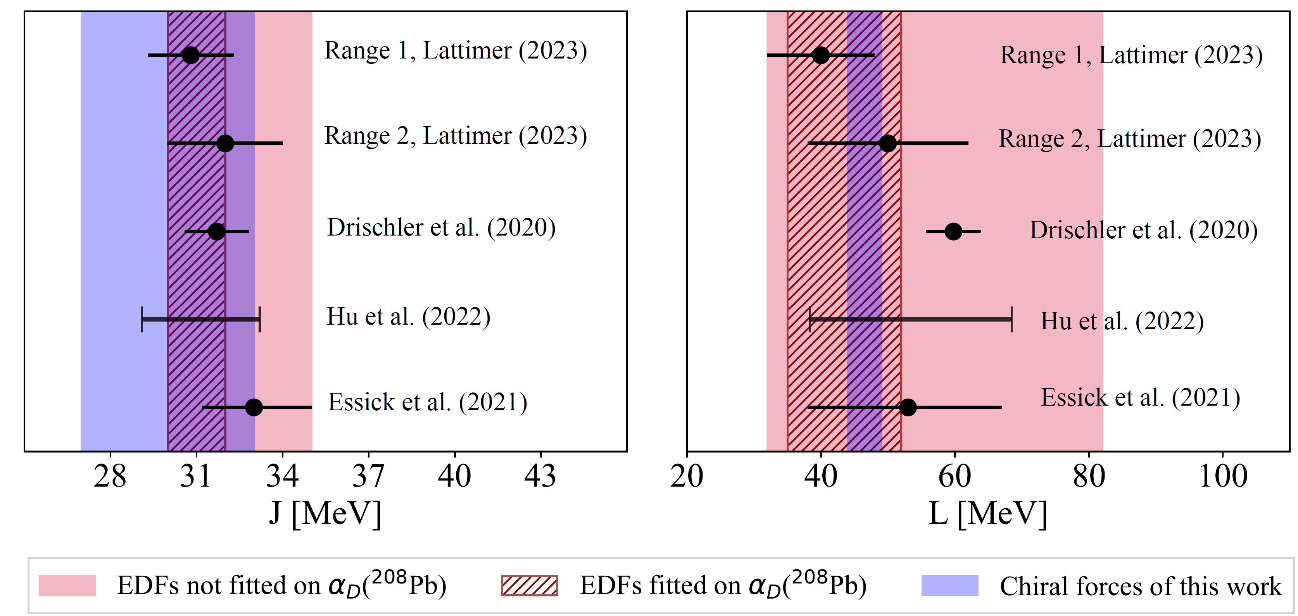
Constraints on symmetry energy
FB, PhD Thesis, JGU Mainz (2024).

Slide 17
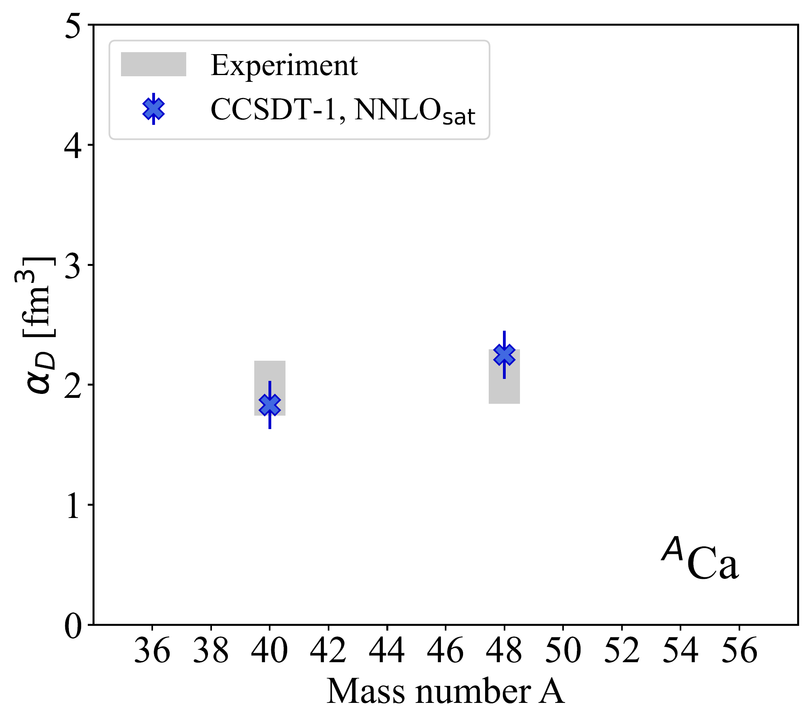
Happy ending for ^{40,48}Ca... but what’s next?
?
?
?
13

Slide 18

Happy ending for ^{40,48}Ca... but what’s next?
New (p,p’) experiments
in open-shell Ca, Ni isotopes,
as e.g. ⁴²Ca, ⁵⁸Ni → see talk
by Peter von Neumann-Cosel
?
?
?
13

Slide 19
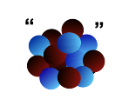
Happy ending for ^{40,48}Ca... but what’s next?
𝛾
New (p,p’) experiments
in open-shell Ca, Ni isotopes,
as e.g. ⁴²Ca, ⁵⁸Ni → see talk
by Peter von Neumann-Cosel
?
?
?
… and with future upgrades, Coulomb excitation possible for very neutron-rich nuclei.
13

Slide 20
Happy ending for ^{40,48}Ca... but what’s next?
𝛾
New (p,p’) experiments
in open-shell Ca, Ni isotopes,
as e.g. ⁴²Ca, ⁵⁸Ni → see talk
by Peter von Neumann-Cosel
?
?
?
… and with future upgrades, Coulomb excitation possible for very neutron-rich nuclei.
We need to extend the LIT-CC method beyond closed-shell nuclei!
13

Slide 21
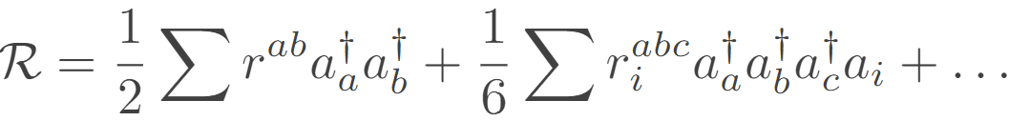
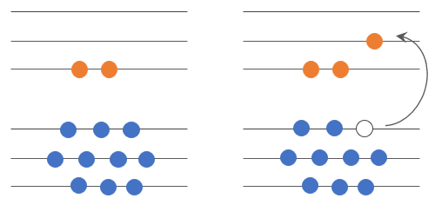
Open-shell nuclei: two-particle-attached (2PA) systems
2p0h
3p1h
FB et al., arXiv:2405.05608 [nucl-th]

Slide 22
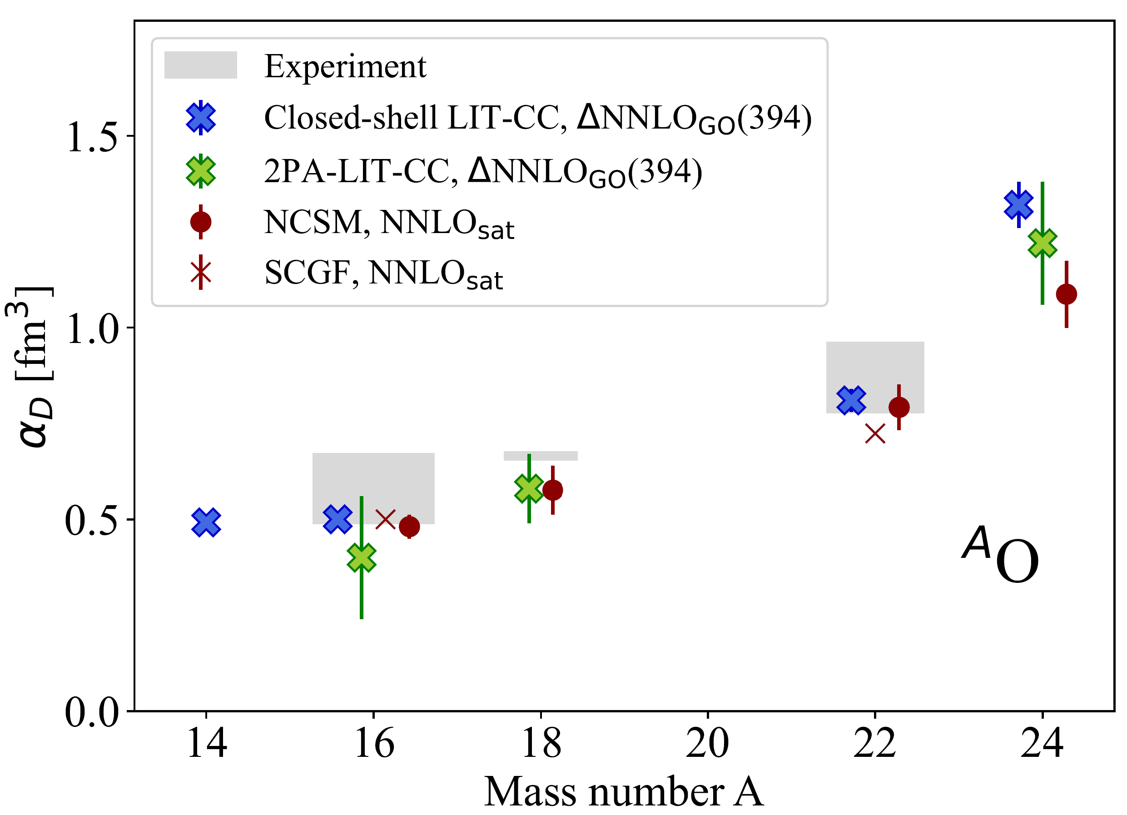
⍺_{D} along the oxygen chain
FB et al., arXiv:2405.05608 [nucl-th].

Slide 23
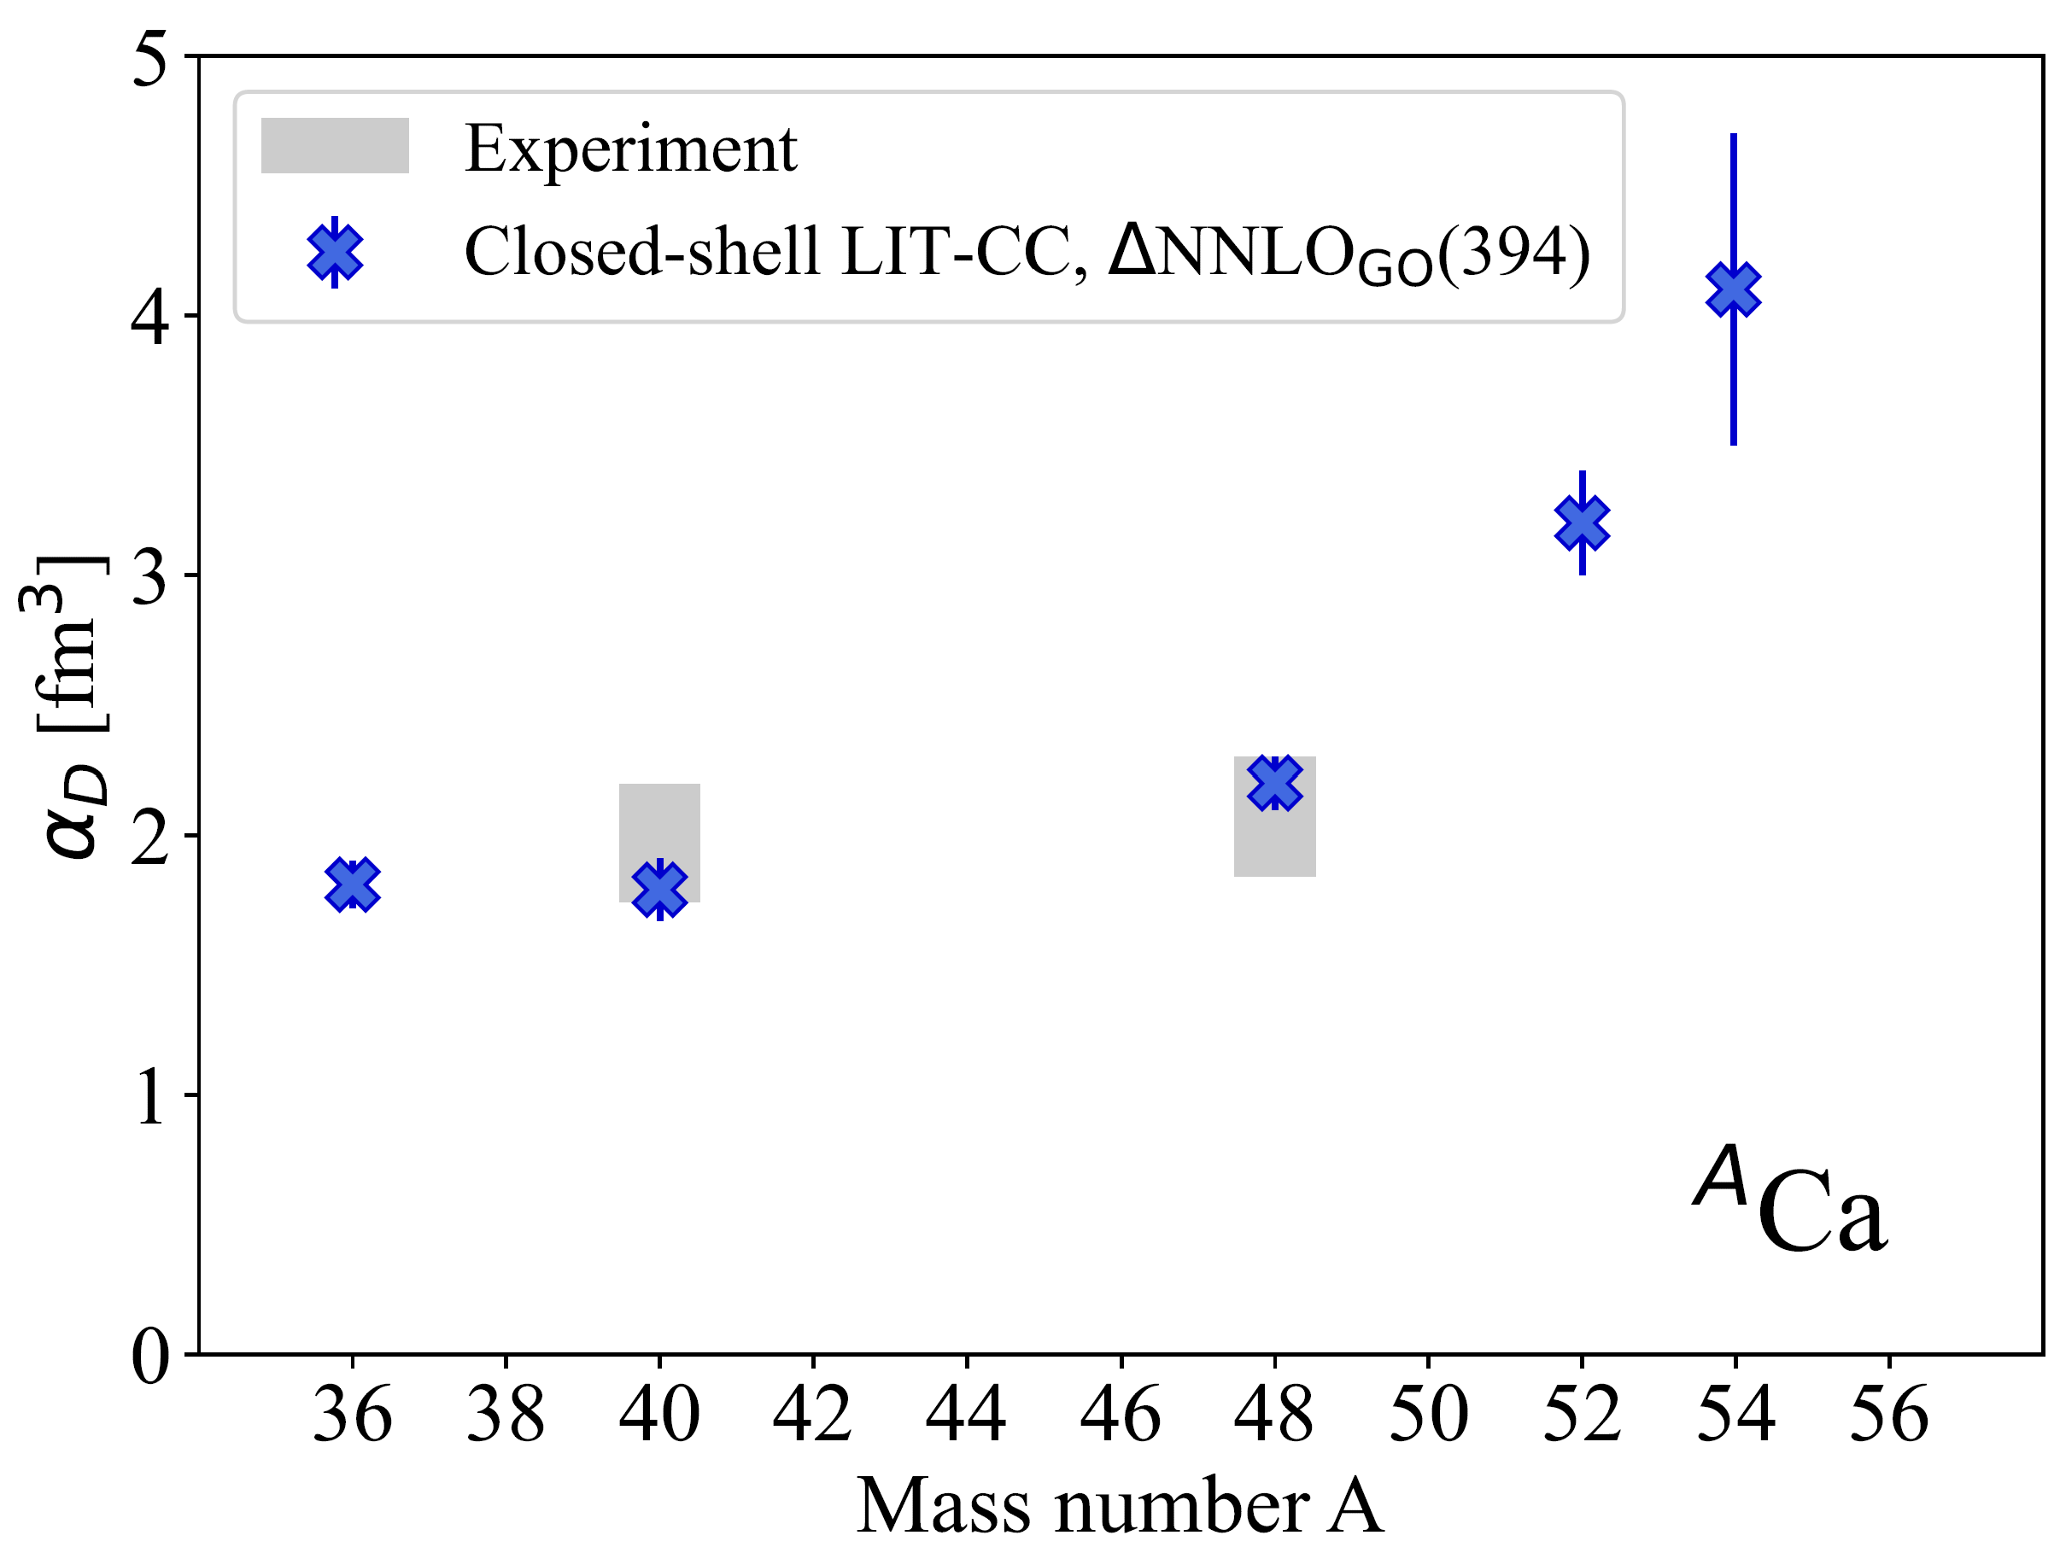
⍺_{D} along the calcium chain
FB et al., arXiv:2405.05608 [nucl-th].

Slide 24
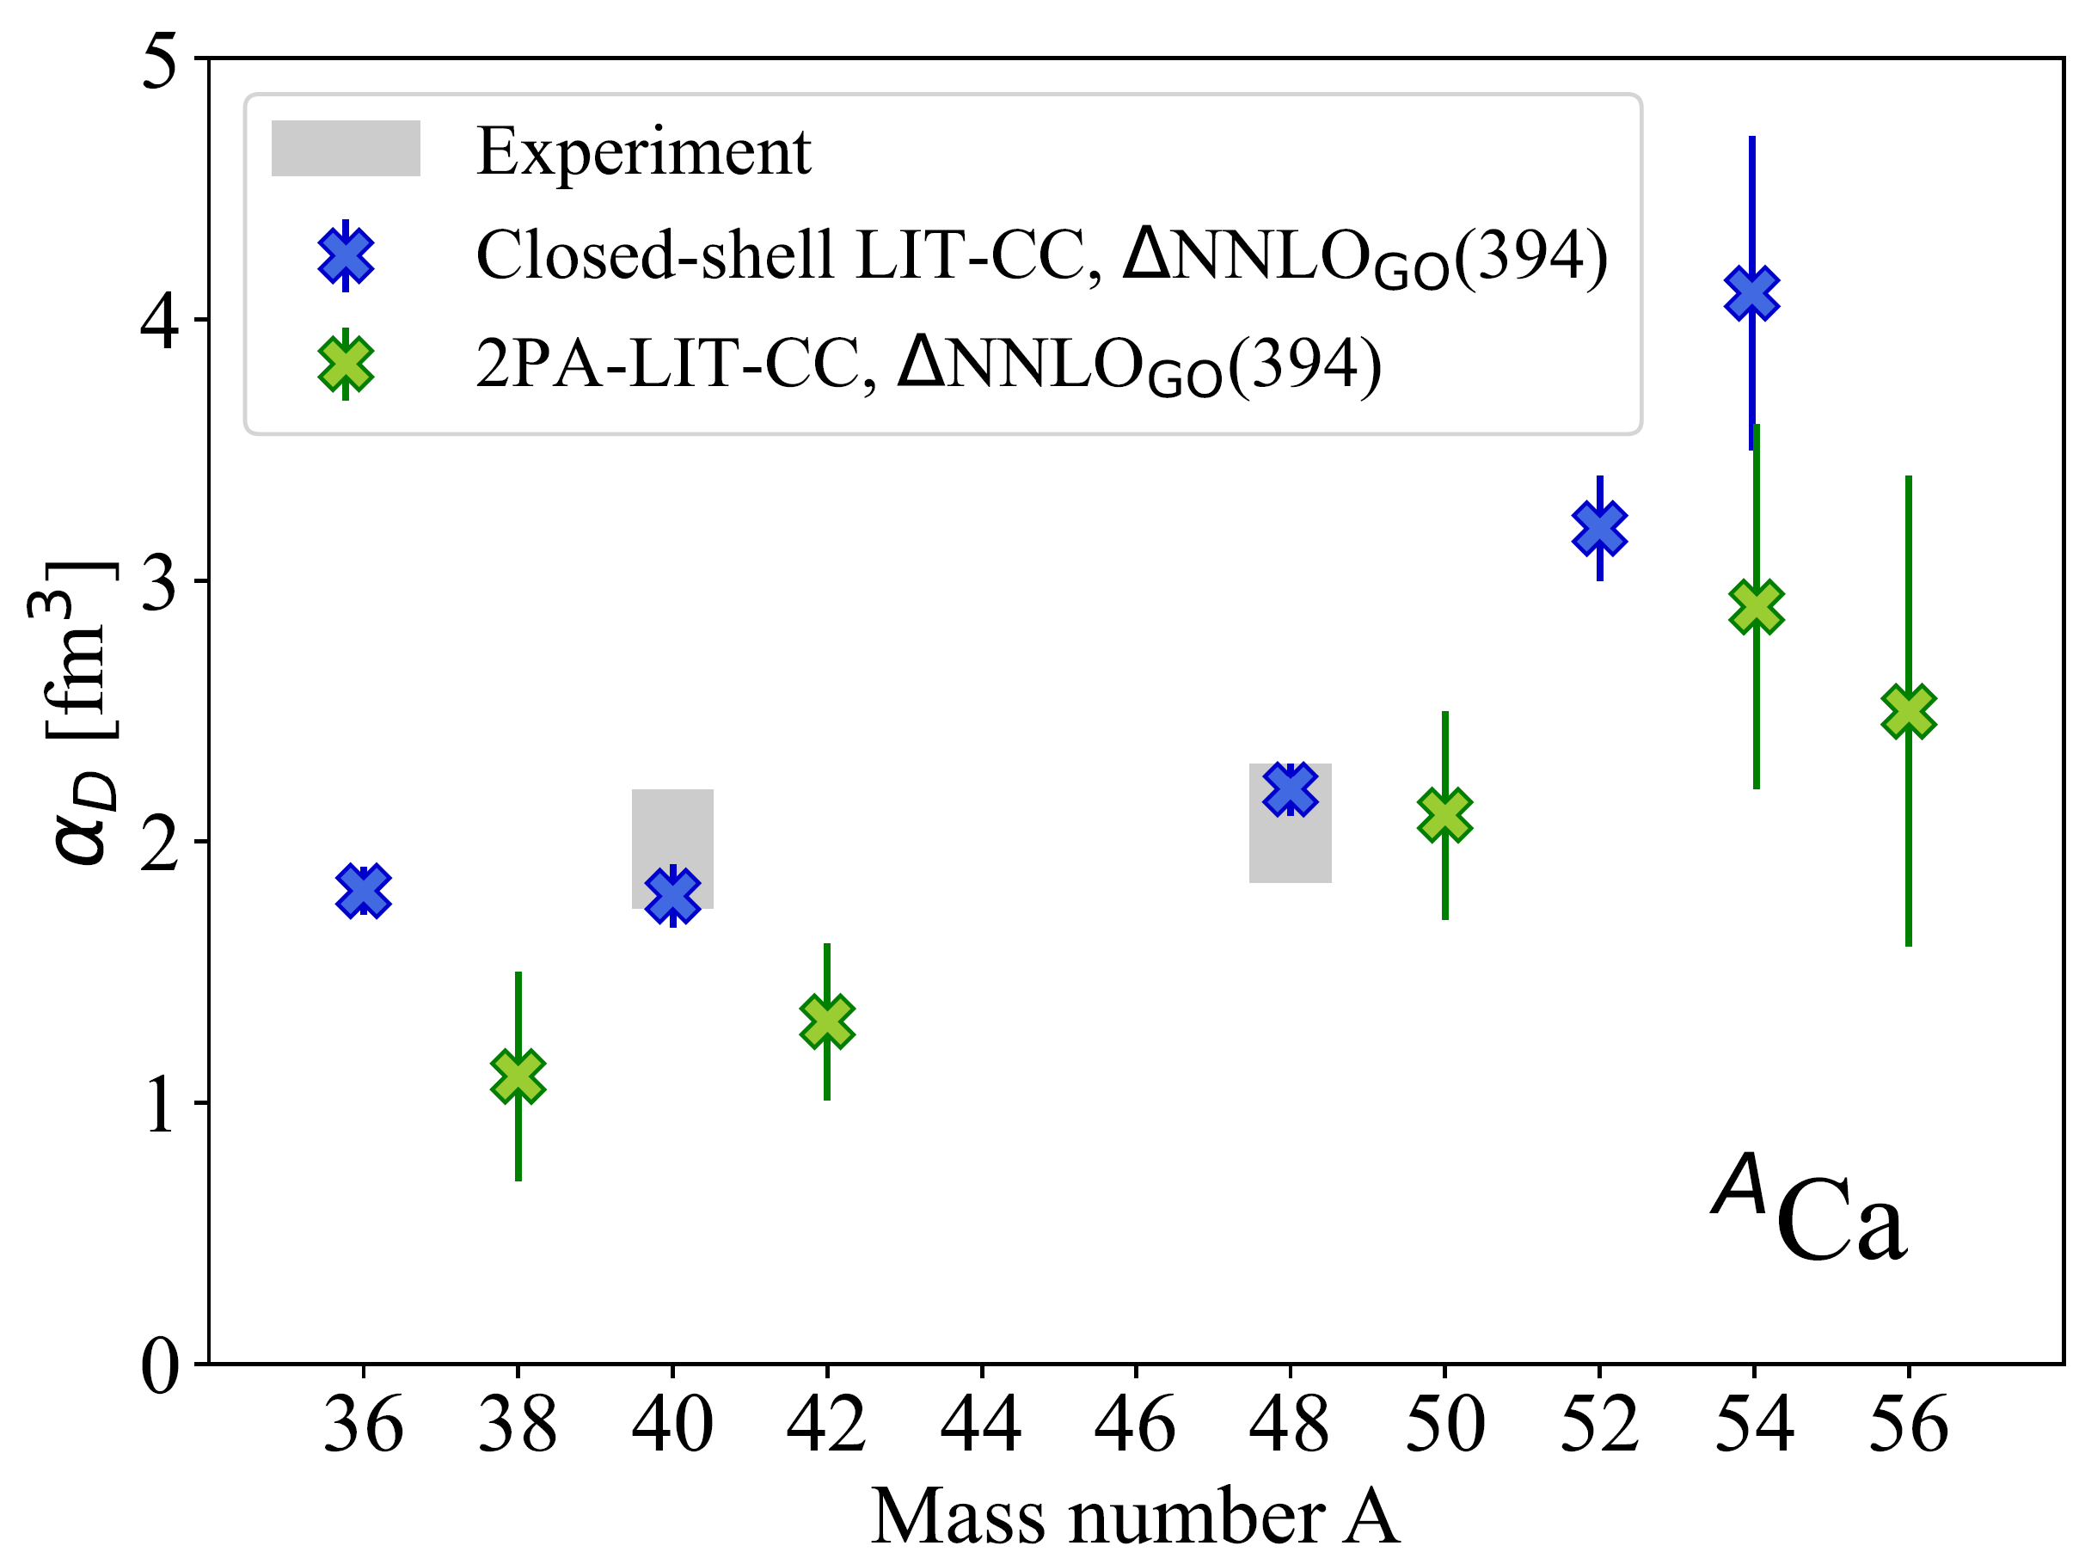
⍺_{D} along the calcium chain
FB et al., arXiv:2405.05608 [nucl-th].

Slide 25
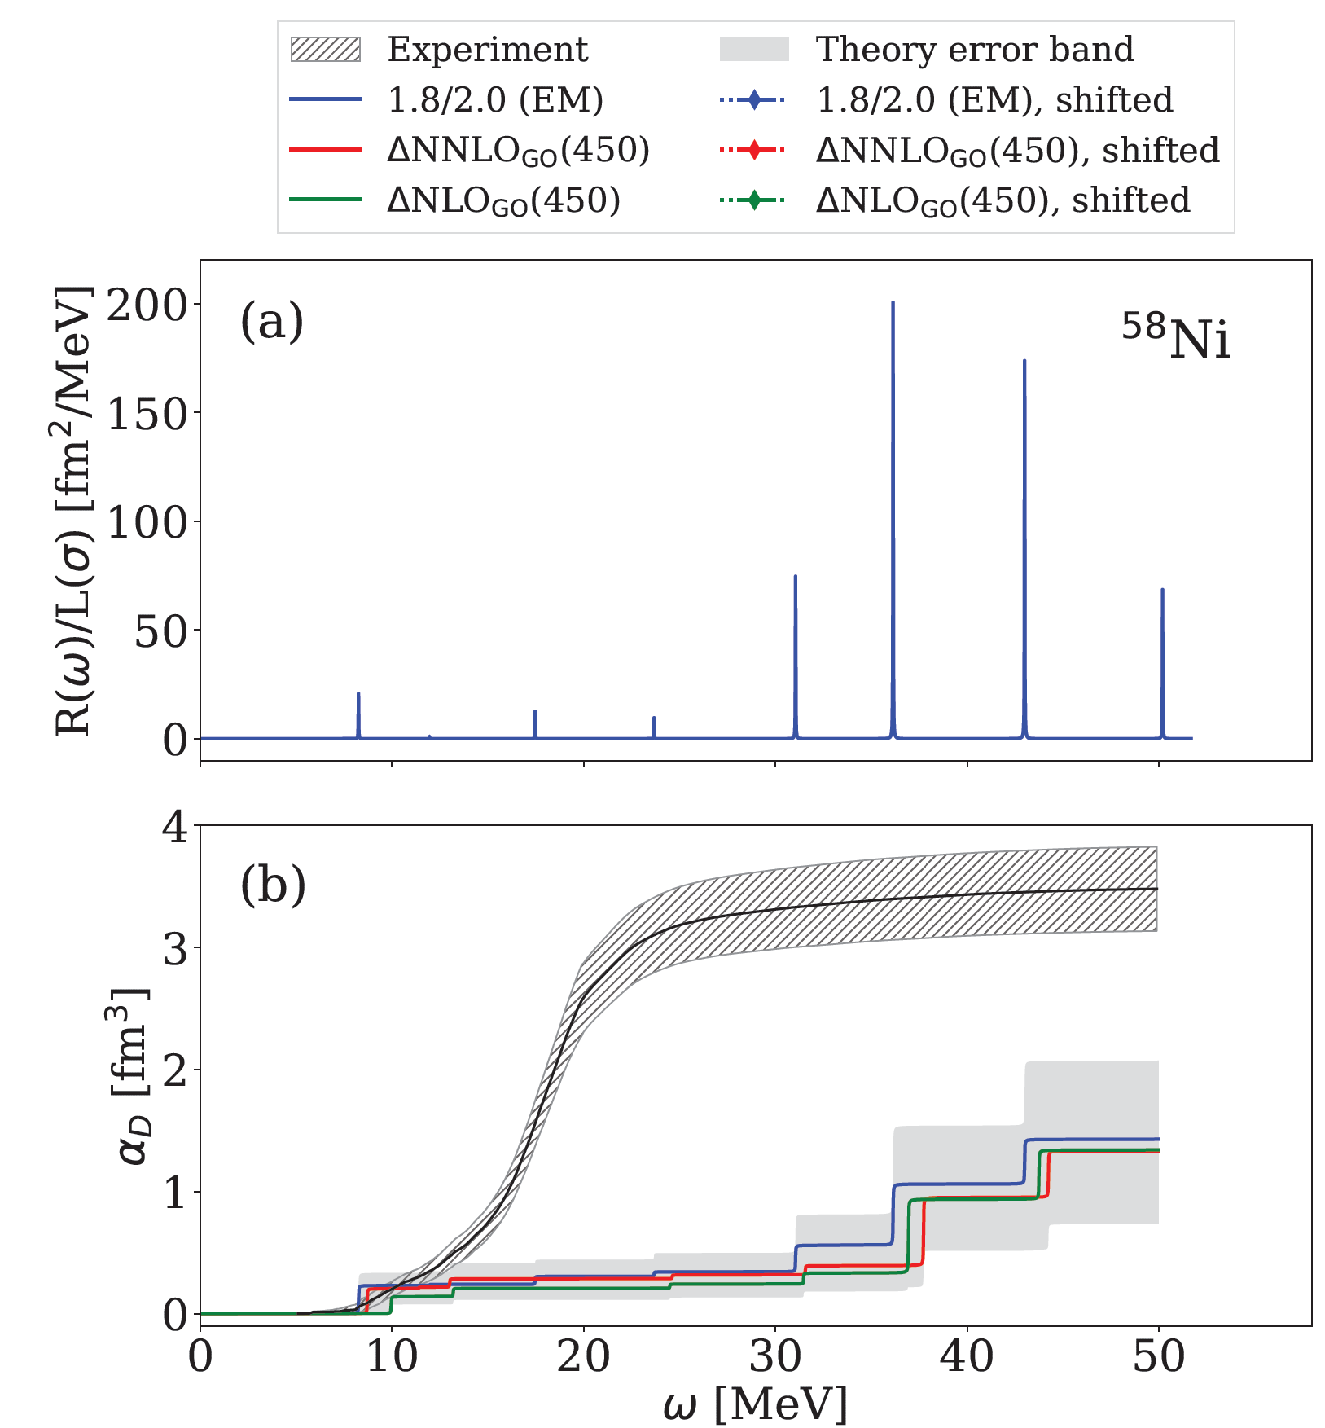
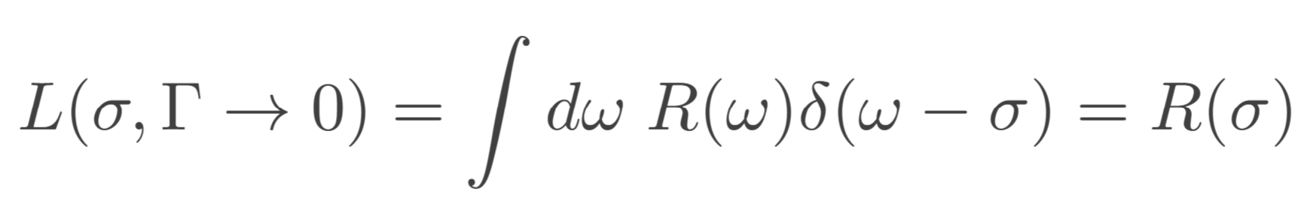
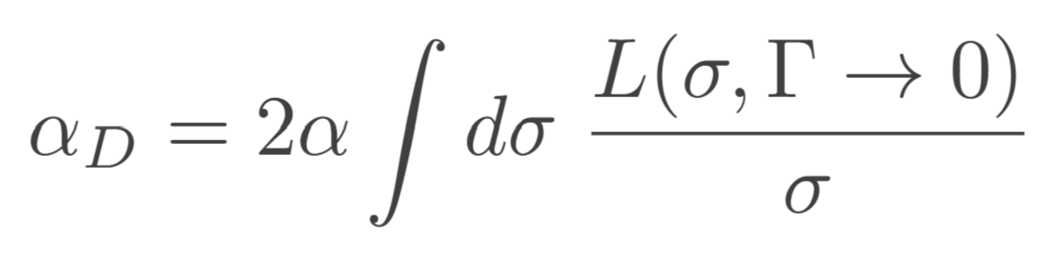
The case of ⁵⁸Ni
I. Brandherm, FB et al., in preparation (2024).

Slide 26
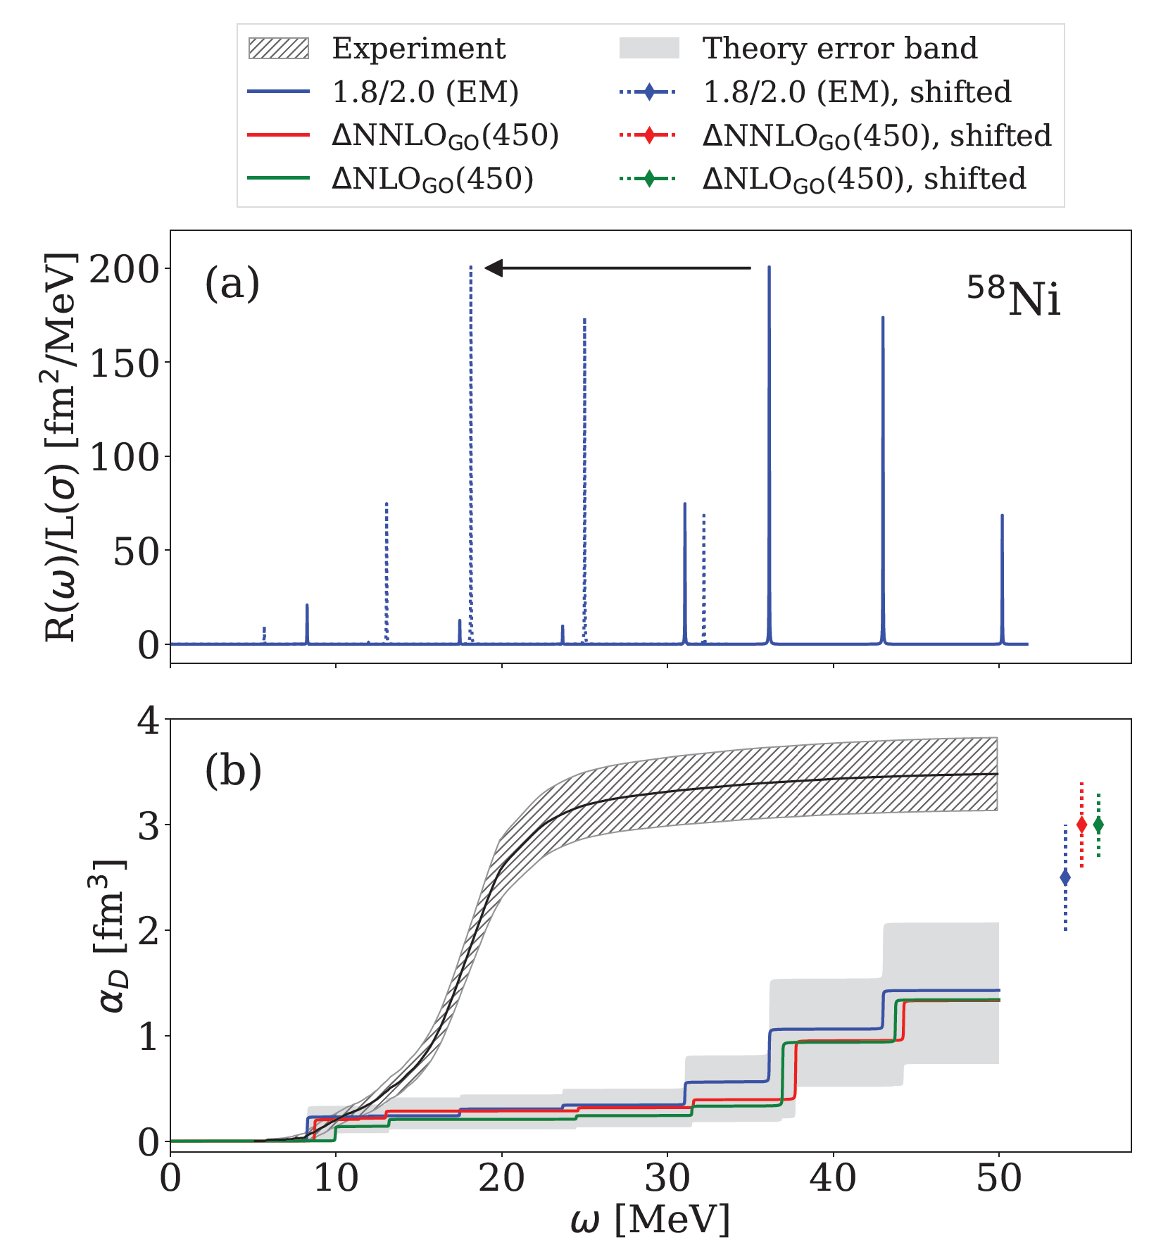
The case of ⁵⁸Ni
I. Brandherm, FB et al., in preparation (2024).

Slide 27
The case of ⁵⁸Ni
New: 2PR/1PA(R) nuclei
see talk by Francesco Marino
I. Brandherm, FB et al., in preparation (2024).

Slide 28
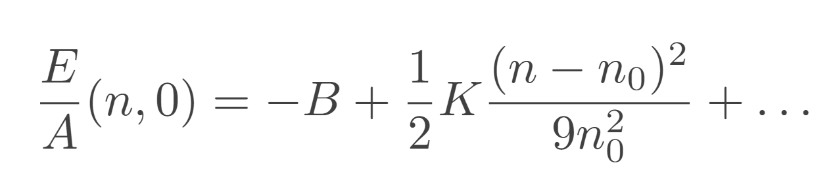
Back to the EOS
Infinite nuclear matter EOS:
where:
saturation density
Incompressibility of
symmetric nuclear matter

Slide 29
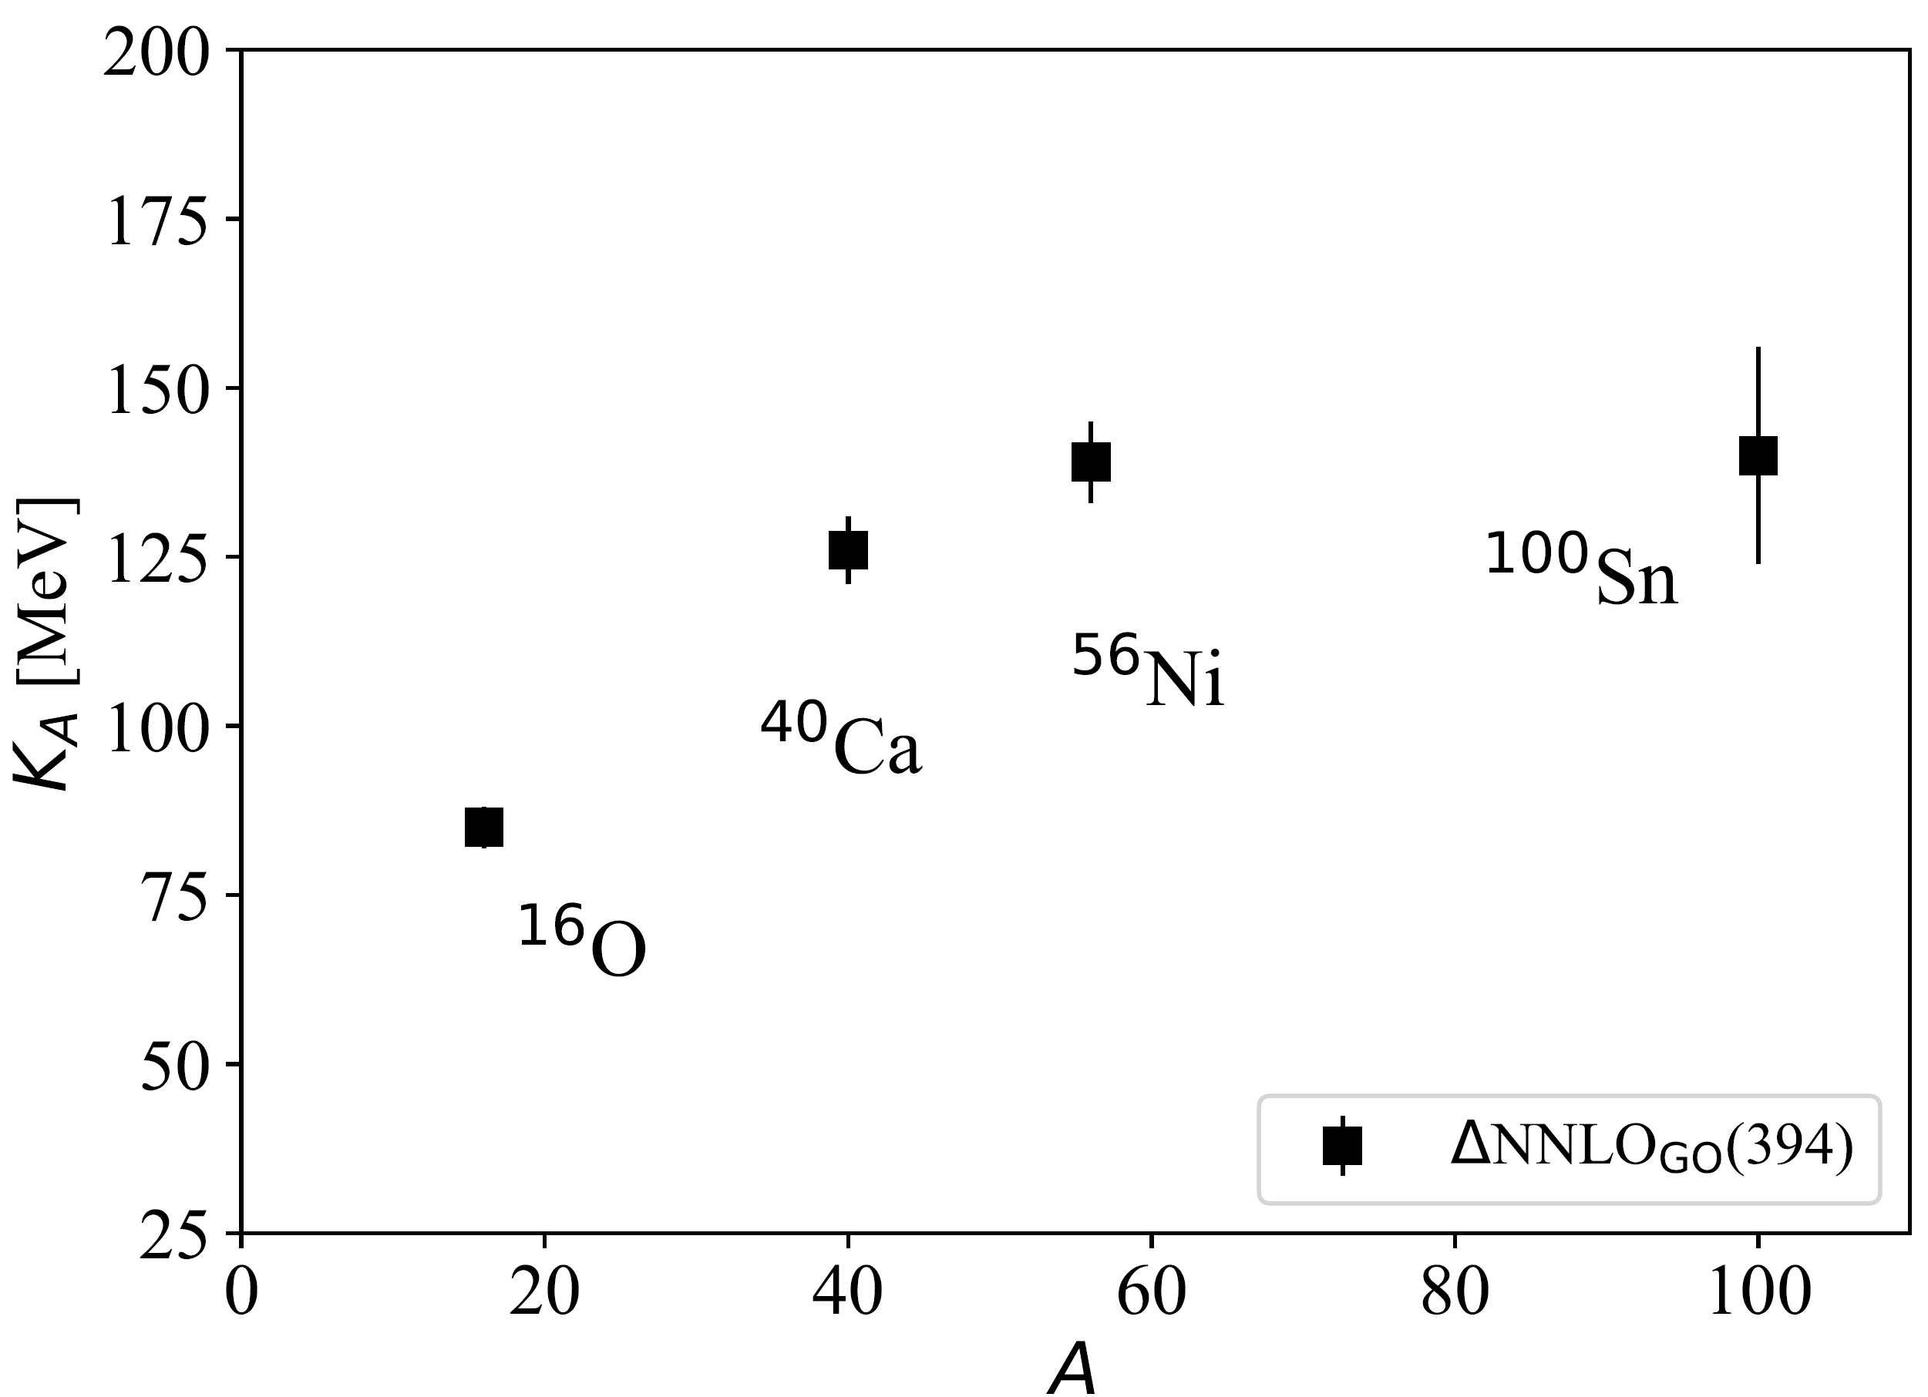
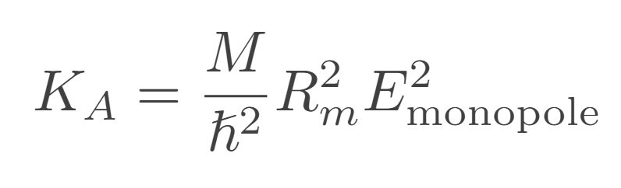
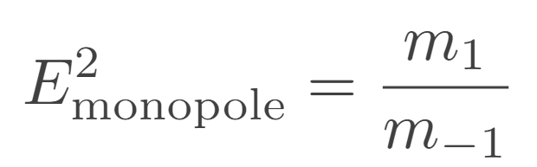
Incompressibility of nuclear matter
Finite-nucleus incompressibility from monopole moments:

Slide 30
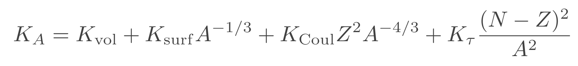
Incompressibility of nuclear matter
Finite-nucleus incompressibility from monopole moments:
Nuclear matter
incompressibility

Slide 31
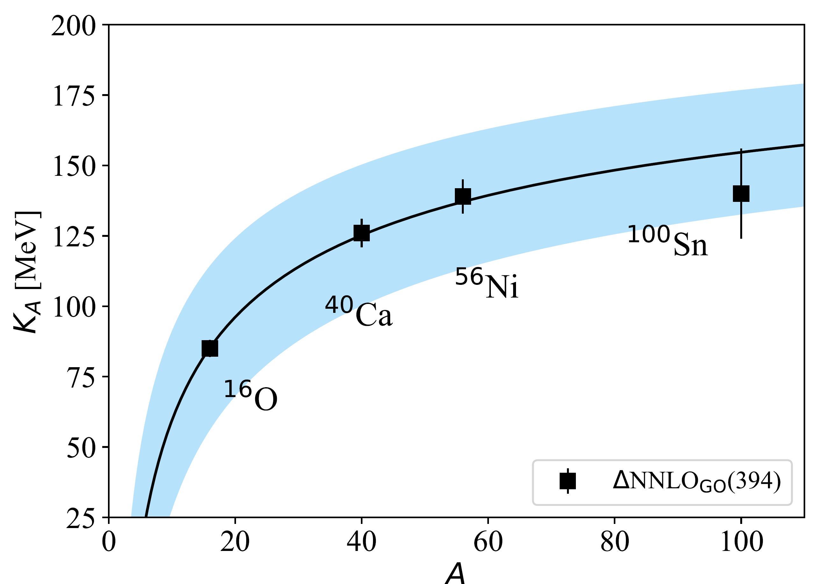
Incompressibility of nuclear matter
Finite-nucleus incompressibility from monopole moments:
Nuclear matter
incompressibility

Slide 32
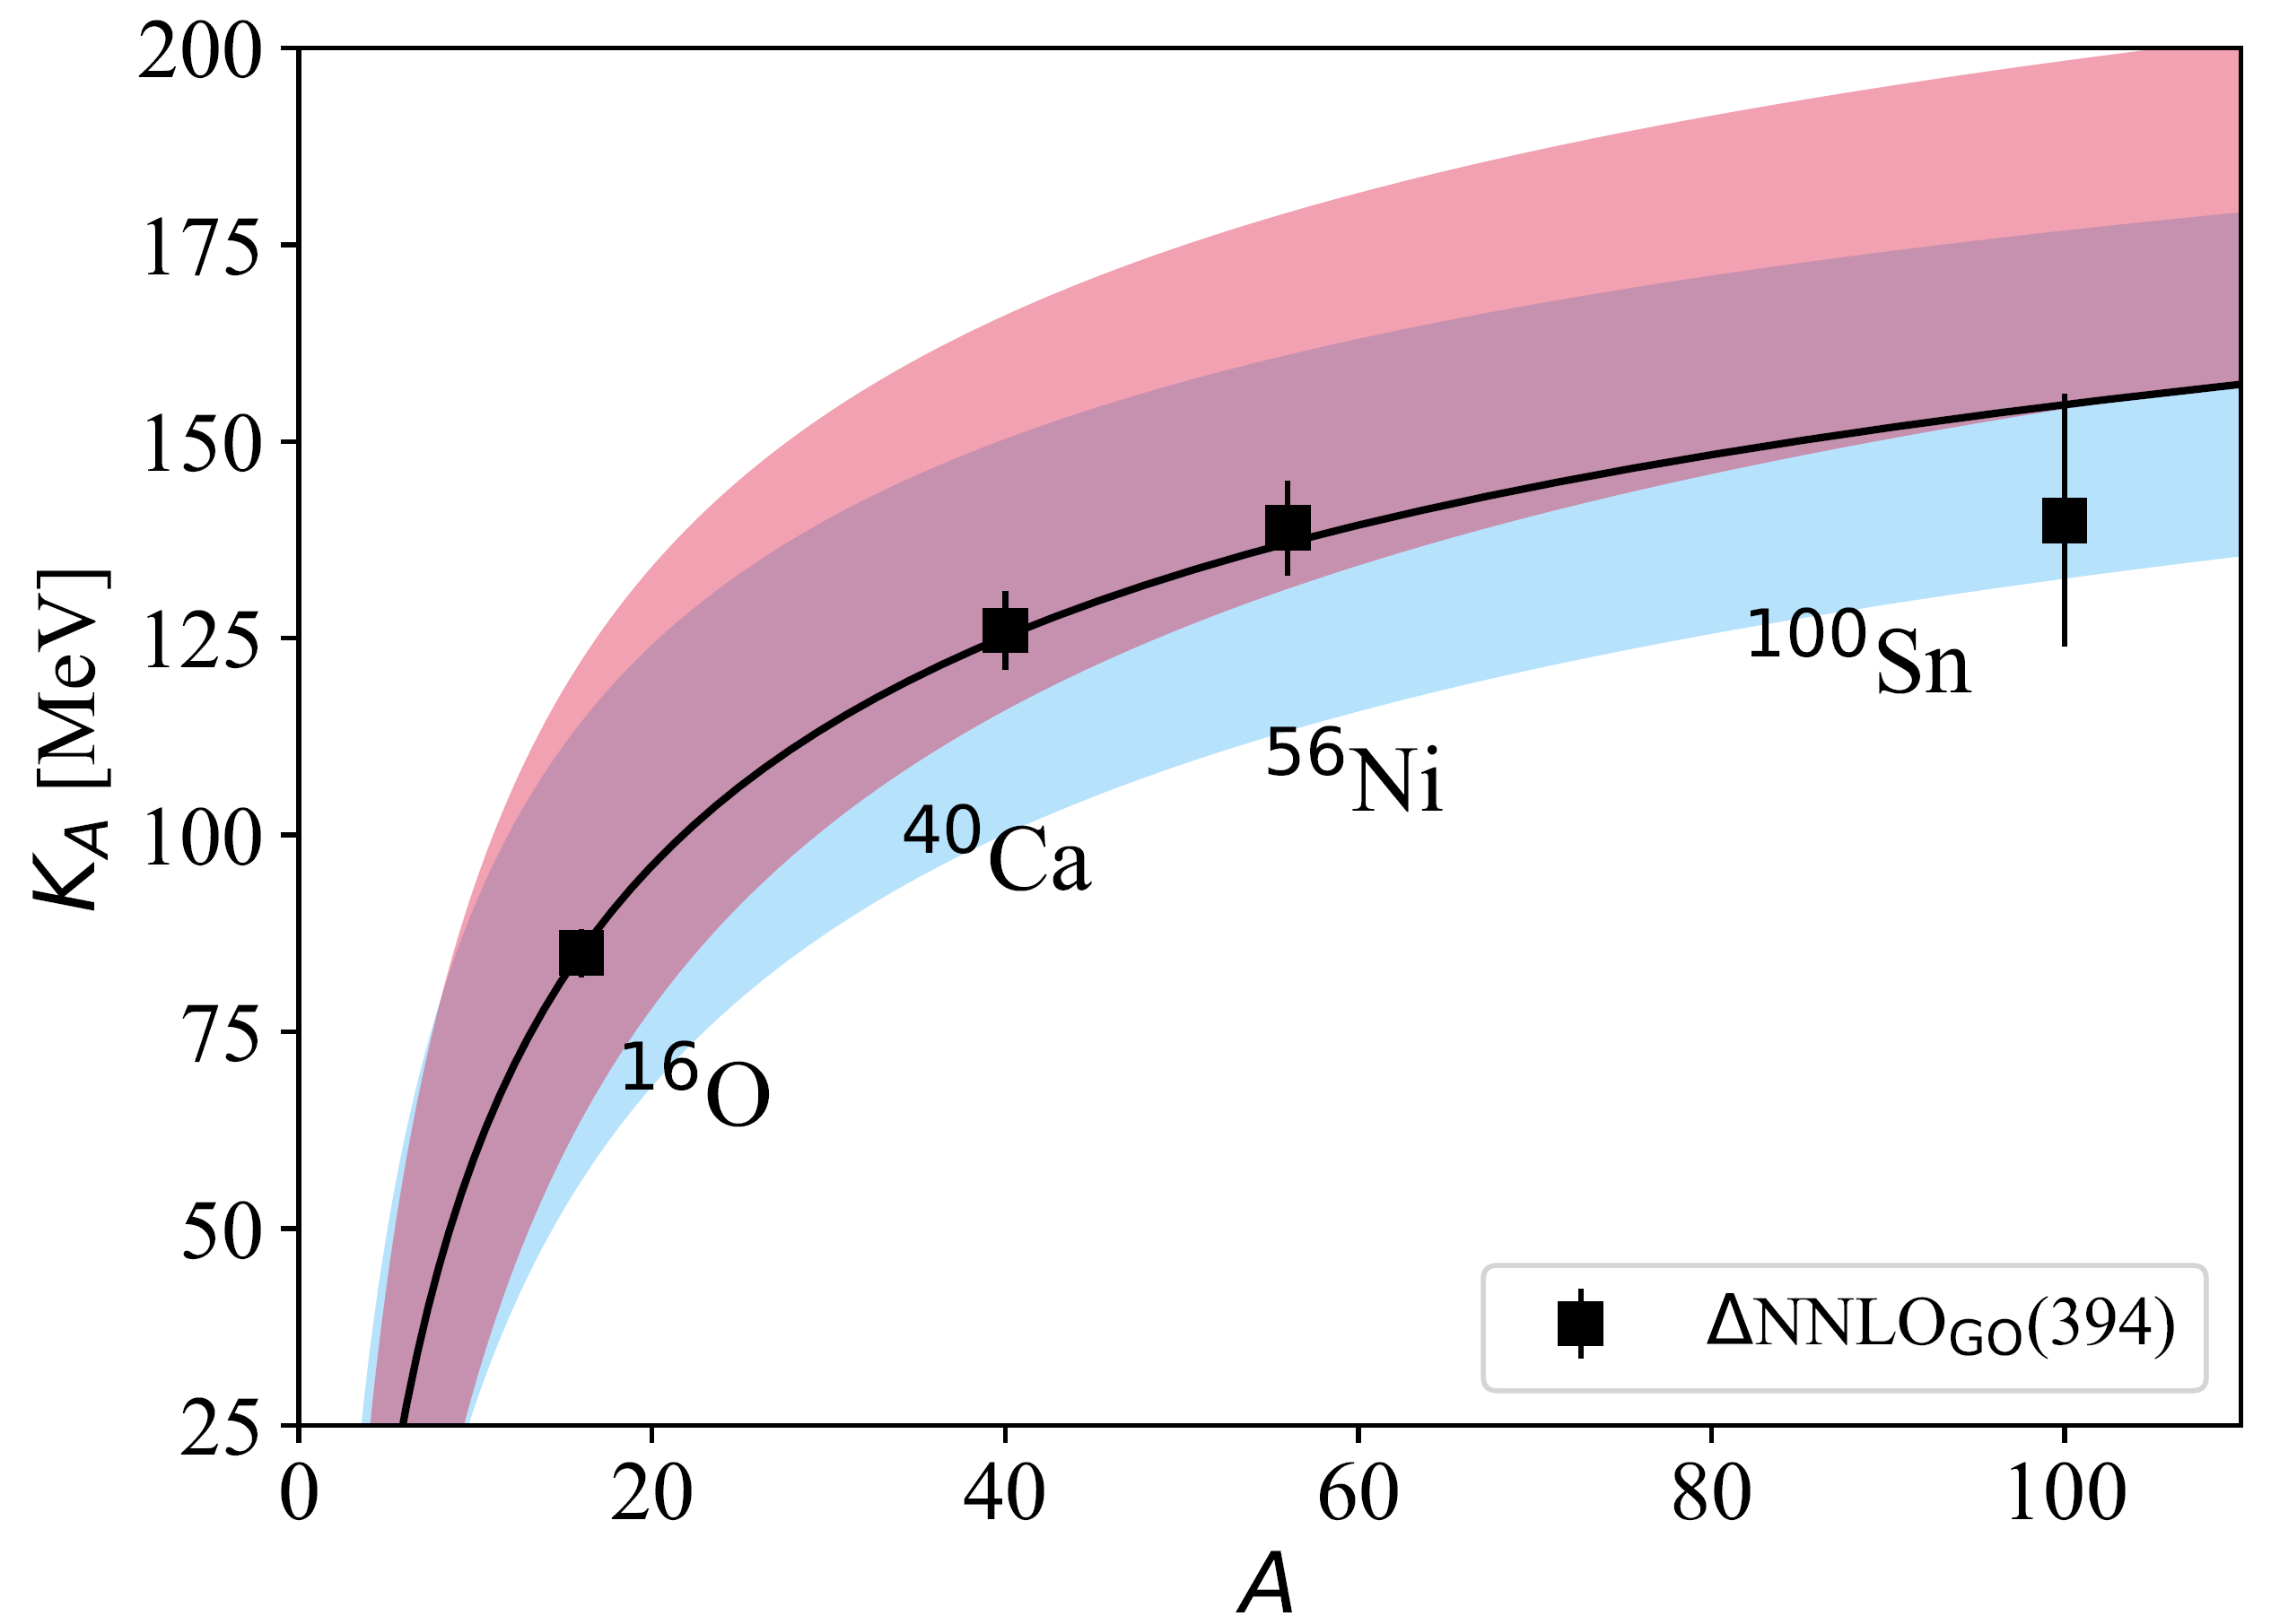
Incompressibility of nuclear matter
Finite-nucleus incompressibility from monopole moments:
with K_{Coul}
no K_{Coul}
K_{Coul} ≈ -5 MeV
from mean-field models
Nuclear matter
incompressibility

Slide 33
Incompressibility of nuclear matter
Finite-nucleus incompressibility from monopole moments:
with K_{Coul}
no K_{Coul}
K_{Coul} ≈ -5 MeV
from mean-field models
Nuclear matter
incompressibility
Final result: K_{vol,fit} = 275(21) MeV
Nuclear matter CC (by Weiguang Jiang): K = 294(4) MeV
From fit to exp data: 250 < K < 315 MeV

Slide 34
Incompressibility of nuclear matter
Benchmark with different ab initio methods
see talk by Andrea Porro
Finite-nucleus incompressibility from monopole moments:
with K_{Coul}
no K_{Coul}
K_{Coul} ≈ -5 MeV
from mean-field models
Nuclear matter
incompressibility
Final result: K_{vol,fit} = 275(21) MeV
Nuclear matter CC (by Weiguang Jiang): K = 294(4) MeV
From fit to exp data: 250 < K < 315 MeV

Slide 35
Conclusions
Electromagnetic observables cast light on collective excitations of the nucleus as well as constraining the symmetry energy and incompressibility.
We extended ab initio reach of these properties to nuclei in the vicinity of closed shells.
What about different observables useful to constrain the EOS, e.g. higher-multipole polarizabilities? Can those be useful? Can they be accessed in experiments?
Thanks to my collaborators:
@JGU Mainz: Sonia Bacca, Tim Egert, Weiguang Jiang, Francesco Marino
@ORNL/UTK: Gaute Hagen, Gustav R. Jansen, Thomas Papenbrock
@TU Darmstadt: Andrea Porro, Achim Schwenk, Alex Tichai (theory),
Isabelle Brandherm, Peter von Neumann-Cosel (exp)
and to you for your attention!

