Slide 1

Circuits and layouts II
E. Giulio Villani
Instrumentation Training Lectures, Oxford 03/05/2024

Slide 2
Overview
Introduction, definitions
Hybrid and Monolithic Sensors
Common isolation techniques
Example of ItK Strips HV biasing
Instrumentation Training Lectures, Oxford 03/05/2024

Slide 3
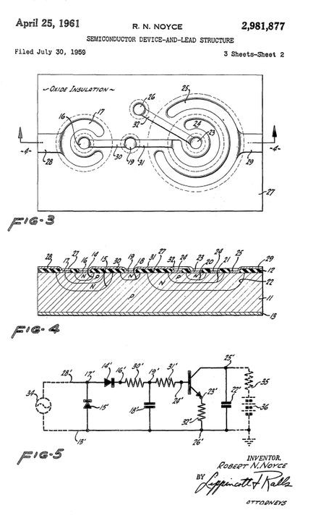
Introduction
IC (integrated circuit) single silicon chip that includes active and passive interconnected devices to implement complex operations (analogue, digital)
Planar technology: the processing steps are implemented in a thin layer of the surface of the chip
Semiconductor device-and-lead structure US2981877A
First planar IC patent, 1961
1
Instrumentation Training Lectures, Oxford 03/05/2024

Slide 4

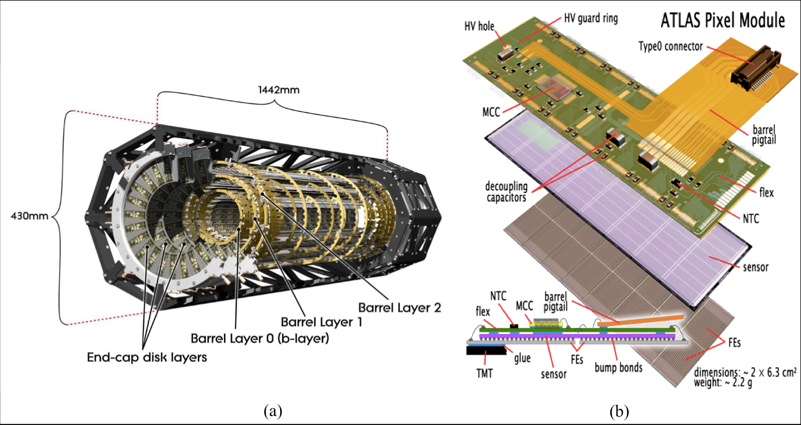
Introduction
Planar technology used also for HEP detector technology
Remarkable evolution in planar technologies impacted on detector technology as well
HEP traditionally used the ‘hybrid’ approach
2
Instrumentation Training Lectures, Oxford 03/05/2024

Slide 5
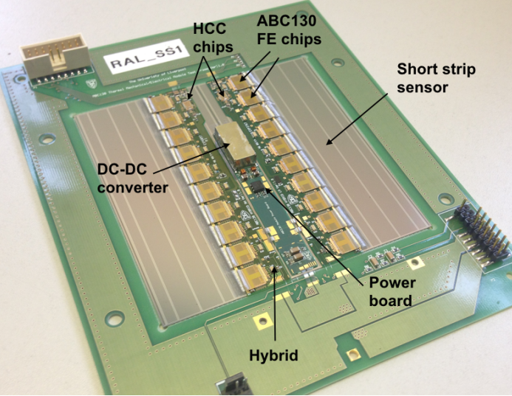
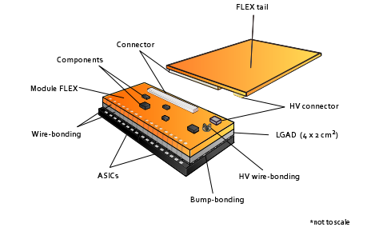
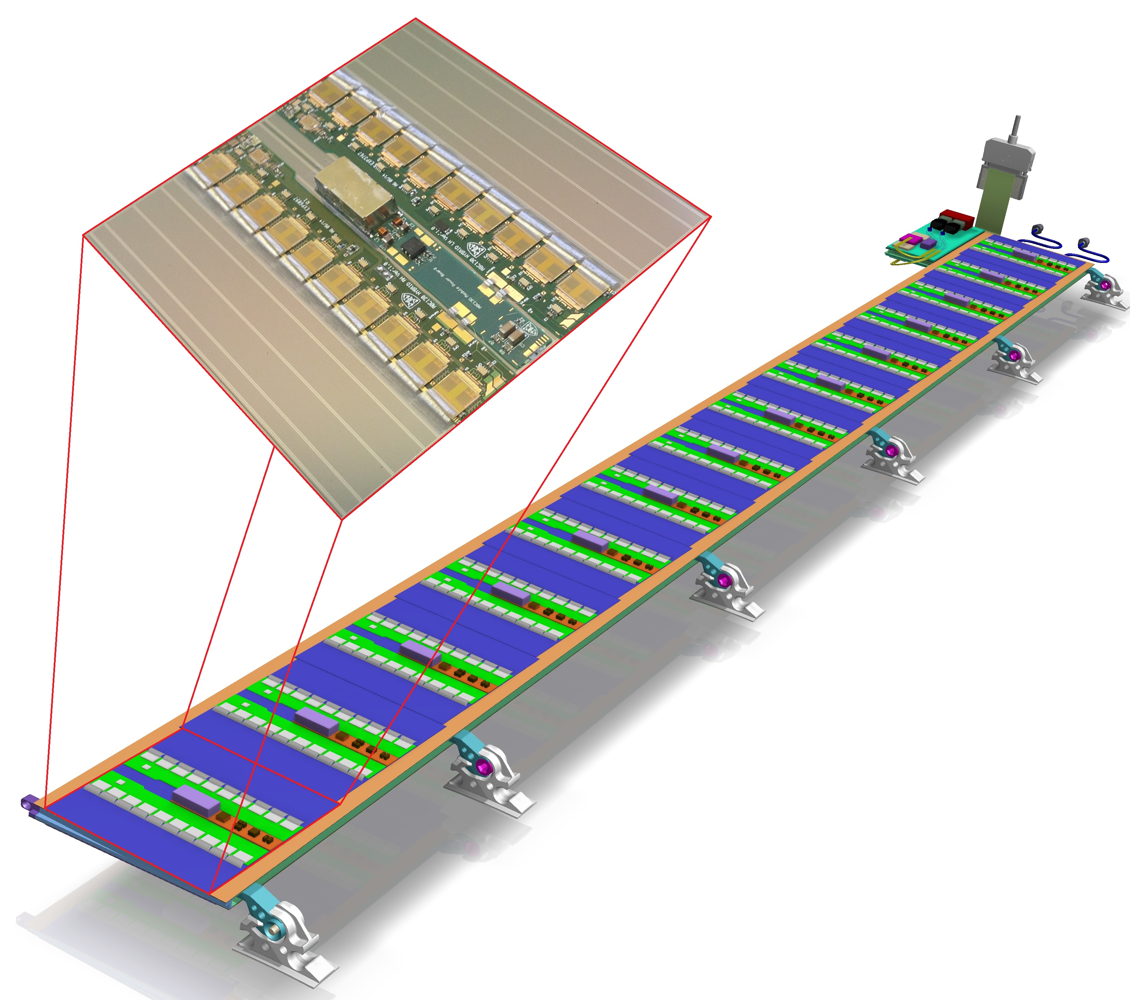
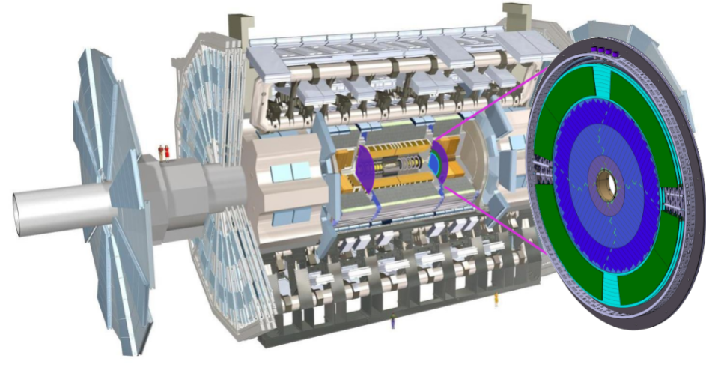
Hybrid solution
Hybrid: different operations are implemented on different silicon chips (like sensing and read out on separate carriers)
    High quality substrate for the sensor to optimize the charge collection efficiency and speed
    It requires interconnect to the readout, i.e. complex bonding, affecting reliability, costs
    Extra material due to the various layers
ATLAS Inner Tracker Upgrade (ITk)
silicon strip module on barrel stave
Hybrid module for the High Granularity Timing Detector (HGTD) for the upgraded ATLAS detector
3
Instrumentation Training Lectures, Oxford 03/05/2024

Slide 6
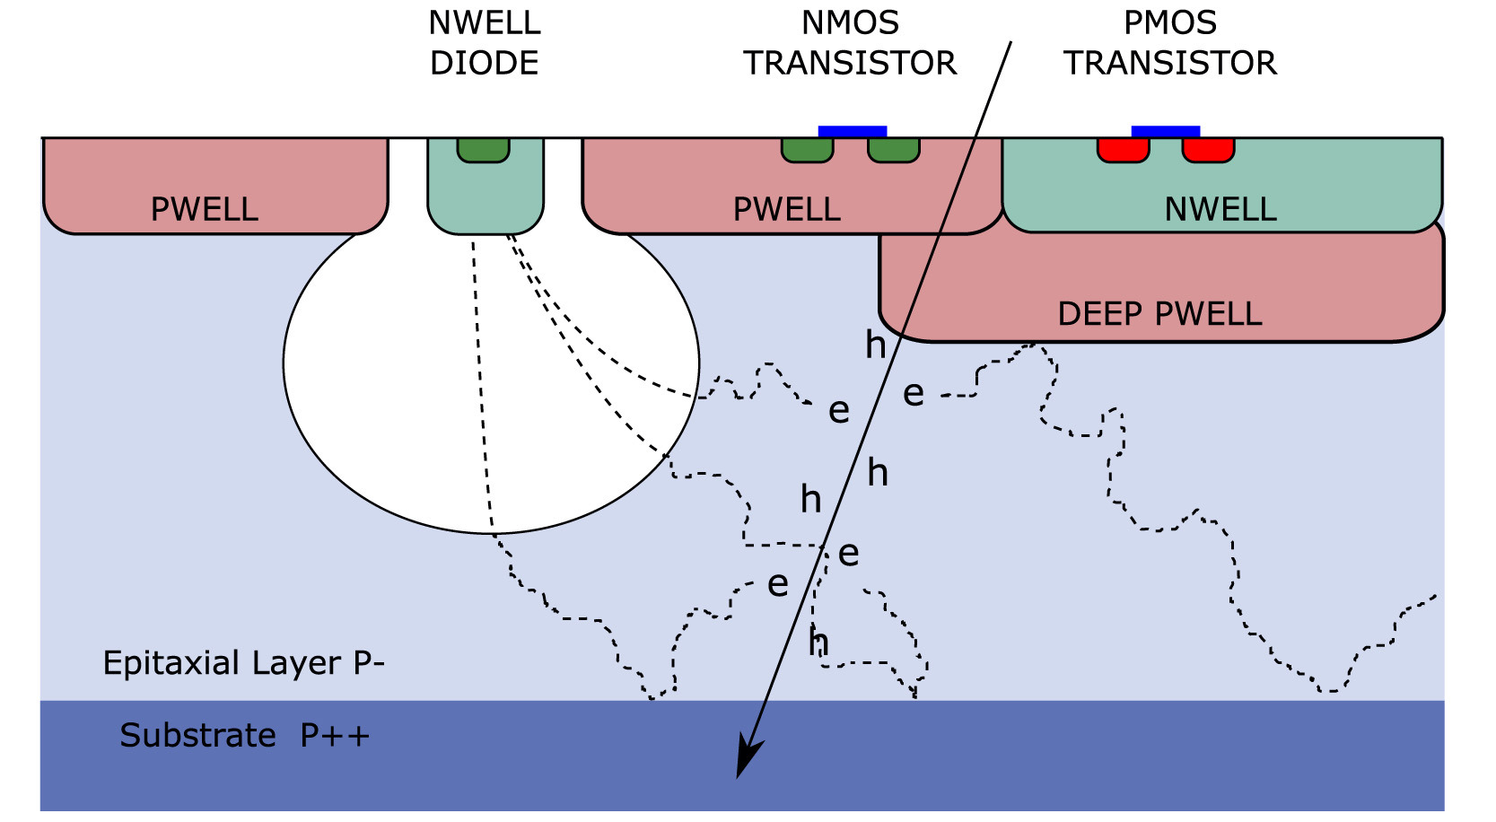
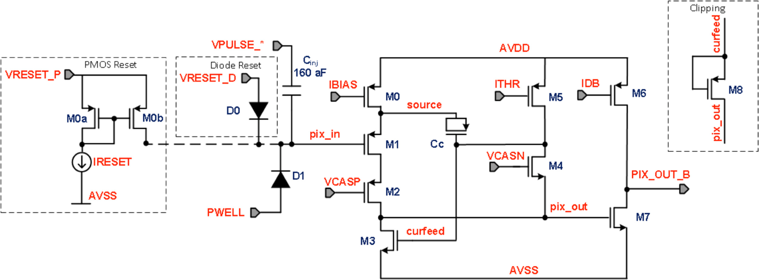
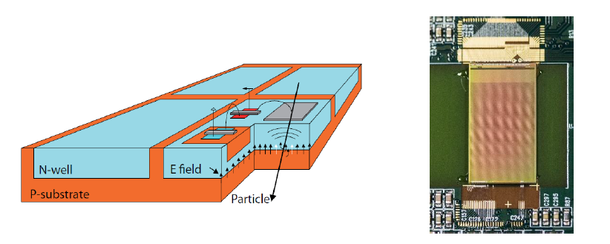
Monolithic solution
Monolithic: sensor and readout are implemented on the same silicon chip
    In-pixel processing possible: amplification and digitization integrated in the same chip
    Small pixels ( ‘10’s x 10’s um )
    Low noise, due to small pixel, low leakage, low capacitance
    Good S/N
    Sensitive region 10’us um, thinning of the sensor is possible, to reduce the overall mass
The vertex detector of the STAR experiment, the first to use CMOS MAPS
MAPS used for ALICE ITS upgrade, with in-pixel FE circuitry
HV MAPS used for Mu3e
4
Instrumentation Training Lectures, Oxford 03/05/2024

Slide 7
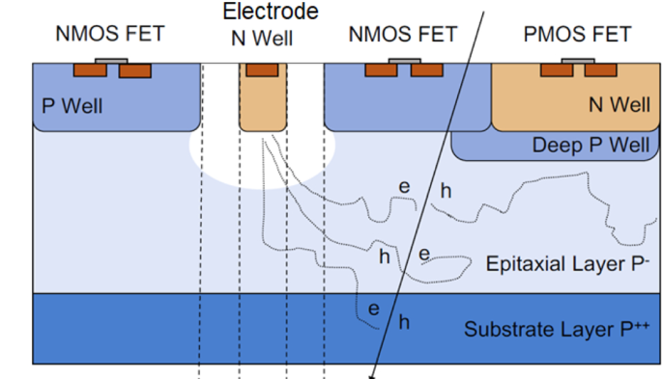

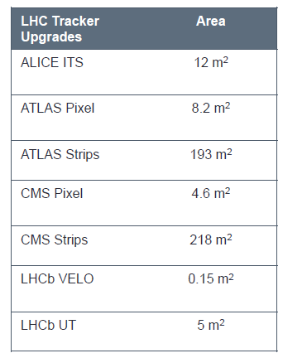
Monolithic solution
Monolithic: sensing and read out are implemented on the same silicon chip
  Mostly use commercial CMOS process
    Redundancies of foundries
    Potentially low cost, large area cover possible
    High yield
  Reliability, no need for wire/bump bonding
Deep N Well
Deep P Well
Monolithic approach is an interesting option for most HEP experiments
HGTD 6.4 m²
5
Instrumentation Training Lectures, Oxford 03/05/2024

Slide 8
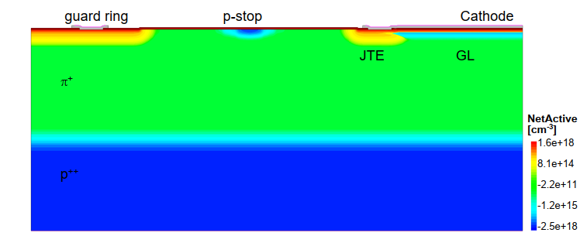
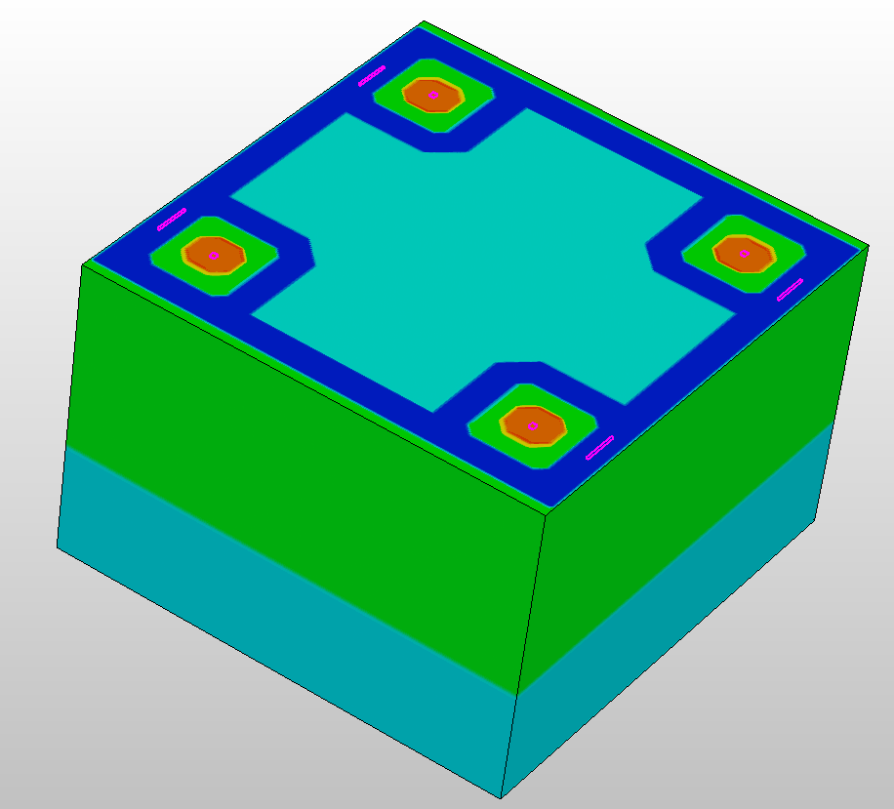
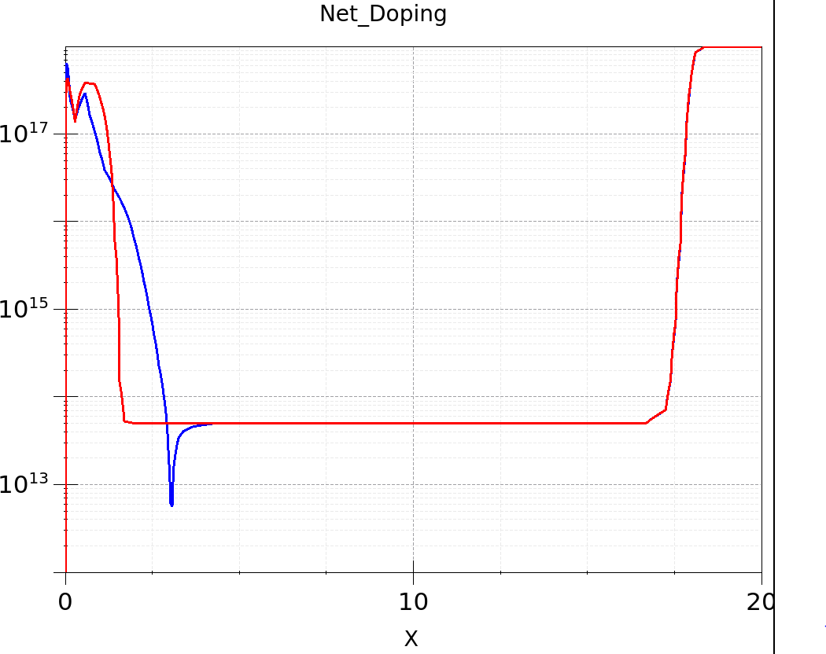
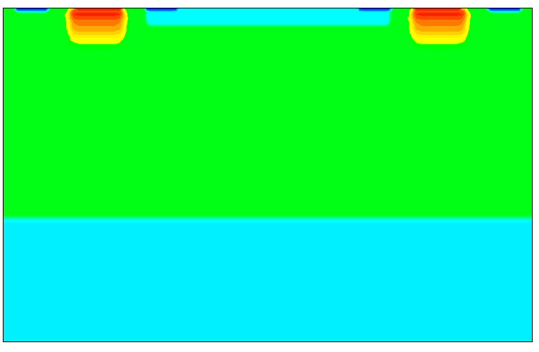
Layout of Hybrid and Monolithic
An example of Low Gain Avalanche Detector (LGAD) x-section, with p-stop for isolation and Junction Termination Extension (JTE) to increase the breakdown
Hybrid and Monolithic approach: the sensors share conceptually similar ‘layouts issues’:
  Guard rings, channel stops to avoid surface currents and improve breakdown
  Usually high voltage (100’s V) are needed for biasing of sensors in hybrid approach, much less for monolithic sensors: HV biasing technique present additional challenges
N Well (Cathode)
2
1
2
1
An example of a CMOS sensor on High Resistivity epitaxial x-section, with only p-stop for inter pad isolation
6
Instrumentation Training Lectures, Oxford 03/05/2024

Slide 9
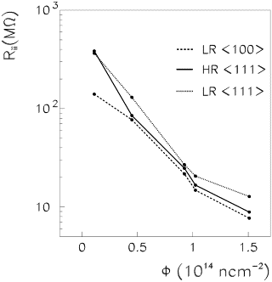
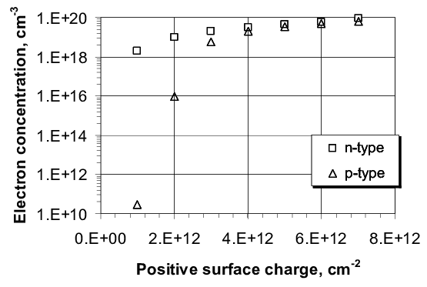
Isolation techniques
pad
pad
SiO₂
₊₊₊₊₊₊
₊₊₊₊₊
n⁺⁺
₋₋₋₋₋₋₋₋₋₋
n⁺⁺
In non-irradiated sensors (depending on the process) the dangling bonds at SiO₂-Si interface usually result in a fixed positive charge around 1e10 (Si <100>) - 1e11 (Si <111>) cm⁻²
This positive charge creates an accumulation layer of electrons in the substrate between two adjacent pads, decreasing the interstrip resistance
Values up to > 1e12 cm⁻² following ionizing irradiation further decrease the interstrip resistance
Inversion layer
Si - p
Interstrip resistance vs non-ionising fluence*
Carrier concentration vs. Oxide surface charge
*G. Calefato, et al, s ., Comparison on radiation tolerance of 〈100〉 and 〈111〉 silicon substrates of microstrip detector,https://doi.org/10.1016/S0168-9002(01)01667-9.
7
Instrumentation Training Lectures, Oxford 03/05/2024

Slide 10
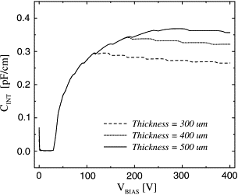
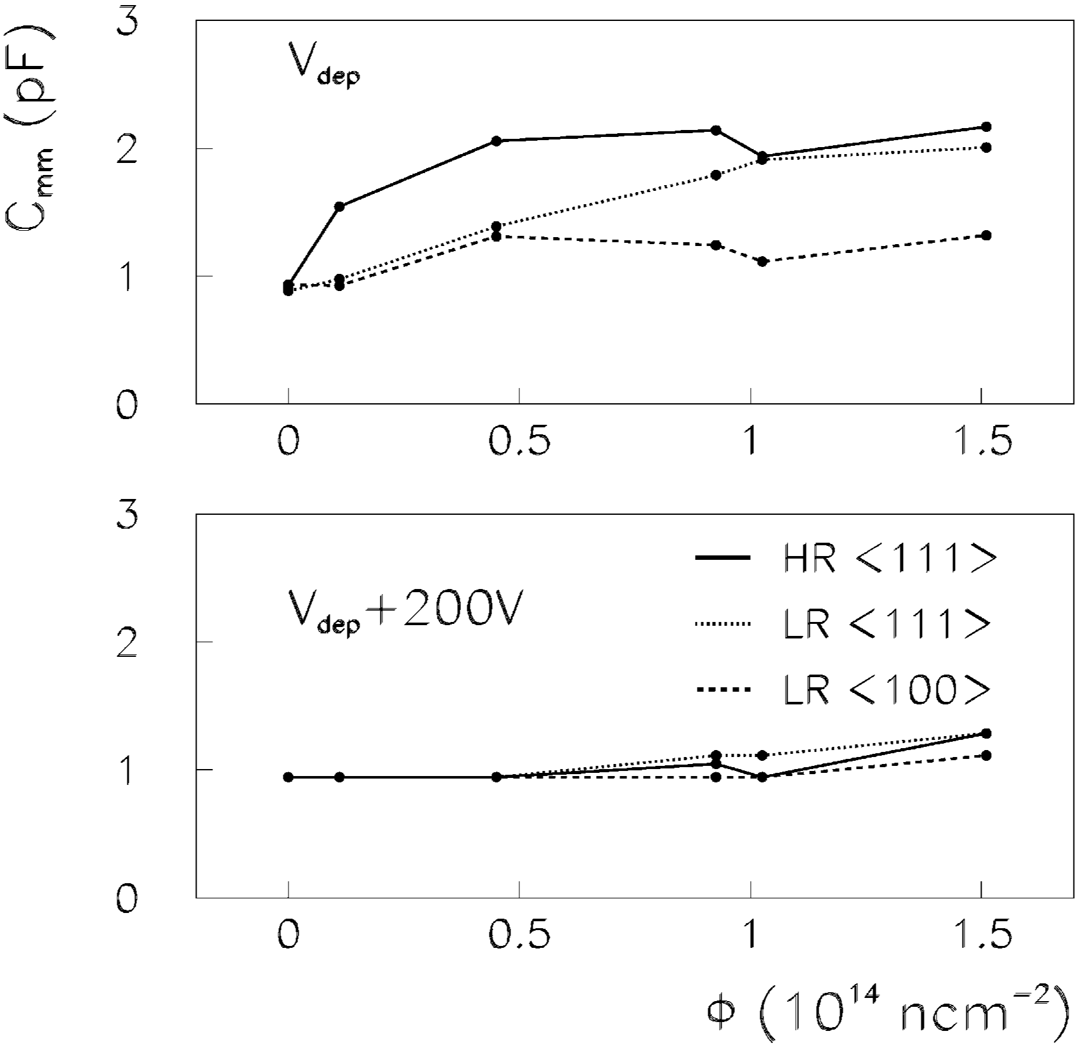
Isolation techniques
V_{bias}
V_{bias}
1
₊₊₊₊₊
3
1
2
2
3
C_{int inv}
3
2
depl
C_{int blk}
The inversion layer also affect the interstrip capacitance, which affects the noise performances of the detector
An increased in Total Ionising Dose (TID) increases the positive charge at Si-SiO2 interface
This might reduce the depletion of the inversion layer and increase the interstrip capacitance
1
GND
D Passeri, et al. Parasitic capacitances in thick-substrate silicon microstrip detectors, https://doi.org/10.1016/S0168-9002(01)01669-2.
₊₊₊₊₊
1
+++++
1
2
2
3
C_{int inv}
3
depl
C_{int blk}
G. Calefato, et al, s ., Comparison on radiation tolerance of 〈100〉 and 〈111〉 silicon substrates of microstrip detector,https://doi.org/10.1016/S0168-9002(01)01667-9.
8
Instrumentation Training Lectures, Oxford 03/05/2024

Slide 11
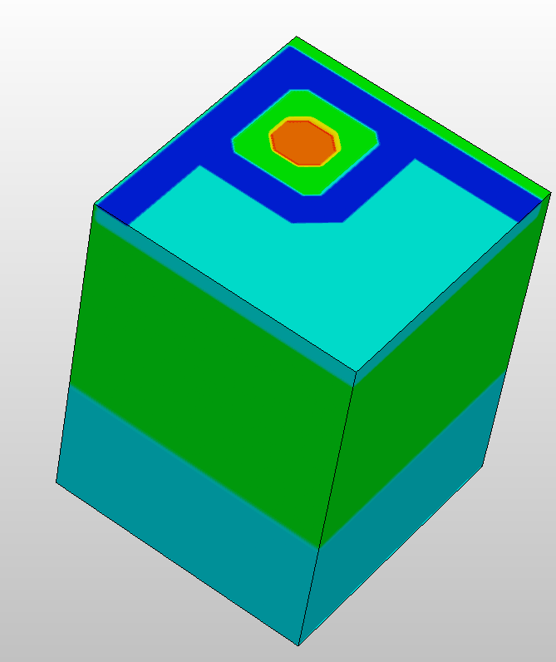
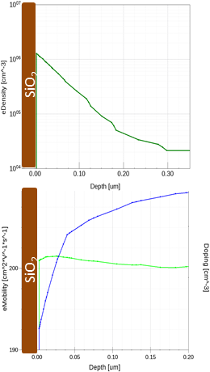
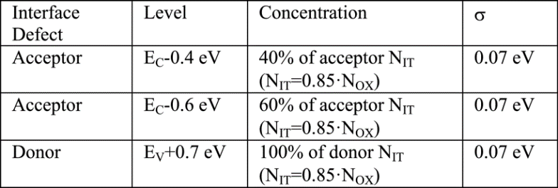
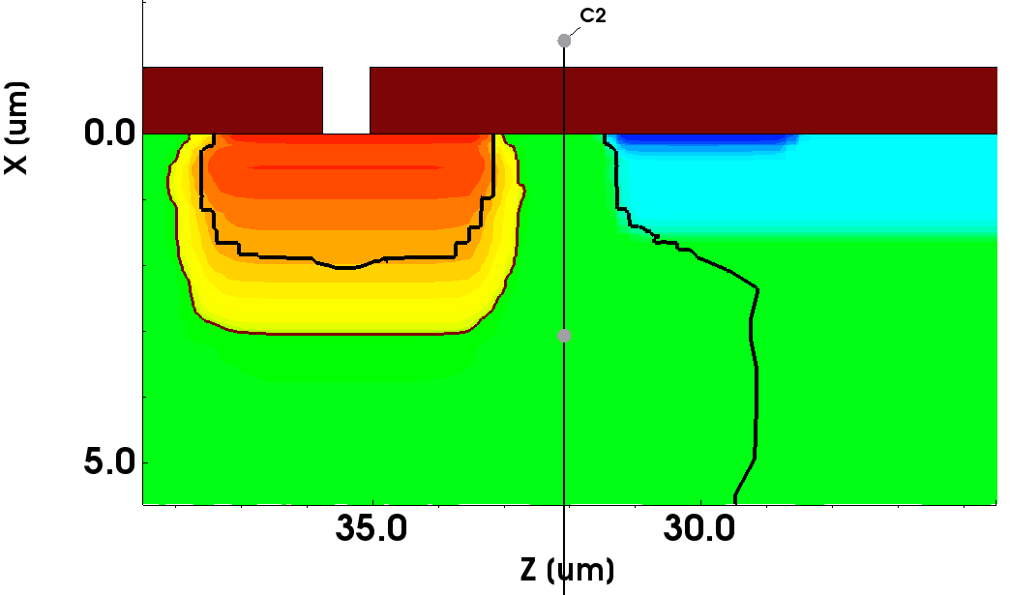
P⁺⁺ Well
N Well
Isolation techniques
The inversion channel might become even more important in low doped p-substrate, because of the segregation coefficient of B in SiO2 is < 1 ( it is the opposite in case of n doping, like with P)
* Effects of Interface Donor Trap States on Isolation Properties of Detectors Operating at High-Luminosity LHC, DOI: 10.1109/TNS.2017.2709815
9
Instrumentation Training Lectures, Oxford 03/05/2024

Slide 12
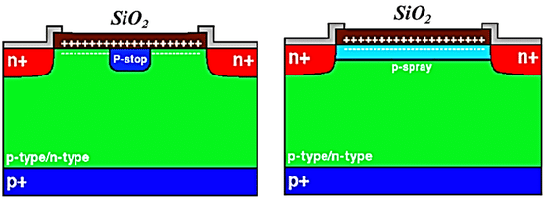
Isolation techniques
P-stop and p-spray isolation techniques
Breaking the inversion channel improves the isolation among cells
The p-stop technique places a p⁺ implant between adjacent wells
The p-spray technique implements an uniform p layer between adjacent wells
The floating p⁺ stop method consists of placing a p⁺ implant in between two adjacent n⁺ strips
It requires an additional mask
It might decrease the BV
The p-spray method consists of having uniform p+ layer
beneath the Si/SiO2 interface.
No additional mask required
It requires careful dose of doping (too low does increase BV but does not isolate, too high isolate but decreases BV)
10
Instrumentation Training Lectures, Oxford 03/05/2024

Slide 13
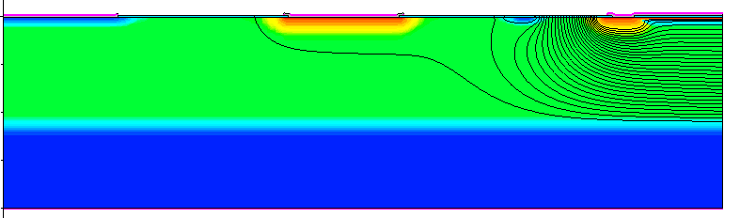
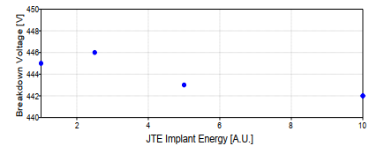
Isolation techniques
Guard ring cutting edge
Guard ring
P-stop
JTE
Cathode
P-epi
The biasing of sensors with high voltage is required to guarantee good charge collection efficiency and short collection time
The bias voltage is usually increased following sensors irradiation, due to loss of charge collection efficiency (reduced depletion, charge trapping – see Rad. Damage Lectures)
Various techniques are used to reduce the likelihood of breakdown due to the high voltage operation
P⁺⁺
The use of junction termination extension (JTE) reduces gradually the potential from the edge of the sensor, decreasing the field and increasing the breakdown
11
Instrumentation Training Lectures, Oxford 03/05/2024

Slide 14
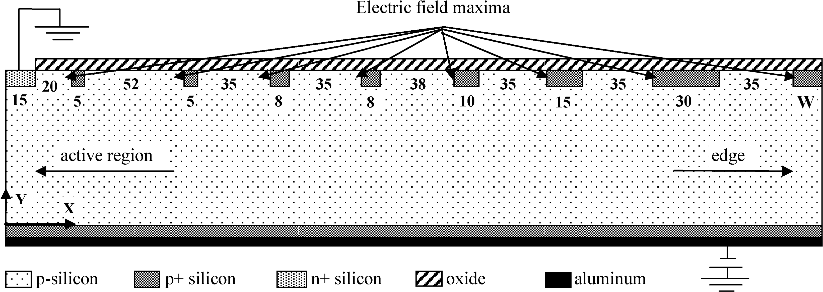
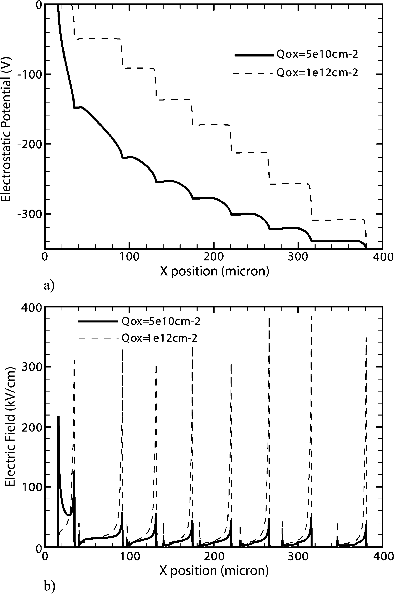
Isolation techniques
Guard rings are used to ensure a smooth transition from HV to ground towards the edge
Their design need to include surface charge effects resulting from irradiation
Multi guard rings are often employed to allow for high voltage operation
Their use increases the design complexity and the required area
Multi guard rings improve the high voltage operation, by decreasing the electric field at the sensor edge
O. Koybasi, et al. "Guard Ring Simulations for n-on-p Silicon Particle Detectors," in IEEE Transactions on Nuclear Science, doi: 10.1109/TNS.2010.2063439
12

Slide 15
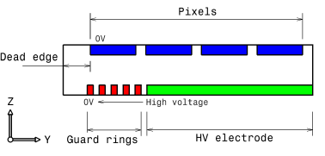
Isolation techniques
The cutting edge of the sensor is usually damaged because of the dicing process, resulting in a very effective generation centre
The depletion region extending laterally may reach this area, giving high leakage current
Usually the sensor surface is terminated with a wide p⁺ implant to prevent this by making the region underneath undepleted
Cutting edge
P implant
Guard ring
P-stop
Cathode
undepleted
Guard rings are used also to avoid the SC region reaching the cutting edge of the sensor
Simulation of guard ring influence on the performance of ATLAS pixel
detectors for inner layer replacement DOI: 10.1088/1748-0221/4/03/P03025
13

Slide 16
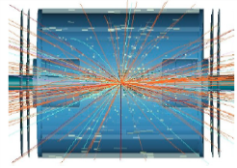
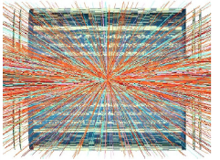

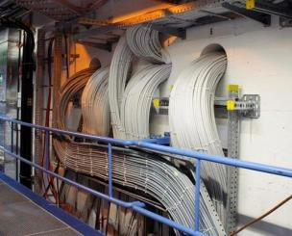
HV biasing
LHC
HL-LHC
Current ATLAS SCT uses independent powering for the 4088 detector modules. Each sensor has its own independent HV bias line.
‘ideal’ solution:
  High Redundancy
  Individual enabling or disabling of sensors and current monitoring
The increased number of sensors in the Upgraded Tracker (>10 k modules in barrel upgrade vs. ∼2 k in present barrel) implies a trade off among material budget, complexity of power distribution and number of HV bias lines.
From 1E33 cm⁻² s⁻¹
…to 7.5E34 cm⁻² s⁻¹
14
Instrumentation Training Lectures, Oxford 03/05/2024

Slide 17
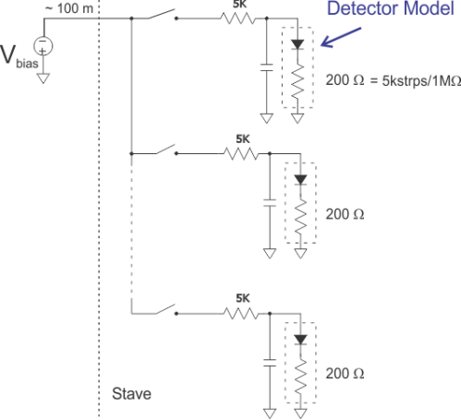
HV biasing
HV (-500V)
Use single (or more) HV bus to bias in parallel all sensors and use one HV switch for each sensor to disable malfunctioning sensors: High Voltage Multiplexing ‘HVMUX’
The HV switch is DCS controlled, with control signals provided by custom ASIC (Autonomous Monitor And Control, AMAC)
DCS controlled HV switch
15
Instrumentation Training Lectures, Oxford 03/05/2024

Slide 18
HV biasing
Partial list of investigated HV devices
FAILED
FAILED
FAILED
High Voltage switches strip detector requirements:
Rated to 500V plus a safety margin
Must be radiation hard, nominal maximum expected ∼1x10¹⁵ n_{eq}/cm² , ∼ 30Mrad (Si) for strip end cap. Multiply by 1.5 to include safety margin
On-state impedance R_{on} << 1kΩ // I_{on} ∼ 10mA (for irradiated strip sensors)
Off-state impedance R_{off} >> 1GΩ // I_{lkg} << I_{sens}
Must be unaffected by magnetic field
Must maintain satisfactory performance at -30° C
Must be small (mass/area constraint) and cheap (around 1E4 needed)
FAILED
FAILED
PASS – N.A.
FAILED
FAILED
FAILED
FAILED
FAILED
FAILED
PASS
GS66502B | GaNFET | 650V | PASS
PGA26E19BV | GaNFET | 600V | PASS
16
Instrumentation Training Lectures, Oxford 03/05/2024

Slide 19
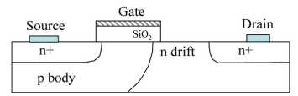
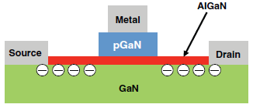
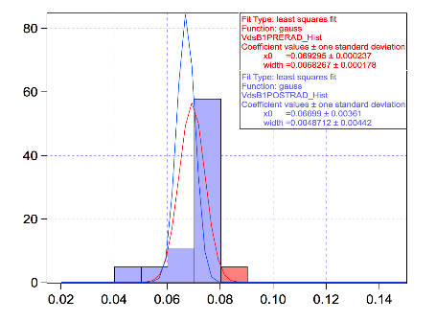
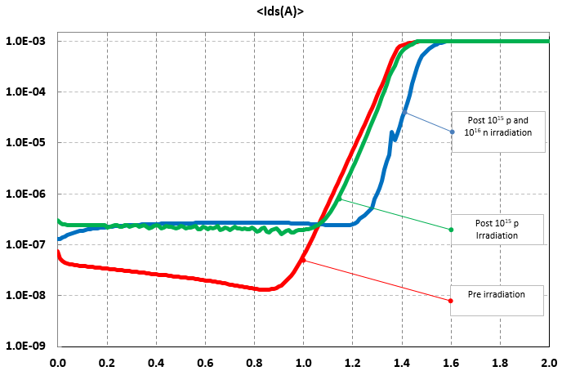
HV biasing
A Lateral Double-Diffused MOS (LDMOS). A long drift region of lower doping reduces the electric field
Example Xsection of a HEMT E. GaN FET. Strain-induced polarization at interface forms a 2DEG
Typical Si HV MOSFET use regions of low doping to increase high voltage capabilities: this affects their radiation hardness
Non-ionizing and ionizing irradiation test results of GaN FET devices indicate very high radiation hardness
Ids [A]
Vds = 550V, T = 21C
Board1 Vds
<Φ> = 9.05E14
TID = 207 [Mrad]
GaN Vds shift with irradiation
Vds [V]
Vgs [V]
Additional test performed on 18 devices Total p fluence 1.0E15, ~TID 200Mrad(GaN) Total n fluence 1.0E16
17
Instrumentation Training Lectures, Oxford 03/05/2024

Slide 20
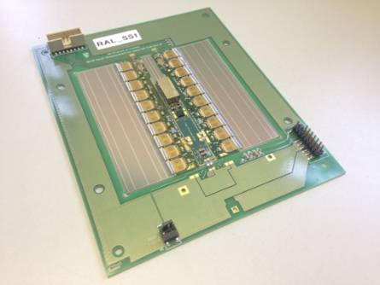
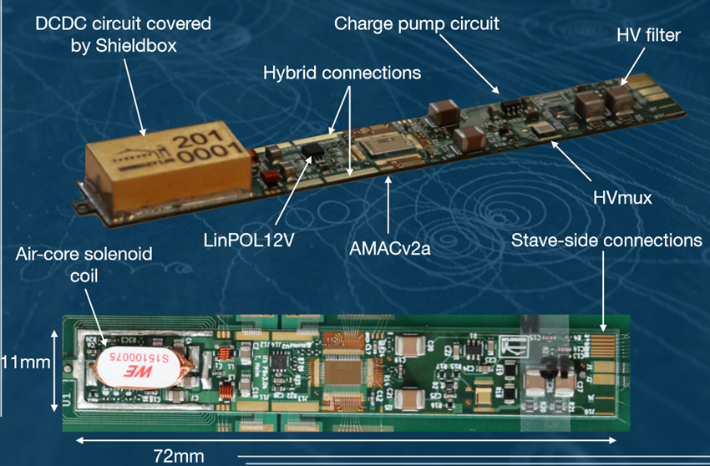
Strips power Board
HV biasing
HV area
The HVMUX sits on the lower side of a flexi power board (PB)
The PB final version incorporates power control and HVMUX elements in the AMAC ASIC
A barrel short strip module with
two hybrids and one powerboard with HVMUX
Power board v3.0b
18
Instrumentation Training Lectures, Oxford 03/05/2024

Slide 21
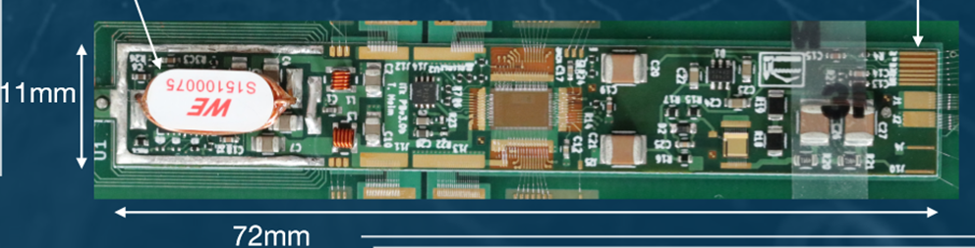
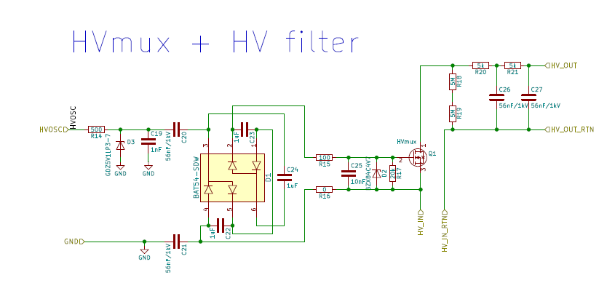
LBNL V3 PowerBoard with HV Mux
HV biasing
AMAC
Sensor
A charge pump voltage multiplier driven by AC drives the gate of a GaN FET, rated for HV
Investigated stacked solutions demonstrated switching voltages > 1kV
Up to 600V with the implemented ItK solution
Baseline solution for HV bias of ItK strips
RC Filters
HV GaNFET
From Bustape
Schottky Diode Charge Pump
for Gate Bias
From Bustape
Gate Overvoltage
Protection Zener
Villani, E.G., Technical Design Report for the ATLAS Inner Tracker Strip Detector, CERN-LHCC-2017-005, ATLAS-TDR-025, https://cds.cern.ch/record/2257755
19
Instrumentation Training Lectures, Oxford 03/05/2024

Slide 22
Circuits and Layouts II
Summary
  Hybrid and Monolithic technology pros and cons
  Common isolation techniques
  Example of ItK Strips HV biasing
    Thank you
    giulio.villani@stfc.ac.uk
20
Instrumentation Training Lectures, Oxford 03/05/2024

