Slide 1
LHC Beam Vacuum System Performance 2011
G. Lanza, V. Baglin, G. Bregliozzi
CERN TE-VSC-LBV
Outline
2011 LHC performances
LHC Vacuum Status
Scrubbing Run
MD 25ns
Pressure rises
  TDI and ALICE background
  Pressure Spikes
  CMS
Christmas Break and Summary

Slide 2
2011 LHC performances
705 physic fills
180 days of scheduled physics
 | 2011 | Nominal
Peak luminosity [cm⁻²s⁻¹] | 3.6 x 10³³ | 1 x 10³⁴
Proton Energy (TeV) | 3.5 | 7
Bunch Intensity (proton) | 1.51 x 10¹¹ | 1.15 x 10¹¹
Bunch spacing (ns) | 50 | 25
Emittance | ~2.3 start of fill | 3.75
Beta* (m) | 1.0, 10, 1.0, 3.0 m | 0.55
Number of bunches | 1380 | 2808
The LHC finished its 2011 proton physics program on Saturday 29 October and t is now operating with Pb ions.

Slide 3
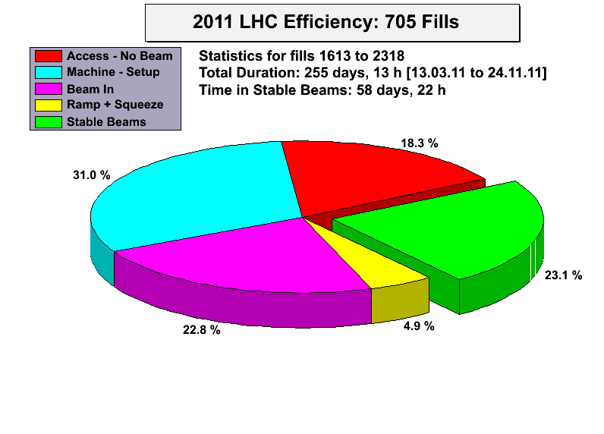
2011 LHC performances
30% efficiency: 54 days in stable beams over 180 days of scheduled physics
Other scheduled periods:
  18 days technical stops
  10 days scrubbing run
  ~17 days of MD
Mike Lamont
LHC operation perspectives
Notes:
One year corresponds to 200days of physics

Slide 4
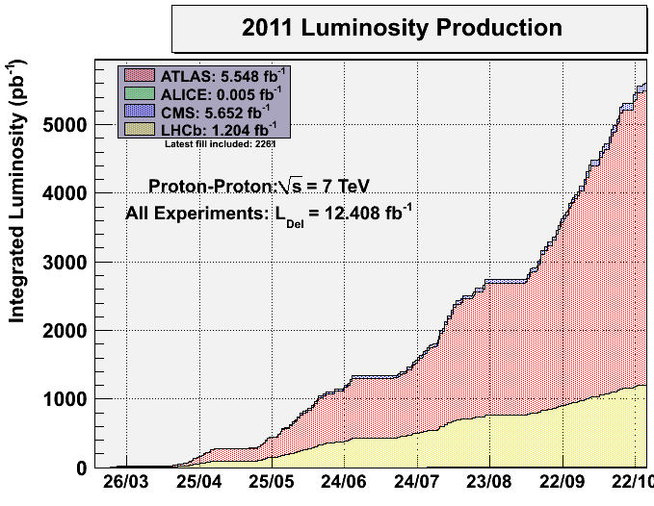
2011 LHC performances
  ATLAS/CMS > 5.5 fb⁻¹
  LHCb 1.2 fb⁻¹
  ALICE ≈ 5 pb⁻¹
~0.4 fb⁻¹/week
0.2 fb⁻¹/week
Mike Lamont
LHC operation perspectives
Notes:
Along the year, the machine parameters improved and the Integrated luminosity (the figure of merit of the machine) weekly rate increased. The plateau correspond to TS, MD or machine set up.
ignificant quantities of data being accumulated by the experiments,

Slide 5



Aim: maximize peak luminosity
2011 LHC performances
N | Number of particles per bunch
K_{b} | Number of bunches
f | Revolution frequency
 | Beam size at interaction point
F | Reduction factor due to crossing angle
 | Emittance
 | Normalized emittance
 | Beta function at IP
Mike Lamont
LHC operation perspectives
Notes:
To increase the peak luminosity:….
And it is what you see in the next plot
The size of the beam in the interaction point is very thiny: 2x 300mA in such a small size

Slide 6
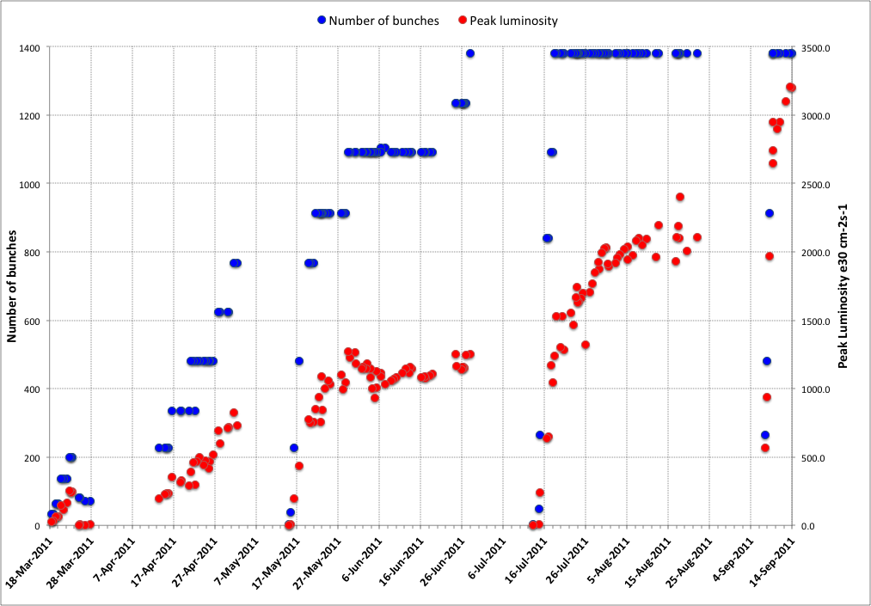
2011 LHC History
Increase bunch intensity
75 ns
50 ns
Increase number of bunches
Scrubbing Run
Squeeze further
Reduce beam size from injectors
Mike Lamont
LHC operation perspectives
Notes:
The next major milestone came on 19 April with a ten-fold increase in luminosity – in other words, the machine started delivering ten times as many collisions to the experiments in a given period of time than had previously been possible. This came about thanks to two simultaneous developments: firstly the number of particles in each bunch was doubled, and secondly the beam size at the interaction point was squeezed down. The term you’ll hear used to describe the beam size at the interaction point is called beta-star, and the smaller the beta, the better. Before squeeze, beta is 11 m at ATLAS and CMS. The ultimate goal is to reduce it to 0.55 m. Today, we’re running with a beta of 2 m. That may not sound very small, and that’s because it’s not the size of the beam: beta is the distance from the interaction point that the beam is twice the size it is at the interaction point. What’s important for physics is that the lower the beta, the smaller the beam at the interaction point. With beta of 2 m, the beam is just 45 microns across at the interaction point, a quarter the width of a human hair, and its cross section is about five times smaller than with a beta of 11 m.

Slide 7
2011 LHC Vacuum Status

Slide 8
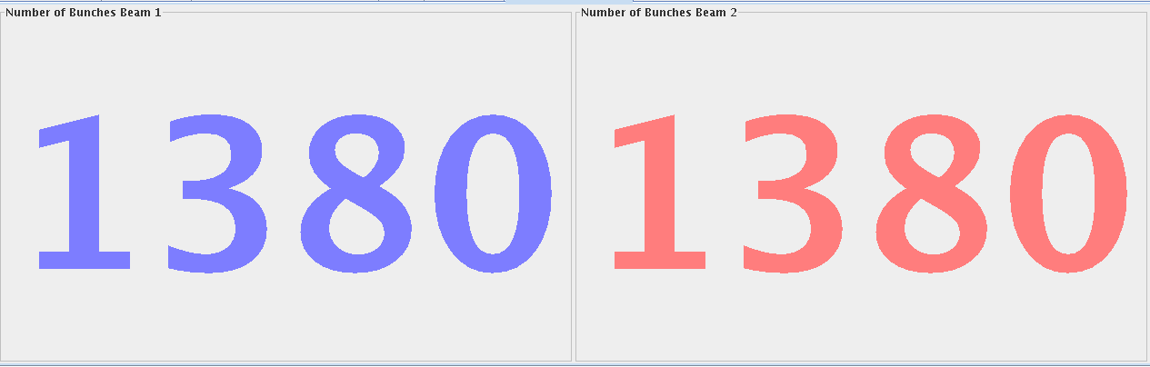
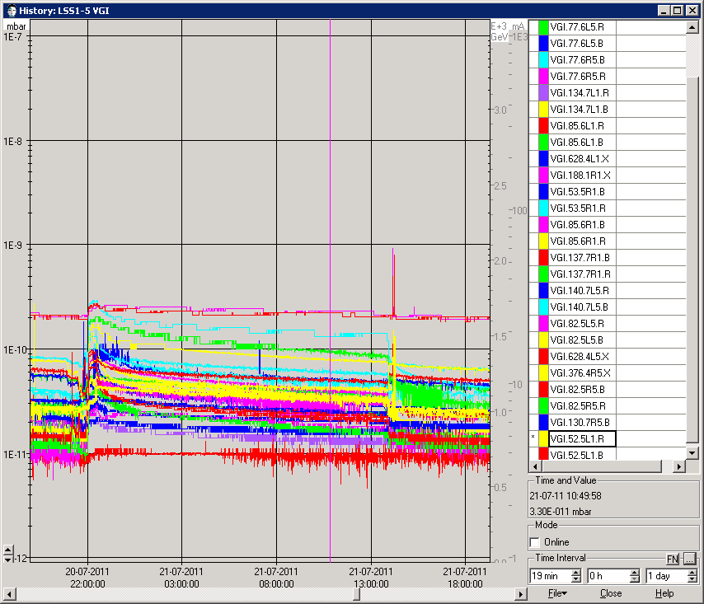
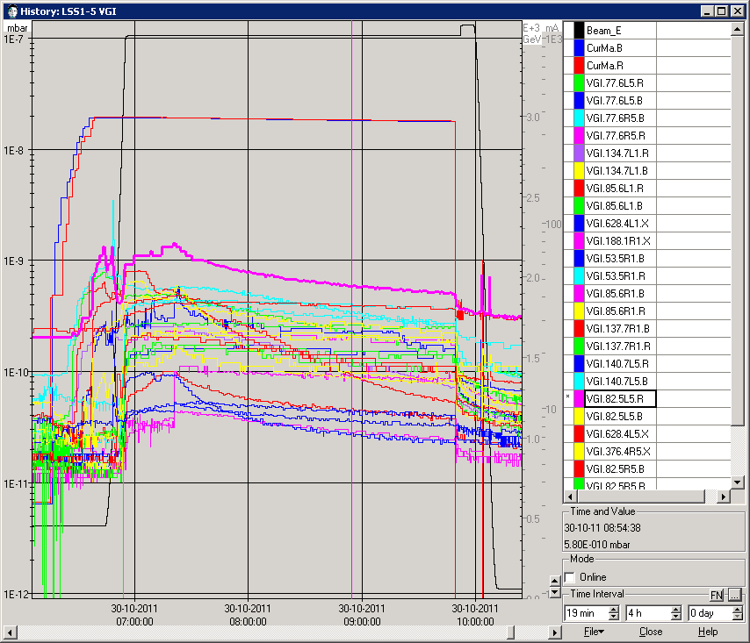
LSS Vacuum Status
Fill 1962
Fill 2266
284 mA/beam - 1 10¹¹ ppb
357 mA/beam - 1.47 10¹¹ ppb
Pressure increase due to different beam parameter
Scrubbing and beam conditioning of the whole vacuum system

Slide 9
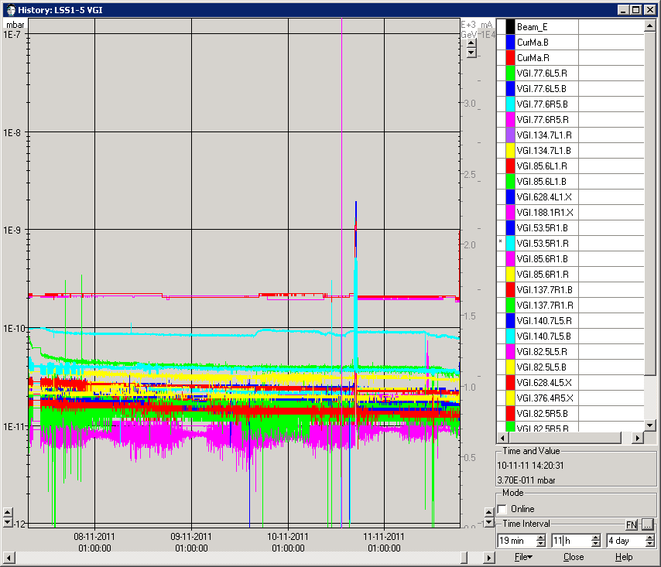
LSS Vacuum Status
Fill 1962
Fill 2267 (last proton fill)
284 mA/beam - 1 10¹¹ ppb
Technical Stop 5 (week 45)
Pressure increase due to different beam parameter
Scrubbing and beam conditioning of the whole vacuum system

Slide 10
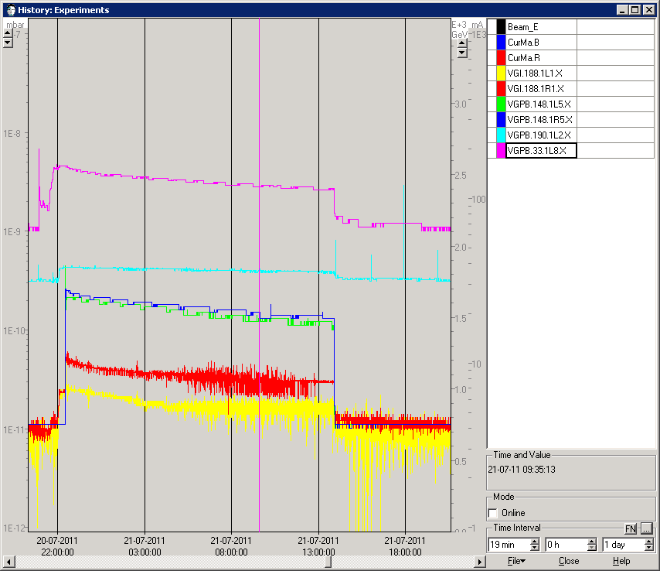
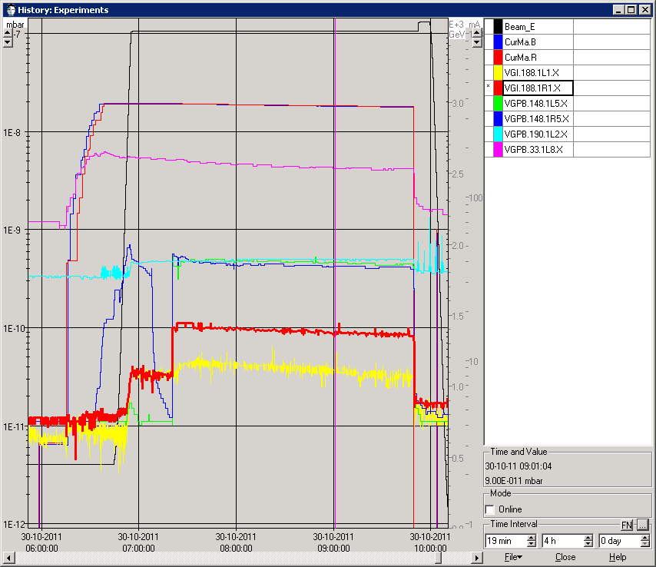
Experiments Vacuum Status
Fill 1962
Fill 2267 (last proton fill)
284 mA/beam - 1 10¹¹ ppb
357 mA/beam - 1.5 10¹¹ ppb
LHCb
LHCb
ALICE
ALICE
CMS
CMS
ATLAS
ATLAS
Pressure increase due to different beam parameter
Scrubbing and beam conditioning of the whole vacuum system

Slide 11
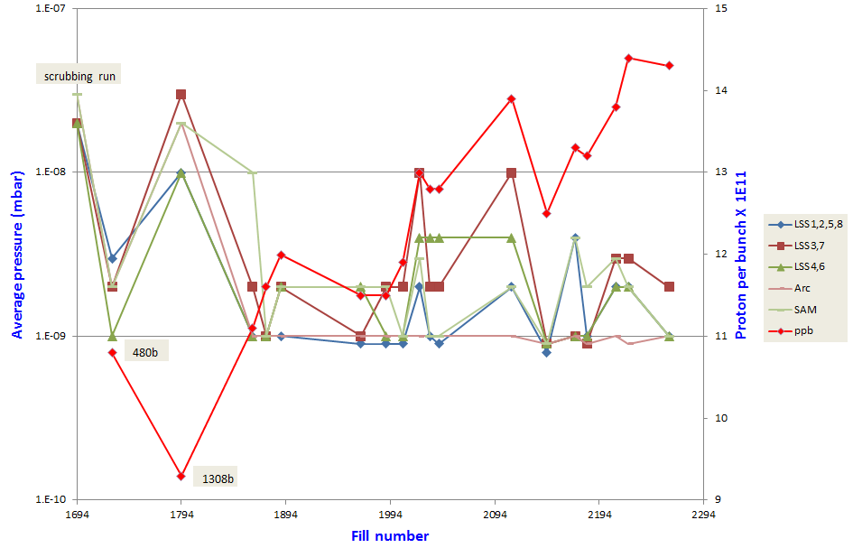
2011 Vacuum Statistic
Pressure reduction observed during the year
Scrubbing and beam conditioning of the whole vacuum system
Notes:
To have a sort of weekly statistic, we average the pressure of the machine, sorting the gauge by zones. The pressure are recorded during one physic fill, just before the collision status.

Slide 12
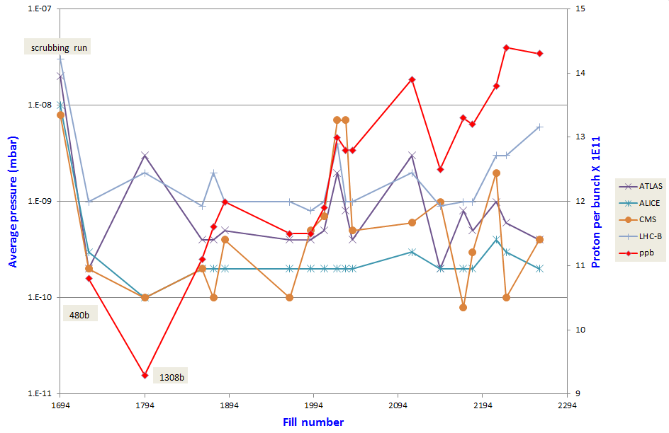
2011 Vacuum Statistic
Pressure reduction observed during the year
Scrubbing and beam conditioning of the whole vacuum system
Notes:
During the scrubbing run, with beam parameters more far from the nominal values we had higher pressure increase than now. Increasing the beam performance didn’t affect the vacuum performances

Slide 13
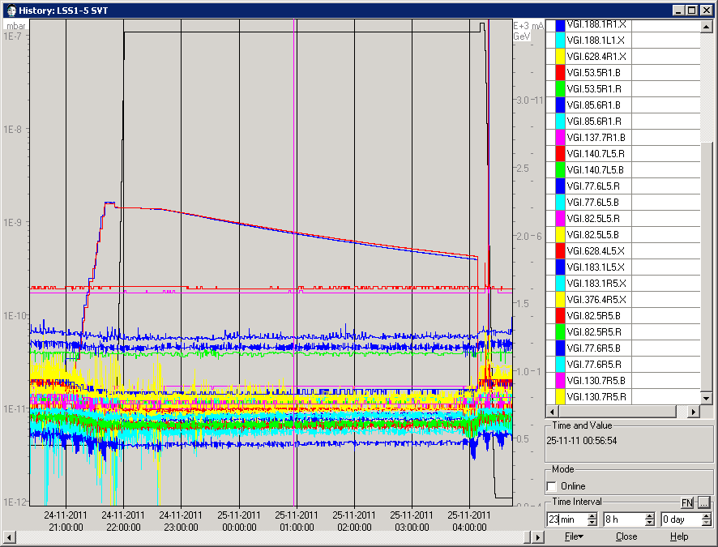
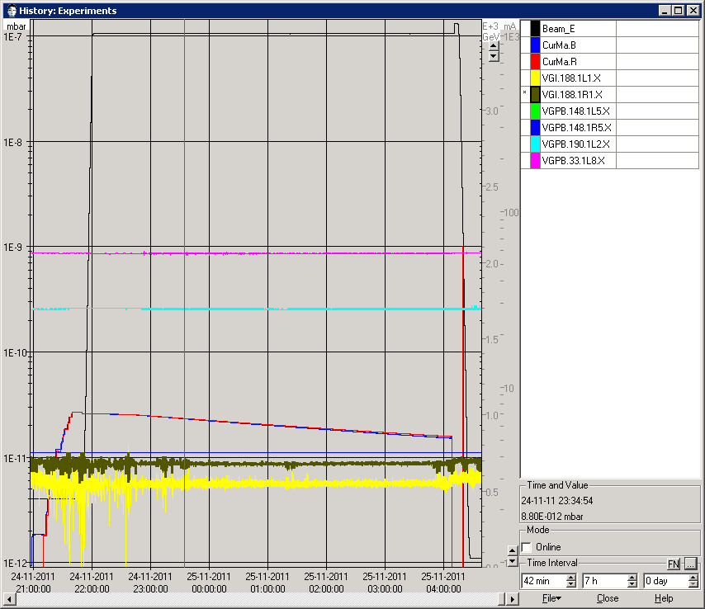
2011 Ion Physics
Fill 2320: 7mA of Ion current
LSS1 and LSS5 SVT (NEG-NEG regions)
Experiments
LHCb
ALICE
CMS
ATLAS

Slide 14
Scrubbing Run

Slide 15
Electron Cloud
Electron clouds in beampipes are generated by electron multipacting on the wall of the vacuum chamber. The electrons are accelerated by the electric field of the bunches.
+
+
+
+
Beam pipe
E-cloud effects
High density of e⁻ in the beam pipe
e⁻ stimulated desorption (ESD)
Beam instabilities
Pressure increase
Heat load in cryogenic system
Notes:
Production of electrons in the vacuum chamber due to beam-gas interaction. Those electrons receive a kick from the circulating proton. Those electrons have enough energy to produce, due to the secondary emission process, two electrons. Depending on the proton density and bunch spacing, those electrons can be reabsorbed on the wall or start multiplying. This surface electron bombardment produce pressure increase due to ESD but a surface conditioning.

Slide 16
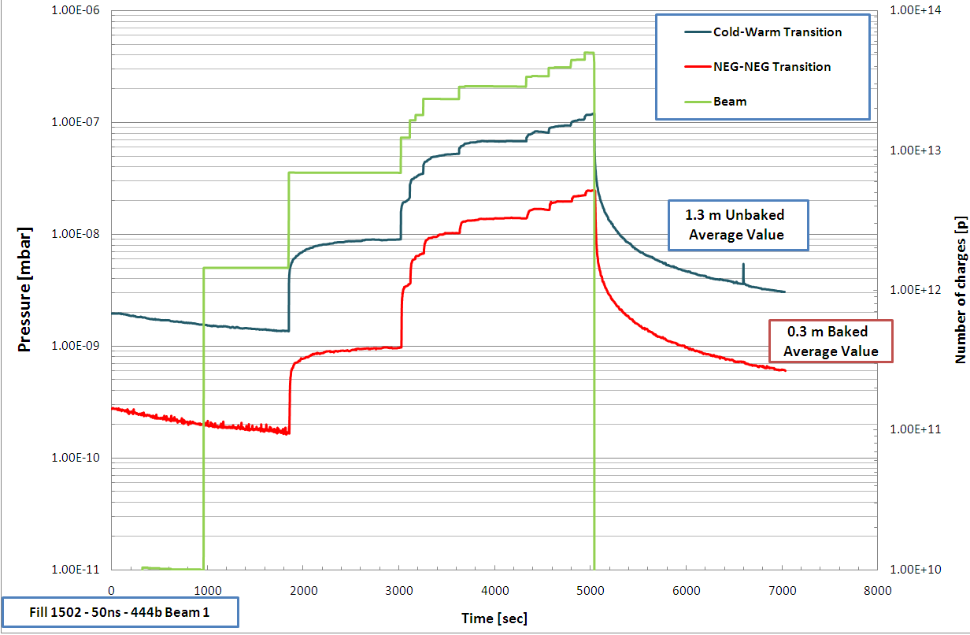
Electron Cloud
Electron cloud induced pressure rise
Notes:
Vacuum pressure rise
Electron stimulated desorption (ESD - η)
Multipacting length
Effective pumping speed S
Electron Flux ( )
Here with 400 bunches we reached high pressures up to 4 x10-7 mbar

Slide 17
Objective Scrubbing Run April 2011
Aims of the scrubbing run were:
(1) reduction of the SEY in the arcs and straight sections to allow for operation with 75 and possibly 50-ns beams with acceptable heat load, vacuum pressure rise and emittance blow-up,
(2) to allow fast ramp up with 75-ns or possibly 50-ns beams up to 400-900 bunches in steps of 100-200 bunches
(3) to validate the strategy for suppression of e-cloud effect defined in the LHC Design Report.
from the Gianluigi Arduini presentation
85th LMC Meeting held on 30 March 2011
Notes:
With this scrubbing run we validate what was said in the past and written in the design report : it works!

Slide 18
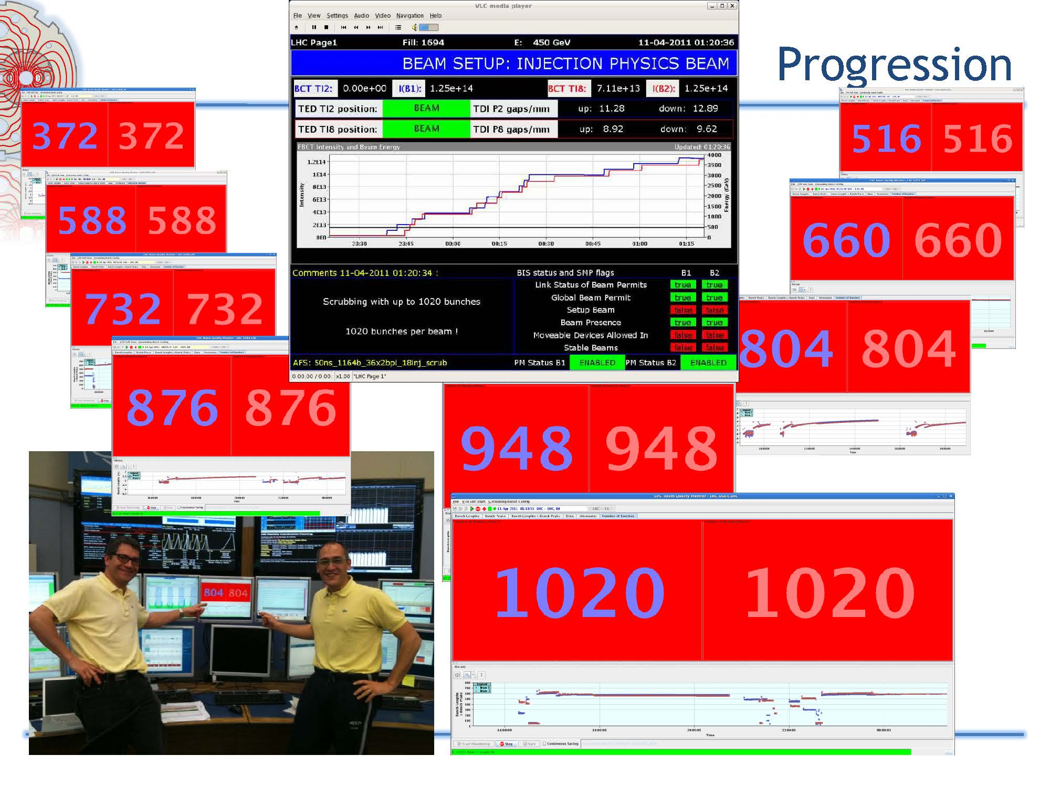
Results Scrubbing Run April 2011

Slide 19
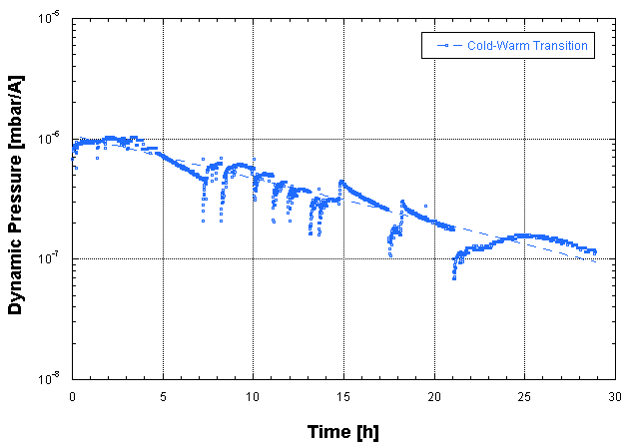
Results Scrubbing Run April 2011
Dynamic pressure function of the beam time for the unbaked transition: after about 28h of vacuum cleaning and beam scrubbing a decrease of one decade in the pressure was measured.
All the desorbed gas due to the bombardment of the electron is partially chemisorbed in the NEG coating and partially physisorbed in the cryogenic system.
Notes:
Dose effects due to the electron bombardments which produce a decrease of the electron desorption yield, η, the number of gas molecules desorbed from the surface of the beam vacuum pipe by the primary electron.

Slide 20
MD 25 ns

Slide 21
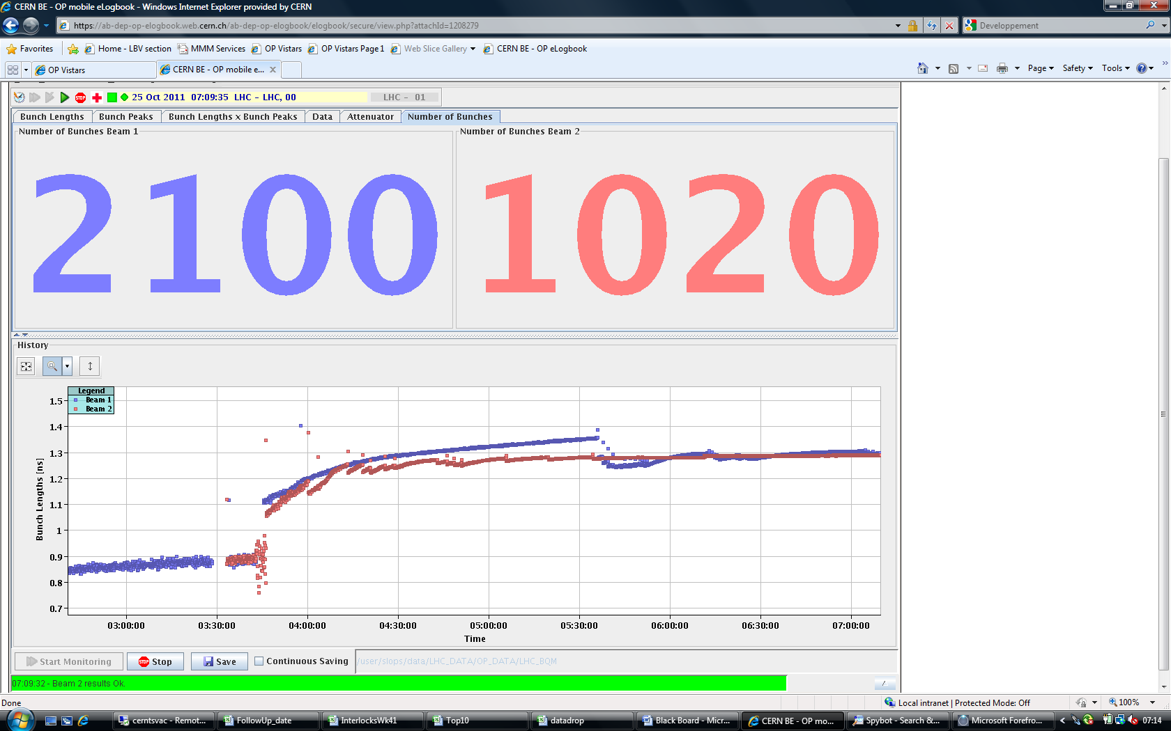
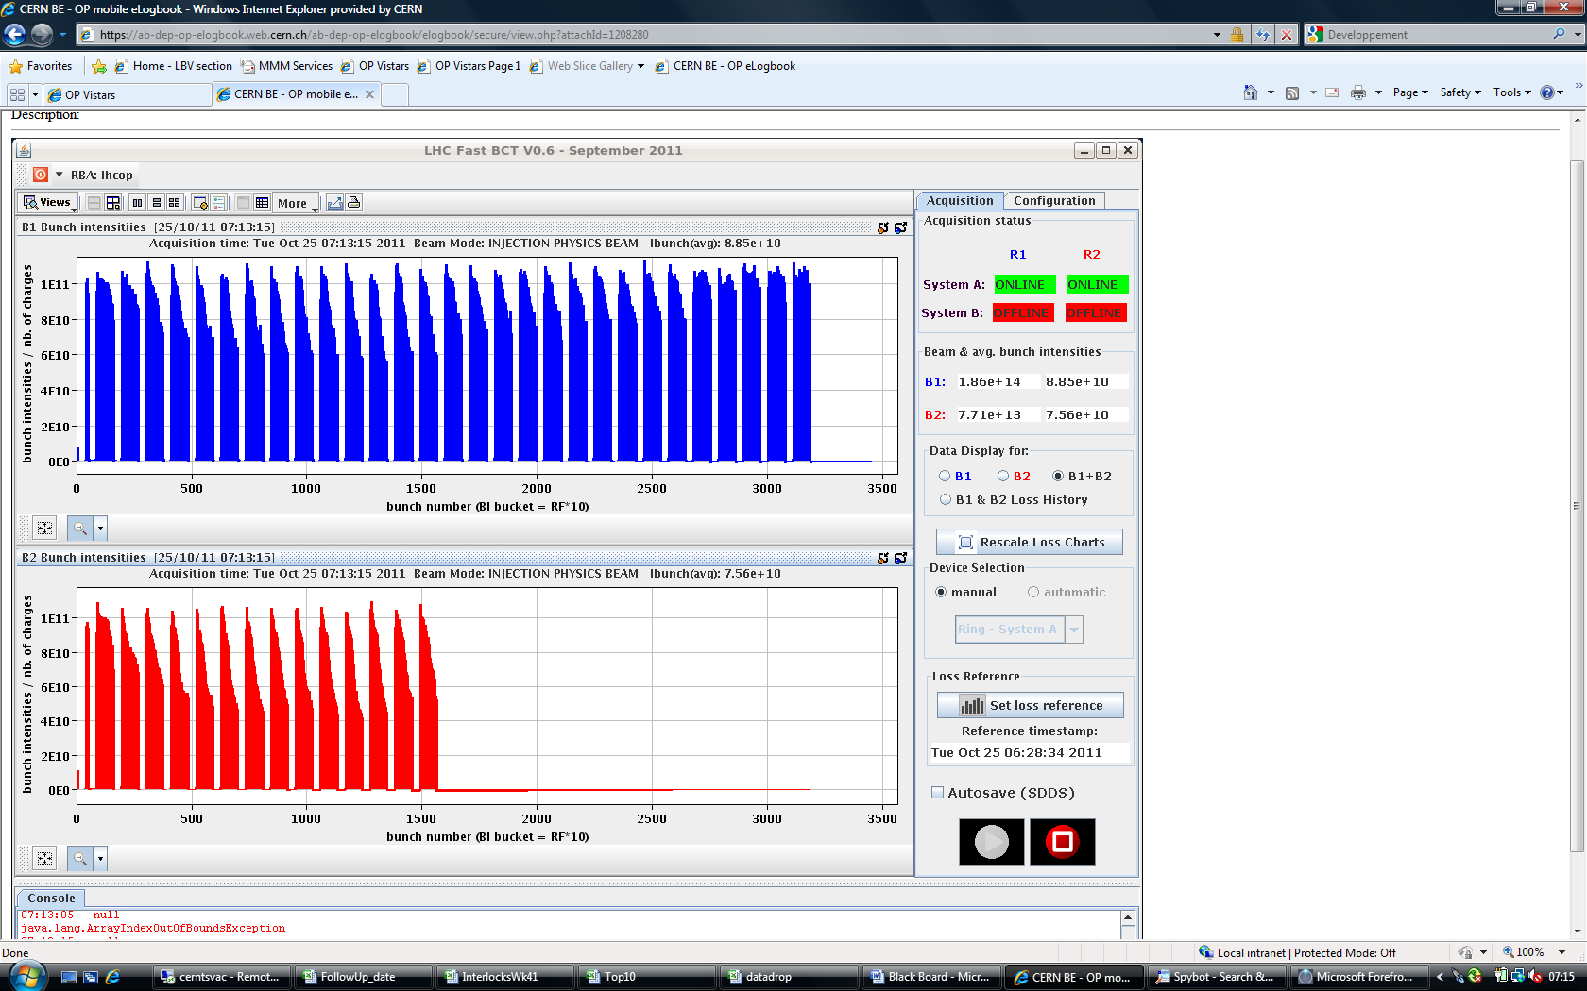
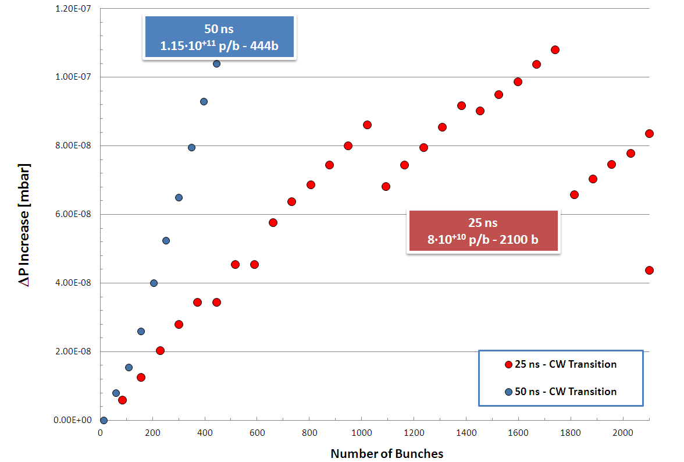
MDs 25 ns
8·10⁺¹⁰ p/b
Case of Cold-Warm
Transition
Not constant bunch intensity could have affected the pressure increase and the multipacting effect
Notes:
Interact with the proton beam and the proton get lost
Near to fill the machine (only 72b)
Due to the proton loss, we do not get the same deltaP
Despite so many bunches, the pressure limit was lower than the interlock level

Slide 22
MDs 25 ns
Heat load in the beam screen: 1W/m per aperture
With 50ns:
heat load in the beam screen was 25mW/m per aperture
Fill
2250
Fill
2249
L. Tavian
Notes:
Heat load in the arcs and in the stand alone. Stimulated gas desorption and the pressure will increase.

Slide 23
Pressure Rise

Slide 24
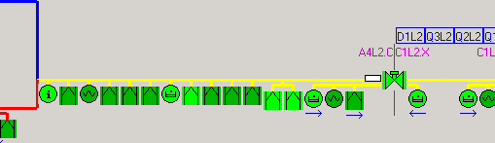
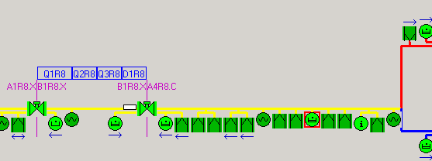
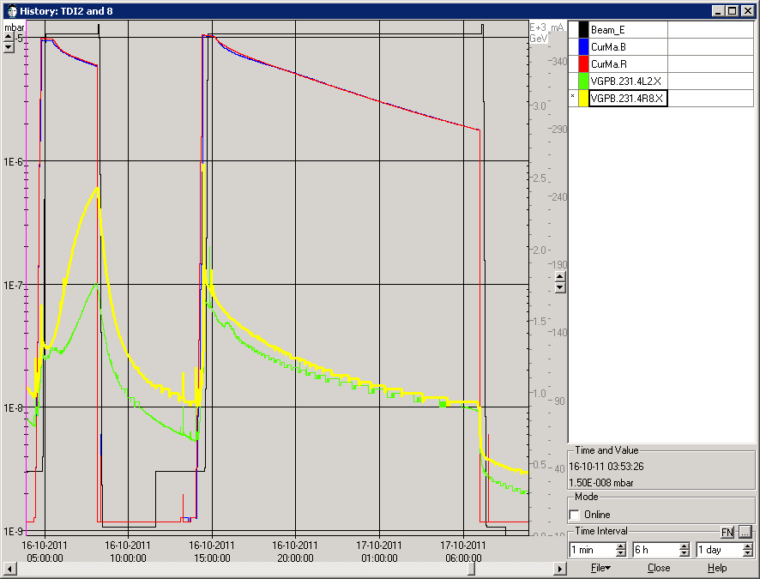
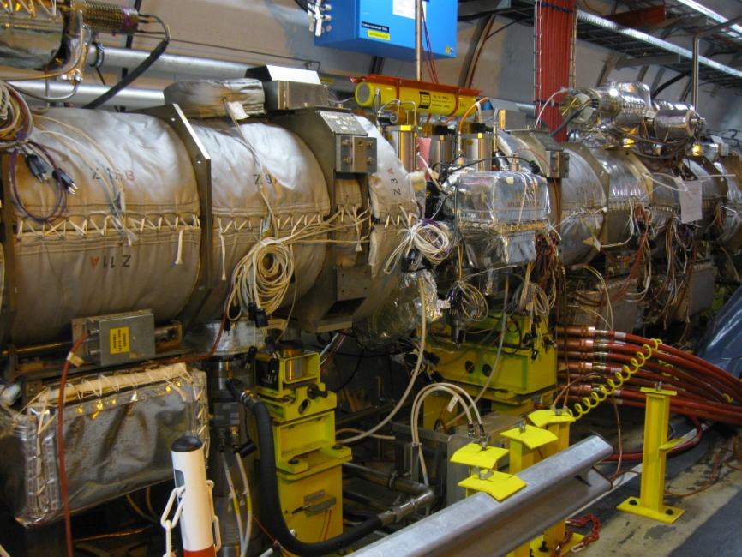
TDI pressure rise
Target Dump Injection for LHC (78 m from IP2)
LSS 2
Parking gaps:
  22 mm: pressure increased
  55mm : pressure stays at 10⁻⁸ mbar
LSS 8
Christmas break: the pumping at TDI2L will be doubled
22mm
55mm
Notes:
Target Dump Injection for LHC
Each LHC injection point contains one TDI tank: LSS 2L (Alice), LSS 8R (LHCb)
These tanks protect the LHC and experiments vacuum system from a collision with the beam in case of MKI failure during the injection of the protons bunches.
We see a pressure increase that has a signature of thermal heating.
The TE-VSC group gives a service to equip, pump, leak test and bake these tanks (validation at the surface, installation and conditioning in the LHC tunnel).

Slide 25
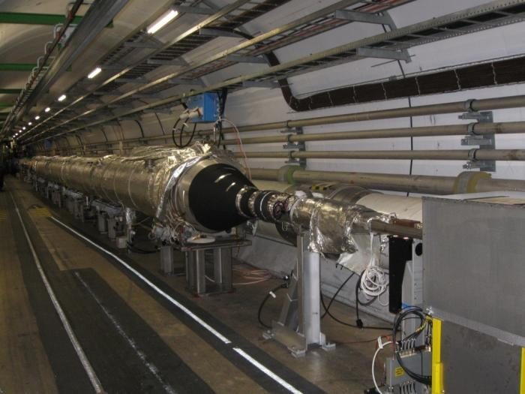
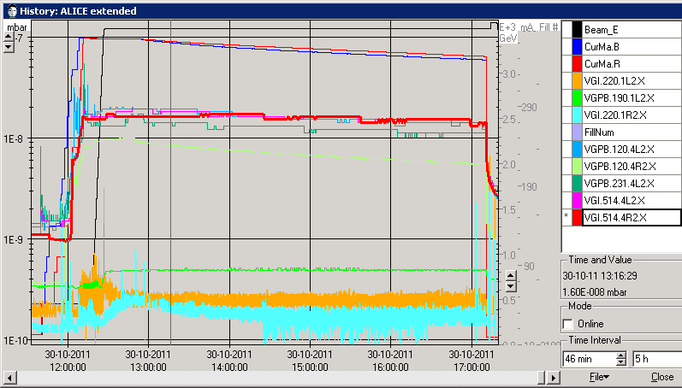
ALICE background
ALICE background is dominated by the pressure rise at 110 m from IP that must be below 10⁻⁸ mbar
One layer of solenoid was installed at each extremity to check potential electron cloud activity: a reduction of 10⁻⁹ mbar was observed with solenoid
Christmas break: layout change, NEG reactivation and solenoid re-installation
 | Pressure (mbar)
m from IP2 | Fill start | Fill end
22 | 2.3 10⁻¹⁰ | 1.910⁻¹⁰
65 | 1.9 10⁻⁸ | 8.4 10⁻⁹
110 | 1.8 10⁻⁸ | 1.6 10⁻⁸
Notes:
The solenoids are installed in the small diameter chamber and in the cone. This pressure increase is under investigation. Still an open issue.
If it’s electron cloud we should observe conditioning, otherwise is something else

Slide 26
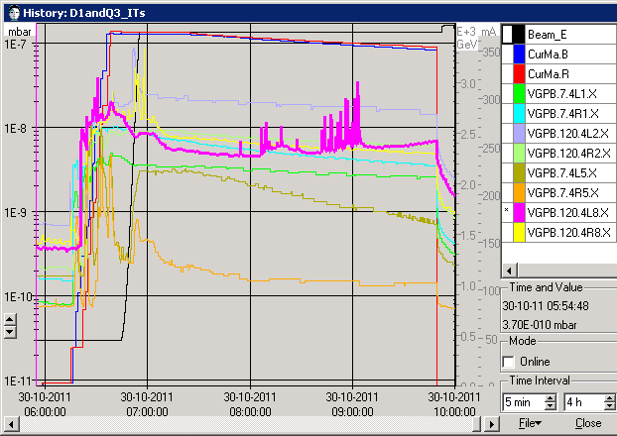
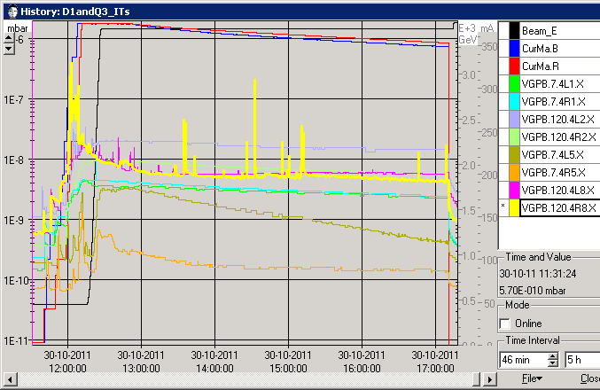
Pressure Spikes LSS8
Frequently, pressure spikes are observed mainly at LSS2 and LSS8
Origin of pressure spikes is in LSS2 and LSS8 at TCTVB-TCLIA/TCDD areas
2266
2267
Spikes during stable beams above 10⁻⁸ mbar
D1L2, D1L8, D1R8
Spikes during injection and stable beams above 10⁻⁷ mbar
D1L8, D1R8
Notes:
Possible issue: influence of the cryogenics, proton lossing, misbehaving of the gauges or the ion pumps.

Slide 27
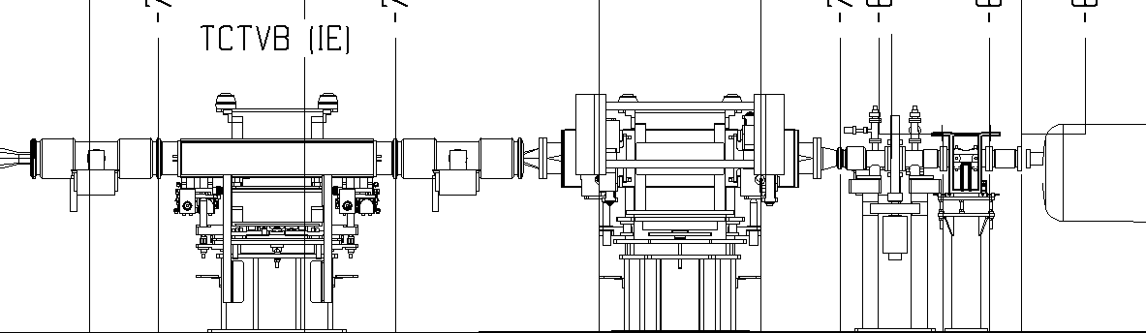
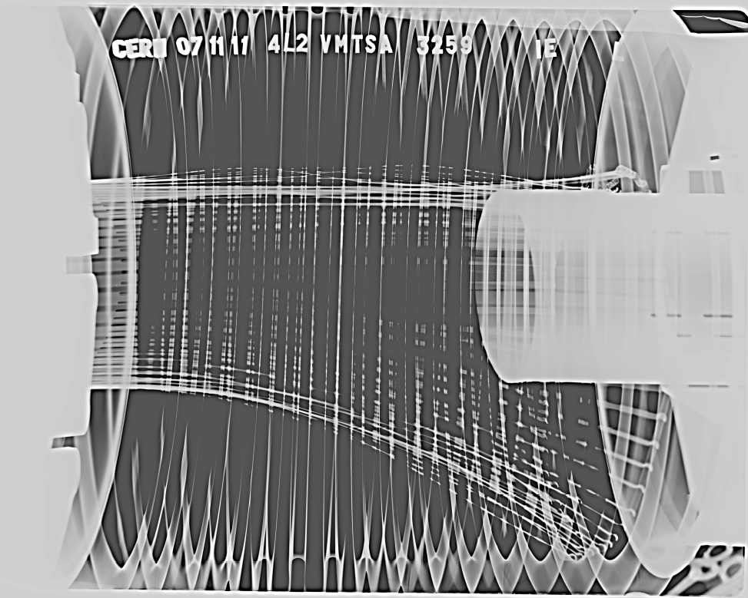
Pressure Spikes LSS2
TCDD
Point 2 Left side: Side view
VGPB.120.4L2.X
D1L2
VPIA.A151.4L2.X
RF fingers falling due to broken spring
Spring was broken between May and November 2011
Christmas break: The 2 non-conform modules will be repaired
Notes:
How the spring could get loose, upgrade
Side view (xray from corridor to QRL)
b) Metallic noise due to loose spring when hitting vacuum chamber
c) RF fingers falling due to broken spring
d) aperture reduced ?

Slide 28
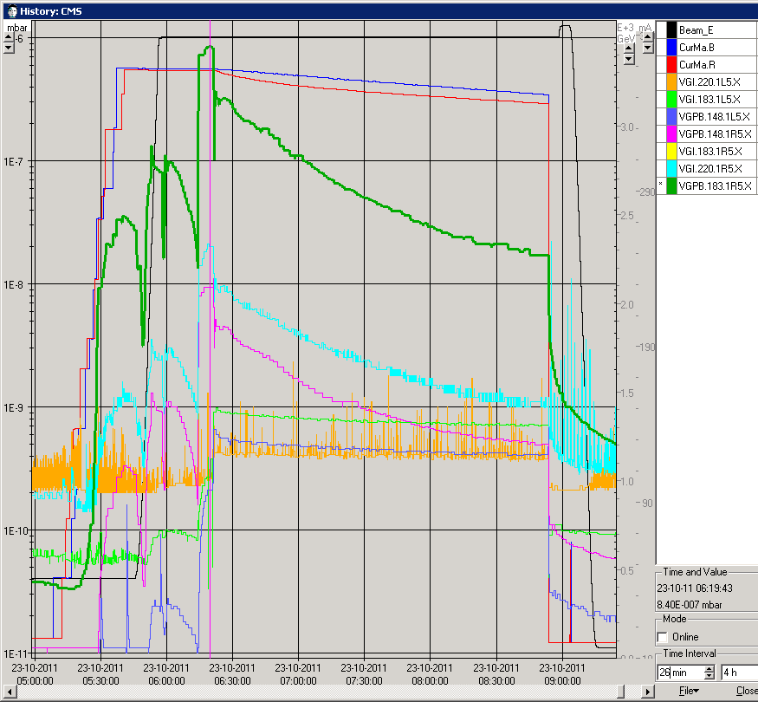
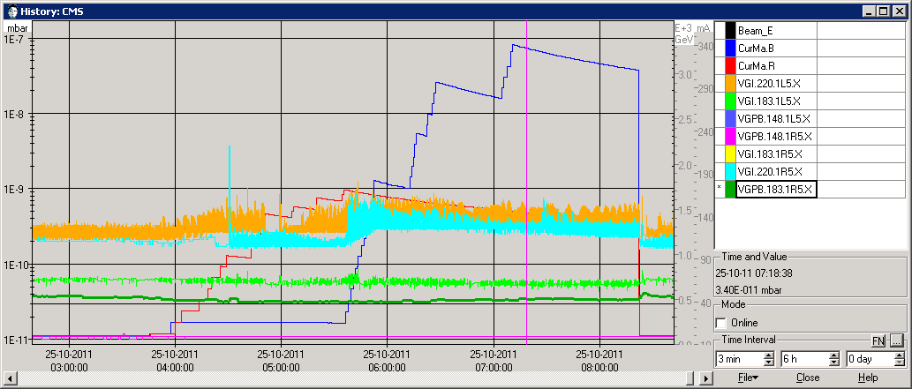
CMS (A1R5 spikes)
CMS background suffers from pressure rise localized around 18 m from the IP
The CMS magnetic field ensure the multipacting suppression
Fill 2241 at 50 ns bunch spacing
Fill 2251 at 25 ns bunch spacing, small pressure rise were detected
Pressure excursion at 18 m is not due to multipacting
Notes:
Spiegare con il laser che questo è il pressure increase we are talking about
Effetto che non si rivela sempre
CMS was not able to take any data

Slide 29
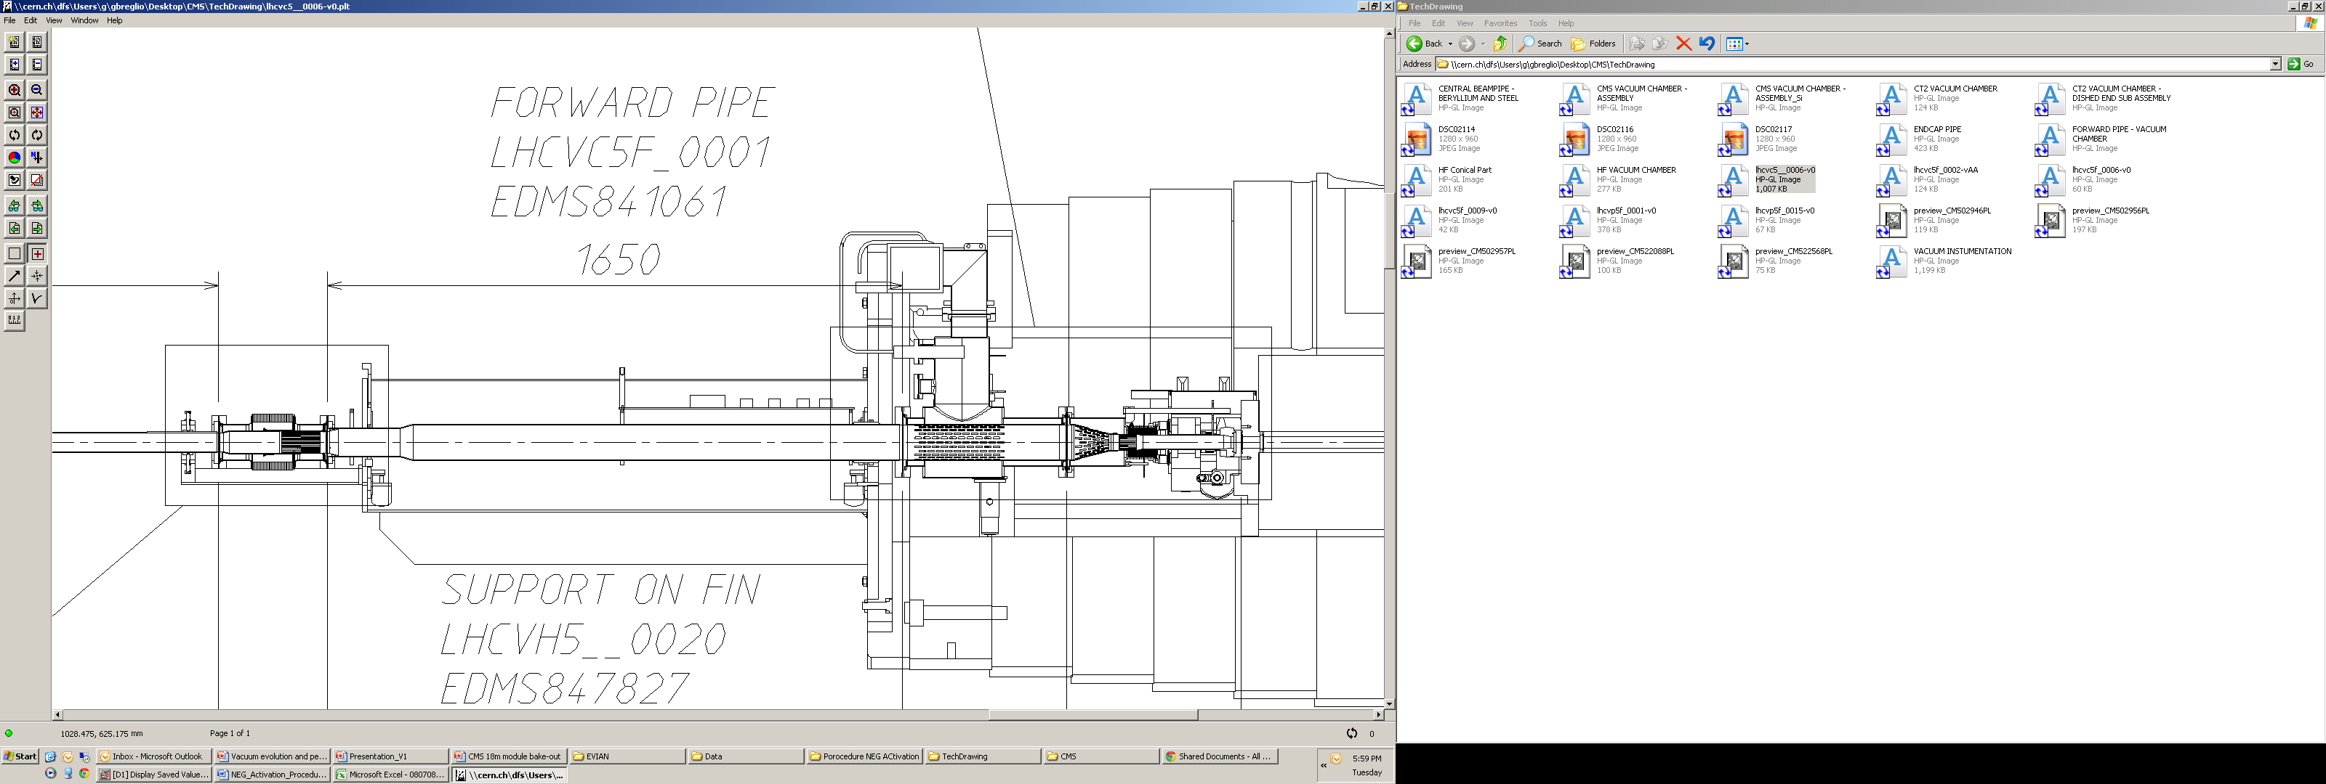
CMS (A1R5 spikes)
18 m pressure gauge
RF Fingers
X-Ray
RF Fingers
X-Ray
IP
18 m, right
IT5R

Slide 30
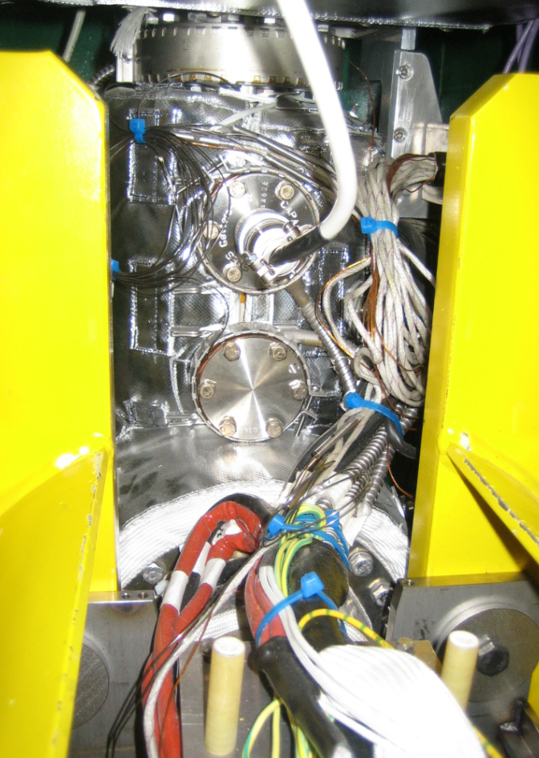
CMS (A1R5 spikes)
Actions and Christmas Break activity:
Ongoing lab measurements
Preparation of a partial Bake Out procedure
X-ray check
Bake-out the pumping dome
Expected gain in pumping speed of a factor

Slide 31
Christmas Break 2011
 |  | wk49 |  | wk50 |  | wk51 |  | wk52 |  | wk1 |  | wk2 |  | wk3 |  | wk4 |  | wk5 |  | wk6 |  | wk7 |  | wk8 |  | wk9
 | task | 1st | 2nd | 1st | 2nd | 1st | 2nd | 1st | 2nd | 1st | 2nd | 1st | 2nd | 1st | 2nd | 1st | 2nd | 1st | 2nd | 1st | 2nd | 1st | 2nd | 1st | 2nd | 1st | 2nd
RF fingers reparation | A4L2 |  |  |  |  |  |  |  |  |  | m | m | m | m | b |  |  | a | a | a | b | b | b
 | A4R2 |  | m | m | m | m |  |  |  |  | b |  |  |  | a | a | a | b | b | b
RF fingers reparation | A4L8 |  |  |  |  | m |  |  |  |  | m |  |  |  | b | b | a | a | a | b | b
 | A4R8 |  |  |  | m | b |  |  |  |  | b |  |  | a | a | a |  |  | b | b
NEG cartridge activation | CMS 18 |  |  |  |  |  |  |  |  |  | m | b | a | a | m
RF module radiogr. | Xray
Triplets pumping | IT_1 |  |  |  | 8L | 8R |  |  |  |  |  |  |  |  |  |  |  |  |  | 2L | 2R
 | IT_2 |  |  |  | 1L |  |  |  |  |  |  |  |  |  |  | 12 | 12 | 1R | 5R |  |  |  | 5L
Consolidation |  | wk49 |  | wk50 |  | wk51 |  | wk52 |  | wk1 |  | wk2 |  | wk3 |  | wk4 |  | wk5 |  | wk6 |  | wk7 |  | wk8 |  | wk9
 | task | 1st | 2nd | 1st | 2nd | 1st | 2nd | 1st | 2nd | 1st | 2nd | 1st | 2nd | 1st | 2nd | 1st | 2nd | 1st | 2nd | 1st | 2nd | 1st | 2nd | 1st | 2nd | 1st | 2nd
Solenoids | MKI2 sole |  | b |  | b | b |  |  |  |  |  |  |  |  |  | b
Wire scanner | E5L4 |  | m | b | a | a |  |  |  |  |  |  | b
Solenoids | MKI8 sole |  | b | b |  |  |  |  |  |  |  |  | b |  |  |  |  |  |  |  |  |  | b | b
(to be confirmed) | MKID8 |  | m | m | b | b |  |  |  |  |  | a | a |  |  |  |  | b
BGI | D5L4 |  |  |  |  |  |  |  |  |  |  |  | m | b |  | a | a |  |  |  |  |  | b
 | D5R4 |  |  |  |  |  |  |  |  |  |  |  |  | m | m |  | b | a | a |  |  | b
 | MKB |  |  |  |  |  |  |  |  |  | m
m | mechanics
b | bake out
a | activation
 | X ray
 | triplets pumping

Slide 32

2012 - draft
 | Days
Commissioning | 23
MD | 22
Technical stops | 20
Recovery & ramp-up | 16
Initial ramp-up | 16
Scrubbing for 25 ns | 5
Proton running | ~125
Special runs | ~8
Ion setup | 4
Ion run | 24
Mike Lamont
LHC operation perspectives

Slide 33
Thanks
To Vincent Baglin, Giuseppe Bregliozzi and Paolo Chiggiato that kindly allowed me to use their presentation slides for this talk
VSC Meeting – 17.12.2010

