Slide 1
Laser status and upgrades

Slide 2
EKSPLA
Water change and cleaning by Ahmad and Lisa
Upgrade of the OPG with a new PPKTP crystal, now it can provide 1640.75 nm (at 24°C) to 1678.25 nm (at 180°C)
Damage on OPA crystal. Currently it is just moved to avoid the damaged spot.

Slide 3
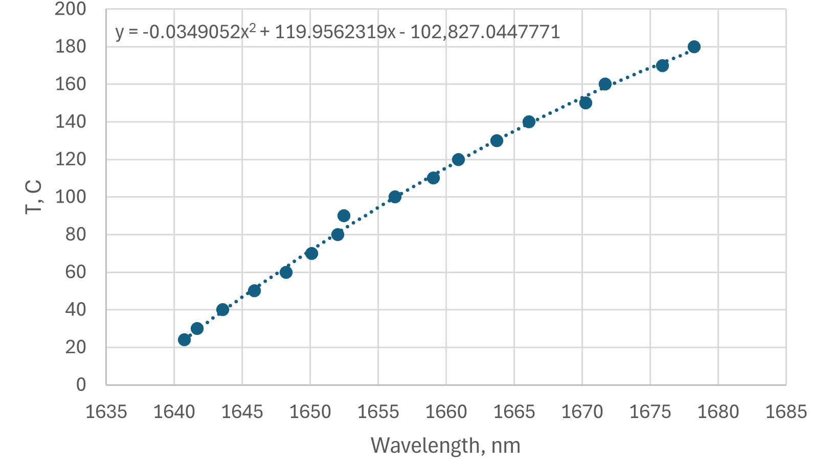
OPG

Slide 4
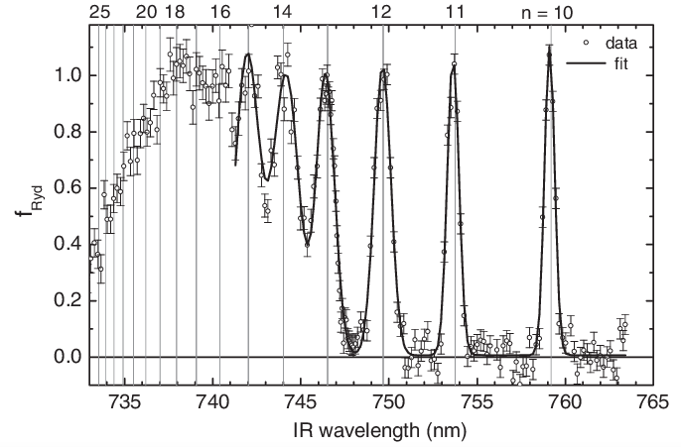
Outlook
Optimize OPA angles
Make sure that laser is aligned with the positronium target
Do a scan of SSPALS dependence on the laser wavelength
Antihydrogen
D. B. Cassidy et.al. 2012

Slide 5
Questions?

