Slide 1

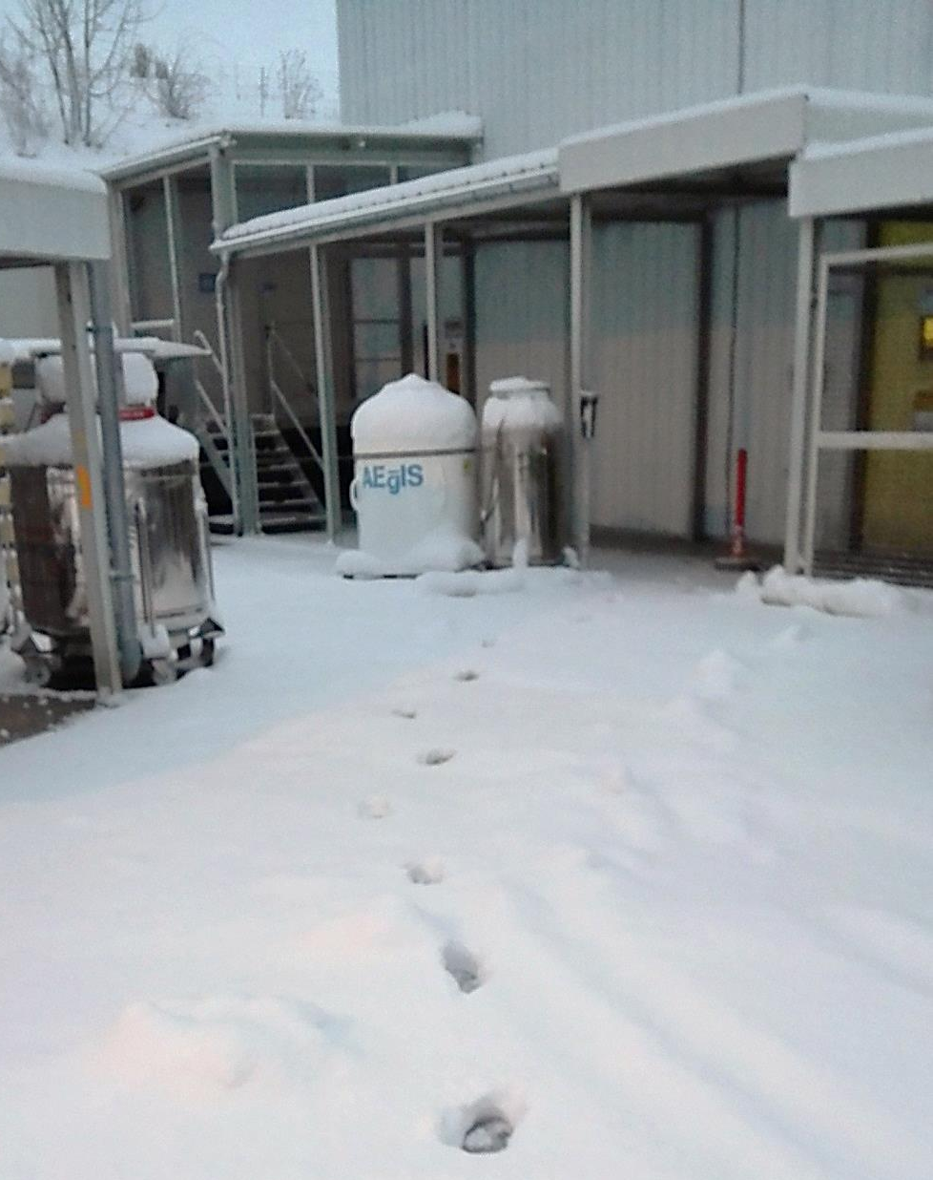

Formation of a forward beam of antihydrogen
Status of the ESDA analysis
R. Caravita

Slide 2
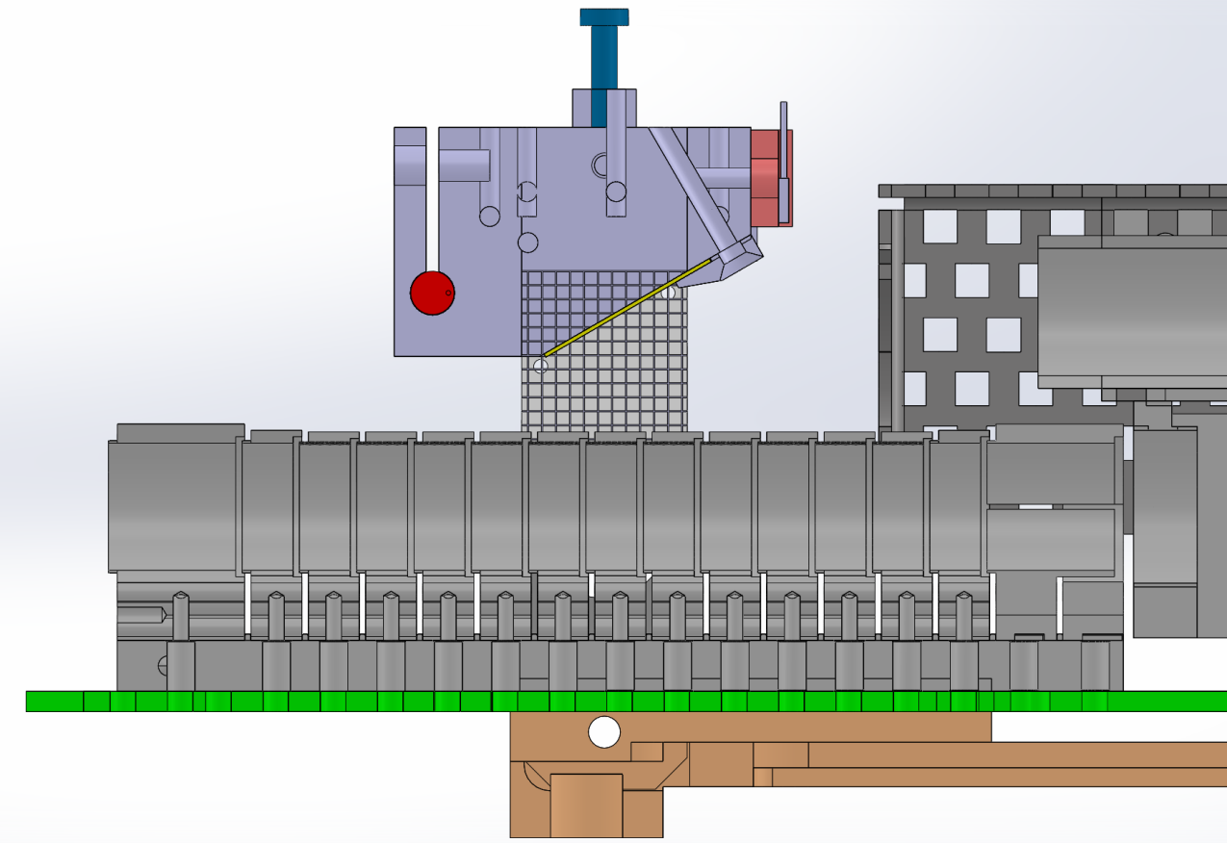
What happens when antihydrogen annihilates
External Scintillation Detector Array (ESDA)
π±
Rydberg Ps
e⁺/Ps converter
Dissociated e⁺
Excitation lasers
4.6 keV e+
MCP
B
1 cm
Antiproton plasma
π±
External Scintillation Detector Array (ESDA)
π±

Slide 3
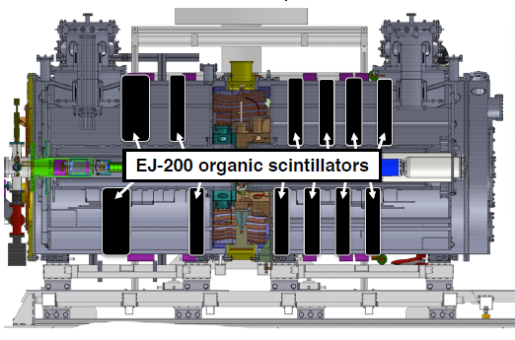
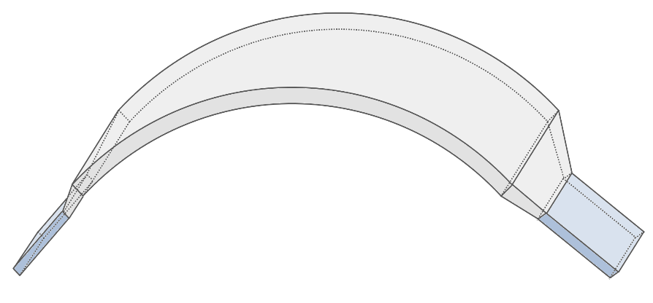
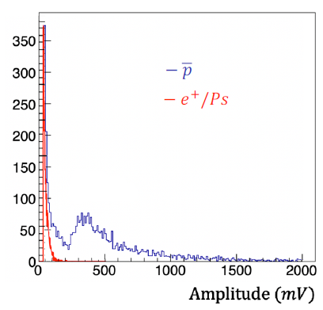
Antihydrogen detector: digitized ESDA
EJ-200 scintillator slab
PMT1
PMT2
Scintillator array for MIP detection
8 x EJ-200 scintillator slabs
Scintillators are read at both ends with photomultipliers
Each PMT is digitized at 250 MHz
Software coincidence to reject PMT noise
Amplitude cut to reject gamma background
MIP threshold
MIP threshold

Slide 4
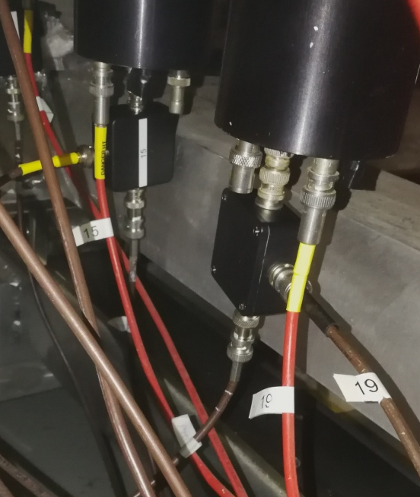
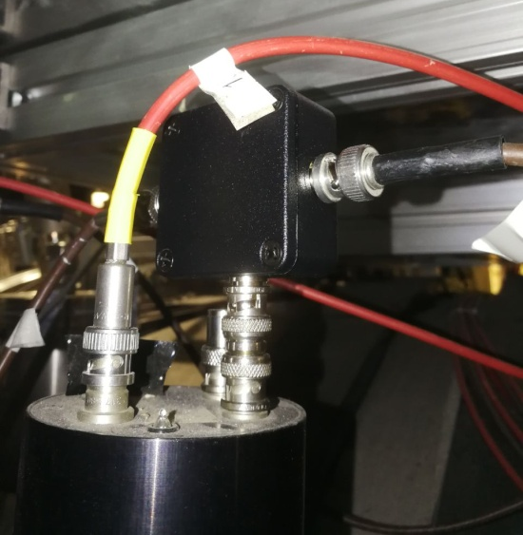
The ESDA digitized acquisition chain in 2023
ESDA single slab, 2024 config
A 50/50 splitter for each 24 PMT (8 PMT @5Tesla, 16 PMT @1Tesla)
One end is directly connected to the discriminated acquisition chain continuosly monitoring antiproton annihilations
The other end is sent to the platform where it is 20 dB attenuated and digitizer for the acquisition of the antihydrogen signal
The splitter is connected directly to the PMT to minimize ringing due to the impedence mismatching.
Splitters have been installed in vertical orientation(top) except for the 8 top PMT @1Tesla that have been installed in horizontal orientation due to lack of space (bottom)
PMT1
PMT2
SPL
SPL
20 dB
CAEN V1720
20 dB
SIS COUNTER

Slide 5
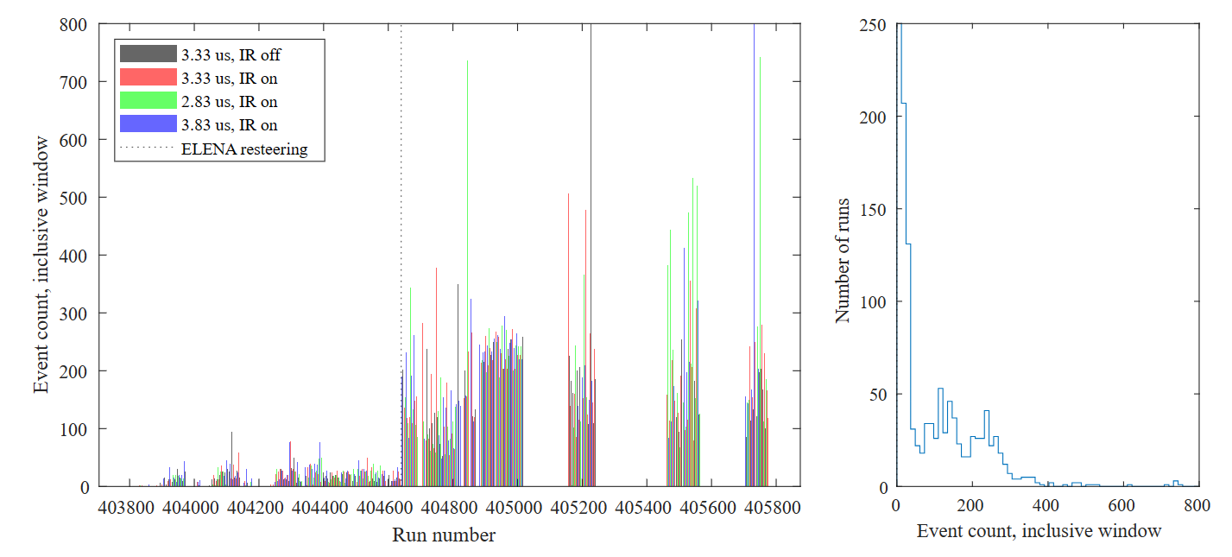
Dataset overview
Higher pbar flux
from ELENA
Lower pbar flux
from ELENA

Slide 6
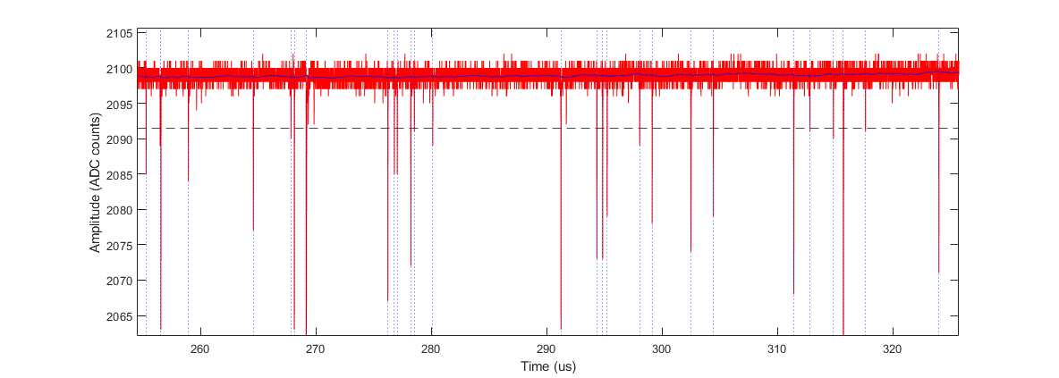
Software trigger and event discrimination
T_{down}
T_{up}
Baseline rms-amplitude A_{rms} estimator from the first 10us of acquisition
Baseline follower: baseline_val = (1.0 – 0.005) * baseline_val + 0.005 .* A(i)
Threshold discriminator with hysteresis (T_{up} = 8 A_{rms}, T_{down} = 3 A_{rms})

Slide 7
Coincidence formation
PMT_{n}
Coincidences filtering
AND on the single PMT events
50 ns coincidence window
PMT_{n+1}
List of coincident events
Average time-of-arrival
Time difference between PMTs
Average deposited charge
Average amplitude

Slide 8
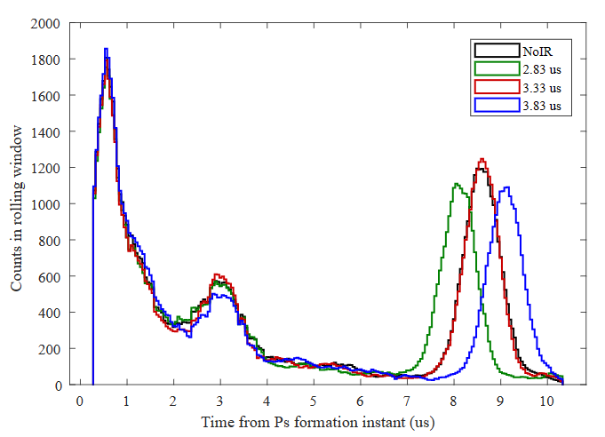
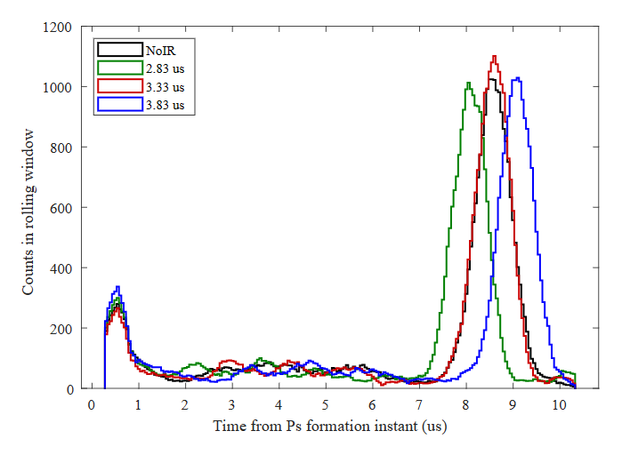
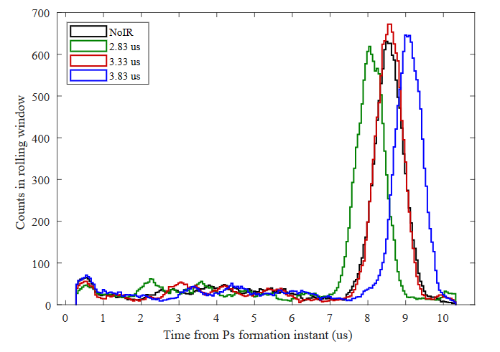
Coincidence formation
Cancelling of PMT afterpulses
No efficiency loss to
pbar/Hbar detection
No coincidence, no charge cut
Coincidence, no charge cut
Coincidence, charge cut
Reduction in gamma ray background

Slide 9
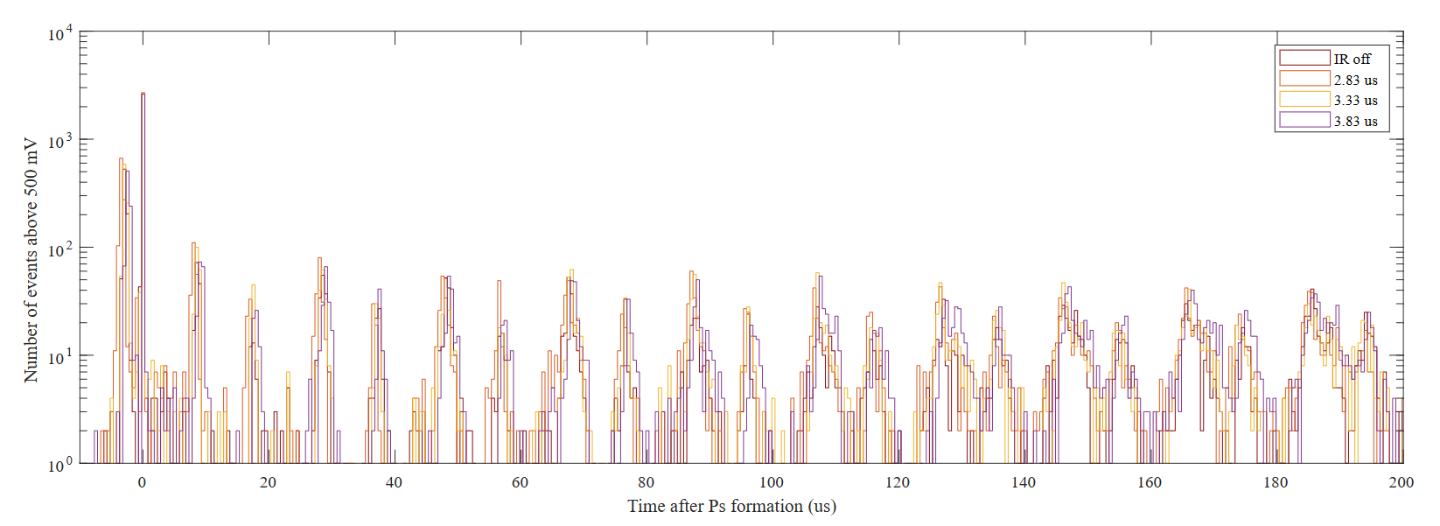
A beautiful observation of antiprotons swinging
e⁺ peak at Ps* formation
Hbar search region
Antiproton losses in oscillations

Slide 10
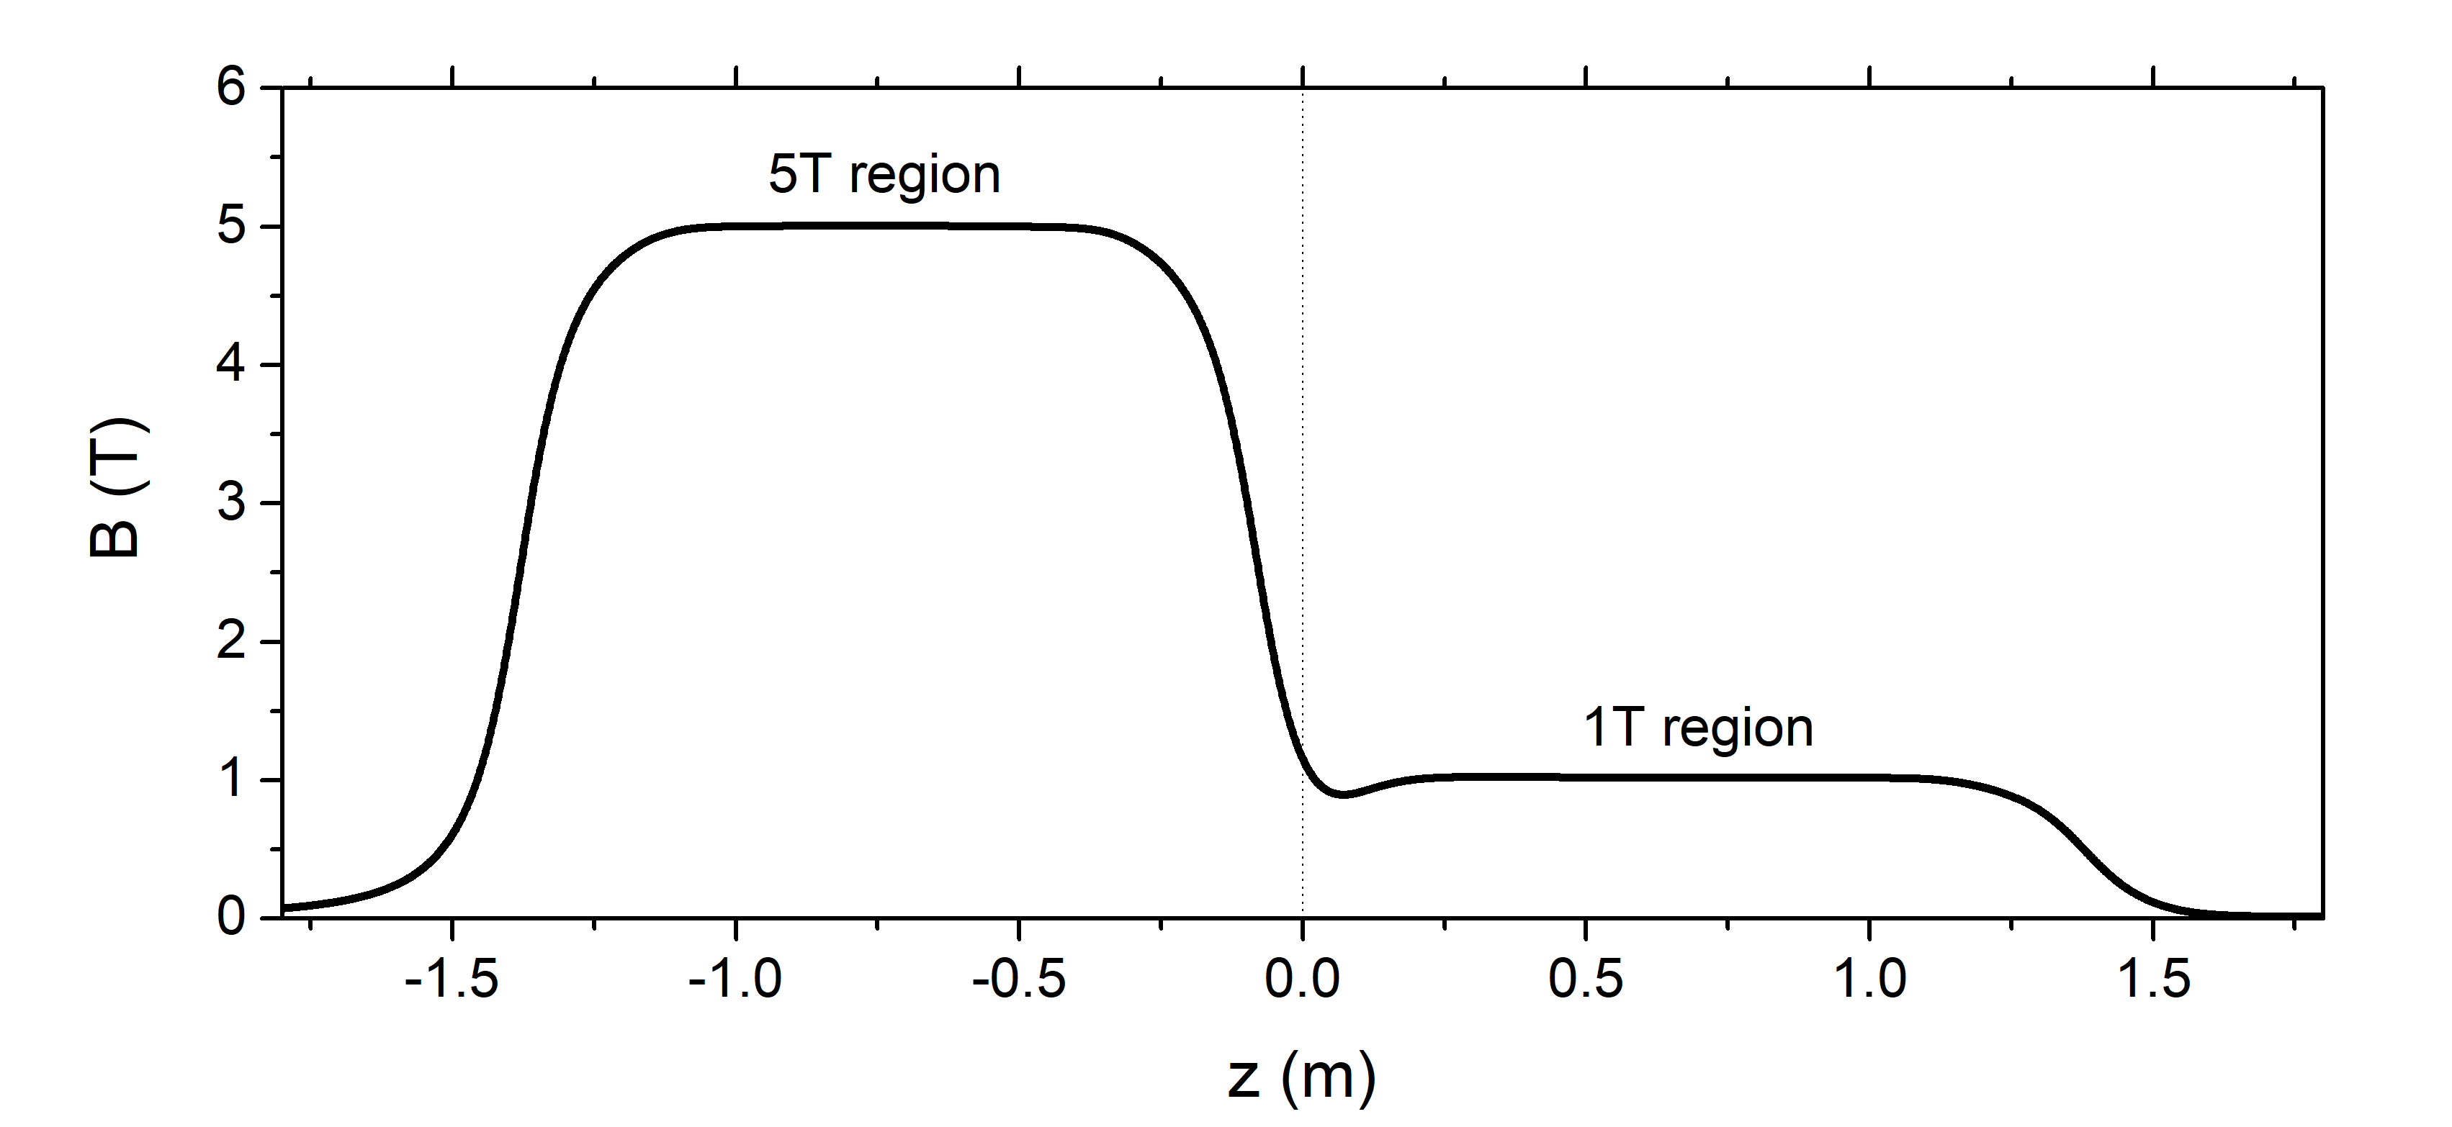
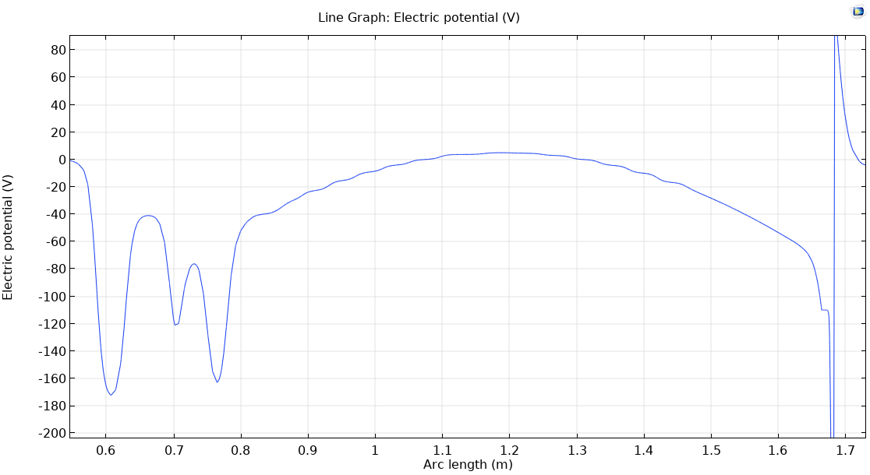
Where are losses occurring?
Here the plasma is largest
Catching trap
Hbar trap

Slide 11
A beautiful observation of antiprotons swinging
From 5T to 1T
Midpoints
From 1T to 5T
Theory: midpoints are the points of null velocity

Slide 12
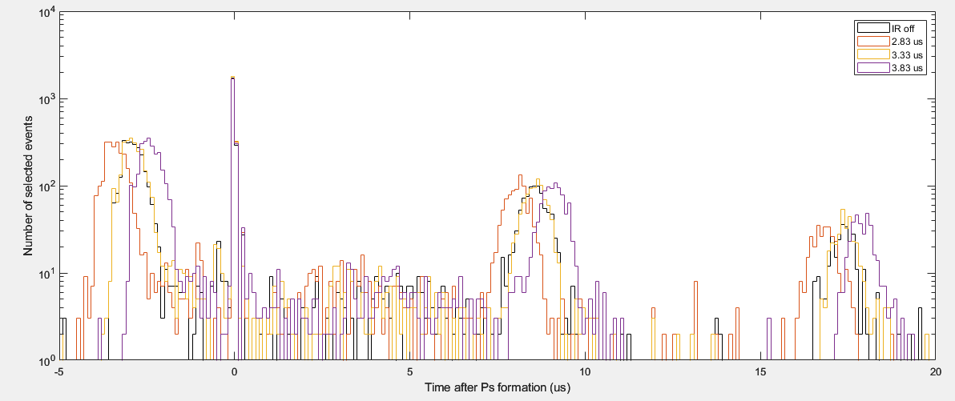
A beautiful observation of antiprotons swinging
4.0 us
3.5 us
2.5 us
From 5T to 1T
Midpoints
From 1T to 5T
Hypothetical conclusion: time calibration procedure was off by us
we were always sending positrons too early, i.e. with a forward boost

Slide 13
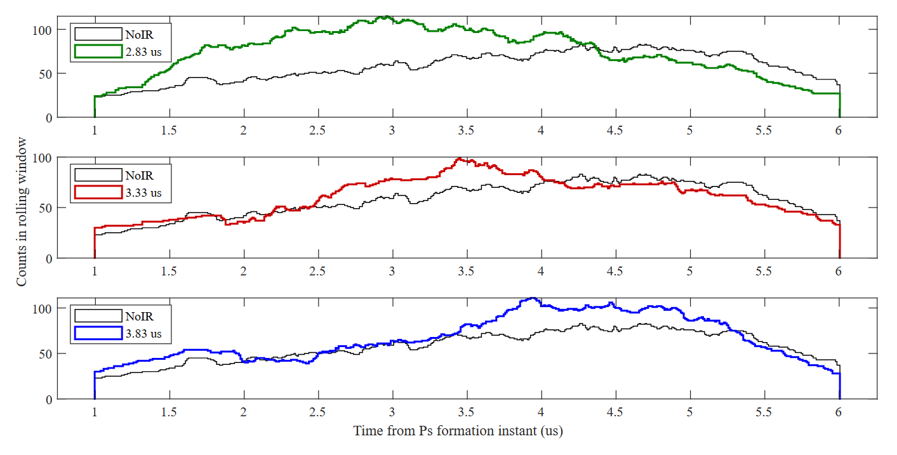
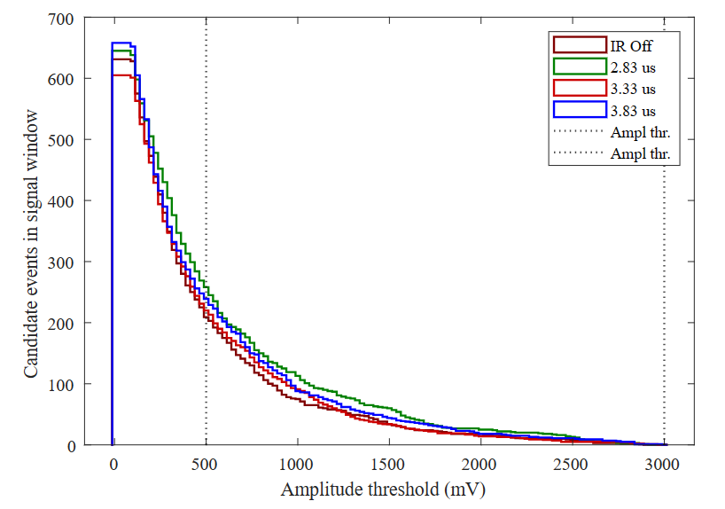
Antihydrogen signal interpretation
500 ns
500 ns
Hypothetical conclusion: most of our current Hbar is hitting the target

Slide 14
Backup

Slide 15
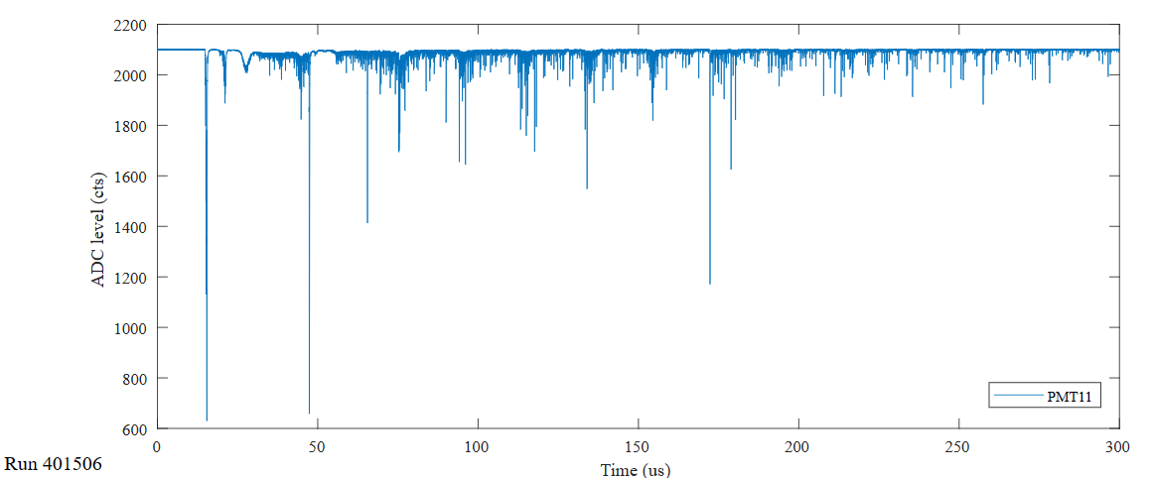
Time calibration 1

Slide 16
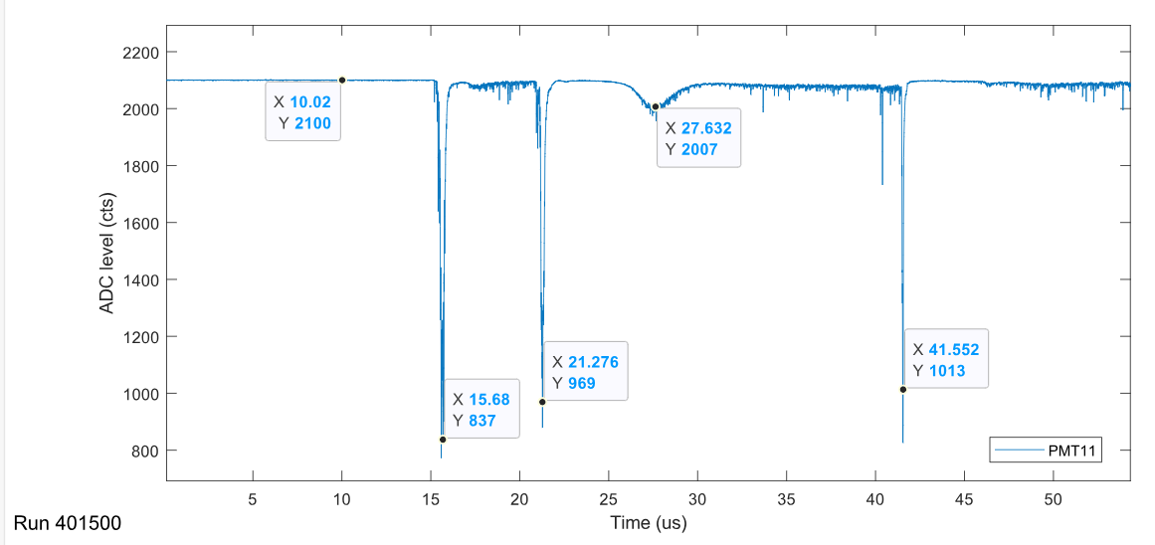
Time calibration 2

Slide 17
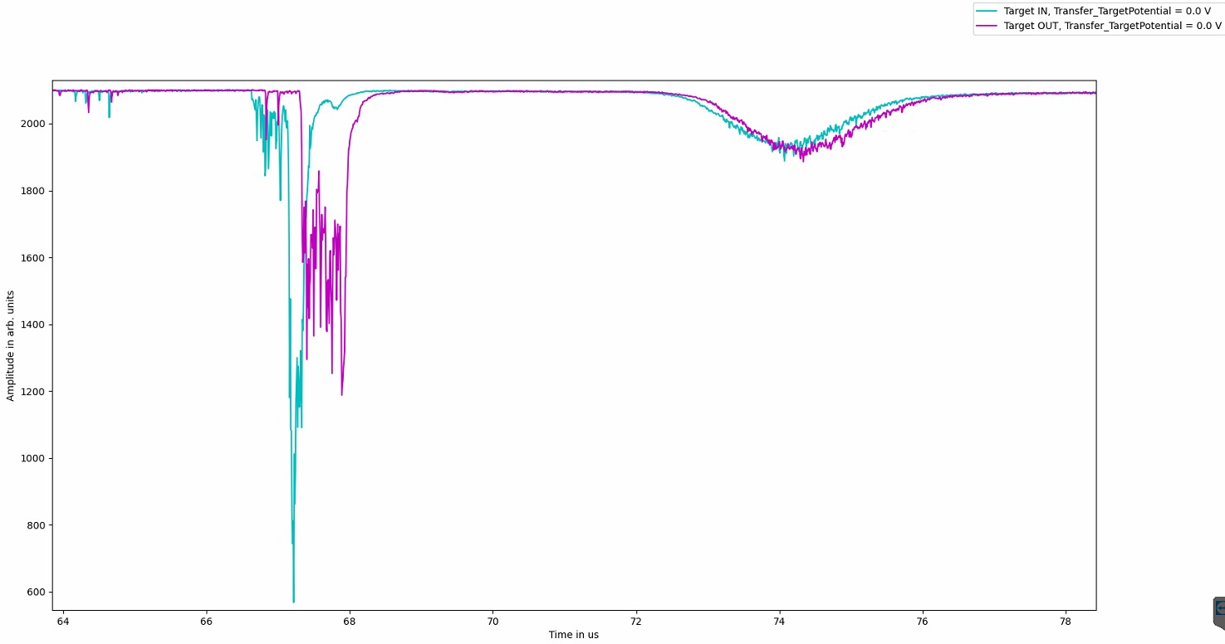

Slide 18
