Slide 1

HCI analysis status
AEGIS Collaboration meeting May 2024
Fredrik PG

Slide 2
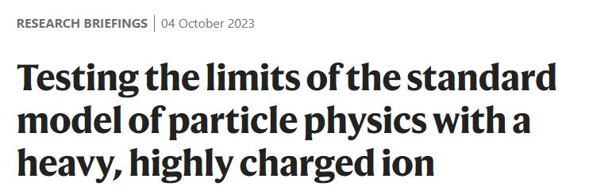

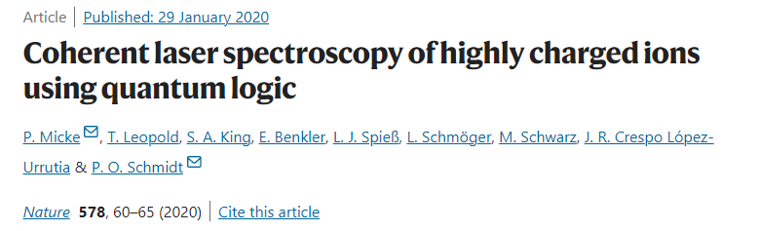
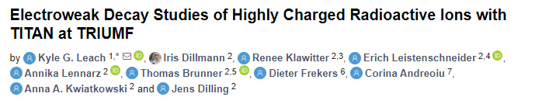
Highly Charged Ions (HCIs)
HCIs are atoms stripped of most or all their electrons.
Exhibit extreme electromagnetic properties:
  - Ideal for test of strong field QED
  - Enhanced sensitivity to nuclear structure (QCD)
Radioactive HCIs have supressed decay:
- Electron capture no longer possible (Weak interaction studies)

Slide 3
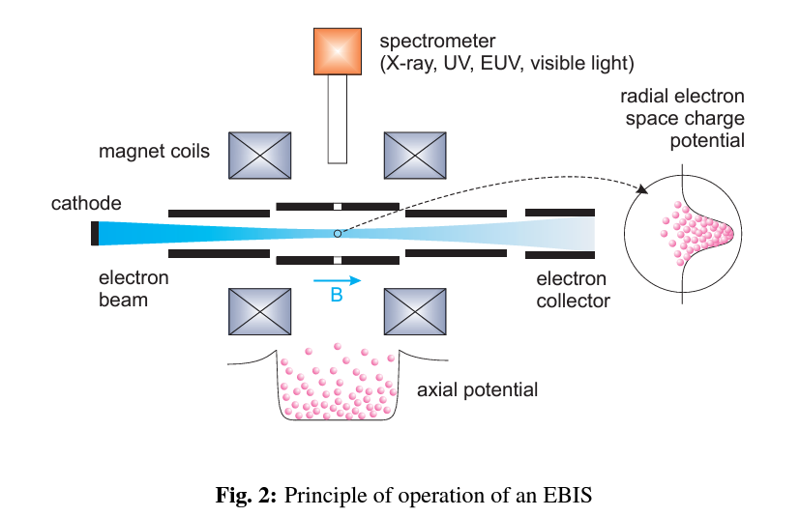
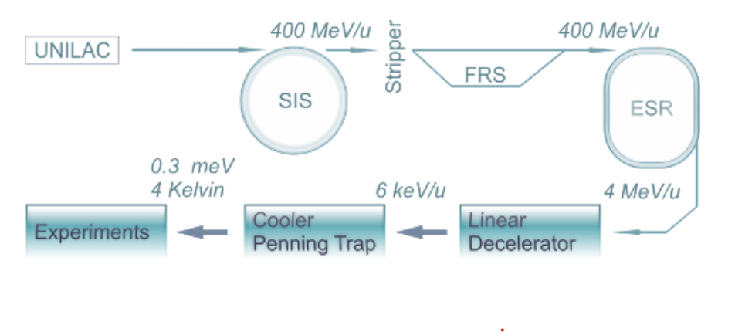
Traditional HCI formation at radioactive beam facilities:
Electron beam ionization:
High energy beam through stripper foil:
Zschornacka, G., M. Schmidt, and A. Thorn. "Electron beam ion

Slide 4
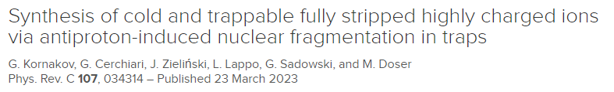
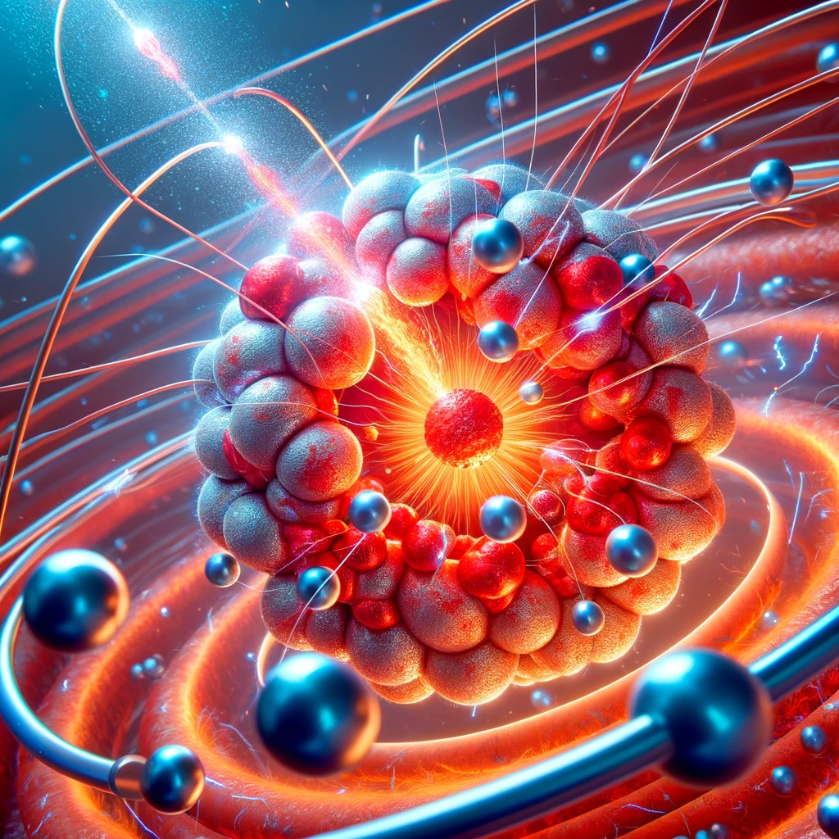
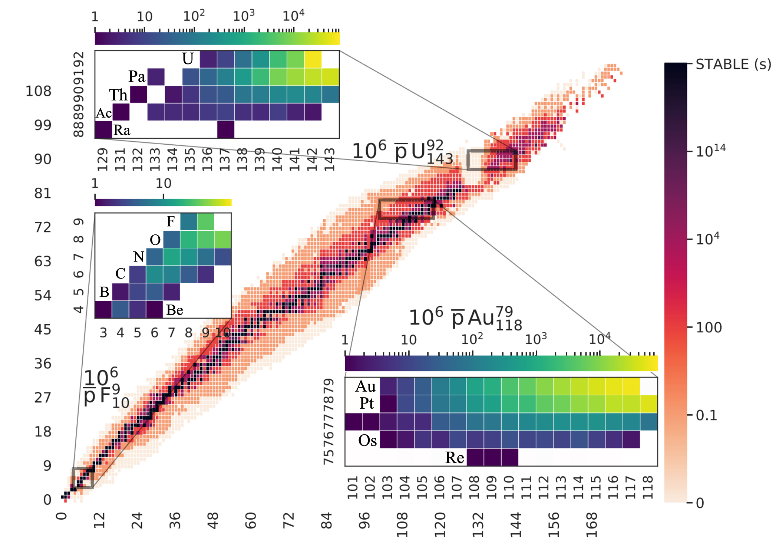
Radioactive HCI formation using antiprotons?

Slide 5
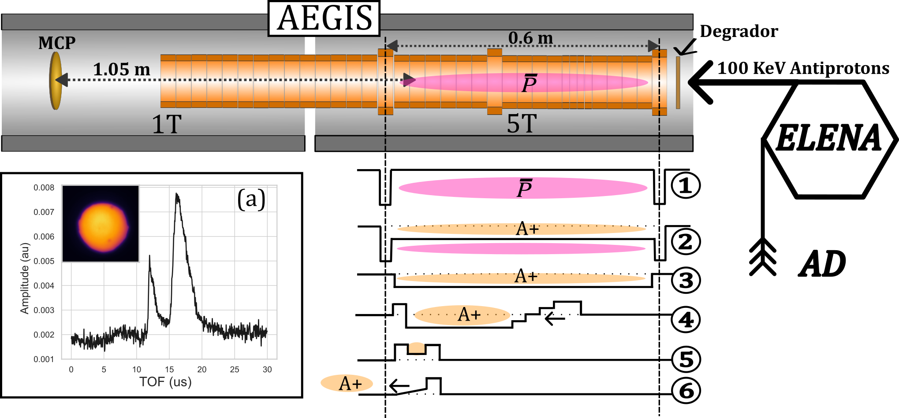
Overview of the fragment capture procedure
(b)

Slide 6
Overview of HCI campaigns in 2023
Air leak campaign: (3 weeks)
- First postive ion signal.
- Techniques developed for manipulating trapped ions.
- Barrier scan, Multi-step, MR-TOF procedure.
- Identifying the energy of the TOF components.
Antiproton and electron calibration:
- Calibration of TOF spectra.
- Confirming linearity with mass and energy.
Nitrogen campaign: (36h):
- Clean nitrogen environment.
- Confirming HCI formation from nitrogen.

Slide 7
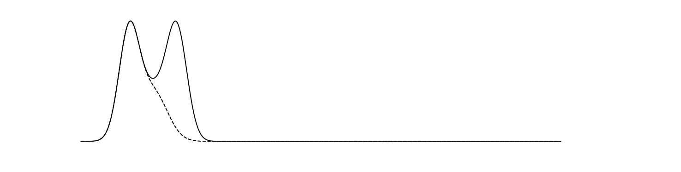
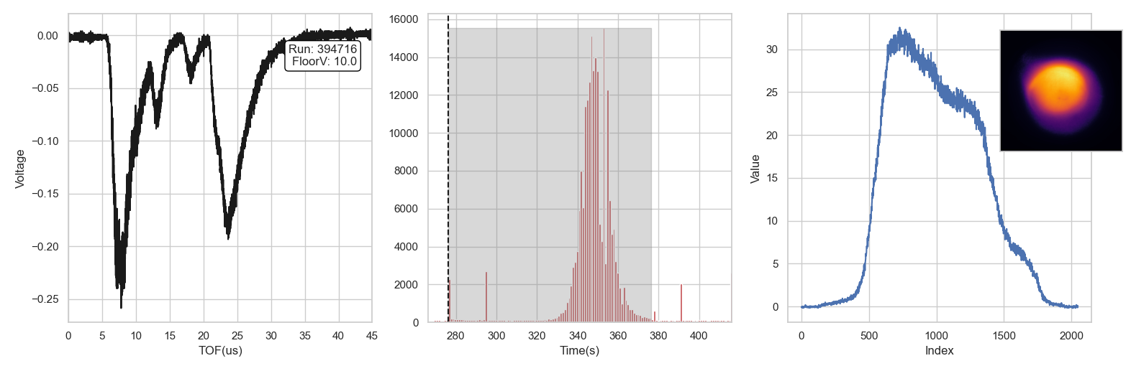
Sample data during air leak campaign
+160V
A+
Floor Voltage
A+
MCP
Cold ions
Scintillator signal (SC21)
MCP screen profile
Hot ions
Negative ions
MCP TOF signal

Slide 8
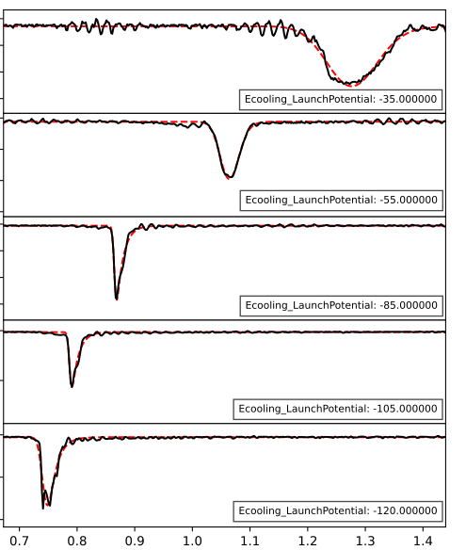
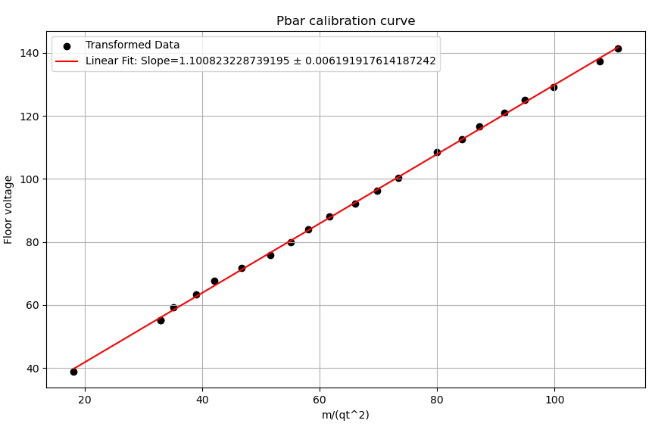



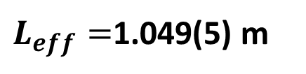
Time-of-flight calibration using Pbars
1.035 m (MCP side)
$$\overline{P}$$
$$\overline{P}$$
-160V
$L_{eff}=$1.049(5) m
$$U\left(t\right)=\frac{L_{eff}^{2}}{2e}∙\frac{m}{t^{2}}$$
Time-of-flight (s*1e-5 )

Slide 9
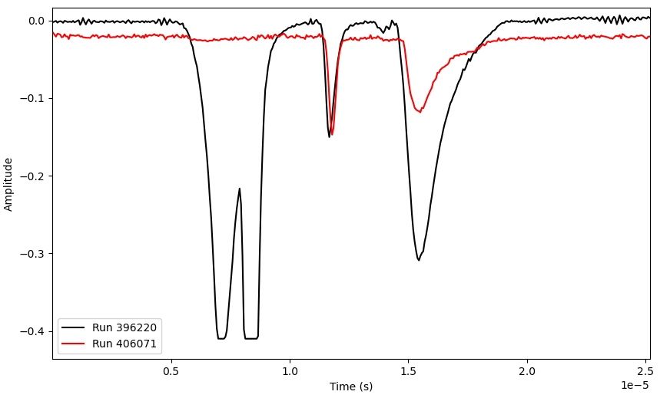
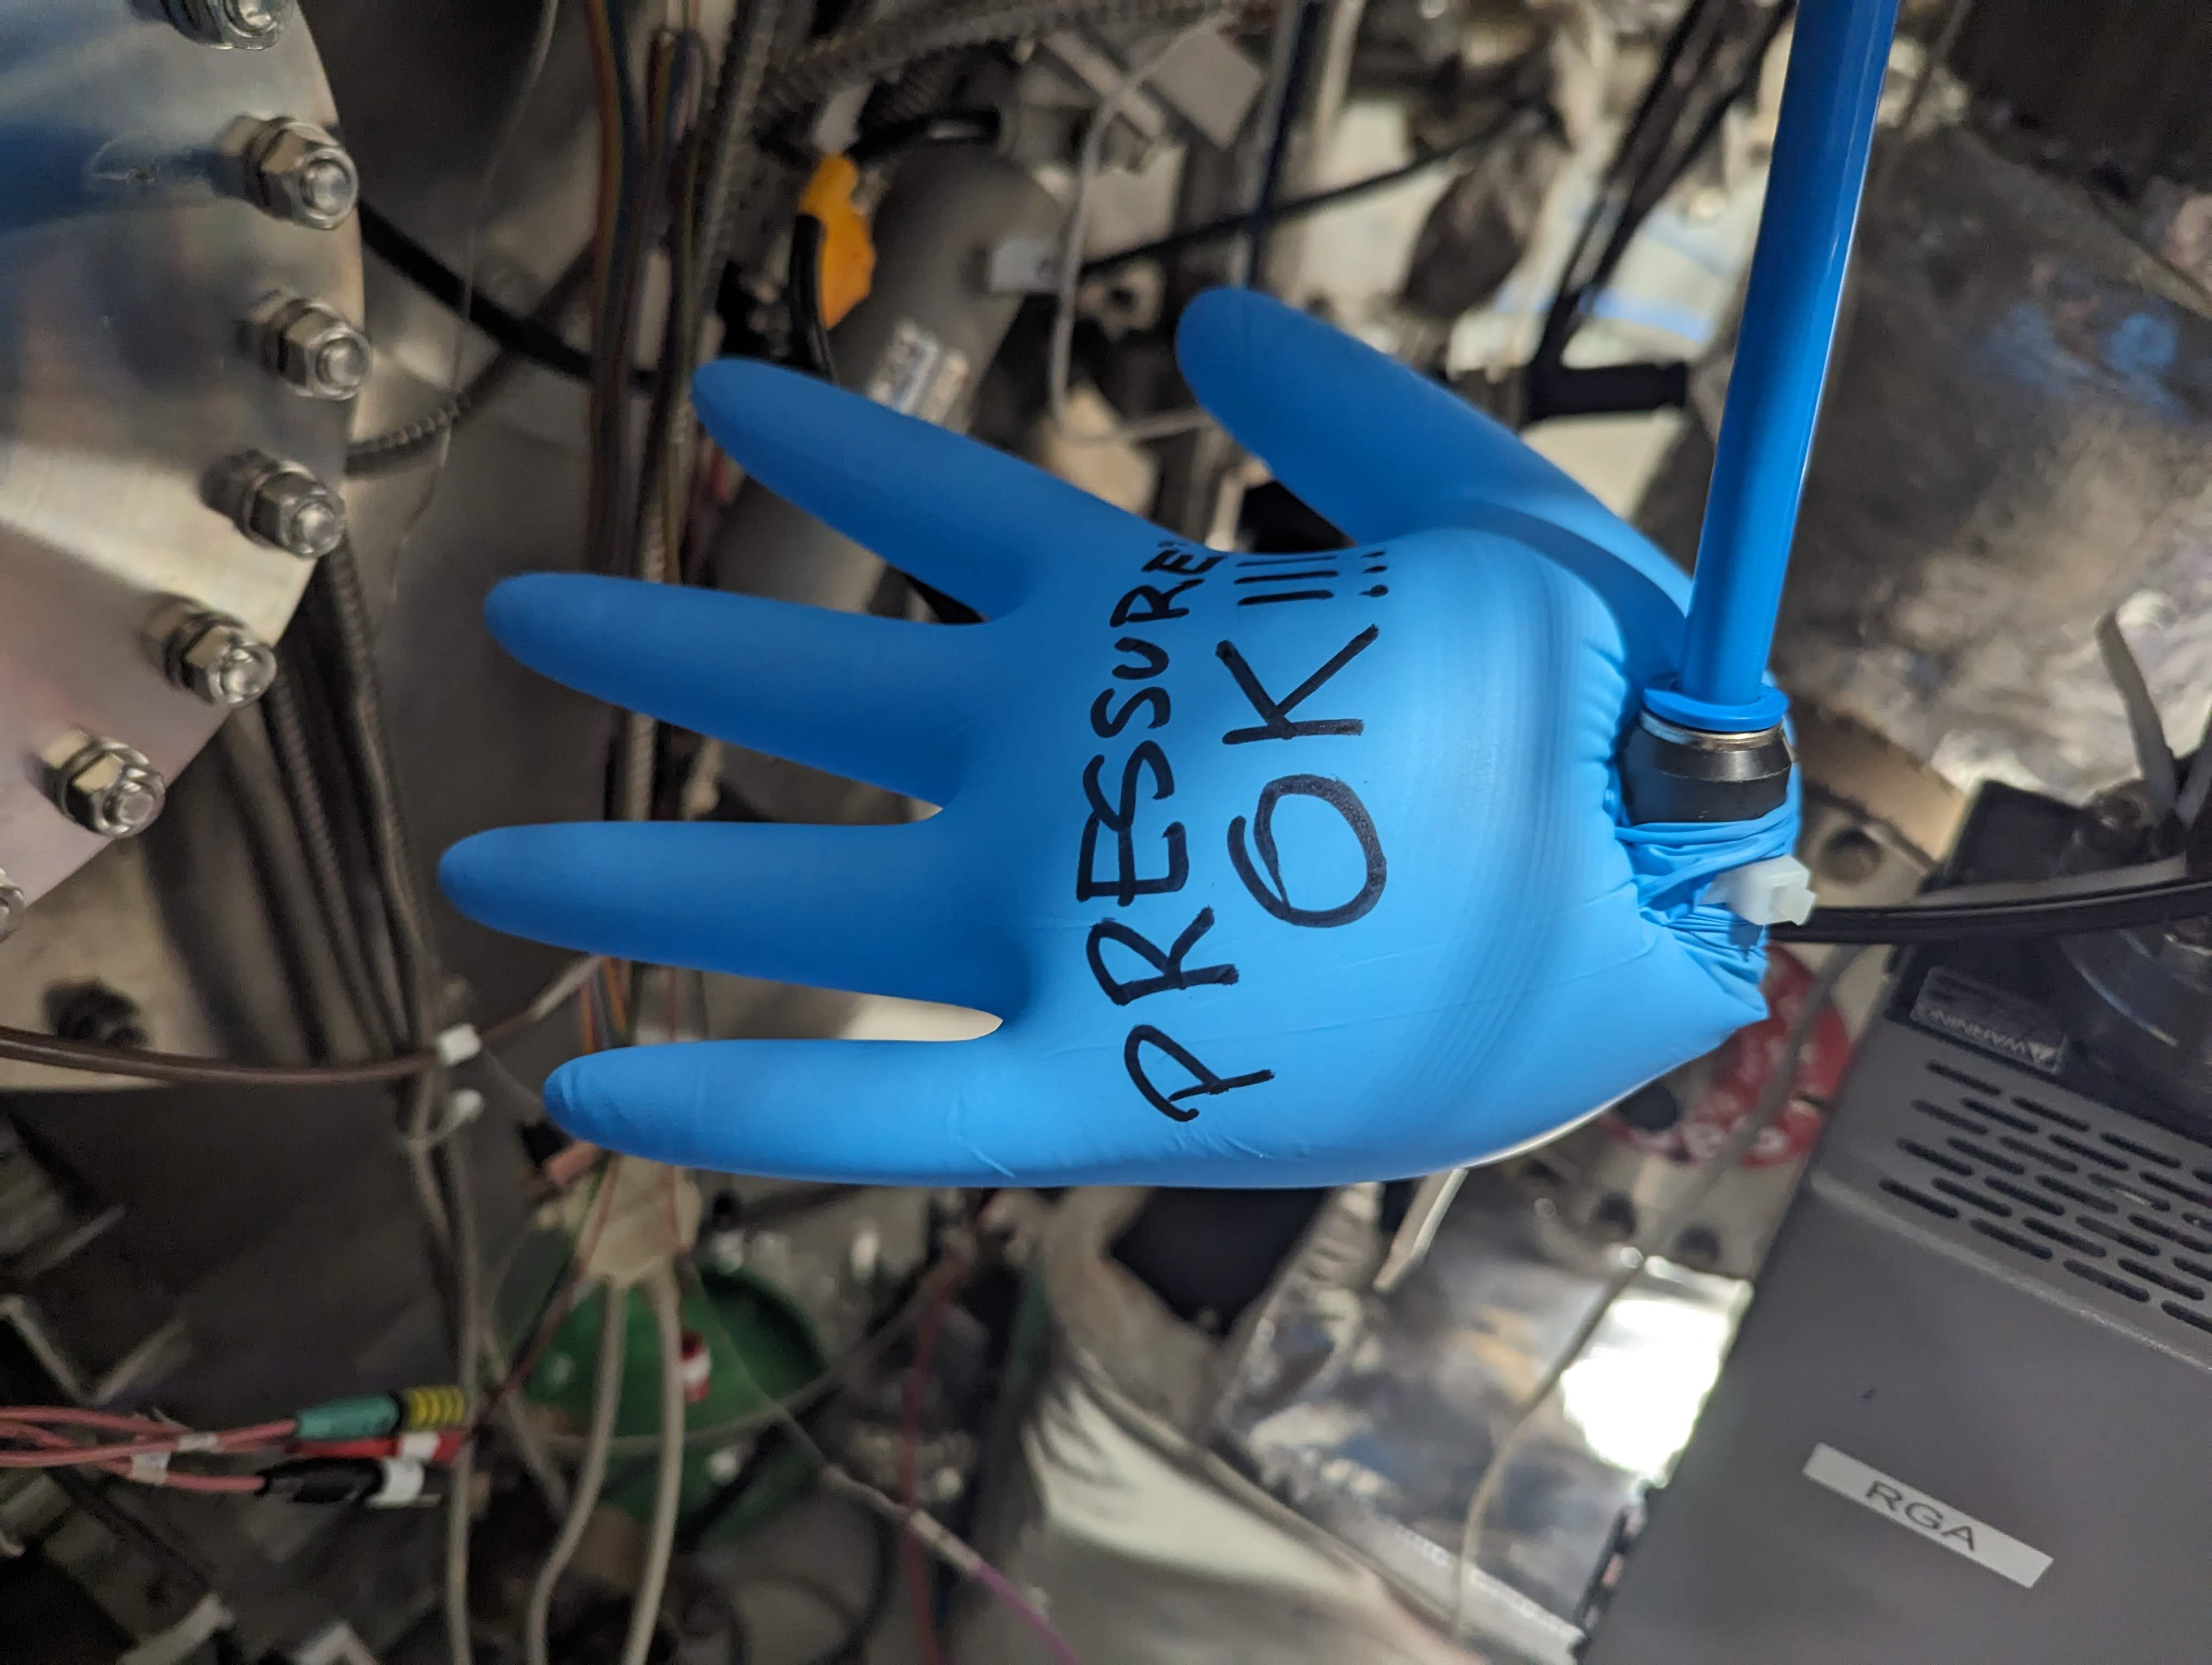



Peak at m/q=2
Fully stripped nitrogen identified?
$$H_{2}^{1+}$$
$$N^{7+}$$
$$O^{8+}$$

Slide 10
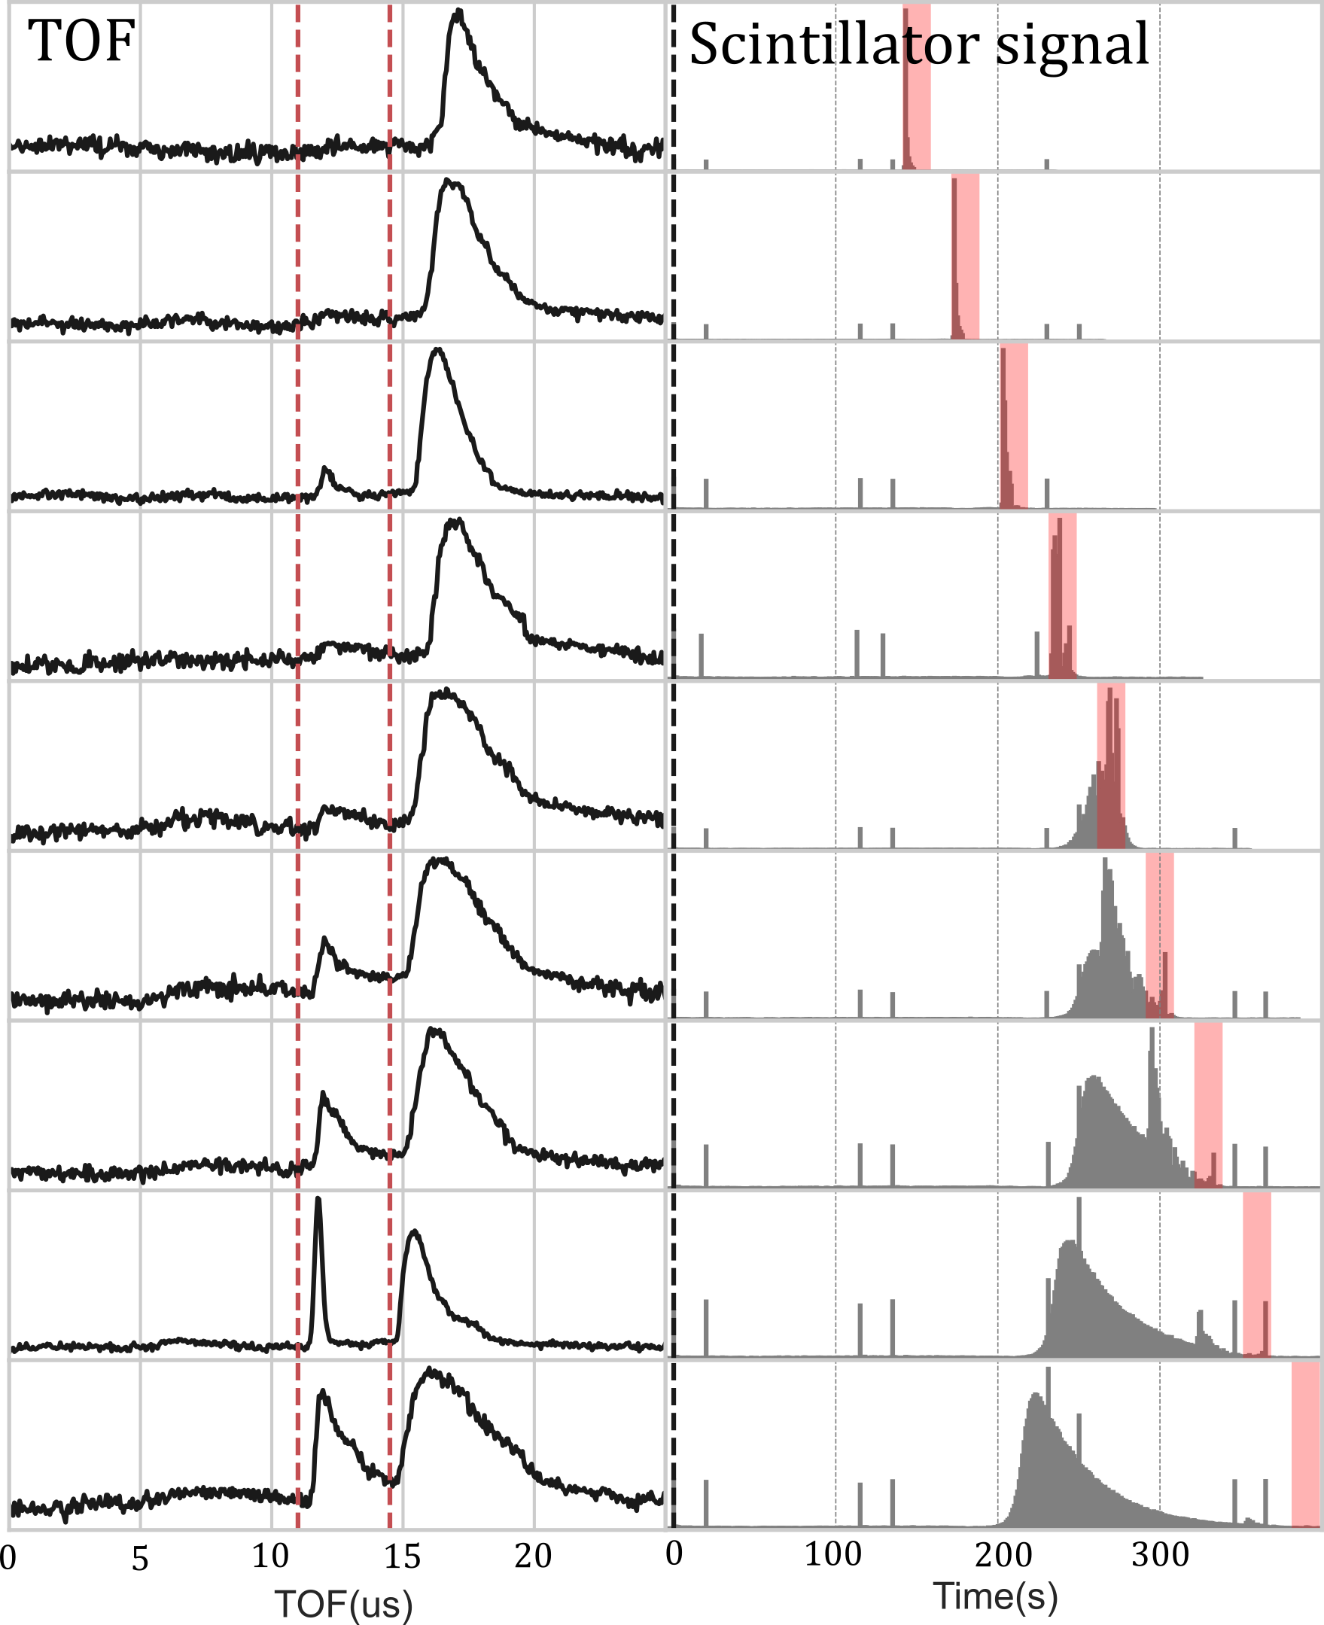
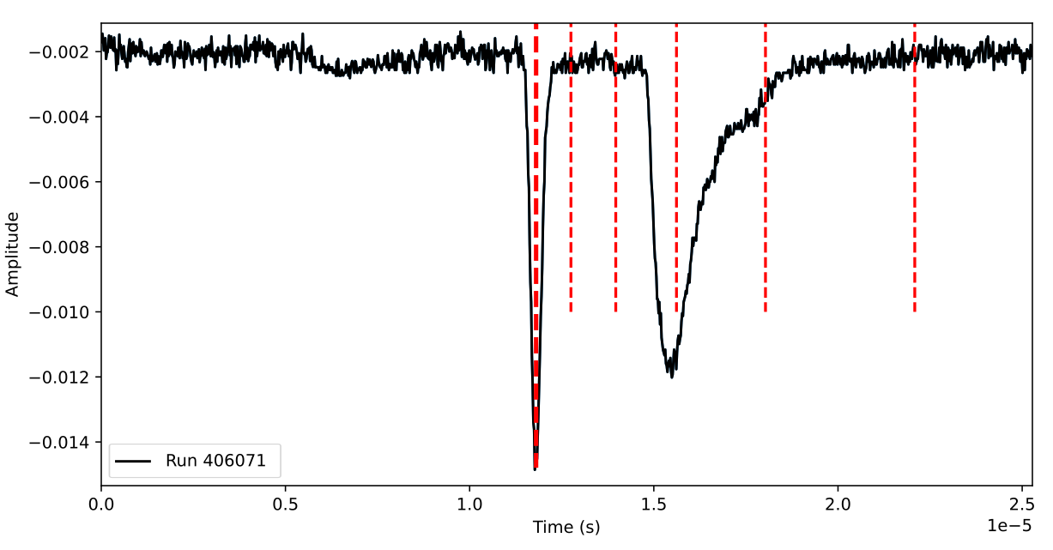
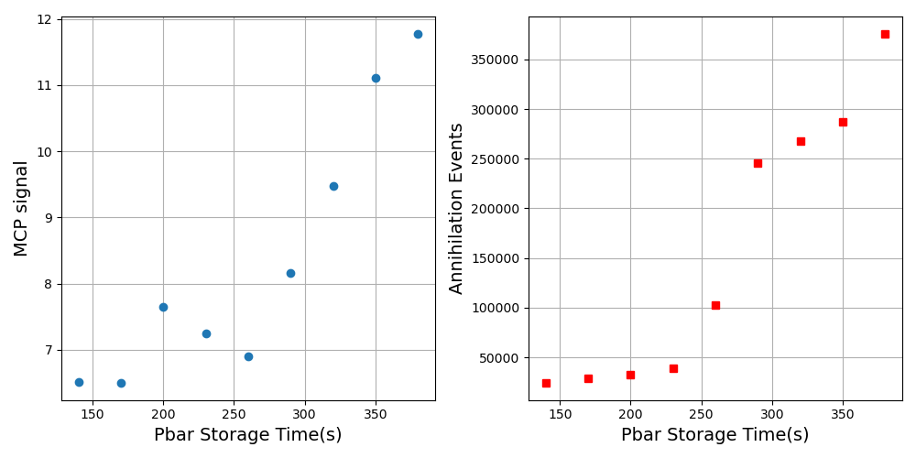
Evolution of formation
N⁶⁺
N²⁺
N⁷⁺

Slide 11
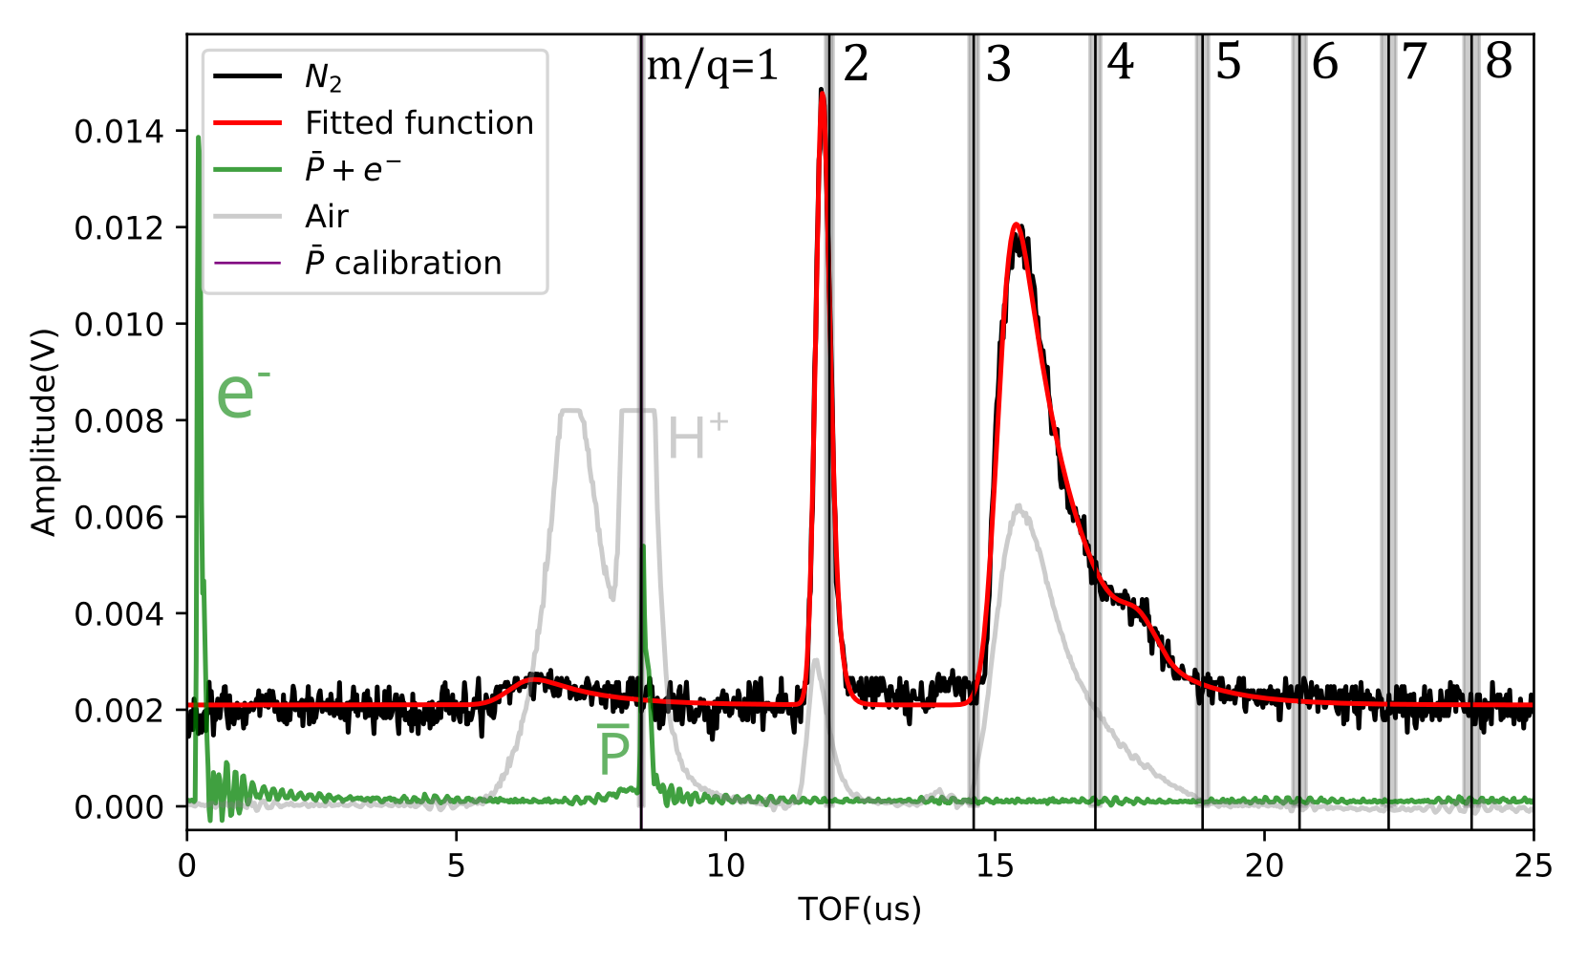

Slide 12
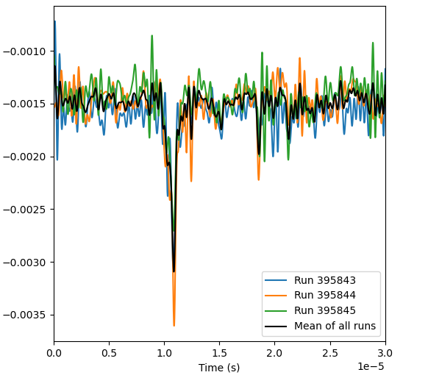
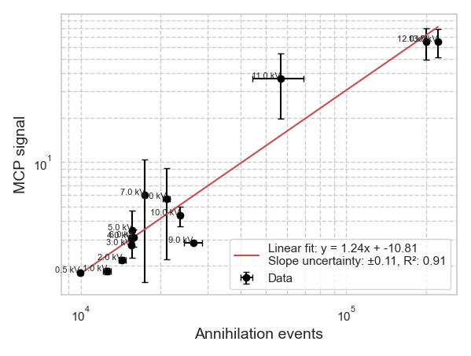
Low energy antiproton interactions
<1 keV trapped pbars
2kV
Signal of m/q=2 peak vs annihilation event:
What could result in the formation of m/q=2 from nitrogen?

Slide 13
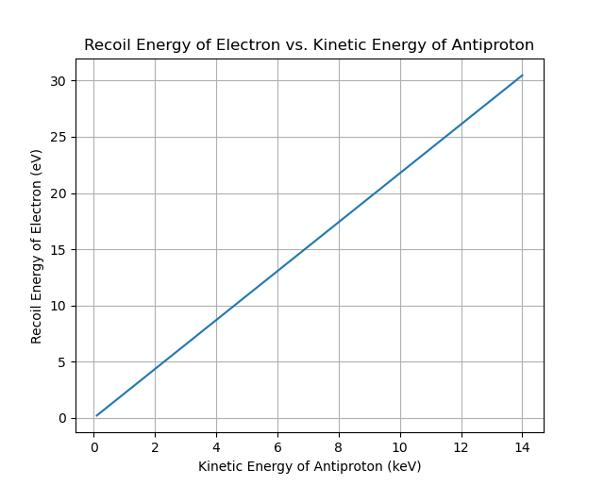
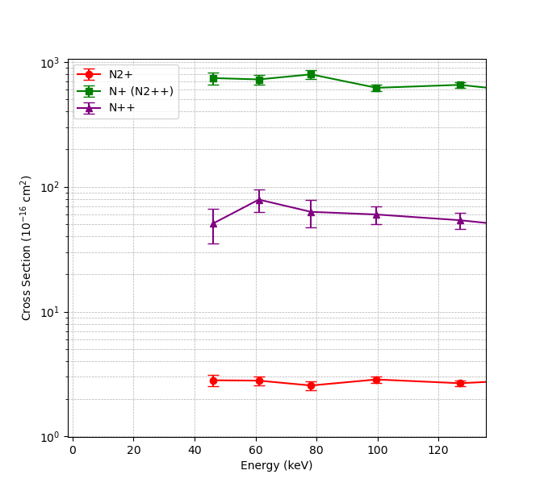
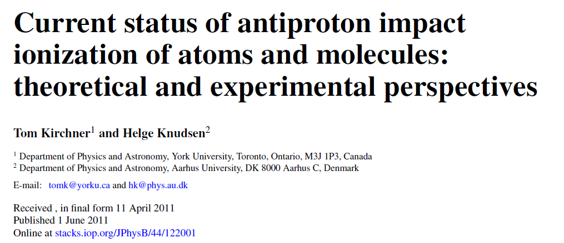

Collissional ionization with antiprotons?
3000 eV is required to form N⁷⁺ from the N₂ molecule
20 eV
$$\overline{P}$$
e-
10 KeV
Could electrons accelerated by HV electrodes strip nitrogen?
Simulation by Bharat using CST in progress...

Slide 14
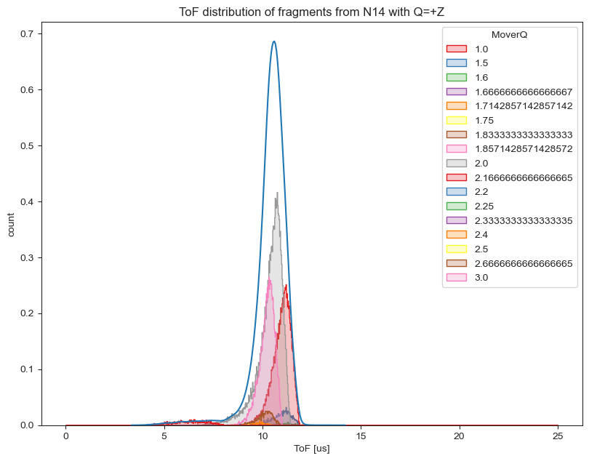
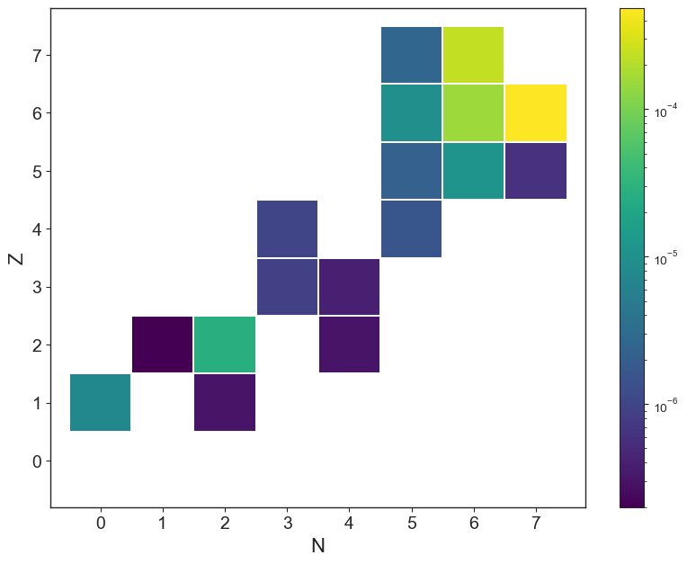
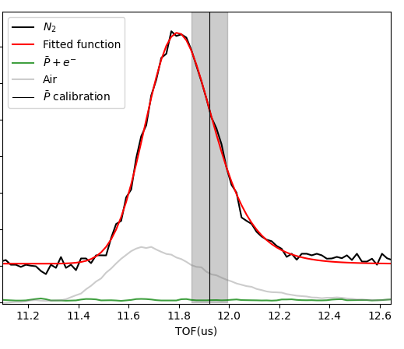

Nuclear fragments?
$T=50000 K$
Jakub simulations
Could fully stripped fragments be formed from impact with high energy recoil fragments?

Slide 15
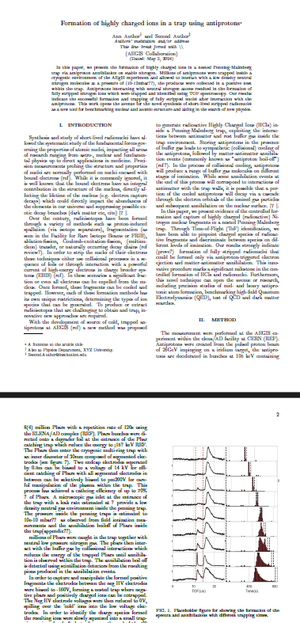
Proof-of-Principle paper:
Formation of HCIs in a trap with antiprotons
Introducing possibilities of trapping nuclear fragments from annihilation.
Presenting mechanism for trapping HCIs formed from Pbar annihilation with N₂ gas.
Identification of TOF spectra.
Discussing origins of formation (Simulations ongoing).
Concluding with most likely origin. Opening door to community to investigate further.
Suggested Journals: PRL, Scientific reports..
Technical paper:
Detailed technical report.
Nested trap procedure, Ion manipulation, MR-TOF procedure, future improvements.. analysis ongoing..

Slide 16
Outlook

Slide 17
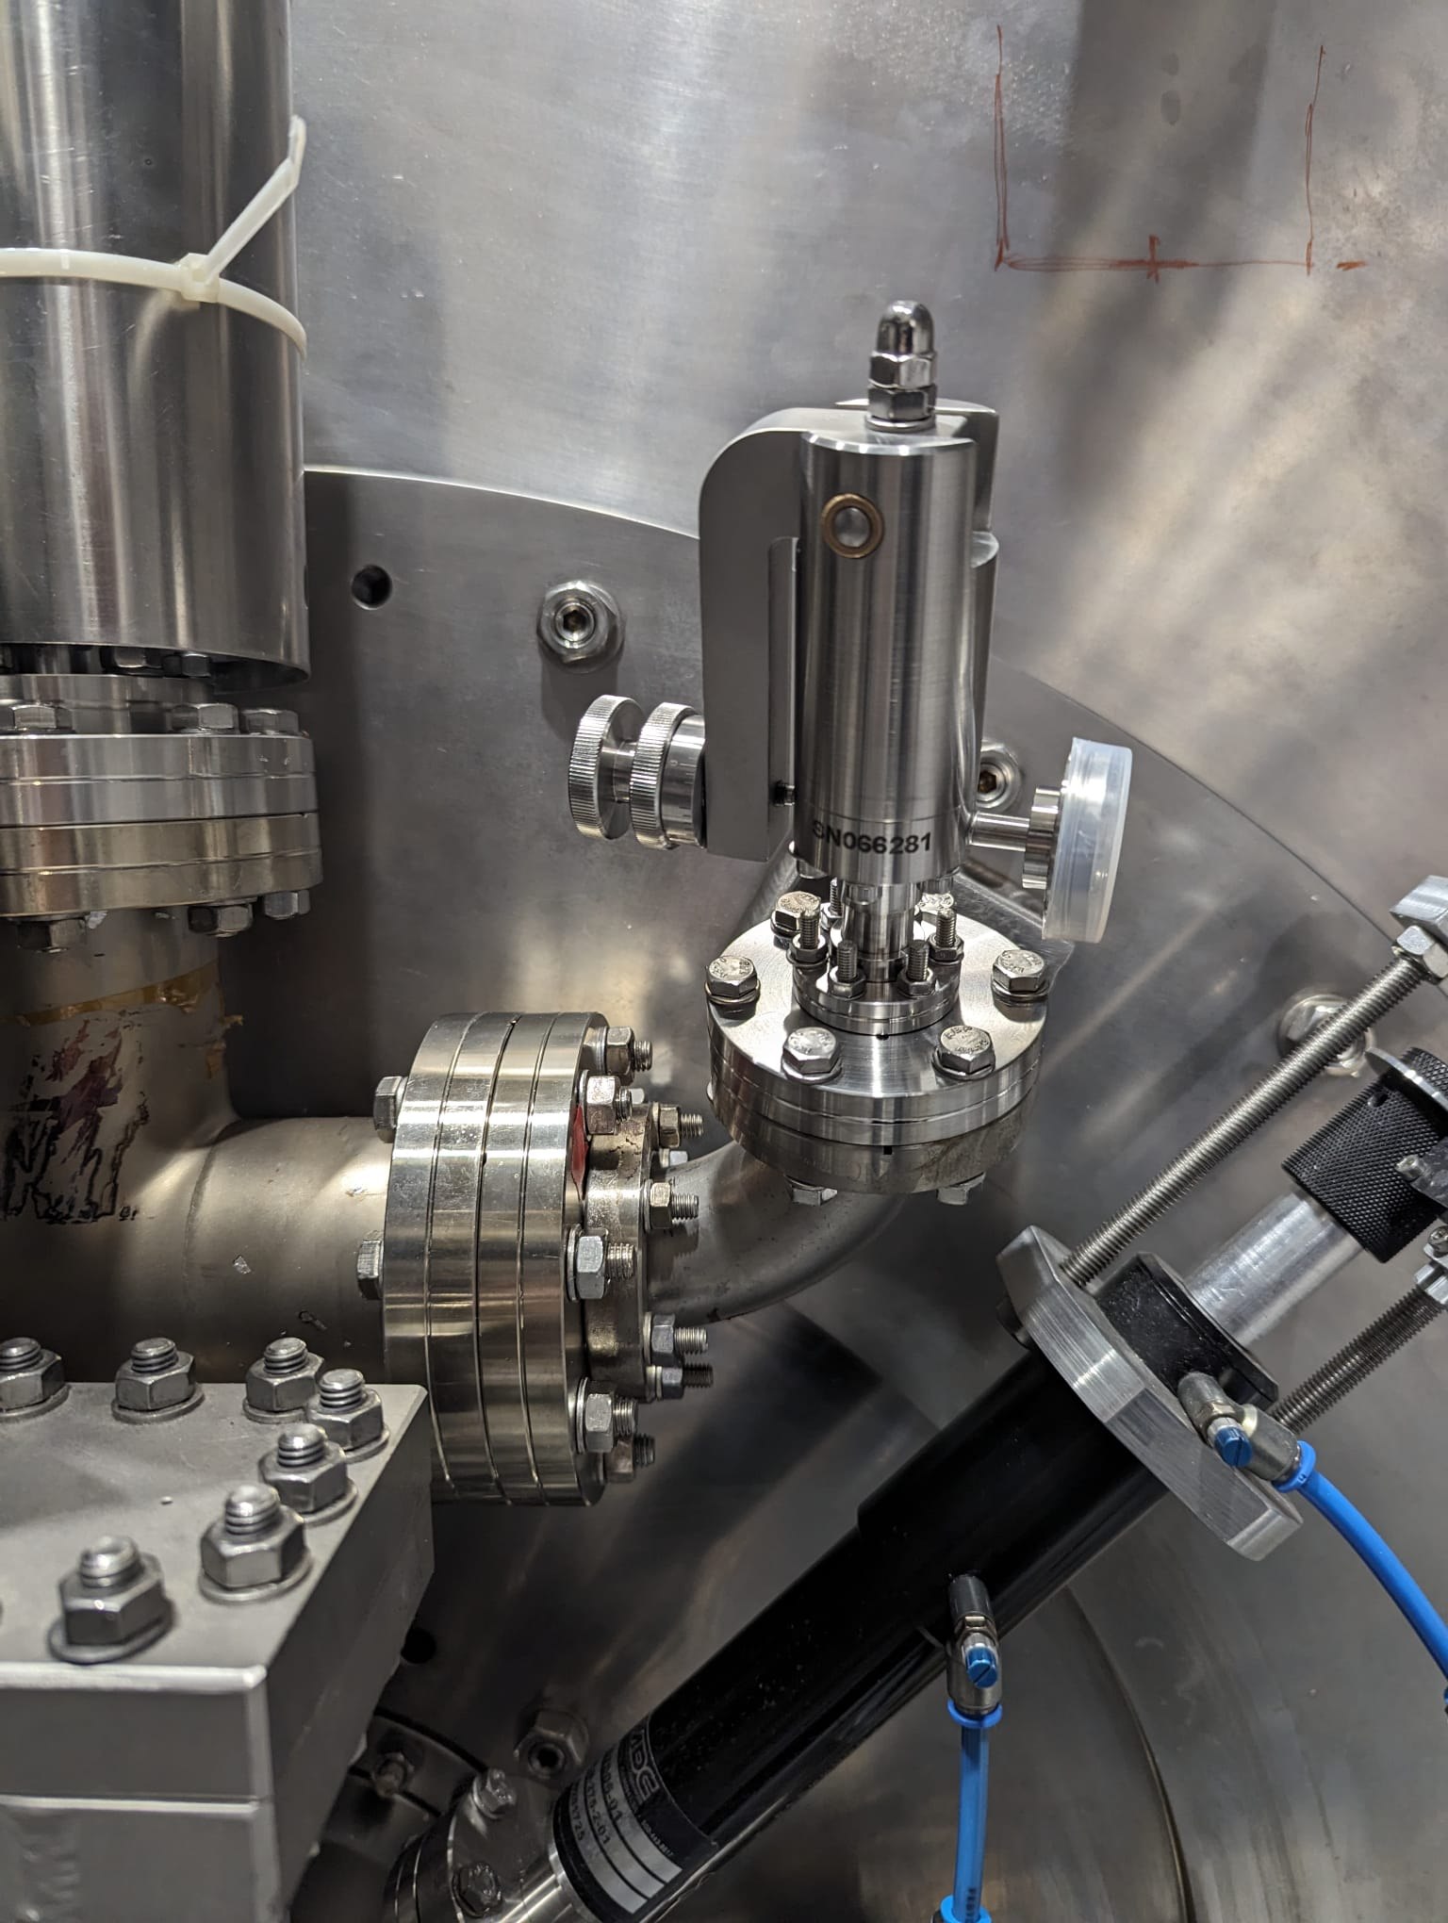
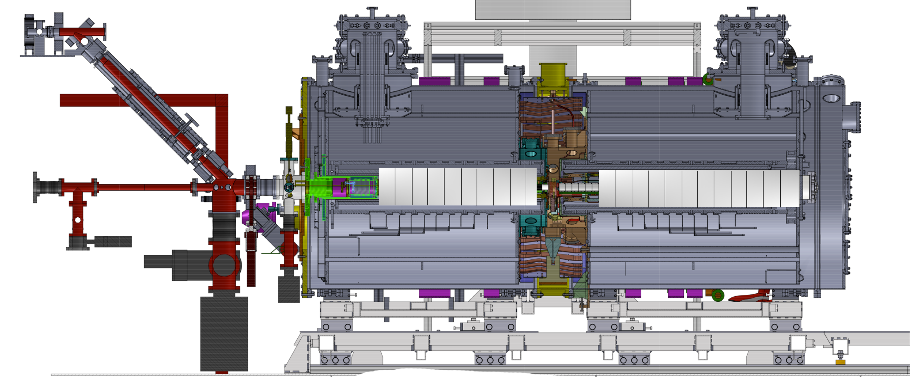
Gas injection valve installed
Controlled injection of gas into AEGIS

Slide 18
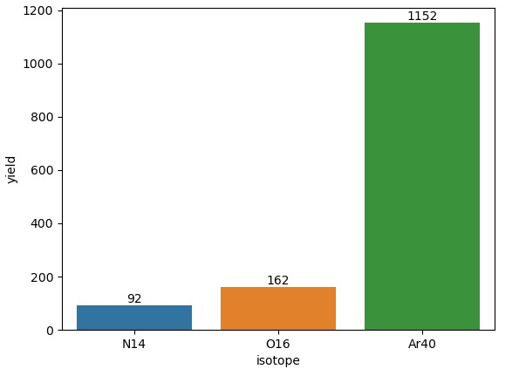
Suggested measurements for 2024
Argon (A=40):
- 10x capture yield fragment yield expected
- Formation of 18+ very difficult with collissions.
Helium (A=4):
- Reference where we expect minimal fragments trapped.
Krypton (A=83):
- Heaviest gas available, largest trappable fraction of HCI.
Nitrogen (A=14):
- For continued technical development, refine resolution and stability.
Antiprotonic atom spectroscopy at AEGIS
- Continuing LEAR era measurments: Plenty of physics cases!
- Teaching us the procedure for antiprotonic atom x-ray spectroscopy.

Slide 19
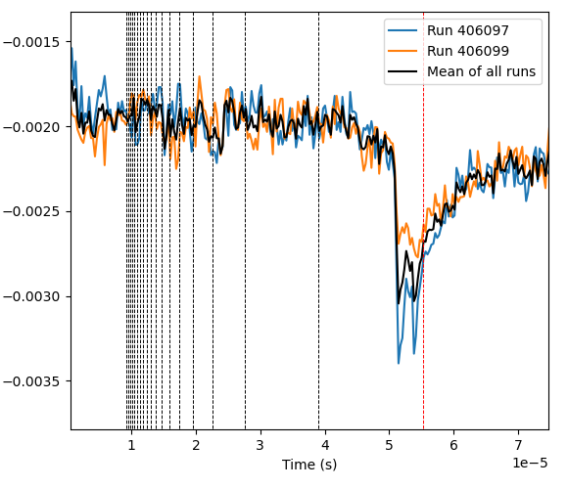
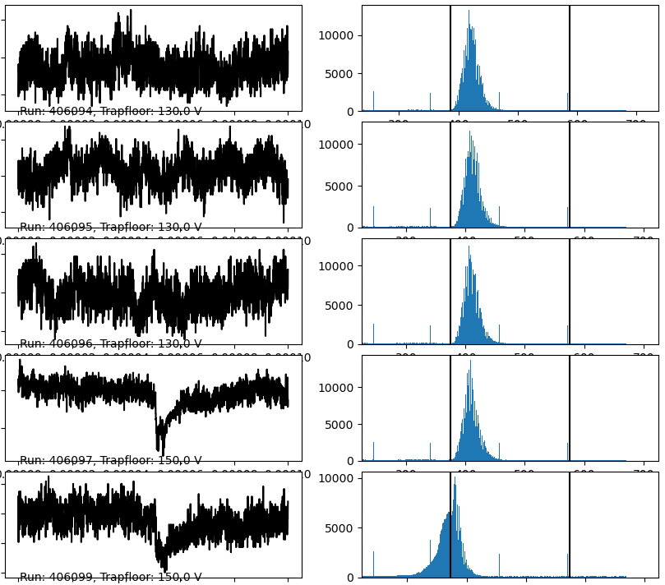
Argon run 2023
MCP signal
Scintillator signal
Ar₂⁻
Ar¹⁸⁺
Ar⁺

Slide 20
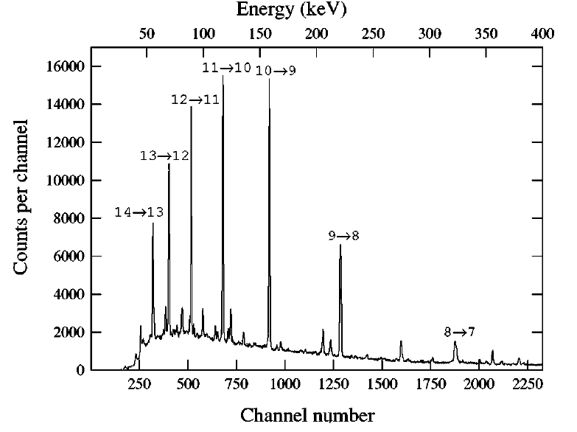
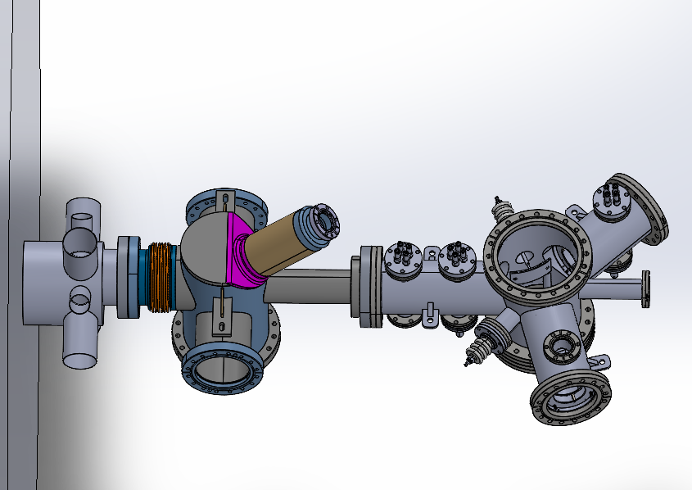






First x-ray spectroscopy at AEGIS
$$e^{+}$$
Sample spectrum
$\overline{p}$
Flange
Spectrometers:
CsI (simple but low efficiency)
BGO detectors (Student project)
HPGe spectrometer (Requesting quote from Mirion)
Gamma spectrometer
$\overline{p}$
$$γ$$
$$γ$$
Target
Ruthenium?
$$γ$$
1 MeV

Slide 21
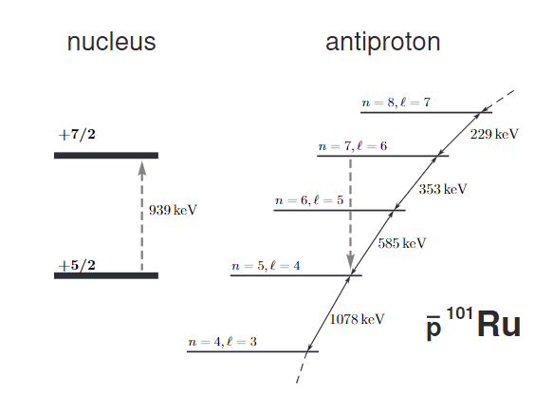
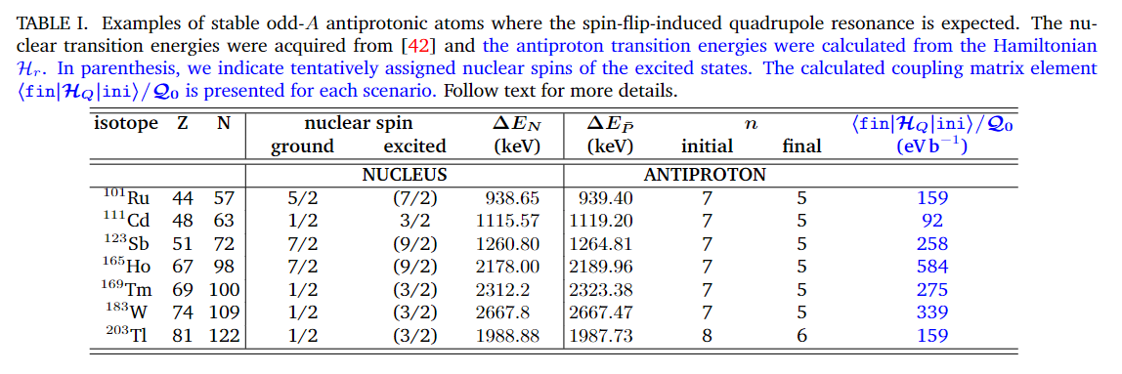

Physics case: The spin-flip-induced quadrupole resonance effect in odd-A exotic atoms
$$\overline{p}$$
Accepted in Physical Review C

Slide 22
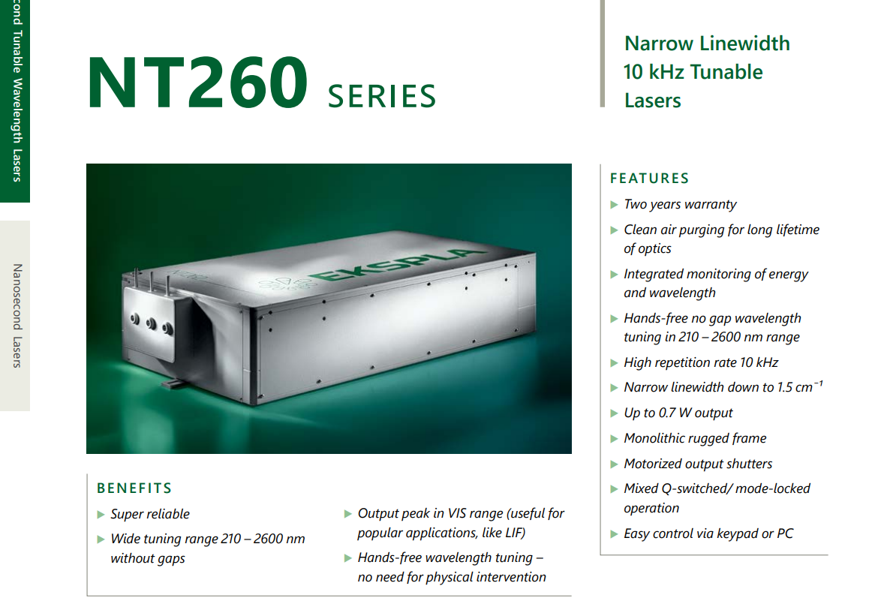
New lasers for AEGIS
1064nm
I+
Goal: Laser triggered formation of antiprotonic atoms in AEGIS. (First case: Iodine)
Broad range (Versatility)
High intensity (Non-resonant and weak transitions)
Pulsed
Resolution? Spectroscopy?
OPO systems from EKSPLA..
4xx nm
I
206nm
I-
266 nm

Slide 23
Summary of outlook:
Continued development of trapping procedure and identification of HCI fragments from antiproton-atom interaction using gas injection (the dirty method).
First x-ray spectroscopy of antiprotonic atoms at AEGIS (initially on target). Characterizing background for spectroscopy inside the trap. Many ’simple’physics cases.
(Triggered formation of antiprotonic atoms through target ablation near trapped cold antiprotons?)
Purchase of laser systems for photodetachment and Rydberg excititatation: Triggered formation of antiprotonic atoms with cotrapped anions.
Goal: Laser triggered formation of antiprotonic atoms (laser/x-ray/auger spectroscopy) and trapping and cooling of resulting HCI fragments.

Slide 24
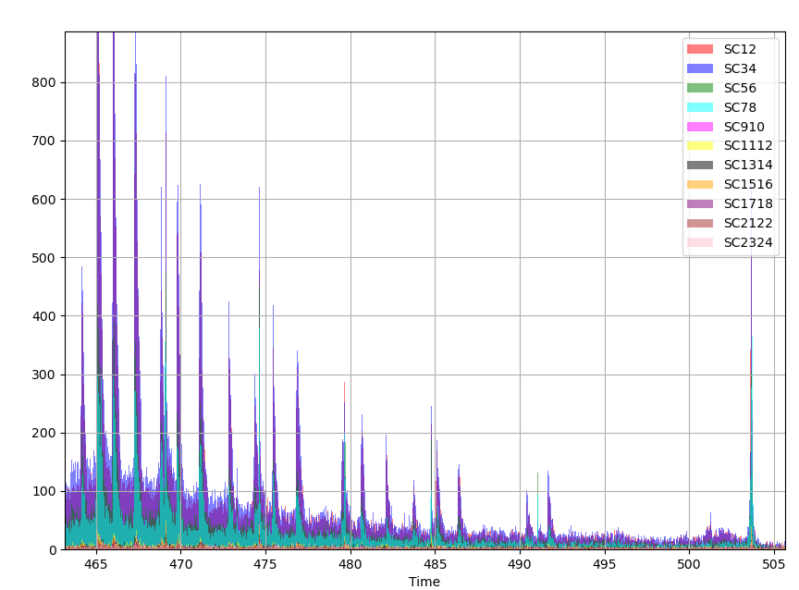
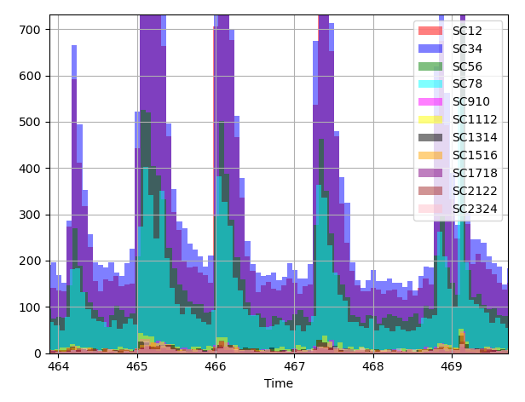
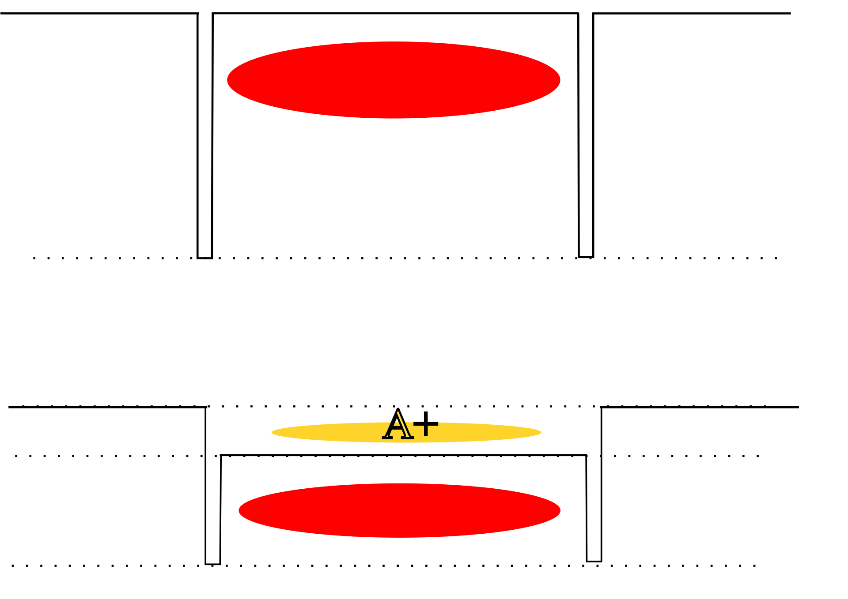


Quasi-periodic Pbar annihilation?
Floating electrode in 5T trap?
$\overline{p}$
$\overline{p}$

Slide 25
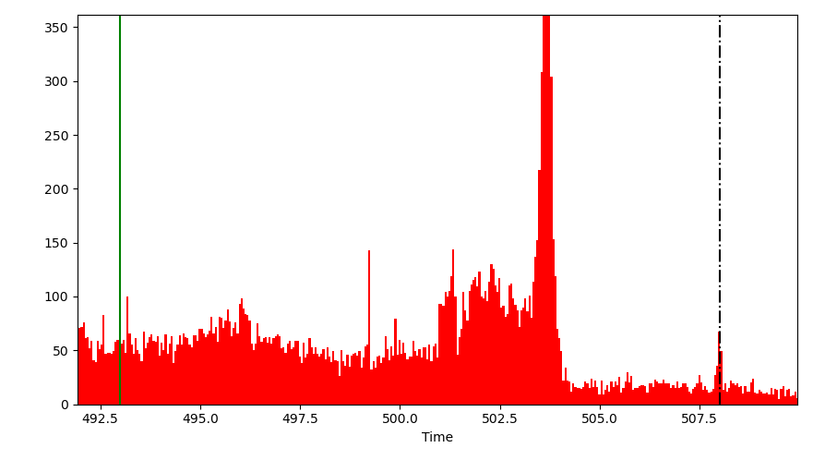
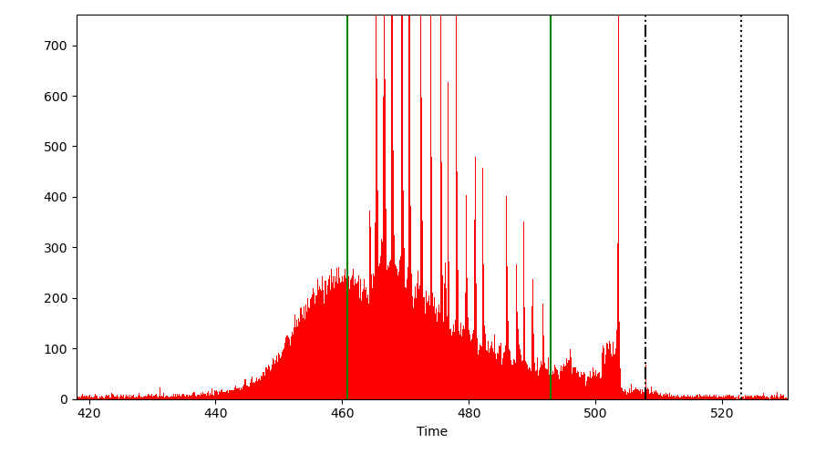
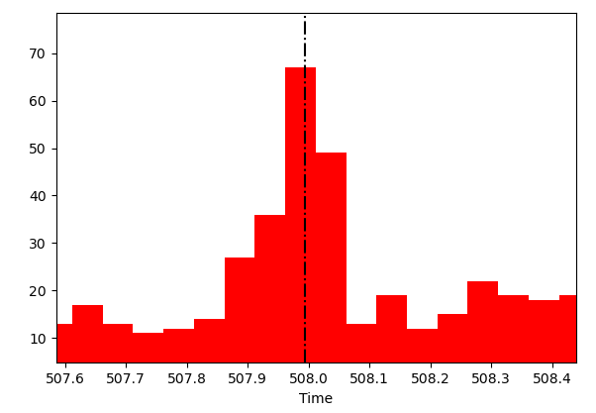
Annihilation peak
3.8 keV?
Sparking of central electrode?
<100 eV

Slide 26
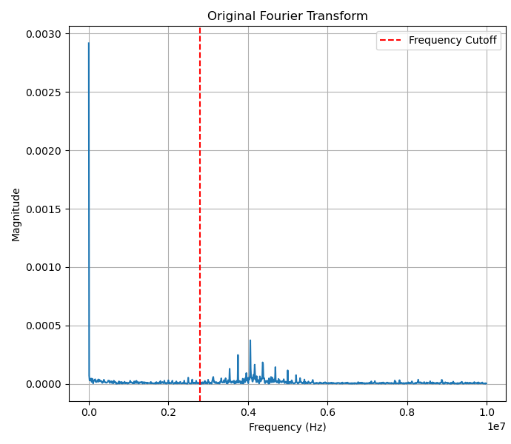
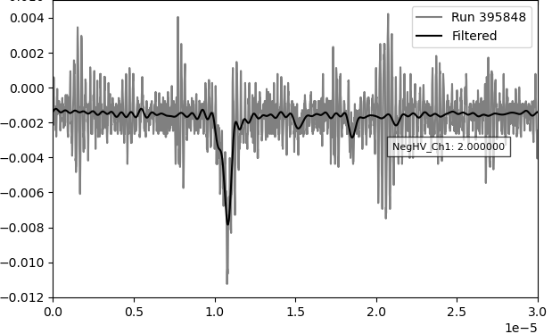
Noise filtering

Slide 27
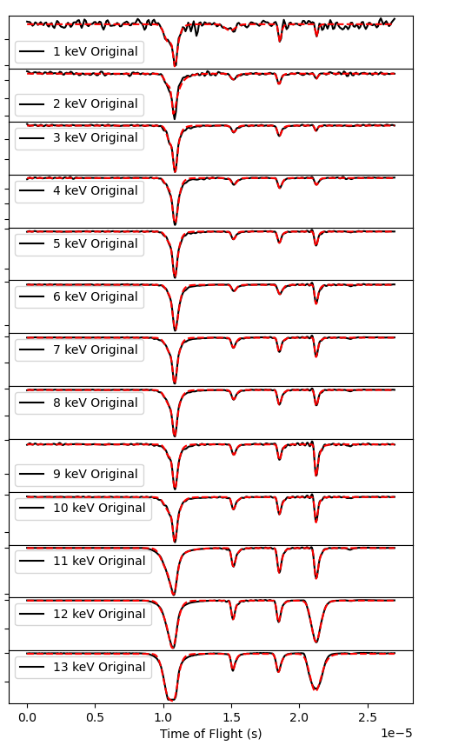
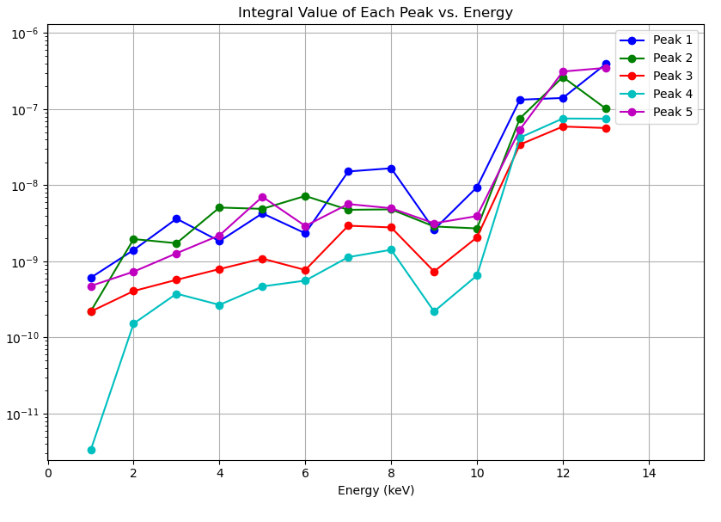
Pbar trapping voltage vs MCP signal

Slide 28


MR-TOF signal using barrier
A+
A+
MCP
140eV N⁷⁺
7.8 us
140eV N²⁺
15.5 us
140V barrier scan, 1s cooling time 1m, 90V floor

Slide 29



Fast TOF component?
Isolating peak with 250 ns gate:
$$?$$

Slide 30


Barrier scan with 10 V floor voltage
TOF vs Barrier height
A+
160V
A+
MCP
A+
155V
Cold
Barrier height
A+
145V
140V
130V
Cold
125V
$$?$$
105V

Slide 31



Isolating slow peak with 160 V Barrier
-180V MCP bias
0V MCP bias
A-
A-
To MCP
A-
A-

Slide 32


Floor voltage scan with release from MCP side
Constant!

Slide 33


Slide 34



Ion time changes the 7+ population
40s
20s
5s
5s
20s
40s
The other peaks do not change significantly with time

Slide 35


Slide 36


Slide 37





Elena side measurment
$$K=\frac{{\left(L_{eff}+L_{5Ttrap}\right)}^{2}k}{2e{10}^{12}}=13000(75)$$
1.568m
+130V floor
-180V
1
2
3
4
5
10 kV trapping potential
¹⁵N³⁺
O⁴⁺
B⁶⁺
N⁷⁺
¹⁵O/¹⁵N⁵⁺
C⁶⁺
H+
10V deep potential @150V

