Slide 1
1T region redesign: bellows assembly progress and August opening timeline
05.2024

Slide 2
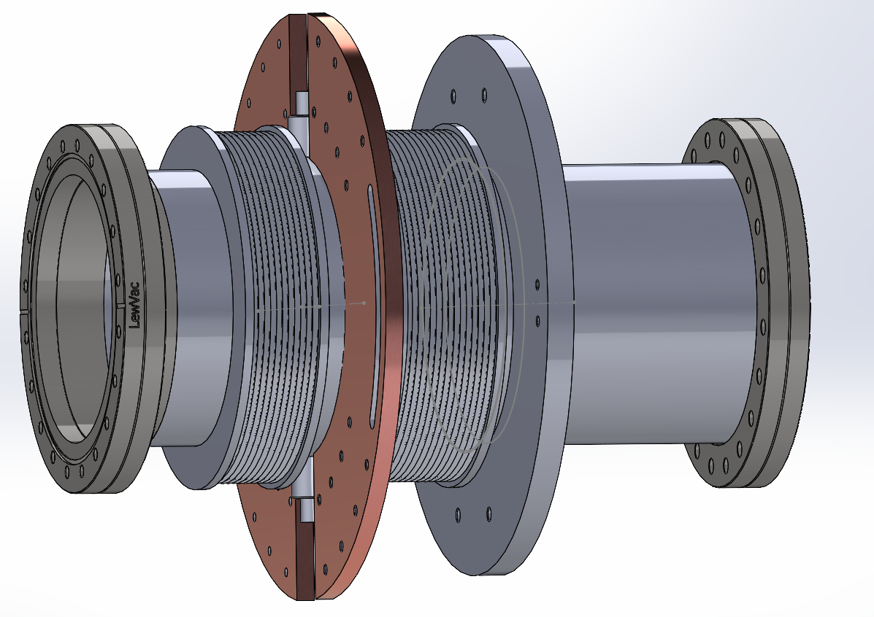
Bellows assembly for the 1T
70K
4K
RT

Slide 3
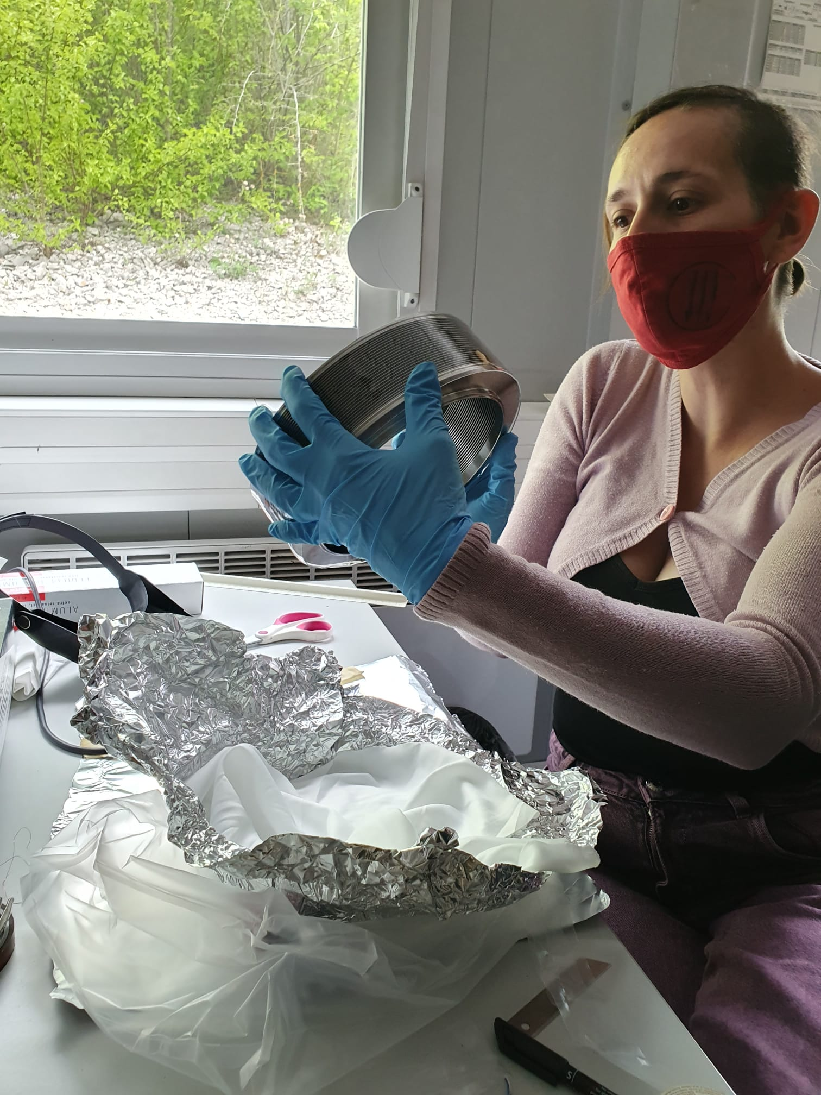
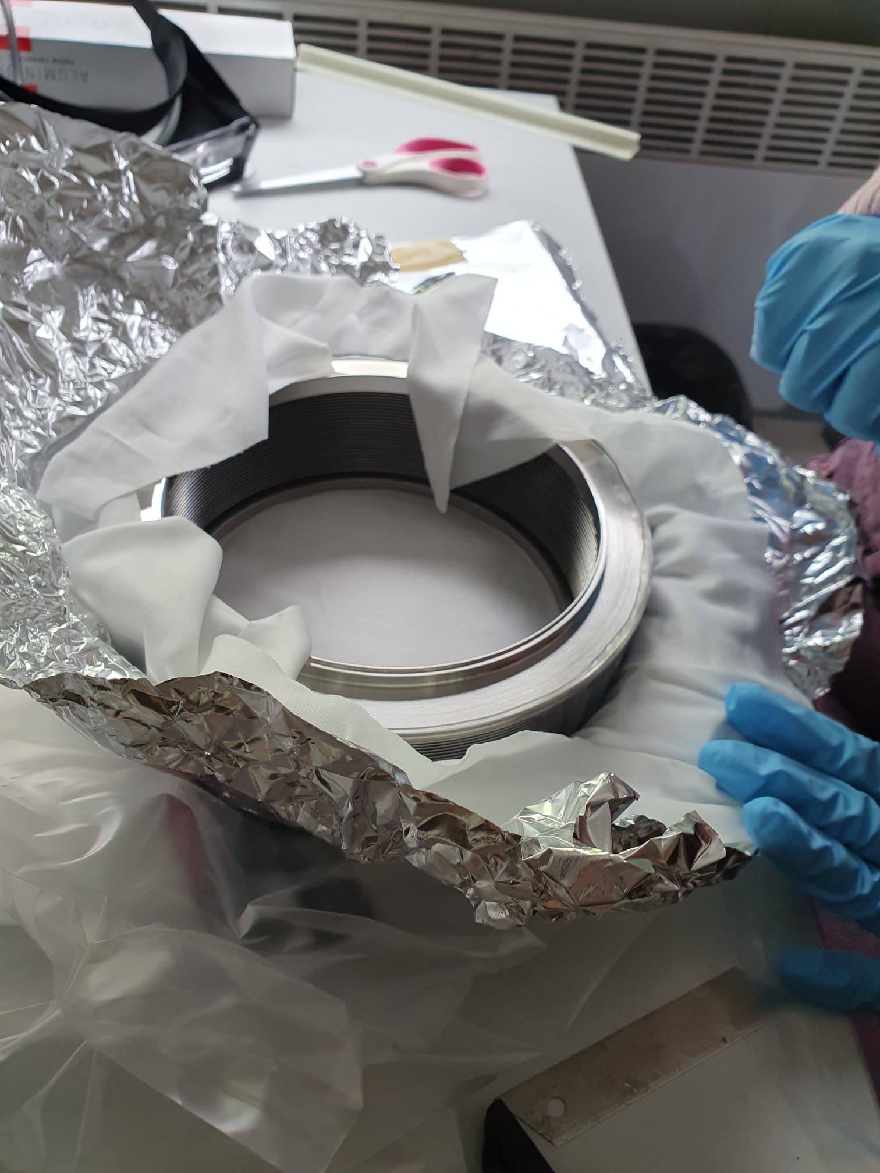
Bellows assembly for the 1T

Slide 4
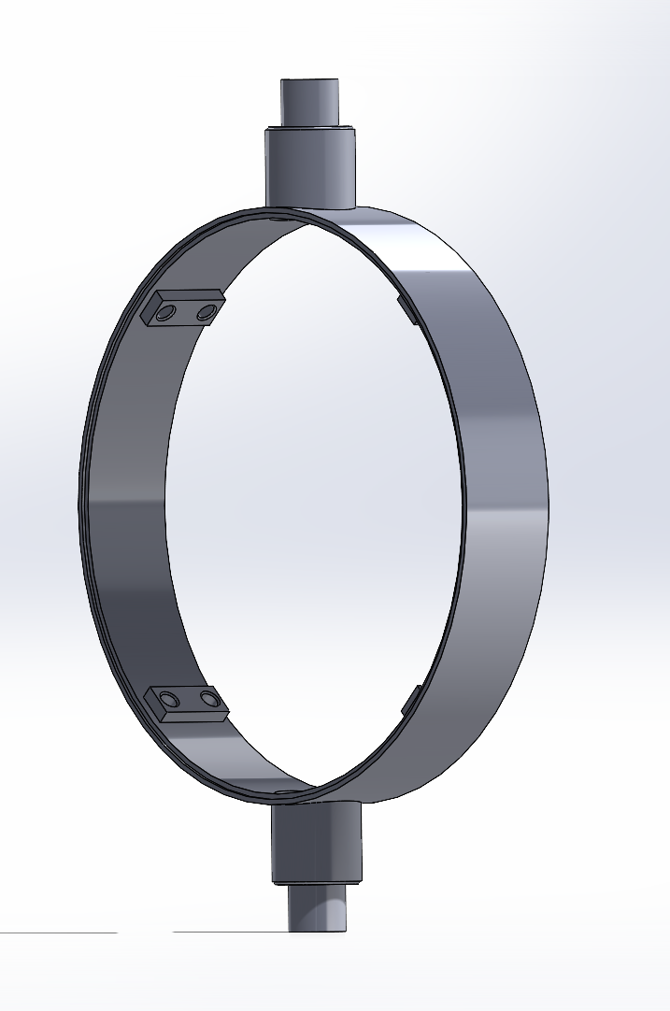
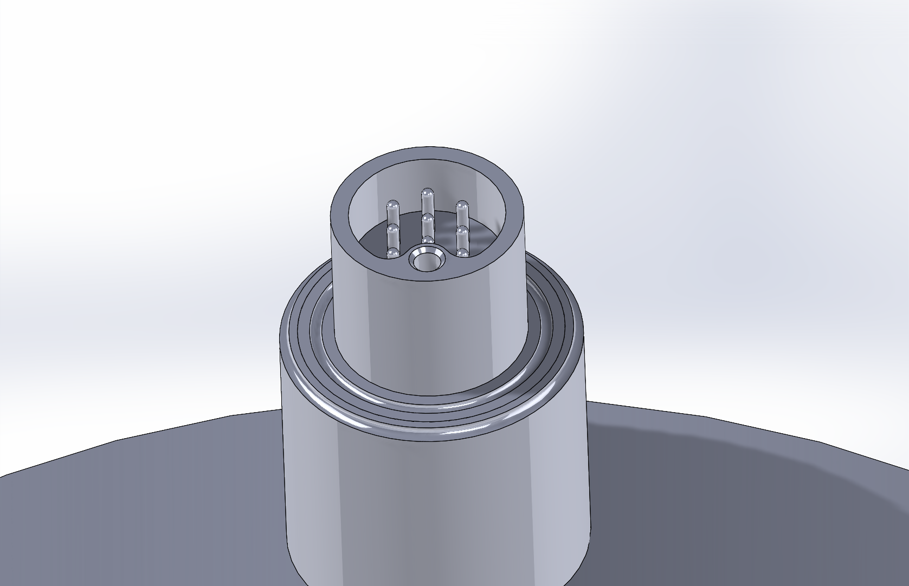
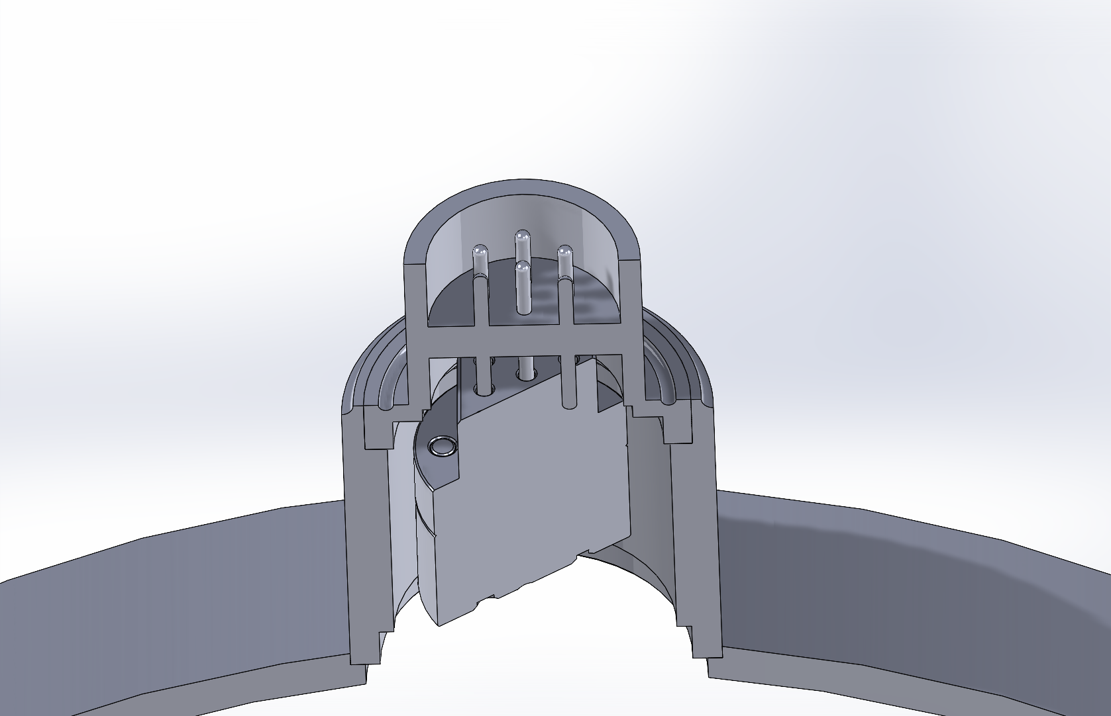
Bellows assembly for the 1T
Electric elements already at CERN

Slide 5
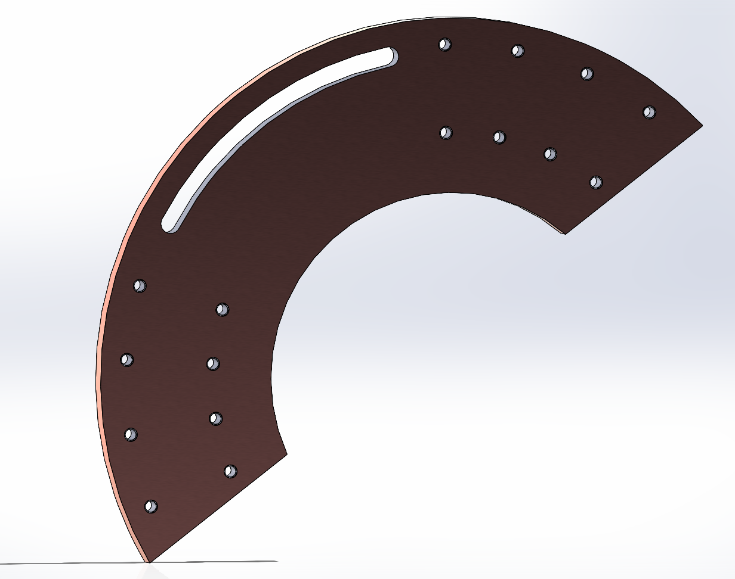
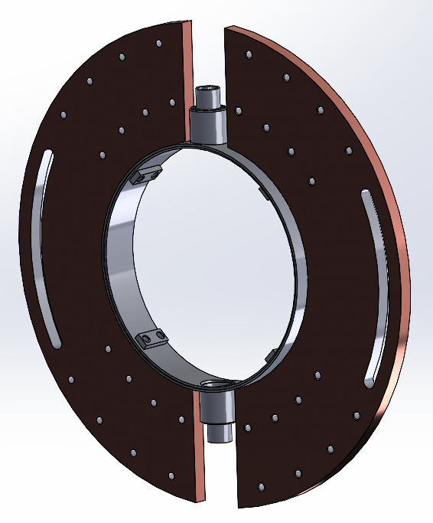
Bellows assembly for the 1T

Slide 6
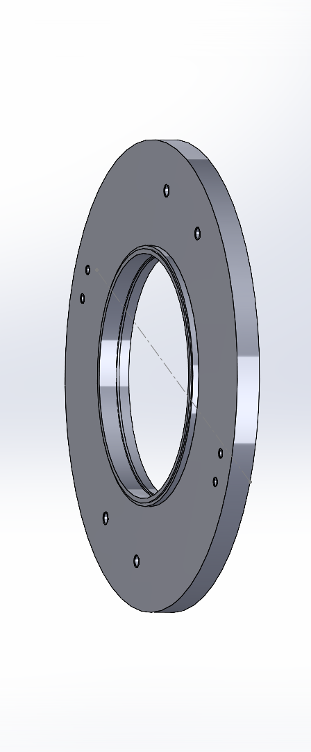
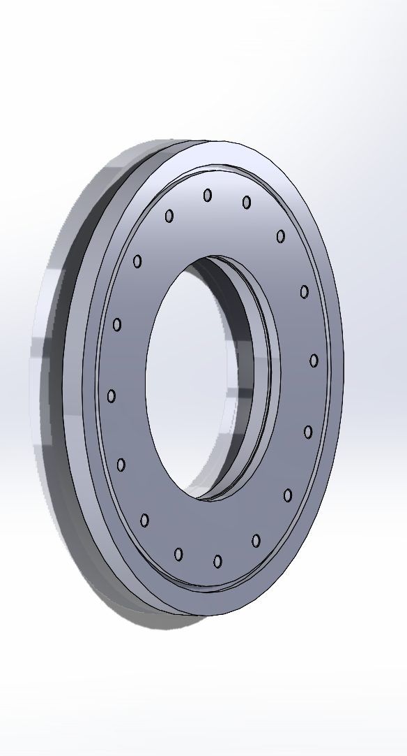
Bellows assembly for the 1T

Slide 7
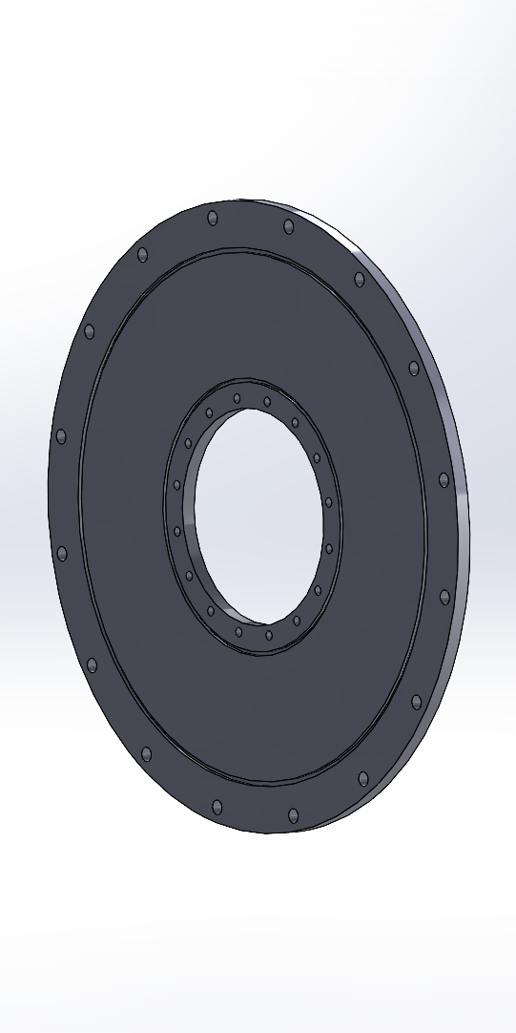
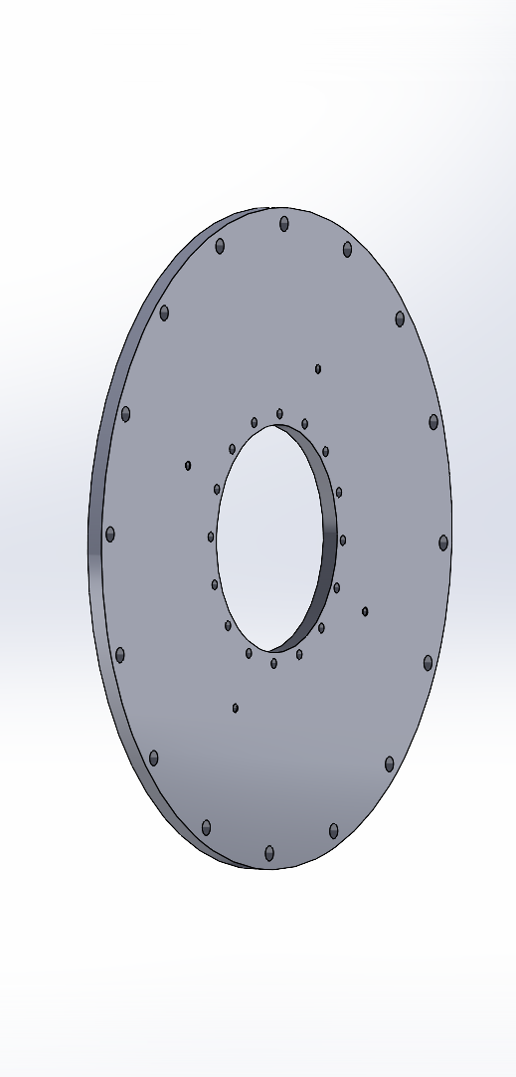
Bellows assembly for the 1T

Slide 8
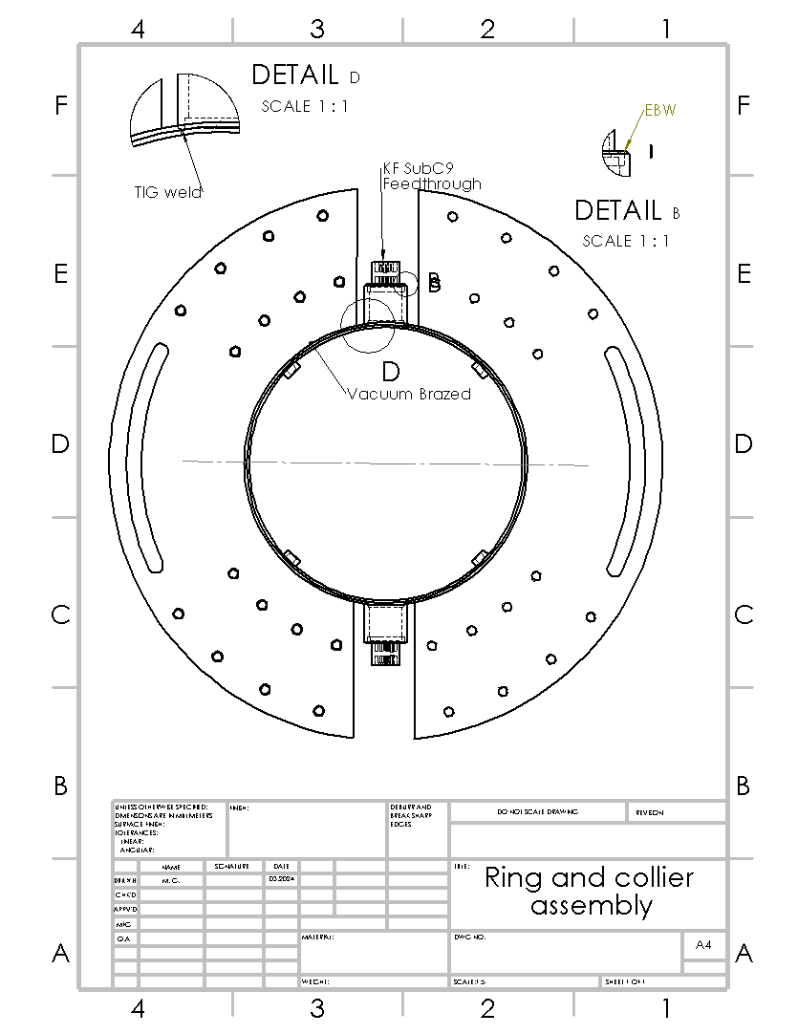
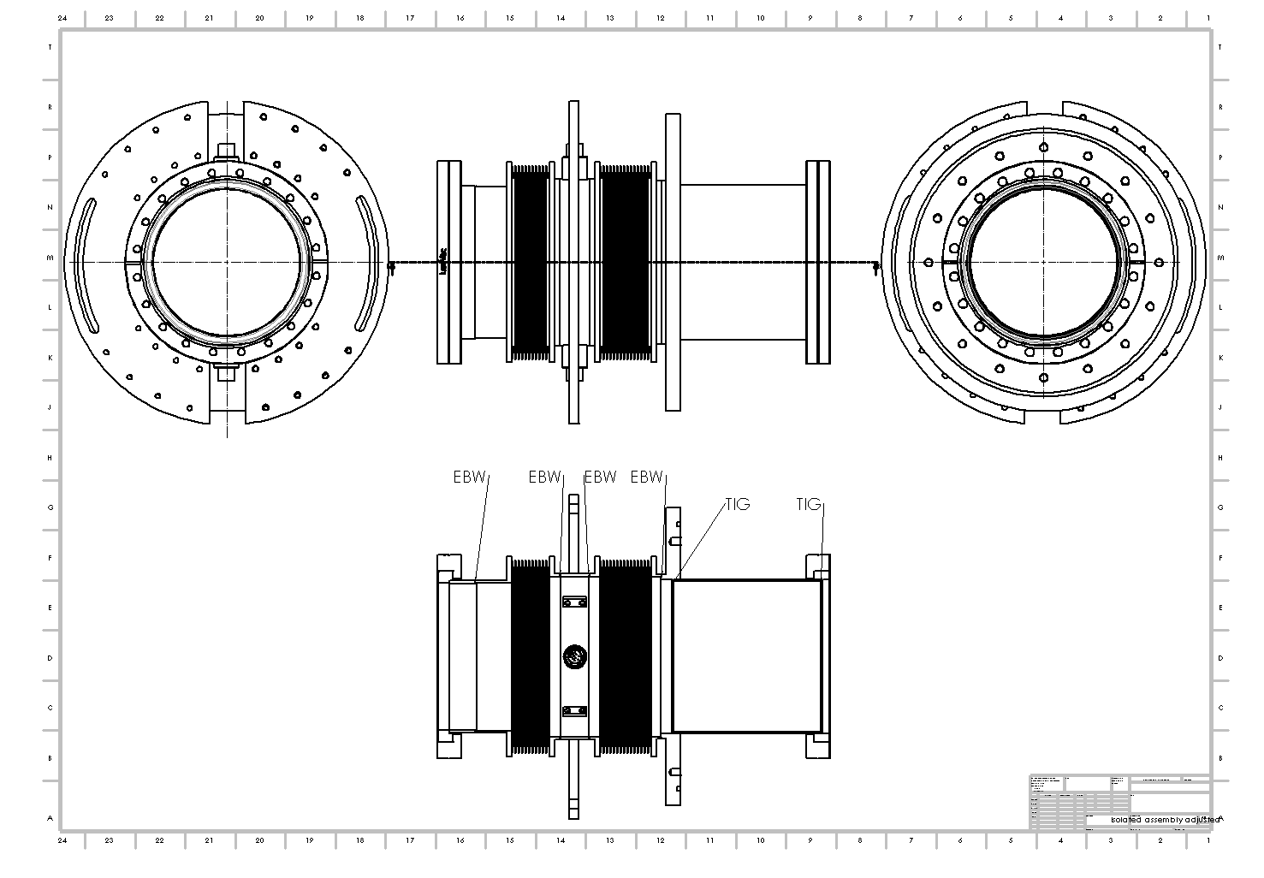
Bellows assembly for the 1T

Slide 9
Bellows assembly for the 1T
Status:
Bellows at CERN
Feedthroughs, rotary flanges… at CERN
Materials in the CERN workshop
Machining of the central ring components is ongoing
Price: ~20K CHF (with leak testing and UHV cleaning)
Lead time: mid-June
To-do
Plastic support for the bellows
Aluminum frame for installation

Slide 10
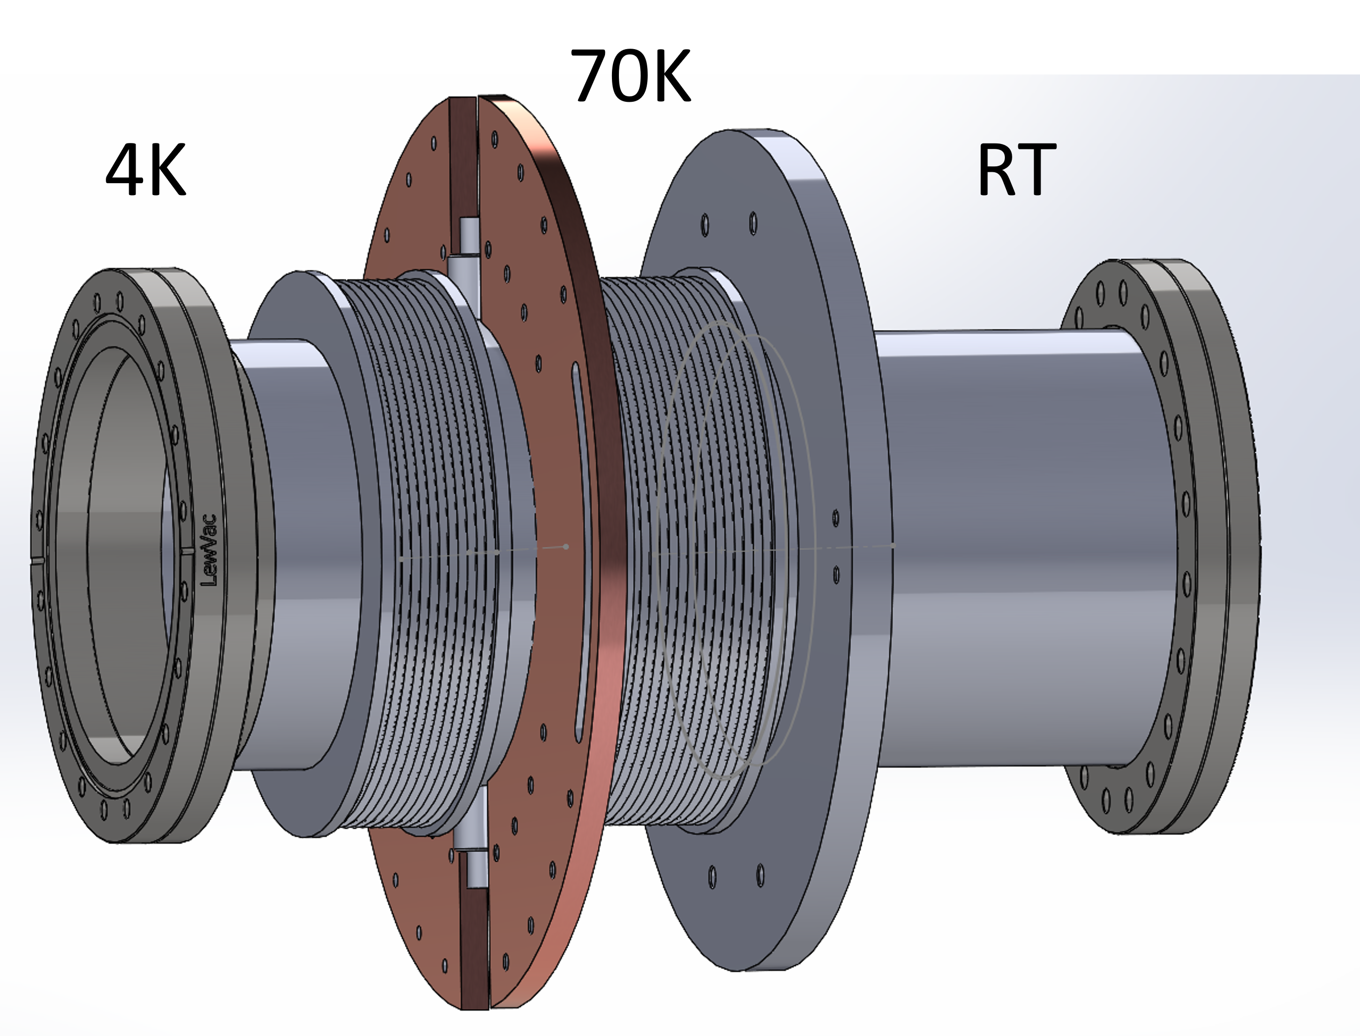
Bellows assembly for the 1T
Issues: Getter pumping for the bellow
Original plan: Getter (NEG covered) stainless steel foil inside of the bellow
Heating element, temp sensor, junction module attached/welded to the foil
Heating element compatible with UHV and
cryo conditions very difficult to find

Slide 11
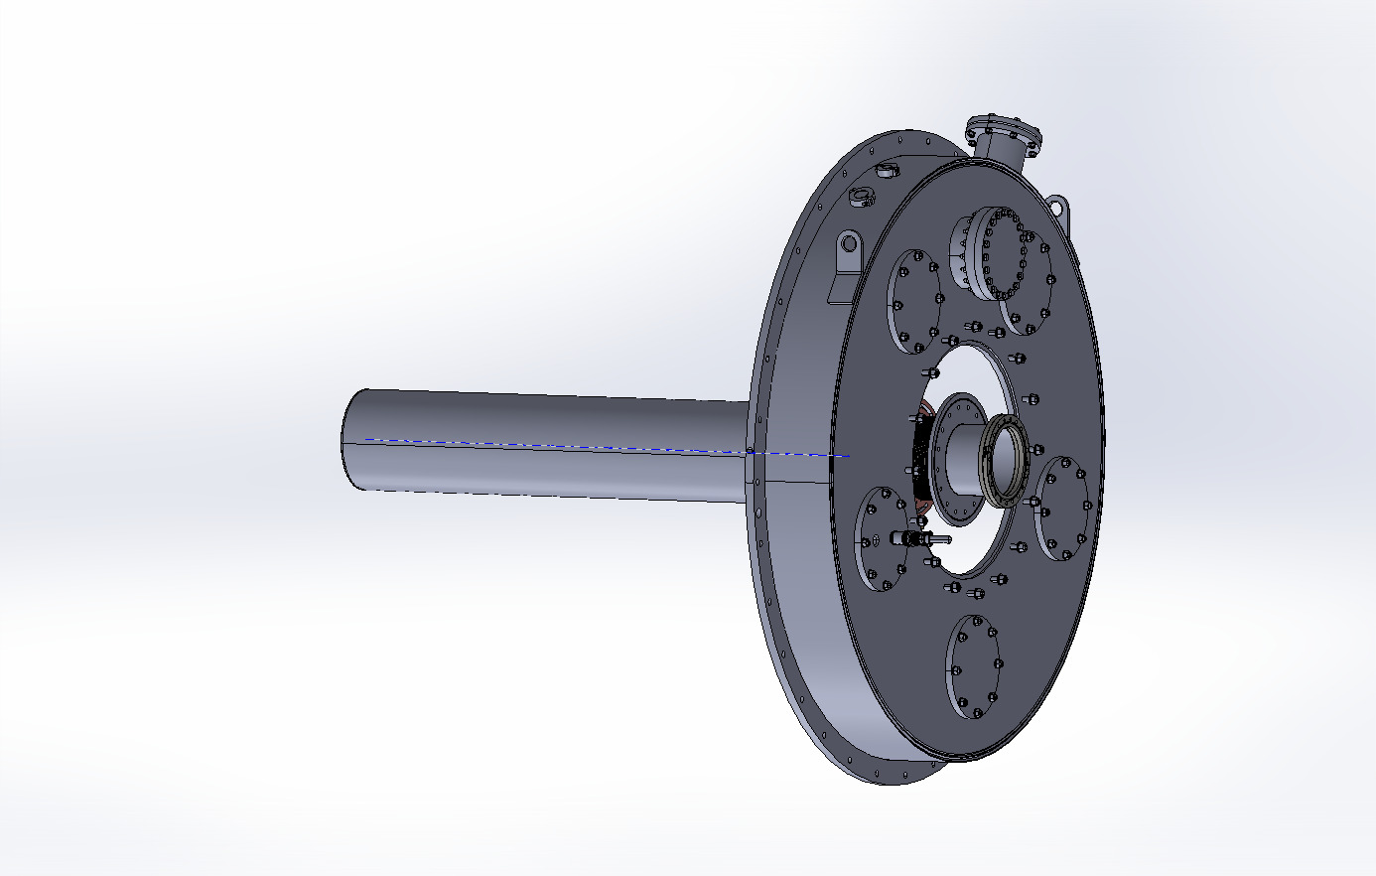
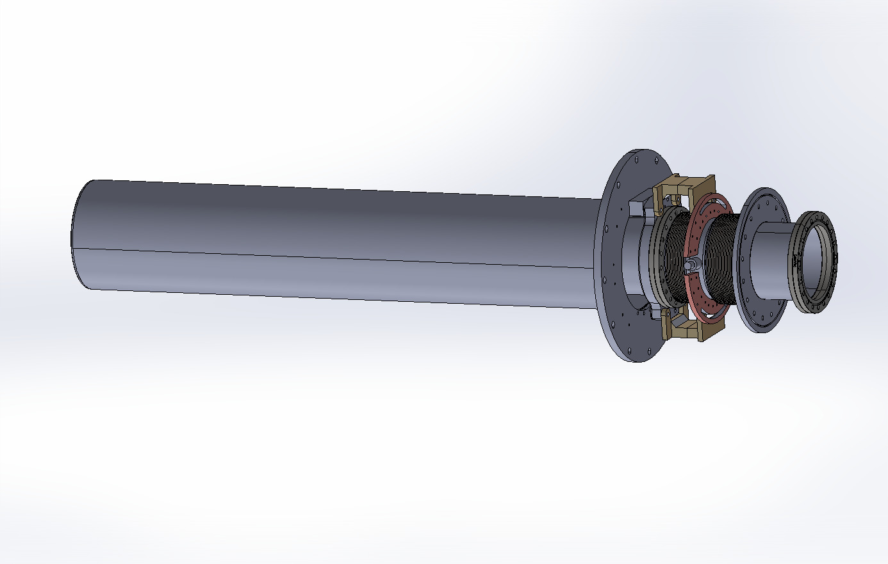
Bellows assembly for the 1T

Slide 12
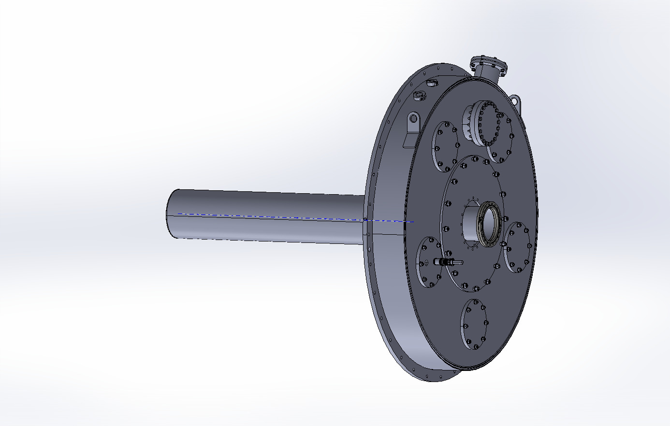

Slide 13
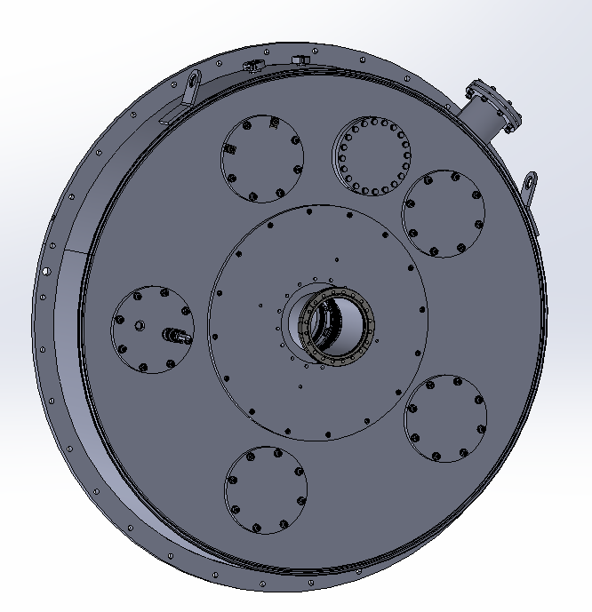
1T cryostat face modifications

Slide 14
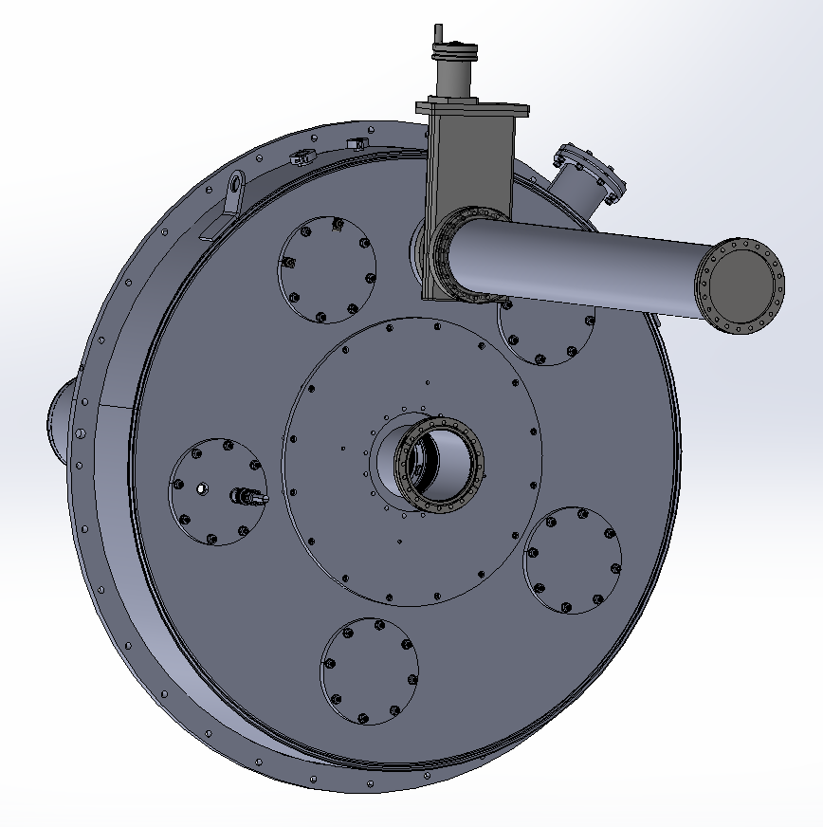
1T cryostat face modifications

Slide 15
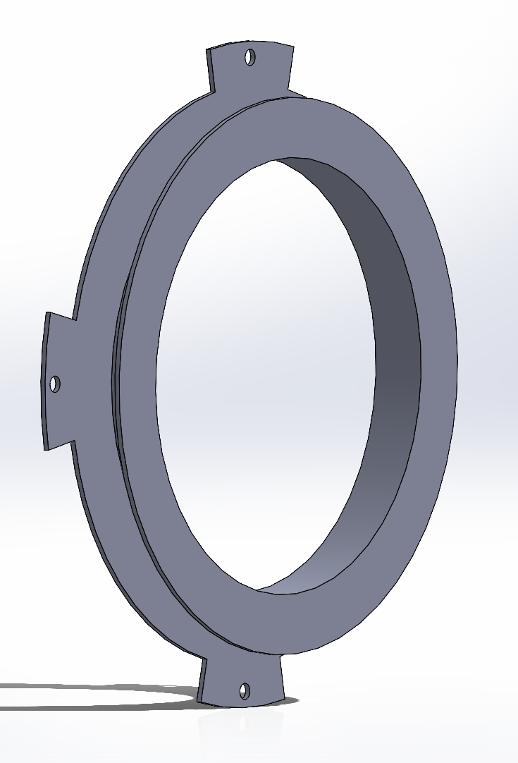


1T cryostat face modifications

Slide 16

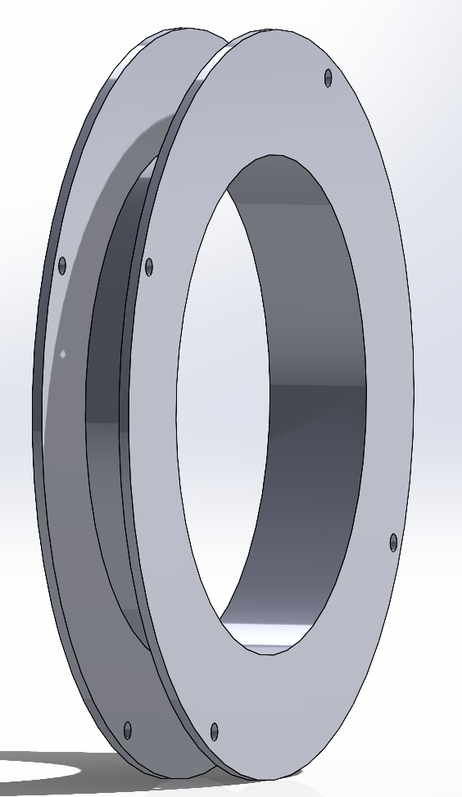
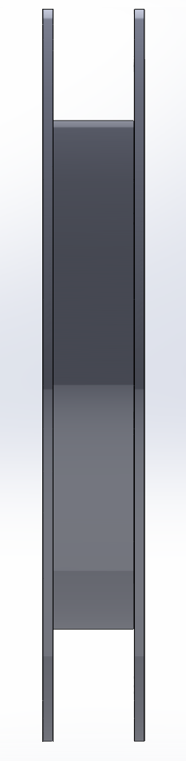
1T cryostat face modifications

Slide 17
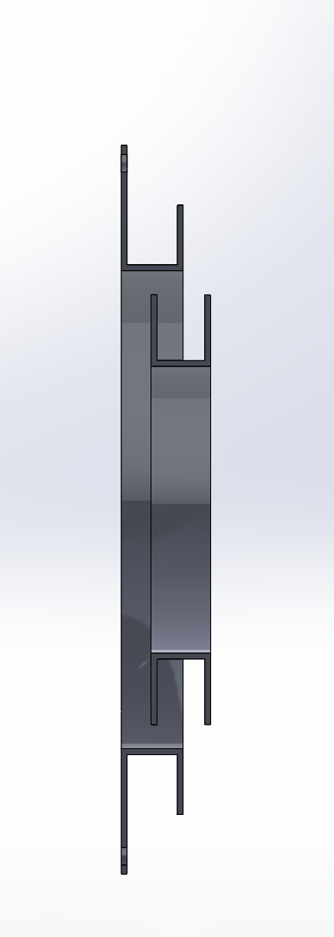
1T cryostat face modifications

Slide 18
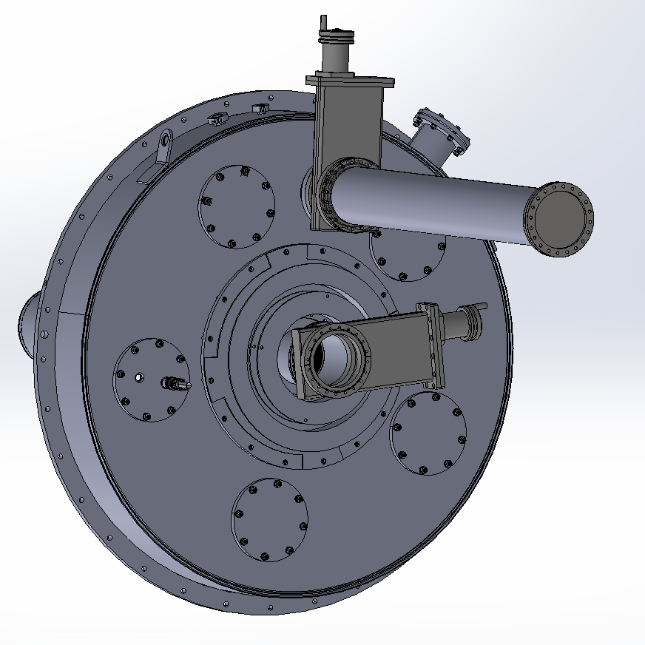
1T cryostat face modifications

Slide 19
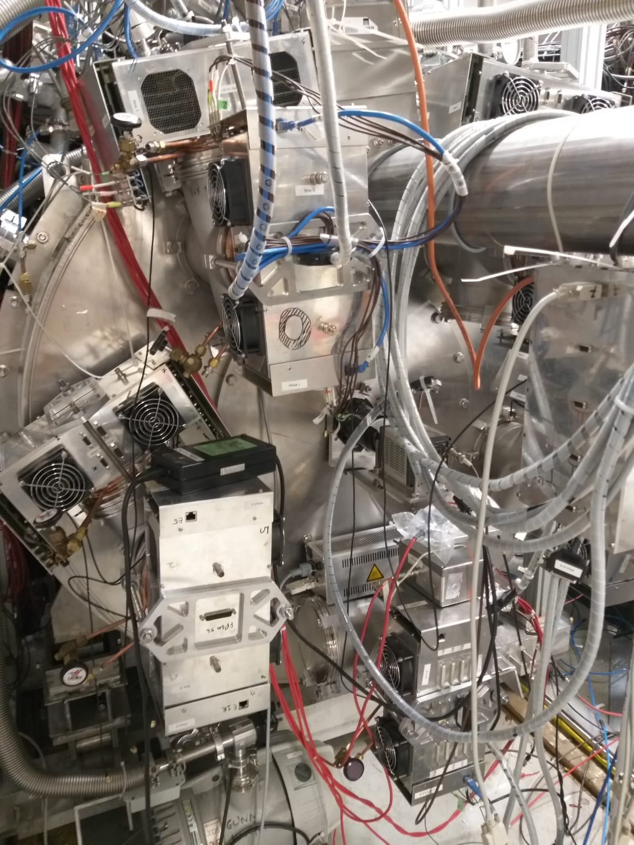
1T cryostat face modifications

Slide 20
FACT module management
Challenges:
Move FACT modules aside to make enough space for the GV, anti-sun and anti-sun ports (including CF63 turbo pump)
Respect the FACT fiber lengths (~30 cm from the cryostat face)
Properly support the weight of the modules

Slide 21
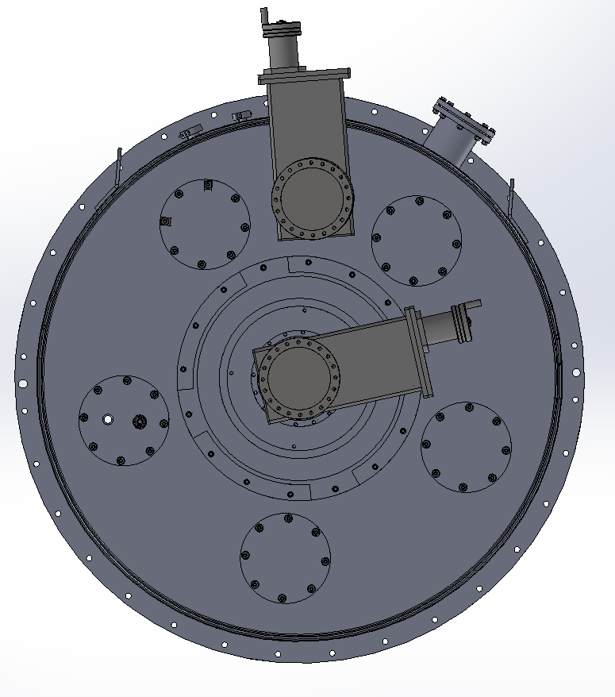
FACT module management

Slide 22
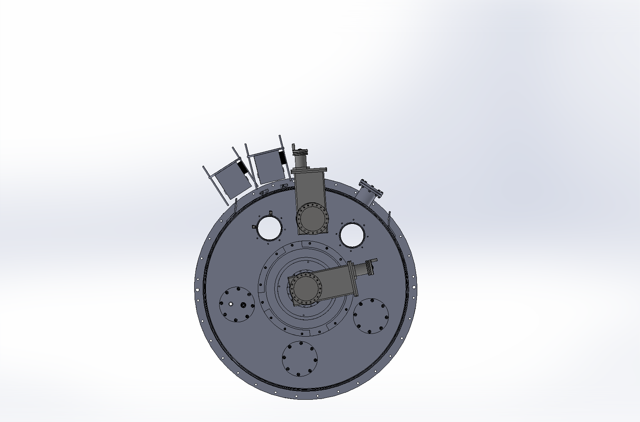
FACT module management

Slide 23
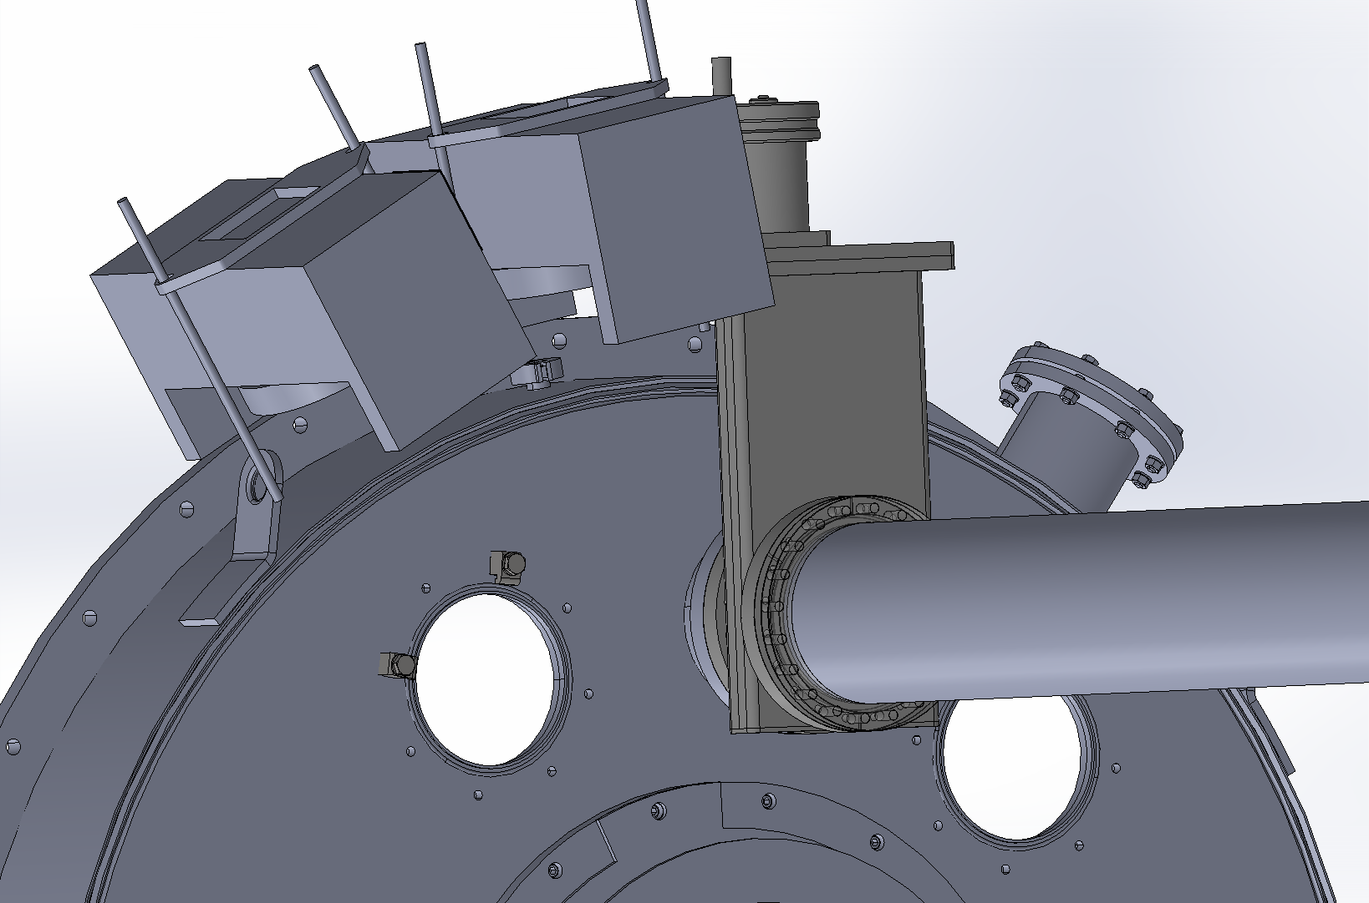
FACT module management

Slide 24
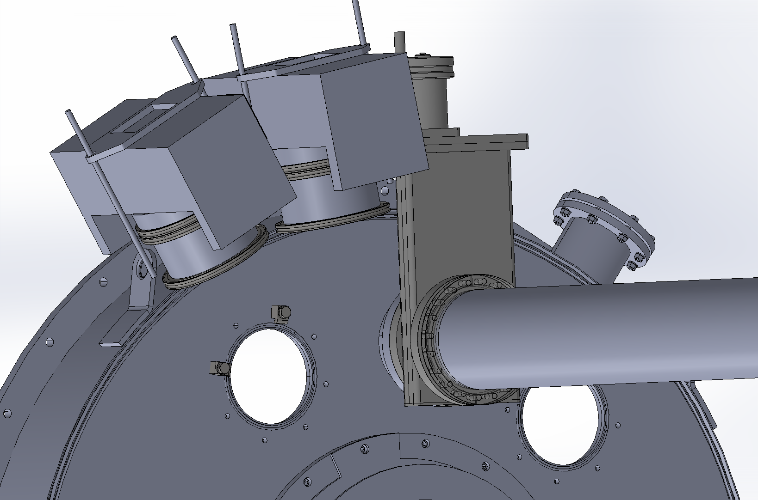
FACT module management

Slide 25
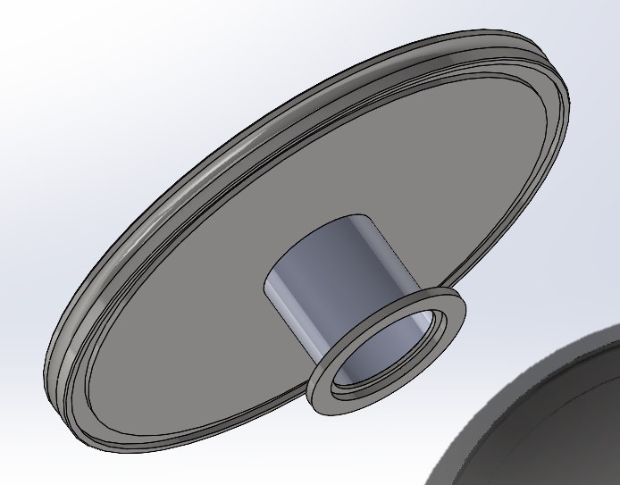

FACT module management

Slide 26
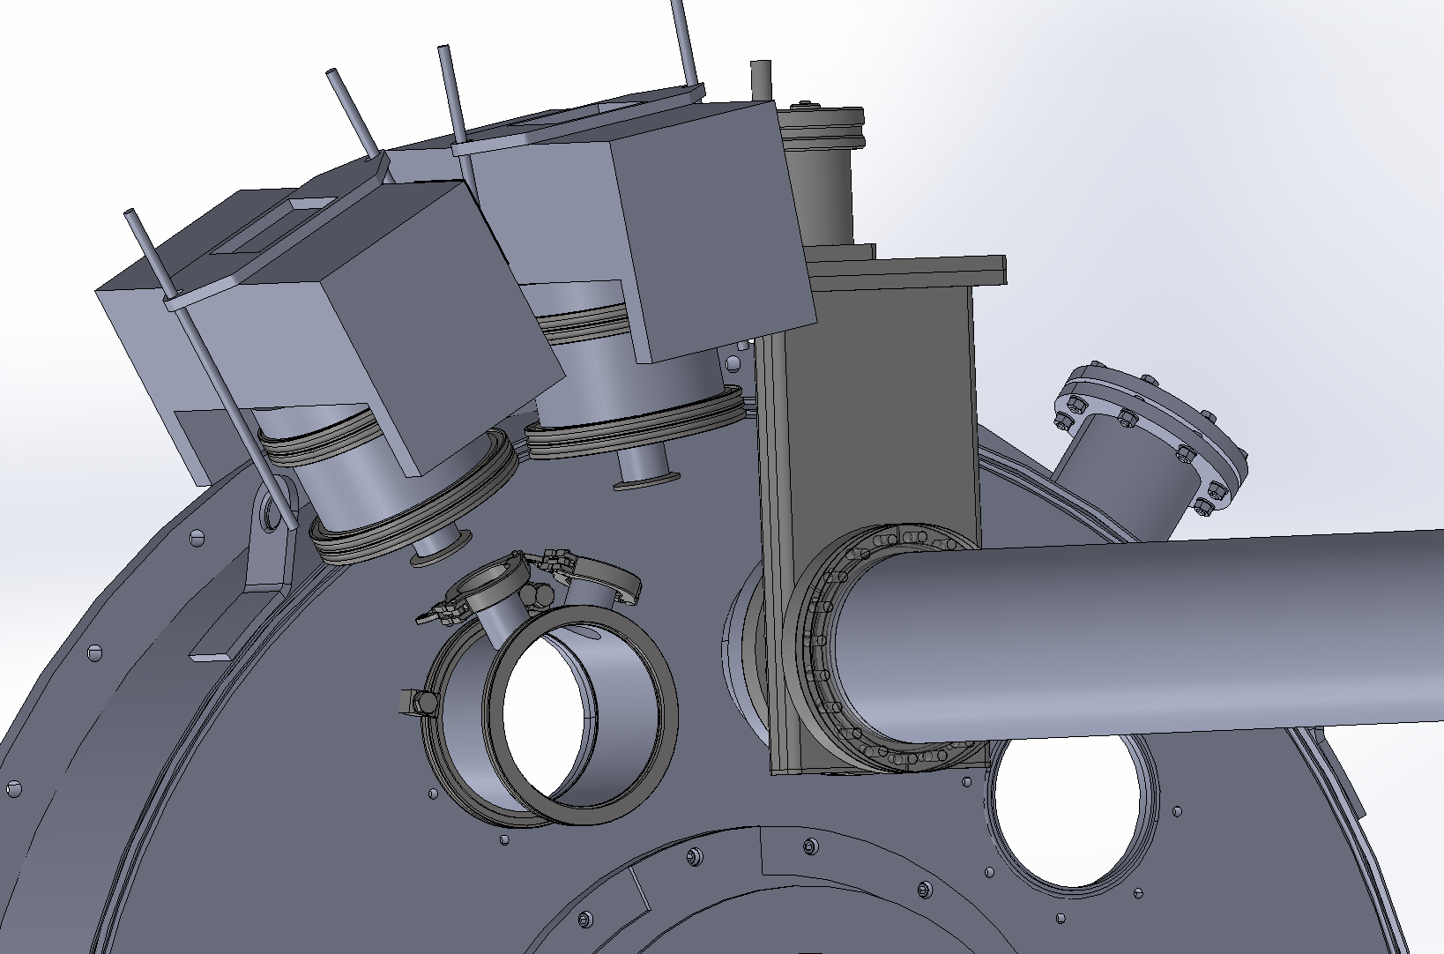
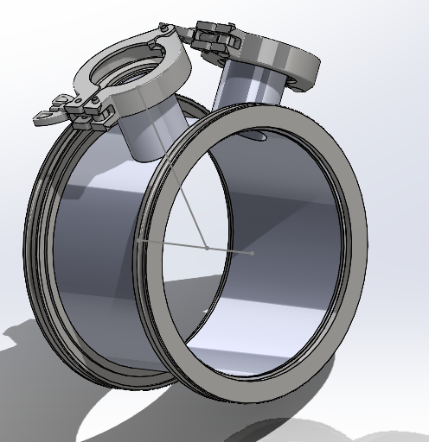
FACT module management

Slide 27
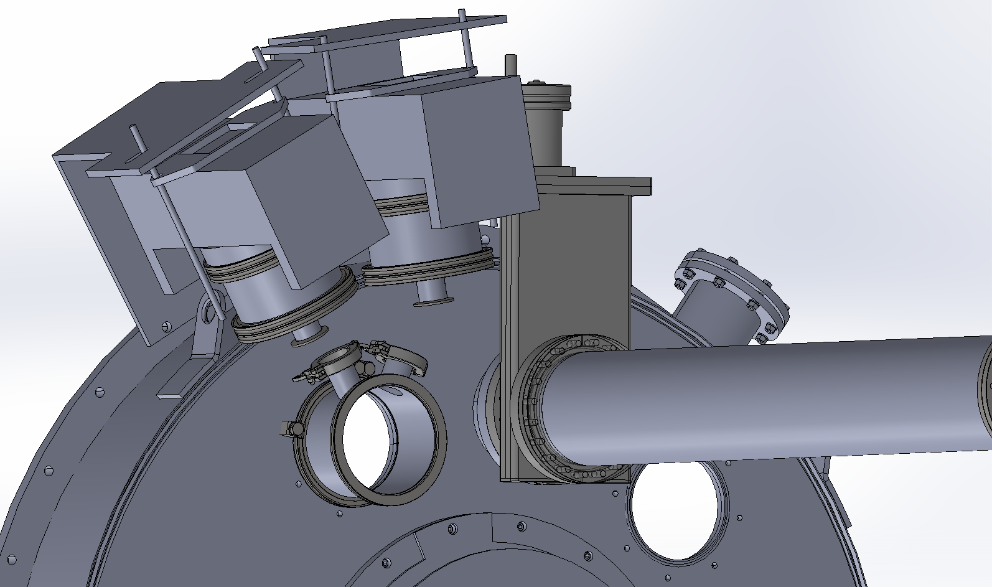
FACT module management

Slide 28
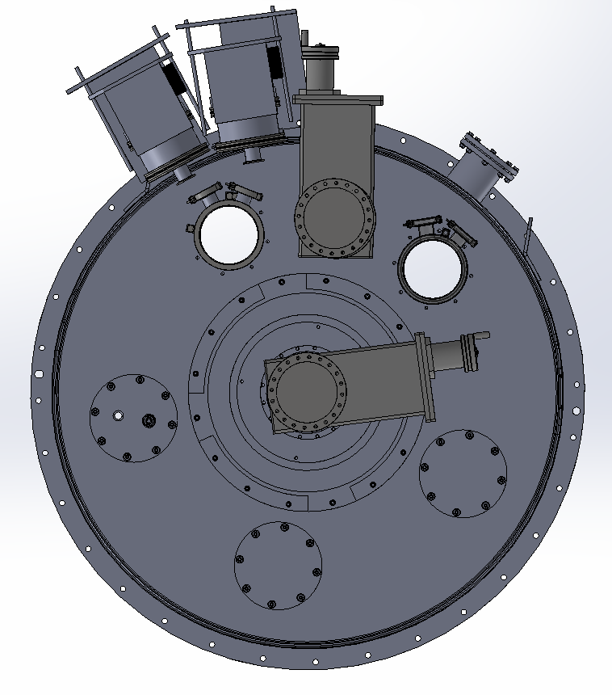
FACT module management

Slide 29
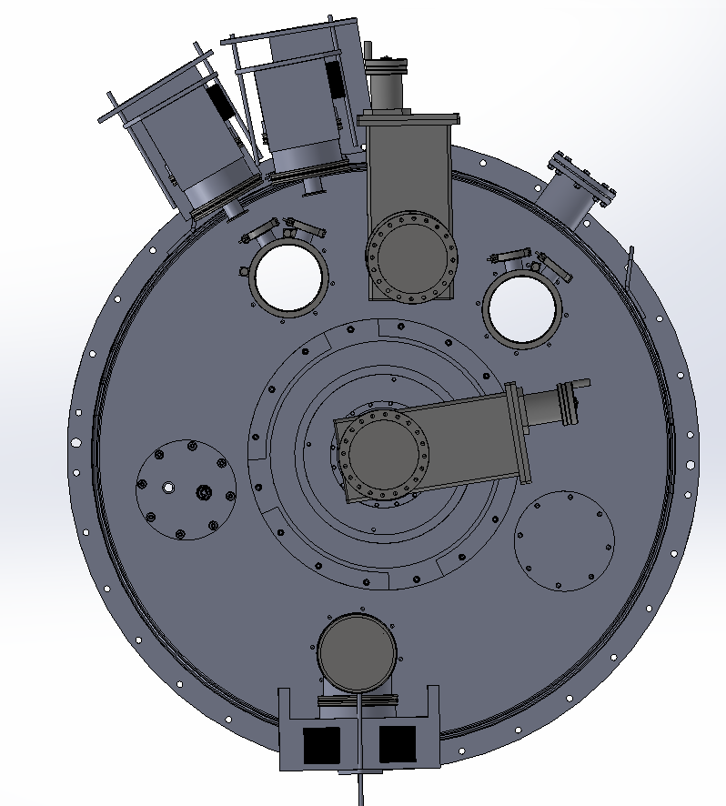
FACT module management

Slide 30
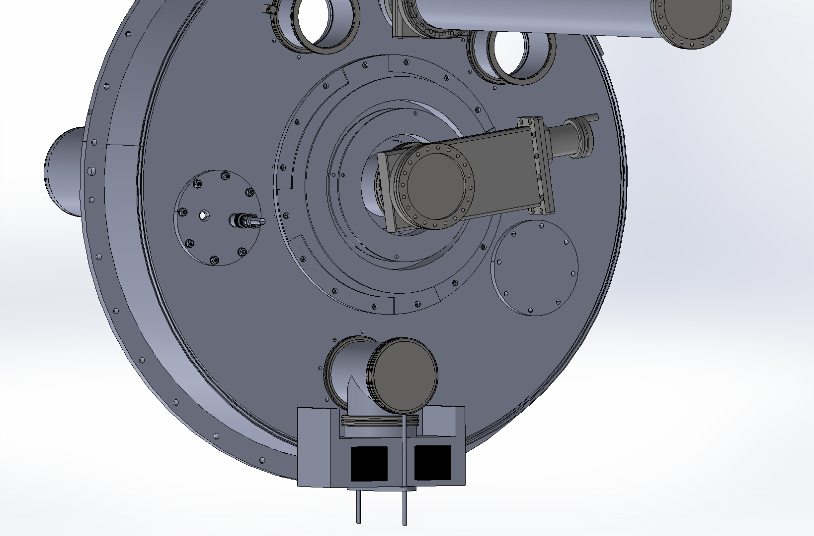
FACT module management

Slide 31
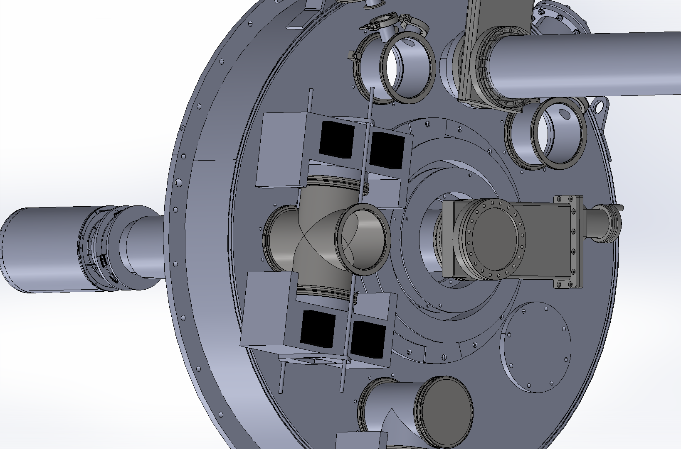
FACT module management

Slide 32
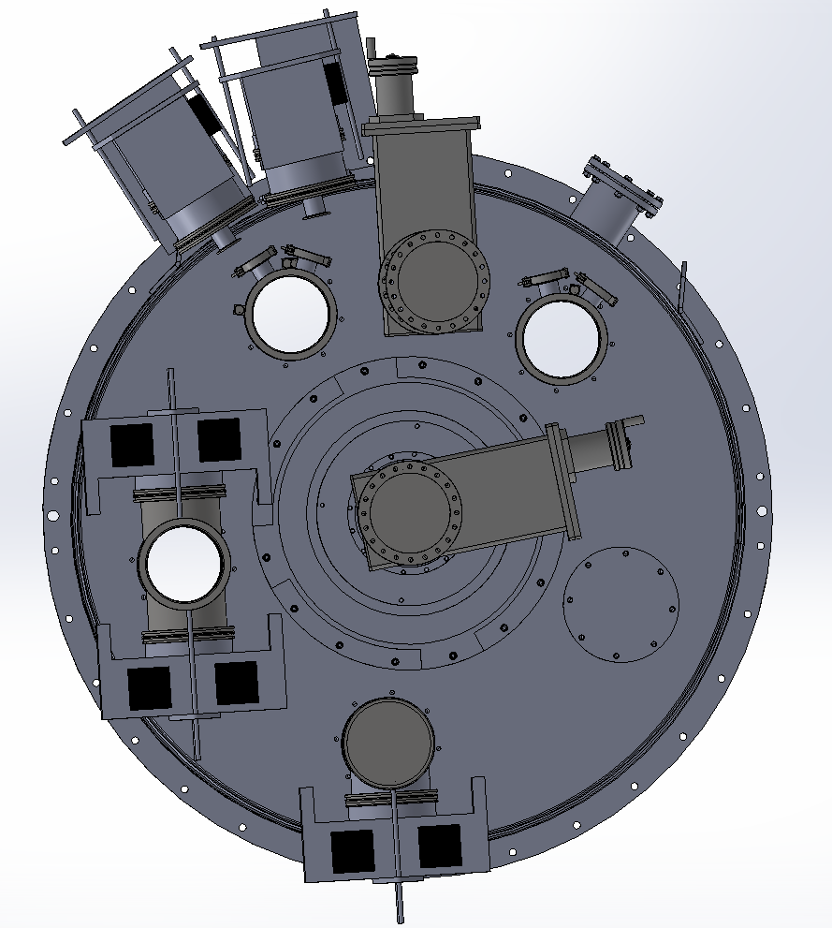
FACT module management

Slide 33
FACT module management
Price estimate:
- (3x) custom LF160 to 2 x KF40 reducer - 400 E
- (6x) short hydraulically formed bellow KF40 – 100 E
- (6x) LF160 to KF40 reducing flange – 250 E
- (1x) custom LF160 tee – 300 E
Total: 3600 E

Slide 34
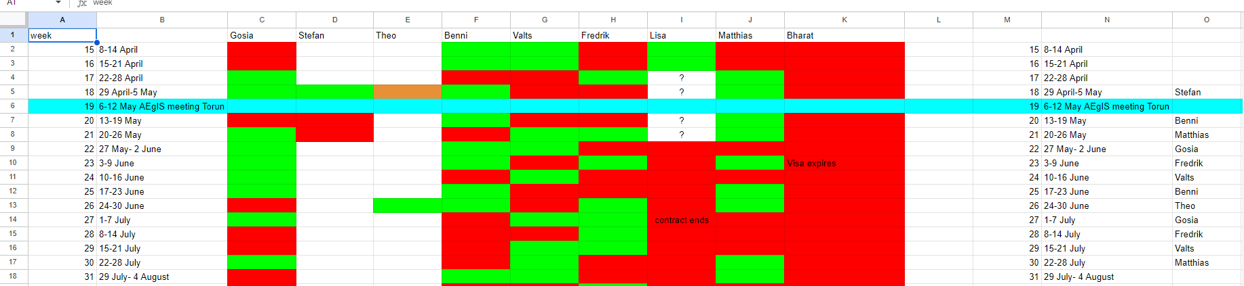
Cryo schedule and August opening

Slide 35
Cryo schedule and August opening
Opening for the 1T bellows installation – beginning of August/end of July
Intervention of min 4 weeks: new 1T MCP mechanism, bellows, FACT module rearrangement, GV1 cleaning, HgHg MCP installation
We should try not to open any more before the LHC run of 2026
We need to have the gravity module (plus the anti-sun) in place by the end of the year

Slide 36
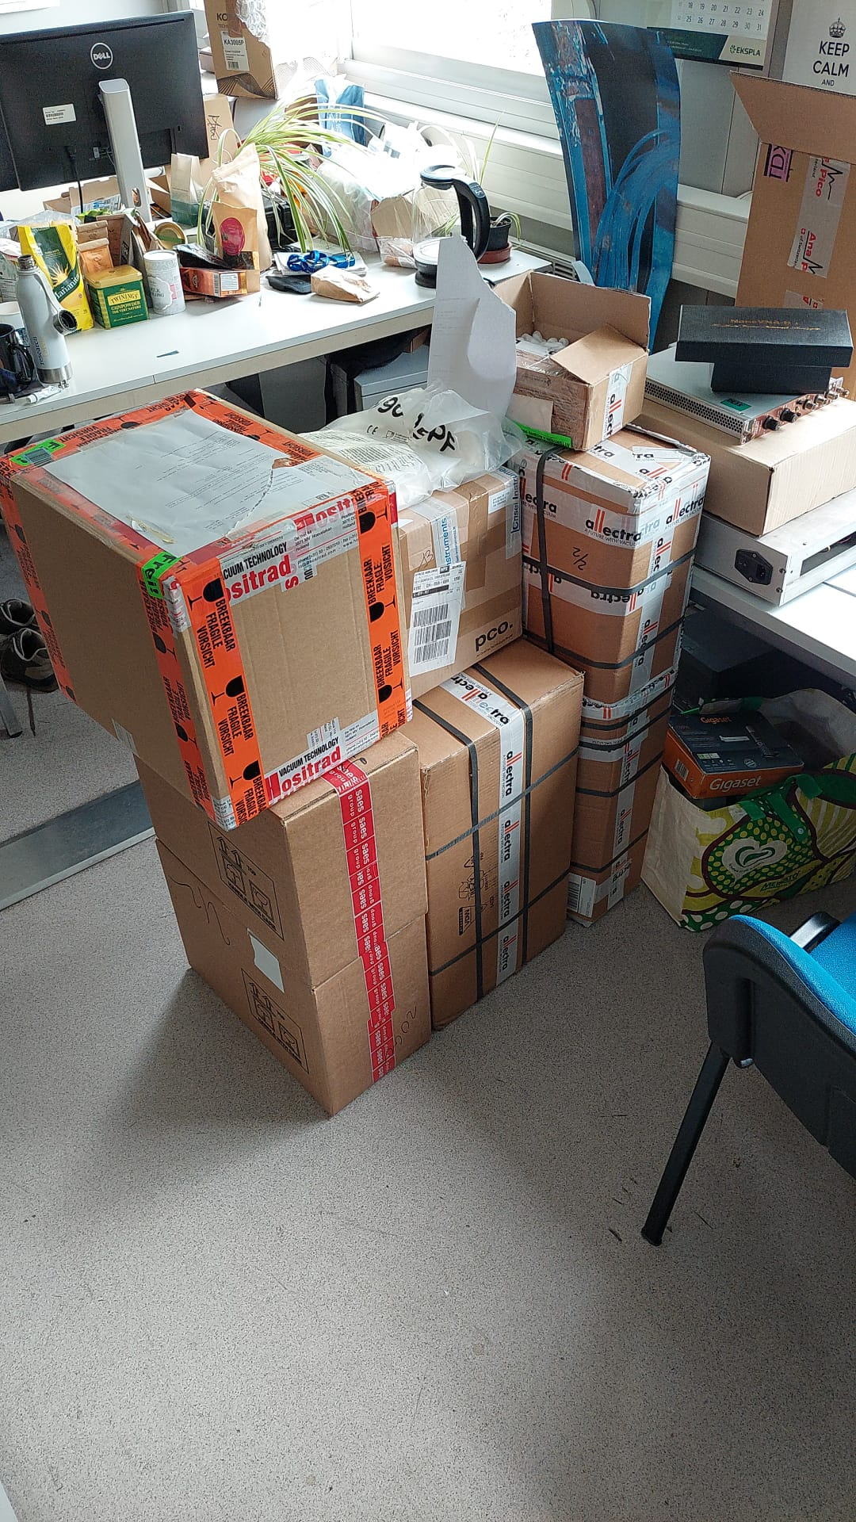

Slide 37
Thank you for your attention

Slide 38
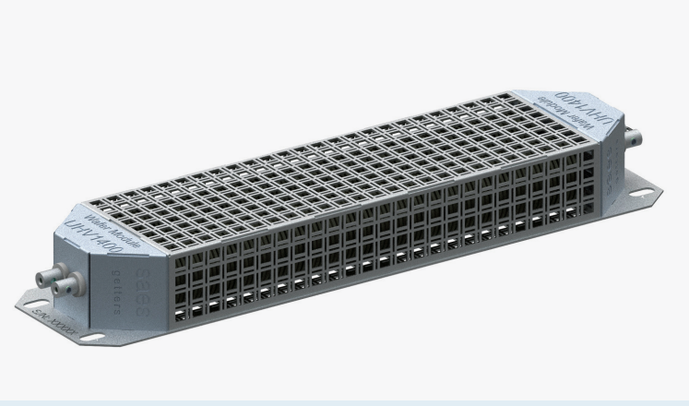
Bellows assembly for the 1T
Issues: Getter pumping for the bellow
Possible solution: Getter Waffer
Off the shelf (4-6 weeks lead time)
Price: 3-6K + 3K for the controller

