Slide 1


Ion source construction: status update
Łukasz Kłosowski
Nicolaus Copernicus University in Toruń
AEgIS Collaboration meeting
Toruń, 08.05.2024

Slide 2
A brief summary of the technique used
Electron dissociative attachment inside a multi-segment linear Paul trap
Iodine:
  Mass 127 a.m.u. (only one natural isotope)
  Electron affinity 3.06 eV
  The heaviest 2-atomic, homonuclear molecule
  Solid at room temperature
D. Frost and C. McDowell, CANADIAN JOURNAL OF CHEMISTRY. VOL. 38. 1960, 407-420 THE IONIZATION AND DISSOCIATION OF SOME HALOGEN MOLECULES BY ELECTRON IMPACT

Slide 3
Design of the device
Picture prepared by Gosia Grosbart

Slide 4
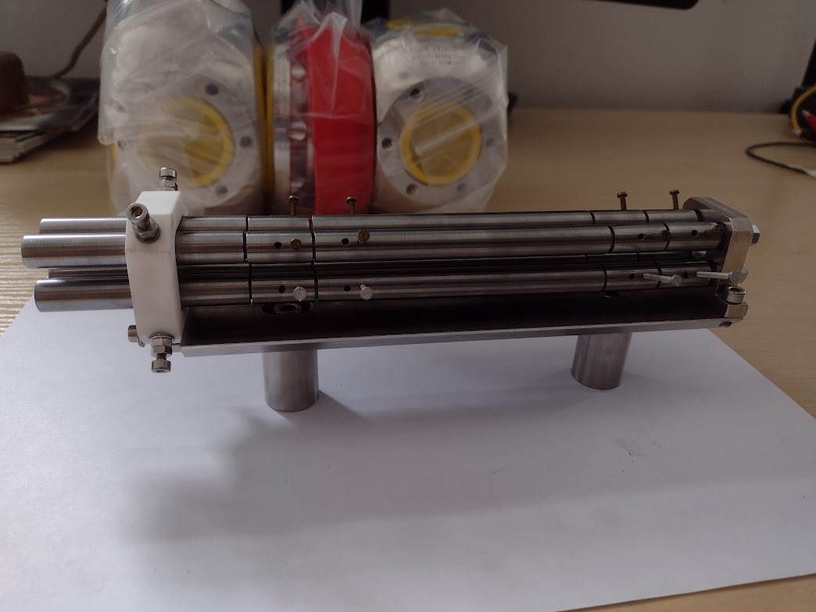
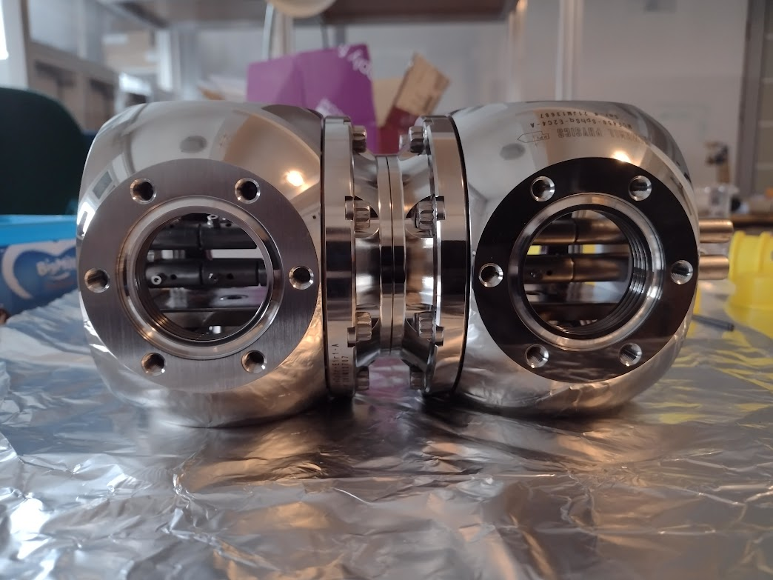
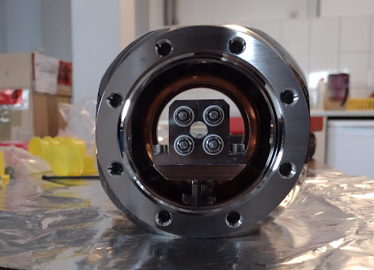
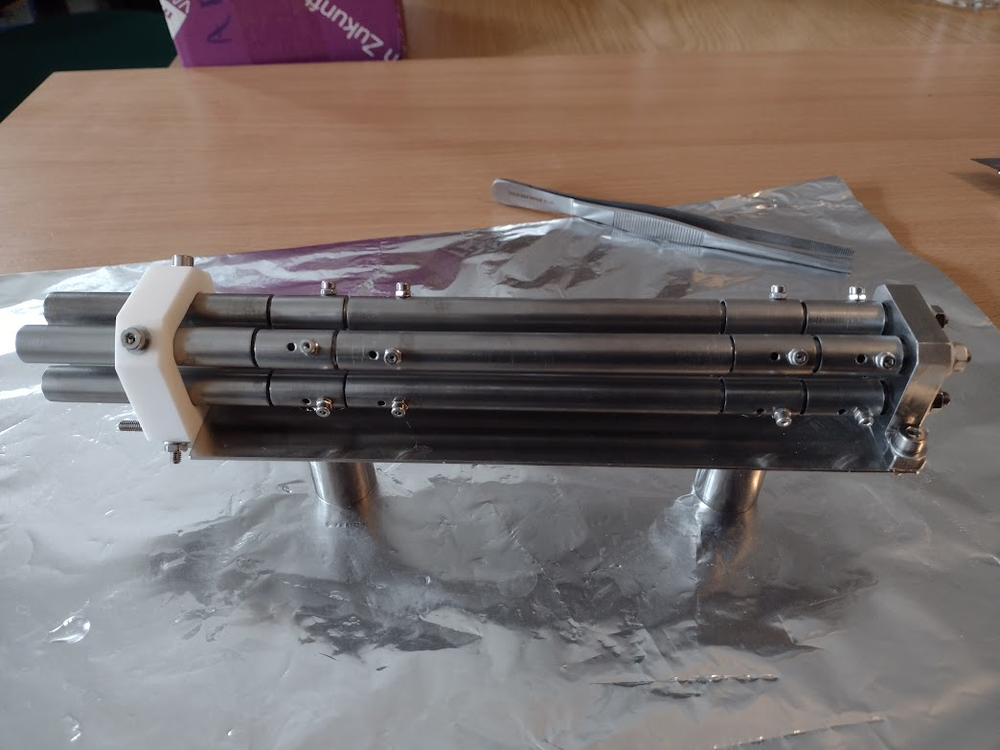
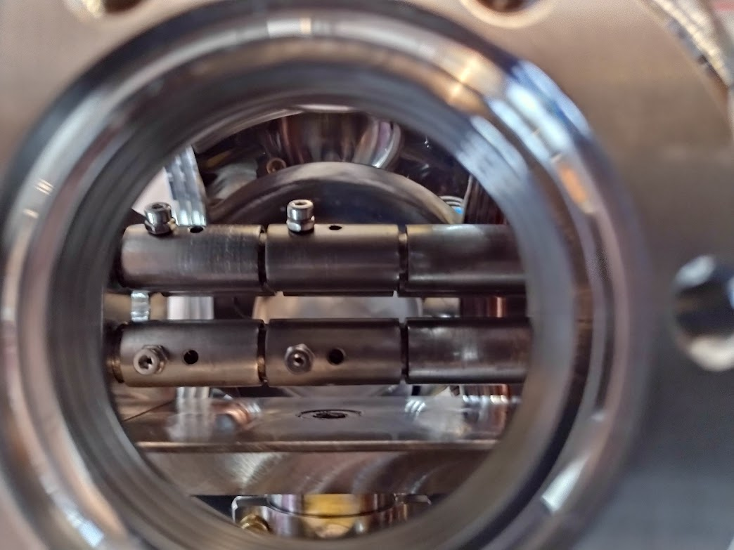
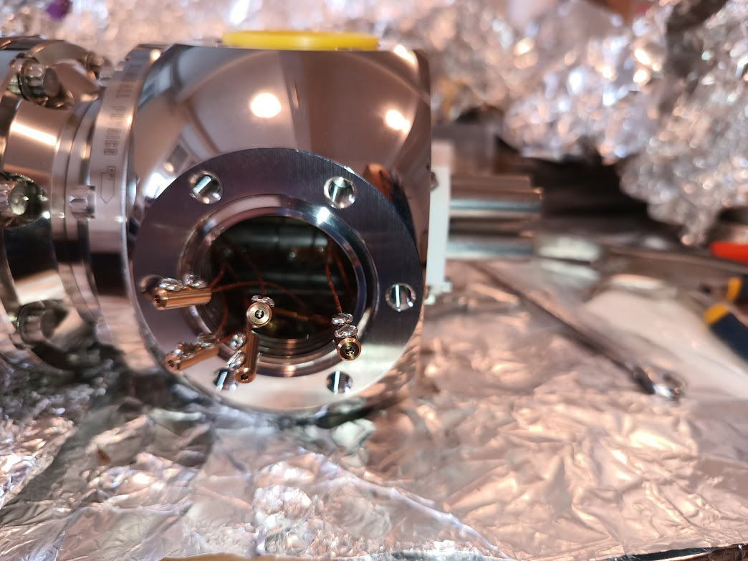
The linear Paul trap

Slide 5
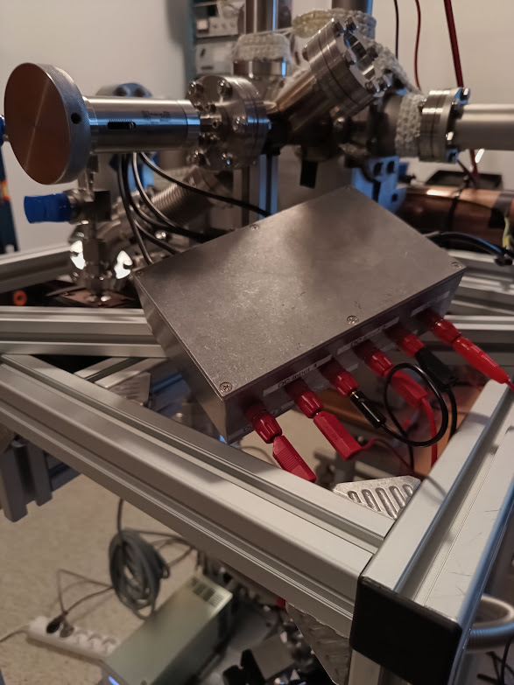
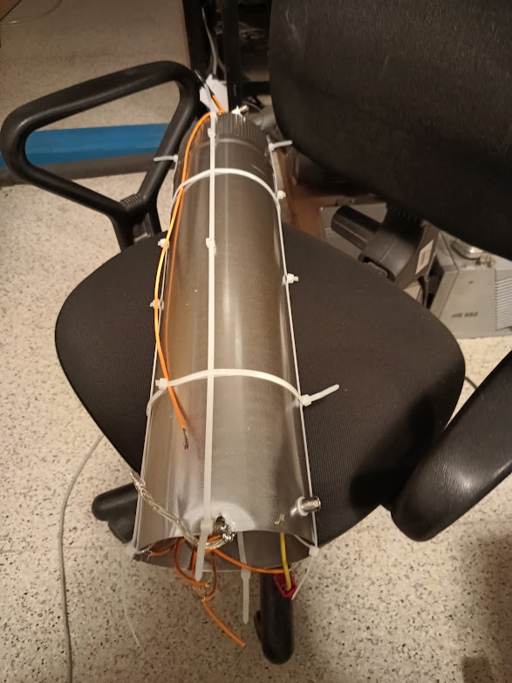
Temporary voltage supply system

Slide 6
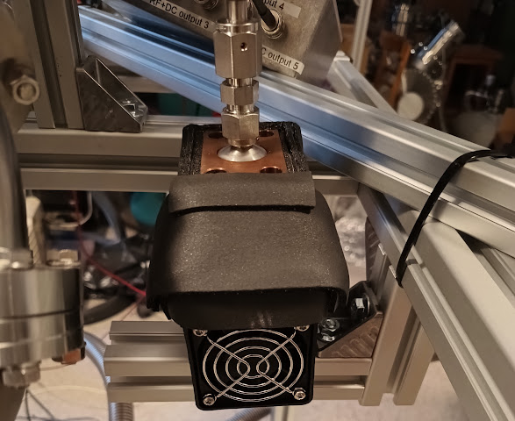
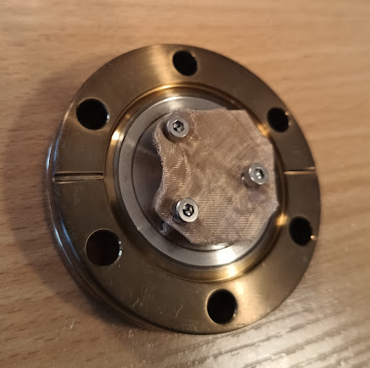
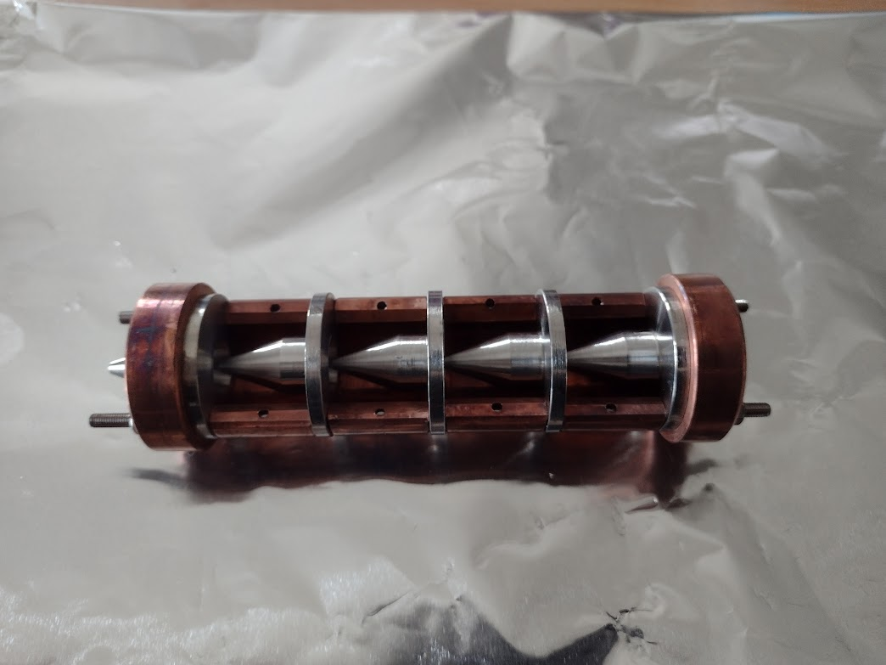
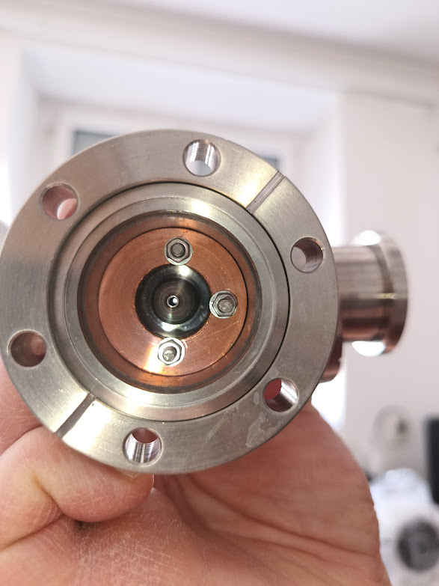
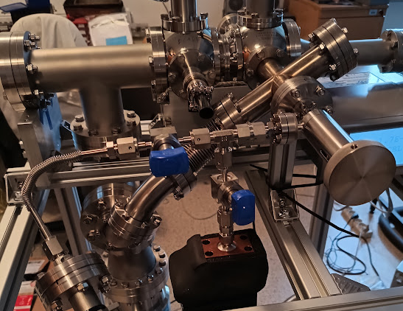
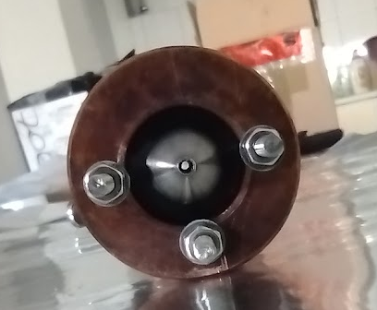
Molecular beam source
Silver mesh absorber of iodine
Thermal shielding for the reservoir designed and built by Adam Linek
(the driver not presented in the picture)

Slide 7
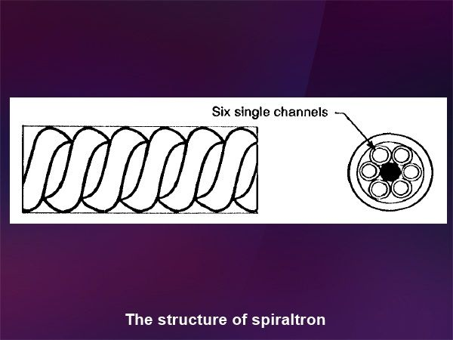
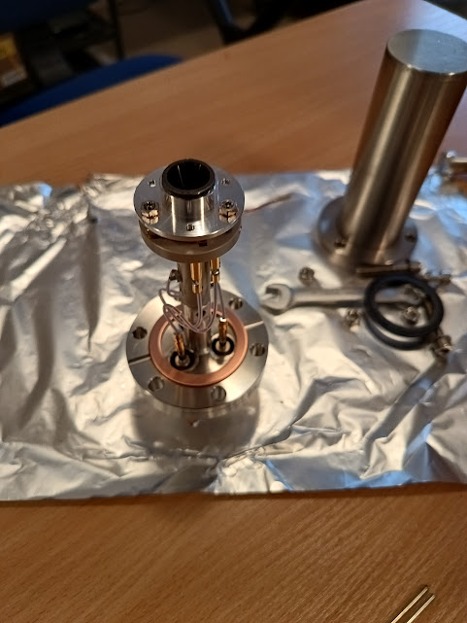
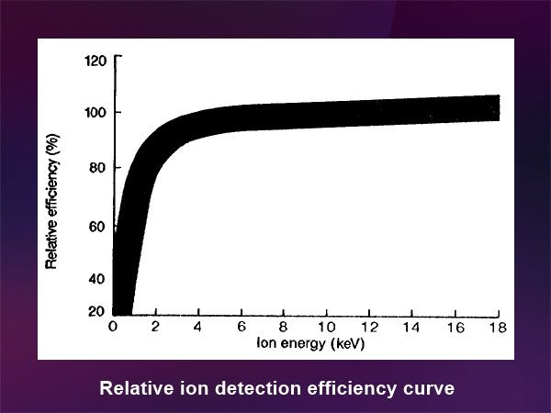
Anion detector (spiraltron)

Slide 8
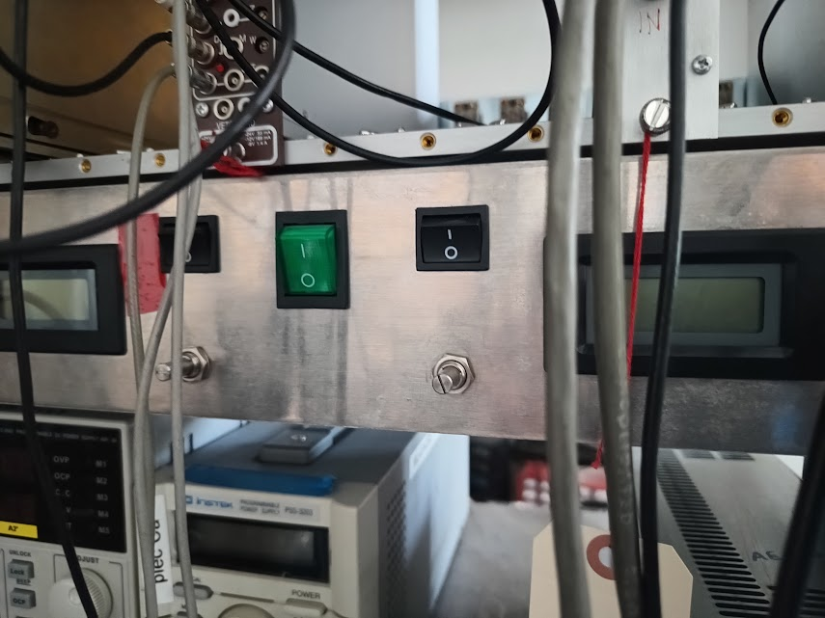
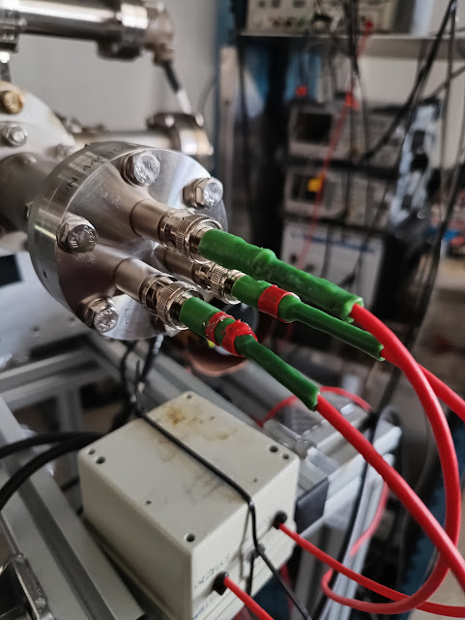
MHV – SHV compatibility issue (solved!)
HV high-pass RC filter
Custom-made HV power supplies

Slide 9
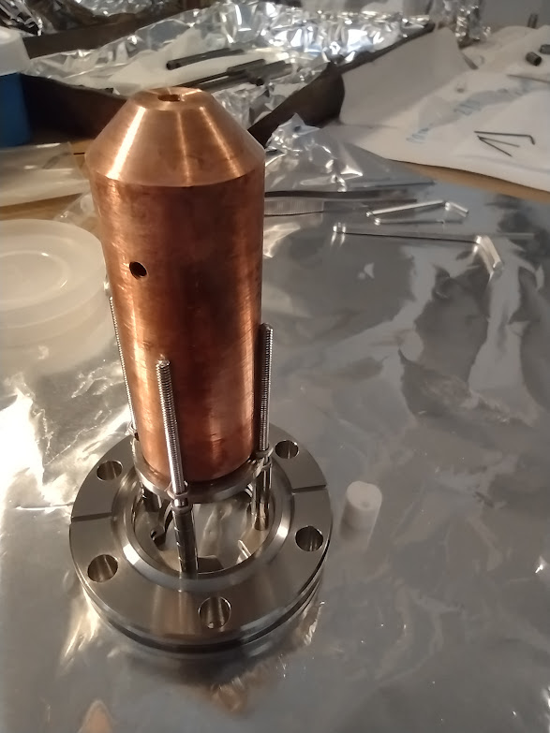
Electron gun
Electron gun efficiency calibration by Gosia in January 2024

Slide 10
Expected cross sections and final kinetic energies

Slide 11
Cooling of the trapped anions
We need temperatures below 1 eV
At the room temperature (molecular beam) it is about 0.025 eV
Two cooling schemes are being considered:
  RLC resonance resistive cooling
  Manipulating the depths of both trapping centres (see the presentation by Marek Teske)
Three-body output will be dominating – do we really need further cooling?
We expect the electron to carry the most of the output energy

Slide 12
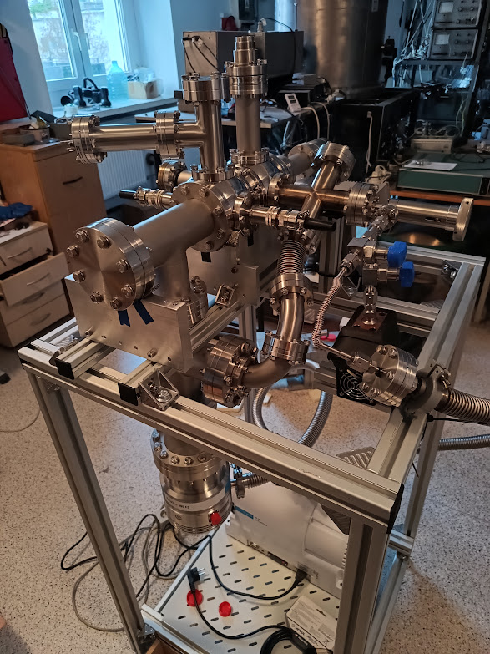
The device assembled together
Electron gun
channeltron
Silver absorber
Feedthrouhs of the trap
To the diagnostic cross and further to the AEgIS main apparatus
skimmers
Leak valve
Iodine reservoir
Turbo pump

Slide 13
Calcium source
Geometry of the trap almost identical with the iodine source
Electron gun aligned axially in the trap
Optical access for cooling and detection

Slide 14
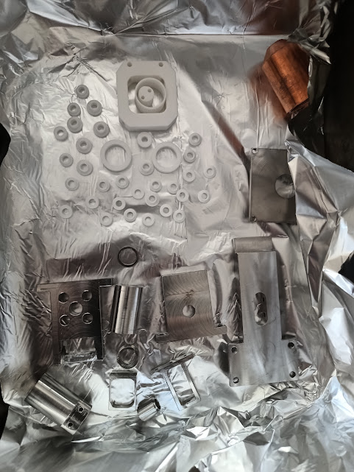
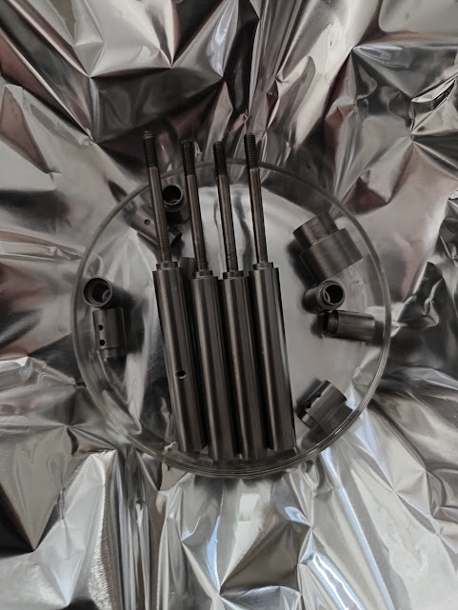
The source components: made by the workshop in Toruń, vacuum cleaned, ready to be assembled

Slide 15
Summary
Completed since the December meeting
Channeltron pulsed electronics (high-pass filter for the signal, premaplifier, constant fracion discriminator, counter) – built
Custom-designed distance tube for the channeltron
High voltage source, MHV-SHV adapters connected
Ion pump – installed
Safety valve for the transport – insatalled
Ion cooling simulations (to be presented by Marek Teske)
Source of Calcium cations
  Designed
  All the parts produced, washed
  Optics for cooling and detection ready in Toruń
  Not yet completed
  Ion signals deteced
  Ion cooling – not confirmed experimentally
  Final version of the Sinara
  Diagnostic cross with the MCP in Toruń with Gosia
Time to arrange the transport!

Slide 16
