Slide 1

Gravity module status Q1 2024
S.Haider

Slide 2

Overview
Present design parameters
First ideas for the Moire
Equipment at hand
Detection principle

Slide 3
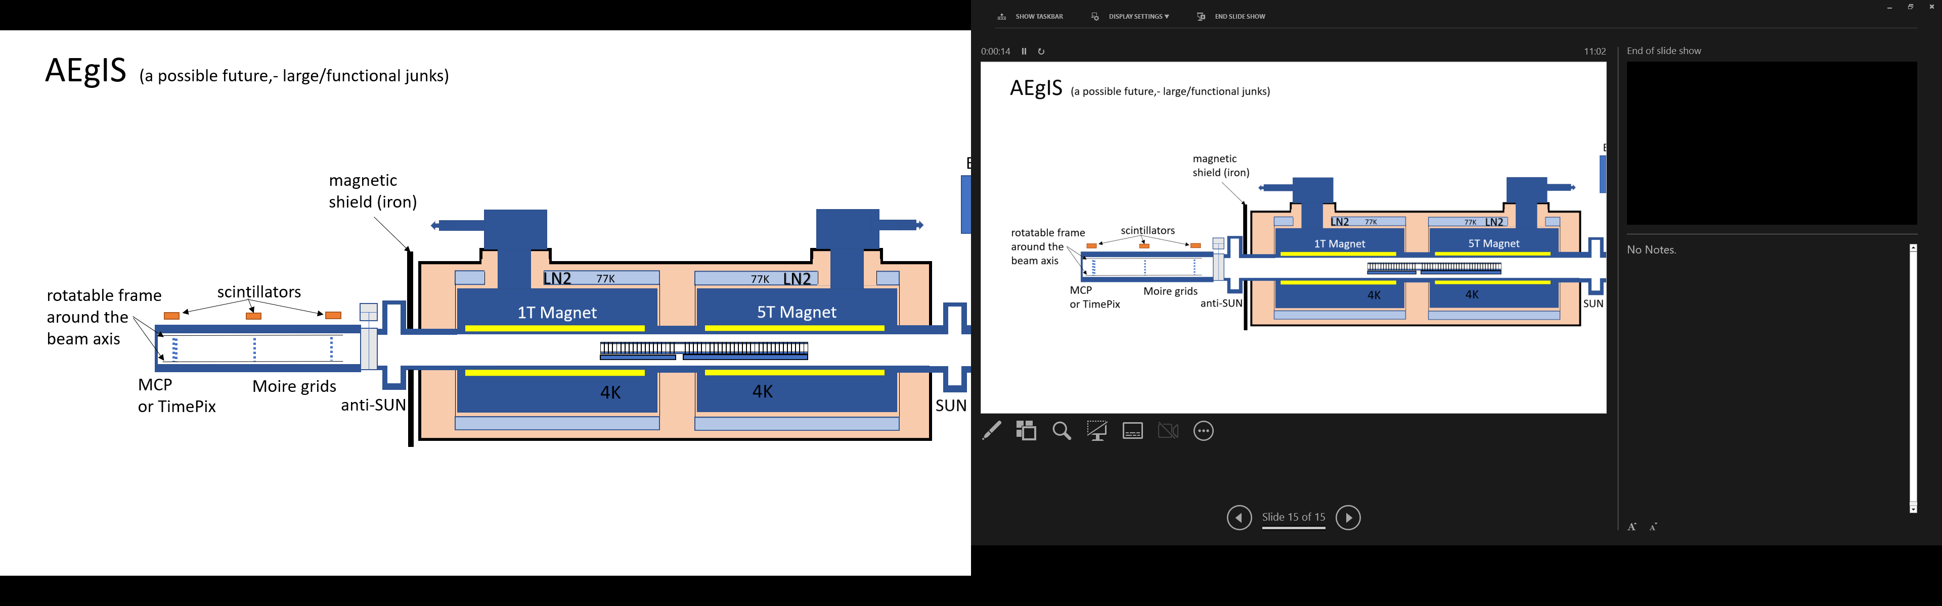
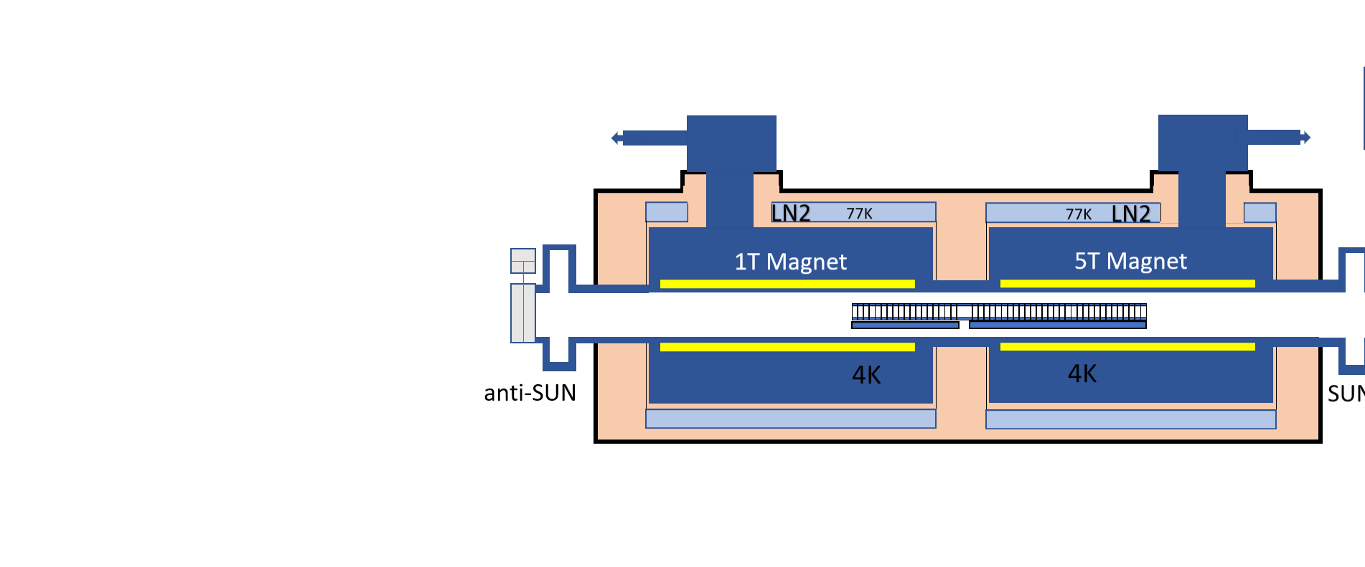
The Gravity module

Slide 4
The Gravity module infrastructure:
2 Correction coil for minimizing the field gradient
X
X
X
X
Turbo Ion Pump Getter pump

Slide 5
Equipment we have bought already:
2 getter pumps ( Capacitor 1000 )
Ion pump Starcell 500
Gate valves
Decoupling bellow
Viewport
Camera for an MCP
Equipment we still need buy:
Large area MCP
A large CF150 turbo (at the moment on loan at Borealis )
Scintillators
Still to be designed:
Vacuum chamber with bellow and support frame
Moire grid holders with angle adjustment in micro-meter range
Actuators for turning the moire 90 degrees
Etc, etc….

Slide 6
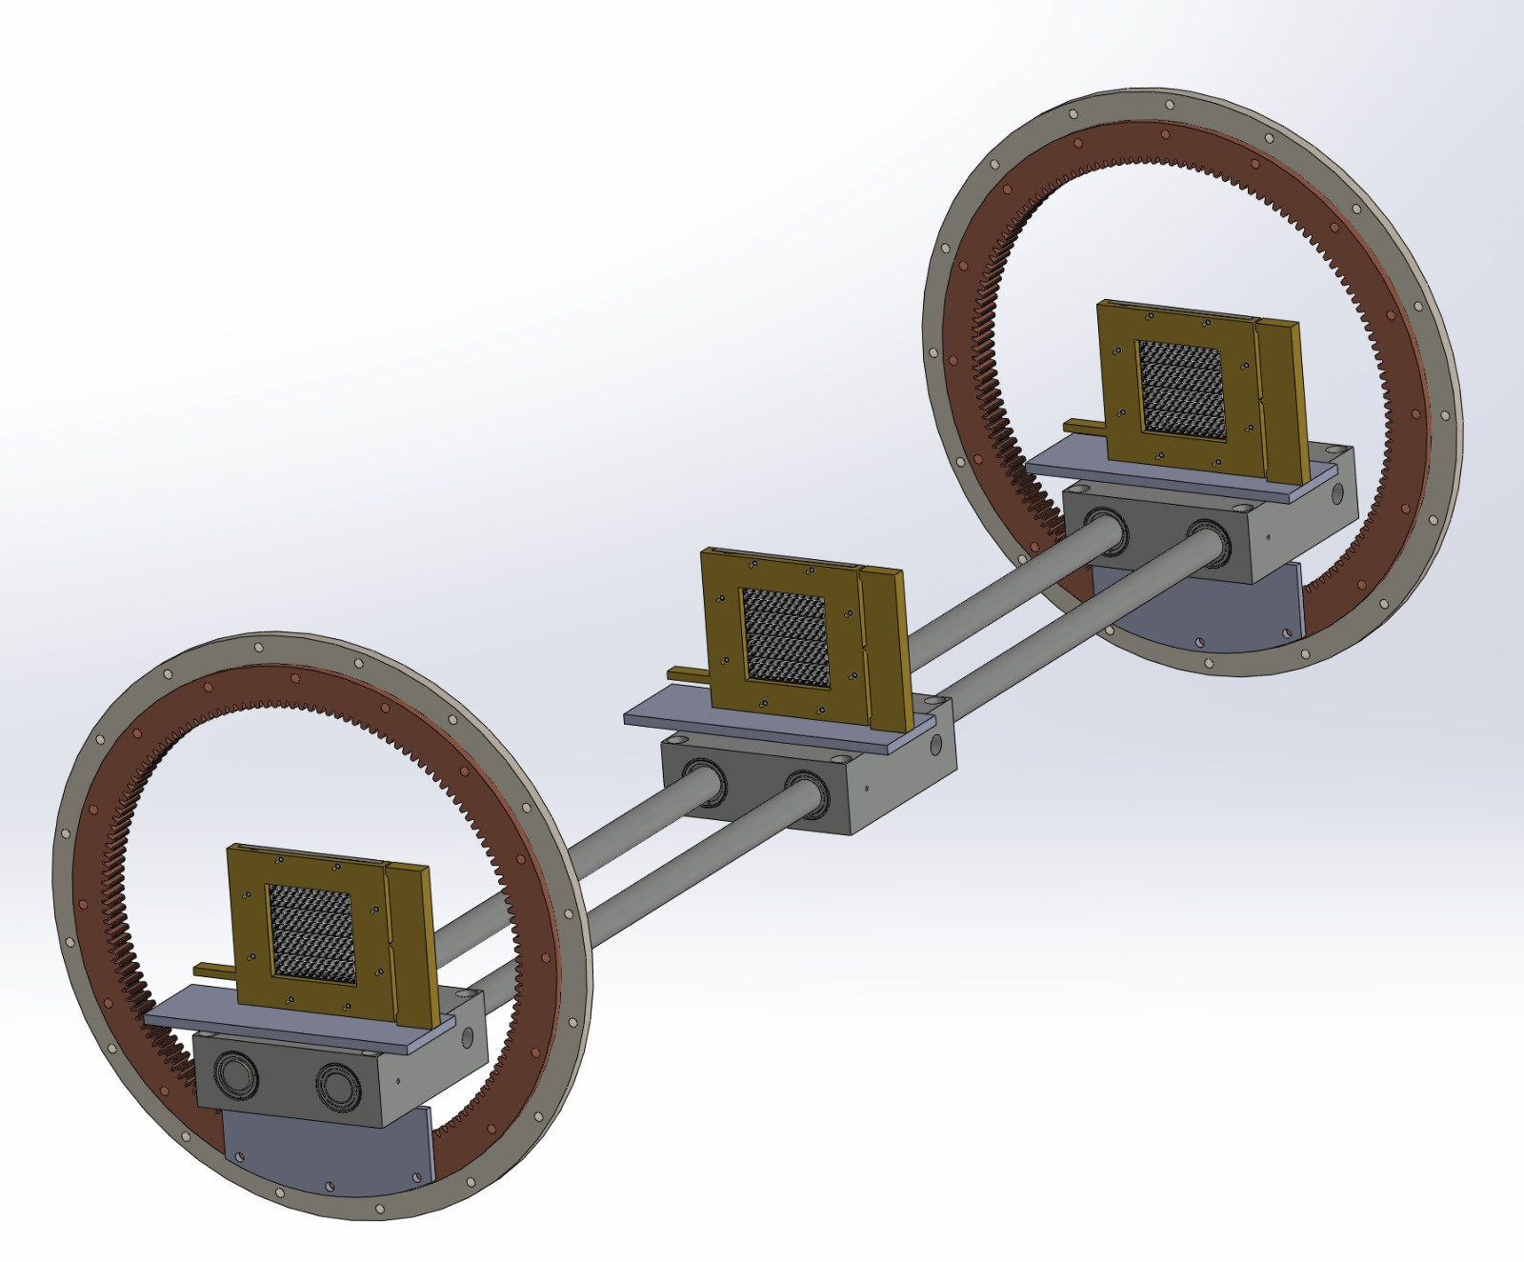
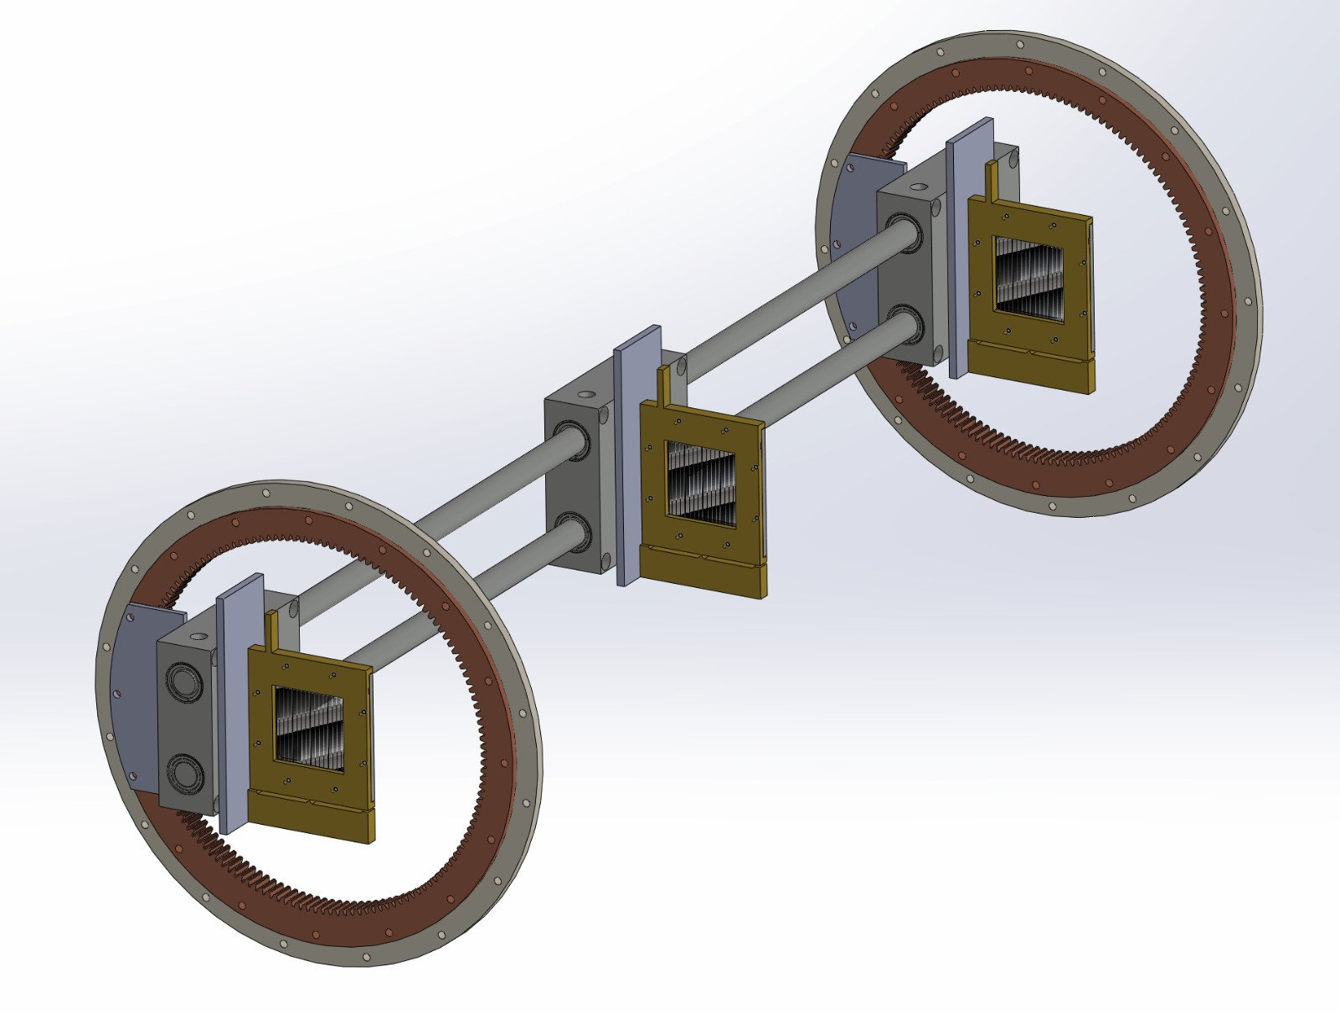
The Gravity module: ( a first sketch for discussions )
Gratings 100um pitch
40um opening
The whole frame is
rotatable by 90 degrees
Adjustable “L”
Of the Moire deflectometer

Slide 7
Two possible detectors for the H-bars:
Large area MCP
  Pros:
    Known technology
    Easy to operate
    Possibility to turn the device with the Moire grids
    No timing info necessary
  Cons:
    Not sensitive to light for alignment purpose
    Much more complex third grating assembly (longitudinal and angle adjustment)
    Scanning measurement of g needs much more H-bars
Camera solution from Franz/Bergi/Markus
  Pros:
    No third grading necessary, hence much simpler Moire design
    No scanning measurement, hence much faster data taking
    Light sensitive for alignment of the grids
  Cons:
    No individual timing info,- no time-of-arrival for each single H-bar, just global exposure time of the camers
    Cannot be turned with the Moire grids, probably fixed installed on the end flange
    Huge data files of several Gbytes per image

