Slide 1
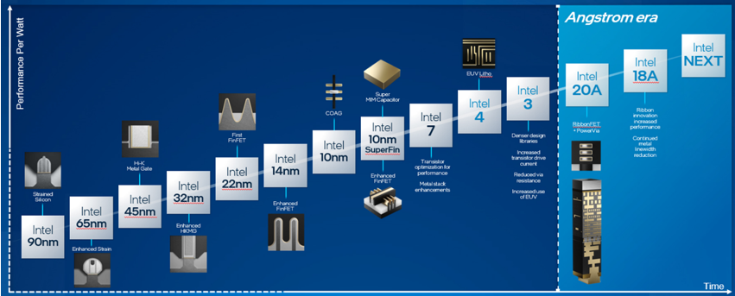
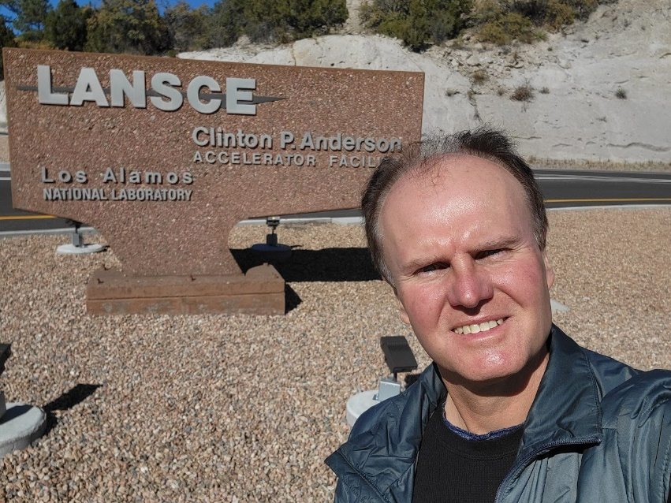
Radiation Effects in Intel
Signal
Layers
Carrier Wafer
Norbert Seifert
^{Principal Engineer}
Foundry Q&R PF Rad Effects Team
^{Intel Austria GmbH}
Transistors
Backside:
PowerVia
for Power
Delivery
Bump
CERN Visit - April 12, 2024 Talk

Slide 2
Outline
Intel Corporation
Radiation Effects in Intel – An Overview
  Short Introduction of radiation effects in Intel
  Trends & Challenges
Summary
Acknowledgements
Backup Material
  Test Structures
  Industry Standards
  RHBD Intel techniques (overview)
  Misc

Slide 3
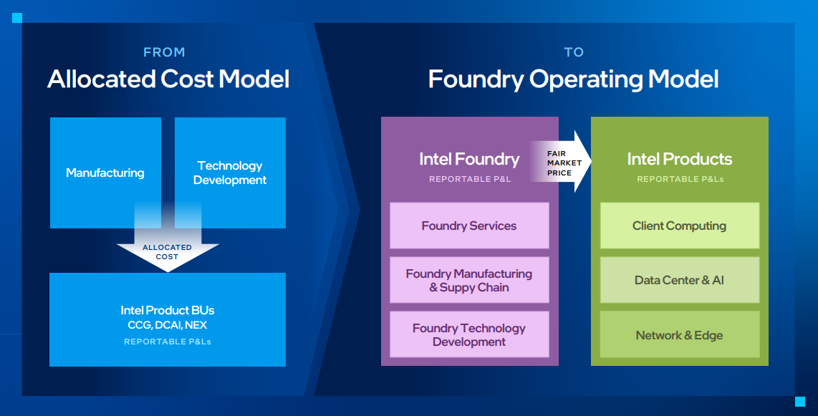
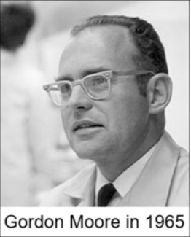
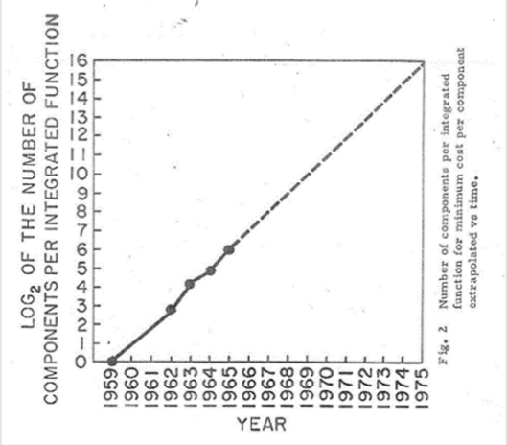
Intel Corporation
Founded in 1968 by Robert Noyce and Gordon Moore
Recent re-org: All about higher efficiency and accountability
“Cramming more components onto integrated circuits”

Slide 4
Mechanisms & Environments
Scope of Talk:
Commercial industry perspective – terrestrial radiation environments
Intel does not design or rate for space or military applications
Single Event Effects (SEE)
  Charge per sensitive volume
  SET, SEU, SEL, SEB, SEGR
  Upsets/noise due to single particles
Total Ionizing Dose (TiD)
  Cumulative Effect
  Parametric shifts
Displacement Damage Dose (DDD)
  Cumulative Effect; Space and military environments
  Parametric shifts
Prompt Dose or Dose Rate (DR)
  Military radiation environment
  Device degradation/destruction due to high current densities
  Other modes: DR Upset, DR Latchup, DDD
Terrestrial Environments
DDD TiD SEE
+
-
+
+
-
Oxide
+
-
+
-
+
-
Silicon
  Interstitials
  Vacancies
Trapped charges
interface traps
Electron/hole
pairs

Slide 5
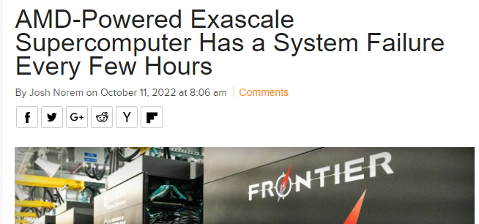
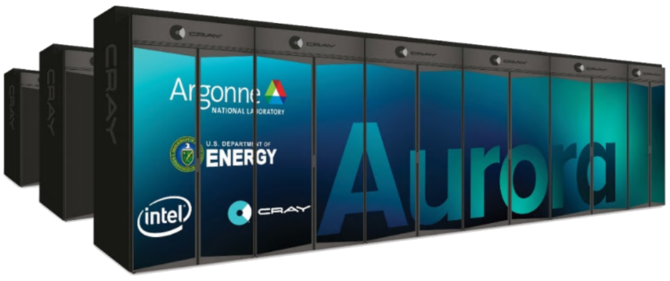
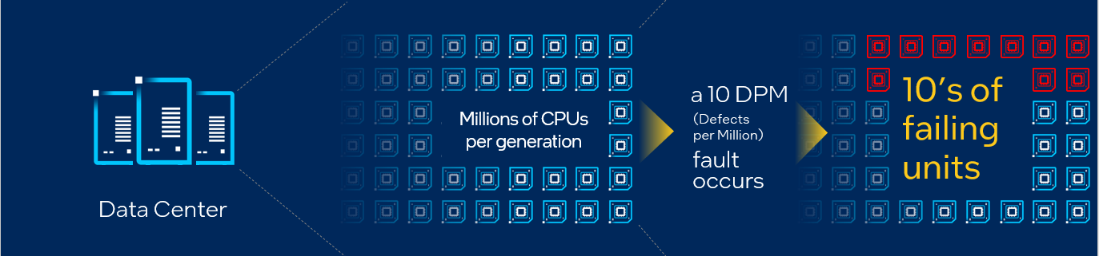
Skip
Radiation Effects Do Matter
Recent Podcast by RadioLab
  https://www.wnycstudios.org/story/bit-flip
Reliable High-Performance Computing
> 800m² of Si!
Datacenters: Increasing scale of systems & applications makes errors more visible to our customers
https://www.extremetech.com/extreme/340136-amd-powered-exascale-supercomputer-has-a-system-failure-every-few-hours
Safety-Critical Applications
(Autonomous Driving, FuSa, Aerospace,…)

Slide 6
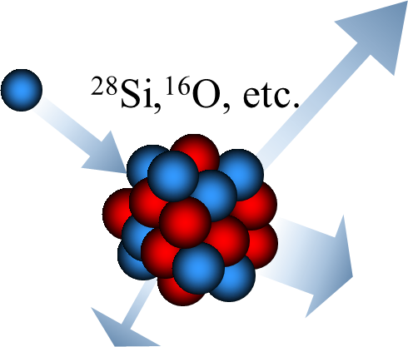
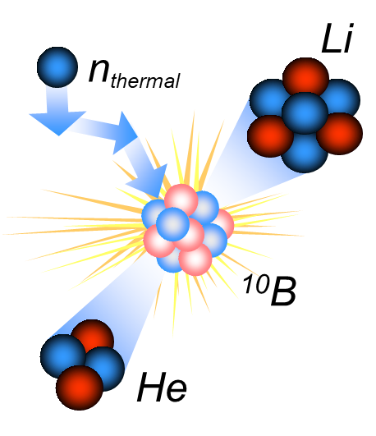
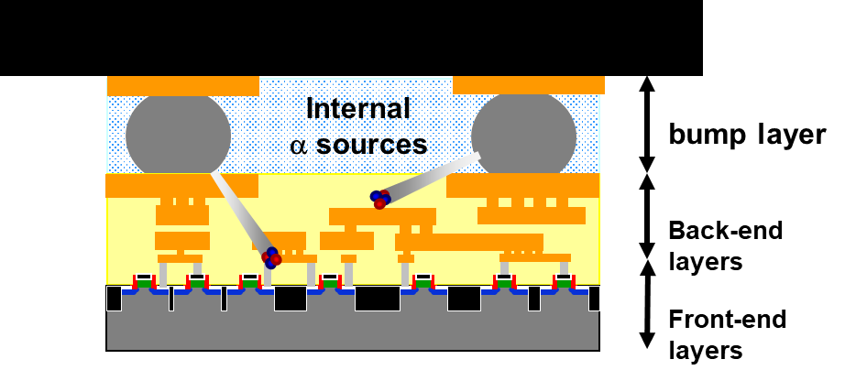
Terrestrial Radiation Environment - SEE
Three key radiation components
High Energy Neutrons
Wide spectrum of secondaries
Dominant in Intel technologies
Altitude dependence
Cannot easily be shielded
Alpha Particles
Emitted from U,Th impurities
Range < 60 um in Si
Dominant if not screening for alphas
¹⁰B and Low Energy Neutrons
Huge ¹⁰B σ_{th}
Small range of secondaries (< 5 um)
Intel eliminated BPSG in 180nm
Still relevant due to W depo process
Ziegler & Lanford (IBM), 1979
May & Woods (Intel), 1979
Baumann & Hossian (TI), 1992, 1995, 2000
6

Slide 7
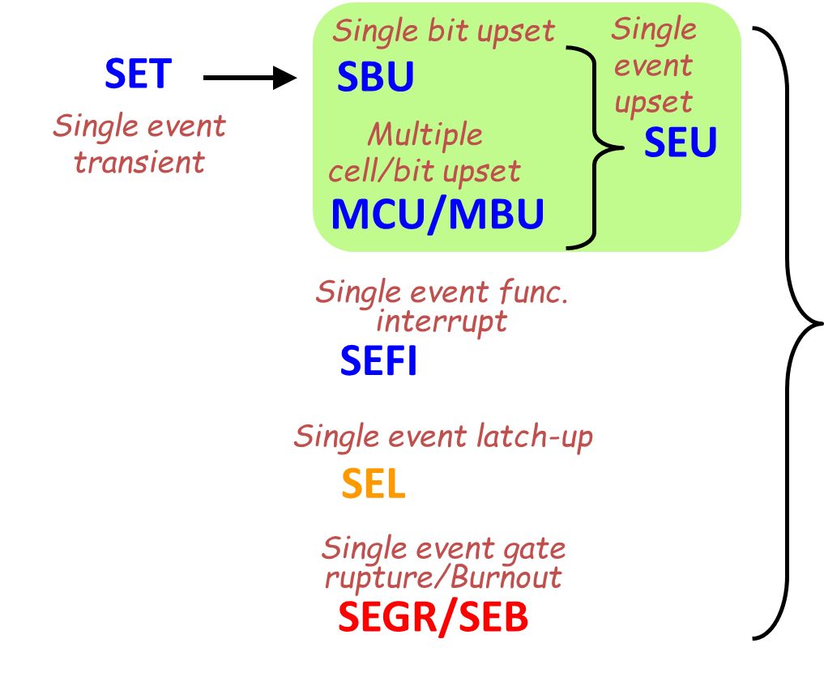
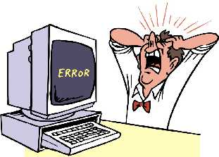
From Faults to Errors: SEE
SEE Fault Types System Level Errors
Wrong Answer:
1+1=17
Silent Data Error
User Observed Error
Detected Uncorrected Error
Detected Corrected Error
Architecture, Design, and Workload
SDE
UOE
SDC = +
Work stops:
Results lost
and cannot
generate new
results
Resilient:
error contained
and corrected

Slide 8
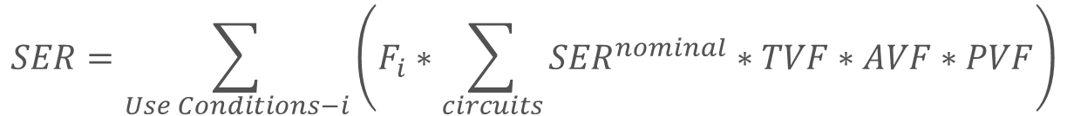
SBU SER Modeling
Compact Model (Circuit level) vs physics based simulations
Terrestrial rad environments only
Static timing tool based
To refine default TVF values
Simulation vs Emulation
Architecturally correct execution (ACE)
Gate level – fault injection
Little’s Law
Nominal SER: terrestrial rad environments only
  Raw circuit error rate under static conditions
TVF = Timing Vulnerability Factor
  Fraction of time a circuit is vulnerable
  Circuit context dependent
AVF/PVF = Architectural/Program Vulnerability
  Scope and workload dependent
  F_{i} = fraction of time in use condition i (i.e., V, Temp, f_{clk})
-) Kerryann Foley et al., IEEE IRPS, 5F.1.1 - 5F.1.9, 2014
-) S.V. Walstra and Changhong Dai, IEEE TDMR, Vol 5, Issue 3, 2005, pp. 358 – 364
Arkady Bramnik et al., IEEE IOLTS, pp. 55-60, 2013
A. Biswas, et al., IEEE International Symposium on Computer Architecture (ISCA), pp. 532–543, 2005
$$SER=\sum_{Use Conditions−i}{\left(F_{i}∗\sum_{circuits}{{SER}^{nominal}∗TVF∗AVF∗PVF}\right)}$$

Slide 9
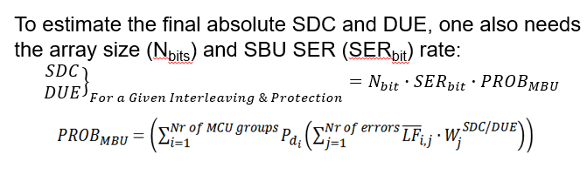
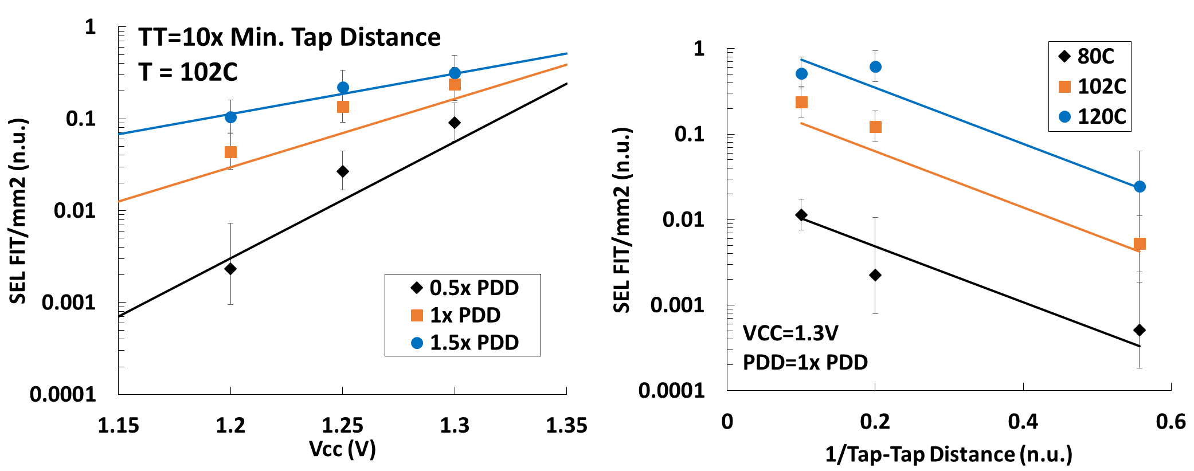
Modeling of other SEE Modes
Skip
MBU SER
  Proprietary MBUCalc tool
SEL
  Component level gross check
  Based on layout database and use conditions
  Compact model fitted to test structure data
Wei Wu, Norbert Seifert, Proceedings of the IEEE IRPS, pp. SE.2.1 - SE.2.6, 2015
Adam Neale and Norbert Seifert, IEEE Transactions on Nuclear Science, vol. 67, no. 1, pp. 15-20, 2020

Slide 10
Radiation Effects in Intel

Slide 11
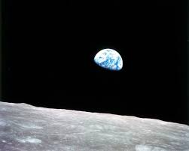
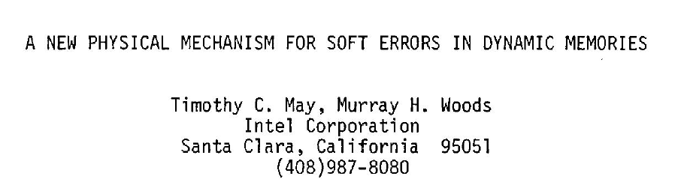

Soft Errors have a long History in Intel
Before 1978 radiation effects were thought to be restricted to space and artificial environments….
…then two Intel employees (May and Woods) published a paper at IRPS in 1978 that changed everything…
2107 DRAM; 4kbit; 12V Vcc; hot packaging material: several hundred kFIT
Nytimes Obituary, Dec.21, 2018

Slide 12
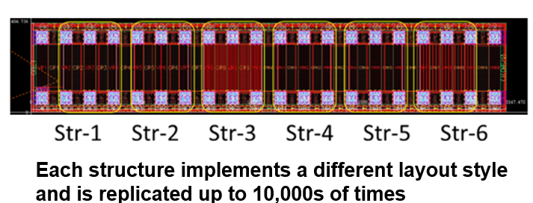
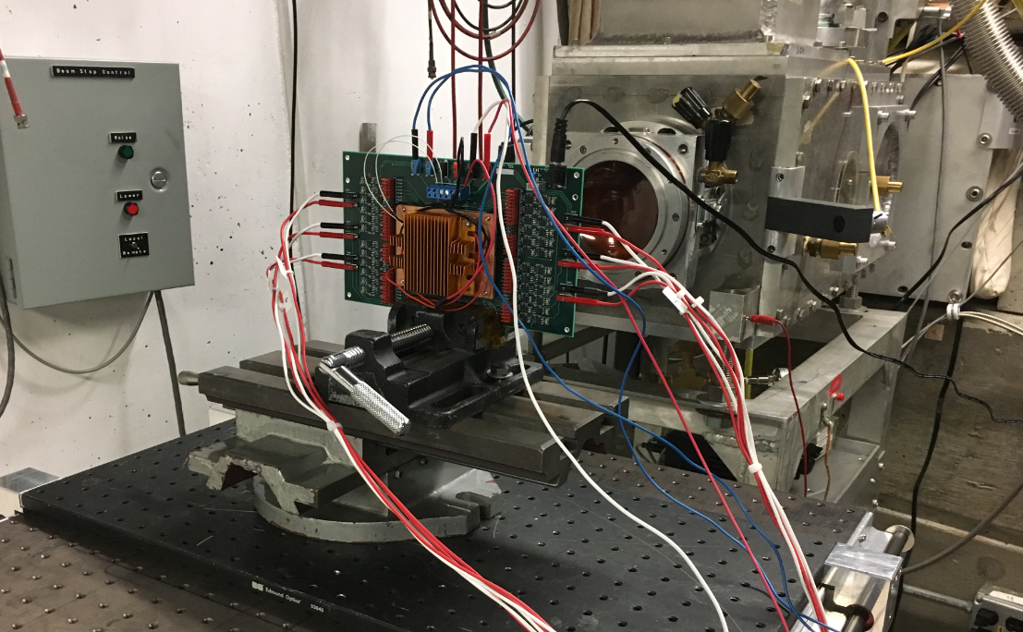
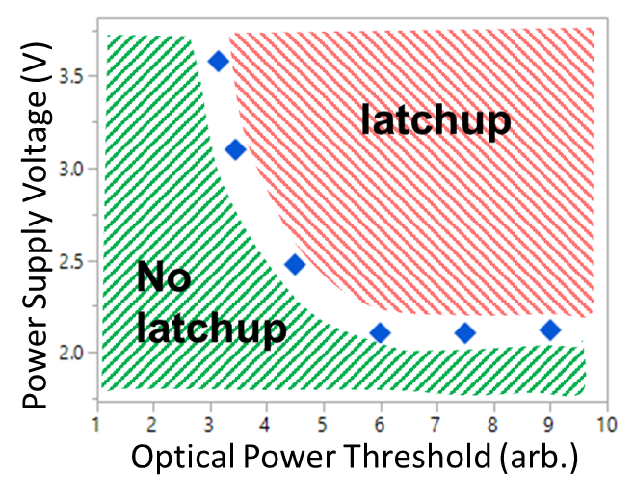
Radiation Effects in Intel – Our Team
Design of test chips
In-house (“SER Lab”) and external testing
  Accelerated and real-time testing (OR, Co and NM - WIPP)
  Alpha particle foils, SPA and TPA pulsed lasers in-house
  x-ray testing leveraging Intel equipment
  External: HE + thermal neutrons, protons, heavy ion testing (for learning)
  Test-chip and product beam testing & characterization, modeling
  Test standard: JEDEC JESD89B
SER and SEL models; TiD x-ray specs
  Proprietary and commercial tools for SBU, MBU SER and SEL
  Model calibration and release to customers; consulting
Influencing standard forming bodies
  JEDEC JESD89b, JESD22-B130 and B121, etc.
Work with partners and customers
  Product and technology development teams
  Library team

Slide 13
Selected Topics – Trends

Slide 14
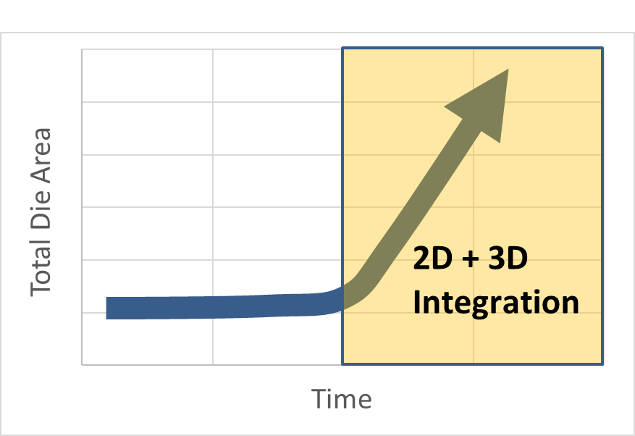
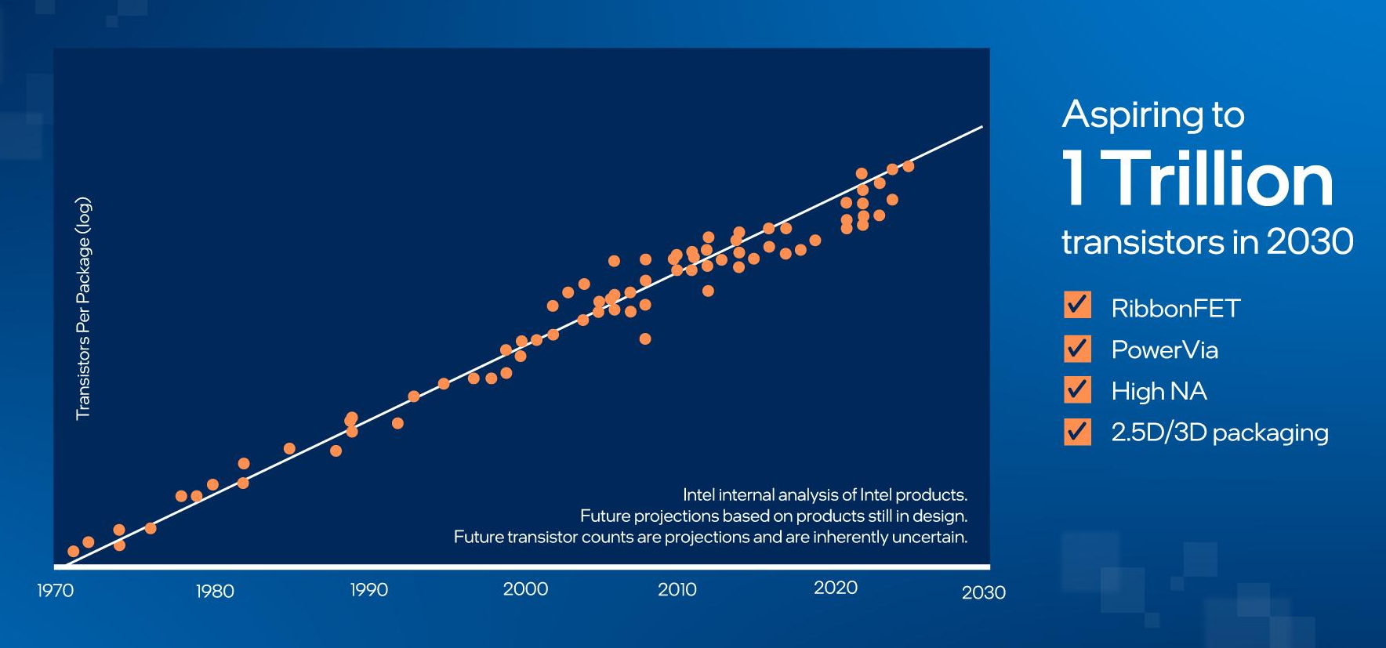
Technology Trends & Innovations
Moore’s law – Well and alive
1929 - 2023
“Cramming more components onto integrated circuits”

Slide 15

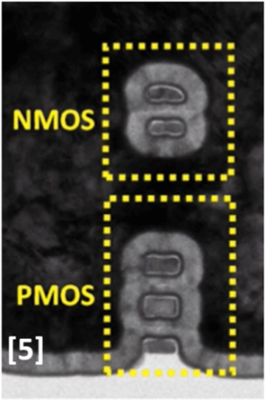
Technology Trends & Innovations
Transistor Architecture – The era of innovation continues
“Cramming more components onto integrated circuits”
M. Radosavljević et al, IEDM 2021

Slide 16

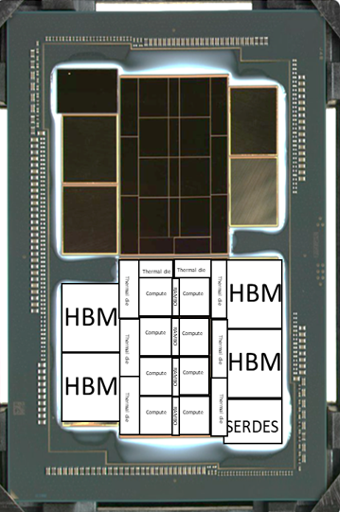
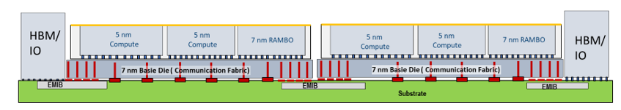
Integration Example: Ponte Vecchio
Skip
100+ billion transistors
5 technology nodes
47 tiles - 2330 mm²
2.5D and 3D IC Packaging: EMIB + Foveros
4,468 pins
W. Gomes et al., 2022 IEEE International Solid-State Circuits Conference

Slide 17
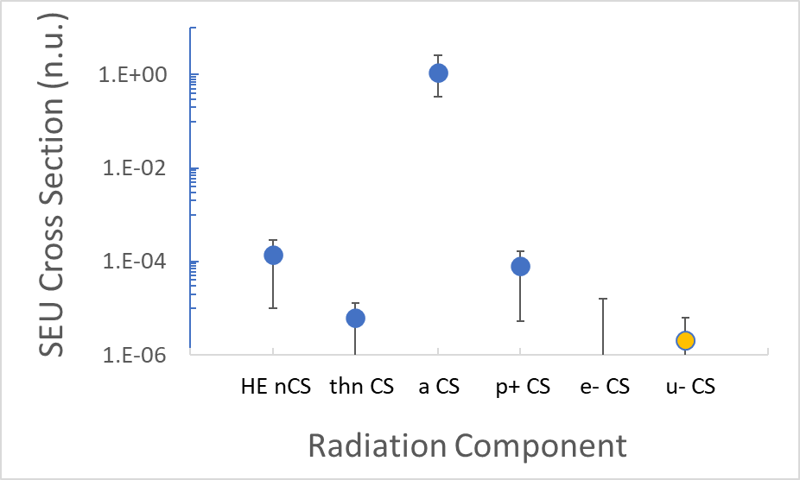
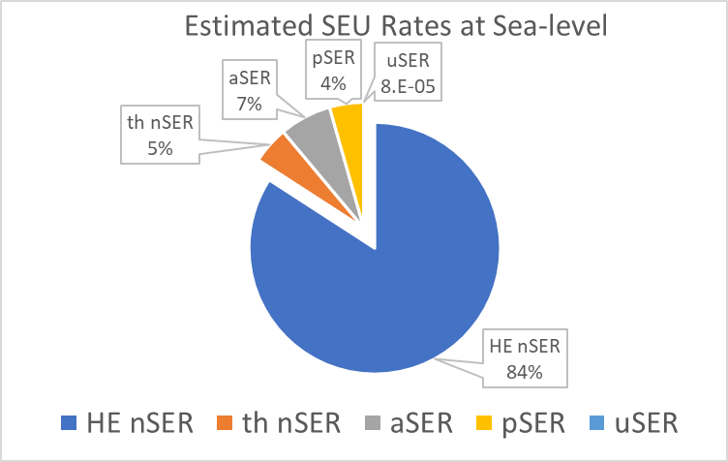
Single Event Upset Susceptibility of 10nm Devices
For terrestrial radiation environments, neutron SER dominates
Accelerated testing results
N.Seifert et al., 2024; submitted to RADECS 2024
Cosmic Ray Component | Energy Range | Integrated Flux (/hr/cm²)
Neutrons | 10 MeV – 8000 MeV | 9.1
Protons | 10 MeV – 8000 MeV | 0.8
Electrons | 10 keV – 8000 MeV | 12.5
Muons (+ or -) | 10 keV – 8000 MeV | 27.5
Table. 1: EXPACS derived integrated fluxes for selected cosmic ray components in 2023 at sea-level

Slide 18
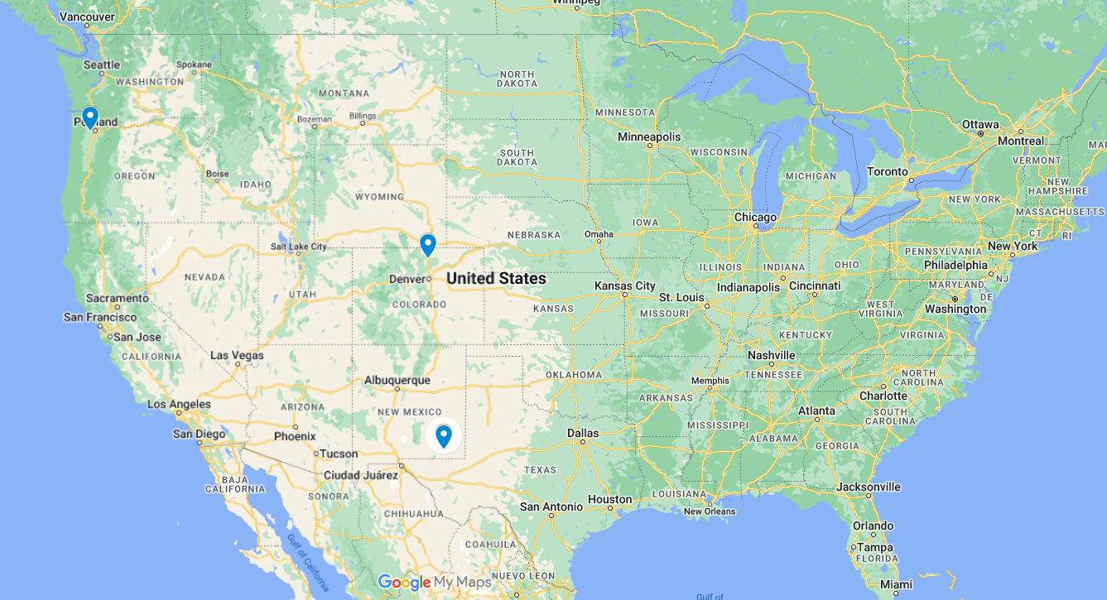
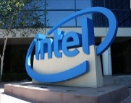
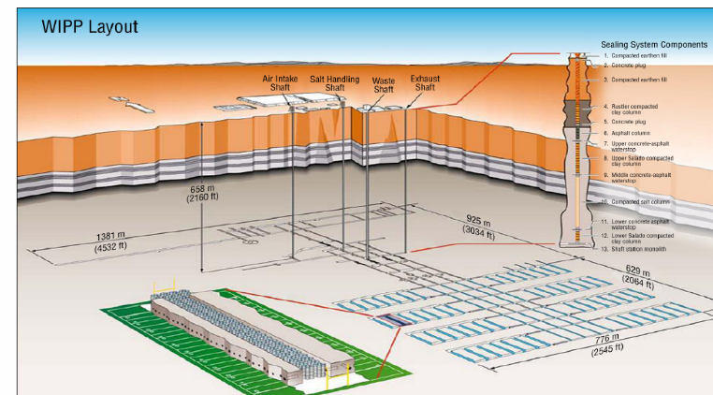
Real-Time Test Locations
“Altitude”Testing:
Fort Collins, Colorado
5000ft above sea-level
Sea-level testing:
Hillsboro, Oregon
200ft above sea-level
WIPP
Underground testing:
Waste Isolation Pilot Plant (WIPP), near Carlsbad, NM
~2150ft below surface

Slide 19
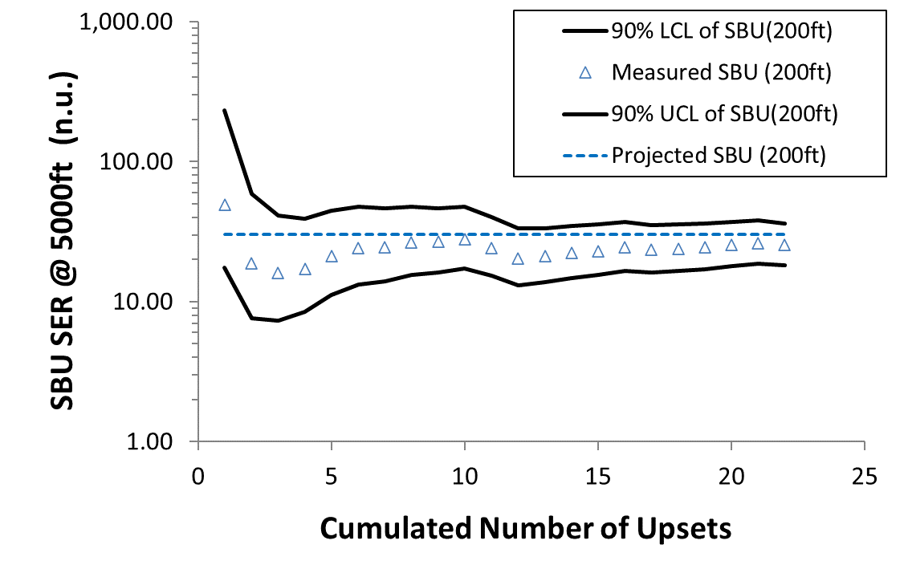
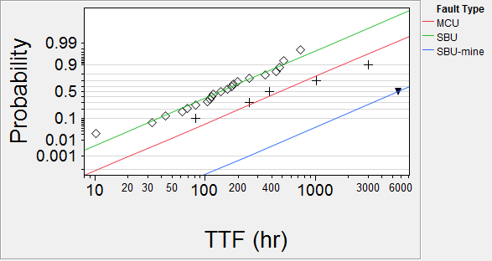
Accelerated vs Real-Time Testing
45nm SRAM SER: demonstrated that alpha-particle SER << neutron SER
SBU (200ft)
Oregon
45nm SRAM
SBU (-2150ft)
WIPP facility
45nm SRAM SER scaled from Hillsboro, OR to FT, Co.
MCU (200ft)
Oregon
Adapted from N. Seifert and M. Kirsch, IEEE TNS 2012

Slide 20
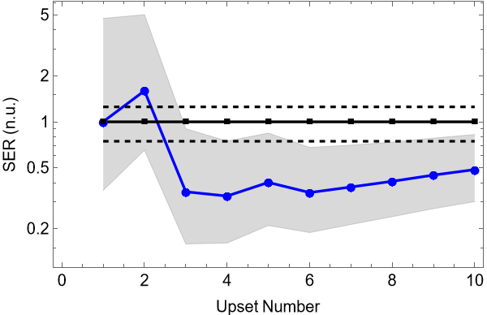
Accelerated vs Real-Time Testing
10nm vs 45nm SRAM scaling: ~50x improvement!
  Same scaling factor applied to both plots
10nm SRAM (FT, Co)
45nm SRAM SER scaled from Hillsboro, OR to FT, Co.
N. Seifert et al., 2024; submitted to IEEE RADECS 2024
N. Seifert and M. Kirsch, IEEE TNS 2012

Slide 21
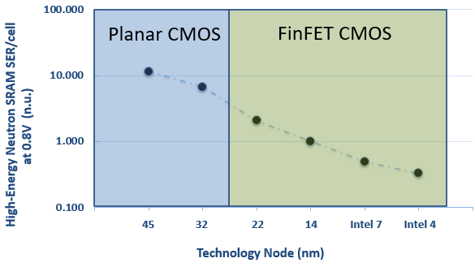
Radiation Induced SBU SER Trend
Technology scaling and innovations continue to improve SBU SER rates
FinFET has provided ~20x cumulative SBU reduction 32nm vs Intel 7 (weighted figure of merit)
Nominal silicon FIT rate improving almost enough to offset generational product trends. Additional RAS added to keep product FIT about constant
New transistor design options should continue and possibly accelerate radiation induced SBU benefits in the long term

Slide 22
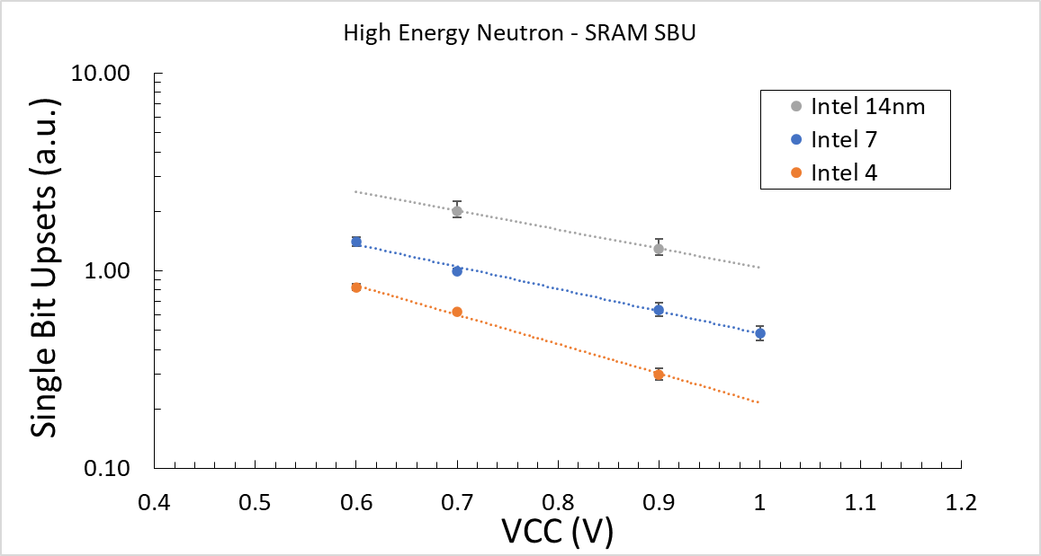
Radiation Induced SBU SER Trend: Voltage Dependence
Skip
C. Connor et al.; submitted to IEEE VLSI, 2024

Slide 23
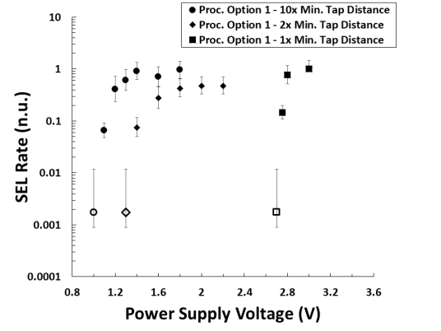
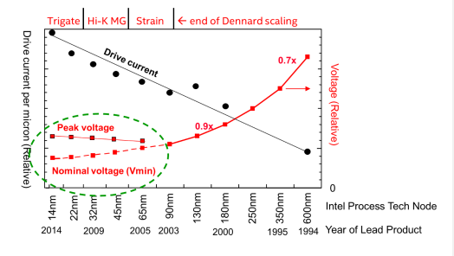
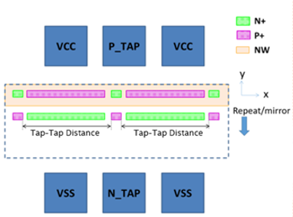
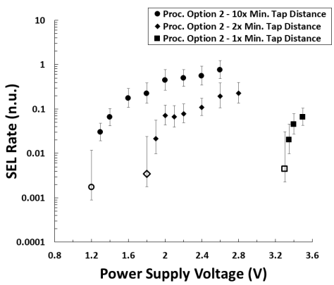
Single Event Latchup (SEL)
SEL performance strong function of use conditions and design parameters
Turbo voltages > nominal voltages <-> SEL impact
SEL rate also depends on technology parameters
A. Neal and N. Seifert, IEEE TNS 2020 and B. Ajdari et al, IEEE IRPS 2020;
23

Slide 24
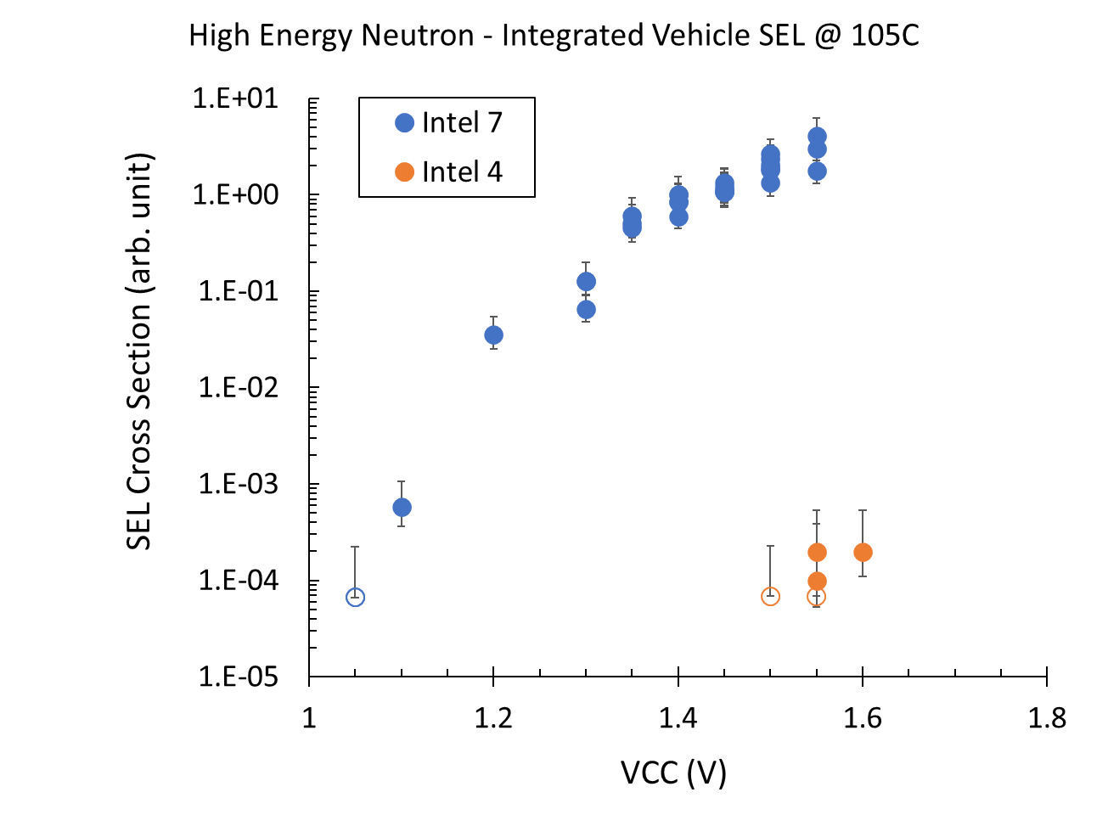
Single Event Latchup (SEL)
Measured, high energy neutron single event latchup (SEL) rates for integrated test vehicles
Huge improvement in Intel 4/3
C. Connor et al.; submitted to IEEE VLSI, 2024

Slide 25
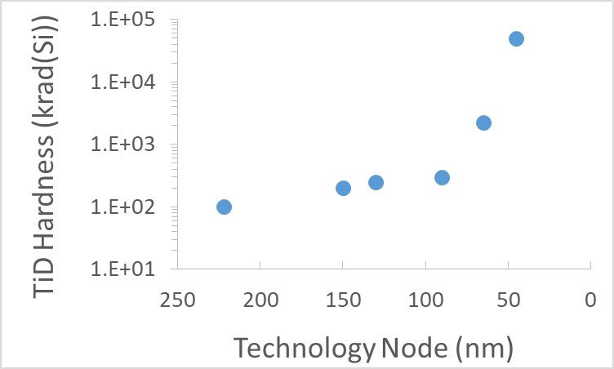
Technology Trend: Dose Effects
Not a concern for terrestrial applications
Total Ionizing Dose performance of modern technologies
Overall improvement with scaling
  Used to be driven by volume and quality
  of gate oxide
  Nowadays quality of oxides and interfaces
  in transistor isolation regions
Intel rates x-ray induced TiD in the context of
manufacturing and quality inspections
  TiD test levels are in the few hundred rad (Air)
  Test standard: JEDEC JES22-B121
Adapted from:
Matthew Gadlage, Microelectronics Integrity Meeting, NSWC Crane, August 2017

Slide 26
Selected Topics – Challenges

Slide 27
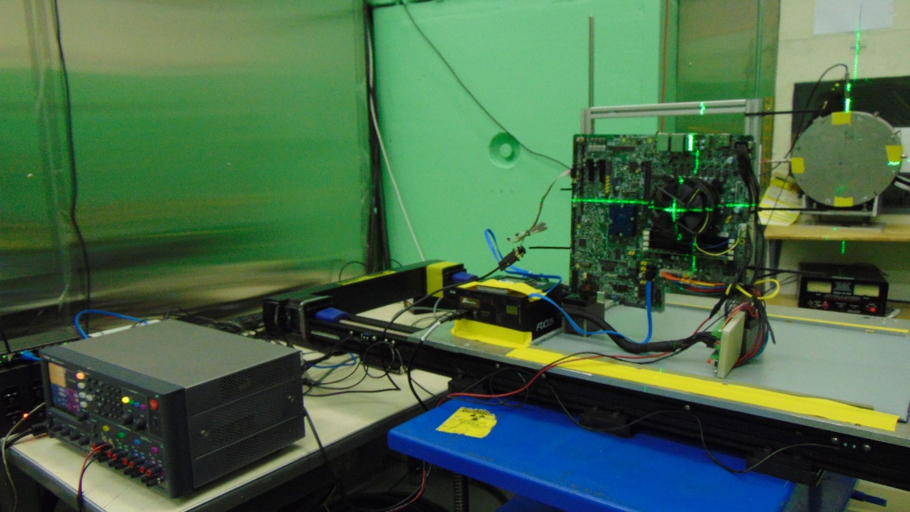
Challenges: Cost of Testing for Radiation Effects
Beam testing is expensive
Strategy
Model calibration based on test structure data
  Several technologies and data turns per year
  Typically characterize up to ~20 library cells
  Nominal and RHBD cells
System level testing for product qualification
and/or model verification
  Cannot test all products/skews
  Few selected systems per generation
  Product beam testing is difficult
Establish correlation with other facilities
Currently considering programs like RADNEXT and test consortia

Slide 28
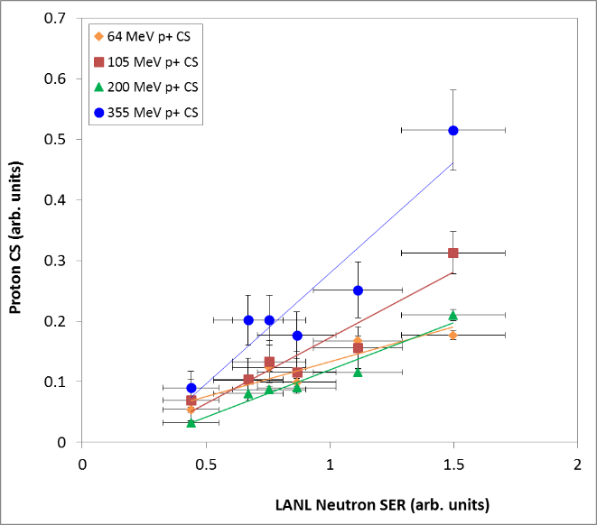
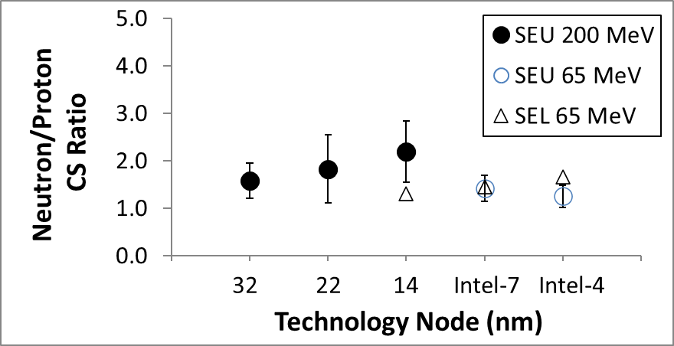
Challenges:
Not sufficient Neutrons – Proton Beams to the Rescue
LANSCE availability
Next best thing to adding neutron BL -> proton beamline
  Proton beams can have much higher fluxes & throughput; many facilities
Proven correlation – Methodology included in latest JEDEC JESD89B standard update
S. Jahinuzzaman et al., IEEE Int. Rel. Phys. Symp., 2017

Slide 29
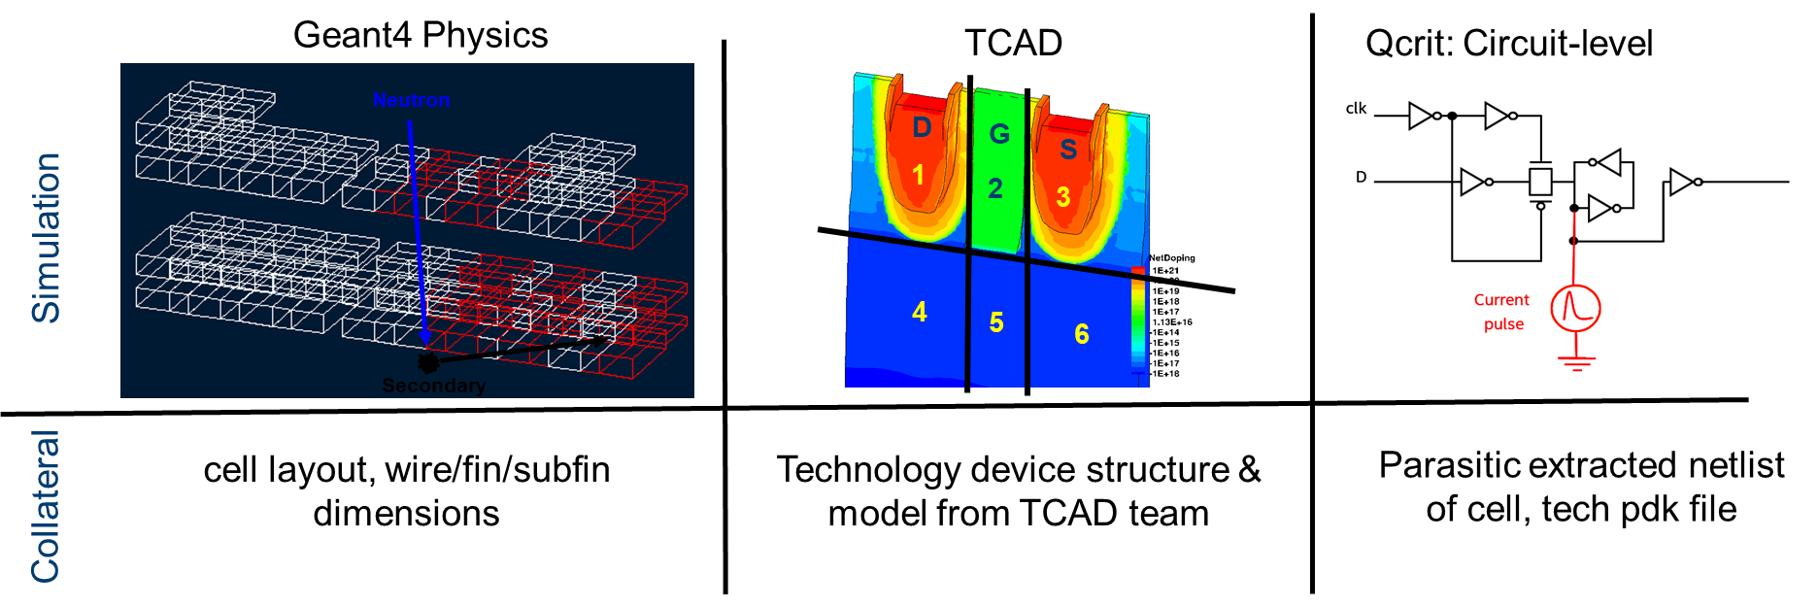
Challenges – Simulations
We rely on projection/modeling to assess radiation-induced risks
  Prohibitively expensive to test all products and SKUs
  Mitigation decisions are made early in the product design cycle; in some cases before any Si is available
Projection accuracy is a challenge in the Angstrom era
  3D TCAD; nm device dimensions and micron ion ranges and diffusion; novel materials/elements

Slide 30
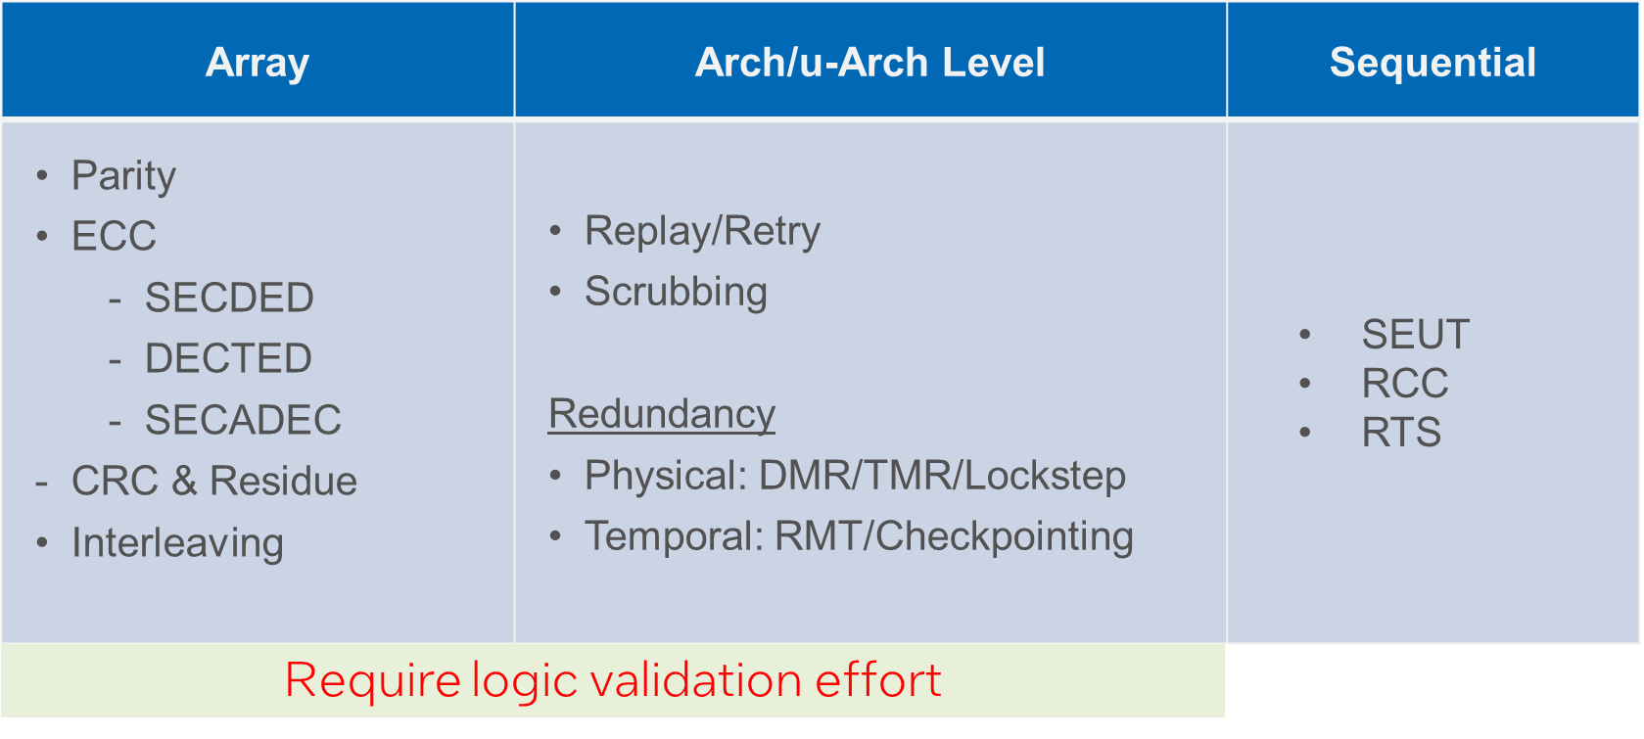
Challenges – Mitigation Cost
Low hanging fruits have already been implemented (such as coding in arrays, RHBD cells); anything else has significant PPA (Power, performance, area) cost
Even if nominal PPA cost is acceptable– library development and characterization may require additional effort, area and power cost for timing improvement
Mitigation Feature | Core SER Reduction | Core Level Impact FOM
100% RHBD RTS | ~4% | Area growth ~negligible Power impact ~negligible
Floating point residue | ~3% | Area growth ~0.5% Power increase ~ 0.5%
100% RHBD SEUT cells | ~28% | Area growth ~ 10% Power increase ~ 25%
Core level lockstep | ~100% | Area & Power growth ~100%

Slide 31
Challenges – Testing
Signal
Layers
Carrier Wafer
PowerVia and 3D Package Integration
Complex SOC - several ICs within focal plane of beam
Nightmare for pulsed laser testing and heavy ion testing
Error location identification
  Less of an issue for IDMs – debug package, hooks/scan
  Ability to focus beam and vary energy may be helpful
Transistors
Backside:
PowerVia
for Power
Delivery
Bump
W. Gomes et al., 2022 IEEE International Solid-State Circuits Conference

Slide 32
Challenges – Export Control Regulations
Intel must comply with all applicable laws
The USG has federal laws and regulations (incl. international treaties) that control the export of strategically important products, services, and technologies to non-US persons
Dual-use articles: under the Export Administration Regulations (EAR); Controlled items are listed on the CCL (Commerce Control List)
  In particular: ECCN 3A001.a.1
  Do not design or rate for parameter limits relating to TiD, dose rate upset and neutron fluence

Slide 33
Summary
Moore’s Law well & alive and evolving
Scaling has mostly benefited radiation-induced reliability
  Transition to non-planar transistors for SEE, reduction in oxide volume for TiD
  Accelerated and un-accelerated test results are consistent => All key components accounted for
  Future technology options look promising (SEU and SEL)
  SEL can effectively be addressed by technology and design measures
Challenges remain as we continue to integrate more IP into SOC and POC
  Radiation Effects is one of the most important and limiting failure mechanisms for functional safety and supercomputer applications
  Testing for radiation testing is expensive – interested in RADNEXT and Test Consortia
  Need to explore innovations in all layers (technology, HW, SW) to keep this problem under control
  PowerVia making testing and debug using heavy-ions and lasers very difficult
  Simulation challenges as we approach the “Angstrom” era
  Intel has to comply with all applicable laws, including export control regulations

Slide 34
Acknowledgements
Contributions by
Jeff Hicks
Adam Neale
Soonyoung Lee
Shah Jahinuzzaman
Nitin Kulkarni
Wilfred Gomes
Michael Paulitsch
Matthew Jones

Slide 35
Thanks for your time and attention
Any questions?

Slide 36
Backup Material

Slide 37
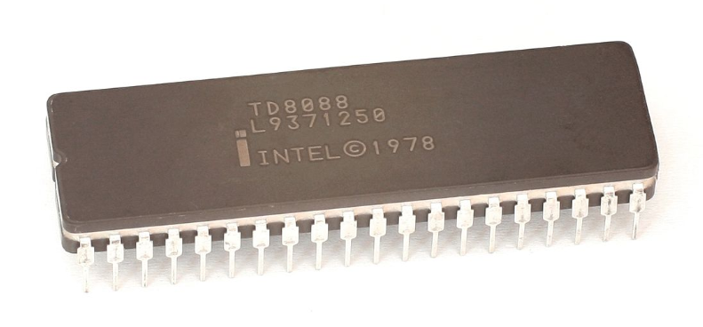
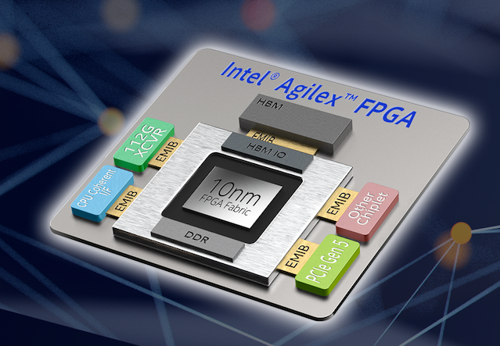
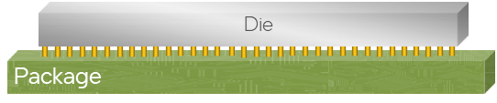



Integration: More than just transistor scaling
System in package: 3D Integration
  Lateral and vertical integration
  Heterogeneous SoC integration
“Cramming more components ….”
150
FCBGA
Aggressive pitch
scaling
100
Interconnect Pitch (um)
EMIB
DoW / Foveros
50
25
DoW – Die on Wafer
HBI – Hybrid Bonding
HBI
Heterogeneous Integration
Mohsen Alavi, IRPS 2022 keynote talk

Slide 38
Selected Test Standards
Terrestrial radiation environments only
Fault Mode | Test Standard | Radiation Source | Significance & Comments
TiD | JESD22 (x-ray TiD) | X-rays for quality inspections | Terrestrial: Negligible but in accelerated environments
SEE | JESD89B (neutrons + α particles) JESD234 (protons) JEP151 (SEB, SEGR; power transistors) | Terrestrial: Neutrons and α particles | Terrestrial & Avionics: Dominating fault mode Proton testing as proxy for neutrons No power transistors in any of the offered Intel technologies & products

Slide 39


What Impacts SER?
Simplified Dependence:
SER$\sim A_{diff}exp(−\frac{Qcrit}{Qcoll})$
Device/technology dominated:
Sensitive Volumes
Charge Collection efficiency
  Materials
  => fin dimensions; # of fins; doping distributions
Circuit dominated parameters:
Critical charge – Qcrit
Layout, incl. cell pitches
=> Caps, drive currents, voltage
clk
clk
D
D
Current
Current
Qcrit ~ V*Cap + I_{k}*τ
pulse
pulse

Slide 40

AVF vs PVF
Scope/Sphere of Vulnerability Analysis
AVF:
Fraction of faults that corrupt architectural state
PVF:
Fraction of architectural state that changes program output
SoC
System
AVF Ballpark Numbers:
Sequential elements: ~5% – 20%
Data cache (write through): ~6%
Data cache (write back): ~30-40%
Data translation buffer: ~36%
Store buffer: ~ 4%
AVF
PVF
A. Biswas, et al., IEEE International Symposium on Computer Architecture (ISCA), pp. 532–543, 2005
40

Slide 41

Laser Testing Strategy
SPA and TPA mode-locked pulsed laser
  1064nm and 1550nm
  Backside irradiation (thinned substrate)
Objectives
  Low-cost, quick-turnaround complement to beam testing
  Debug tool: unique control on the location and timing of the charge injection
  Primarily used in radiation effects studies for identifying SEL sensitive locations
Laser data and beam CS showing good correlation

Slide 42
Test Structures
Physical learning and model calibration - accelerated testing
SEE and TiD characterization
    SBU on SRAM, RF and sequentials; (incl RHBD: not all technologies)
    MBU on SRAM and RFs
    Combinational SER: FOM to bound per sequential (or SRAM) cell-level SER
    SEL: on SRAM test vehicles and special test structures (not all technologies)
    TiD: mainly on bare die/wafers
Test Chip | Radiation Environment |  |  |  |  | Description
 | High Energy Proton | High Energy Neutron | Thermal Neutrons | Th-232 | Positive Muons
SERSL | 32, 22, 14nm | 32, 22, 14nm | 22, 14nm | 32, 22, 14nm |  | Latches: Sensitive Volume & Qcrit dependence
SERSM | 22, 14nm | 22, 14nm | 22, 14nm | 22, 14nm |  | Selected library elements (FFs and latches)
SERRS | 32, 22, 14nm | 32, 22, 14nm | 22, 14nm | - |  | RSER latches (SEUT, RCC and RTS)
SRAM | 32, 22, 14nm | 32, 22, 14nm | 22, 14nm | - | 32, 22, 14nm | 6T SRAM array; SBU and MCU
SERCL | 32, 22, 14nm | 32, 22, 14nm | 22, 14nm | - |  | Comb. Logic

Slide 43
Combinational SER
Test Chip: skewed N/P + balanced paths; varied path lengths
Gill et al., IRPS 2009
9/12

Slide 44

Combinational SER
No change in relative contribution; Absolute tracking SBU SER
  Memory and sequential element SER still dominate product SER
  FOM ~1% of underated latch neutron SER per comb. gate at 1GHz
N.Seifert, SEE Symposium 2015
9/12

Slide 45
SER Mitigation Options
Array | Arch/u-Arch Level | Sequential
Parity ECC SECDED DECTED SECADEC CRC & Residue Interleaving | Replay/Retry Scrubbing Redundancy Physical: DMR/TMR/Lockstep Temporal: RMT/Checkpointing | SEUT RCC RTS
Require logic validation effort

Slide 46

SEUT (Soft Error Upset Tolerant) Storage Element
SEUT is single error correcting state machine. Radiation induced single state bit error is corrected immediately after pulse is gone.
Critical diffusions must be separated apart to avoid double state bit upset.
Requires redundant data and clock signals. Otherwise, FIT improvement is limited by data and clock signal FITs.
Qcrit based SER benefit
0
1
0
1

Slide 47
Reinforcing Charge Collection (RCC)
P0
Qcrit based SER benefit
Particle strike deposits charge in Silicon
  Charge collected by one diffusion can upset state (solid circles)
  Charge collected by another diffusion can reinforce state (dashed circles)
  Placing reinforcing diffusion physically close to victim diffusion reduces SER
    Minimize N0-N1 distance and P0-P1 distance in layout
    Maximizes probability that reinforcing charge is collected along with the upsetting charge from a single strike
Charge collection is dynamic
  Reinforcing diffusions are poor collectors to start (no reverse-bias on diffusion)
    Changes with circuit response
N0
0
1
P1
N1

Slide 48


RTS (Reverse TriState)
Stack node re-ordering => reduction of state node diffusions
RTS
Layout and performance cost are negligible

Slide 49
Export Control Regulations: 3A001.a.1
The US and other jurisdictions control the export of radiation hardened integrated circuits and the corresponding technology used to design or manufacture the chip.
From the US Export Administration Regulations (EAR):
3A001.a.1 General purpose integrated circuits designed or rated as radiation hardened to withstand any of the following:
    A total dose of 5 x 10³ Gy (Si), or higher;
    A dose rate upset of 5 x 10⁶ Gy (Si)/s, or higher; or
    A fluence (integrated flux) of neutrons (1 MeV equivalent) of 5 x 10¹³ n/cm² or higher on silicon, or its equivalent for other materials;
Courtesy of Todd Brusnighan and Rebecca Napolitano

