Slide 1
CTMC 2024
General Assembly
Richard MORTON
4th April, 2024

Slide 2
General Assembly 2024
CTMC: General Assembly Agenda 2024
Committee presentation for 2023
Nomination of president of the session and two vote counters
Presentation and approval of the previous GA report
Activity report 2023
  Activities in the club room
  Equipment report
  Purchases
Membership 2023/3
Annual finance presentation by the treasurer Jamie Pinnell
Election of the NEW Committee Members and volunteers for 2024
Approval budget for 2024 for new equipment and supplies.
AOB

Slide 3
Committee presentation for 2024
The CTMC committee for 2023 was:
Richard Francis MORTON → CTMC President,
Hannes BARTOSIK → CTMC Secretary,
Jamie Thomas PINNELL → CTMC Treasurer
Byamba WICKI → Vice Treasurer

Slide 4

Nomination of president of the session and two vote counters
Nomination of President of the Session and two vote counters!

Slide 5
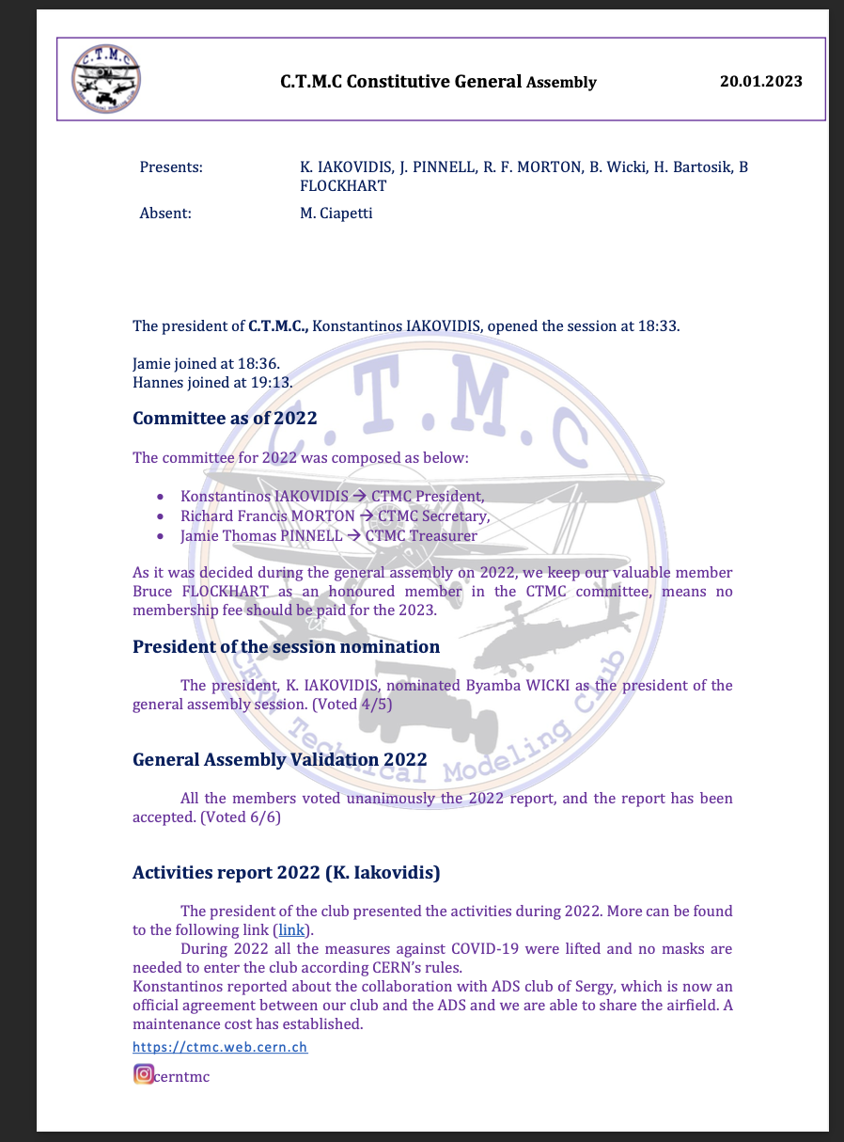
Presentation and approval of the previous GA report

Slide 6
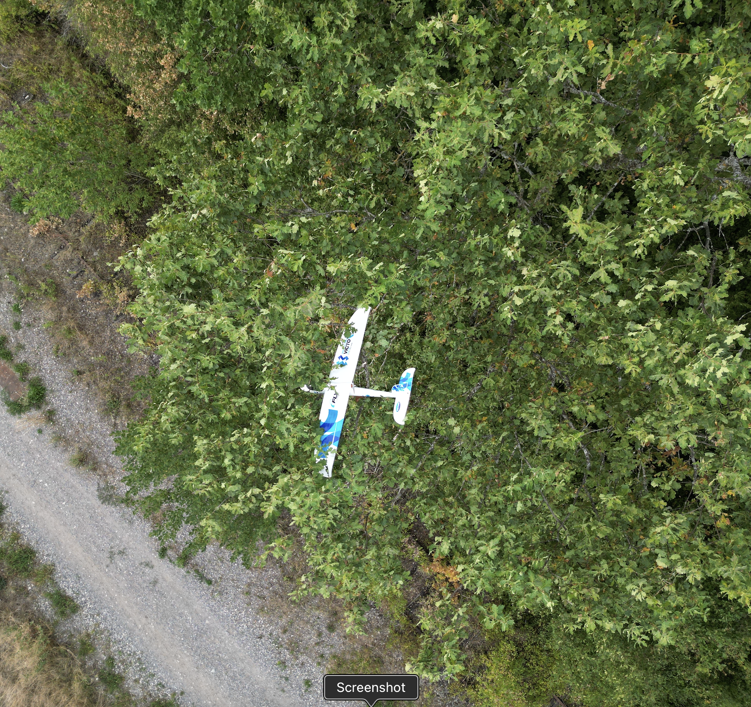
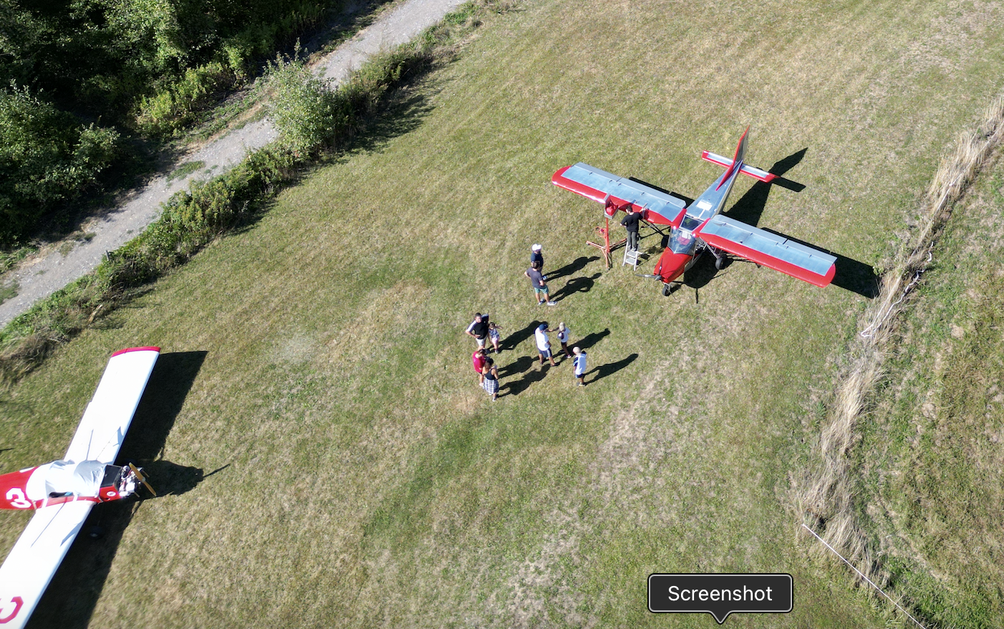
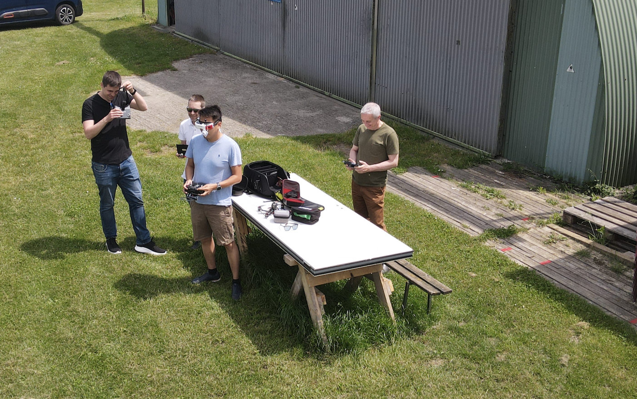
Activity Report 2021 – Activities in the club’s room
2023 has bean a very active and exciting year for CTMC, welcoming new and returning members alike. The partnership with ADS has finally given us an easy to access flying facility, which I am happy to say has been well used and respected by the club members.
Our presence at ADS has has been welcomed and they have now given us full use of the barrack next to the hangar.
The club has benefitted from a spring clean and thorough wash down from the roof leak. WE have acquired the laser cutter, two new planes, two radios and a number of batteries and other exciting stuff.
The objective for the coming year should be to make the most of the flying time, encourage new members from ADS and the CERN community and participate in more events such as the Relay race.

Slide 7
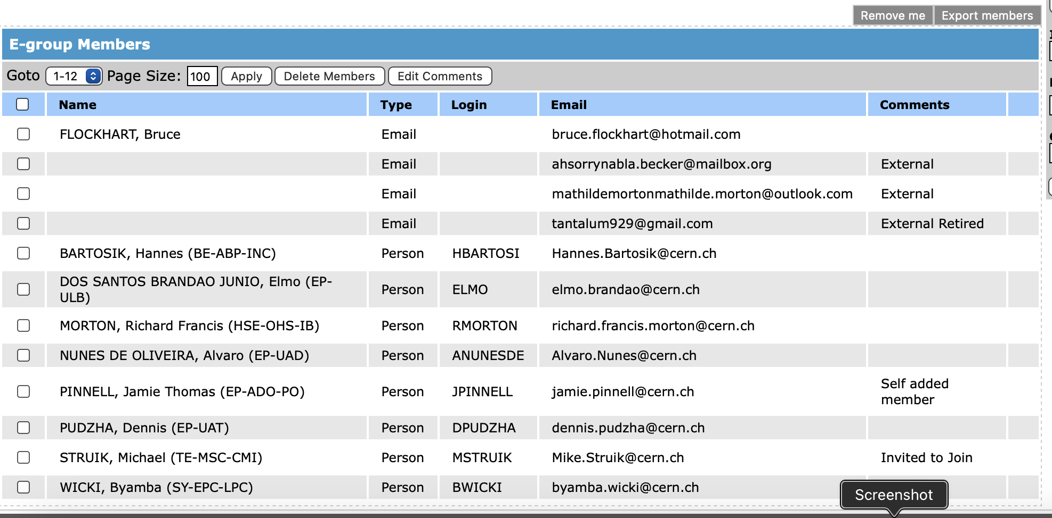
Membership 2023
The current membership is 11 with 3 members in arears.
The membership fee was reduced to 50Chfs for full members.
It is proposed to introduce a Student rate (for CERN users who are not on a fully paid stay at CERN or short term contracts.
Insurance is compulsory for flying at the club and whilst individual household policies do include third party cover it is recommended to take out the FFAM insurance.

Slide 8
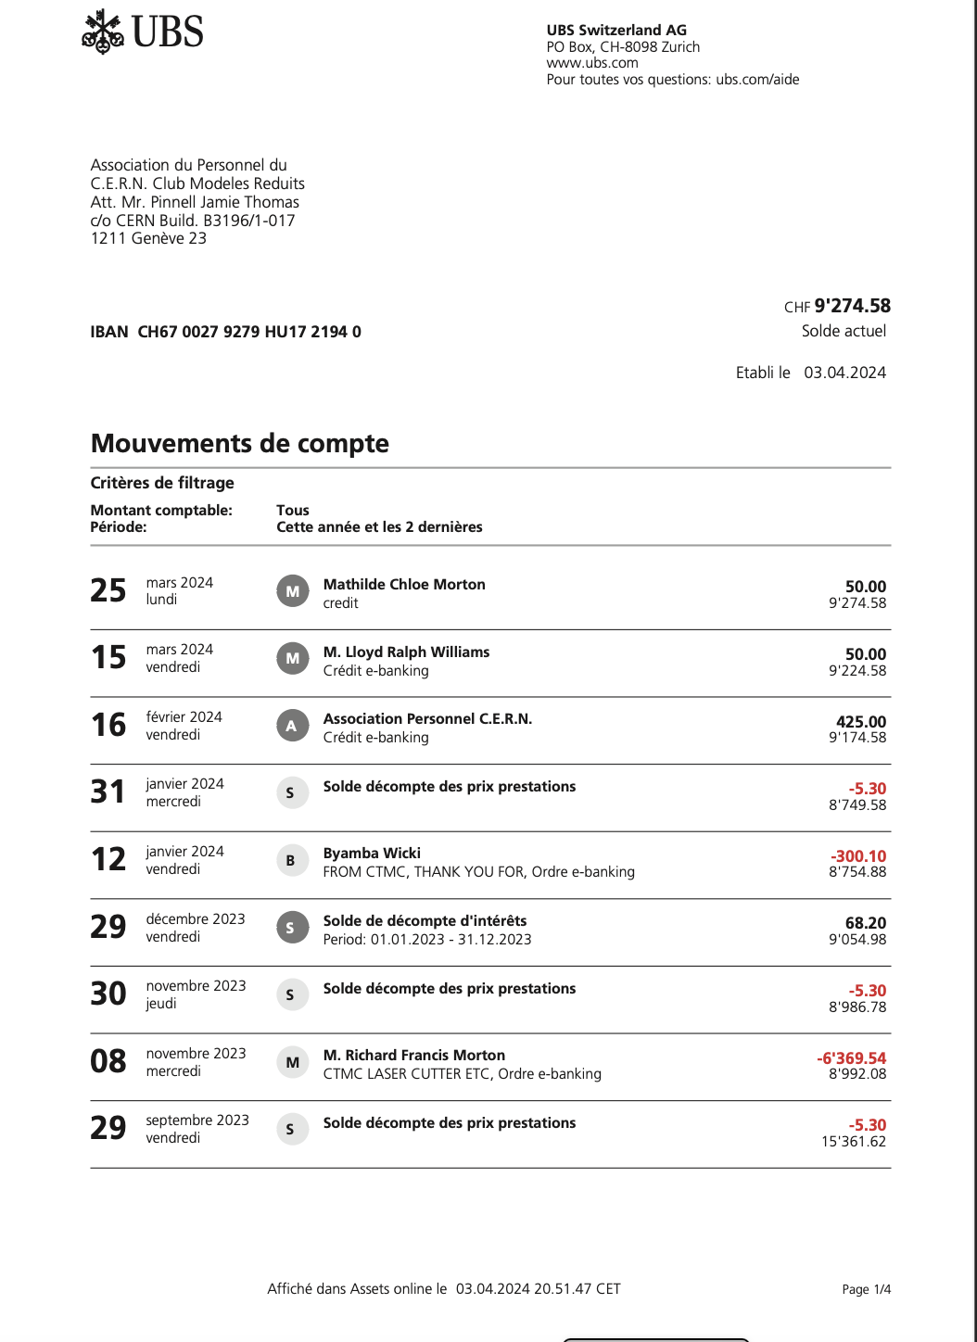
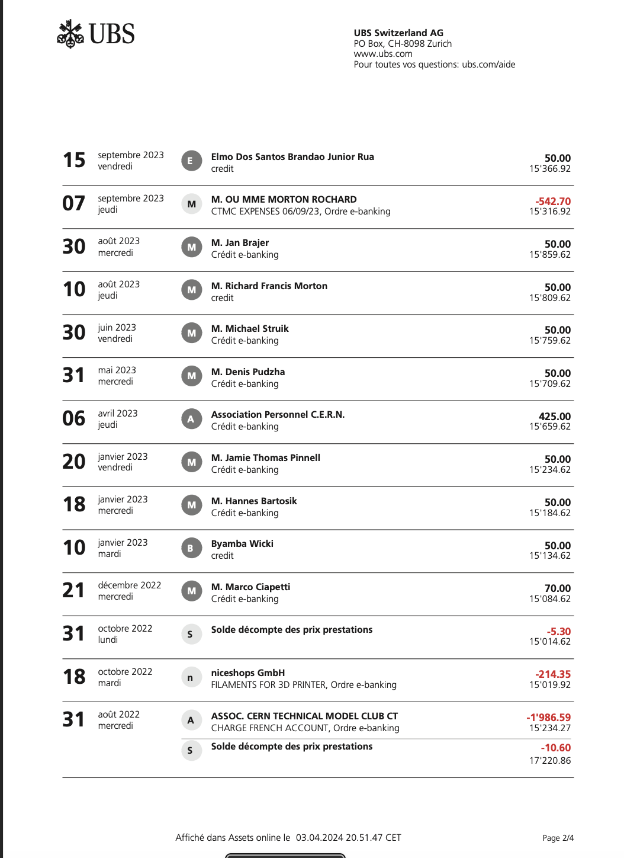
Annual finance presentation by the treasurer Jamie Pinnell
UBS Account

Slide 9
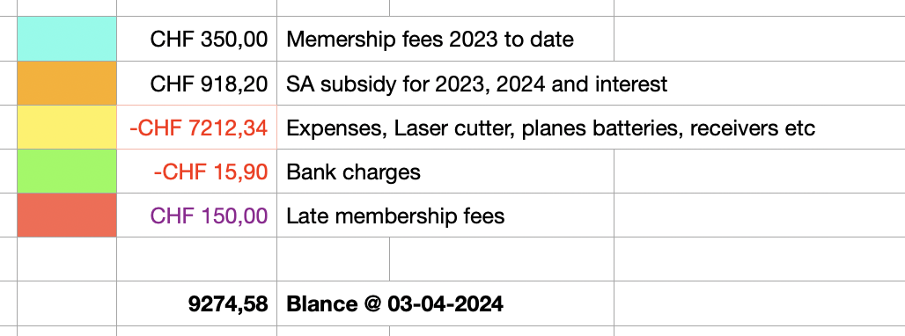
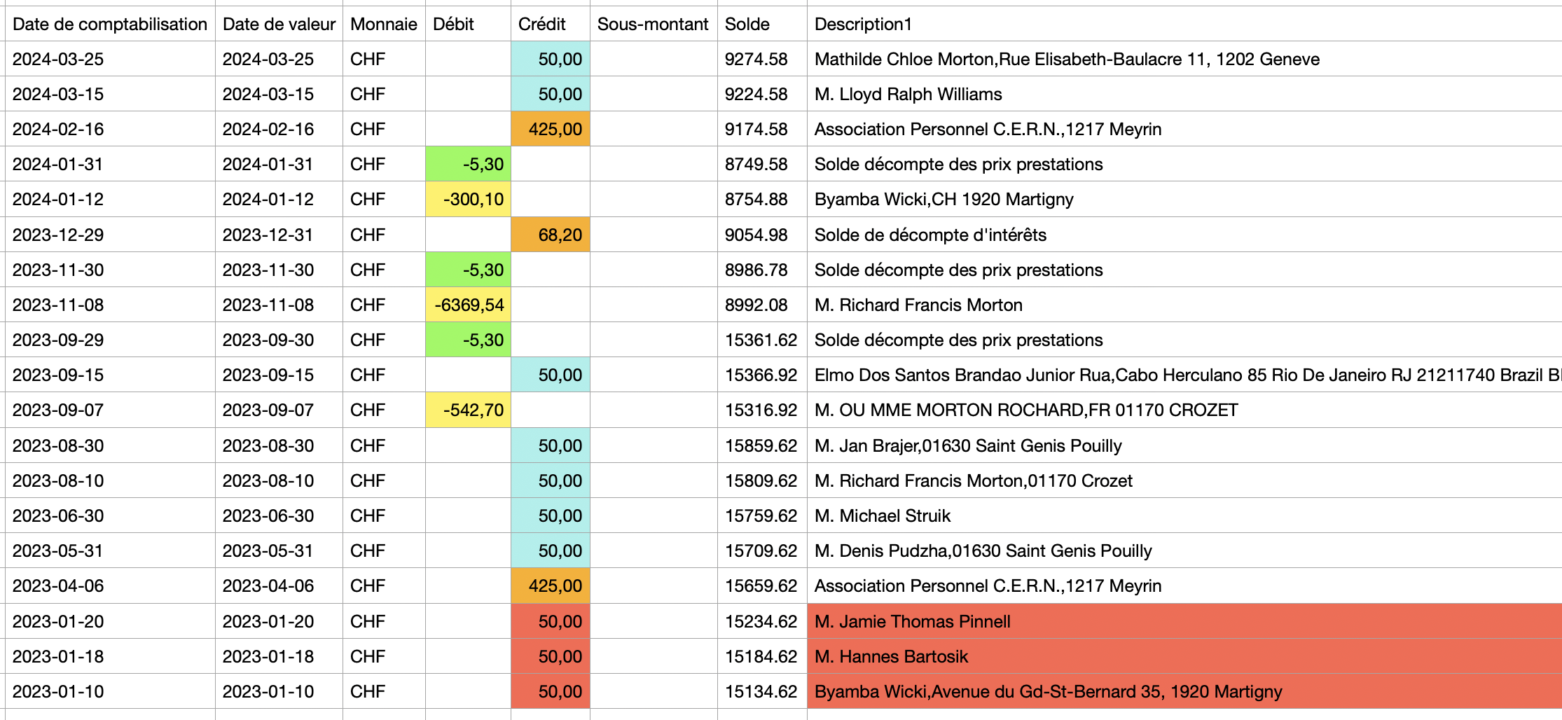
Annual finance presentation by the treasurer Jamie Pinnell
UBS Account Summary

Slide 10
Annual finance presentation by the treasurer Jamie Pinnell
Credit Agricol
Euro Account
Only used for FFAM and ADS payments. Summary to be added.
Current balance 1568,19 Euros (does not include the last payment made to ADS

Slide 11
2024 shopping list
Proposed acquisitions for 2024:
Excel table with materials to be purchased

Slide 12
To Do List
We need to write a privicy statement (CCC can provide an example)
Review the Statutes to clarify our organisation
Update the web pages, mailing list etc - volunteer
Other?

Slide 13
Few words from the president
I would like to thank all of you for your enthusiasm and enjoyment of this activity. The work done to tidy the club house, get things set up and working with ADS, Repairing the roof, but most of all for your participation and enjoyment of our hobby.
This coming year presents many opportunities to grow the club and with your help I hope to increase the amount of flying, building and number of active members.

Slide 14
Elections of the NEW Committee
New committee election

Slide 15
AOB
Around the table discussion

