Slide 1
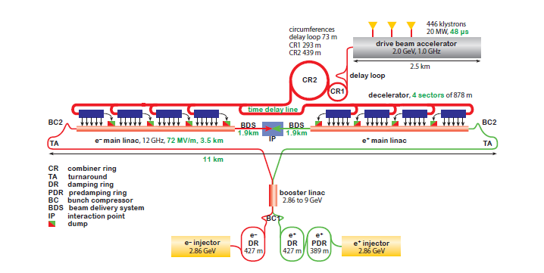
CLIC layout 380 GeV
Drive Beam + Injector
Main Beam Injector Complex

Slide 2
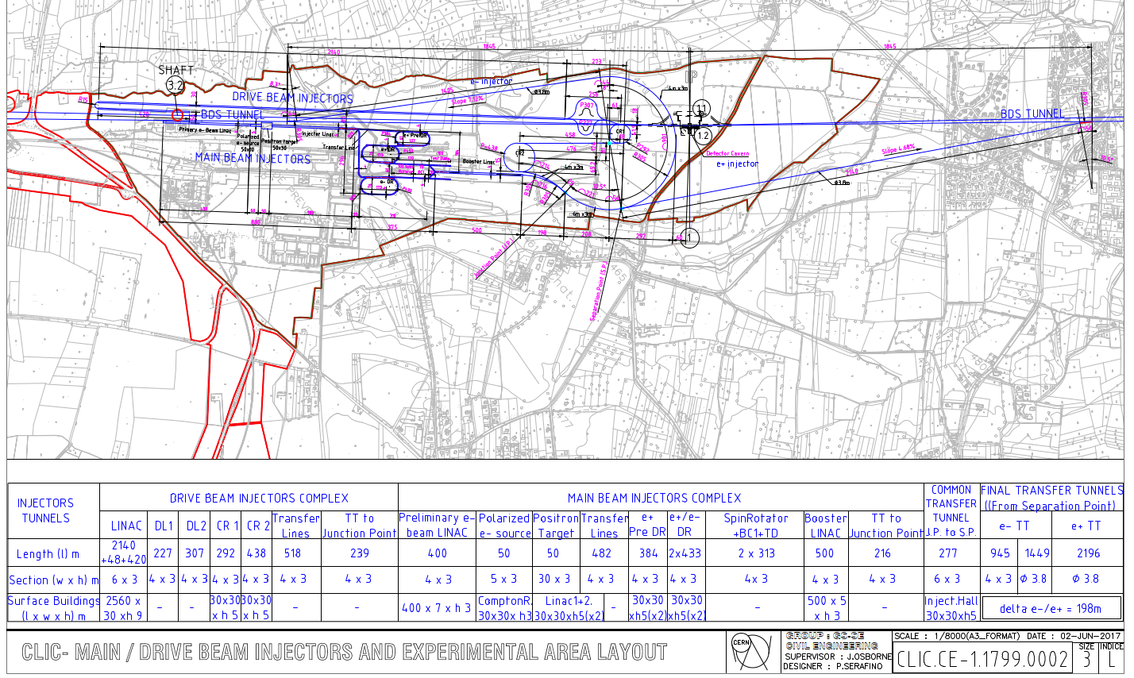
Injector infrastructure

Slide 3
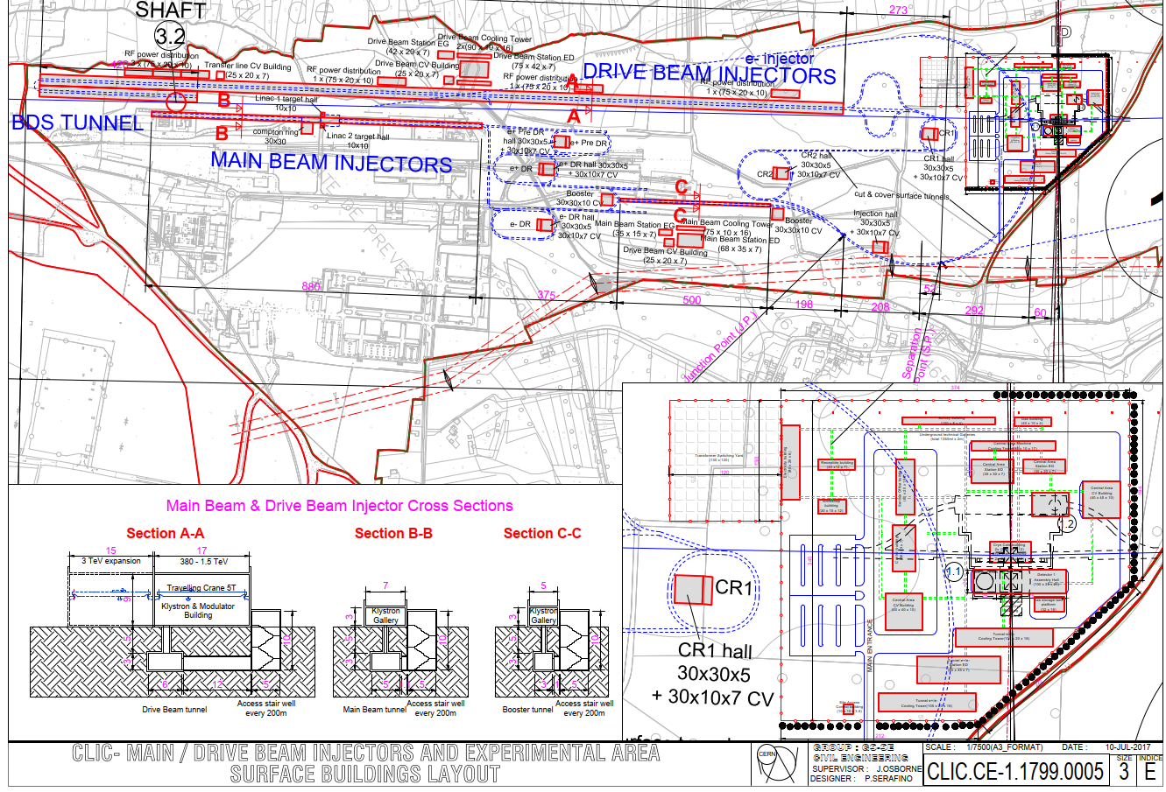
Zoom into the injectors

Slide 4
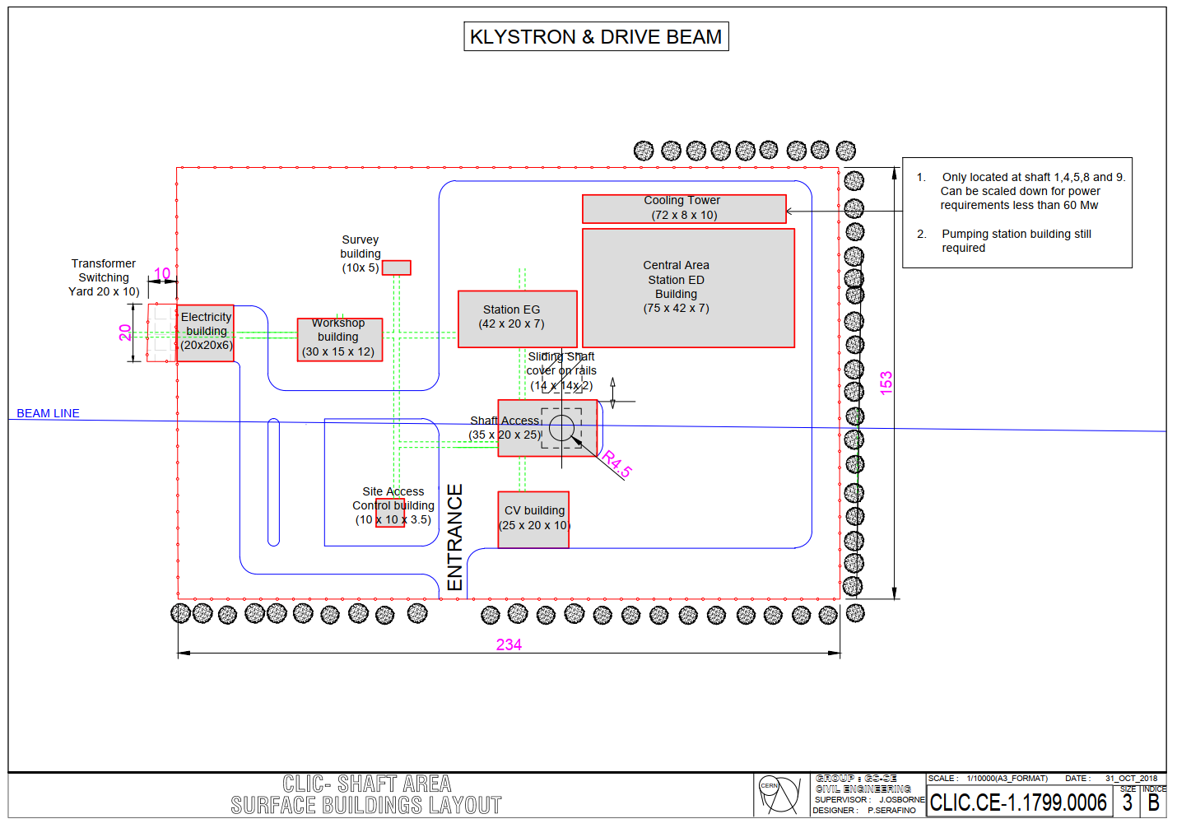
Infrastructure close to shafts

Slide 5


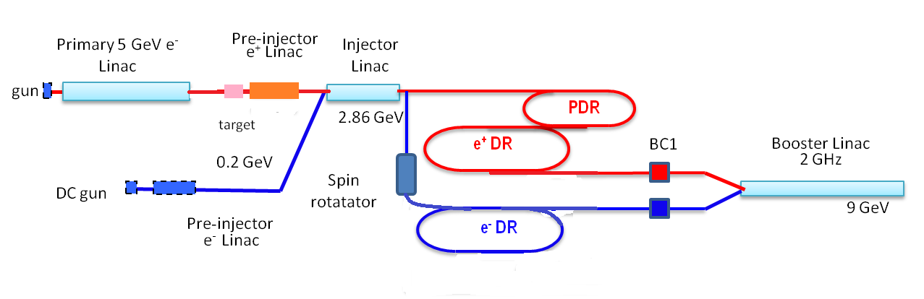
Schematic layout

Slide 6
Rf-module cost model
Typical 2 GHz rf module including accelerators and beam line
Kly 1
50 MW, 8 μs
Mod
Pulse compressor
This unit is used everywhere,
gradient adapts for each LINAC
Kly 2
BPM
Quad
Acc 1
Acc 2
Acc 3
Acc 4

Slide 7
Generic transfer line
BPM
BPM
Quad
Quad
Infra structure ?
Cooling, ventilation, cable trays ?

Slide 8
Cost per linac updated
380 GeV
380 GeV parameters
LINAC | Energy Gain (MeV) | Bunch charge (10^9) | rf pulse length (ns) | Power per structure (MW) | Loaded gradient (MV/m) | Configuration (structure/ 2 klystrons) | No of rf modules | pulse compressor gain | No of structures | Length (m) | Energy gain per module | Cost
e- pre-injector | 200 | 6 | 600 | 75 | 16.7 | 4 | 2 | 4.4 | 8.0 | 15.6 | 100.2 | 4910
e+ pre-injector | 200 | 20 | 600 | 87 | 8.3 | 4 | 6 | 4.4 | 17.0 | 22.1 | 33.2 | 14730
injector linac | 2660 | 7 | 2x600 | 77 | 17 | 4 | 26 | 3.7 | 105.0 | 204.75 | 102 | 63830
positron drive linac | 5000 | 7 | 600 | 90 | 19 | 4 | 44 | 4.4 | 176.0 | 343.2 | 114 | 108020
booster linac | 6140 | 5.6 | 2x600 | 75 | 18.2 | 4 | 56 | 3.7 | 225.0 | 438.75 | 109.2 | 137480

Slide 9
Total injector costs in PBS
 | PBS 380 GeV PP |  |  |  | Generated :
cmd | wu | pbs | pbs description | relative start | duration
cmd | Mxx |  |  | pv | unit
cmd | Pxx |  |  | pv | unit
 | wu | 1.1.1. | Thermoionic gun unpolarized e- | 0y | 0y
 | MP |  |  | 1000000 | CHF
 | wu | 1.1.2. | Primary e- Beam Linac for e+ | 0y | 0y
 | MP |  |  | 108020 | kCHF
 | wu | 1.1.3. | e-/e+ Target | 0y | 0y
 | MP |  |  | 7000000 | CHF
 | wu | 1.1.4. | Pre-injector Linac for e+ | 0y | 0y
 | MP |  |  | 14730 | kCHF
 | wu | 1.1.5. | DC gun Polarised e- | 0y | 0y
 | MP |  |  | 3000000 | CHF
 | wu | 1.1.6. | Pre-injector Linac for e- | 0y | 0y
 | MP |  |  | 4910 | kCHF
 | wu | 1.1.7. | Injector Linac | 0y | 0y
 | MP |  |  | 63830 | kCHF
 | wu | 1.1.8. | Bunching System e- for e+ | 0y | 0y
 | MP |  |  | 500000 | CHF
 | wu | 1.1.9. | Transfer Lines e- to Single Targets Station | 0y | 0y
 | MP |  |  | 100000 | CHF
 | wu | 1.1.10. | Transfer Lines e+ to Injector Linac | 0y | 0y
 | MP |  |  | 100000 | CHF
 | wu | 1.1.11. | Bunching System e- for e- | 0y | 0y
 | MP |  |  | 300000 | CHF
 | wu | 1.1.12. | Pre-injector to Injector Linac Transfer Line | 0y | 0y
 | MP |  |  | 100000 | CHF
 | wu | 1.1.14. | Spin Rotator e- before PDR | 0y | 0y
 | MP |  |  | 500000 | CHF
 |  |  | Booster linac

Slide 10
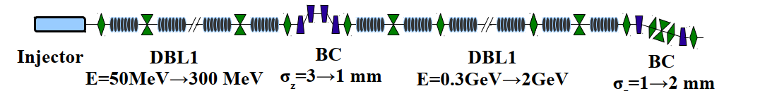
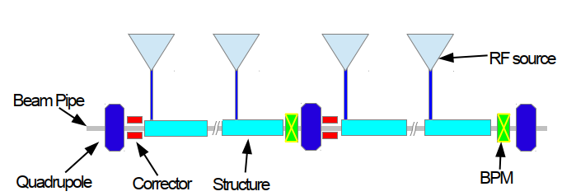
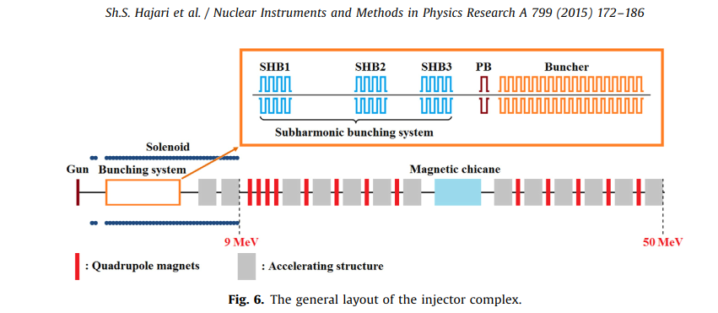
Drive Beam Linac and Injector
Avni Aksoy, CLIC WS 2018
Shahin Hajari

Slide 11
Drive Beam Injector and LINAC cost
Drive Beam Linac uses 470 RF stations (459+ 11 spares), each one powers one structure
We have 200 quadrupoles, correctors and BPM’s
The injector is costed as a lump sum
DB-Injector: 1 x 40 MCHF
L-band Klystron (MBK): 470 x 380 kCHF
Modulator: 470 x 370 kCHF
LLRF: 470 x 50 kCHF
Acc-structure 470 x 250 kCHF
Waveguides 470 x 30 kCHF
Magnet system: 200 x 50 kCHF
Powering: 200 x 18 kCHF
BI: 200 x 15 kCHF
Vacuum: 470 x 43 kCHF

Slide 12
Klystron and modulators
Unified approach for all systems:
-Bottom up cost model for klystrons (O. Brunner) benchmarked with known prices and discussed with Industry to determine prototype price.
-Apply learning curve of 0.92 for number of units
-Determine average unit price.
Klystron | L-band | 2 GHz | X-band
Prototype price | 685 k | 454 k | 595k
Number of units | 470 | 300 | 5800
Average price | 380 k | 260 k | 240 k (see Carlo’s talk)
Very similar for modulators, learning curve 0.92 based on Industry quotation
Unit price L-band (470 units): 370 kCHF
Unit price 2 GHz (150 units): 420 kCHF

Slide 13
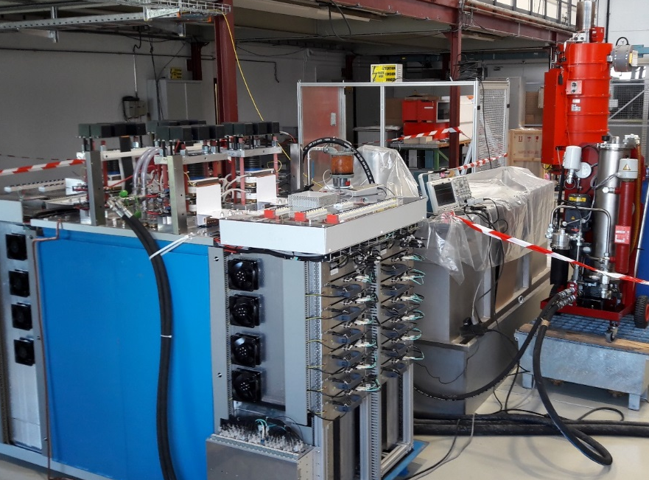
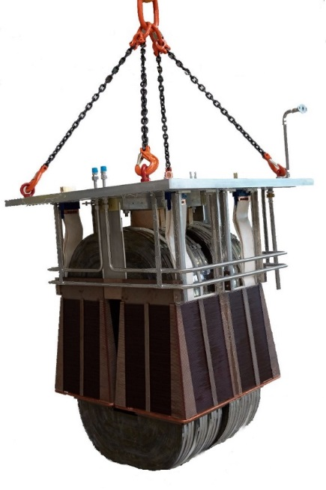
Klystron modulator R&D
CERN-ETHZ collaboration for design & delivery of a CLIC’s Drive Beam klystron modulator
Modulator installed, tested and ready for commissioning with klystron in building 112
World première for precise 180 kV – 30 MW pulse with 3µs rise/fall times & a “long” flat top (150µs) !
Pulse stability better than 0.1 % !
Collaboration with ETHZ successfully ended
CERN-ETHZ Modulator
4 years of R&D studies achievements:
  Feasibility to create voltage pulse verified
  Solutions found to decouple 39 GW of pulsed power from electrical grid
  Optimal number of powering sectors found (For civil engineering)
  Optimal grid layout for power distribution proposed
  Proposal of a new very high repeatable / precise measuring system for high voltage pulses
  Discovery of excellent R&D partners in Canada, UK, Italy, & Switzerland!
180 kV split-core pulse transformer
Pulse transformer tank

Slide 14
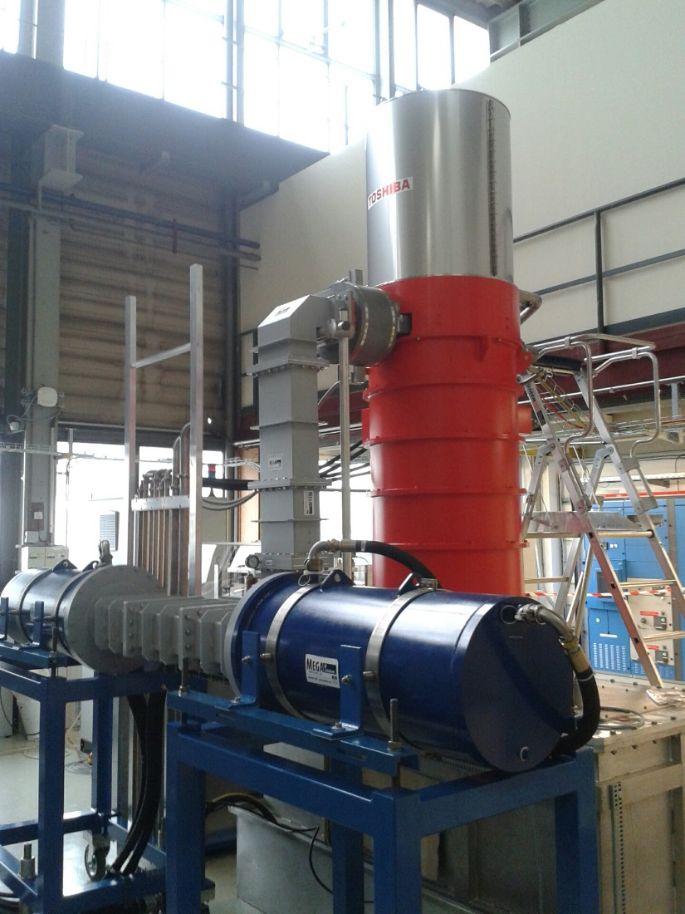
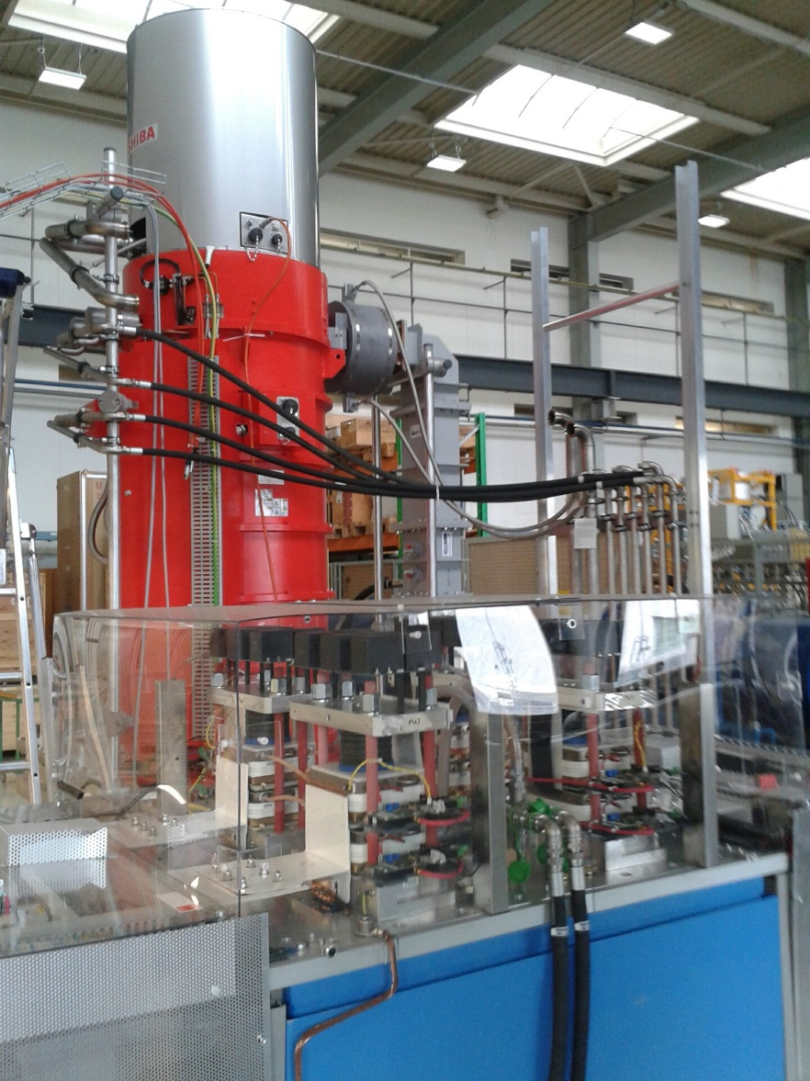
Klystron Test Stand
Location: CERN Bldg: 112

Slide 15
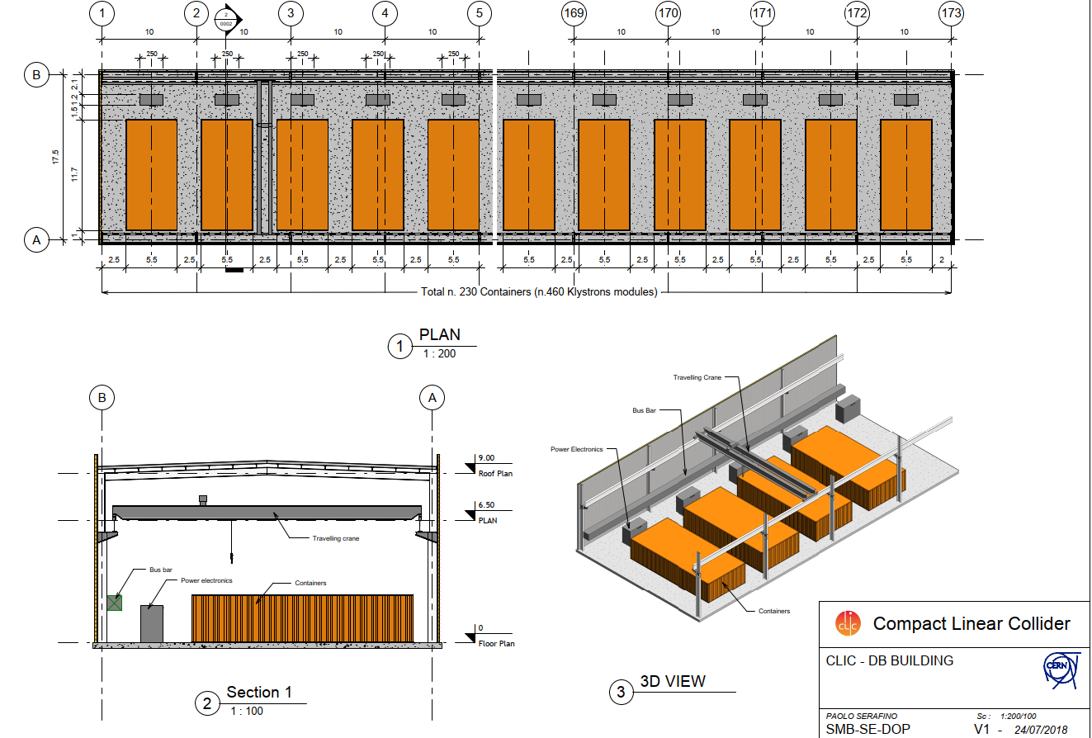
DB LINAC klystron gallery layout

Slide 16
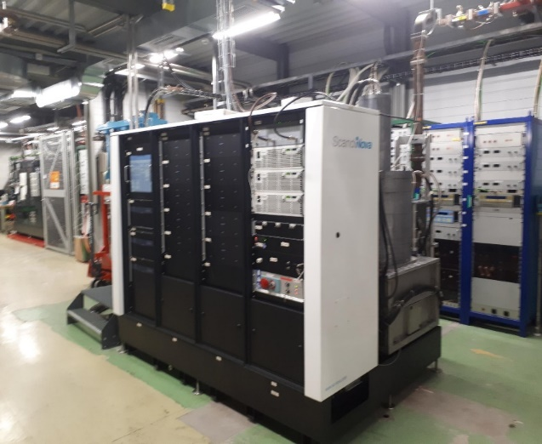
Typical injector modulator/klystron system
Contacted company for input to this study
( Integrated system value or material breakdown )

Slide 17

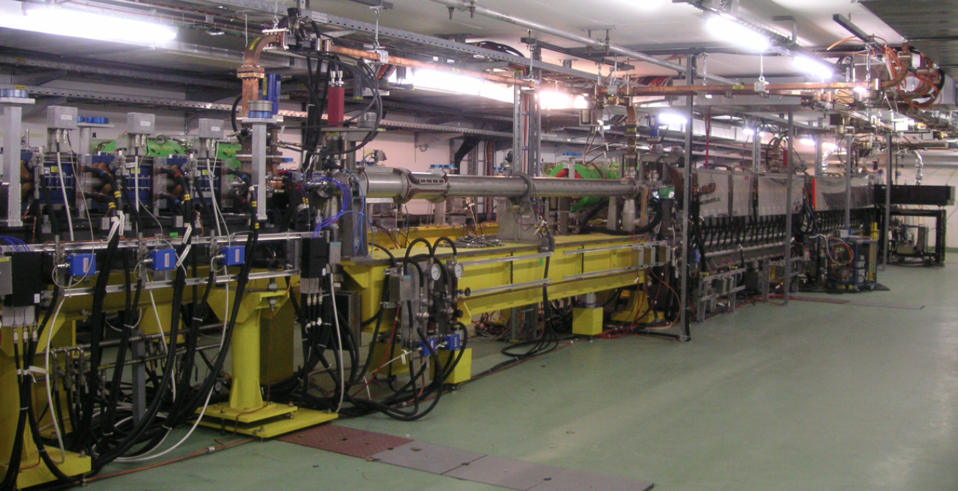

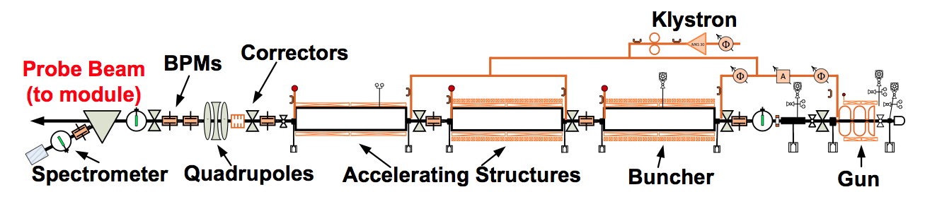
Example of an injector unit

Slide 18
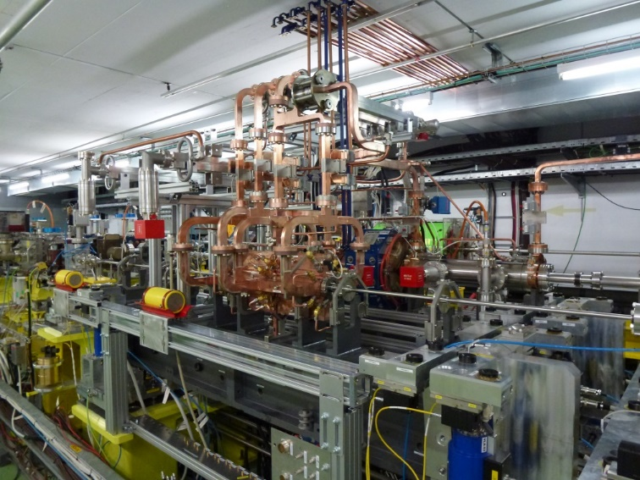
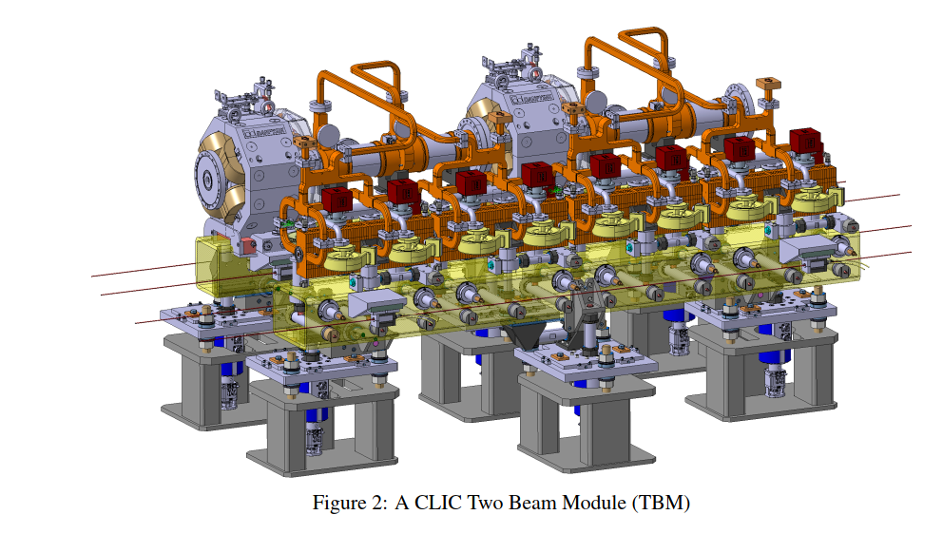
Example of a CLIC main linac module
(see Benno talk)

Slide 19
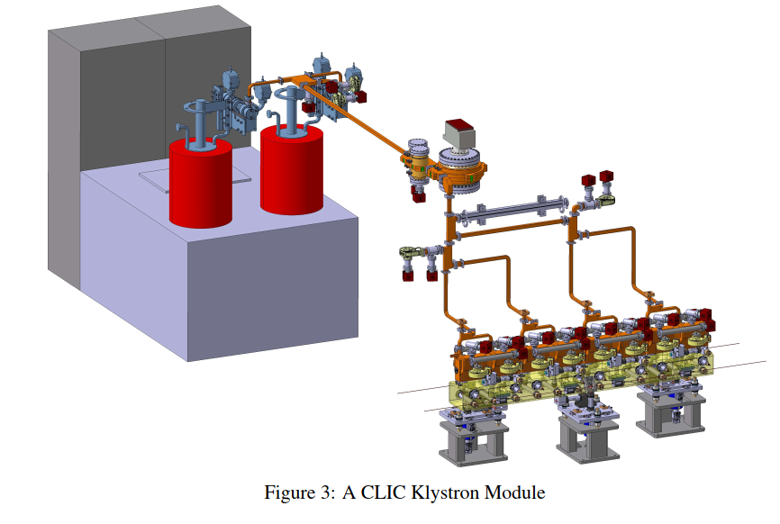
CLIC klystron base module

Slide 20
Discussion
We would like to break down the machine in several sectors with a length and a cross-section, will generate table (see preliminary example below)
Will provide data of main building blocks either per meter or per unit and number of units.
Attention some updates needed with respect to shown data
Drawing 1.17999.0002 | Type | Length (m) | Dimension | CE | Shafts and caverns | Surface buildings | Materials | Comments
 |  | (all to finalised) | (to be checked)
 | ML | 7000 | 5.6 | Done | Included in studies made | At shafts and coll. point? | Specify (include turn around) | All CE covered in earlier studies, check surface buildings
 | BDS | 4000 | 5.6 | Done | Included in studies made |  | Specify | All CE covered in earlier studies
 | Detector(s) | NA |  | Cavern done | Included in studies made | Surface buiLding? | Specify | Attempt to provide overall material breakdown
DRIVE BEAM INJECTOR COMPLEX AND TRANSFER TO ML TUNNEL | DB | 2300 | Cut out, give dim | Cut out and building | NA | 30x9 | Specify | On surface
 | DL and CR | 1100 | Cut out?, 4x3 ? | Cut out? Buildings? | NA | Surface building? | Specify | Understand surface or cut out
 | DB transfers until ML tunnel | 4500 | 4x3 and then down | Cut out? Transfer tunnel | NA | Surface building? | Specify | Surfce/cut out and then transfer tunnel
MAIN BEAM INJECTOR COMPLEX | Injectors "active" | 900 | Surface buildings | Buildings | NA | Surface building | Specify | Buildings (no cut out?)
 | Transfer to ML tunnel | 3000 | 4x3 and then down | Same transfer tunnels as DB | NA | Surface building? | Specify | Surfce/cut out and then transfer tunnel
 | DR | 1200 | Cut out?, 4x3 | Cut out and/or building | NA | Surface building? | Specify | Building or cut out

