Slide 1
CERN Project Updates
Jeevi Scarozza
3/27/24

Slide 2
Project Status
Breast cancer screening: Assisting when needed
Preprocessing and Recursive Feature Selection
LCH Project: New
Literature review and testing out of the box models
Implementation of deep learning models
Supervised Learning Approach
Feature pyramid networks, and Unet models
This part edit by "Insert > Header and Footer”

Slide 3

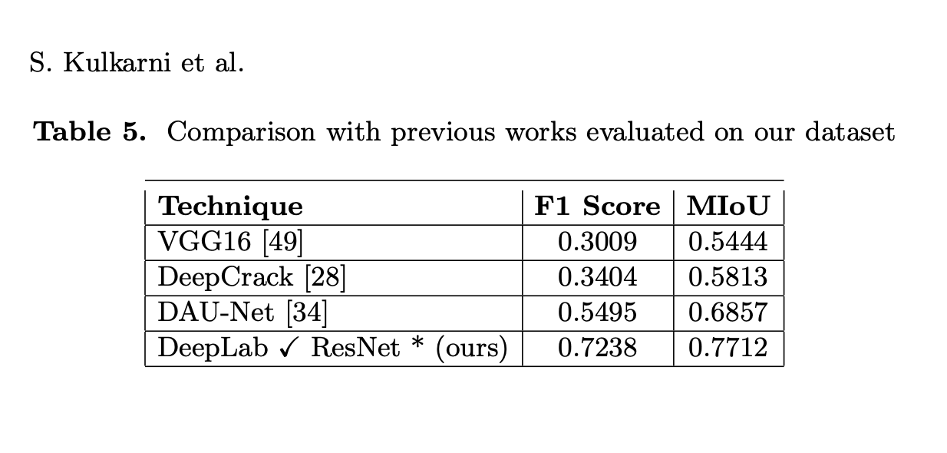
Literature Review
Deeplab V3 plus performs best (feature pyramid network)
Best on linear cracks
Why is crack detection difficult?
Noise and distortions
Most existing work has been developed on one type of dataset (eg, walls, pavement)
Linear, webbed, branched

Slide 4
The Dataset
Crackseg9k dataset
Preprocessing data. Splitting and normalization
Normalization Process: Dividing by 255: transforms pixel values from the original range of 0 to 255 to a new range of 0 to 1.
Standard Image Size: 400x400
Train set: 5052 images Validation set: 631 images Test set: 632 images
Training Process:
Training using large amounts of labeled data to learn patterns and relationships. In my case, dataset of 9000 images of cracks.
The training process involves iteratively adjusting the model's parameters to minimize the difference between predicted and actual outputs.
Once trained on the publicly available data, will implement on the LHC images

Slide 5

What are Convolutional Neural Networks
A Convolutional Neural Network, is a type of neural network specifically designed to handle data with a grid-like structure, such as images. Images are digital representations composed of pixels organized in a matrix.
Binary Image: Set of real numbers from 0 to 255
For color image of 28 pixels for instance. The representation is 7x4x3
3 corresponds to the RGB channels
Color Image Example

Slide 6
Preparing the Model
What is x?
Algorithm takes images of cracks as input. Images are matrices (example 2d array or 3d array). Each image is constructed of pixels. Each pixel has 3 values in color images
What is y?
Segmentation mask
Each pixel in the segmentation mask is labeled as a crack or not.
The loss function?
Ground truth mask is the manual segmentation. Loss function is determined by difference between predicted mask and ground truth.
We use images with cracks and segmentations to train. Then we can predict segmentation masks in new images to detect cracks.

Slide 7
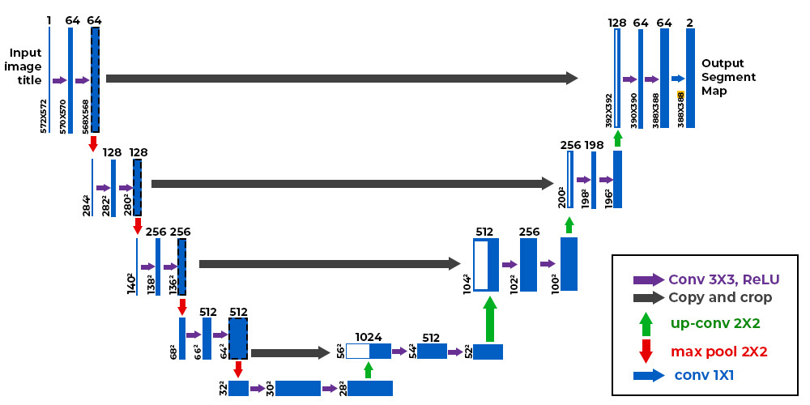
UNETS
Contracting Path (Left Side):
This path resembles a typical convolutional network architecture.
Expansive Path (Right Side):
This path focuses on upsampling and reconstructing the feature map.
The final layer serves to transform the high-dimensional feature representation into a segmentation map with the desired number of channels, where each channel corresponds to a specific class or category.

Slide 8
Keras Model: Unet
In a Keras sequential model
We compile the model, then fit, and then predict
Compiling: defines loss function, the optimizer, and the learning rate
Fitting model: determining values for the weights and biases from labeled examples. Training
Predicting: using test set to predict instances of cracks (0 or 1)

Slide 9
Training a Model
The Behavior of Training and Validation Loss:
In a well-trained model, the training loss should decrease over epochs as the model learns to minimize the error between predicted and actual values.
The validation loss, which measures the model's performance on a separate validation dataset, should also decrease initially.
However, if the model starts overfitting, the validation loss may begin to increase even with a decrease in training loss.

Slide 10
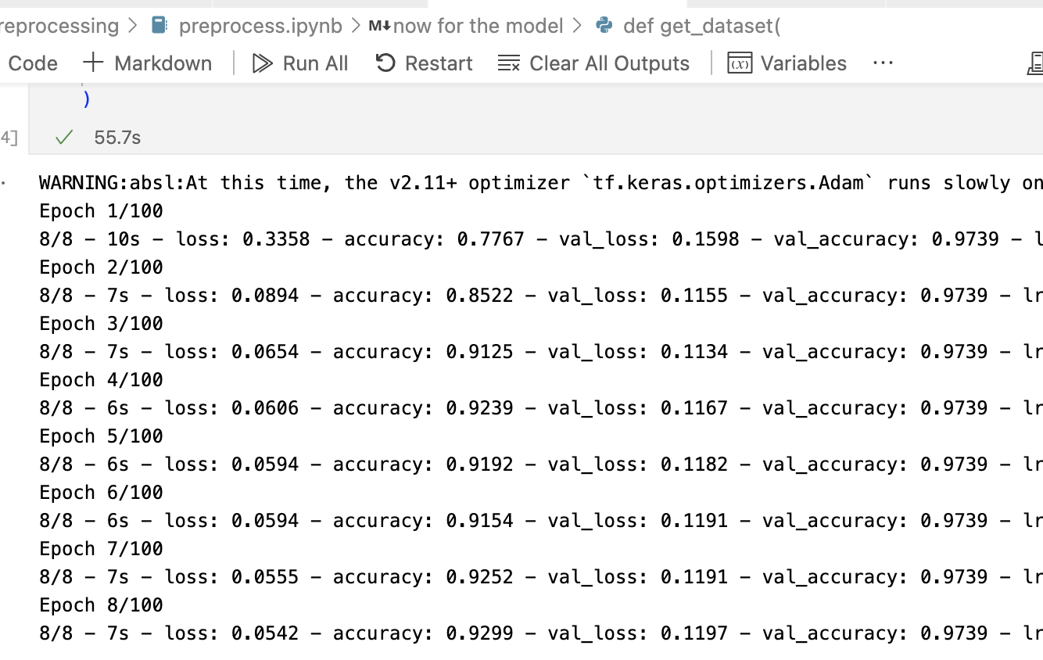
Dealing with Imbalanced Data
Current issue:
The dataset suffers from class imbalance, where one class (non cracks) is significantly outnumbered by the other class. The model might prioritize accuracy by predicting the majority class, leading to poor segmentation of the minority class.

Slide 11
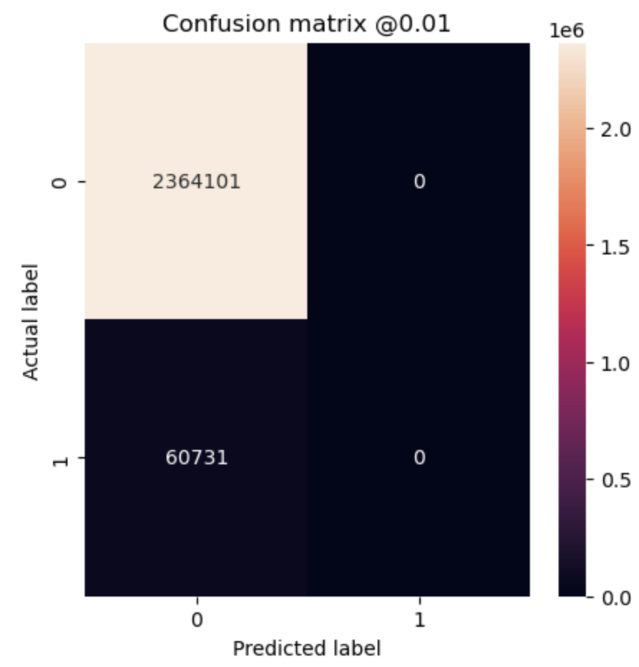
Developing Model
Scaling by weighting is a technique used to address the imbalance in the dataset by assigning different weights to each class during training.
Calculating the weights based on the class frequencies and incorporating these weights into the loss function during model training.
Implementing early stopping

Slide 12
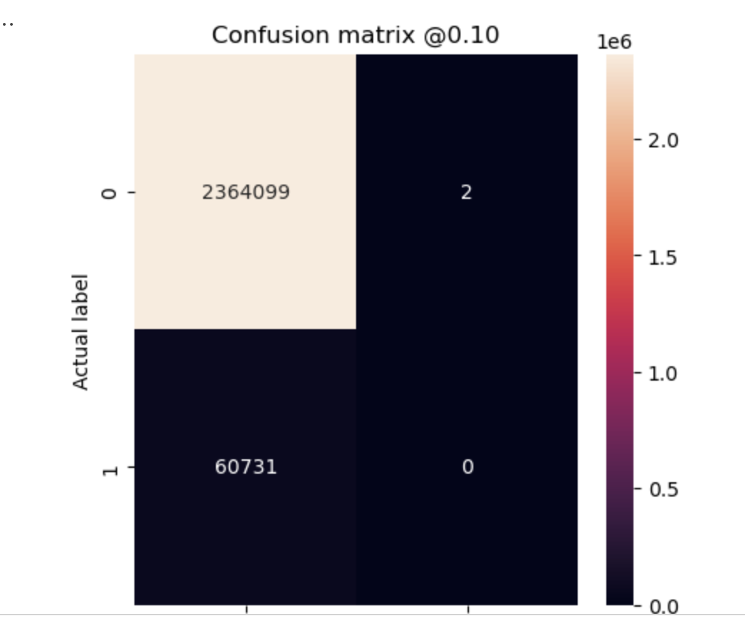
Current Issues
Adjusting the model weights barely improved the class imbalance issue

Slide 13
Further Plans
Fixing the Keras model, then testing on LHC images.
Deeplab V3+ (tried to implement from Gitlab but was outdated)
- Finding updated code
NNUnet Model (Gitlab): fully automatically configures an entire segmentation pipeline

Slide 14
Sources
https://www.geeksforgeeks.org/u-net-architecture-explained/
https://arxiv.org/pdf/1505.04597.pdf
https://github.com/Dhananjay42/crackseg9k/tree/main/DeepLab
https://github.com/MIC-DKFZ/nnUNet/blob/master/readme.md
https://www.researchgate.net/publication/330244656_Feature_Pyramid_and_Hierarchical_Boosting_Network_for_Pavement_Crack_Detection
https://arxiv.org/pdf/2208.13054v1.pdf
https://www.tensorflow.org/tutorials/structured_data/imbalanced_data

