Slide 1

TESTBEAM
Starring Philip Templeman
Produced by the CMS GEM Lab

Slide 2
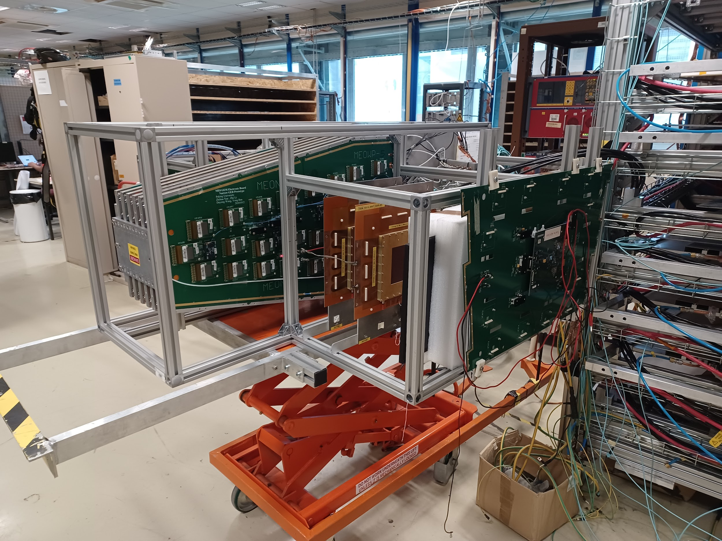

Slide 3
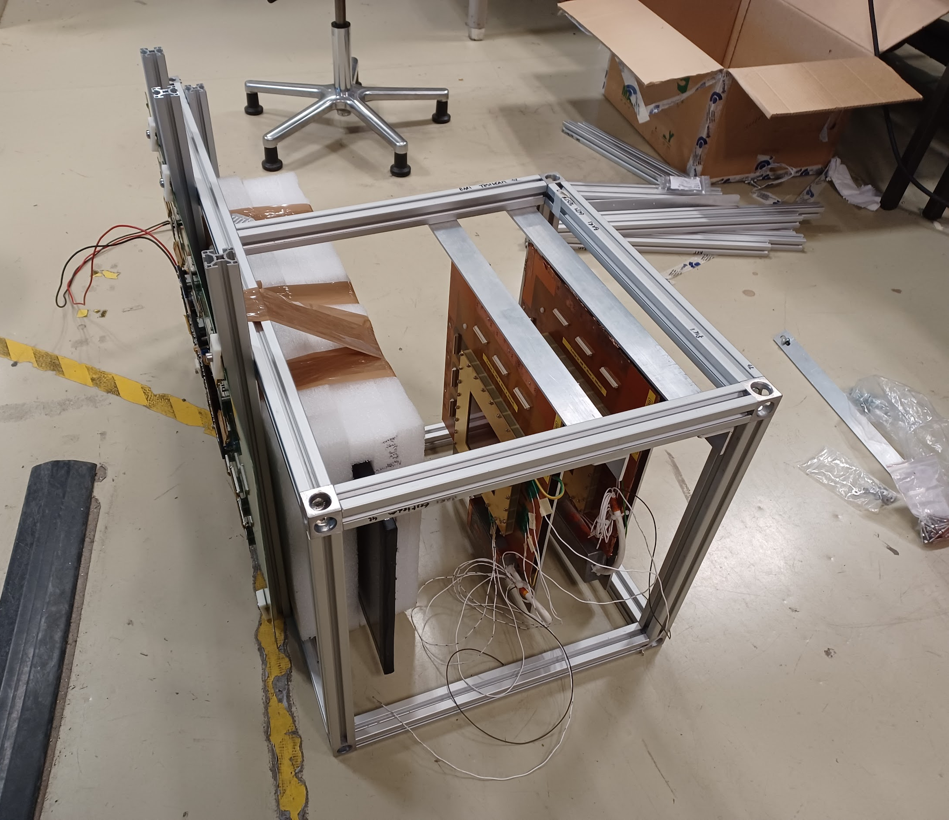
Time Calibration:
Scintillator
Position Calibration:
GEM Tracking Chambers
GEM Electronics Board

Slide 4
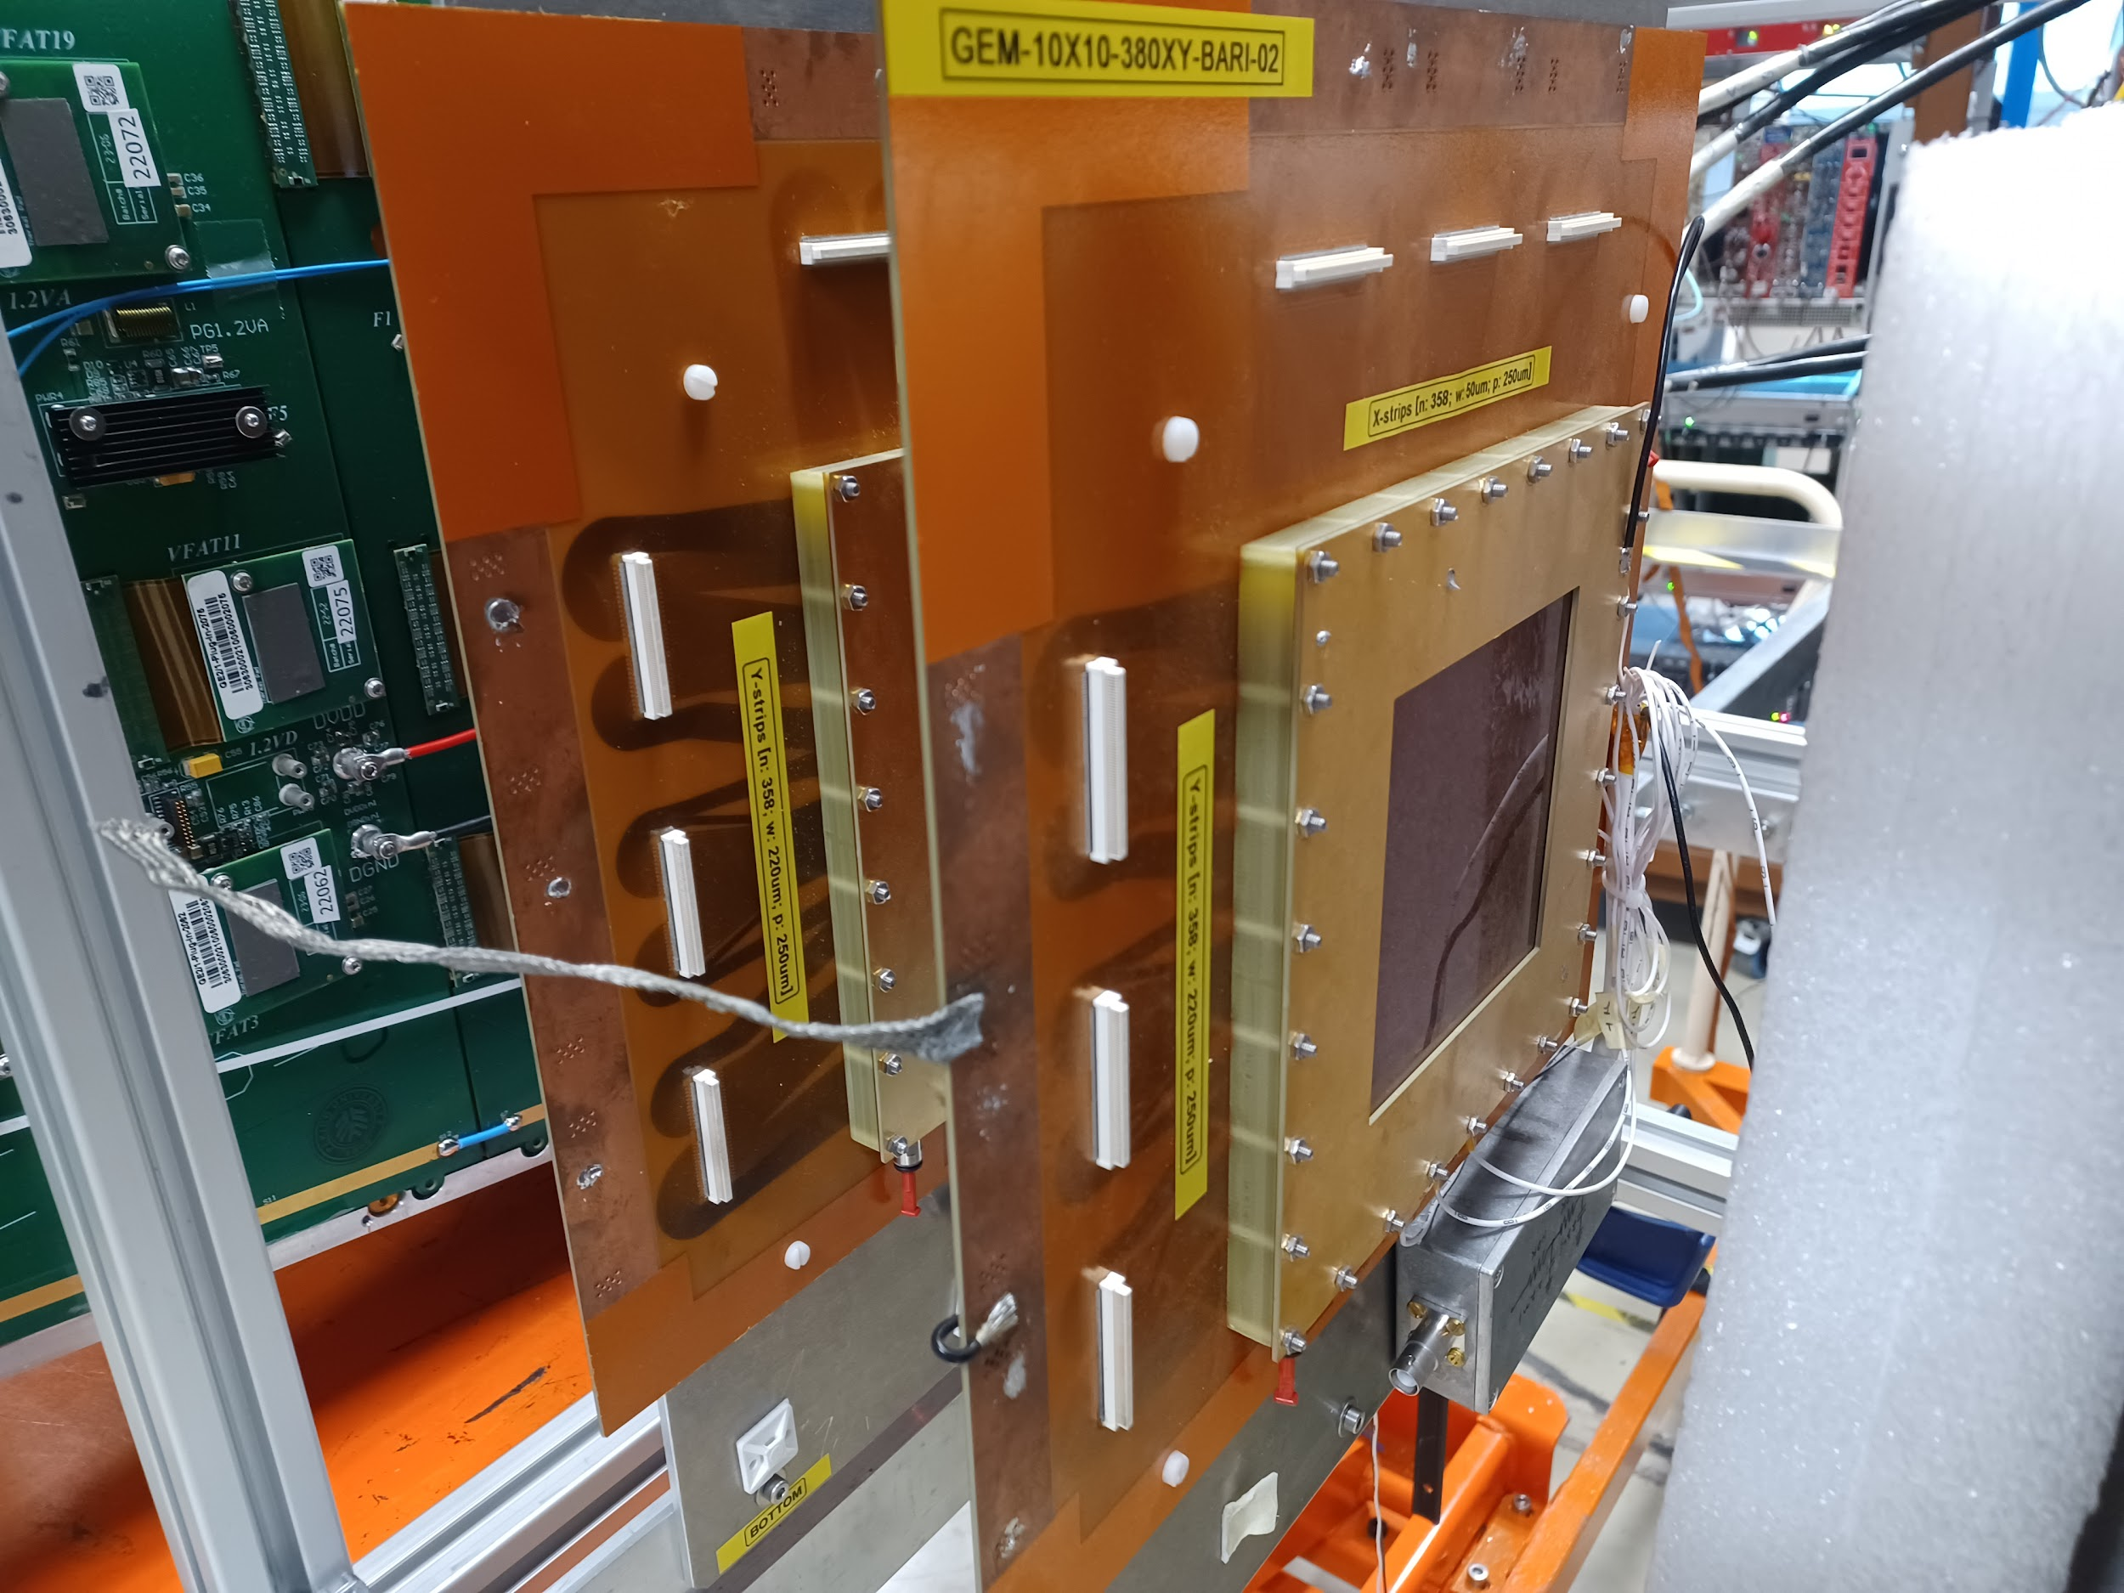

Slide 5
