Slide 1
LKr highlights
R. Fantechi
9/9/2011

Slide 2
Status of the TALK board
G. Lamanna

Slide 3
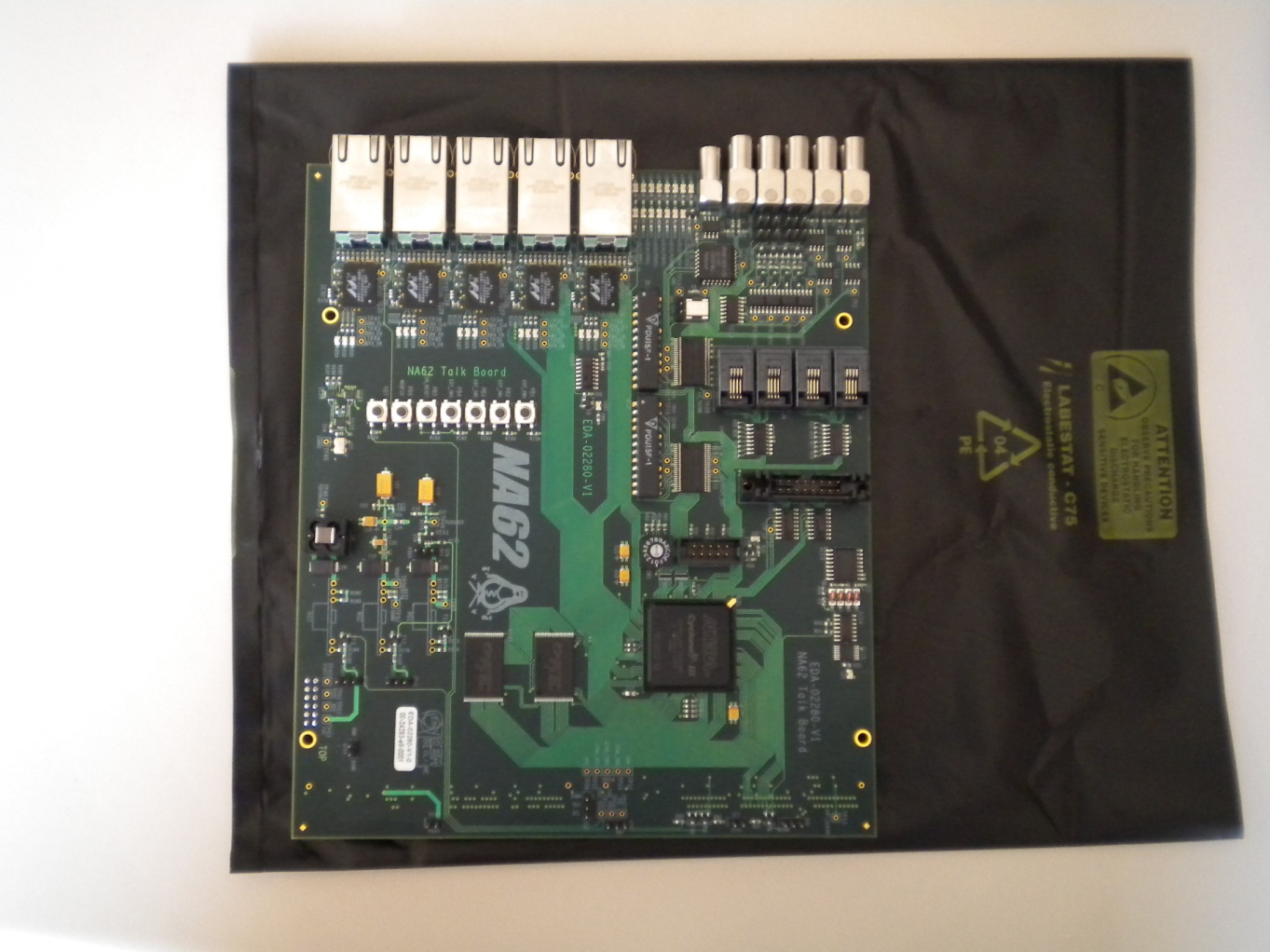
TALK board
Two mounted TALK board prototypes arrived 25.7.2011 (+ 1 naked PCB)
One month of delay due to PCB construction (epoxy between two layers with controlled impedance)
Missed 3 DC-DC converter in the mounting (due to wrong components) → fixed by our self
The mounting is well done.

Slide 4
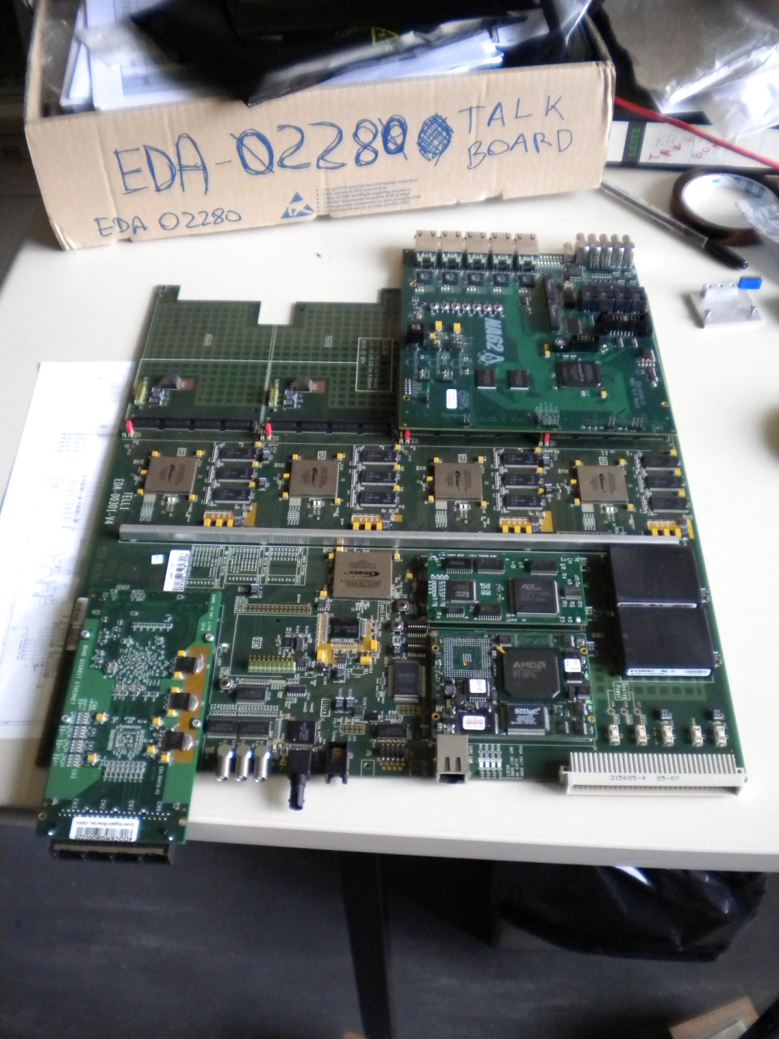

Mechanical, electrical and smoke test
The TALK board fits very well in the TELL1 (no particular stress on the connectors, the screws are correctly located)
Power ok, both through power connector and TELL1
No smoke!

Slide 5
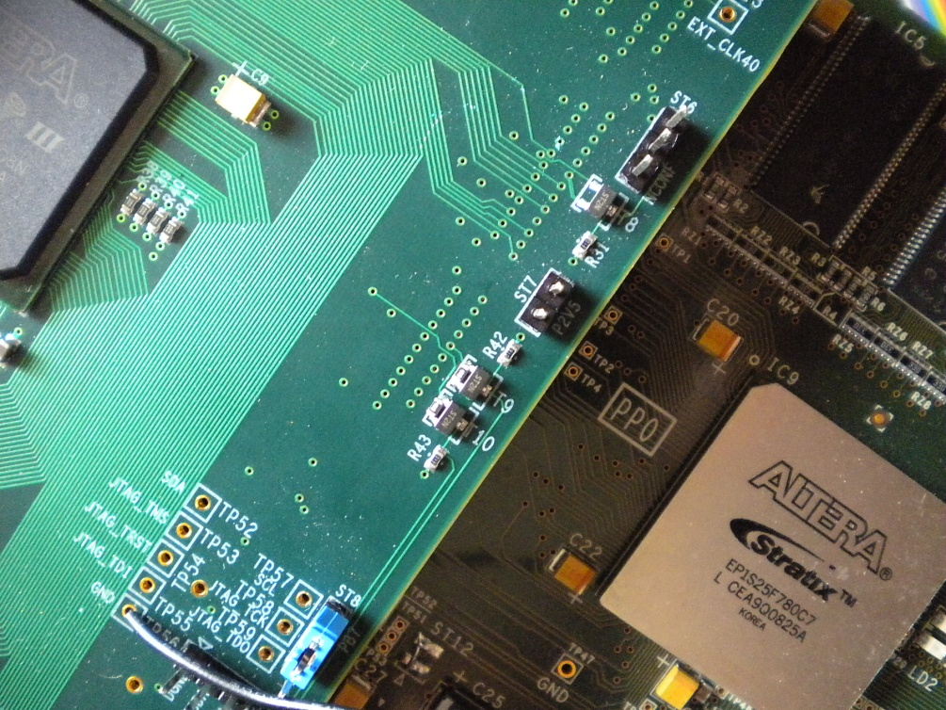
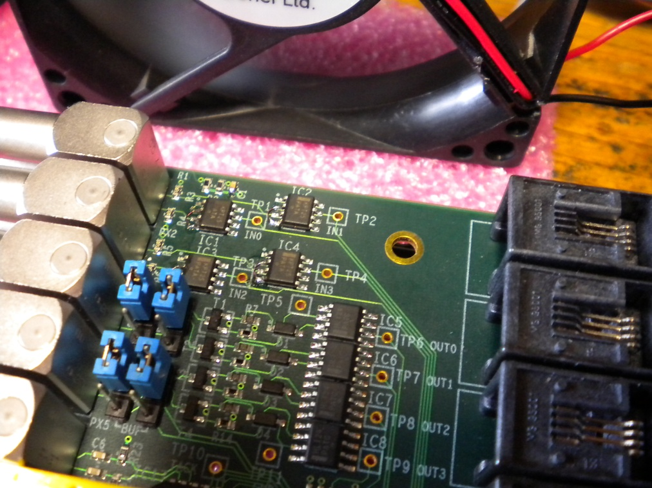
Small mistakes
Three small mistakes:
  NIM-TTL converter (5 chips): wrong pin used for level reference
  Pull-down resistor on MOSFETs to control the power from the TELL1 PP registers: unstable behavior due to the undefined value of the signal at start-up
  JTAG jumpers: impossible to disconnect the JTAG chain on the TALK board when connected to the TELL1. Troubles with the TELL1 JTAG chain (lines cut, further investigation)
All these problems have been fixed
The final version of the board will include these changes.

Slide 6
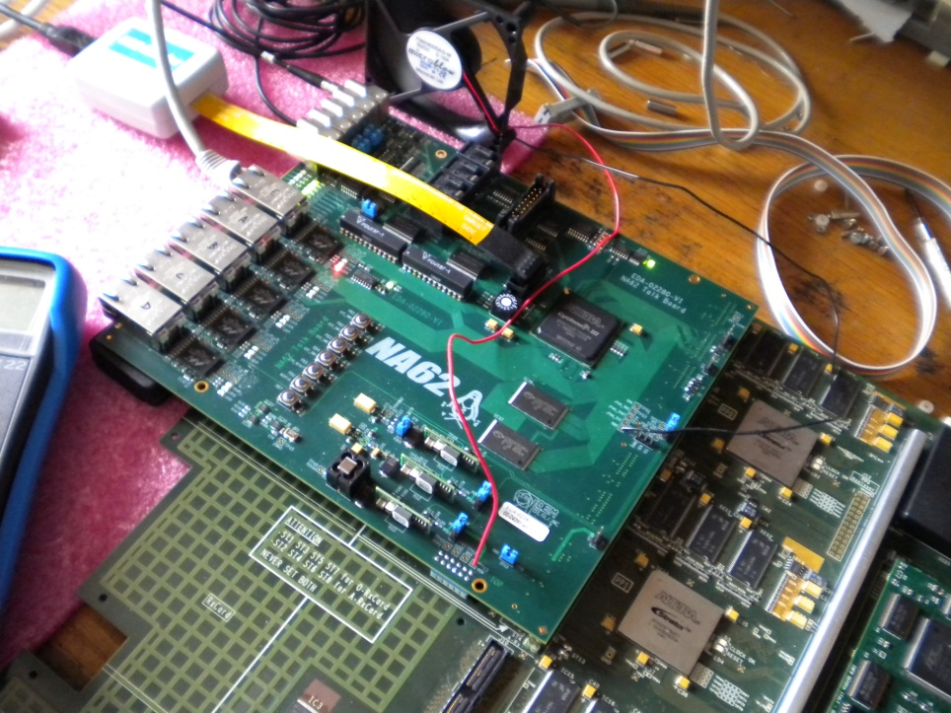
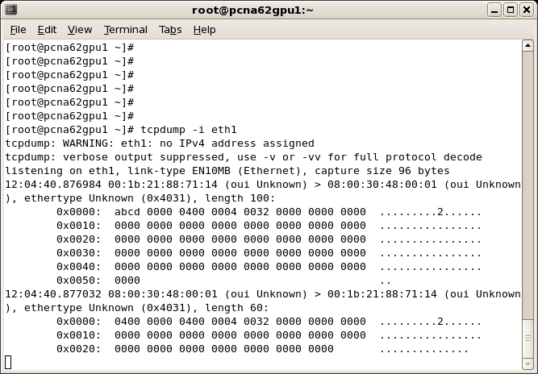
Tested features
The firmware can be easily loaded through JTAG
The I2C access works fine
The Ethernet controller works fine, both in input and output. Several functions tested: ping, read mem, set calib, read calib,…
NIM translators work in both ways
External memories: I2C+ETH, I2C+I2C
Control software in preparation

Slide 7
Coming soon
TALK firmware
  Write memory from ethernet: essential in case of use as L0TP (with some limitations due to the speed of the static memory)
  Packet sender simulator: for very precise latency test
  External triggered timestamp generator: in order to measure the SEU in TEL62 (i.e. for the CEDAR)
TELxx firmware
  Start to develop and test the firmware for the timestamp generation and taxi handling
Hardware tests
  Check with the proper firmware the functionality of taxi, delay lines, choke/error inputs, LTU connector
To have the board ready before the end of the year

Slide 8
LKr activities
R. Fantechi

Slide 9
Fastbus power supplies
Reminder
  Refurbishing of the old Fastbus power supply needed to have the readout working in 2012 and before the arrival of the CREAMs
  Wiener is updating 10 old power supplies
Prototype received early August
  Inspection showed that it was wired to use two phases
  Test in the lab with a standard 3-phase cable connected to a switch was ok
  But in ECN3, replacing one faulty PS with the new one…
    Boum!!!! Sparks, bad smell, etc.
    We guessed a problem with “live” insertion of the power cord/normabarre connector
  PS sent back to Wiener for inspection
    With a little delay due to their holidays, we had a report and good news….

Slide 10
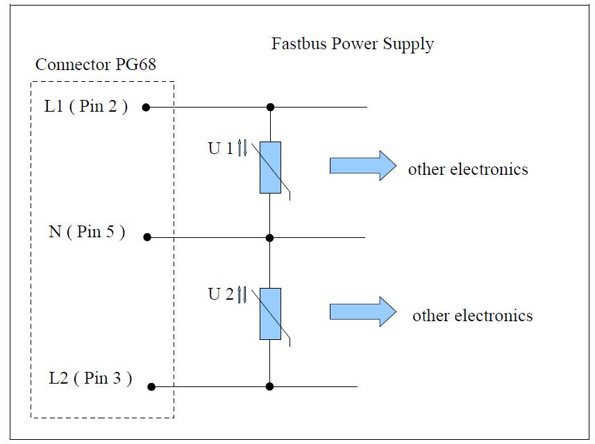
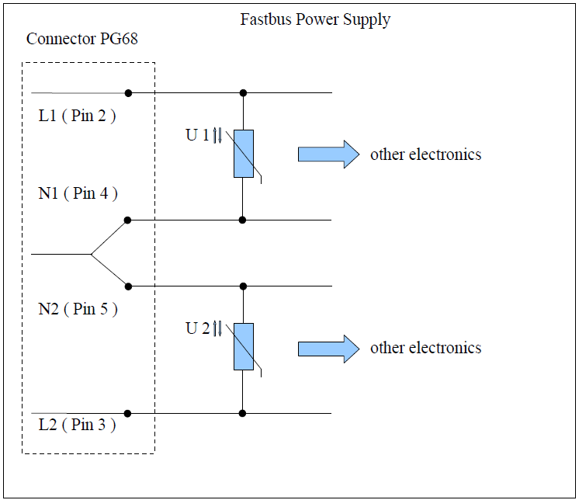
Fastbus power supplies
Modification proposed by Wiener
VDR’s broken
A bad “live” insertion of the connector, implying that the neutral line is not connected, gives rise to an overvoltage between L1 and L2 (tested by Wiener )
In this scheme the connection between the “neutrals” of the two sets of power modules is done externally. A bad “live” insertion of the connector, implying that the neutral line is not connected, will not connect in series the two sets of power units
It is a good solution, we have anyway to re-wire the power distribution to balance the phases.
Plan to have 10 modules ready in two months

Slide 11
CREAM
As already announced
  The tender procedure for the CREAM is completed
  The next Finance Committee (in 10 days) will consider and (hopefully) approve the tender result
Try to advance as much as possible
  Waiting for the decision, as everything is still unofficial, we had an informal meeting on Sep 1st with the proposed firm (a well known one with a red and blue logo….)
  Three technical people (FADC, firmware and integration) were present together with the commercial representative
  On our side Augusto, Gianluca, Vladimir and myself

Slide 12
CREAM
Program of the meeting
  A visit in ECN3 to show them the installed hardware and to touch the real problems
  A discussion in the conference room in 918, driven by slides from Vladimir and by the questions from them
A very fruitful meeting
  The project is challenging in all its aspects, but our general feeling is that they are able to do it.
  We have decide to have a monthly exchange to follow the progresses.
  For some of the more sensible points, decisions has been taken
    Quickly design and build a one-channel shaper board to be tested both in the lab and with real calibration signals
    Quickly understand the solutions to have a solid installation of 50-pin D connector on the front of a 6U VME module
    Refine the requirements for the network protocol to be used to transfer the data to L2/EB

Slide 13
LKr DCS
After the presentations at the last WG
  The implementation of the “LKr vertical slice” of the NA62 DCS system is almost complete
  HV control and monitor (Brian O’ Connell) is being integrated in the standard way
  ELMB adapters (designed by myself..) has been built and installed by Valeri
    Tests to be completed this week
  PLC for digital I/O installed and configured
    To switch on/off transceiver and preamplifier power supplies

Slide 14
Next steps
Talk
  See Gianluca
Fastbus readout
  Complete power supply acceptance
  Go back to the SLM readout software and implement all what is needed to run in 2012
    Zero suppression
    Control framework
    Handling of timestamps from the talk
    Implementation of data merger
  Integrate the SLM PCs in the new NA62 network scheme
Clock and timing
  The old NA48 clock system has been installed in the EB
  Complete the move of the timing system from 918 to EB to prepare the signals for the TTC system
DCS
  For the HV monitoring system (Brian’s work) upgrade the software to use a Linux SBC instead of the old LynxOs system
CREAM test bench (ICE Cream)
  Start to procure the hardware and to design the firmware/software

Slide 15
LKr database
A. Norton, R. Fantechi

Slide 16
LKr constants in NA48
Kept in HEPDB
  KTRA (transconductances, to convert calibration signals to currents): 128x128 matrix, one float/channel
  PLIC (pedestals): one PLIC per CPD with 64 x (status flag, ped and sigma)
  KLIC (gains and offsets) one KLIC per CPD with 64 x (status flag, then gain, offset for each 4 gain ranges )
  KFIL (digital filter constants):
    128x128 shape/cell,
    nshapes(max 20)x2x51x3 coefficients first type
    nshapes(max 20)x2x81x2 coefficients second type
    nshapes(max 20)x2x61x2 coefficients third type
  KKE3 (Ke3 intercalibration factors): 128x128x(correction factor, number of events used, average electron energy)
  Active CPDs on a run by run basis
  List of dead channels, on a run by run basis, with the indication of the malfunction reason

Slide 17
Towards NA62
Some simplification
  Gains and offset will have only one set of values (no gain switching
  Digital filter data will be reduced: possibly less shapes, it is likely that the absence of gain switching will allow us to avoid use “second” and “third” type.
Use of old HEPDB data to debug the reco code
  Extract each block of constants from HEPDB into a suitable memory structure and store them into the new database when defined and available.
  As an example, there is a job (now with Eva) which extracts the KFIL constants.
  The plan is to provide equivalent jobs for the other structures

