Slide 1
RICH WG
M.Lenti

Slide 2
RICH Situation: news
All the RICH mirrors at CERN since may
Aluminization will start at CERN in the coming weeks
Mirror support project to be finalized by the end of 2011, then start the tender
Aluminum disk for light collection (“Winston Cones” disks) and PM lodging (“PM disks”) in fabrication in Firenze

Slide 3
CRATE POSITIONS
R.Ciaranfi
43U rack 21 POSITIONS
H=213 cm
HV
9U BIN (without PS)
16 X 32 CH HV FILTER
SIG
16 X 32 CH FE_DAQ
SLOW CNTRL GATEWAY
11U crate
3U AIR gap
SIG
16 X 32 CH FE_DAQ
SLOW CNTRL GATEWAY
11U crate
HV
16 X 32 CH HV FILTER
9U BIN (without PS)
43U TOTAL HEIGTH

Slide 4
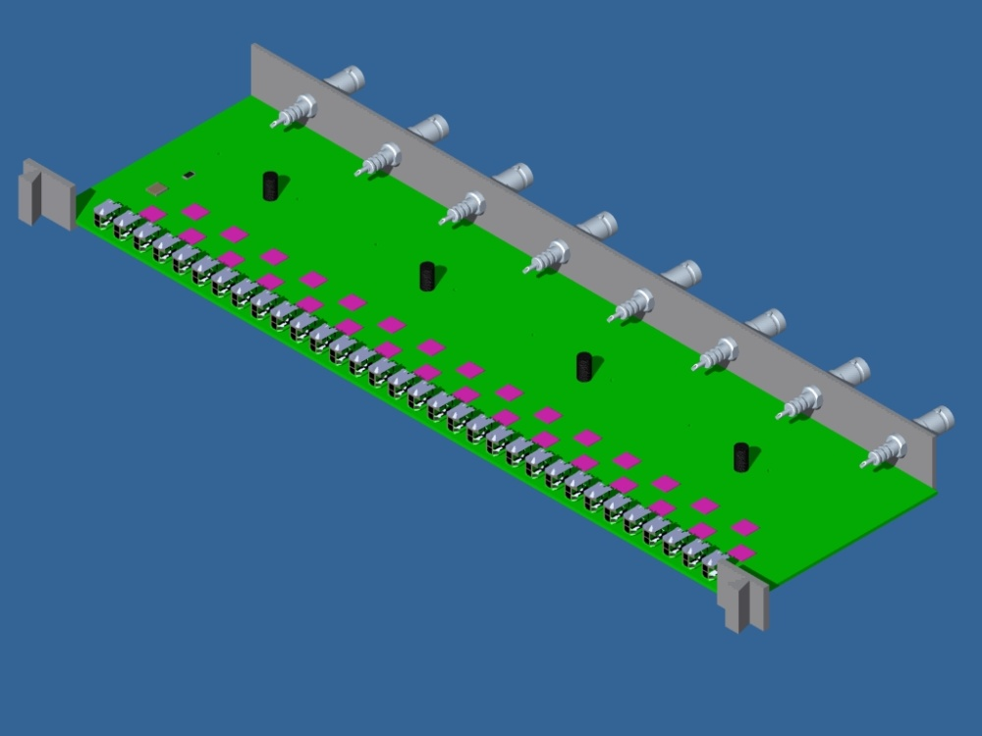
3D PCB VIEW: HV FILTER BOARD
R.Ciaranfi
BRACKET TO FIX BOARD TO THE 9U EMPTY CHASSIS
SHV CONNECTOR FROM CAEN HV-PS
32 CH HV TO PMT
SPACERS SUPPORT FOR SECURITY COVER

Slide 5
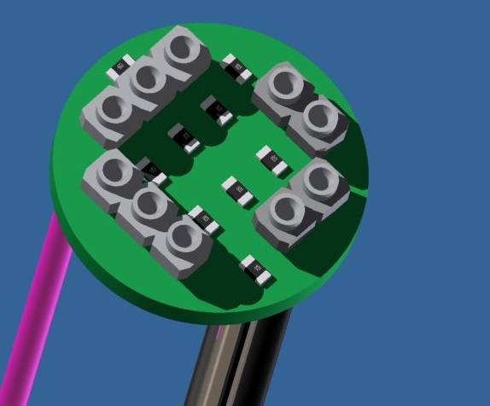
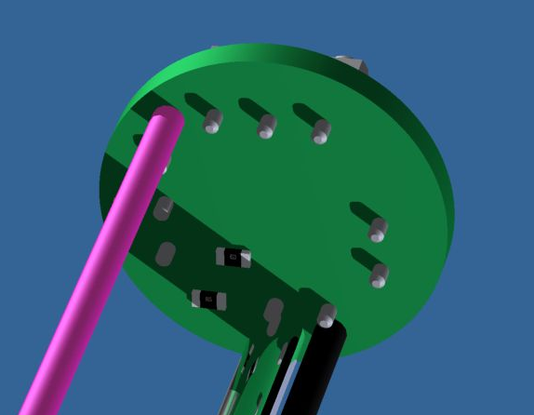
3D VIEW: PM HV DIVIDER (SOCKET)
R.Ciaranfi
SOLDERED HV+ (GND)
TOP AND BOTTOM SMD COMPONENTS
COAX SHIELD AND HV+ SOLDERED TOGETHER
SIG OUT COAX
SOLDERED HV- CONNECTION

Slide 6
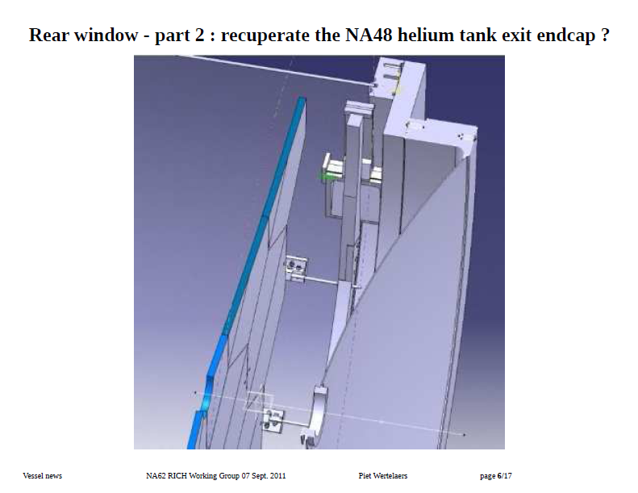

Slide 7
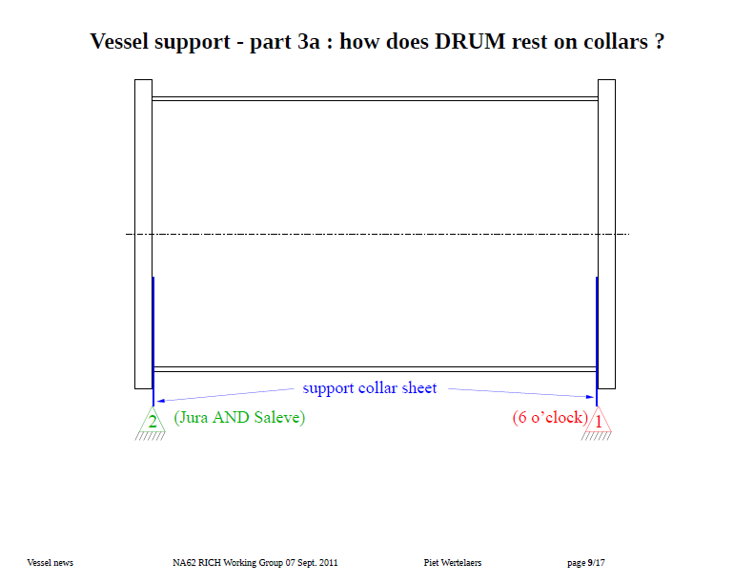

Slide 8
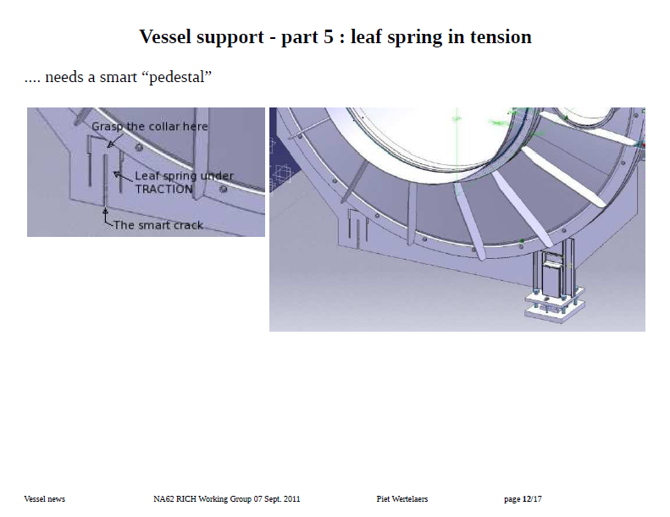

Slide 9
2010:
Number of PMT | Delivery date | Cost (euro)
FIRENZE
80 | 24/02/2010 | 23728.66
100 | 01/04/2010 | 28978.08
PERUGIA
120 | 09/05/2010 | 38368.01
400 | 02/07/2010 | 131582.39
400 | 09/09/2010 | 134522.59
110 | 30/09/2010 | 35131.30
TOTAL | 1210 PM | 392311.03 €
M.Pepe
2011:
Number of PMT | Delivery date | Cost (euro)
60 (at Firenze) | 25/02/2011 | 18900
40 (at Perugia) | 27/05/2011 | 12600
15 (at Perugia) | 28/07/2011 | 4725
40 (to be delivered) | November? | 12600 ??
SPARES ?

Slide 10
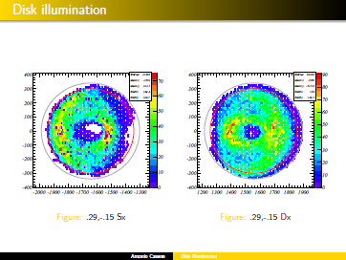

Slide 11
Conclusions
RICH on a critical path towards the Tech. Run
Market survey for the RICH vessel ongoing

