Slide 1
DCS WG report

Slide 2
DCS main activities (April – September)
LAV storage area temperature monitoring system
HV system – participation in tender preparation
User Requirements
LKr calorimeter High and Low voltage vertical slice

Slide 3
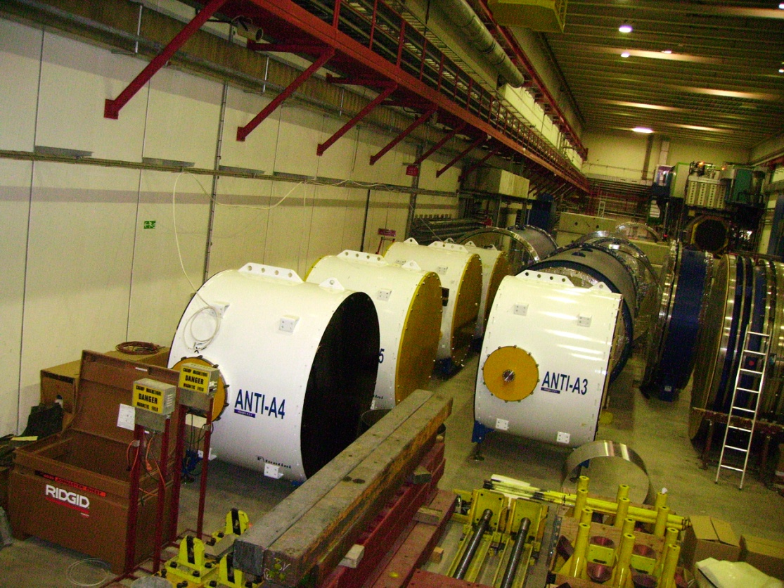
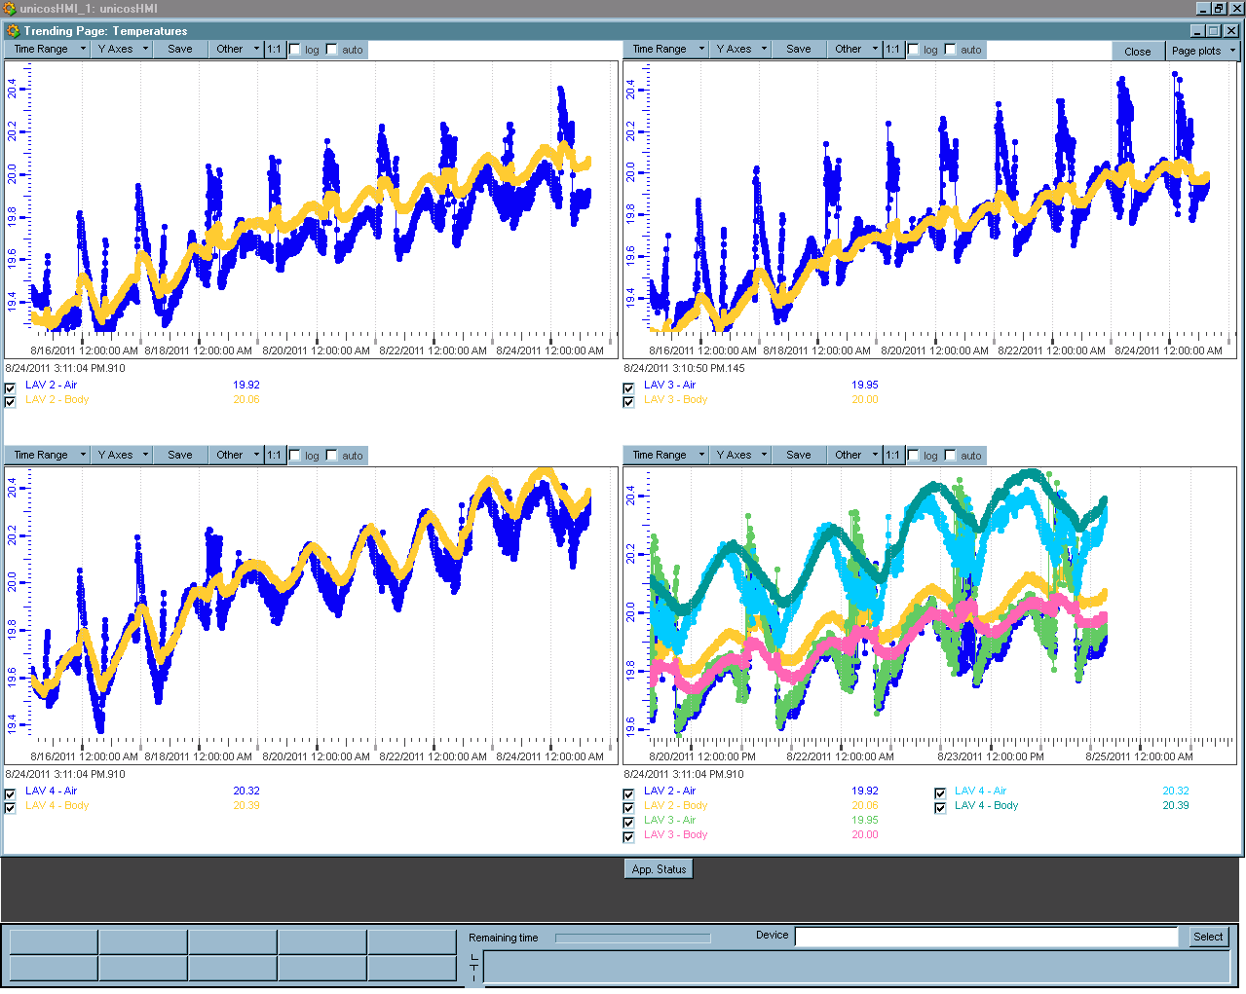
LAV storage area temperature monitoring system
The system is running permanently starting from March 2011:
Archiving of temperatures in an Oracle DB
SMS in case of alarm
Nightly mail reports
Adaptation to new stations position
LAV storage area in ECN3
Powerful trend tool

Slide 4

HV system – participation in tender preparation
Technical Specification for “High Voltage power supply system for photomultiplier tubes” prepared by Riccardo and Paolo
  LAV: 2496 channels
  MUV: 560 channels
  CEDAR: 256 channels
  Grand total: 3312 channels
Software requirements prepared by DCS team and EN/ICE

Slide 5
User Requirements
Definition of Hierarchical Control and detector operation models. Two options are under evaluation.
    LHC like
    NA48 like
    A discussion of the differences needs an introduction and will happen on first DCS Users meeting in October.
    The LKr vertical slice includes both options and will be used for an assessment
E-mail users survey concerning of 2 special cases of system behavior during data taking:
    Should we allow an automatic HV channel trip recovery (YES with parameterization)
    Should we allow playing with individual HV(LV) channel (YES with special flag)
    Strong appeal for general policy. An DCS users meeting will be organized in October

Slide 6
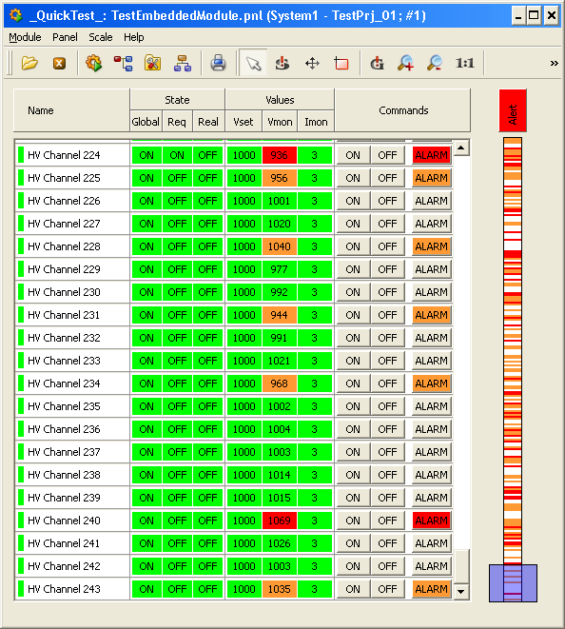
User Requirements - 2
User Interface
  Study of other experiments example (CMS, COMPASS). Other will come soon.
  Development of generic HV channel table panel (the HV channels represent of about 60% of all channels)
Table prototype
244 channels in one table
Zoom out right column
Sliding selection window

Slide 7
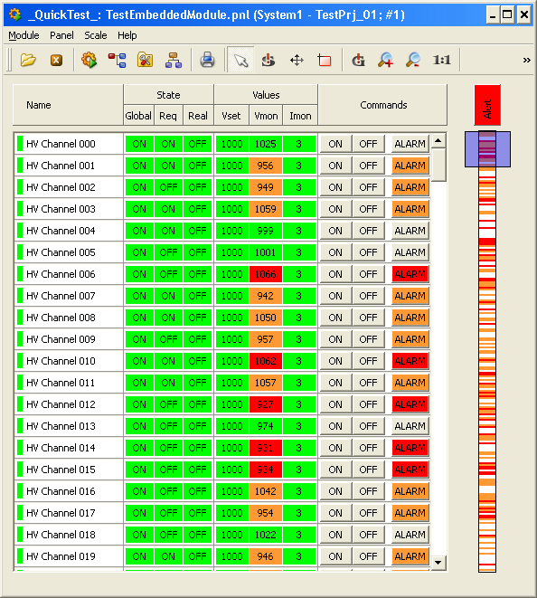
Prototype of Generic HV channel table panel
Beginning of the table
End of the table

Slide 8
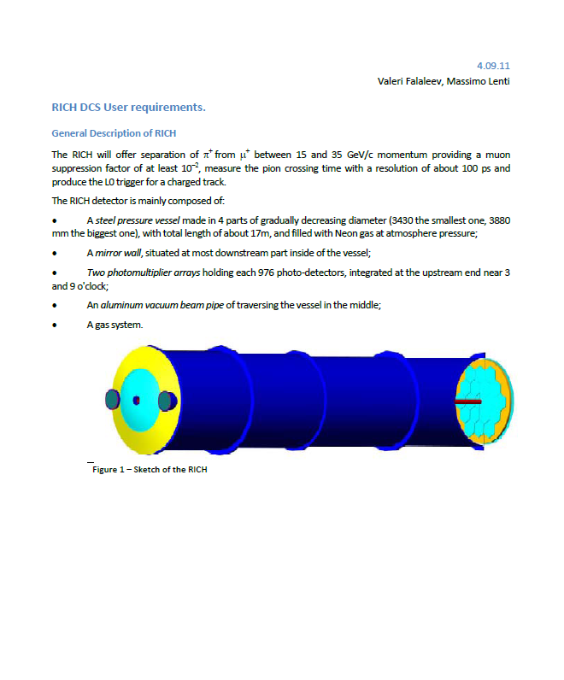
Sub-detector user requirements
LAV, STRAW, MUV, SAC/IRC - preliminary UR were presented in December 2010. Detailed version should be prepared ASAP
RICH User requirement document – example to follow
  General description of detector
  Detector Logical structure
  Detailed description of each sub-system including:
    General requirements
    Logical names
    Hardware description and naming scheme
    Hierarchical control and alarms
  User Interface
  The document is available on EDMS Number 1160153 v.1
All sub-detectors participating in Technical Run should prepare an URD and put in on EDMS this year

Slide 9
LKr High and Low voltage vertical slice
Motivations and constrains:
LKr High and Low voltage system already exists and will be used in NA62 without modification
Excellent current and high voltage measurement system, good quality cables and patch panels – everything is worth to keep
Heavy integration of custom made system is preferable now when the most other equipment is not yet available
The “Vertical slice” should include and validate whole DCS chain from the sensors to an user interface and ORACLE Data Base

Slide 10
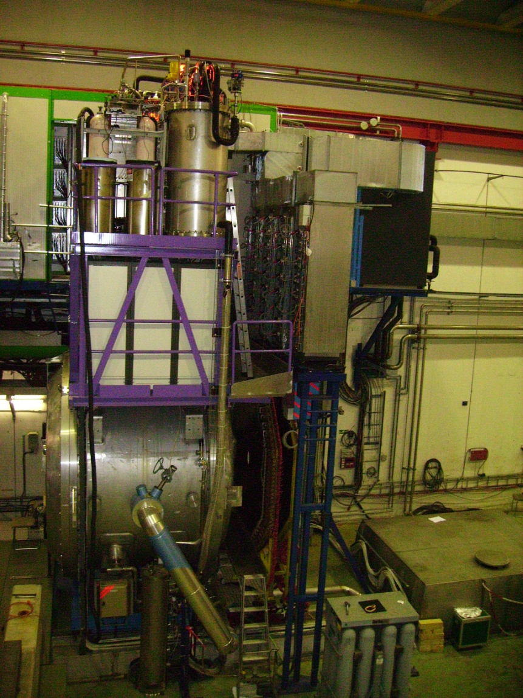
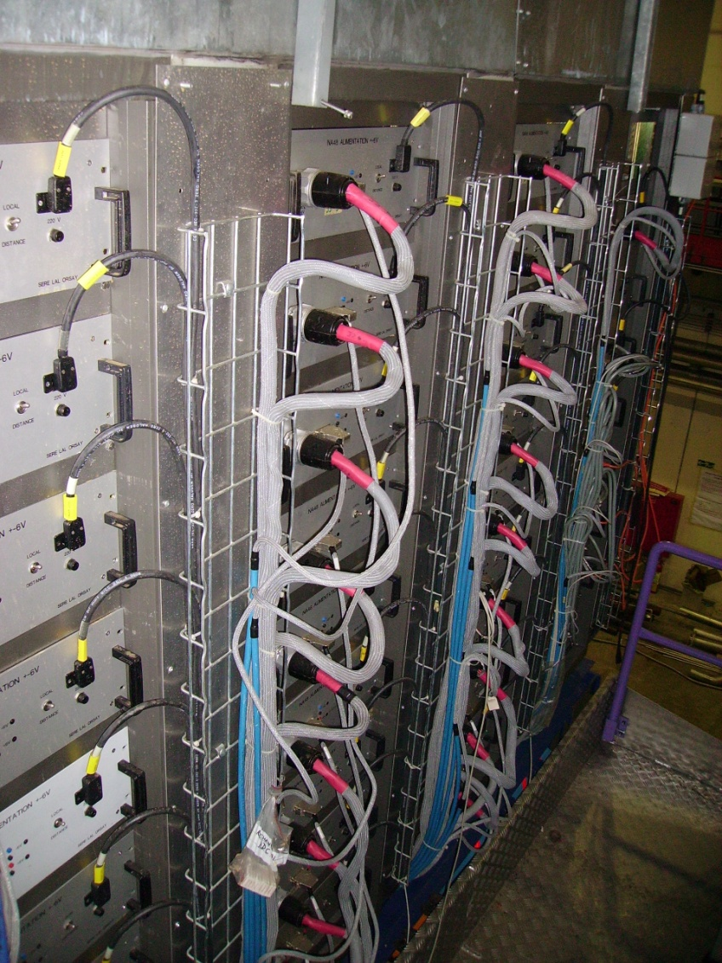
LKr High and Low voltage vertical slice - 2
Short reminder : Transceivers and Preamplifiers power supplies
27 transceivers PS’s
4 preamplifiers PS’s
64 regulator boards
Commands: ON/OFF
Reading:
Status ON/OFF
About 500 low voltage channels

Slide 11
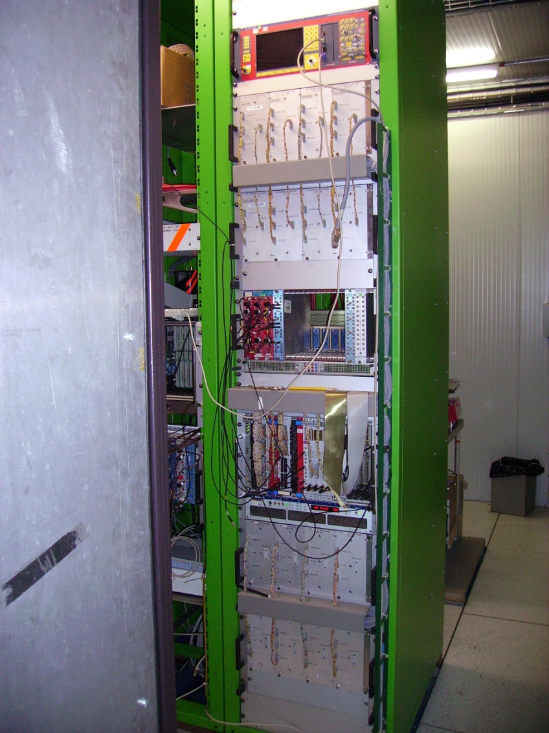
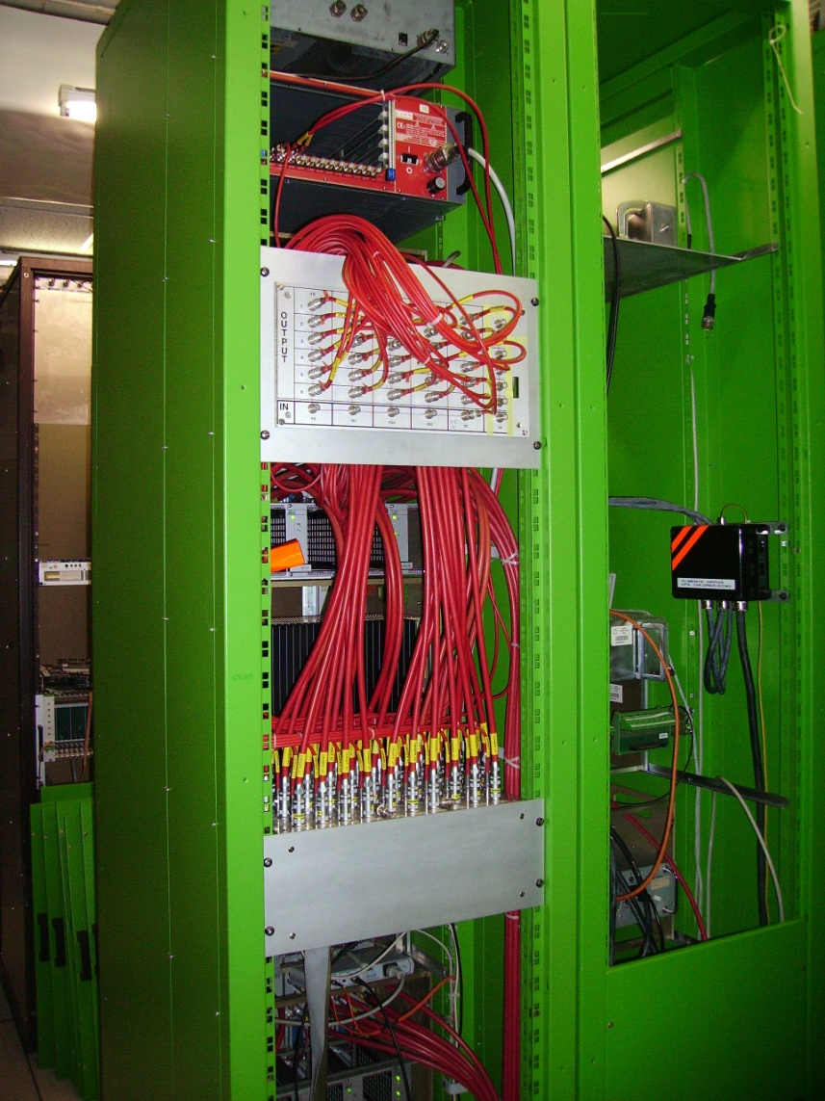
LKr High and Low voltage vertical slice - 3
Short reminder :
HV power supply system
SY127
In spill, Out of spill current measurement
Front
Back
LKr
Output voltage measurement
All cells of calorimeter are grouped in 32 columns
  30 columns are powered by 1 HV channel of CAEN Power supply
  2 high current columns are powered by an individual HV channel each
Custom made VME based system measures 32
  “In” and “Out of” spill currents
  Output voltages

Slide 12
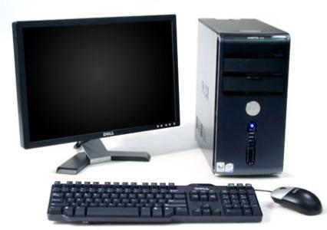
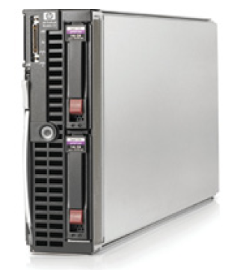
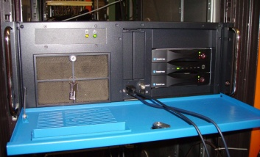
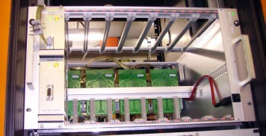
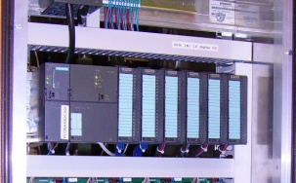
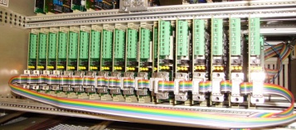


LKr vertical slice - 4
ORACLE DB
Front-end computer: KONTRON KISS 4U PC:
OPC servers
Back-end computer: HP ProLiant BL460c
G7 Server Blade:
PVSS application
(hosted in CCC farm area)
User Interface PC (s)
CAN branch power supply
ELMB based analog signals reading
SY2527 HV Power supply
PLC based digital I/O
27 transceivers PS’s
4 preamplifiers PS’s
64 regulator boards:
about 500 channels in total
VME based CPU:
DIM server

Slide 13

New control for LKr High Voltage system
The SY127 is replaced by SY2527 HV Power supply:
Ethernet interface
CAEN OPC server
JCOP supported component
SY2527
Custom current and voltage measurement system, VME based CPU.
Old communication layer is replaced by DIM (Distribute Information Management system)
Old hardware synchronisation is replaced by DIM signals
In spill, Out of spill current measurement
Front
LKr
Output voltage measurement

Slide 14
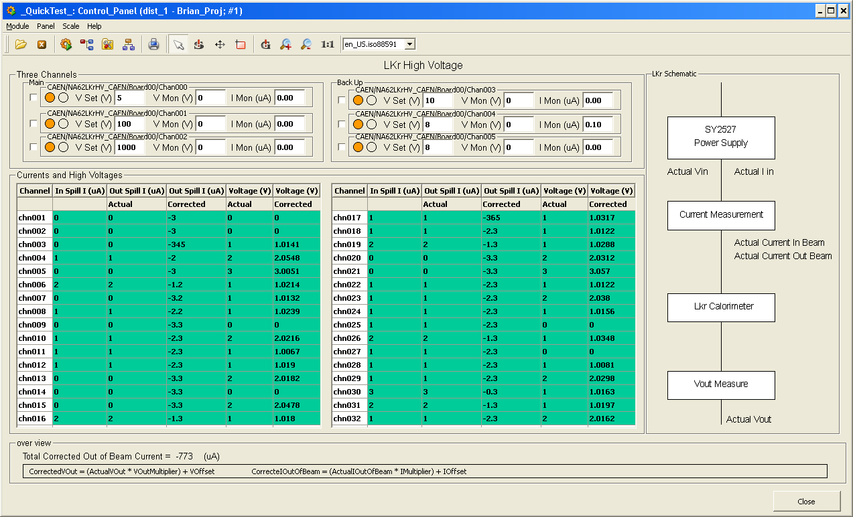
LKr High Voltage system – Integration in PVSS
3 active SY2527 channels + 3 spares
32 “In” and “Out of” spill current + Vout readings

Slide 15
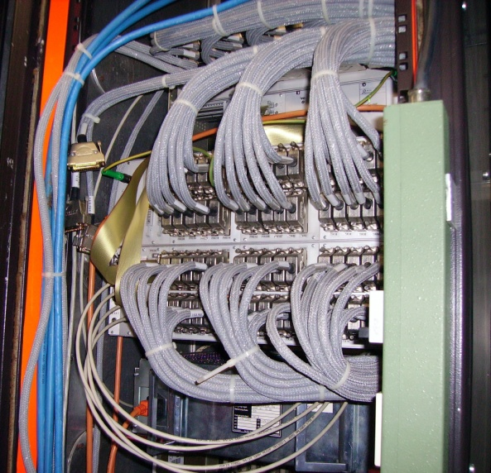
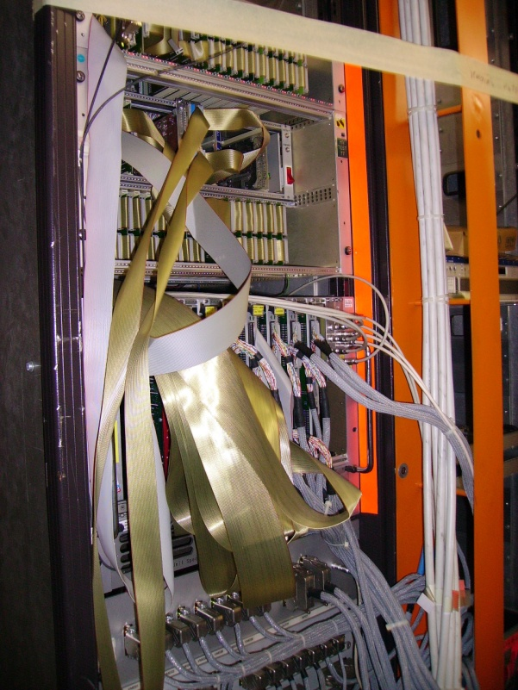
LKr LV power supplies
DCS rack
Back
Cables from the power supplies and regulator boards are routed to DCS rack in the Electronic Barrack.
In the rack the
digital (switch ON/OFF command and ON/OFF status) and
analog (voltages, currents and temperatures ) signals
are split
Front
The old system was based on:
G64 Analog Multiplexer system
VME/G64 Interface (SL/RF)
Motorola MVME167 processors
Greenspring VIPC610 IndustryPack carrier
Various IP Carrier (PT100 conditioning, ADC, Digital I/O)

Slide 16
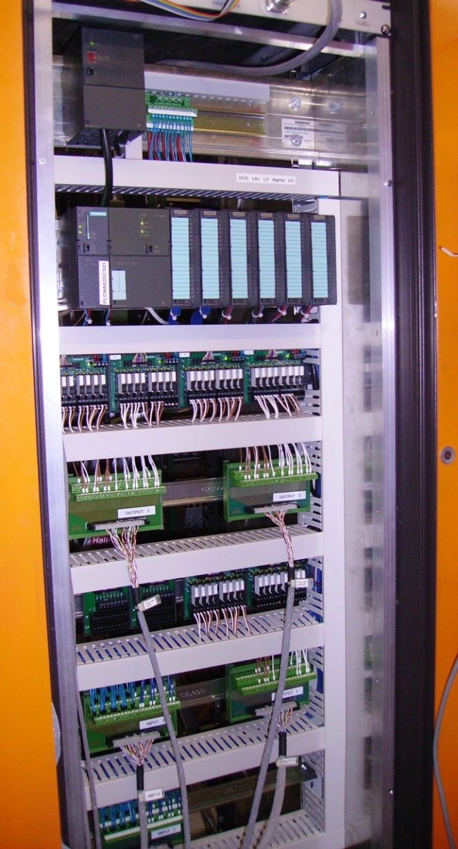
New control for LV power supplies – PLC based digital I/O
The preamplifier power supplies are equipped with a contact which reflects ON/Off state of the supply
All power supplies can be switched ON/OFF by means of short closing of corresponding contact
Taking into account requested reliability of the information and commanding, a PLC (Programmable Logic Controller) based solution was chosen.
The system is using SIEMENS S7-300 equipment with full hardware and software support from EN/ICE
Some spare I/O channels are available

Slide 17
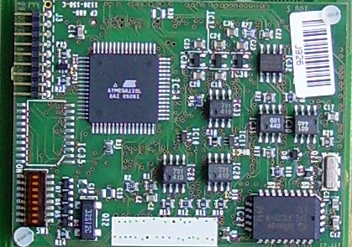
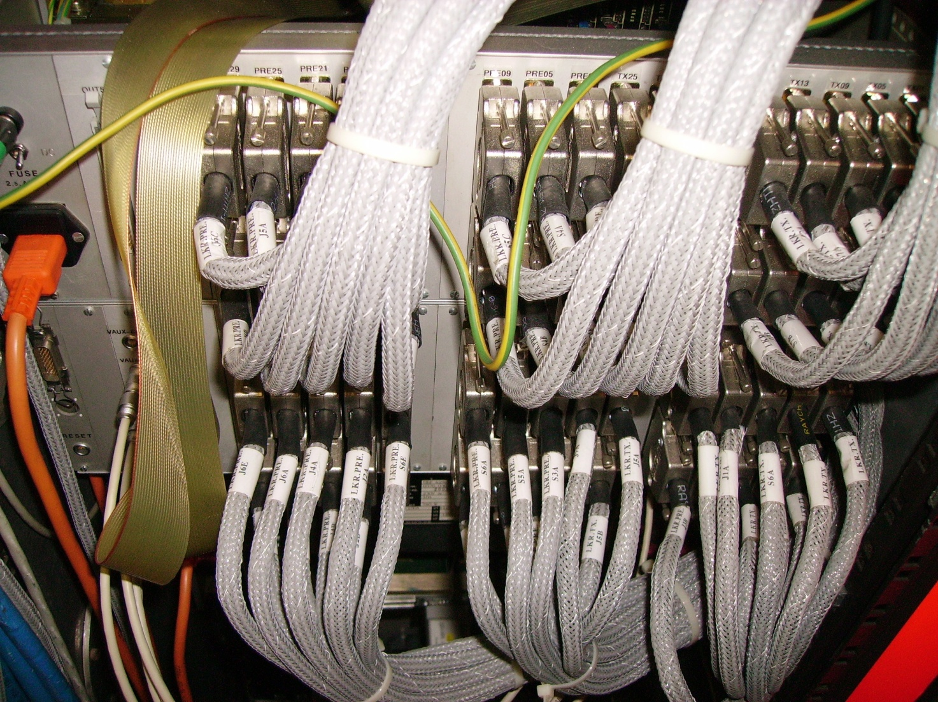
LV power supplies – ELMB based analog signals reading
ELMB
The ELMB is the only budget analog signal reading device fully supported by the JCOP framework community
Existing cables and patch panels are good quality and worth to be reused
The idea was to replace existing G64 multiplexor cards by new ELMB adaptor card and keep whole chain up to the multiplexor intact

Slide 18
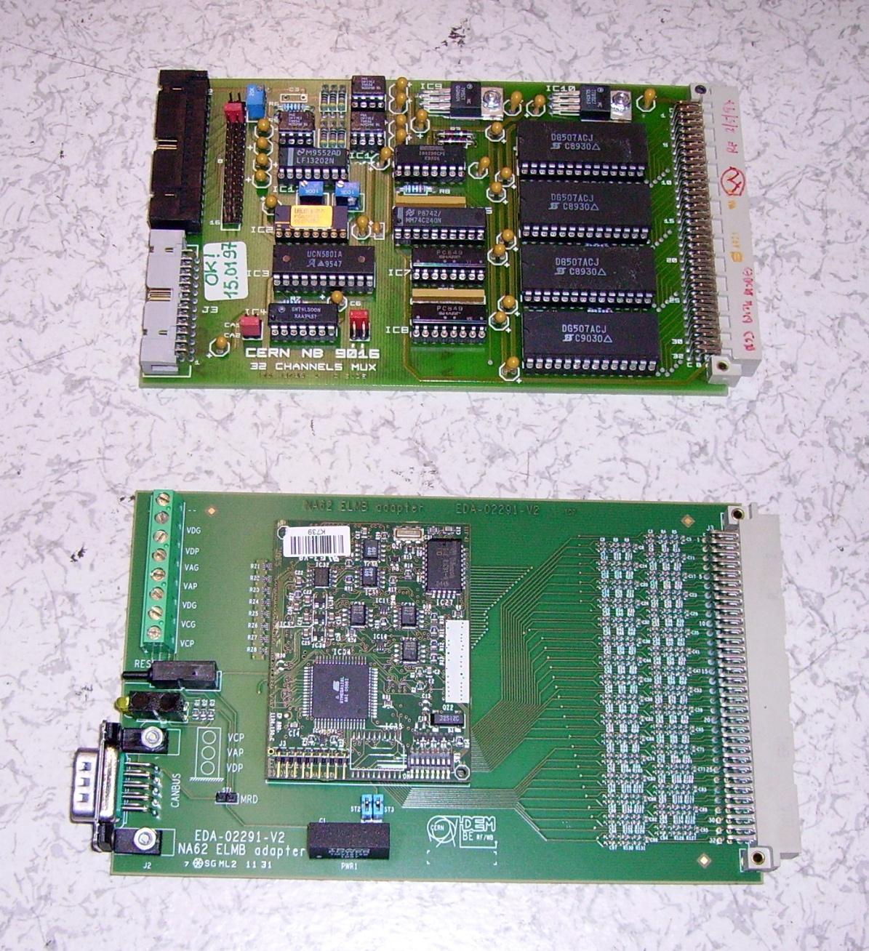
LV power supplies – ELMB base analog signals reading
G64 multiplexor card
A new ELMB adaptor card was developed for replacement of existing G64 multiplexor card
ELMB
The ELMB is fully supported by JCOP framework community
ELMB adaptor card

Slide 19
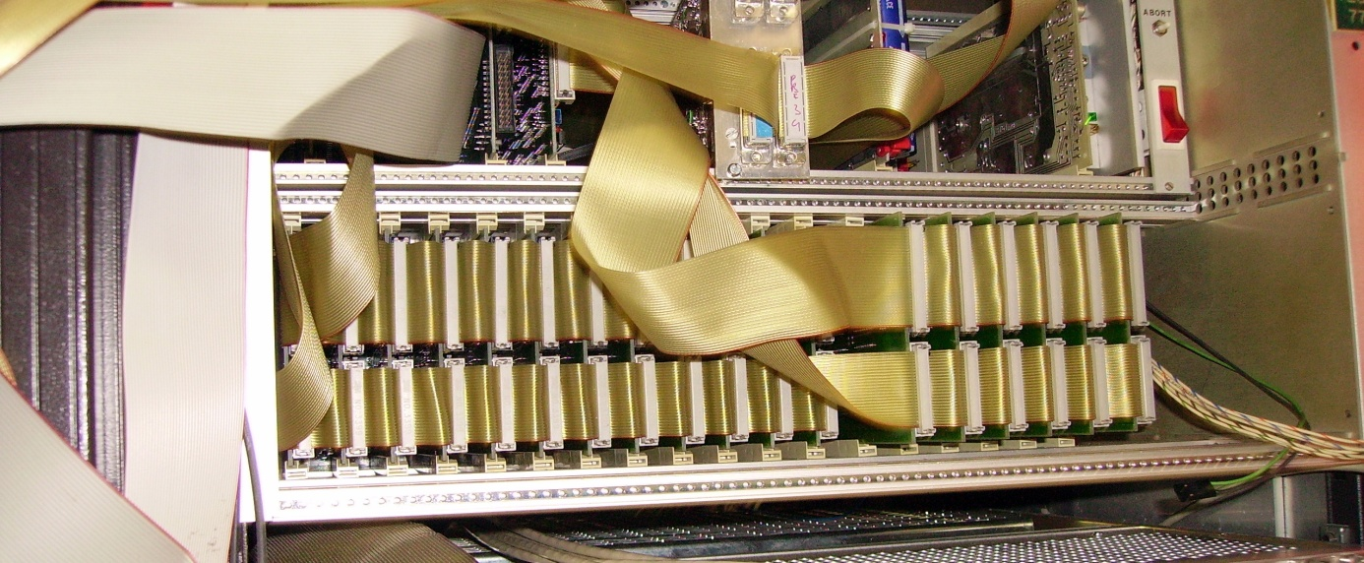
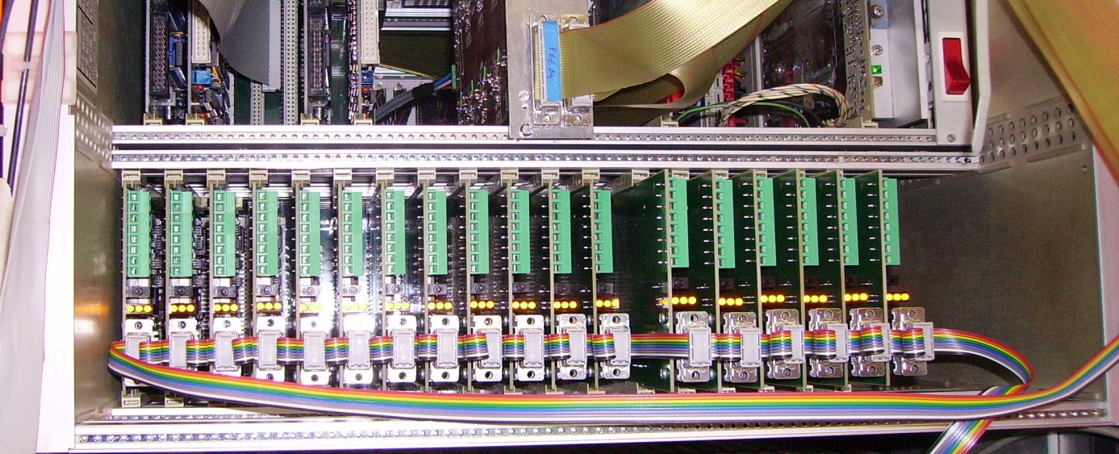
LV power supplies – ELMB based analog signals reading
Old G64 system
New ELMB based system

Slide 20
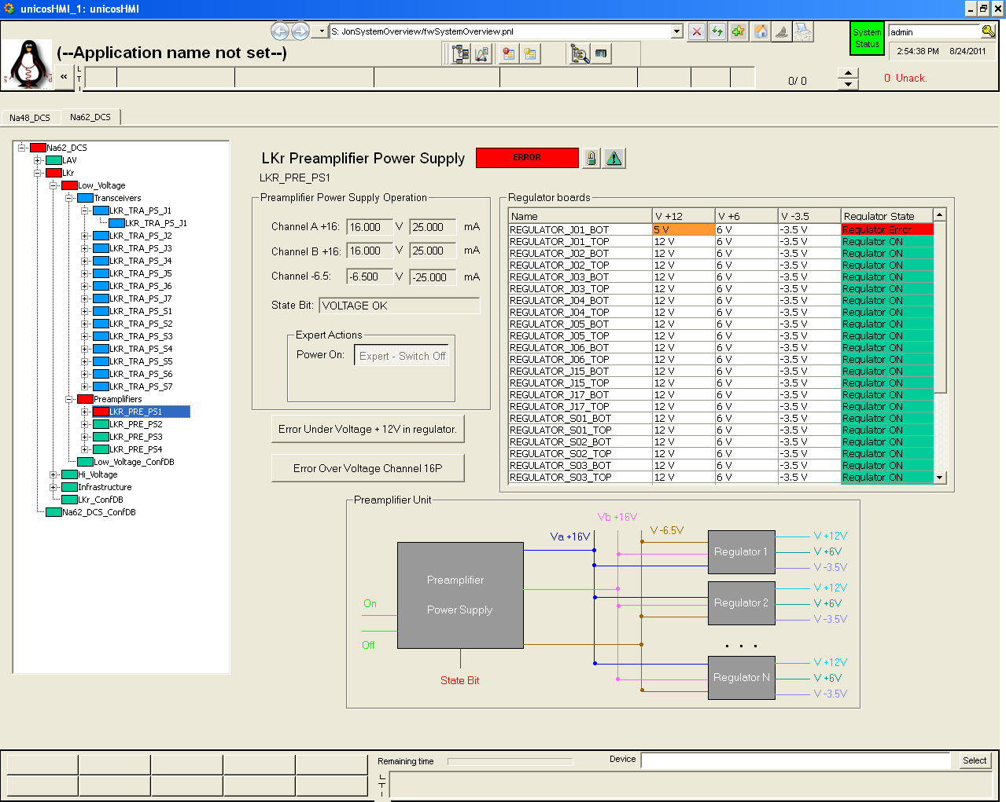
LKr vertical slice – PVSS implementation
Preamplifier power supply monitoring
Navigation
Tree with Hierarchical control colors
Regulator boards monitoring

Slide 21
LKr vertical slice – other main features
Two levels computer structure:
  Multi slots front-end (7PCI 32 bits, 3 PCI_e x 1, 1 PCI_e x 16)
  Powerful back-end (24 logical cores (12 physical), at 2.8GHz, 12 GB of RAM, etc…)
Full CANbus branch, including branch power supply
Hierarchical Control
ORACLE DB:
  Archiving
  Configuration
Alarms, Trends, Navigation, Access Control, etc…

Slide 22
Credits
High Voltage power supply system Technical Specification
  Benjamin Farnham (EN/ICE-SIC)
Generic HV channel table panel
  Roman Fedoseev (EN/ICE-SCD)
LKr HV system
  Brian James O'Connell
  Riccardo Fantechi
LKr LV system
  Riccardo Fantechi
  Jeronimo Ortola Vidal (EN/ICE-PLC)
LKr Vertical Slice integration and PVSS implementation
  Jonas Arroyo Garcia (EN/ICE-SCD)
Coordination, support, motivation, etc :
  Piotr Golonka (EN/ICE-SCD)
  Valeri Falaleev

Slide 23
Plans
Integration run (shifted to the end of January 2012)
  Main goals: First attempt of external contribution integration. Assessment of CPU power.
  Hardware to control
    LKr (~ 600 channels)
    STRAW tracker hardware (1 module ~ 500 channels)
    RICH HV system with a few loaded channels (500 channels)
    About 1600 channels in total – ¼ of full system
  DCS hardware – the same as was used in the LKr vertical slice
        Sergey Sergeev should come at least 2 weeks in advance

Slide 24
DCS plans - 2
Dry DCS test run (May 2012 )
  Main goal: Validation of all control solutions and confirmation of CPU power. The success of this run will depend a lot on availability of hardware.
  Hardware : all detectors participating in Technical Run
    8 (9) LAV stations: HV (all power supplies should be available) + some FE crates (≥ 1 should be available) + some thresholds reading (≥ 1 FE board should be available)
    1 (2) STRAW tracker module: HV(should be available) + LV(should be available) + ELMBs
    MUV2 and 3 (full system): HV (all power supplies should be available) + ELMBs
    CEDAR (full system): HV (all power supplies should be available) + FE crate (≥ 1 should be available) + NINO parameter setting/reading (≥ 1 FE board should be available) + ELMBs + cooling system?
    LKr (already integrated in Vertical Slice)
    CHOD (existing NA48)?
    The same rule as for the TDAQ: the hardware for which the control will not be tested in the dry DCS run will not be controlled during the Technical run.
    The hardware should be available at least 3 months in advance (February 2012)

Slide 25
DCS plans - 3
Dry DCS test run (May 2012 ) - continuation
  DCS hardware:
    Additional 3 front-end computers (KONTRON)
    New 3 data servers
      We are considering 2 options
        Reinforced version of PC farm computer (do we know the model?)
        Rack mounted version of CCC blades
      The model should be selected this year
  Software
    Final version of everything including FE boards control
    ORACLE Data Base
      Do other NA62 users plan use the ORACLE in 2012?
      Coordination question: Will we have general NA62 policy (and responsible) regarding the ORACLE (remember the ORACLE service is not for free)
    External development (and developers) should be available 2-3 weeks in advance

