Slide 1
Sustainable Heating Plant in Prévessin (B.776)
SCE Coordination meeting n1
G. Rouge
Apr 2024
EDMS

Slide 2
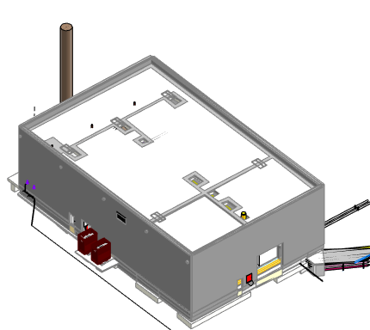
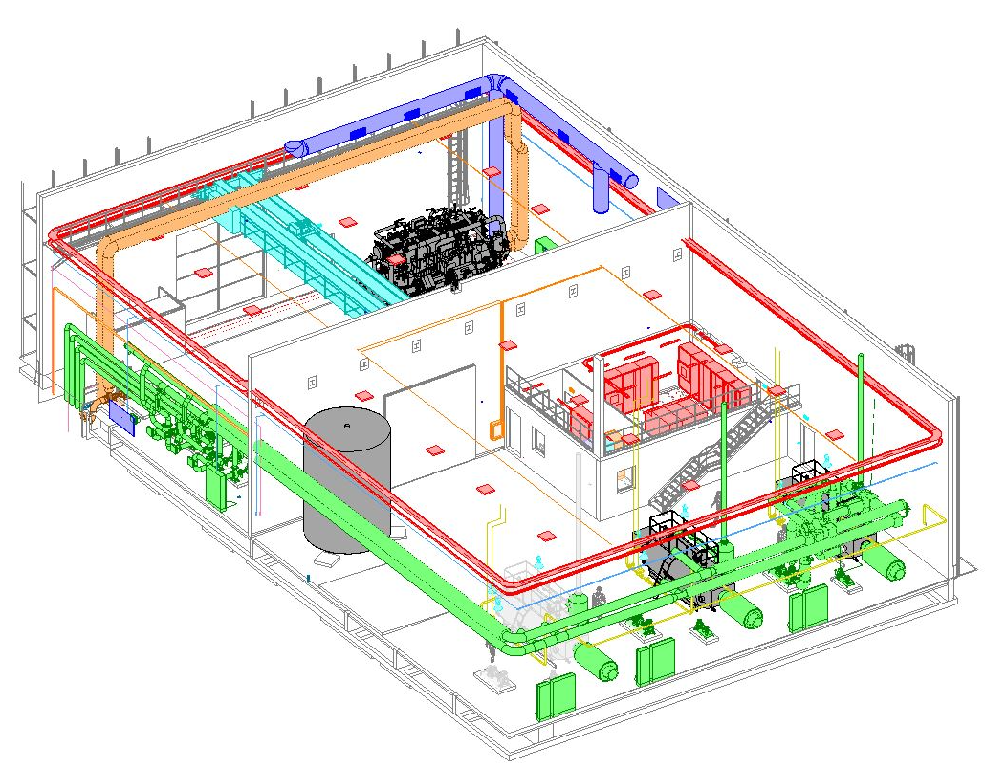
Outline
Technical description
Project strategy
Organisation
CERN Standards
Documentation
Schedule
Questions

Slide 3
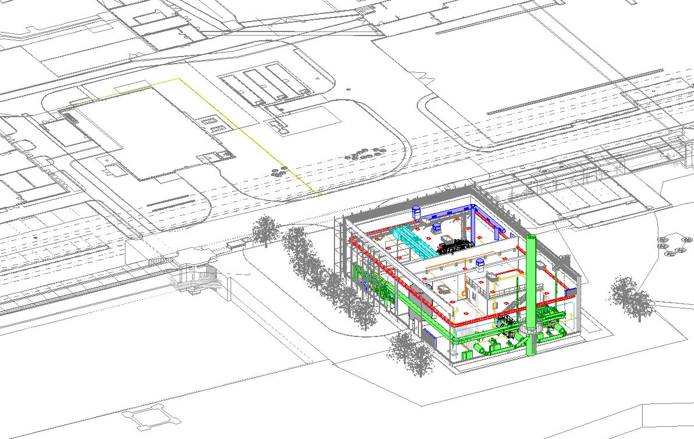
Technical Description
Objectives:
Create the new B.776 for housing the heating plant
Install the new heating plant with gas boilers and heat pump
Dismantle the current heating installation in B.860
B.776 main works :
Earthmoving and roads
Building construction.
Ventilation (ATEX)
Gas boilers and heat pump
Sanitary block
Electricity: cubicles, distribution, sockets, lighting
Travelling crane for HP maintenance (if budget)
Connection gallery to GT818.
Connection to PCC (B.775) for energy recovery
B.860
PCC, B.775
B.776

Slide 4
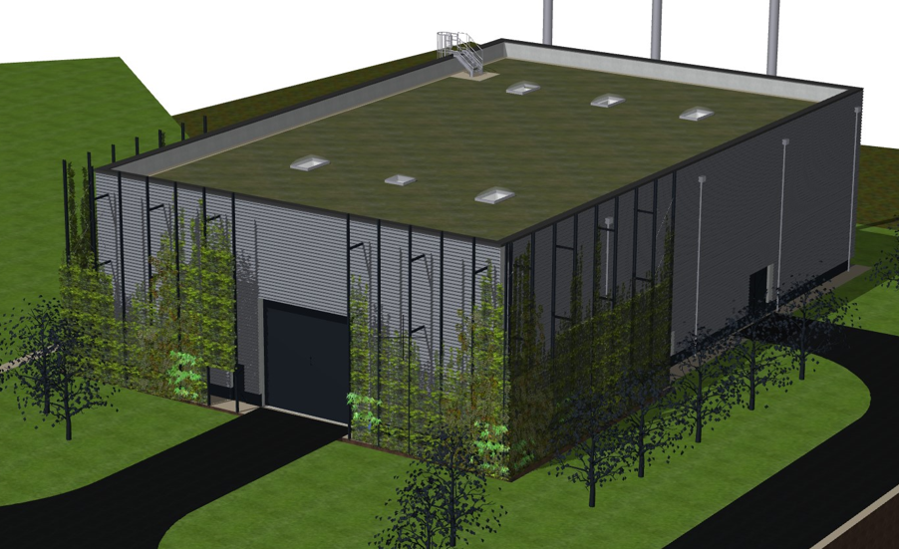
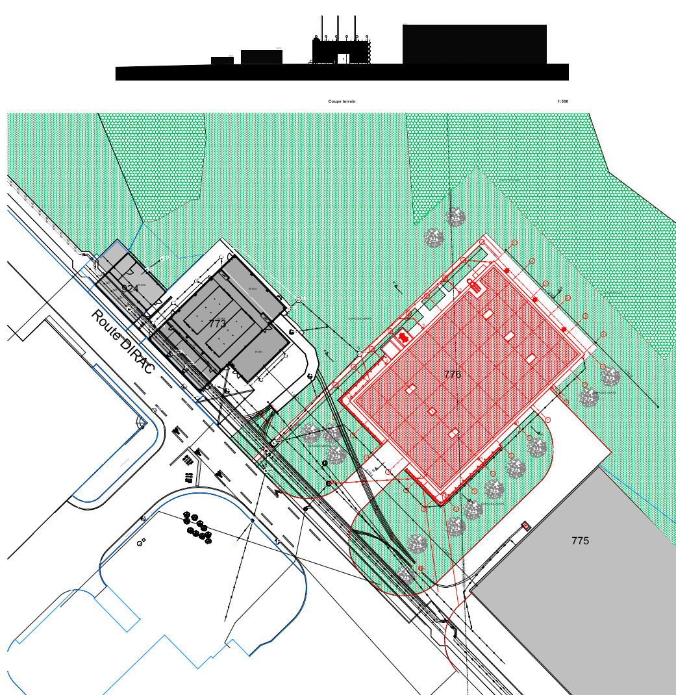
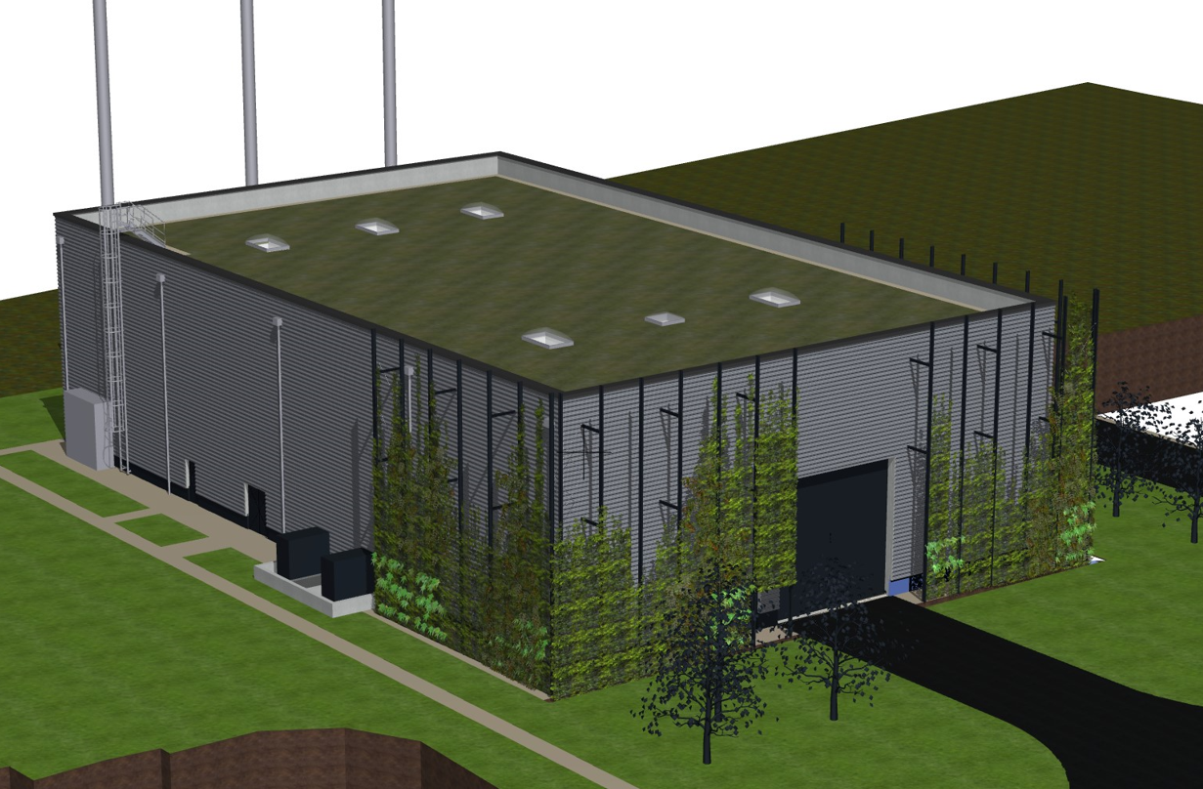
Presentation of the project WP1
Heating plant Prevessin WP1
Reuse fatal energy from the new PCC with heat pumps powered by electricity,
much-reduced carbon emission and raise of the renewable energy rate,
Within the SITE-CONS programme
Total surface = 950 m2
  Gas Boilers room (m2): 460
  Electrical room (m2): 75
  Heat pump room (m2): 415
Height = 11 m
Two access roads
Rainwater storage (10 m3)
Green façade and roof
Connection to existing TG
IRP study – EDMS 2820036

Slide 5
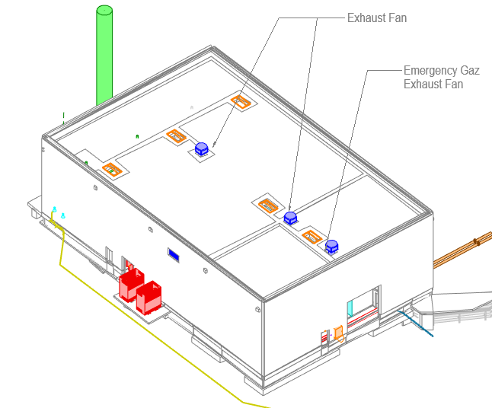
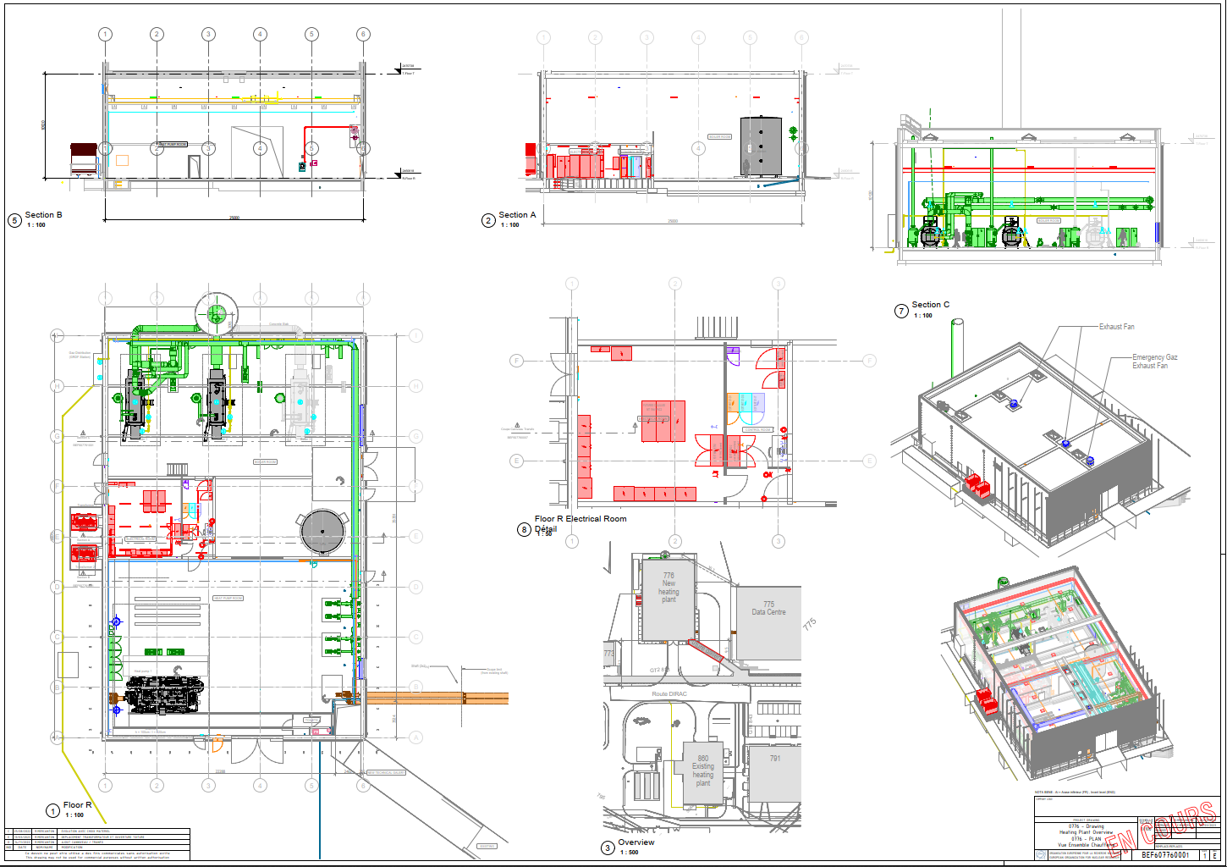
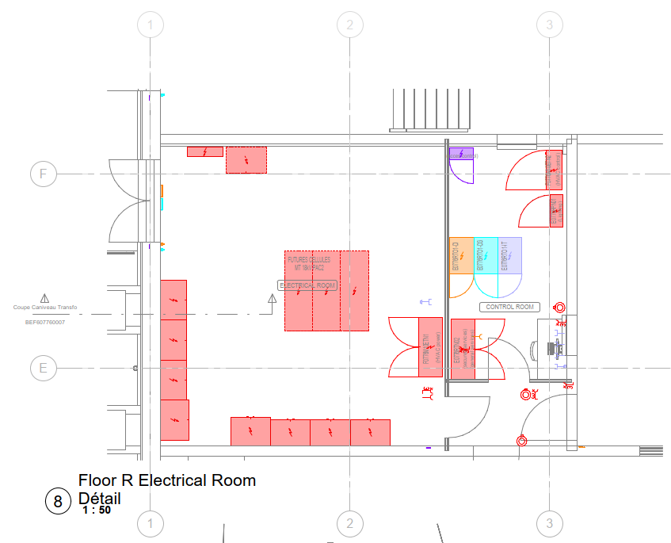
General layout
775
860

Slide 6
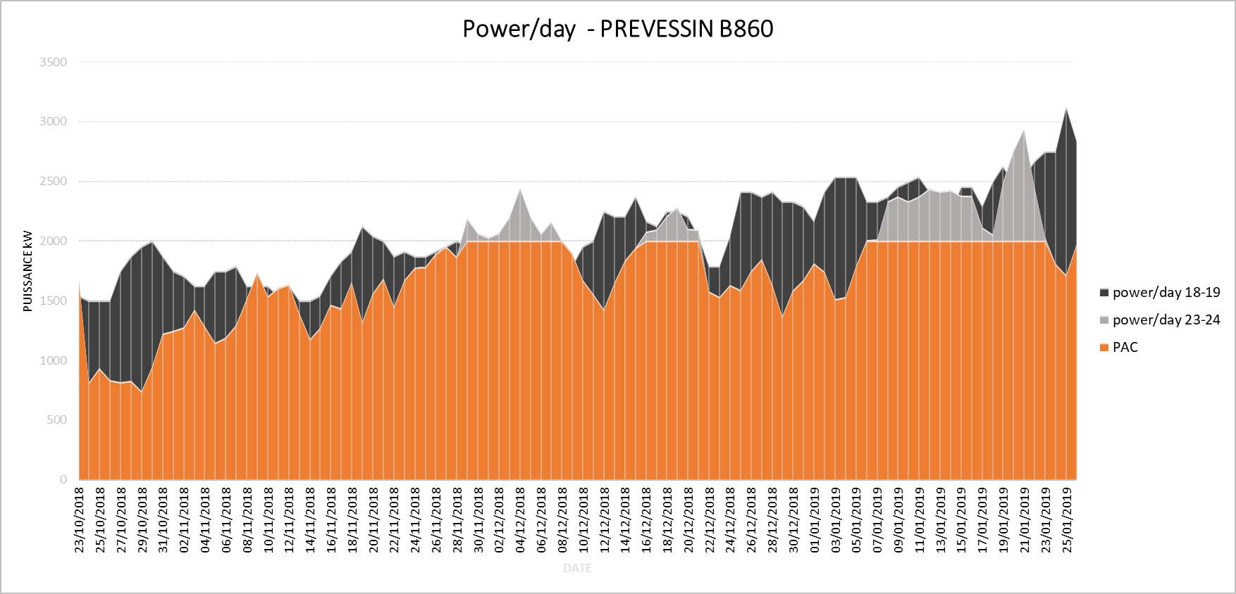
Energy consumption
Heating plant configuration:
  2 boilers, 2MW+4MW Gas&Fuel
  1 heat pump 2 MW.
  Space for future heat pump.
Objectives:
  Basis: winter 2021-2022
  Flexibility with gas boilers.
  1 heat pump 2 MW heating capacity (1.6 MW evaporator = IT load).
  Space for future heat pump.
Heat pump = 85%

Slide 7
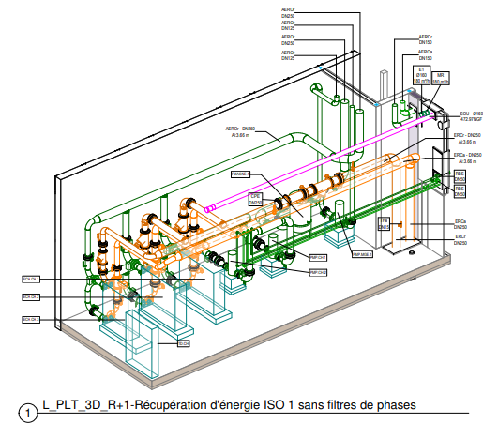
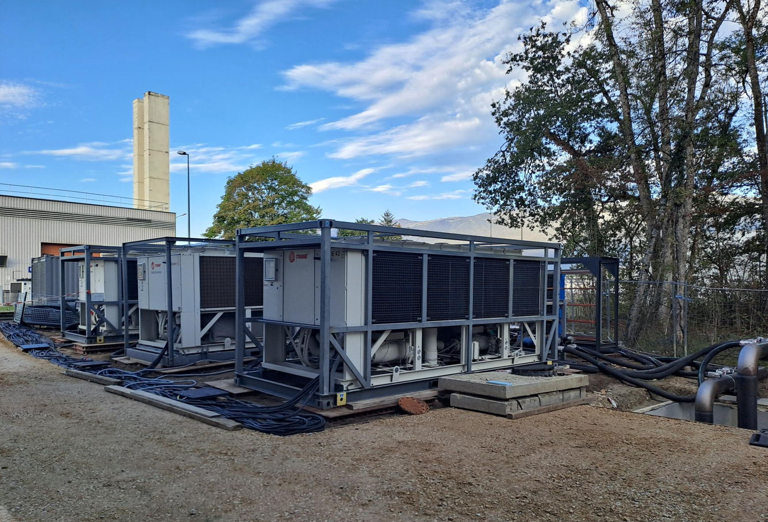
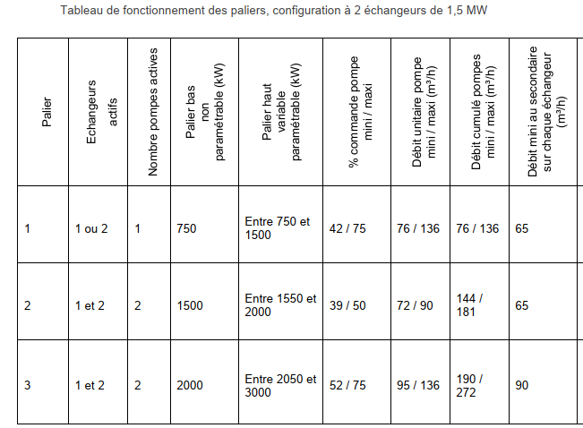
775 PCC Commissioning test
Phase 1: 3MW - 2 exchangers of 1.5 MW each
Phase 2: +1MW - 1 exchanger
Primary circuit : 32/22°C, 270 m3/h.
Secondary circuit : 30/20°C
✓
✓
✓
✓

Slide 8
776 CERN Project Organisation
Steering Committee
M. Capeans (SCE) – Chair
W. Salter (IT/FA)
S.Deleval (EN)
N. Bellegarde (ATS-DO)
M. Vadon (SCE/DOD)
DRAWING
R. Mercanton
Steering Committee meetings (2/y) attended by:
Budget Control
PL, DPL, and invited WP leaders
BUDGET CONTROL
E. Weymaere
SCE-DOD
MAINTENANCE
G. Genamy
SCE-SAM
PROJECT LEADER
G. Rouge
SCE-SAM-IN
DPL: A.Martinez
PROCUREMENT
S. Magnan
IPT-PI
MAINTENANCE
G. Genamy
SCE-SAM
ENVIRONMENT
S. Schadegg, J,P, Bergoeing
HSE-ENV
WP9
CIVIL ENGINEERING
A. Martinez / F.Cesca
SCE-SAM
HVAC & ELECTRICAL INSTALLATIONS
J. Gomez, G. Rouge
SCE-SAM-IN
CV FLUIDS
S. Deleval
EN-CV
LV POWERING & O. FIBER
M.Parodi, J.P. Vincent
EN-EL
SAFETY
D. Tshilumba
HSE-OHS
WP1
WP2
WP3
WP4
DI & GAZ DETECTION
D. Raffourt, N. Broca
EN-AA-AS
ACCESS CONTROL
G. Smith
EN-AA-AC
INFORMATION TECHNOLOGY
M.A. Denis
IT-CS-DO
TRAVELLING CRANE
R. Rinaldesi
EN-HE
SAFETY COORDINATOR
J,M. Jounin
APAVE
WP5
WP6
WP7
WP8

Slide 9
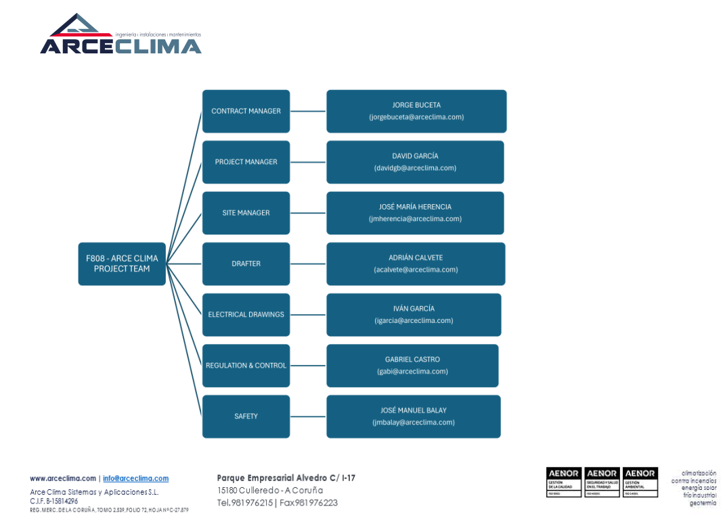
776 ARCECLIMA Project Organisation

Slide 10
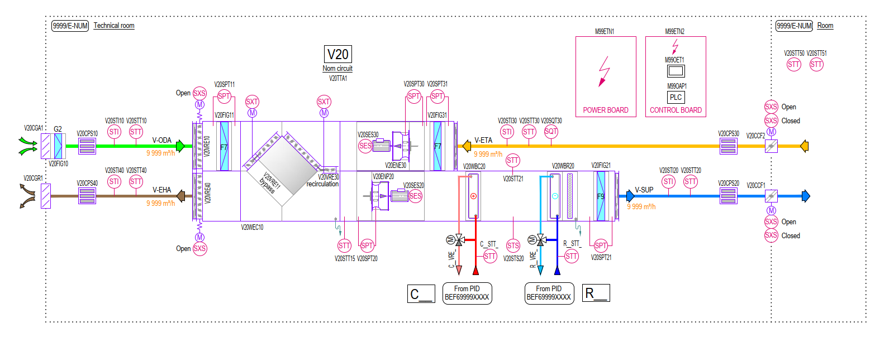
Standards SAM IN

Slide 11


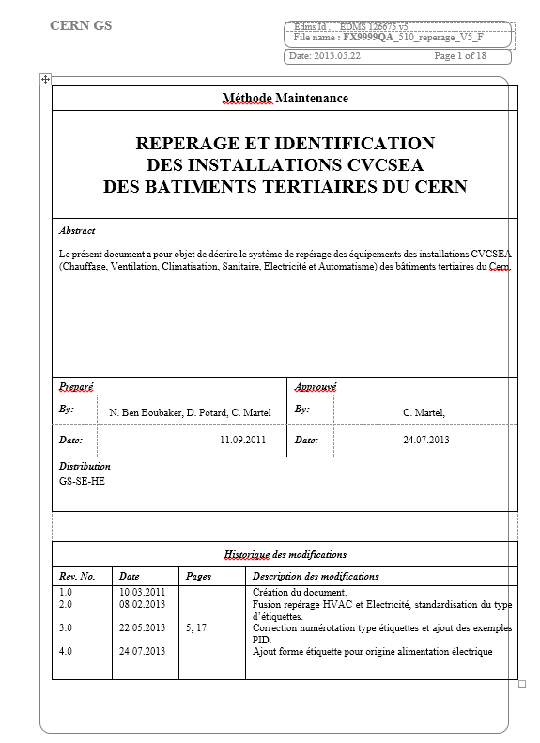

SAM IN Methods
Codification
Building / parent = circuit / child = component
Classification
Systeme/parent/child/part
Système | Code
Réseau de chaleur | C
Chauffage | C
Ventilation | V
Refroidissement | R
Sanitaire | S
Incendie | I
Air Comprimé | A
Distribution de gaz | G
Electricité | E
Multi technique | M
Restauration | T
Marking = CAMM code
Quality Assurance Plan
FX9999QA_510_reperage_V5_F
Edms 126675 V5

Slide 12
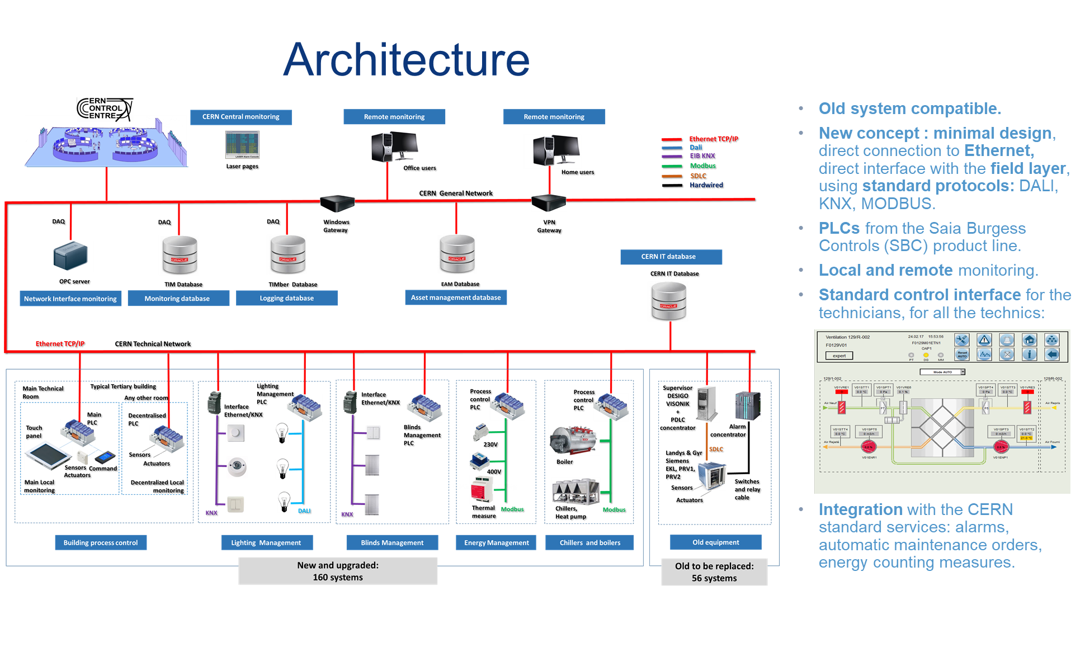
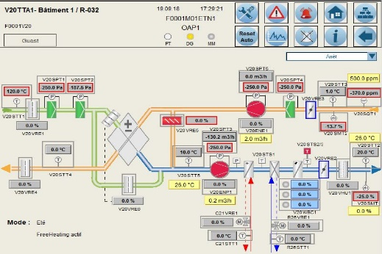
SAM IN Control & Regulation

Slide 13
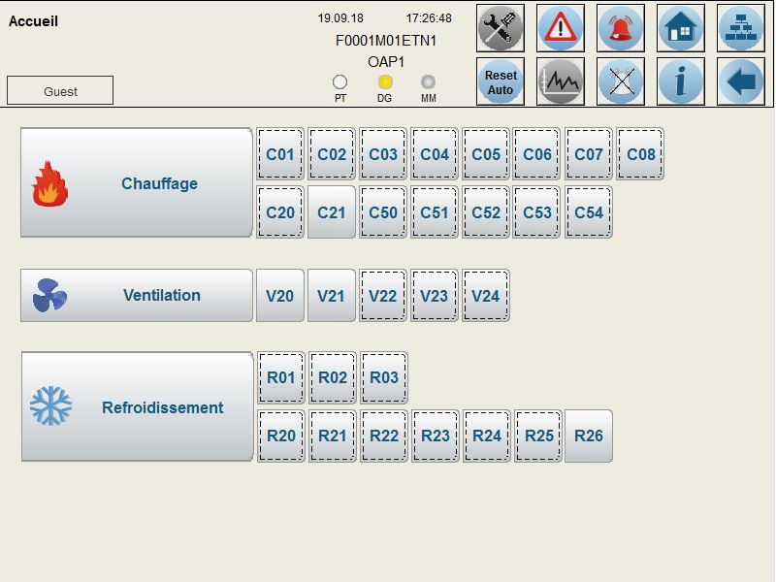
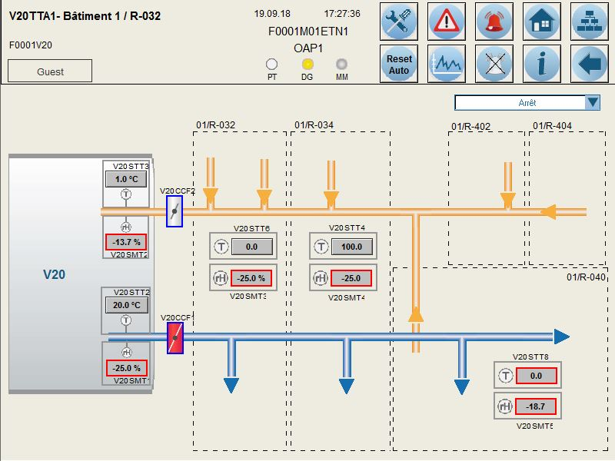
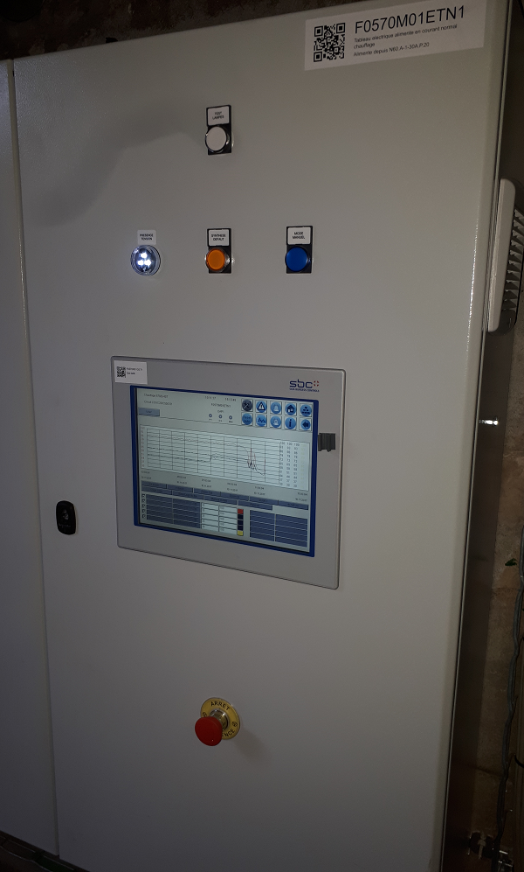
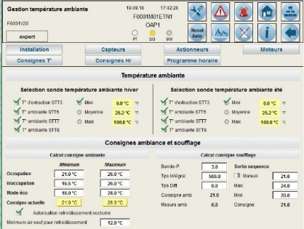
SAM IN Control & Regulation

Slide 14
Standards SAM IN
9 STANDARDs CERN / CERN STANDARDS
Codification et gabarit GMAO / Maintenance codification and template :
FX9999QA212 : CVCS / HVAC & SANITARY codification (Ref. 1816853),
FX9999QA213 : ELEC codification (Ref. 1262812).
FX9999QA409 : Maintenance format CVCS / HVAC & Sanitary (Ref. 1761416),
FX9999QA409 : Maintenance format ELEC (Ref. 1761419).
Procédures / Procedures:
FX9999QA510 : Repérage et étiquetage / Marking & labelling (Ref. 1266775),
FX9999QA513 : Documentation DIUO/ABF (Ref. 1357755),
FX9999QA555 : Consigne exploitation électrique (Ref. 2736616).
CAO, plans et schémas standards / CAD, standard drawings and schematics:
FX9999QA502: Format CAO BIM / BIM CAD format (Ref. 1262827),
FX9999QA210: Symboles graphiques PID / PID graphical symbols (Ref. 1322316),
FX9999QA548: Cartouche Autocad / Autocad titleblock (Ref. 2593341),
FX9999QA542 : Revit Gabarit projet MEP/ MEP Revit template (Ref. 2192621),
FX9999QA544 : Revit Bibliothèque de familles / Revit family biblio (Ref. 2253910),
BEF399990001: Schéma tableau puissance / power board schematic (Ref. 2736632),
BEF399990002: Schéma tableau contrôle / control board schematic (Ref. 2736636),
BEF399990003: Schéma tableau DTU / DTU board schematic (Ref. 2736640),
BEF399990004: Principe terre bâtiment- Building grounding principle (Ref. 2736642),
BEF399990005: Mise à la terre béton / Concrete grounding (Ref. 2736645),
BEF599990011: PID type sanitaire / typical sanitary PID (Ref. 2736610),
BEF699990050 PID production d’eau glacée / chilled water production (Ref. 1855963),
BEF699990010 PID sous-station de chauffage / heating sub-station (Ref. 1855960),
BEF699990059 PID CTA/AHU type 0 (Ref. 1855965),
BEF699990060 PID CTA/AHU type type 1 (Ref. 1855966),
BEF699990061 PID CTA/AHU type type 2 (Ref. 1855967),
BEF699990062 PID CTA/AHU type 3 (Ref. 1855968),
BEF699990063 PID CTA/AHU type 10 (Ref. 1855969),
BEF699990068 PID CTA/AHU type 15 (Ref. 1855970).
Contrôle / control :
FX9999QA601 : Automation plc control and regulation (Ref. 2736613).
FX9999QA601 : Test Automatisme / Automation test (Ref. 1814996).
CERN PTG HVAC
CERN PTG ELEC
CERN PTG SAN

Slide 15
Documentation
Documents principaux: Annexe A: Prestation sur le site du CERN (Réf. 1155899), Annexe B: PTG CVC Annexe C: PTG Electicité Annexe D: PTG Sanitaire Annexe E : Plan de coordination du travail et de la sécurité (PCTS) Annexe F: BEF607760005 PID de l’installation Annexe G: FM.0776.R23 Maquette Revit du projet. 2997431/1 Annexe H : Documents et plans CVC 2997398/1 BEF607760001 776 Implantation chaufferie. BEF607760010 Plan réseau Air Comprimée. BEF607760011 Plan réseau Eau Chaude Chauffage. BEF607760012 Installation Eau déminéralisée. BEF607760013 Installation Eau Froide Sanitaire. BEF607760014 Installation Gaz Fioul. BEF607760017 Installation de ventilation. Annexe I: Documents et plans Electricité. 2997416/1 BEF307760001 Installations Electriques-schema tableau E0776RTN02.Plan de pre-etude. BEF307760002 Installations Electriques-Plan d’eclairage. BEF307760004 Installations Electriques-Plan de mises à la terre. Plan de pre-etude. BEF307760005 Installations Electriques-Plan de force. BEF301840006 Installations Electriques-Plan de cheminements. Plan de pre-etude. BEF301840007_Schema armoire (TGBT). Pour information. Note de calcul ELECALC MF_SPSEB___9010_Future chaufferie JAG | Main documents: Annex A: Working on the CERN site (Ref. 1155899), Annexe B:PTG HVAC Annexe C: PTG Electicity Annexe D: PTG Sanitaire Annex E: Work and safety coordination plan (PCTS) Annex F: PID schema of the installation Annex G: Revit model of the project 2997431/1 Annex H: HVAC Documents and drawing 2997398/1 BEF607760001 776 heating plant overview. BEF607760010 Compressed Air drawing. BEF607760011 Heating water piping drawing. BEF607760012 Demineralised water drawing. BEF607760013 Sanitary water drawing. BEF607760014 Gas and fuel drawing. BEF607760017 Ventilation drawing. Annexe I: Documents and drawing Electricity. 2997416/1 BEF307760001 Electrical Installations-Board schema E0776RTN02. Preliminary study drawing. BEF307760002 Electrical installations – Lightning drawing. BEF307760004 Electrical installations – Earth connection drawing. Preliminary study drawing. BEF307760005 Electrical installations – Power supply drawing. BEF301840006 Electrical installations – Distribution drawing. Preliminary study drawing. BEF301840007_Board schema (TGBT). For information. Calculation note ELECALC MF_SPSEB___9010_Heating plant JAG.
BIM Track
https://cern2020fm.bimtrackapp.co/Projects/36183/Models3D

Slide 16
776 Project Schedule
775 Connection move according with the CE works.
2022
2023
2024
2025
2026
2027
IT-4871
Design
Building construction
Study
MS
IT-4870
Design
Boiler manufacturing
Hvac & elec installation
Heat Pump manufacturing
FC
General Services
775 connection
Commissioning
Recep
Installation of the anchor for the chimney.
775 Data Center should run with 2MW of heating recovery available.
Today
860 Dismantling works should start after the last heating season 2026-2027.

Slide 17
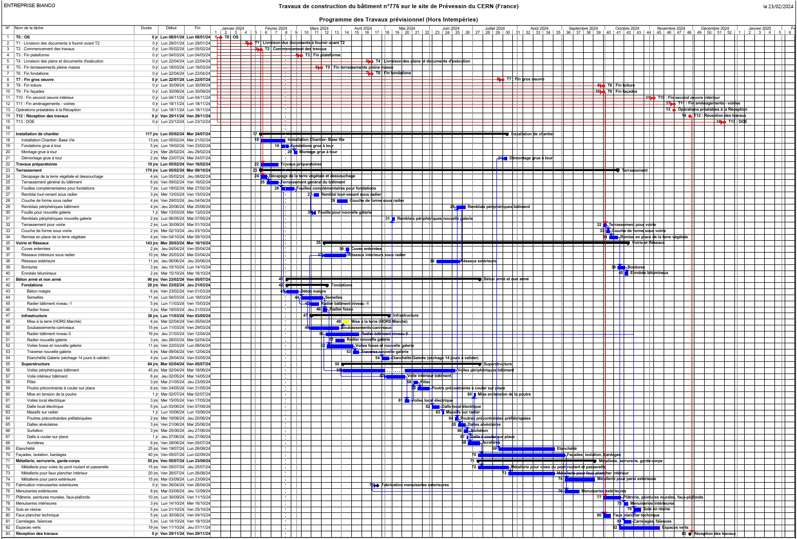

Slide 18
776 Studies Schedule
FC
2024
Building construction
Design
Heat pump selection
Boiler selection
PID
Elec Power board selection
Elec Automation board
Pumps
EXE folder with all the documents
3D BIM
Today
Power bord order.
Boiler order.
Heat pump order.

Slide 19
Questions ?

Slide 20
Next step
Meeting on zoom every 2 weeks, next Tuesday 16th of April.
Important meeting 21th of May.

Slide 21

Talk

