Slide 1
Imaging
The Future
Jeff Buchsbaum
Stella@CERN 2024

Slide 2
Conflicts and Caveats
The author has no conflicts to declare.
The presented data is sources from publicly available data and integrated by the author.
The opinions presented are those of the author and do not represent those of his workplace, CERN, ICEC, or any other entity.
If a slide has the number 007 in the footer, it means please do not photograph or share it.

Slide 3
“Now” Stuff
The Ground State

Slide 4
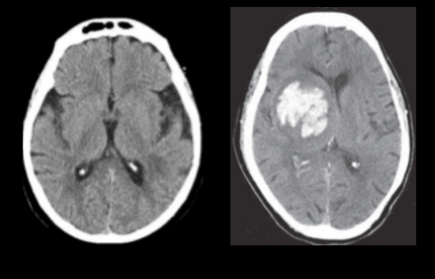
Machines that exist
Cone Beam CT (CBCT)
  Tomotherapy option (MV, kV)
  C-ARM option (TrueBeam)
  Couch ring (for gantries…)
MRI LINAC (with dosimetry issues)
  ViewRay – Co60 then MV LINAC)
  Elekta – LINAC and higher field
PET auto LINAC (NCI SBIR product)
DOI:10.26493/978-961-7055-82-5.61-66

Slide 5
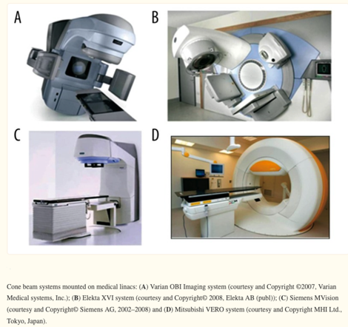
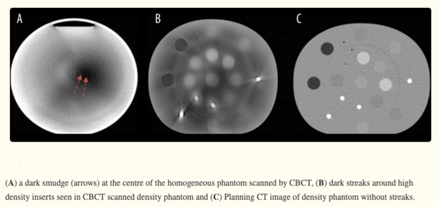
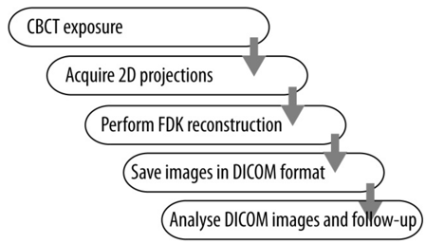
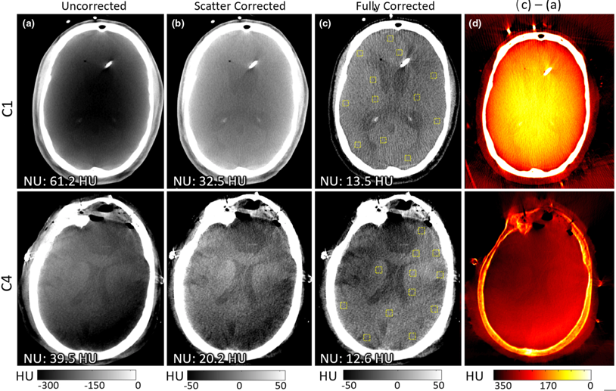
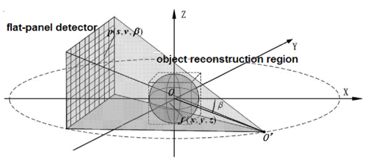
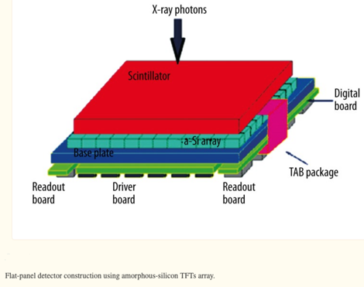
Cone Beam CT – Standard Form up to 2020 Artifact Correction Work
10.12659/PJR.890745
10.1109/BMEI.2009.5304987
10.1002/mp.14124

Slide 6
Near Term Future
3-6 years out

Slide 7
Better and Novel
Improved algorithms
Improved sensors
Faster CPU’s, FPGA’s, edge detectors
AI

Slide 8
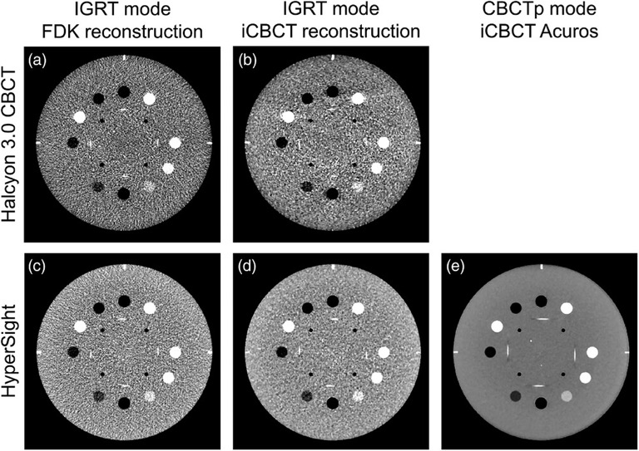
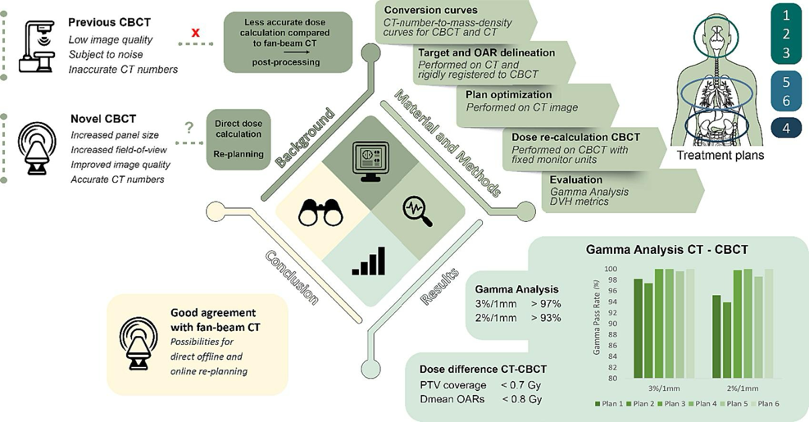

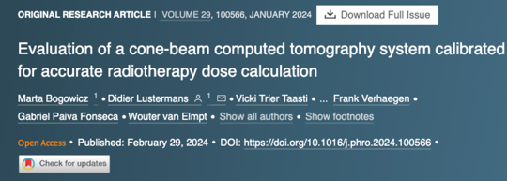
Example: Hypersight (Varian) and Planning Possible on a CBCT

Slide 9
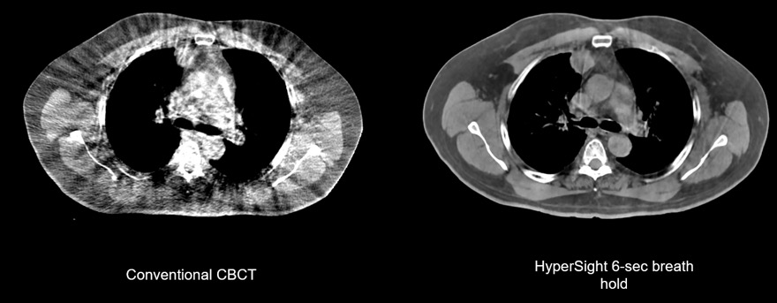
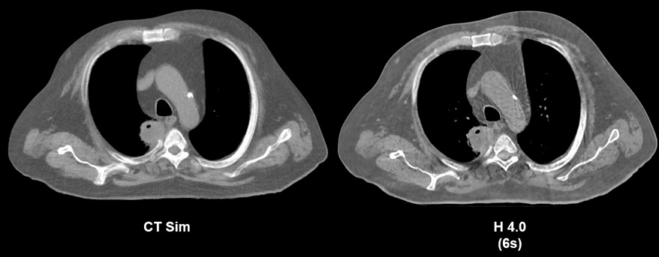
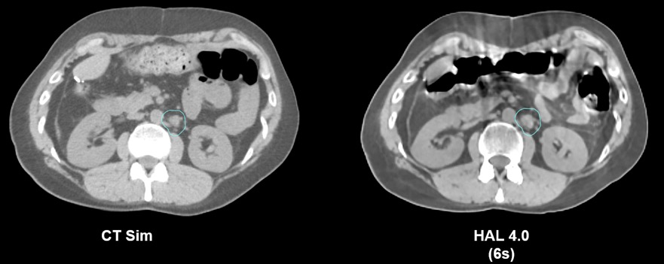
Example Image Pairs from medicalaffairs.varian.com/hypersight
What is it;
The detector: novel cesium iodide scintillator,
yielding approximately twice the dose efficiency compared
with the previous generation of detector on the Halcyon/Ethos platform.
The detector includes a focused grid for scatter rejection, low-noise electronics, and image readout at up to 70 frames per second.
Size: 86x43 cm (prior was 43 x 43 cm).
And better software.
https://doi.org/10.1016/j.prro.2023.10.014

Slide 10
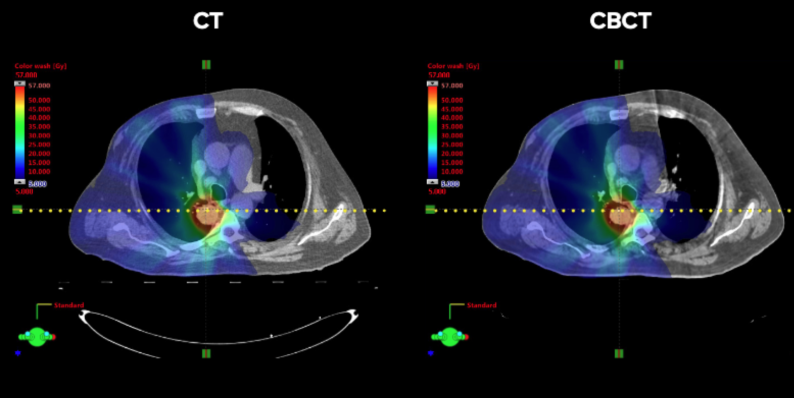
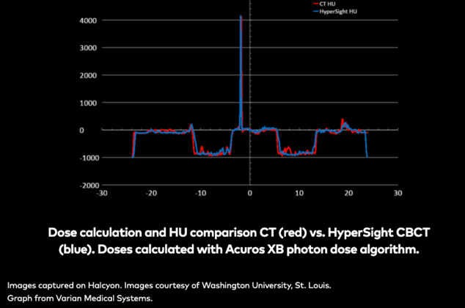
Planning on a CBCT

Slide 11
Long Term Future
7-20 years
Big Stuff

Slide 12
Transformative
Biological - processes with AI support
Target present imaging
Drug present imaging
Tissue response imaging (dynamic biomarker)
Multiscale (part of a digital twin) so able to move from modality to modality based on path optimization .

Slide 13
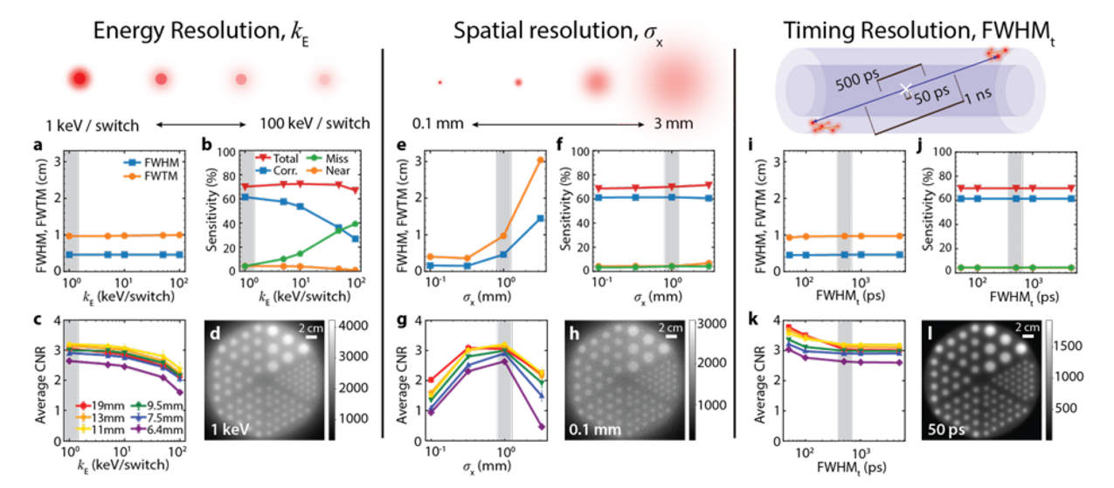
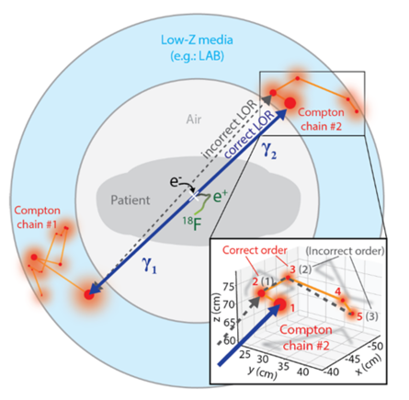
Super Sensitive PET Detectors – Compton Scatter Detectors
Highest-quality image for varying kE is obtained at kE = 1 keV/switch, at fixed σx = 1 mm and FWHMt = 500 ps.
d
Highest-quality image for varying σx is obtained at σx = 0.1 mm, at fixed kE = 1 keV/switch and FWHMt = 500 ps.
h
Highest-quality image for varying FWHMt is obtained at FWHMt = 50 ps, fixed kE = 1 keV/switch and σx = 1 mm.
l
https://arxiv.org/pdf/2305.07173

Slide 14
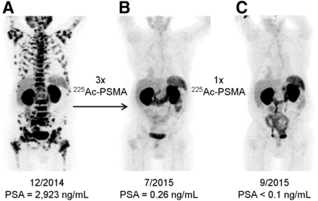
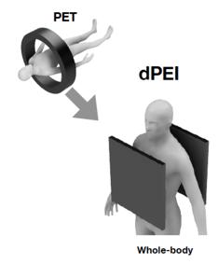
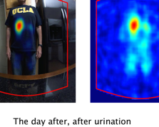
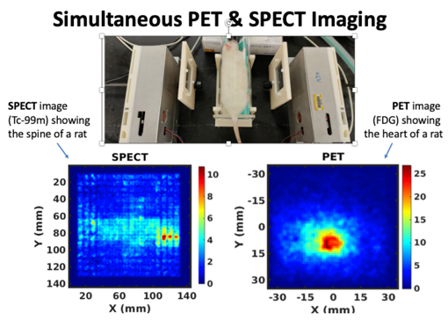

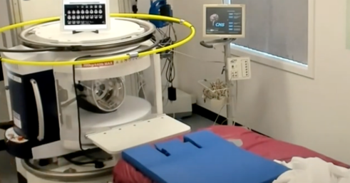
Some Other Areas of Interest
Direct Positron Emission Imaging (dPEI)
Radiopharmaceuticals
Improved SPECT detectors
CZT
https://jnm.snmjournals.org/content/57/12/1941
indico.jlab.org/event/693/contributions/12187/attachments/9021/13084/2023_Joint_DOE_NIH_SUN_IL_KWON.pdf
https://www.isoe-network.net/publications/pub-proceedings/symposia/international-symposia/beijing-china-october-2019/slides-39/4372-w-wang2019-ppt/file.html
Digital Twins
Micro MRI (smaller everything)
https://www.youtube.com/watch?v=nOtA1nJ_1y8
https://indico.jlab.org/event/693/ Zhong He talk
007

Slide 15
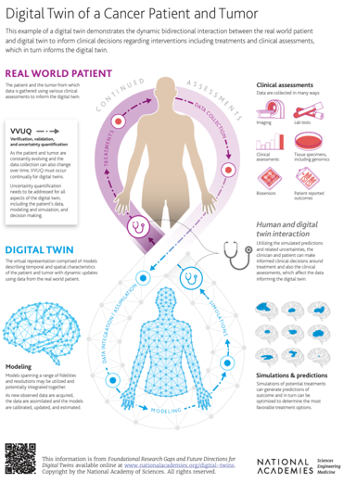
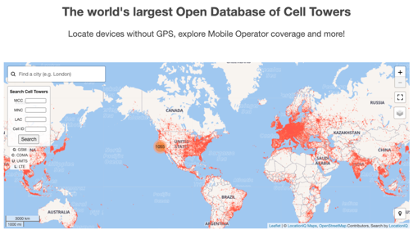
Summary: A Time of Big Ideas
Detectors
Improve the Detectors
New Biology is Learned
Rethink Detection to be Biology Tuned
Smart contrast agents
Bio-contrast
Dose-contrast
Toxicity-contrast
Tumor-resistance-contrast
Time to try something else contrast……
Wearables Detectors
Dynamic Images – Movies….fine time, low spatial load…
Opencellid.org

Slide 16
Thank you
Questions as time allows welcome

